Slide 1
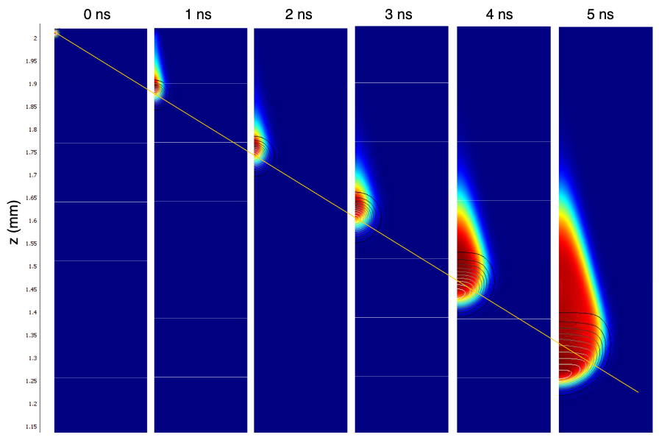
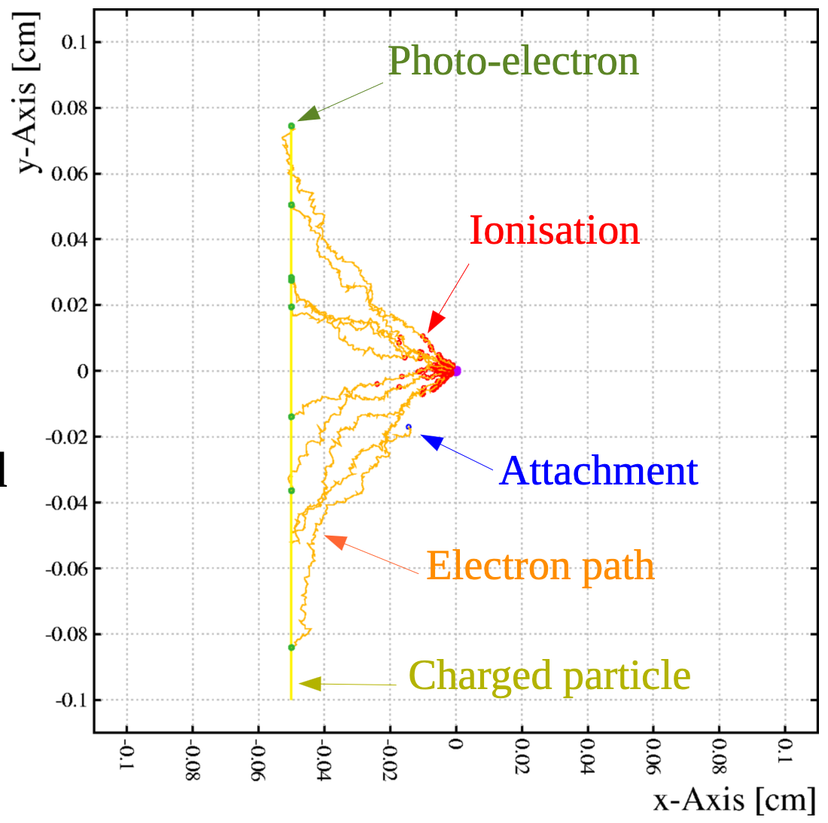
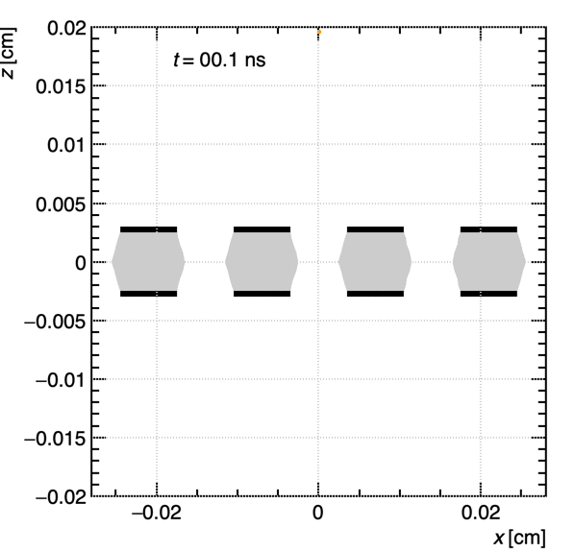
WG4 in future EU Funding proposal
DRD1 Scientific Coordination Board (SCB) 04-04-’25
Proposal in the following slides discussed and written by all WG4 conveners

Slide 2
A bit of Context
AIDA-innova is currently finishing (2021-2024 + ext)
Idea is to have a new proposal by this summer
With funding to start in 2026
No Open Call for Expressions of Interest
Use Detector Development Roadmap
  Implemented in Detector R&D Collaborations (DRD)

Slide 3
WP 6 Task 3 Modelling & Simulation
Develop Simulation of Large Avalanches including Space-Charge effects & update Electric-field
  developing of SW tools that will be integrated / made available to the whole DRD1 community
  physics study performed with the developed tool to validate the approach and illustrate the possibilities
Three sub-tasks and three benificiaries:
  6.3.A “FEM” :: Space-charge calculation with GPU & FEM
  6.3.B “BEM” :: Space-charge field update with neBEM
  6.3.C “Semi-Analytical Approach & Better Algorithms”
Benificiaries/Partners:
  Plan to present this in a WG4 Working meeting (April 15th), where we invite everybody interested in the topic to investigate who can join as beneficiary / partners – we hope Timeline is OK

Slide 4
6.3.A “FEM” :: Space-charge calculation with GPU & FEM
Integration of FEM/GPU tools that exist and are open source and write core sw code that would allow DRD1 users to implement easily their geometry / application
  We already have a specific example working
  Idea is to extend the framework to be detector-independent
Use this tool to study one specific example where these space charges are relevant
  Which topic? – to be negociated with beneficiary
  Possible candidate: Triple-GEM where space-charge changes gain with factor 2³
Possibile beneficiary:

Slide 5
6.3.B “BEM” :: Space-charge field update with neBEM
Support further development of neBEM towards space-charge induced field modifications
  parallel processing acceleration effort using code optimisation, multi-threading, code optimization
  We have a basic working version – but it is slow
  We also know where to put our hands to improve speed
This tool can be used for space-charge calculation inside Gaseous Detectors as well as Silicon Detectors
  Overlap/Synergy with WP on Silicon Detectors
  Cross-technology exchanges can enrich our community
Physics Study:
  One Gaseous Detector + One Silicon Detector (SiPM?)
Possible beneficiary:
  Ideal candidate is CERN:
    Guidance for BEM / Computing improvements
    Benificiary is fertile ground both for Gaseous as Solid State Detector

Slide 6
6.3.C “Semi-Analytical Approach & Better Algorithms”
Development and implementation of a computational module that parametrizes large avalanche growth using semi-analytical functional forms
Better Algorithms: (have to see if this is possible to combine)
  Optimize computing time of Avalanche simulation by smart combination of methods
  Hybrid approach: Microscopic Tracking + Charge Clustering / GRID
Comparison of the semi-analytical approximation results against full particle-tracking simulations and hydrodynamical models
Physics Study:
  RPC – where semi-analytical approach can be developed best
  MPGD – for hybrid / better algorithm
Possible Benificiary

Slide 7
Financial Aspect
Task | Budget | Contract | Possible location
6.3.A | 100k | 2 year contract
6.3.B | 100k | 2 year / 4 yr (stud)
6.3.C | 100k | 2 year contract
Given interest also from Solid State area, we have assumed that the overall coordinators of the Funding Proposal could maybe allocate a slightly higher budget and we propose a budget for our task of 300kEUR
At CERN a PhD student would be also possible at the price of 50 kCHF / year for a period of 3 years
Basic Idea (also for previous EU funding proposals is co-financing:
Built-in: to 10MEUR total financing of EU must correspond our working hours
Extra: We ask the benificiaries if they can finance the contracts by 50%

