Slide 1

CERN-MEDICIS
Visit of Lithuanian delegation
Thierry STORA
CERN – 10 Apr 2025

Slide 2

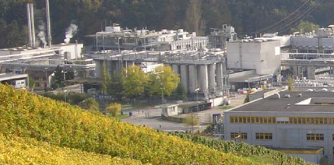
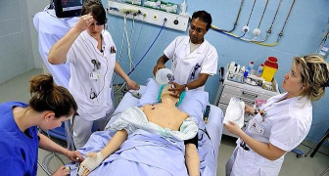
Did you say ?
(non conventional) radionuclides production (by/with istotope mass separation)
For clinical research translation

Slide 3
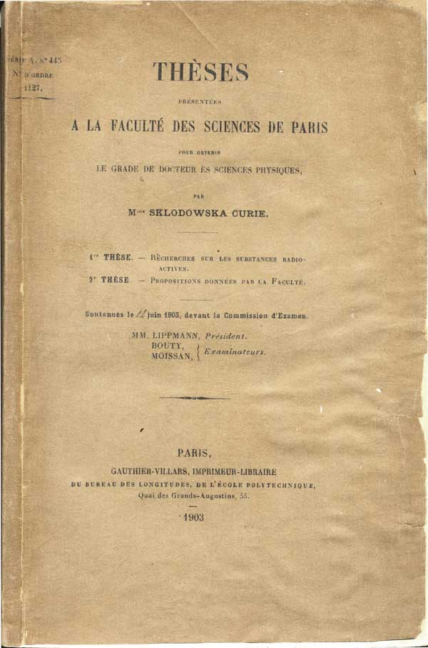
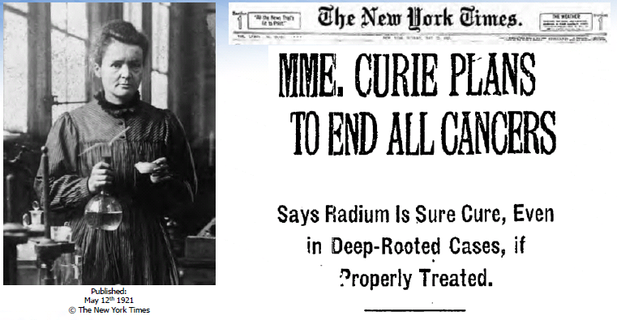
The early days
Marie Sklodowska-Curie
1867-1934
Courtesy prof O. Ratib

Slide 4
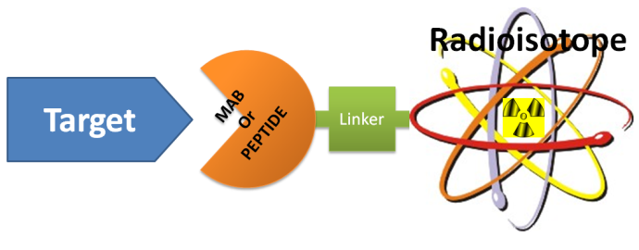

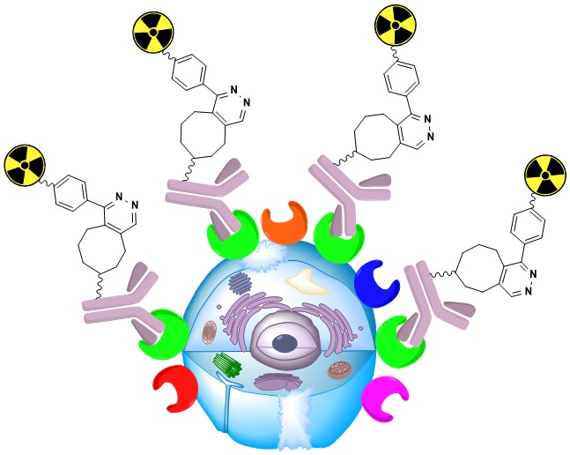
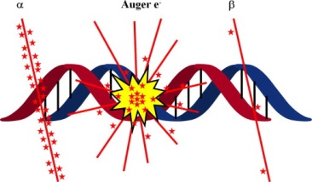
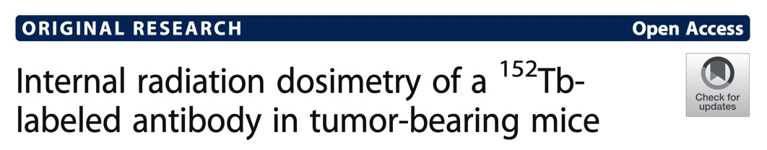
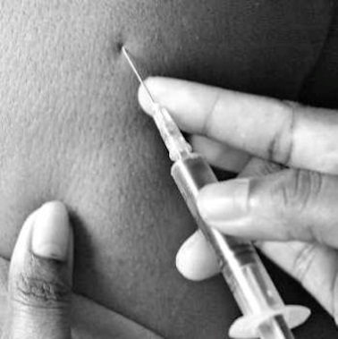
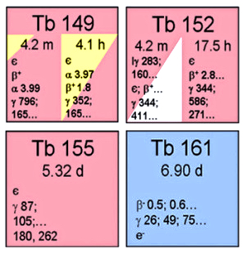
Example of theranostics concept in pre-clinical research
PET 152-Terbium radionuclide in antibody-based targeted moleculer therapy
Diagnostics
THERAPY
A
B
Matched therapeutic Tb
Injectable drug
C. Müller et al.,
Journal of nuclear medicine 53.12 (2012): 1951.

Slide 5
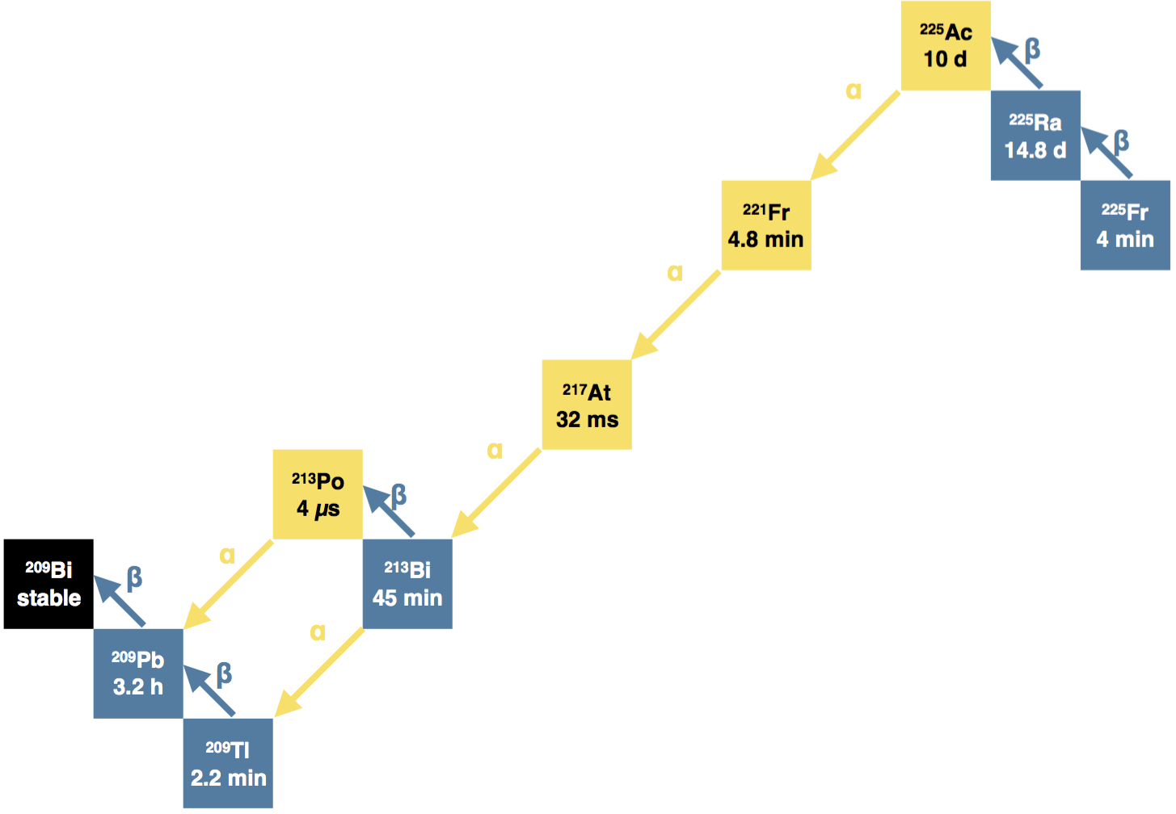
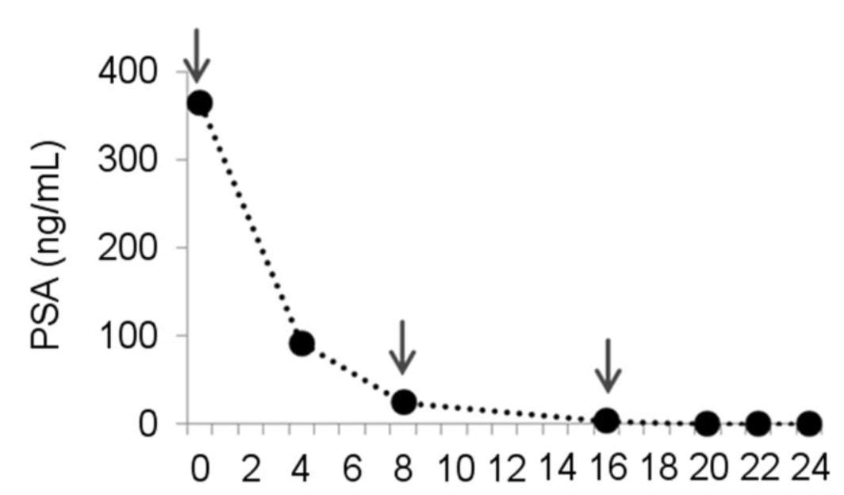
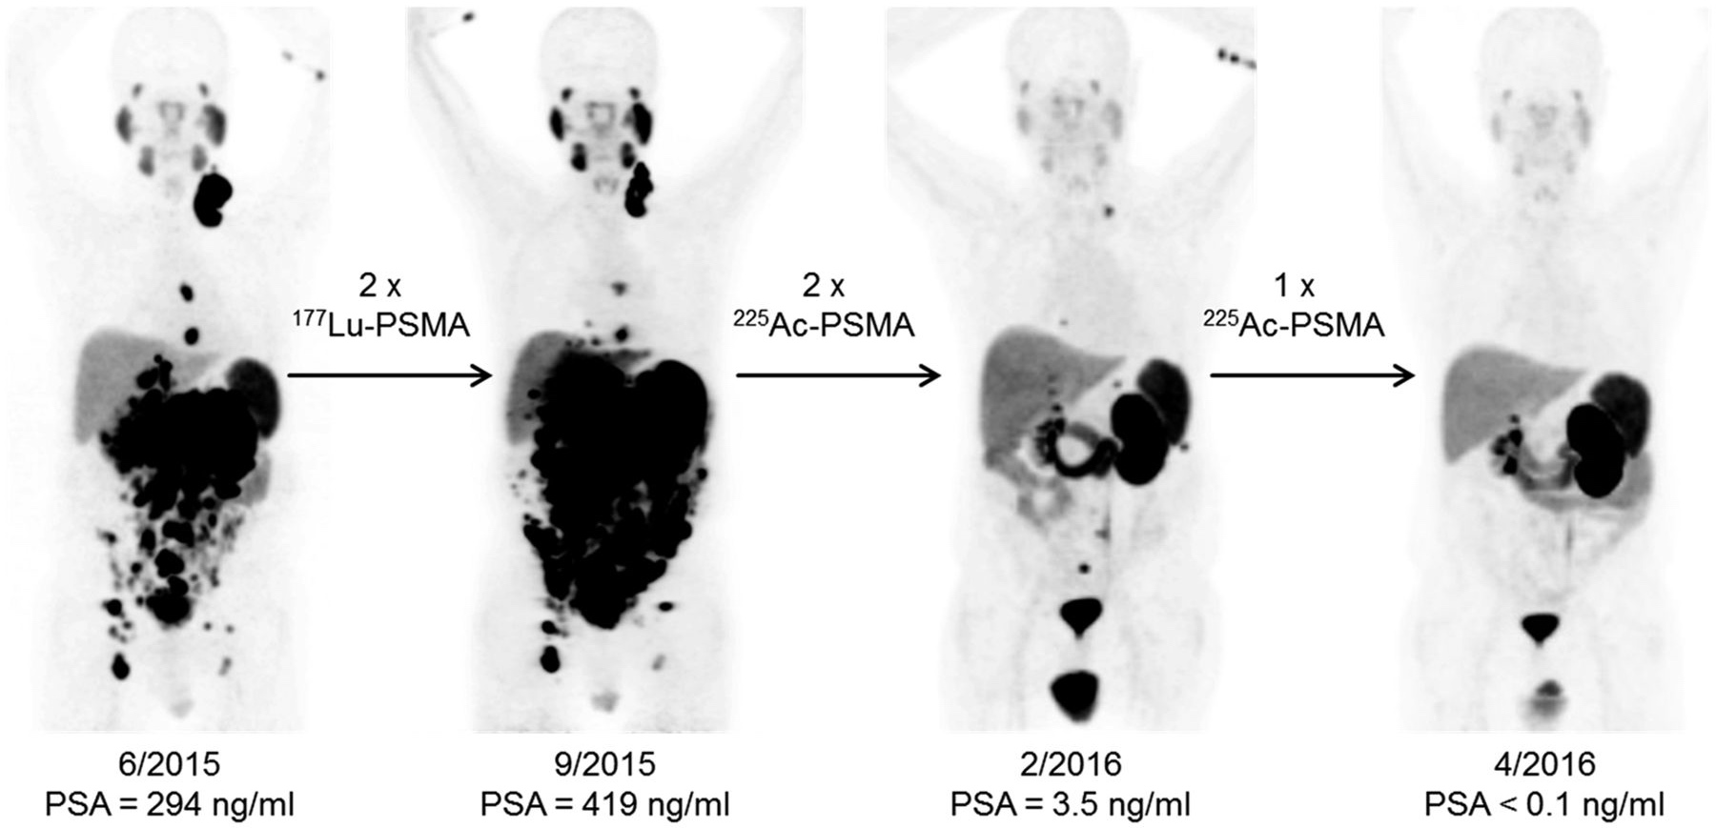
²²⁵Ac-PSMA – Targeted Alpha Therapy
Kratochwil et al, JNM 2016

Slide 6
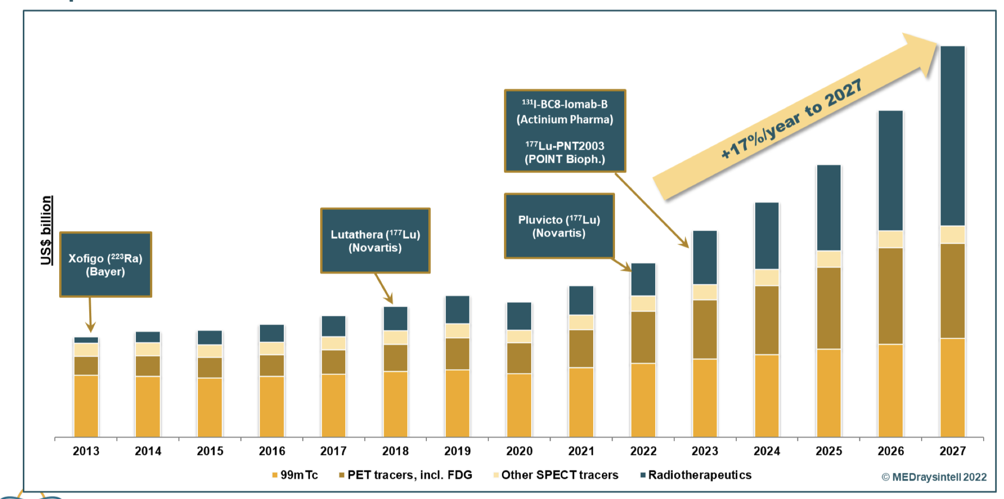
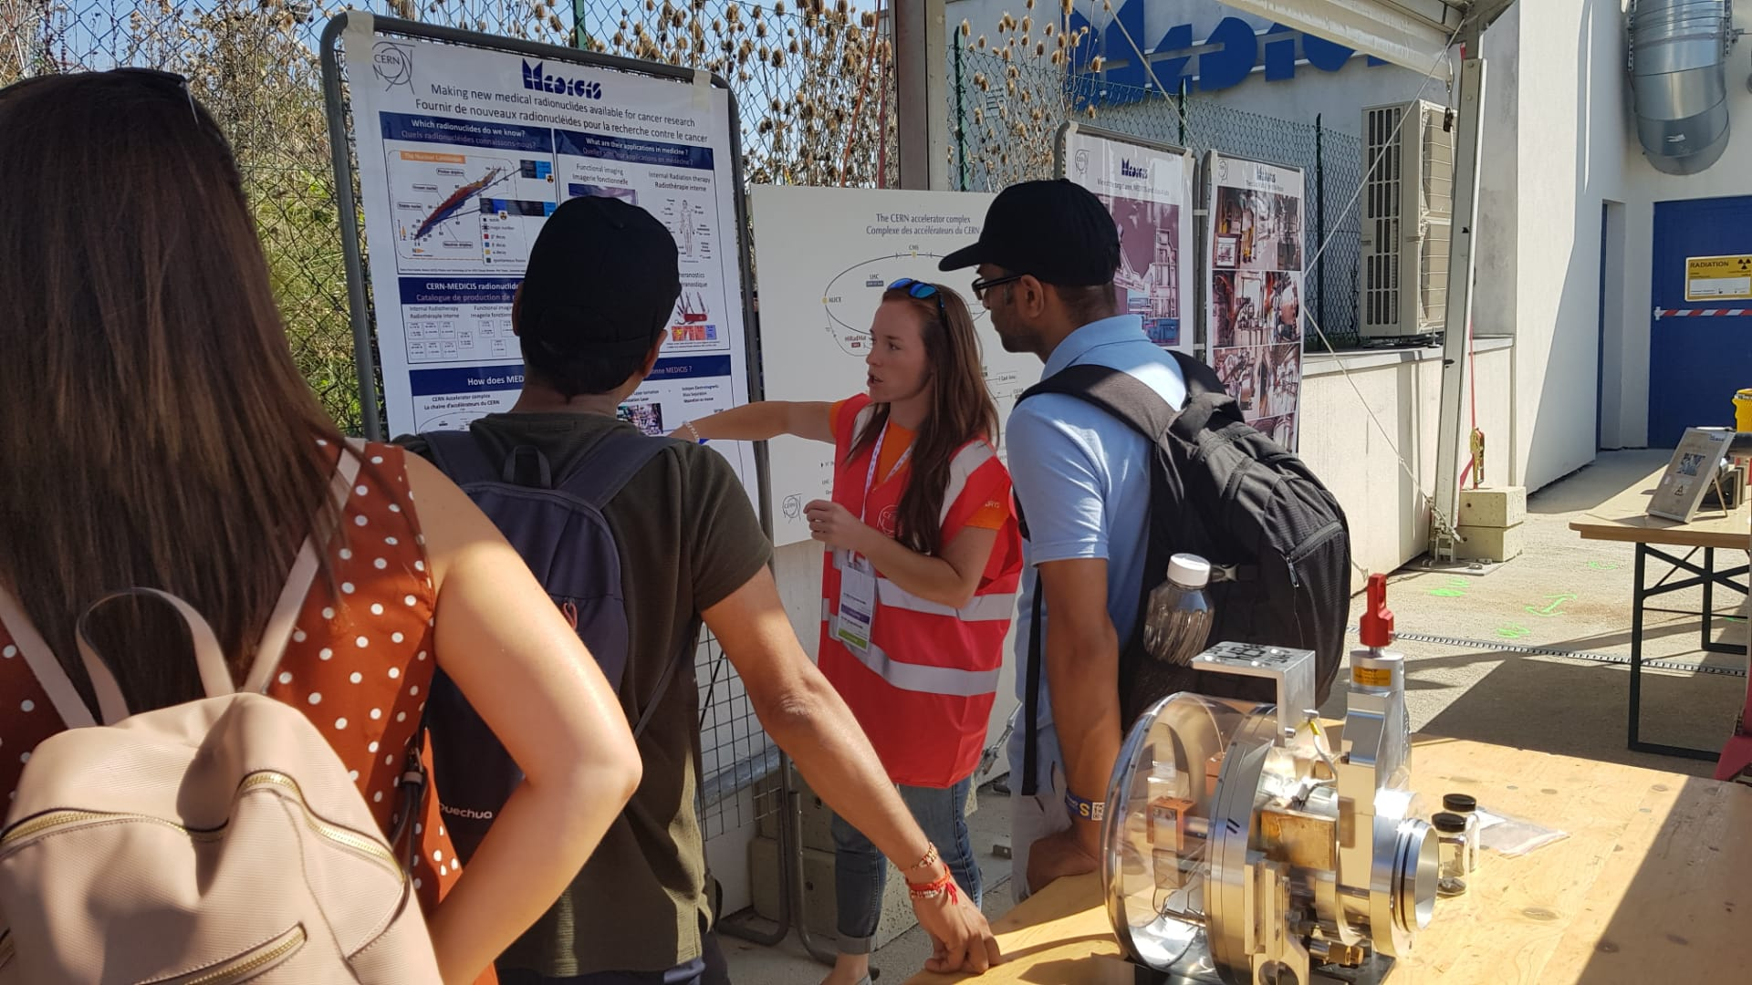
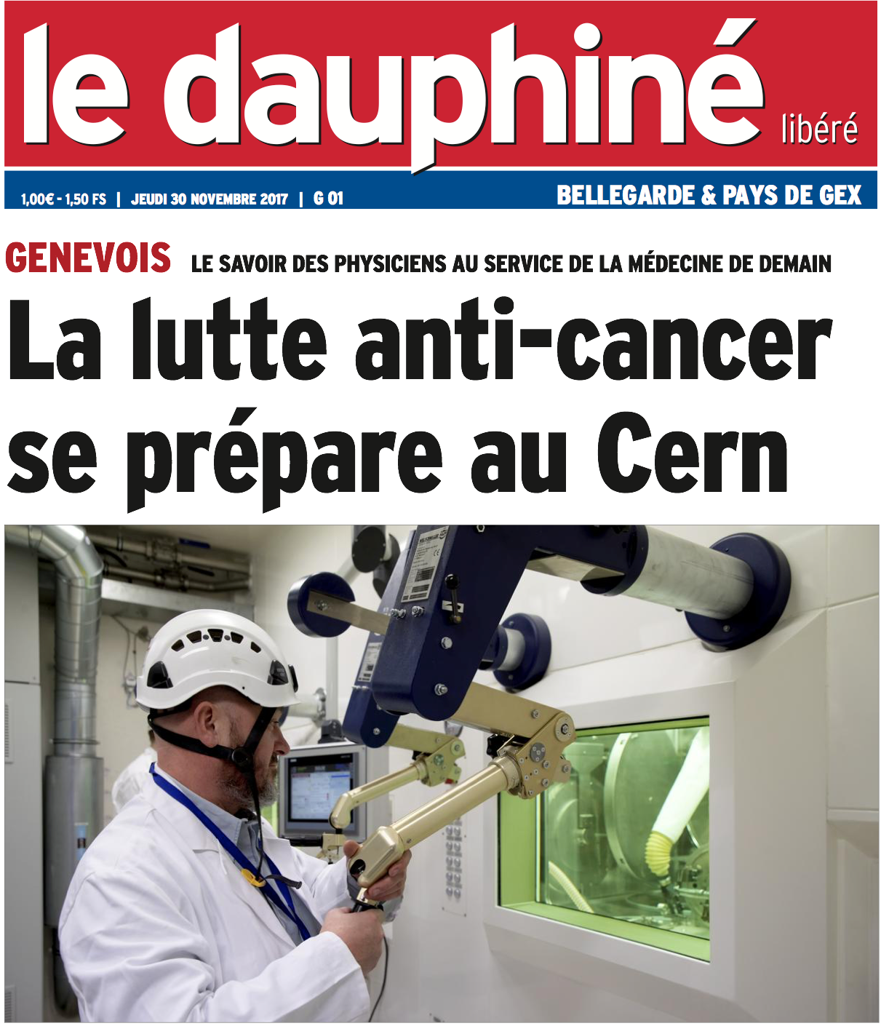
New treatments in nuclear medicine : a large and “recent” interest in Europe
€, $
Physics & Chemistry Nobel Prizes
Economics, Innovators
Time
European Commission
ENER/17/NUCL/SI2.755660
Accelerator Labs Worldwide
(eg PSI, TRIUMF ),
You Today !
Helene Langevin-Joliot at MEDICIS,
professor in nuclear physics,
grand-daughter of Marie Curie
Finally Monsieur et Madame tout le monde

Slide 7
Did you say ?
(production/purification by isotope mass separation)

Slide 8
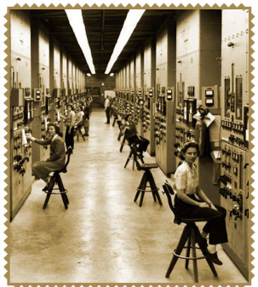
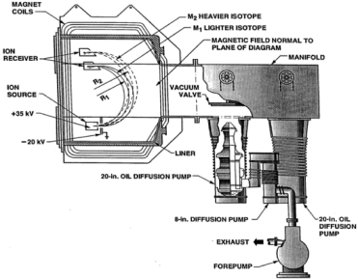
(“Stable”) Isotope mass separation added value
Non carrier added radioisotope fraction (high specific activity)
Efficiencies to be developed
Can this process be applied in large scale ?
A first terrifying use: 235 uranium enrichment of “Little Boy”
And later a much more positive application :
isotope enrichment for medical isotope production
The Calutron (E. Lawrence)

Slide 9
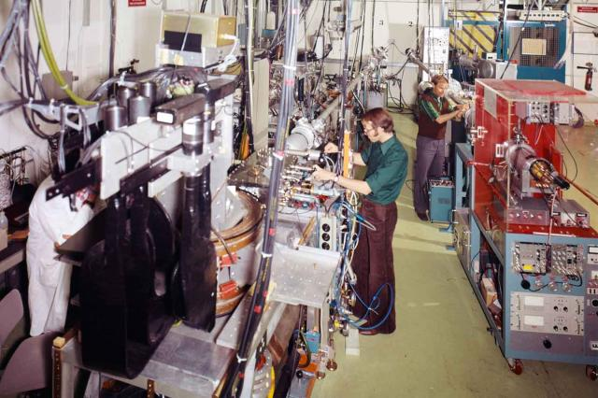
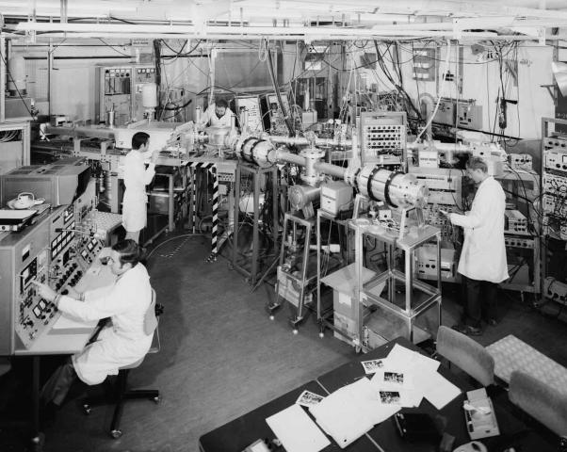
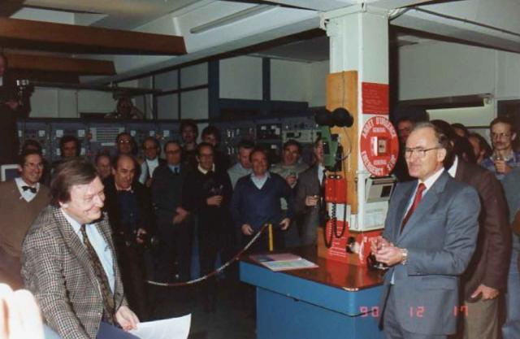
ISOLDE : celebrating 60 years at CERN (CERN celebrating 70+1 years)
June 1983: ISOLDE III approved –
high resolution separator (2x) HRS magnet
Delta M/M ~ 5000
1964: CERN approves ISOLDE
CERN Convention: 1953
1967: First beam at ISOLDE
Dec 1990: The Synchrocyclotron beam ends
New ISOLDE facility → Online in 1992@PSB

Slide 10
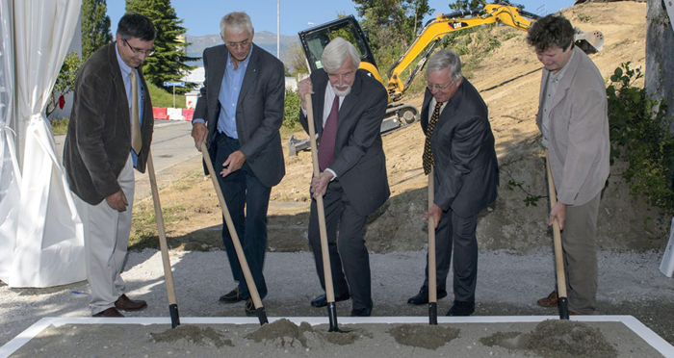
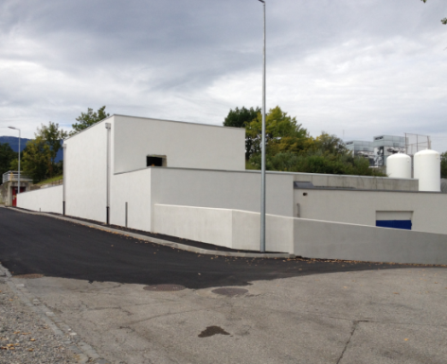
CERN-MEDICIS : A new facility
September 2013
October 2014
1st collected isotope : December 2017
Isotopes collected in salt layer in 2018
Equipment, services

Slide 11
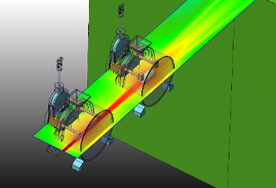
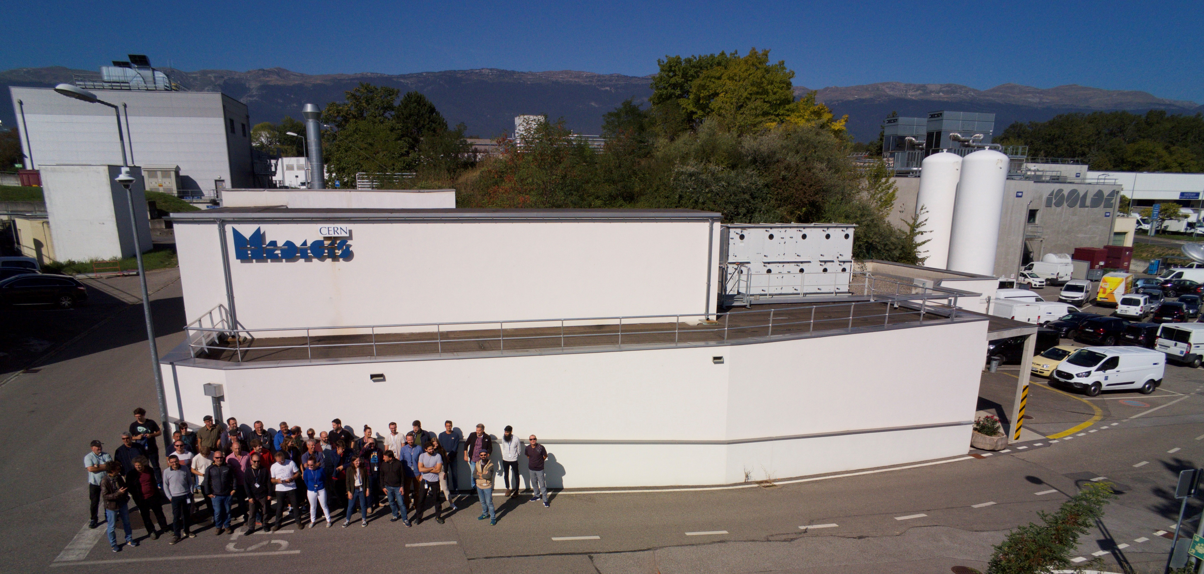

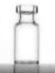
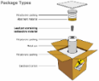

Mass separation as applied in MEDICIS in a snapshot
“Free” proton beam
(otherwise lost in the dump)
Some MEDICIS isotopes :
High activity Sm-153, Ba/Cs-128, Tm/Er-165
MEDICIS
1.4 GeV protons
ISOLDE
120MBq Auger ¹⁶⁵Tm >99%
Produced/delivered in 24hr
A dedicated
medical isotope
Mass separation facility
in Europe.
From CERN- MEDICIS to the lab/Hospital

Slide 12
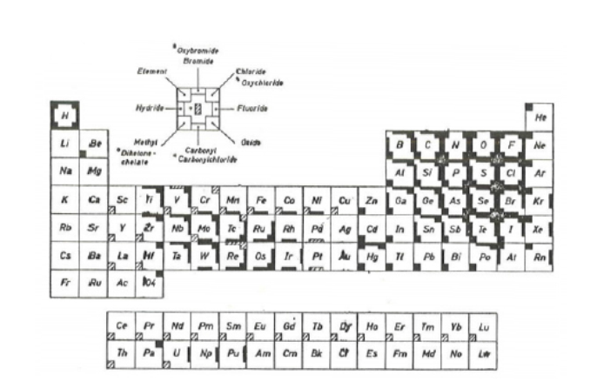
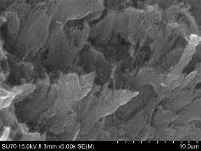
1st Boron ISOL beams: ⁸BF₂⁺ from carbon nanotubes
⁸BF₂⁺ (T_{1/2} 880ms) produced
from multiwall carbon nanotube target (fast diffusion)
and SF₆ reactive gaz injection (volatile BF₃ molecule)
« CHEMICAL EVAPORATION »
Multiwall Carbon Nanotubes
C. Seiffert, Production of radioactive molecular beams for CERN-ISOLDE.
PhD thesis TU Darmstadt, CERN (2015)

Slide 13
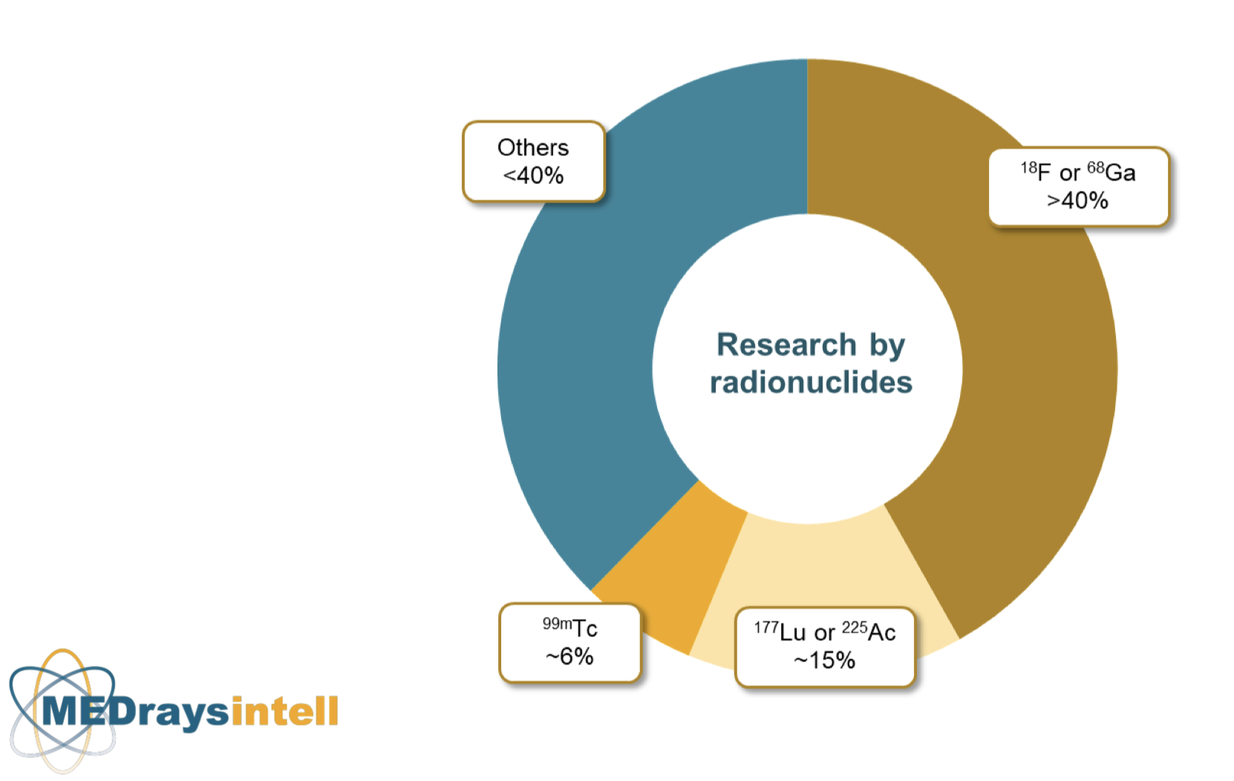
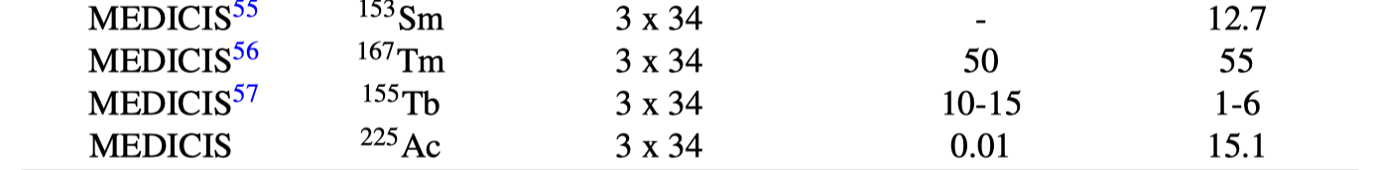
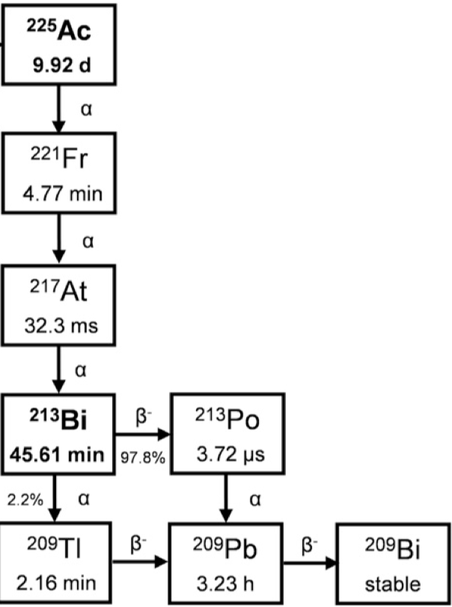
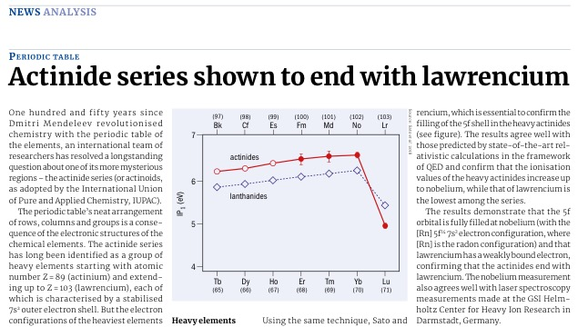
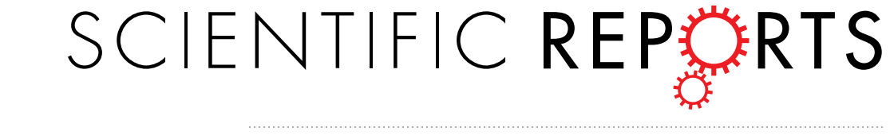
Fom one-atom-at-a-time experiments to larger production needs
Ionisation efficiencies
%
%
²²⁵Ra 50-70%

Slide 14
Did you say ?
in personalised medicine

Slide 15
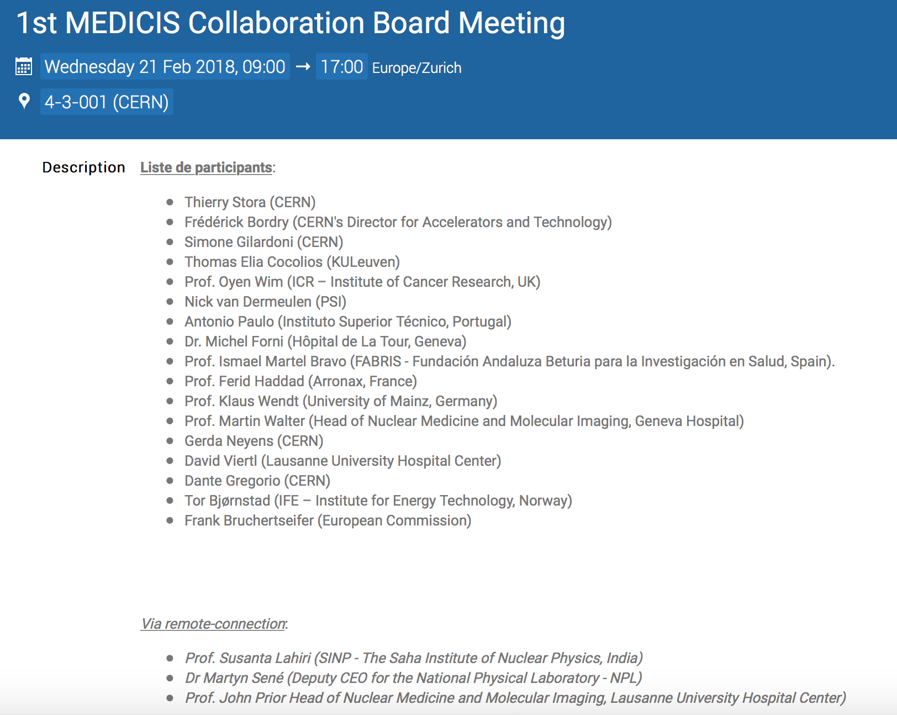
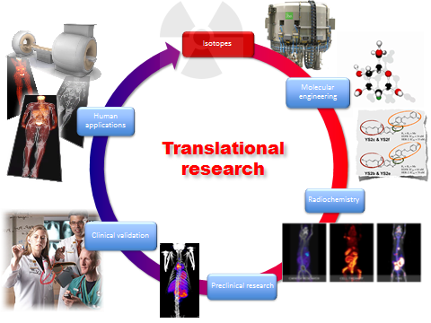
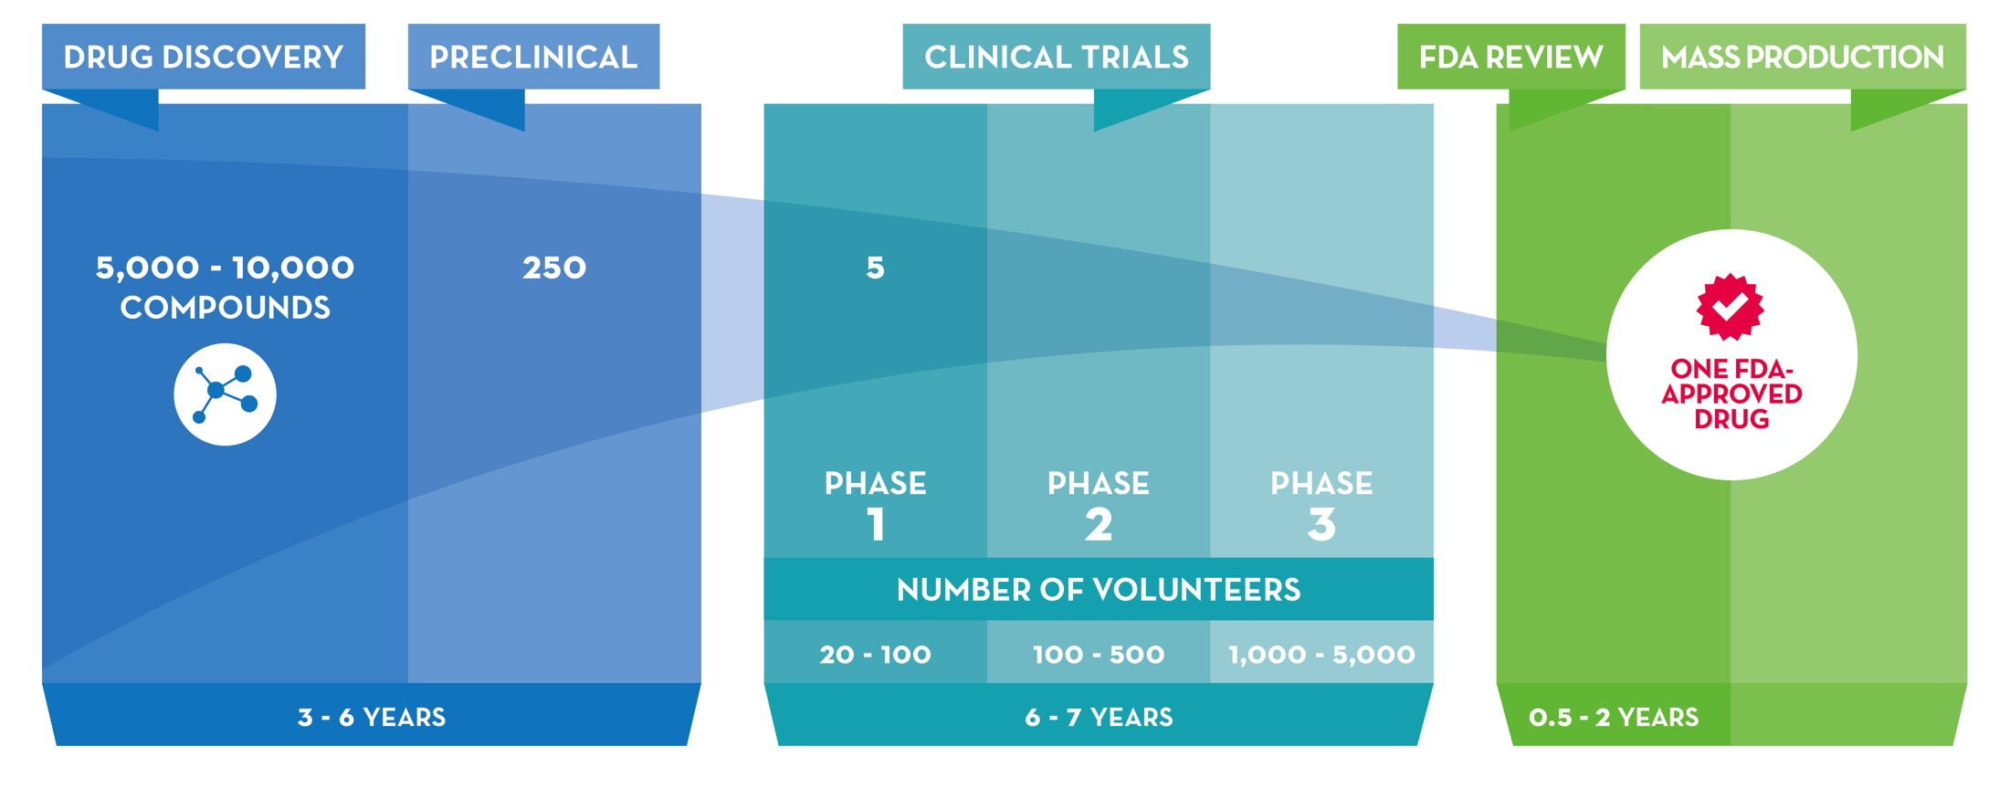
How to progress in the field (The MEDICIS approach) ?

Slide 16
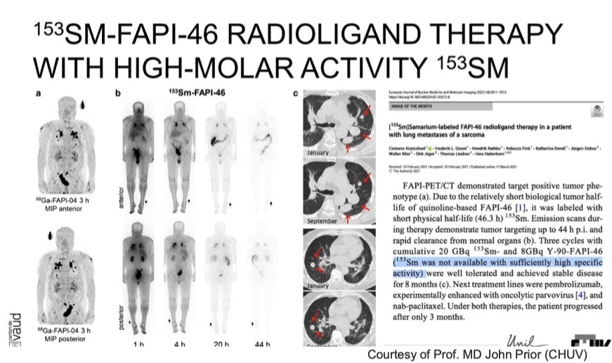
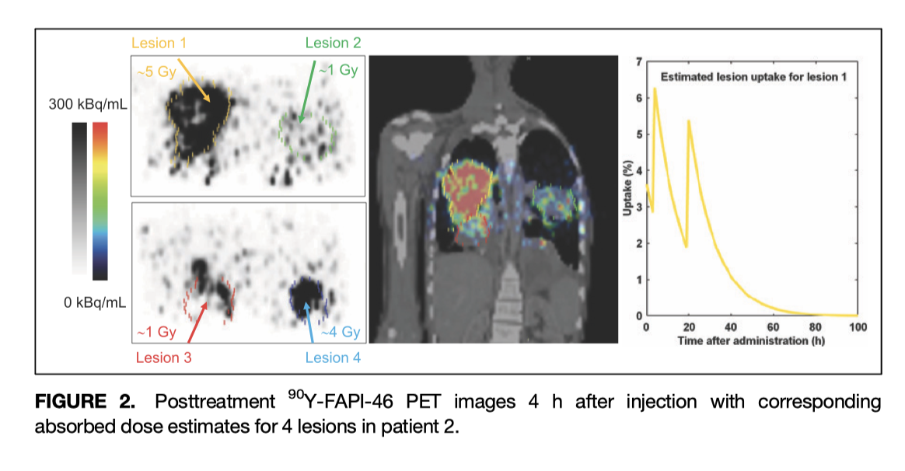
MEDICIS Sm-153 (produced at SCK/ mass purified at MEDICIS) perfect match to FAPI-46 (radio)pharmaceutical

Slide 17
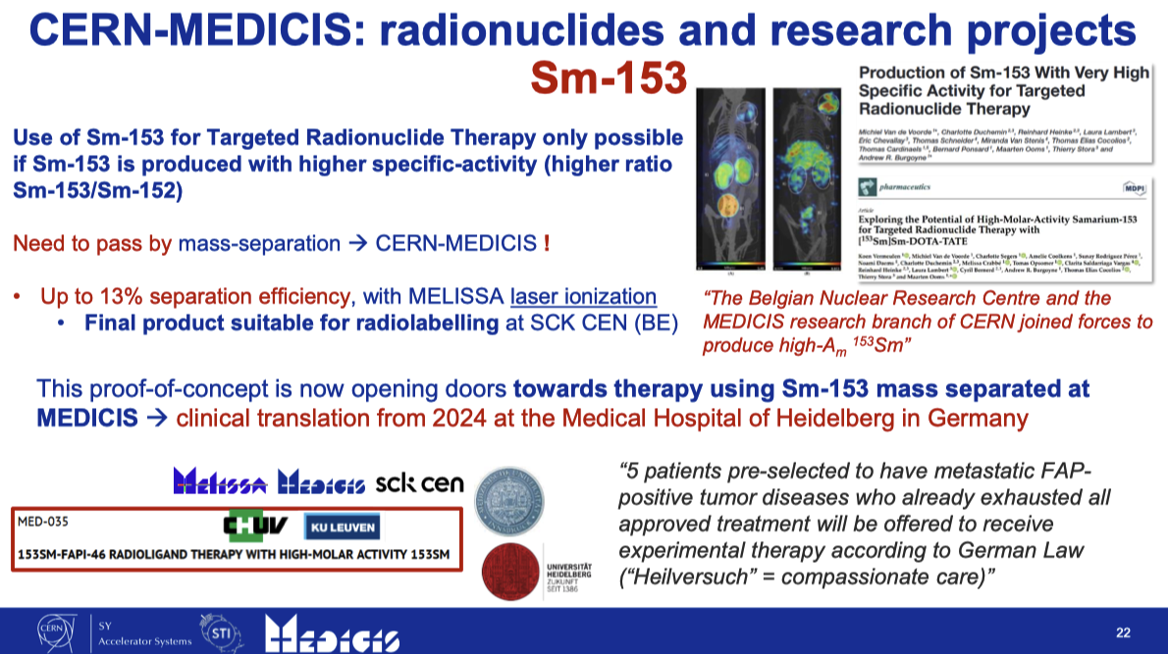
MEDICIS Sm-153 (produced at SCK/ mass purified at MEDICIS) perfect match to FAPI-46 (radio)pharmaceutical

Slide 18
Did you say (take-home message) ?
non conventional radionuclides (production/purification by isotope mass separation)
in personalised medicine

Slide 19
Fom one-atom-at-a-time experiments to large production needs
Ionisation efficiencies
%
%

Slide 20
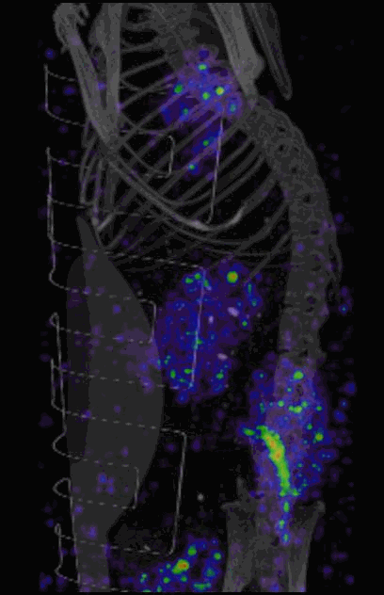
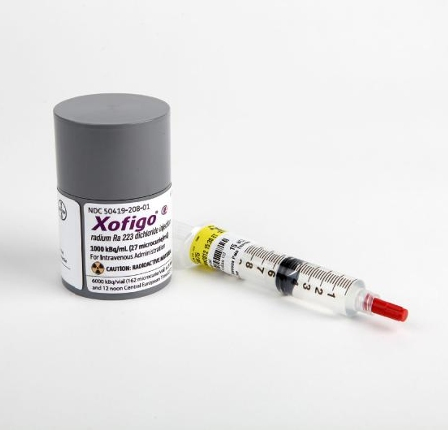
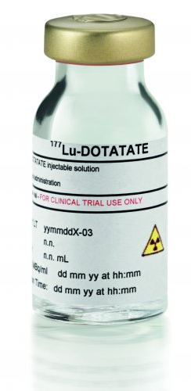
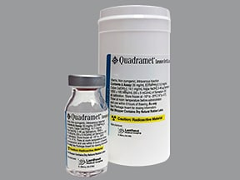
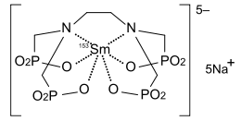
From low to high specific activity radiopharmaceuticals for theranostics
Production of Sm-153 with high specific activity for targeted radionuclide therapy
M. van Voorde et al.
¹⁵³Sm-DOTATATE or other ?
¹⁵³Sm-EDTMP
(low specific activity)
²²³RaCl₂
¹⁷⁷Lu-DOTATATE

Slide 21
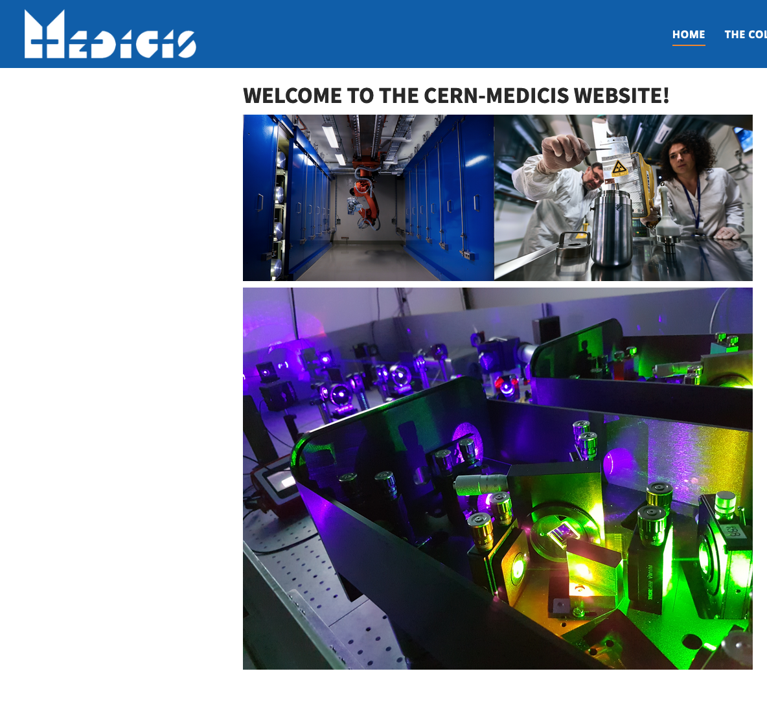
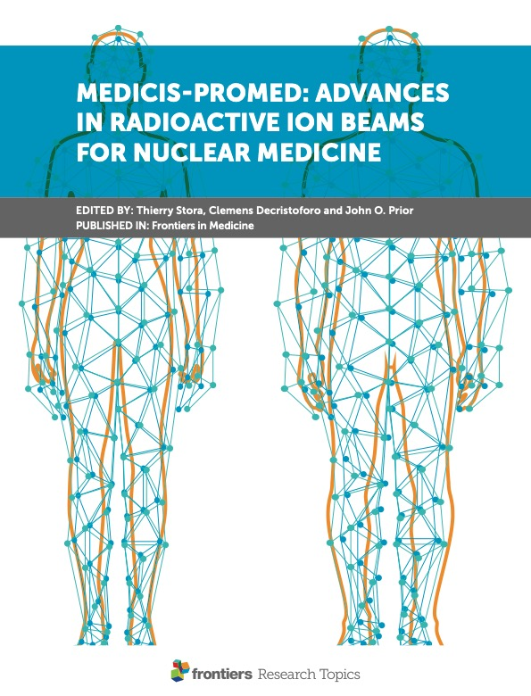
Thank you ! Questions ?
Some references:
Frontiers in Medicine : Advances in Radioactive Ion Beams for Nuclear Medicine
(J. Prior, C. Decristoforo, T. Stora eds) ISBN 978-2-83250-522-9
Acknowlegement:
Charlotte Duchemin, Laura Lambert, Edgars Mamis, Ralf Rossel,
The MEDICIS Collaboration, and MEDICIS colleagues
https://medicis.cern
https://medical-radionuclides.eu

Slide 23
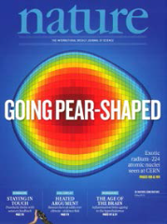
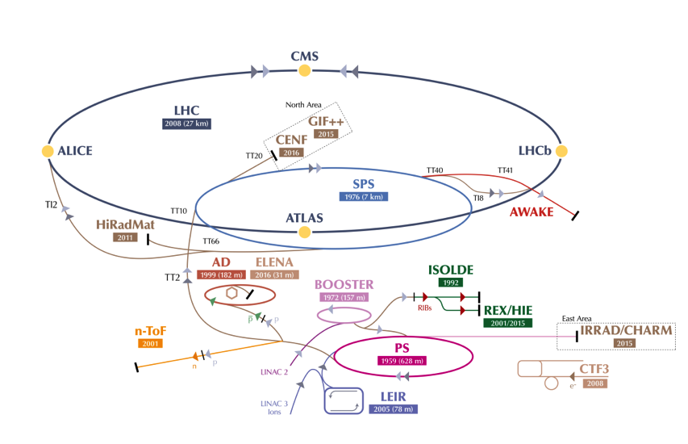
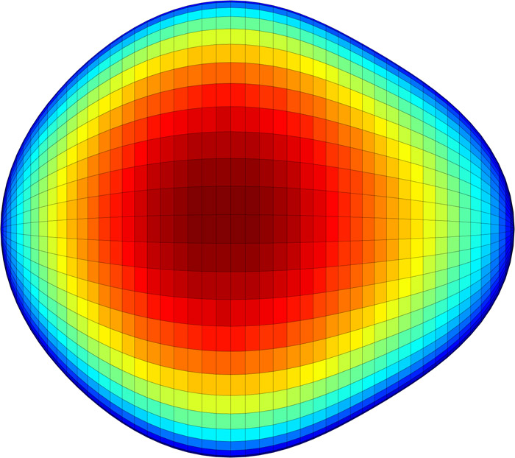

ISOLDE….
²²⁴Radium is pear shaped.
Highlighted by Physics World as one of the 10 breakthroughs in 2013

Slide 24






Whole body PET imaging of ¹²⁸Ba/¹²⁸Cs in a naïve mouse
7 Days
200
22 hours
kBq/cc
Movies and MIP projections of PET images of a mouse injected with 5 MBq of Ba/Cs-128 in a longitudinal study over seven days
D. Viertl et al., MED-028
https://medicis.cern/approved-projects
7 Days
0
2 hours
22 hours
4 Days

