Slide 1


Social protection at CERN
CERN Pension Fund

Slide 2
CERN Pension Fund – Story of Successes and Challenges
SA Seminar, June 24th 2025
O.Capatina & P.Hristov

Slide 3
Outline
General Information
History
Statistics and Status
Investment and Results
Active Working Groups

Slide 4
CERN Pension Fund
General Information

Slide 5
The purpose of the CERN Pension Fund
Article I 1.01 The purpose of the Fund is to insure its members and beneficiaries as well as the members of their families* against the economic consequences of the disability and old age of its members and of the death of its members and beneficiaries.
*Pursuant to a decision of the CERN Council on 17 December 2015, legally registered partnerships are treated as to marriage in determining family rights and obligations within the CERN pension scheme as from 1 January 2016.
As international organisations, CERN and ESO operate their own social security system, including a pension scheme, the CERN Pension Fund.
Defined benefits
CERN Pension Fund
Benefits are promised by CERN at recruitment. Pensions depend on years of membership and reference salary. Not affected by the market volatility.
No member has an individual balance. All benefits are paid from a common fund. Members support one another by pooling resources and risks.
A solidarity scheme

Slide 6
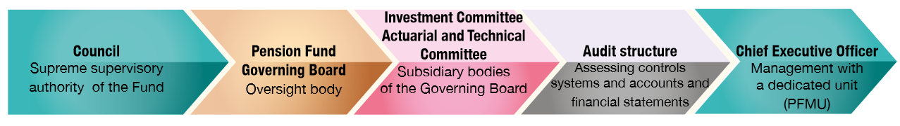
Pension Fund - Introduction
Governance
  The Fund is an integral part of CERN, has no separate legal personality and is under the supreme authority of the Council.
  The oversight of the Fund shall be entrusted to the Governing Board, assisted and advised by the Investment Committee and Actuarial and Technical Committee. The management of the Fund shall be entrusted to the Chief Executive Officer.

Slide 7
Governance Arrangements for the Pension Fund
Governance principles
Set out how the Fund is governed.
CERN Council
The Supreme Authority: defines the Pension Fund and its arrangements; acts as ultimate oversight body and approves significant policies or changes. Contributions & benefits: the Council acts on recommendations from the Director-General.
Governing Board
Primary oversight body. Includes professional (independent) members and representatives from all key stakeholder groups. Meets quarterly to review performance of the Pension Fund.
Investment Committee
Sub-committee (of PFGB) responsible for oversight of investment strategy and related matters. Comprised of two PFGB members and two external professional experts with substantial technical expertise.
Chief Executive Officer
Legal representative of the Fund. Analogous to CERN Department Head. Responsible for the Management Unit and all delegated activities of the Fund.
Actuarial & Technical Committee
Sub-committee (of PFGB) responsible for oversight of actuarial matters. Includes two PFGB members and three external experts with relevant qualifications and experience.

Slide 8
Governance Principles
1 The Fund is an integral part of CERN, has no separate legal personality and is under the supreme authority of the Council. The activities of the Fund are part of the official activities of CERN and benefit from privileges and immunities.
4 The oversight of the Fund shall be entrusted to the Governing Board, assisted and advised by the Investment Committee and Actuarial and Technical Committee. The management of the Fund shall be entrusted to the Chief Executive Officer.
2 The Fund has operational autonomy within CERN and shall be managed in accordance with its Rules and Regulations. The Director-General shall have no responsibilities with respect to the management of the Fund.
3 The assets of the Fund shall be held separately from those of CERN and shall be used solely for the purpose of the Fund. Neither CERN nor ESO shall reclaim, borrow or impose a lien upon the assets of the Fund.

Slide 9
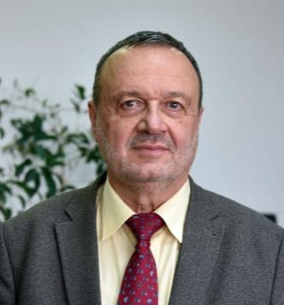

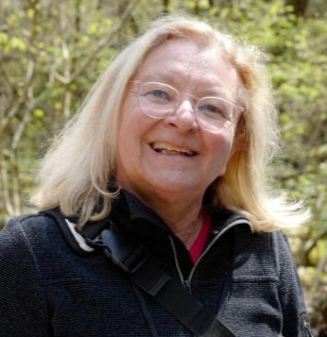
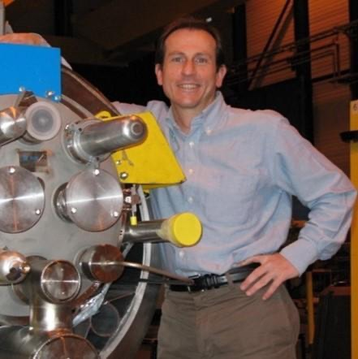
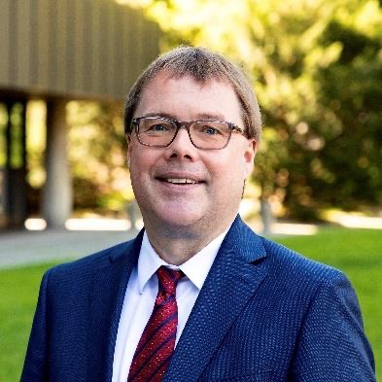
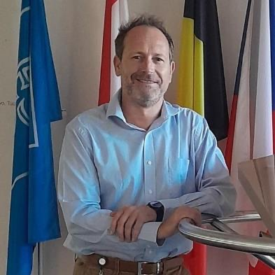
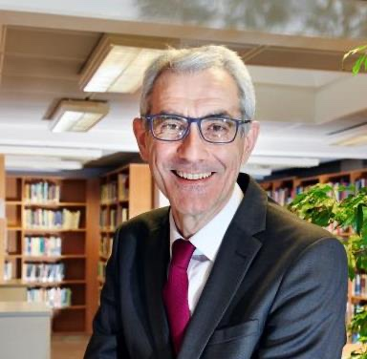

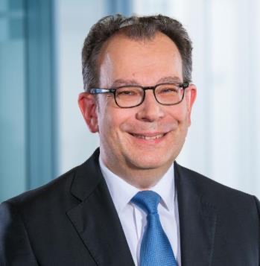
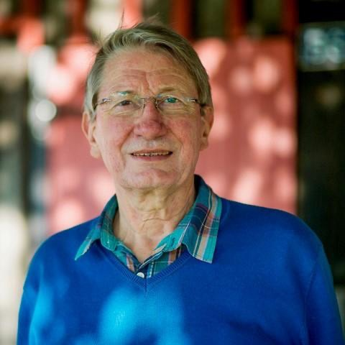
CERN Council (2)
CERN Staff Association (2)
Pension Fund Governing Board (10)
F.Buzatu, Chair
ESO Council (1)
ESO Staff Association (1)
O. Capatina, Vice Chair
Professional members (2)
Ex officio (1)
GAC-EPA (1)
C. Biino
V. Parma, IC Member
T. Groffmann
A. Delorme
R. Bello, IC Chair
J. Segars, ATC Chair
A. Hilka
P. Charpentier, ATC Member

Slide 10
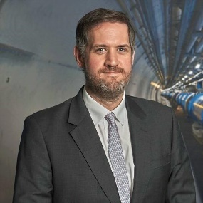
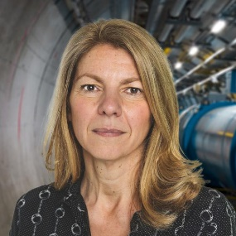
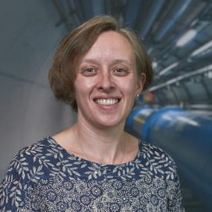
The Pension Fund Management Unit (PFMU)
Strong and stable leadership of the PFMU provides consistent strategy and beneficiary experience.
Doug Heron
Chief Executive Officer
Elena Manola-Bonthond
Chief Investment Officer
Kandy Mitchell
Chief Operating Officer
PFMU since
2021
2012
2011
Finance (years)
25
13
25+
Qualifications
Accountancy (CGMA) Investments (MCSI)
PhD, MBA, Investments (CAIA)
Accountancy (CA)
External Boards
2 (UK PF + IO PF)
5 (IO PF + 2 x IO Inv Co + CAIA + Standards body)
Team
Team of 17 managing investments
6 Portfolio Managers
Av experience: 20 years
Quals: PhD, CAIA, CFA, MA
Experience: Barclays, Reuters, Bank of China, BNP, Pictet, Bank of New York, Deutsche Bank, Bank of England
5 Benefits Services specialists
4 accountants
Av Experience: 20 years
Experience: Barclays, UN Joint Staff Pension Fund, Deloitte, CTF Audit, BNP, Real Estate agencies, PwC, Deutsche Bank

Slide 11
The Pension Fund: Strategic Partners
Actuarial Services
Northern Trust (UK)
Asset Safe Custody
Ortec (CH)
Risk Consultant
Apex (IRE)
AON (CH)
Investment back-office services
Portuguese Court of Auditors
External Auditor
CERN / PwC (UK)
Internal Auditor
UBS (CH)
Main Banker
Payments
Valuation of liabilities
Advise on investment risk
Review annual accounts
Perform internal audits

Slide 12
CERN Pension Fund
History

Slide 13
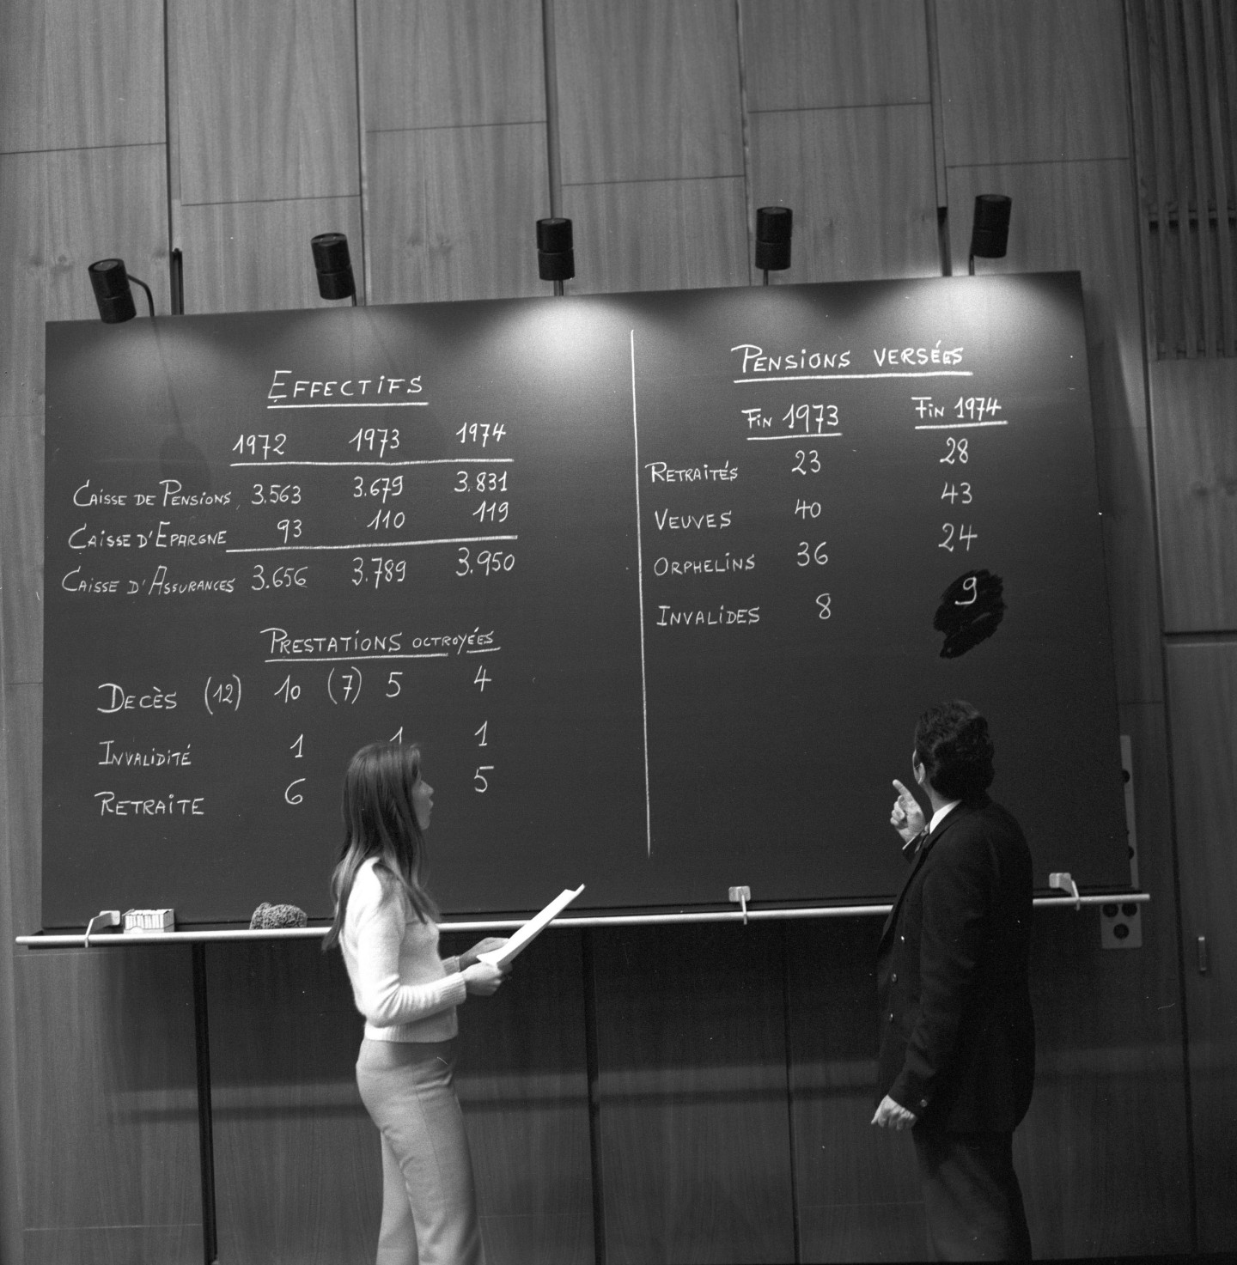

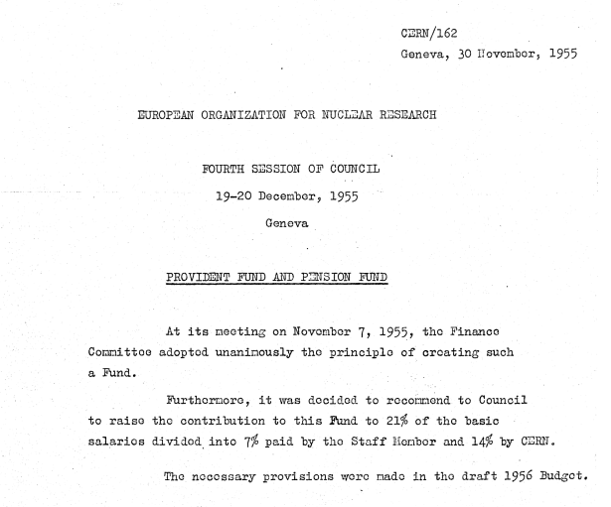
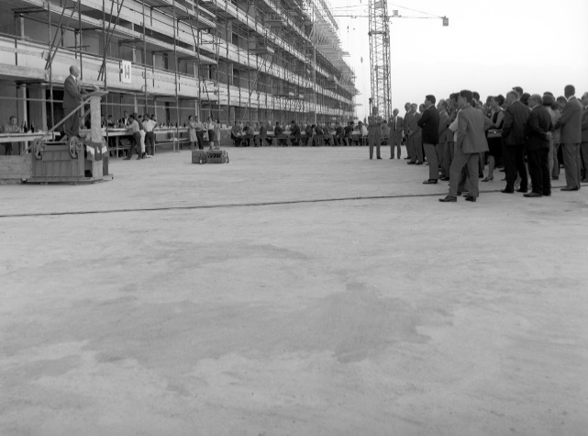

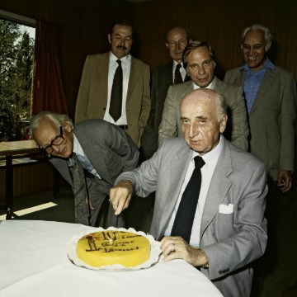
History
1955-56
1967
1975
1990
2017
CERN set up a pension fund to provide social protection for CERN personnel
First retirement pension paid
Assets of 1 843 MCHF
Provided benefits to those based in 48 countries around the world
Average age of retirees and surviving spouses was 68 years
Annual benefit payments of 5 MCHF
4 430 members
3 700 beneficiaries
332 MCHF benefits paid
4 622 MCHF in assets
Average age of beneficiaries is 75 years
First ESO members join the Fund
Purchase and construction of residential building in Grand Saconnex
2000
Today
1964
1971
1980

Slide 14
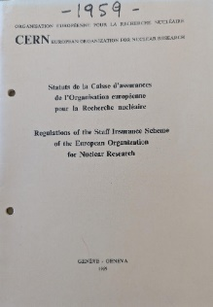
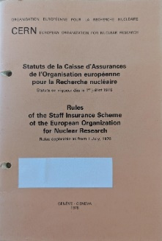
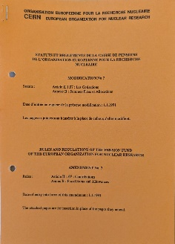
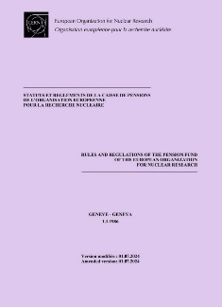
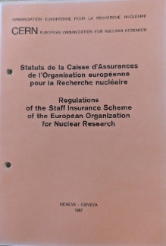
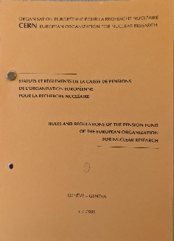
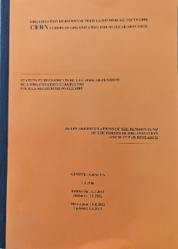
Looking back over seven decades…
First set of (provisional) Regulations dated 1 June 1956 - substantially the same purpose as today
Founded as an insurance scheme with separate pension and provident (savings) sections – membership required medical examination and had an upper age limit of 55
Over the years the PF has evolved with modifications to rules, benefits and contributions to reflect changing conditions inside and outside of CERN
Today it is a comprehensive system of insurance against the financial consequences of death, disability and old age; supported by best practice standards of governance and providing coverage to 7’500 members and beneficiaries
1967
1976
1986
1991
2012
2024
1959
1956

Slide 15
 | Terms and conditions applicable to pensions
Parameters | 1956-1976 | 1976-1980 | 1980-1987 | Pre-2012 | From 2012
Legal retirement age | 65 years M 62 years F | 65 years (no reduction after 60) | 65 years (no reduction after 60) | 65 years (reduction until 65) | 67 years (reduction until 67)
Contribution rate | 21% basic salary | 21% basic salary | 21% basic salary until 1985 22% ref. salary | 1995 30.00% 2000 30.37% 2005 30.88% 34% ref. salary | 31.60% reference salary
Division CERN - Employee | 2/3 – 1/3 | 2/3 – 1/3 | 2/3 – 1/3 | 2/3 – 1/3 | 60% – 40%
CERN Contribution | 14% | 14% | 14.33% | 22.67% | 18.96%
Accumulation rate | 2% | 2% | 2% | 2% | 1.85%
Maximum retirement | 30 years to 60% 33 years from 1968 to 60% | 35 years to 70% | 35 years to 70% | 35 years to 70% | 37 years 10 months to 70%
Pensionable reference salary | Average salary over the last three years | Last salary since 1967 | Last salary | Last salary | Average salary over the last three years

Slide 16
Some milestones from the history…
1980-1985 Revision of Pension Fund. Active participation of the SA
RESCO working group: CERN pension are lower than those of comparable European institutions due to the taxation and family allowances (CERN/1349);
Increase in pension entitlements (i.e. pension related to the reference salary instead of the basic salary). Retroactive payments (“rappel de cotisations”) were requested from active and retired staff as well as the Organization (without the total equivalent of the cumulative capital return) to benefit from the new pension entitlements; Major SA achievements
Proposals by CERN management to change to a budgeted system refused by Member States in 1980, proposal to create a debt to the Pension Fund instead.
1987 Re-introduction of reduced pension entitlements in case of early retirement for newly recruited staff
1991 Award of additional periods of membership in the Pension Fund to shift-workers. SA achievement
1990-1995 Contributions increase in various steps to 30% of reference salary, i.e. an increase of the contributions of the currently and future active members is used to reduce the technical deficit created previously by too low contributions and implied shortfall in net capital returns
1996 Guarantees for the pensions of the CERN personnel in the event of the dissolution of the Organization. Major contribution from the SA
1996 Study of the calculation of the transfer value and purchase of additional years of membership of the Pension Fund. Proposed by the SA

Slide 17
Some milestones from the history…
1998-2001 Compensation to the Pension Fund for the early departure and for the reduction of the active membership (CERN/FC/4074). Major SA achievement
2001 Modification of the Rules and Regulations of the Fund (CERN/FC/4511): award of a deferred retirement pension after five years of service (instead of ten years)
2005 Equilibrium package – Introduction of partial indexation depending on the funding ratio (CERN/FC/4993)
2005 Amendments to the Rules of the Pension Fund - Family Composition. Purchase of surviving spouse pension for marriage of a beneficiary (CERN/FC/4995)
2007 Report Levaux: change in the CERN PF governance. Introduction of PFGB in its current form (CERN/2733)
  The SA preferred the previous composition of the PFGB with direct elections of members and alternates since it provides training period for the alternates.
  The SA formally opposed the 6 years limit since it makes difficult to find PFGB members with experience in the financial matters

Slide 18
Pension Fund Deficit
2010 Pension fund deficit. Analysis of the structural causes (CERN/FC/5415/RA). The SA has expressed its worries on many occasions.
On 31 December 2008, the funding deficit of the CERN Pension Fund (defined as the difference between assets and liabilities) stood at 2.1 Billion CHF.
Past Major Council Decisions Affecting Benefits Granted to Participants. Estimated Impact (BCHF)
1967 Inflation adjustment of pensions - 1.0
1967 Pension based on last salary - 0.2
1976 Retirement at 60 without actuarial adjustment - 1.1
1976 Increase maximum pension from 60% to 70% of last salary - 0.8
1982 Introduction of allowances and complementary pensions - 0.4
1986 Introduction of reference salary - 0.5
1986 Introduction of fixed sum for surviving spouse negative (difficult to calculate)
Note: the estimated impacts are not additive due to overlap effects. The estimates correspond to the effect on 2008 liabilities should the decision be reversed.
Without the introduction of recovery measures the deficit of the Fund is forecast to
increase by some 80 MCHF per year for the next 5 years. In the same context it is foreseen
that the funding ratio will decline to 15.4% in 2033, and that the fund will have run out of
money by 2038.

Slide 19
Package of Measures 2010-2012
2010 WG2 Report. Proposals:
Increase in contribution rate by 3.12 percentage points from 30.88% to 34%.
Impact: average of +15.5 MCHF/year over 30 years
Introduction of a mechanism by which Member States would retrocede to the Fund a percentage of the taxes levied on CERN pensions. Actively promoted by the SA
Impact: average of +45.3 MCHF/year over 30 years
Creation of a buffer fund supported by special contributions from Member States.
Impact: average of +53.3 MCHF/year over 30 years
2010 The measures adopted in December:
For members recruited before 2012: increase in contributions from 30.88 % to 34 % of the reference salary (1/3 staff, 2/3 Organization).
For beneficiaries recruited before 2012: freezing of pensions up to a cumulative individual loss of purchasing power of 8 %.
For the Organizations: additional special contributions until full capitalisation is reached. CERN 60 MCHF/year, ESO 1.3 MCHF/year
June 2011 and March 2012 new pension conditions for members recruited from 2012.
The SA opposed to the significantly worse conditions for new members

Slide 20
Package of Measures: Effect
The value of expected new benefit accruals and expenses as % of reference salary is lower
than the average contribution rate to the Fund. This means there is a net positive effect to the
Fund from providing ongoing benefits to members compared to the contributions received.

Slide 21
CERN Pension Fund
Statistics and Status

Slide 22
Statistics (01/01/2025)
13 older than 100

Slide 23
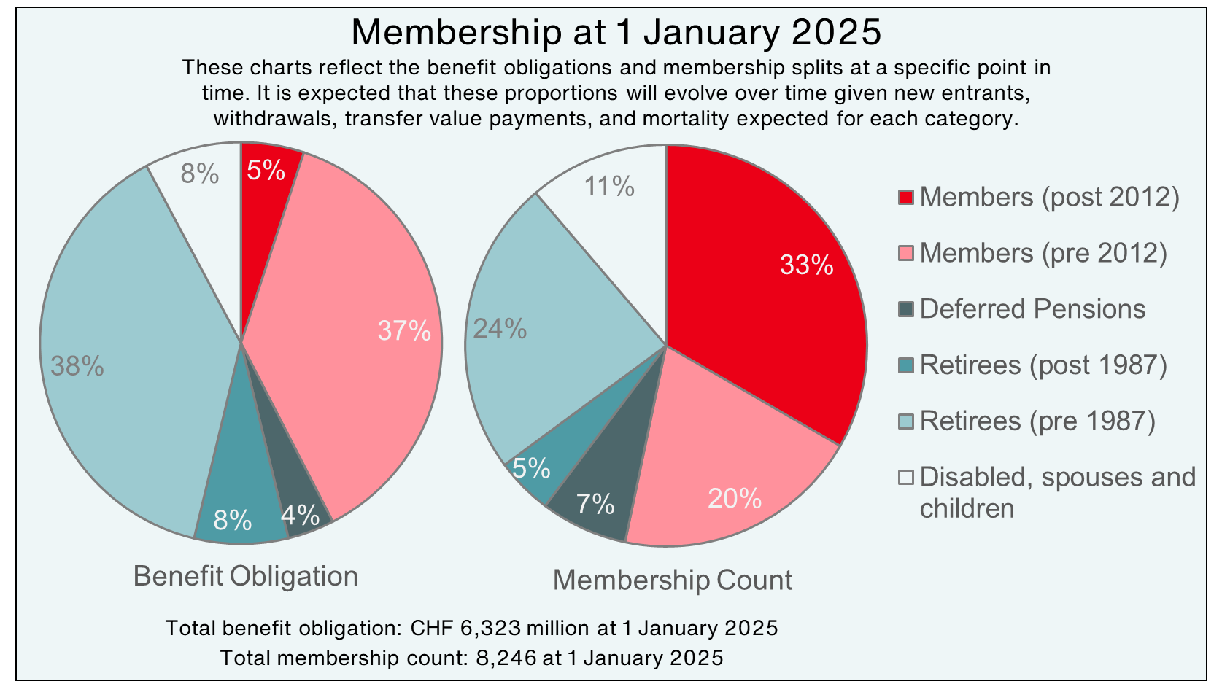

Slide 24

Actuarial Calculations: Some details
Assets: calculated using their market value or independent valuation in case of illiquid classes (real estate, private equity). 4620 MCHF
Age
Membership Data
Projected Yearly Benefits (cash flows)
Present Values of Projected Yearly Benefits
Liabilities
6323 MCHF
(preliminary)
Gender
Contract date
Family status
Reference salary
Discount
Factors
Years of membership
Sum
Discount rate 4.2%
Main
Best Estimate Assumptions
Inflation: 1.25%
Salary increase: 1.5%
Life table: ICSLT2023
generational, scaled

Slide 25
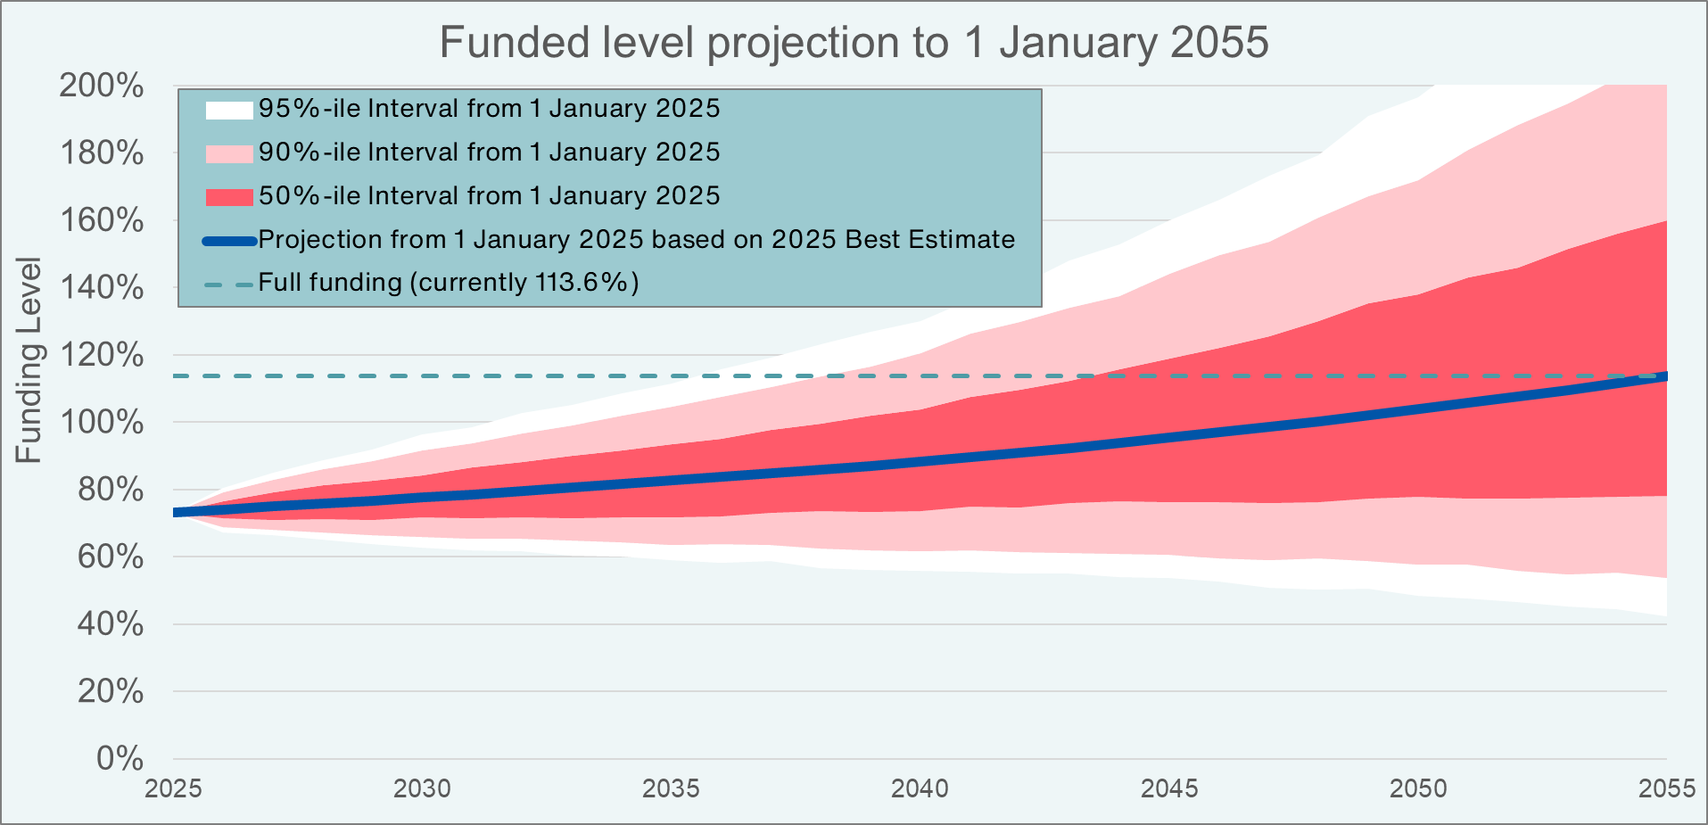
Funded level = Assets/Liabilities
73.1%
Full Funding = 100% + Fluctuation Reserves
Fluctuation Reserves depend on the investment strategy (expected return and risk (CVaR))
Large extrapolation error (solid green – extrapolation, dashed green – one sigma away)

Slide 26
Investment and Results

Slide 27
Asset Classes
Precious metals
Store of value, diversification of risk
Access to early-stage capital growth with a premium for complexity and risk
Hedge Funds
Risk management; access to uncorrelated returns through active management
Real Assets
Fixed Income
Access to capital growth and income from corporate profits
Equities
Real estate, timber, infrastructure: Store of value, stable income and protection from inflation
Benefit of liquidity, with premium over cash deposits for limited default risk
Private Equity and Venture Capital
Cash
Diversification, synthetic assets, derivatives, pensions

Slide 28
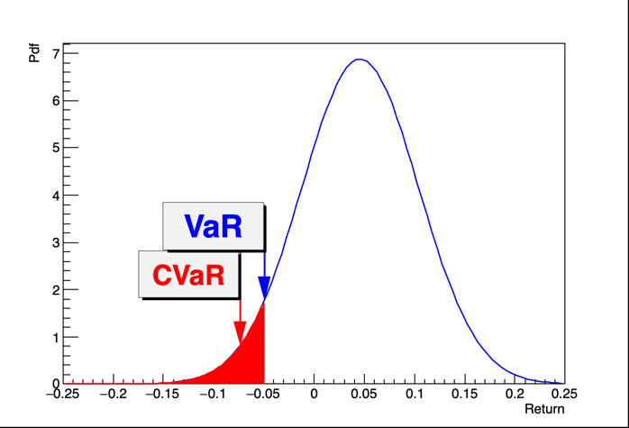
Risk Measure – Conditional Value at Risk
Value at Risk (VaR) at given confidence level (CL) α ∈ (0, 1) is the return where the probability of smaller return is 1 - α. Typically, α=95%.
Conditional value at risk (CVaR) at 95% CL is the average of the lowest 5% of returns.
  Account for the distribution tails
The risk consultant (Ortec) proposes risk limit in terms of CVaR @ 95%CL that is approved by the PFGB. The risk limit initially was -8%, since 2024 is -10%.
The portfolio optimization is maximizing the return while respecting the CVaR limit.

Slide 29
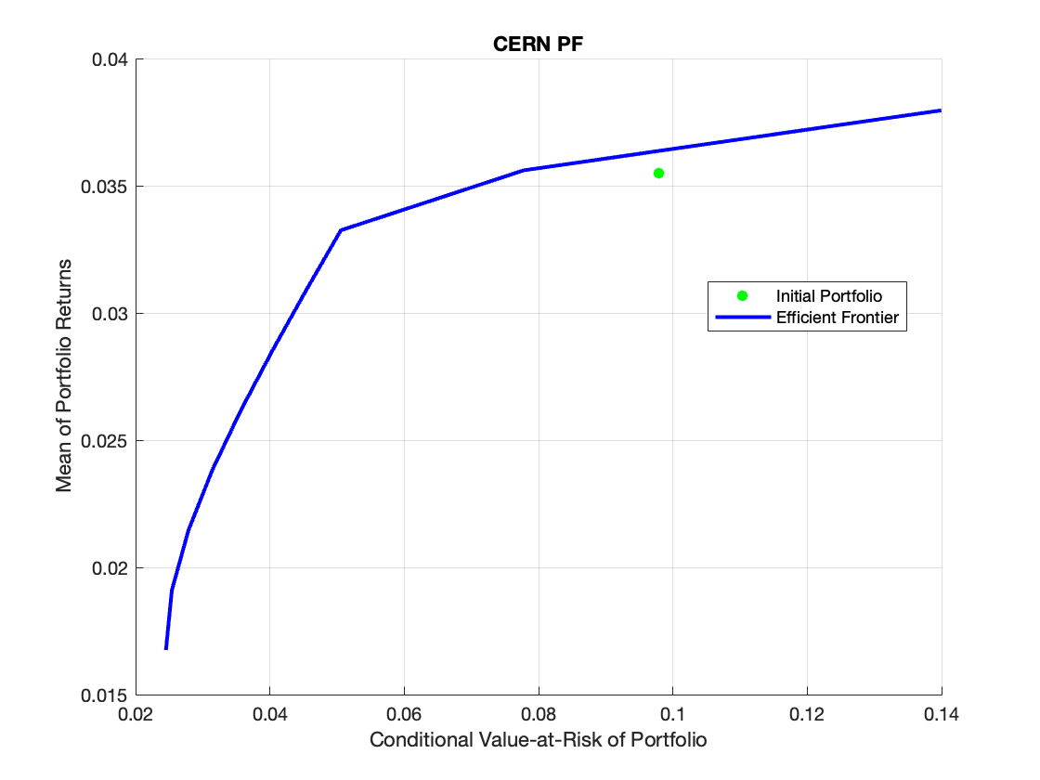
Strategic Asset Allocation (SAA)
The SAA is the result of the portfolio optimization provided by the risk consultant (Ortec).
The Ortec model calculates the expected return and standard deviation for each asset class together with the correlations between the asset classes.
The constrains for the asset classes consider the liquidity, the cash needs, etc.
The SAA is on the efficient frontier corresponding to the CVaR limit. The proposed portfolio is approved by the PFGB.

Slide 30
Risk of the Current Asset Allocation vs Risk Limit

Slide 31
Strategic asset allocation vs current. Net asset value

Slide 32
Pension Fund Cash Flows 2024, MCHF
Members
CERN-ESO
Special
Other
72
125
61
3
IN 261 MCHF
OUT 326 MCHF
Contribution
Balance -65 MCHF
Assets
01.01.2024: 4460
31.12.2024: 4620
225
Investment return (net)
252
52
14
8
Retirement
Spouse Orphan Disability
Transfer
PFMU

Slide 33
2001 9/11, dot-com bubble
2008 Financial Crisis
2022 Russian
invasion in Ukraine
1992
Black Wednesday
1973
Oil Crisis
2010 European Debt Crisis

Slide 34
Contributions Balance

Slide 35
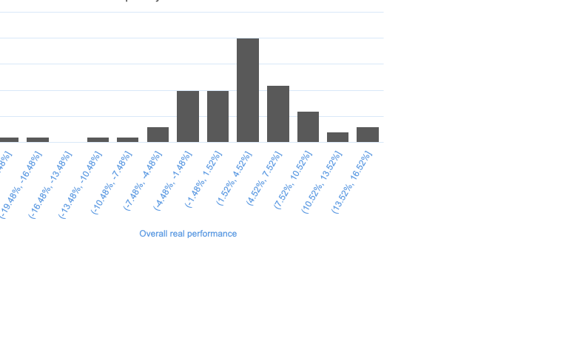
Real Return = Nominal Return - Inflation
Geom. Mean since 1956 = 1.87% Min real return in 2008 = -22.48%
Geom. Mean since 2012 = 3.17% Max real return in 1999 = 15.56%

Slide 36
Long term performance vs objective

Slide 37
Comparisons with Swiss Pension Funds

Slide 38
Pension Fund – Active Working Groups

Slide 39
Working Group on PF Factors and Parameters
The working groups have broad membership and have led to balanced discussions
Updated factors in early retirement
  New reduction factors based on “best estimate” with PAR2022 parameters in place
  More favourable to the members of the PF
Updated rules and prices for purchase of membership periods
  Some loopholes in the PF rules and regulations closed
Ongoing work on the transfer values
  Actuarial studies based on “best estimate” provided
Discussion on modification of rules for young spouses
  Wrongly designed protection against “deathbed” marriages became obsolete
The purchases are now “fair for members and fair for the Fund”.
Future plans to review fixed sums and allowances.

Slide 40
Working Group on the solutions in case of CERN closing
In 1996 the Council adopted a plan for foundation under the Swiss law that replaces the CERN PF in case of CERN closing
The introduction of guarantees for CHIS makes this foundation incompatible with the Swiss law
Active discussions with Swiss authorities
The preferred solution is a (single legacy purpose) international organisation that takes care of the activities related to CERN dismantling and of the CERN social system (PF, CHIS) until the death of the last beneficiary
  This would require changes in the CERN Convention and possibly ratification by the parliaments of the member states

Slide 41
Conclusions
Since 1955 the CERN Pension Fund has fulfilled its purpose of providing insurance to its members against the final consequences of death, disability and old age, with an excellent service record
The governance model in place is well-developed and ensures all stakeholders are represented in decision-making
The PFMU is led by financial experts with substantial experience
The scheme is maturing, and the number of beneficiaries will soon exceed the number of active members
The resulting negative cash outflows are serious challenge since they affect the accumulation of assets
Several decisions in the past have affected the funding level of the PF and still have an influence today
The investment environment is subject of bigger uncertainties than in the past and achieving positive real returns without excessive risk is challenging
The PF has sound investment strategy and reliable risk management; its results are among the best in the Swiss pension fund universe
The package of measures adopted in 2010-2012 leads to projections of full funding in the future, without which the Fund would be in decline
The SA plays active role in the PF: supports strong governance, raises important questions, monitors the situation and generates new ideas

Slide 42
Additional information & References
Special Proton: Towards a lasting social protection
CERN Pension Fund Web site
Pension Fund Annual Information Meetings
Articles from ECHO: BUL-SA-2014-048, BUL-SA-2014-055, BUL-SA-2014-063, BUL-SA-2014-079, BUL-SA-2014-080
CERN Pension Fund Annual Report and Financial Statements for 2023 (and the CDS links there)
A Governance Framework Designed for Dynamic Asset Allocation: The CERN Pension Fund Model
Should Pensions Think Like Macro Funds?

Slide 43
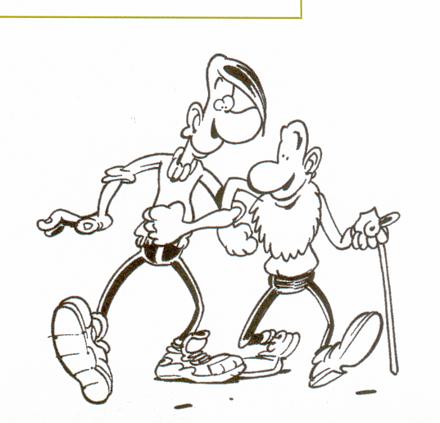
END
Thank you for your attention
Many thanks to the PF CEO and the SA Council for the help, slides, information and useful suggestions

