Slide 1

The Ghost Collider
An Innovative Higgs Factory
Andrew Hutton¹
Peter Williams ², Rob Apsimon ³, William Clampitt ³, Randy Gamage¹, Todd Satogata¹, Balša Terzić ⁴
¹Jefferson Lab, ²STFC, ³Lancaster University, ⁴ODU

Slide 2
Motivation
From the European Accelerator R&D Roadmap https://arxiv.org/pdf/2201.07895.pdf
For percent-level measurements, a luminosity of 10³⁶ cm⁻² s⁻¹ is required
This is significantly beyond the present proposals and will need a new vision
The “Ghost Collider” is an initial concept for such a facility
A particularly interesting prospect is to design and possibly build an energy efficient, ultra-high- luminosity ERL-based electron-positron collider, which would enable the exploration of the Higgs vacuum potential with a precise measurement of the tri-linear Higgs coupling. The e+e− → ZH → HH production cross-section is maximal near 500 GeV collision energy with a value of about 0.1 fb

Slide 3
The Linear Collider Facility
A Linear Collider vision statement * was published in March 2025, reiterating the need for a high luminosity, high energy Higgs Factory
The maximum center-of-mass energy envisioned increased from 500 GeV to 550 GeV
  The Ghost Collider will aim for 550 GeV center-of-mass, 275 GeV per beam
The number of interaction regions increased from 1 to 2, sharing the luminosity
  The Ghost Collider will have at least 2 interaction regions, each with the maximum luminosity
The Ghost Collider will adopt parameters from the 2013 The International Linear Collider Technical Design Report **
* C. Balazs et al., “A Linear Collider Vision for the Future of Particle Physics,” https://arxiv.org/pdf/2503.19983
** https://linearcollider.org/files/images/pdf/Executive%20Summary.pdf

Slide 4
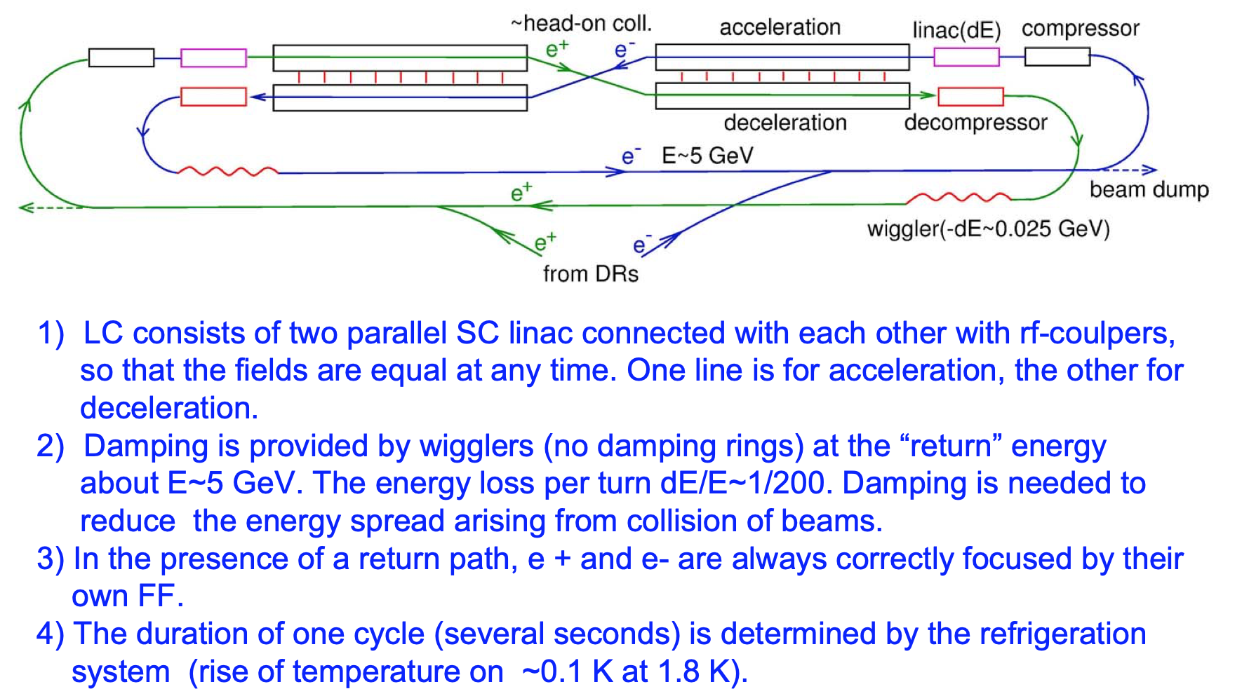
ERLC Proposal by Valery Telnov*
*V. Telnov, Journal of Instrumentation 16 (2021) P12025

Slide 5
Modification Suggested by Erk Jensen*
Erk Jensen suggested a different layout*, and realized that if accelerating electrons and decelerating positrons (or vice versa) shared the same bucket, there would be:
  No excitation of higher modes (HOMs)
  No Multi-bunch Beam Break-Up (MBBU)
Bunches consisting of equal numbers of electrons and positrons going in the same direction can be thought of as “ghost” bunches which do not interact electromagnetically with their environment
  They produce synchrotron radiation
  They will be visible on a fluorescent screen
Magnetic fields will separate the electrons and positrons
* https://indico.cern.ch/event/1040671/#9-energy-recovery-and-sustaina

Slide 6
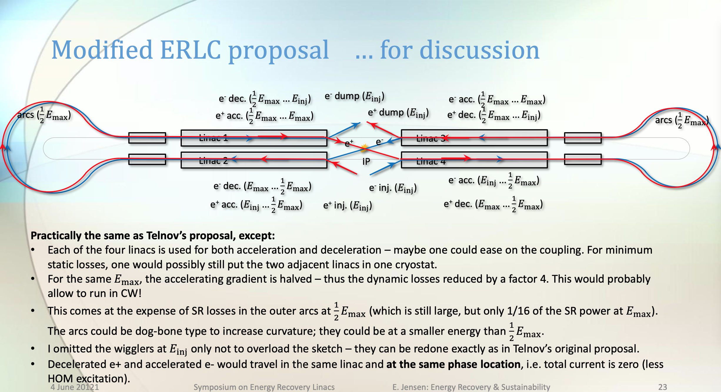
Suggested Layout by Erk Jensen

Slide 7
“Ghost” Bunches
There are also other advantages to “ghost” bunches:
  No excitation of dipole HOMs
  No requirement for a large aperture to allow HOMs to couple out
    Higher frequencies are possible – 3 GHz or (perhaps) 6 GHz
    Alternatively, the aperture could be reduced to reduce the cryogenic load at 1.3 GHz
  Minimize requirement to couple out HOMs to higher temperature (with associated heat leakage)
Obviously, these advantages are only true to first order
Note that bunches are accelerated in both directions in the Linacs
  The twin-axis linac can be considered as a folded linac with the same total length and equal gradient
Energy is transferred between electrons and positrons in each bucket
  Intra-bucket energy recovery
No twin axis cavities!

Slide 8
Loss Rate due to Interactions within Ghost Bunches
Since the electrons and positrons don’t have the same energy, they don’t have exactly the same velocity
  There is a finite probability that an electron and a positron will undergo a hard interaction
Ghost bunches do not interact with the RF, the center-of-energy is constant along the linac
  Calculate collisions in the center of mass frame
  Collision energy varies from 0.511 MeV to 1.929 MeV (not GeV!)
To obtain an upper limit, assume collision overlap is always at the maximum value
  Maximum is where the electron and positron energies are equal
Cross-section has two parts: Bhabha scattering (dominant) and pair annihilation
To obtain the particle interaction rate, integrate the luminosity times the cross-section for the transit time along the linac
William Clampitt, PhD student at Lancaster University, will present the complete results at the UK Particle Accelerator and Beam Conference, July 9-10, 2025

Slide 9
Further Opportunities – The Ghost Collider
Positrons and electrons in a single bunch can be brought into collision with positrons and electrons which are also in a single bunch
  This is like two neutral plasmas colliding
  There will be no coherent beam-beam effect
This was first tried (unsuccessfully) at Orsay by Joel Le Duff and the DCI Storage Ring Team*
  “Experimental results on space charge compensation with the two rings are presented which include studies with three beams (strong-weak interaction) and four beams (strong-strong interaction). These studies were carried out at the energy of 0.8 GeV”
  “The present status of the space charge compensation does not permit a gain in luminosity with double ring operation, apart from a factor 2 that could be achieved with two independent rings”
In a high-energy linear collider, the interaction would be more stable
  And again, this cancellation is only true to first order
So how can this be achieved?
*“Status Report on D. C. I, The Orsay Storage Ring Group, IEEE Transactions on Nuclear Science, Vol. NS-26, No.3, June 1979

Slide 10


Bringing the Four Bunches into the IP Simultaneously
Inject electrons into a bucket which accelerates the electrons
Inject positrons into the bucket 𝜆_{Linac}/2 behind the electrons which accelerates the positrons
Introduce a chicane for the electrons between the Linac and the Interaction Region to delay the electrons by 𝜆_{Linac}/2
Do the same for the other linac
Collide with a small or zero crossing angle
Arrows indicate change in energy
← e-
← e+
Linac

Slide 11
Linac and Chicane Layout
After collision, send the electrons through the opposite chicane to delay them by 𝜆/2
  Requires a total of four chicanes
  This layout returns the order of the bunches to its initial state
e4 →
← p2
p3 →
← e1
← e1
p1 →
← p2
e2 →
Linac 4
Linac 2
Linac 3
e1 →
← p1
Linac 1
← p3
e1 →
← e4
p2 →
p2 →
← e2
Alex Bogacz proposed a different layout in the muon collider for a similar purpose: https://indico.fnal.gov/event/8903/contributions/110580/attachments/71967/86347/Acceleration_NF_MC.pdf

Slide 12
Detailed Description
Linac 2 at the IP end, coming from the right
  There is one bunch of electrons, e1, and one bunch of positrons, p1, λ_{Linac}/2 behind coming from the Arc going to the IP at collision energy
  There is one bunch of positrons, p2, and one bunch of electrons, e2, λ_{Linac}/2 behind coming from the Arc superposed on e1 and p1 at injection energy
  The electron bunch e1 is bent into the curved beamline going to the IP
  The positron bunch p1 is bent into the straight beamline going to the IP
  The positron bunch p2 is bent towards one of the positron damping rings
  The electron bunch e2 is bent towards one of the electron damping rings
Linac 4 at the IP end, coming from the left
  There is one bunch of positrons, p3, and one bunch of electrons, e3, λ_{Linac}/2 behind coming from the Arc going to the IP at collision energy
  There is one bunch of electrons, e4, and one bunch of positrons, p4, λ_{Linac}/2 behind coming from the Arc superposed on e1 and p1 at injection energy
  The positron bunch p3 is bent into the curved beamline going to the IP
  The electron bunch e3 is bent into the straight beamline going to the IP
  The electron bunch e4 is bent left towards one of the electron damping rings
  The positron bunch p4 is bent right towards one of the positron damping rings

Slide 13
Beam Shape at the IP
In most colliders, the colliding beams are wide and flat, and since the electrons and the counter-rotating positrons focus identically, both beams have the same shape – wide and flat
If the beams at the IP of the Ghost Collider follow this trend, electrons from the left against positrons from the right would also be wide and flat
But for electrons from the right and positrons from the left, the beam shape would be tall and thin
This shape mismatch minimizes the compensation of electromagnetic interactions at the IP
The best solution is to have equal horizontal and vertical emittances in all four beams and to have equal horizontal and vertical beta functions at the IP
  All four beams will then be round and equal in size at the IP ensuring cancelation of the electromagnetic interaction
To achieve this condition, the quadruples should be rotated 45° throughout the Ghost Collider, including the damping rings, the linacs, the Arcs and the chicanes
  This ensures equal horizontal and vertical emittances of the beams
Triplets focus the beams at the IP, creating equal horizontal and vertical beta functions

Slide 14
Linacs

Slide 15
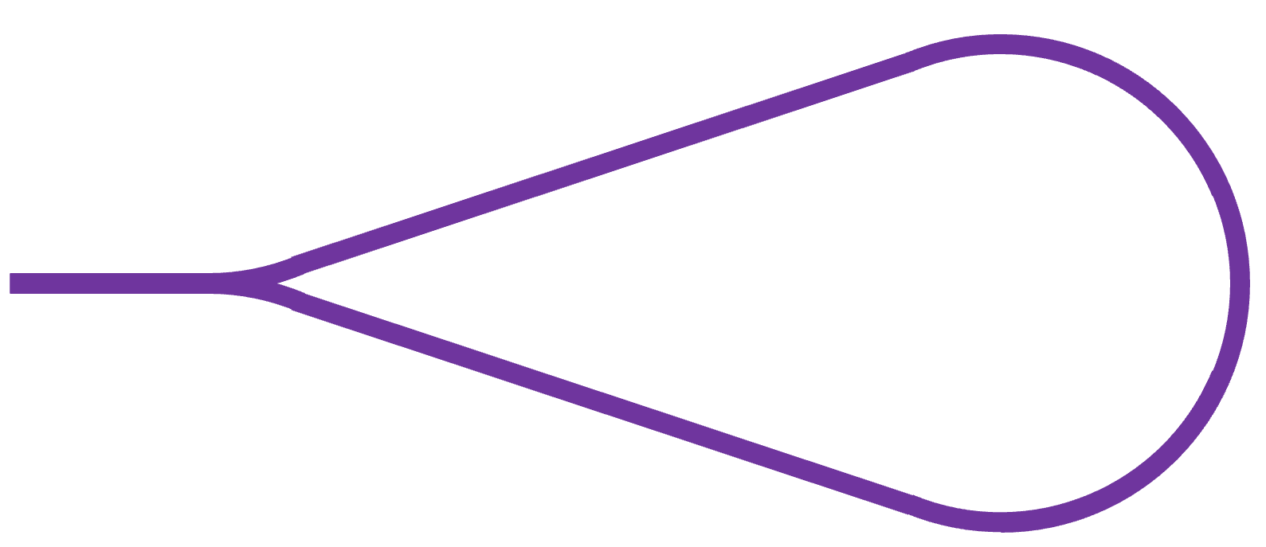
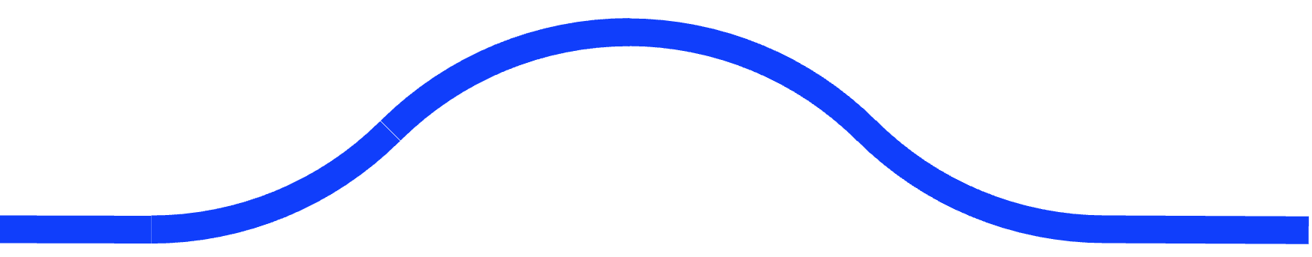


Single Linac
The ghost bunches have no electromagnetic interaction with their surroundings
This means that ghost bunches have no electromagnetic interaction with ghost bunches which are travelling in the opposite direction in the linac
This enables a major simplification, a single bi-directional linac on each side of the IP
  There will be head-on collisions in the linac, but the luminosity will be small with minimal loss of particles*
The chicanes in this layout function exactly like the four linac case described before
SRF Linac
Chicanes
SRF Linac
Arc
Arc
IP
*Also addressed by William Clampitt at the UK Particle Accelerator and Beam Conference, July 9-10, 2025

Slide 16
Linac Parameters
Three options can be envisaged:
  Use the ILC RF parameters (1300 MHz, 31.5 MV/m, 2 K cryogenics) and half the ILC linac length
    RF is pulsed
  Use the ILC linac length but half the gradient (1300 MHz, 16 MV/m, 2 K cryogenics)
    RF is gated 2 seconds on, four seconds off following Telnov’s proposal
  Use the ILC linac length but half the gradient (1300 MHz, 16 MV/m, 4 K cryogenics)
    RF is CW: requires R&D to reach a Q₀ = 3 x 10¹⁰ @ 16 MV/m @ 4 K
In what follows, Option 1 will be used for numerical calculations in this presentation
The RF parameters are those achieved for the ILC
  1300 MHz, 31.5 MV/m, 2 K cryogenics, Q₀ = 2.7 x 10¹⁰
As soon as superconducting cavities with Nb₃Sn coating become available, they could be used with a corresponding decrease in cryogenic losses by a factor 3

Slide 17
The Arcs

Slide 18
“Normal” Arc Geometry
Using the standard scaling for a storage ring, the radius of curvature should scale as the square of the energy
So, the arcs in the Ghost Collider should have a radius and circumference ¼ of that of a circular collider of the same energy at the IP
For the normal design, the entry and exit to the arcs is a 60° bend of the same radius
  The circumference of each arc is then 7/6 of 2πR
This geometry has the shortest tunnel length
  Is there a better geometry?
What is the “best” geometry
60°
60°

Slide 19
Improved Arc Geometry
Reducing the total bend angle reduces the synchrotron radiation
Requires additional straight tunnel
The optimum shape balances reduced arc length and increased total tunnel length
Total Arc Length = 2 x R(π/2 + 2θ)
Each straight section length = {(R cosθ - (R – R cosθ)}/sinθ = R(2cosθ - 1)/sinθ
Total beamline length = R(π + 4θ) + (4cosθ - 2)/sinθ
Total length of the turn-around = R sinθ + {R(2cosθ - 1)/sinθ}cosθ +R sinθ + R
= R{1 + 2sinθ +2Rcotθcosθ - cotθ}
θ
Rcosθ
R
Rcosθ
θ
R-Rcosθ

Slide 20
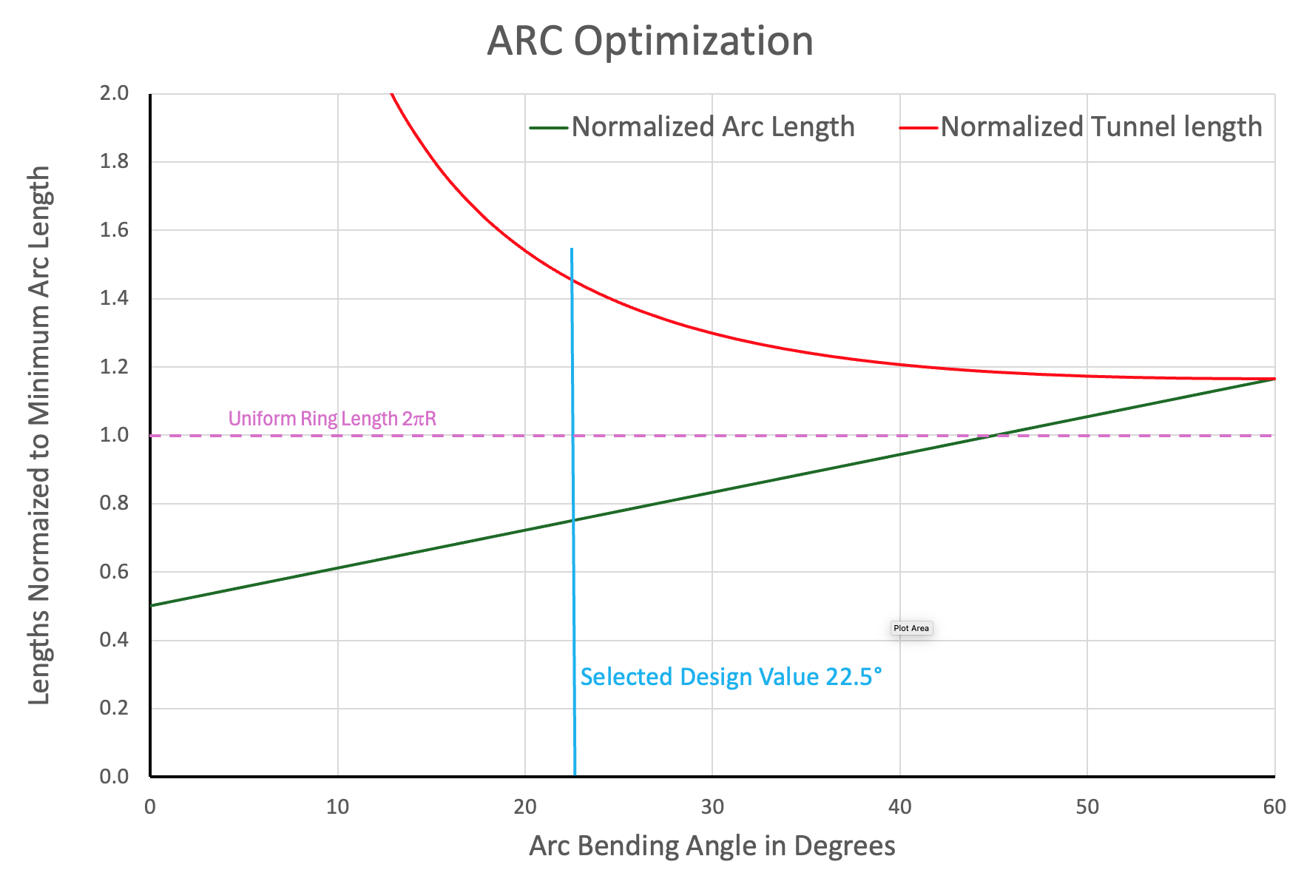
Arc Length and Total Length Normalized to 2πR
The arc length decreases linearly with θ
At small values of θ the total length rises rapidly
The selected design value of θ is 22.5°
Total Arc length = 64.2% of normal design
  Reduces synchrotron radiation by 35.8% compared to previous design
  Synchrotron radiation is 75% of ring with same arc radius R
Total length = 24.7% longer than normal design
Straight section length = 2.215 R

Slide 21
Solution Adopted
The shape with the Arc bending angle of 22.5° seems optimum
The radius of curvature of the Arc, R, is a variable to be determined by a cost optimization
Assume the Arc radius equals the LEP radius R = 3,500 m
  The bending radius ρ = 3,096 m
  Filling factor = 88%
Injection energy = 5 GeV; Maximum energy = 275 GeV
Arc Energy = 140 GeV
Synchrotron radiation loss = 8.85 x 10⁻⁵ x 140⁴ / 3,096 = 11 GeV for a full arc
Each Arc is ¾ of a full arc so synchrotron radiation loss per Arc = 8.24 GeV

Slide 22
Arc Beamlines
There are two options for the Arc beamlines:
Electrons and positrons are in the same vacuum chamber going in opposite directions
    Cheapest solution, simplest magnets
    Need to avoid collisions in the Arcs
Electrons and positrons are in different vacuum chambers – either in the same or opposite directions
    Expensive solution for magnet and vacuum chamber components
    Splitter design more complex
Adopt solution with both particle types in the same vacuum chamber

Slide 23
Separating Electrons and Positrons in the Arcs
Electrons and positrons will be counter-rotating in a single vacuum chamber
They will be separated by establishing double-helix trajectories using two low-frequency RF separators at each end of the regions where electrons and positrons are counter-rotating
A horizontal RF separator provides a positive horizontal kick to the electrons and a negative horizontal kick to the positrons
A vertical RF separator, one quarter betatron wavelength downstream of the horizontal separator provides a positive vertical kick to the electrons and a negative vertical kick to the positrons
This initiates a helical rotation of both beams with the electrical center of the beams in the center of the beampipe, avoiding excitation of transverse fields
An identical pair of RF separators at the end of the beamline with counter-rotating beams restores the bunches to the central trajectory
The beamline can contain magnets and/or RF systems

Slide 24
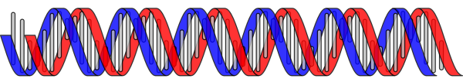
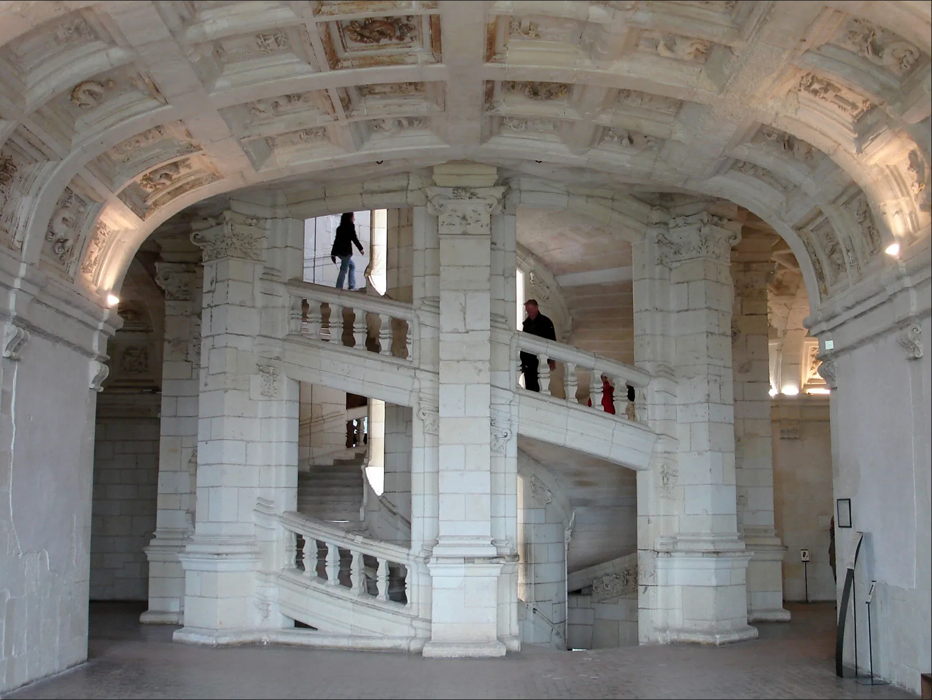
Helical Trajectories
The electron and positron trajectories are like the strands of DNA or the famous double staircase at the Chateau de Chambord in France, designed by Leonardo da Vinci
This configuration was successfully used in the Tevatron for many years *
* Y. Alexahin, “Optimization of the helical orbits in the Tevatron,”
https://accelconf.web.cern.ch/p07/PAPERS/FRPMS006.PDF

Slide 25

Arc-Linac Interface
p1 →
← e2
e1 →
← p2
Towards the Arc
Electrons
RF
Separators
SRF Linac
Horizontal
Bend
V
H
Arc
RF
V
H
← e1
p2 →
← p1
e2 →
From the Arc
Positrons

Slide 26
Details of the ARC-Linac Interface
There is one electron bunch, e1, and one positron bunch, p1, λ_{Linac}/2 behind, accelerating into the Arc coming from the damping rings
There is one positron bunch, p2, and one electron bunch, e2, λ_{Linac}/2 behind, decelerating into the Arc coming from the IP superposed on e1 and p1
All the bunches have the same energy
A horizontal dipole bends the electrons left and the positrons right by an equal angle
The bunches enter the Arc, electrons clockwise, positrons counterclockwise
To avoid collisions in the Arcs, helical orbits are initiated:
  Horizontal RF kick followed by a vertical RF kick for the electrons λ_{betatron}/2 downstream
  Vertical RF kick followed by a horizontal RF kick for the positrons λ_{betatron} /2 downstream
After traversing the Arc, the helical orbits of the electrons and positrons are closed by the RF kickers if the distance around the ARC is exactly (n+½)λ_{kick} measured between the horizontal RF kickers or the vertical RF kickers
The horizontal dipole again bends the electrons left and bending the positrons right, sending them both into the linac
The phases of all the bunches will be correct in the Linac if the distance around the arc measured from the center of the last RF cell in the linac back to the center of the last cell in the RF linac is exactly (n+½) λ_{Linac}

Slide 27
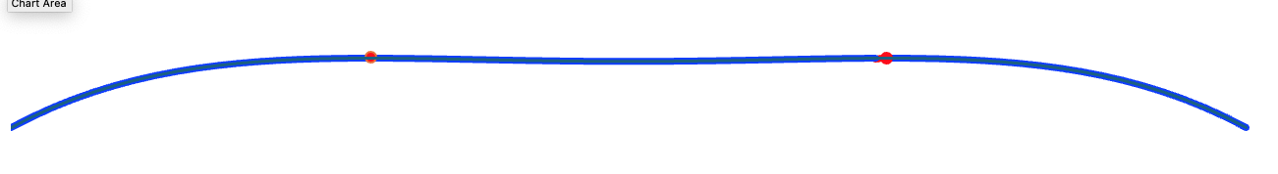
Arc Energy Replacement
Both the electrons and positrons lose energy in the Arcs
The two electron bunches in each Arc are separated by 𝜆_{Linac} /2
The two positron bunches in each Arc are separated by 𝜆_{Linac} /2
  One going to the IR, one coming from the IR
Since all the bunches lose energy in the Arcs, an RF system must accelerate both bunches
Proposed solution: RF system at 325 MHz plus a second harmonic RF system at 650 MHz, 180° out of phase
Advantage – bunches have no no energy chirp and can be decelerated without loss
Disadvantage – takes more power
  1.33 x voltage at ¼ frequency + 0.33 x voltage at ½ frequency = total of 1.66 x voltage = 11 GV/Arc

Slide 28
Arc RF System Parameters
The Arc RF is 325 MHz with parameters of LEP scaled from 352 MHz
  LEP cryomodule: 7.5 MV/m, 102 MV per cryomodule with Q₀ = 3 x 10⁹ @ 4.5 K, length = 12 m
  Filling factor = 80%
Using the scaled LEP cavities eight 4-cell cavities per cryomodule
  Arc cryomodule total length = 12 m x 325/353 = 11.1/0.8 m = 13.9 m
  Arc cryomodule energy gain = 102 MV x 353/325 = 110 MV
Each RF system requires 5.5 GV / 110 MeV = 50 cryomodules
50 cryomodules are 50 x 13.9 m = 695 m
650 MHz cavities are about 25% of this length
Straight section length = 2.215 x 3000m = 6.645 km
There is more than enough room
Linac Coherent Light Source II High Energy Upgrade (LCLS-II-HE) Conceptual Design Report (SLAC-R-1098)
Hübner, K., “The LEP Superconducting RF System,” CERN-SL-2001-059-DI

Slide 29
Linac-Chicane Interface

Slide 30
The Linac-Chicane Interface
To Positron Damping Ring
From Electron Storage Ring
p →
← e
p →
RF Separators
H
V
RF Separators
RF Separators
Horizontal
Bend
e →
SRF Linac
Twin-Axis
Quadrupoles
H
V
Bend
← e
H
V
RF Separators
← p
e →
← p
To Electron Damping Ring
From Positron Storage Ring

Slide 31
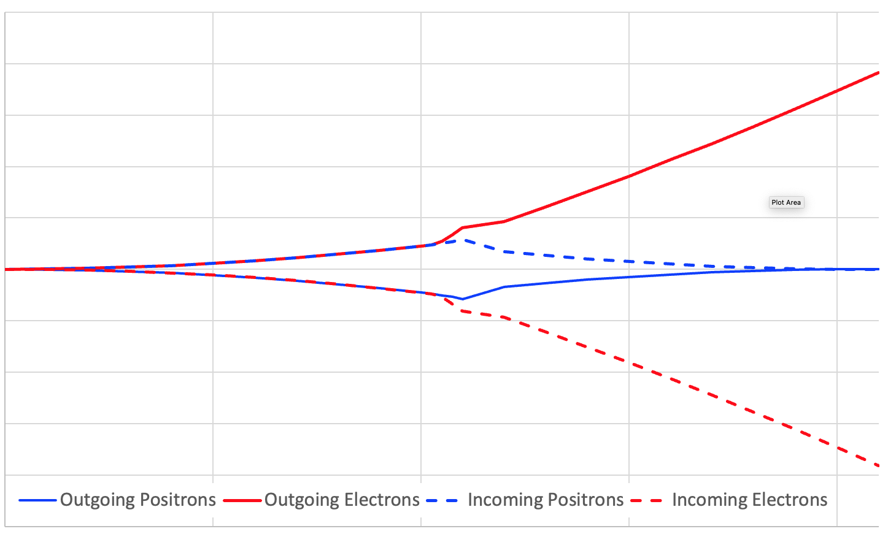
Trajectories in Separation Region
RF Separator
RF Separator
Septum

Slide 32
Left Linac-Chicane Interface
Upstream, a low field dipole extracts electrons to the right and positrons to the left
  The same magnets injects positrons from the right and electrons from the left
A curved beamline delays the outgoing positrons (positive current)
A curved beamline delays the incoming positrons (negative current)
A straight beamline transports the outgoing electrons (negative current)
A straight beamline transports the incoming electrons (positive current)
A Lambertson Septum magnet bends positive current left and negative current right
The outgoing curved positron beamline is to the far left
The incoming curved positron beamline is to the far right
A common electrostatic field cannot deflect outgoing positrons left and incoming positrons right
Therefore, either an RF kicker or two separate electrostatic bends are required

Slide 33
Design Parameters for RF Dipole Deflector
From the parameters of the LHC-HL dipole crab cavities:
Undressed cavity length = 775 mm @400 MHz = 954 mm scaled to 325 MHz
Assume dressed cavity length = 1.5 x 954 mm = 1430 mm
Cavity aperture = 84 mm @400 MHz = 103.4 mm @ 325 MHz
Kick per cavity = 5 MV *
Total kick for 5 single-cell cavities = 25 MV
Total length of 5 single-cell cavities = 1430 x 5 = 7.15 m
Adopt cryomodule length = 10 m to allow for end effects
10 m cryomodule with a 25 MV kick
Real estate gradient = 2.5 MV/m
* De Silva et al., “Electromagnetic Design of 400 MHz RF-Dipole Crabbing Cavity for LHC High Luminosity Upgrade,” Proceedings of the 17th International Conference on RF Superconductivity (SRF2015)

Slide 34
Chicanes

Slide 35
Chicanes
The chicanes delay the leading bunches so that they arrive at the IP at the same time
  On the right-hand side, a curved beamline delays the incoming electrons
  On the right-hand side, a curved beamline delays the outgoing electrons
  On the left-hand side, a curved beamline delays the incoming positrons
  On the left-hand side, a curved beamline delays the outgoing positrons
Two curved beamlines are required on either side
Similarly, two straight beamlines are required on either side
The bunches all have the same energy at the end of the linacs – 275 GeV
The bunches should all have the same energy at the IP – 275 GeV
The energy lost to synchrotron energy in the curved chicane must be replaced by RF
  Use the same 325 MHz cavities as the Arcs

Slide 36
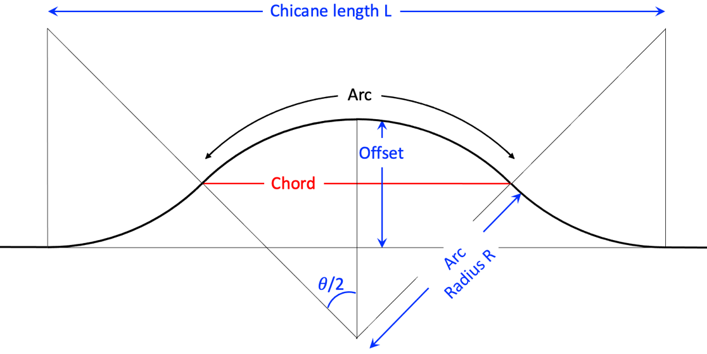
Chicane Geometry
Since the electron and positron bunches are 180°apart in the linac, the difference between the straight beam line and the arc should be 𝜆_{Linac}/2, The central arc and chord are exactly half the chicane (= L/2), and the transverse separation between them (the sagitta) is exactly half of the chicane offset.
Arc length = R𝜃 where R is the radius of curvature of the arc and 𝜃 is the bending angle
Chord length = L/2 = 2Rsin(𝜃/2) ≃ 2R[𝜃/2 – (𝜃/2)³/6]
Arc length – chord length = 𝜆_{Linac}/4 ≃ R𝜃 - 2R[𝜃/2 – (𝜃/2)³/6] ≃ R𝜃³/24
𝜃 = (6𝜆_{Linac} /R)^{1/3}
Total bend angle of the chicane 𝜃_{chicane} = 2𝜃 = 2(6𝜆/R)^{1/3}
Chicane length = L ≃ 2R𝜃 ≃ 2R(6𝜆_{Linac}/R)^{1/3}
Using the intersecting chords theorem:
Sagitta ≃ (L/4)²/2R = L²/32R
Chicane offset = L²/16R
The synchrotron radiation loss in the chicane is U_{chicane}, where:
U_{chicane}(GeV) = (𝜃_{chicane}/2𝜋) x 8.85 x 10⁻⁵ x E(GeV)⁴ /𝜌(m) = 1.408 x 10⁻⁵ x 𝜃_{chicane} x E(GeV)⁴ /𝜌(m)
The average filling factor of the magnets in the arc is ∼80%, so 𝜌 = 0.8 R
U_{chicane} (MeV) = 1.76 x 10⁻⁵ x 𝜃_{chicane} x E(GeV)⁴ /R(km)

Slide 37
Chicane Layout
The electrons and positrons should have the same energy at the IP, independent of whether they traversed the chicane or the straight beamline
  The chicane needs an RF system to replace the synchrotron radiation loss
  This adds to the total length of the chicane
The smaller the bending radius, the more synchrotron radiation, the shorter the chicane beamline but the longer the RF section required to replace the synchrotron radiation
There is a broad minimum total length of the chicane

Slide 38
Chicane Optimization
The optimum chicane bending radius is between 4 and 7 km
The design value chosen is R = 6 km
Synchrotron Radiation loss per curved chicane = 3 GeV
Total Chicane Length = 1.4 km
Bending field = 1.53 T
Selected Design Value R = 6.0 km

Slide 39
Interaction Regions (IR) and Interaction Points (IP)

Slide 40
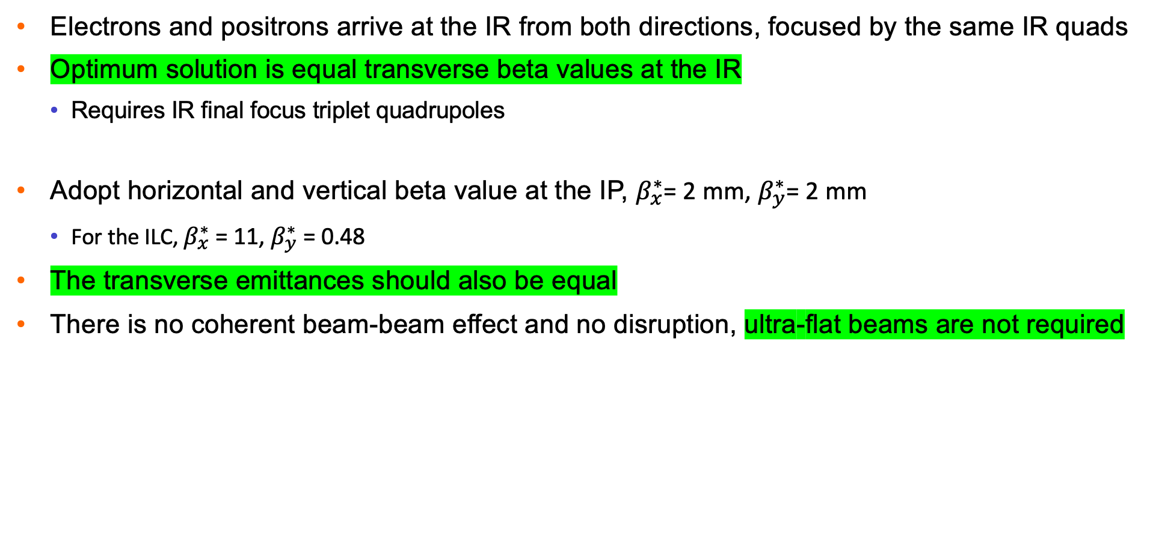
Interaction Region
Electrons and positrons arrive at the IR from both directions, focused by the same IR quads
Optimum solution is equal transverse beta values at the IR
  Requires IR final focus triplet quadrupoles
Adopt horizontal and vertical beta value at the IP, $β_{x}^{∗}$= 2 mm, $β_{y}^{∗}$= 2 mm
  For the ILC, $β_{x}^{∗}$ = 11, $β_{y}^{∗}$ = 0.48
The transverse emittances should also be equal
There is no coherent beam-beam effect and no disruption, ultra-flat beams are not required

Slide 41
Additional Interaction Regions
The Ghost bunches are not disrupted by the beam-beam collisions at the IP
That means it is possible to put two IPs in series, one behind the other
The luminosities would be additive, not shared
The criteria is that there is a –J matrix (nπ ± ½) betatron wavelengths between the two IPs so chromatic errors cancel
Cancelation removes the need for additional chromatic correction of the IPs

Slide 42
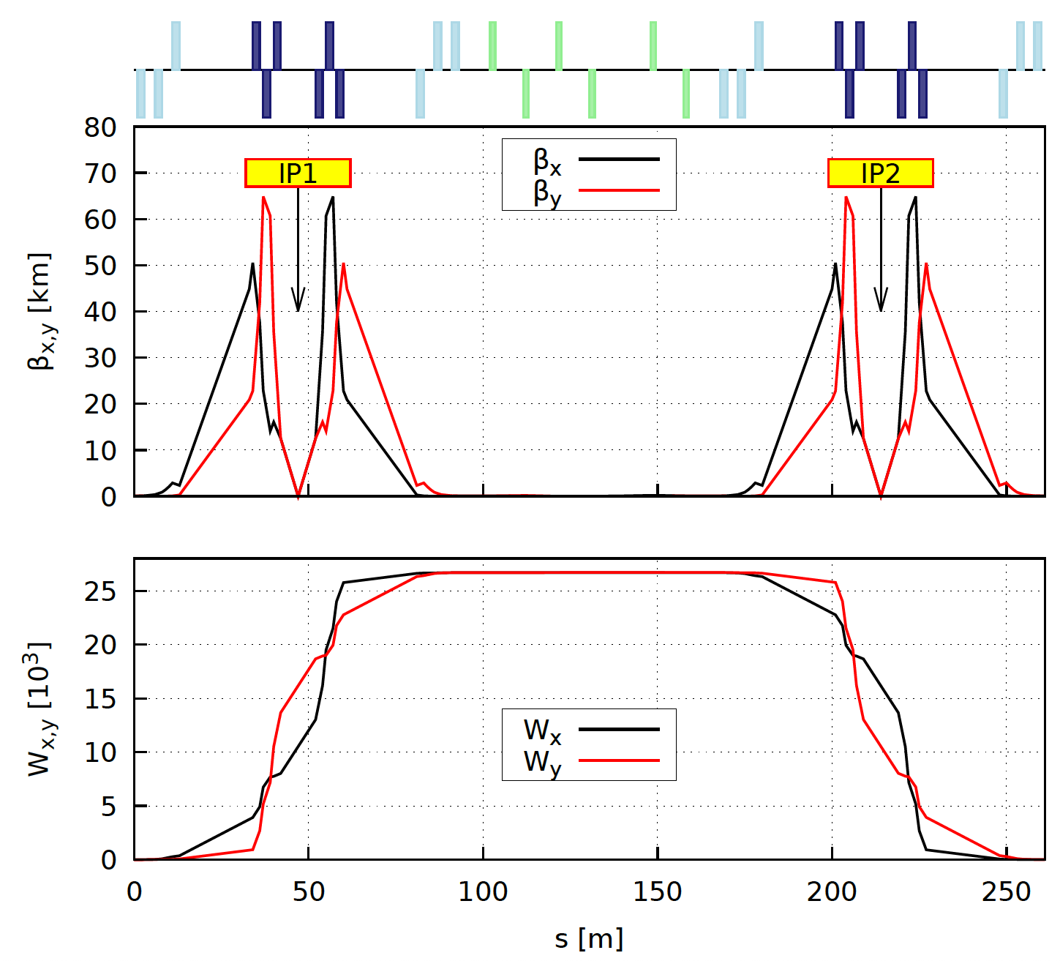
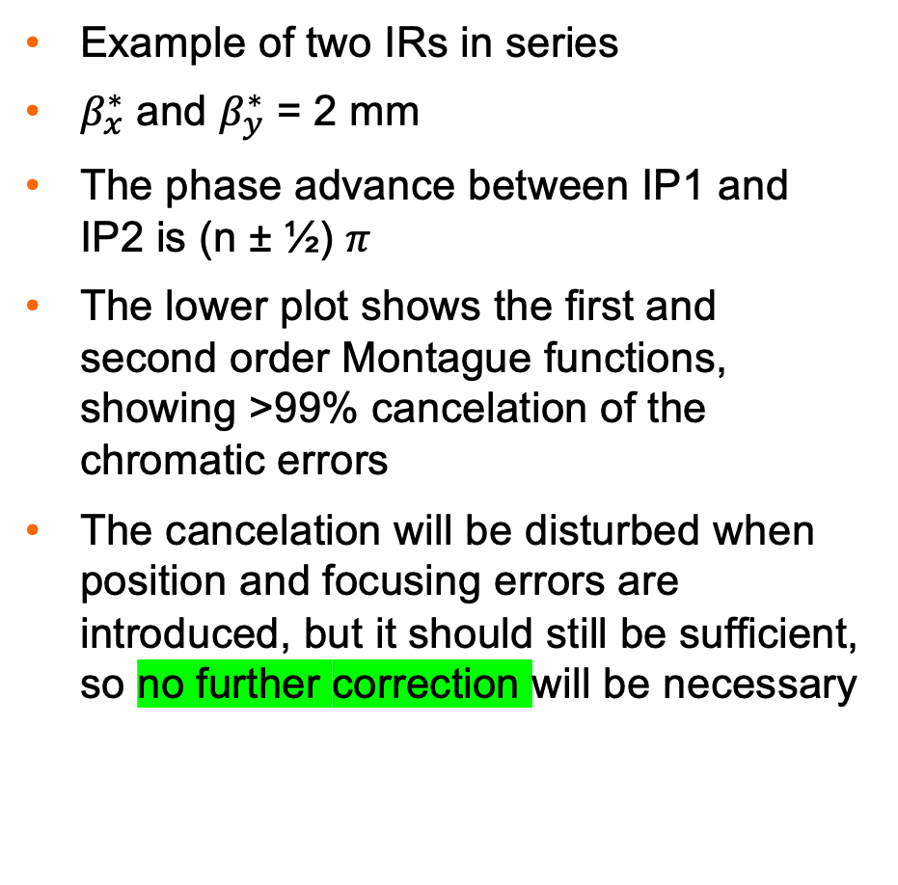
Interaction Region Matching
Example of two IRs in series
$β_{x}^{∗}$ and $β_{y}^{∗}$ = 2 mm
The phase advance between IP1 and IP2 is (n ± ½) $π$
The lower plot shows the first and second order Montague functions, showing >99% cancelation of the chromatic errors
The cancelation will be disturbed when position and focusing errors are introduced, but it should still be sufficient, so no further correction will be necessary
167 m
Matching by Randy Gamage

Slide 43
Luminosity Estimate

Slide 44
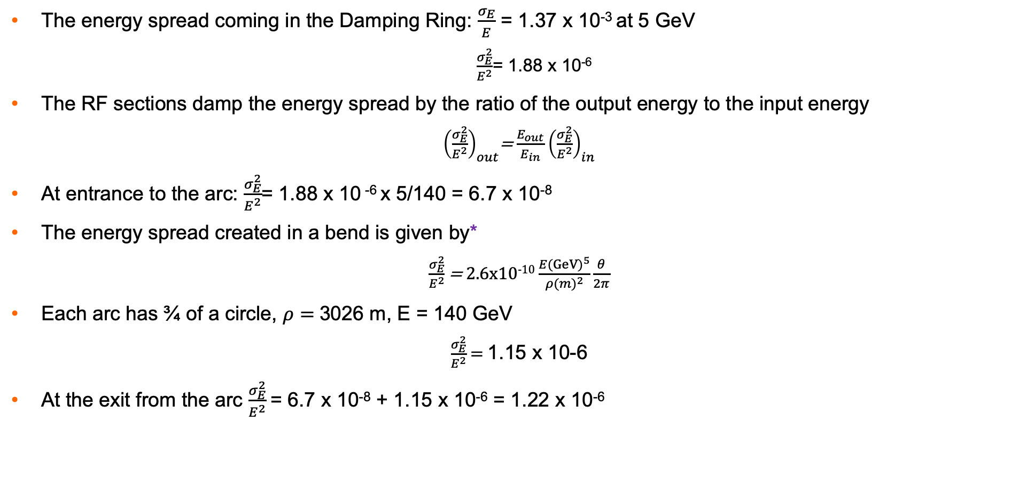
Energy Spread
The energy spread coming in the Damping Ring: $\frac{σ_{E}}{E}$ = 1.37 x 10⁻³ at 5 GeV
  $\frac{σ_{E}^{2}}{E^{2}}$= 1.88 x 10⁻⁶
The RF sections damp the energy spread by the ratio of the output energy to the input energy
${\left(\frac{σ_{E}^{2}}{E^{2}}\right)}_{out}$= $\frac{E_{out}}{E_{in}}$ ${\left(\frac{σ_{E}^{2}}{E^{2}}\right)}_{in}$
At entrance to the arc: $\frac{σ_{E}^{2}}{E^{2}}$= 1.88 x 10 ⁻⁶ x 5/140 = 6.7 x 10⁻⁸
The energy spread created in a bend is given by*
$\frac{σ_{E}^{2}}{E^{2}}$ = 2.6x10⁻¹⁰ $\frac{{E(GeV)}^{5}}{{ρ(m)}^{2}}\frac{θ}{2π}$
Each arc has ¾ of a circle, $ρ=$3026 m, E = 140 GeV
$\frac{σ_{E}^{2}}{E^{2}}$ = 1.15 x 10-6
At the exit from the arc $\frac{σ_{E}^{2}}{E^{2}}$= 6.7 x 10⁻⁸ + 1.15 x 10⁻⁶ = 1.22 x 10⁻⁶
* G. A. Krafft and I. V. Bazarov, “4th Generation Light Sources II ERLs and Thomson Scattering,”
https://casa.jlab.org/publications/viewgraphs/lecture/bazarov_uspas_day4.pdf

Slide 45
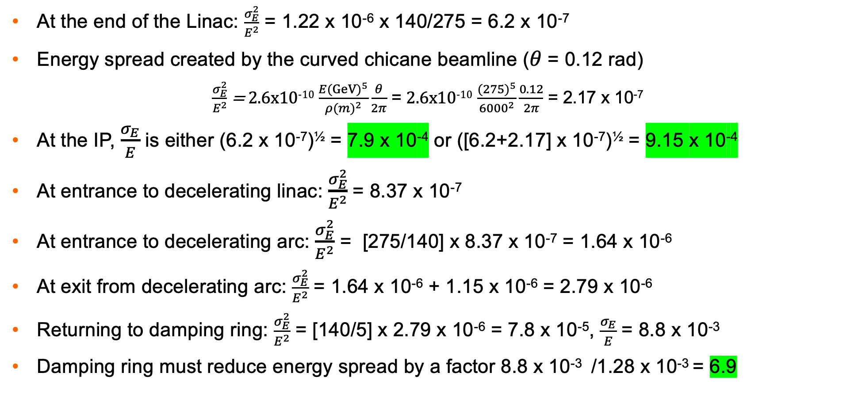
Energy Spread (cont.)
At the end of the Linac: $\frac{σ_{E}^{2}}{E^{2}}$ = 1.22 x 10⁻⁶ x 140/275 = 6.2 x 10⁻⁷
Energy spread created by the curved chicane beamline ($θ$ = 0.12 rad)
  $\frac{σ_{E}^{2}}{E^{2}}$ = 2.6x10⁻¹⁰ $\frac{{E(GeV)}^{5}}{{ρ(m)}^{2}}\frac{θ}{2π}$ = 2.6x10⁻¹⁰ $\frac{{(275)}^{5}}{{6000}^{2}}\frac{0.12}{2π}$ = 2.17 x 10⁻⁷
At the IP, $\frac{σ_{E}}{E}$ is either (6.2 x 10⁻⁷)^{½} = 7.9 x 10⁻⁴ or ([6.2+2.17] x 10⁻⁷)^{½} = 9.15 x 10⁻⁴
At entrance to decelerating linac: $\frac{σ_{E}^{2}}{E^{2}}$= 8.37 x 10⁻⁷
At entrance to decelerating arc: $\frac{σ_{E}^{2}}{E^{2}}$ = [275/140] x 8.37 x 10⁻⁷ = 1.64 x 10⁻⁶
At exit from decelerating arc: $\frac{σ_{E}^{2}}{E^{2}}$ = 1.64 x 10⁻⁶ + 1.15 x 10⁻⁶ = 2.79 x 10⁻⁶
Returning to damping ring: $\frac{σ_{E}^{2}}{E^{2}}$ = [140/5] x 2.79 x 10⁻⁶ = 7.8 x 10⁻⁵, $\frac{σ_{E}}{E}$ = 8.8 x 10⁻³
Damping ring must reduce energy spread by a factor 8.8 x 10⁻³ /1.28 x 10⁻³ = 6.9

Slide 46
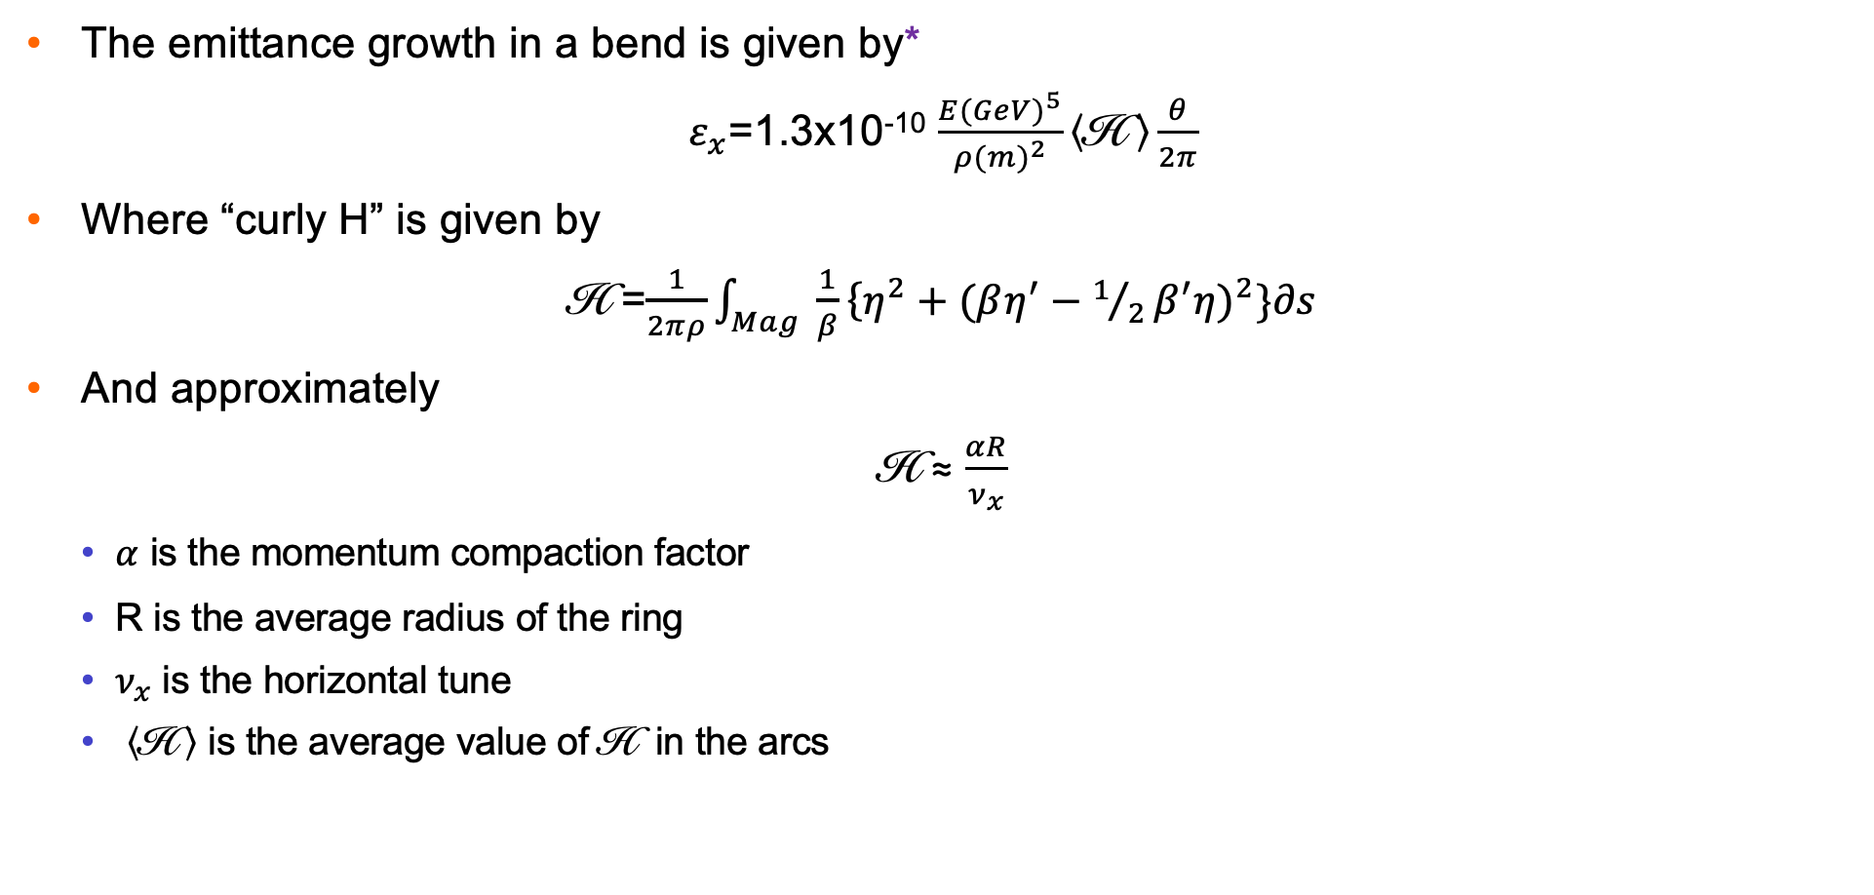
Emittance Growth
The emittance growth in a bend is given by*
$ε_{x}$=1.3x10⁻¹⁰ $\frac{{E(GeV)}^{5}}{{ρ(m)}^{2}}\left\langle \text{H} \right\rangle \frac{θ}{2π}$
Where “curly H” is given by
$\text{H}$=$\frac{1}{2πρ}\int_{Mag}^{ }{ \frac{1}{β}\left\{{η^{2}+(βη^{′}−1/2β^{′}η)}^{2}\}∂s\right.}$
And approximately
H ≈ $\frac{αR}{ν_{x}}$
  $α$ is the momentum compaction factor
  R is the average radius of the ring
  $ν_{x}$ is the horizontal tune
  $\left\langle \text{H} \right\rangle$ is the average value of H in the arcs
I Bazarov, G Krafft, “Recirculated and Energy Recovered Linacs,” https://www.classe.cornell.edu/~ib38/uspas08/lec1.pdf
M. Sands, “The Physics of Electron Storage Rings: An Introduction,” SLAC- 121 (1970)

Slide 47

Curly H
For the Ghost Collider, adopt the PETRA IV value: H = 3.3 x 10⁻⁵
This value of is the lowest that has been fully validated
A detailed design of the Ghost Collider damping ring should be carried out to validate this choice – or even improve upon it
Lowering the value of improves the luminosity
 |  | LEP 1 | LEP 2 | MAX IV | ESRF | APS-U | PETRA IV
Momentum Compaction Factor | α | 3.87E-04 | 1.40E-04 | 3.00E-04 | 8.50E-05 | 3.80E-05 | 1.49E-05
Circumference | C | 26658.9 | 26659.9 | 528 | 843.977 | 1103.98 | 2304
Average Radius | R | 4242.90 | 4243.05 | 84.03 | 134.32 | 175.70 | 367
Horizontal Tune |  | 70.35 | 102.28 | 42.2 | 76.21 | 95.09 | 1.64E+02
Curly H |  | 2.33E-02 | 5.81E-03 | 5.97E-04 | 1.50E-04 | 7.02E-05 | 3.30E-05
$ν_{x}$
H
H
H

Slide 48
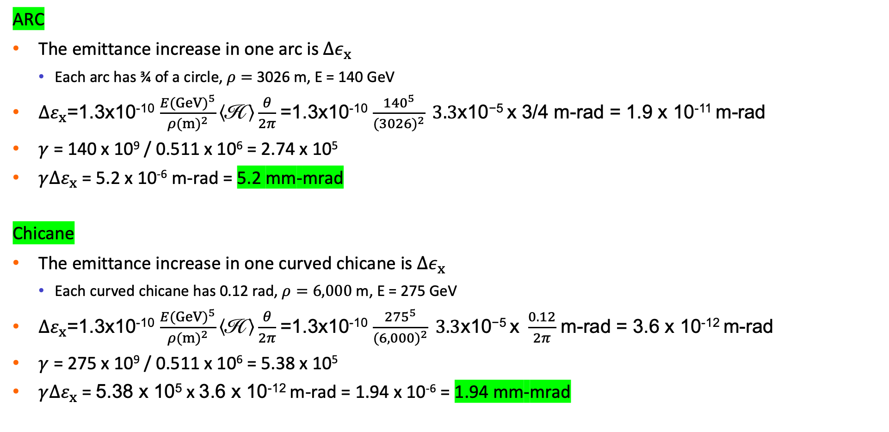
Emittance Growth
ARC
The emittance increase in one arc is $Δε_{x}$
  Each arc has ¾ of a circle, $ρ=$3026 m, E = 140 GeV
${∆ε}_{x}$=1.3x10⁻¹⁰ $\frac{{E(GeV)}^{5}}{{ρ(m)}^{2}}\left\langle \text{H} \right\rangle \frac{θ}{2π}$ =1.3x10⁻¹⁰ $\frac{{140}^{5}}{{(3026)}^{2}}\text{ 3.3}\text{x}\text{10−5 }\text{x}\text{ 3/4}$ m-rad = 1.9 x 10⁻¹¹ m-rad
$γ$ = 140 x 10⁹ / 0.511 x 10⁶ = 2.74 x 10⁵
$γ{∆ε}_{x}$ = 5.2 x 10⁻⁶ m-rad = 5.2 mm-mrad
Chicane
The emittance increase in one curved chicane is $Δε_{x}$
  Each curved chicane has 0.12 rad, $ρ=6,000$ m, E = 275 GeV
${∆ε}_{x}$=1.3x10⁻¹⁰ $\frac{{E(GeV)}^{5}}{{ρ(m)}^{2}}\left\langle \text{H} \right\rangle \frac{θ}{2π}$ =1.3x10⁻¹⁰ $\frac{{275}^{5}}{{(6,000)}^{2}}\text{ 3.3}\text{x}\text{10−5 }\text{x} \frac{0.12}{2π}$ m-rad = 3.6 x 10⁻¹² m-rad
$γ$ = 275 x 10⁹ / 0.511 x 10⁶ = 5.38 x 10⁵
$γ{∆ε}_{x}$ = 5.38 x 10⁵ x 3.6 x 10⁻¹² m-rad = 1.94 x 10⁻⁶ = 1.94 mm-mrad

Slide 49

Emittance and Energy Spread Evolution
Both the emittance and the energy spread need significant damping between successive pulses
The damping ring emittance is about half the emittance at the IP
The luminosity per bunch is small, so a high bunch repetition rate is required to obtain an acceptable luminosity
Note that emittance values are for the sum of transverse emittances
Adopt 16 mm-mrad = 2 x 8 mm-mrad
Injection Linac Arc Chicane IP Linac Arc Extraction

Slide 50
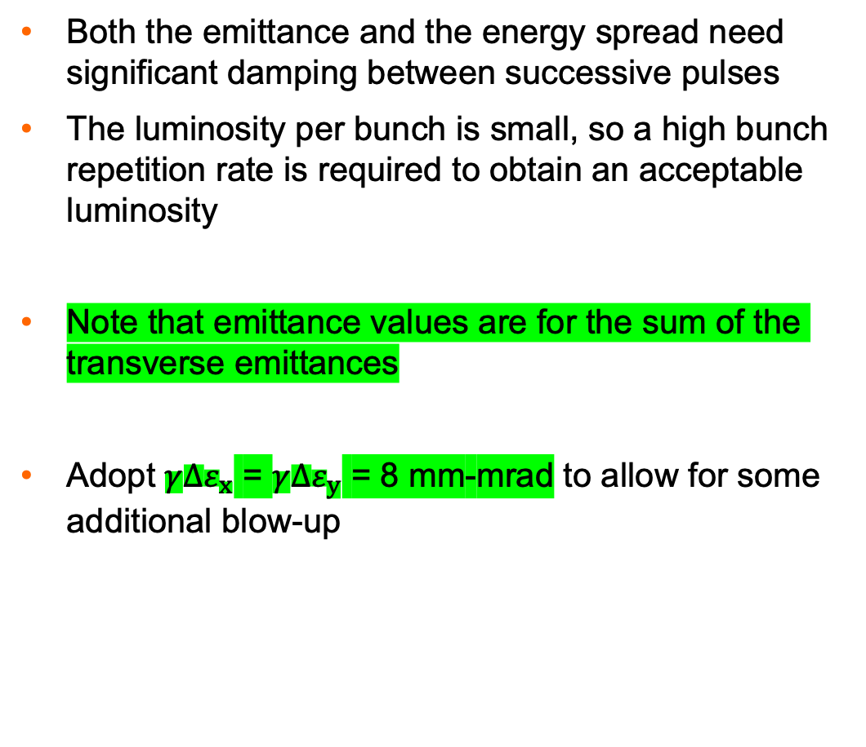
Evolution of Energy Spread and Emittance
Both the emittance and the energy spread need significant damping between successive pulses
The luminosity per bunch is small, so a high bunch repetition rate is required to obtain an acceptable luminosity
Note that emittance values are for the sum of the transverse emittances
Adopt $γ{∆ε}_{x}$ = $γ{∆ε}_{y}$ = 8 mm-mrad to allow for some additional blow-up
 | Energy Spread ‰ | Normalized emittance mm-mrad
Damping Ring Nominal | 1.37 | 6.4
Change in Linac |  | 1
End of Linac 1 | 0.26 | 6.4
Additional from Arc |  | 5
End of Arc 1 | 1.10 | 12
Change in Linac |  | 1
End of Linac 2 | 0.79 | 12
Additional from Chicane |  | 2
IP | 0.91 | 14
Change in Linac |  | 1
End of Linac 3 | 1.28 | 14
Additional from Arc |  | 5
End of Arc 2 | 1.67 | 19
Change in Linac |  | 1
Return to Damping Ring | 8.84 | 19
Required Damping | 6.5 | 2.9

Slide 51
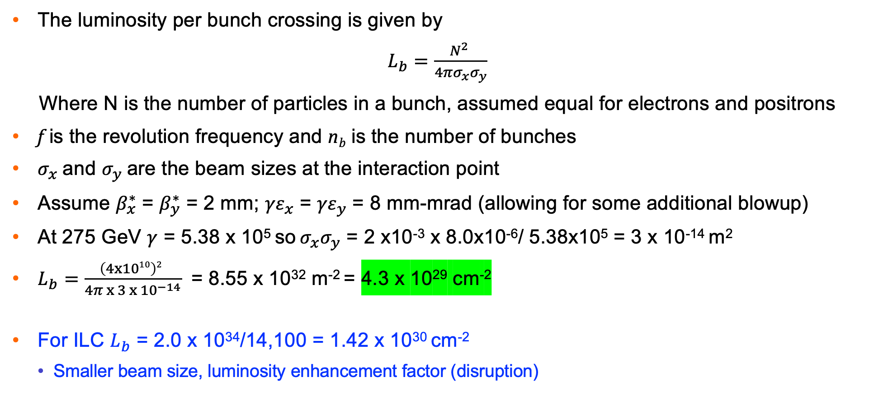
Luminosity per Ghost Bunch Crossing
The luminosity per bunch crossing is given by
$L_{b}=\frac{N^{2} }{4πσ_{x}σ_{y}}$
Where N is the number of particles in a bunch, assumed equal for electrons and positrons
f is the revolution frequency and n_{b} is the number of bunches
$σ_{x}$ and $σ_{y}$ are the beam sizes at the interaction point
Assume $β_{x}^{∗}$ = $β_{y}^{∗}$ = 2 mm; ${γε}_{x}$ = ${γε}_{y}$ = 8 mm-mrad (allowing for some additional blowup)
At 275 GeV $γ$ = 5.38 x 10⁵ so $σ_{x}σ_{y}$ = 2 x10⁻³ x 8.0x10⁻⁶/ 5.38x10⁵ = 3 x 10⁻¹⁴ m²
$L_{b}=$ $\frac{\left(4x1010\right)2 }{4π x 3 x {10}^{−14}}$ = 8.55 x 10³² m⁻² = 4.3 x 10²⁹ cm⁻²
For ILC $L_{b}$ = 2.0 x 10³⁴/14,100 = 1.42 x 10³⁰ cm⁻²
  Smaller beam size, luminosity enhancement factor (disruption)
N. Phinney, “SLC: The first linear collider,”
https://www.worldscientific.com/doi/pdf/10.1142/9789814436403_0005

Slide 52
Bunch Frequency and Current for 10³⁴ cm⁻²s⁻¹ in one IR
Luminosity per bunch crossing = 4.3 x 10²⁹ cm⁻²
Bunch frequency for 10³⁴ cm⁻²s⁻¹ = 10³⁴ / 4.3 x 10²⁹ = 23,250 collisions/sec
Each ghost bunch contains 2 x 3.2 nC = 6.4 nC
Two-beam current for 10³⁴ cm⁻²s⁻¹ = 2 x 6.4 x 10⁻⁹ x 123,250 = 0.3 mA
Assume that the damping ring damping times are similar to the ILC positron ring:
  transverse = 12.9 ms and longitudinal = 6.4 milliseconds
For the Ghost Collider, need 2.9 transverse damping times = 37.4 ms, and 6.5 longitudinal damping times = 44 ms
Assume a repetition rate of 20 HZ and a duty factor D = 10%
The bunch train would be 10% x 50 ms = 5 ms long with 45 ms between trains
  Bunches are extracted and re-injected once every 50 ms and are damped for 50 ms

Slide 53
Synchrotron Radiation Loss – Arcs and Chicanes
Synchrotron radiation loss in the Arcs:
Accelerating arc 11 GeV
Decelerating Arc 11 GeV
Synchrotron radiation loss in the chicanes:
Curved chicane 3 GeV
Straight beamline –
Total Synchrotron radiation loss 25 GeV
RF Acceleration required to accelerate particles from the damping rings to the IP and back to the damping ring = 25 GV
Assume 50% efficiency wall plug to RF
RF power required = 2 x 2 x 25 GeV x I x 10⁻³= 100 I MW
Where I is the Ghost Collider beam current

Slide 54
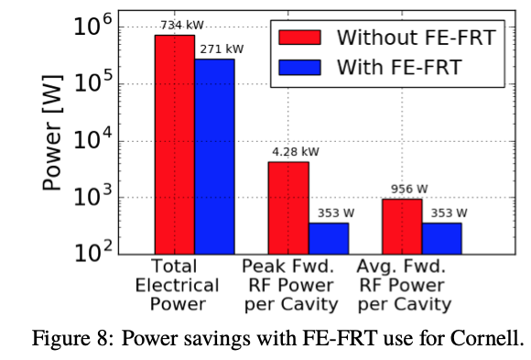
Linac RF Requirements
Use the ILC cavities at 31.5 MV/m: each produces 32.75 MV
For 135 GV, we need 135,000/32.75 = 4,122 cavities per linac
Each cavity requires an average power of 353 x 4 = 1,412 watt*
  Assumes cavities are equipped with FE-FRTs
Total power per linac = 4,122 x 1,412 watt = 5.82 MW RF
Assume 50% efficiency, wall plug to RF
The duty cycle = D
Electrical power required per linac = 11.6 D MW
Electrical power for 2 linacs = 23.2 D MW
Note that the power is independent of the current
For the Ghost Collider, need twice the gradient for half the length so total power required is doubled
*N Shipman · 2020 — 63th ICFA Advanced Beam Dynamics Workshop on Energy Recovery Linacs. ERL2019, Berlin, Germany. JACoW Publishing. ISBN: 978-3-95450-217-2

Slide 55
Damping Ring RF Requirements
The ILC Positron damping ring synchrotron radiation = 8.4 MeV/turn
The Ghost Collider positron damping ring must be longer to accommodate more bunches
Assume Ghost Collider damping ring synchrotron radiation = 10 MV/turn
Assume beam current = 1,000 x collider current
Assume 50% efficiency, wall plug to RF
Electrical power required = = 2 x 1,000 x 10 x 10⁶ x I = 20 I MW

Slide 56
Cryogenics
The 1.3 GHz ILC cavity has 𝑅/𝑄= 1036 Ohm and a cavity length = 1.04 m
Assume an accelerating gradient 𝐺= 31.5 MeV/m and 𝑄₀ = 2.7 ×10¹⁰
Thermal dissipation 𝑃_{diss} = (31.5 x 10⁶)² / (1036 x 2.7 x 10¹⁰) = 11.64 W/m, or 12.1 W/cavity
There are 4,122 cavities per linac in the Ghost Collider
Total power dissipated = 2 x 4,122 x 12.1 = 99.8 kW
Assume that the cryogenic efficiency = 900 watts /watt
Wall power per linac = 90 D MW for operation with duty factor D

Slide 57
Total Power for RF
Arcs and Chicanes 100 I MW
Linac RF 23.2 D MW = 2.32 MW for D = 0.1
Damping Ring 20 I MW
Cryogenics 90 D MW. = 9.0 MW for D = 0.1
Total 120 I + 11.32 MW
This does not include magnets, site power and the experimental apparatus
Possible areas for improvement:
  Smaller value of in the arcs decreases the emittance at the IP, reducing the beam current for the same luminosity
  Operation of the Linacs at 4.5 K reduces the cryogenic load by ~1/3
H

Slide 58
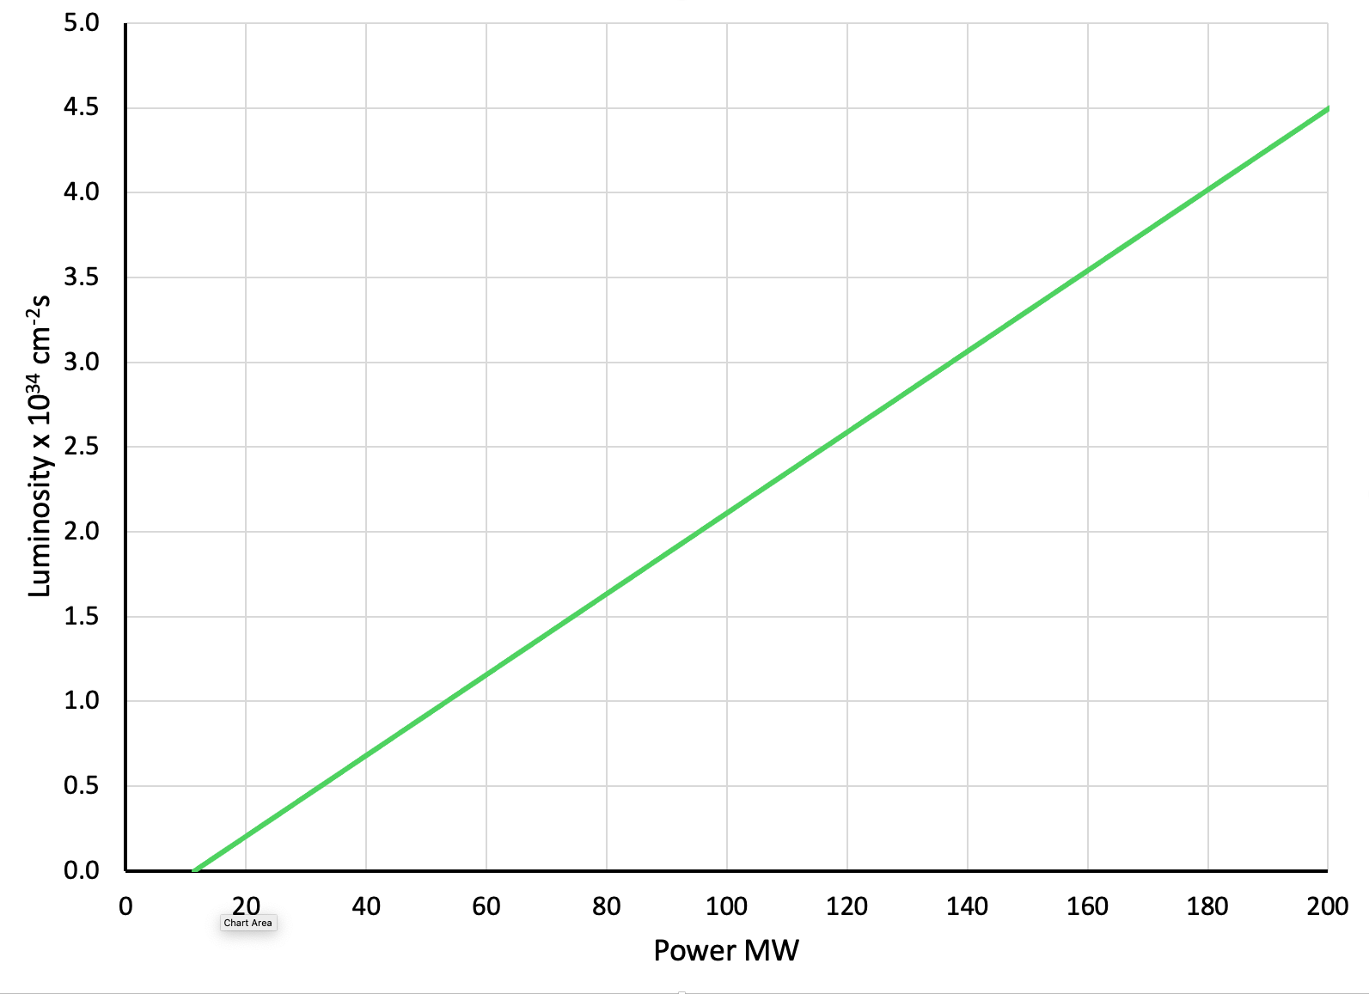
Luminosity per IP – Power Relationship
Luminosity = 2.2 x 10³⁴ cm⁻²s⁻¹ for RF power of 100 MW

Slide 59
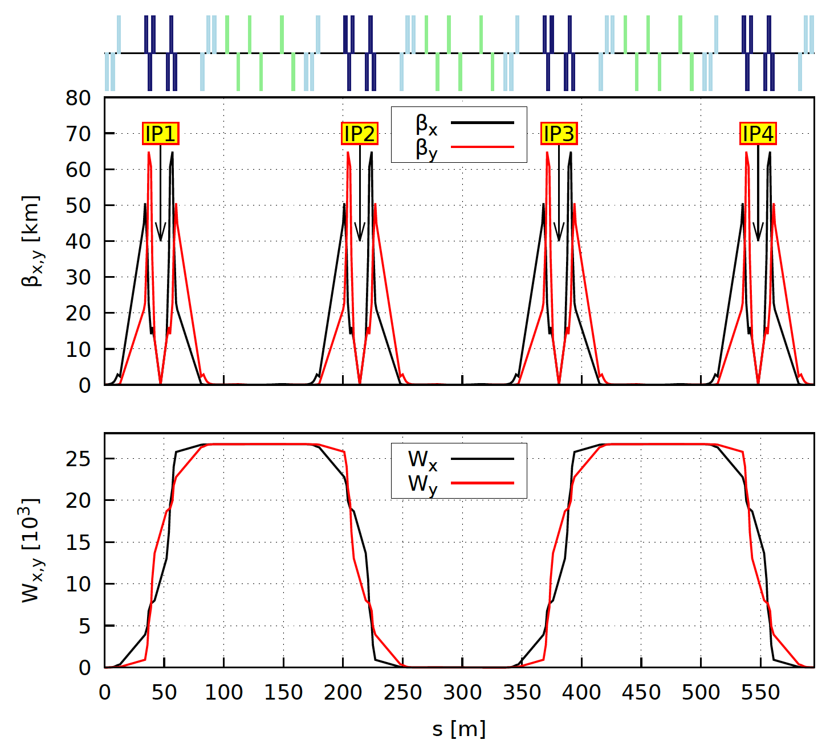
Four IPs – Unique Feature of Ghost Collider
Breaking News
The chromatic compensation of the two IPs was so good that four is possible
The >99% correction of the chromatic aberrations is maintained
If the bunches are separated by twice the IP separation, the bunches collide at different times in adjacent IPs
This should allow easy identification of the low-angle fragments by timing
Apertures and quad strength are OK
167 m
Matching by Randy Gamage

Slide 60
Conclusions
The Ghost Collider is a viable Higgs Factory, meeting the requirements of the Linear Collider vision statement
Neutral bunches of electrons and positrons travel together in the same Linac buckets
  No excitation of higher modes (HOMs)
  No Multi-bunch Beam Break-Up (MBBU)
There is a single, bidirectional linac, half the length of the ILC on either side of the IR region
The linacs are half the length as the ILC linacs with pulsed RF @ 10% duty cycle
The arcs are a new shape, reducing synchrotron radiation by 35.8%
Two or four interaction points with the nominal luminosity
Luminosity per IP = 2.2 x 10³⁴ cm⁻²s⁻¹ @ 100 MW electrical power for RF
  Facility Luminosity = 8.8 x10³⁴ cm⁻²s⁻¹ @ 100 MW
Proof of principle solutions have been worked out for all the major components
Detailed optimization is required to validate the design

Slide 61
Thank you for your attention

