Slide 1
Computational Accelerator Physics (CAP)
section meeting
Giovanni Iadarola
13 Jun 2024

Slide 2
Information
ATS sector grads and students have been invited to a networking event that will
take place on Friday 27 June (10:00-11:30)
There will be a presentation from Knowledge Transfer on healthcare applications followed by an informal coffee meeting to allow students and grads to network and make connections with others from the sector
The event will take place in bldg. 30, with plans to hopefully hold a similar event in Prévessin in the autumn
For your information, please note that the position Accelerator Physicist (BE-ABP-
CEI-2025-113-LD) has been published on the CERN career website and posted on
relevant internet job portals.
Publication date: 26.05.2025
Publication deadline: 23.06.2025

Slide 3
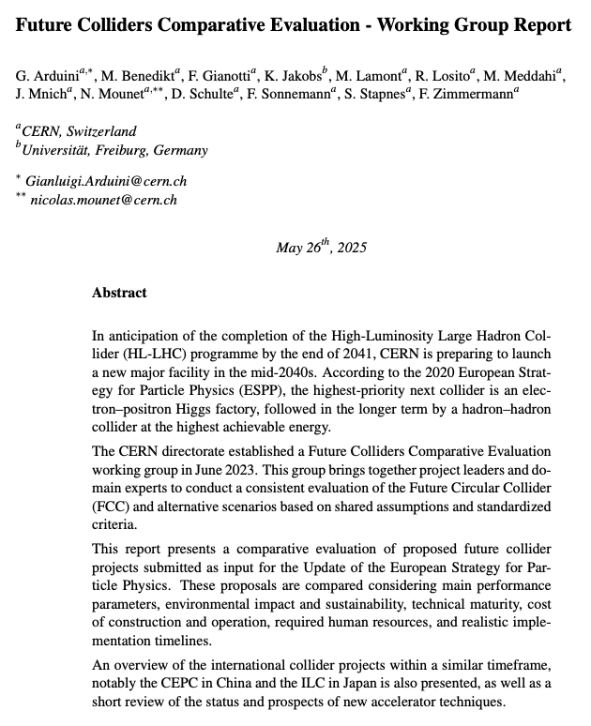
Information
The report from the Future Colliders Comparative Evaluation working group is out

