Slide 1



Subtraction and Residual PDFs: Heavy-quark treatments in global QCD analyses
Marco Guzzi
with
Pavel Nadolsky and Keping Xie
CTEQ Spring 2025 Meeting April 23, 2025

Slide 2
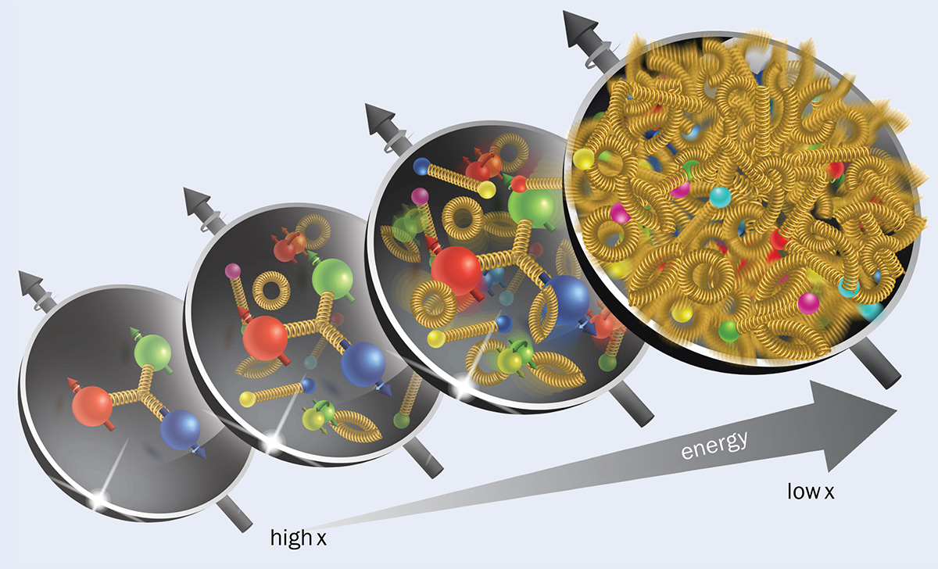

Motivations 1
Modern PDF analyses: continue to extend on a wider range of collision energies. Sensitive to mass effects, e.g., phase space suppression, large radiative corrections to collinear $Q\overline{Q}$ production. Magnitude comparable to NNLO and N^3LO corrections.
Natural to evaluate all fitted cross sections in a factorization (GMVFN) scheme, which assumes that the number of (nearly) massless quark flavors varies with energy, and at the same time includes dependence on heavy-quark masses in relevant kinematical regions.

Slide 3
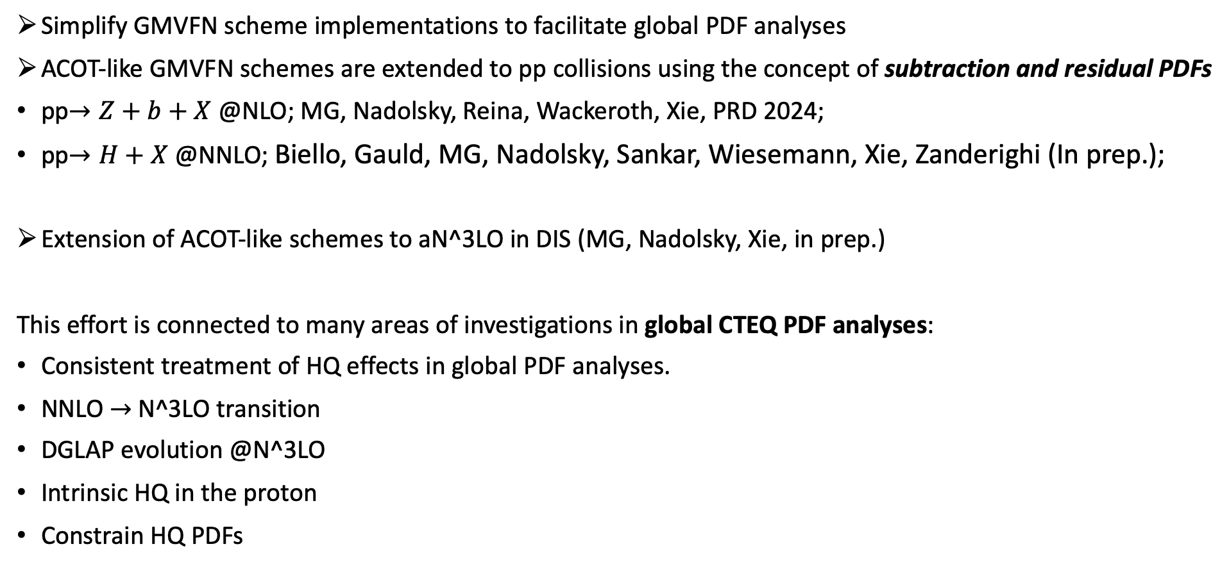
Motivations 2
Simplify GMVFN scheme implementations to facilitate global PDF analyses
ACOT-like GMVFN schemes are extended to pp collisions using the concept of subtraction and residual PDFs
pp$→Z+b+X$ @NLO; MG, Nadolsky, Reina, Wackeroth, Xie, PRD 2024;
pp$→H+X$ @NNLO; Biello, Gauld, MG, Nadolsky, Sankar, Wiesemann, Xie, Zanderighi (In prep.);
Extension of ACOT-like schemes to aN^3LO in DIS (MG, Nadolsky, Xie, in prep.)
This effort is connected to many areas of investigations in global CTEQ PDF analyses:
Consistent treatment of HQ effects in global PDF analyses.
NNLO $→$N^3LO transition
DGLAP evolution @N^3LO
Intrinsic HQ in the proton
Constrain HQ PDFs

Slide 4
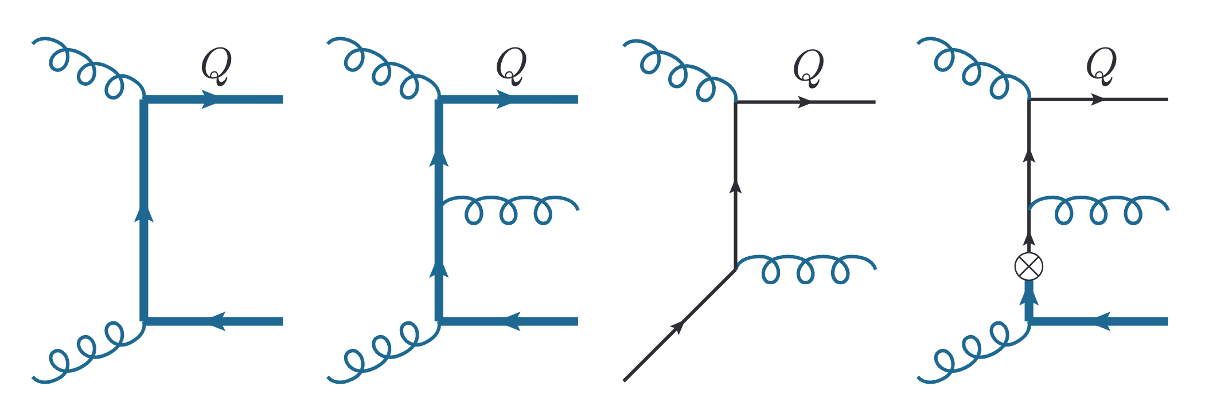

Subtraction/Residual PDFs: Basic idea
S-ACOT-MPS Inclusive production of a HQ as an example
The subtraction term avoids double counting
and cancels enhanced collinear contributions
from FC when $\hat{s}≫m_{Q}^{2}$ or $p_{T}≫ m_{Q}$
Collinear splitting $gg→Q\overline{Q}$
LO FC
NLO FC
LO FE
Subtraction
Mass fully retained
in $\hat{σ}$ and $dPS$
Mass fully retained in $dPS$
allows us to get (FE-Subtraction) in one step
Subtraction well defined also in the $p_{T}→0$ limit
FE and Subtraction facilitated by introducing Residual PDF:
More details in: K. Xie, “Massive elementary particles in the standard model and its supersymmetric triplet higgs extension.”
https://scholar.smu.edu/hum_sci_physics_etds/7, 2019. PhD Thesis
Subtraction PDF

Slide 5
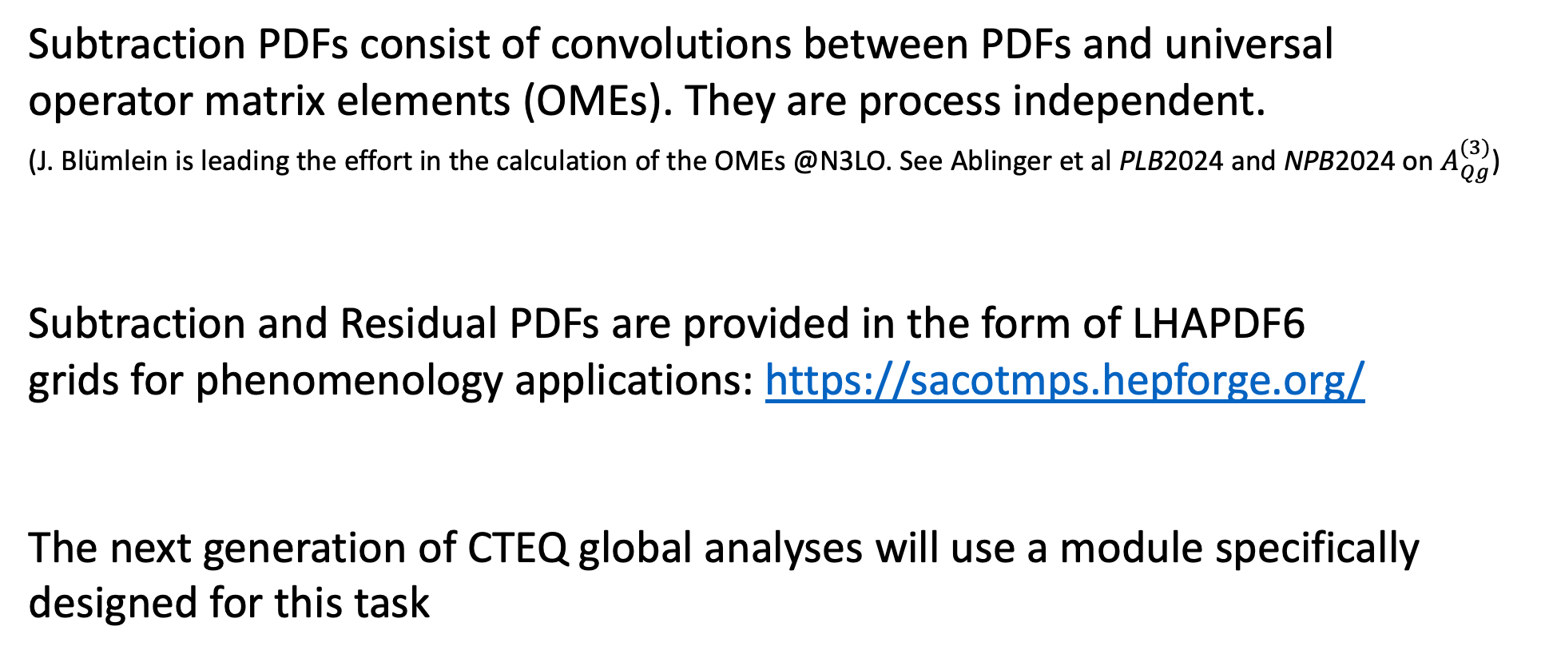
Subtraction and Residual PDFs
Subtraction PDFs consist of convolutions between PDFs and universal
operator matrix elements (OMEs). They are process independent.
(J. Blümlein is leading the effort in the calculation of the OMEs @N3LO. See Ablinger et al PLB2024 and NPB2024 on $A_{Qg}^{(3)}$)
Subtraction and Residual PDFs are provided in the form of LHAPDF6
grids for phenomenology applications: https://sacotmps.hepforge.org/
The next generation of CTEQ global analyses will use a module specifically
designed for this task

Slide 6
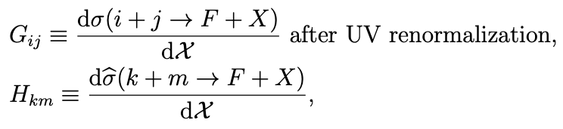
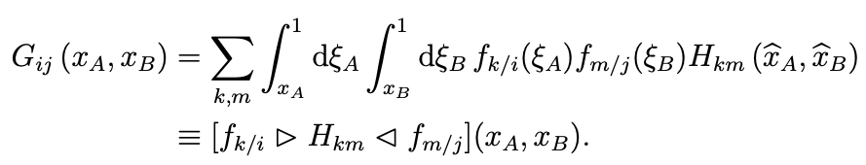

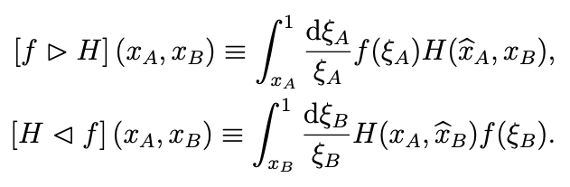
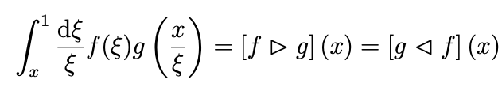
GMVFN Theory framework (pp collisions)
The differential cross section for $p_{A}$ $p_{B}$ $→$ $F + X$ where F contains at least one HQ, can be written
After UV renormalization on dσ/d$χ$, we identify its infrared-safe part d$\hat{\text{σ}}$/d$χ$ by factoring out parton-level PDFs
Convolution product with two variables
Convolution product with one variable

Slide 7

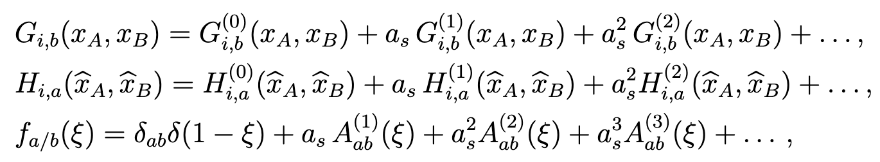



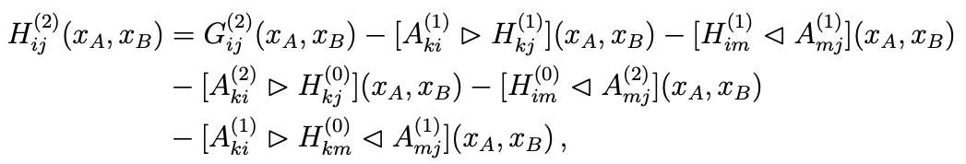
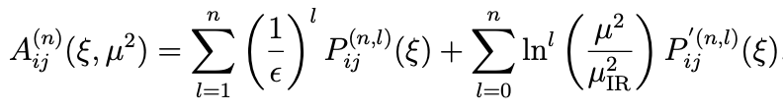
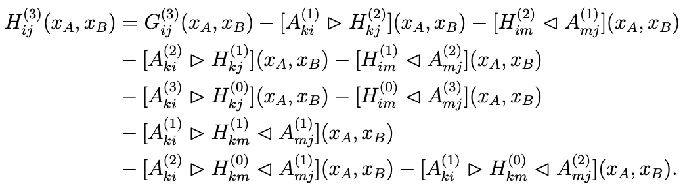
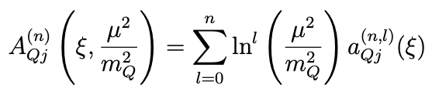


GMVFN Theory framework (pp collisions)
The perturbative expansion of terms leads to
OMEs
*
for $g→Q\overline{Q}$
Substituting these in the previous formula for $G$ and solving for $H^{(k)}$ order by order in $a_{s}$ one obtains
Two forms for the OMEs
*Our convention for the splitting functions
….

Slide 8
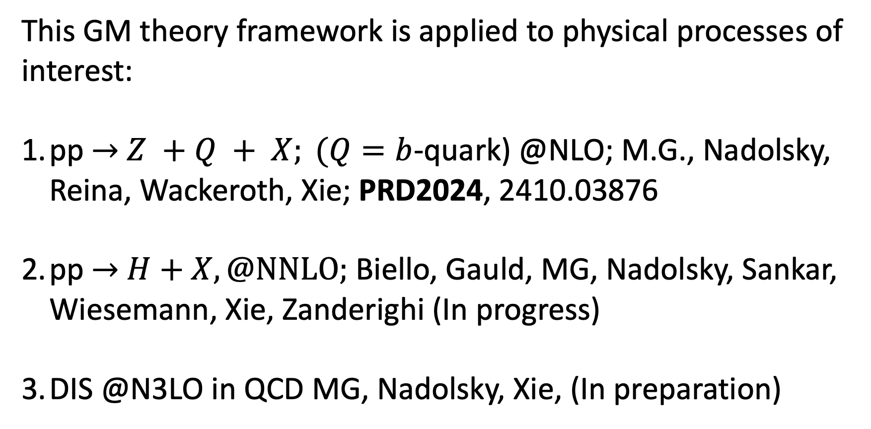
This GM theory framework is applied to physical processes of interest:
pp $→$ $Z +Q + X; (Q=b$-quark) @NLO; M.G., Nadolsky, Reina, Wackeroth, Xie; PRD2024, 2410.03876
pp $→$ $H+X, @NNLO;$ Biello, Gauld, MG, Nadolsky, Sankar, Wiesemann, Xie, Zanderighi (In progress)
DIS @N3LO in QCD MG, Nadolsky, Xie, (In preparation)

Slide 9
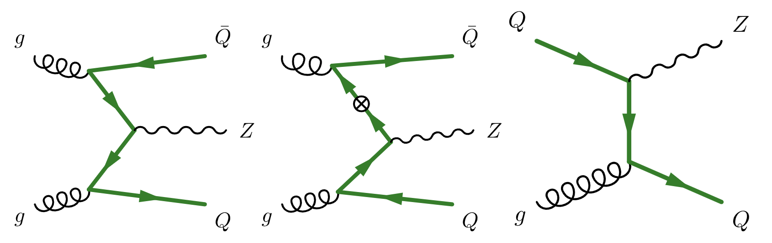
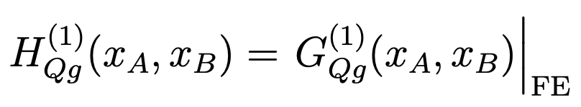
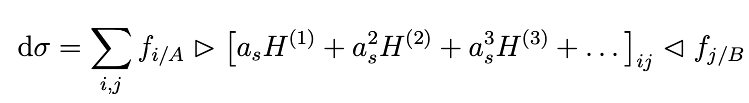
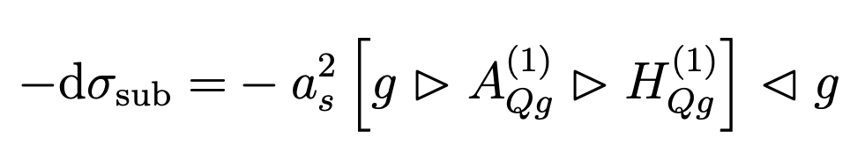
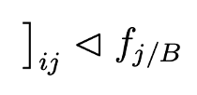



pp$→$Z+Q+X @LO: cancellation pattern
(for $pp→Z+Q+X$ this is $O(α_{s}^{2})$)
FC term
FE term
Subtraction
FE
Sub
FC

Slide 10
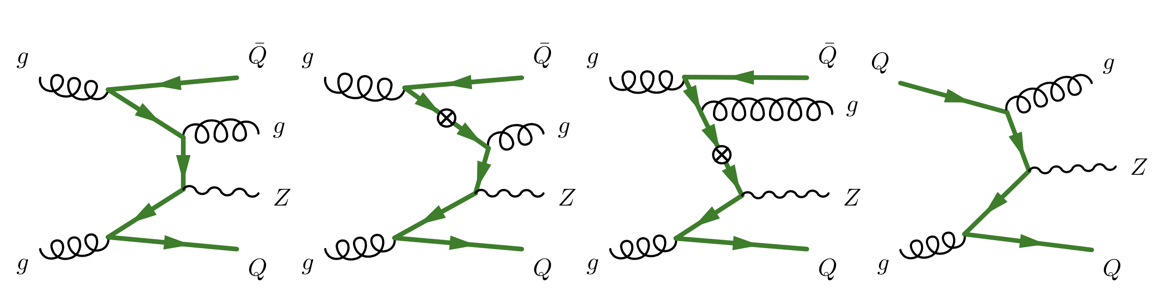
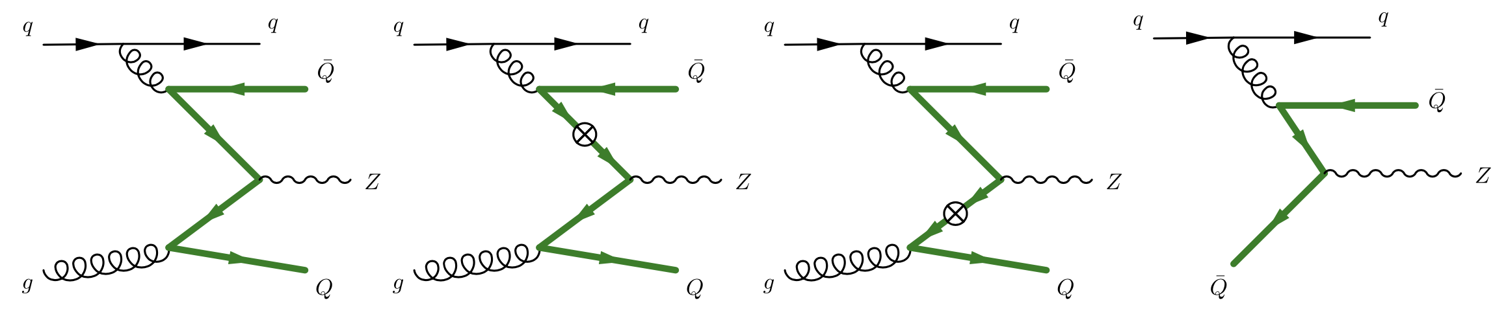
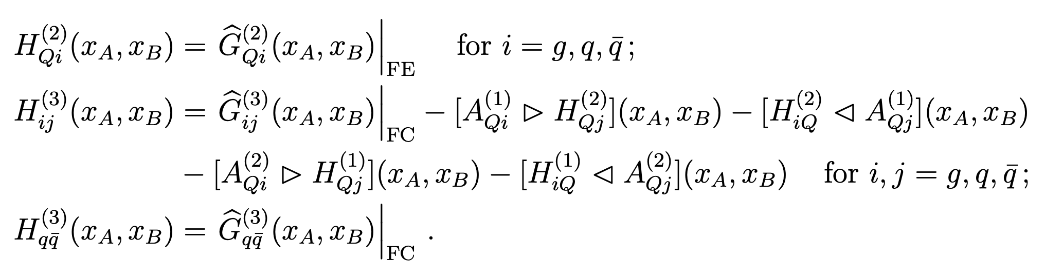

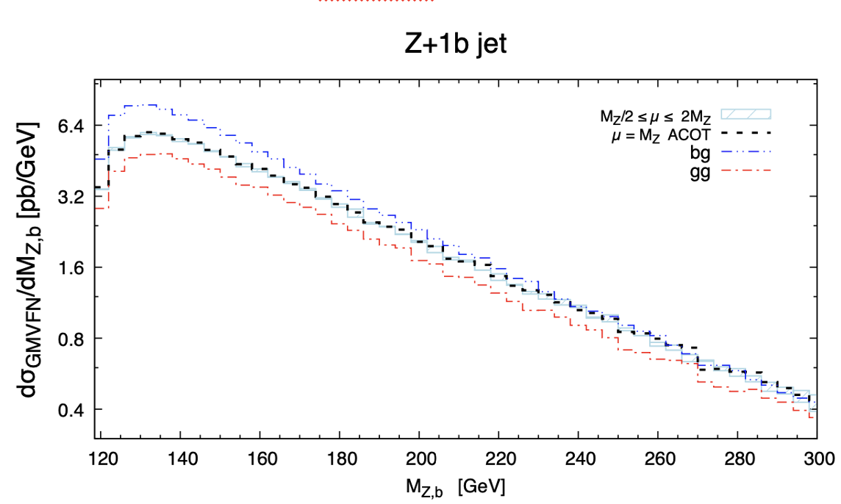
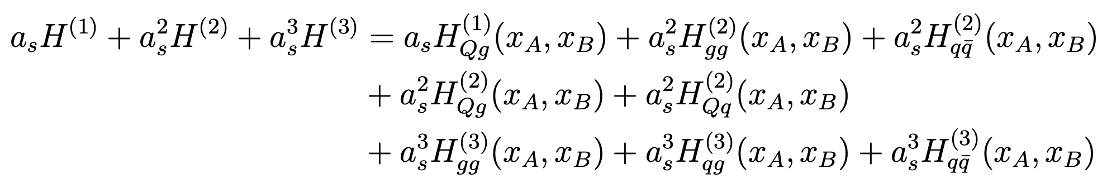

pp$→$Z+Q+X @NLO: cancellation pattern
(for $pp→Z+b+X$ this is $O(α_{s}^{3})$)
FC
FE
Sub
FE
FC
Sub
gg-channel
qg-channel
Virtual diagrams are not shown here,
but are included in the calculation.
2410.03876

Slide 11
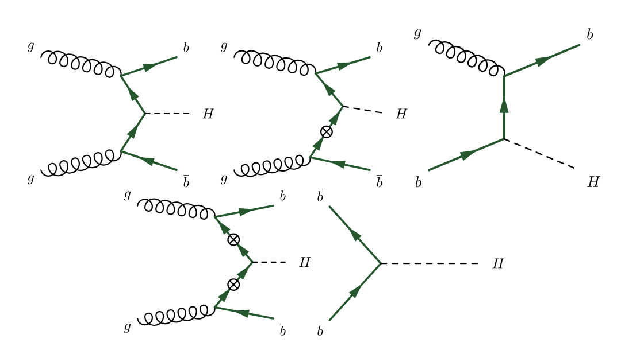
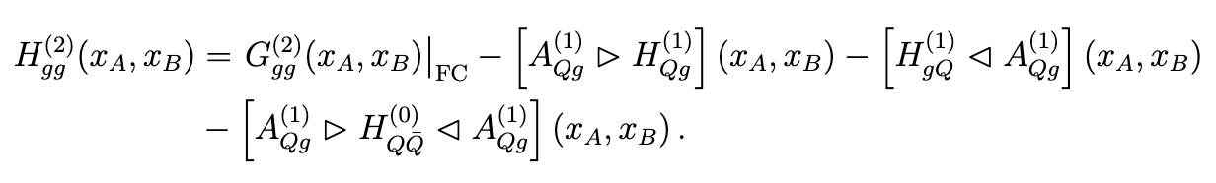
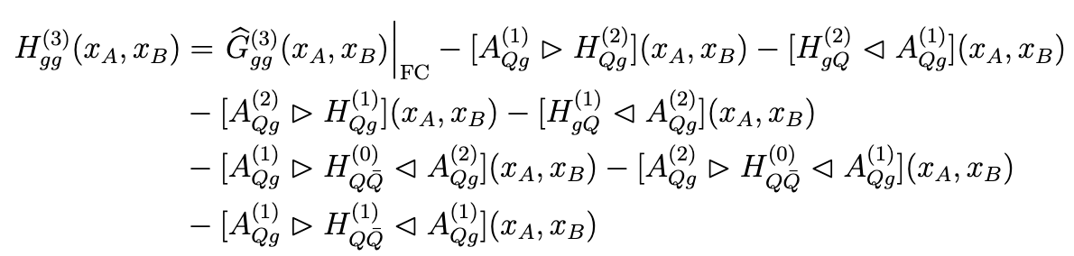
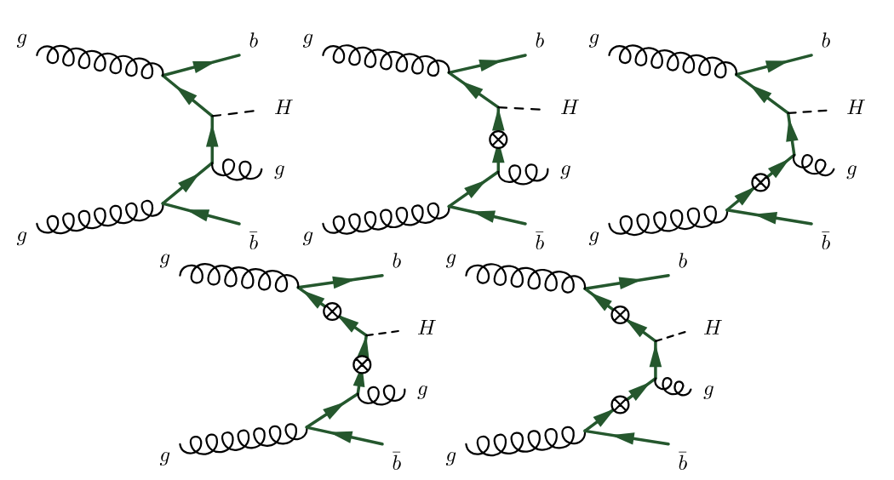
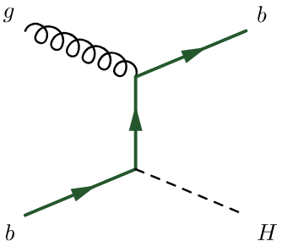

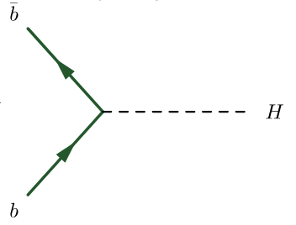

pp$→$H+X @LO, NLO: cancellation patterns
+ …

Slide 12
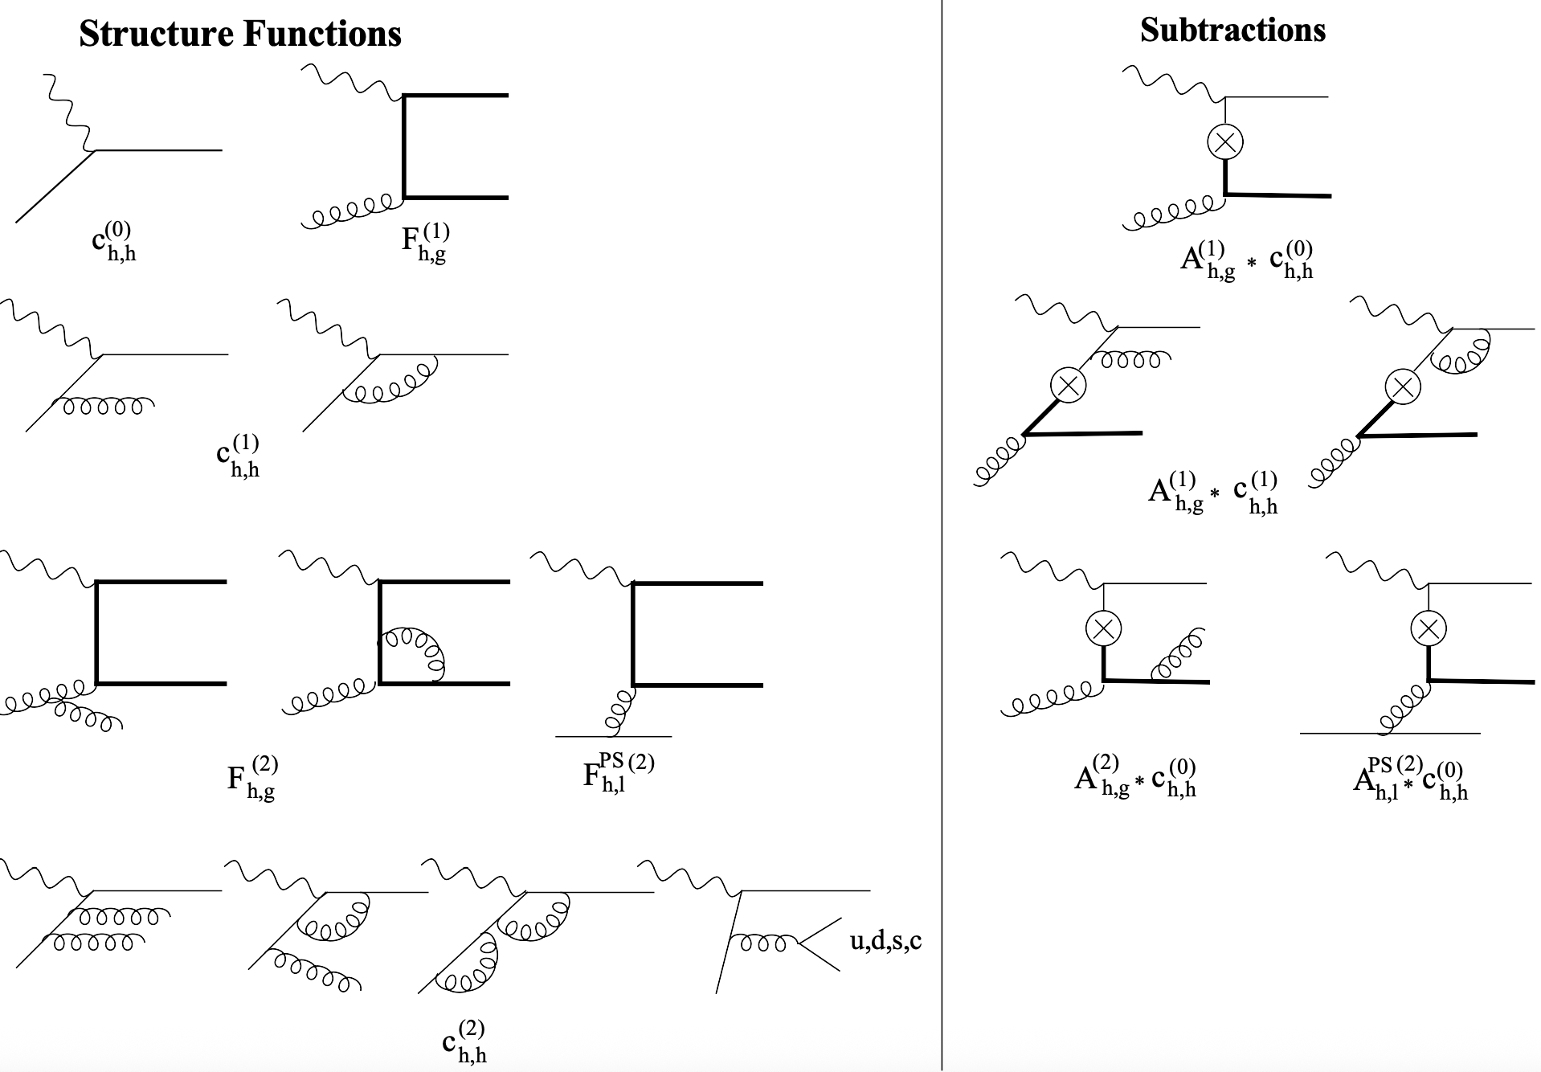
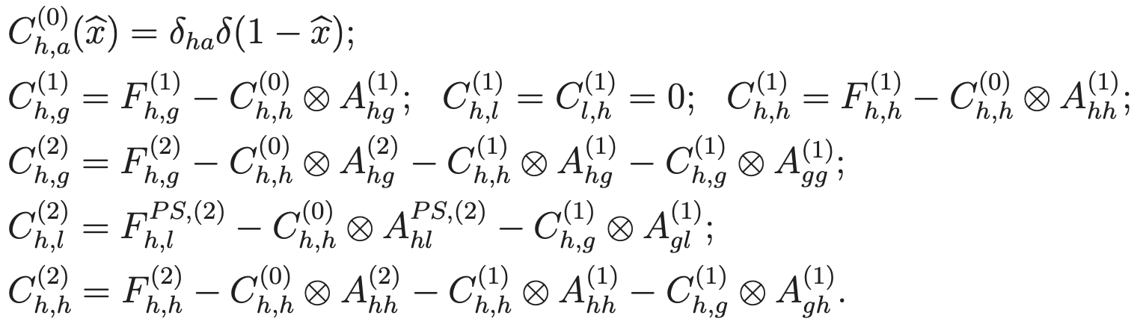
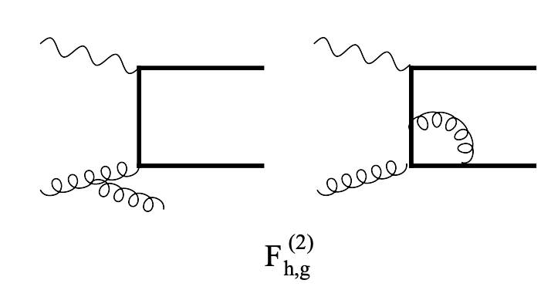

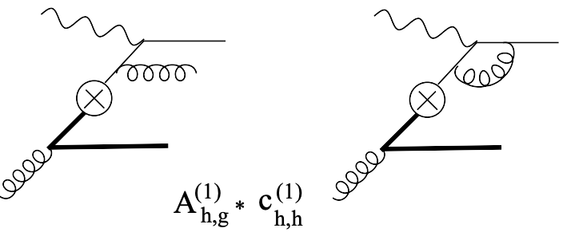
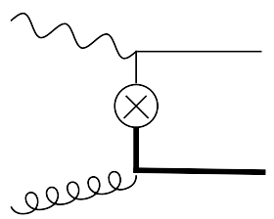







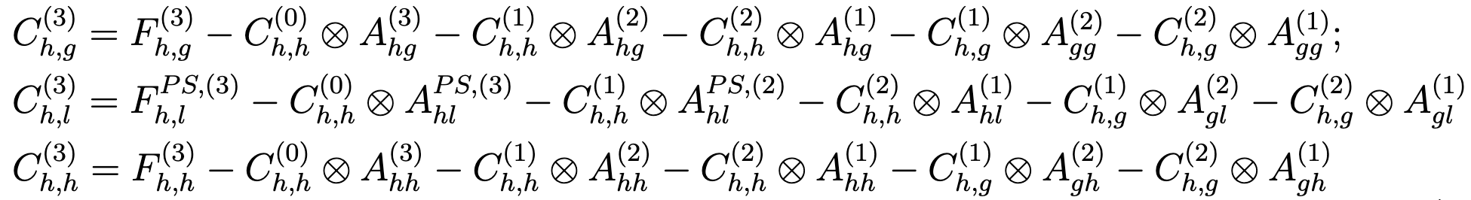




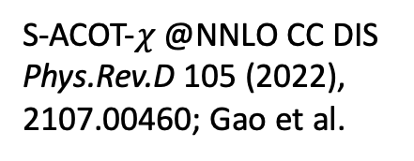
DIS @NNLO, N^3LO: cancellation patterns
S-ACOT-$χ$ @NNLO NC DIS, MG, Nadolsky, Lai, Yuan, PRD 2012
Default GM scheme for DIS in CTEQ PDF analyses
At N^3LO we have (MG, Nadolsky, Xie, In prep.)
$$−$$
$$−$$
$$−$$
S-ACOT-$χ$ @NNLO CC DIS
Phys.Rev.D 105 (2022),
2107.00460; Gao et al.
$$F_{h,g}^{(3)}$$
See also 2504.13317,
by P. Risse et al.

Slide 13
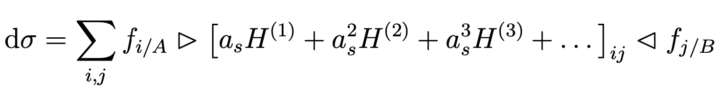
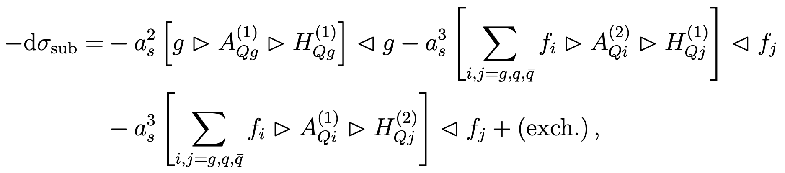
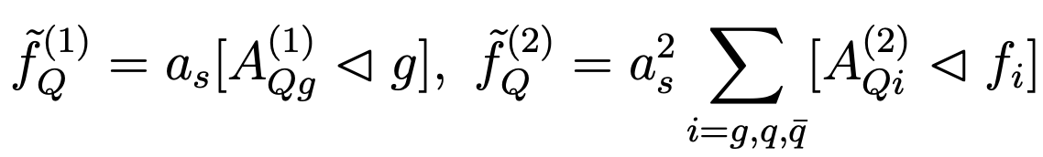
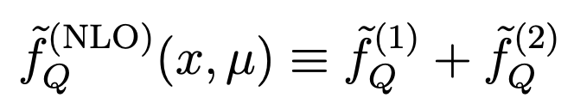
Subtraction PDFs
Once the $H_{ij}^{(k)}$ functions are determined, the hadronic cross section in pp collisions can be written as
Then, the various subtraction (“sub”) terms can be collected as follows:
In DIS, one proceeds in a similar fashion to reshuffle the various contributions in the Wilson coefficient functions.
At this point we can define subtraction HQ PDFs

Slide 14
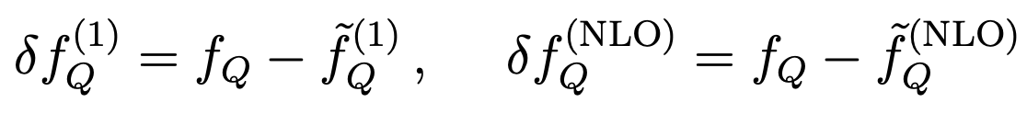
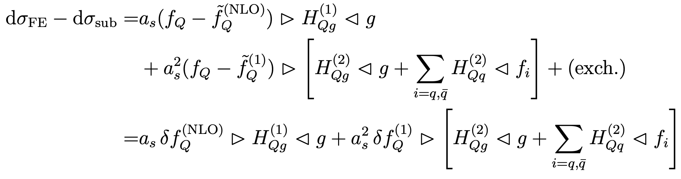
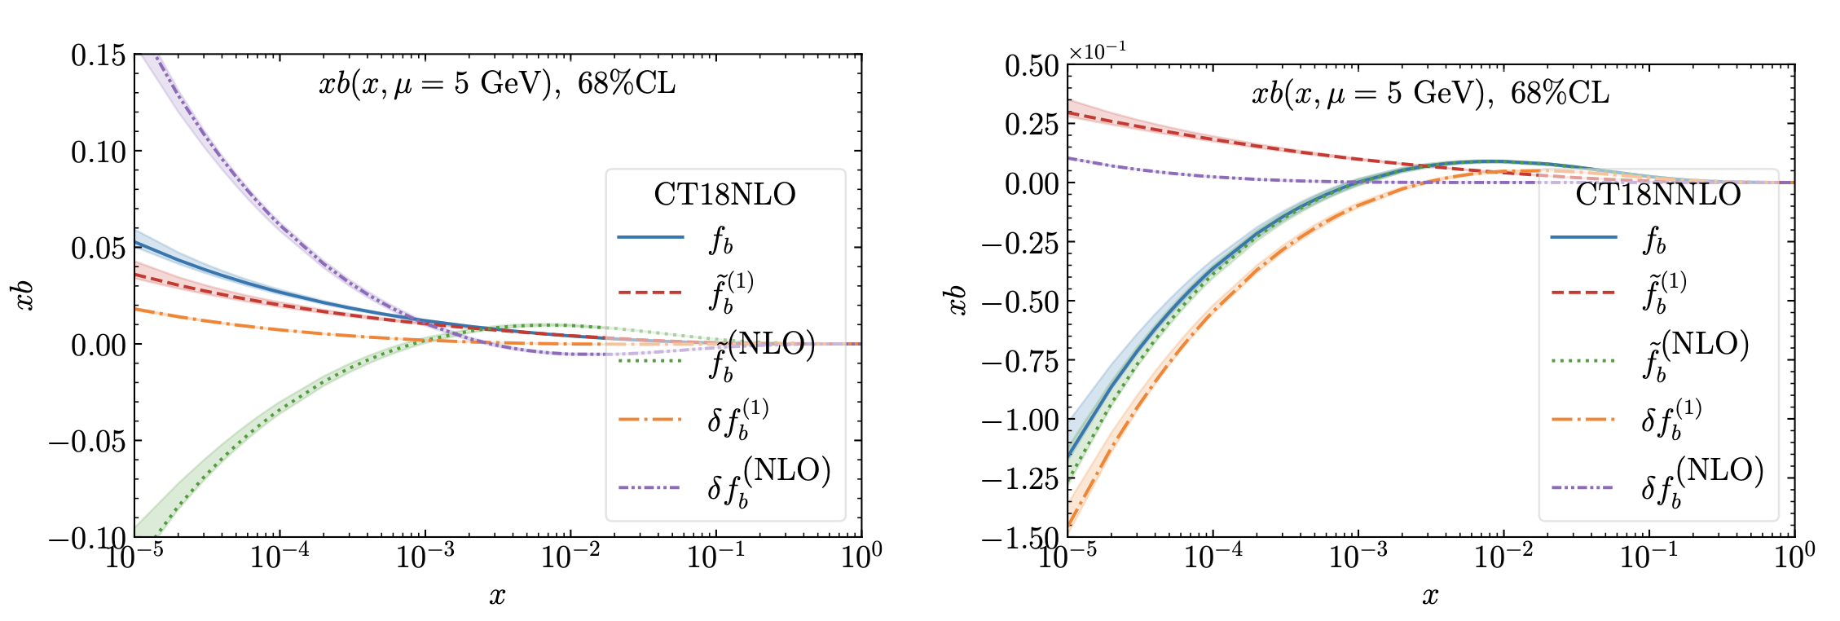
Residual PDFs
FE and SUB share the same matrix elements and
can be combined in one piece in terms of residual PDFs!
HQ, Subtraction and
Residual PDFs near the
b-quark threshold

Slide 15
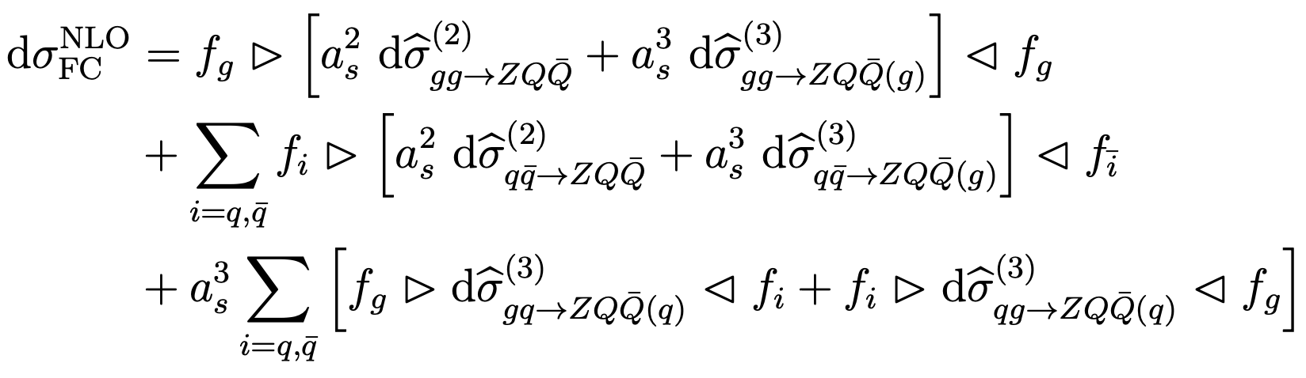
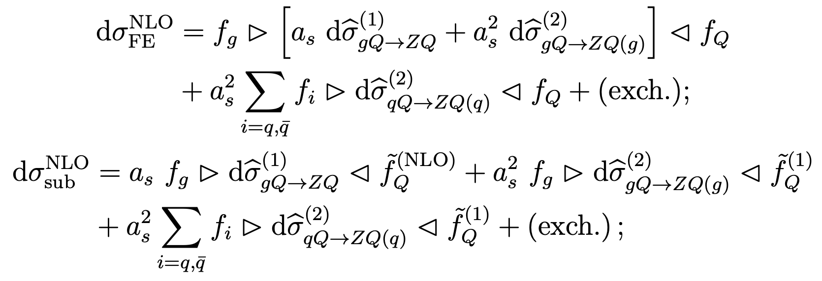
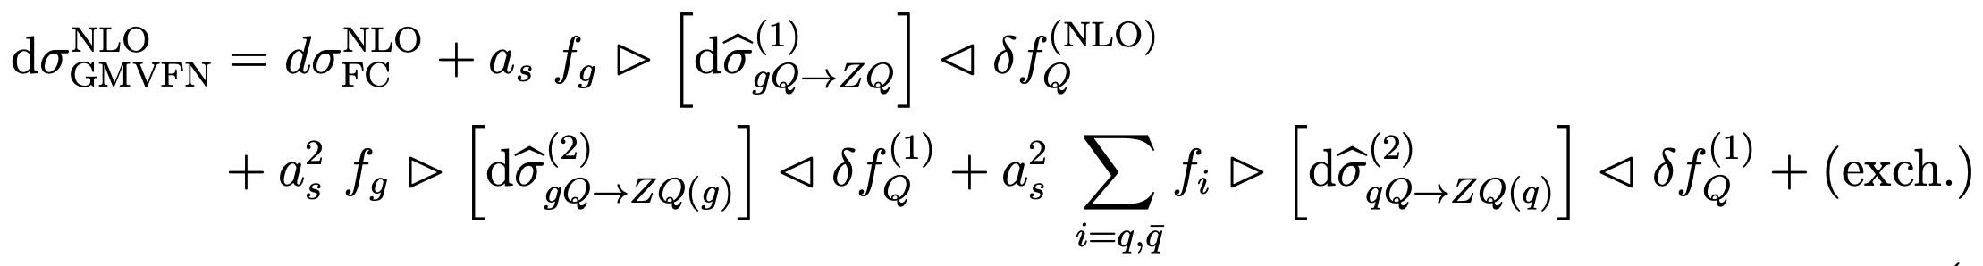
GMVFN scheme Xsec for $pp→Z+Q+X$ @NLO
Equivalently, with the dσFE − dσsub reorganized in terms of HQ PDF residuals we obtain a very simple form
Lowest mandatory order” (LMO) representation at NLO in that it retains only the unambiguous terms up to order $a_{s}^{3}$
required by order-by-order factorization and scale invariance. Any ACOT-like scheme must contain such terms.
2410.03876, PRD 2024

Slide 16
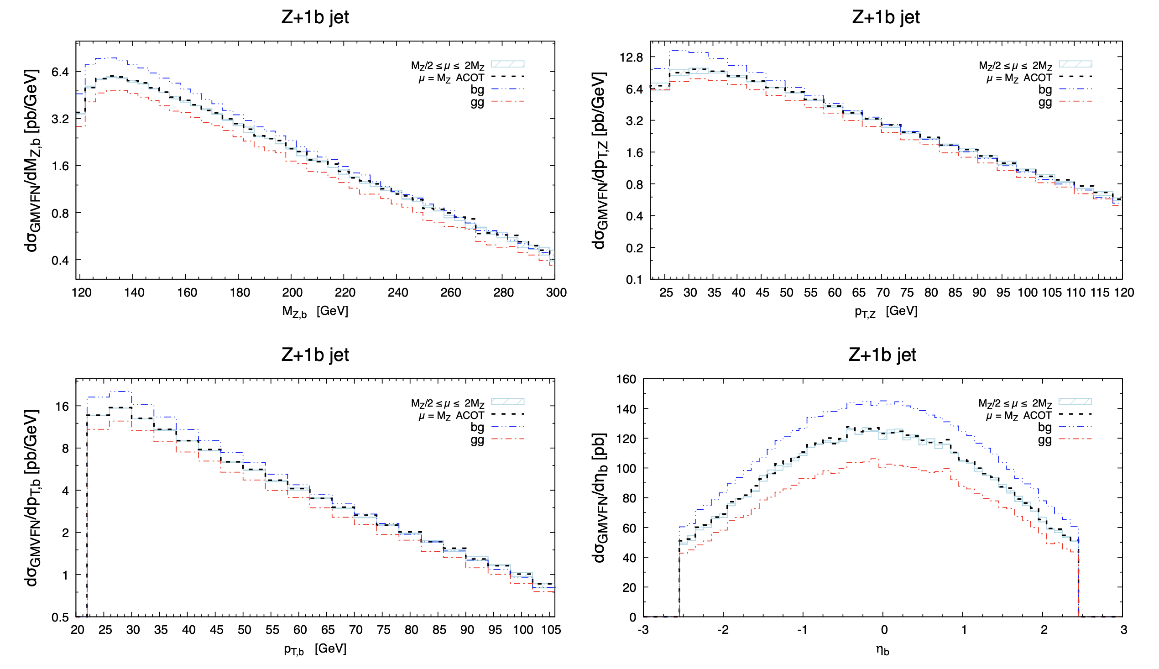
Results: Z+b differential distributions (gg channel)

Slide 17
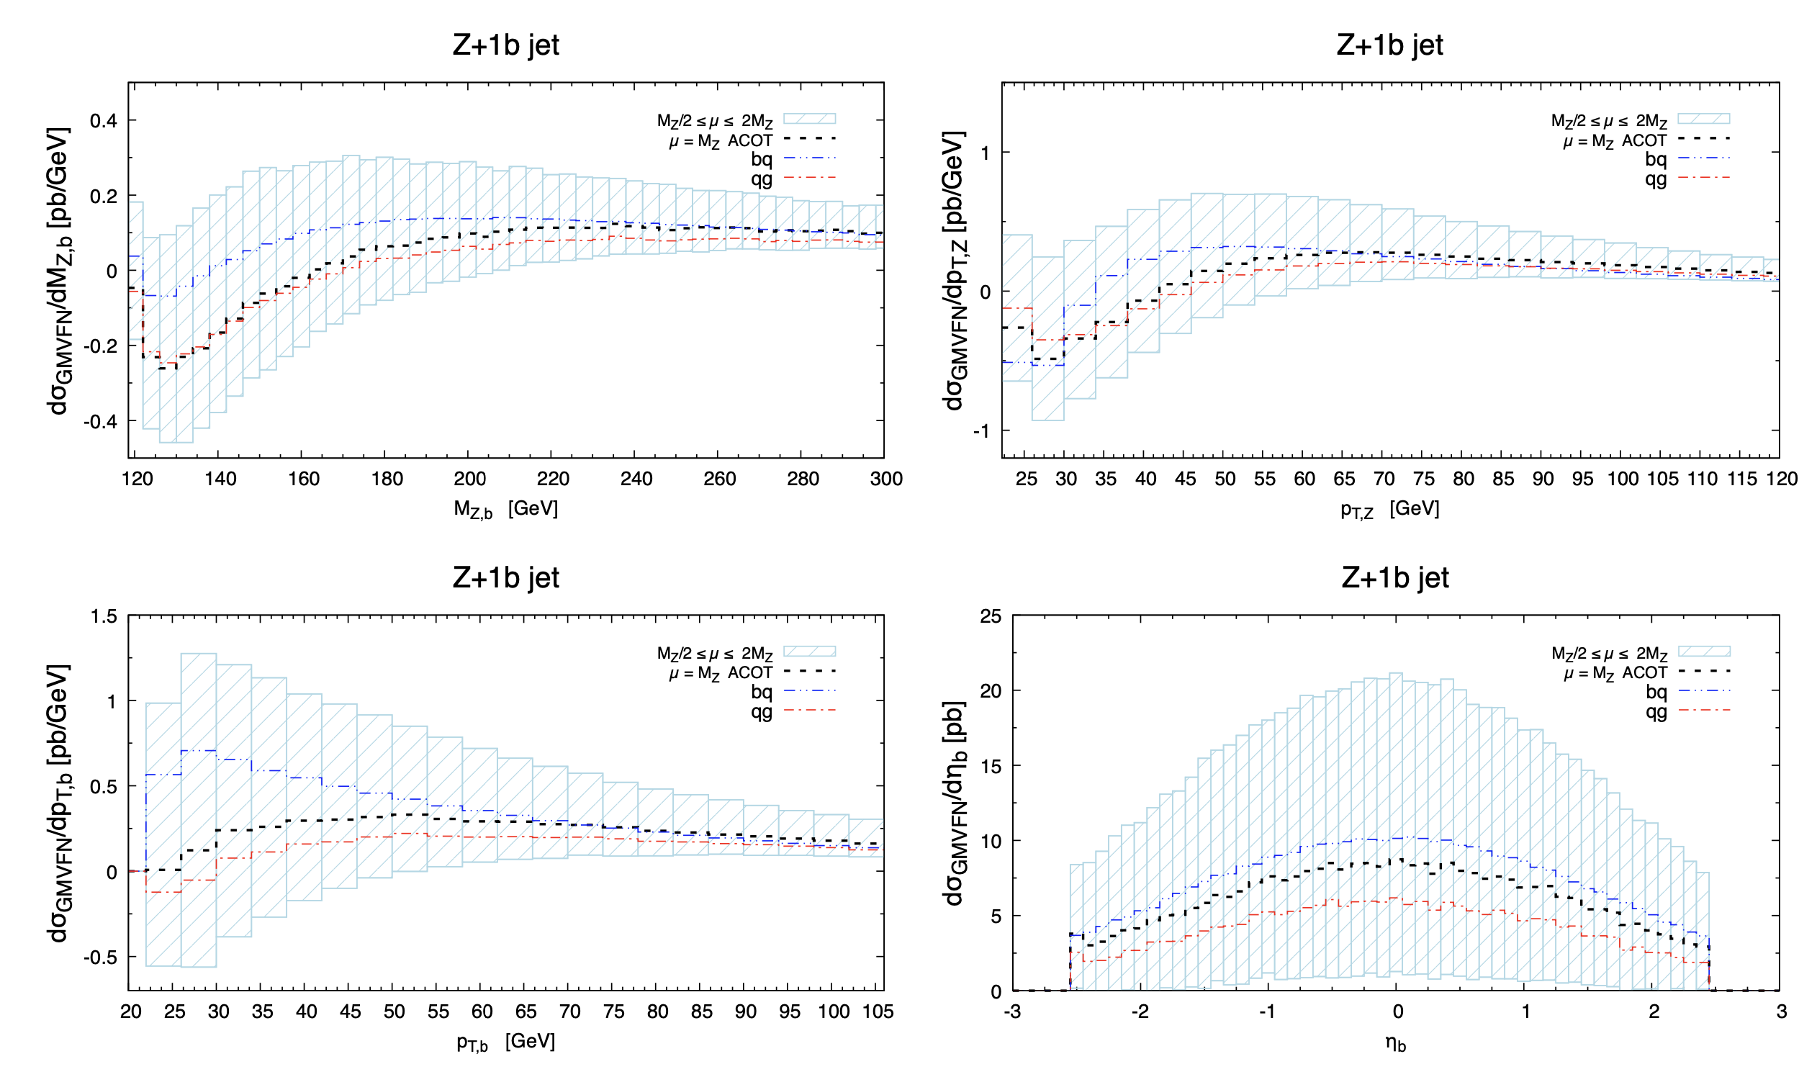
Results: Z+b differential distributions (qg channel)

Slide 18

Further simplifications in ACOT-type schemes
$δf_{Q}^{(NLO)}$?
Lowest mandatory order” (LMO) representation at NLO in that it retains only the unambiguous terms up to order $a_{s}^{3}$
required by order-by-order factorization and scale invariance. Any ACOT-like scheme must contain such terms.

Slide 19





Further simplifications in ACOT-type schemes
One generally can augment with extra radiative contributions from higher orders with the goal to improve consistency with the specific GMVFN scheme adopted in the fit of the used PDFs. The GMVFN scheme assumed for determination of CTEQ-TEA PDFs with up to 5 active flavors is closely matched with the following additional choices:
1. Evolve αs(μ) and PDFs fi(ξ,μ) with Nf = 5 at μ ≥ mb. The hard cross sections are also evaluated with Nf = 5 in virtual loops both for massive and massless channels. If the virtual contributions are obtained in the Nf = 4 scheme, they should be converted to the Nf = 5 scheme by adding known terms to the hard cross sections.
2. The sums over initial-state light quarks and antiquarks in are extended to also include the b-quark PDF via the introduction of the singlet PDF
3. replace in and in by f^(NLO) and δf^(NLO), respectively.
4. The αs and PDFs must be evolved at least at NLO, although evolution at NNLO is acceptable or even desirable in some contexts.
5. In the hard cross sections inside dσFE − dσsub, dependence on the HQ mass can be eliminated altogether or simplified, producing a difference only in higher-order terms.

Slide 20



Further simplifications in ACOT-type schemes
With the simplifications discussed above, we obtain

Slide 21





Other results using ACOT-like schemes
Charm hadroproduction and Z + c production
at the LHC can constrain the IC contributions.
LHCb Z+c data deserve attention as they can
potentially discriminate gluon functional forms
at $x≥0.2$ and improve gluon accuracy.
For small $x$ below ${10}^{−4}$, higher-order QCD terms
with $ln⁡(1/x)$ dependence grow quickly at factorization
scales of order 1 GeV. FPF facilities like FASERν
will access novel kinematic regimes where both
large-x and small-x QCD effects contribute
to charm hadroproduction rate. [arXiv:2109.10905]
FPF paper 2109.10905
Transverse momentum at central rapidity at LHCb 13TeV
(LHCb data from JHEP 03 (2016) 159).
Error bands are scale uncertainties.
Rapidity distributions of prompt charm at the LHC 13 TeV in the
very forward region (yc > 8). Error band represents the CT18NLO
induced PDF uncertainty at 68% C.L.
NLO theory predictions for the pT and y distributions
obtained with CT18NLO and CT18XNLO PDFs
compared to ${\text{B}}^{\text{±}}$ production data from LHCb 13 TeV
[arXiv:2203.06207]
Theoretical uncertainties at NLO are large (O(50%))
and mainly ascribed to scale variation. This can be
improved by including higher-order corrections
which imply an extension of the S-ACOT-MPS scheme
to NNLO

Slide 22
Concluding remarks
We developed the theory framework to extend ACOT-like schemes to pp collisions.
ACOT/S-ACOT used to describe Z+b production differentially at NLO in QCD
Possible to generate predictions within the ACOT-type schemes for many important processes (@NNLO for Higgs production, and @aN^3LO for DIS)
Important to constrain heavy-flavor PDFs: direct access to c/b-PDF
Subtraction PDFs provided in the form of LHAPDF grids to for pheno applications

Slide 23
BACK UP

Slide 24


Z+b: ACOT vs S-ACOT

