Slide 1
Status of the CRIS experiment
Kieran Flanagan
University of Manchester

Slide 2
Outline of talk
Introduction to collinear resonant ionization spectroscopy (CRIS)
Progress since 2008
Recent Results: laser spectroscopy of Fr
Outlook

Slide 3

Nuclear moment and radii from laser spectroscopy
3p
²P_{3/2}
F_{j}
Spin, magnetic and electric
moments , all nuclear
observables are extracted
without model dependence.
²P_{1/2}
3s
F_{i}
²S_{1/2}
Isotope Shift
Changes in nuclear charge
radii and sensitive to changes in the dynamic nature and deformation as well as volume.
ppm shift
Δν_{IS} = Δν_{MS} + Δν_{FS}

Slide 4
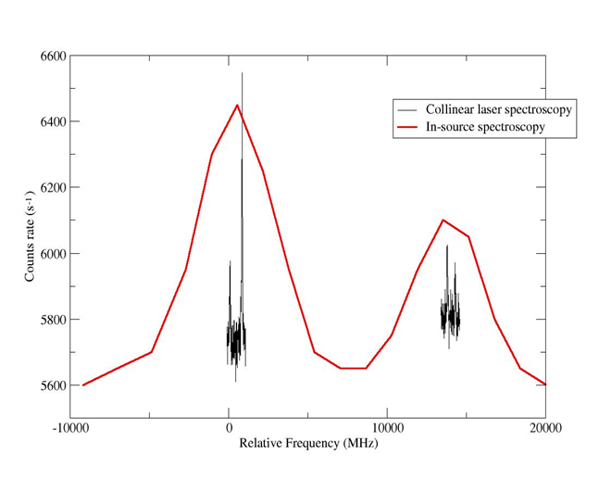
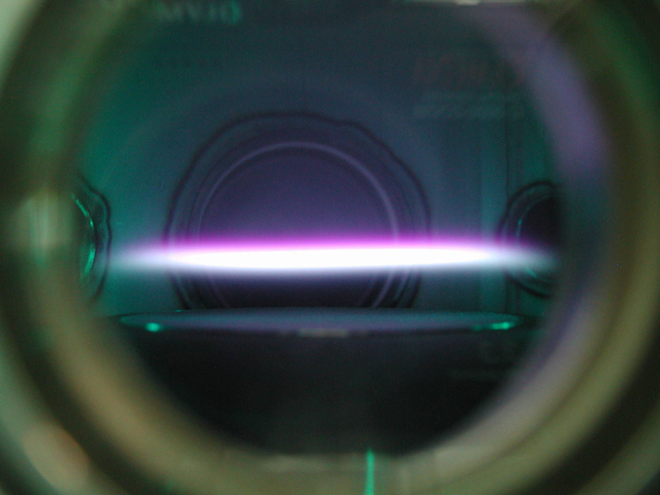
Sensitivity or resolution?
In-source
laser spectroscopy
Collinear Concept
ΔE=const=δ(¹/₂mv²)≈mvδv
Charge
exchange
⁶⁸Cu
Ion
Source
For ionic spectroscopy
Doppler tuning voltage
applied to light collection
region
Separator
electrostatic
acceleration
Applied Doppler
tuning voltage
PMT
10
0
10
20
Relative Frequency (GHz)
High resolution (sub 10MHz) but low sensitivity (>10⁶ /s)
Sensitive to sub 1 atom/s but limited by Doppler broadening to cases with large hfs

Slide 5
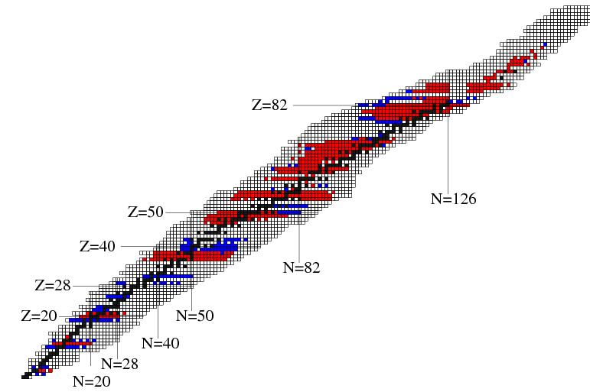
Status of laser spectroscopy
Since 1995
Before 1995
Gaps in chart
Production difficulties
Half life
Chemistry
Atomic physics
Z
N
J. Phys. G 21 707 (1995)
J. Phys. G 37 113101(2010)

Slide 6
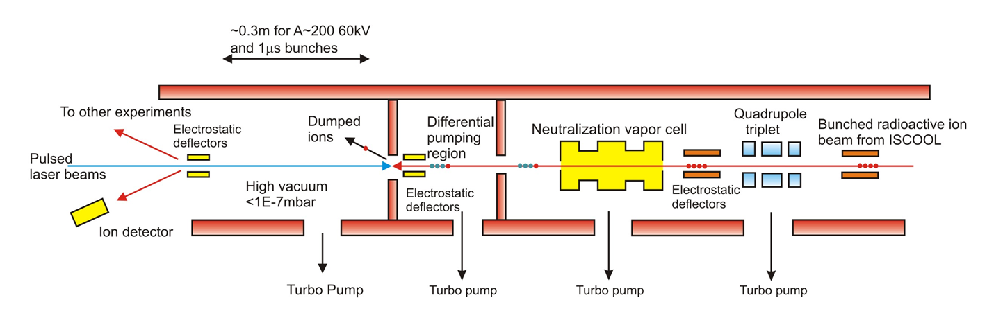

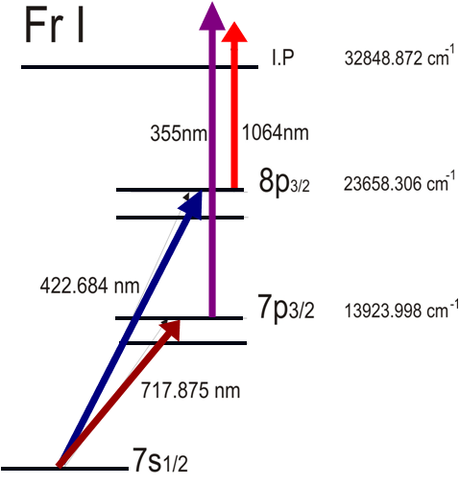
Collinear Resonant Ionization Spectroscopy (CRIS)
⁶⁸Cu
30MHz
4GHz
Combining high resolution
nature of collinear beams
method with high sensitivity
of in-source spectroscopy.
Allowing extraction of
B factors and quadrupole
moments.
10
10
0
10
20
Relative Frequency
(GHz)
Yu. A. Kudriavtsev and V. S. Letokhov,
Appl. Phys. B29 219 (1982)

Slide 7
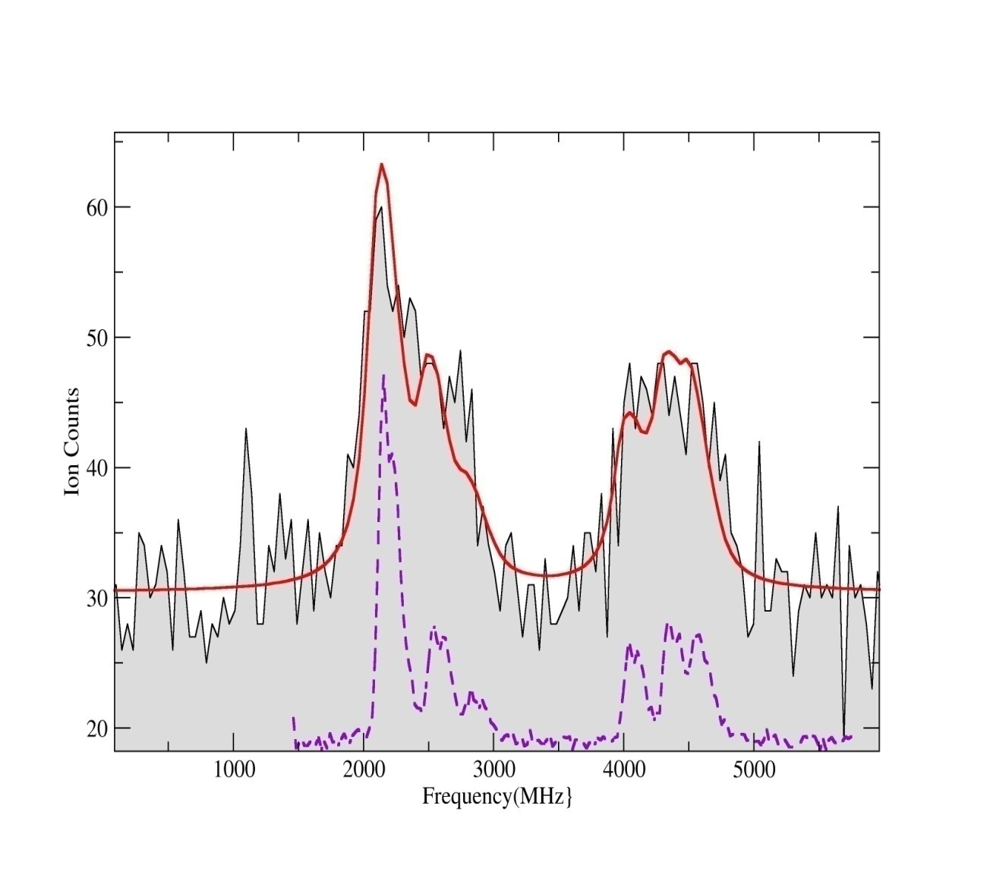
Previous CRIS at JYFL
1:30 From Jyvaskyla off-line tests
50
Factor of 1000 improvement on photon detection
Ion Counts
30
150MHz linewidth
2000
4000
Relative frequency (MHz)
High background rate 5cts/bunch

Slide 8
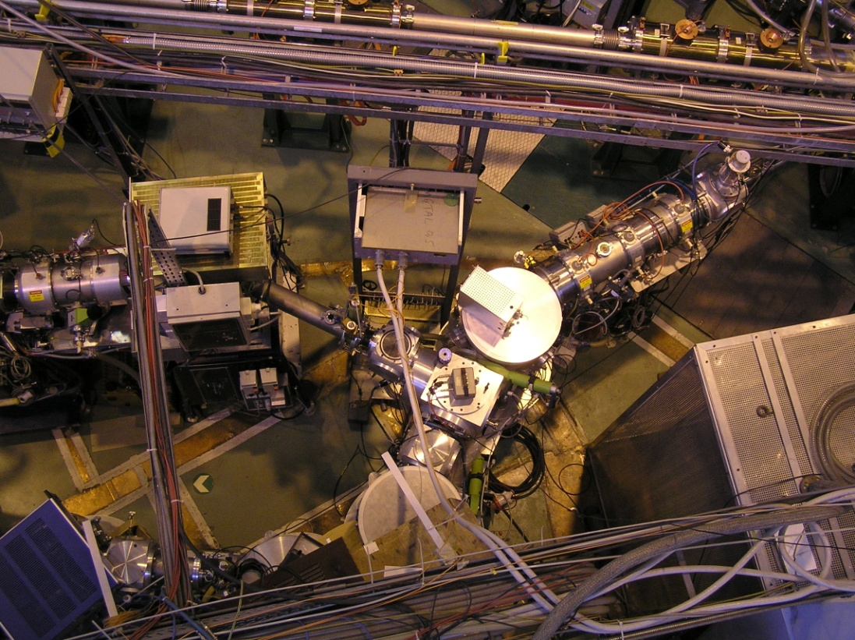
Status in 2008
Proposal to the INTC accepted
New beam line to be
located in the old
COMPLIS area.
COMPLIS decommissioning
scheduled for the summer
of 2008.
Design work for new beam line started in spring of 2008.

Slide 9
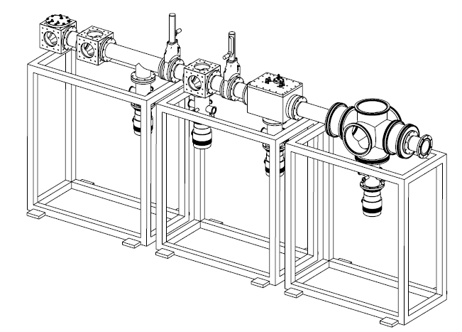
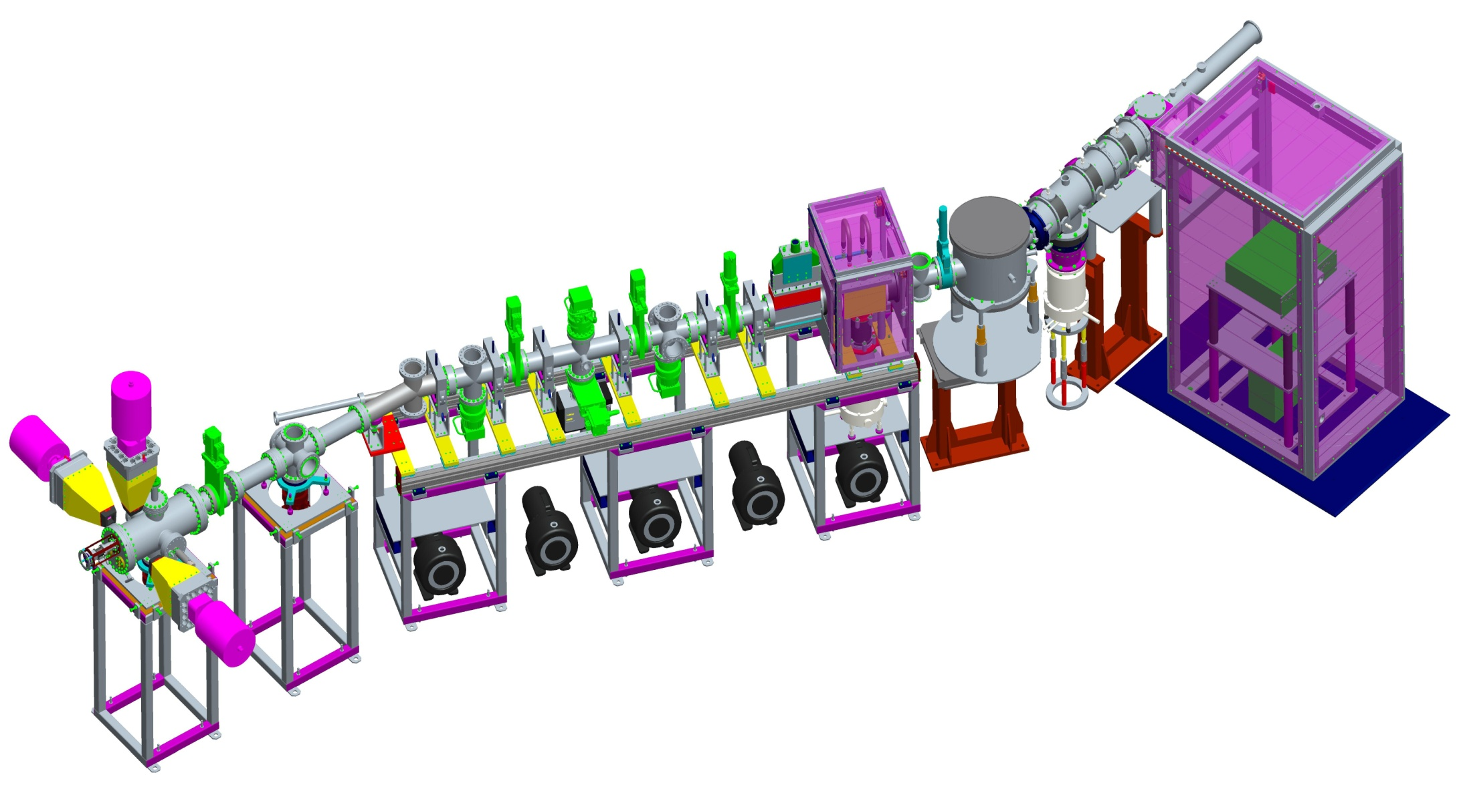
Technical Design
Basic scheme went through several iterations before converging on the final design in 2008.
UHV requirements constrained the design and forced the beam line to be ~3m in length

Slide 10
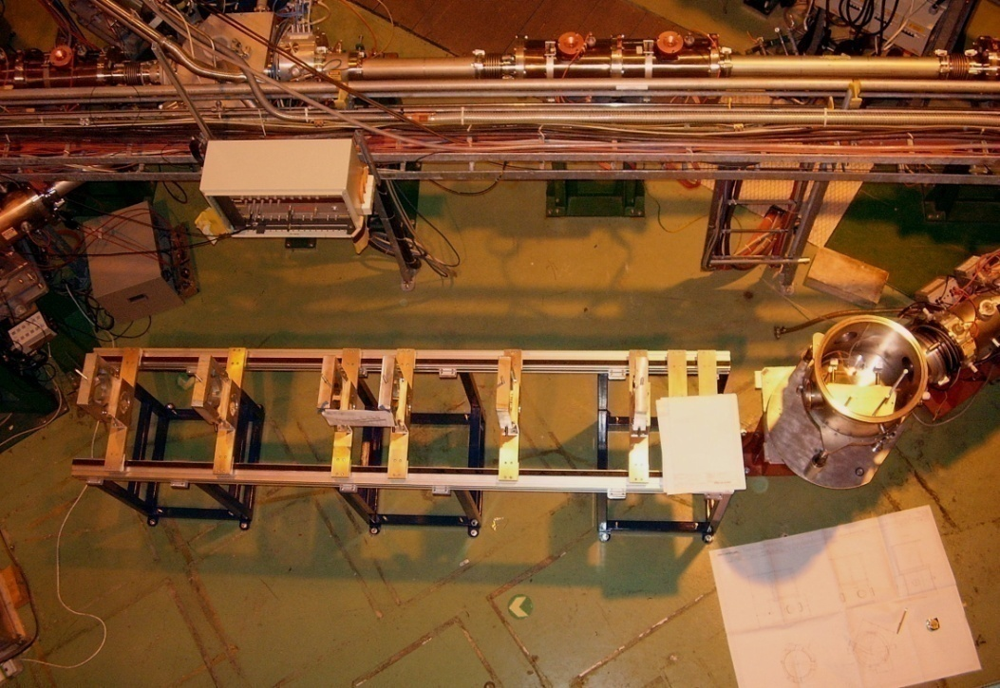
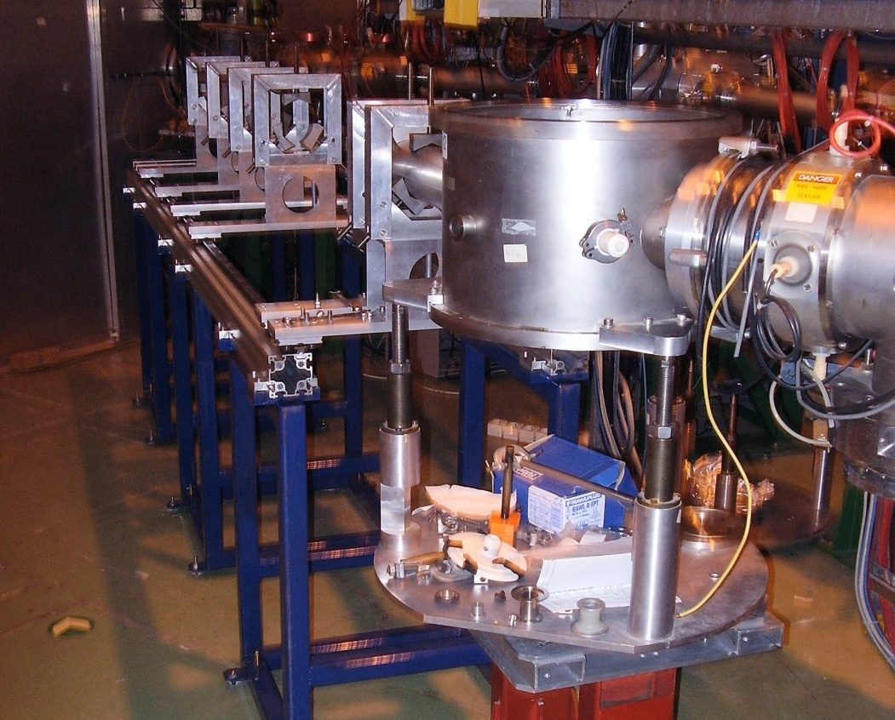
November 2008
Initial Installation of railway track for the beam line. The concept allows an individual to remove vacuum sections.

Slide 11
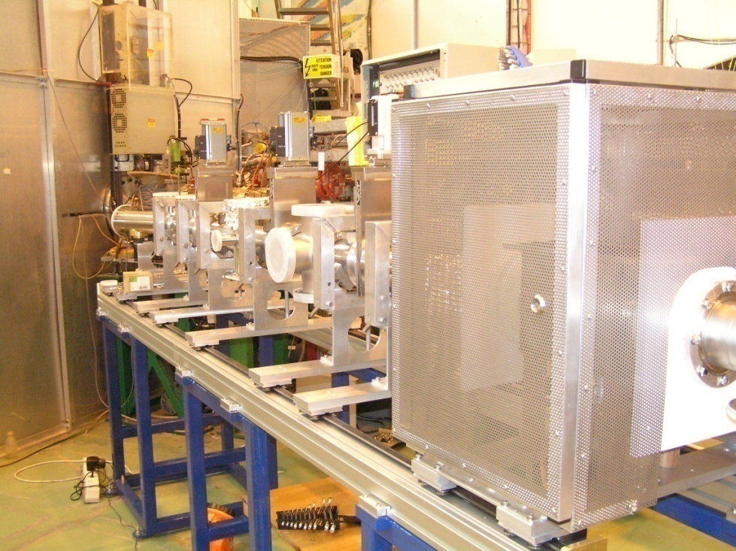
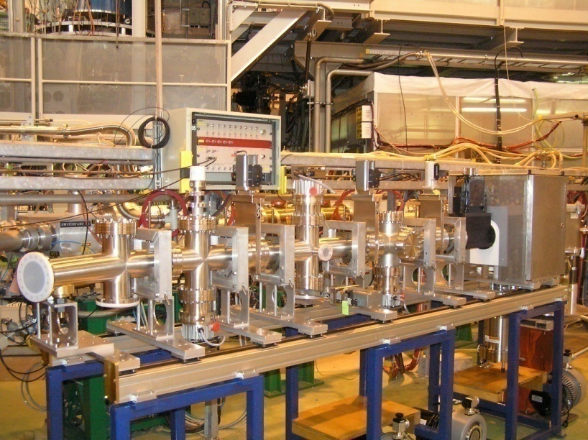
April 2009
Beam line installation

Slide 12
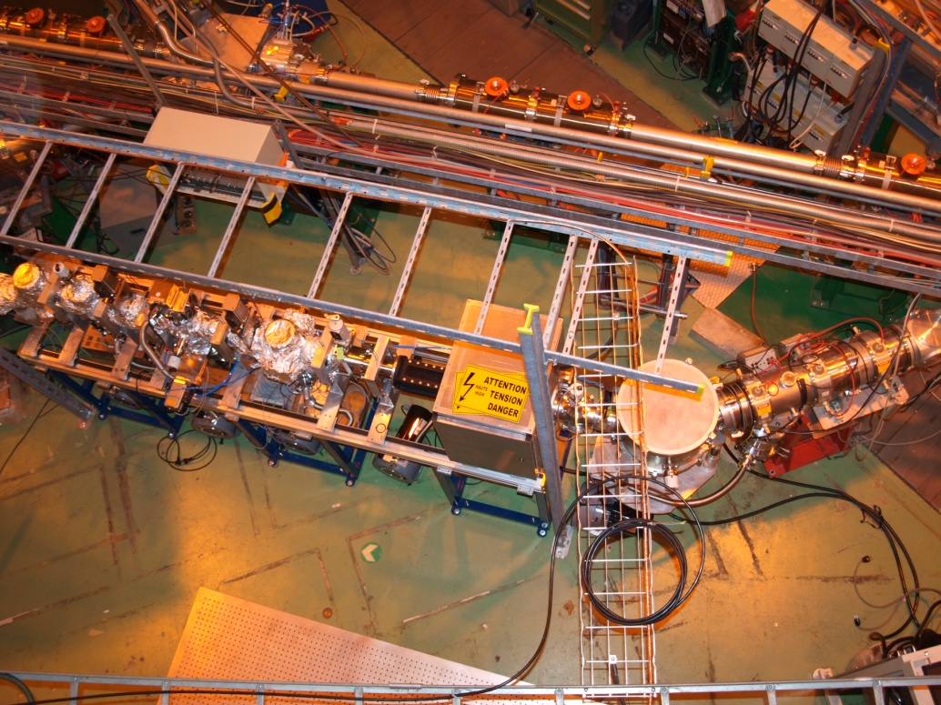
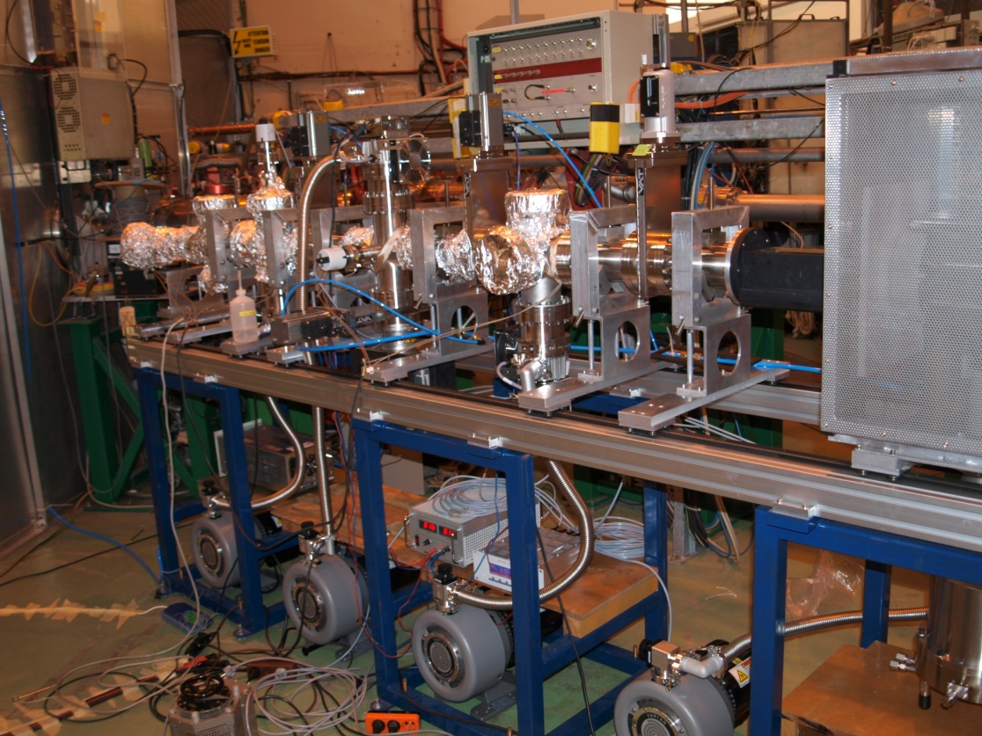
2009: Vacuum testing
Initial bake out of the UHV section and differential pumping tests.
Charge exchange cell and hot oil circulator was tested (with mixed results)

Slide 13
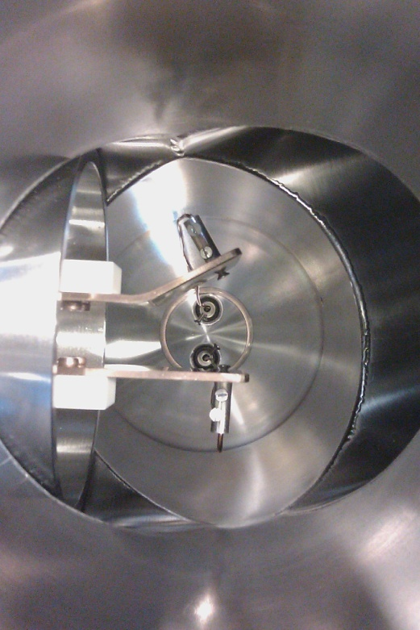
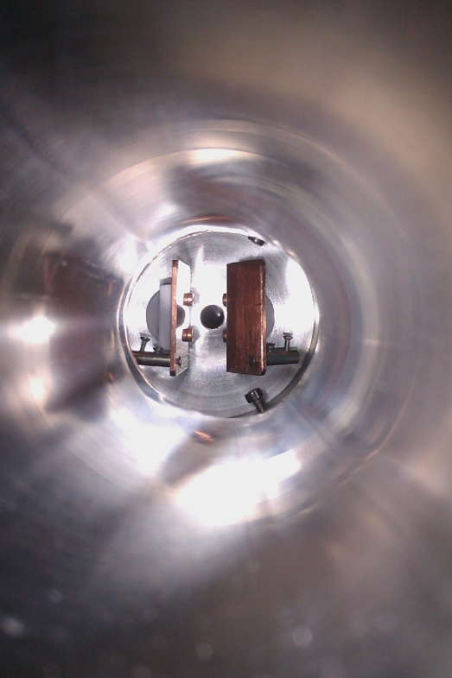
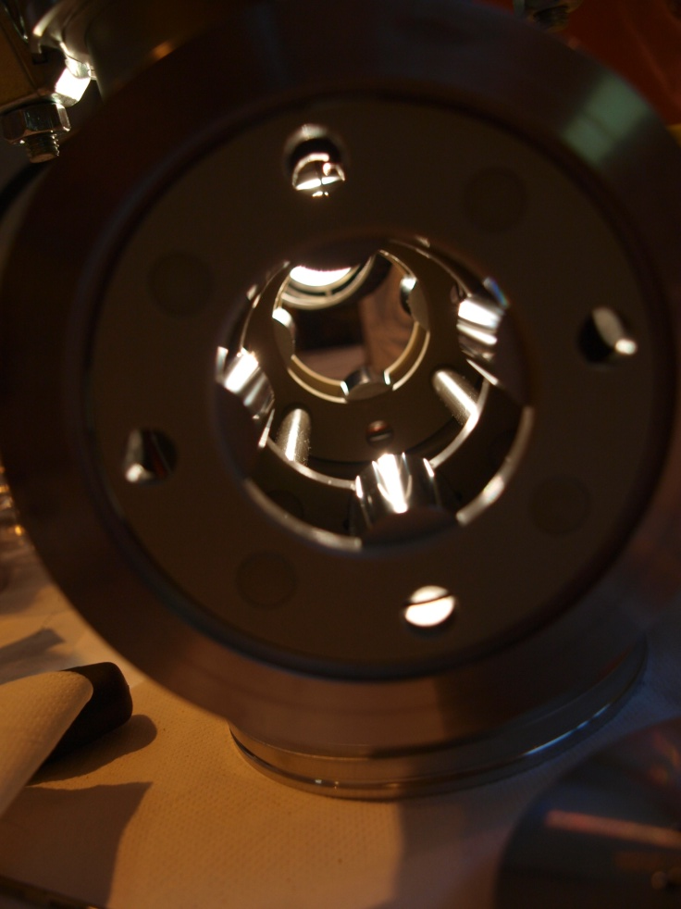
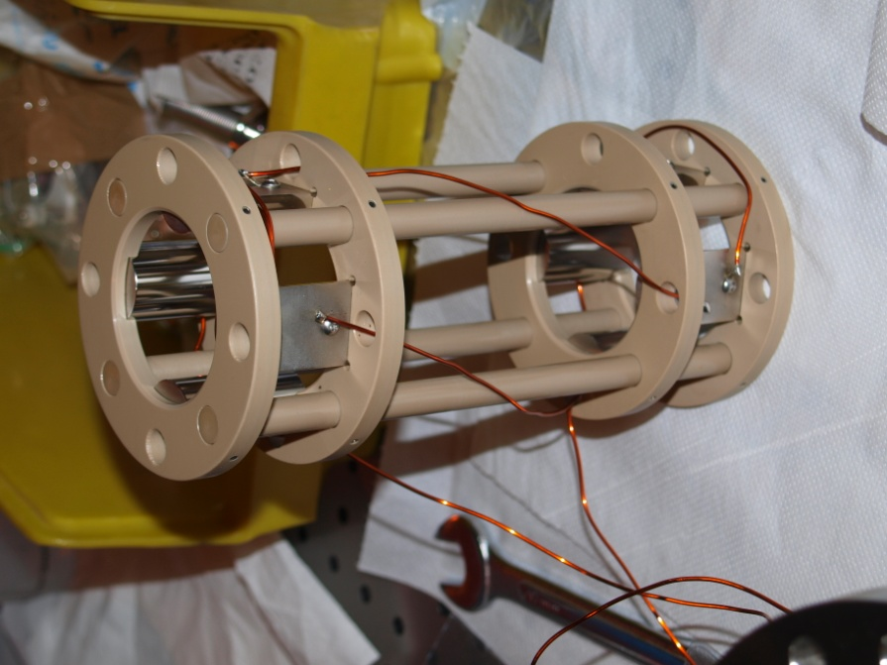
2010: Ion optics installation

Slide 14
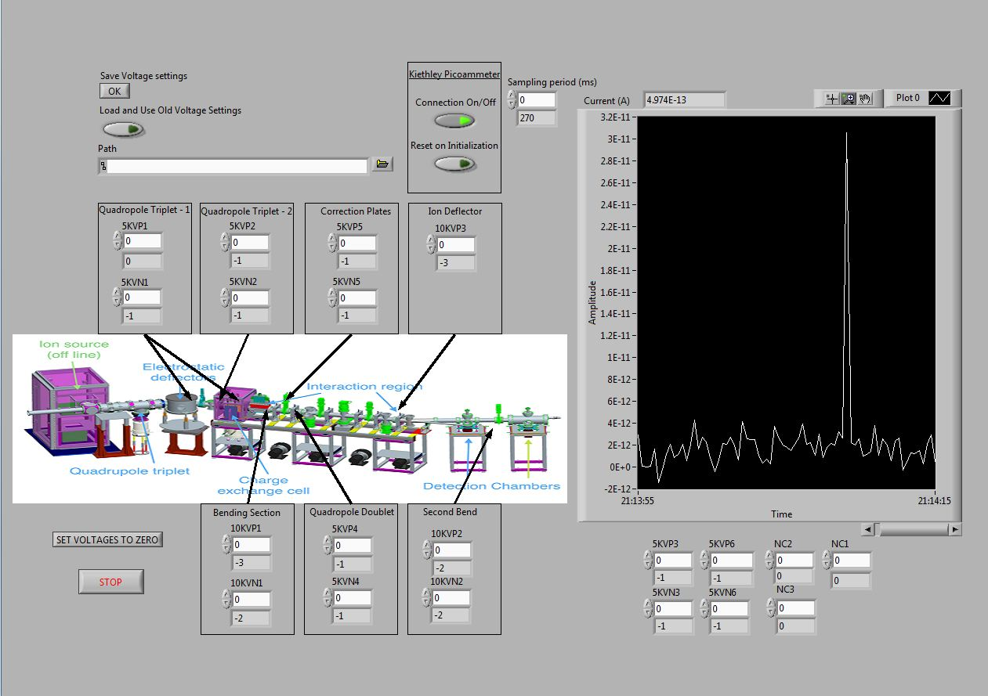
Ion optic tuning
National Instruments PXI based system
Can control up to 36 high voltage supplies (currently 20 supplies are used)
System uses 5kV and 10kV Spellman supplies (MPS series)
Signal from a Keithley picoammeter is transferred to the PC for tuning.

Slide 15
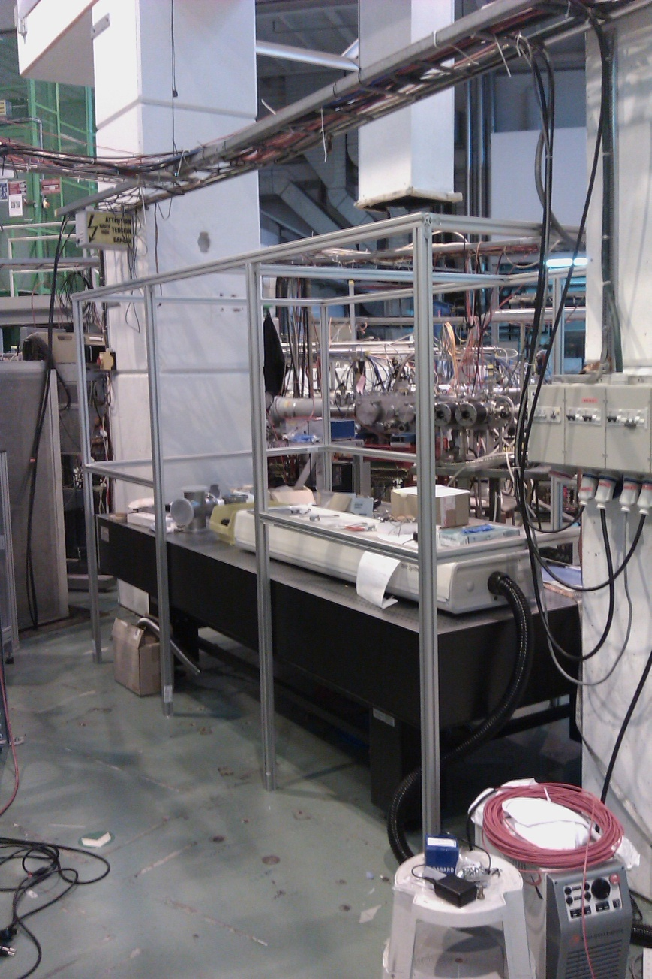
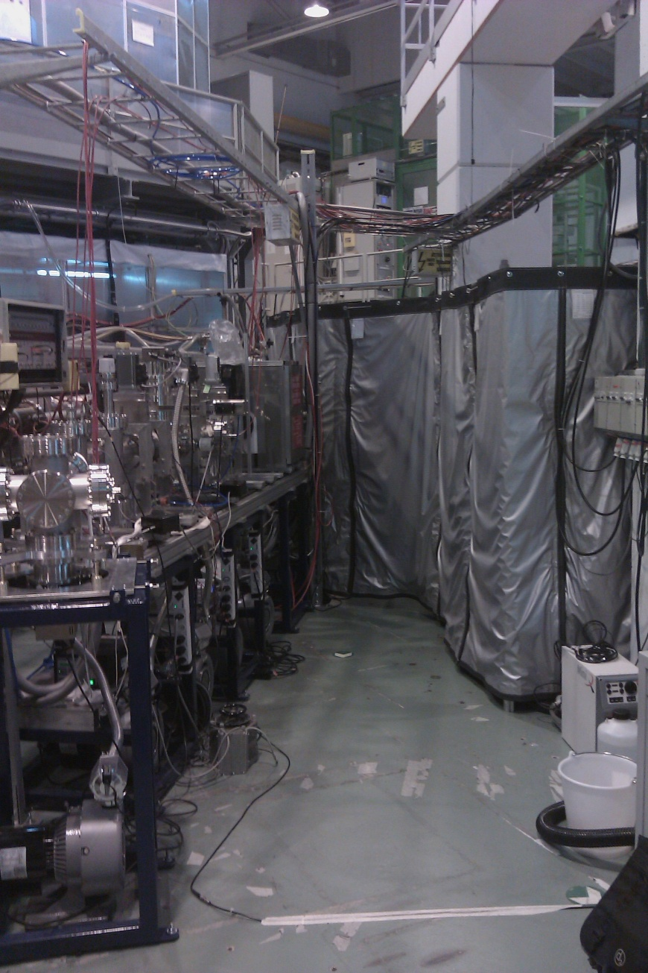
2010: Installation of lasers

Slide 16
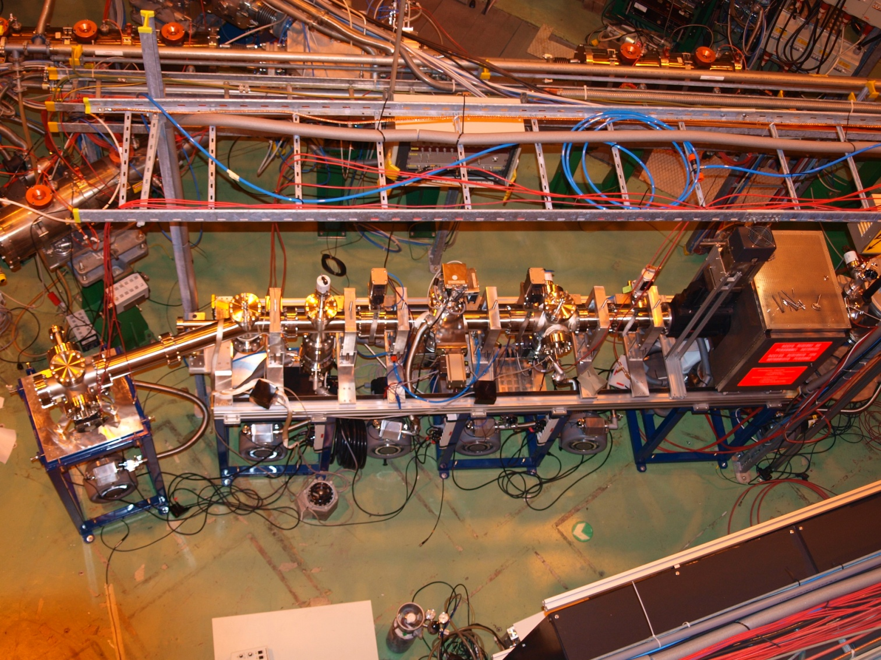
October 2010

Slide 17
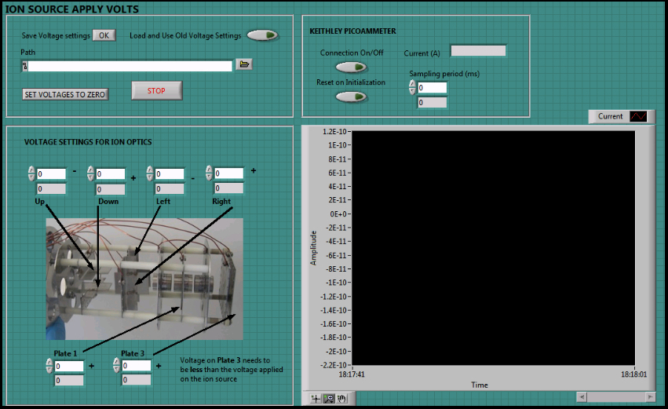
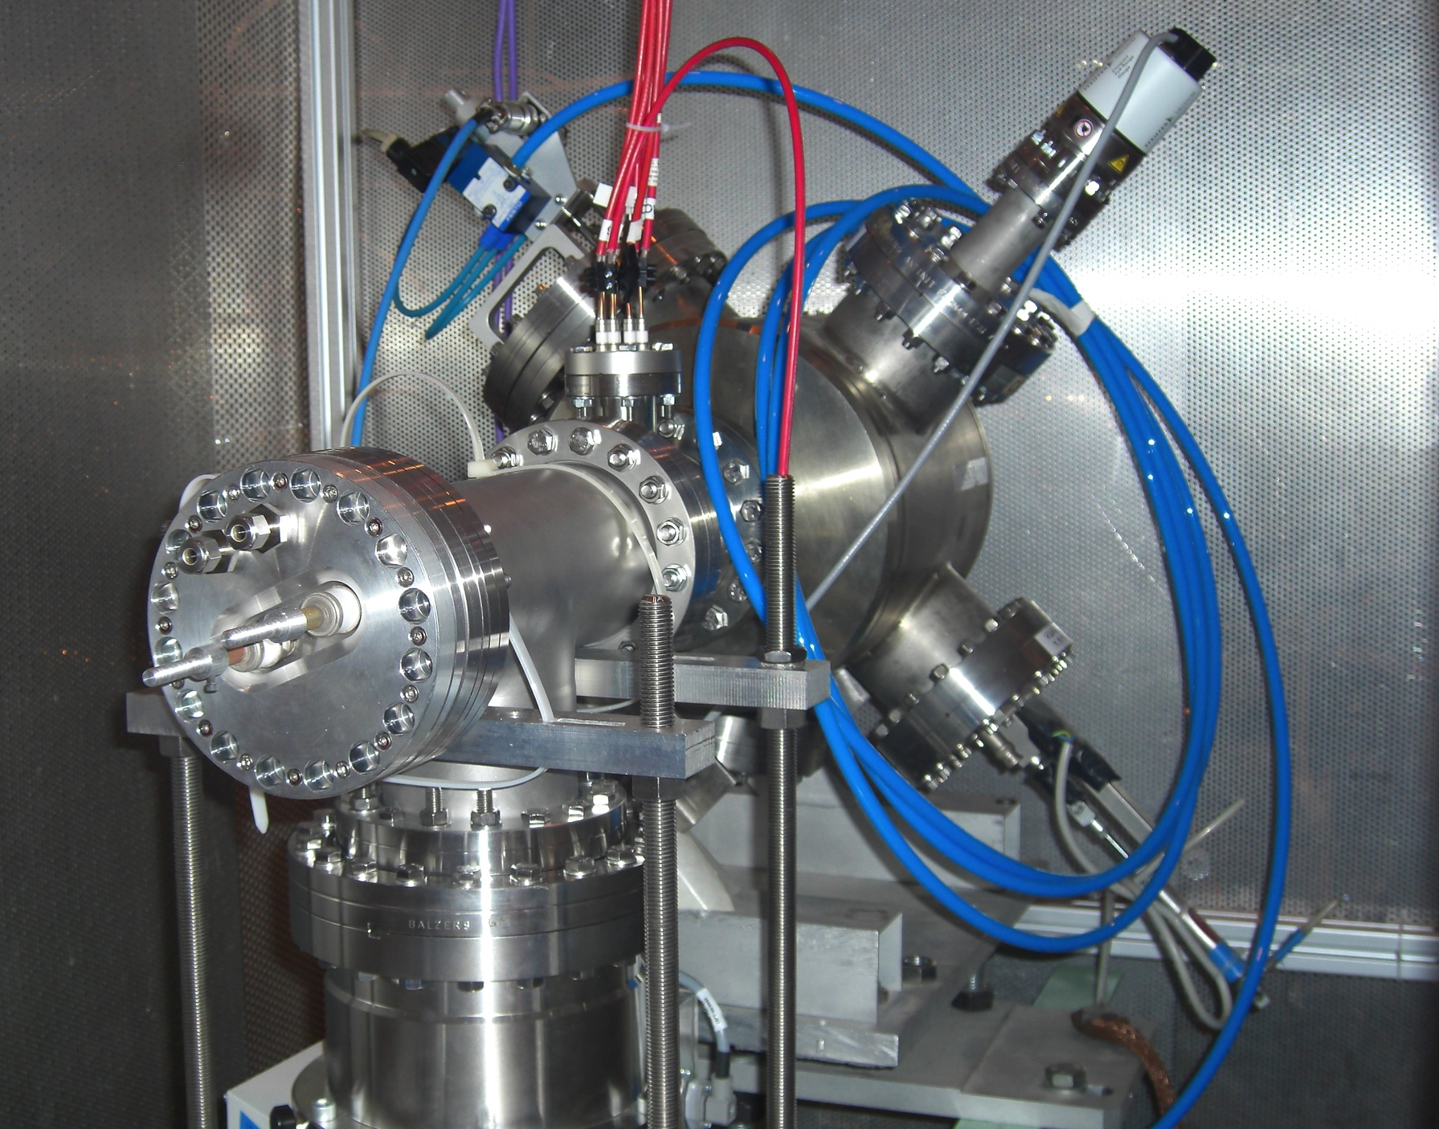
2011:Off-line ion source
Diagnostics on the ion source were carried out with a wire scanner and a Faraday cup.
A LabView programme was created to apply volts to the steering and focusing optics in the chamber, and to read the current on the Faraday cup.

Slide 18
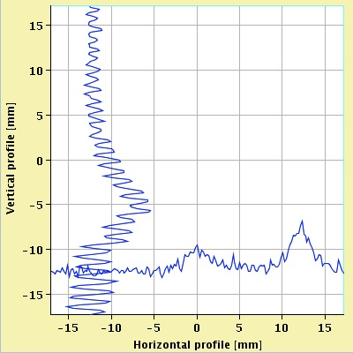
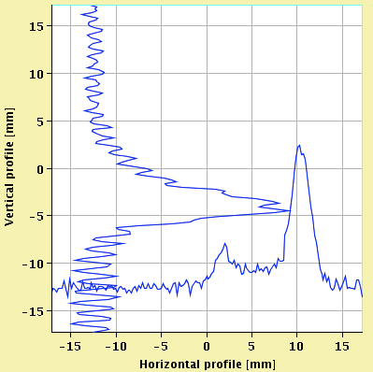
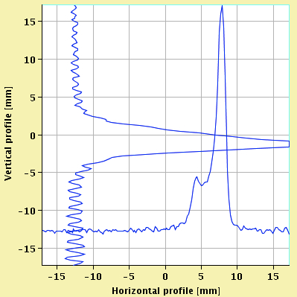
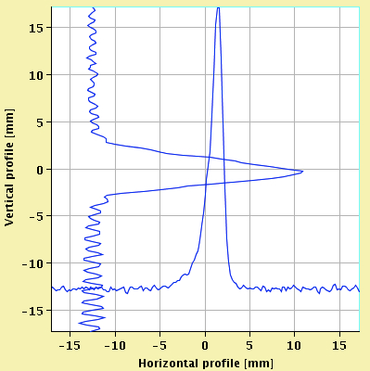
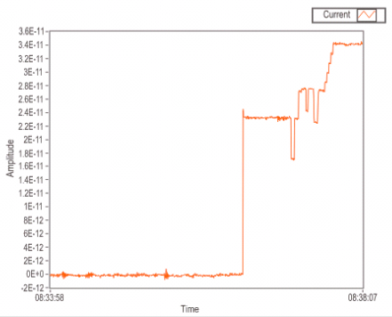
Ion source tests
Optimizing the ion beam profile using the optics of the Einzel lense.
The current on the ion source was set at 40 A and the bias voltage was 2 kV.
Stable operation of 100-300pA over many days of use.
Currently tested with Rb, Cs and In.

Slide 19
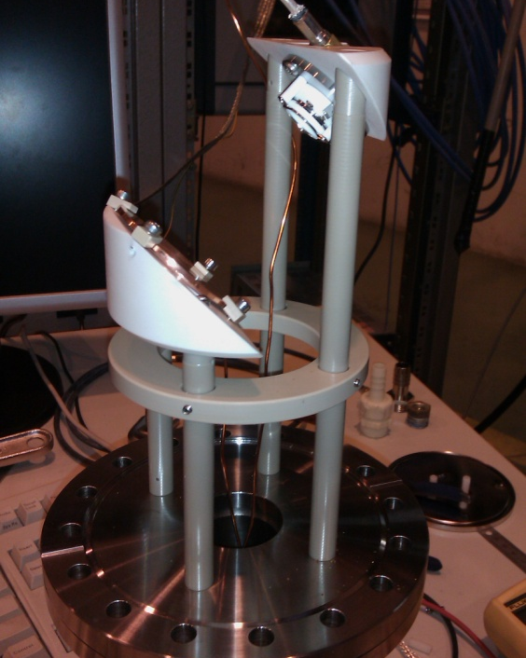
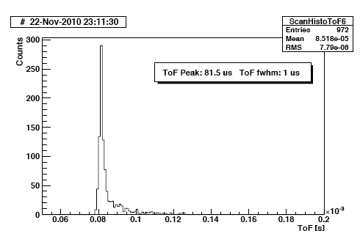
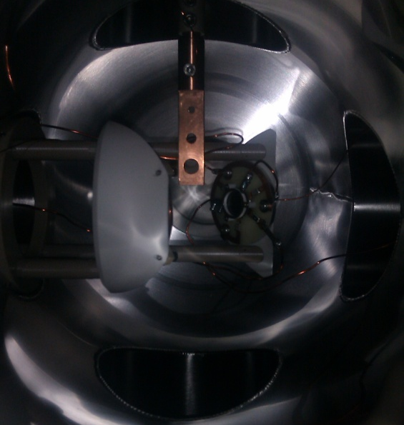
MCP detector installed and tested
MCP arranged to look at secondary electrons from a biased copper dynode.
For beam tuning the dynode acts as a Faraday cup.
TOF spectra of a bunched Rb beam from ISCOOL measured.
~10³ ions/bunch
FWHM~1μs

Slide 20
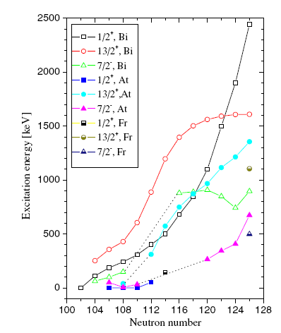
Re-ordering of quantum states in Francium
7/2⁻
1/2⁺
Systematic reduction in energy of the
deformed π(1/2+) in isotopes in this
region of the chart
1/2⁺
7/2⁻
π(1/2+) proton intruder state becomes the ground state in 195At and 185Bi
9/2⁻
9/2⁻
²⁰¹Fr
²⁰³Fr
The isomer shifts of ^{201,203}Fr
and their magnetic moments
will provide important
information to better
understand the evolution of
nuclear structure in this region.
Suggestion that ¹⁹⁹Fr has
I=1/2⁺ ground state spin
with an associated large
oblate deformation.

Slide 21
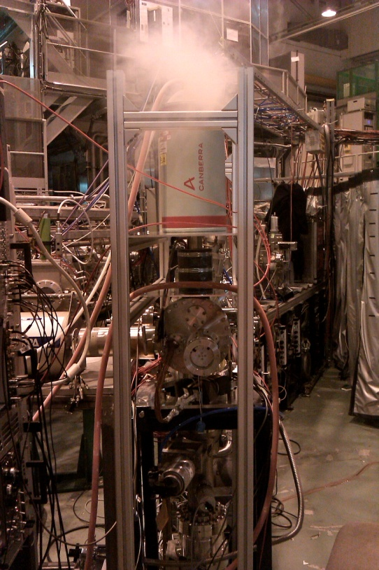
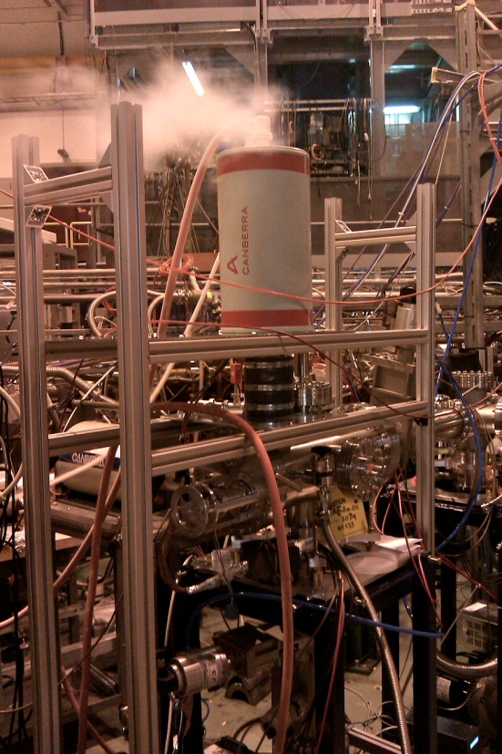
On-line run 2011
Commissioning run of the CRIS experiment
Goals of the experiment
  Demonstrate CRIS at ISOLDE
  Demonstrate laser assisted decay spectroscopy with CRIS (Kara Lynch)
  Fully commission the beam line (charge exchange cell, high voltage tuning, ion detection setup and digital data acquisition.
  Test new laser system for CRIS.

Slide 22
Data Acquisition
MCP/PMT
Lecroy digital scope
Data Acquisition PC
NI PXI chassis
Laser system
Trigger generator
Voltage scanning (PC)
ISCOOL

Slide 23
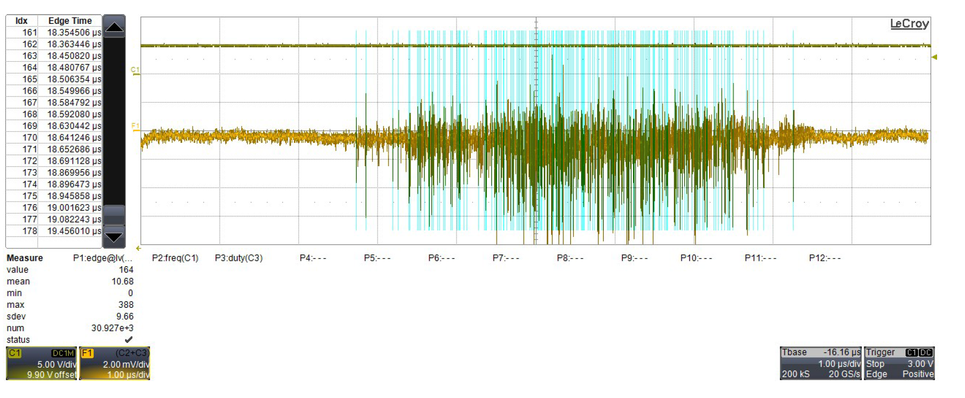
Digital Data Aquisition
Example of an ion bunch recorded by the digital data acquisition.
Full time stamping of every event for off-line analysis.

Slide 24
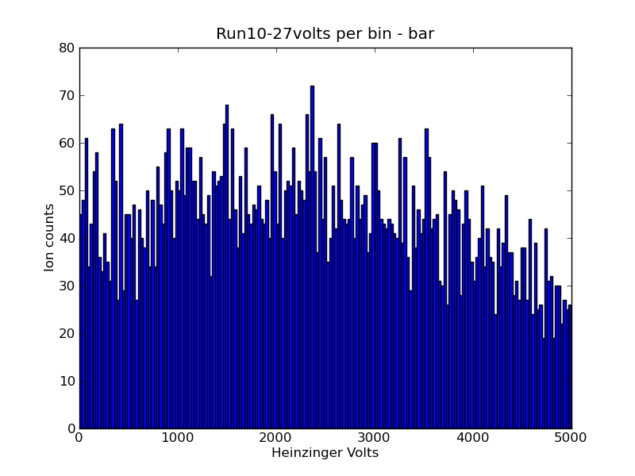
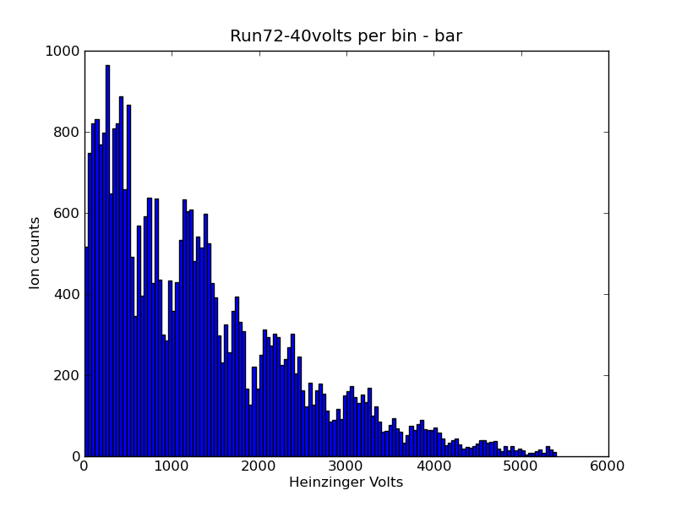
Beam tuning effect
Negative voltage
Positive voltage
Associated with a misalignment of the beam through the charge exchange cell. As a high voltage is applied to the cell the beam is further deflected.

Slide 25
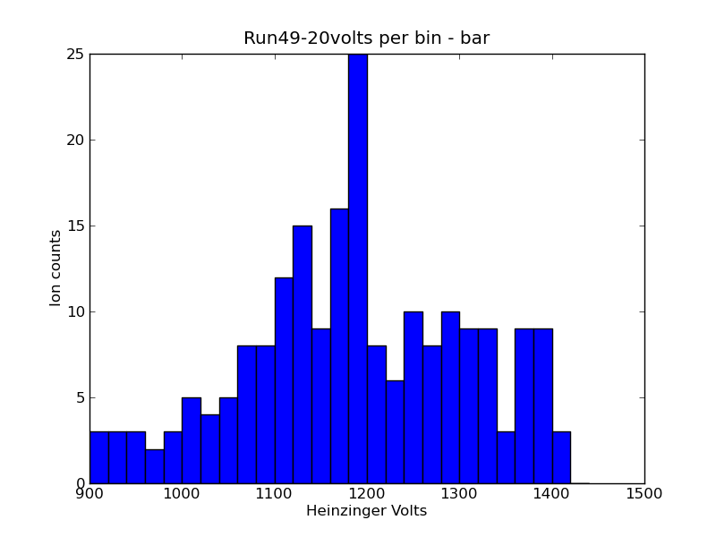
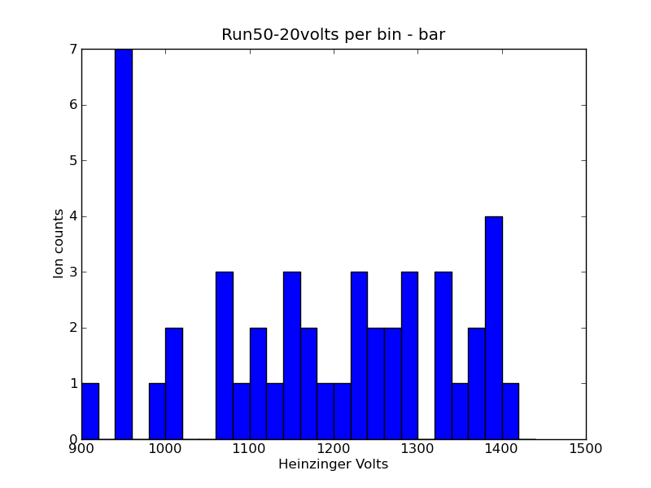
Results
Laser on
Resonant ionization of Fr
Two step scheme.
1064nm laser off
Laser off

Slide 26
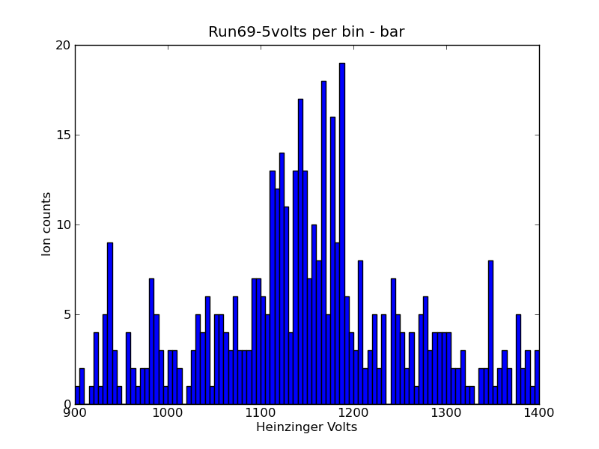
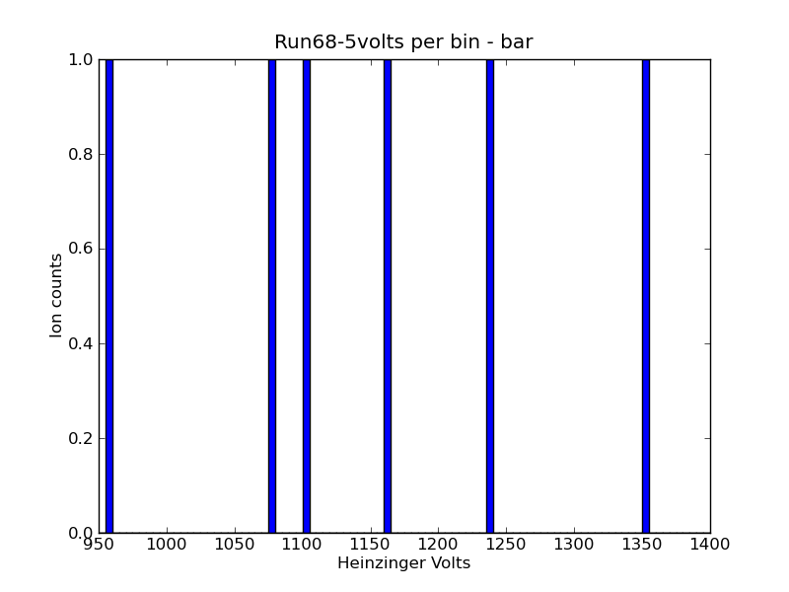
Results
Laser on
Further optimization of the 422nm (scans carried out over a range 20-200μJ/pulse.
Majority of the background is due to 422+422 non-resonant ionization.
With both lasers blocked the observed background is associated with collisional ionization.
Pressure ~1-2x10⁻⁸mbar
Laser off

Slide 27
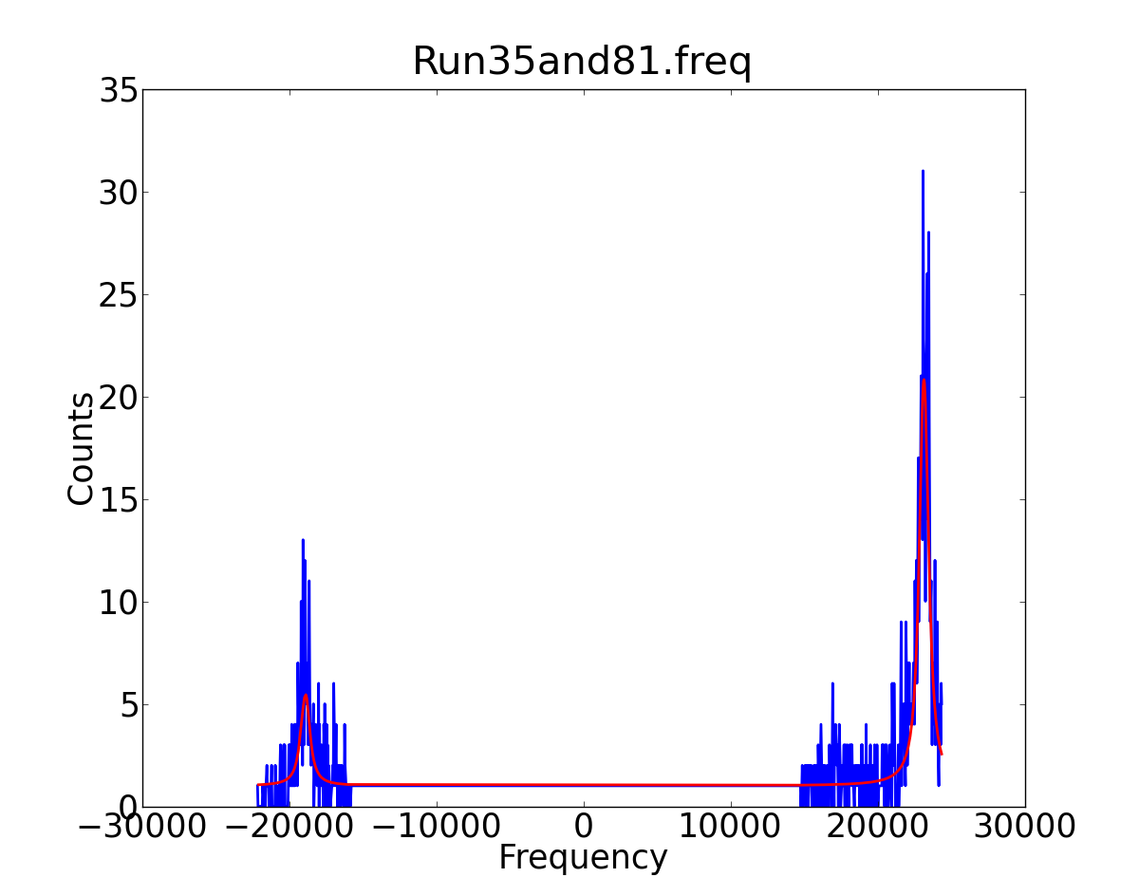
Results: HFS of ²⁰⁷Fr
Literature: A(S_{1/2})=8484(1)MHz I=9/2
Preliminary result from this work: A(S_{1/2})=8390(100)[200]MHz
Low background
rate~0.05/s
Efficiency~1:10⁶
Low power 1064
Noise in the mcp
Transmission (10%)

Slide 28
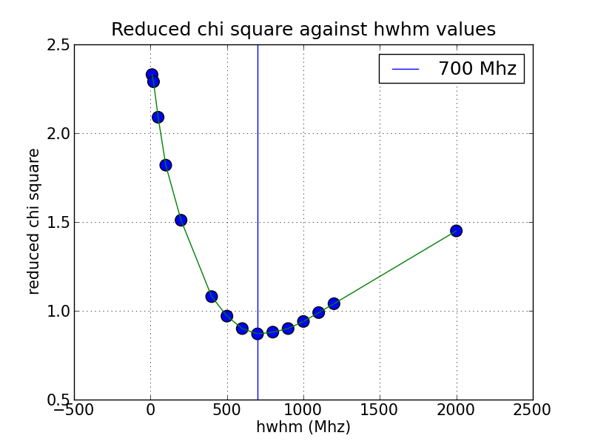
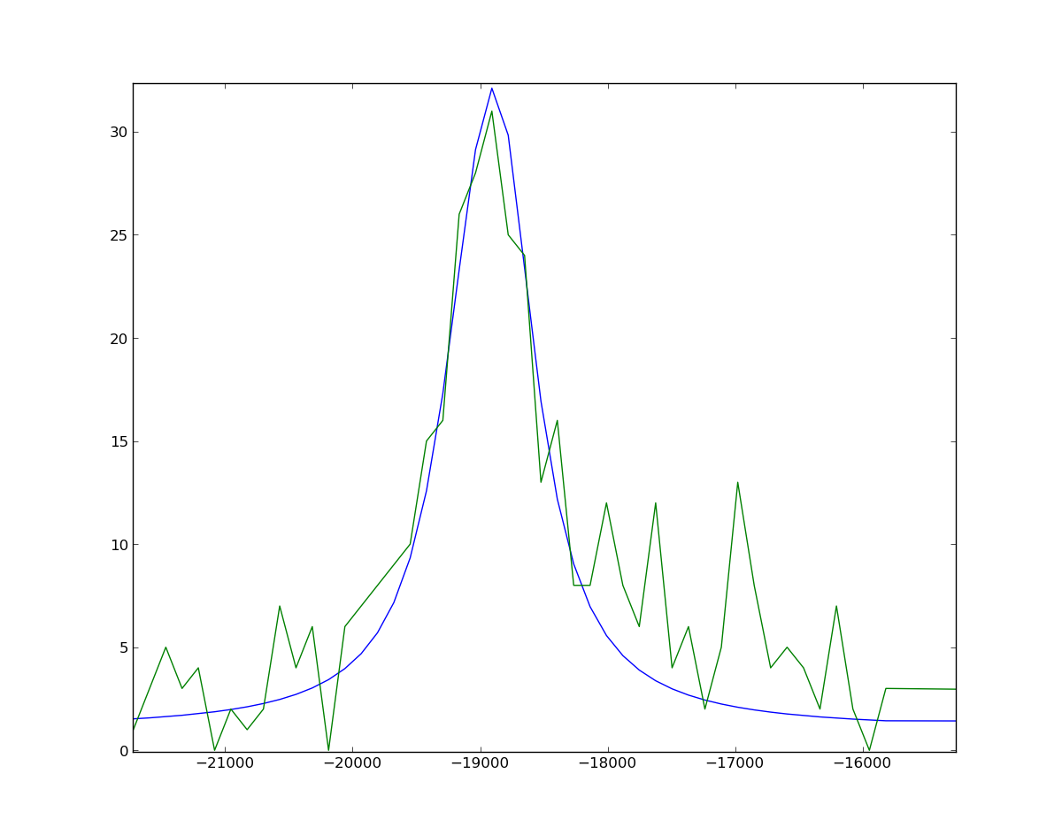
Results: resolution
Multiplet of three transitions within the peak.
Linewidth ~1GHz.
Preliminary results.
Analysis is on-going.
New laser system was used in this experiment. Characteristics of this device are under study.

Slide 29
Summary
Beam line fully commissioned
~50% neutralization efficiency of Fr demonstrated. Beam mistuning minimized.
First hyperfine spectra of Fr measured.
Digital data acquisition demonstrated
Decay spectroscopy station demonstrated (Kara Lynch, the next talk)
Suppression of Fr (with lasers off) is ~ factor of 10000
Currently low experimental efficiency, can account for some this effect.

Slide 30
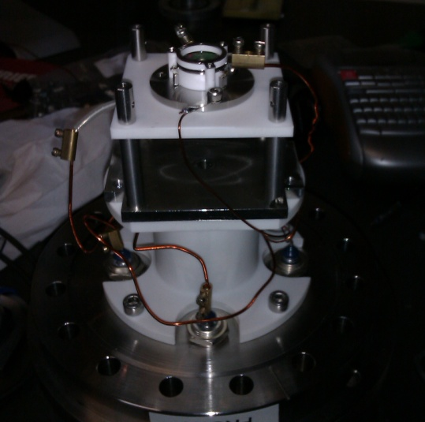
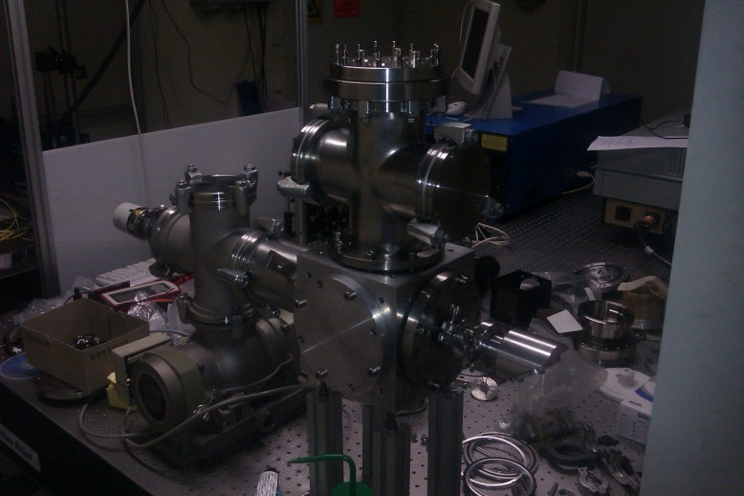
Outlook for 2012
On-going off-line tests using the CRIS beam line and ion source.
New atomic beam unit has been constructed to study future RIS schemes and better test the laser system.
Further on-line experiments planned for Fr and now also neutron rich Cu.

Slide 31
Many thanks to the ISOLDE team and all of the people involved in the CRIS project.

Slide 32










Thank you for your attention
Collaboration
J. Billowes, M.L Bissell, B. Cheal, T.E. Cocolios, A. Dax, K.T. Flanagan, M. Hori, H. A. Khozani‎, T. Kobayashi, F. Le Blanc, O. Levinkron, D. Lunney, K.M. Lynch, G. Neyens, T.J. Procter, M.M. Rajabali, S. Rothe, A.J. Smith, A. Soter, H.H Stroke, W. Vanderheijden, K. Wendt.

