Slide 1
Laser assisted decay spectroscopy at the cris beam line at
Kara M Lynch
CERN Doctoral Student
The University of Manchester

Slide 2
Outline
Introduction
Collinear resonant ionization spectroscopy
  Selectivity of resonant ionization
Laser assisted decay spectroscopy
  Physics case of low-lying isomer in ²⁰⁴Fr
The CRIS beam line at ISOLDE
Characterizing the decay spectroscopy station
  Energy resolution, attenuation and efficiency measurements
Recent results from the on line run IS471
  Laser assisted decay spectroscopy of ²⁰⁷Fr
  Decay spectroscopy of ²⁰⁴Fr
Outlook and Summary

Slide 3
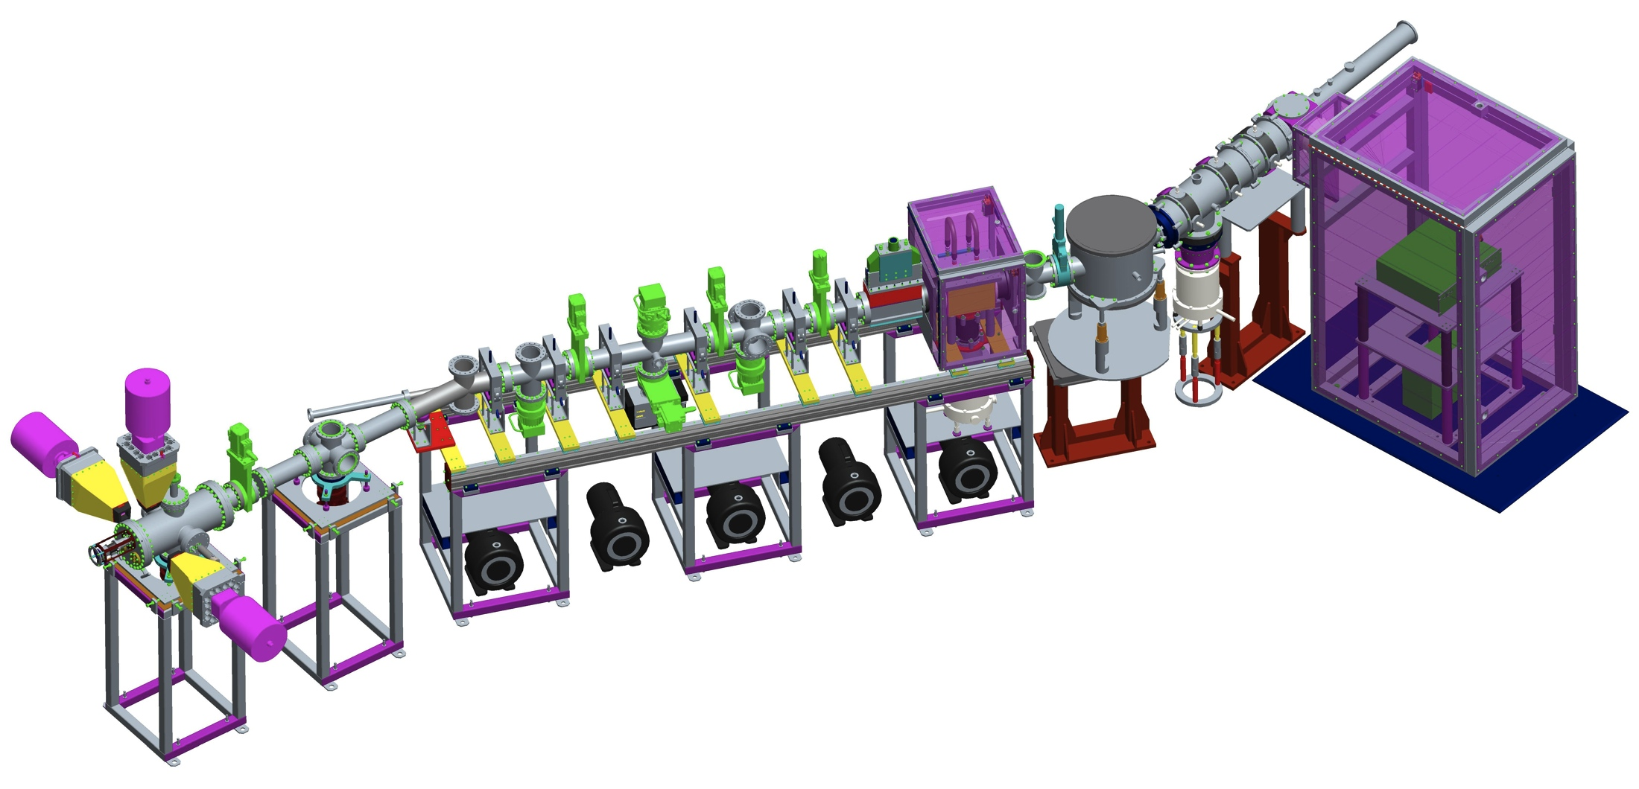
Introduction
The CRIS beam line facility at ISOLDE
  Laser spectroscopy: spin and moments from parent nucleus
  Decay spectroscopy: level scheme from daughter nucleus
This allows for spectroscopy measurements to be performed on pure ground state or isomeric beams

Slide 4
Collinear resonant ionization spectroscopy
The resolution of collinear spectroscopy and the sensitivity of ion detection

Slide 5
Laser spectroscopy
Scan the frequency, probing an isotope’s hyperfine structure
Nuclear parameters extracted with model-independence:
²⁰⁴Fr
I = 9/2
F = 6
z
8p²P_{3/2}
F = 5
F = 4
M_{z}
F
J
J = 3/2
F = 3
I
7s²S_{1/2}
F = 5
F = I + J
J = 1/2
F = 4
Nuclear spin
Electric quadrupole
moment
Magnetic dipole
moment
Change in mean square charge radii

Slide 6
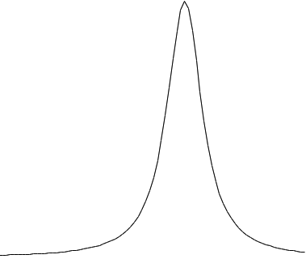
Selectivity of resonant ionization
When the laser frequency is on resonance with a Hf transition, the isotope is resonantly ionized
Resonant ionization selects the isotope of interest
Analogous to the mass resolution in mass spectrometry
Selectivity of an isotope is:
IP
Isotope A
Isotope B
E₂
S = S₁ × S₂
S = ∏ S_{n}
S₂
E₁
The higher the number of excitation steps, the greater the selectivity
S₁
GS
Isotope A
Isotope B

Slide 7
Laser assisted decay spectroscopy
Due to the high selectivity of collinear spectroscopy, sensitive secondary experiments can be performed

Slide 8
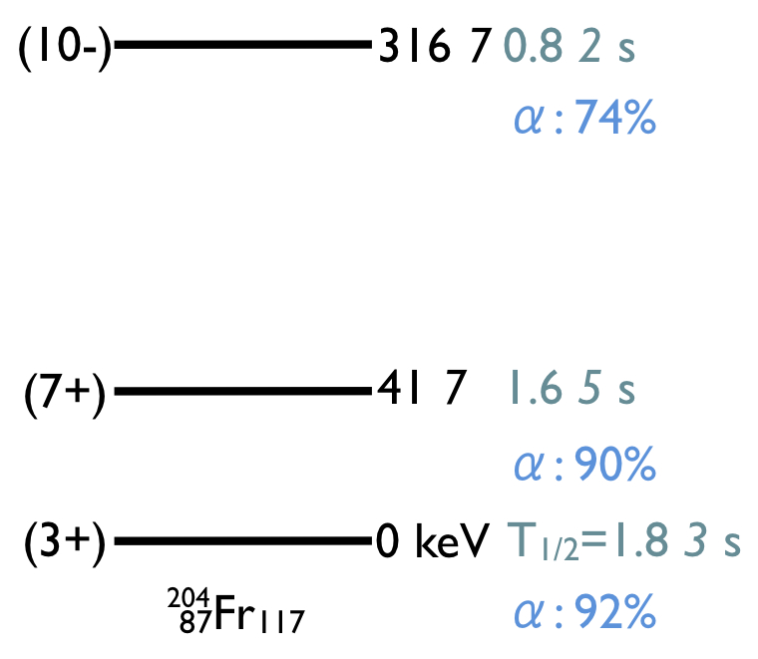
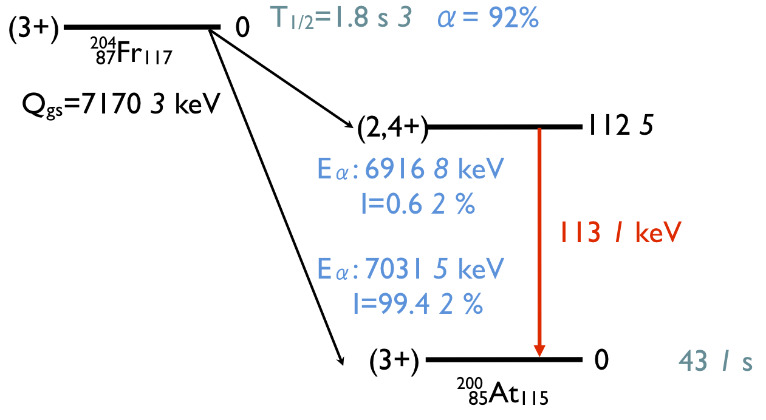
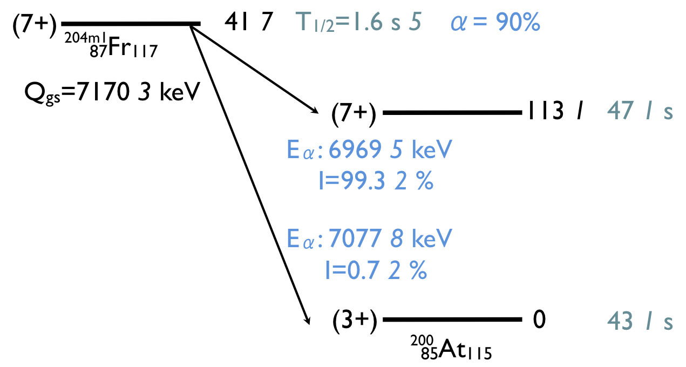
Physics case of ²⁰⁴Fr
^{204g}Fr and ^{204m1}Fr are within 41 keV of each other
Different spins leads to different Hfs
Decay spectroscopy can be performed on pure isomeric beams with a suppression of the ground state by a factor of 10⁴

Slide 9
The cris beam line

Slide 10
Layout of the CRIS beam line
Radioactive bunched ion beam from ISOLDE
Charge exchange cell
Doppler tuning voltage applied
UHV interaction
region
Stable beam from off line ion source
MCP: ion detection
Laser beam
Ge detectors
Si detectors
PMT: fluorescence detection
Decay spectroscopy station: decay measurements
Collinear geometry gives a reduction in the thermal Doppler broadening by a factor of 10³, improving resolution
ΔE = δ(½ mv²)
= mvδv
≈ constant

Slide 11
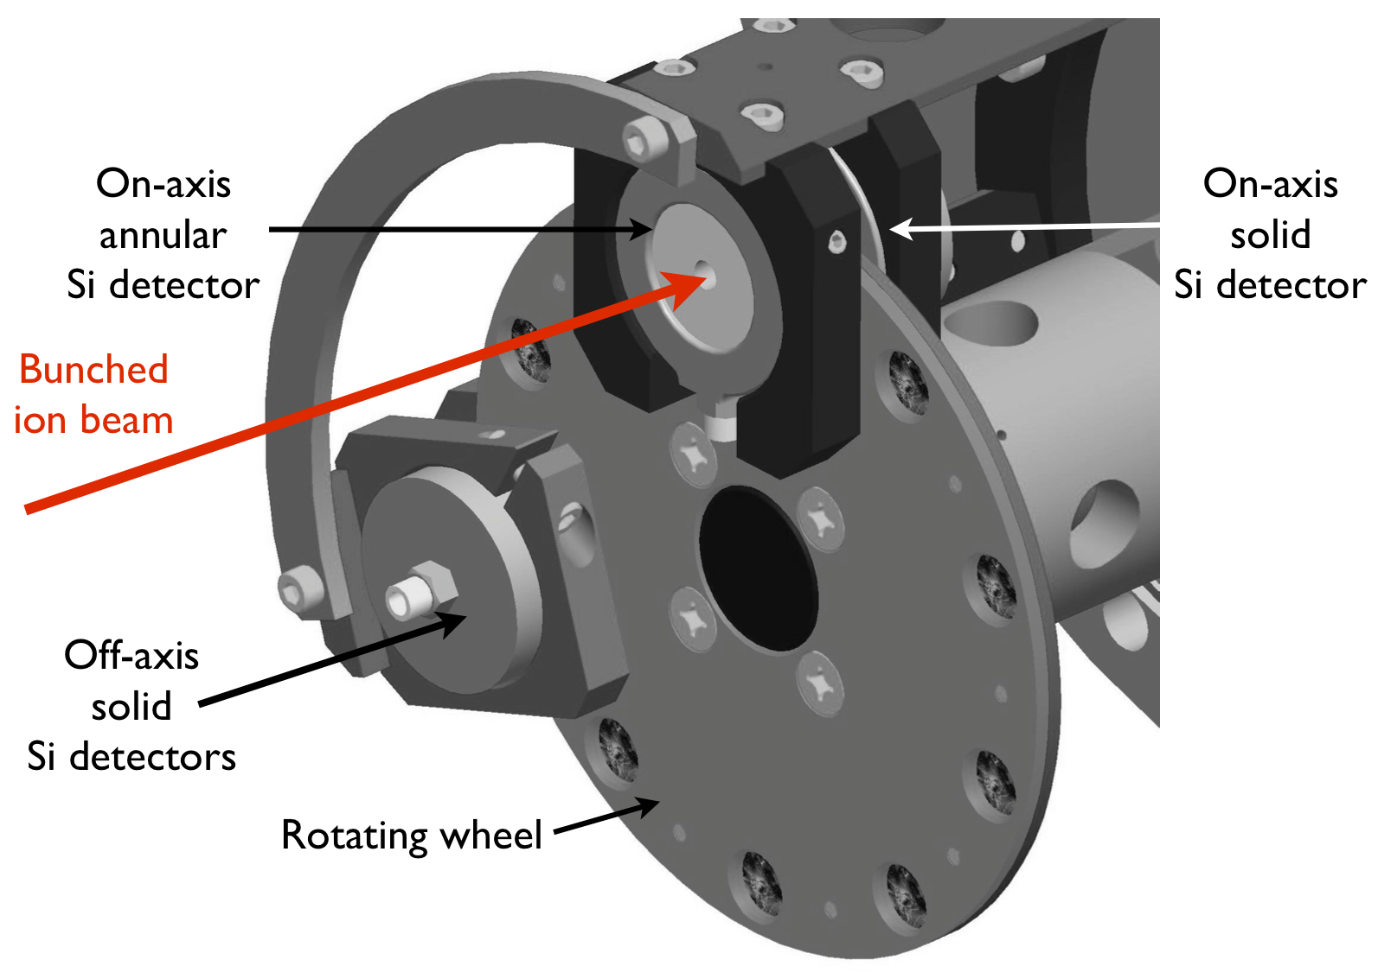
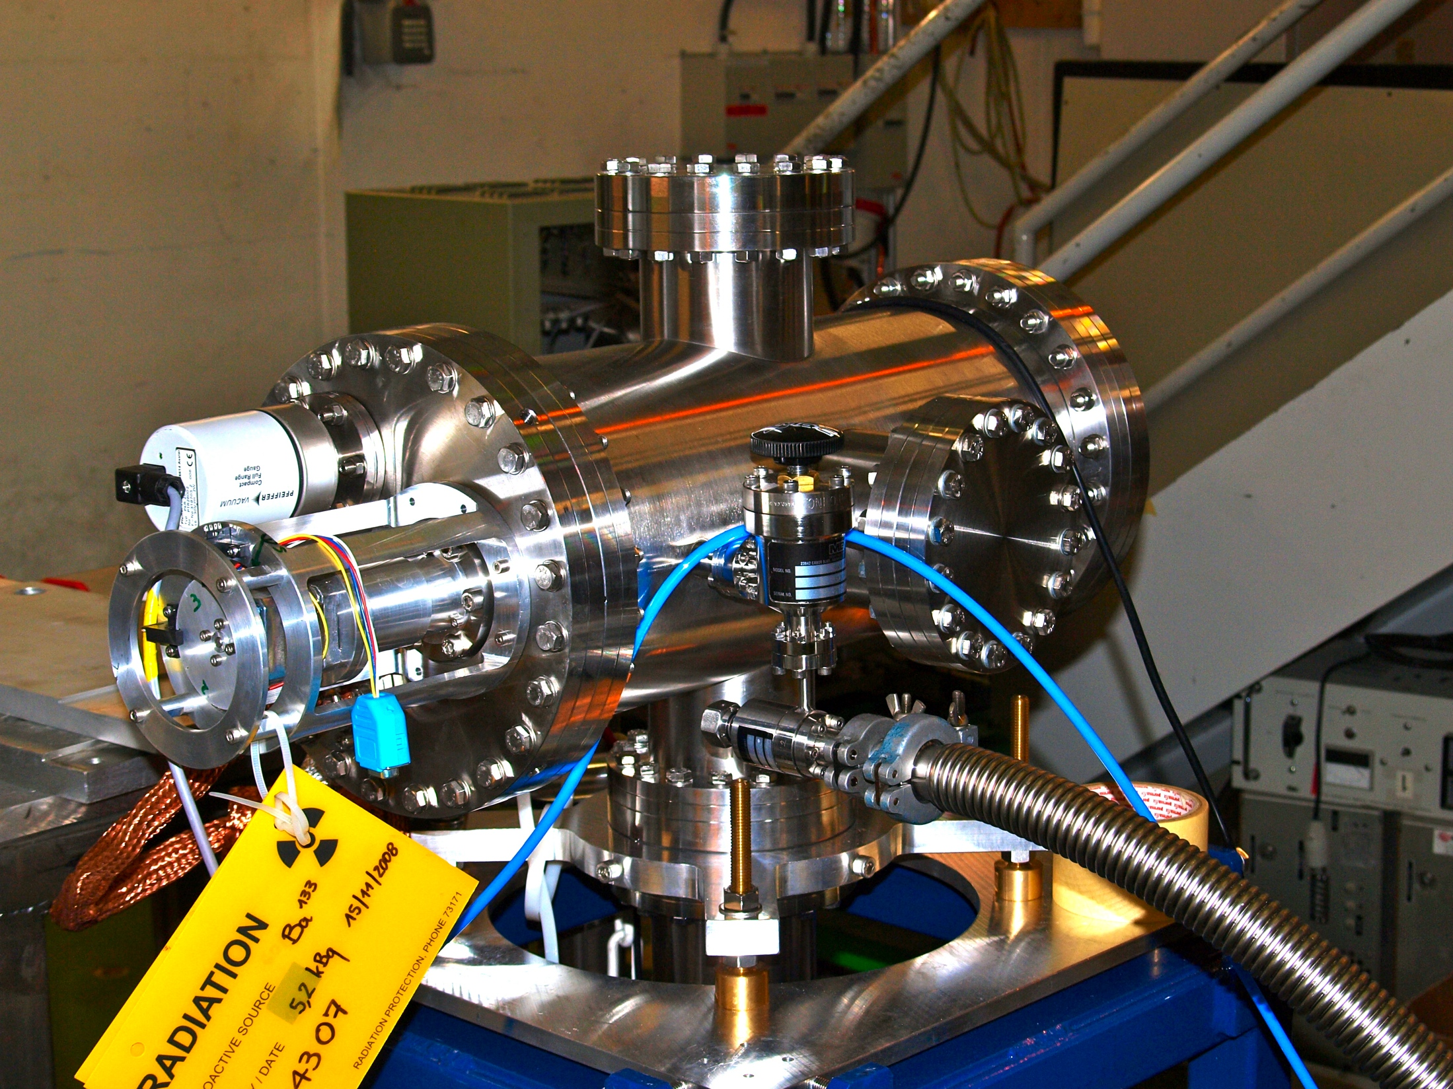
The decay spectroscopy station
Rotating wheel implantation system
10 carbon foils
Two Si detectors for alpha-decay detection either side of carbon foil
Ge detectors for gamma-ray detection
Steel wheel rotates and a new ion bunch is implanted into the fresh carbon foil

Slide 12
Characterizing the dss

Slide 13
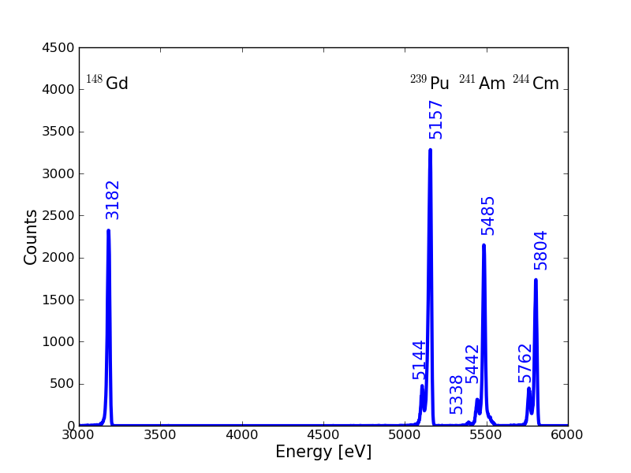
Energy resolution measurements
The energy resolution of the SLD silicon detector was calculated off line
17.8 ± 0.2 keV at 5.485 MeV
Notes:
----- Meeting Notes (05/12/2011 09:36) -----
Energy res of Gd line?
Energy dependence?

Slide 14
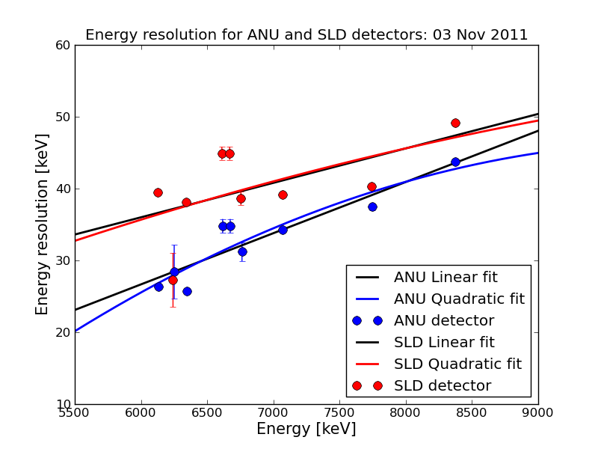
Energy resolution measurements
The energy resolution of the silicon detectors was also calculated on line
ANU: 26.4 ± 0.4 keV at 6.126 MeV
SLD: 39.5 ± 0.4 kev at 6.126 MeV

Slide 15
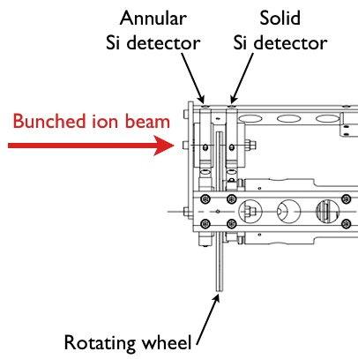
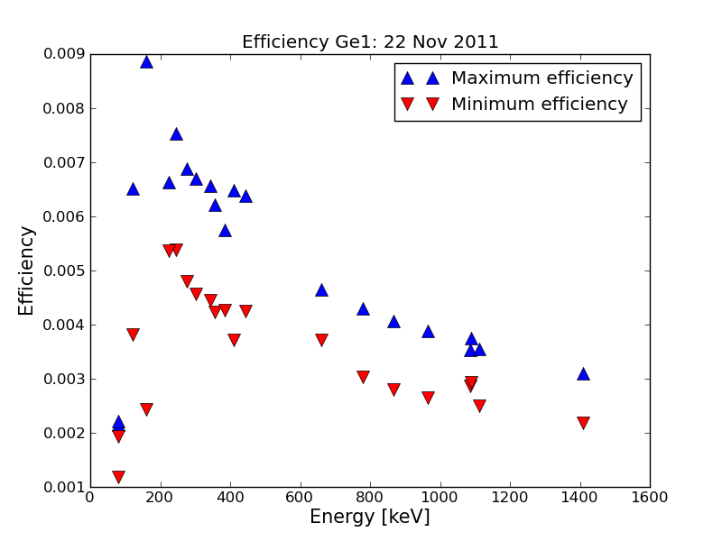
Efficiency of the Ge detector
The efficiency of the Ge detector was corrected for the presence of the two SLD and ANU silicon detectors in the chamber
The SLD detector had no effect
The ANU detector attenuated the gammas rays by:
5 ± 1 %

Slide 16
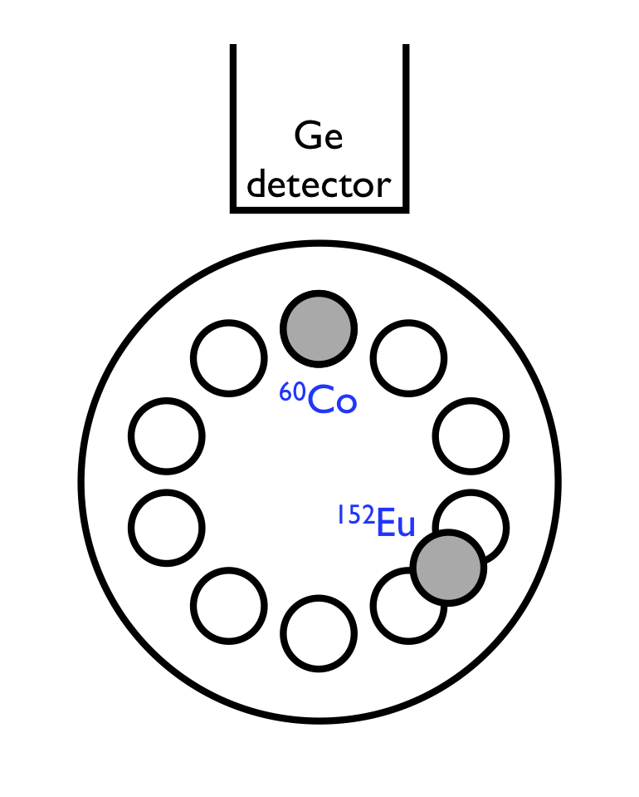
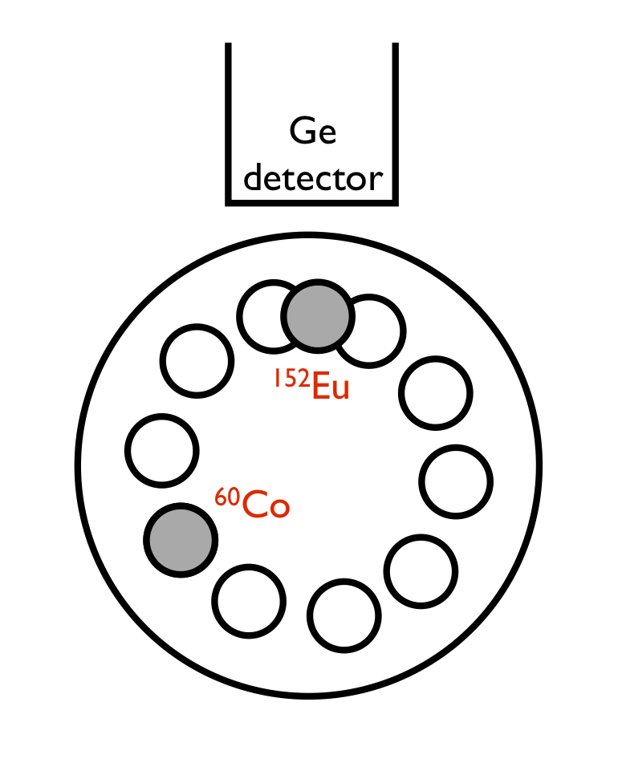
Attenuation measurements
The attenuation of the gamma rays by the steel windmill was measured:
  Blue spectrum shows ⁶⁰Co in front of Ge detector, ¹⁵²Eu at 120°
  Red spectrum shows ¹⁵²Eu in front of Ge detector, ⁶⁰Co at 120°

Slide 17
Attenuation measurements
Large attenuation of the gamma rays by the steel wheel

Slide 18
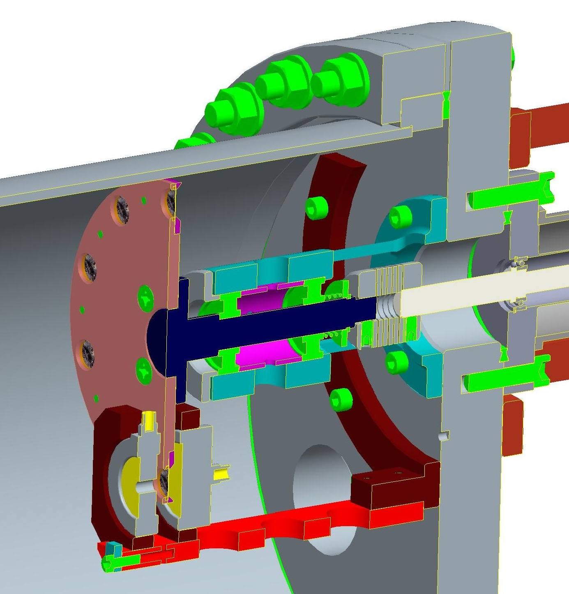
Attenuation measurements
The attenuation of the gamma rays by the wall of the steel chamber was measured with ²⁴¹Am and ¹⁵⁴Eu sources:
Steel chamber wall
Steel wheel
Carbon foil
Si detectors

Slide 19
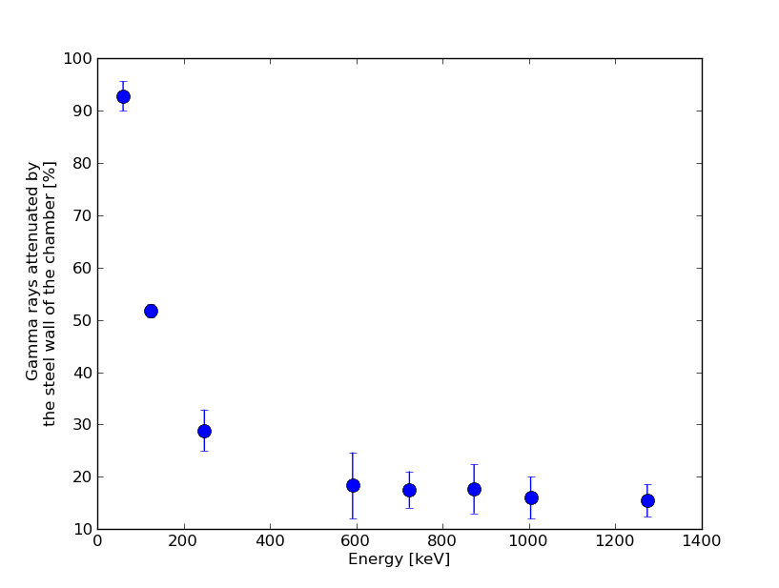
Attenuation measurements
The attenuation of the gamma rays by the wall of the steel chamber was measured with ²⁴¹Am and ¹⁵⁴Eu sources:
92% at 59 keV
52% at 123 keV
< 18% at 591 keV

Slide 20
Recent results from is471

Slide 21
Laser assisted decay spectroscopy of ²⁰⁷Fr
²⁰⁷Fr
6768 keV
²⁰³At
6087.4 keV
βetas

Slide 22
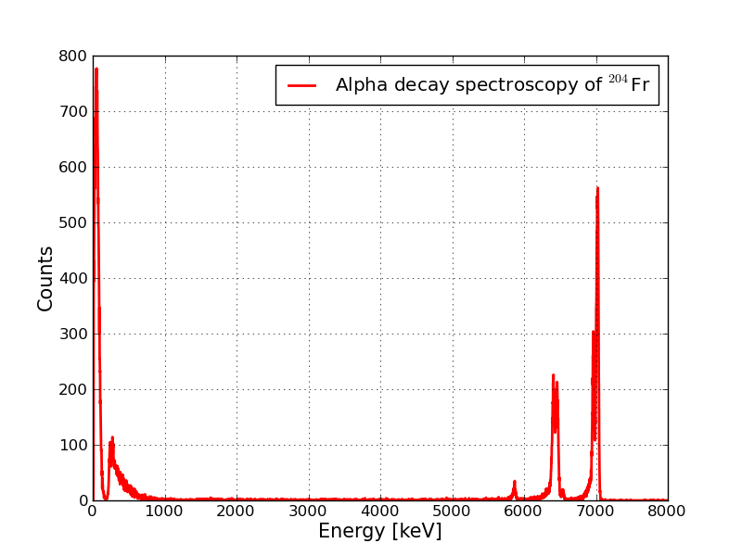
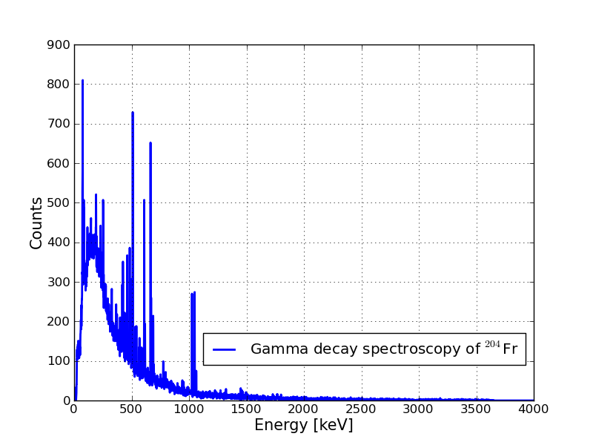
Decay spectroscopy of ²⁰⁴Fr
²⁰⁴Fr
²⁰⁰At
βetas
²⁰⁰Po

Slide 23
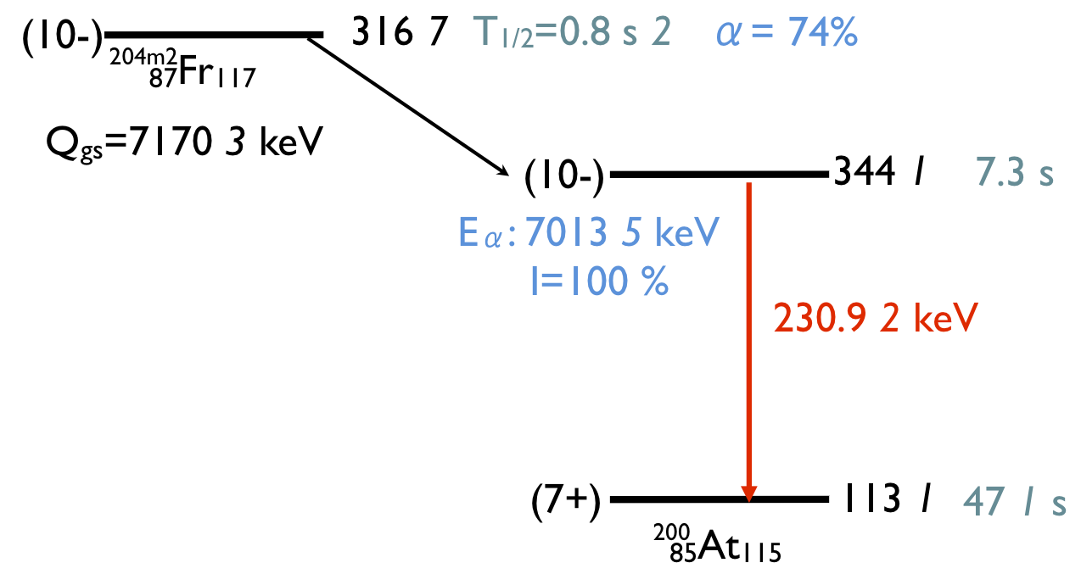
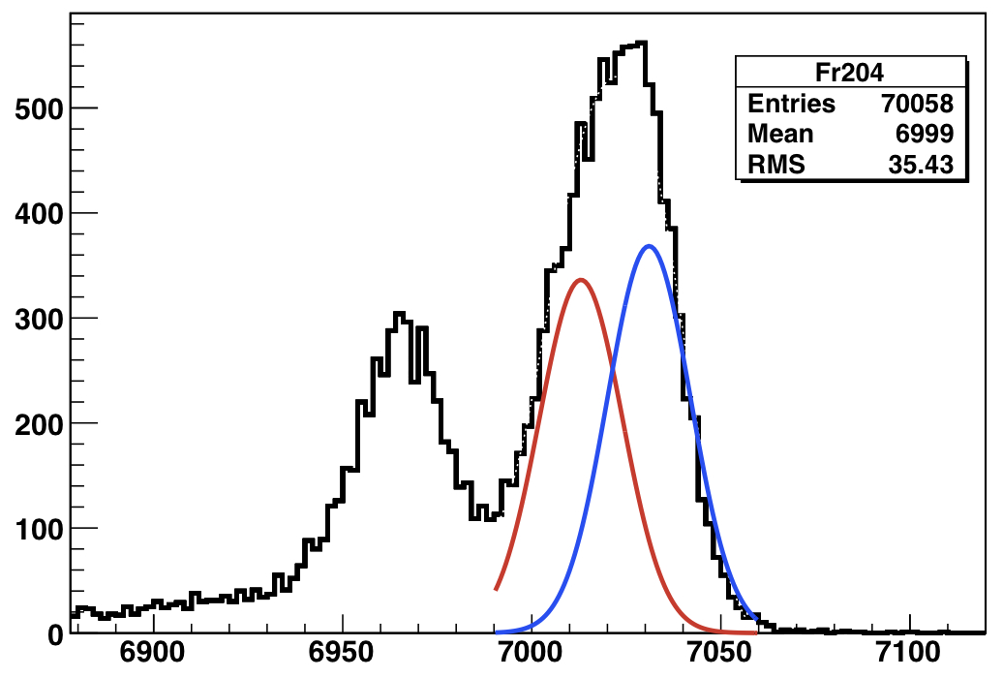
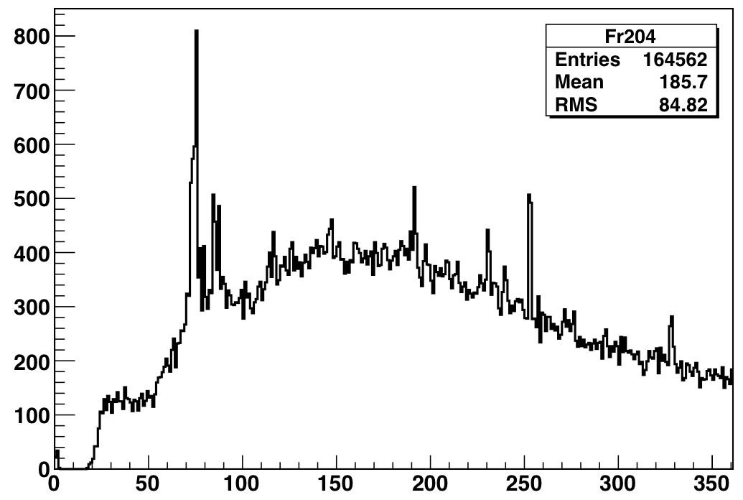
Decay spectroscopy of ²⁰⁴Fr
The alphas emitted from ²⁰⁴Fr
^{204m2}Fr
^{204g}Fr
^{204m1}Fr
The gammas detected
^{204m2}Fr
230.9 keV
Using the characteristic Hfs of each isotope, a pure Gs or isomeric beam can be studied
Tuning the lasers on resonance, the blue spectrum would be obtained for ^{204g}Fr and the red spectrum for ^{204m2}Fr

Slide 24
Outlook
Finalize the data analysis from on line run IS471 in November 2011
Preparation for laser assisted decay spectroscopy of:
  the remaining francium isotopes ^{201 – 206, 218, 219}Fr
    the detailed study of the two isomers of ²⁰²Fr for β-delayed fission
  neutron-rich copper isotopes ⁷⁶ ⁻ ⁷⁸Cu
    search for isomers
    and understanding their decay

Slide 25
Summary
Use the selectivity of collinear resonant ionization spectroscopy to perform decay spectroscopy on pure isomeric beams e.g. ²⁰⁴Fr
  Laser spectroscopy provides spin, moments and change in mean square charge radii
  Decay spectroscopy provides level scheme of the daughter nucleus
Laser assisted decay spectroscopy has been performed on ²⁰⁷Fr in November 2011
Future experimental campaigns involve the remaining francium isotopes and copper isotopes

Slide 26


The CRIS Collaboration
J. Billowes, B. Cheal, K.T. Flanagan, T.J. Procter, A. Smith.
M. Bissell, S. De Schepper, K. Dewolf, G. Neyens,
M.M. Rajabali, W. Vanderheijden, P. Vingerhoets
T.E. Cocolios,
K.M. Lynch, B. Marsh
R. Hayano, T. Kobayashi
G. Simpson
S. Rothe, K. Wendt
M. Hori,
H. Aghai Khozani
F. Le Blanc
H.H. Stroke

Slide 27
Thanks for your attention

Slide 28
Back up slides

Slide 29
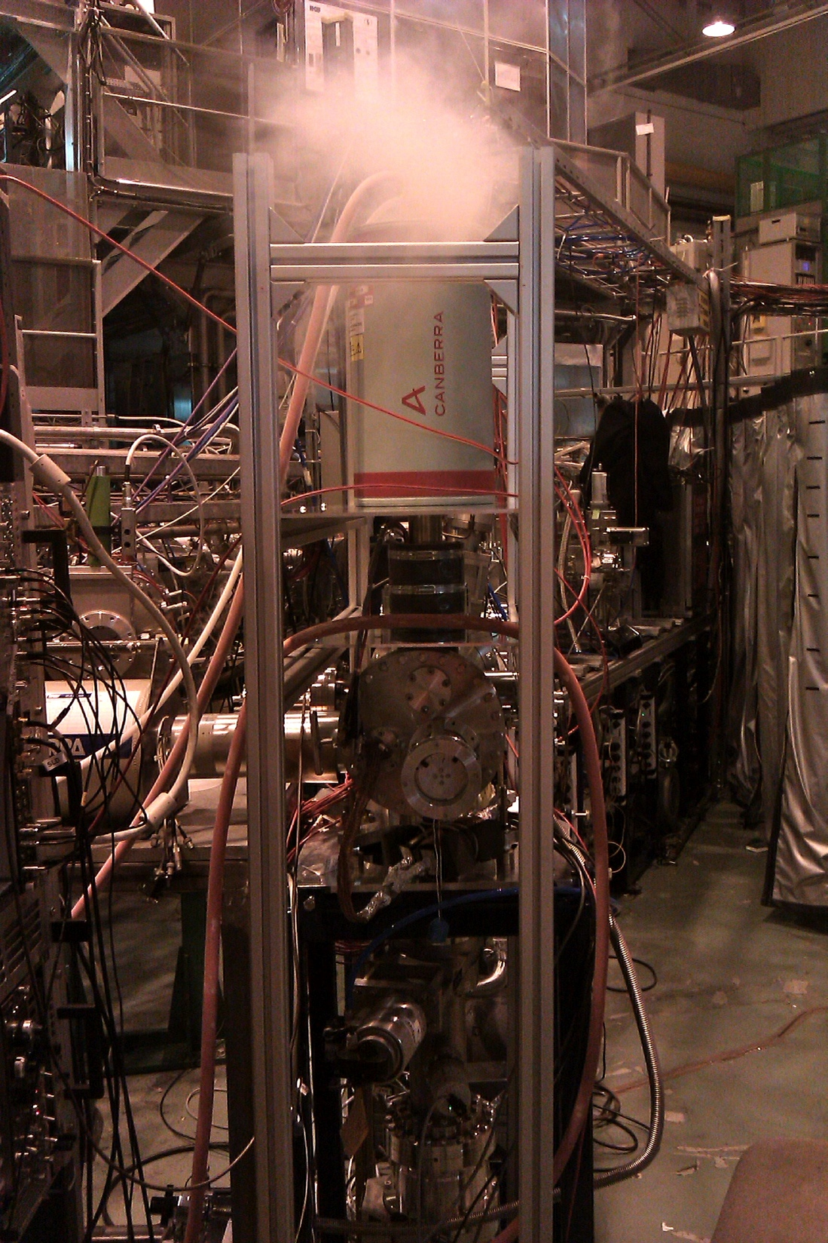
The decay spectroscopy station
X-ray detector
CRIS beam line
Ge detector
Decay spectroscopy
station

Slide 30
Ionization of francium
Beam collinearly overlapped with the two laser beams
  422nm
  1064nm
Atoms resonantly ionized when on resonance with the laser
Pulsed amplified TiSa laser used
Ionization scheme of francium

Slide 31
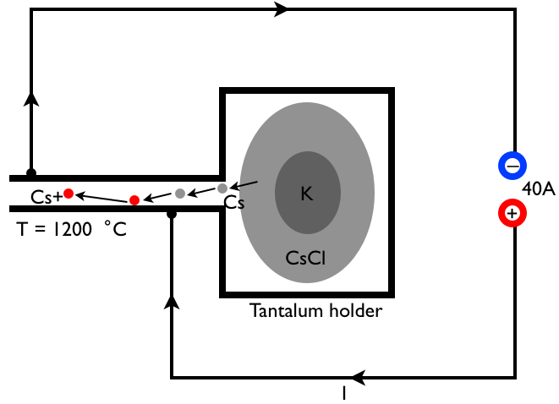
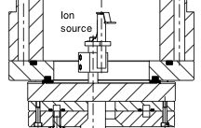
The CRIS ion source
Off line ion source produces Cs⁺ ions
Einzel lens focuses the ion beam
90° bend deflects the ion down the beam line
Notes:
K + CsCl -> KCl + Cs

Slide 32
Ion detection vs. fluorescence detection
Higher energy resolution with fluorescence detection
  high powered pulsed laser causes power broadening
Ion detection is a factor of 10³ more efficient than fluorescence detection
    sacrifice resolution for the ability to detect rare isotopes
Ion detection
Fitted spectrum
Fluorescence detection
200 ions per bunch
6 scans
1:30 efficiency

