Slide 1
Dispersion through TT20 and P42 continued
Fabian Metzger, Dipanwita Banerjee, Laurie Nevay, Florian Stummer
Matthew Fraser, Alex Gorn, Francesco Velotti
17.04.2025

Slide 2
Dispersion along TT20 and P42
Through the extraction, we ramp the fields in some of the magnets according to the sweep in momentum, while some stay fixed at the reference field for 400.3GeV/c
  This results in a centroid shift for off-momentum particles through non-swept magnets
  Macroscopically, we account this to dispersion as it appears as a blow-up of beam size after integrating over the full spill
  Normal dispersion is just the symmetric increase in beam size due to a finite, symmetric Δp
We can investigate the dispersion function in BDSIM by comparing to reference particles at different times meaning different momenta
  Particle 1 is at t=0 with 400.3GeV/c
  Particle 2 is at t=0.6s with 400.6GeV/c
We only focus on Post LS3 and Post LS4 with an adapted final focus for σ=16mm

Slide 3
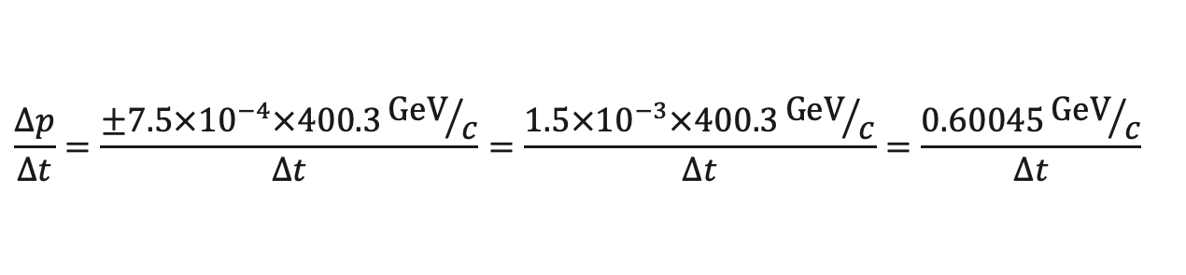
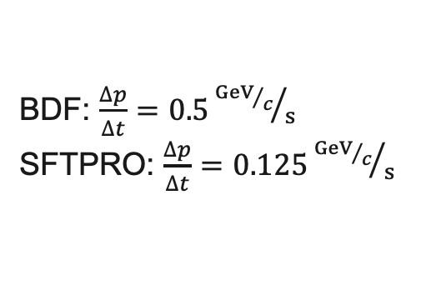
Momentum Sweep
$$\frac{∆p}{∆t}=\frac{±7.5×{10}^{−4}×400.3{GeV}/c}{Δt}=\frac{1.5×{10}^{−3}×400.3{GeV}/c}{Δt}=\frac{0.60045{GeV}/c}{Δt}$$
BDF: $\frac{∆p}{∆t}=0.5{{GeV}/c}/s$
SFTPRO: $\frac{∆p}{∆t}=0.125{{GeV}/c}/s$

Slide 4
Sweep Possibilities
Today
TT20
TT21
TT22
Splitter
TT24
P42/BA80
P42/BA81
✅
✅
✅
❌
❌
❌
❌
Post LS3
TT20
TT21
TT22
Splitter
TT24
P42/BA80
P42/BA81
✅
✅
✅
❌
❌/✅
✅
❌
Post LS4
TT20
TT21
TT22
Splitter
TT24
P42/BA80
P42/BA81
✅
✅
✅
❌
❌/✅
✅
✅

Slide 5
Final Focus
Final focus changed with last three quadrupoles to more realistic case for BDF
We used the following conditions:
  β_{x}=5385m, β_{y}=21585m
  ⍺_{x}=0, ⍺_{y}=0
  5σ stay within quadrupole aprtures

Slide 6
Momentum Sweep Post LS3
The splitter introduces a dispersive orbit shift
  Focus on MBBs flips dispersion that leads to inverted dispersion in P42
  Results in higher shift with ramping of TT24

Slide 7
Momentum Sweep Post LS4
Also, when ramping the whole of P42 it is worse when ramping TT24 with the same argument
Effect is noticabely smaller as bend7 is ramped now

