Slide 1
Beam Instrumentation in TCC8 before BDF
Failure scenarios on the Target
Mike Parkin
27/3/25

Slide 2
Scenarios required to provide inputs for the target and beam instrumentation requirements
Effects the beam interlock and beam instrumentation, & to check consequence on target
Beam parameters:
Intensity 4e13ppp
Energy 400GeV
Dilution pattern 4 turns per pulse
pulse time 1s
cycle time 7.2s
0.16s
0.50s
No dilution – beam at centre
Full spill @4e13 ppp (8mm vs 16mm σ)
Full spill @5e13 ppp (16 mm σ)
Full spill @4e13 ppp (16 mm σ) from cold
Dilution failure
1, 2 and 3 turns + dilution stop @4e13 (16mm σ)
0.40s
Model uses: (except when from cold)
Steady state + 1s beam pulse
with 6.2s cooldown
+ beam pulse stationary in centre
0.65s
Block 16 will be optimized somewhat,
With this in mind, a reaction on the order of 0.1s allows all blocks to remain within stress & temperature limits (which themselves have margins)
0.15s from beam freeze
(+0.75s beam already swept for)
0.26s
(+0.25s)
0.21s
(+0.5s)

Slide 3
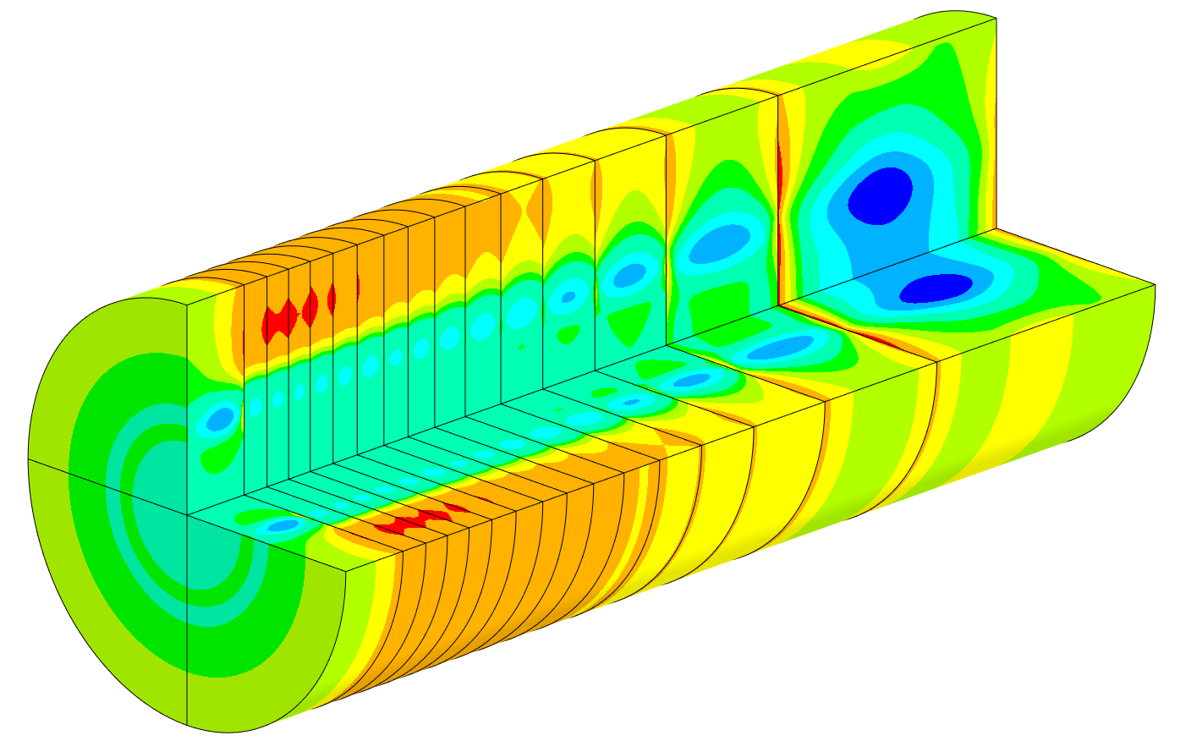
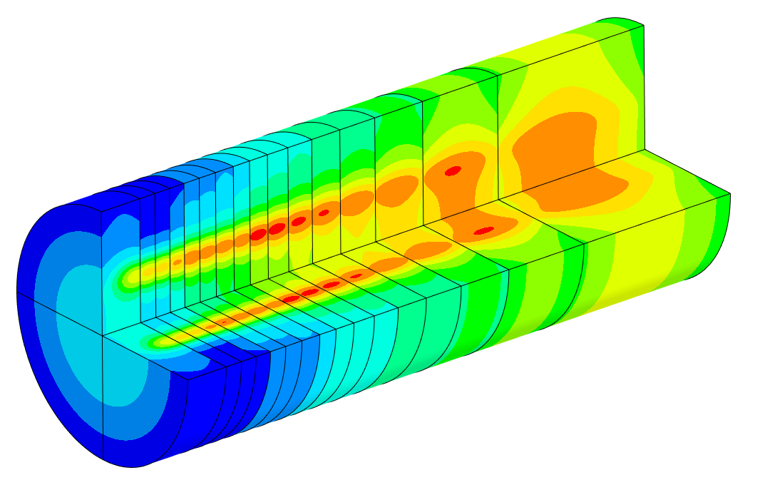
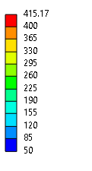
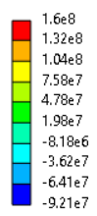
Slide from TSAC #1
Generic heat load after full pulse 8mmσ
block 15
block 16 will be optimised
blocks 1-14
blocks 1-14
Max temperature
Max principal stress
415°C-
160MPa-
0MPa
52°C-
-97MPa-
Beam
The US 600mm of target
Beam
Block 16 will be optimized

Slide 4
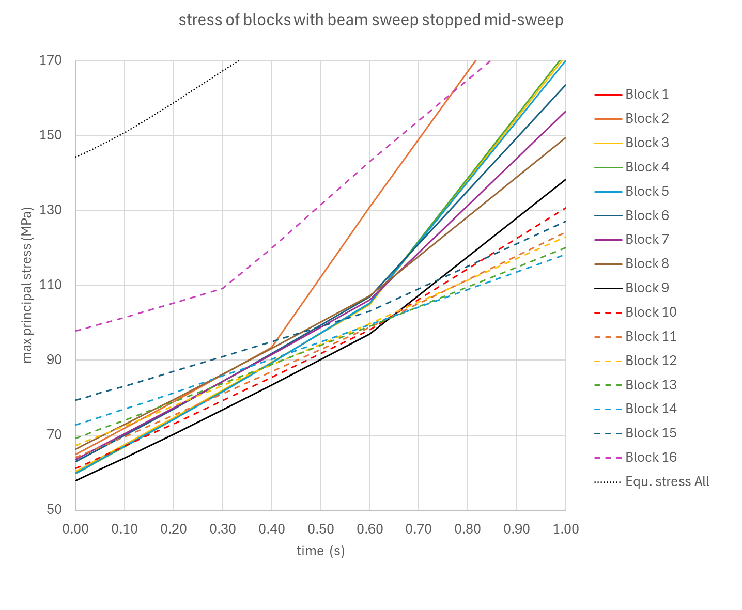
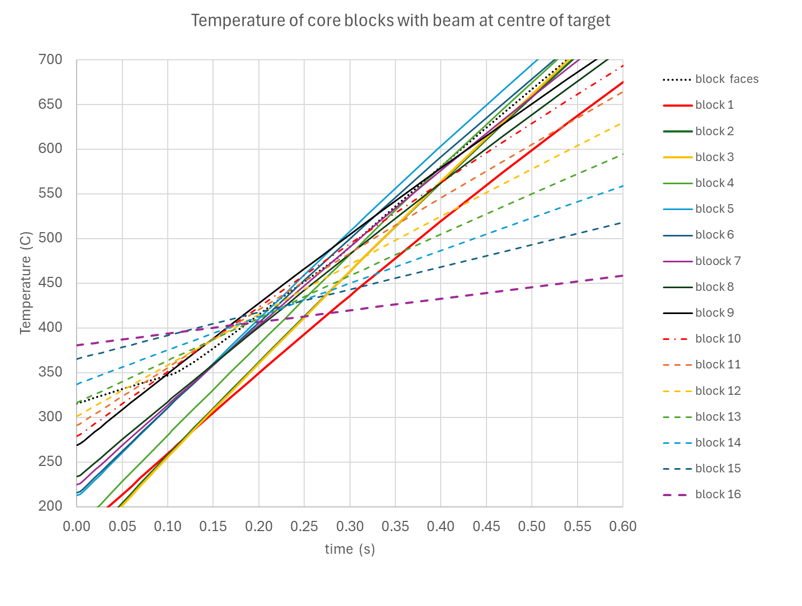
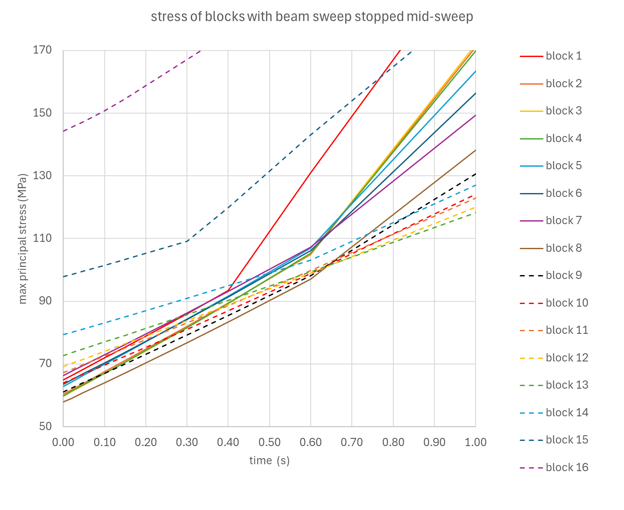

Beam at centre 16mm σ at start of pulse 4e13ppp
Model uses:
Steady state + 1s beam pulses with 6.2s cooldown
+ beam pulse stationary in centre
16mm beam
Ø250mm core
4e13ppp
50mm sweep radius
Temperature limit references:
EDMS 2648378
Kubaschewski & Hopkins, 1960
Gulbransen, Andrew & BVassart 1963
Formation of WO₃
700°C
TIME BASED LIMIT
Stress limit
150MPa
HAS MARGIN OF ×2!
Temperature limit for time based formation of WO₂
400°C
Normal running limit
Surface temperature soft limit 400°C reached at 0.18s (block 15)
Temperature limit 700°C reached at 0.50s (block 5)
Stress limit reached at 0.66s (block 15)
Stress limit reached at 0.705s (block 2)
Conclusion: Beam should be prevented from reaching target after 0.5s at centre (temperature)

Slide 5
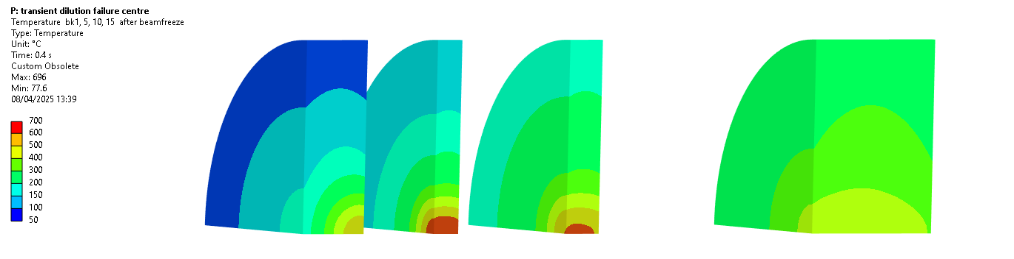
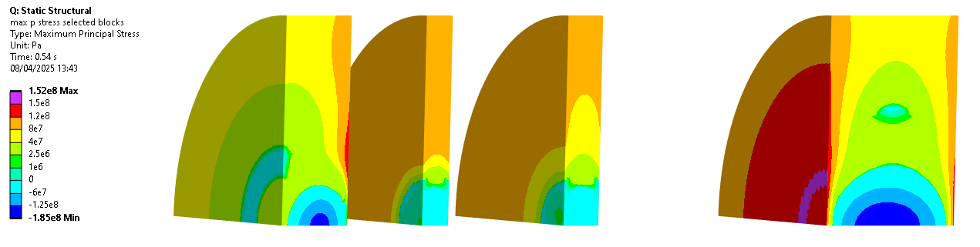
Beam at centre at start of pulse
Selected blocks (1/4 model)
16mm σ, 5e13ppp
0. 4s after beam begins at centre
Beam
0. 54s after beam begins at centre
Beam
Conclusion: Beam should be prevented from reaching target after time at centre
0.1s to allow all blocks to remain within stress & temperature limits (which themselves have margins)

Slide 6

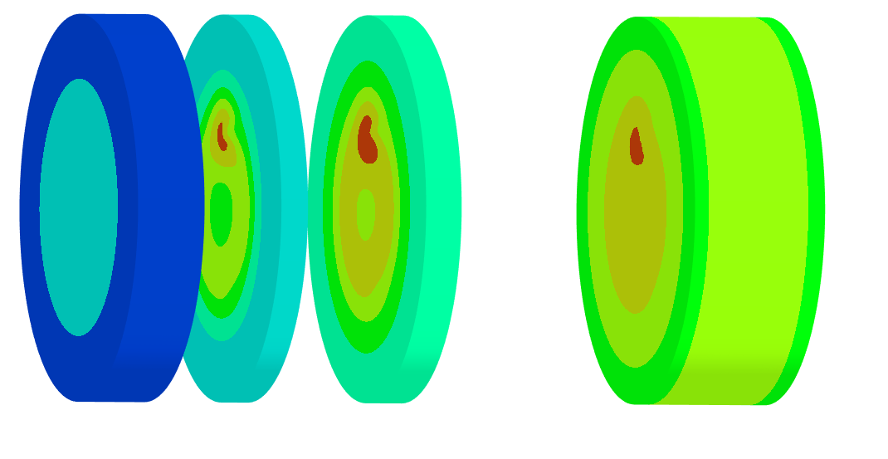
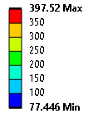

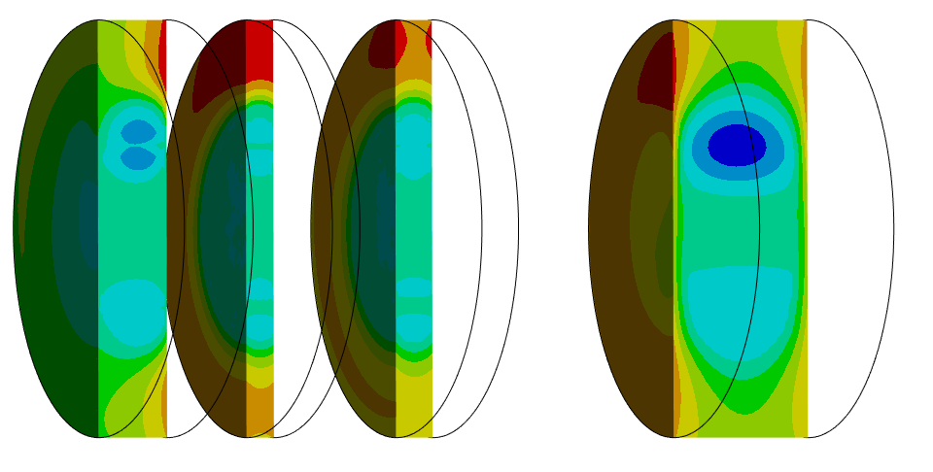
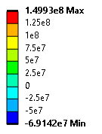
Beam freezing during sweep σ = 16mm, 4e13ppp.
Selected blocks 16mm σ, 4e13ppp
A normal pulse is 4×sweeps, total time 1s.
0. 1s after beam begins at centre
Beam
0. 15s after beam begins at centre
Unit: Pa
Beam
*
*
* Temperature limit not reached by end of pulse.

