Slide 1

Sparks! 2025 overview
24 April 2025

Slide 2
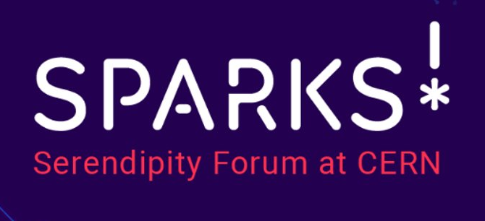
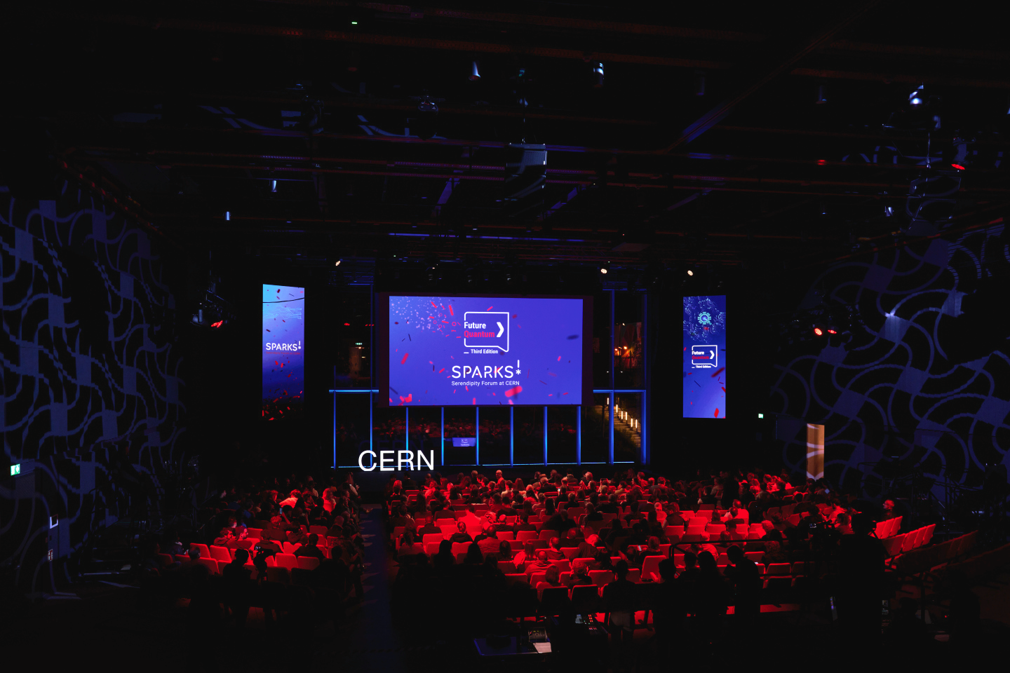
History of Sparks!
Conceived as a science & innovation forum and public event, bringing together renowned scientists, decision-makers, industry representatives, ethicists and the general public around topics of interest to CERN and its engagement with societal challenges.
Started in 2020, Sparks! engages both experts attending the event and the general public, fostering a spirit of serendipity and collaboration between different fields, geared towards tackling societal issues, thereby also highlighting the importance of CERN’s science and technology development for society at large.
The last edition of Sparks! was in November 2023, focused on discussions in the quantum field. It was set as a prelude to a bigger conference, which will be Sparks! 2025 on 19 June.
Sparks! Past editions
2020 & 2021*: Future Intelligence
2022: Future Technology for Health
2023**: Future Quantum
2025: Imagining Quantum City
*Due to the COVID-19 Pandemic, the first edition of Sparks! was spread between two years
**smaller conference, serving as a prelude to the 2025 edition

Slide 3
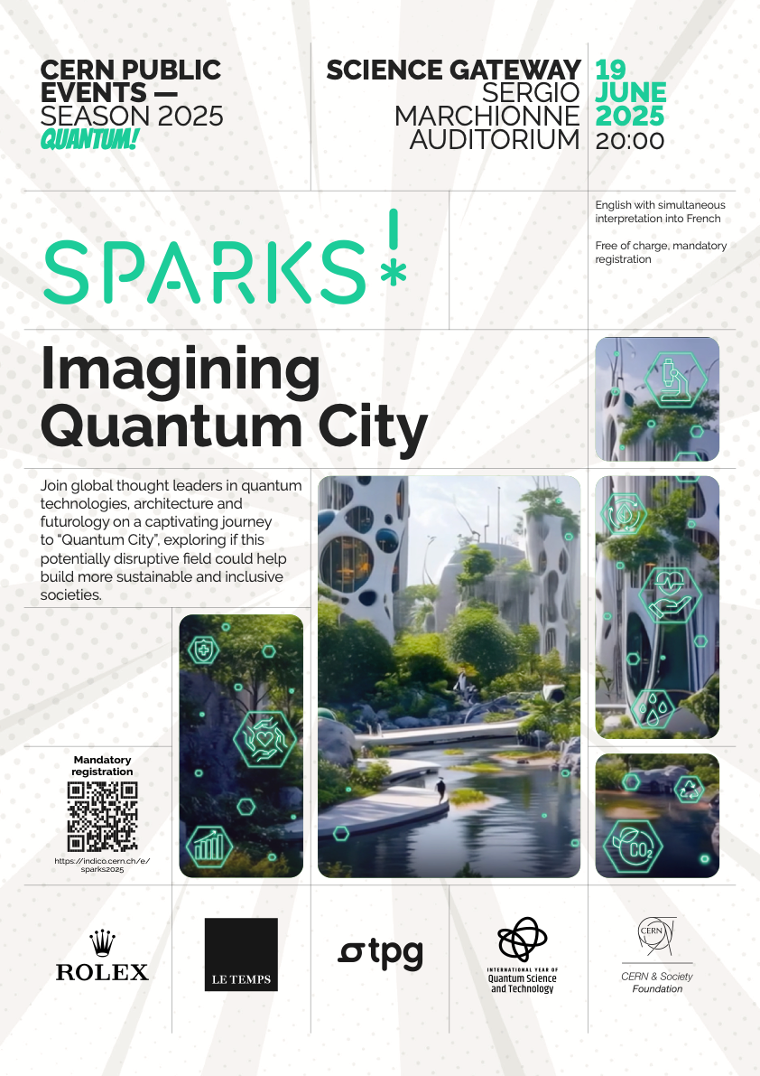
Imagining Quantum City Draft Poster and branding

Slide 4
Sparks! 2025 19 June – day overview
Sparks! Internal Forum
13:00 – 15:30
Globe of Science and Innovation
Quantum Technology Initiative Forum
The aim of this event is to create awareness at CERN about the QTI and explore new areas where colleagues across the organization could engage with the initiative
Lead: QTI
Sparks! connect
16:00 – 18:30
IdeaSquare
CERN Innovation for Urban Futures
The Sparks! connect workshop & networking session will host an external specialised audience in the field of urban technologies and planning, allowing them to meet CERN staff, exploring opportunities for the transfer of CERN’s technology and know-how in their fields.
Lead: KT/ECO
Networking reception
18:30 – 19:30
TBD
Networking reception for the attendees of the Internal Forum, Sparks! connect and the public event speakers (50-70 people)
Lead: ECO/SG
Sparks! Public Event
20:00 – 22:00
Sergio Marchionne Auditorium
Imagining Quantum City
The public event will take the audience through a futuristic journey to a hypothetical “Quantum City”, exploring how quantum mechanics could one day help build more sustainable and inclusive societies.
Lead: ECO/SG

Slide 5
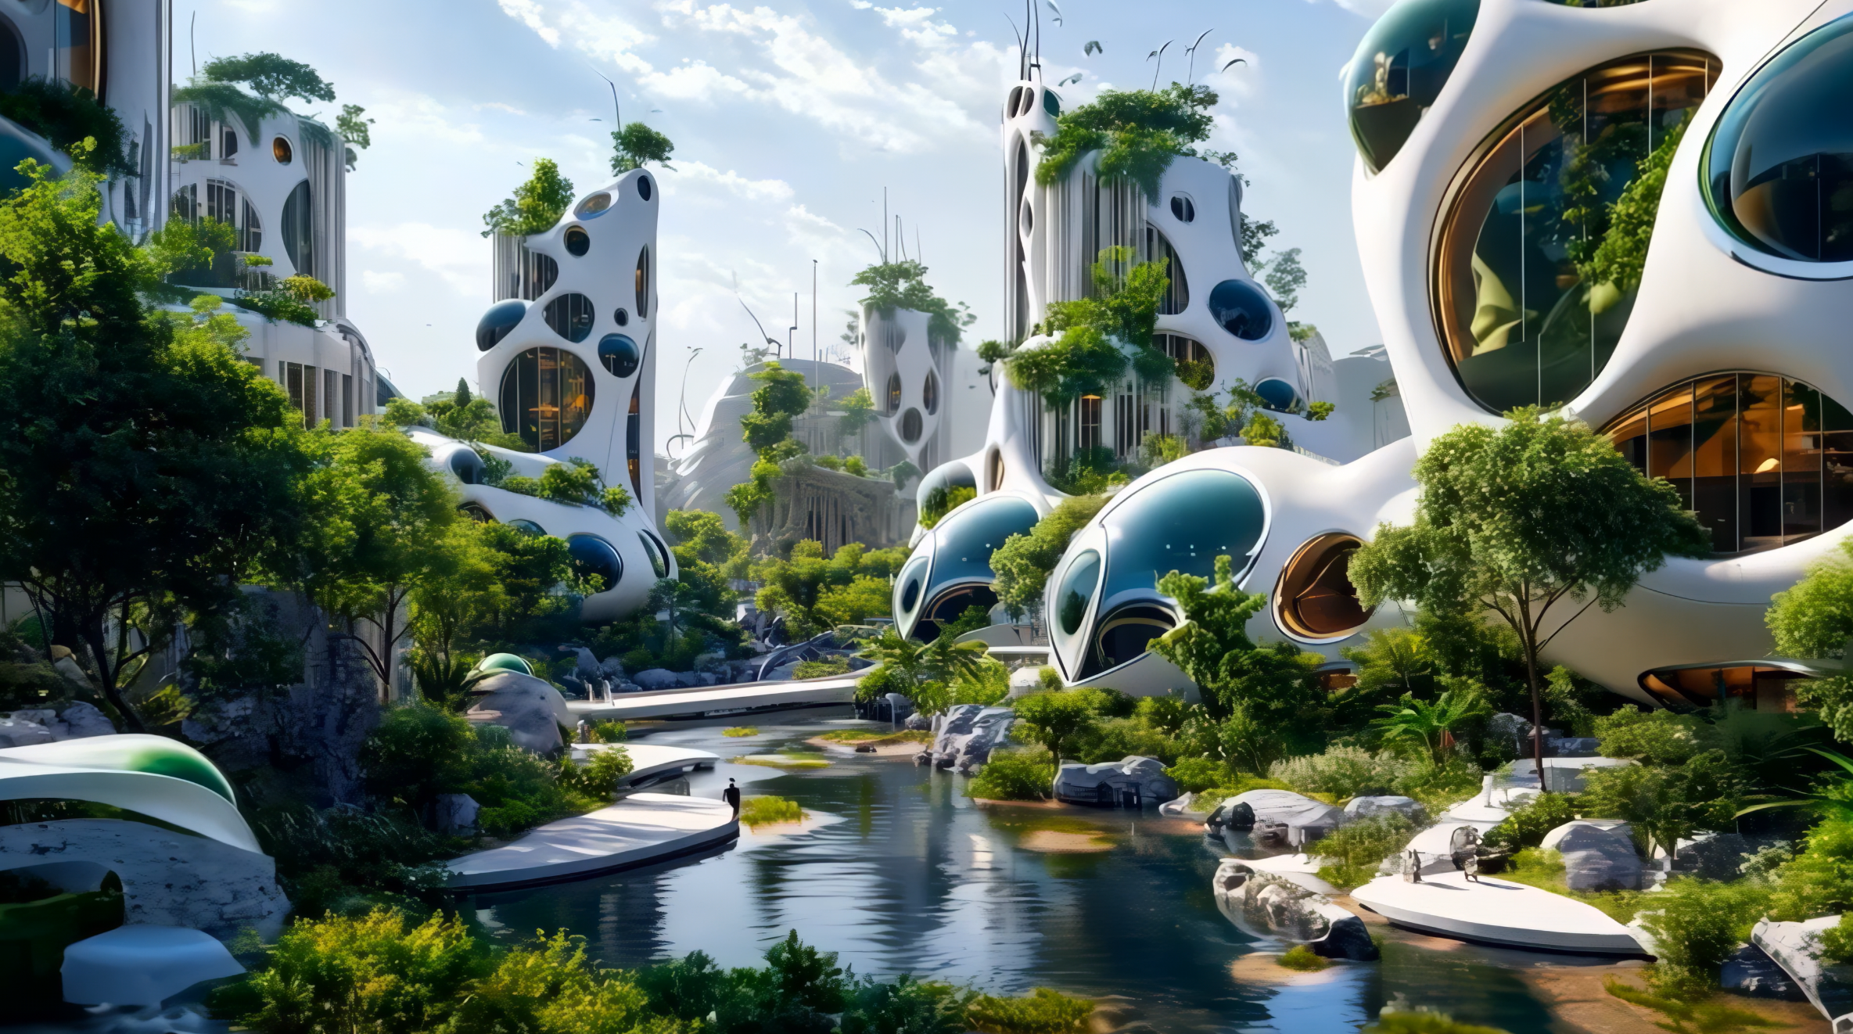
Imagining Quantum City Sparks! Public Event
Throughout history, cities have always served as clusters of innovation. In this spirit, this event will take you through a futuristic journey to a hypothetical “Quantum City”, exploring how quantum mechanics could one day help build more sustainable and inclusive societies.
Chris Luebkeman (moderator) | Futurologist, head of Strategic Foresight Hub of ETH Zürich
Carlo Ratti | Architect, professor at MIT (Senseable City Lab), Curator of the 19th Venice Biennale of Architecture
Nicolas Gisin | Physicist and professor at the University of Geneva, founder of ID Quantique
Johanna Sepúlveda | Vice-chair, EU Quantum Flagship Strategic Board, Senior Expert on Quantum Secured Communications at Airbus
Sabrina Maniscalco | Professor of Quantum Information, Computing and Logic at the University of Helsinki, CEO and co-founder of Algorithmiq
CERN | Presenting the CERN perspective in three to four 3 min capsules throughout the event

Slide 6
Imagining Quantum City CERN messages “capsules” ideas
20:00
Start: Welcome
remarks
Charlotte Warakaulle
20:05
Introduction to
the event
Chris Luebkeman
20:10
Technology in the City of tomorrow
Carlo Ratti
20:30
Introduction to quantum
Nicolas Gisin
20:45
Quantum communication
Johanna Sepúlveda
21:00
Quantum
computing
Sabrina Maniscalco
21:15
Panel
discussion
All Speakers
21:45
Q&A
22:00
End
1 The study of quantum mechanics at CERN: Past and Present
What Showcasing CERN’s heritage (Ex: John Bell) and current scientific achievements in the field (ex: 2024 measurement of entanglement thanks to LHC)
Who Theory or Experimental DPT
How Video or pitch (3 min)
2 CERN IT: advancing
quantum technologies
What sharing how CERN IT infrastructure and data management are contributing to the implementation of quantum tech
Who IT DPT
How Video or pitch (3 min)
3 QTI: Quantum for Particle Physics
What Quantum technologies being implemented at CERN (IT, accelerators, detectors)
Who QTI
How Video or pitch (3 min)
4 KTI: CERN quantum tech for society
What Quantum technologies created at CERN (ex: White Rabbit) and how they can benefit wider society
Who KTI
How Video or pitch (3 min)
5 The CERN model: blueprint for a quantum future
What sharing how the CERN model of open science and international dialogue and peace through research can help quantum technologies to become inclusive and beneficial for society at large
Who OQI ?
How Video or pitch (3 min)

