Slide 2
Forced Convection Flow Modelling
B. Naydenov

Slide 3
Content
Convection
Numerical Model
Single-phase flow
Supercritical flow
Two-phase flow
Results

Slide 4
Convection

Slide 5

Convection - Heat transfer
Heat transfer by mass motion of a fluid$.$
Common in cryogenics:
  Liquid baths
  Transfer lines
  Heat exchangers
  Capillaries
Enable remote cooling systems
Heat transfer rate (and pressure drop) depend on:
  Fluid properties
  Convection type
  Flow regime
  Flow state
Notes:
Remote cooling systems could also be achieved just by means of conduction or radiation, but that would limit them in different aspects, either the mechanical decoupling would fail, or the transported cooling power would be too small (big losses).

Slide 6
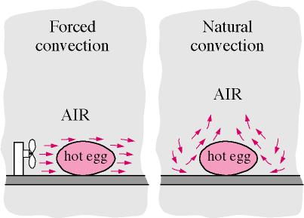

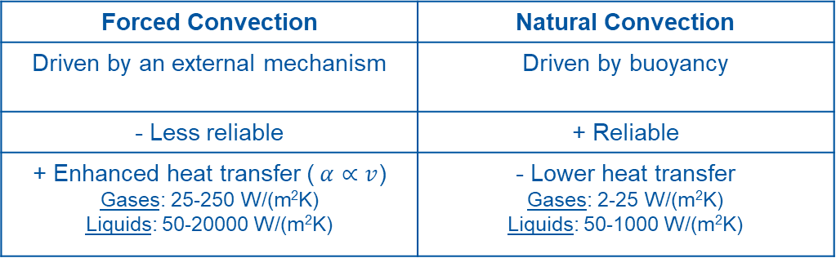
Convection - Types
http://www.mhhe.com/engcs/mech/cengel/notes/ConvectionHeatTransfer.html
Forced Convection | Natural Convection
Driven by an external mechanism | Driven by buoyancy
- Less reliable | + Reliable
+ Enhanced heat transfer ($α∝v$) Gases: 25-250 W/(m²K) Liquids: 50-20000 W/(m²K) | - Lower heat transfer Gases: 2-25 W/(m²K) Liquids: 50-1000 W/(m²K)
$$\dot{Q}=αA(T_{s}−T_{∞})$$
Notes:
External pump causes a pressure difference.

Slide 7
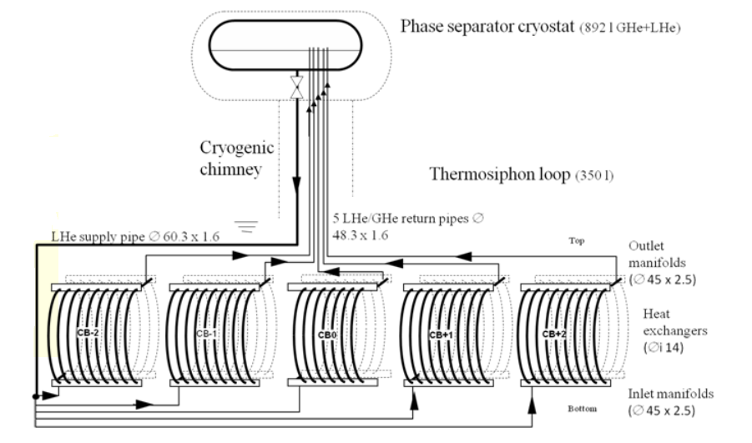
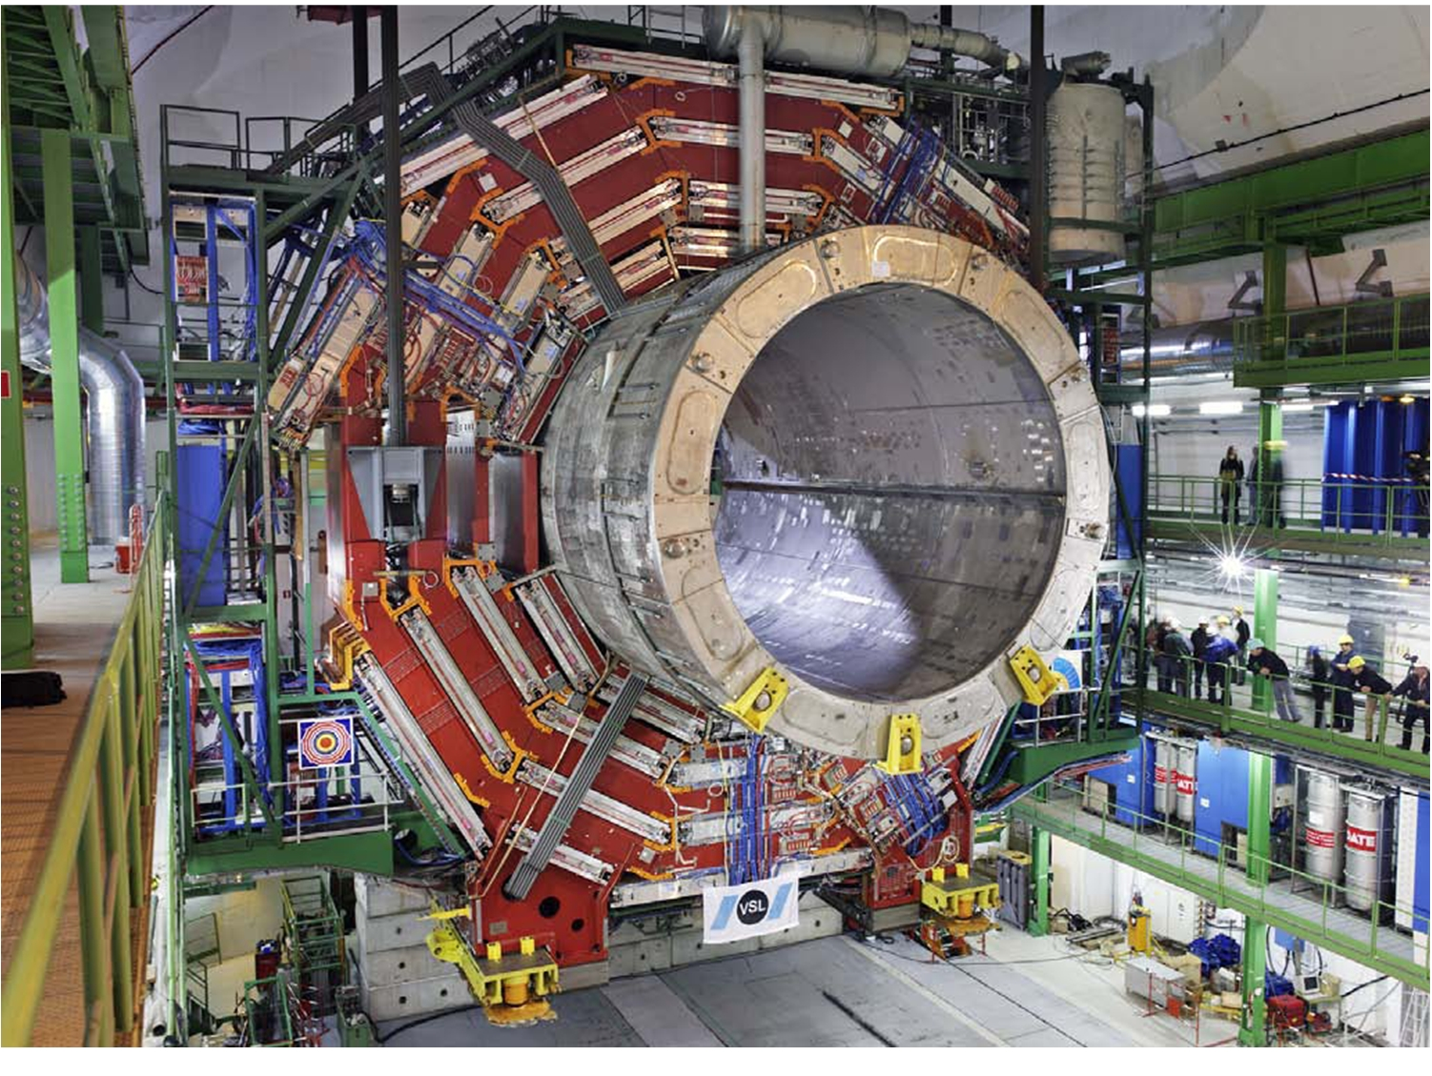
Convection – Types – Natural Convection
Example 1: CMS solenoid cooling
European Graduate Course in Cryogenics 2010
He thermosyphon loop
1.5 kW @ 4.5 K cryoplant
https://cms.cern/detector
Notes:
100 m depth

Slide 8
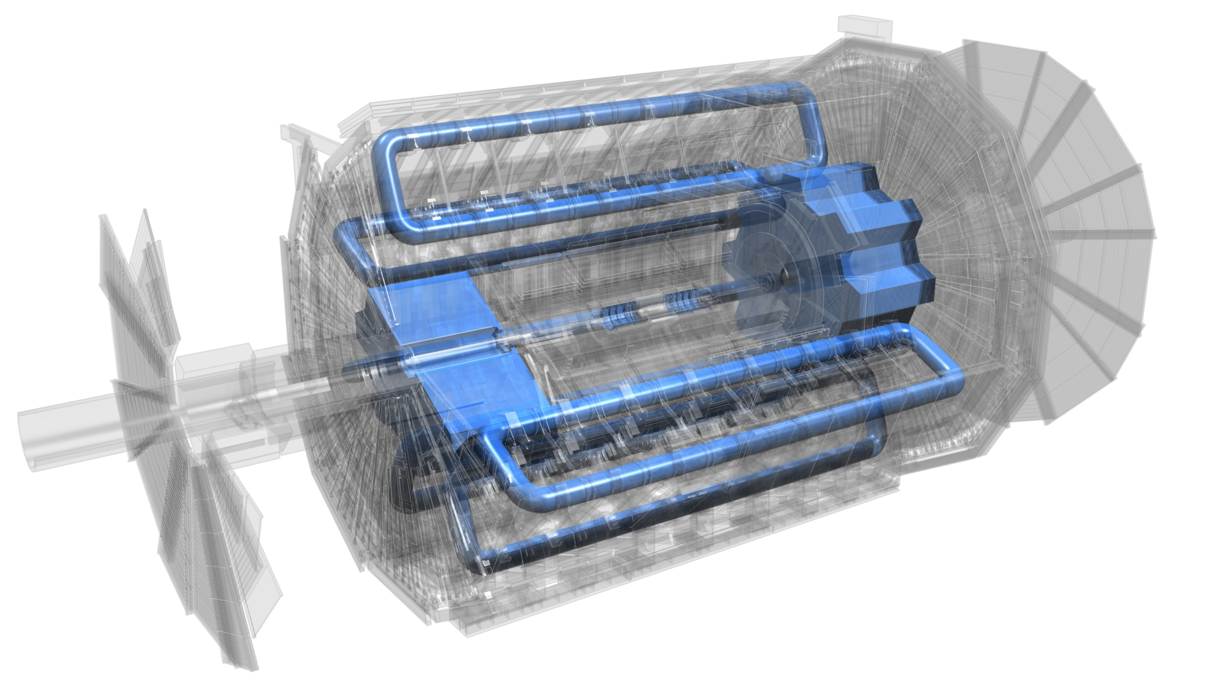

Convection – Types – Forced Convection
Example 2: ATLAS toroid cooling
End-cap toroid
Solenoid
https://atlas.cern/Resources/Schematics
Les JournéesThématiques AFF-CCS – G. Passardi
Barrel toroid
Notes:
Centrifugal pumps forcing the circulation of 1200 g/s saturated He flow.

Slide 9
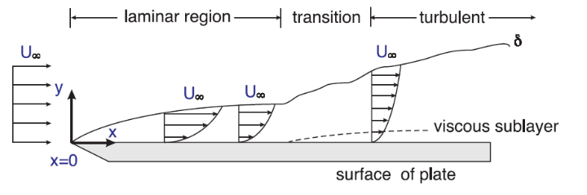
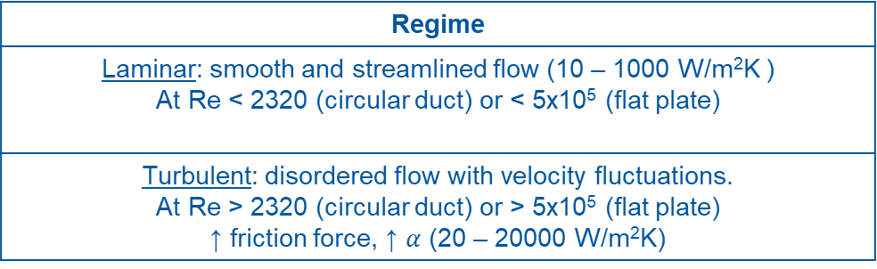

Convection - Regimes
https://www.sfu.ca/~mbahrami/ENSC%20388/Notes/Forced%20Convection.pdf
Regime
Laminar: smooth and streamlined flow (10 – 1000 W/m²K ) At Re < 2320 (circular duct) or < 5x10⁵ (flat plate)
Turbulent: disordered flow with velocity fluctuations. At Re > 2320 (circular duct) or > 5x10⁵ (flat plate) ↑ friction force, ↑ $α$ (20 – 20000 W/m²K)
$$Re= \frac{ρυD}{μ}$$
Notes:
The intense mixing of the fluid in turbulent flow enhances heat and momentum transfer between fluid particles.
Critical Reynolds number

Slide 10
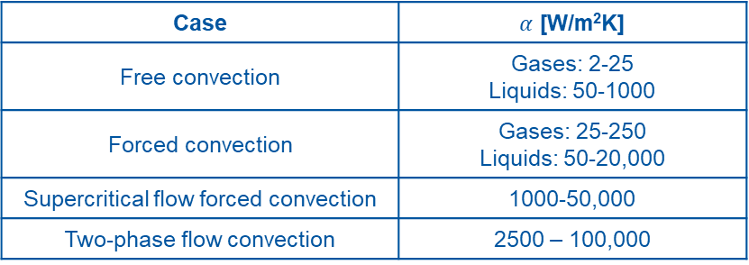
Convection - States
REFPROP
He critical point
(5.2 K – 2.23 bar)
Supercritical flow
Liquid
Two-phase flow
Gas
The friction factor varies as well
Saturation line
Case | $α$ [W/m²K]
Free convection | Gases: 2-25 Liquids: 50-1000
Forced convection | Gases: 25-250 Liquids: 50-20,000
Supercritical flow forced convection | 1000-50,000
Two-phase flow convection | 2500 – 100,000
Notes:
External pump causes a pressure difference.

Slide 11
Numerical Model
Cooling Interface

Slide 12

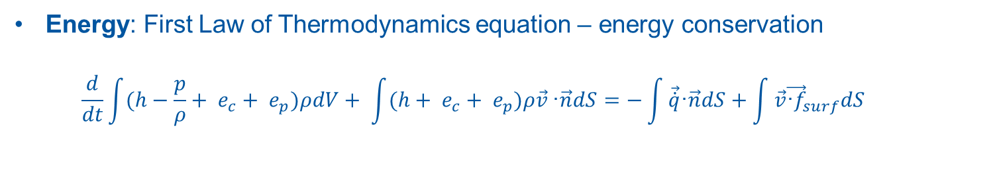
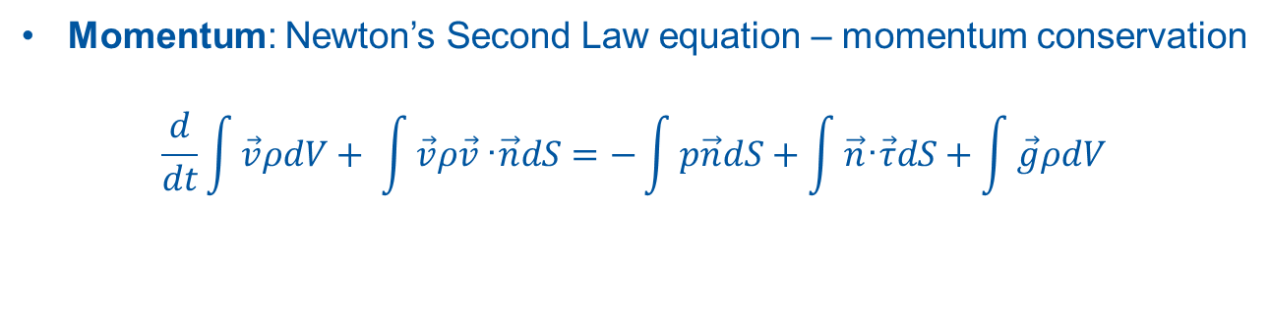
Forced Convection - Modelling
Convection: heat transfer by mass motion of a fluid.
Fluid dynamics involved → Navier-Stokes equations need to be solved.
Mass: Continuity equation – mass conservation
      $$\frac{d}{dt}\int{ρdV+ \int{ρ\vec{v}}}\text{·}\vec{n}dS=0$$
Momentum: Newton’s Second Law equation – momentum conservation
      $$\frac{d}{dt}\int{\vec{v}ρdV+ \int{\vec{v}ρ\vec{v}}}\text{·}\vec{n}dS=−\int{p\vec{n}dS}+\int{\vec{n}\text{·}\vec{τ}dS}+\int{\vec{g}ρdV}$$
Energy: First Law of Thermodynamics equation – energy conservation
  $$\frac{d}{dt}\int{(h−\frac{p}{ρ}+ e_{c}+ e_{p})ρdV+ \int{(h+ e_{c}+ e_{p})ρ\vec{v}}}\text{·}\vec{n}dS=−\int{\vec{\dot{q}}\text{·}\vec{n}dS}+\int{\vec{v}{\vec{\text{·}f}}_{surf}dS}$$
Notes:
Momentum equation has
surface forces (pressure force and viscous force) and
body forces (massic force and electromagnetic force).
Energy equation is basically U = Q (heat flux) – W (work of viscous forces). Work of mass forces has been also neglected here.
Electromagnetic energy and forces have been neglected here.

Slide 13
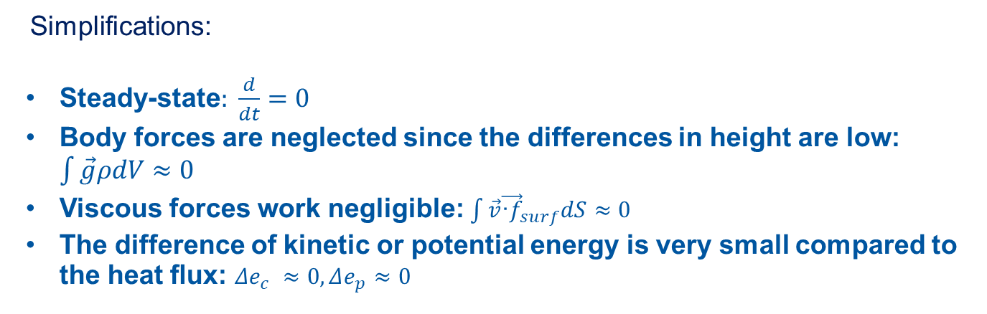
Forced Convection - Modelling
Simplifications:
Steady-state$: \frac{d}{dt}=0$
Body forces are neglected since the differences in height are low: $\int{\vec{g}ρdV≈0}$
Viscous forces work negligible: $\int{\vec{v}{\vec{\text{·}f}}_{surf}dS}≈0$
The difference of kinetic or potential energy is very small compared to the heat ﬂux: $Δe_{c} ≈0, Δe_{p}≈0$

Slide 14
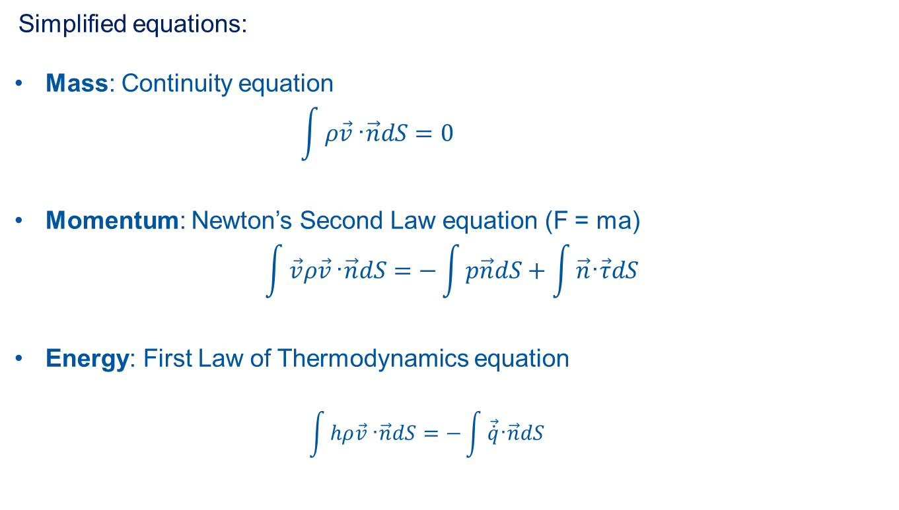
Forced Convection - Modelling
Simplified equations:
Mass: Continuity equation
      $$\int{ρ\vec{v}}\text{·}\vec{n}dS=0$$
Momentum: Newton’s Second Law equation (F = ma)
      $$\int{\vec{v}ρ\vec{v}}\text{·}\vec{n}dS=−\int{p\vec{n}dS}+\int{\vec{n}\text{·}\vec{τ}dS}$$
Energy: First Law of Thermodynamics equation
  $$\int{hρ\vec{v}}\text{·}\vec{n}dS=−\int{\vec{\dot{q}}\text{·}\vec{n}dS}$$
Notes:
External pump causes a pressure difference.

Slide 15





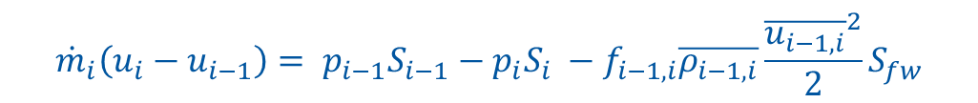





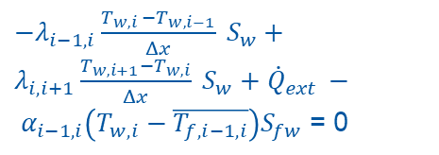













Forced Convection – Capillary modelling
Finite Volume Method (FVM) discretisation approach:
${\dot{q}}_{ext}$ [W/m²]
wall
t
$$T_{w,0}$$
$$T_{w,1}$$
$$T_{w,i−1}$$
$$T_{w,i}$$
$$T_{w,i+1}$$
$$T_{w,N−1}$$
$$T_{w,N}$$
Flow
inlet
$$T_{f,o}$$
$$T_{f,1}$$
$$T_{f,2}$$
$$T_{f,i−2}$$
$$T_{f,i−1}$$
$$T_{f,i}$$
$$T_{f,i+1}$$
$$T_{f,N−1}$$
$$T_{f,N}$$
$$T_{f,N+1}$$
∆x = L/N
$${\dot{Q}}_{ext}$$
Symmetry Axis
Convection: face-centred control volume
Conduction: cell-centred control volume
$$T_{w,i}$$
$$T_{f,i−1}$$
$$T_{f,i}$$
$${\dot{Q}}_{cond_{i−1,i}}−{\dot{Q}}_{cond_{i,i+1}}+{\dot{Q}}_{ext }−{\dot{Q}}_{conv_{wf}}=0$$
$${{\dot{m}}_{i}={ρ_{i−1}u}_{i−1}S_{i−1}=ρ}_{i}u_{i}S_{i}$$
$${\dot{m}}_{i}\left(u_{i}−u_{i−1}\right)= p_{i−1}S_{i−1}−p_{i}S_{i} −f_{i−1,i}\overline{ρ_{i−1,i}}\frac{{\overline{u_{i−1,i}}}^{2}}{2}S_{fw}$$
$−λ_{i−1,i}\frac{T_{w,i }−T_{w,i−1}}{Δx} S_{w}+λ_{i,i+1}\frac{T_{w,i+1}−T_{w,i}}{Δx} S_{w}+$ ${\dot{Q}}_{ext }− α_{i−1,i}\left(T_{w,i}−\overline{T_{f,i−1,i}}\right)S_{fw}$ = 0
$${\dot{m}}_{i}C_{p_{i−1,i}}\left(T_{f,i}−T_{f,i−1}\right)=α_{i−1,i}\left(T_{w,i}−\overline{T_{f,i−1,i}}\right)S_{fw}$$
Notes:
FVM, FDM and FVM: https://knowledge.autodesk.com/support/cfd/learn-explore/caas/CloudHelp/cloudhelp/2014/ENU/SimCFD/files/GUID-12A9AED8-2047-4D3A-BC80-82BE9CF47517-htm.html
FVM is very suitable for the conservation laws.
On a first iteration, heat flux is constant along the capillary. Could be refined later.

Slide 16
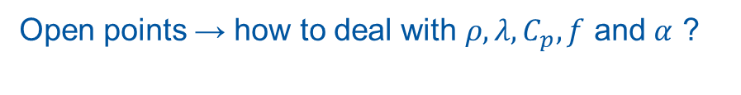

Forced Convection – Capillary modelling
Iterative solver procedure:
Solve fluid
  Initial properties distribution assumed.
  Solving cell by cell, until all the capillary is calculated.
Solve solid with the updated fluid properties.
Check convergence criteria for both fluid and solid.
  If not passed, go back to 1.
  If passed, save values and finish.
Open points → how to deal with $ρ, λ, C_{p}, f$ and $α$ ?
Depends on the flow regime and the flow state.
Notes:
FVM, FDM and FVM: https://knowledge.autodesk.com/support/cfd/learn-explore/caas/CloudHelp/cloudhelp/2014/ENU/SimCFD/files/GUID-12A9AED8-2047-4D3A-BC80-82BE9CF47517-htm.html
FVM is very suitable for the conservation laws.

Slide 17
Single-phase flow

Slide 18
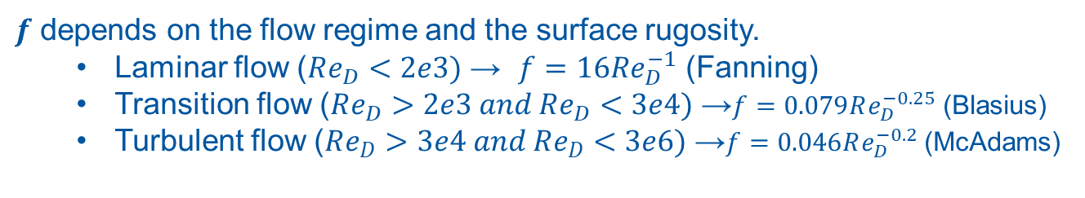



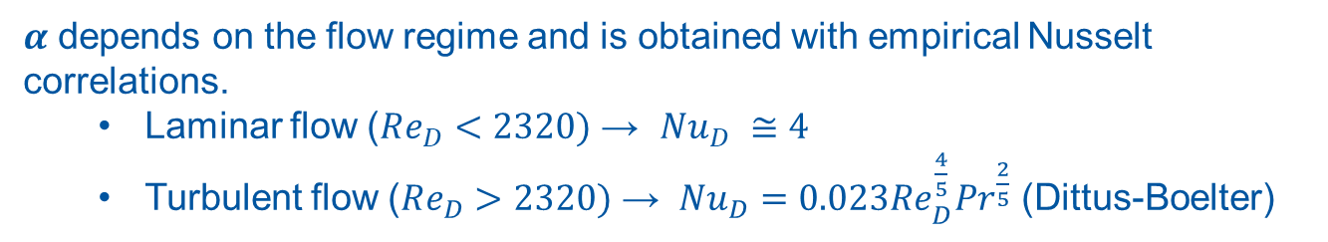
Forced Convection – Single-phase flow inside a circular tube
$ρ, λ$ and $C_{p}$are evaluated at the mean cell temperature, with the help of a thermophysical library (CoolProp or Hepak).
$α$ depends on the flow regime and is obtained with empirical Nusselt correlations.
  Laminar flow ($Re_{D}<2320)$ → $Nu_{D} ≅4$
  Turbulent flow ($Re_{D}>2320)$ → $Nu_{D}=0.023Re_{D}^{\frac{4}{5}}{Pr}^{\frac{2}{5}}$ (Dittus-Boelter)
$$Nu_{D}= \frac{αD}{λ}$$
$$Re_{D}= \frac{ρυD}{μ}$$
$$Pr= \frac{μC_{p}}{λ}$$
$f$ depends on the flow regime and the surface rugosity.
  Laminar flow ($Re_{D}<2e3)$ → $f=16Re_{D}^{−1}$ (Fanning)
  Transition flow ($Re_{D}>2e3 and Re_{D}<3e4)$ →$f=0.079Re_{D}^{−0.25}$ (Blasius)
  Turbulent flow ($Re_{D}>3e4 and Re_{D}<3e6)$ →$f=0.046Re_{D}^{−0.2}$ (McAdams)
Notes:
# # also, Johannes Correlation (1972) https://uspas.fnal.gov/materials/10MIT/Lecture_3.2.pdf
# Nu_m = 0.0259 * Re_m ** (4/5) * Pr_m ** (2/5) * (Tt[i]/Tm) ** (-0.716)

Slide 19
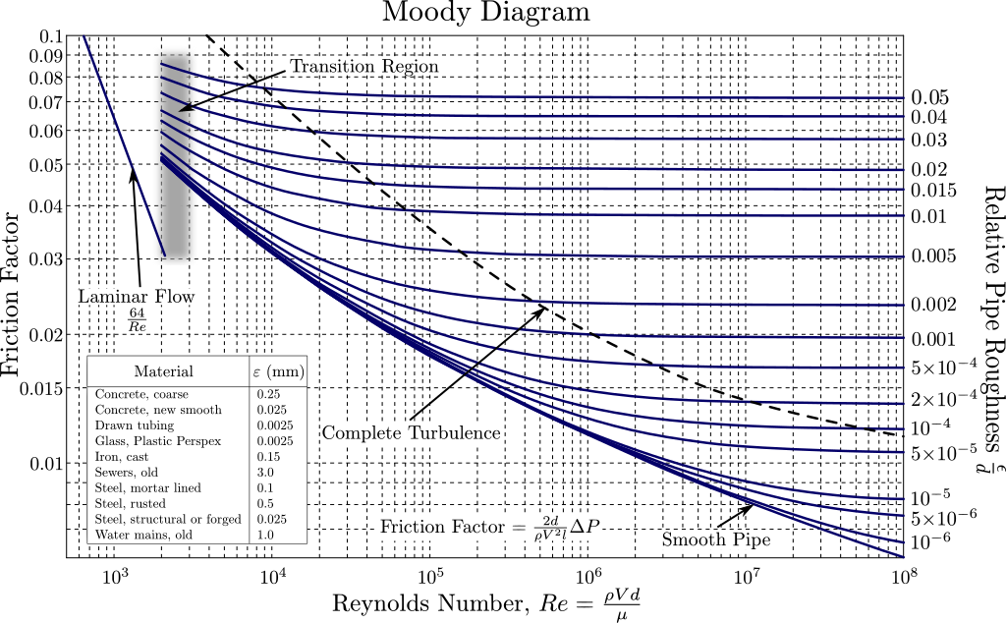

Forced Convection – Single-phase flow inside a circular tube
https://en.wikipedia.org/wiki/Moody_chart
Common confusion between Fanning and Moody (aka Darcy-Weisbach) friction factors. If wrongly used, factor 4 difference in pressure drop calculations.
Recommendation: use Fanning for NS equations and Moody for an isolated pressure drop calculation.
Notes:
# # also, Johannes Correlation (1972) https://uspas.fnal.gov/materials/10MIT/Lecture_3.2.pdf
# Nu_m = 0.0259 * Re_m ** (4/5) * Pr_m ** (2/5) * (Tt[i]/Tm) ** (-0.716)

Slide 20
Supercritical flow

Slide 21
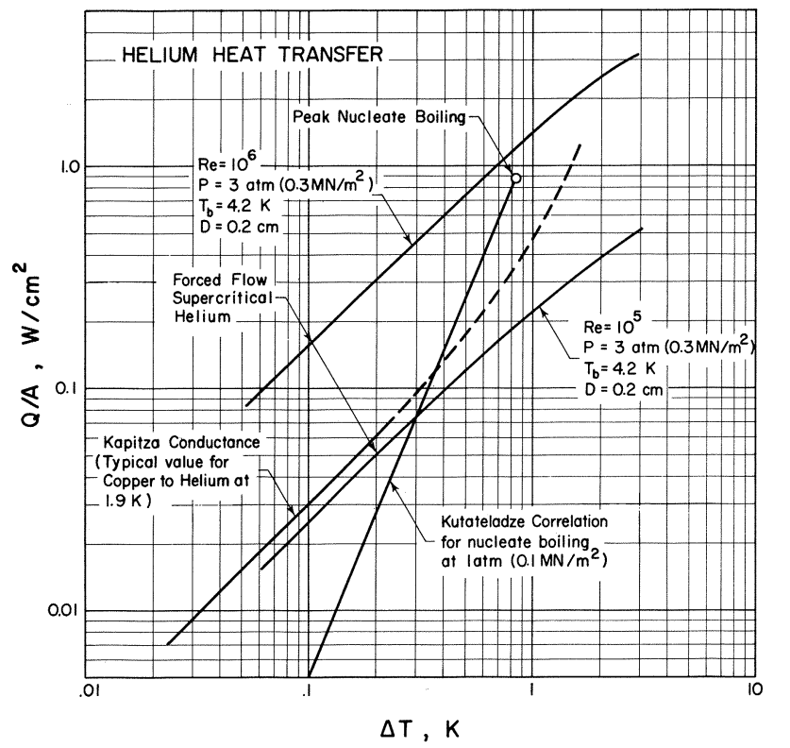
A comparison of heat transfer to helium
Higher Re increases heat transfer
For higher ΔT nucleate boiling reaches SC forced flow
Kapitza at 1.9 K is not that bad
R_{Kap} dominant only below 1 K
“ “
Source: V. Arp, Adv. Cryogenic Eng., Vol. 17, pp. 342.
Notes:
Big property change over a small temperature difference.
Similar behavior is expected for any fluid.

Slide 22
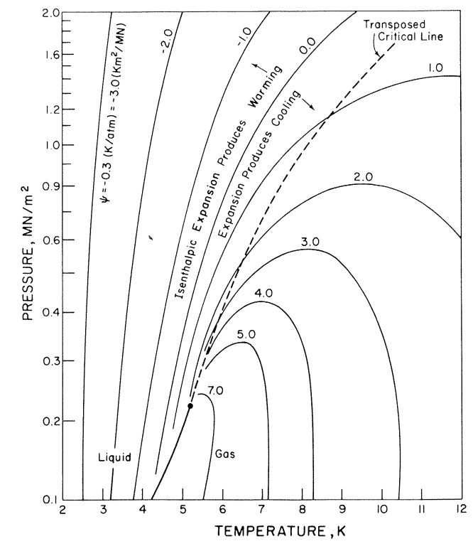
Particularities of Supercritical flow (SCF)
Properties change a lot near the critical point. Example for He:
or maximum specific heat line
Heat capacity peak defines the pseudo-critical point at each pressure.
Fluid changes from liquid-like to gas-like.
Big change of properties over small temperature difference.
The density changes could lead to unstable behaviour.
Source: V. Arp, Adv. Cryog. Eng., Vol. 17, 342
He critical point → 5.19 K and 2.24 bar
Notes:
Big property change over a small temperature difference.
Similar behavior is expected for any fluid.

Slide 23
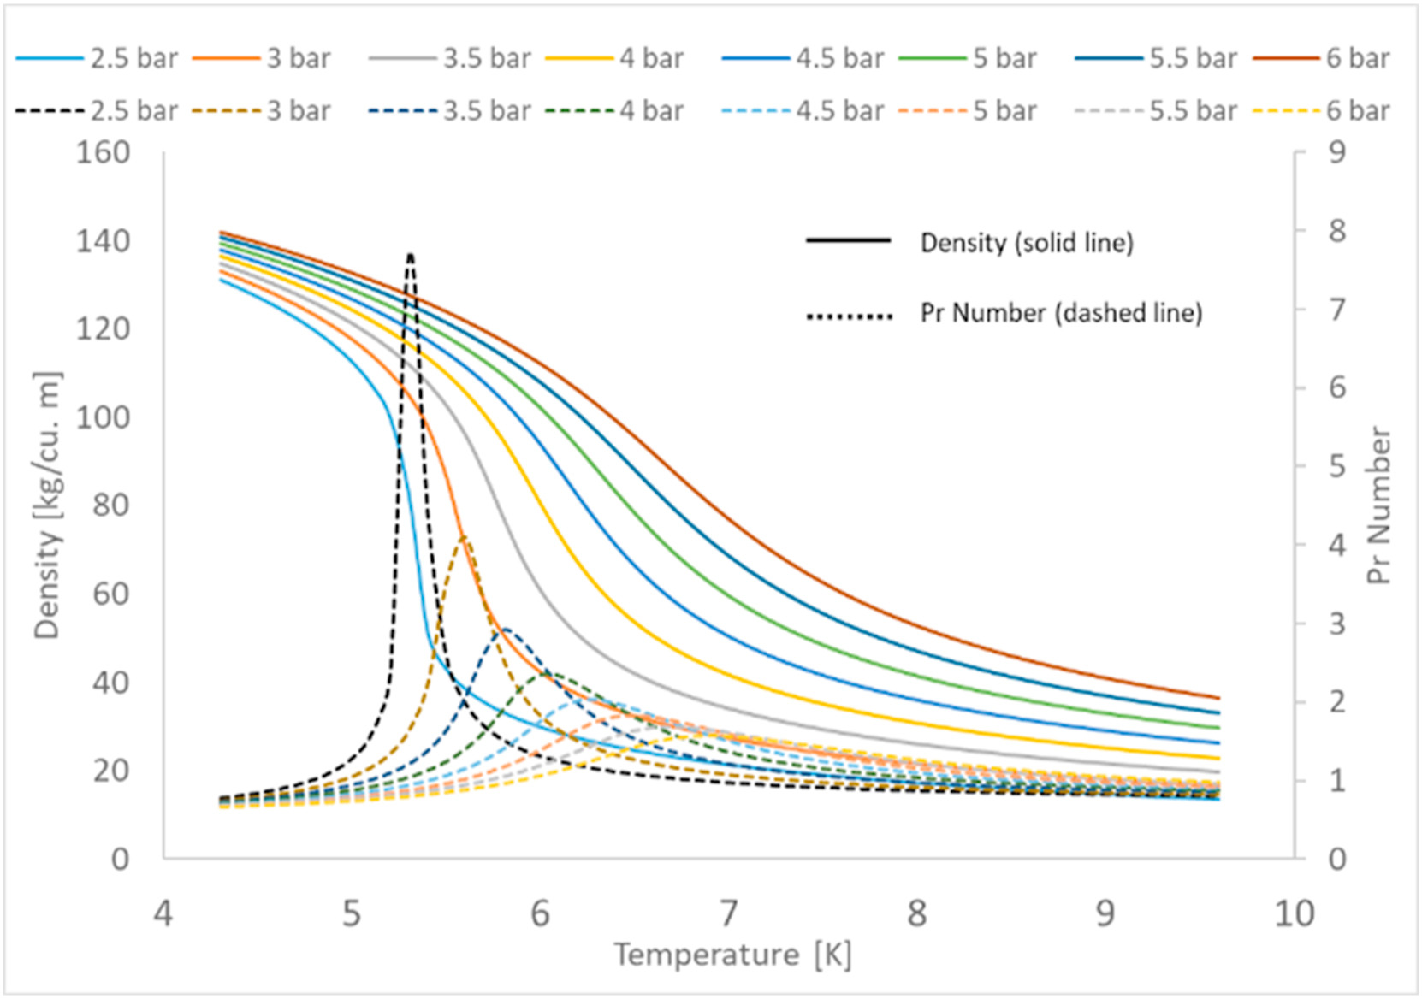
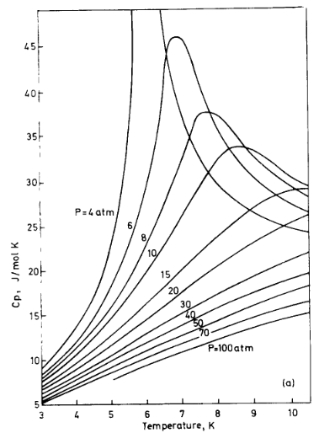

Particularities of Supercritical flow (SCF)
Properties change a lot near the critical point. Example for He:
$$Pr=\frac{υ}{a}=\frac{ηc_{p}}{λ}$$
Source: Vvaghela, Forced flow cryogenic cooling in fusion devices: A review
From: Smith, A Review of Heat Transfer to Helium I
Notes:
Big property change over a small temperature difference.
Similar behavior is expected for any fluid.

Slide 24
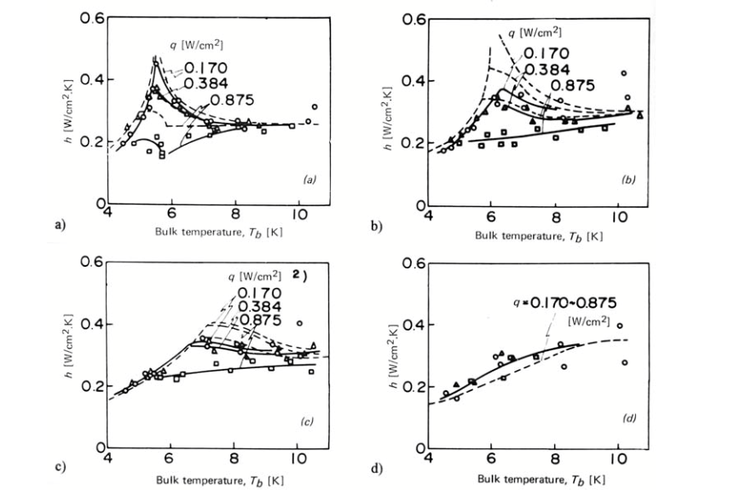
Particularities of Supercritical flow (SCF)
Increase of heat capacity leads to an improvement of the heat transfer coefficient.
α
α
Heat transfer coefficient to supercritical forced flow of Helium:
Mass flow =0.17 g/s, as fct. of temperature pressure and heat flux.
3 bar, 5.6 K
5 bar, 6.4 K
8 bar, 7.5 K
15 bar, 9.7 K
Simulation made with
Nu=0.023 * Re^{0.8}*Pr_{min}
Source: H. Ogata, S. Sato, Proc. ICEC 4, Eindhoven, (1972), 291
α
α
↑heat flux →↓ peak
↑pressure →↓ peak
The improvement is mainly near the critical point (transposed critical line).
Notes:
Big property change over a small temperature difference.
Similar behavior is expected for any fluid.
Increasing the flux reduces the high $C_{p}$ region in the fluid. As the temperature difference is increased, the proportion of the flow experiencing this high specific heat shrinks, and the heat transfer coefficient is reduced.
Improvement is valid mainly for high mass fluxes forced convection cases. For mixed or free convection, the heat transfer could also worsen depending on the orientation.

Slide 25
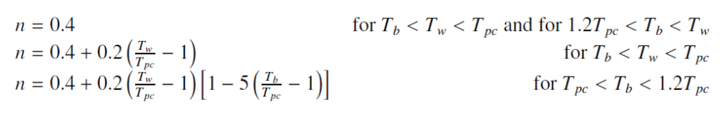
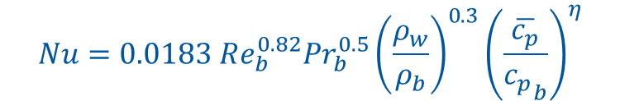
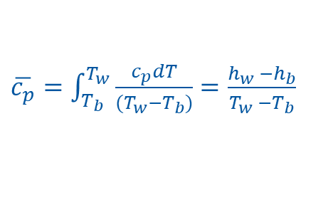
Forced Convection – Supercritical flow inside a circular tube
Heat transfer correlation requires modifications to account for the property variations. The most complete one was found to be the one from Jackson:
$$Nu=0.0183 Re_{b}^{0.82}{Pr}_{b}^{0.5}{\left(\frac{ρ_{w}}{ρ_{b}}\right)}^{0.3}{\left(\frac{\overline{c_{p}}}{{c_{p}}_{b}}\right)}^{η}$$
Where w refers to conditions at the wall, and b to the bulk of the fluid. $\overline{c_{p}}$ is defined as:
$\overline{c_{p}}=\int_{T_{b}}^{T_{w}}{\frac{c_{p}dT}{(T_{w}−T_{b})}=\frac{h_{w} −h_{b}}{T_{w} −T_{b}}}$
Finally, $η$ is a function on $T_{w}, T_{b}$ and $T_{pc}$ (pseudo-critical temperature). [1]
[1] Jackson, J. D. et al. Heat transfer to supercritical pressure fluids, 1975 (referred from https://thermopedia.com/content/1173/)
Notes:
F is more a function of regime and rugosity.
Forced Convection in the Absence of Buoyancy

Slide 26

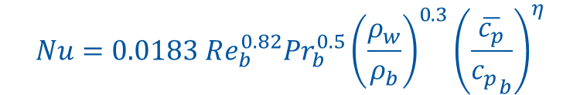

Forced Convection – Supercritical flow inside a circular tube
$ρ, λ, C_{p}$ and $f$ are evaluated in the same way as the single-phase flow case.
$α$ is obtained from:
  Jackson, if conditions are close to the critical point.
  Dittus-Boelter, otherwise.
$$Nu=0.0183 Re_{b}^{0.82}{Pr}_{b}^{0.5}{\left(\frac{ρ_{w}}{ρ_{b}}\right)}^{0.3}{\left(\frac{\overline{c_{p}}}{{c_{p}}_{b}}\right)}^{η}$$
$$Nu_{D}=0.023Re_{D}^{\frac{4}{5}}{Pr}^{\frac{2}{5}}$$
Helium’s critical point → 5.19 K and 2.24 bar
Helium conditions | Correlation
4.2 K < T < 9 K 2.24 bar < p < 5 bar | Jackson
T > 9 K p > 5 bar | Dittus-Boelter
Notes:
Helium limits for Jackson are personal choice. Tested to use Jackson always if SC but it didn’t make a big change compared to Dittus Boelter.

Slide 27
Two-phase flow

Slide 28
Particularities of Two-phase flow (TPF)
REFPROP
He critical point
(5.2 K – 2.23 bar)
Supercritical flow
Liquid
Two-phase flow
Gas
Saturation line
Why TPF?
  Cryogens are volatile and are often distributed near saturation conditions.
  Attractive heat transfer rate.
  Constant temperature.
TPF implications:
  Mostly an empirical subject due to its complexity.
  Variables that affect it: mass flow rate, temperature, pressure, orientation and phase change.
  Instabilities should be assessed.
Notes:
Cryogens are volatile and are often distributed near saturation conditions.
Two phase flow instabilities are undesirable as they can result in mechanical vibrations and system control problems, affect normal operation, restrict operating parameters and influence system safety.

Slide 29
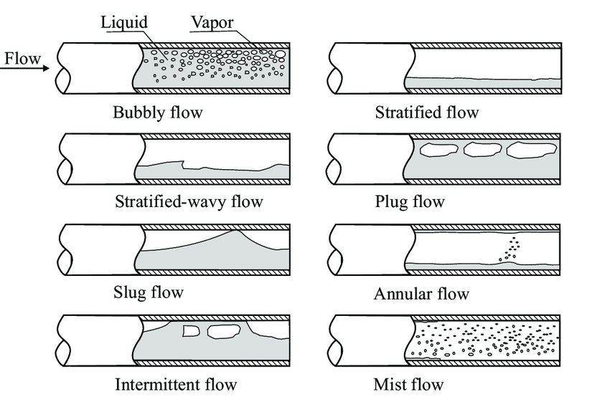
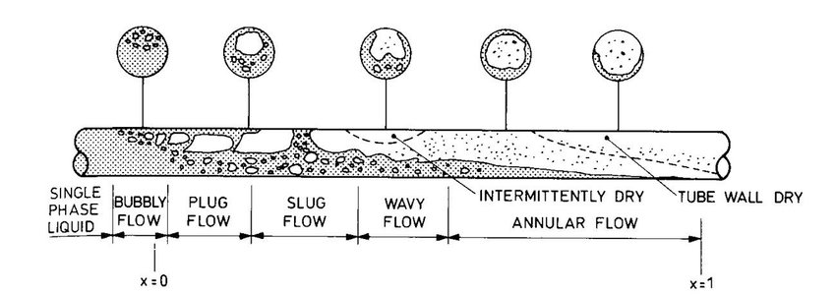
Particularities of Two-phase flow (TPF)
Flow patterns in a horizontal pipe:
Quibén, Jesús. (2005). Experimental and analytical study of two-phase pressure drops during evaporation in horizontal tubes. 10.5075/epfl-thesis-3337.
Notes:
Adiabatic: pattern depends on mass flow rate, vapour quality, geometry of the capillary.
Diabatic: with uniform heat throughout the pipe.

Slide 30
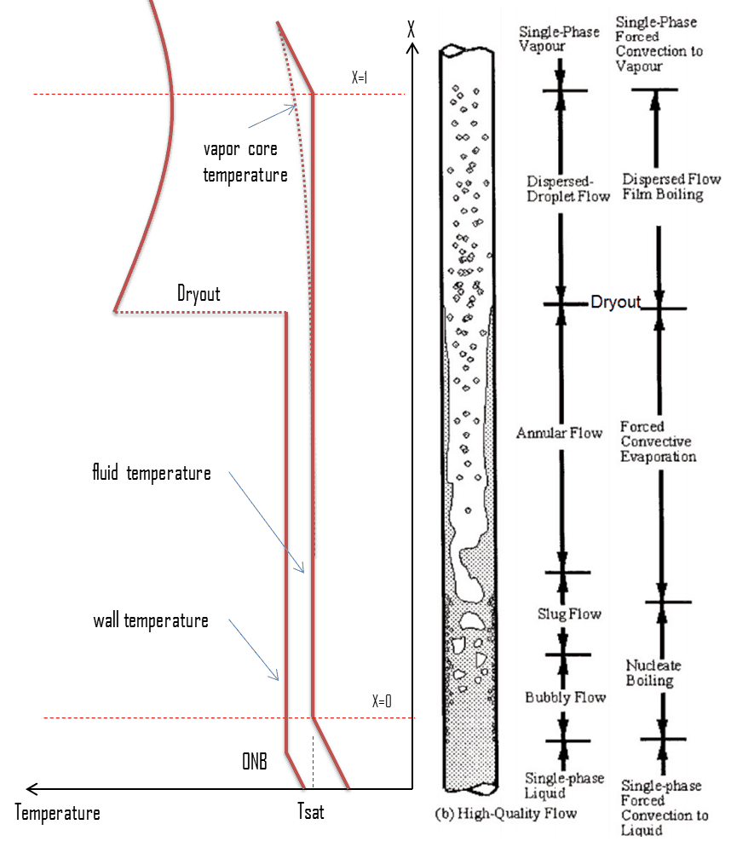
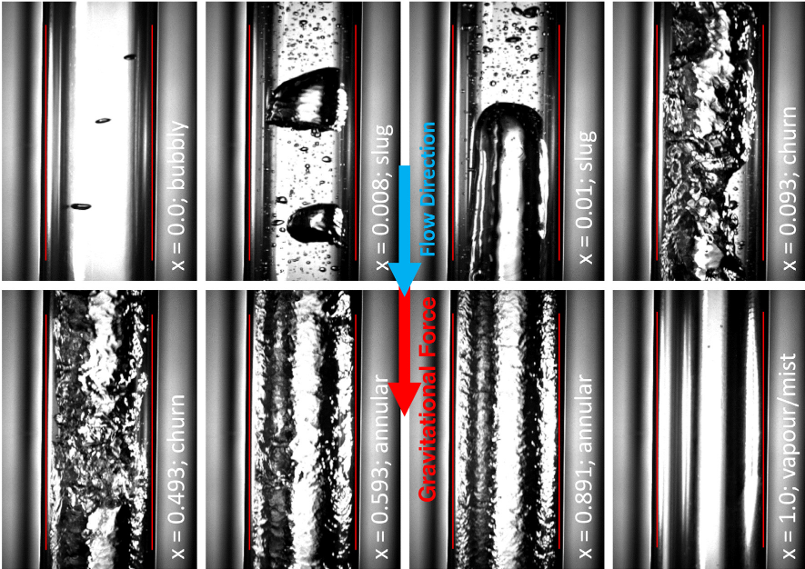
Particularities of Two-phase flow (TPF)
Flow patterns in a vertical pipe:
D. Schmid. (2022) Flow pattern observations and flow pattern map for adiabatic two-phase flow of carbon dioxide in vertical upward and downward direction. 10.1016/j.expthermflusci.2021.110526

Slide 31
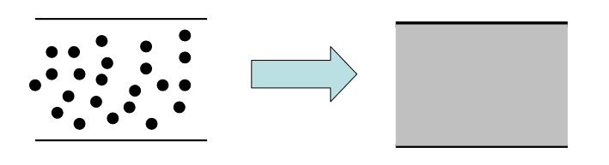
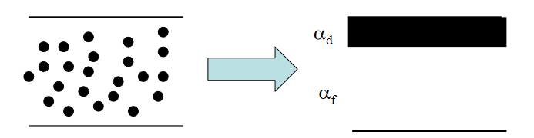
Methods of analysis – TPF models
How to adapt the numerical model to a TPF?
Homogeneous flow model: assumes that the two phases travel at equal velocities and mix well. Hence, they are treated as one phase, with averaged properties.
Separated flow model: separates the flow in two differentiated parts. Slip velocities and mass transfer between the phases need to be accounted for.
Flow pattern model: it is necessary to know the flow pattern and solve the equations accordingly per pattern forming in the tube. Flow pattern maps are used.
Notes:
Homogeneous flow is accurate for bubbly flow and mist flow. Especially not accurate for stratified flow.

Slide 32
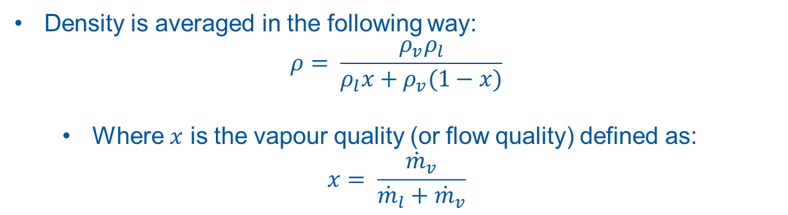
Methods of analysis – TPF model
Approach: homogeneous flow model combined with a flow pattern map.
Density is averaged in the following way:
$$ρ= \frac{ρ_{v}ρ_{l}}{ρ_{l}x+ρ_{v}(1−x)}$$
  Where $x$ is the vapour quality (or flow quality) defined as:
$$x= \frac{{\dot{m}}_{v}}{{\dot{m}}_{l}+{\dot{m}}_{v}}$$
As for the heat transfer coefficient and the friction factor (pressure drop), a flow pattern map adapted from CO2 (Wu) is used (See Cheng Part I and II).
Inside the iterative numerical model, at each cell:
The pattern of the flow is identified. It is a function of the heat flux, temperature, mass flux, geometry of the capillary and vapour quality.
The heat transfer coefficient is determined using the model for the obtained pattern.
The pressure drop is determined using the model for the obtained pattern.
- Cheng 2007. New prediction methods for CO2 evaporation inside tubes: Part I – A two-phase flow pattern map and a flow pattern based phenomenological model for two-phase flow frictional pressure drops
- Cheng 2008. New prediction methods for CO₂ evaporation inside tubes: Part II—An updated general flow boiling heat transfer model based on flow patterns
Notes:
The new density is used to get the speed of the flow – which is used to calculate the pressure.
flow pattern based phenomenological model. A phenomenological study explores what people experienced and focuses on their experience of a phenomena.
With this approach, the iterative model can be solved now.

Slide 33
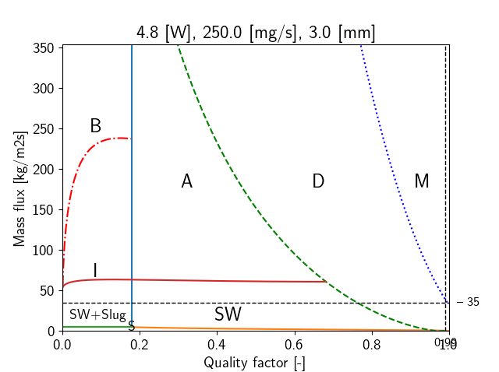
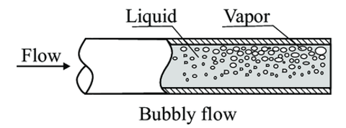
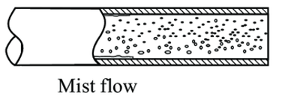
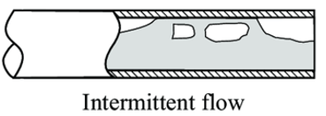
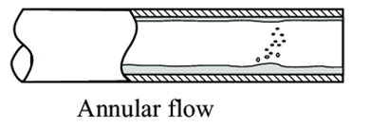
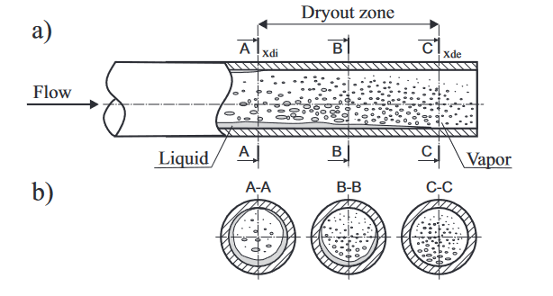
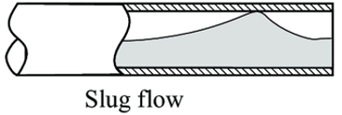
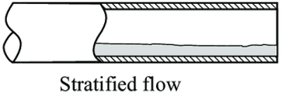
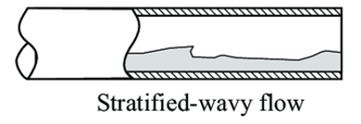
Methods of analysis – TPF model
Example flow pattern map for Helium:
Dryout represents the transition between annular and mist flow.
(10.5075/epfl-thesis-3337)
Notes:
Mist onset is extracted from the dryout completion (which means the wall remains completely dry).

Slide 34
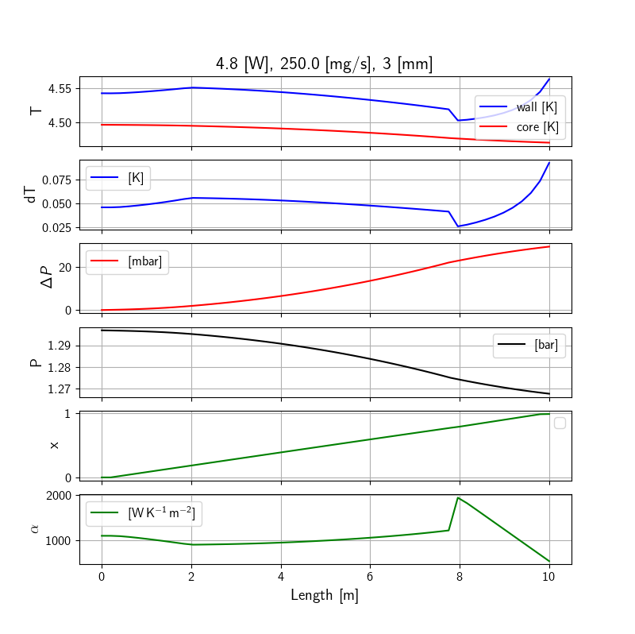
Methods of analysis – TPF model
Evolution of properties along the capillary:
Distance along capillary [m]

Slide 35
Summary – regimes comparison
(a) Fluid temperature and (b) pressure drop variation along the capillary CIF for various flow
conditions. CIF inner diameter is 3 mm, heat load is 3 W (distributed), $\dot{m}$ = 200 mg/s, $T_{CIF,in}$= 4.5 K.

Slide 36
Summary – regimes comparison
Influence of the capillary’s diameter on (a) the difference between the average capillary and
fluid temperatures, and (b) the total pressure drop for different flow conditions. CIF length is 10 m,
heat load is 3 W (distributed), $\dot{m}$ = 200 mg/s, $T_{CIF,in}$= 4.5 K.

Slide 37
Conclusions
Convection relevance.
1D capillary numerical model solved for convection and conduction.
Convection part accounts for:
  Single-phase flow: traditional approach
  Supercritical flow: modification near the critical point
  Two-phase flow: new approach mixing the classic homogeneous model with a flow pattern map.
Two-phase flow pattern map adapted from CO2 for horizontal channels.
  Results to be verified in experimental campaigns.

Slide 39
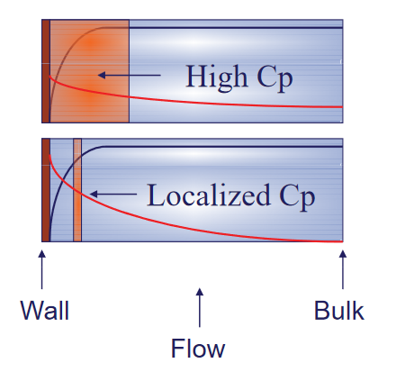
Particularities of Supercritical flow (SCF)
Increasing the heat flux reduces the high $C_{p}$ region in the fluid.
http://indico.ictp.it/event/a10196/session/19/contribution/14/material/0/0.pdf

Slide 40
Methods of analysis – TPF models
Example flow pattern map for Helium:
Capillary: 3 mm / 10 m
Heat load: 3 W
Mass flow rate: 200 mg/s
Notes:
- dryout : when the heat flux exceeds a critical value (CHF – critical heat flux) the flow pattern may reach the dryout conditions (thin film of liquid disappears)

Slide 41
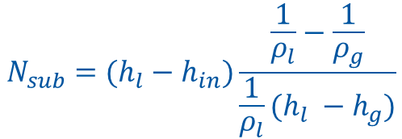
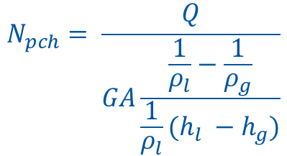
TPF DWO instabilities
Ishii stability map:
$$N_{pch}= \frac{Q}{GA\frac{\frac{1}{ρ_{l}}−\frac{1}{ρ_{g}}}{\frac{1}{ρ_{l}}(h_{l} −h_{g})}}$$
$$N_{sub}=(h_{l}−h_{in})\frac{\frac{1}{ρ_{l}}−\frac{1}{ρ_{g}}}{\frac{1}{ρ_{l}}(h_{l} −h_{g})}$$
Notes:
https://folk.ntnu.no/cadorao/TPFlowInstabilities.html
Pressure drop oscillations https://www.youtube.com/watch?v=TYJcEgQAZ38
Density wave oscillations https://www.youtube.com/watch?v=AKuddK7du6Y

Slide 42
TPF and SC DWO instabilities – Stability map

