Slide 1
PSB - Consolidation of BE.BSW
PSB Complex Integration Study
D. del Álamo – EN-ACE-INT
ICL 23-04-2025
EDMS#

Slide 2

Track-it Data
Tracks for the Integration Studies:
Consolidation of BE.BSW (extraction bumper magnets) – 123877
https://trackit.cern.ch/track/123877
#

Slide 3
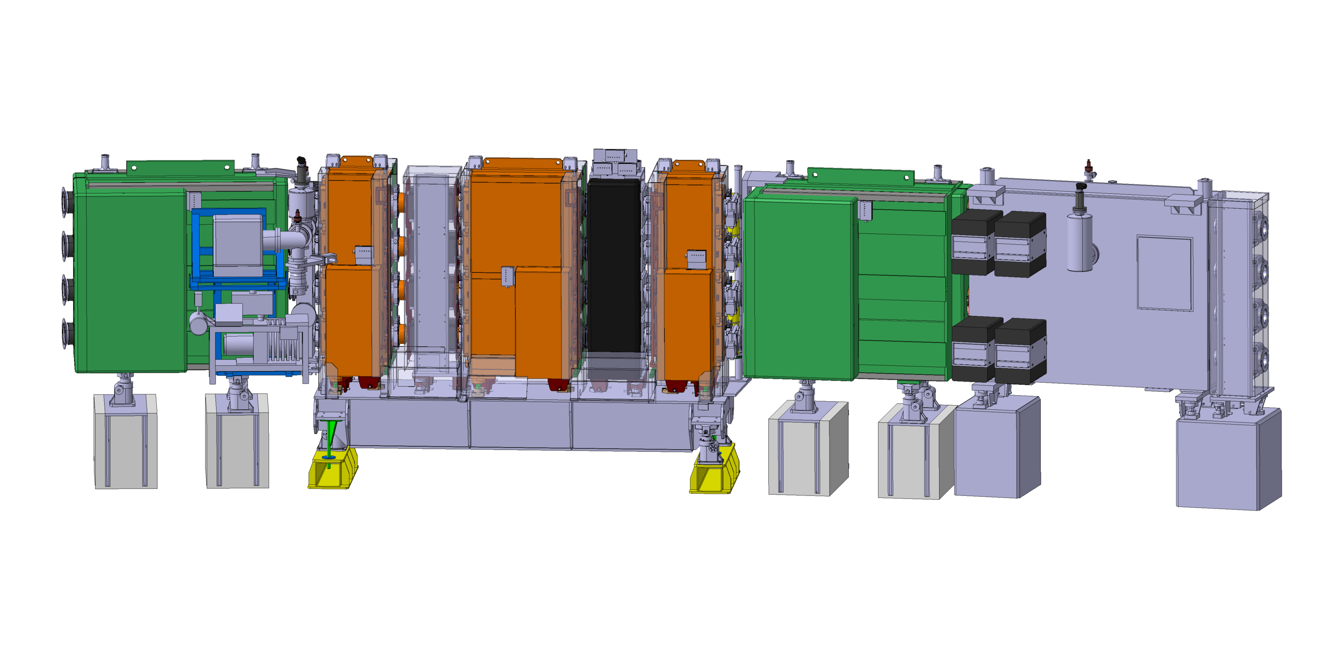
Period 14
ST0557192_07
Is the consolidation process for the BSW intended to be a like-for-like replacement, or are any Form-Fit-Function modifications foreseen?
#

Slide 4
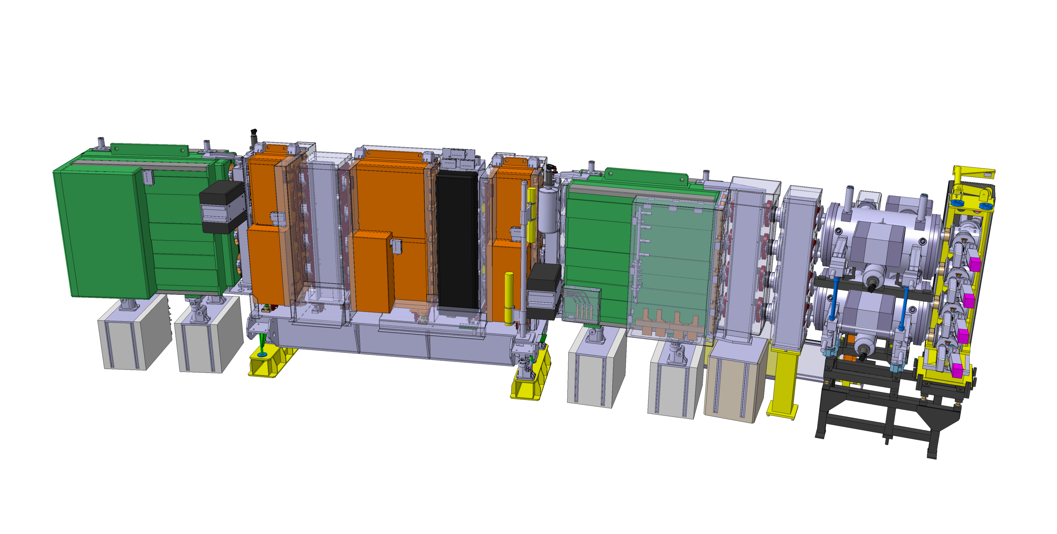
Period 15
ST0428956_09
Is the consolidation process for the BSW intended to be a like-for-like replacement, or are any Form-Fit-Function modifications foreseen?
#

