Slide 1


Certifications in Sustainable Real Estate
26/05/2025
All texts, comments, illustrations and images contained in the documentation of any kind provided by SuReal are the exclusive property of SuReal and are protected worldwide by copyright and intellectual property laws. Any reproduction in whole or in part without the prior consent of SuReal is strictly prohibited.

Slide 2
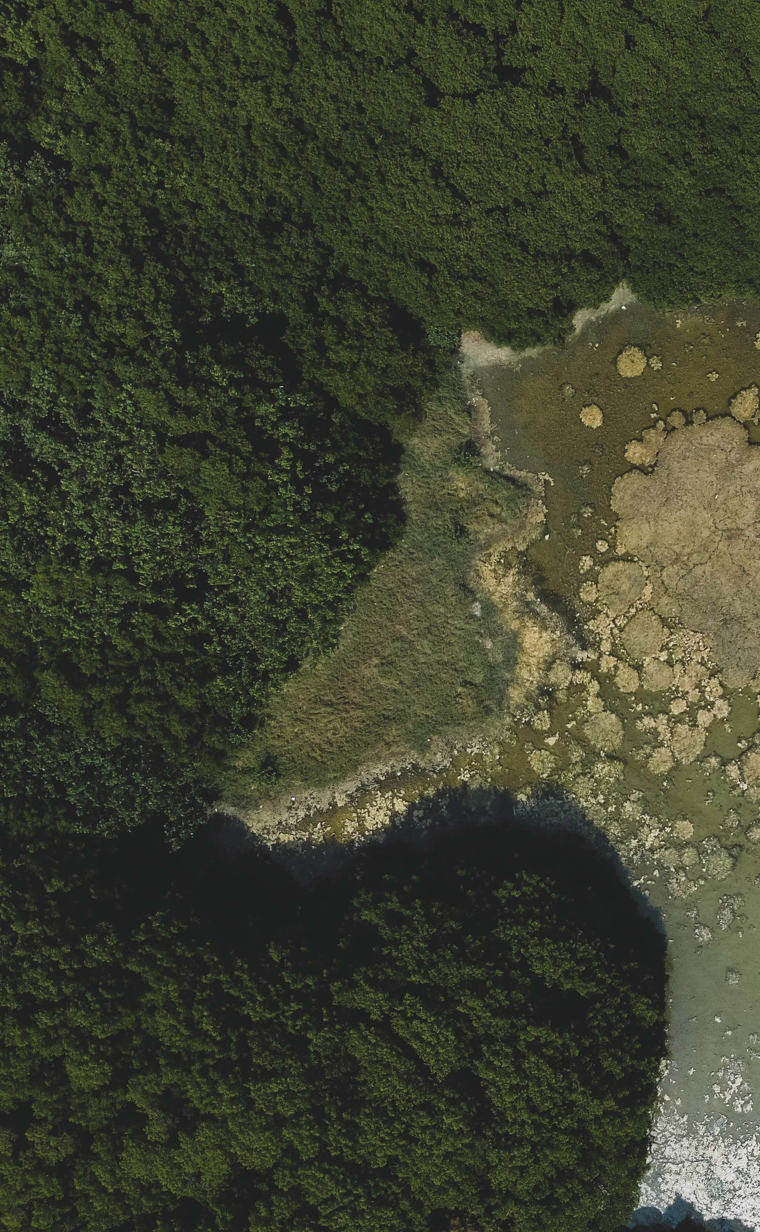
Together, we go towards
a zero carbon society.
Who is SuReal?
SuReal is a “boutique” consultancy firm offering strategic ESG advice to very in-depth expertise in all domains of sustainability. We guide investors, developers, architects, governement agencies, contractors, manufacturers and general companies in making their projects, standing assets and companies more sustainable.
Our approach is not based on gimmicks or greenwashing but on truly realistic and future-proof actions with one sole aim: having an impact on society.
> 6.000.000
> 6.000.000
> 1.200.000
14
30
m2 of ESG Guidance
m2 Real Estate projects
CO2eq.ton/year saved
countries operative
sustainability experts

Slide 3
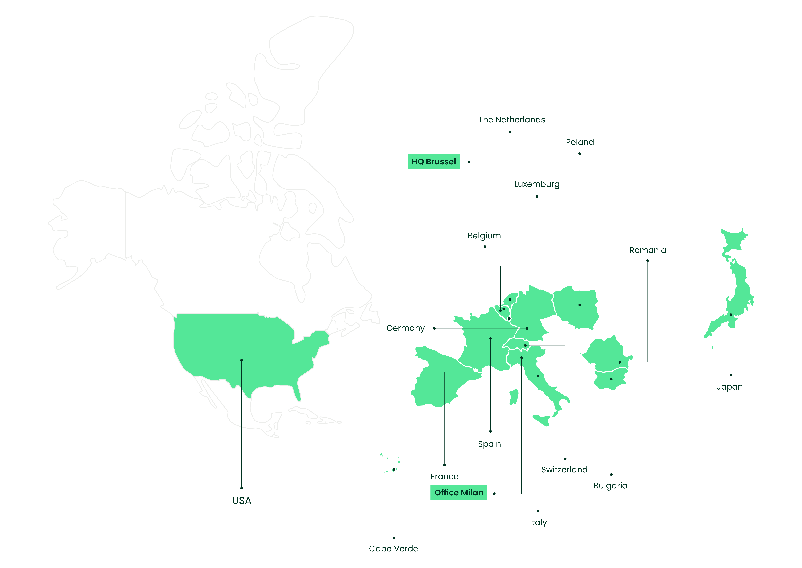

Slide 4
Context
INTRODUCTION
BREEAM
WELL
MINERGIE
EXAMPLES
Q&A

Slide 5
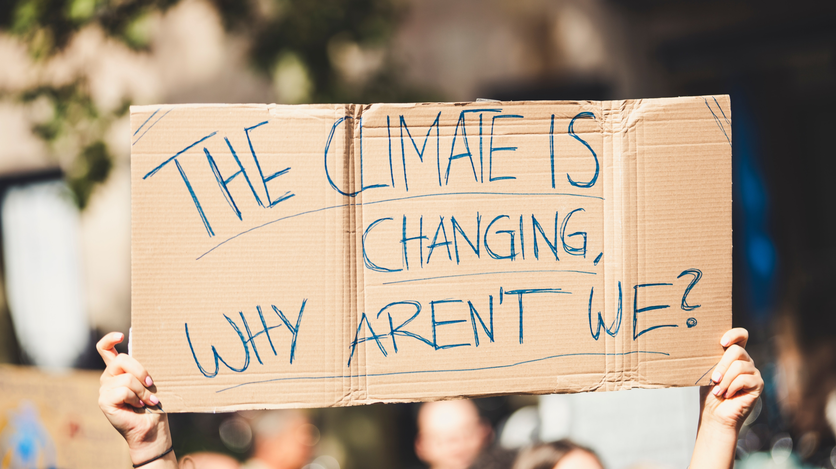
From greenwashing
to green
Understanding the why

Slide 6

MINERGIE

Slide 7
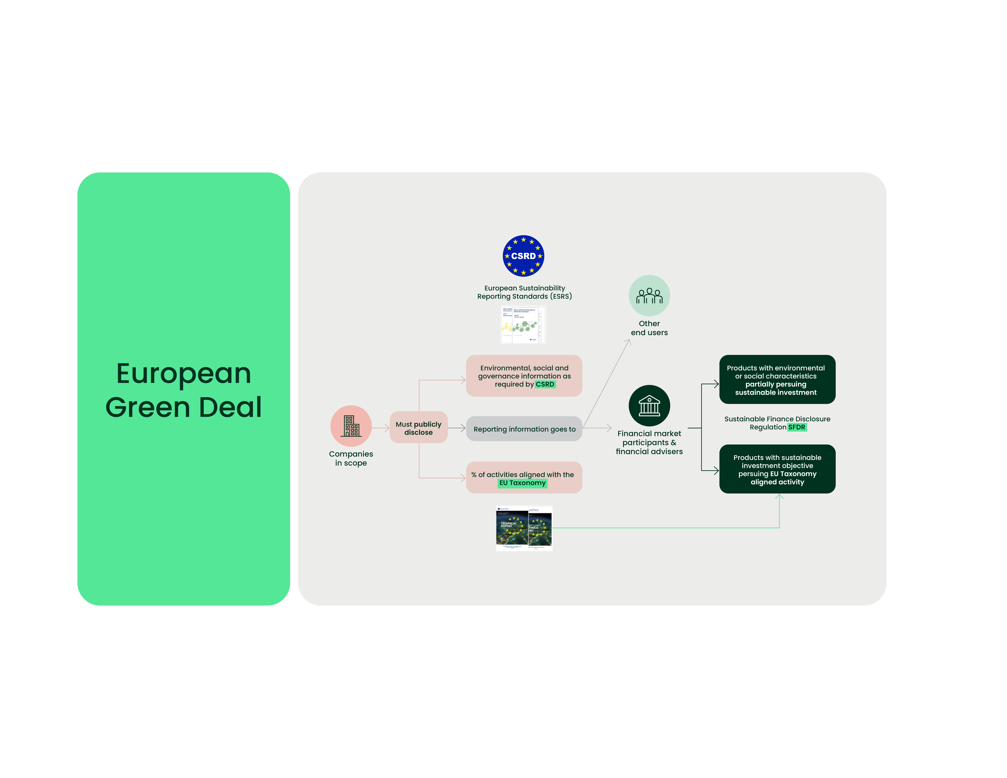
Source: Sphera

Slide 8
3 pillars

Slide 9



Benefits – Why?
Risk Management and Asset value
Build trust
Deliver positive impact
Better performing assets
Increased asset value
Mitigated asset and reputation risk
Easy to assess costs
Reduce operational costs
Contribute to ESG goals
Internationally recognised
Third-party assurance
Asset, portfolio and market level benchmarking
Enhancing economic and social value
Assessment & solutions for various sustainability goals
A credible scientific framework to inform decisions
Disclosures and reporting on international commitments and regulations
Mitigating environmental impact
Notes:
Commercieel succes
Vertrouwen opbouwen
Possitieve impact

Slide 10
BREEAM

Slide 11
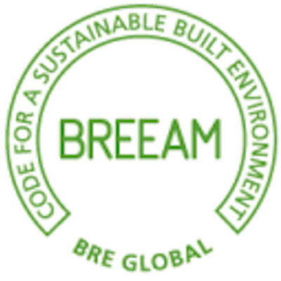
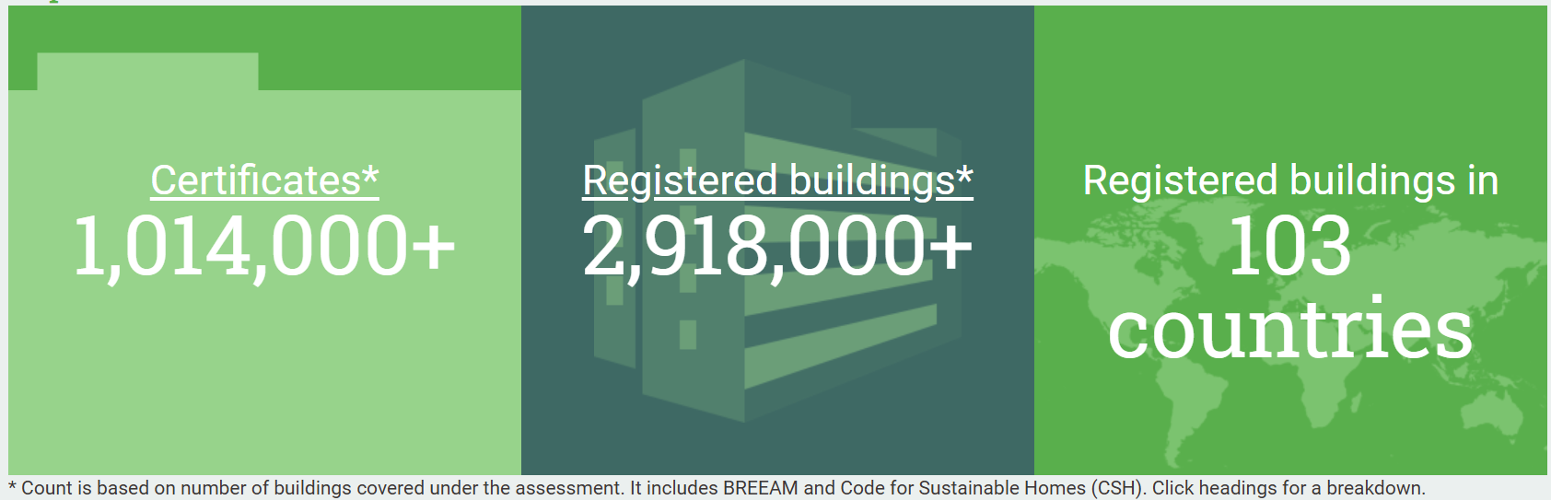
BRE : Building Research Establishment
- EAM : Environmental Assessment Method
Object | Integrated sustainability
Origin | UK
Historic | 1990
Independant certification organisation | Yes, independant third party verification
Recognition | International recognition
Cotation system | Themes (10), points (prerequisite and optional)
Additional construction cost | +- 0,5% - 4% of construction cost
Certificate validity | Depending on type of certificate
ESG importance | Clear link with SDG’s, ESRS & EU Taxonomy – focus buildings

Slide 12
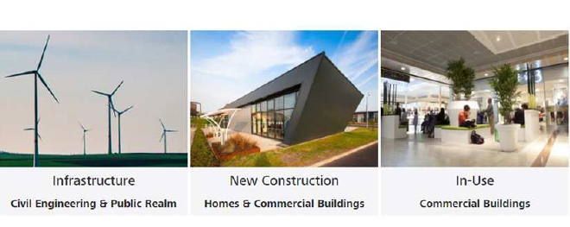
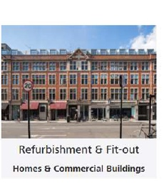
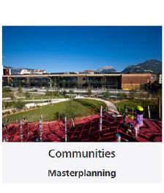
Scopes

Slide 13
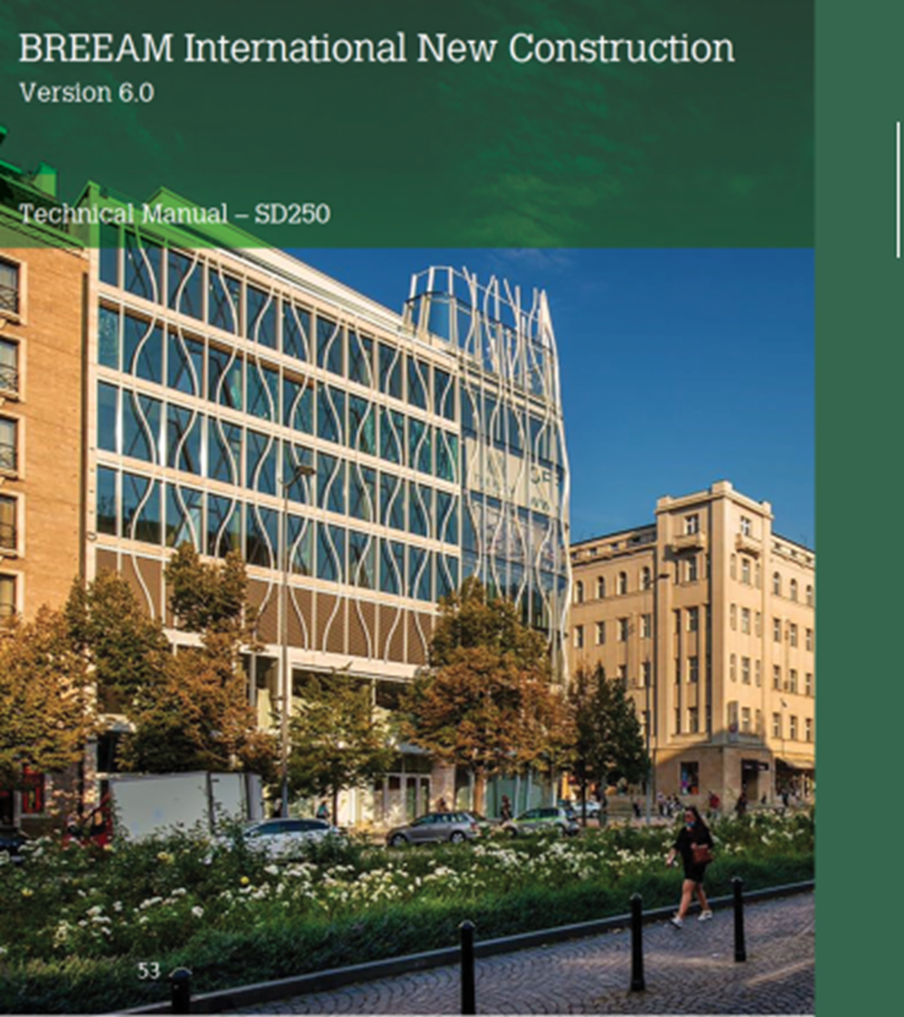
New Construction scheme
The New Construction standards can be used to assess the design, construction, intended use and future-proofing of new building developments, including the local, natural or manmade environment surrounding the building.
The standards can be used to assess most types of new buildings, including new homes and new-build extensions to existing buildings. Each uses a common framework that is adaptable, depending upon the building’s type and location.
The manual will be updated during 2025 and will be stricter than the V6 version.

Slide 14
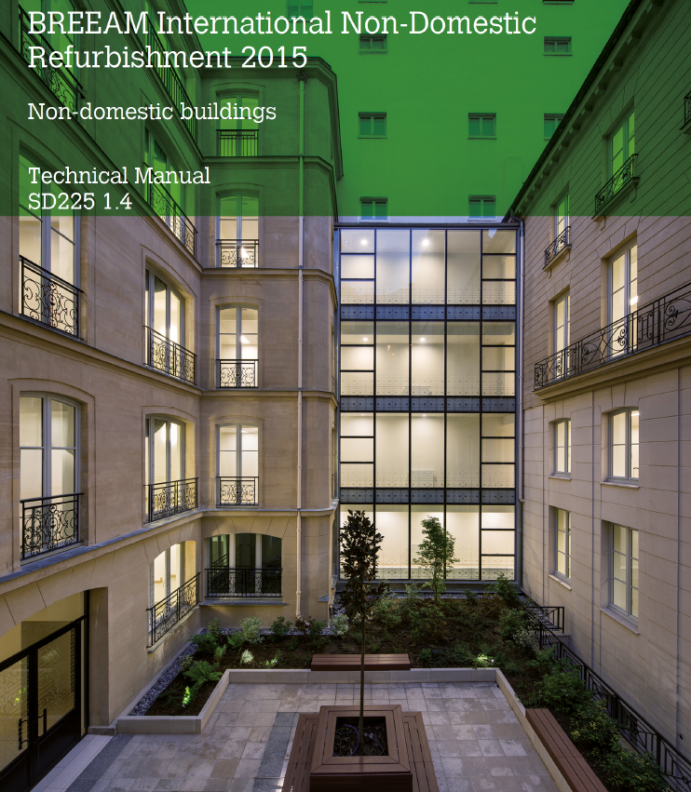
Refurbishment & Fit-doo Scheme
Mainly applied to renovation. Different parts to be chosen from:
  Part 1 : Fabric and Structure
  Part 2 : Core Services
  Part 3 : Local Services
  Part 4 : Interior Design
Same themes but adapted credits available
Example : ENE 01 is an audit of the building and not a PEB file
Is particularly adapted for Heritage building (adapted credits, stricter or softer)
-> A renovation project can also be considered for the New Construction scheme but tougher credits

Slide 15
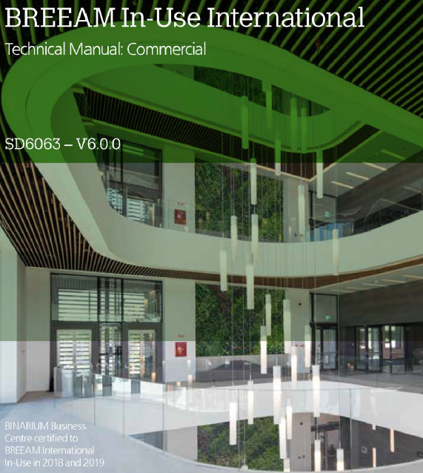
In-Use scheme
BREEAM In-Use is an environmental assessment method that enables property investors, owners, managers and occupiers to determine and drive sustainable improvements in the operational performance of their buildings. It provides sustainability benchmarking and assurance for all building types.
Certification is valid for 3 years

Slide 16










Environmental Categories
(New Construction and RFO)
Energy
Health & Wellbeing
Innovation
Land use
Materials
Management
Pollution
Transport
Waste
Water

Slide 17
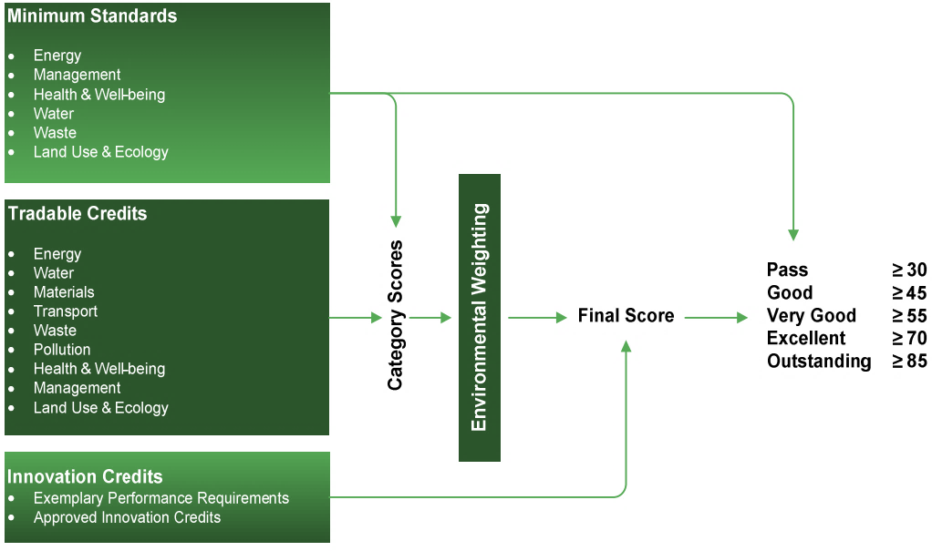
Ratings

Slide 18
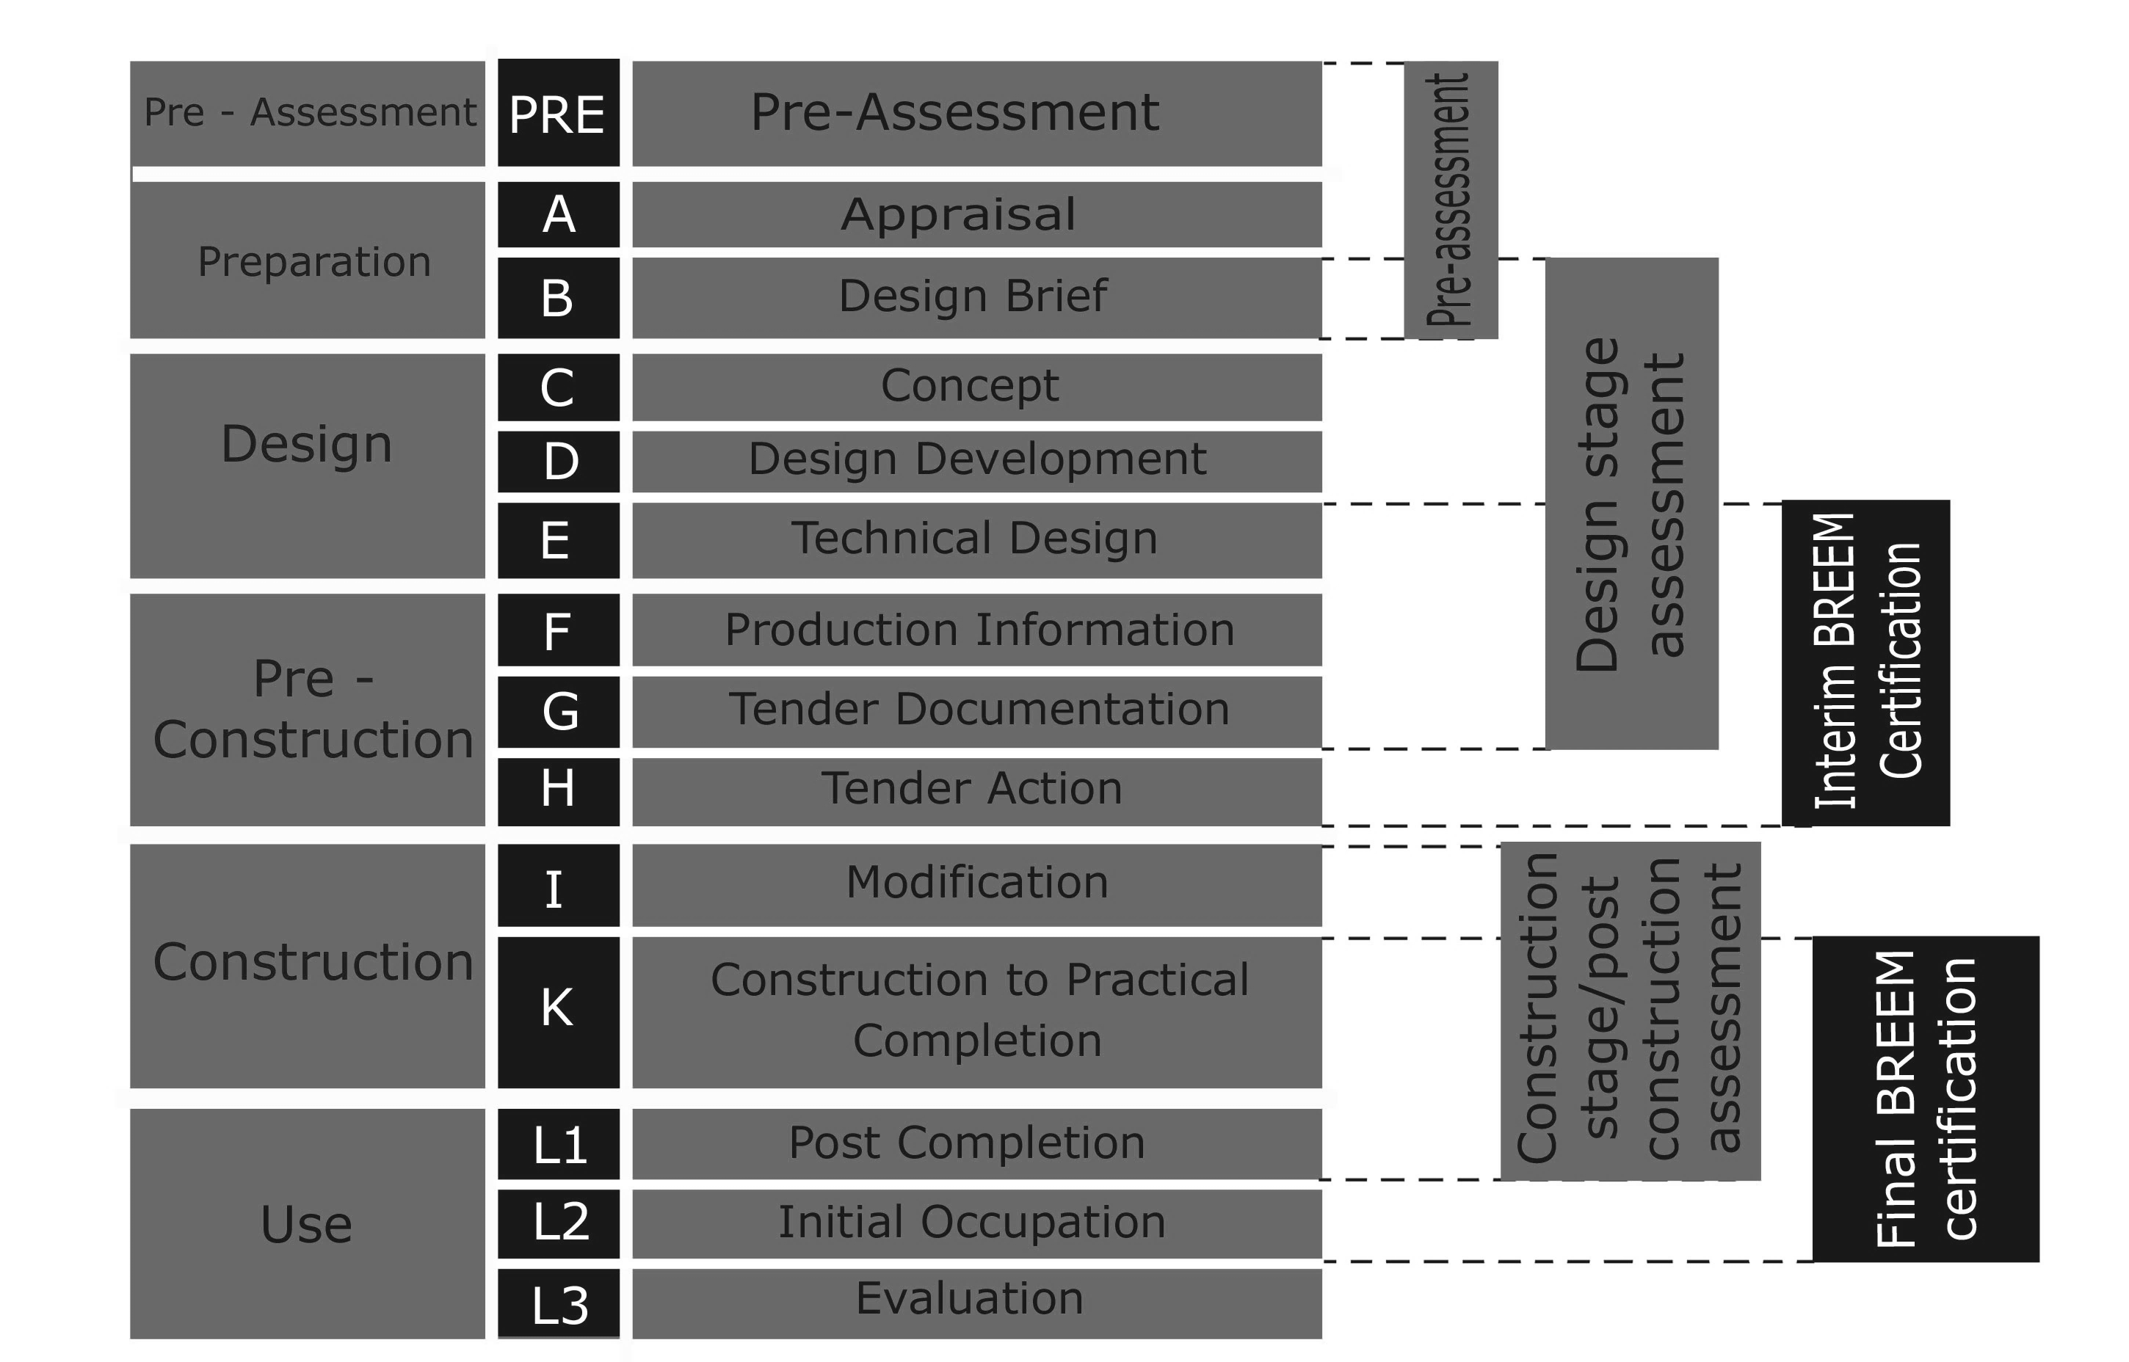
Assessment Stages
Concept design
Detailed design
Design Stage Certificate
Post Construction Stage Certificate

Slide 19
Assessment Stages BREEAM
CHOOSE DESIGN TEAM
REGISTER PROJECT
PERMIT
PERMIT
RECEIVED
BUILDING COMPLETION
Design and brief
Detailed Design
Construction
Post construction
Concept Design
Concept
Design development
Technical design
Production information + Building specifications
Tenderinjg documentation
Modificating and evidence gathering
Construction to practical completion
Post construction
Initial occupation
Evaluating
Starting to design
Pre assessment
SUREAL
Hand-in + correct remarks
Construction stage assessment
Hand-in + correct remarks
Design stage assessment
BREEAM
Registration + pre assessment
Interim design stage CERTIFICATE
Final PCS BREEAM CERTIFICATE
WELL
Registration + pre assessment
Pre certification
Final PCS WELL CERTIFICATE

Slide 20
WELL
Healthier companies outperform their peers

Slide 21

WELL
Object | Wellbeing of users
Historic | 2015
Independant certification organisation | Yes
Recognition | International recognition
Origin | USA
Cotation system | Themes (10), points (prerequisite and optional)
Cost | +- 0,6% - 5%
Certificat validity | 3 years, then recertification
CSR importance | Beyond buildings – best integration
from IWBI : International Well Building Institute

Slide 22
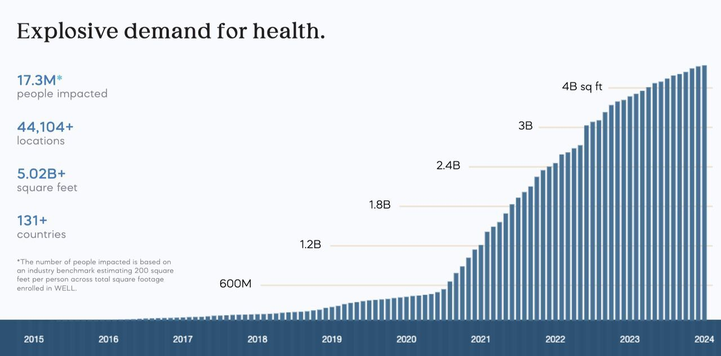

Slide 23
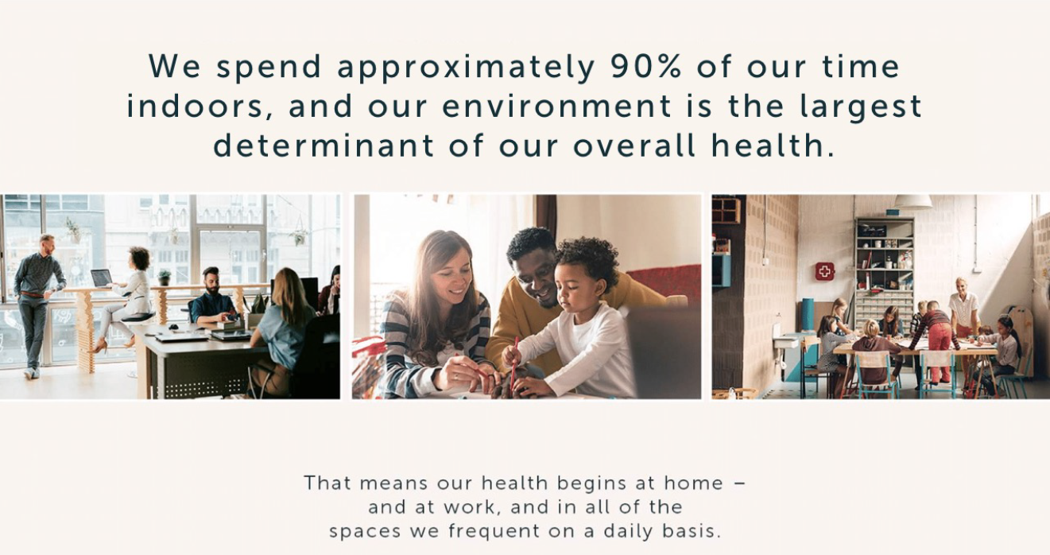
WELL Certification

Slide 24
WELL Certification
Education
Management
Accessibility
Promote
Controllability
Prevention
Communication
Adaptability
Restorative
On site performance test
Certification validity

Slide 25


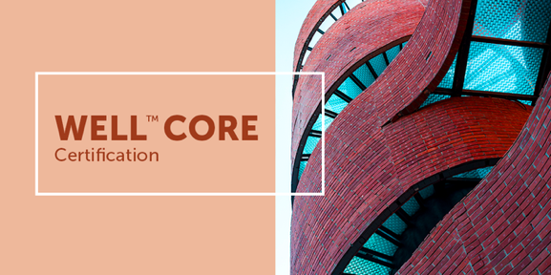

WELL Scopes
WELL Certification
WELL Community
WELL Core
WELL Portfolio

Slide 26

WELL Evidences
Types of evidences :
On site performance testing and photographic evidence
Policies and operational schedule
Professional narratives
Technical drawings and documents
Ongoing reporting
Notes:
There is a testing after in contrary with BREEAM

Slide 27


WELL Features
Air
Water
Nourishment
Light
Movement
Thermal Comfort
Sound
Materials
Mind
Community

Slide 28
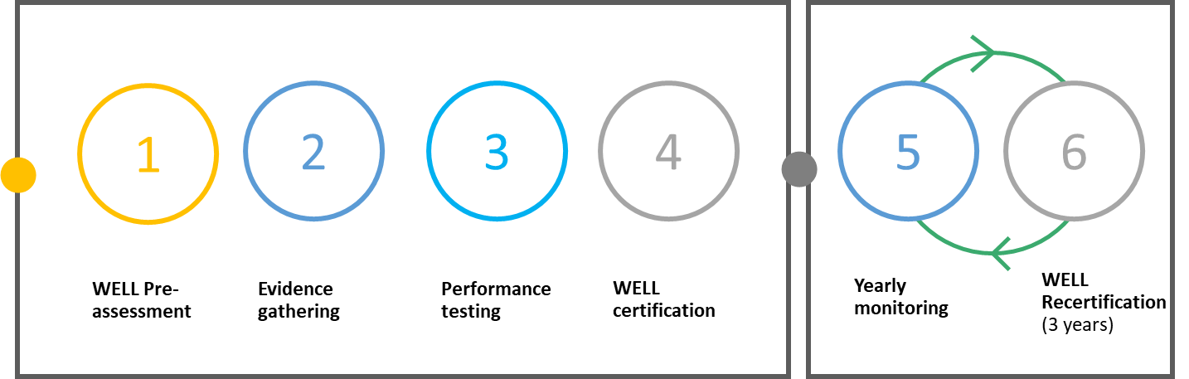
WELL Timeline Recertification

Slide 29

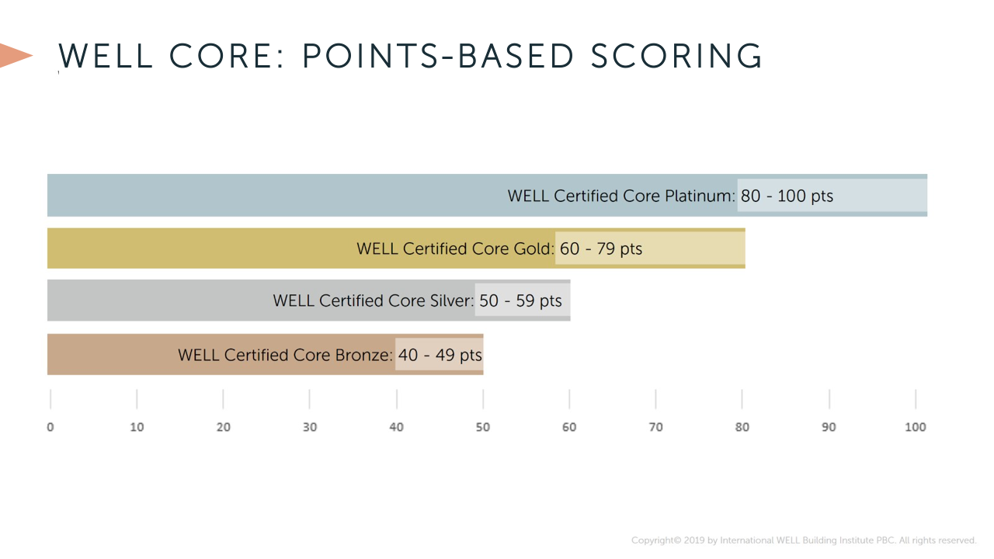
Ratings
Notes:
Platinium: only if cooperation with tenant
Gold: only promoter

Slide 30
MINERGIE

Slide 31
MINERGIE
Minergie promotes sustainable and high-quality buildings by focussing on reducing energy consumption while still enhancing comfort within buildings. It introduces stringent requirements for insulation, air tightness and the use of renewable energy sources.
Minergie is recognised as the most important sustainability standard for buildings in Switzerland. It is furthermore aligned to legislation and can be used in the Canton Geneve to comply to standards in terms of energy.
The Minergie label defines clear elements that all have to be implemented in the building to obtain the label, and is thus not a label like BREEAM where multiple options are necessary to come to the required result.
Notes:
The benefit of Minergie, compared to BREEAM, is that it’s simpler to implement as there is a clear list of requirements, if you reach all of them, you have the label. In that sense it is thus closer to the EU Taxonomy. There is thus no system of different levels of label.
It can be used to comply to the requirements of the Canton Geneva in terms of energy: a building that is Minergie certified is HPE (Haute Performance Energetique) and a building that is Minergie-P-Eco or Minergie A is THPE (Tres Haute Performance Energetique). HPE is required as a minimum, THPE can be used to get extra subsidies from the Canton.
It is significantly stricter than BREEAM in terms of energy, which is the main focus. The comfort is more in line with BREEAM, but a bit more difficult to obtain in terms of thermal comfort.

Slide 32
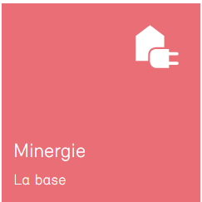
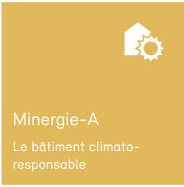
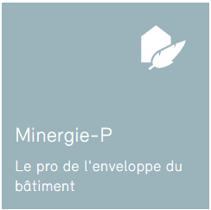
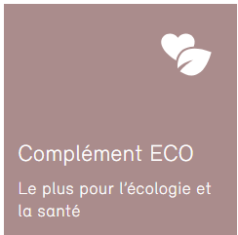
MINERGIE Versions
Basis version of Minergie
Focus on energy efficiency and thermal comfort
Minimisation of energy consumption
On top of Minergie Base
Net-zero energy balance
Produce as much energy as it consumes
On top of Minergie Base
Aims for ultra-low energy consumption
Envelope of the highest quality
Supplement to be added to any other version of Minergie
Introduction of extra aspects of ecological construction and health
Notes:
Minergie is the basic version, requirements on thermal comfort, consumption, thermal comfort and (very light) LCA requirements
Minergie-P contains all requirements of the Minergie Base but is close to the passive house standard. There is very high standards on the envelope (such as results of blower door test).
Minergie-A contains all requirements of the Minergie Base but focusses on net-zero energy. A Minergie A building has to produce as much energy as it consumes.
Minergie Eco can be added on top of all other Minergies, and contains extra requirements on health of the occupants (like WELL) and ecological construction. It functions as BREEAM or WELL: it is a list of credits where at least 50% of these credits has to be implemented.

Slide 33
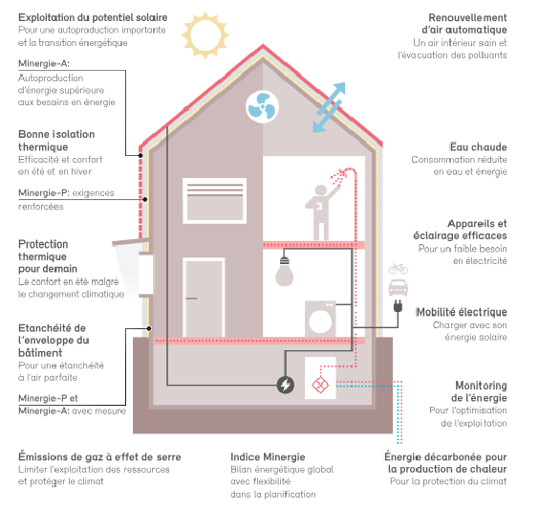
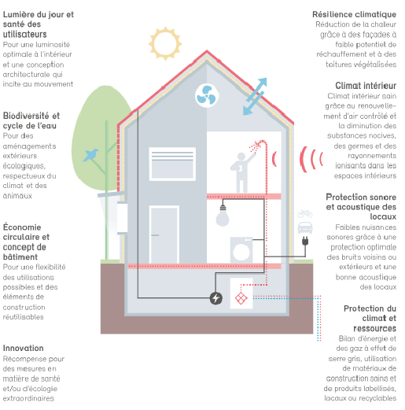
MINERGIE Requirements
Source: Minergie.ch
Notes:
To be seen if interesting: This slide contains all the requirements of Minergie Base, P & A.

Slide 34
EXAMPLES OF SUCCES

Slide 35
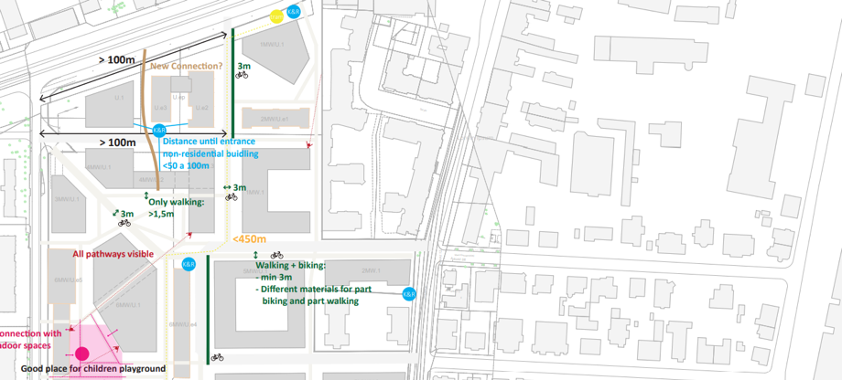
Well being
BREEAM + WELL communities Accessibility
© Amazon Office

Slide 36
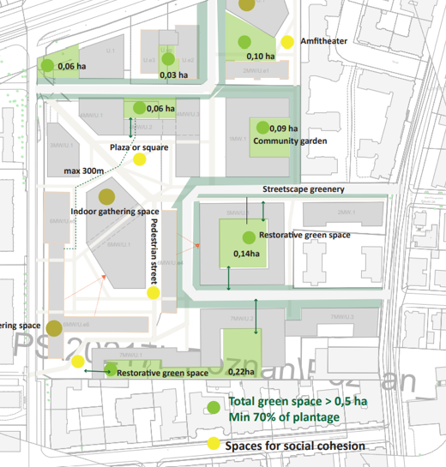
Well being
BREEAM + WELL communities green and social cohesion
© Amazon Office

Slide 37
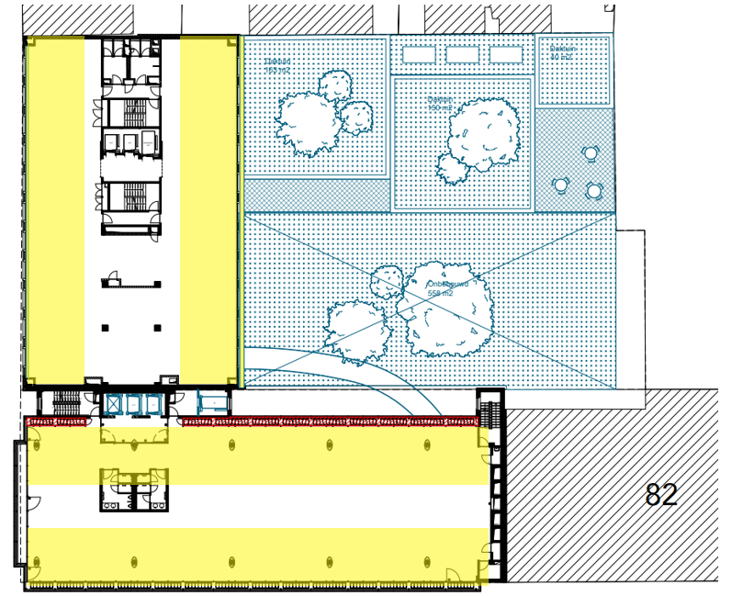
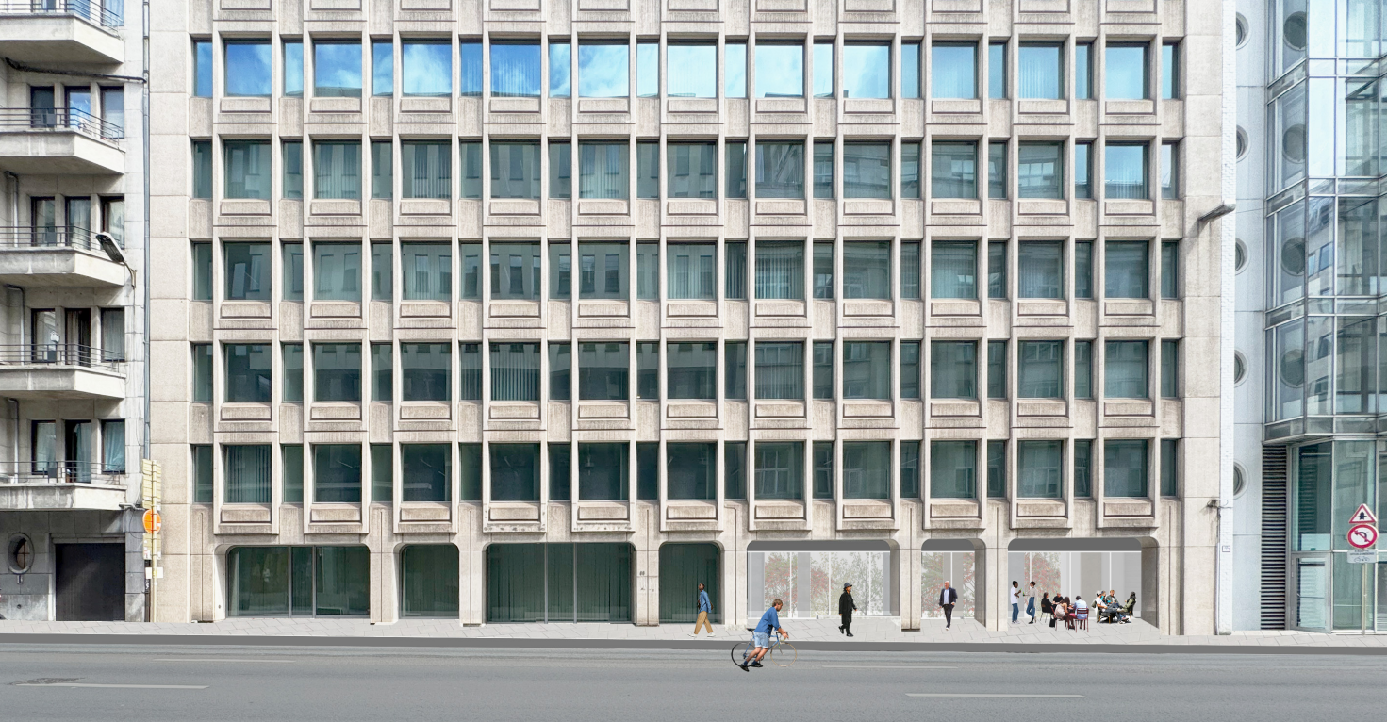
Windows: Daylight and view out
>30% is within 6 m of windows
80% of occupied spaces have an average daylight factor (2%) and minimum daylight point of min 0.6%.
Window-to-wall ratio >20%
View out of min. 10 m
Façade Belliard
Notes:
L01.1: Provide Indoor Light
At least 30% is within 6 m of windows
Hea 01: Daylight
80% of occupied spaces have an average daylight factor (2%) and minimum daylight point of min 0.6%.
Hea 01: View out
Window-to-wall ratio of at least 20%+ view out of min. 10 m
15% of occupants can sit in common space

Slide 38
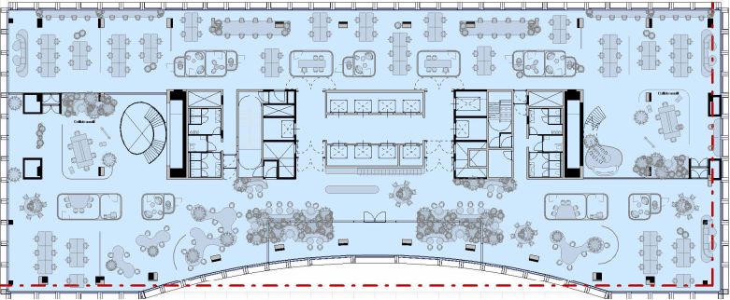
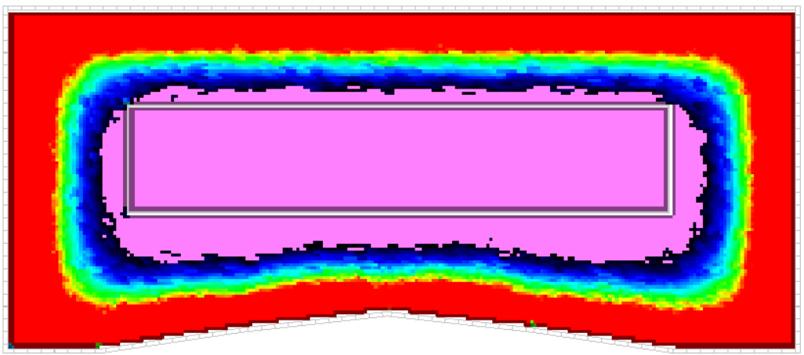





70 m
Glazing properties:
Ug: 0,54
g-value: 0,3
LT: 60%
<0,6

Slide 39
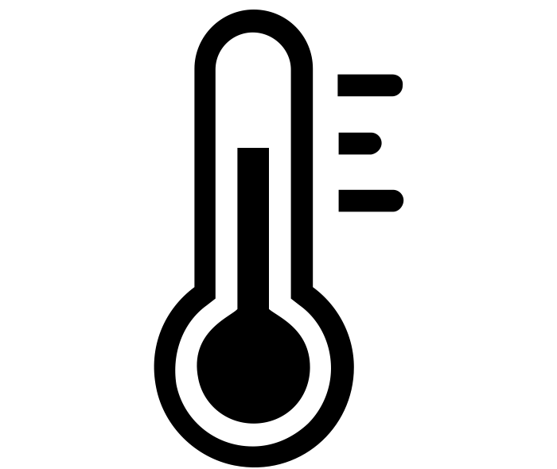
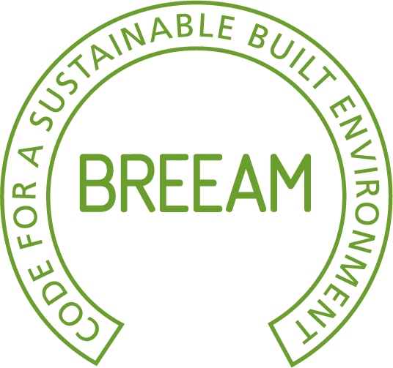


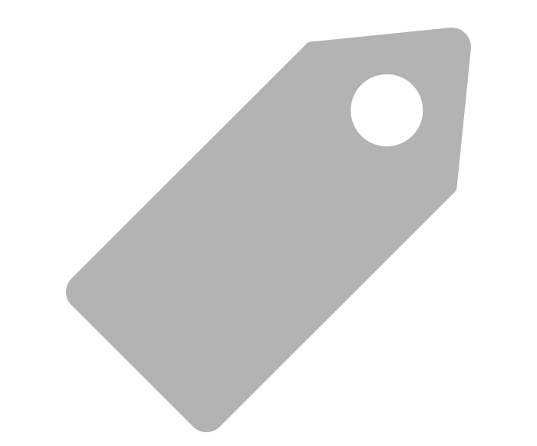

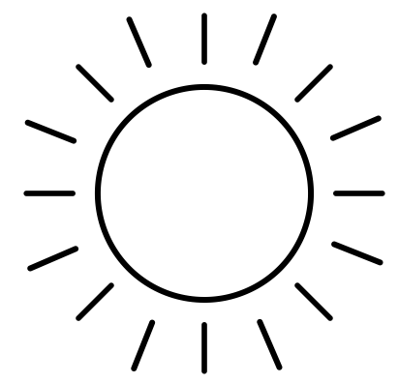

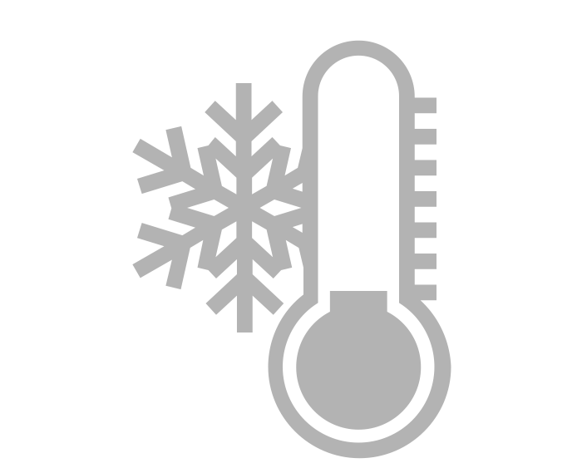

Thermal comfort
Hea04
Thermal comfort
T01
CO₂
$
Optimal Solution
Low energy
consumption
Daylight
Daylight
Energy
Hea01
Ene01
Ene04
L01
L06

Slide 40
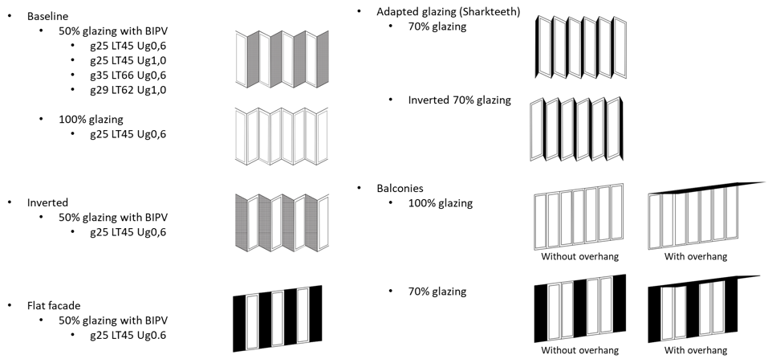
Comfort and Energy
©SuReal

Slide 41
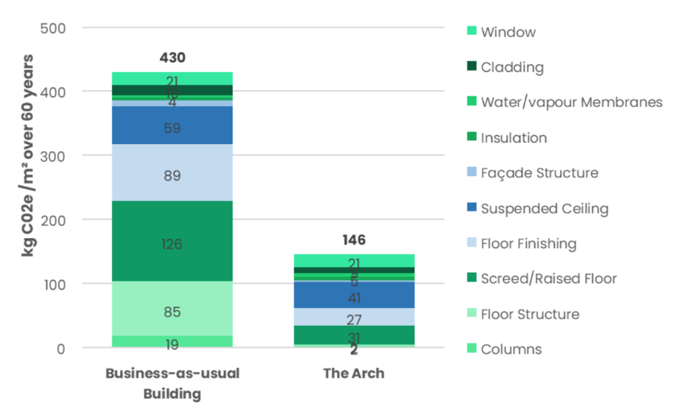
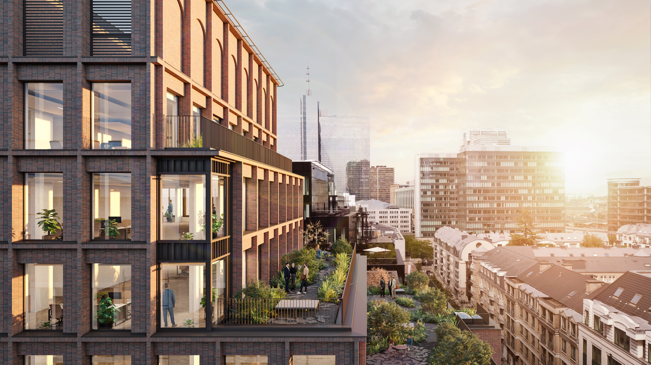
Embodied carbon

Slide 42
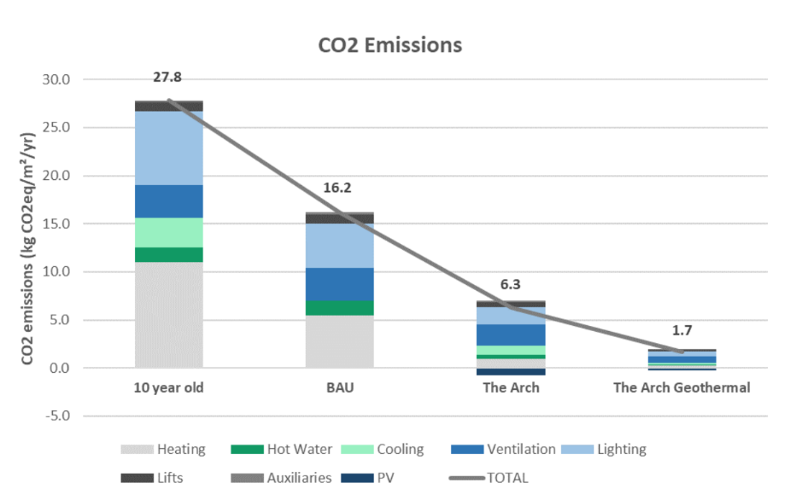
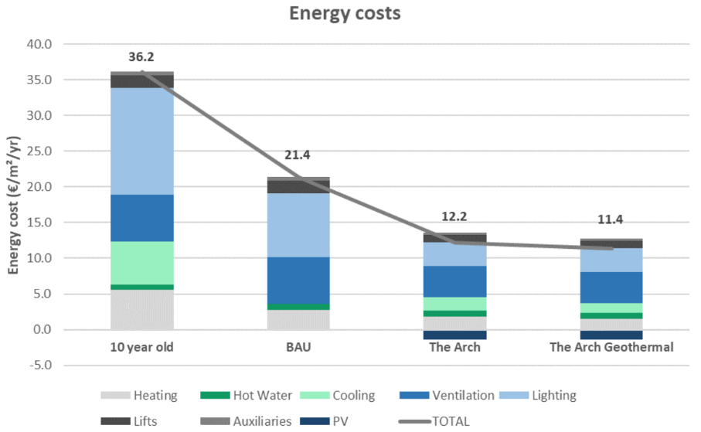
Energy

Slide 43
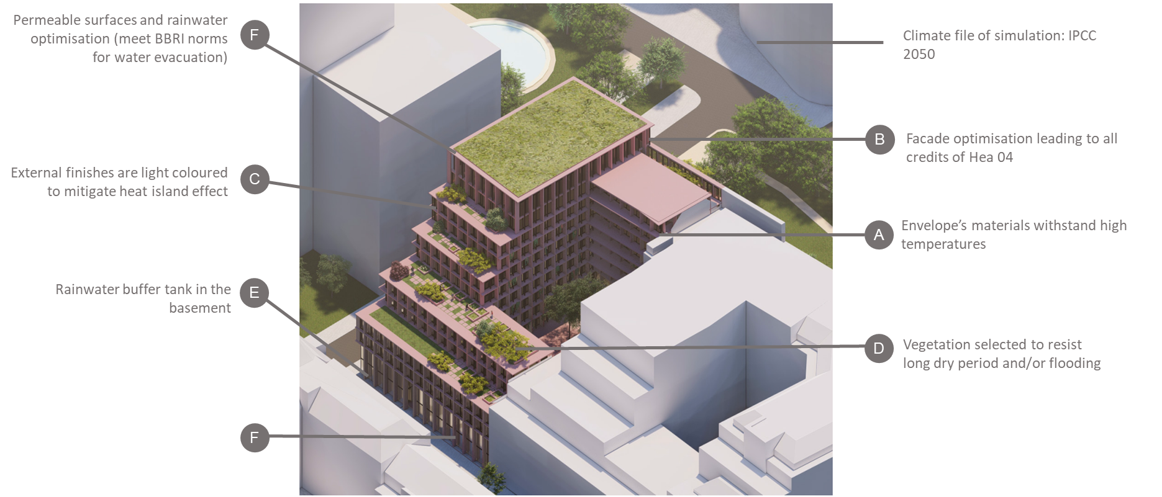
Climate Change Adaptation

Slide 44
Q&A

Slide 45
Thank you
Sunita.vanheers@sureal.be
All texts, comments, illustrations and images contained in the documentation of any kind provided by SuReal are the exclusive property of SuReal and are protected worldwide by copyright and intellectual property laws. Any reproduction in whole or in part without the prior consent of SuReal is strictly prohibited.

