Slide 1
Green building certifications
CERN buildings 777, 3189 and 140
Sara Tenchini (SCE-PPM)
26/05/2025

Slide 2

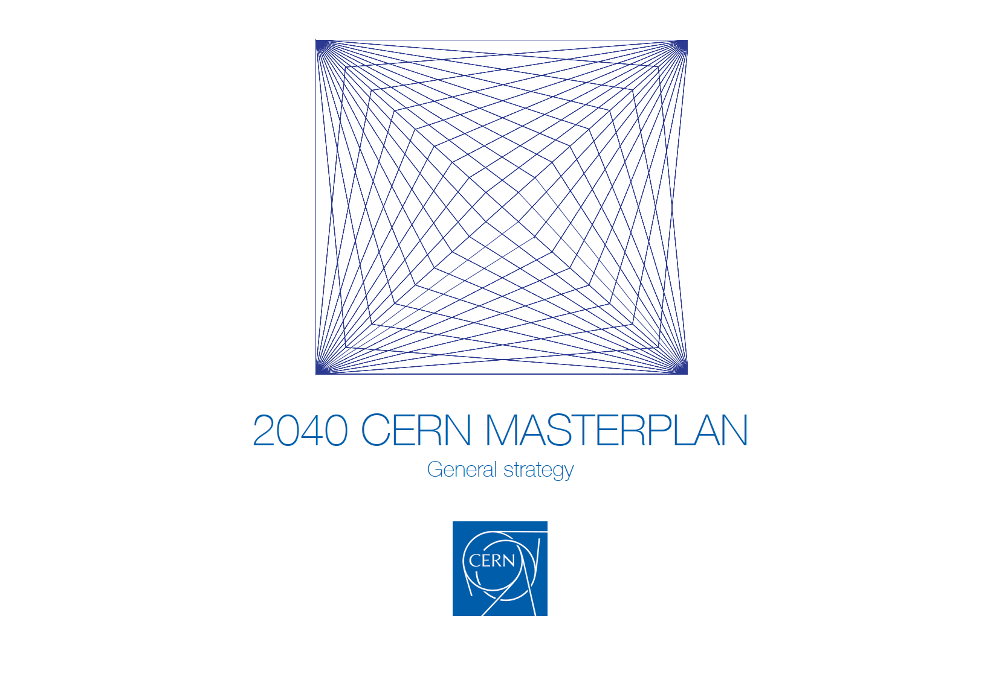
1. How do these certifications apply to CERN?
The Organization is committed to setting an example for environmentally responsible research and strives to contribute actively towards the UN Sustainable Development Goals
→ Action across 11 high-priority environmental domains
→ Publication of Environment Reports
→ 2040 CERN Masterplan
Still, there is no specific sustainability policy for its buildings
SCE has identified some pilot projects to test globally recognized frameworks for
tracking and measuring sustainability performance in the build environment
→ What are the benefits/implications of obtaining such certifications?
→ Where do our current efforts for a more sustainable campus stand in comparison to
industry benchmarks?
→ Could the experience obtained with the pilot projects help in the long term in
defining a clear policy, applicable to all construction projects?

Slide 3
1. How do these certifications apply to CERN?
 | BREEAM (UK) | WELL (USA) | Minergie (CH)
Main focus | Environmental sustainability | Health & Well-being | Energy efficiency & Comfort
Energy efficiency | Strong | Moderate | Very strong
Indoor Air Quality | Moderate | Strong | Strong
Comfort (termal, acoustic, etc.) | Moderate | Strong | Strong
Health & Well-being | Moderate | Very strong | Moderate
Water Use | Strong | Moderate | Moderate
Materials & Waste | Strong | Moderate | Low
Ideal use cases | Holistic certification, widely used in Europe, applicable to all types of buildings | Ideal for workplaces where health, productivity and comfort are top priorities | Perfect for energy-efficient buildings in Switzerland

Slide 4
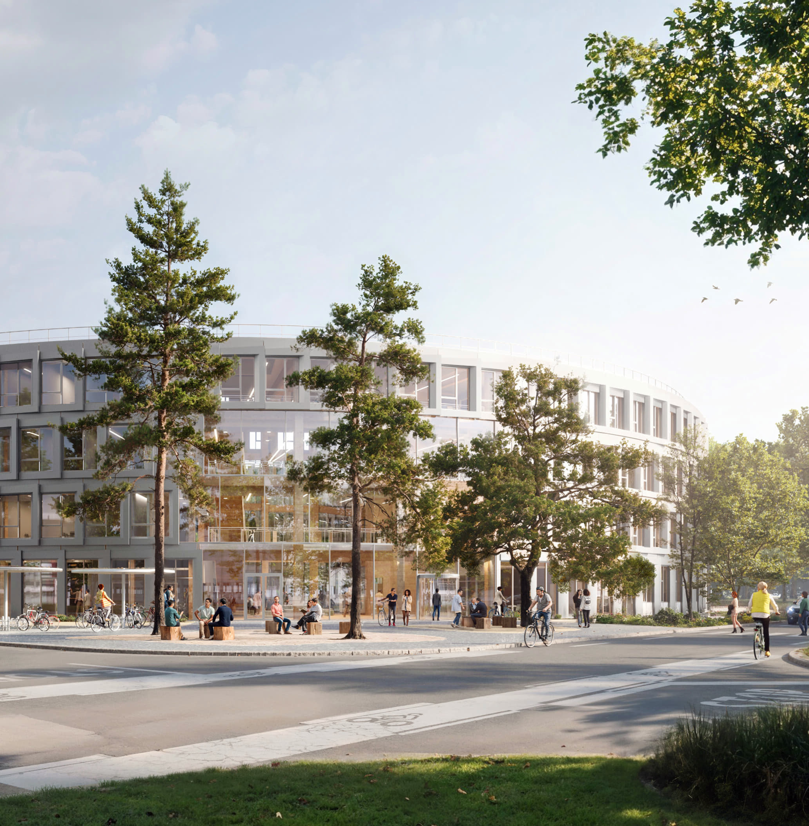
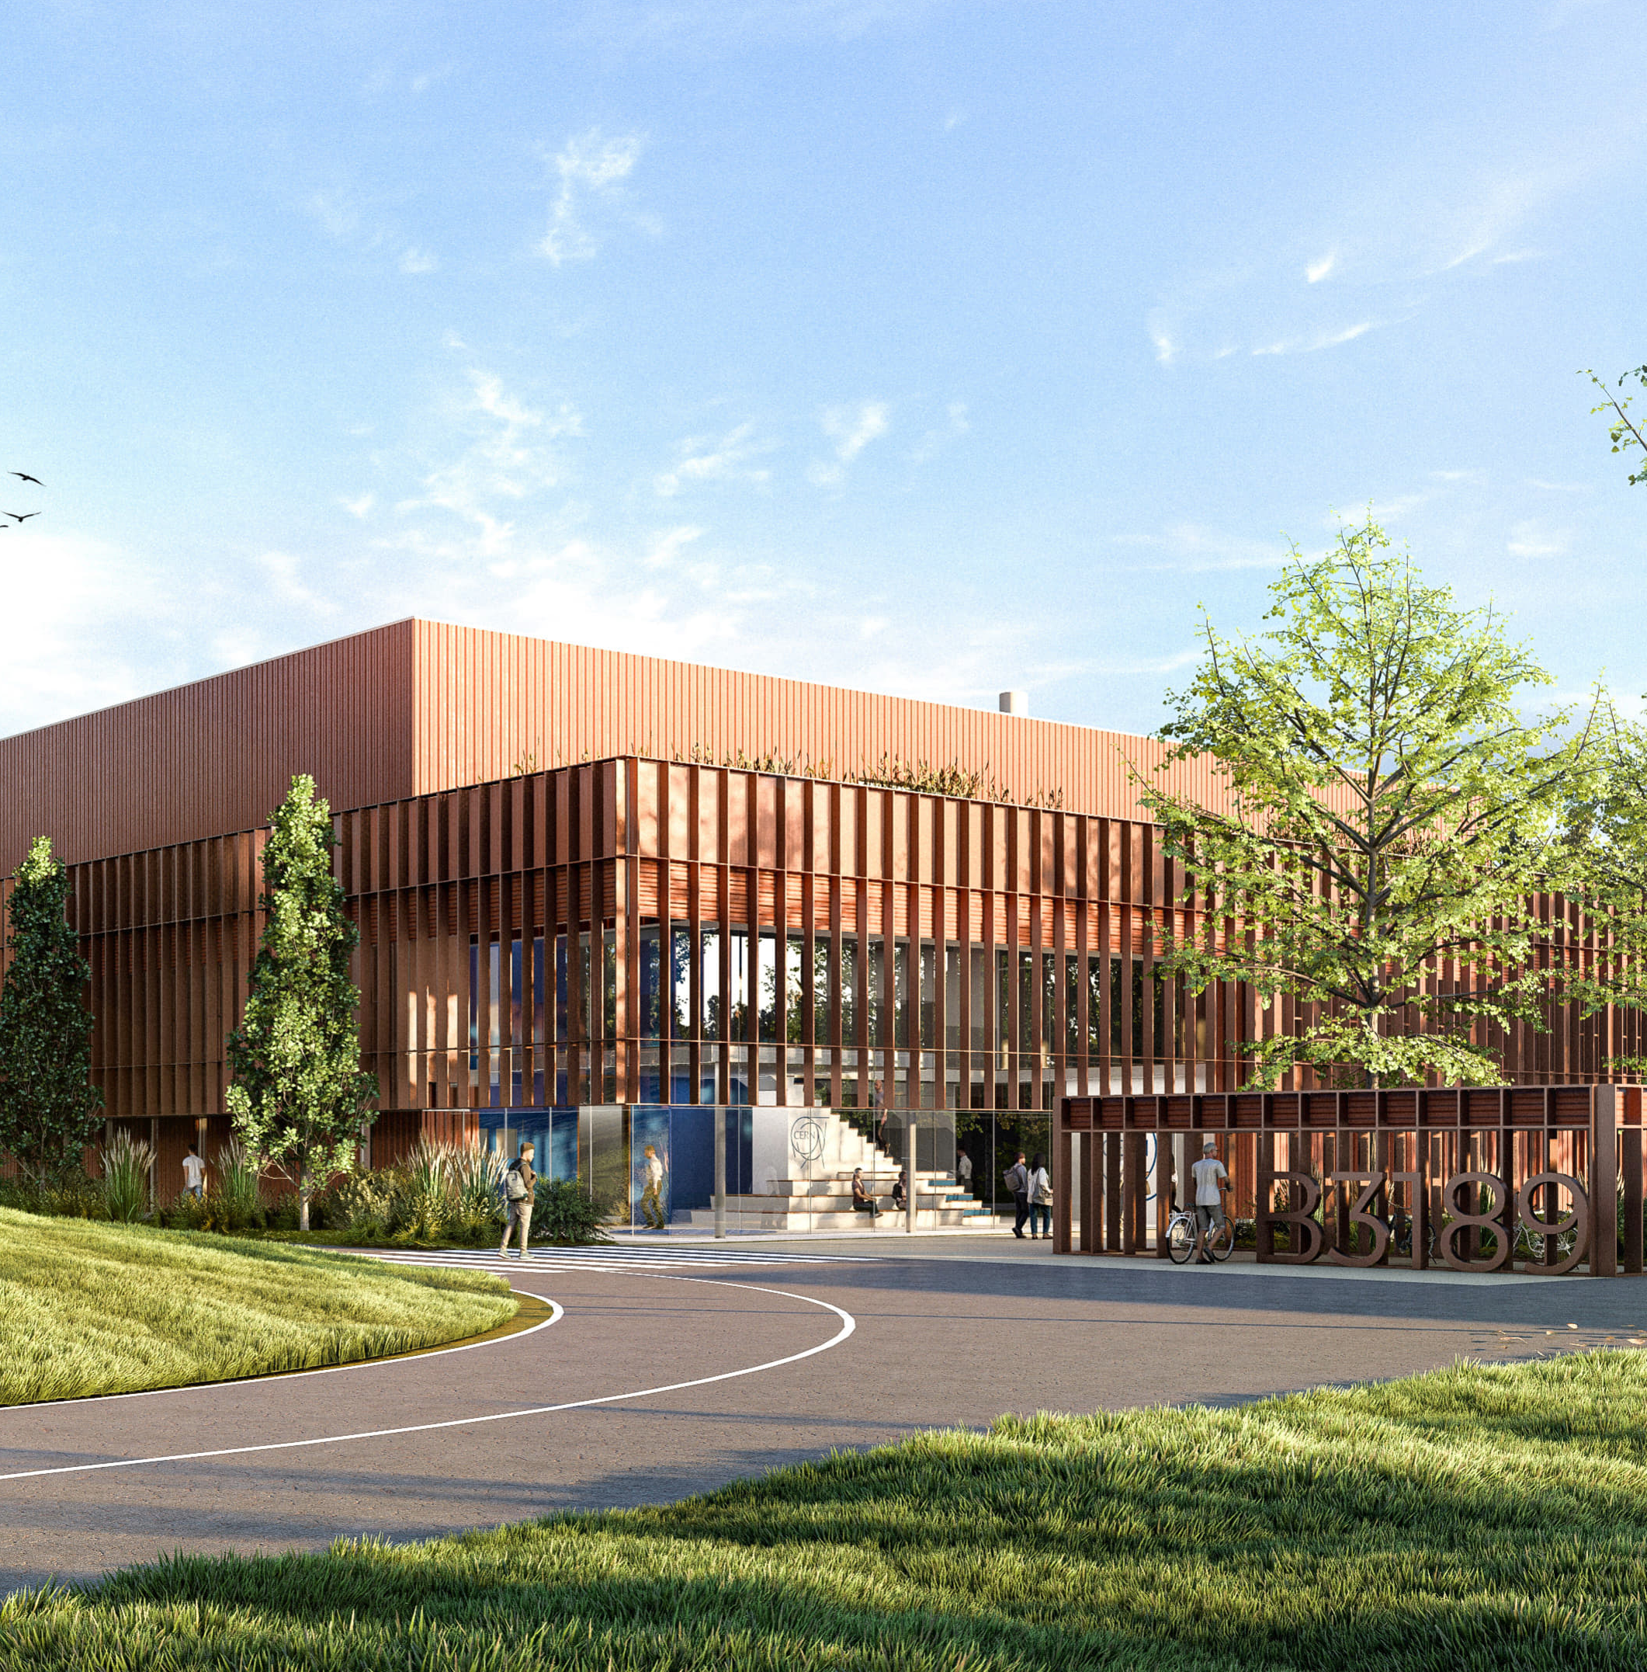
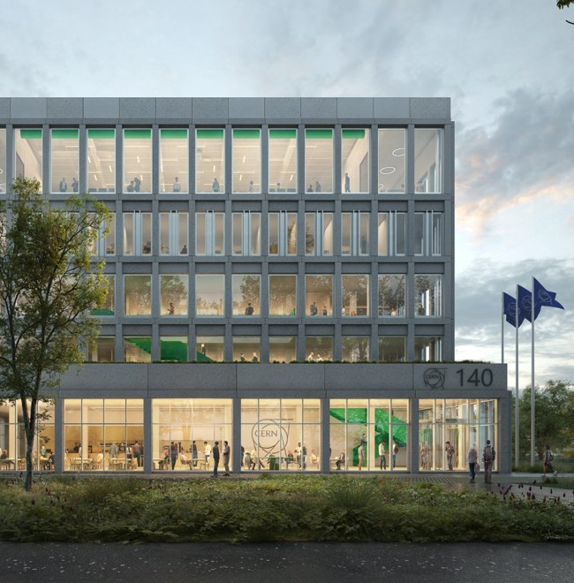
2. Ongoing projects at CERN
777_Tertiary
3189_Machine
140_Tertiary
BREEAM International New Construction v6
Type: Offices → Excellent
WELL Building Standard™ version 2 → Gold
BREEAM International New Construction v6
Type: Offices → Excellent
BREEAM International New Construction v6
Type: Offices → Outstanding
Minergie → Label base, P, A, Eco

Slide 5
3. Coordination
These certifications evaluate the overall performance of a building → all different work packages are concerned
Regular meetings with consultants and CERN stakeholders are required to check the progress status and collect the necessary information, both for design and documentation collection
Coordinated by SCE-PPM
TERTIARY BUILDINGS
777, 140
CONSULTANT
BREEAM
AP
SCE-
PPM
MACHINE BUILDINGS
3189
*A higher involvement of the client is needed for WELL
CONSULTANT
BREEAM
AP
SCE-
PPM

Slide 6
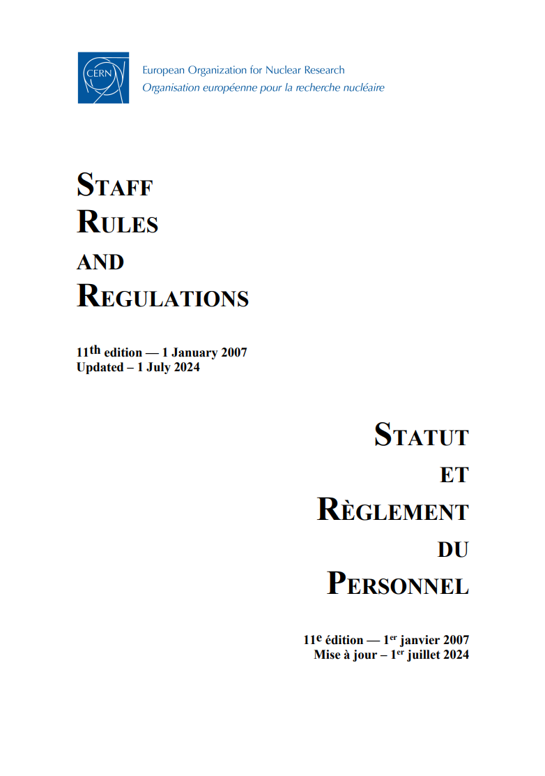
3. Coordination
The WELL Building Standard™ has several requirements concerning internal policies in various domains
It has called for discussion with different groups, usually not involved in building design/management (ex. HSE-OHS, HR-DH, HR-LD, HR-PXE, etc.)
→ Modifying CERN policies is a long process, but if modifications are ongoing
some further requirements can be implemented
(ex. “Smoking on the CERN site” policy)
→ It is in any case an occasion to open the discussion and understand what could
be implemented in the long term

Slide 7
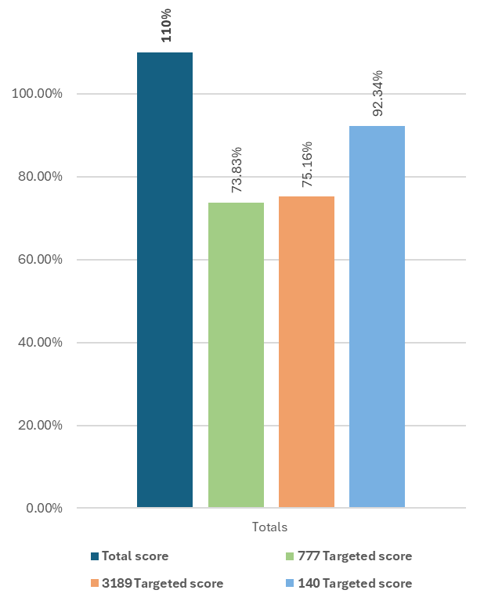
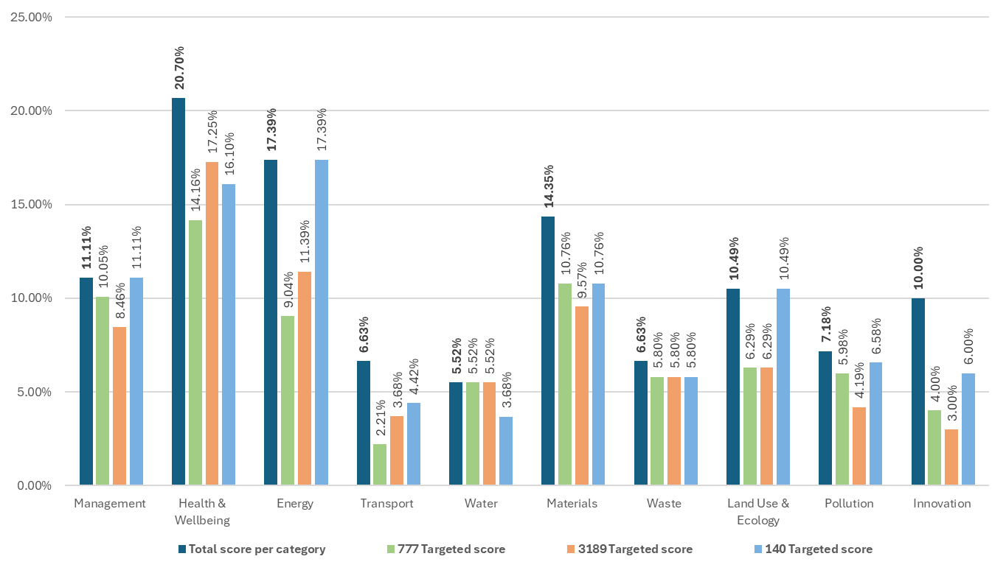
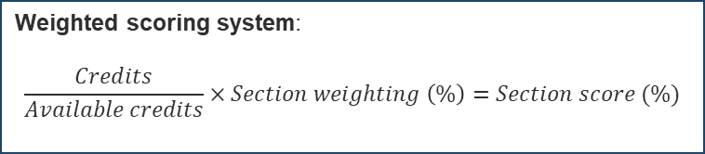
4. BREEAM Credits
Weighted scoring system:
$$\frac{Credits}{Available credits}×Section weighting \left(\%\right)=Section score (\%)$$
Credits chosen for each project depend on several factors:
Certification level
Project site
Project typology and baseline design
OUTSTANDING
85%
EXCELLENT
70%
VERY GOOD
55%
777 - EXCELLENT
3189 - EXCELLENT
140 - OUTSTANDING

Slide 8

5a. Key tasks - BREEAM
PROJECT PHASE | DEADLINE | BREEAM - TO DO
Concept design | Building Permit | Develop clear sustainability objectives and targets Consult all the relevant stakeholders The design is influenced by the BREEAM requirements → all work-packages
Detailed/Tender design | Contractor appointment – Start of construction | Include the BREEAM requirements in all tender documents → all work-packages Produce the necessary documentation for BREEAM DESIGN SUBMISSION → - Technical specifications + Drawings - Calculation reports - Confirmation letters - Meeting minutes, etc.
INTERIM (DESIGN) CERTIFICATION
Construction | End of construction | Monitoring the building site and construction Collect the necessary documentation for BREEAM FINAL SUBMISSION → - As design stage with as-built data - Manufacturers' product details - Site inspection reports - Photographic evidence, etc. Testing and commissioning
FINAL (POST-CONSTRUCTION) CERTIFICATION
In use | 1 year/3 years after initial building occupation | Ongoing data monitoring for energy and water consumption Follow maintenance requirements + Seasonal commissioning
Sustainable strategies are more effective with a lower additional cost
Coordination between different departments, groups and sections is critical
Low Nuisance Construction Site Charter
Contractor
BREEAM Assessor
Independent 3rd party

Slide 9
5b. Key tasks - WELL
PROJECT PHASE | DEADLINE | TO DO - WELL
Concept design |  | Develop clear sustainability objectives and targets Consult all the relevant stakeholders The design is influenced by the WELL requirements → all work-packages
Detailed/Tender design |  | Include the WELL requirements in all tender documents → all work-packages
Construction | Close to handover | Monitoring the building site and construction Prepare for WELL DOCUMENTATION SUBMISSION → - Letters of assurance - Professional narrative - Policy and/or Operations schedule - Technical documents - On-site photographs - Sensor data Performance pre-testing
End of construction | After construction is complete + 50% occupancy | Performance verification testing → - Air quality - Water - Light - Termal comfort - Sound
CERTIFICATION
For B777 the tender documents include both BREEAM and WELL requirements
Tests are conducted by an external WELL Performance testing agent

Slide 10
5b. Key tasks - WELL
PROJECT PHASE | DEADLINE | TO DO - WELL
Concept design |  | Develop clear sustainability objectives and targets Consult all the relevant stakeholders The design is influenced by the WELL requirements → all work-packages
Detailed/Tender design |  | Include the WELL requirements in all tender documents → all work-packages
Construction | Close to handover | Monitoring the building site and construction Produce the necessary documentation for SUBMISSION Performance pre-testing
End of construction | Construction complete + 50% occupancy | Performance verification testing
CERTIFICATION
In use | Every year | Ongoing data monitoring for air, water and thermal comfort Follow maintenance requirements
 | Every 3 years | Produce the necessary documentation for SUBMISSION → As first submission + On-going data/maintenance reports
RE-CERTIFICATION
Ongoing performance and data monitoring requirements are more stringent than for BREEAM.
For both certifications, handover from SCE-PPM to Facility management has to be carefully prepared:
Discussions during design phase (assess feasibility+engagement)
Provide clear list of requirements at the end of construction

Slide 11
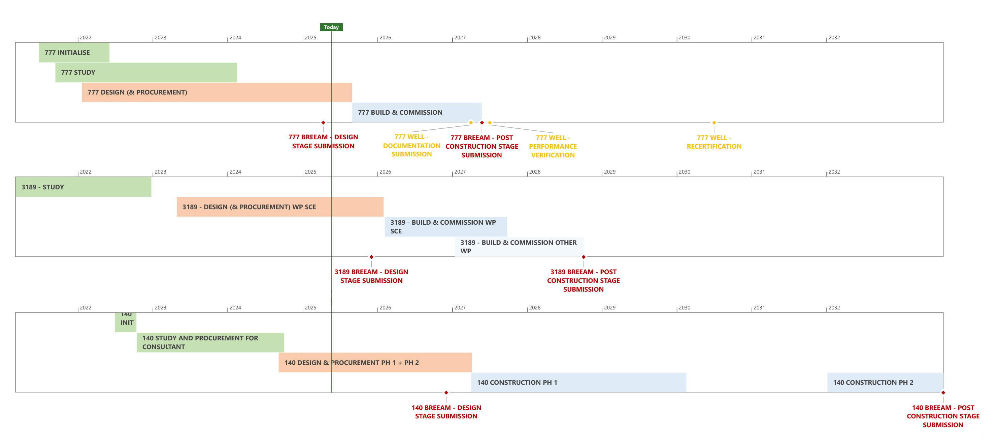
6. Timeline – BREEAM + WELL
140 3189 777

Slide 12
7. Conclusions
BENEFITS |  |  | DOWNSIDES |  | MITIGATION STRATEGIES
Early planning and clear goals |  |  | Not always context-sensitive |  | Use as guideline, but tailor strategies to the project
Integrated design approach |  |  | Bureaucratic and time consuming |  | Independent of the project size | Bigger projects are more suitable to be assessed
From upfront cost to life-cycle value |  |  | Additional costs
Learning by doing |  |  | Learning curve |  | Use data to refine your approach in future projects Focus on outcome not only on certification, go beyond certifications if it makes sense
Building performance verification |  |  | Mesurable over meaningful

Slide 13
7. Conclusions
The ongoing work allows to evaluate the current effort for a sustainable development of CERN sites against globally recognised sustainability assessment methods
ON-TRACK | IMPLEMENTED – COULD BE BENEFICIAL
Landscape preservation + Biodiversity protection Mobility strategy Water protection Operational+hazarduous waste management Noise limitation ... | Building’s functional adaptability + End of life Life cycle cost analysis (Investment - Maintenance - Variants) Low environmental impact of construction site Data collection and building performance verification (Actual/Predicted) ...
Even if a certification is not pursued, some principles and good practices can be applied, regardless of the size of the project
A post-construction evaluation of the 3 pilot projects will be necessary, to be able to compare the results and draw conclusions about the overall benefits and impacts on project development and building performance

