Slide 1


BTL Progress Update @ CMS
4.29.2025
Zhihao Cheng

Slide 2
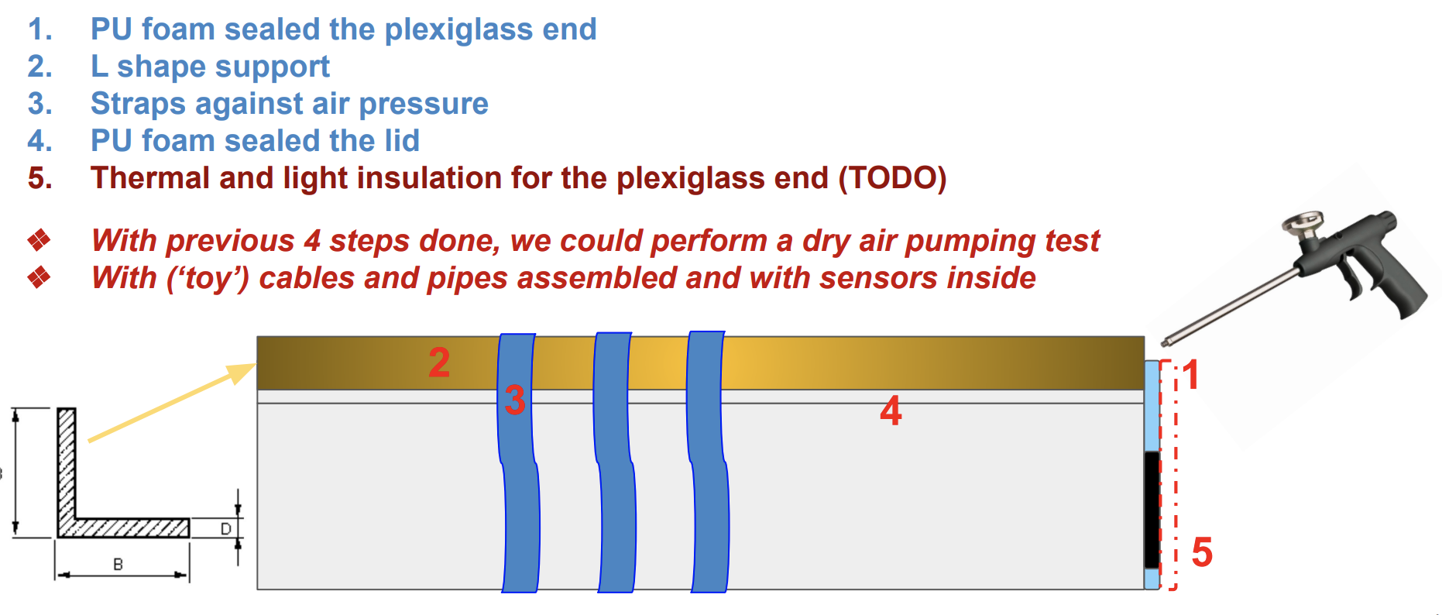
TIF Assembly Update
Unknown problem found on the BTST; date of access still uncertain (earliest: June)
Increase efficiency for beam assembly and feet calibration
2nd Coldbox sealed onto the new tray for the dry air test
Airex sheets arrived for thermal insulation and tray protection

Slide 3
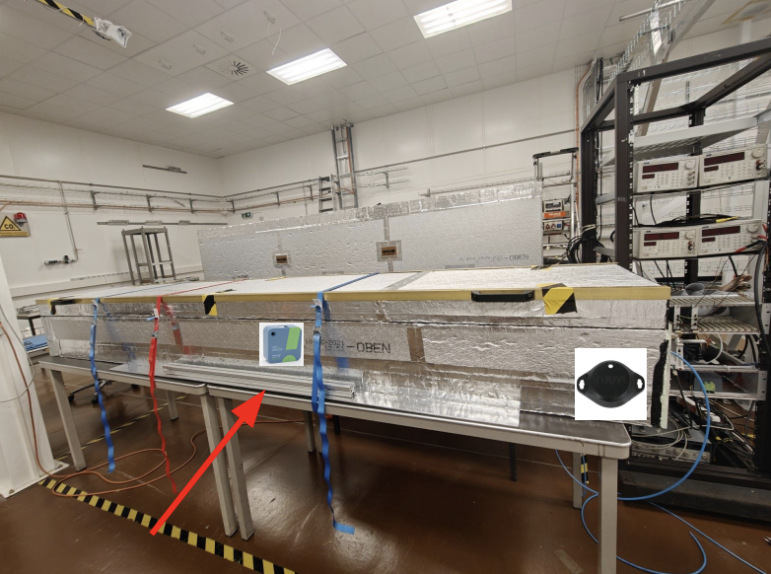
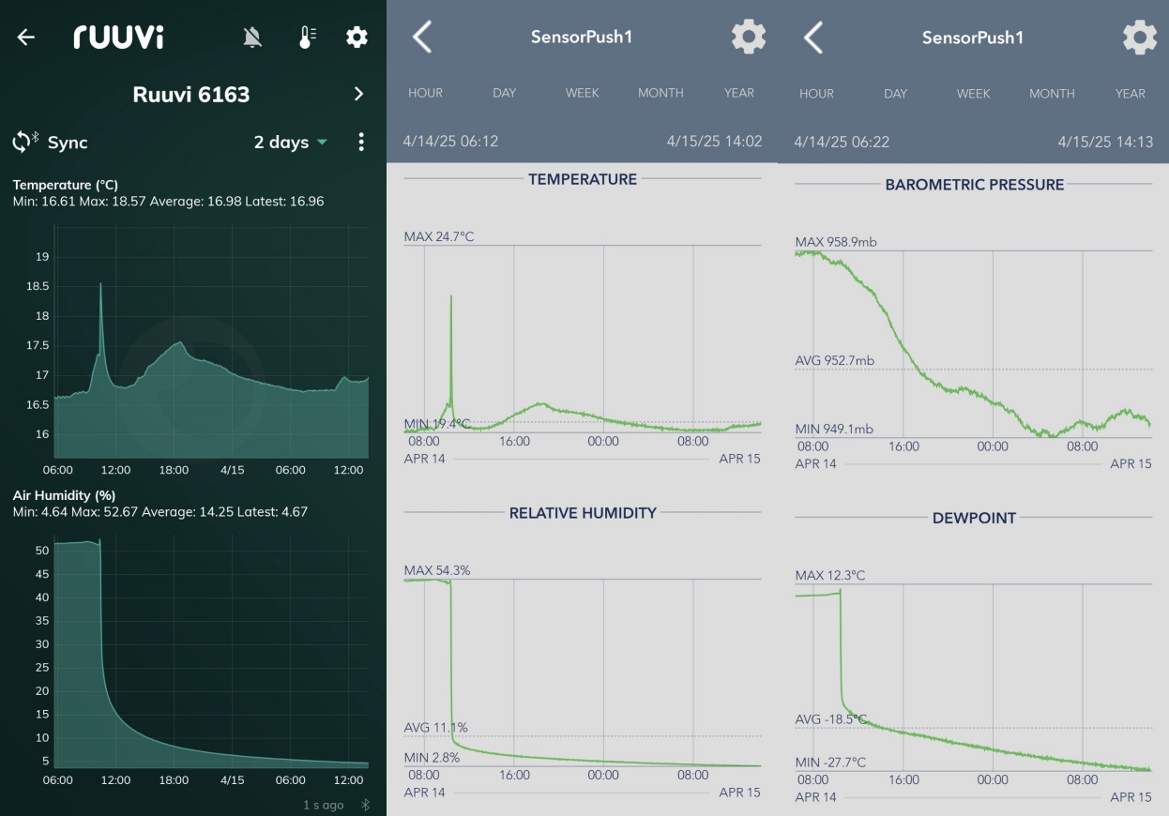

Slide 4
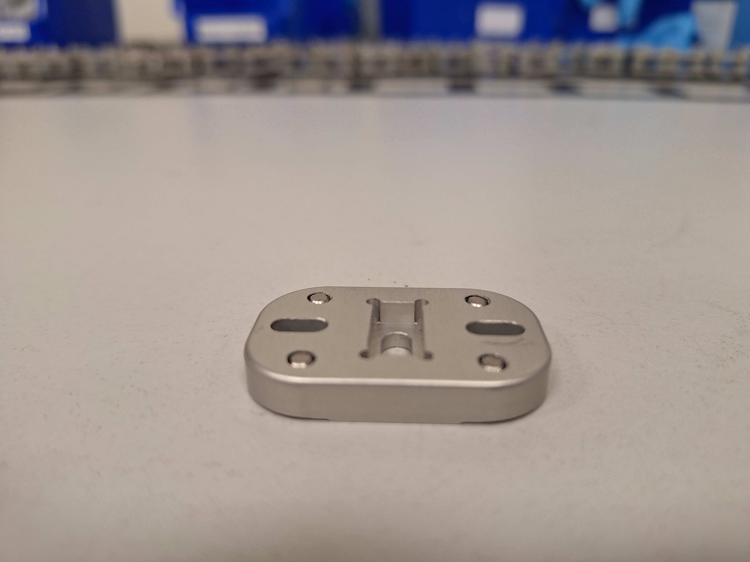
Feet Calibration Update
Old feet calibration procedure ceased because of the material problem and calibration time
Instead, we created an “archaic” method that roughly adjust the height based on Allen key turns
# of turns = (height - 6) * 3/2
Less accuracy, but much faster and easier to calibrate

Slide 5
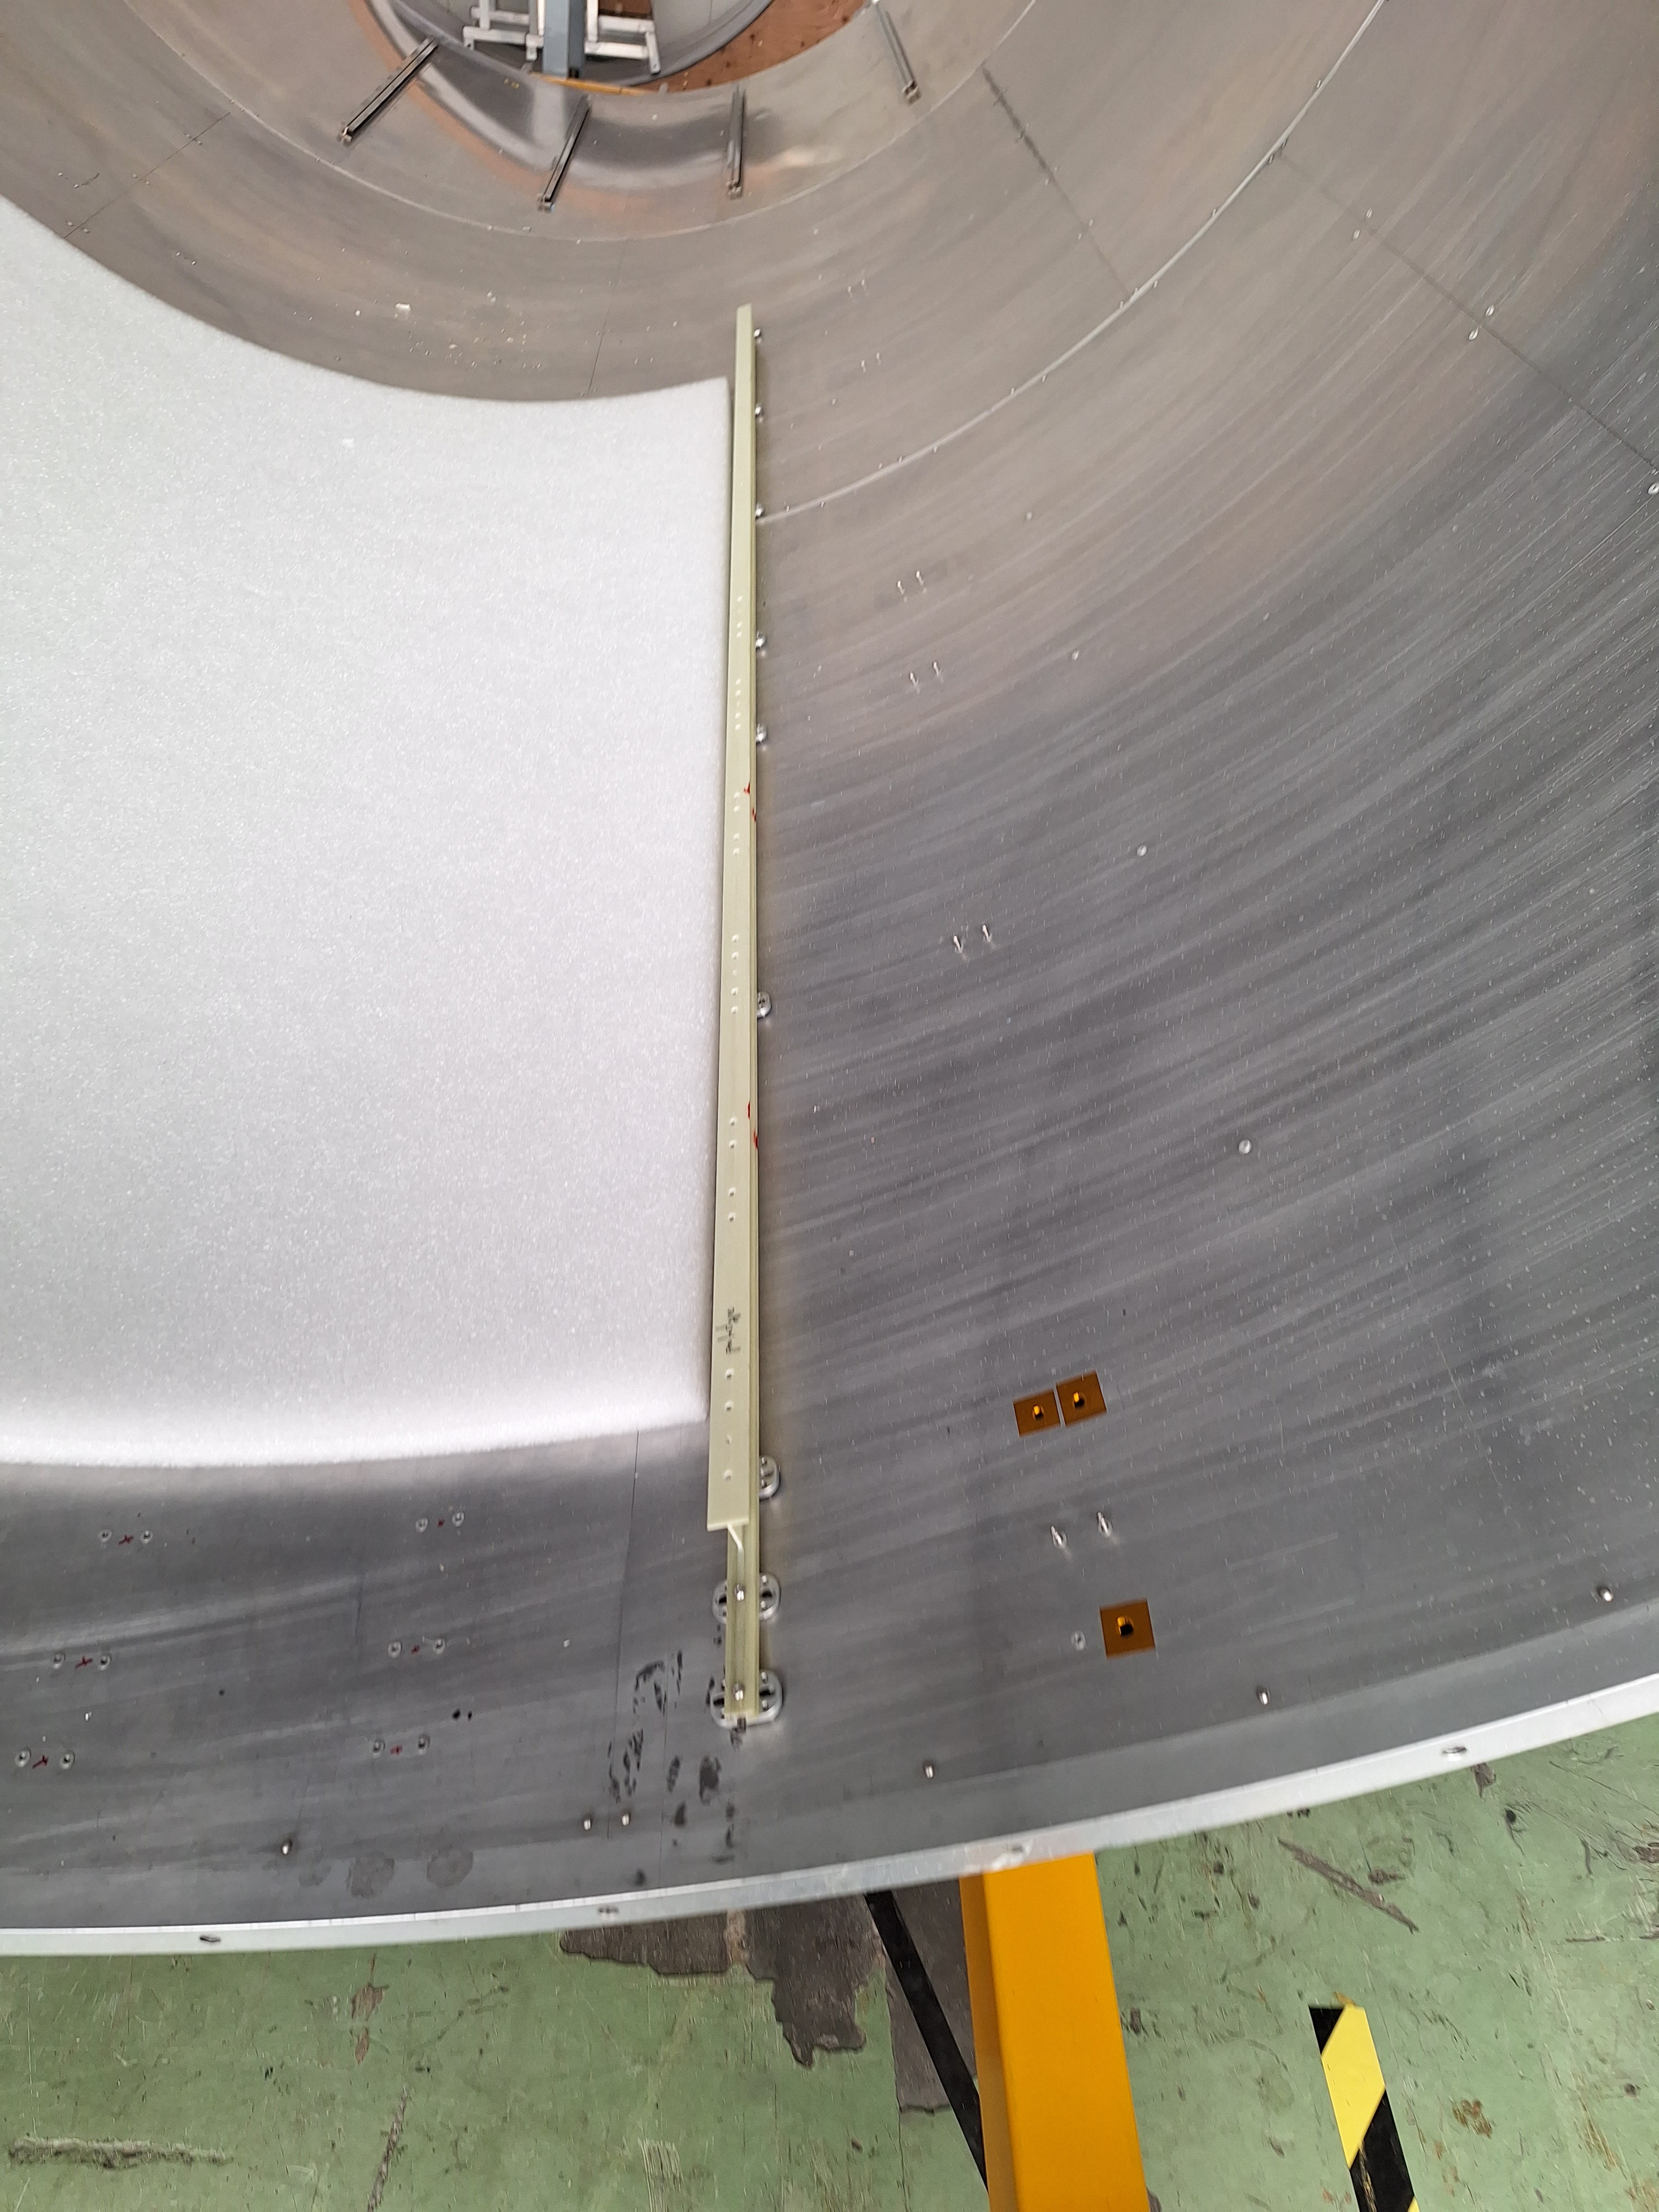
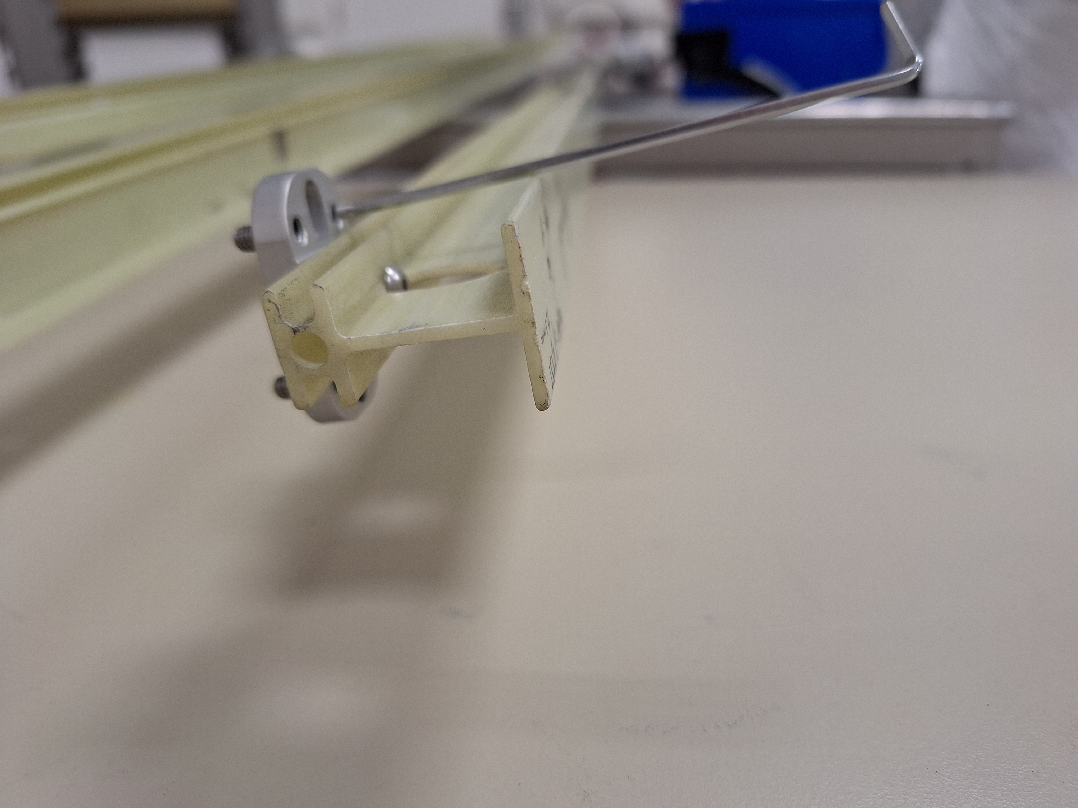
Beam Assembly Update
Cannot access the BTST -> test the assembly procedure on the testing support tube (TST)
Still require refinement of feet calibration while attached to the beam
Angling of Allen key makes calibration difficult (need to drill holes?)
We don’t have the data for TST -> picked random feet height

Slide 6
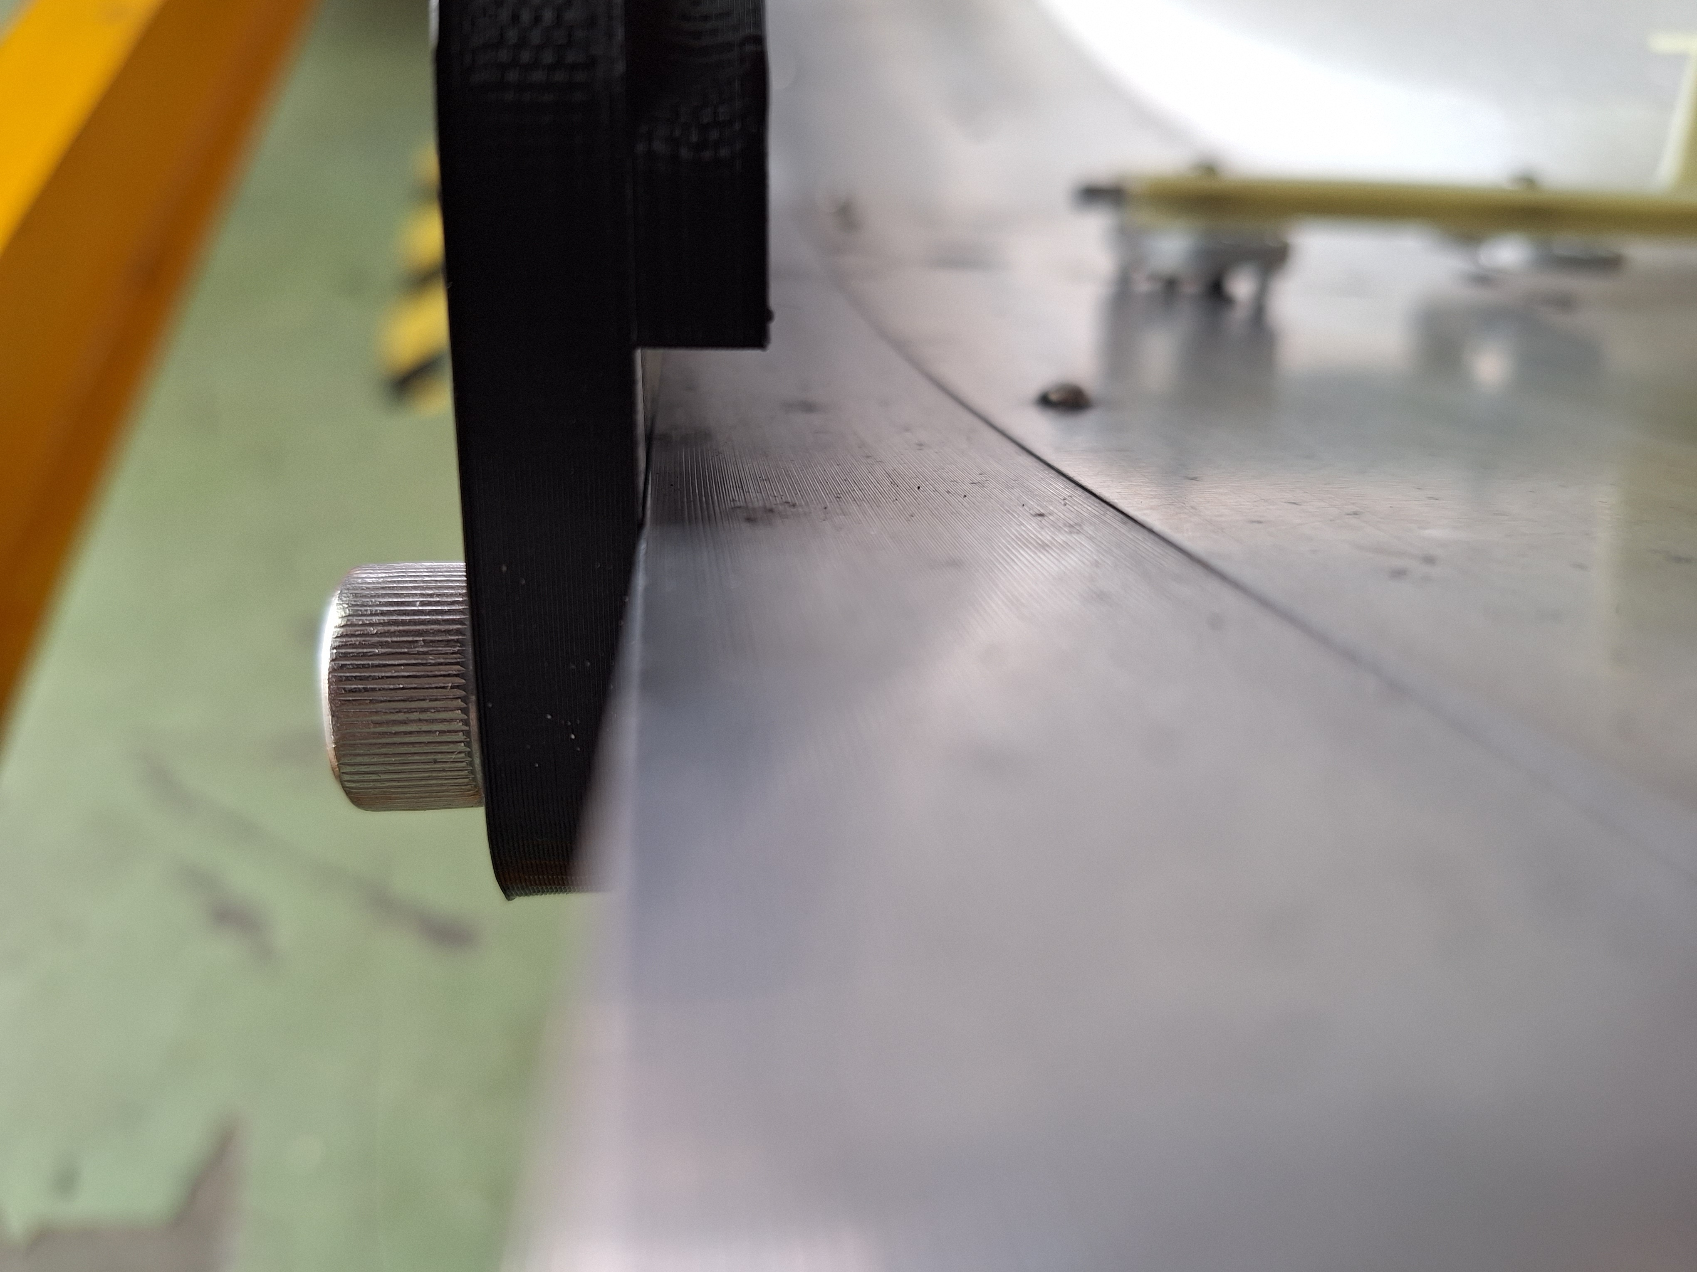
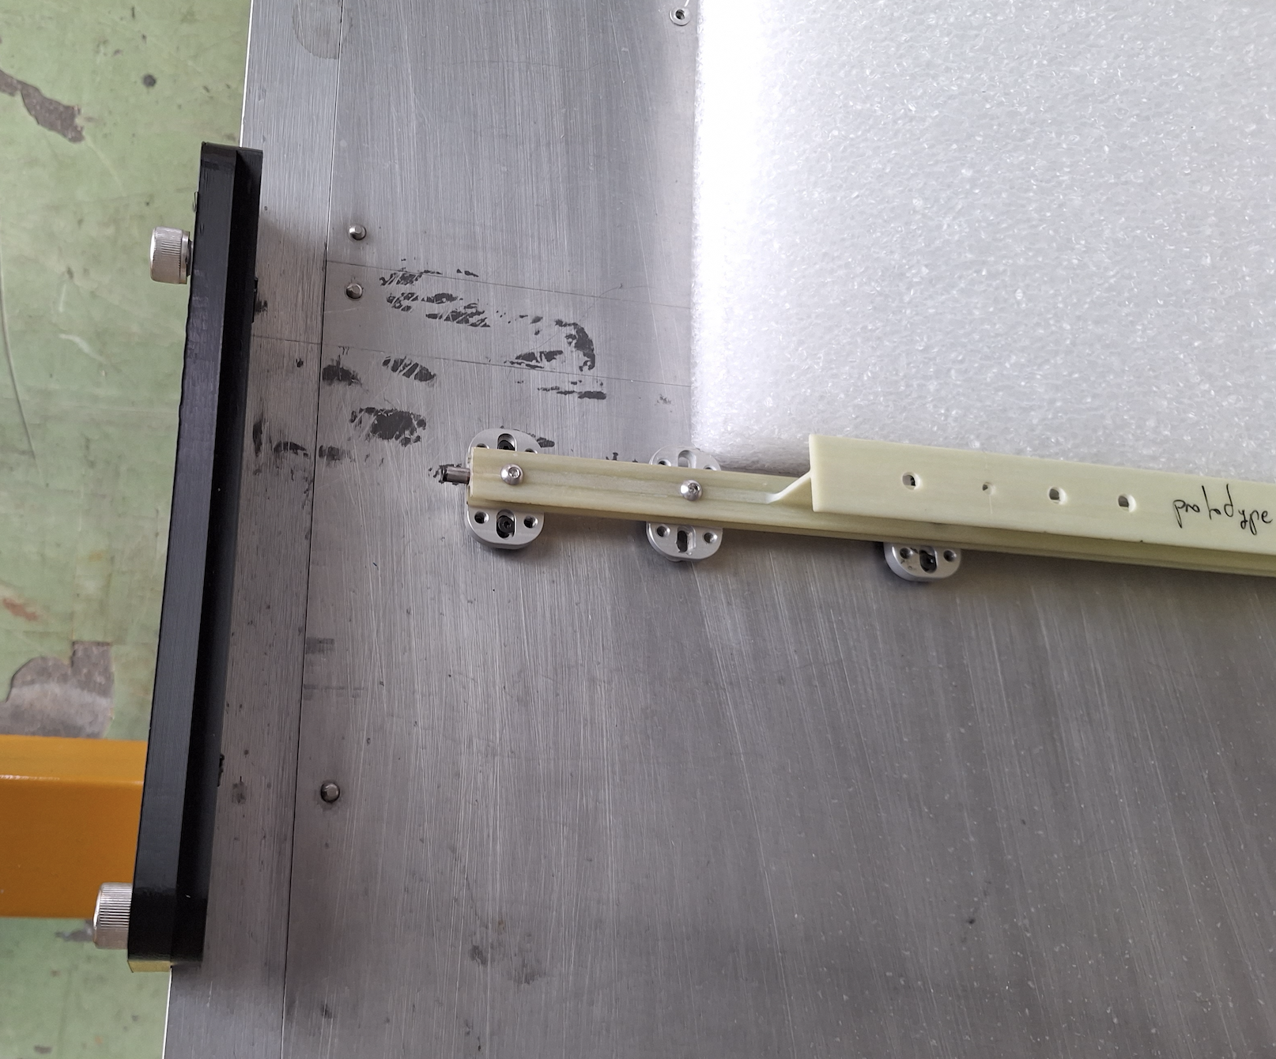
Beam Assembly Update
Have a U-shaped profile for unknown reason (beam support?)
Need a spacing of 8mm between the profile and the beam
The assembly on TST doesn’t say so; don’t know if it’s the case on BTST
Not enough space for mockup beam assembly

Slide 7

Next Step
Get more shifts at TIF to work on beam assembly (feet calibration), dry air test with the 2nd Coldbox, airex sheet mounting, etc.
Discussed with my tray testing advisor on future meetings, including MAI meetings on Tuesdays & commissioning meetings on Wednesdays
Tray Assembly: TECs testing, LYSO energy spectra…; fiberglass strips arrived for DM/SM spacers

