Slide 1



Weekly Updates
Pedro Baculima – 29/04/2025
1

Slide 2
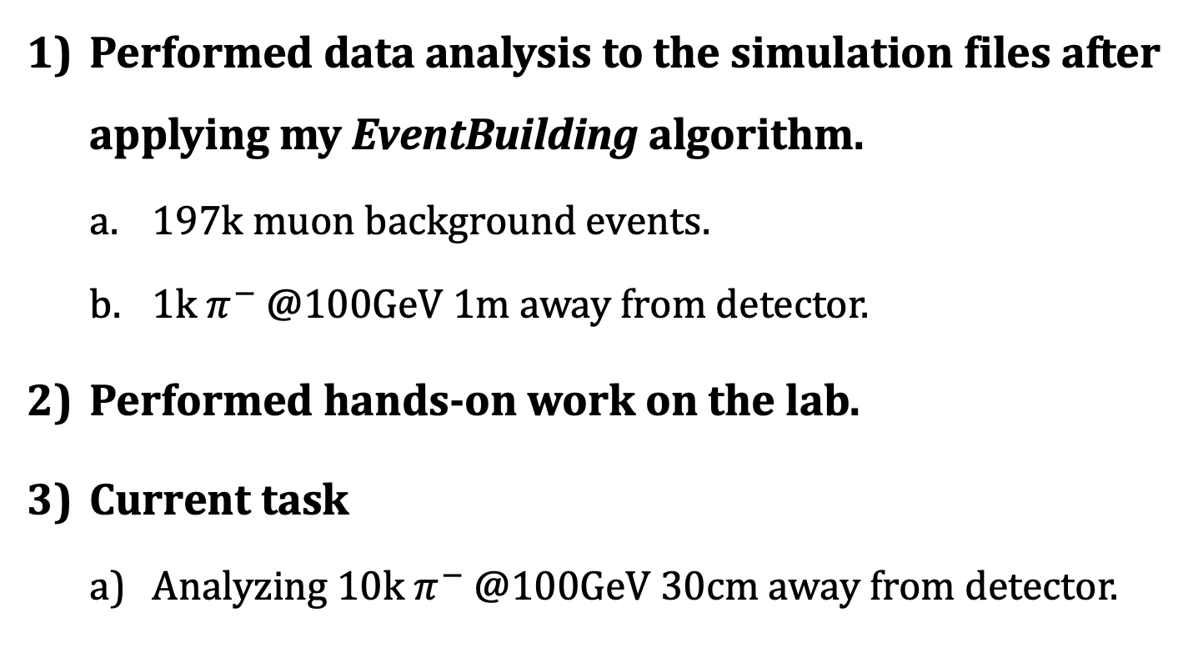
Overview
Performed data analysis to the simulation files after applying my EventBuilding algorithm.
  197k muon background events.
  1k $π^{−}$ @100GeV 1m away from detector.
Performed hands-on work on the lab.
Current task
  Analyzing 10k $π^{−}$ @100GeV 30cm away from detector.
Pedro Baculima – 29/04/2025
2

Slide 3
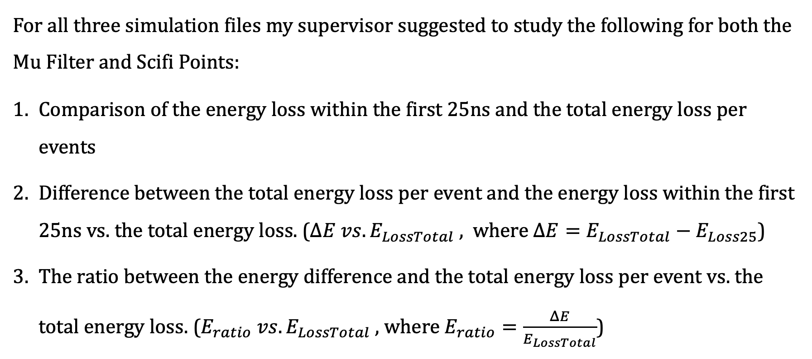
Common tests
For all three simulation files my supervisor suggested to study the following for both the Mu Filter and Scifi Points:
Comparison of the energy loss within the first 25ns and the total energy loss per events
Difference between the total energy loss per event and the energy loss within the first 25ns vs. the total energy loss. ($ΔE vs. E_{LossTotal} ,$ where $ΔE=E_{LossTotal}−E_{Loss25}$)
The ratio between the energy difference and the total energy loss per event vs. the total energy loss. ($E_{ratio} vs. E_{LossTotal}$ , where $E_{ratio}=\frac{ΔE}{E_{LossTotal}}$)
Pedro Baculima – 29/04/2025
3

Slide 4
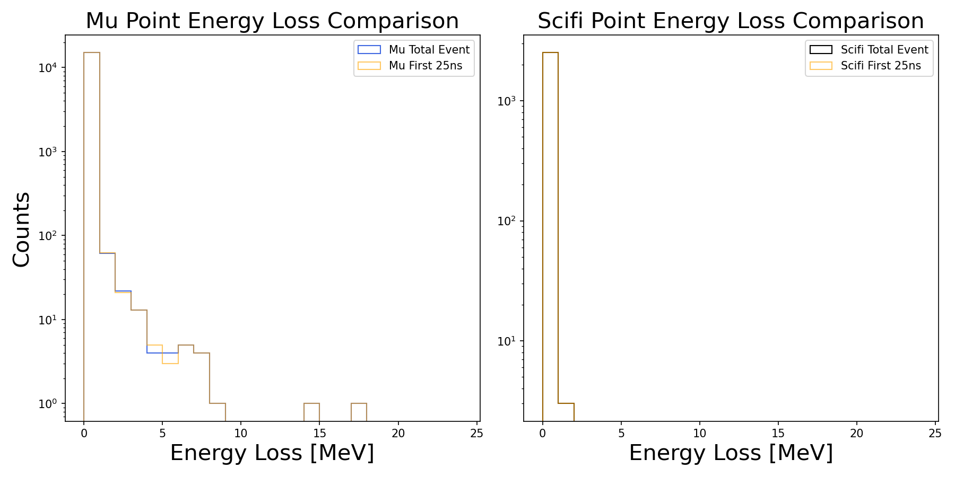
Muon background events
Pedro Baculima – 29/04/2025
4

Slide 5
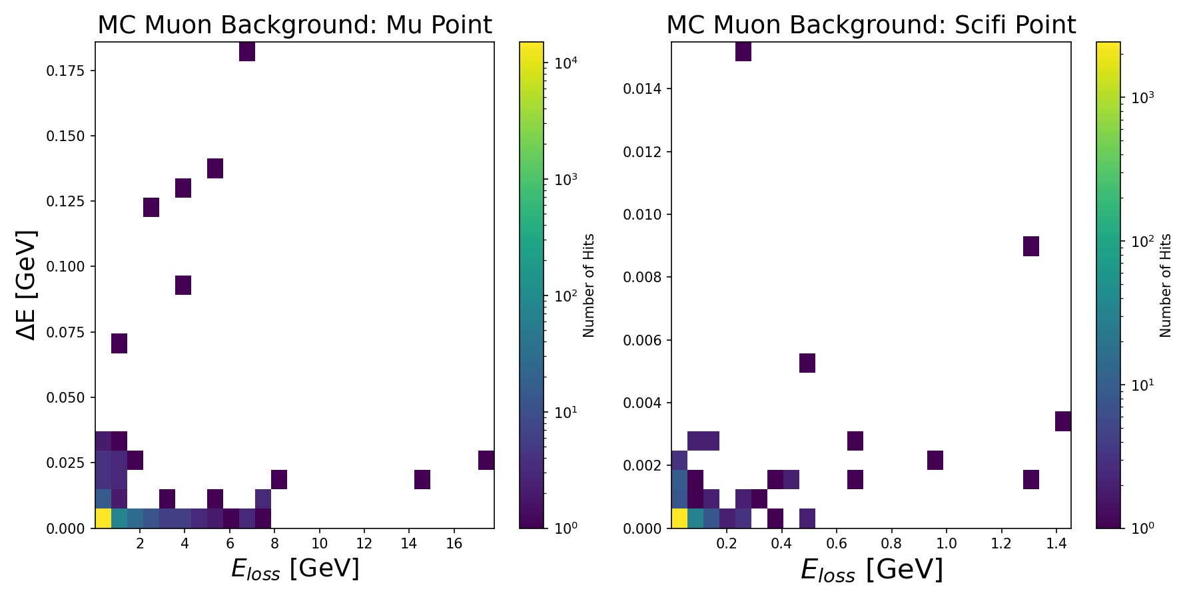
Muon background events
Pedro Baculima – 29/04/2025
5

Slide 6
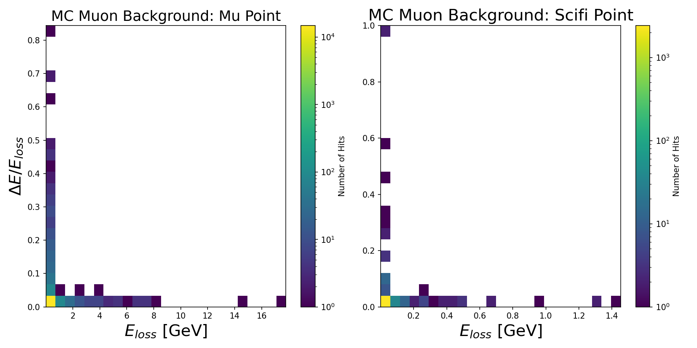
Muon background events
Pedro Baculima – 29/04/2025
6

Slide 7
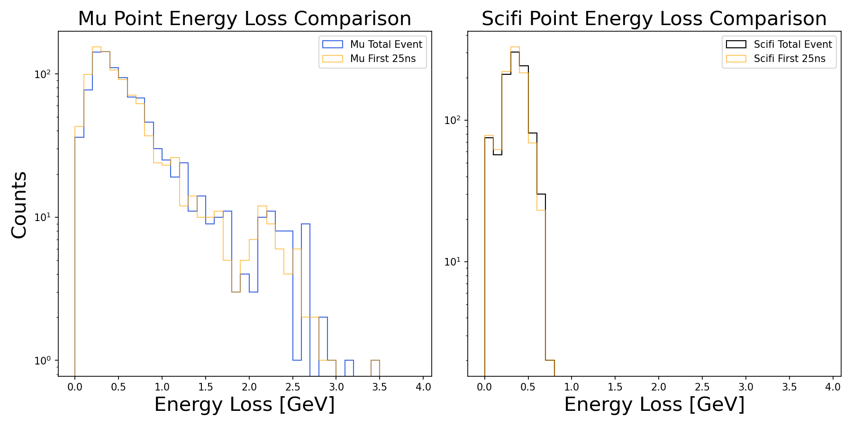

$π^{−}$ @100GeV, 1m away
Pedro Baculima – 29/04/2025
7

Slide 8
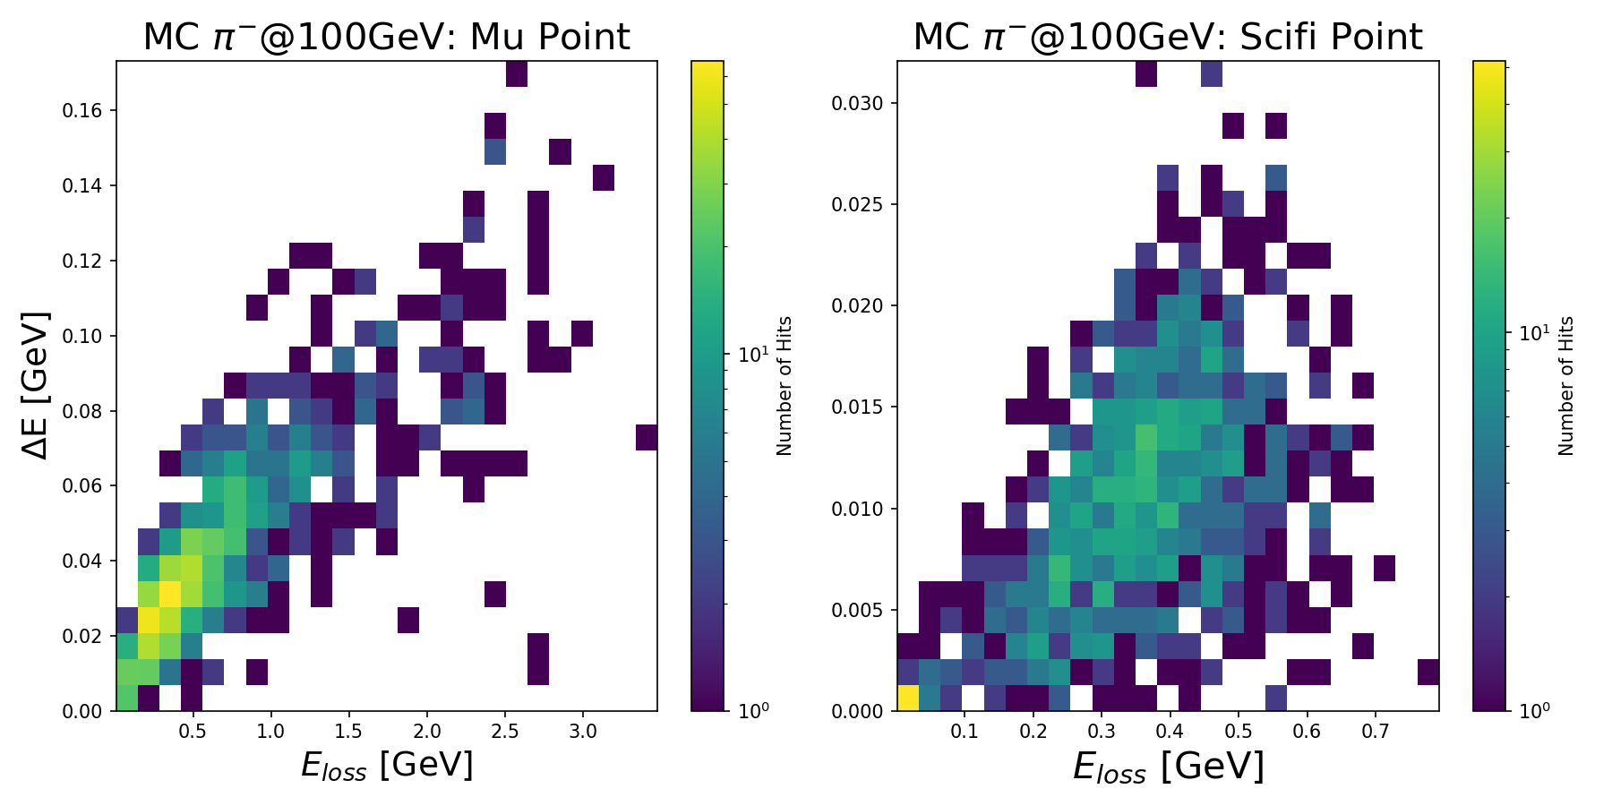
$π^{−}$ @100GeV, 1m away
Pedro Baculima – 29/04/2025
8

Slide 9
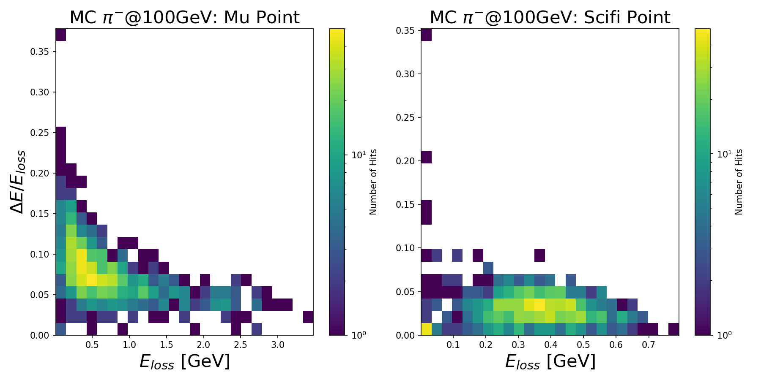
$π^{−}$ @100GeV, 1m away
Pedro Baculima – 29/04/2025
9

Slide 10

$π^{−}$ @100GeV, 30cm away
Working on this!!
All the reconstructed events seem to have the same id which makes it complicated to match them with the original.
I will be meeting with my supervisor today to discuss this issue.
Pedro Baculima – 29/04/2025
10

Slide 11
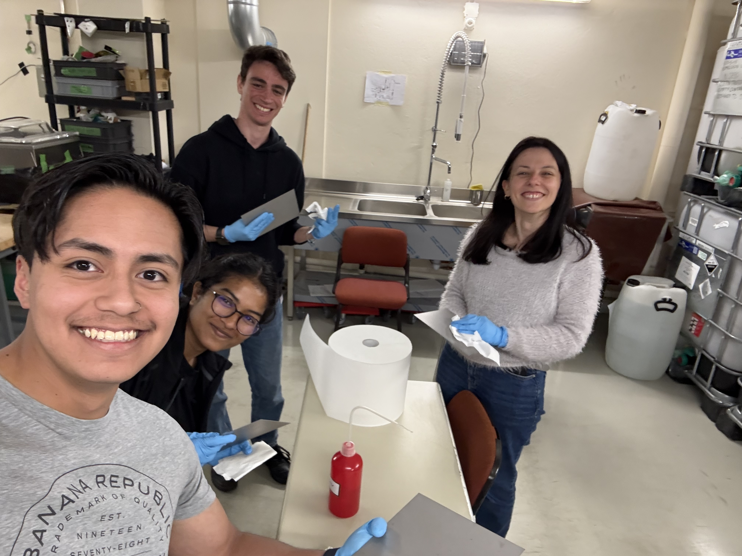
Other Updates
I helped with the cleaning of the tungsten plates of the detector.
We use alcohol to clean any emulsion left in the plates and also look for any corrosion.
I will be performing hands-on work whenever an extra help is needed to speed up the process.
Pedro Baculima – 29/04/2025
11

Slide 12
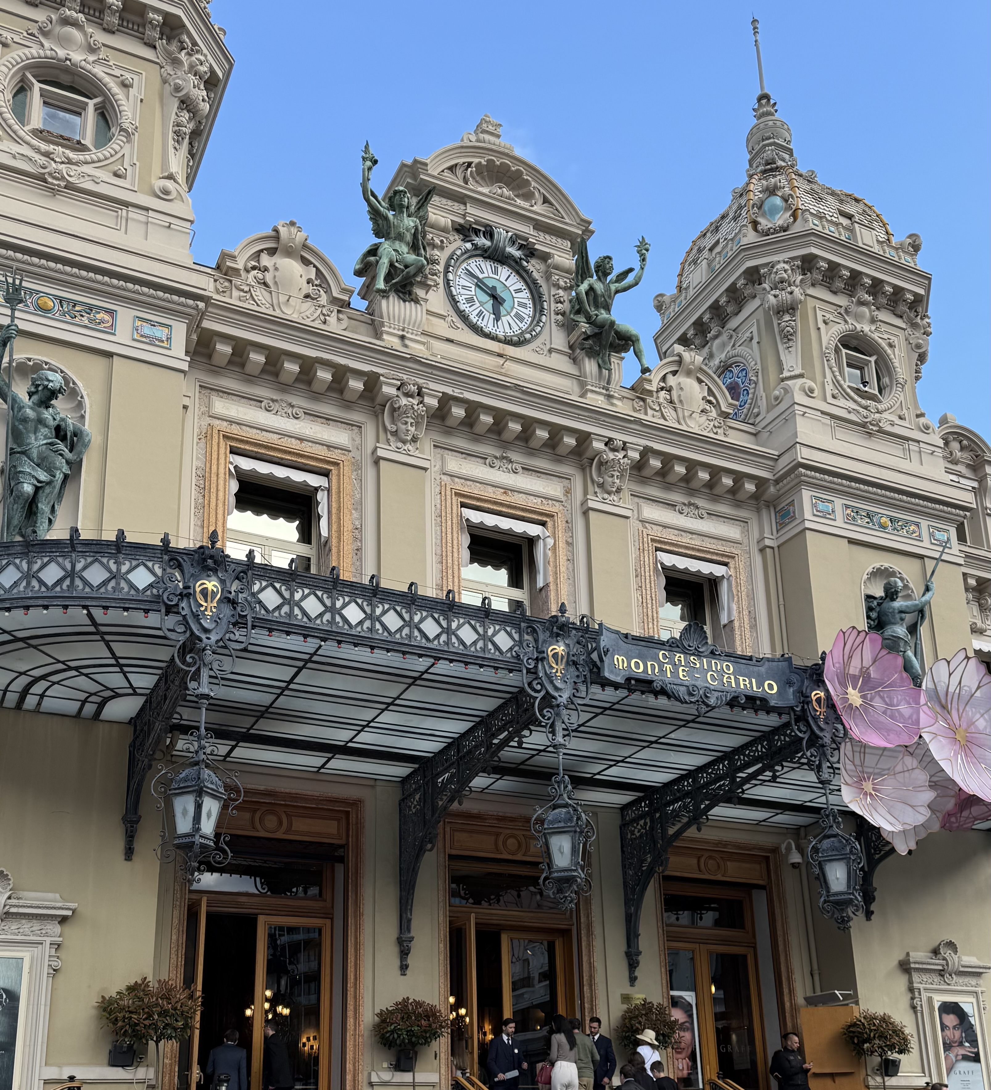
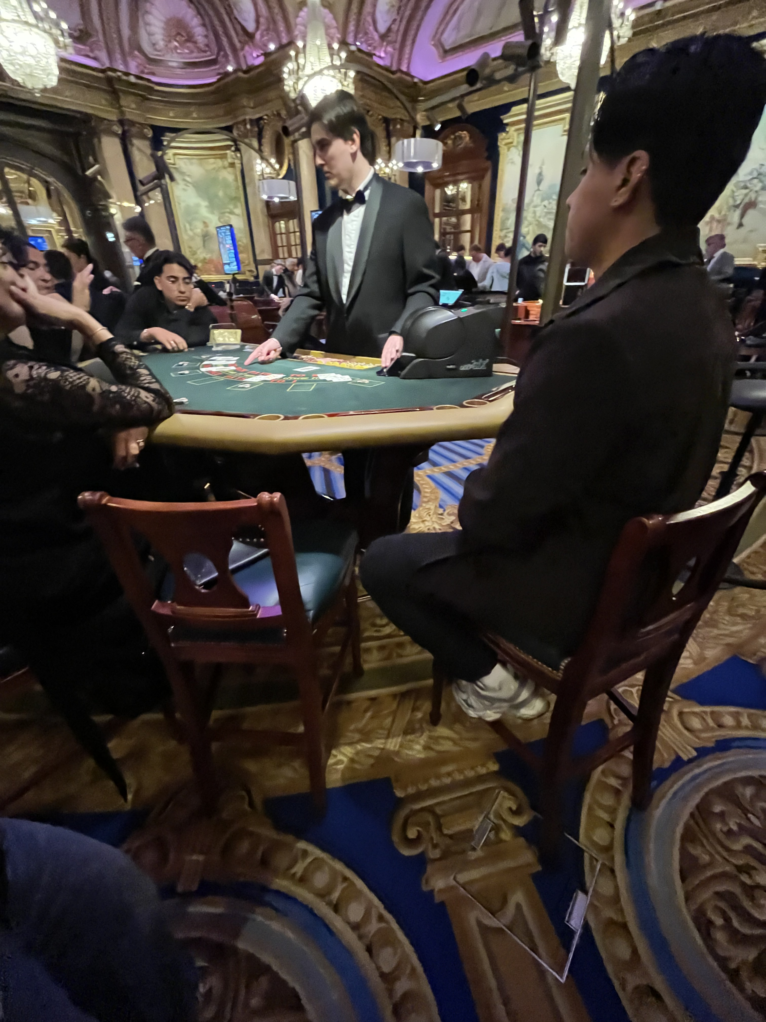
Spring break updates
Monte Carlo simulations? I had to go check the source of this nonsense!!!
Pedro Baculima – 29/04/2025
12

Slide 13
Thank you!
Pedro Baculima – 29/04/2025
13

