Slide 1


Performance Evaluation of TOF-PET Readout Electronics: Progress & Contributions #5
Cesar Cardona*
Boston University | Group: EP-CMX-DD
Mentors: Carsten Lowis✲ , Giulia Terragni※
* sciences@bu.edu | ✲ carsten.lowis@cern.ch | ※ giulia.terragni@cern.ch
Cesar Cardona
April 29, 2025

Slide 2
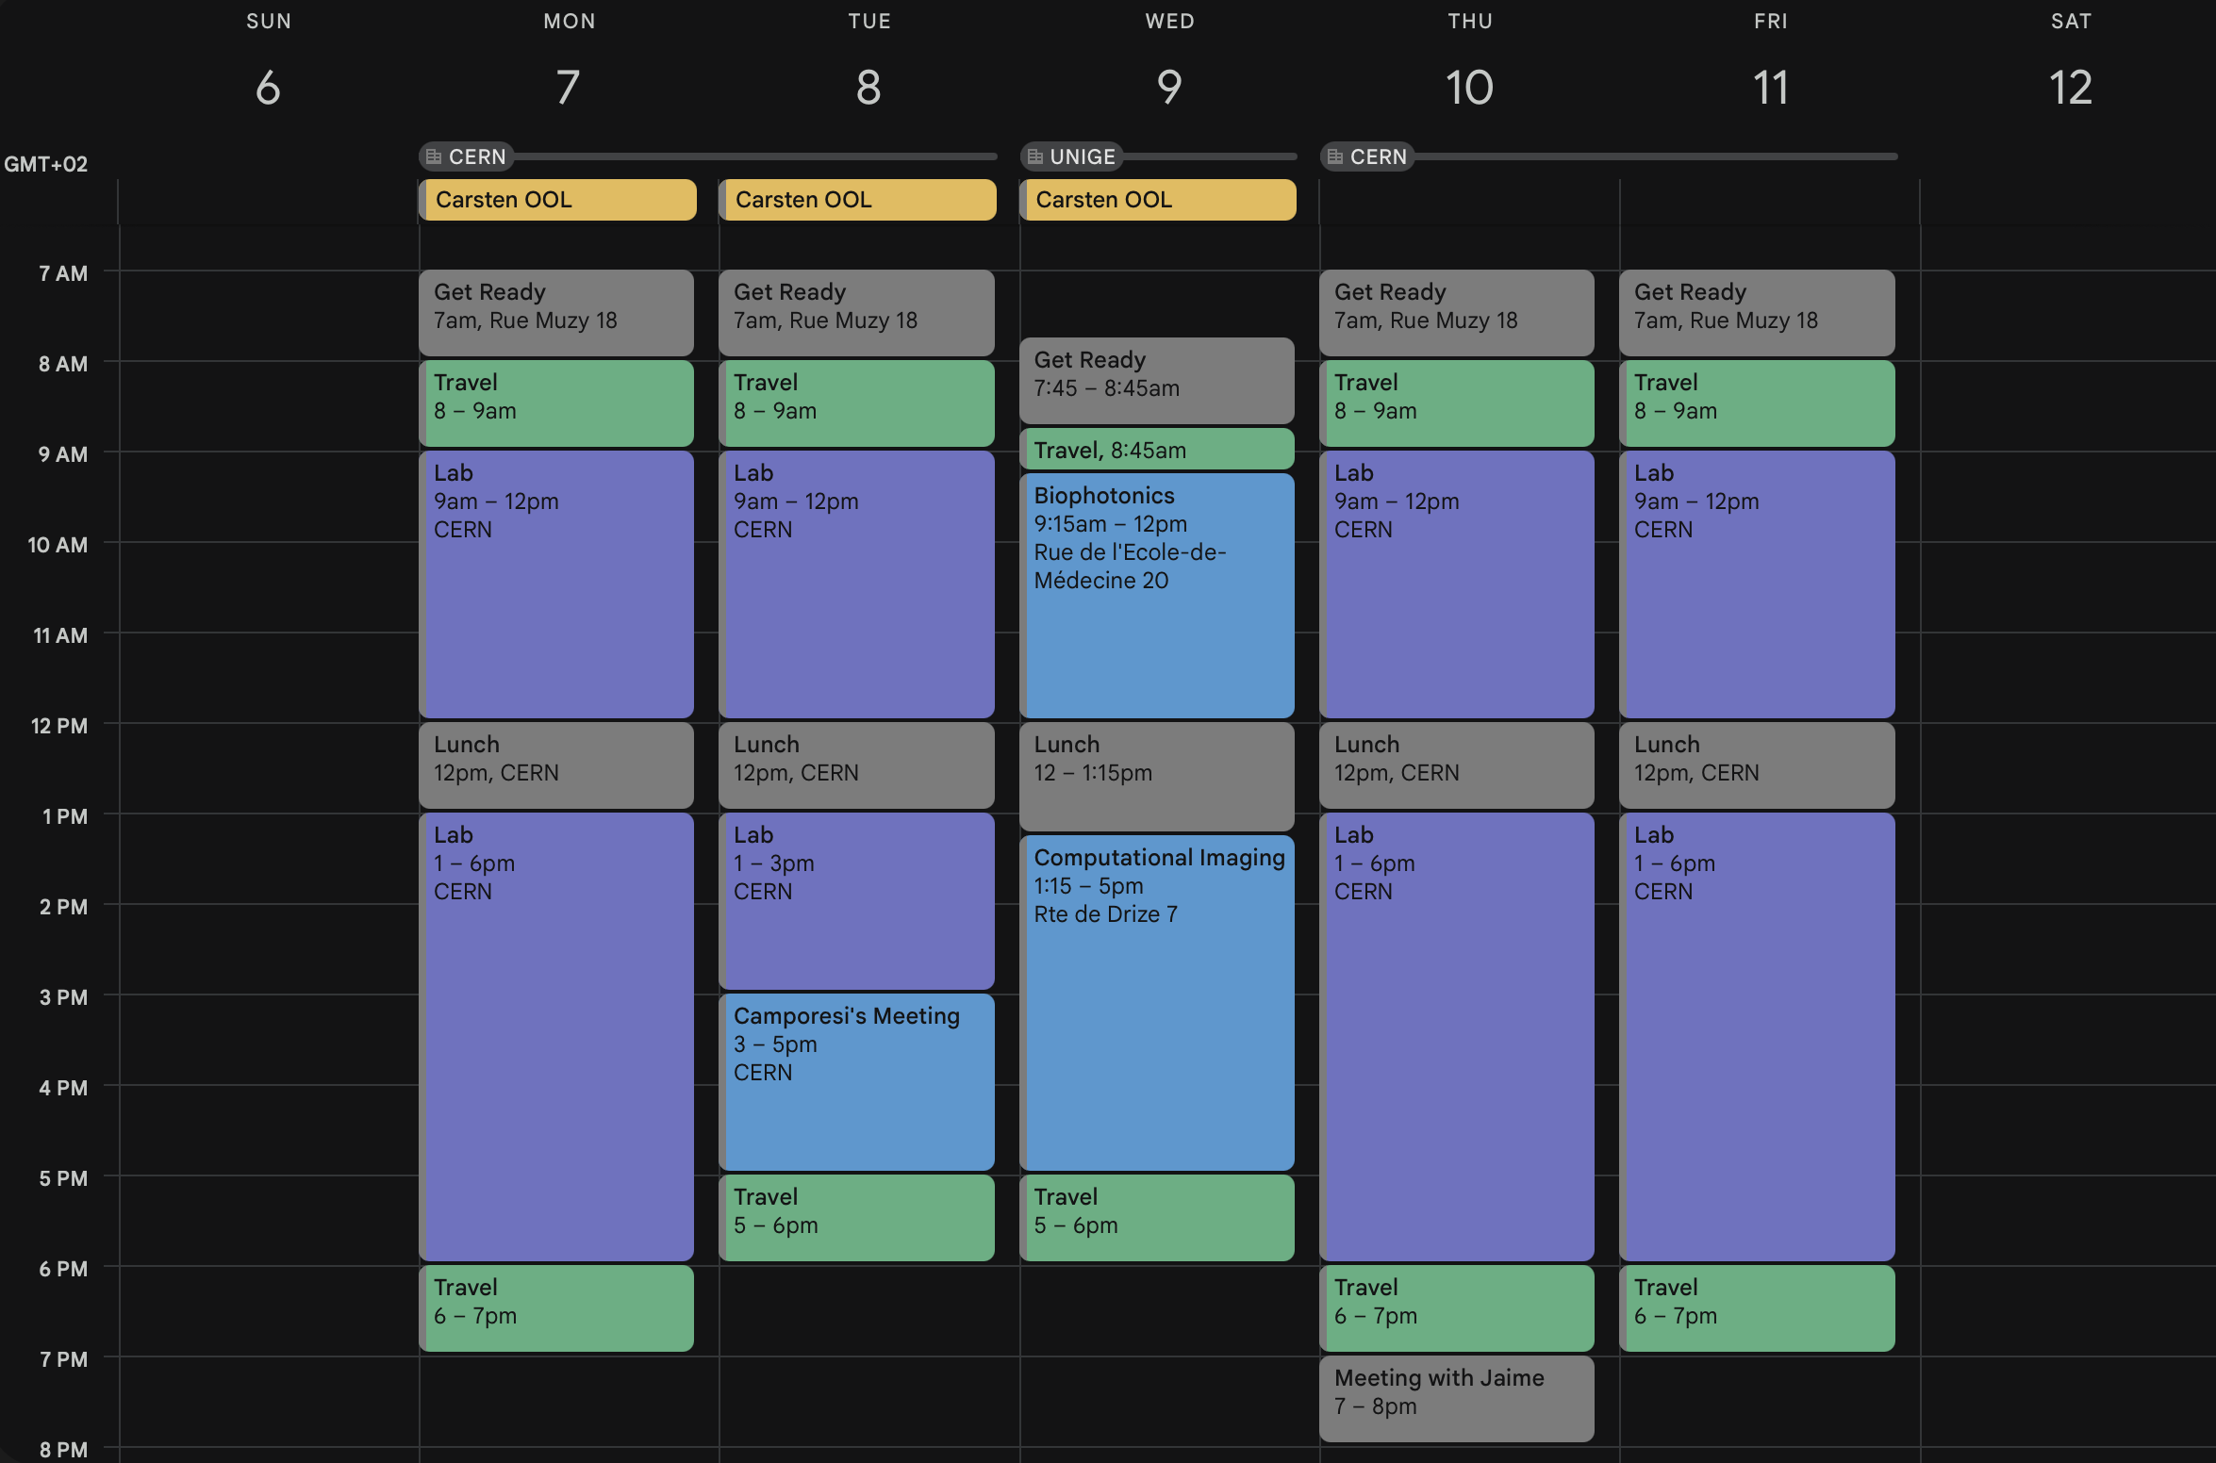
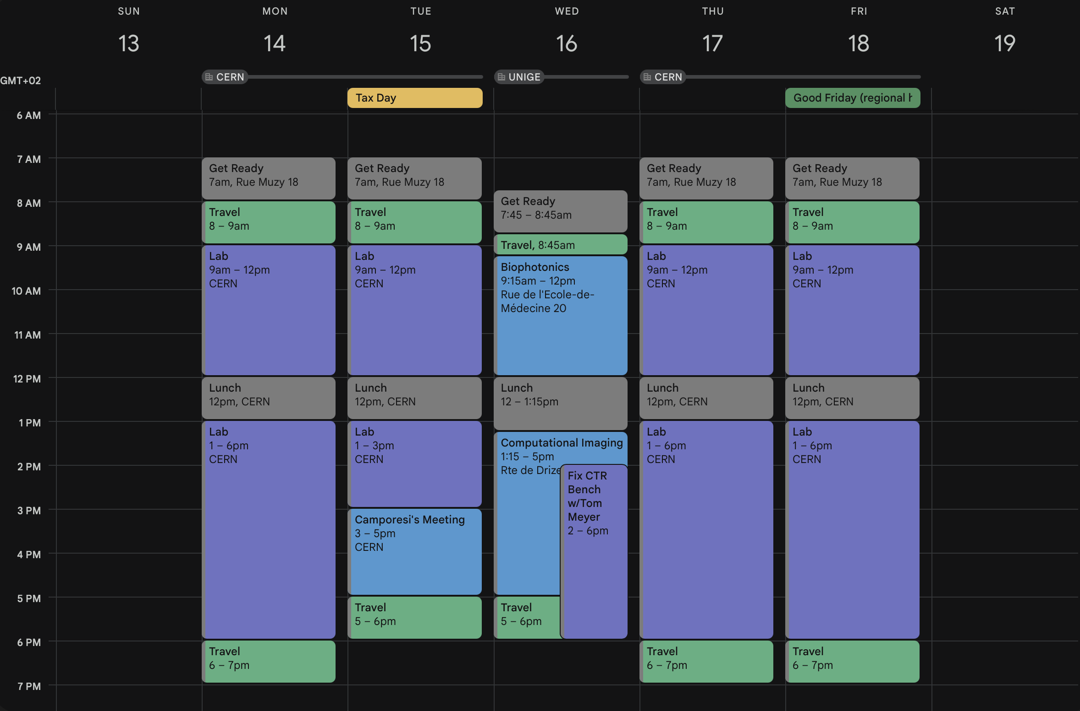
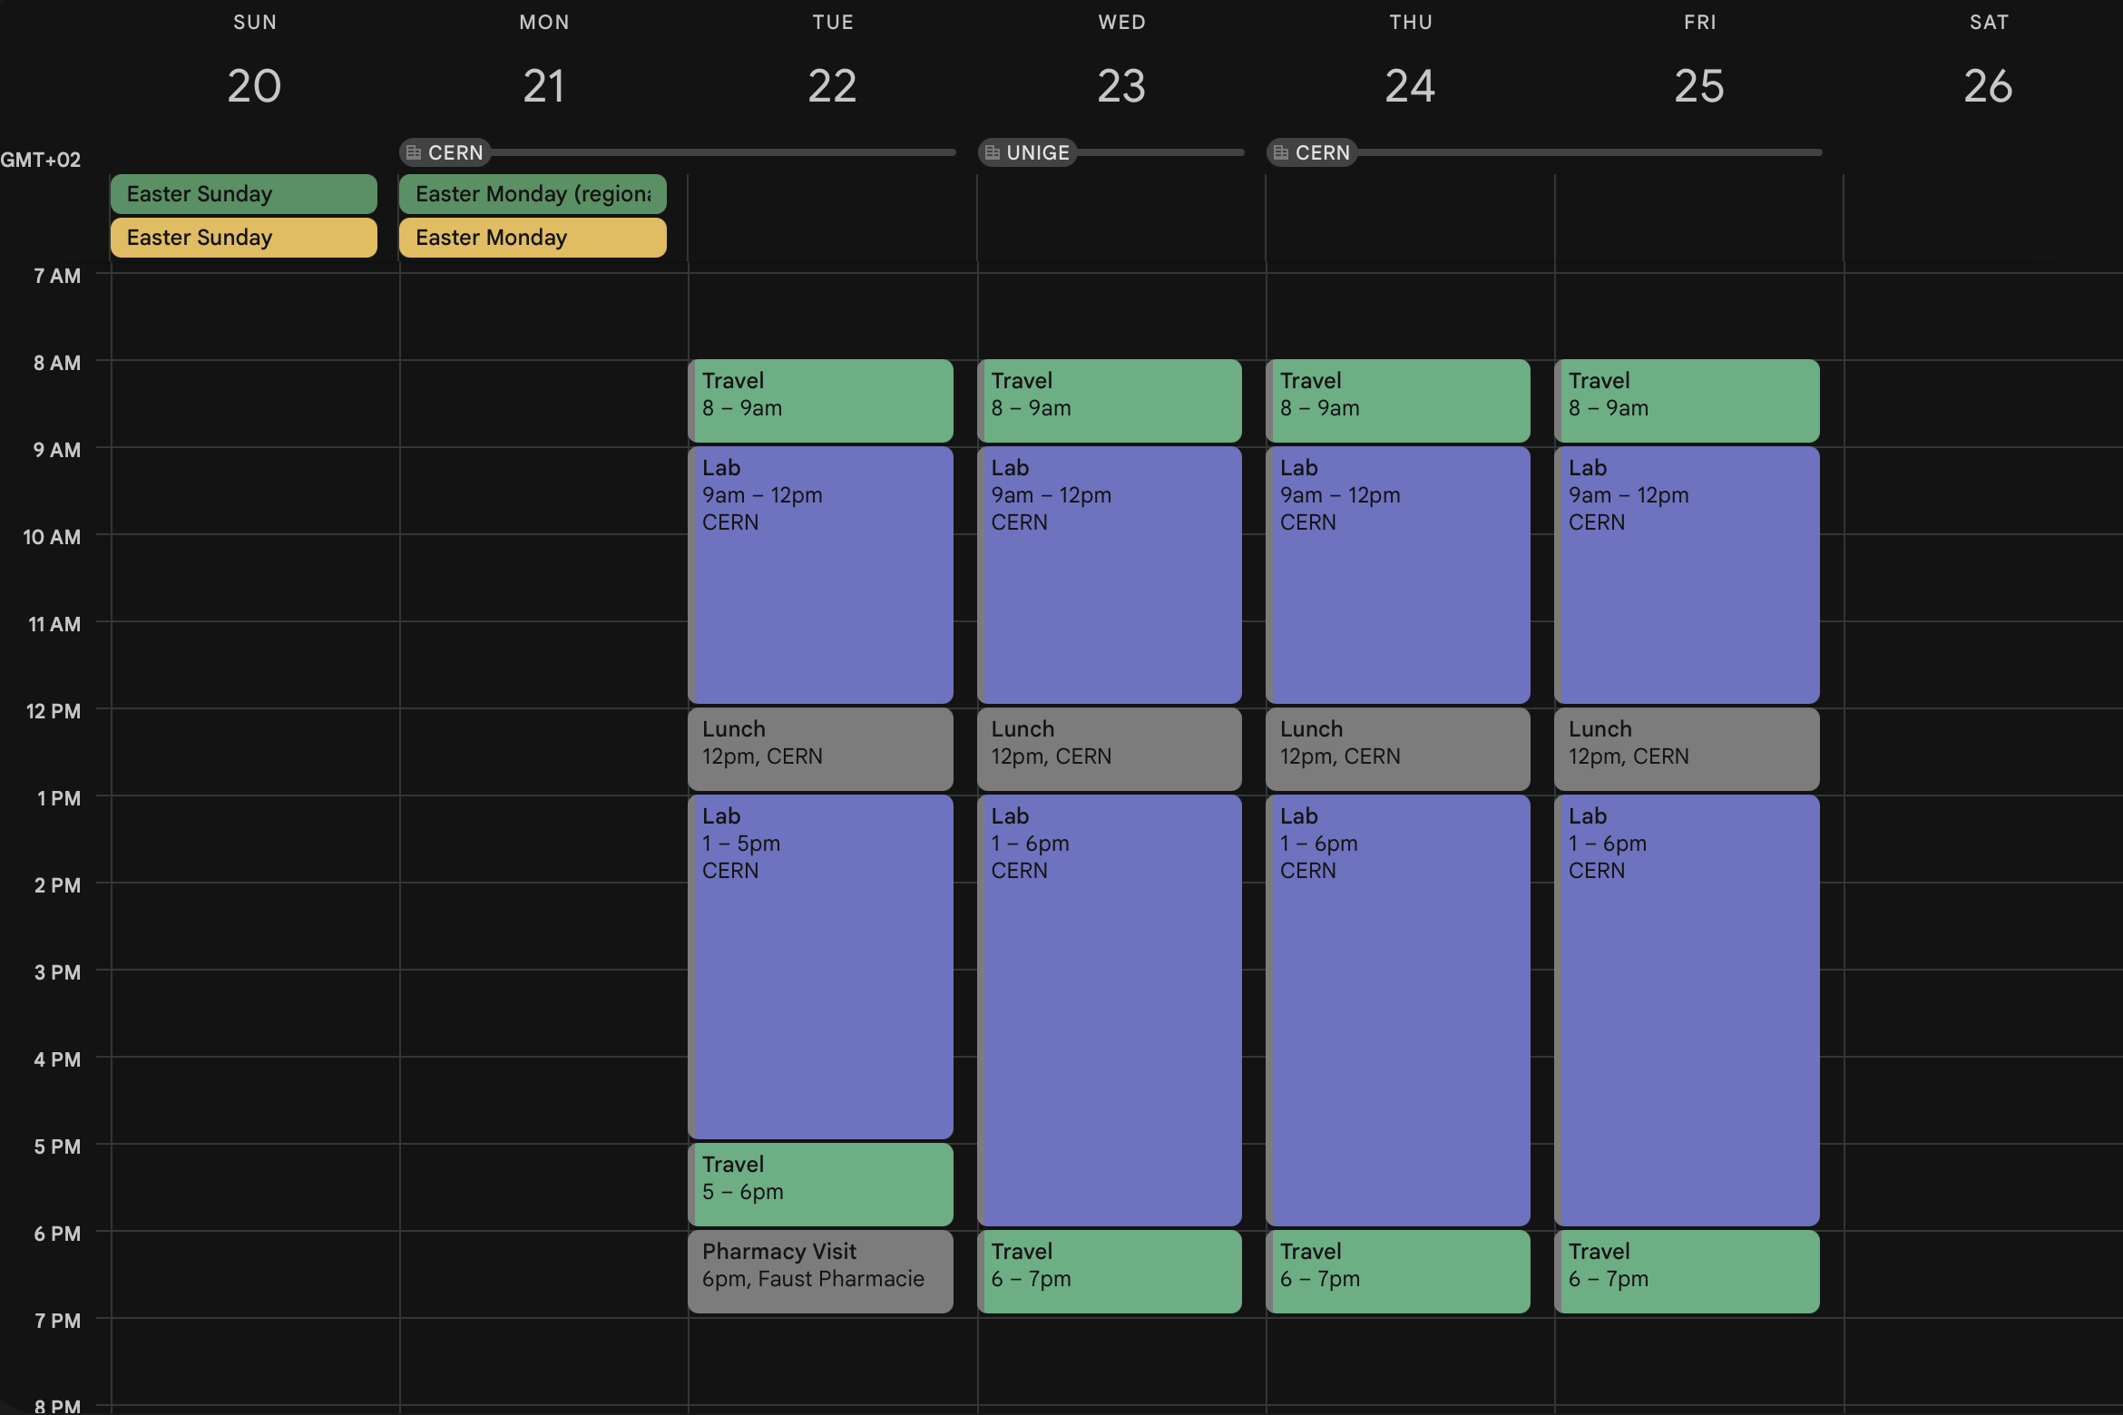
April 6 – April 25
Cesar Cardona
April 29, 2025

Slide 3
Fixing CTR Bench
Cesar Cardona
April 29, 2025

Slide 4
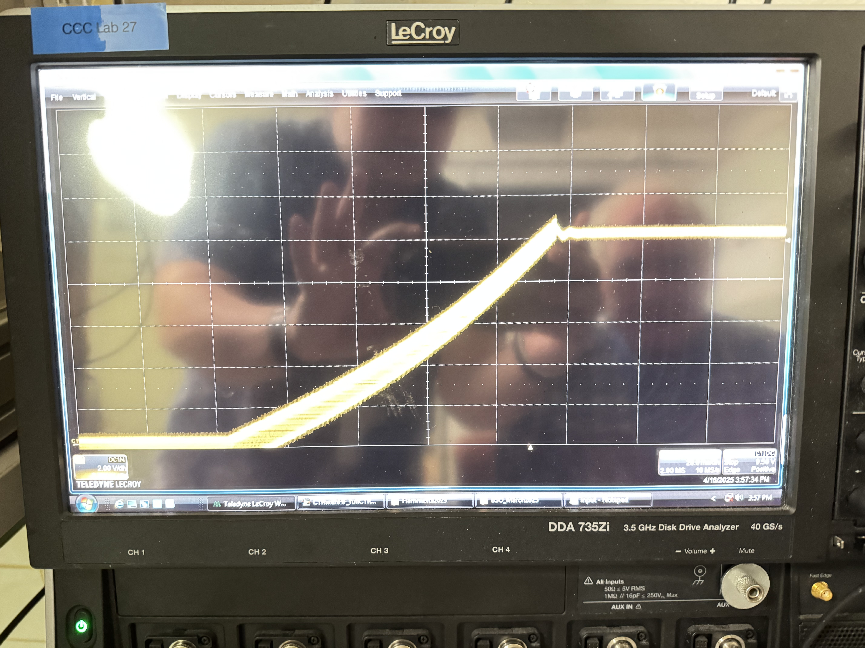
Fixing CTR Bench
The CTR Bench broke.
This is not the bench we are using (we use a double sided CTR bench which can also do normal ctr runs, and the FastIC+ bench)
The bench seems to fry the boards and SiPMs. It has broken 3 that I know of.
I volunteered myself to fix with Thomas Meyer. Mostly to learn how the electronics work.
Cesar Cardona
April 29, 2025

Slide 5
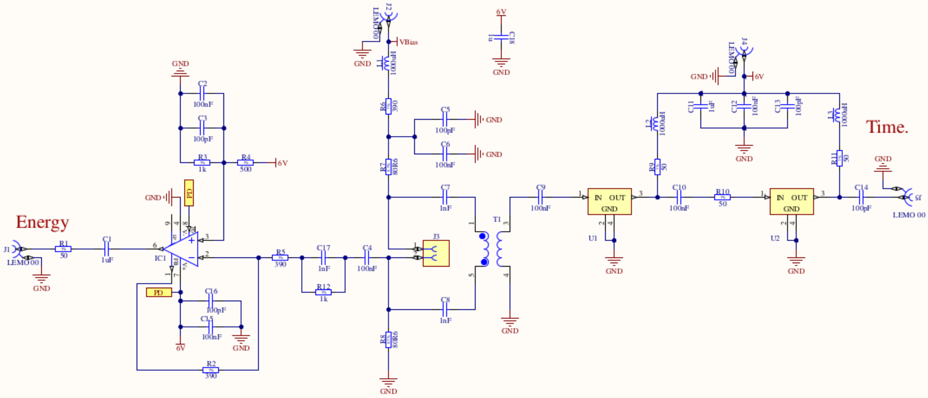
Electronics Circuit Diagram
Cesar Cardona
April 29, 2025

Slide 6
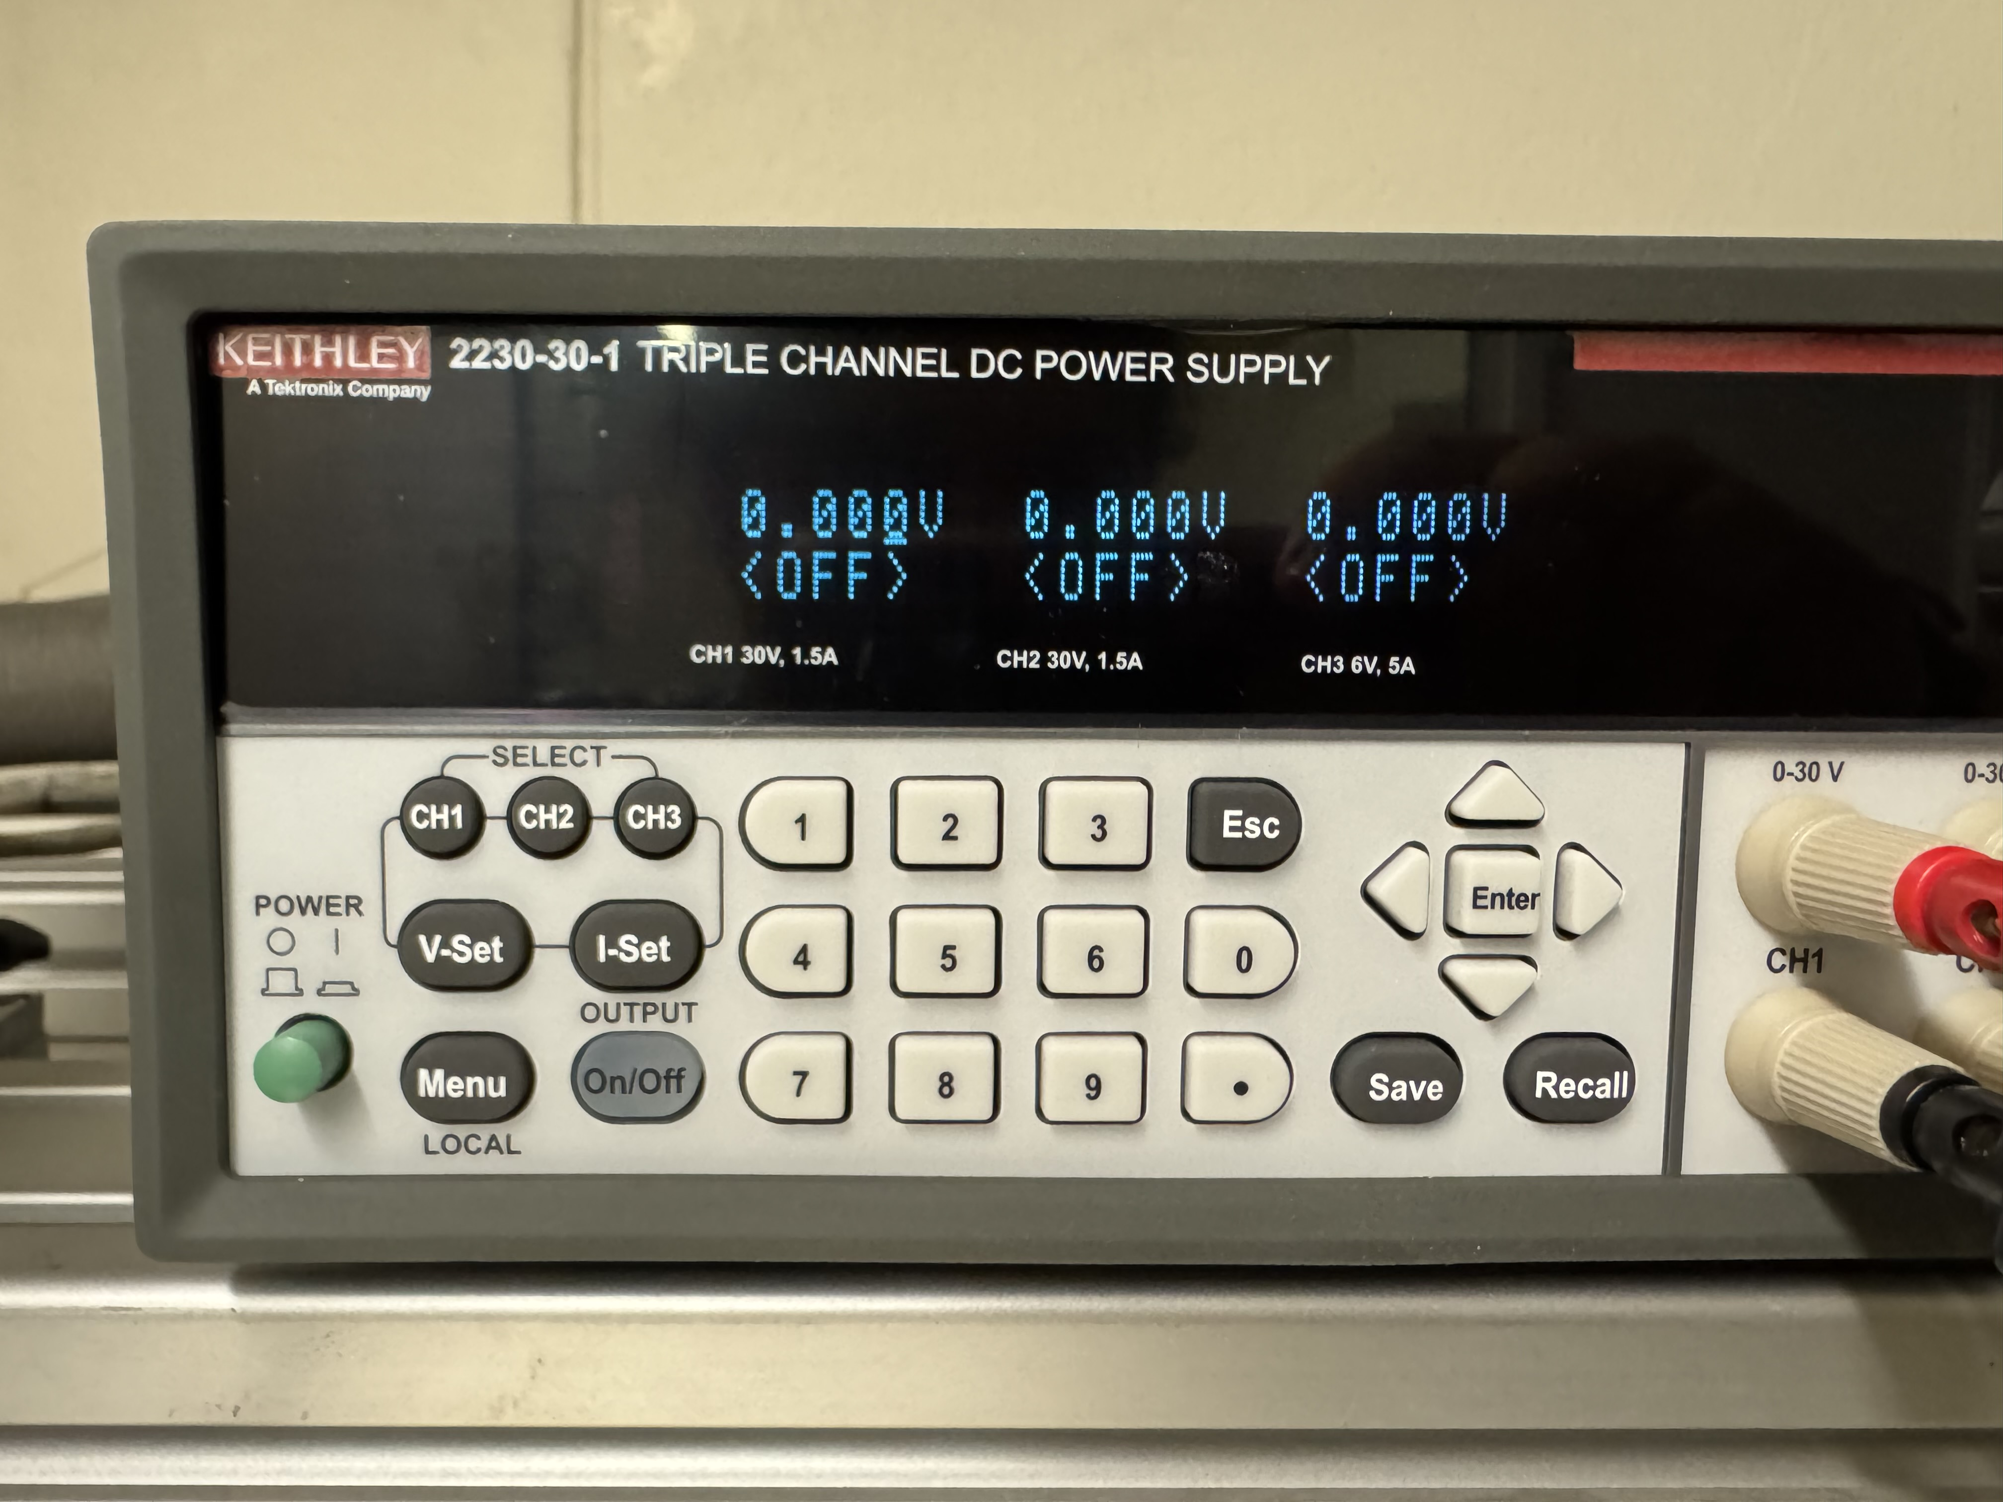
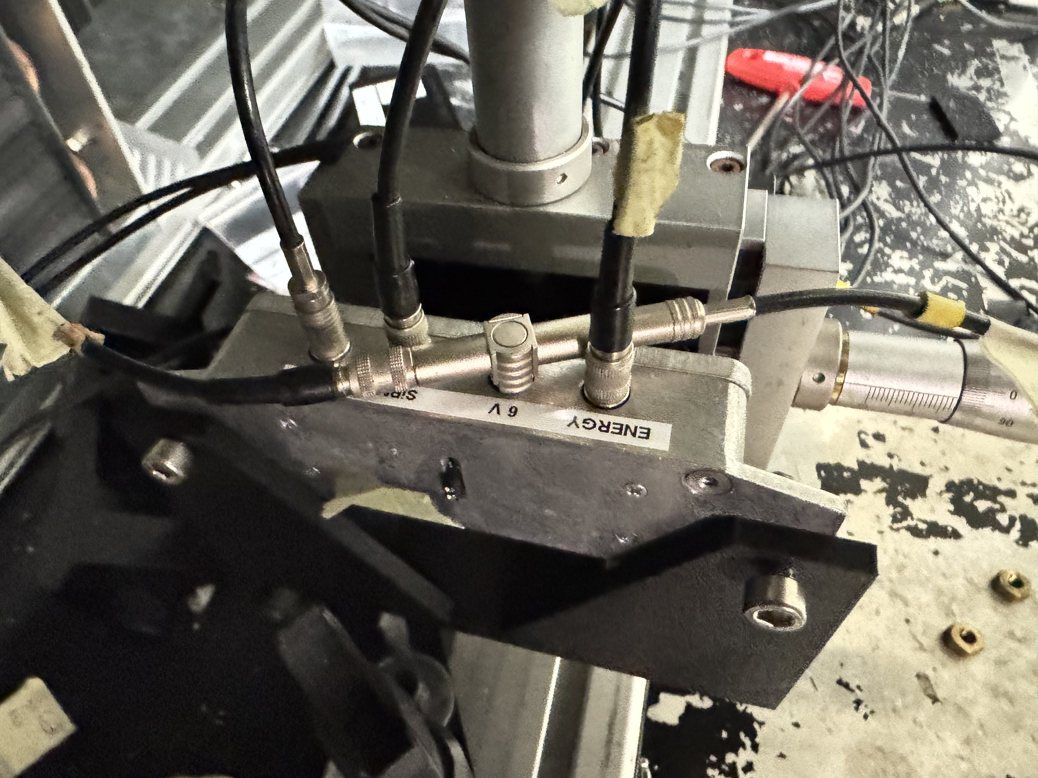
6V Power Supply Problems?
Checked to see if Power supply had any spikes when:
Turned On/Off with the button.
Turned On/Off with physical switch.
Dis/Connected directly off the wall.
Plug (offscreen)
On/Off Switch
On/Off Button
Scope
Power Supply
Cesar Cardona
April 29, 2025

Slide 7
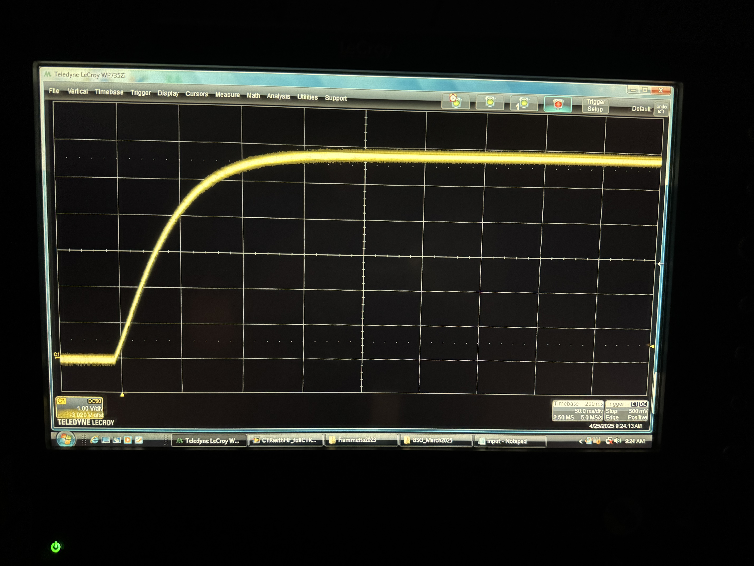
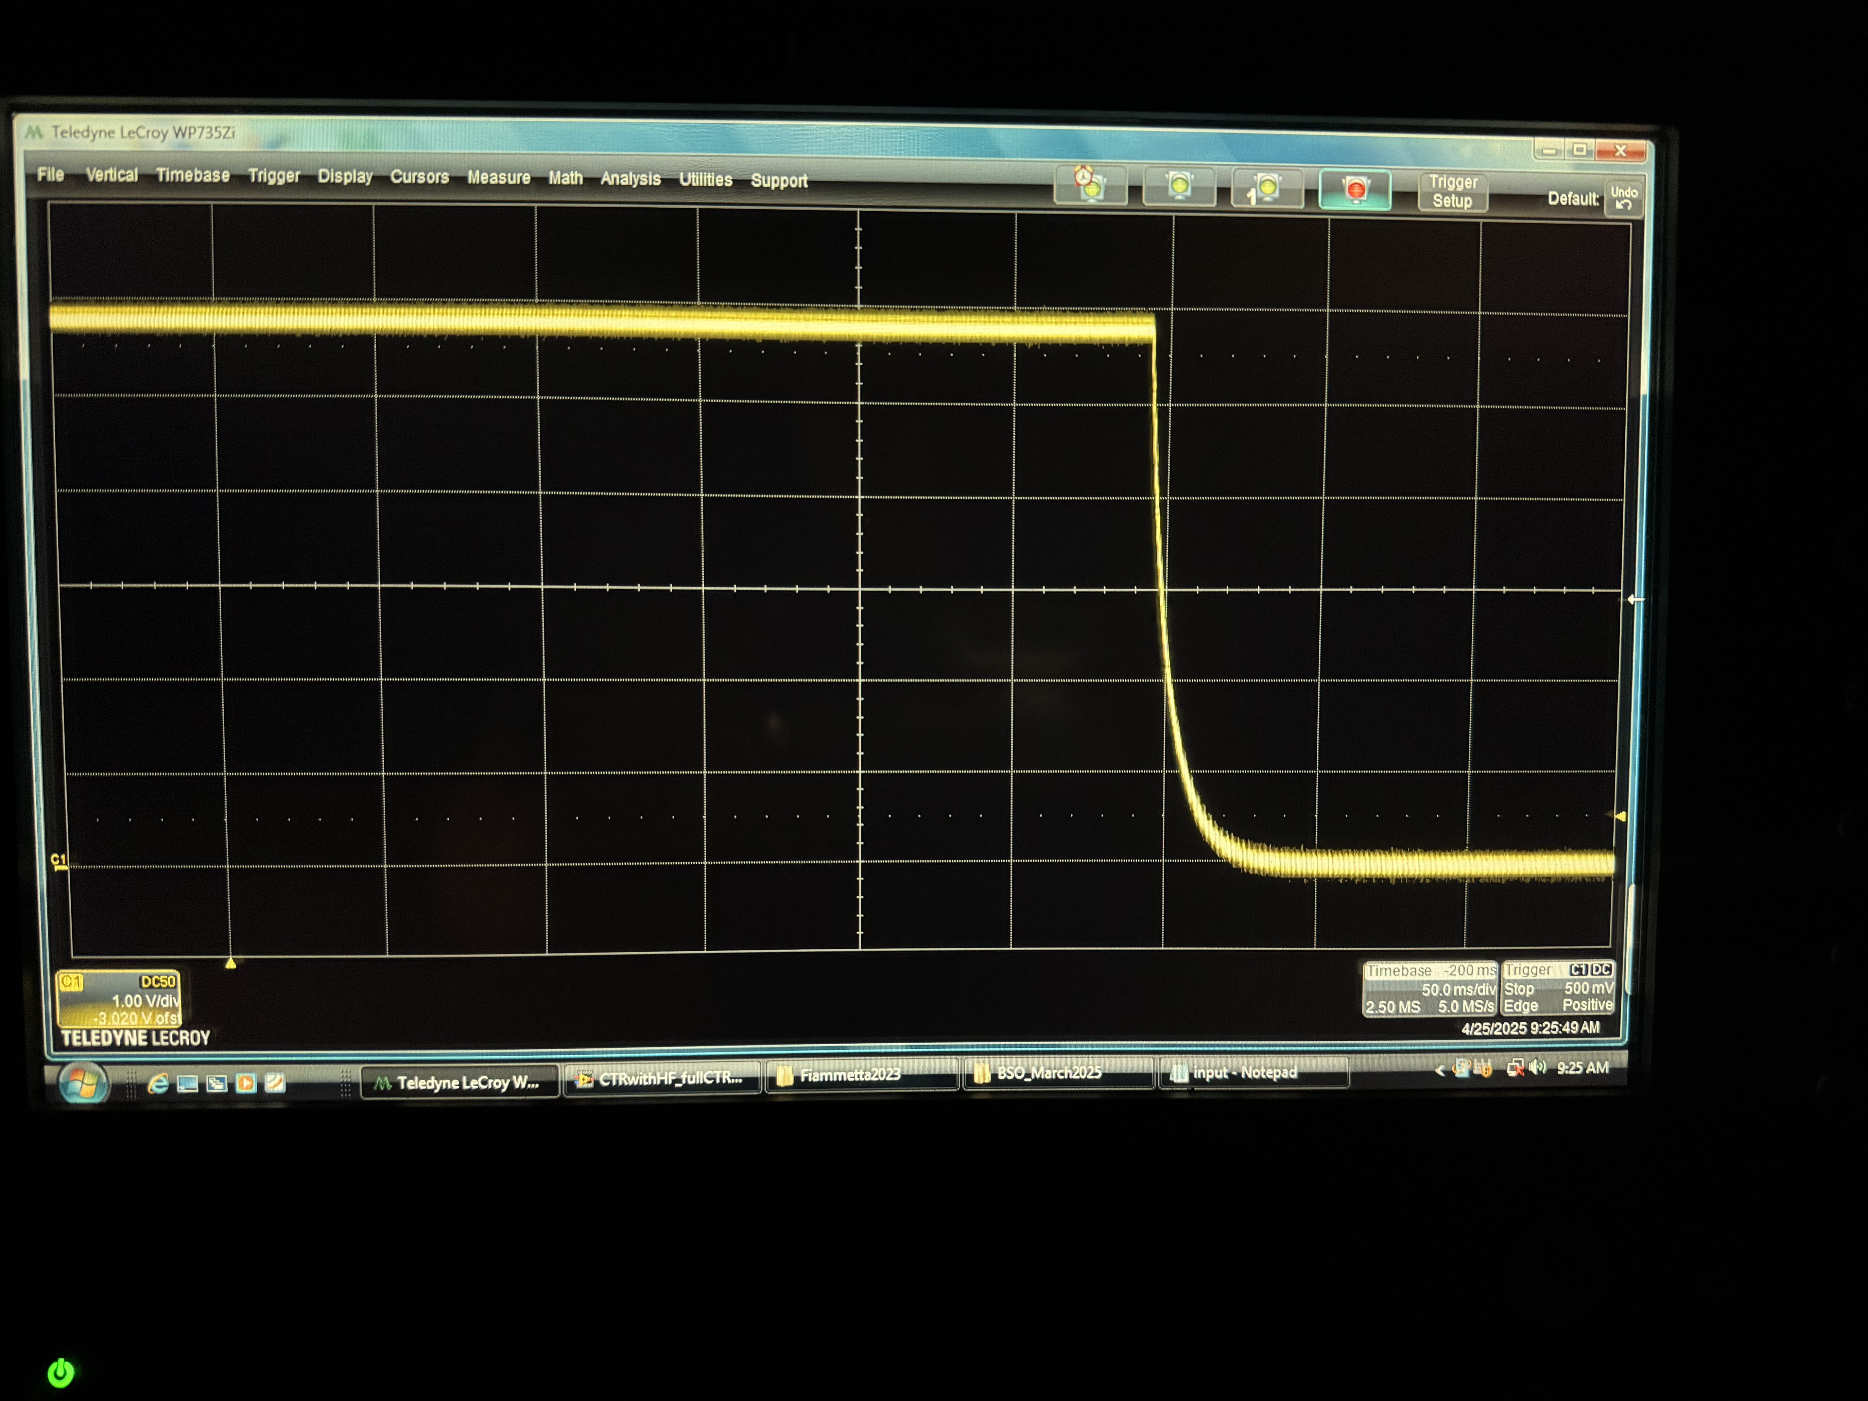
6V On/Off Button
50 ms
1 V
50 ms
1 V
Good board. On Button.
Good board. Off Button.
Cesar Cardona
April 29, 2025

Slide 8
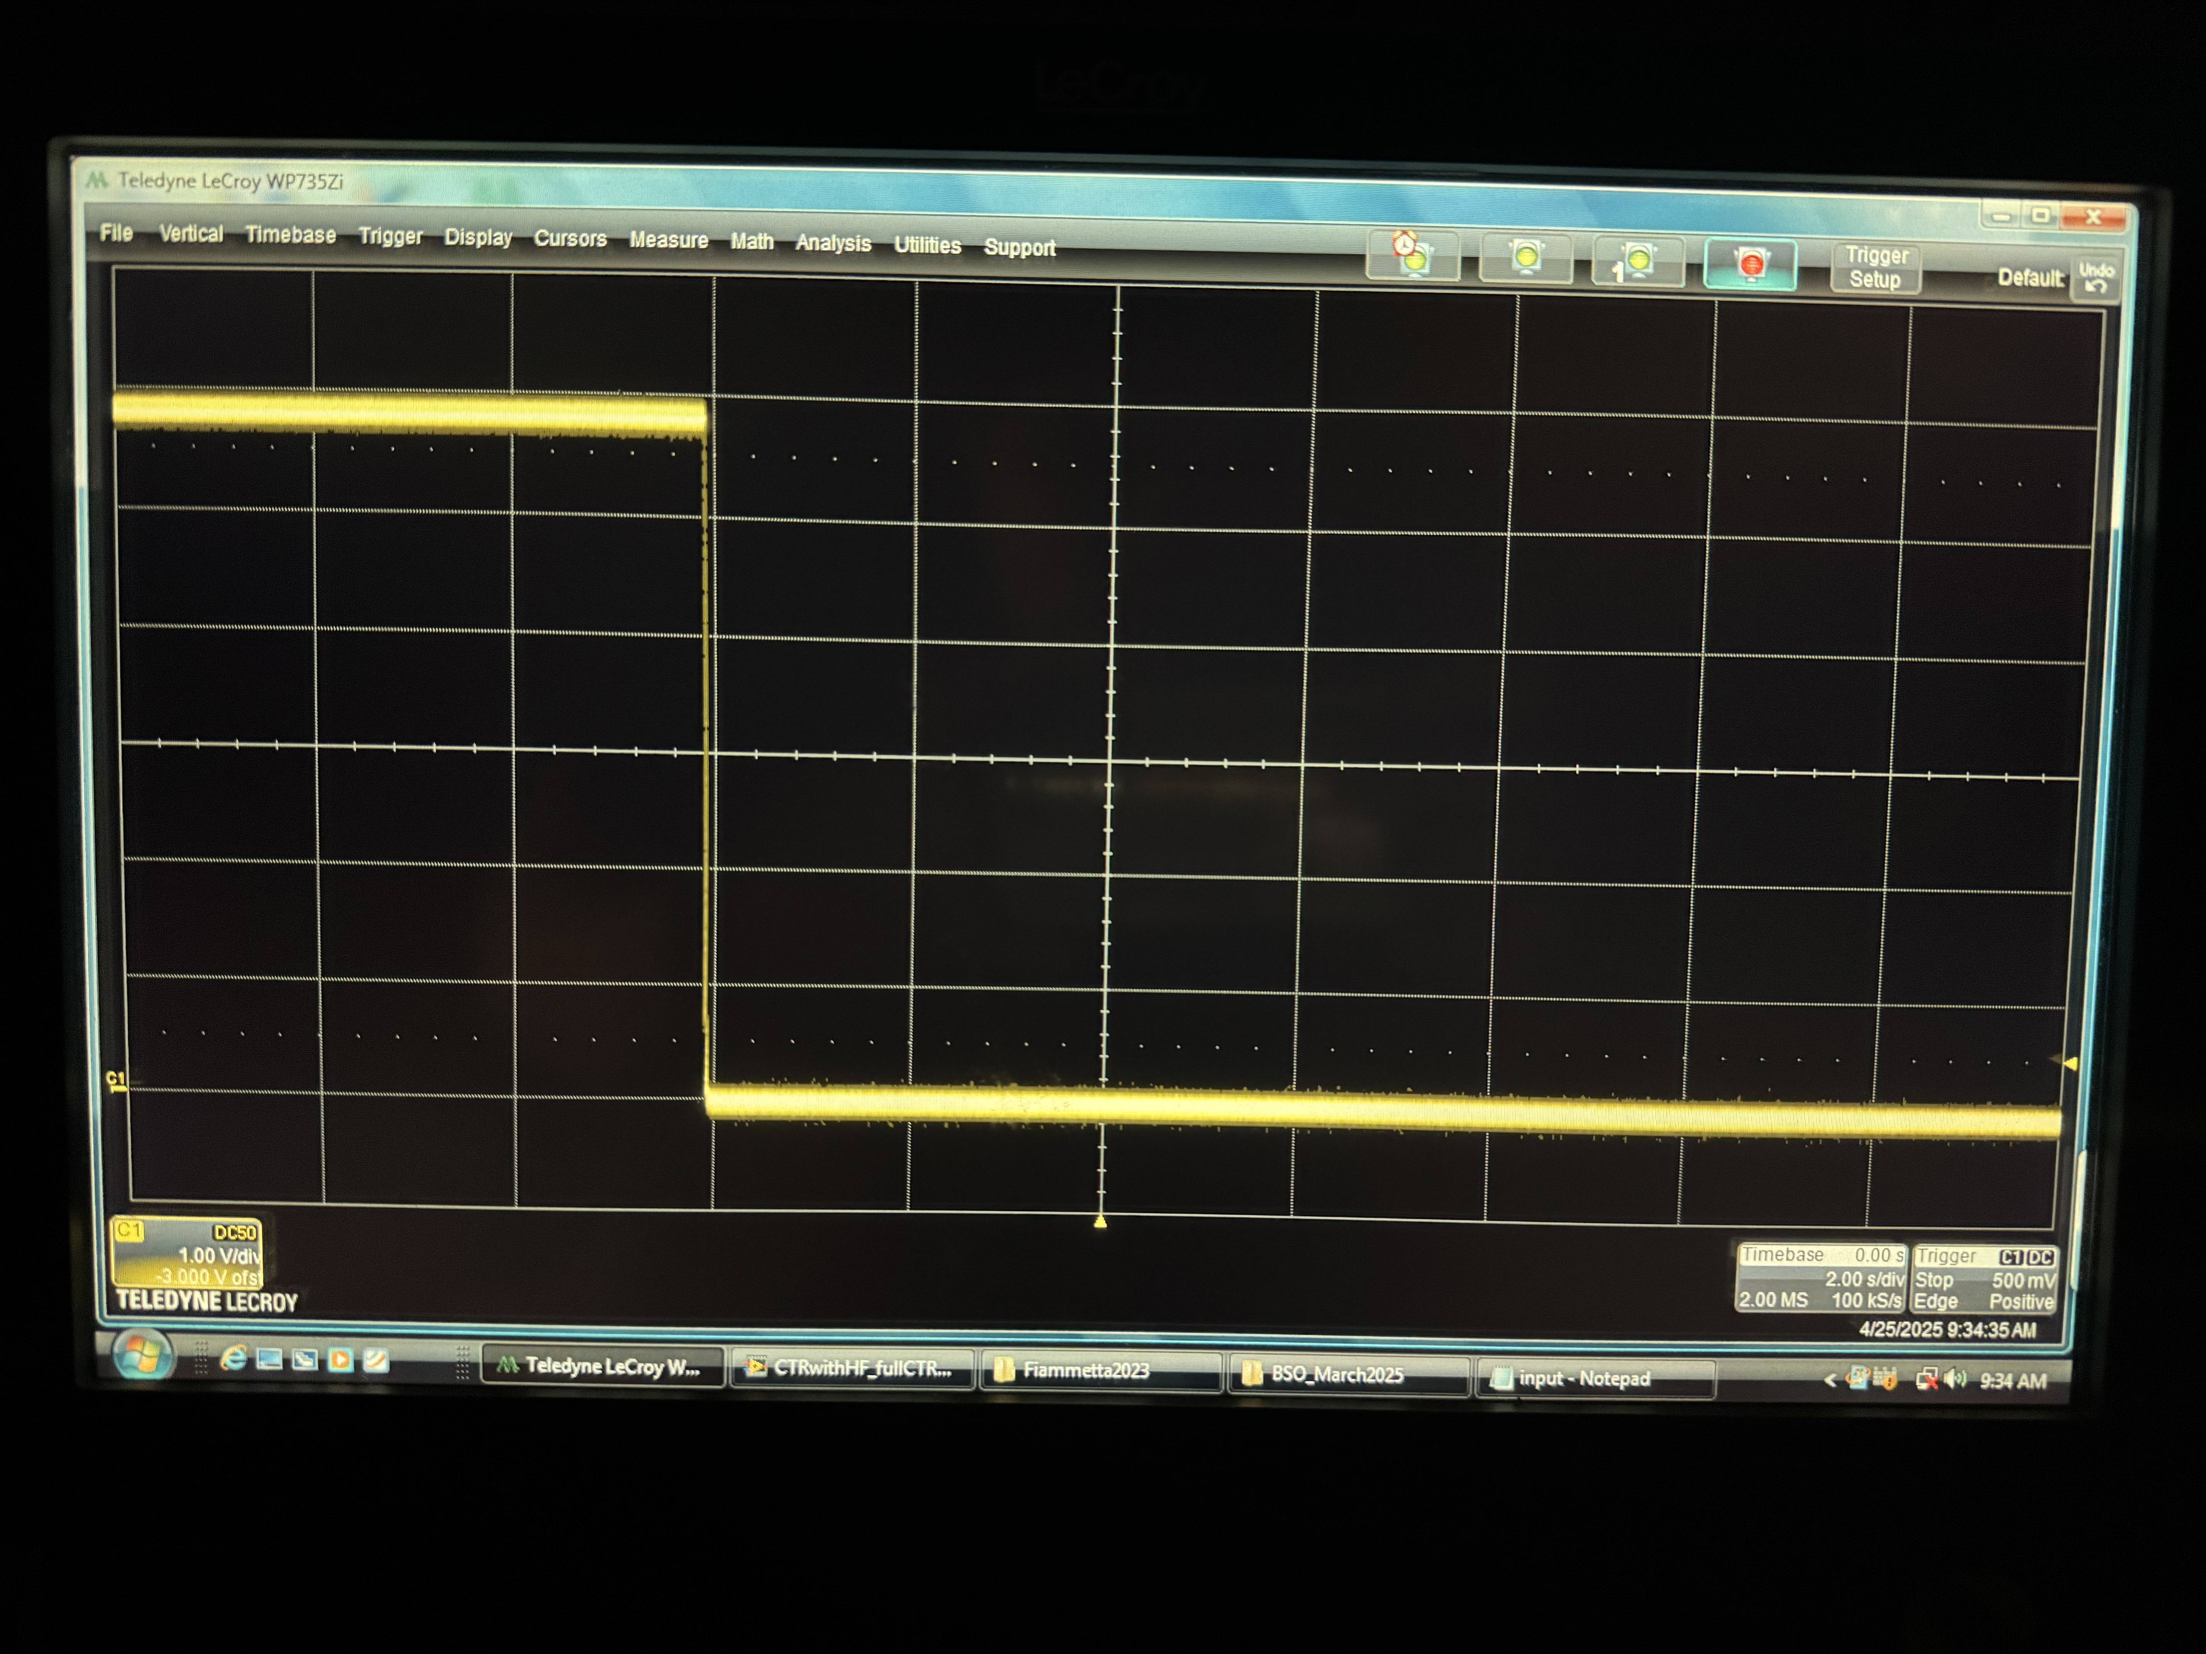
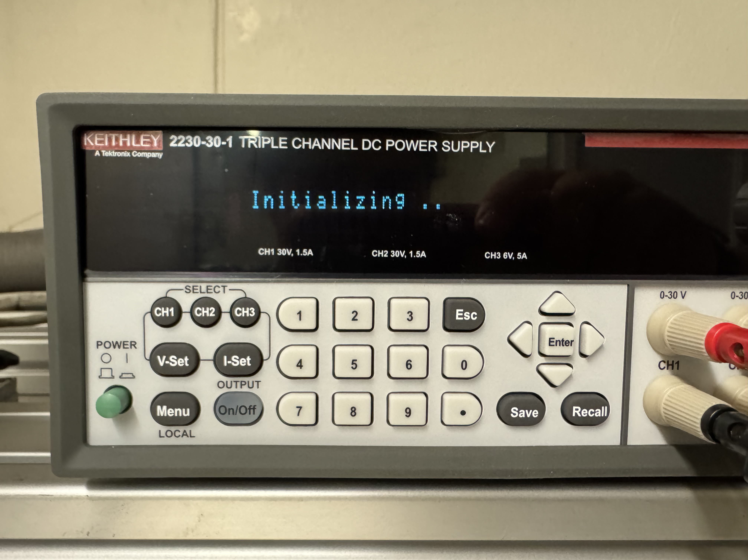
6V On/Off Switch
2 s
1 V
Good board. Off then On Switch.
Power supply resets when switched off
Cesar Cardona
April 29, 2025

Slide 9
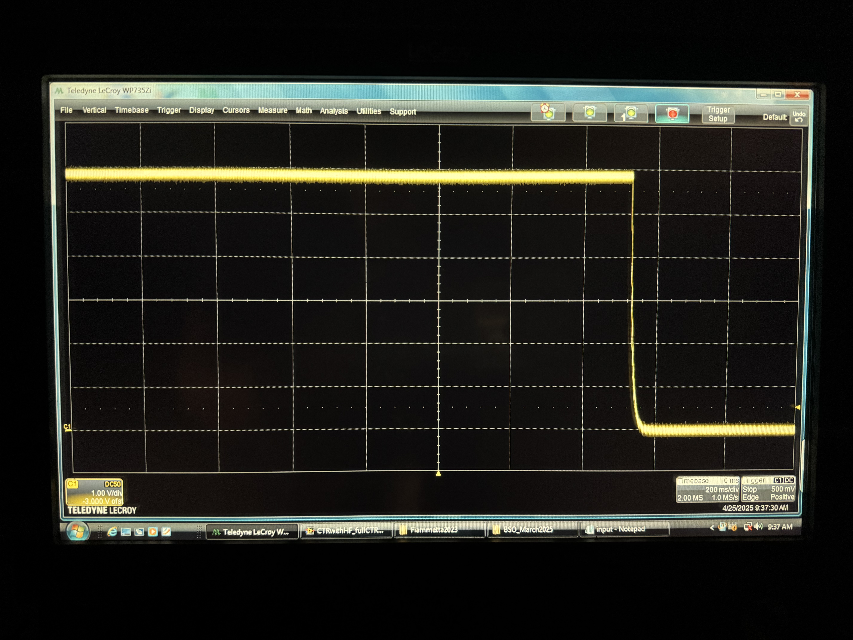
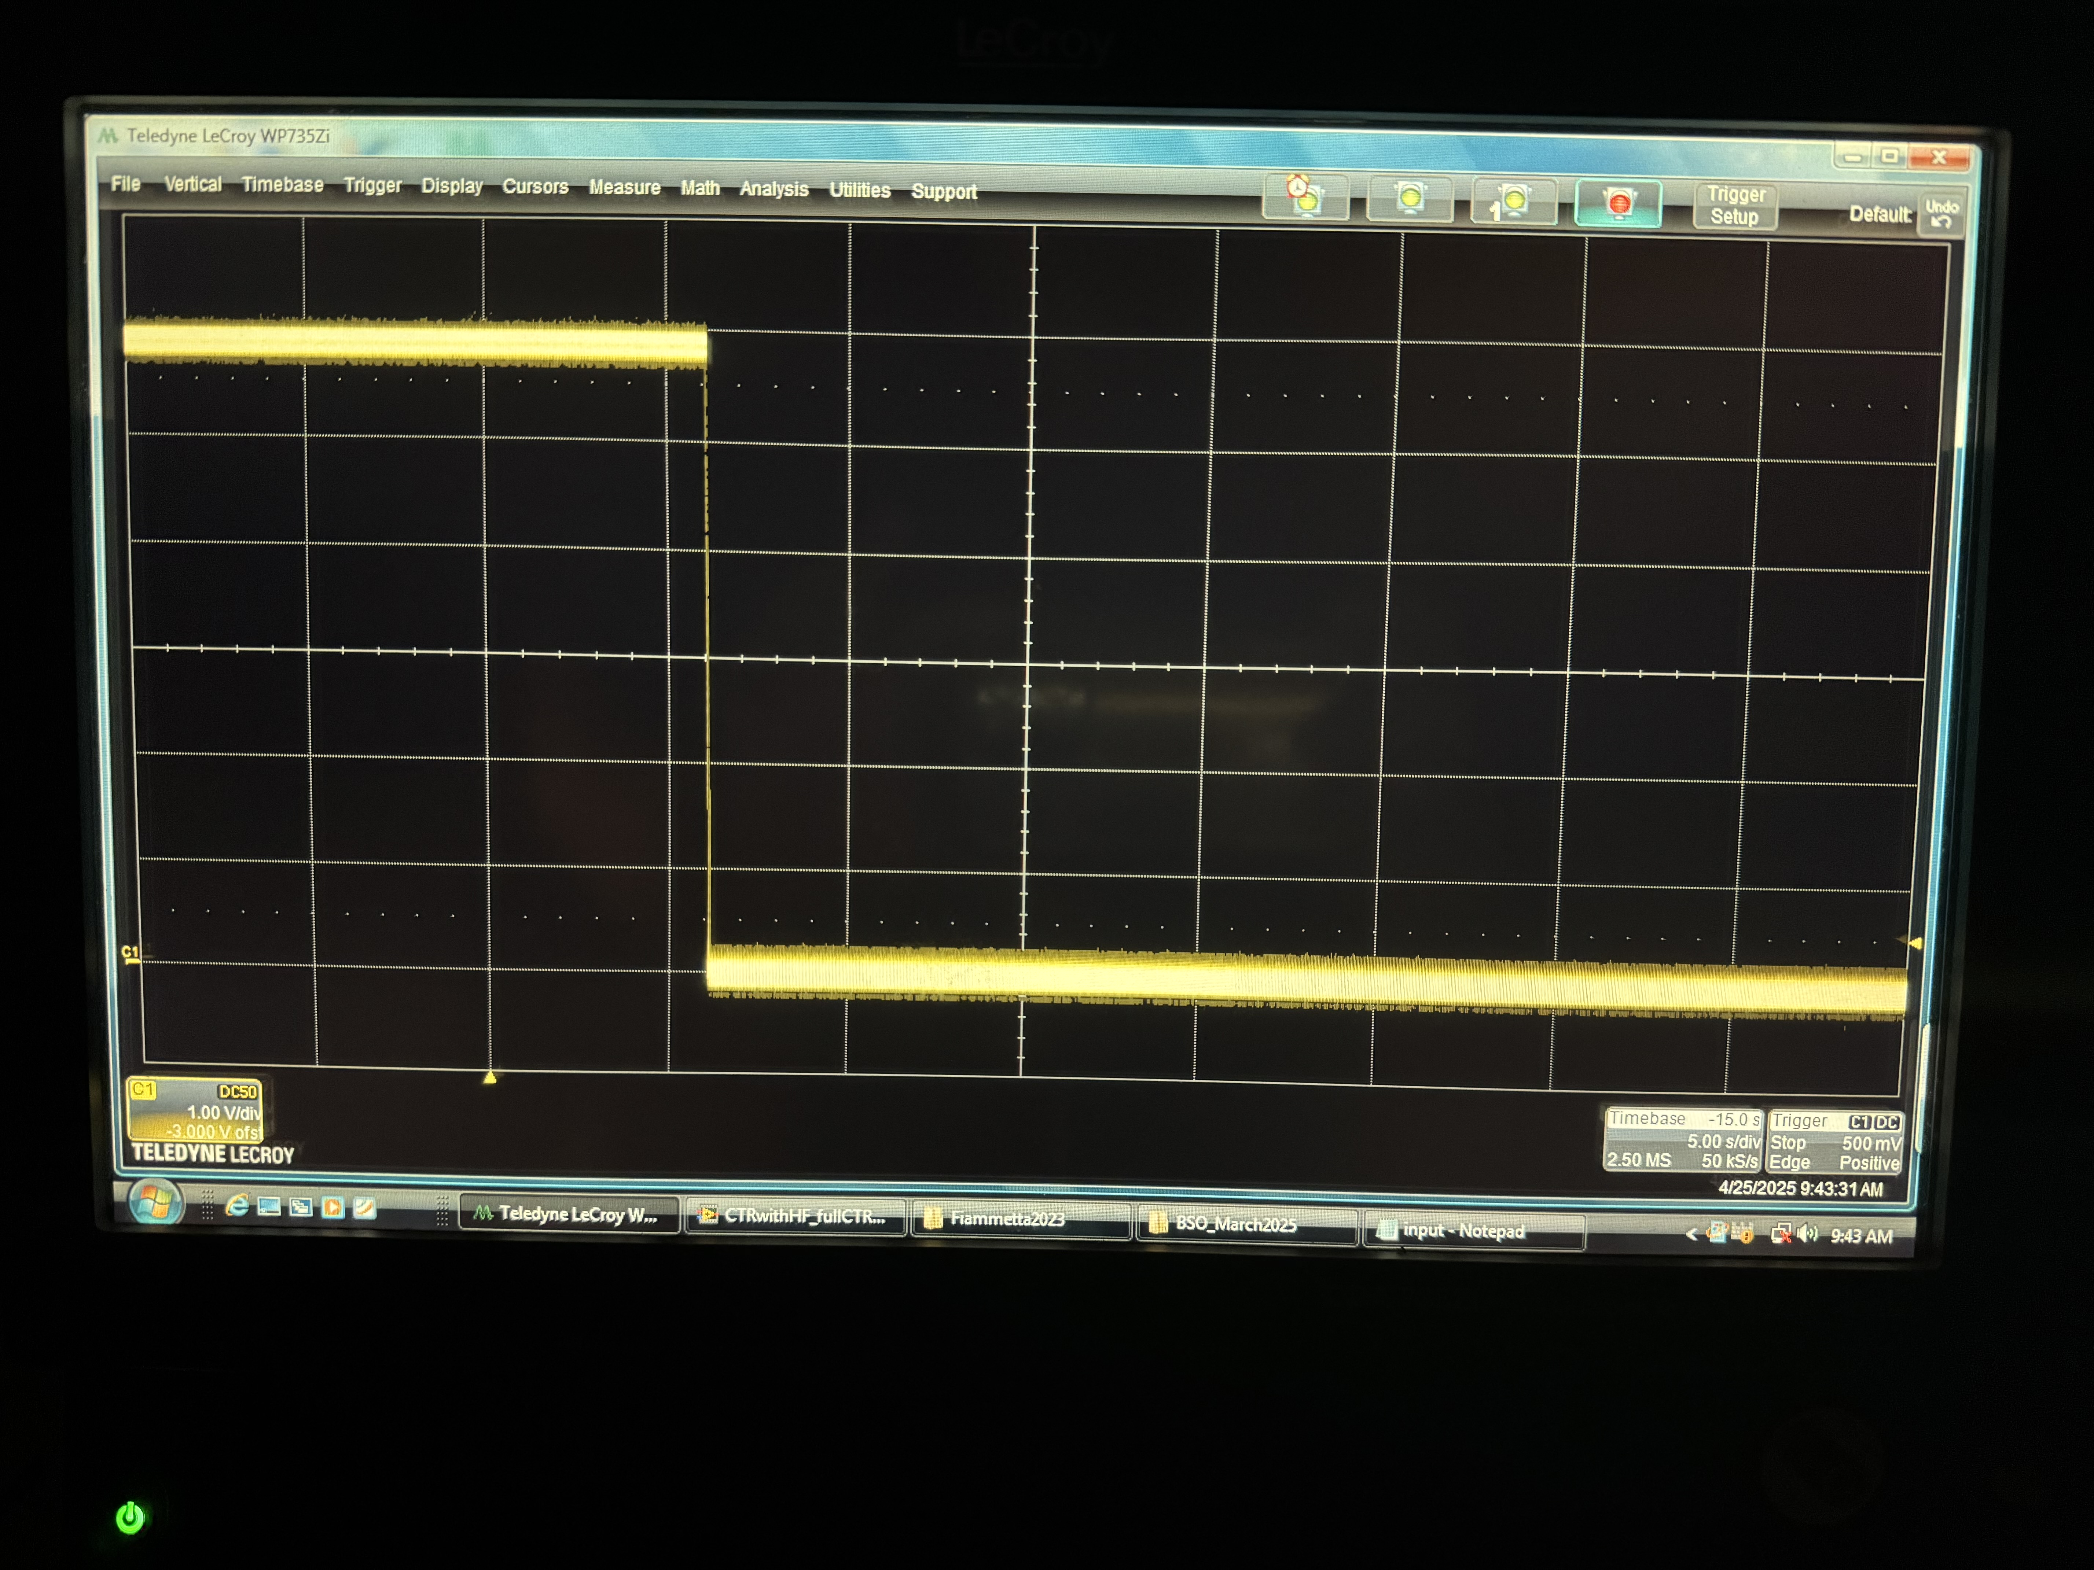
6V Disconnected from Wall
200 ms
1 V
5 s
1 V
Good board. Disconnected.
Good board. Dis then Connected.
Cesar Cardona
April 29, 2025

Slide 10
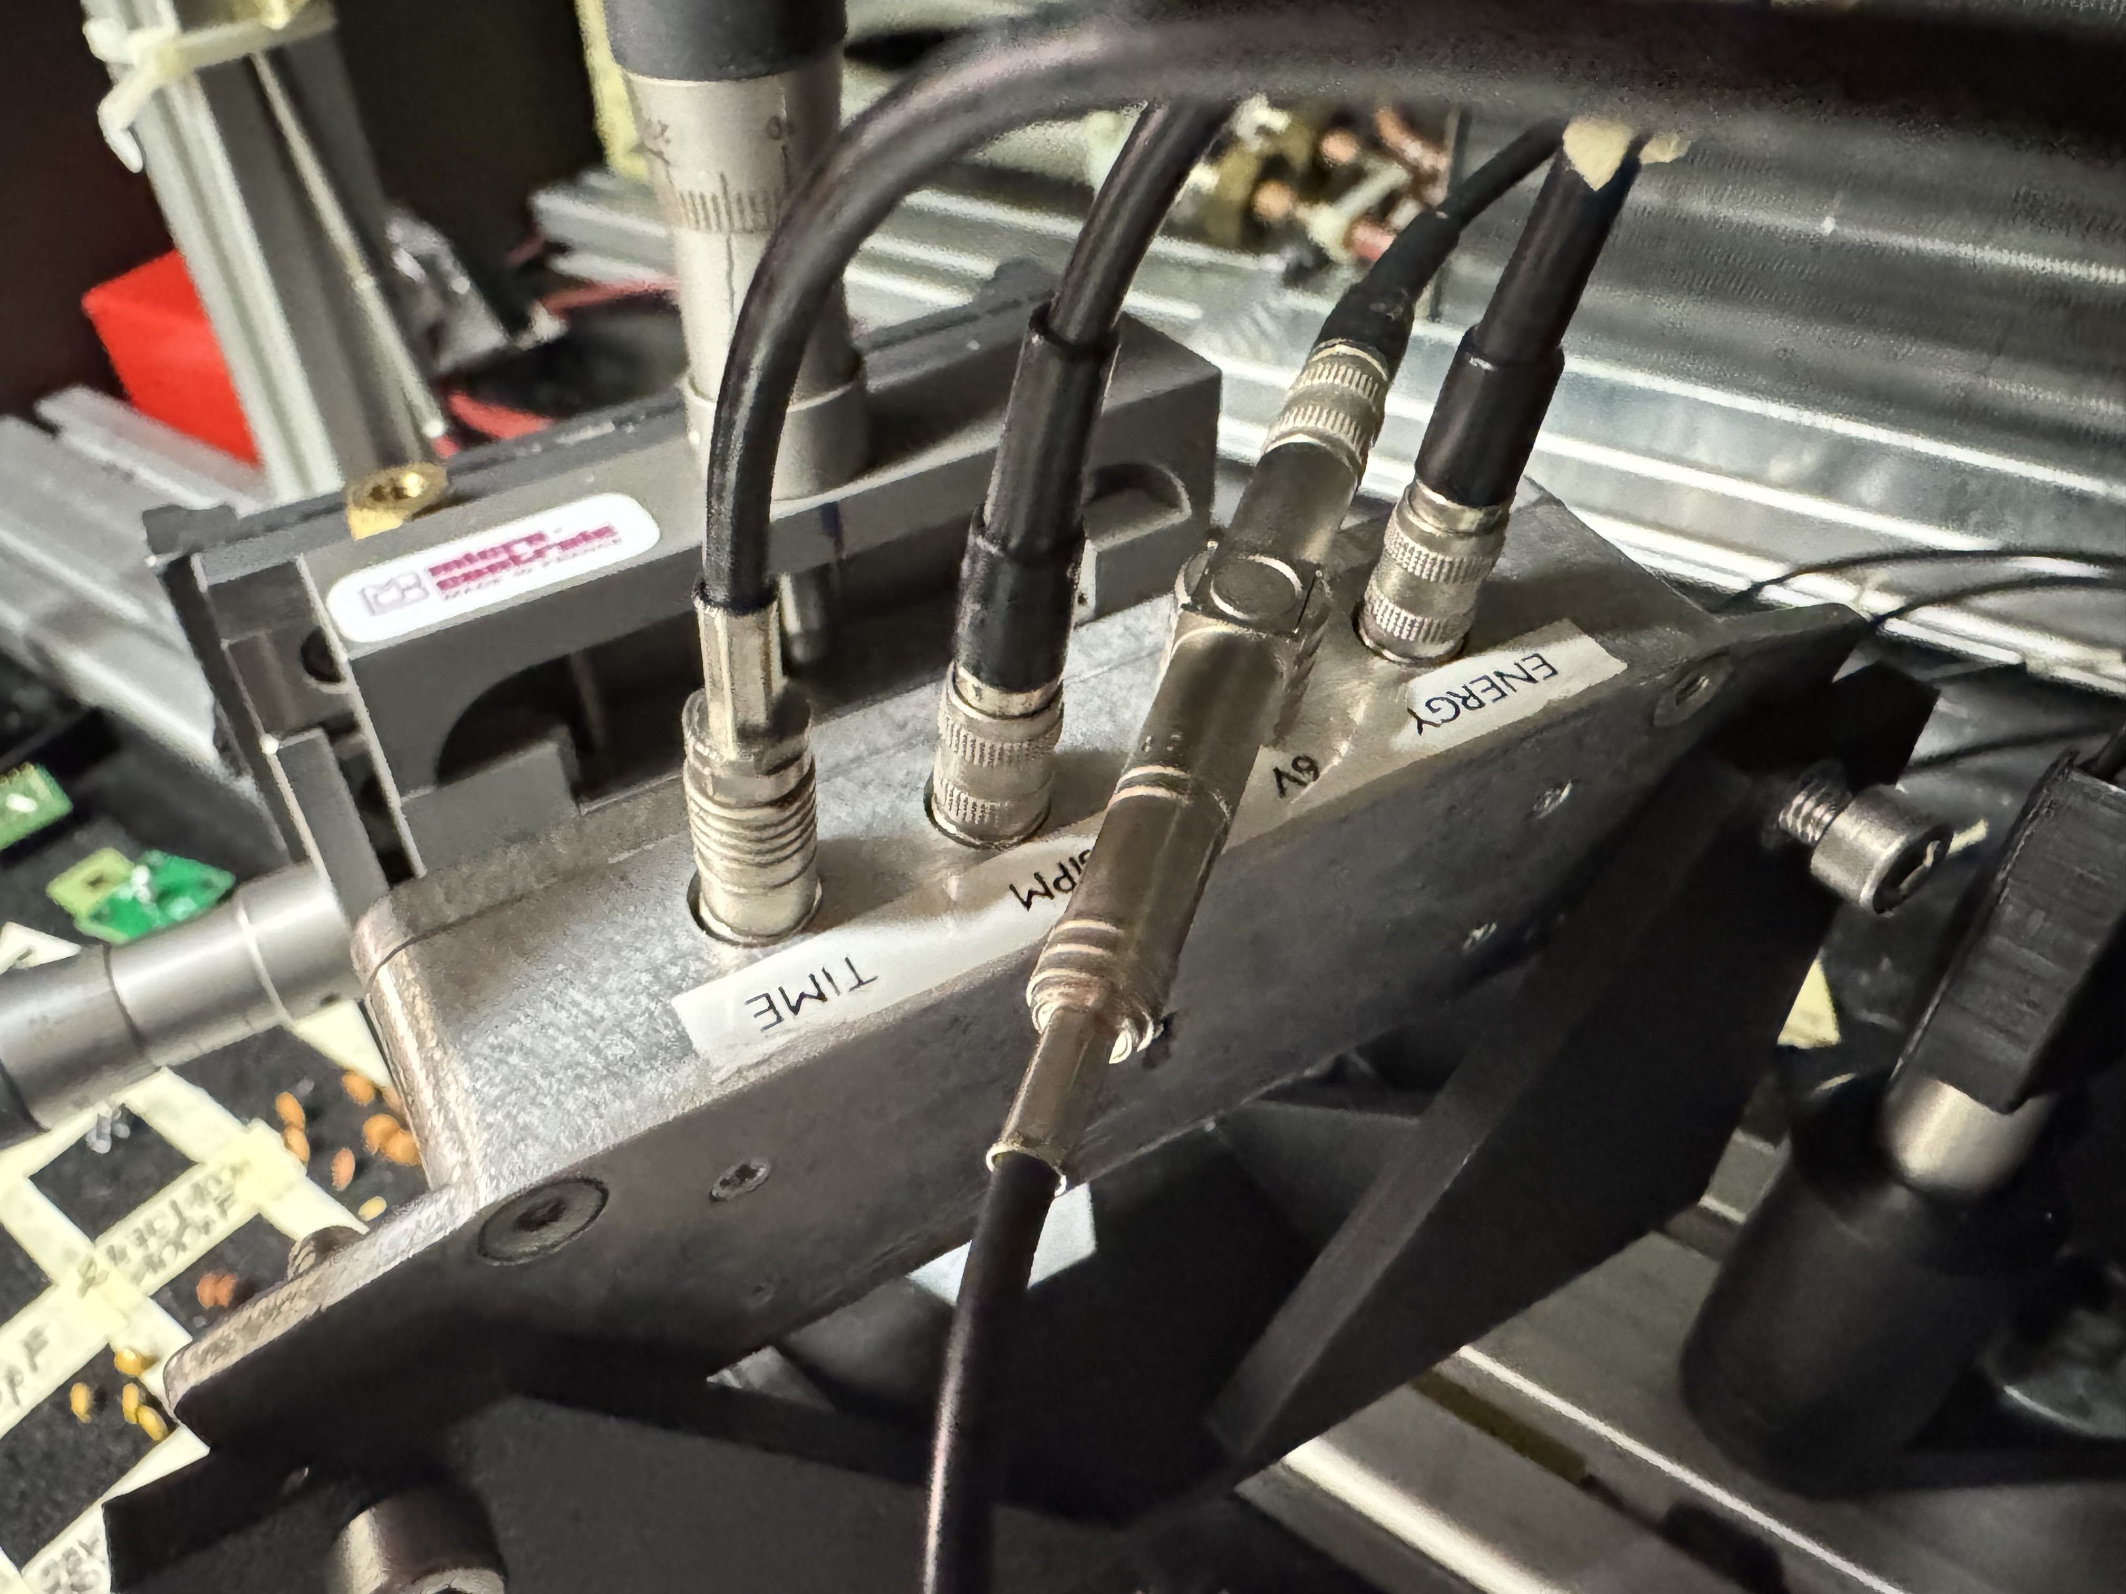
6V Power Supply on Bad Board
There are 3 Broken Boards that I can check.
Same procedure as with the good board, same cables even.
I have been told that all three have a dead time branch.
Cesar Cardona
April 29, 2025

Slide 11
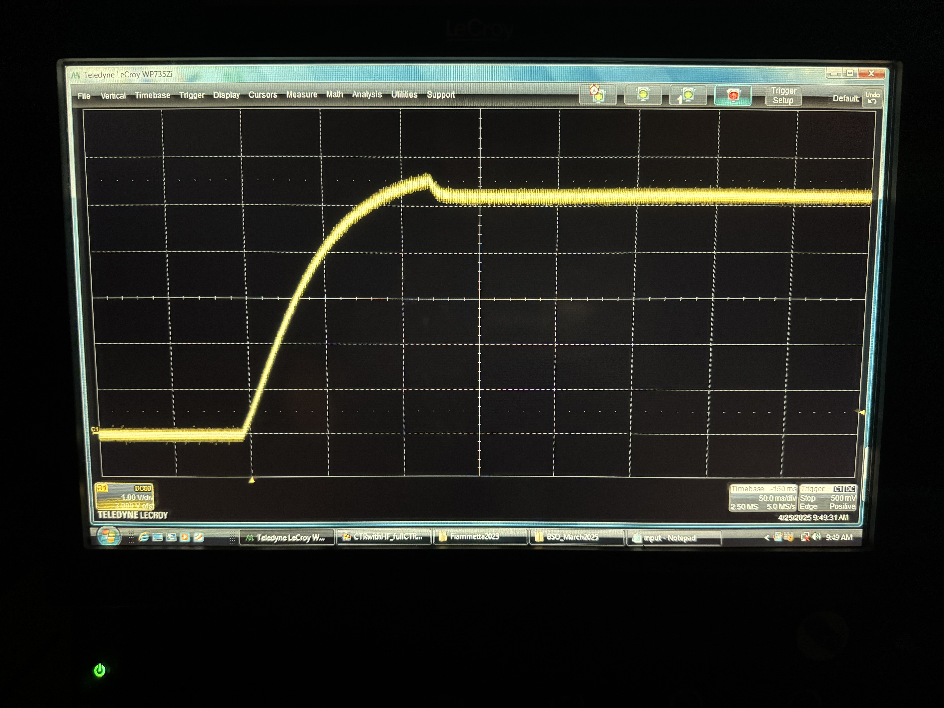
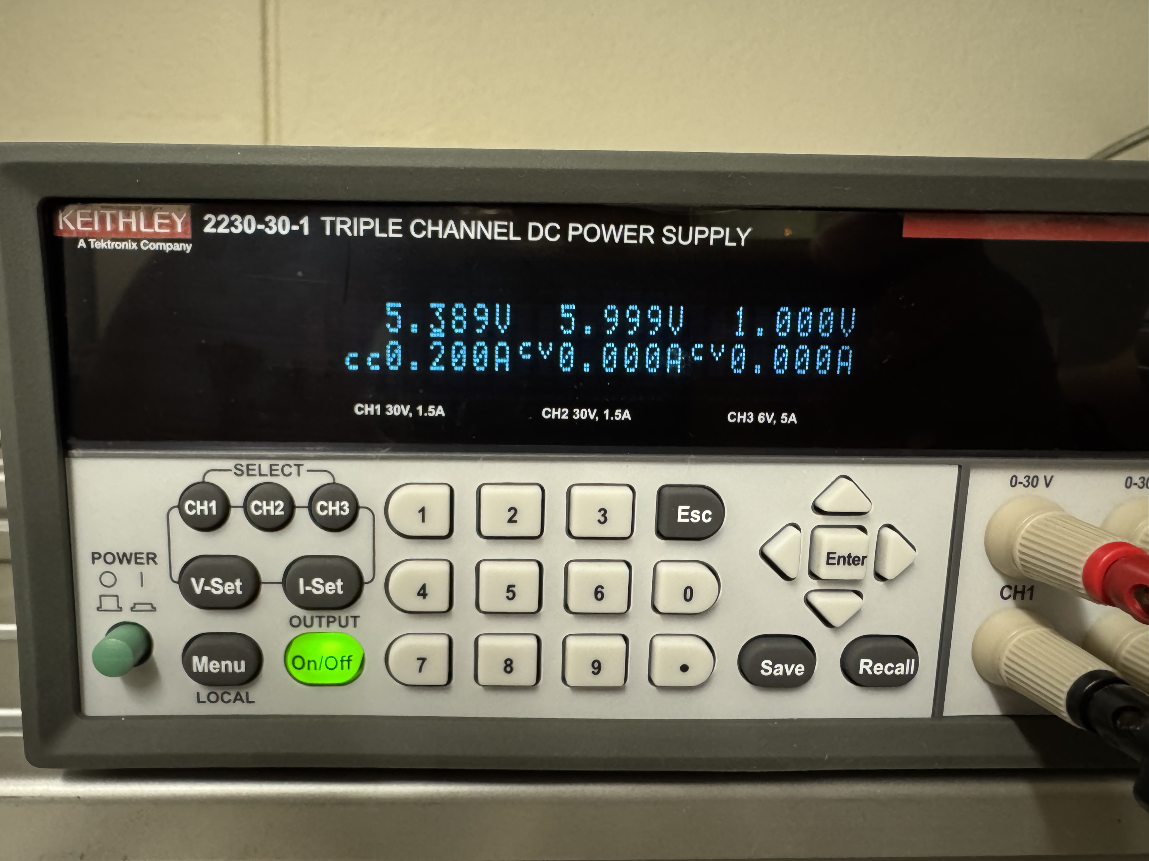
6V On Button Bad Boards
6V
5.3V
50 ms
1 V
Bad Board #1. On Button
Current is limiting voltage.
Cesar Cardona
April 29, 2025

Slide 12
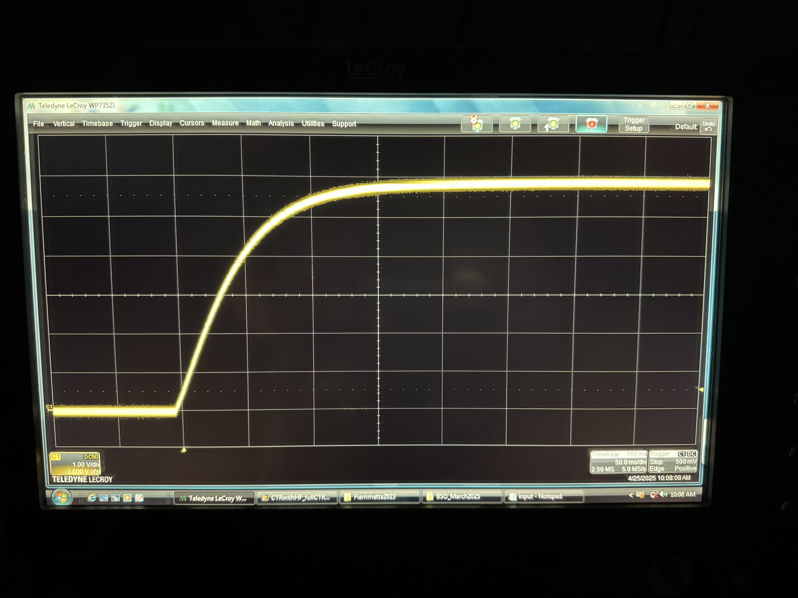
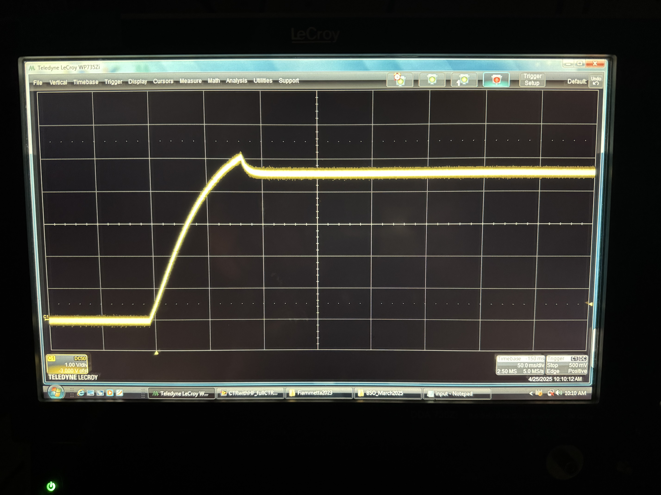
6V On Button Bad Boards
6V
6V
4.75V
50 ms
1 V
50 ms
1 V
Bad Board #2. On Button
Bad Board #3. On Button
Cesar Cardona
April 29, 2025

Slide 13
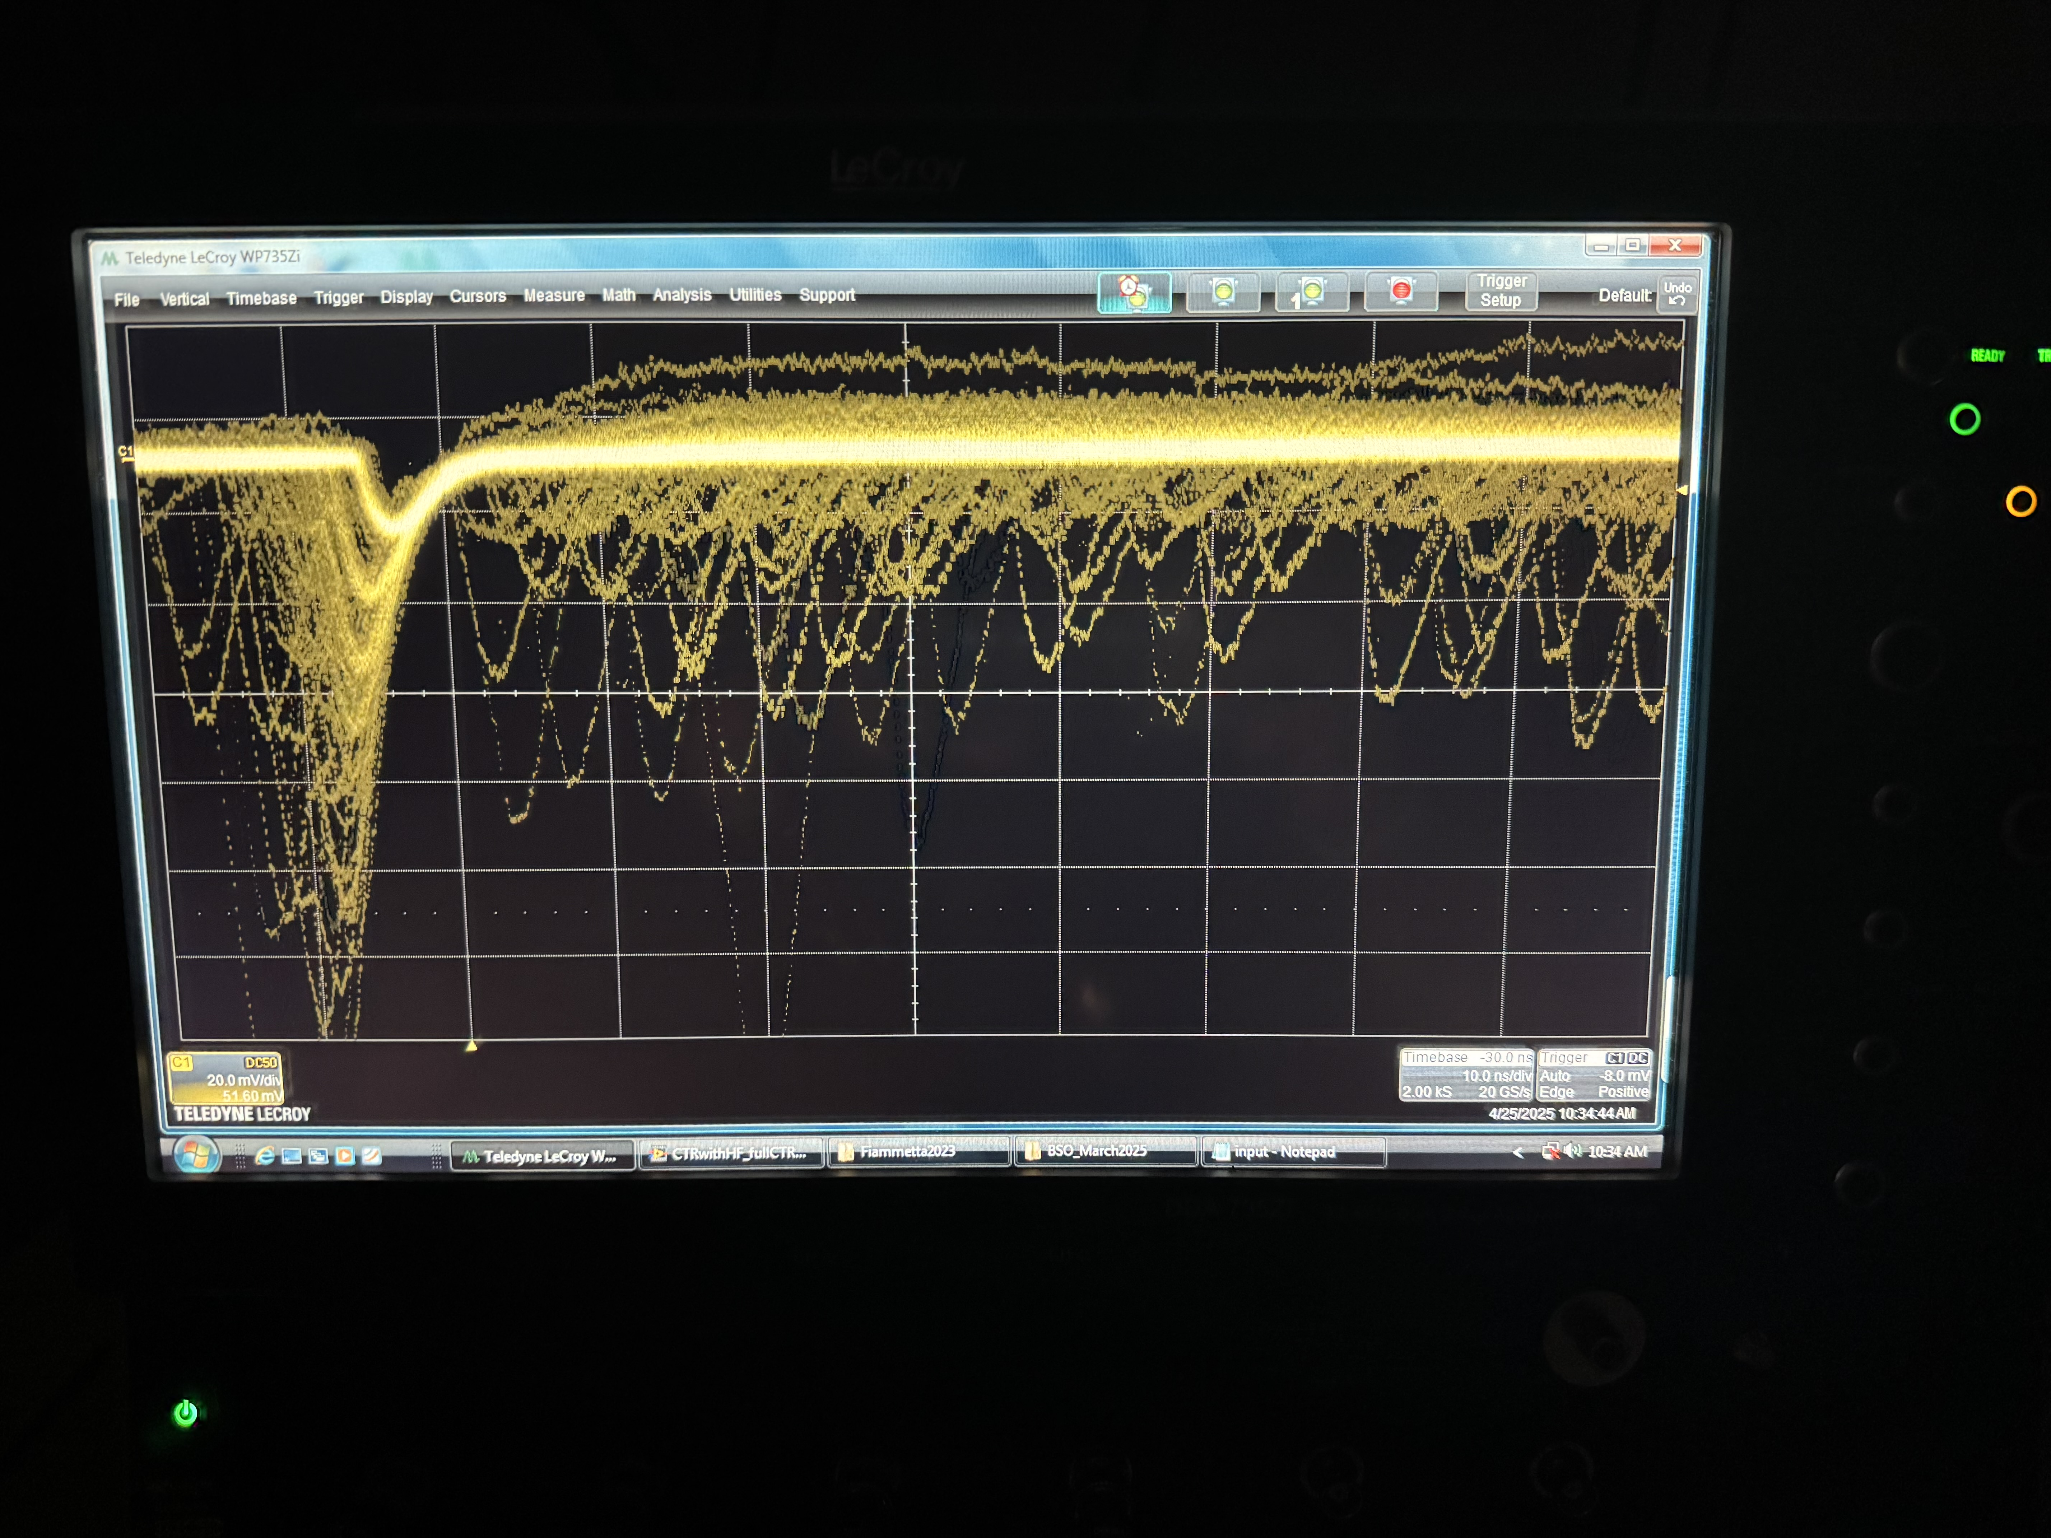
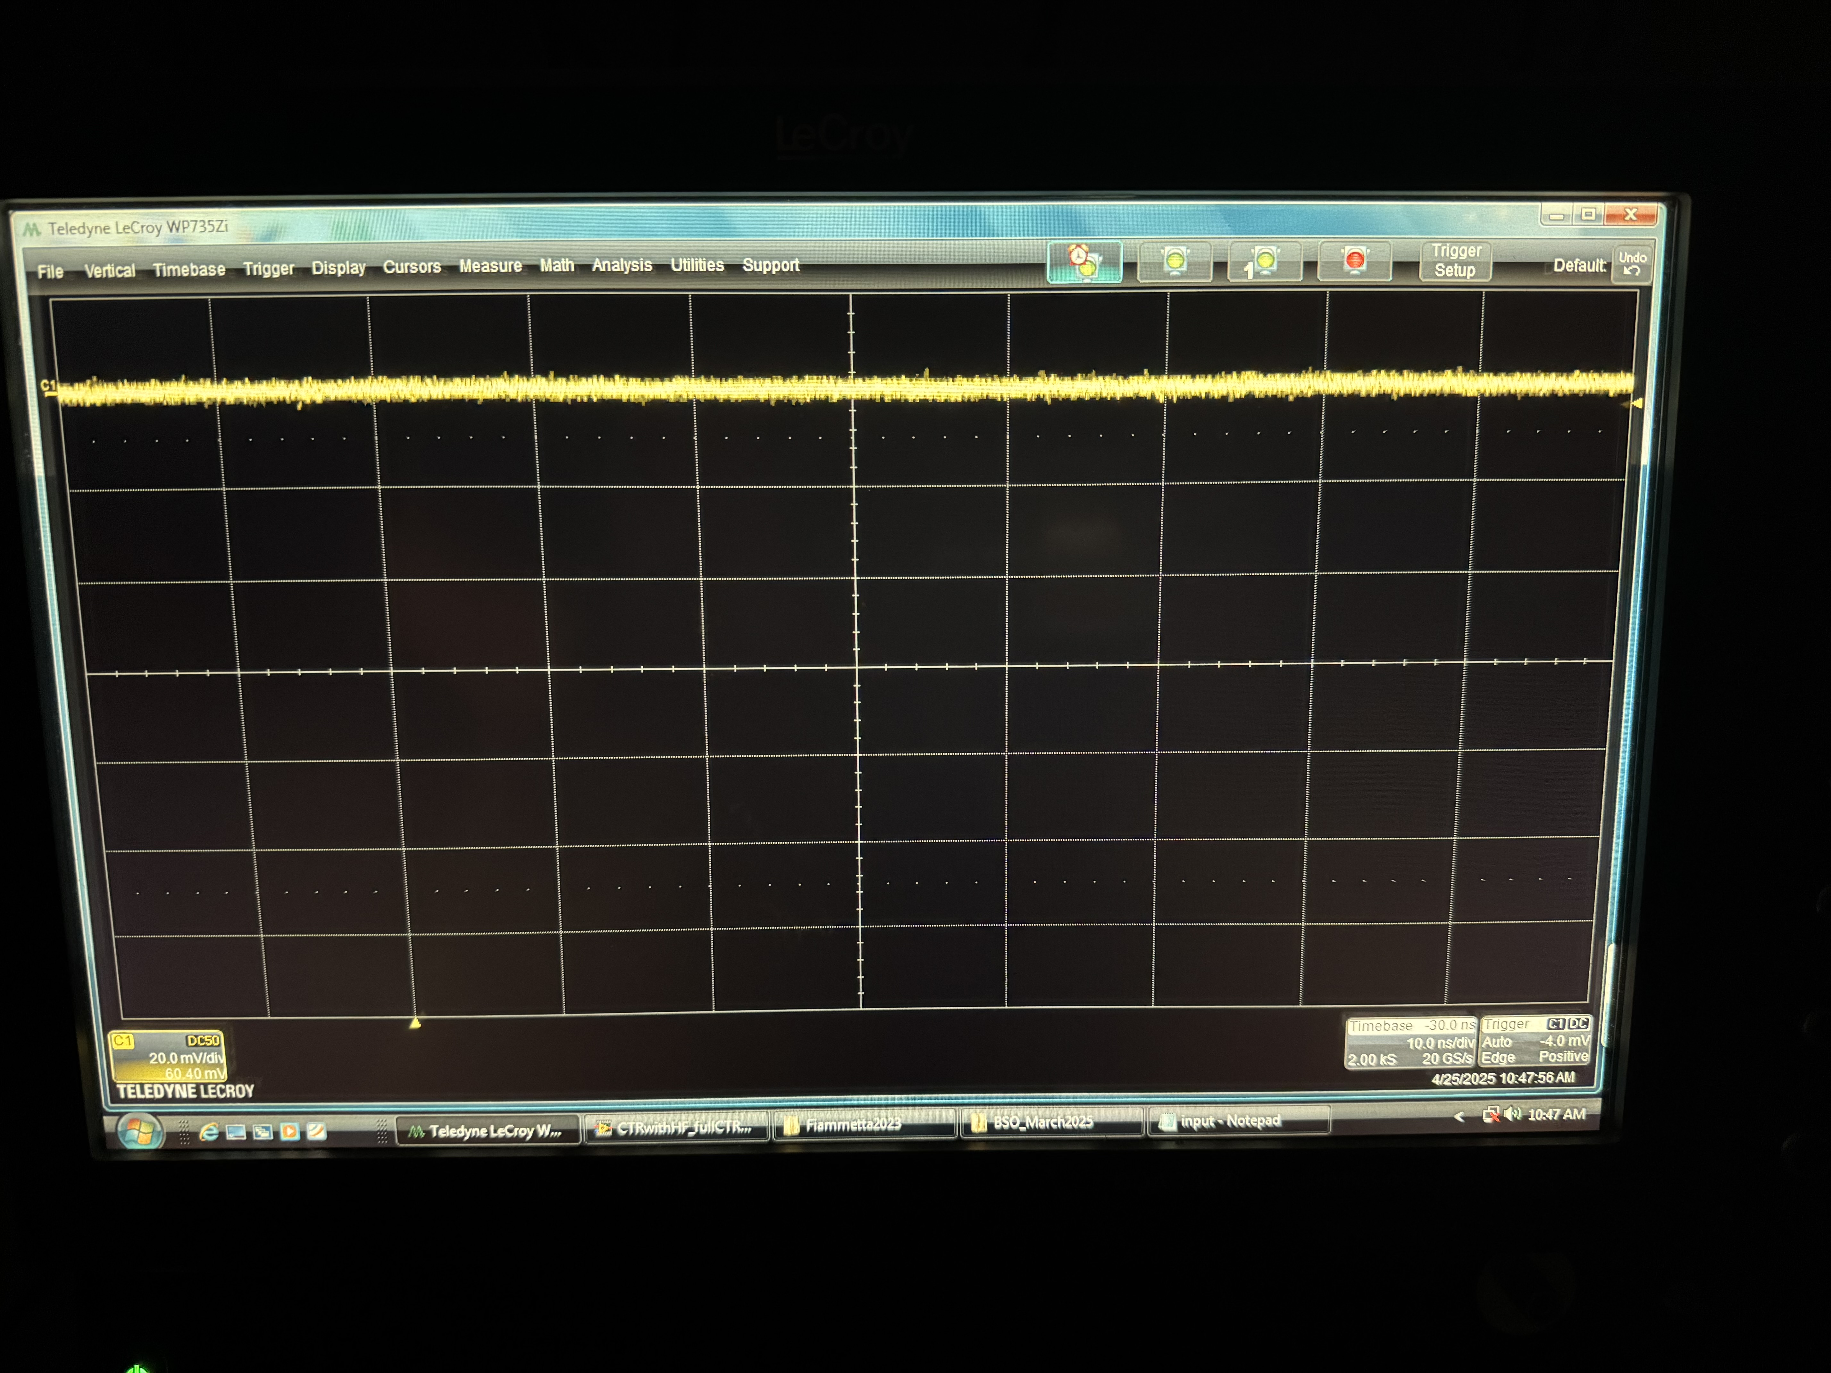
Time Branch
10 ns
20 mV
10 ns
20 mV
Good Board Time Branch (35V Biased)
Bad Board #2 Time Branch (35V Biased)
Cesar Cardona
April 29, 2025

Slide 14
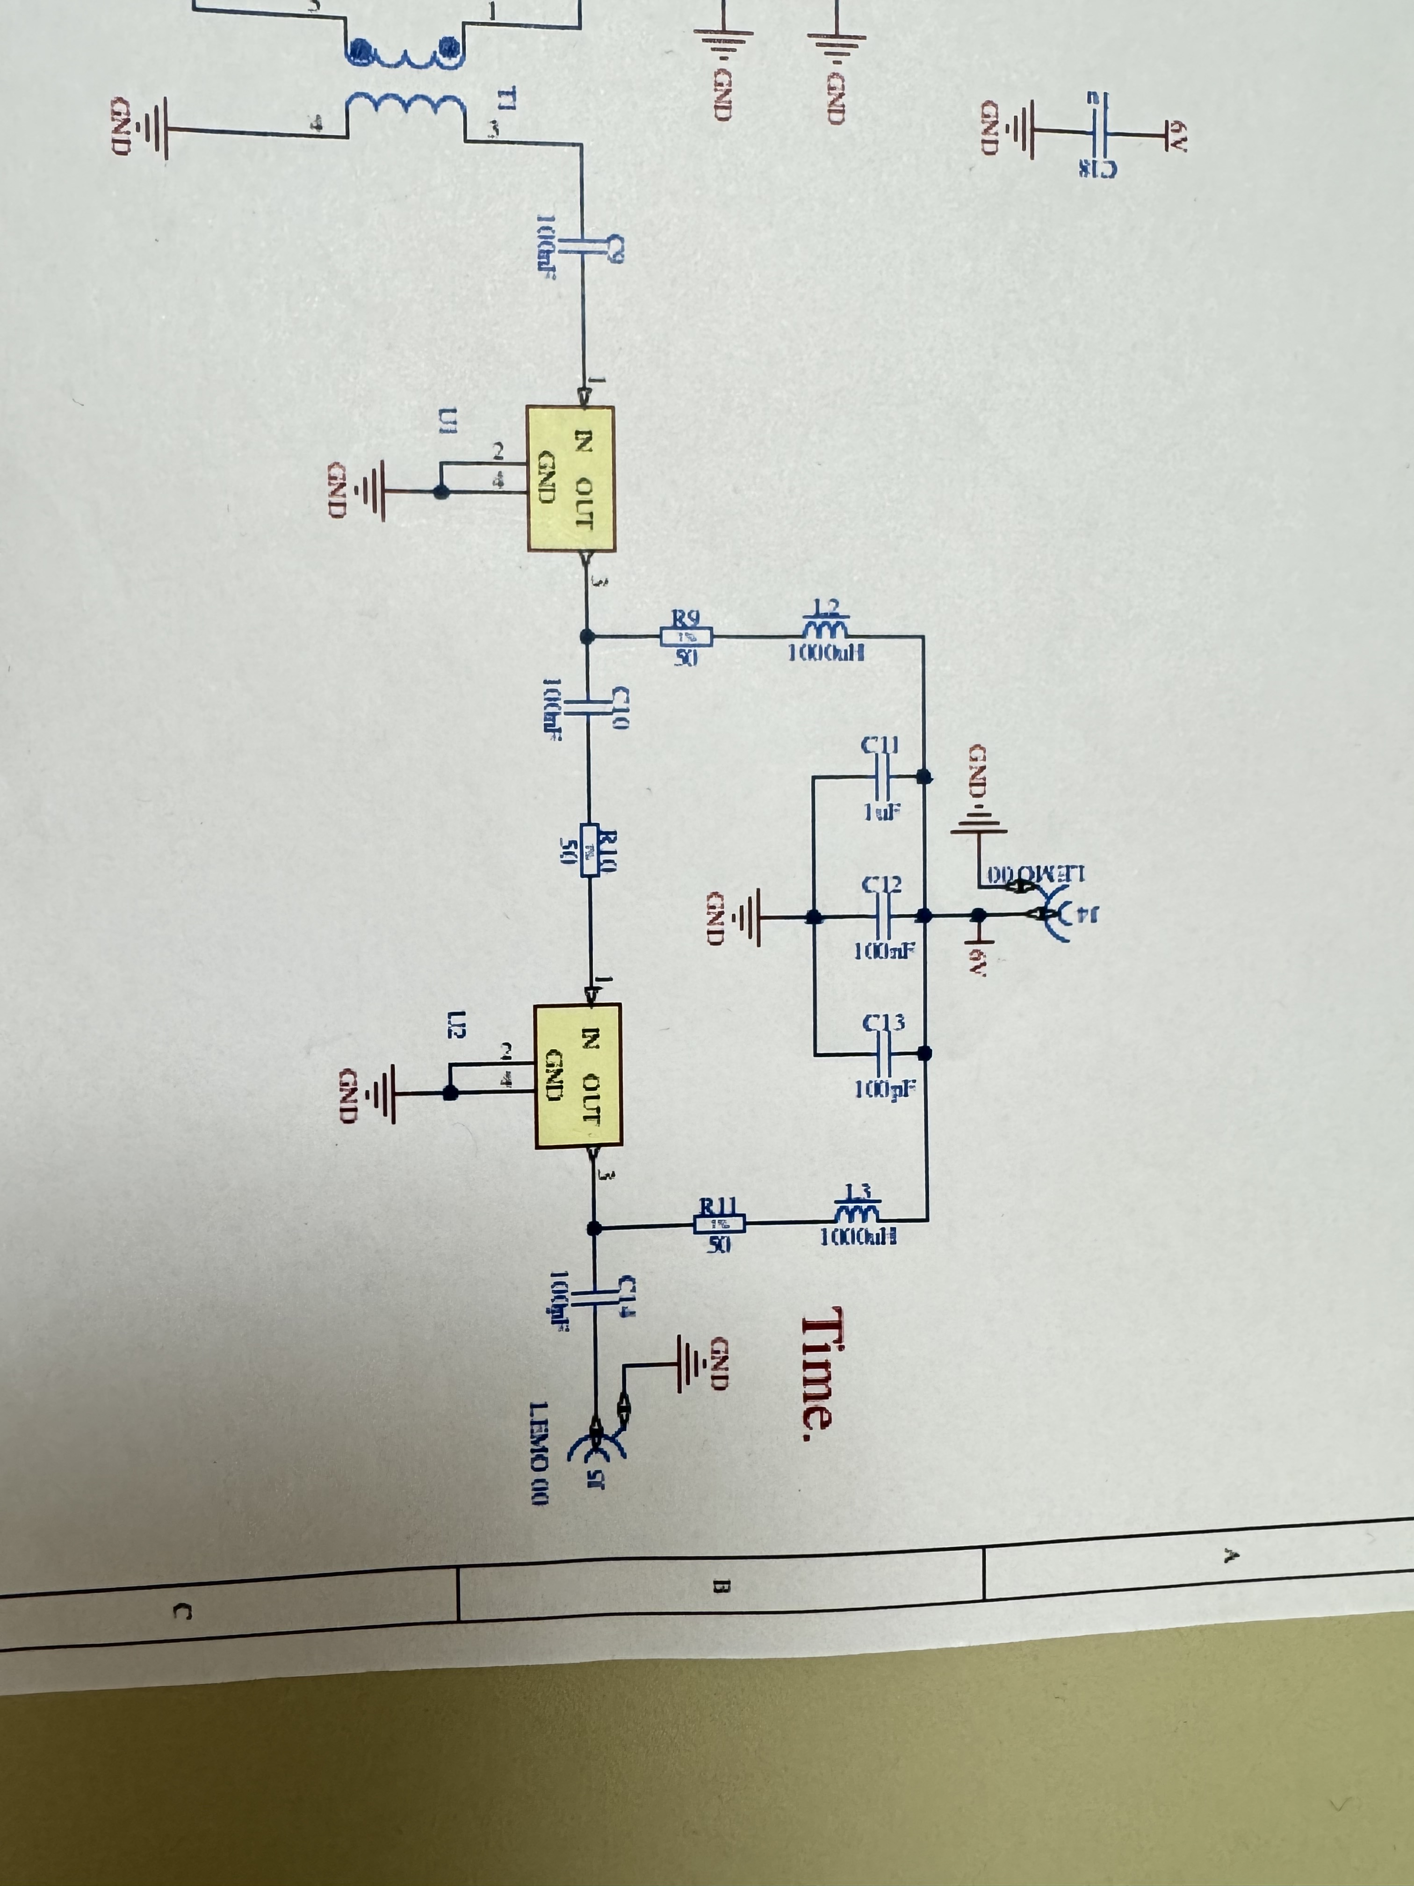
Capacitors? Amplifiers?
When measuring resistance across capacitors C11, C12, and C13, each board reads a different resistance.
Board | Resistance
Good Board | 487 Ω
Bad Board 1 (V2-C001-A3) | 76 Ω
Bad Board 2 (V2-C003-A2) | 377 Ω
Bad Board 3 (Caseless) | 45 Ω
Cesar Cardona
April 29, 2025

Slide 15
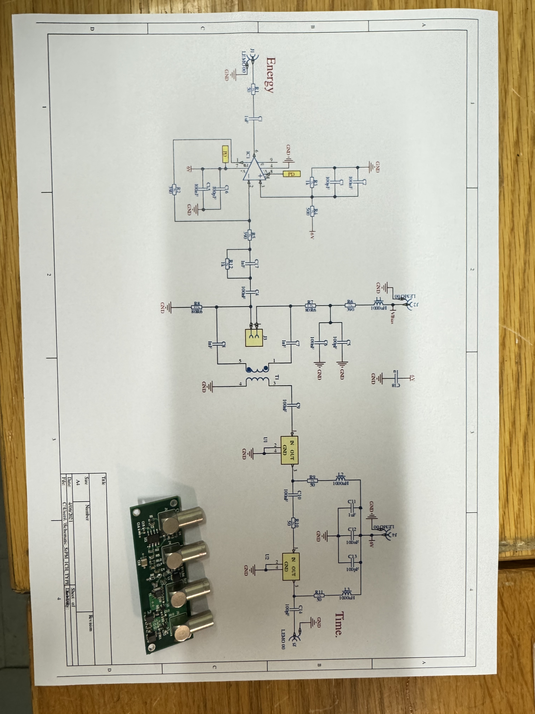
Conclusion?
So what's wrong with the bench?
We have discounted the power supplies and energy blackouts as a possible culprit.
What takes the boards out seems to be cheap electronic components mixed with user error.
More test will take place.
Cesar Cardona
April 29, 2025

Slide 16
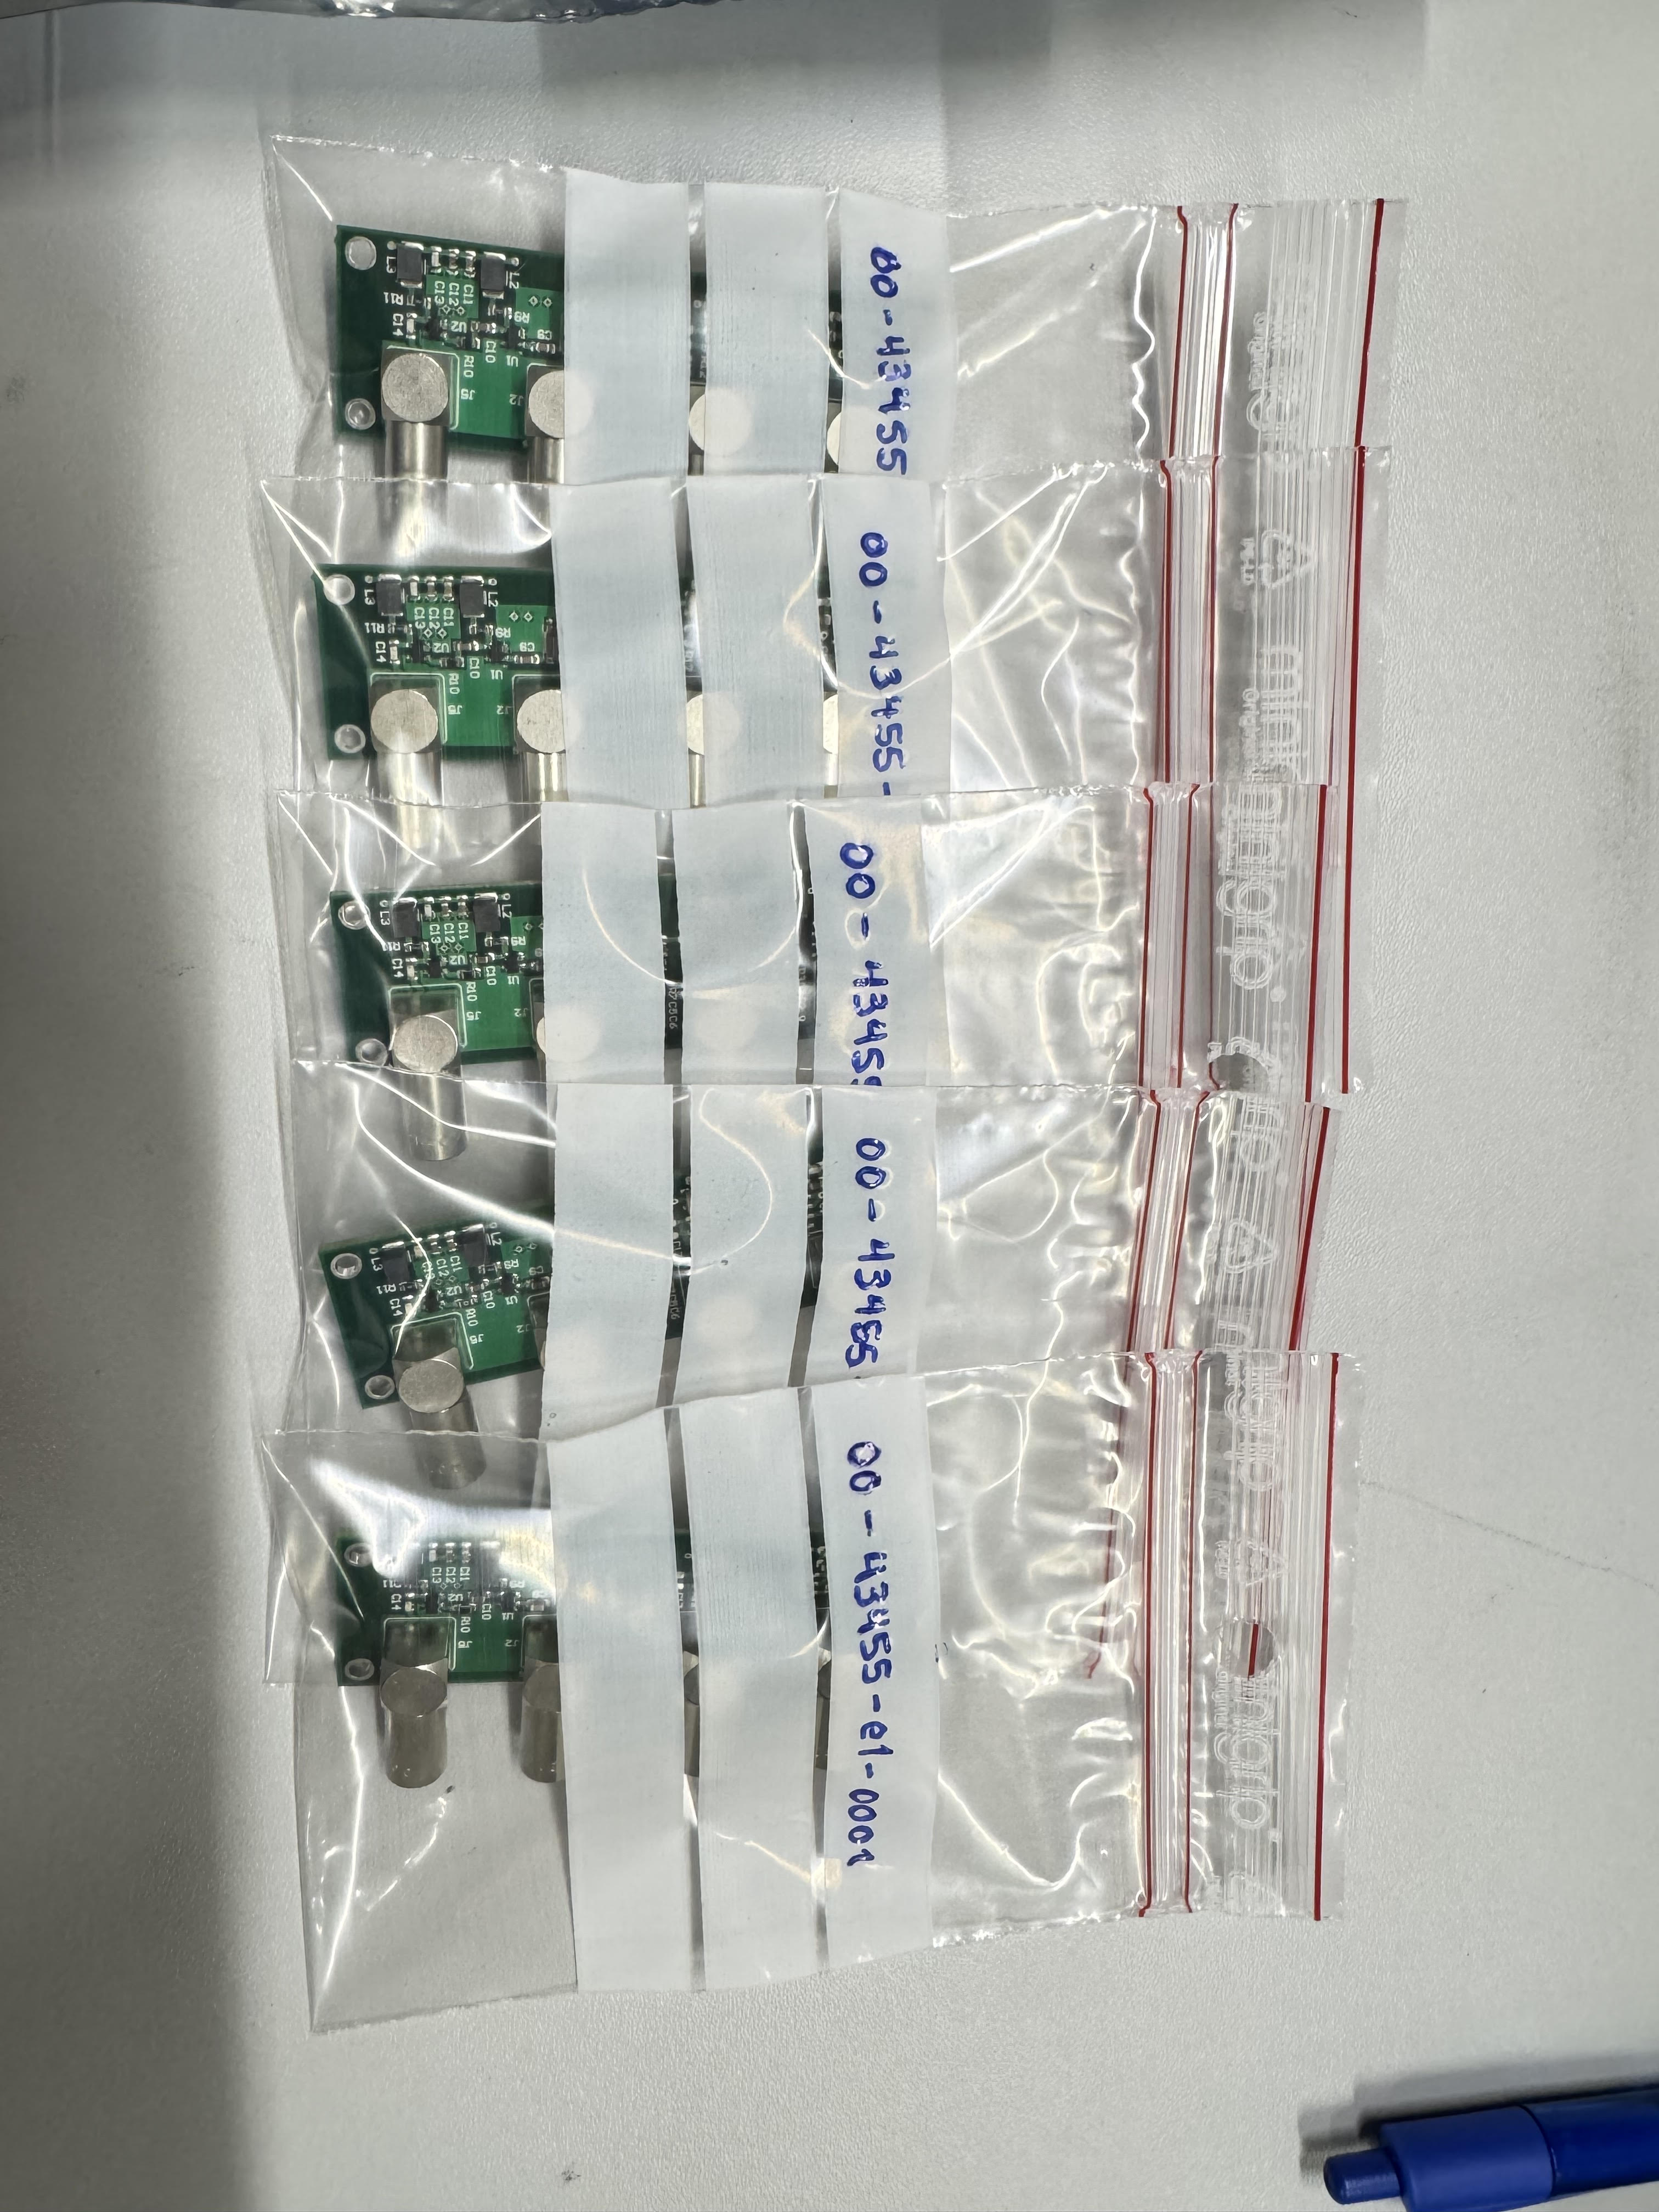
Another Update
We got new boards!
Just this morning we received 5 new boards. I checked their resistance over the capacitors and found this:
We will change components U1 and U2 from Bad Board 1.
Board | Resistance
Good Board | 487 Ω
00-43455-e1-0001 | 481 Ω
00-43455-e1-0002 | 482 Ω
00-43455-e1-0003 | 480 Ω
00-43455-e1-0004 | 480 Ω
00-43455-e1-0005 | 483 Ω
Cesar Cardona
April 29, 2025

Slide 17
FastIC+ Updates
Cesar Cardona
April 29, 2025

Slide 18

Writing Abstract for IEEE Conference
Deadline Thursday May 8, 2025
We are submitting an abstract for conference.
Topic being:
Exploring Scalable Electronics for Heterostructured Scintillators Using FastIC+
Cesar Cardona
April 29, 2025

Slide 19
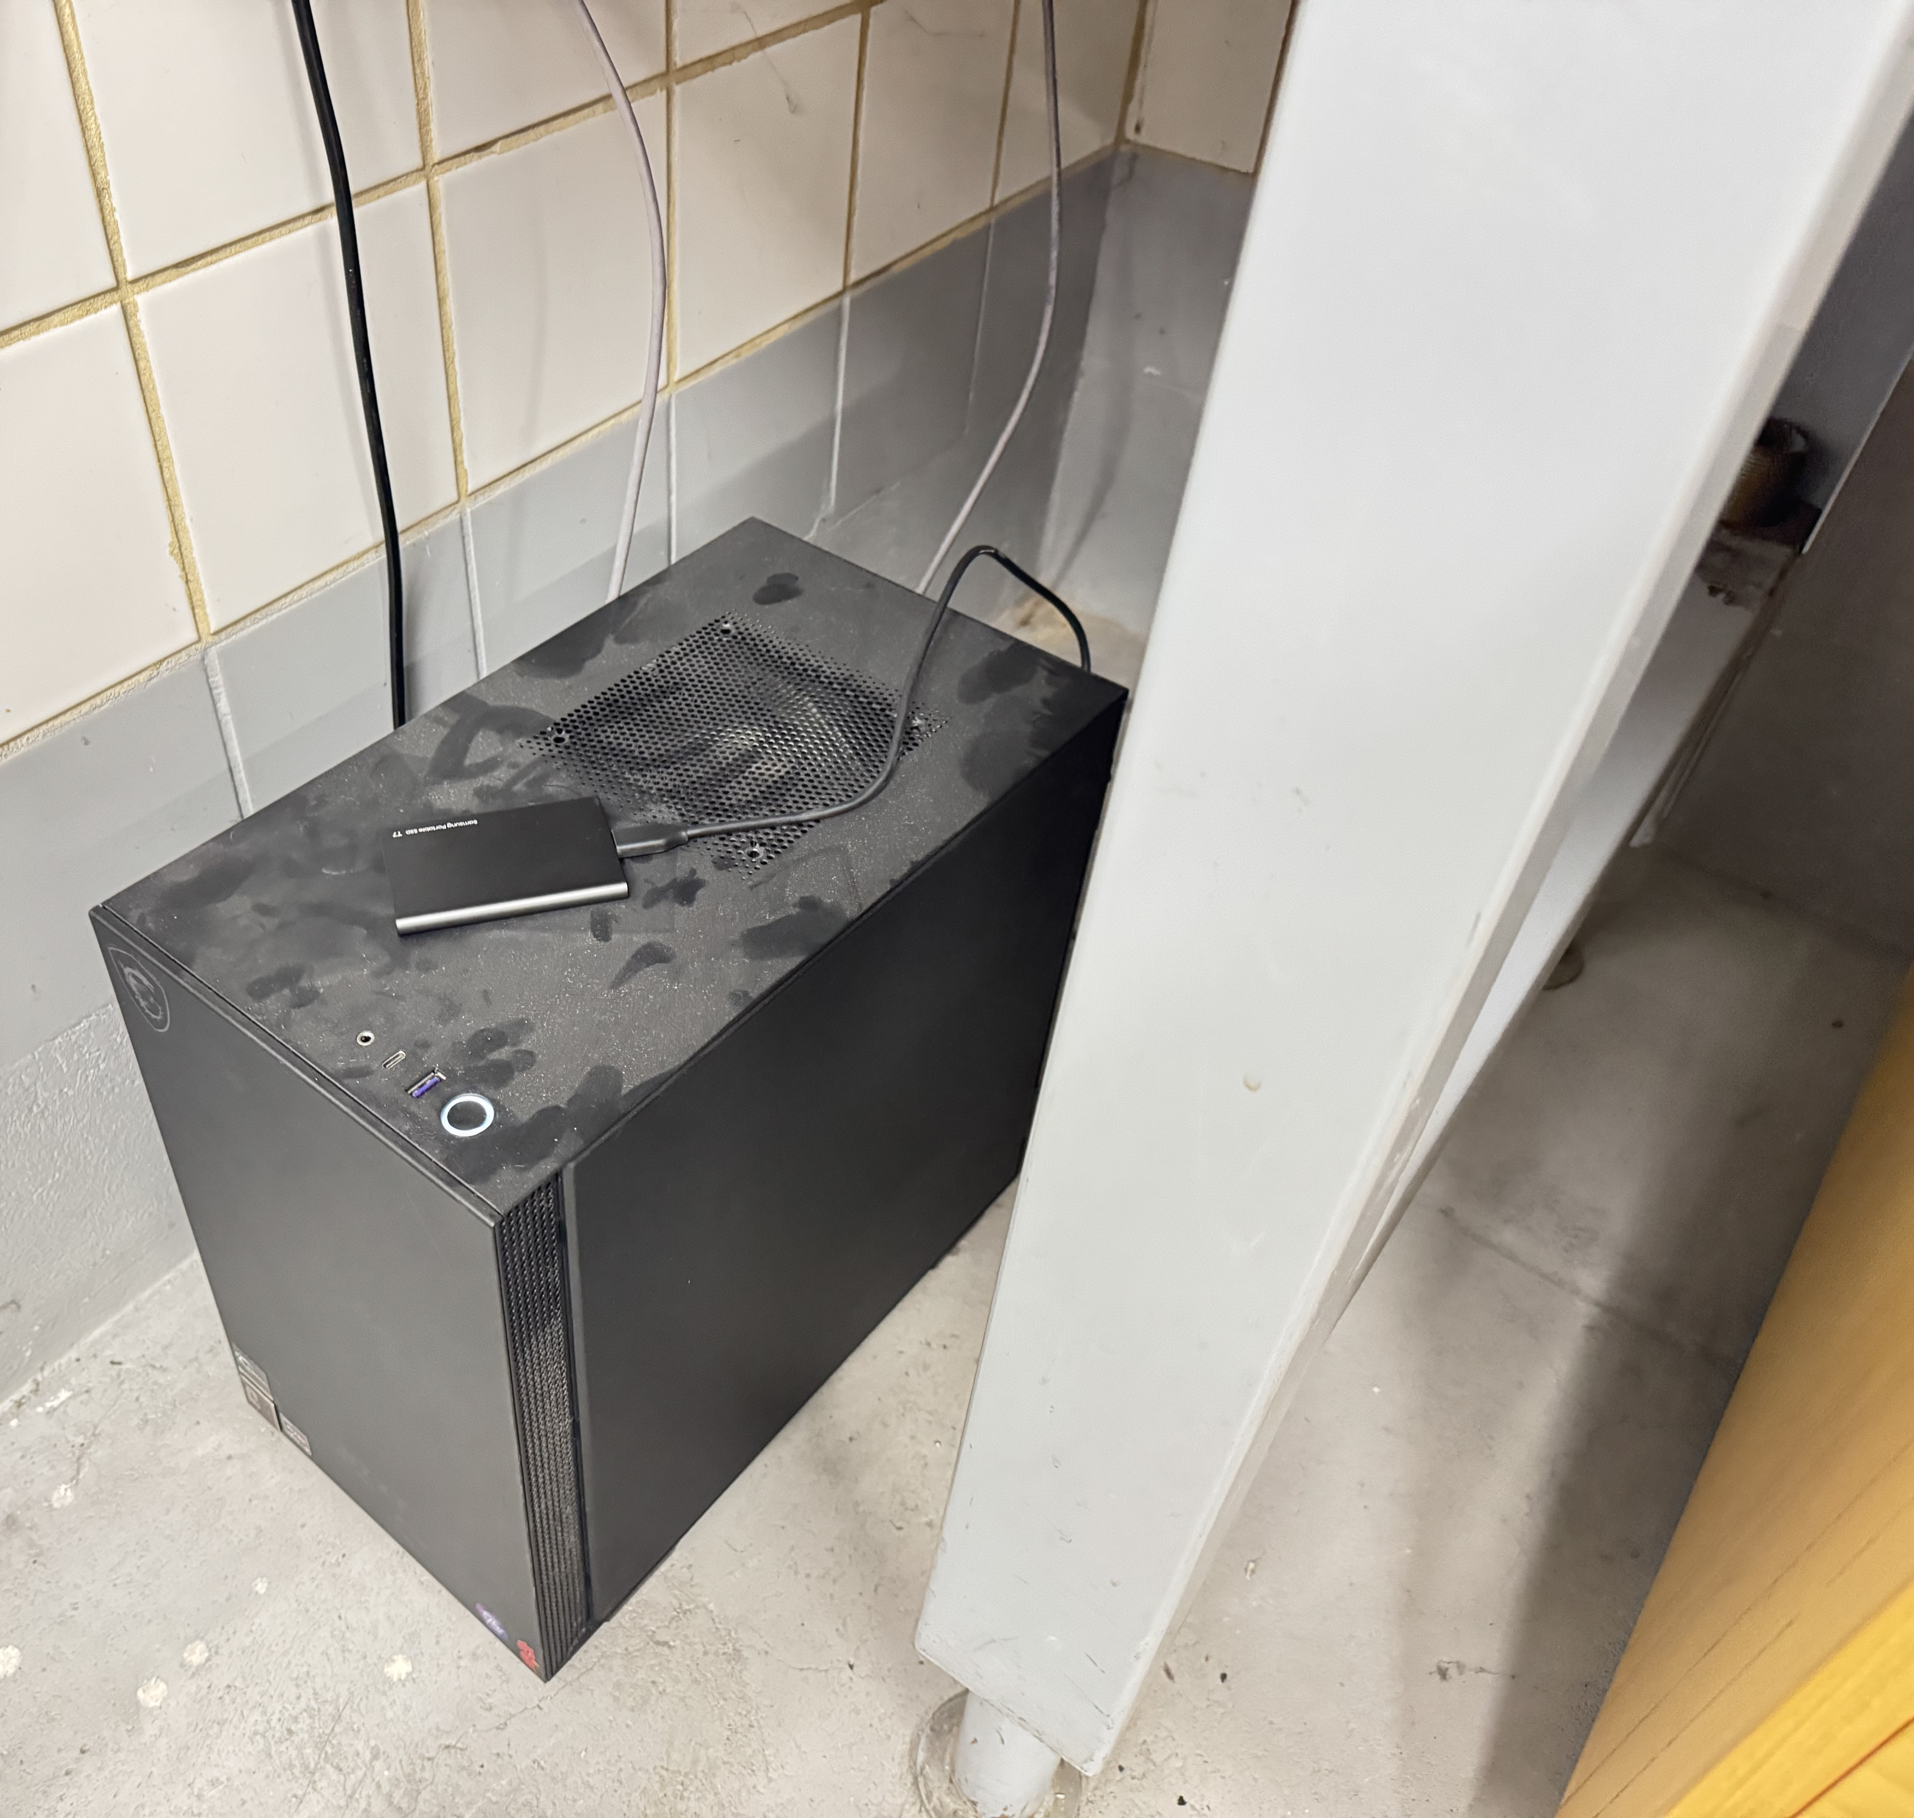
FastIC+ Operation
We have gotten mostly used to it…
FastIC+ records a lot of Data (~10 GB per single pixel 20 minute run).
Most of it is useless, but we still get considerable statistics on coincidences.
Since the FastIC+ boards output .txt files, we need to use a BEAST computer to first filter the data before we can do analysis in our laptops.
Cesar Cardona
April 29, 2025

Slide 20
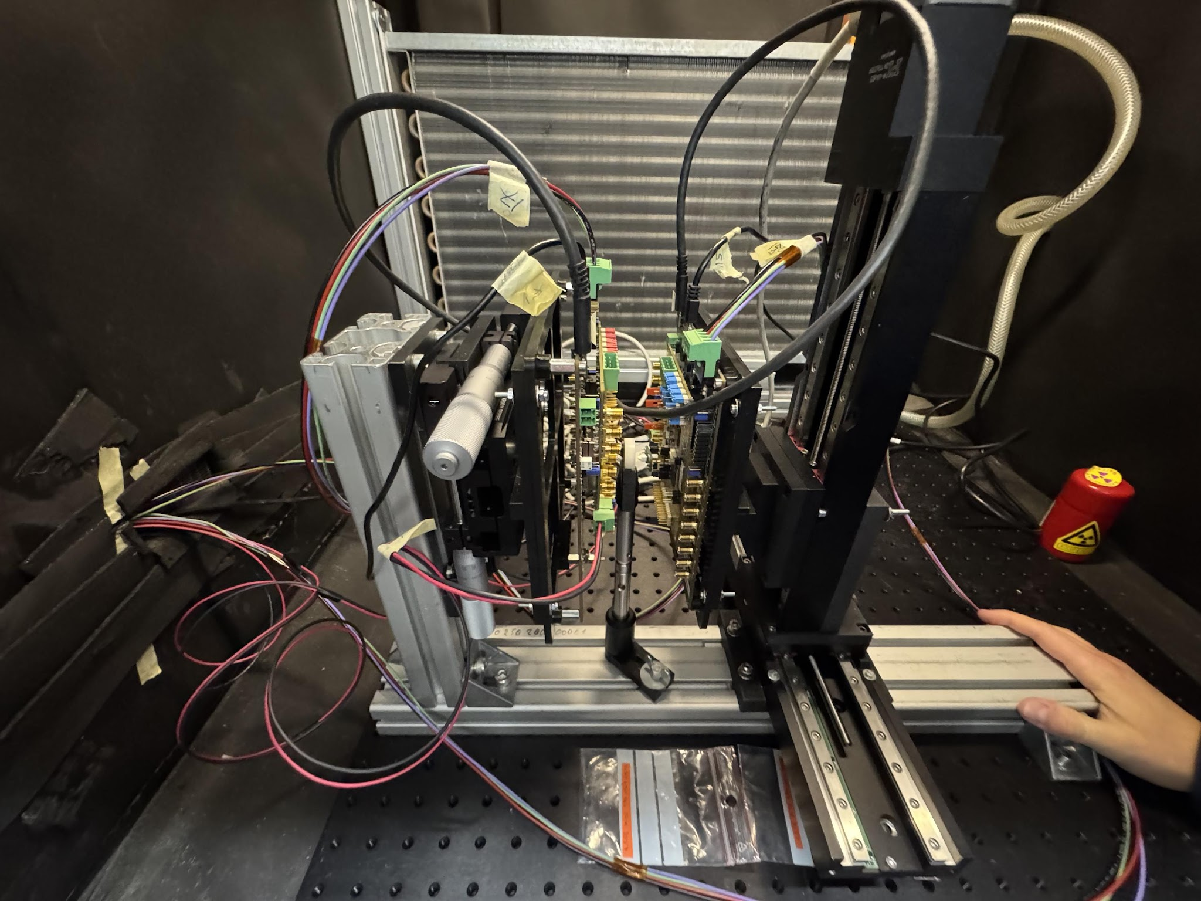
Detector Setup and Motivation
Heterostructure Timing Studies with BGO + EJ232
We are investigating a heterostructure crystal composed of BGO and EJ232 (3×3×20 mm), paired with a reference LYSO:CeCa crystal (2×2×3 mm) on a Broadcom NUV-MT SiPM at 40 V.
Goal: Improve Coincidence Time Resolution (CTR) while maintaining high detection efficiency.
Motivation for heterostructures:
BGO: High stopping power, but slow scintillation.
EJ232: Very fast light emission, but low stopping power.
Combining them could yield the best of both worlds: better timing + good sensitivity.
Cesar Cardona
April 29, 2025

Slide 21
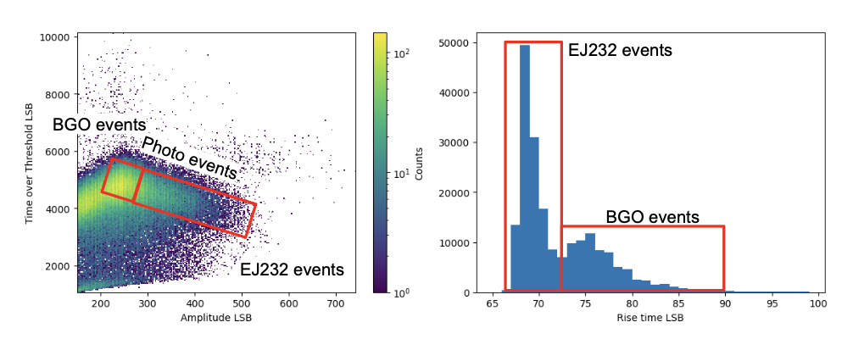
Event Classification
What is Event Classification?
In heterostructures, gamma rays may interact in:
Just the BGO, Just the EJ232, Or both (shared events)
We use signal features (e.g., rise time, amplitude, time-over-threshold) to classify the event type.
Classification enables us to isolate fast events and study their timing separately.
Cesar Cardona
April 29, 2025

Slide 22
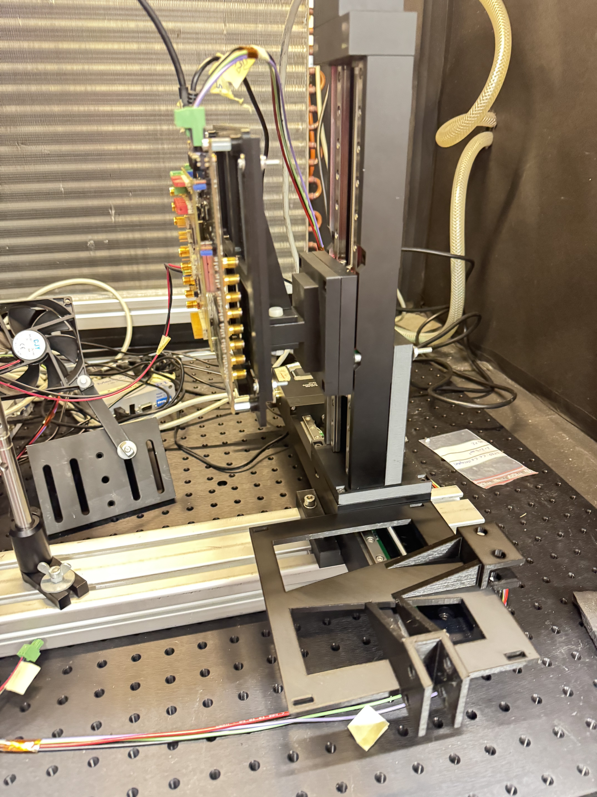
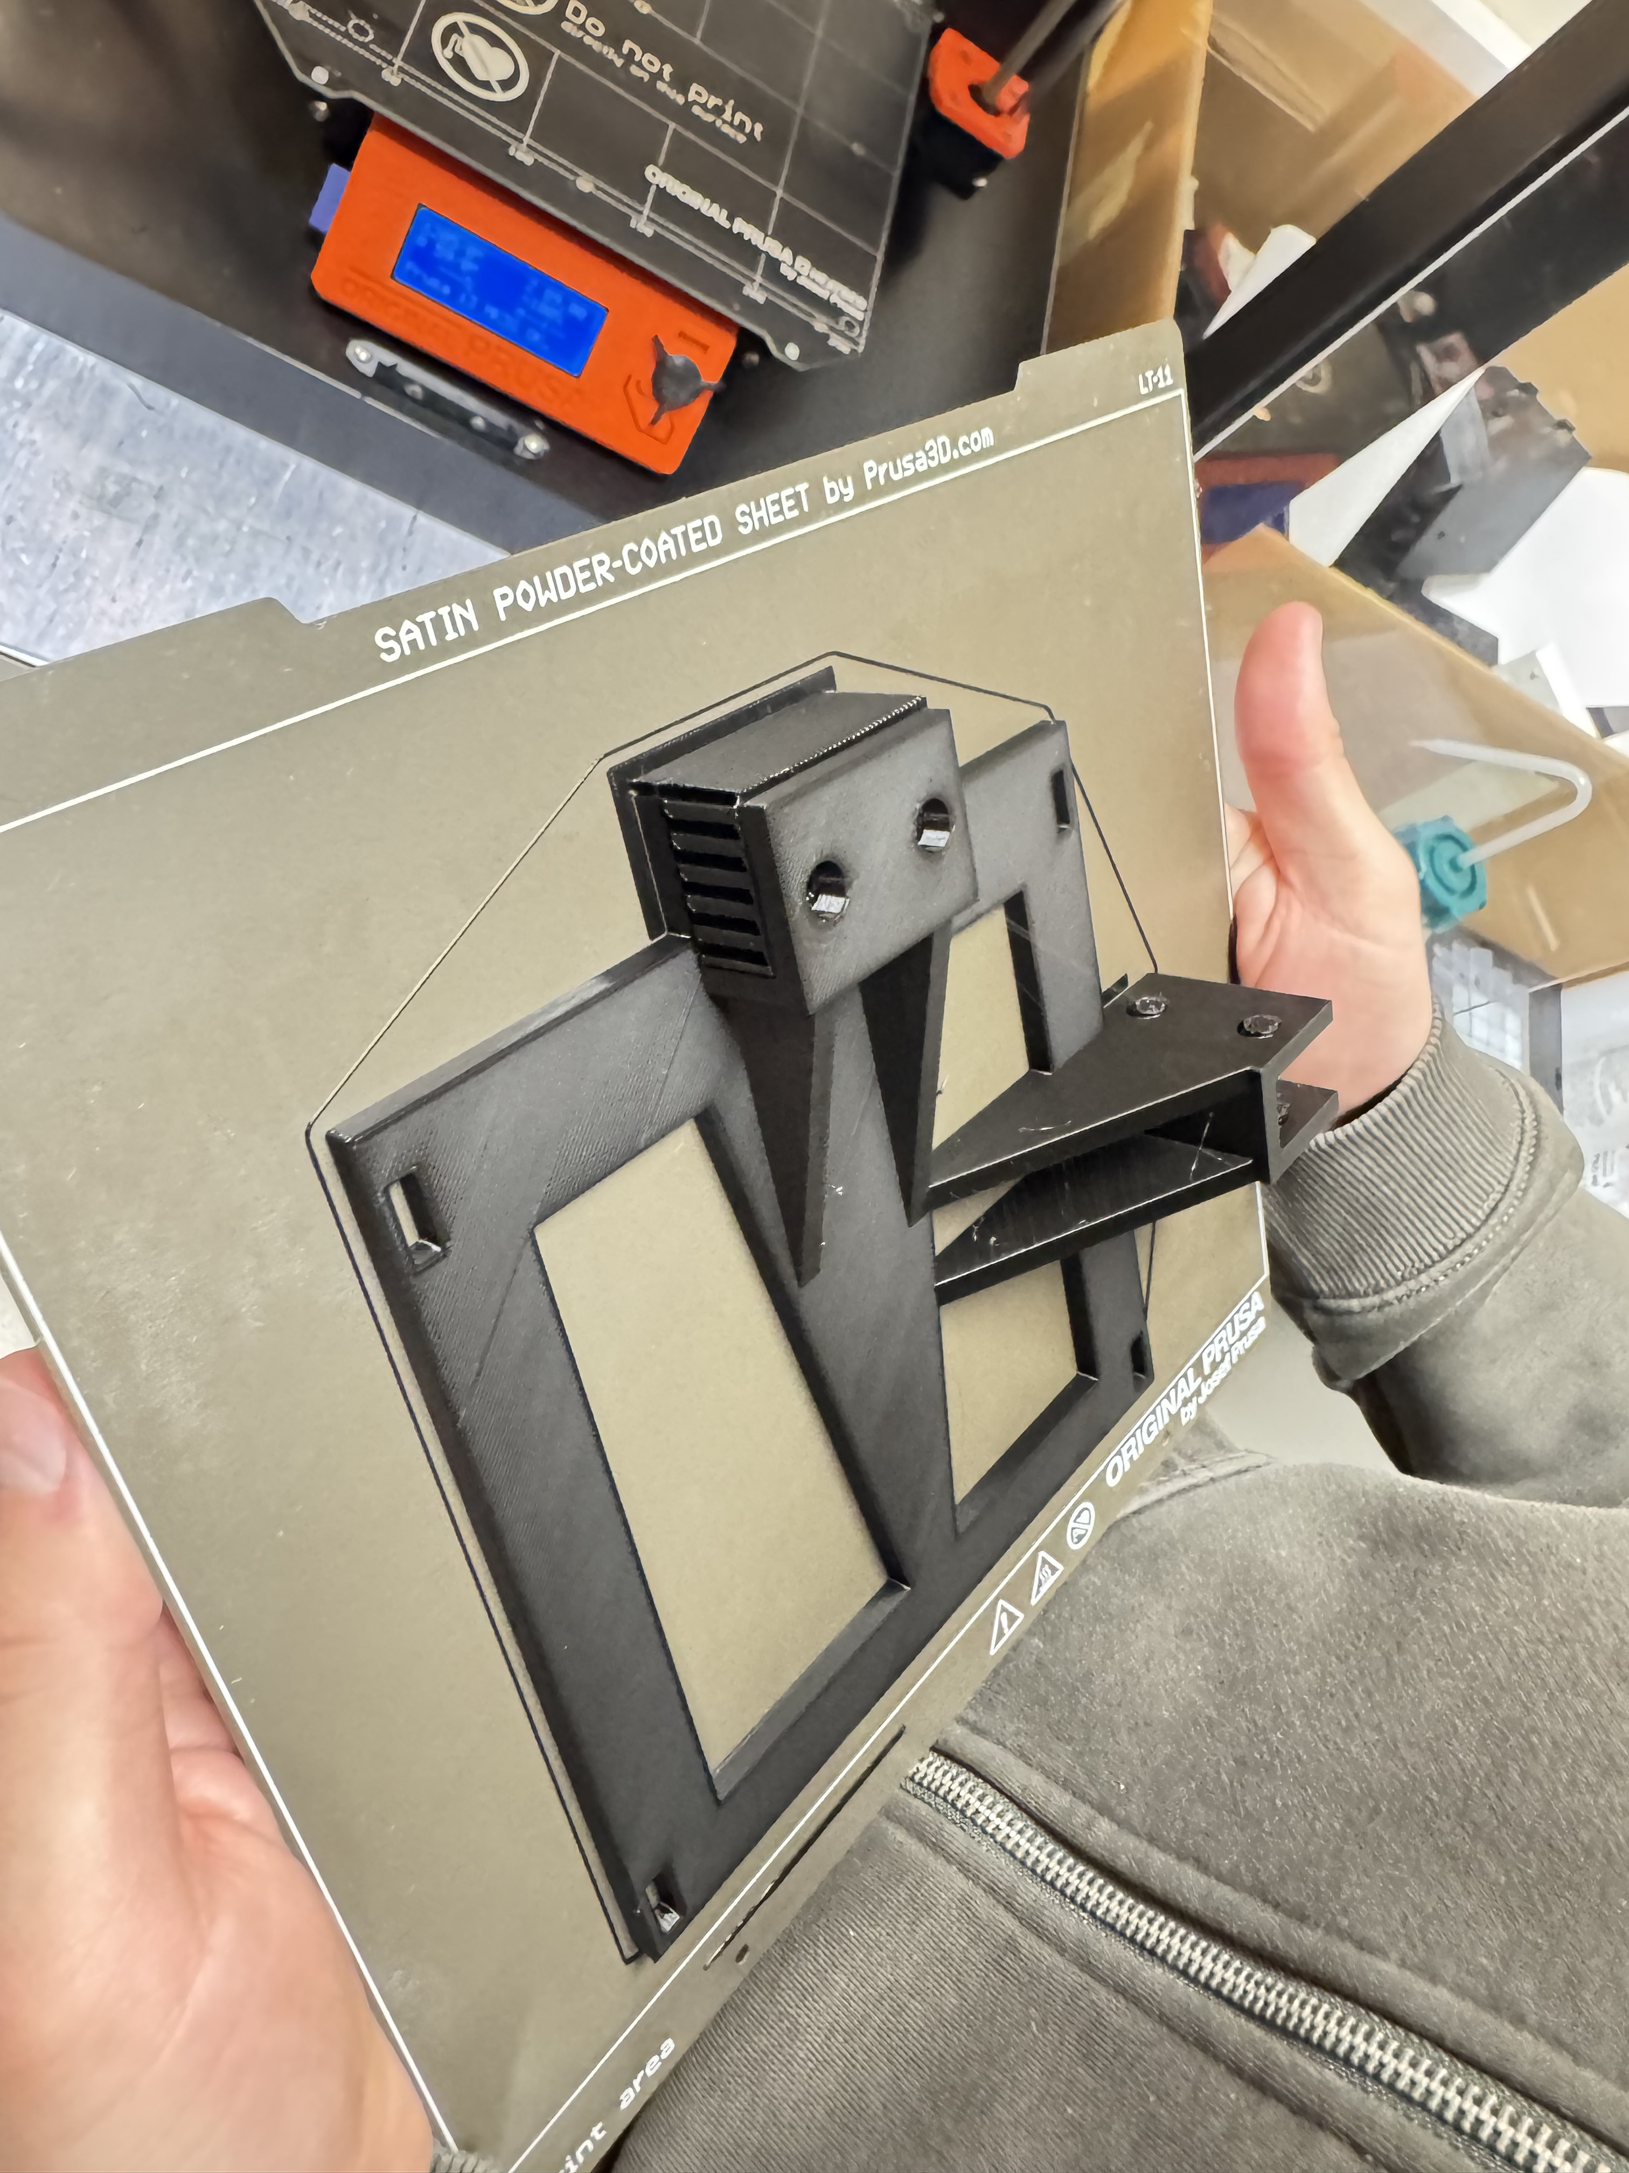
Other Measurements
DOI (Depth of Interaction)
We are also using the FastIC+ to study DOI
I helped by designing a 3D mount to set the crystals at different orientations.
Two techniques used:
Double Sided Readout (Carsten)
Light Sharing Matrix (Giulia)
Cesar Cardona
April 29, 2025

Slide 23
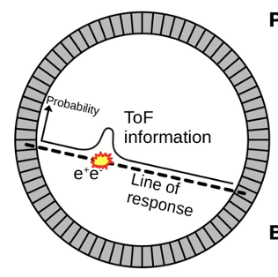


Why DOI Matters in PET?
In standard PET, detectors assume gamma photons always interact near the front of the crystal, but they can actually interact deeper inside, leading to parallax error.
Parallax error worsens as the angle between the incoming photon and the detector face increases — especially in systems with large ring diameters.
Depth of Interaction (DOI) techniques aim to measure the exact depth at which the photon interacts inside the crystal.
Scintillators
vs
SiPMs
Cesar Cardona
April 29, 2025

Slide 24
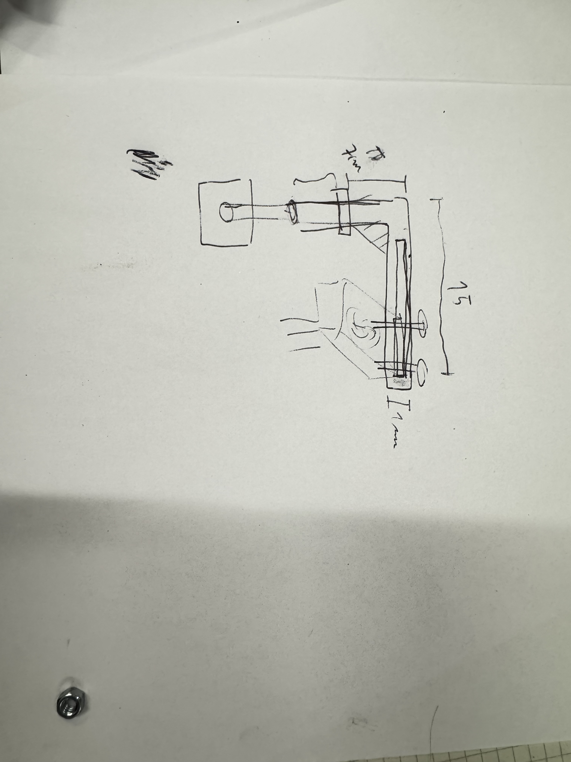
My Best Work Yet…
The FastIC+ got a little hot…
When using matrices, the current is high enough that it causes the SiPMs to get a little toasty, and melt the Meltmount supporting the crystals… Not Good.
We decided to build a fan to keep things cold.
We came up with many ideas as to how to mount it, but then came my genius!!!
Cesar Cardona
April 29, 2025

Slide 25
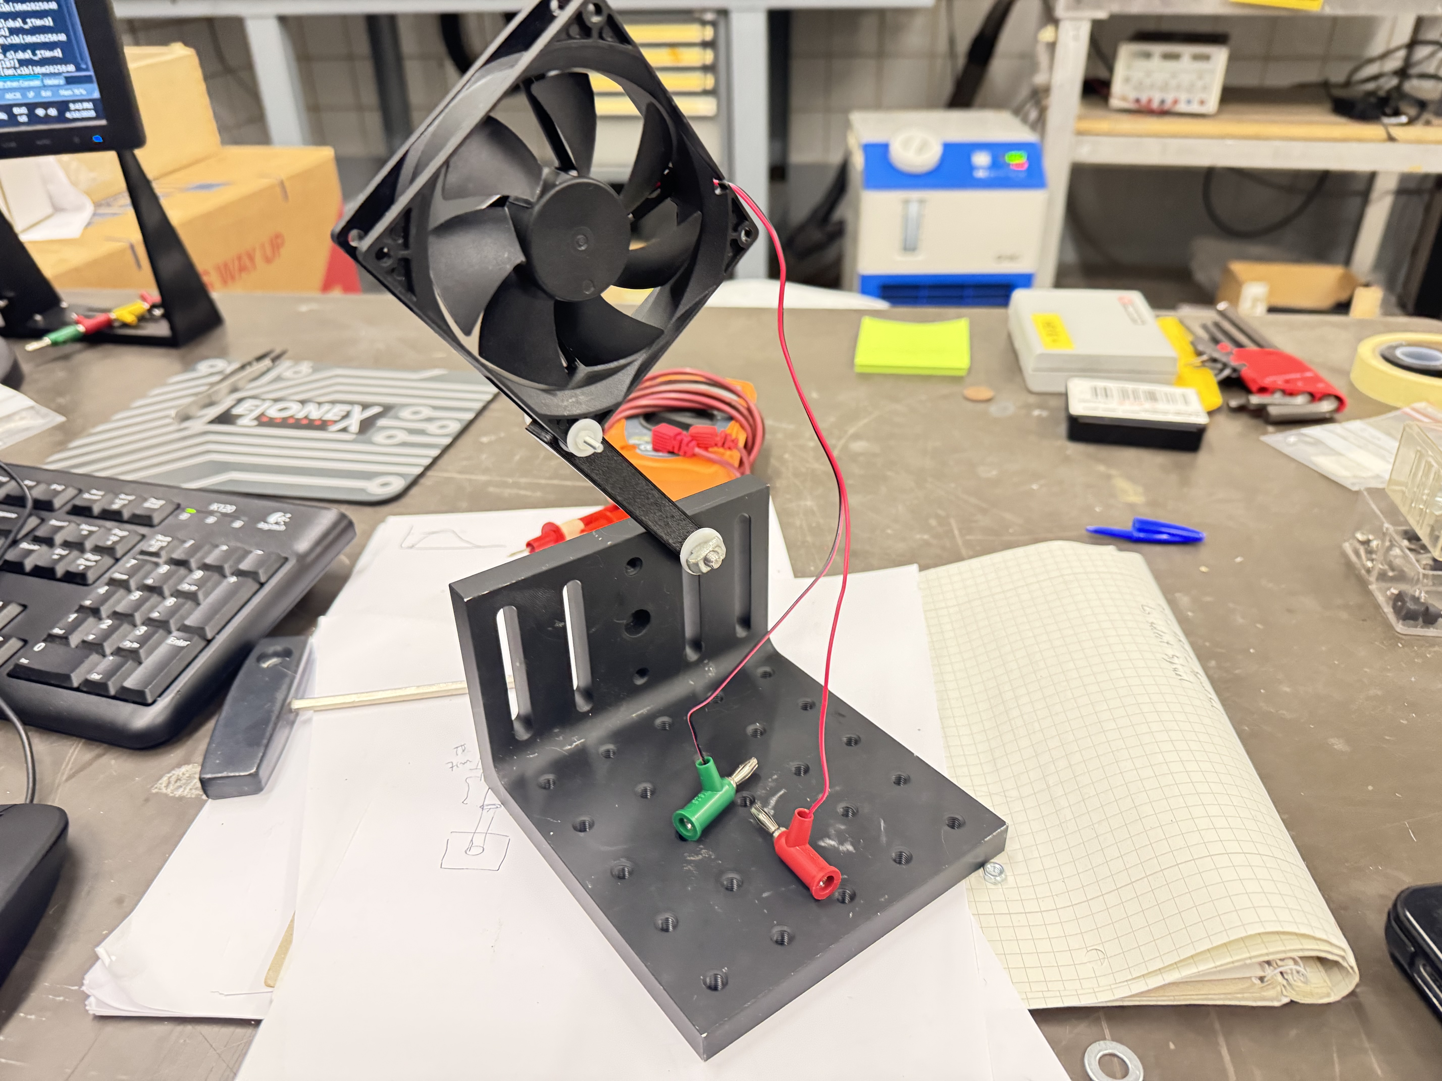
My Best Work Yet…
Only 3D printed a 10g. Brace, and used parts from the lab to create this beauty!
But, it was too short to provide the SiPM with good airflow…
Until…
Cesar Cardona
April 29, 2025

Slide 26
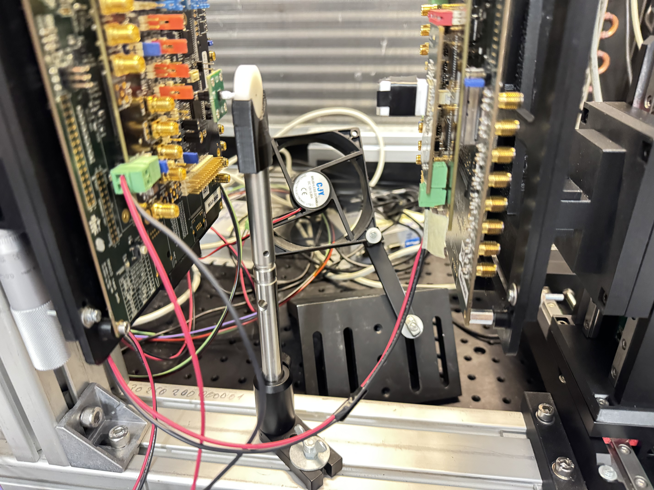
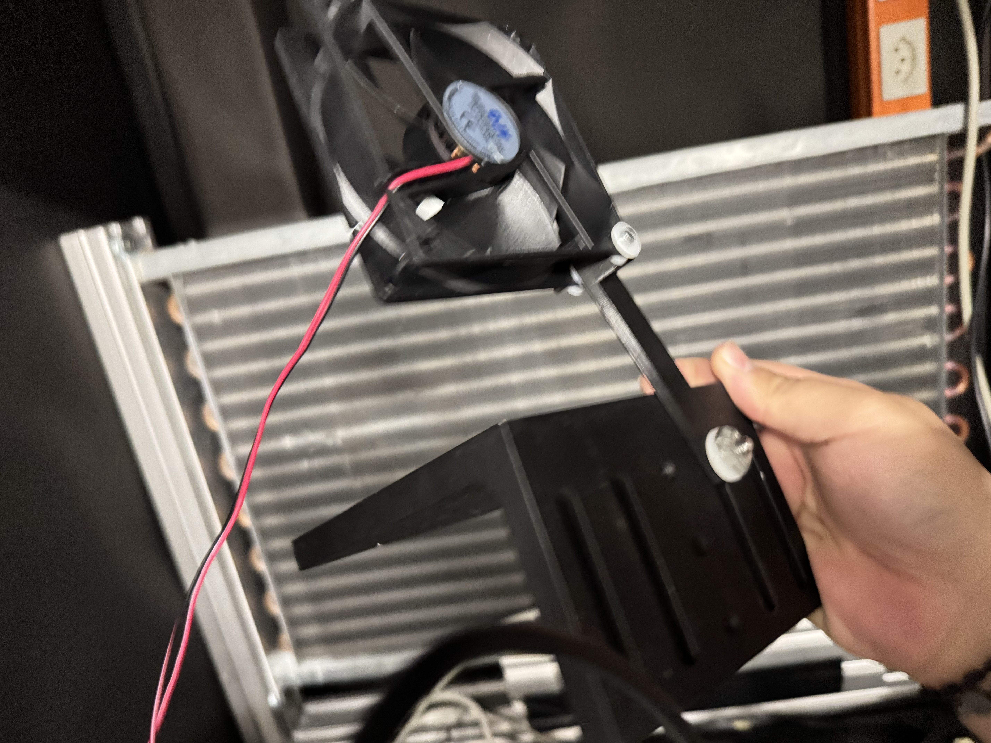

Carsten to the Rescue
CARSTEN’S GENIUS ARRIVED!!!
Cesar Cardona
April 29, 2025

Slide 27
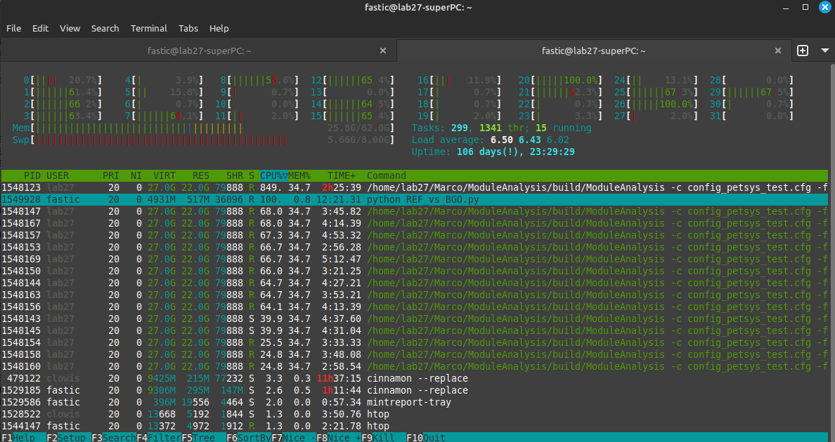
Questions?
Cesar Cardona
April 29, 2025

