Slide 1
Gamma Factory Updates
Shelby Cavanaugh

Slide 2
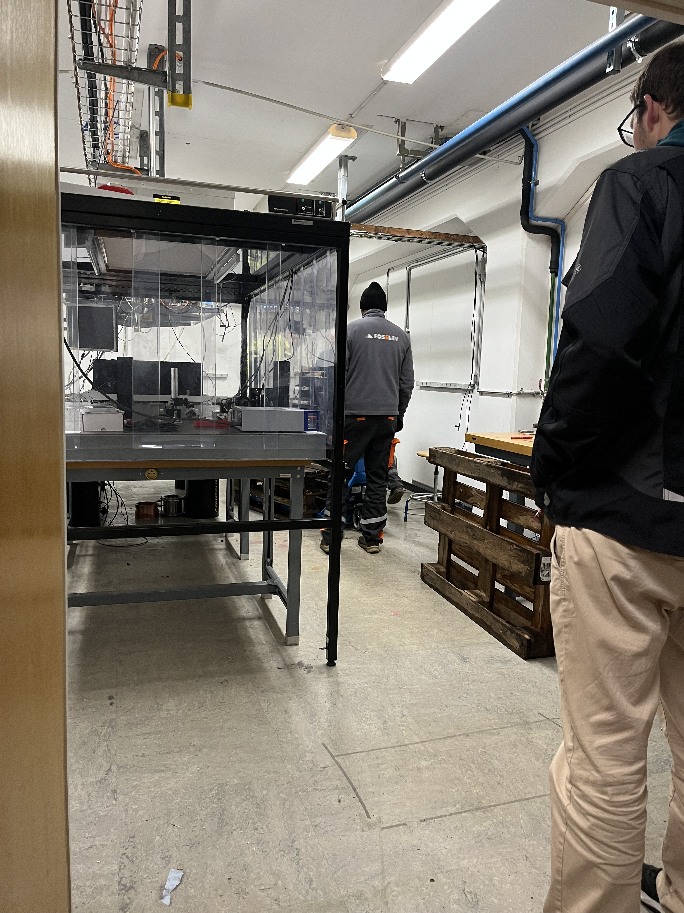
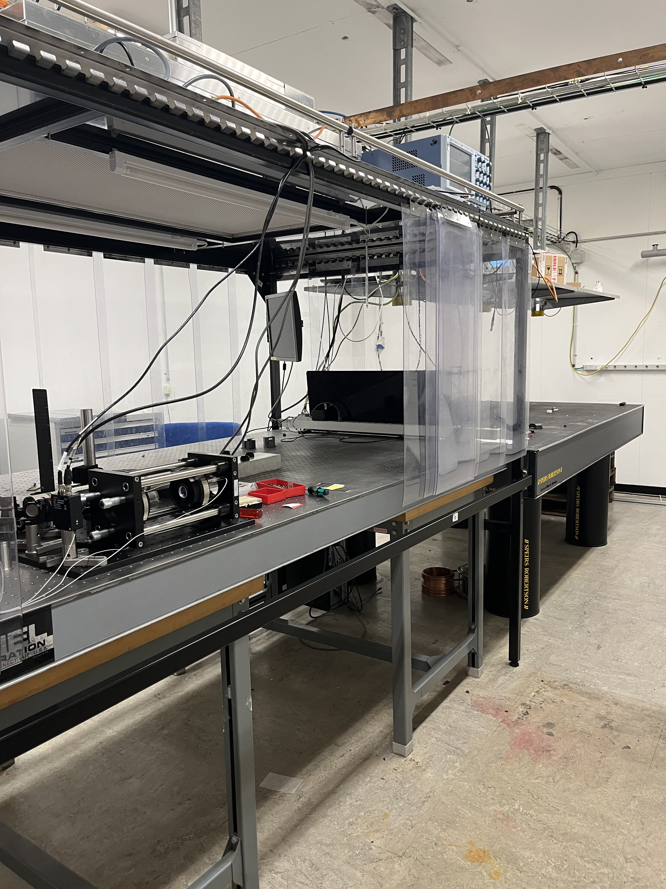
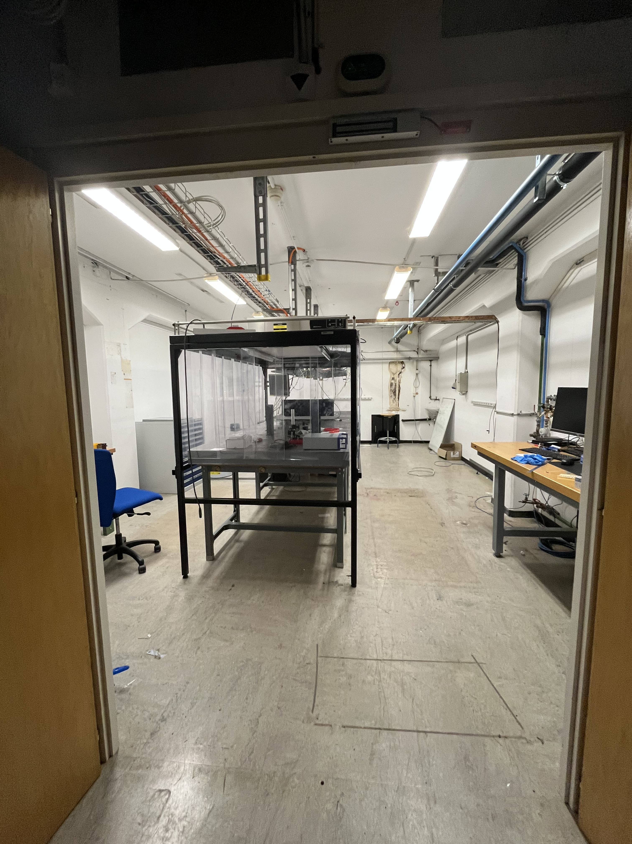
To Start
Changing labs

Slide 3
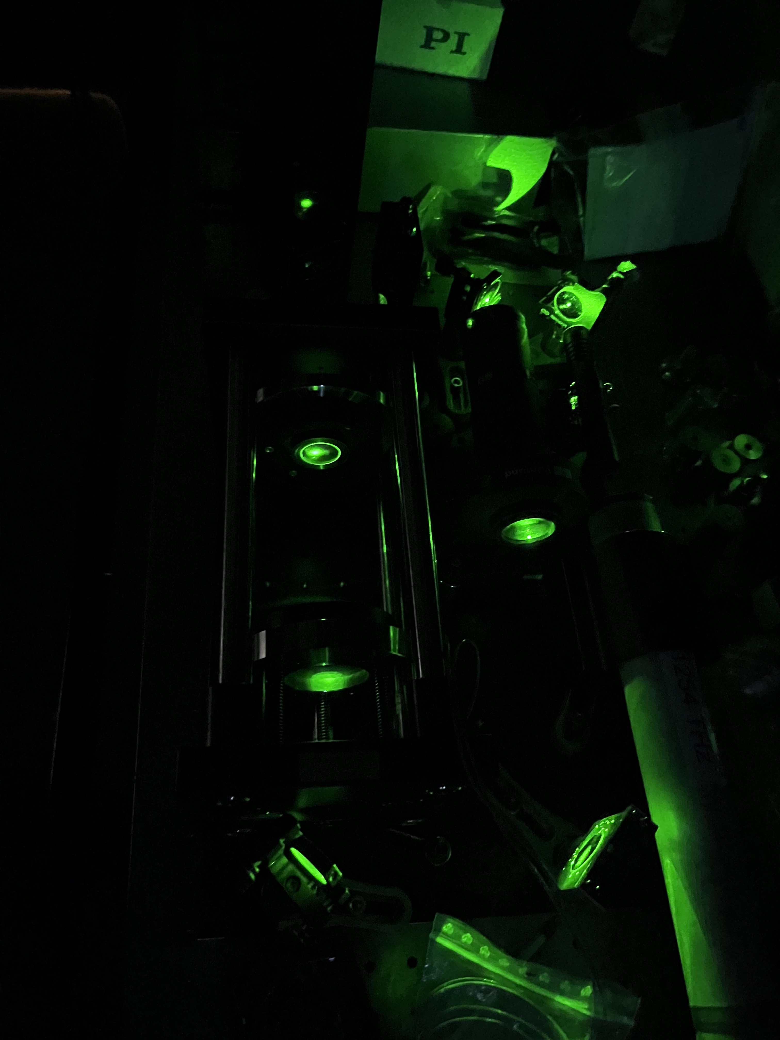
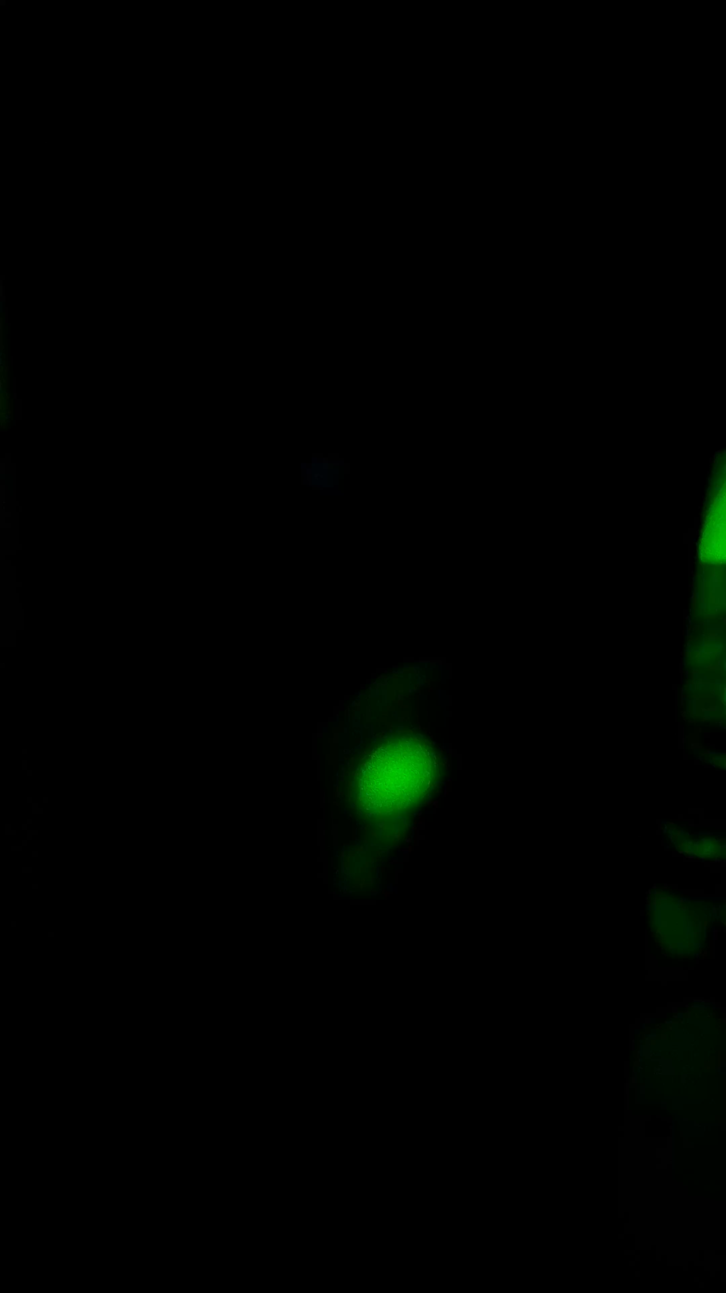
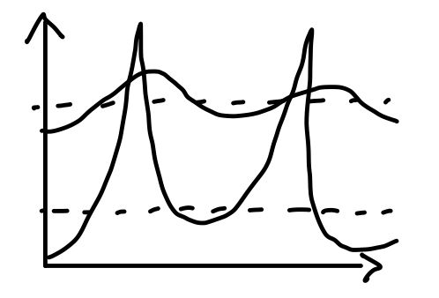
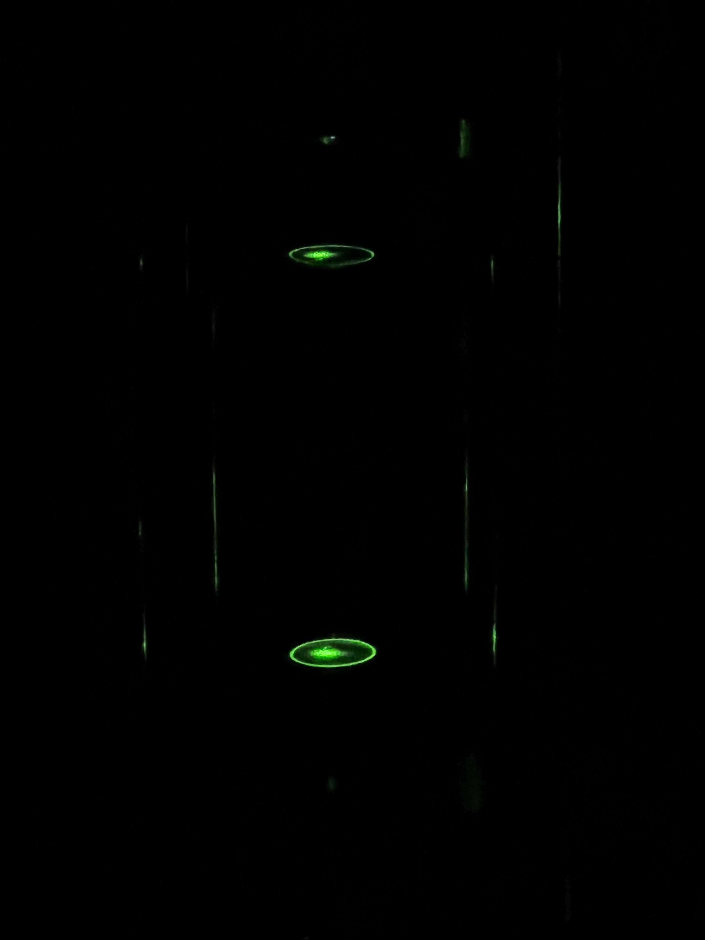
Alignment
Started with small aligning laser
  Green for 532nm spare mirrors
  Has less coherence
    Switch to mirrors with worse reflectivity
  Alignment was ok
    Having issues with divergence before cavity

Slide 4
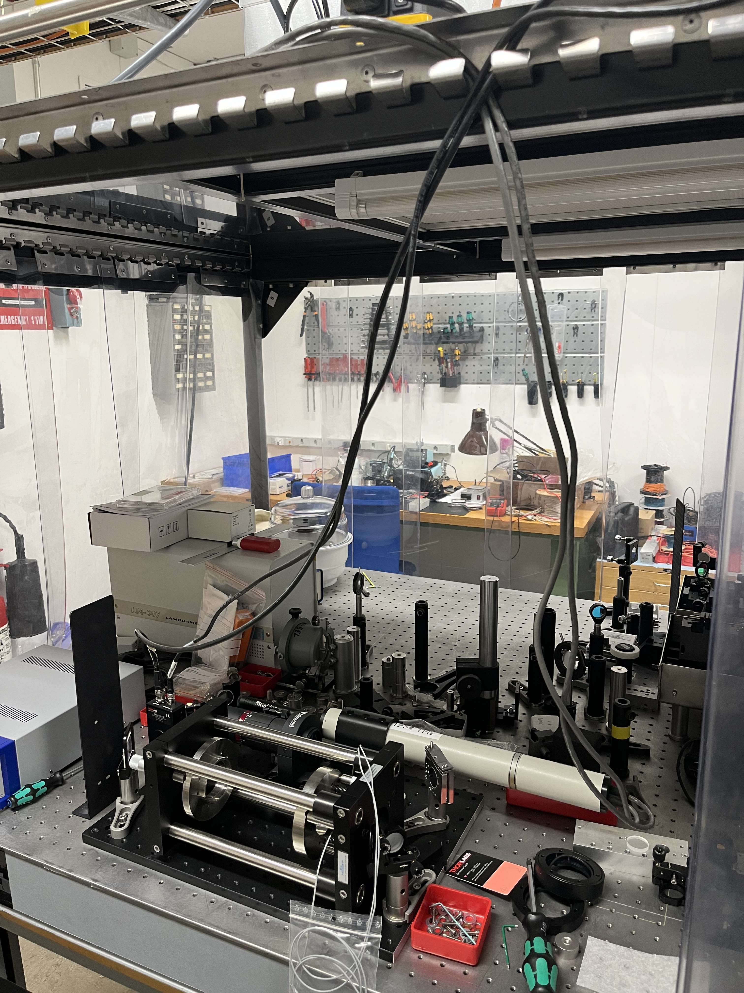
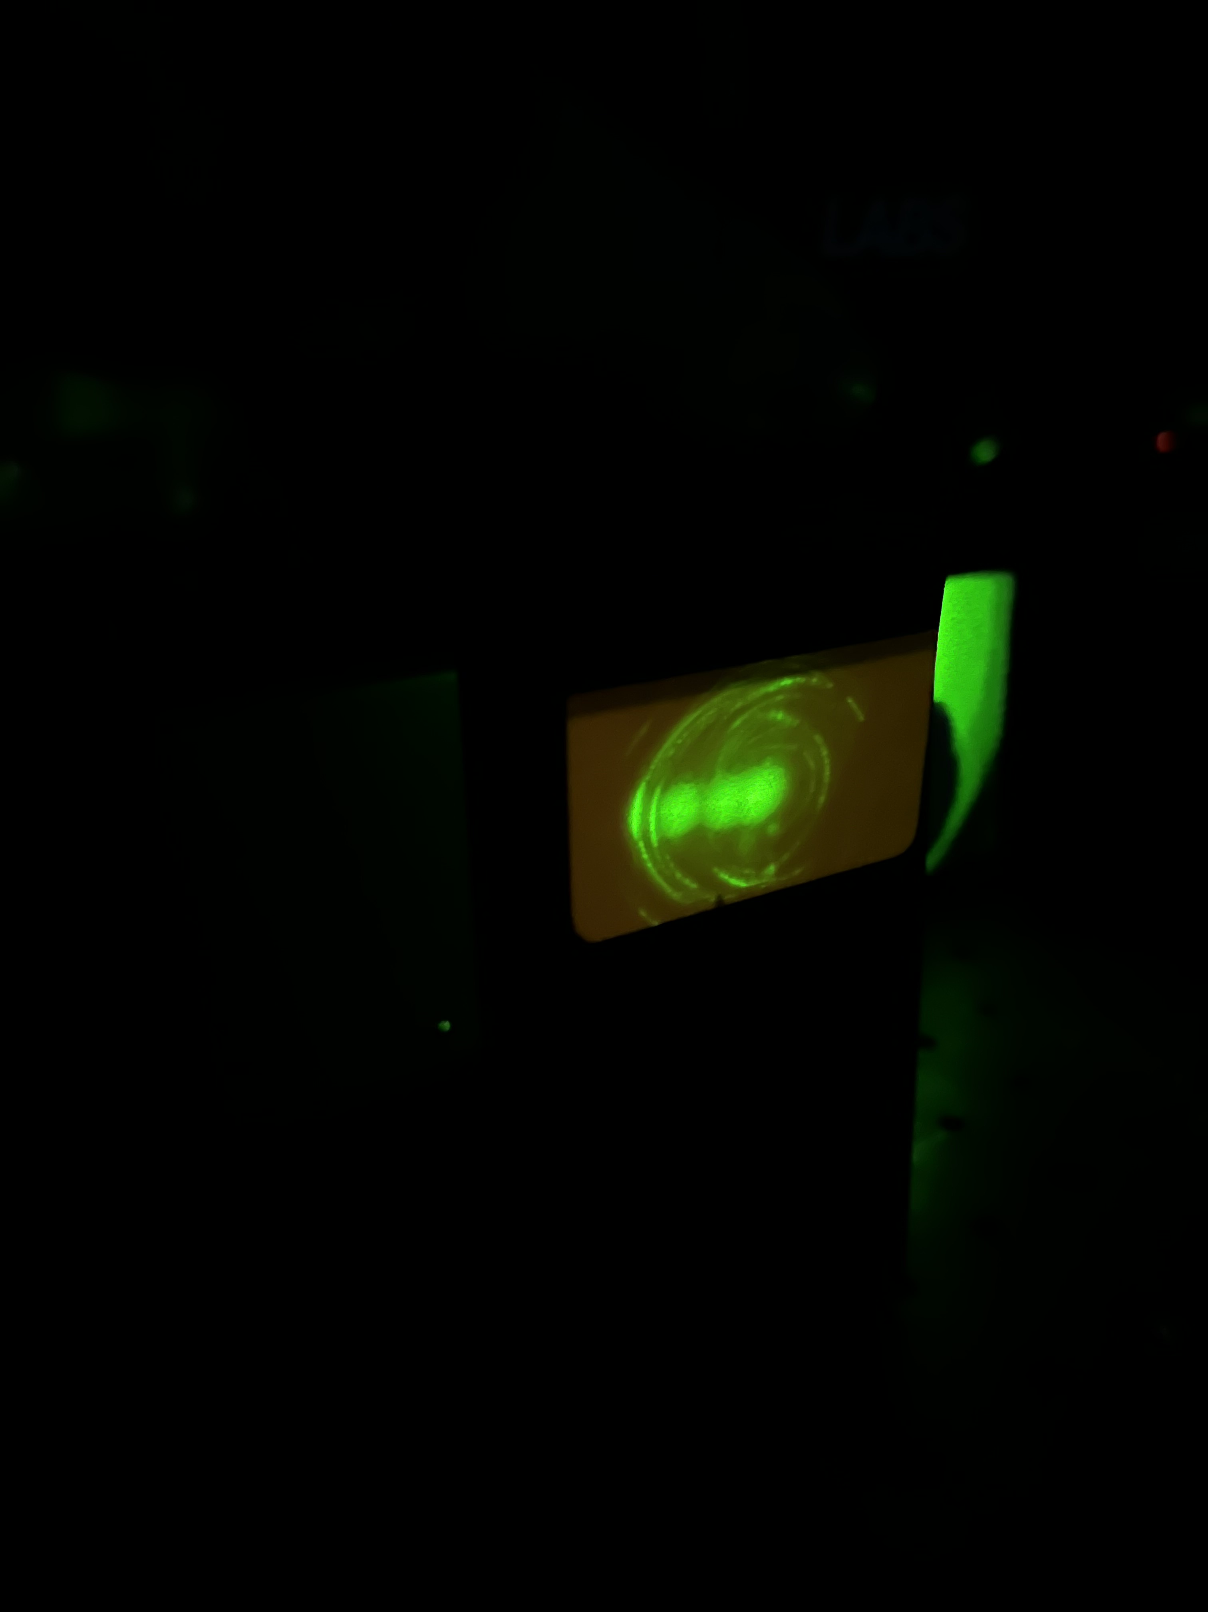
Red Laser
Switching to red laser for better coherence
  Need less divergence seen before laser enters cavity
Intention was to use a more coherent green laser
Green mirrors >99.95%
  Reflectivity to high for green laser
  Reflectivity unknown in red
    Estimating too high
Led to issue with beam alignment inside the cavity
  Too difficult to align
  Not enough beam transmitting

Slide 5
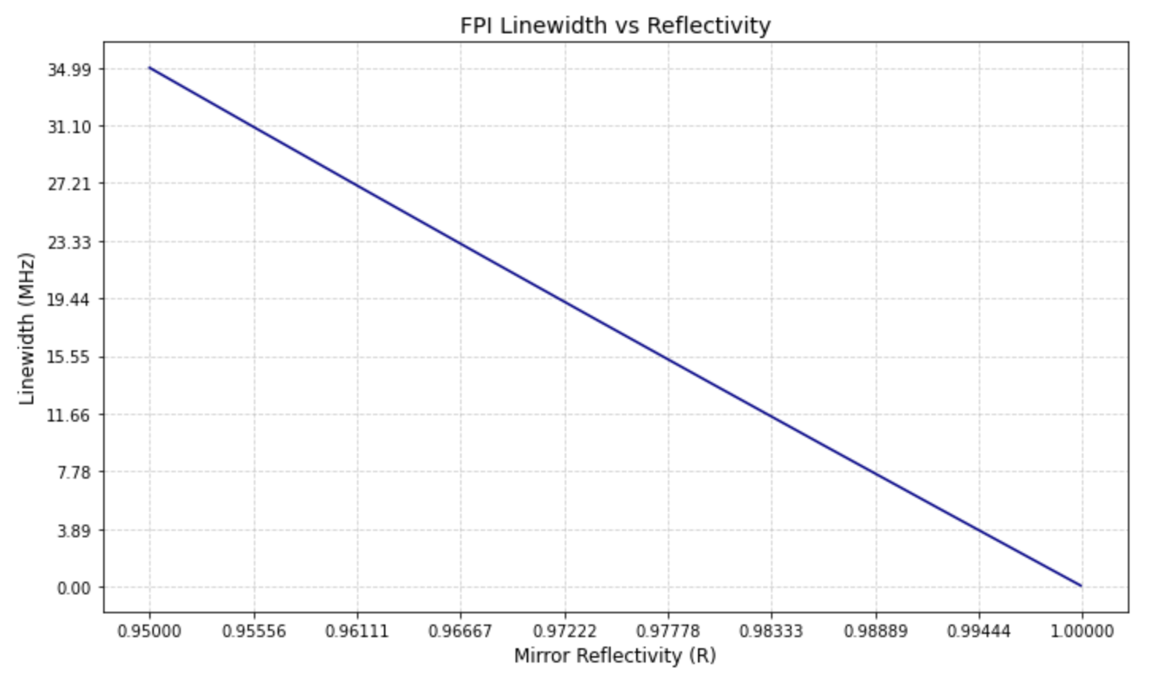
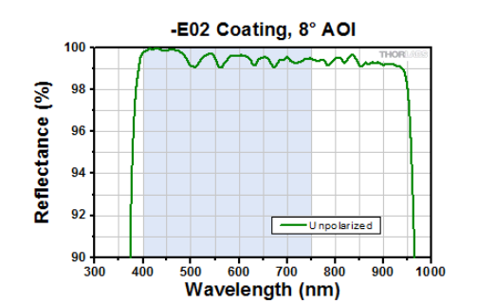
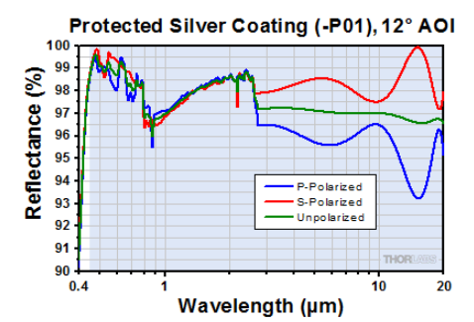
Changing Reflectivity
Going to see if decreasing reflectivity makes it easer
  99.0%
  99.3%
Red Laser
λ = 473.61254 THz
Range = 2.6 MHz
~99.0% → 6.85MHz
~99.3% at 630nm → 4.79MHz

