Slide 1
FCC-ee Layout and
Optics Design WG
2nd meeting – 17 April 2025
FCC-ee Layout and Optics Design
Ghislain ROY

Slide 2
List of Layout issues to be addressed
Technical insertions
Experimental insertions
Vertical height & separation
Instrumentation
Miscellaneous

Slide 3
Technical insertions
General layout issues:
Beams lateral separation: 350 mm lateral separation between the two beams in the arcs. Evaluate whether increased separation is needed in specific insertions (e.g. injection, collimation).
Vertical separation between Collider and Booster.
Vertical bypass: Impact of long-range beam-beam due to small crossing angle in beam crossing. Scheme to mitigate: separate vacuum chambers and vertical separation between the two beams via closed vertical orbit bump. Add vertical bumps in all optics and investigate potential collision between vertical bump for collider and booster above.

Slide 4
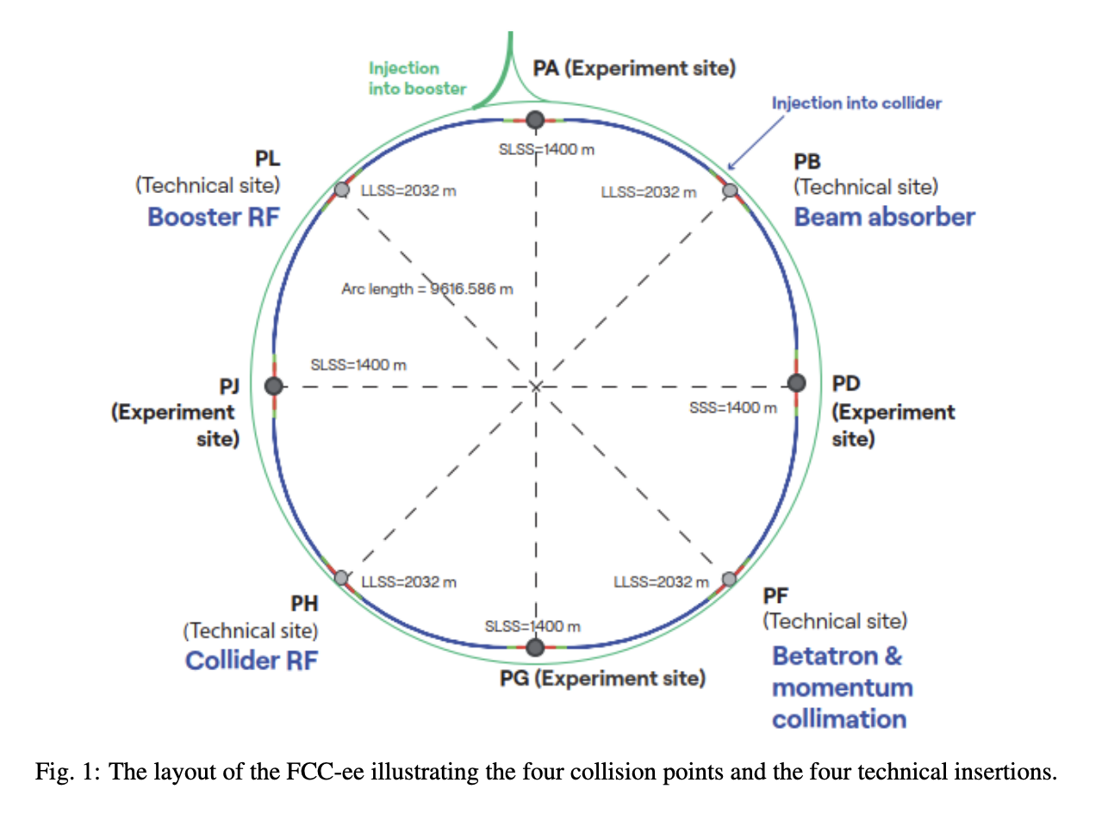
Technical insertions
Insertion specific layout issues:
Point B Injection:
  Under ABT responsibility.
  Space needed for injection elements (dipoles. quadrupoles, septa, kickers, instrumentation, collimators).
  Define lateral and vertical deviation needed to connect Booster to Collider, precise path of transfer line (Y. Dutheil).
Point F Collimation:
  Betatron and momentum collimation position in the layout: depending on beam direction, sequence of collimation systems seen by each beam can be the same or reversed.
  Assess whether 350 mm lateral separation between the two beams is sufficient. Single aperture quadrupoles!
  Collimator geometry (dimensions, jaws etc.)

Slide 5
Technical insertions
Insertion specific layout issues:
Point H RF:
  Need to equalize path length difference with combined scheme that allows switching between Z, W & H (33 cryomodules for Z, W and bypass other 33, while 2x33 for H)
  Equalisation with other technical insertions -> doglegs?
  Not enough space for all 800 MHz cavities for ttbar. Possible solutions: increased gradient and less modules, replacement of 400 MHz cavities with 800 MHz, continuous cryostat, install some 800 MHz cavities in point L.
Z & W
Point L Booster RF:
  Information on overall length, crossing with vertical bypass, lateral separation
H
Combined 400 MHz for Z,W & H

Slide 6
Experimental insertions
Booster-collider geometry:
  Same total circumference
  Same cell length in the arcs for repetitive arc-cells (no slippage)
  In the detector caverns, Booster can bypass on inside.
  Path length difference is compensated in the arcs with lateral offset (to outside)
  Also 50m ballistic path of the Booster inside the experimental cavern with no active component (no supports / cooling / powering…) but only a beam pipe.
GHC Optics:
  Matched optics version from K. Oide with quadrupoles and bending magnets downstream of final doublet pushed outside of the experimental cavern.
  More room for anti-solenoid installation in the “non-local compensation scheme”. Improves the detector opening strategy, since having no magnets within the cavern simplifies access and mechanical movement
  → should also be addressed by MDI meetings.

Slide 7
FCC-ee Mock-Up - Supports design – Next steps
“Work in progress” points for the Pre-TDR phase :
The choice of optics will have a major influence on the design.
Changes on the booster’s beam axis ?
Detailed study of transport, installation, maintenance and alignment compatibility.
Optimisation of the design for large-scale production (cost reduction).
Study the impact of SR absorbers and shielding position.
Study the detailed integration of all SSS elements.
  Interconnexions, BPM, Vacuum, Orbital correctors, etc…
Continuing stability studies for the different structures.
Work needed in collaboration with TE-MSC, BE-GM, BE-ABP, SY-BI, TE-VSC, EN-HE, HSE, …
Booster support
F. Carra et al.
EN/MME - CERN
02-04-2025

Slide 8
Vertical height and separation
Booster-collider relative elevation offset: booster currently located at 1.03 m above collider, investigate whether it can be increased or decreased if needed. Note: For polarisation preservation, preferable that both machines lie in same horizontal plane, vertical bendings can depolarise the beam.
Collider elevation with respect to ground: currently placed at 0.98m above ground. Investigate if this is a strict requirement (for support structures and jacks?). Assess if it can be reduced to decrease sensitivity and improve stability of magnets and girders to lateral movements.
Collider-booster elevation with respect to ground: Study potential benefits (mechanical stability, supports, accessibility, safety) from lowering both systems with respect to ground.
RF sections in Point H and L: lowering tunnel floor at these locations to gain vertical space for integration of 400 & 800 MHz cryomodules.

Slide 9
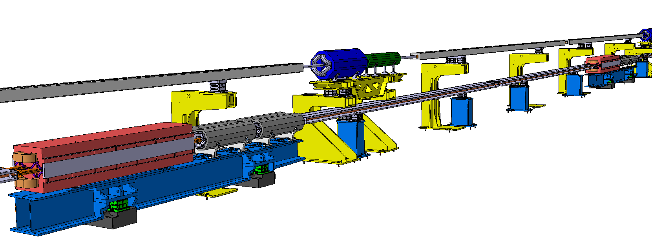

FCC-ee Mock-Up - Supports design status
F. Carra et al.
2025 DESIGN
SSS Booster girder
SSS Collider girder
BOOSTER
Quadrupole
BOOSTER
Sextupoles
Booster dipole supports
COLLIDER
Sextupoles
COLLIDER
Quadrupole
BOOSTER
Dipole
Collider dipole supports
COLLIDER
Dipole
Magnets supports design are drafts !
Still work in progress !
Shielding are not represented
SSS Booster girder supports
SSS Collider girder supports
EN/MME - CERN
:
ST2408329_01 AA.14
02-04-2025

Slide 10
Instrumentation
Polarimeter:
  Will be installed at the start of experimental insertions
  Requires dedicated lateral and longitudinal space.
Depolarising kickers:
  Will be installed at the start of the arcs
  Requires reserved space.
BPMs:
  Space and length reservation
  Proper integration of BPMs with quadrupoles and vacuum chambers.

Slide 11
Miscellaneous
Fire doors location:
  Exact locations must be defined with respect to cell layout, repetitive placement to simplify integration. Example: Fire sector consisting of 8 FODO cells of 52 m will create a 416m fire sector length, slighlty exceeding the standard 400m.
  Fire door and sectorization should be included in the Arc Half-Cell Mock-up and in the layout design.
Maximum element length: no element should exceed 12 m in length due to size limitations of access shafts. Longer elements will need to be modelled as assembly of shorter than 12m sub-elements.
Normalized dipole lengths in layout: in some cases, dipole lengths are slighlty different (few nm) or length is specified with unnecessary precision that can be normalized.

