Slide 2
Comparison criteria for GHC and LCC: Injection
Y. Dutheil (SY-ABT-BTP), on behalf of
SY-ABT
FCCee Top-up injection WG (fcc-ee-topup-injection)

Slide 3
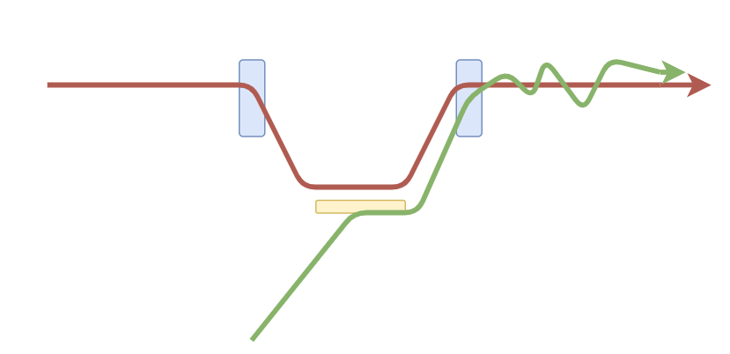
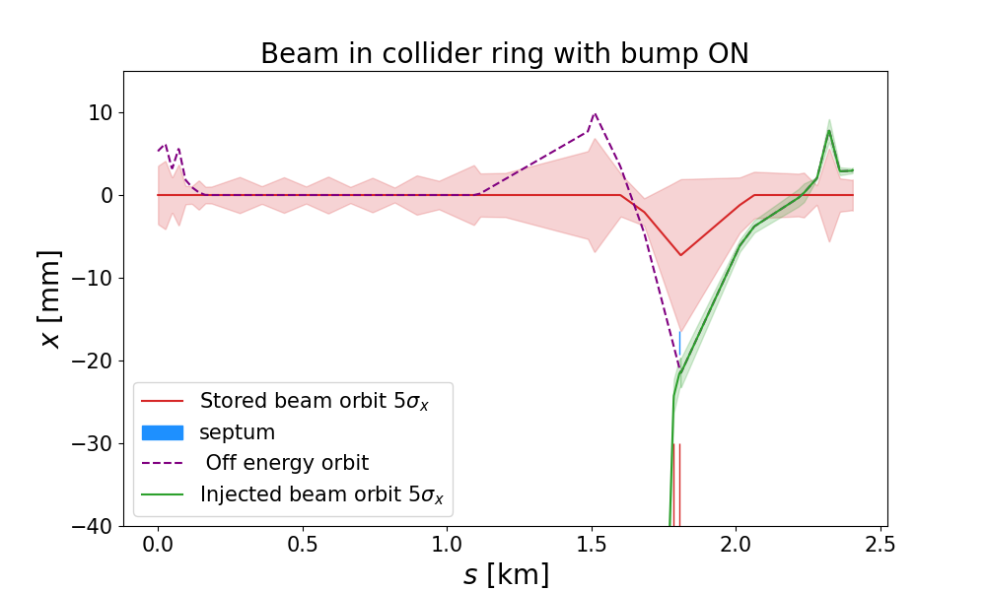
Introduction : Collider injection scheme
Top-up injection
  Continuously adds small bunches to the circulating bunches
  Triggers every ~6 s (Z-mode) to ~30 s (high energy modes)
Location
  In PB straight section
  Around the middle of the downstream half for each beam
Layout
  Hardware systems integration volumes
  Distance to alcove is a critical point for fast kicker systems

Slide 4
Prerequisite for comparison the two lattices
Optics
  Optics requirements at the injection point
  Optics requirements for the pi-bump
  Presently fulfilled only in GHC
Beam parameters
  Emittance of the circulating and injected beams
  Abord gap length in the collider
Layout
  Crossing scheme in PB with separation
  Presently fulfilled only in GHC

Slide 5
Required input from other teams
Beam parameters
  Interface between booster and collider
  Requires close interaction with booster, RF and ABP team and constancy in using the Complex Parameter Table
Layout and Optics for both optics
Strong contribution of BE-ABP is needed to the top-up injection working group
  Injection scheme tracking w/ collective effects
  Injection losses simulation and background studies
Input from STI and MP WG for beam absorption devices concepts and developing together a machine protection strategy

Slide 6
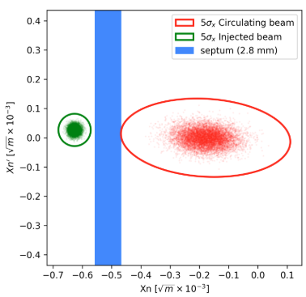
Deliverables and possible timeline
Feasibility of the hardware system
  Placement of the elements in the lattice
  Hardware specification and requirements
  1 month after a new lattice/layout/version presented and published on gitlab
  (3 month for hardware feasibility and costing in case of hardware changes required)
Injection efficiency
  Tracking of injected beam w/o and w/ beam-beam
  Losses in injection region
    possibly background on experiments, tbd w/ BE-ABP-COLL)
    machine protection in case of accidental beam losses
    radiation environment and activation of equipment in Point B due to regular injection losses
  1+3 months after a new lattice/layout/version presented and published on gitlab

Slide 7
Criteria for comparison
Injection efficiency
  Using established beam distribution definitions and beam physics
  Using different codes to benchmark results
  Is the on-axis injection possible at every mode ?
Injection losses
  How and where particle lost during the injection process ?
  Is the lattice and geometry allowing placing protection systems ?
  What is the impact of injection losses onto experiments ?
Hardware requirements
  Are the hardware choices considered up to now usable for both lattices
  Convention injection scheme : space available for additional kicker to use a 4-bump instead of Pi-bump
  Multipole injection kicker : space available for MKI and its compensation kicker

Slide 8
Conclusion
Collider injection is at the interface between booster and collider
  Does the comparison also need to include the booster lattice if linked to the collider one ?
  ABT also oversees the design of the booster injection and extraction schemes
Impact of the optics choice on ABT activities
  Ideally the same hardware solution can be used on both lattices to limit impact of the choice
Summary of requirements
  Beam parameters
  PB optics and layout
Summary of deliverable
  Hardware feasibility 1 months after new optics presented and delivered on gitlab only using PB and momentum acceptance
  Injection efficiency 3 months after new optics presented and delivered on gitlab w/ full lattice for realistic tracking
Not discussed in here
  PH separation scheme : present concept only developed on GHC layout
  Collider dump scheme : the concept is flexible and should be able to adapt to any lattice and geometry but this requires confirmation with optics and layout in PB

