Slide 1
CERN Knowledge Transfer

Slide 2



CERN’s Knowledge Transfer Mission
Maximise the technological and knowledge return to society, in particular through Member States industry
Promote CERN as a centre of excellence for technology and innovation
Demonstrate the importance and impact of fundamental research investments

Slide 3
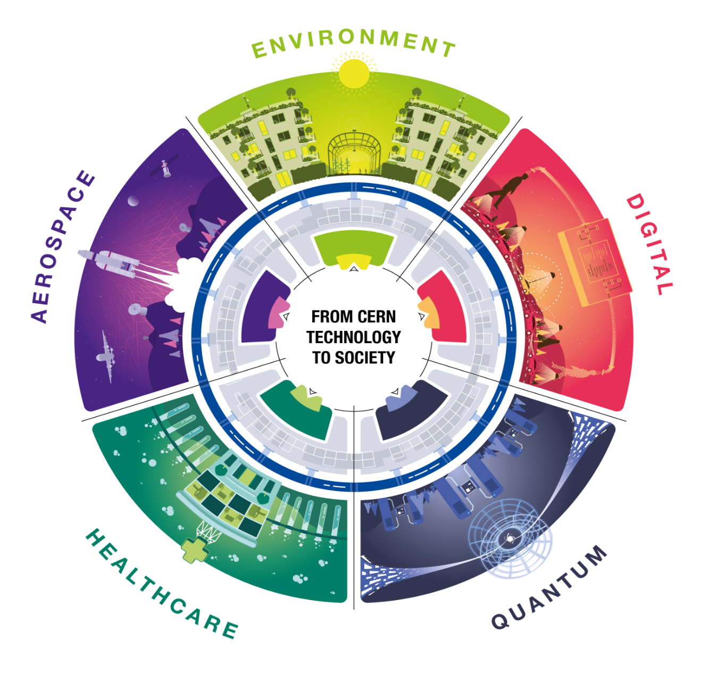
From CERN technology…
… to society

Slide 4
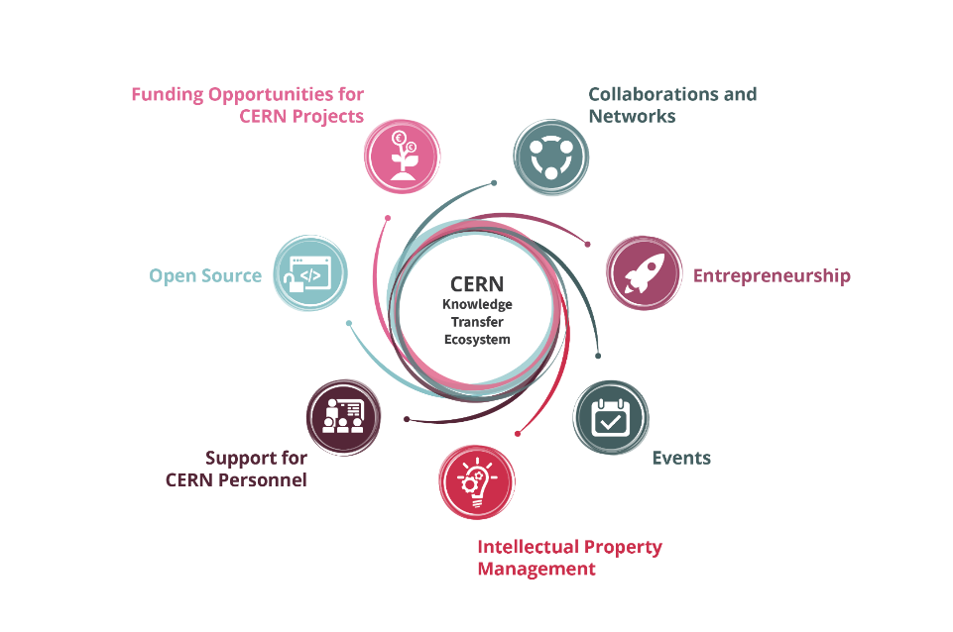
Knowledge Transfer Tools

Slide 5




Knowledge Transfer Policies
Intellectual Property Policy
Patent Policy
Software Dissemination Policy
Spin-off Policy

Slide 6
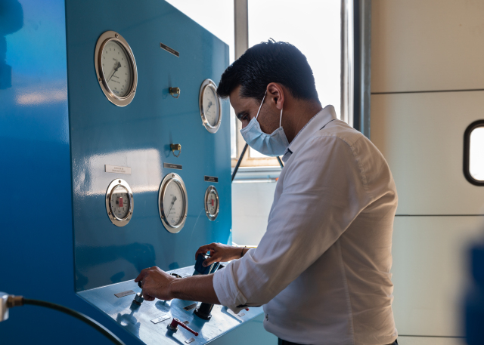
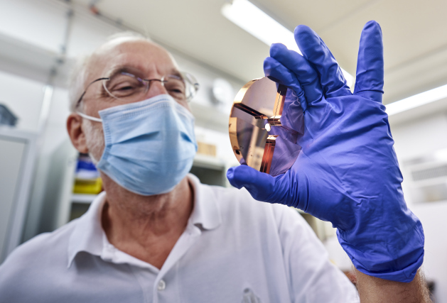
Funding Opportunities for CERN personnel
>75
>50
Projects funded since 2011
Projects funded since 2014
CERN Knowledge Transfer Fund
CERN Medical Applications Budget
Since 2021 15kCHF-900kCHF Range of funding received per project

Slide 7
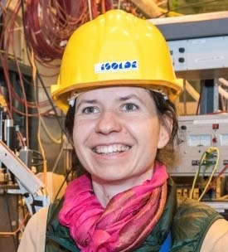

Funding Opportunities for CERN Personnel
Gamma MRI
supported by the KT fund
“
The grant we obtained from the KT fund allowed us to start working on the Gamma MRI project, which aims at performing sensitive MRI studies.
Additionally, the KT Fund and MA Budget gave us a solid basis to apply for additional EU funding.
Magdalena Kowalska,
Senior Researcher at CERN
“
In 2020, their application within the European Commission’s FET-OPEN Programme was successful, enabling work on a full-scale prototype and first in-vivo experiments.
Renaud B. Jolivet,
Senior Lecturer, University of Geneva

Slide 8
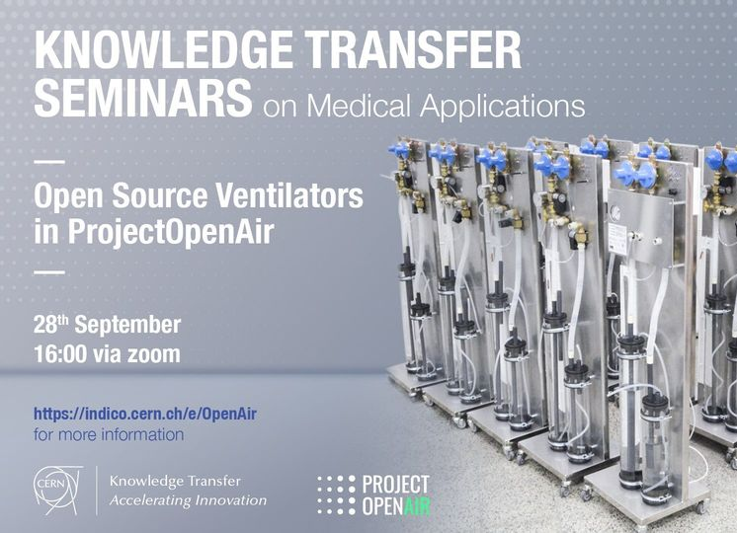
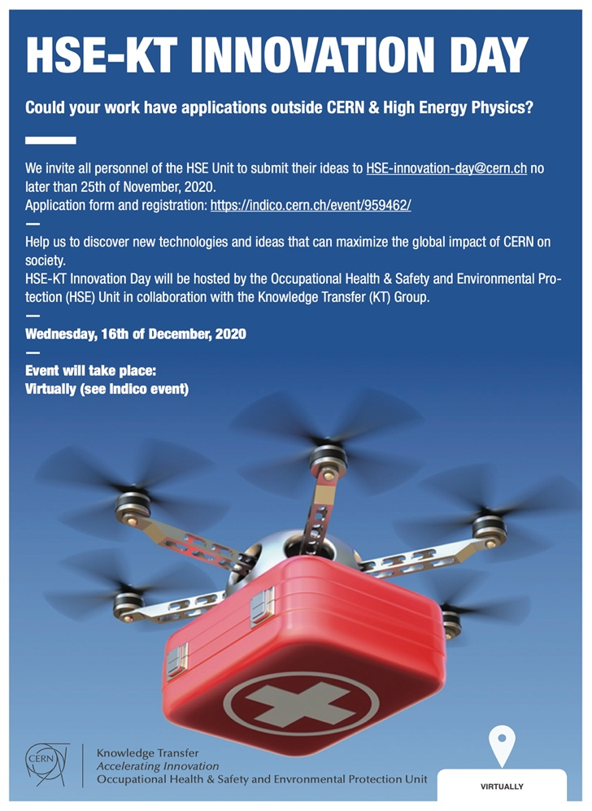
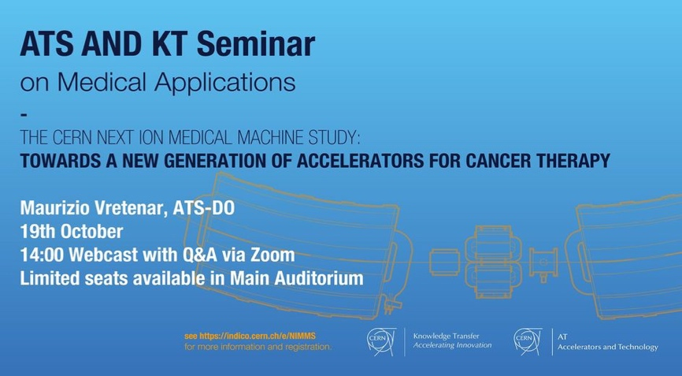
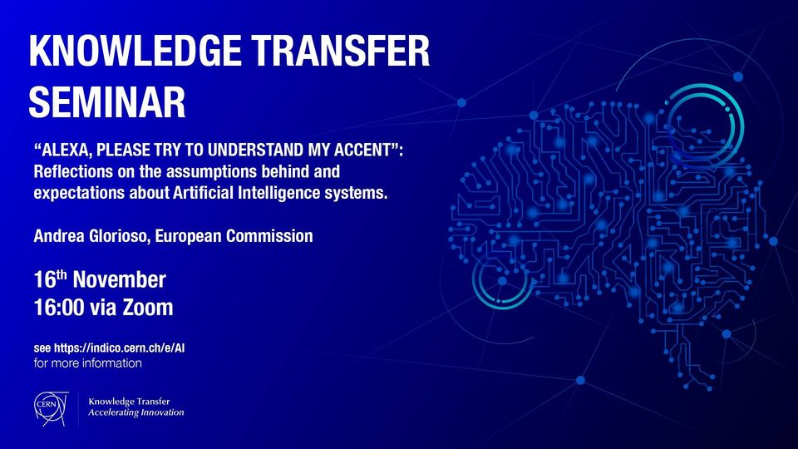

Events
https://knowledgetransfer.web.cern.ch/events

Slide 9
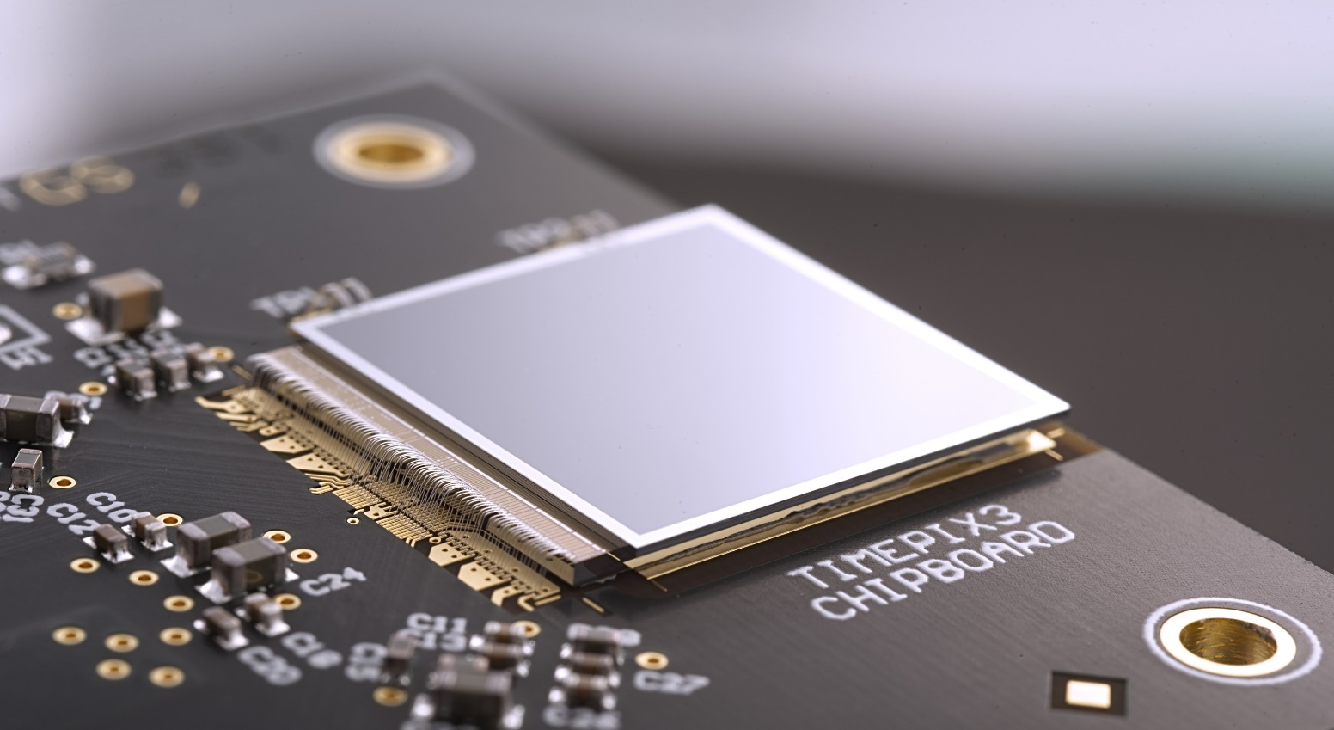
Training sessions
New courses coming soon!

Slide 10
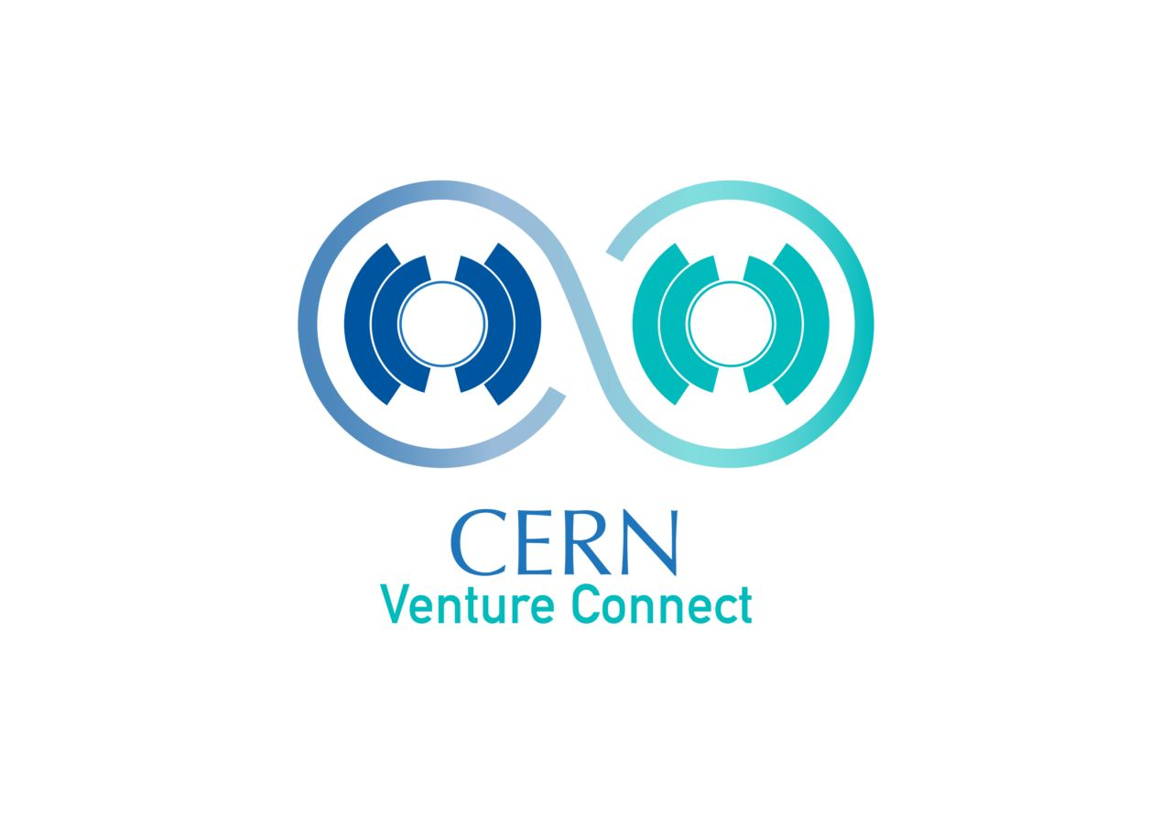
Entrepreneurship
CERN Venture Connect (CVC) supports deep-tech startups in CERN’s Member States and Associate Member States. The programme helps founders by giving fast-track access to cutting-edge CERN technologies and partner investor companies or venture incubators.
https://cernventureconnect.web.cern.ch/

Slide 11

Knowledge Transfer Highlights 2023
https://kt.cern/annual-report

Slide 12

Follow us, tag us and share our posts!
https://www.linkedin.com/showcase/cern-innovation-partnerships/

Slide 13
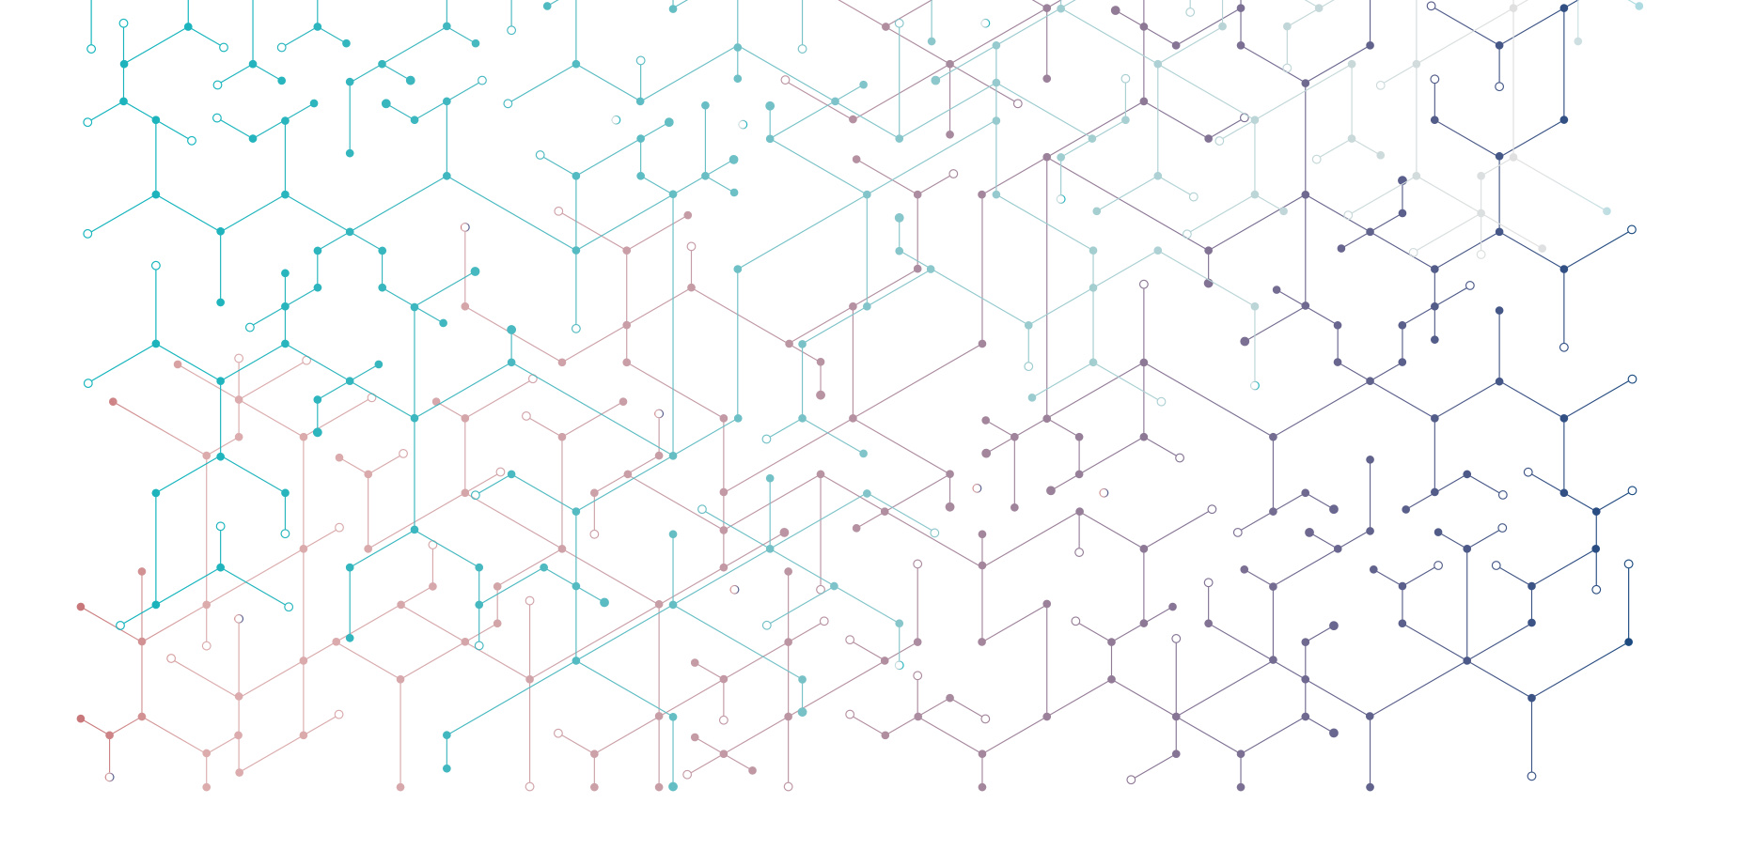
Find out more at kt.cern
The Knowledge Transfer (KT) group is always available to help take your CERN technology from lab to market.
Contact us: kt@cern.ch
Visit KT.CERN

