Slide 1
Connecting the DOTS
2025

Slide 2
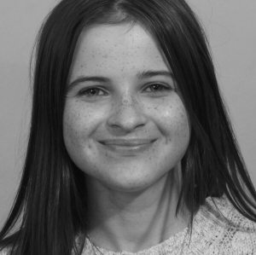
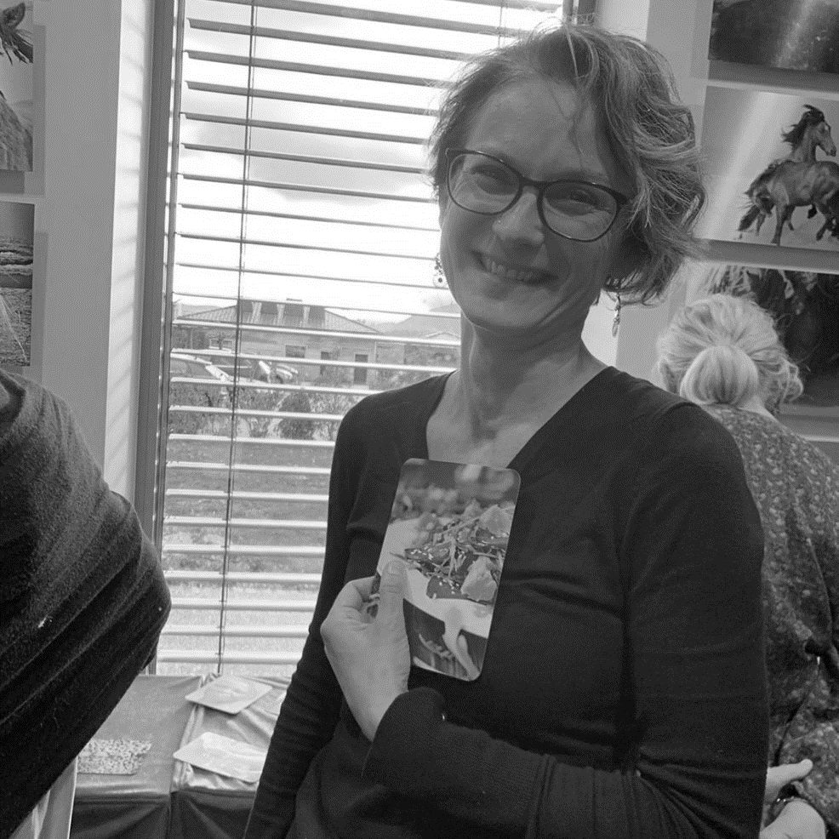
About us
Welcome / Bienvenue
Amy COLLINS
HR Department
LD Group
Nathalie PERKINS
HR Department
LD Group

Slide 3
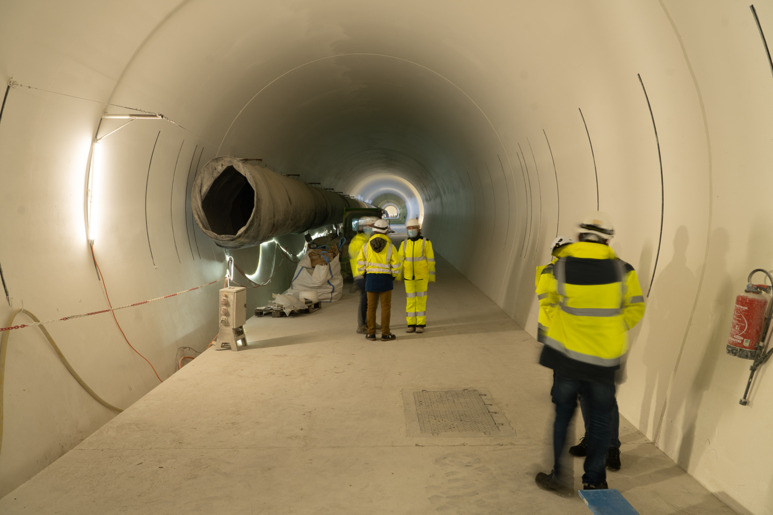
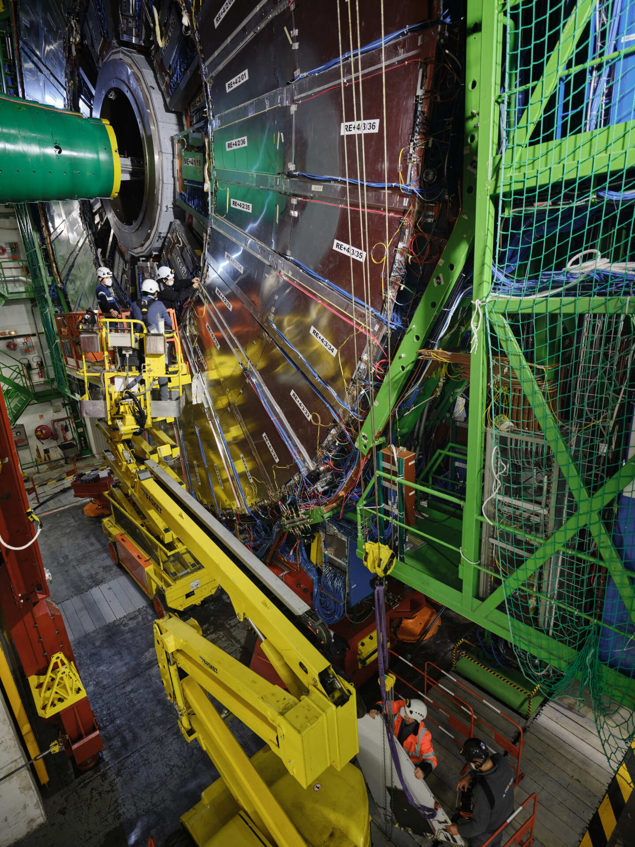
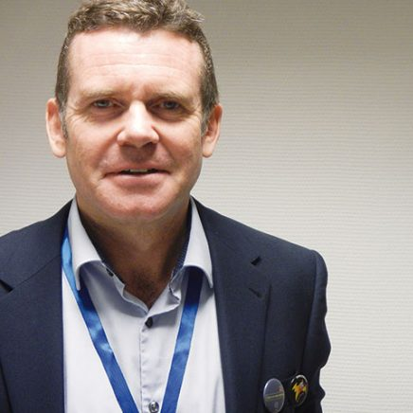
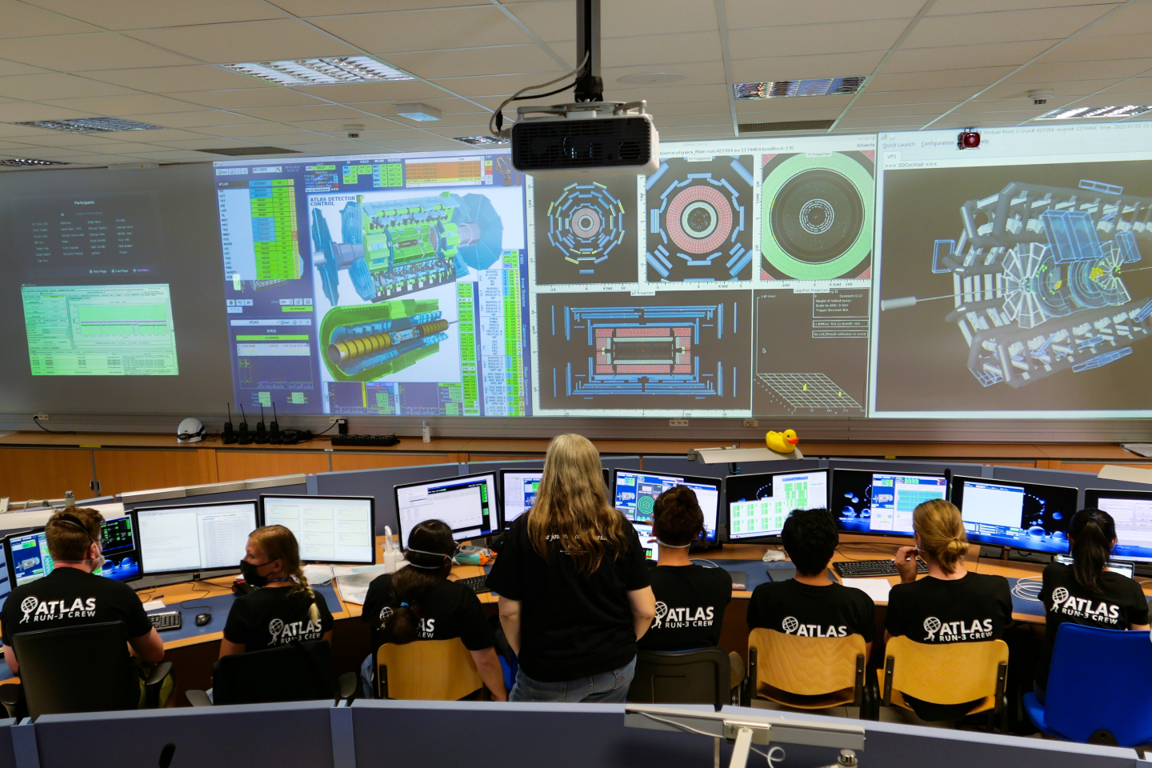
Welcome to CERN
James Purvis
HR Department Head

Slide 4
Agenda
Your Onboarding Journey at CERN
Ice-Breaker
CERN’s Scientific Programme – Giovanna Lehmann Miotto, EP Deputy Department Head
Knowledge Transfer – Manuela Cirilli, Communication Marketing & Training SL, KT Group
Coffee Break - Meeting CERN Services, Clubs & informal networks + Game
CERN’s Accelerator Complex – Rende Steerenberg, BE Operation Group Leader
Q&A with a CERN Director – Charlotte Warakaulle, Director for International Relations
Prize Draw
Closing drinks and Networking

Slide 5



Logistics

Slide 6
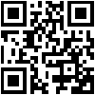

Slides & Videos
Available on Indico
https://indico.cern.ch/event/1430897/

Slide 7
Your Onboarding Journey at CERN
NEWCOMERS@CERN Members
Welcome Session
Short
Online Sessions
CERN Visit for you and family members/ friends
Connecting the Dots
Computer Security Awareness
Scientific Information Service (Library & Open Science)
Pension Fund Benefits (for Members)
Mattermost: newcomers@CERN

Slide 8
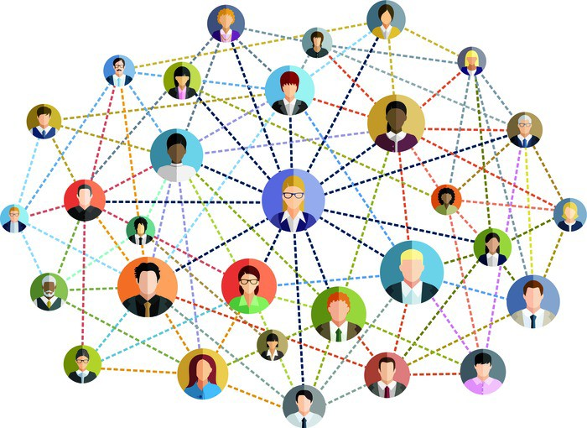
Today’s main objective

Slide 9

Ice-Breaker
In small buzz groups, discuss together:
What is my role at CERN and how does my job contribute to CERN’s mission?

Slide 10
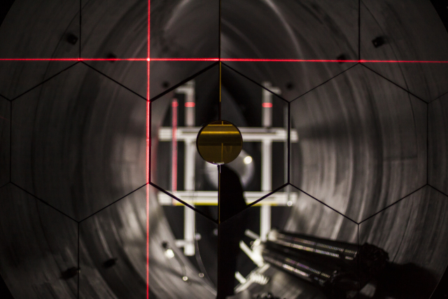
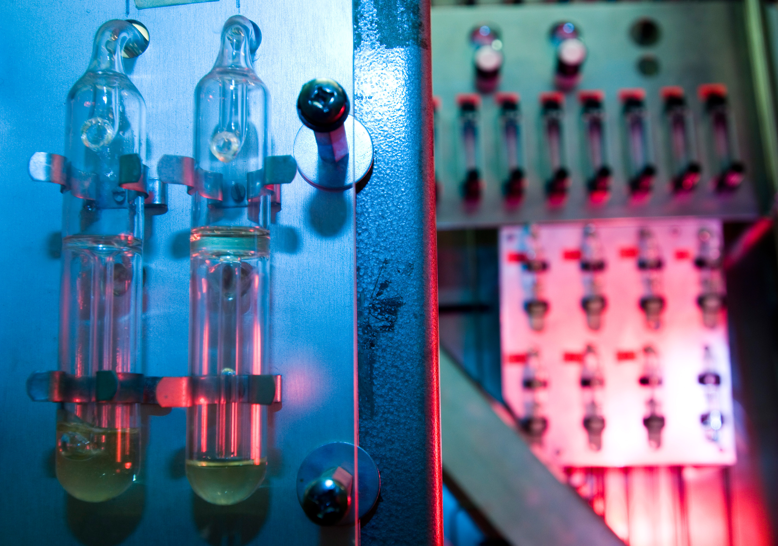
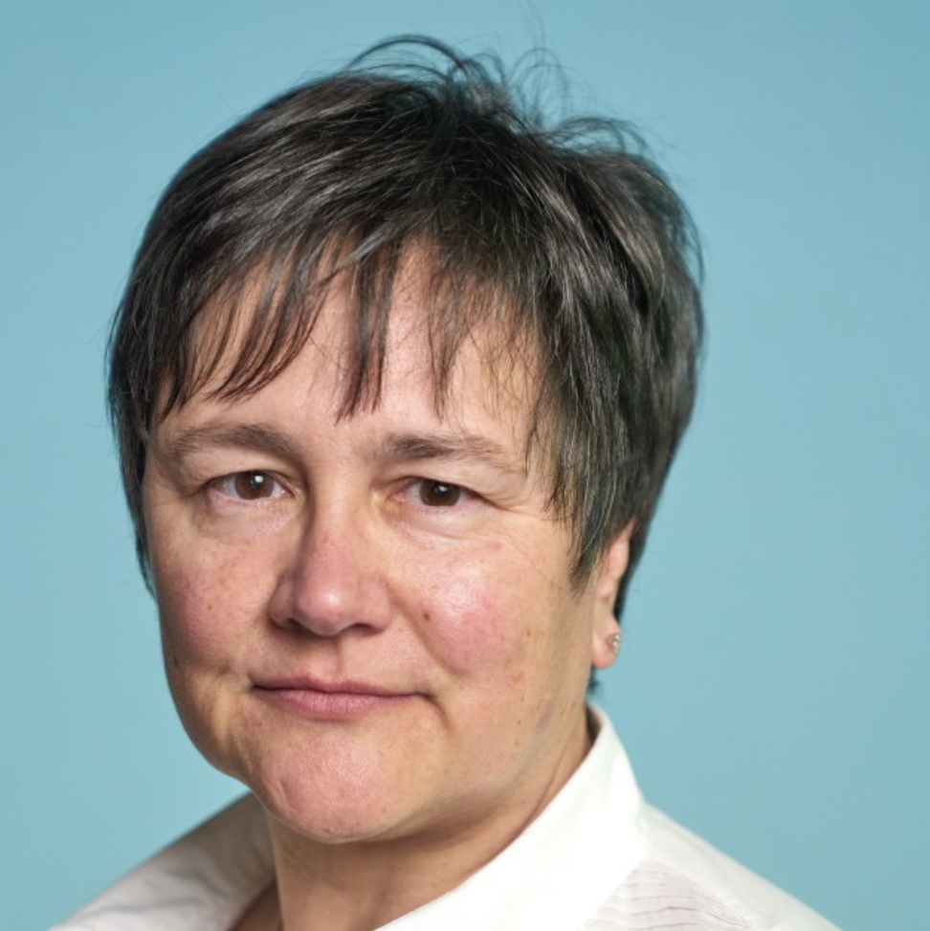
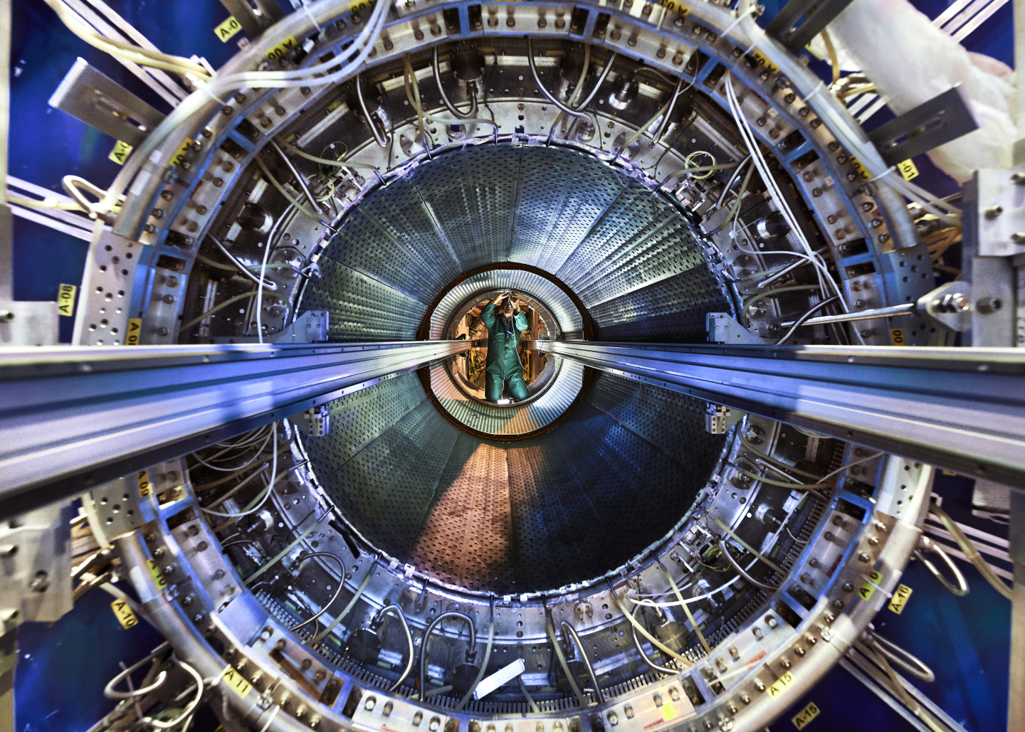
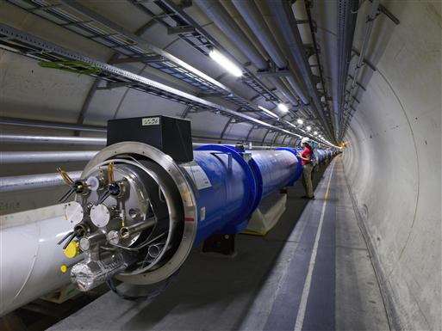
Scientific Programme
Giovanna LEHMANN MIOTTO
EP Deputy Department Head

Slide 11
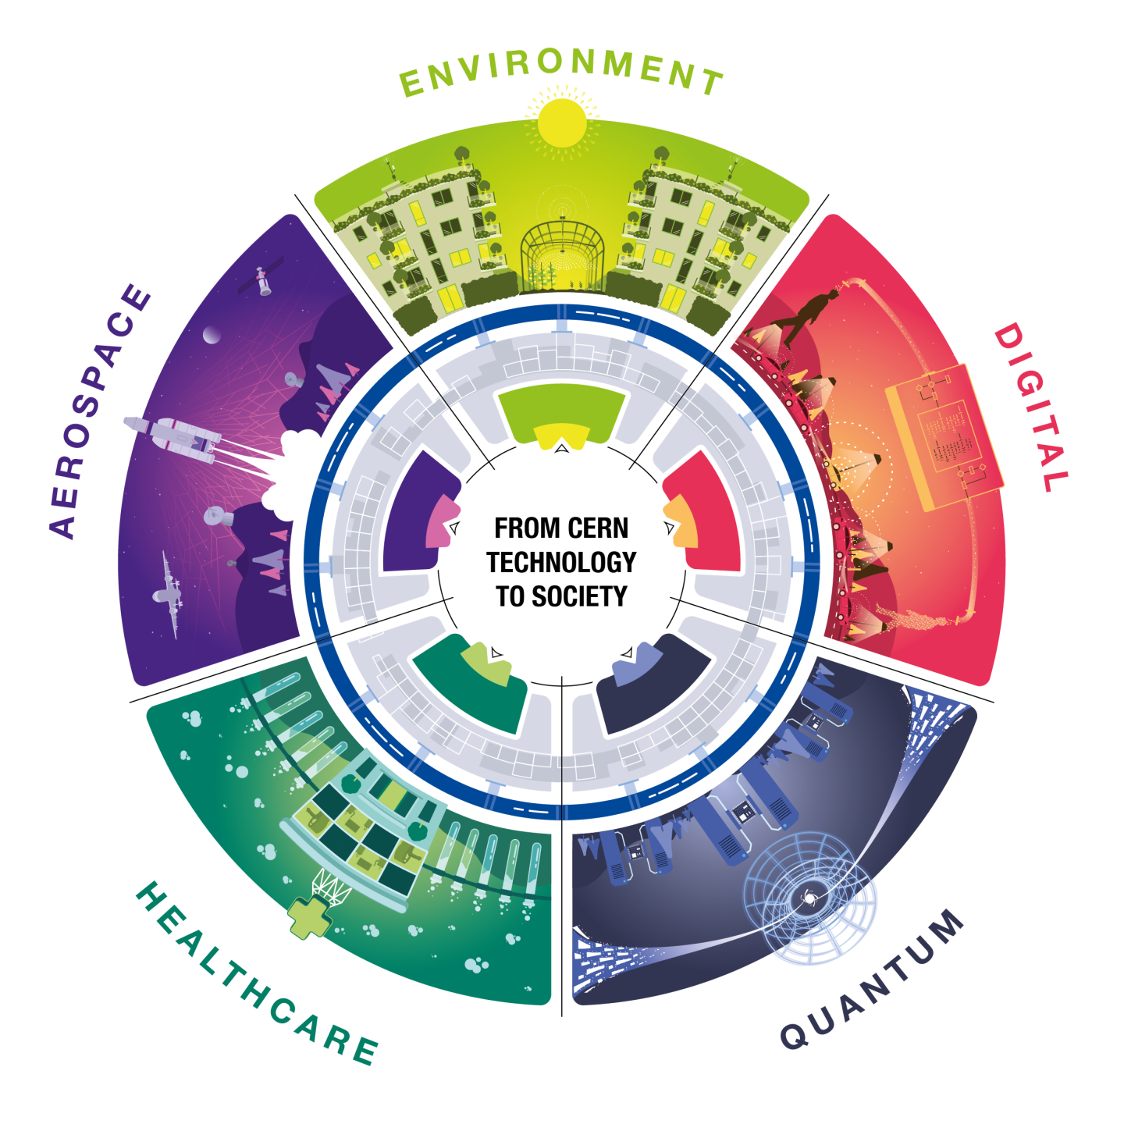
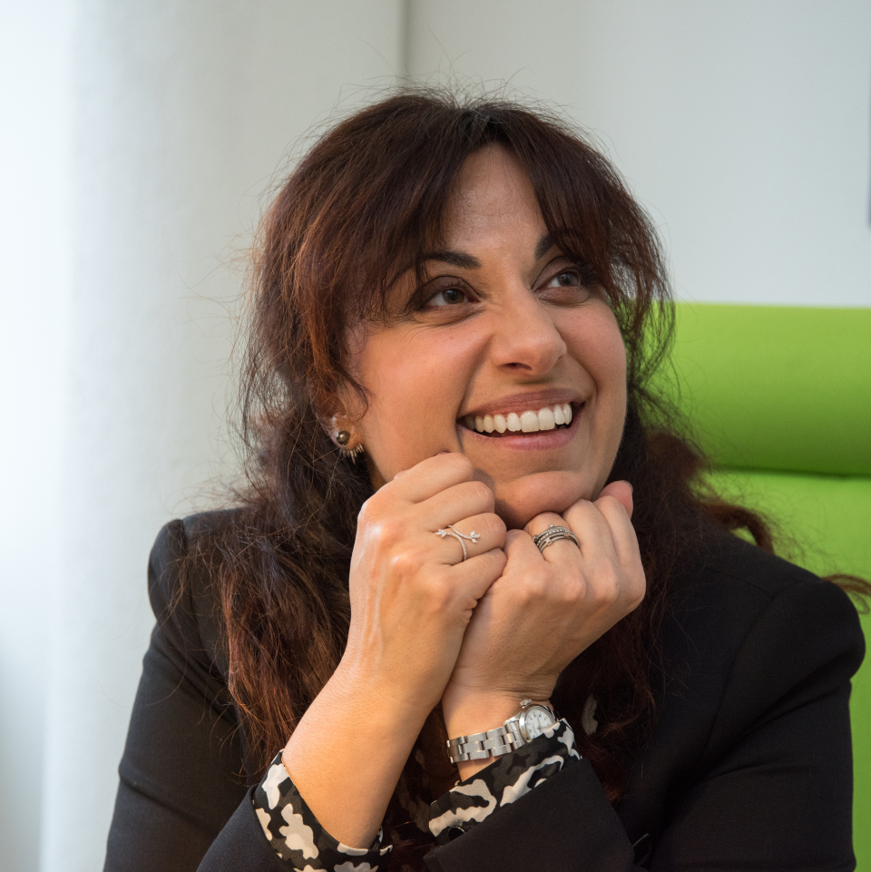
Knowledge Transfer
Manuela Cirilli
Section Leader Communication and Training
Medical Applications Advisor

Slide 12








Coffee Break – Part 1
CERN Services and informal networks

Slide 13


Coffee Break – Part 2
Game: Answer 6 specific questions
Aim: fill in the boxes with the name of 6 different people attending the session today
Get a pen and sheet
Write your name and surname on the piece of paper before submitting it for the prize draw
Watch out - we will check the information
Please be back in this room at 16:00
13

Slide 14

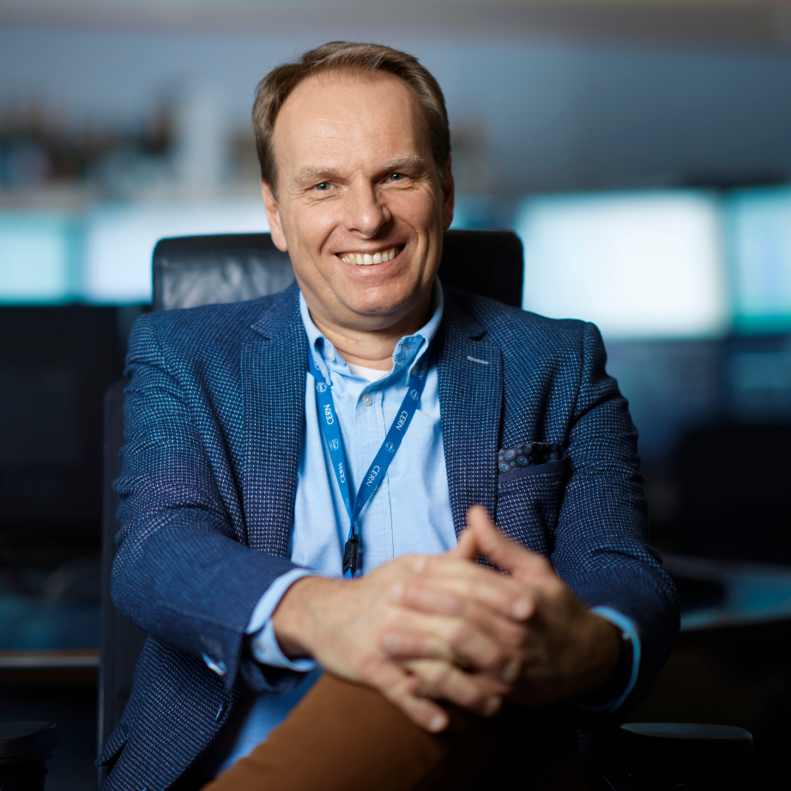
CERN’s Accelerator Complex
Rende Steerenberg
BE Operations Group Leader
To go more in-depth, check the Learning Hub for the 2h recorded presentation

Slide 15
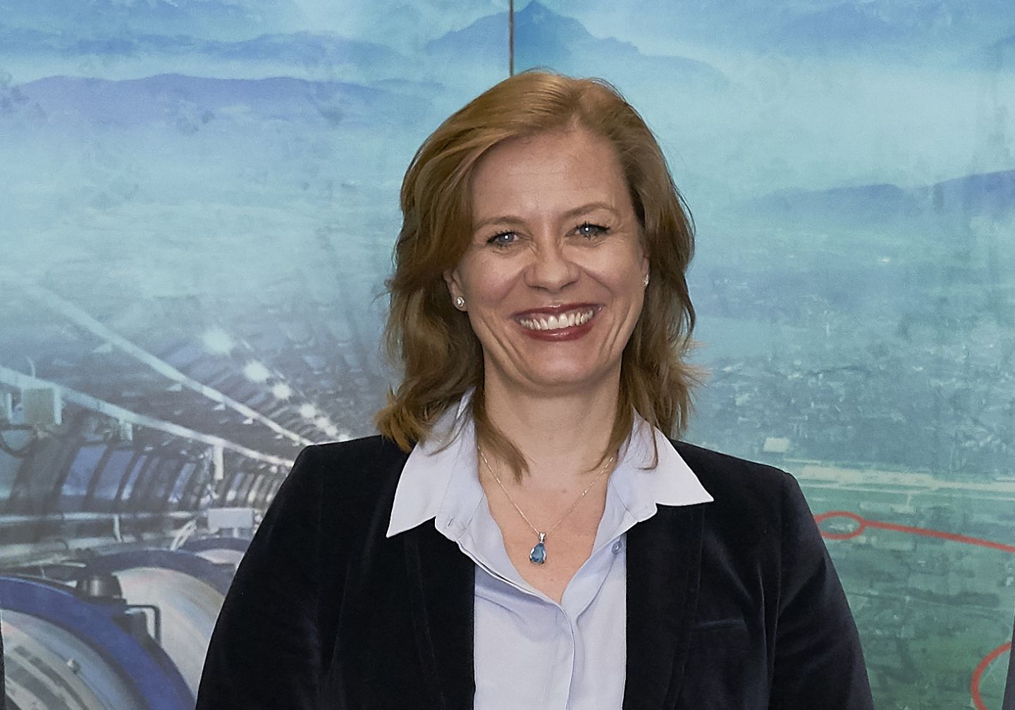
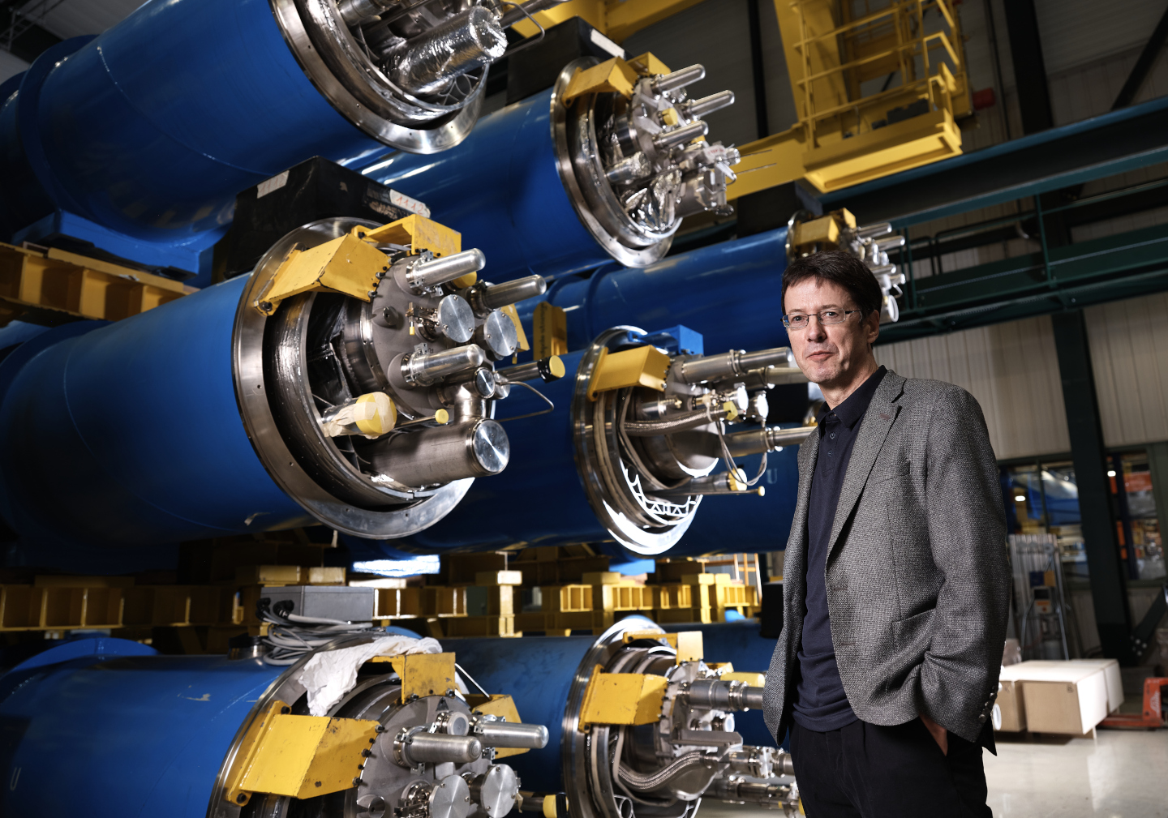
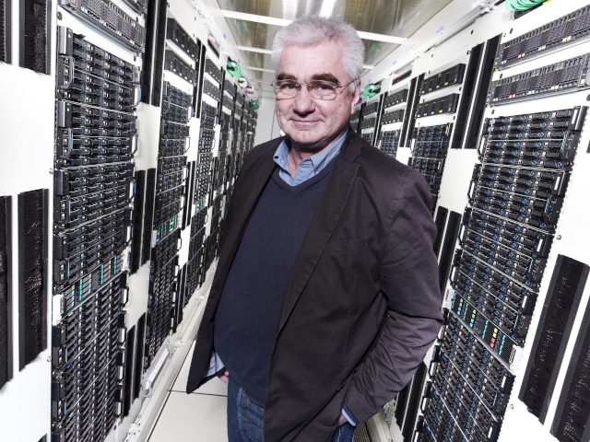
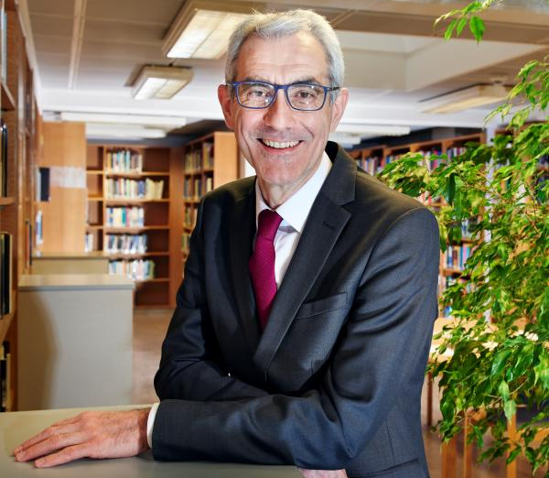
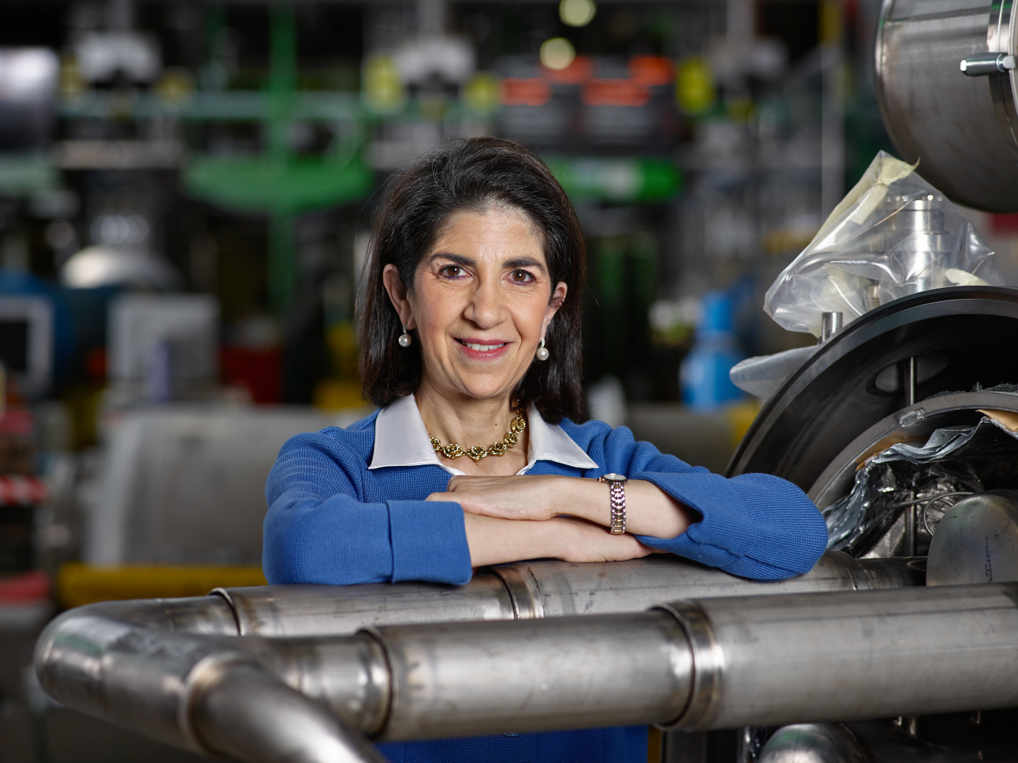
Q&A with a CERN Director
Charlotte Lindberg Warakaulle
Director for International Relations
Mike Lamont
Director for Accelerators &
Technology
Joachim Mnich
Director for Research & Computing
Raphaël Bello
Director for Finance & Human Resources
Fabiola Gianotti, Director General
You can check the video presentation by each Department Head on this link.

Slide 16



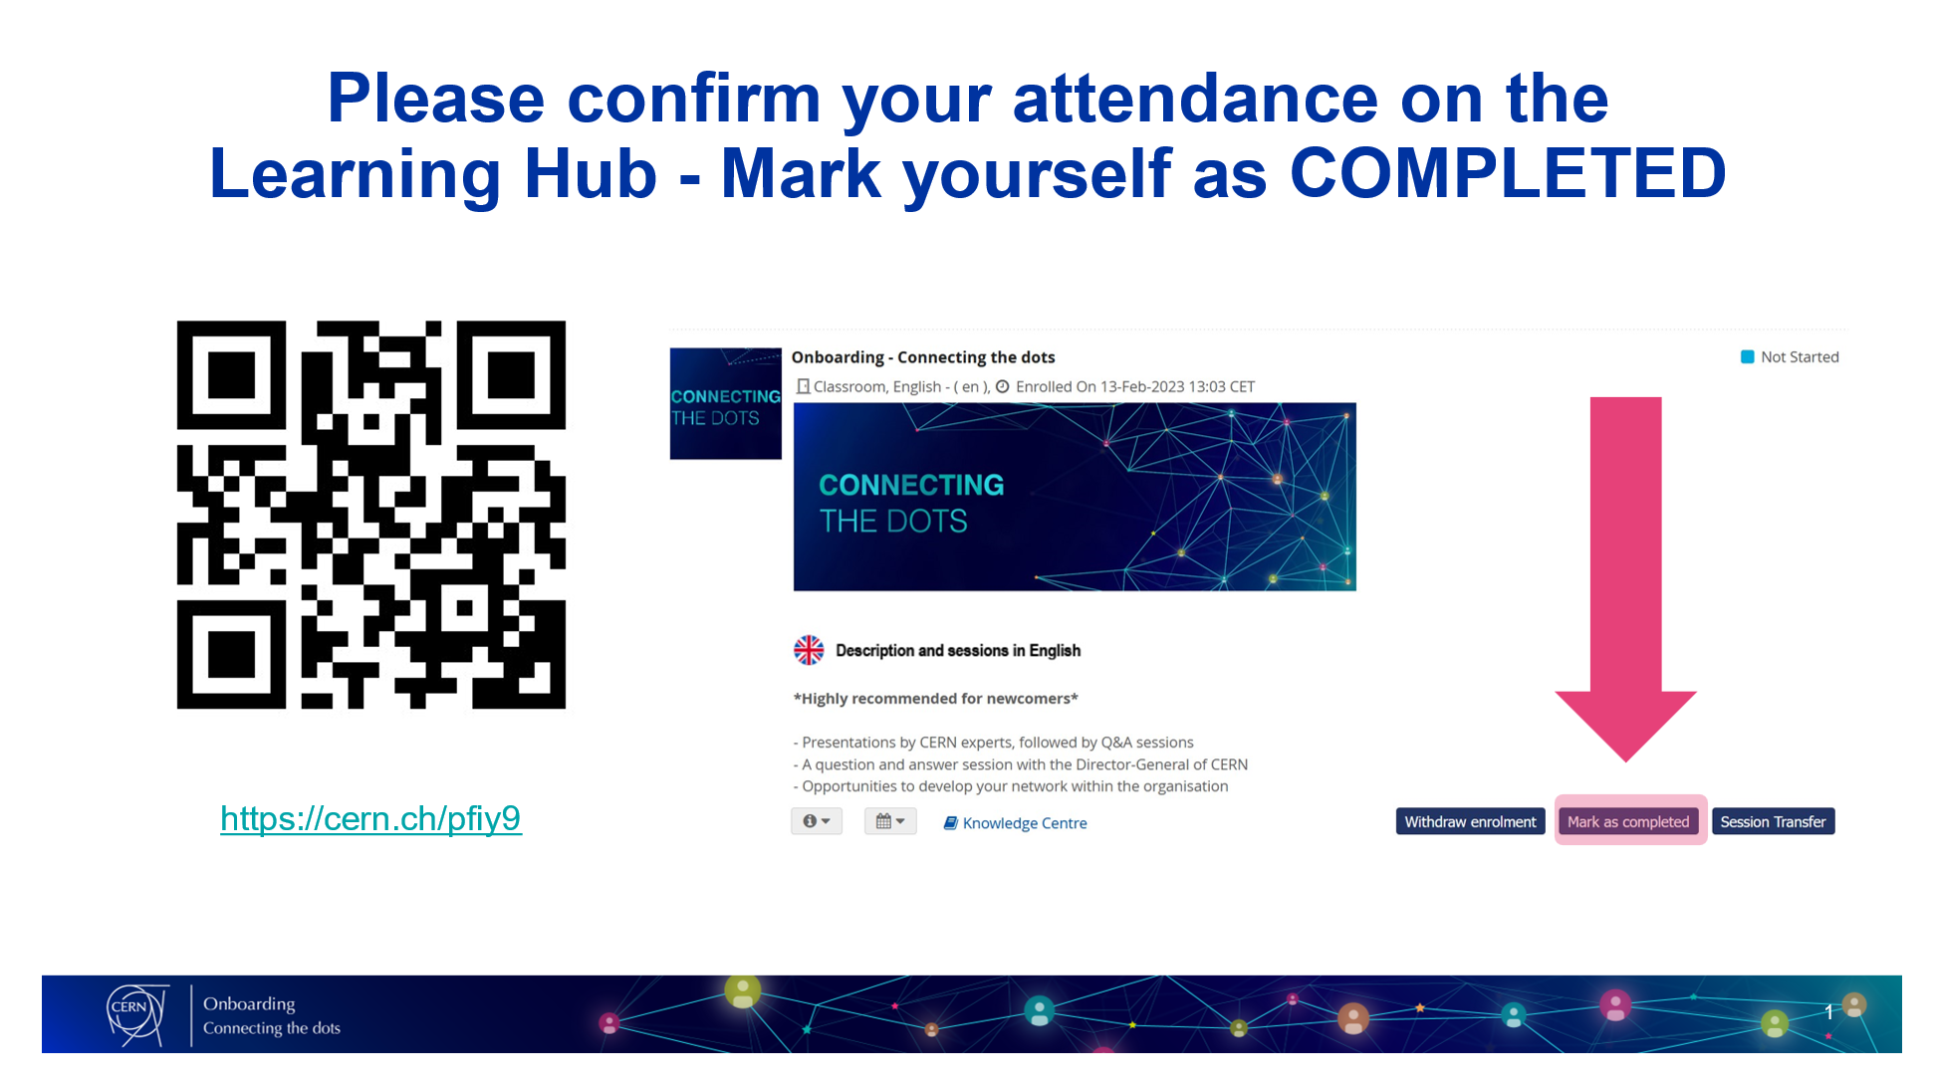

Please confirm your attendance on the Learning Hub
1
2
3
Scan the
QR Code
Go to
‘My Learning’
Click on
‘Mark as Completed’

Slide 17

Prize Draw

Slide 18




Closing Drinks
Meet with Department Heads, HRAs and L&D Team
Snacks & Drinks

