Slide 1
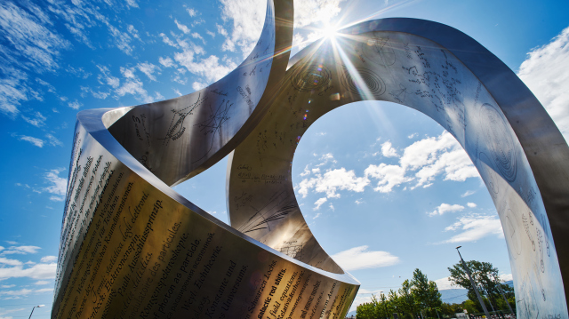
The CERN scientific programme
Richard Hawkings (CERN - EP dept)
A tour around the largest laboratory
in the world for particle physics
  The highest-energy accelerator (LHC)
  But also a very broad scientific programme

Slide 2
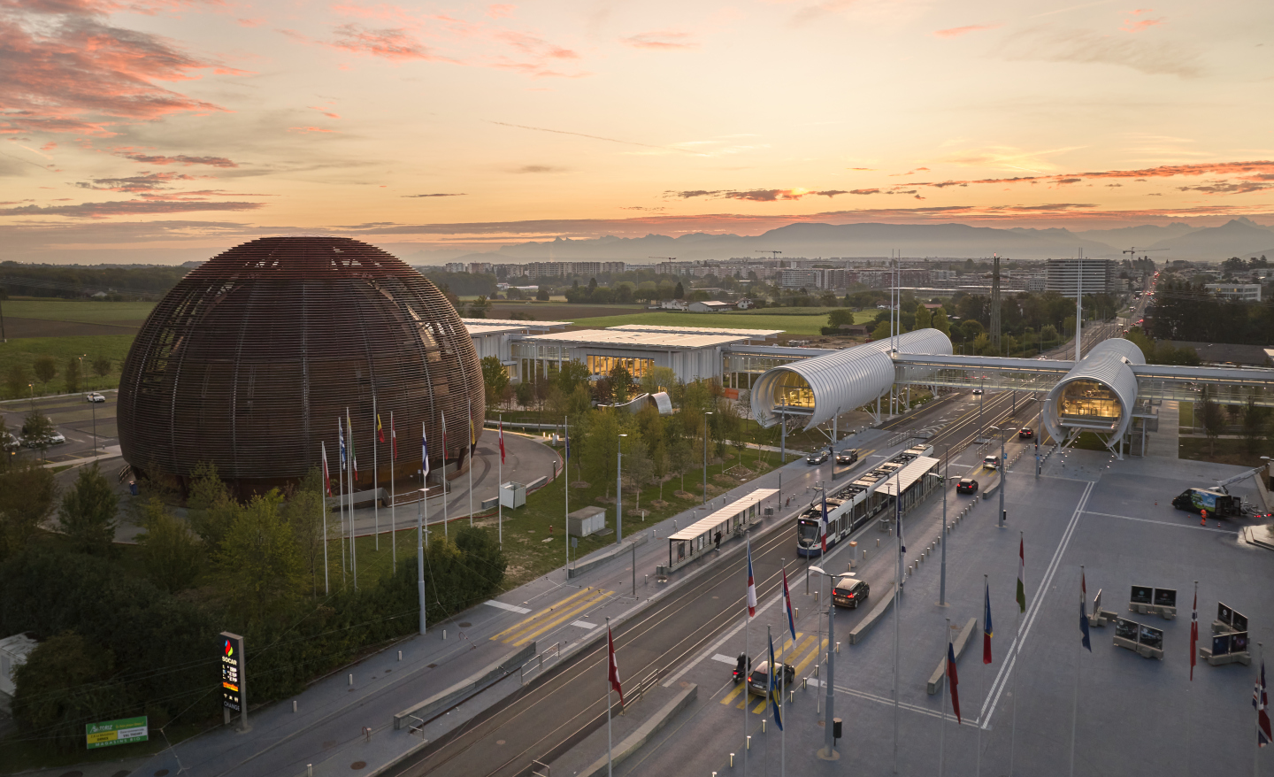
CERN history and members
Founded in 1954 with 12 European member states
  Nuclear / particle physics experiments getting too expensive for individual countries
  Against the background of the Cold War; ‘Science for Peace’
70 years of success – now 24 member states, plus 10 associated members
  2600 staff, 1800 other paid personnel, 12500 scientific users from all over the world
Member States: Austria, Belgium, Bulgaria, Czech Republic, Denmark, Estonia, Finland, France, Germany, Greece, Hungary, Israel, Italy, Netherlands, Norway, Poland, Portugal, Romania, Serbia, Slovakia, Spain, Sweden, Switzerland, United Kingdom
Associate Members: Brazil, Croatia, Cyprus, India, Latvia, Lithuania, Pakistan, Slovenia, Turkey, Ukraine
Observers to Council: Japan, Russia (suspended), United States of America, JINR (suspended), European Commission, UNESCO

Slide 3
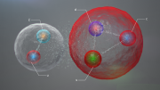
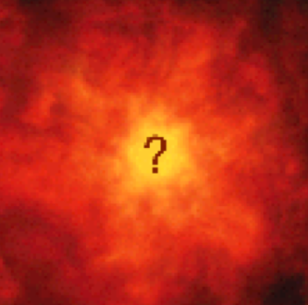


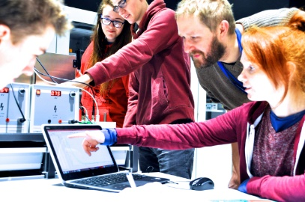
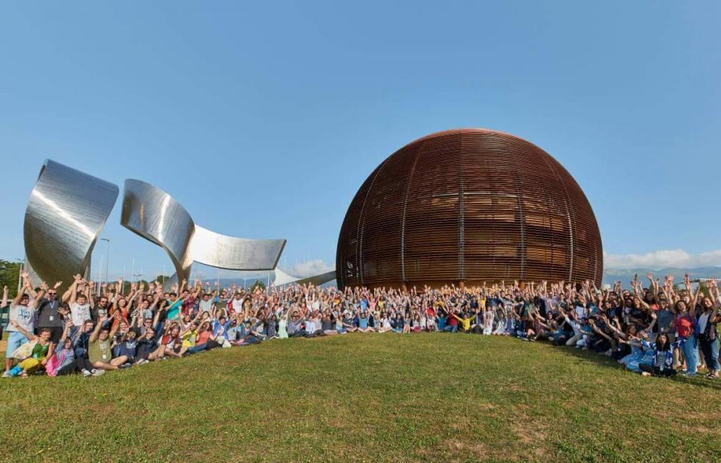
The mission of CERN
Three pillars…
Push back the frontiers of knowledge
  Structure of matter at small distances and high energies
    Conditions in the early universe
Develop new technologies for accelerators and detectors
  Bringing benefits for society – accelerator technology, medicine, WWW and Grid
Train scientists and engineers of tomorrow
  Student, trainee and graduate programmes
... uniting people from different countries and cultures

Slide 4
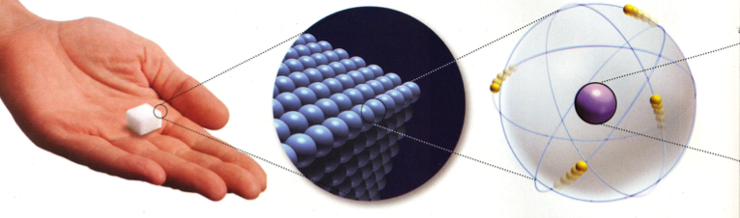
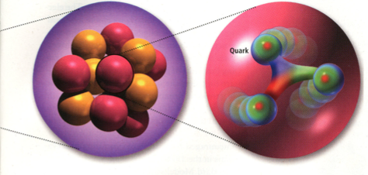
The structure of matter
All matter is built from atoms…
  Atoms consist of a small dense nucleus and orbiting electrons
  The nucleus contains protons and neutrons (hadrons)
  Protons and neutrons consist of up and down quarks
    And then…?
Probing smaller distance scales needs higher energy accelerators / colliders
  Super-microscopes to study smaller and smaller distance scales
  Probing the physics important in the early universe, just after the Big Bang
    Increasing connections between particle physics and astrophysics/cosmology
10⁻¹⁰ m
10⁻¹⁵ m

Slide 5
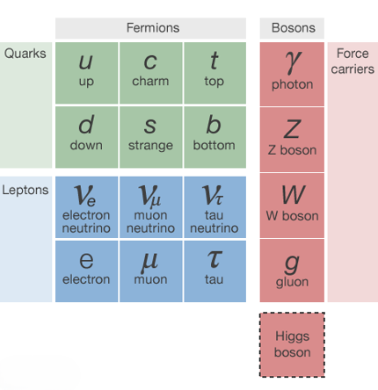
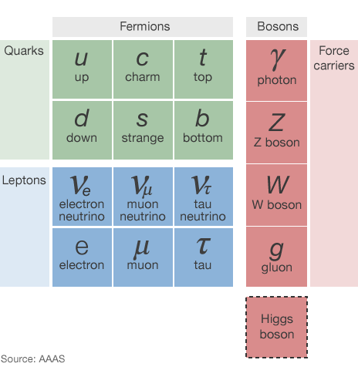
The particle zoo – the Standard Model
Quarks: spin ½, charge 1/3e, 2/3e
  Bound by QCD (strong force) in 2s and 3s into hadrons, cannot be ‘free’
    Up/down make up proton and neutron
    100s of exotic hadrons
    Top quark as heavy as gold nucleus
Leptons: spin ½, charge 0 or 1
  Only feel EW interactions
  Electron and neutrino, heavier cousins muon (cosmic rays), tau
    Neutrinos have non-zero mass (!)
  3 families of quarks + leptons (why?)
Force carriers – spin 1 bosons
  Photon (electromagnetism), W/Z (weak force), gluon (strong force)
Higgs boson (spin 0)
  Gives mass to other particles
light … heavy
+ antimatter partners

Slide 6
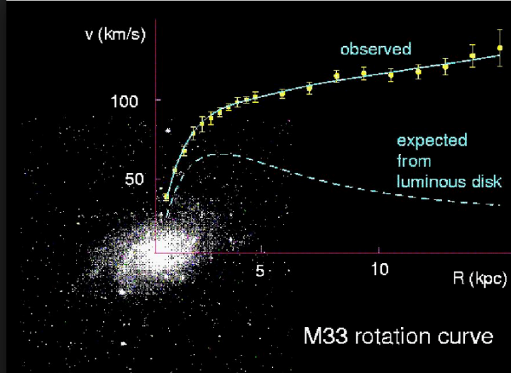
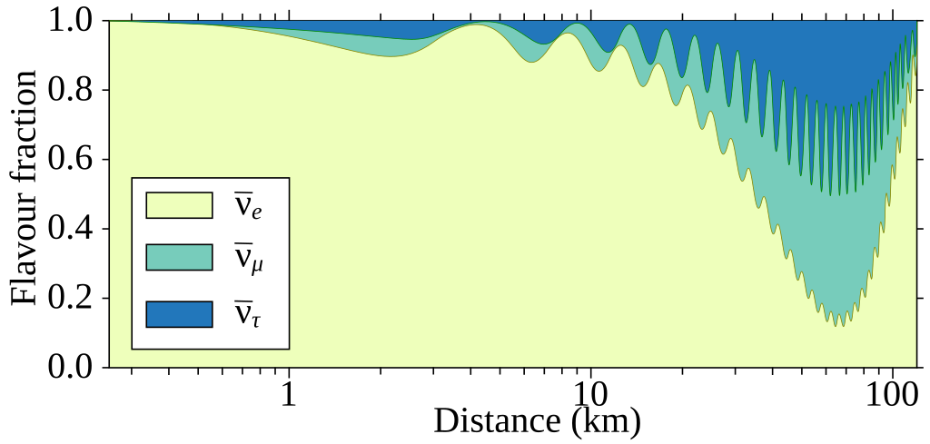
What is missing?
The Standard Model is great, but
  Many unexplained observations/mysteries
Dark matter
  Astrophysical observations suggest 5x more ‘dark’ matter in universe than we can see
    New particles? What are they?
Matter/antimatter asymmetry
  Should have been produced equally in Big Bang, where has the antimatter gone?
    Differences between matter/antimatter?
Neutrino oscillations
  Neutrinos change flavour as they travel (requires mass) – what drives this?
How to include gravity in the picture
We are not done – more Nobel prizes?
dark matter?
Neutrino flavour oscillations

Slide 7
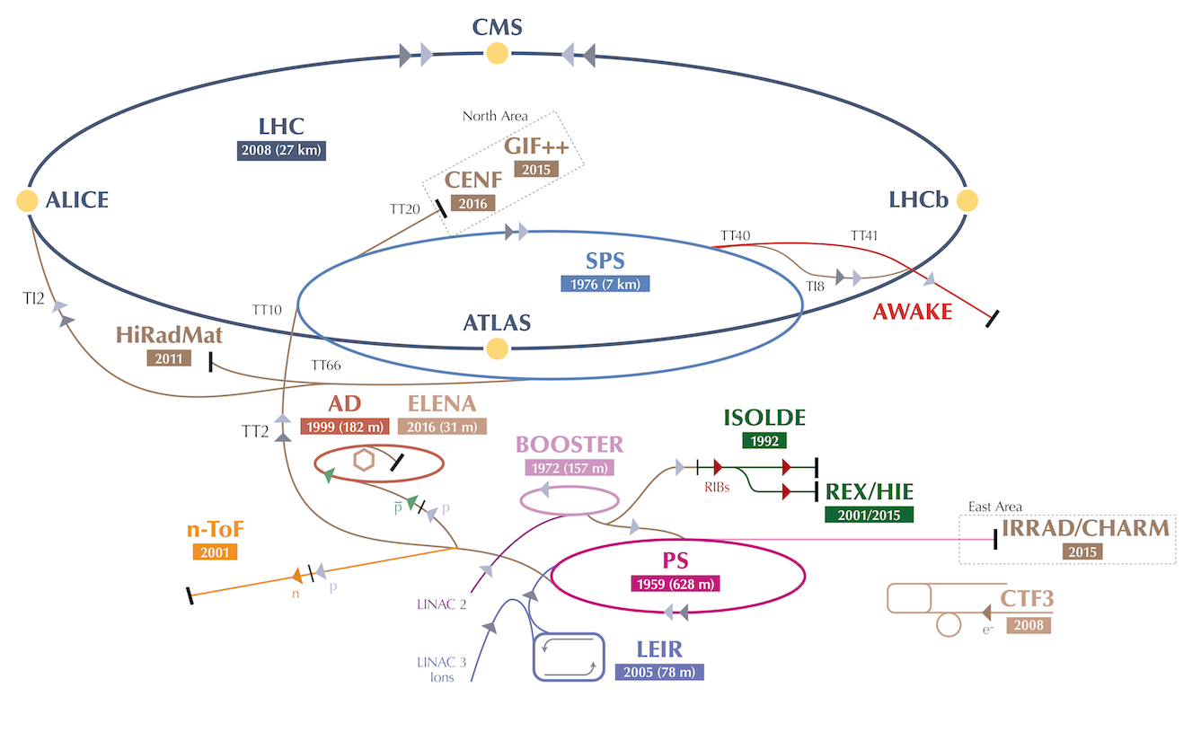
Research at the CERN accelerator complex
World-leading facilities
built up over decades

Slide 8
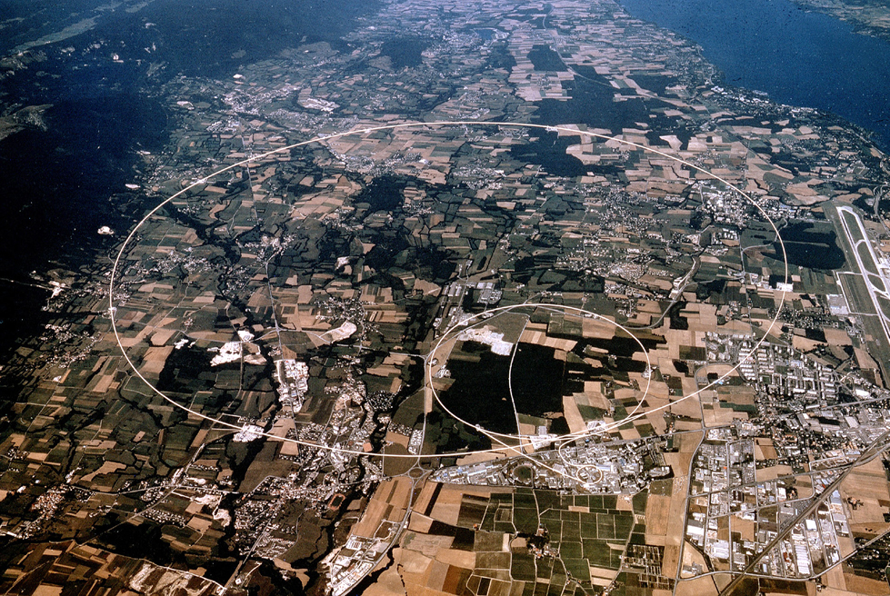
The LHC and its experiments
Exploration of a new energy frontier in pp and PbPb collisions
  Search for and study the Higgs boson, search for new particles or forces
CMS
LHCb
flavour physics
ATLAS
ALICE
QCD in PbPb/pp
+ small experiments:
FASER, SND@LHC,
LHCf, MoEDAL

Slide 9
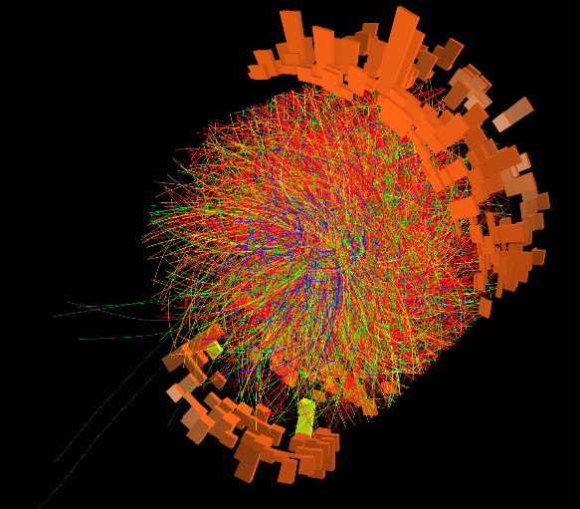

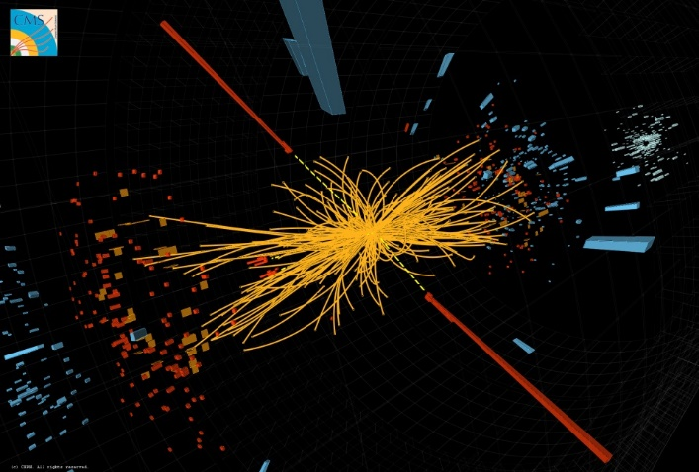
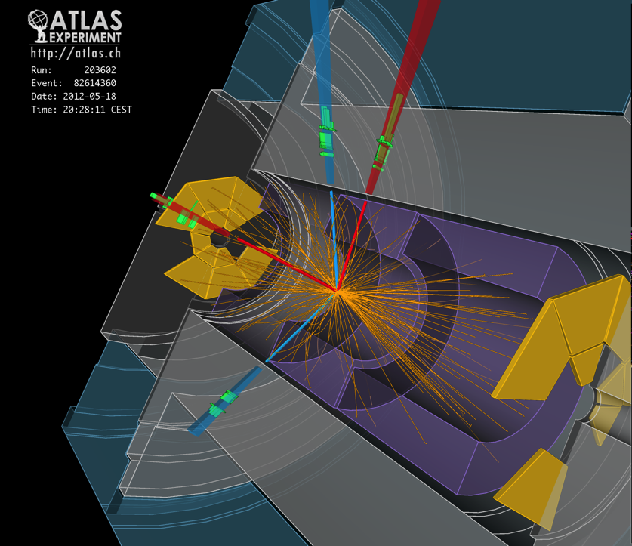
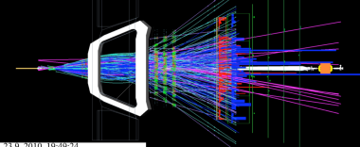
LHC datataking
Halfway through LHC programme
  Brilliant peformance of accelerator, experiments and LHC computing grid so far
HL-LHC upgrade on the horizon
Some event displays …
 | Run | Years | Energy √s | Data (fb⁻¹)
LHC | 1 | 2010-12 | 7-8 TeV | 25
 | 2 | 2015-18 | 13 TeV | 150
 | 3 | 2022-26 | 13.6 TeV | ~350
HL-LHC | 4-5 | 2030-41 | ≤14 TeV | ~3000
CMS
ATLAS
ALICE
LHCb

Slide 10

Hunting the Higgs boson
In 2011 and 2012, ATLAS and CMS discovered a new particle
Cannot observe Higgs directly
  Decays quickly to stable particles
  Two-photon decay H→𝛾𝛾
  Four leptons: H→ZZ*→4l (e or μ)
Measure particle energies, angles
  Calculate mass of ’parent’, m_{𝛾𝛾}
Accumulate 𝛾𝛾 events in data
  Most from ‘background’ processes
  … but a small ‘excess’ at 125 GeV, growing with time
Public announcement in July 2012
  … Nobel prize for Higgs & Engelert

Slide 11
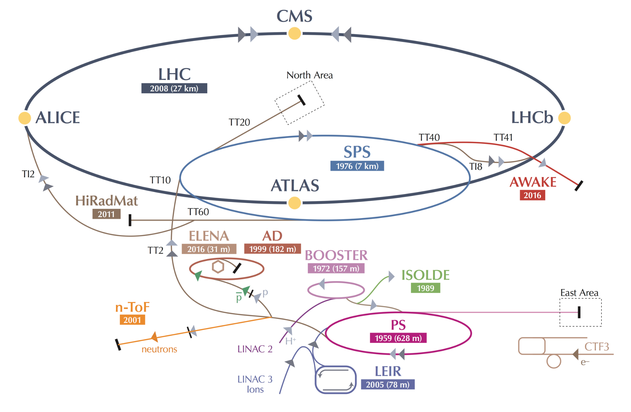
SPS – Fixed target physics in the North Area

Slide 12
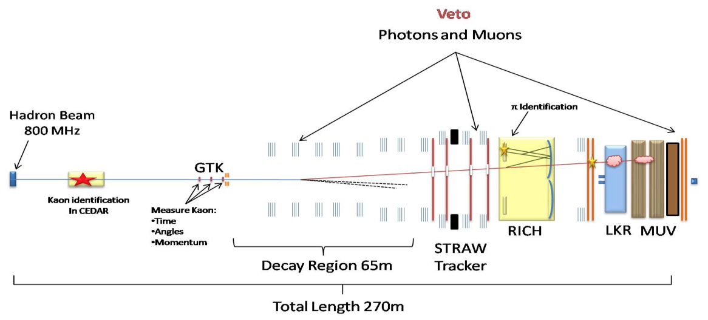
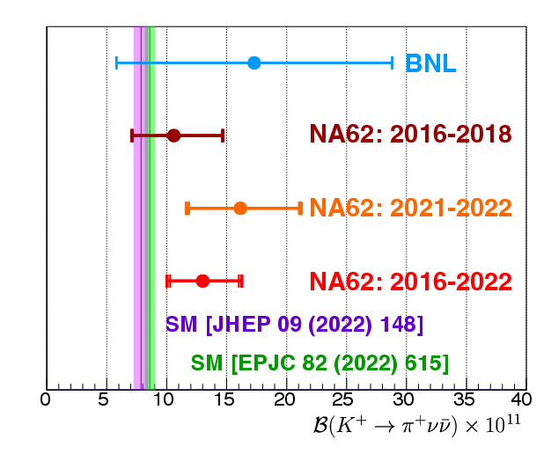
Searching for rare processes with the SPS
SPS secondary beams from impact of protons on ‘fixed target’
  Flexible production of 𝜋±, K± p, e±, μ±, photons, ions with 10s-100s GeV energy
  Exploited by variety of experiments with dedicated and shared beamlines
    And ‘test beams’ for developing future particle detectors, irradiation facilities
Example, NA62 searching for very rare kaon decay, K±→𝜋±𝜈𝜈
  Expect that 1 in 10¹⁰ kaons decays this way, rate sensitive to new physics
  Challenging – look for kaon in, pion out, small direction change from invisible 𝜈s
  After 5 years of data-taking, 51 event candidates, rate of 1.3±0.3 10⁻¹⁰ ☺

Slide 13
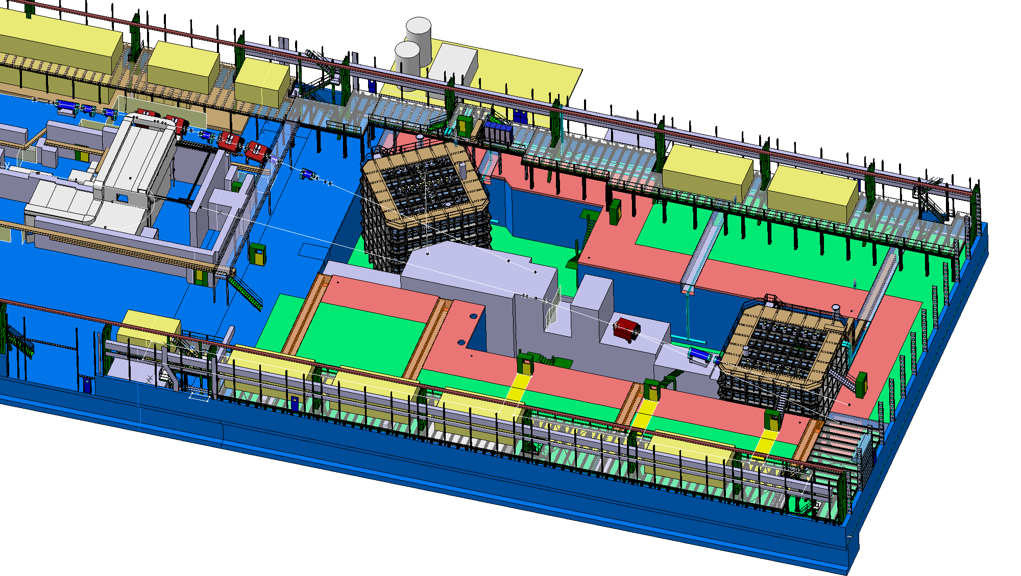
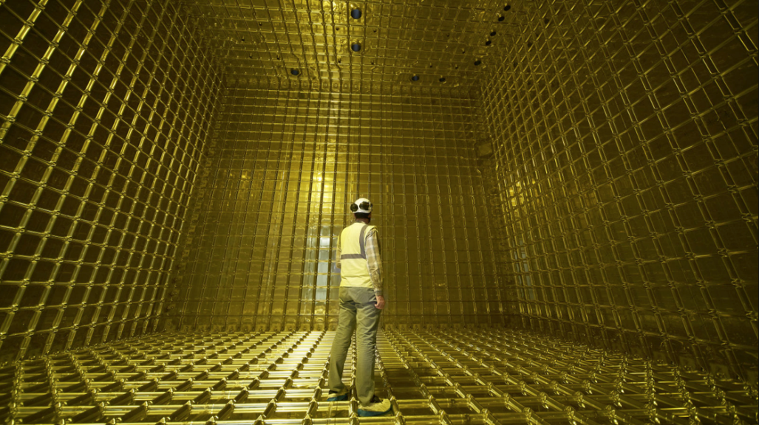
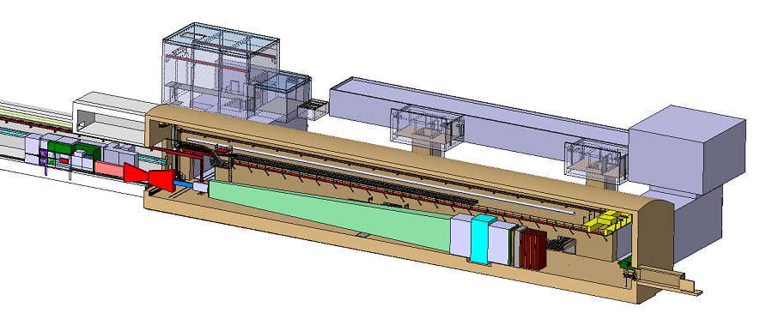
Neutrino platform and future activities
Extension to North Area houses large liquid argon neutrino detectors
  Prototypes for DUNE 𝜈 experiment in USA
    Neutrino interactions very rare
    Tested with hadron beams from SPS
  Neutrino platform is focus for European participation in experiments in USA / Japan
    Benefits from CERN facilities and expertise
Future SPS ‘beam dump’ facility (BDF)
  SPS proton beam hits heavy target
  Hoping for the production of postulated ‘feebly-interacting particles’ (FIPs)
SHiP experiment aims to detect their scattering or decay into ordinary matter
  Large instrumented decay volume
  Approved for design phase, operation from early 2030s
8x8x8 m
cryostat
SHiP
50 m

Slide 14
Nuclear physics at ISOLDE and nTOF

Slide 15
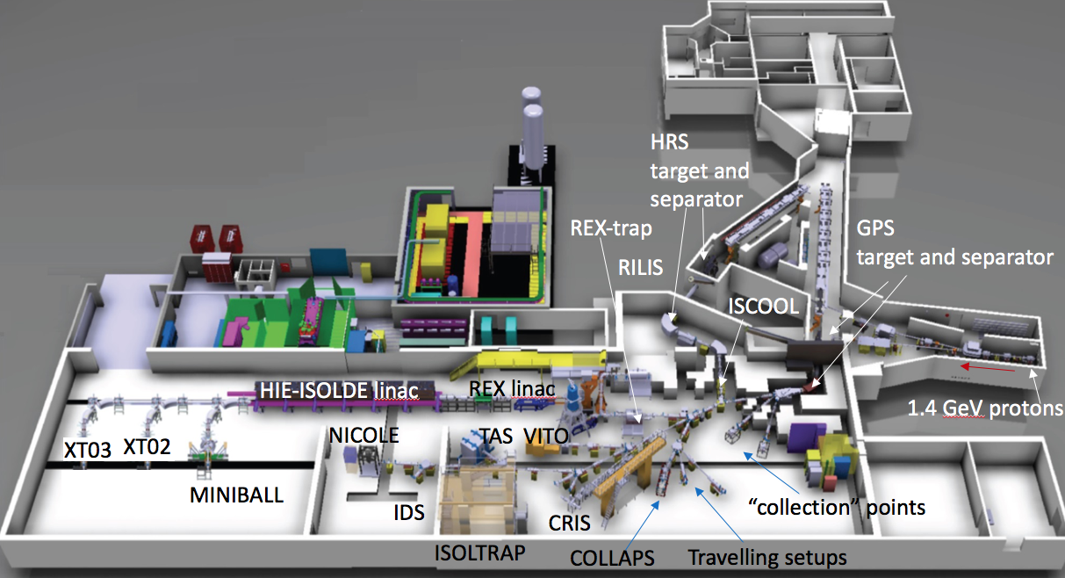
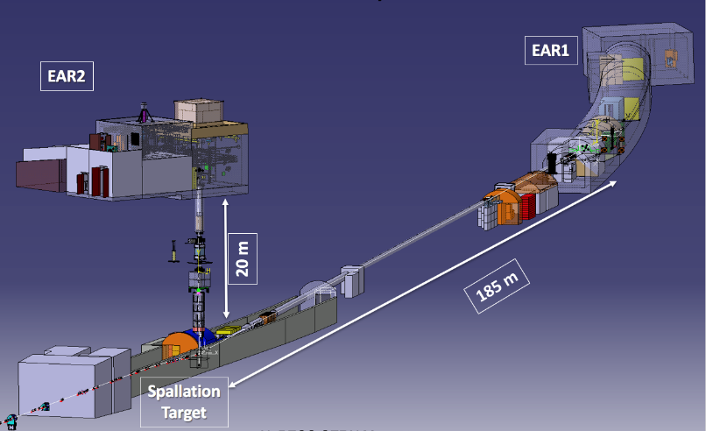
Nuclear physics at ISOLDE and nTOF
ISOLDE – radioactive ion beams
  Flexible facility – can produce 1000 different nuclides of >75 elements
  ~50 experiments per year with various fixed and temporary detector setups
    Including post-acceleration with REX and HIE-ISOLDE linacs
nTOF – neutron time-of-flight measurements using spallation target
  Studying neutron-induced reactions
Together, address a variety of physics
  Nuclear physics, esp. exotic nuclei
  Nuclear astrophysics
  Fundamental interactions
  Medical applications, e.g. MEDICIS
  Materials science
  Nuclear waste transmutation
ISOLDE
MEDICIS
nTOF

Slide 16
AD and ELENA – Antimatter physics

Slide 17
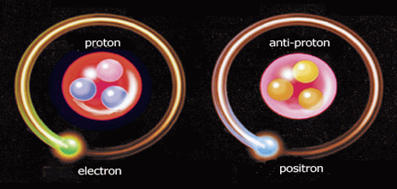
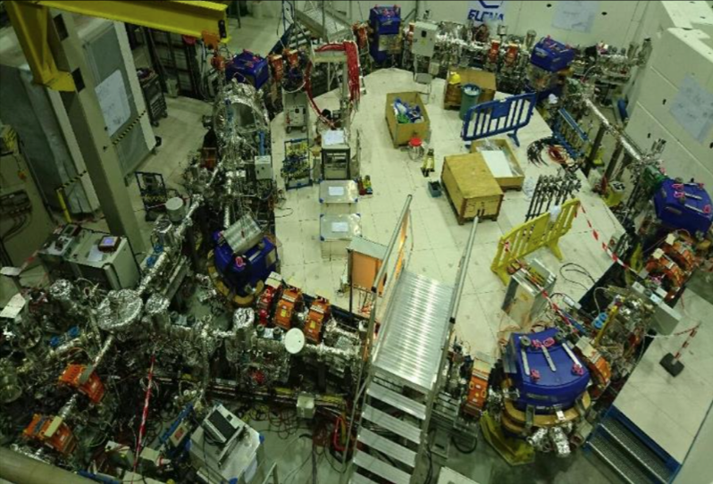
Physics with antimatter
Every particle has an anti-particle counterpart
  Equal and opposite properties, e.g. charge
    Same mass m and magnetic moment g
  Tested to 10⁻⁹ level in e.g. BASE experiment with trapped antiprotons
GeV antiprotons produced from PS target
  Decelerated to 5.3 MeV (AD), 100 keV (ELENA)
  ‘Slow’ antiprotons combined with positrons
    Making anti-hydrogen atoms (and more)
  Spectroscopy of antihydrogen
    ALPHA, ASACUSA, AEgIS
  Effect of gravity on antimatter
    ALPHA-g, GBAR, AEgIS
    2023 ALPHA result: anti-hydrogen falls down!
  New… trapping and transporting antiprotons
    BASE-STEP: to ‘quieter’ labs, e.g. in Germany
    PUMA: to ISOLDE – react with exotic nuclei
H
H
ELENA ring

Slide 18
Physics at the PS East Hall

Slide 19
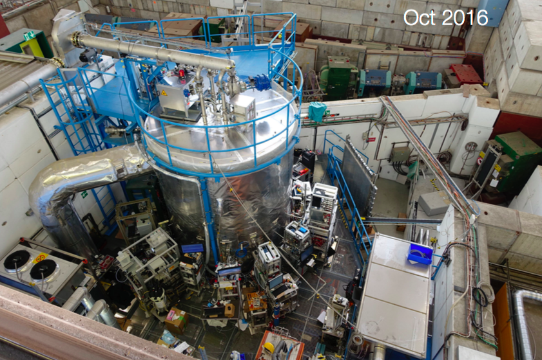
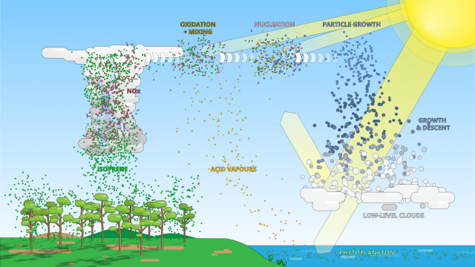
CLOUD experiment – environmental physics
Studying impact of cosmic rays on aerosols (and hence cloud) formation
  Poorly known… large uncertainty in climate models
26 m³ ultra-clean chamber
  Precisely controlled gas composition
  PS 𝜋⁺ beam simulates cosmic rays
Several breakthroughs since 2009
  Cloud formation higher in pre-industrial times than previously thought
  Recently – influence of isoprene C₅H₈ produced from tropical forests on aerosol particle formation
    Can seed low-level clouds
    Impact on Earth’s radiative balance

Slide 20

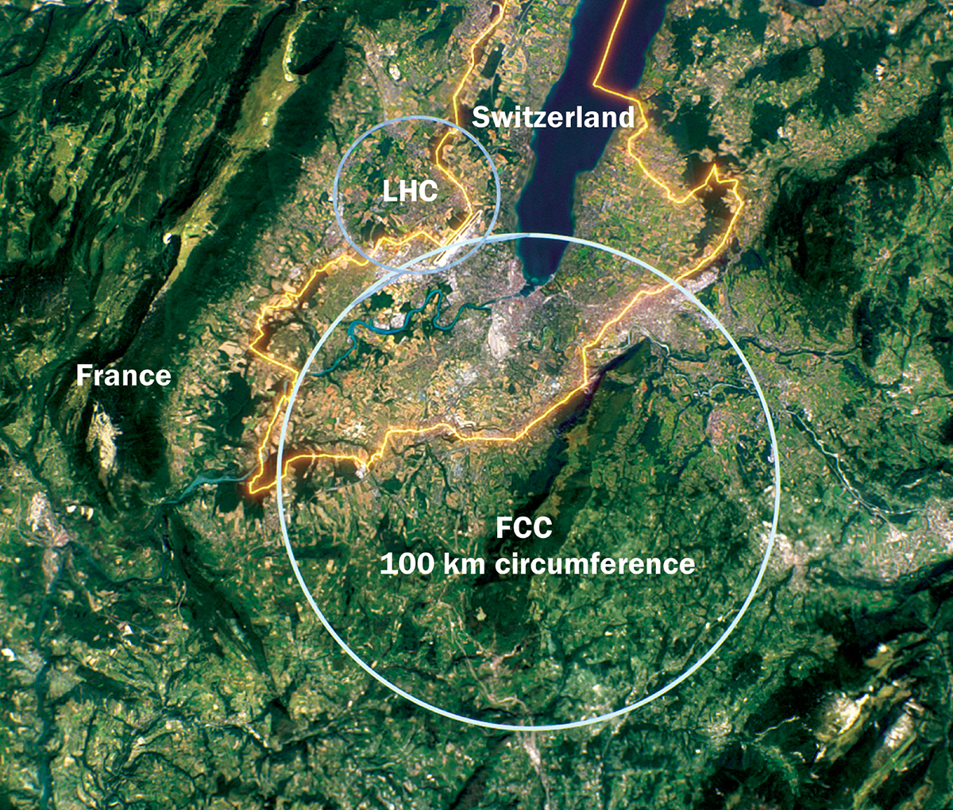
Towards the future of CERN
High-luminosity LHC upgrade in next 5 years
  HL-LHC operation from 2030-2041
  But need to prepare what comes next …
Community roadmap from European Strategy for Particle Physics (ESPP)
  2020 update: mandated two studies at CERN
    1) FCC – Future Circular Collider
    Feasibiliy study for a 80-100km collider
    FCC-ee: e⁺e⁻ Higgs/Top/EW factory 90-365 GeV
    FCC-hh: pp collider at ~100 TeV (~7x LHC)
    2) Physics beyond colliders
    Possibilities for the rest of the CERN accelerator complex
    E.g. the recently-approved SHiP experiment
Exciting times – next update of ESPP should be released in mid-2026…

Slide 21
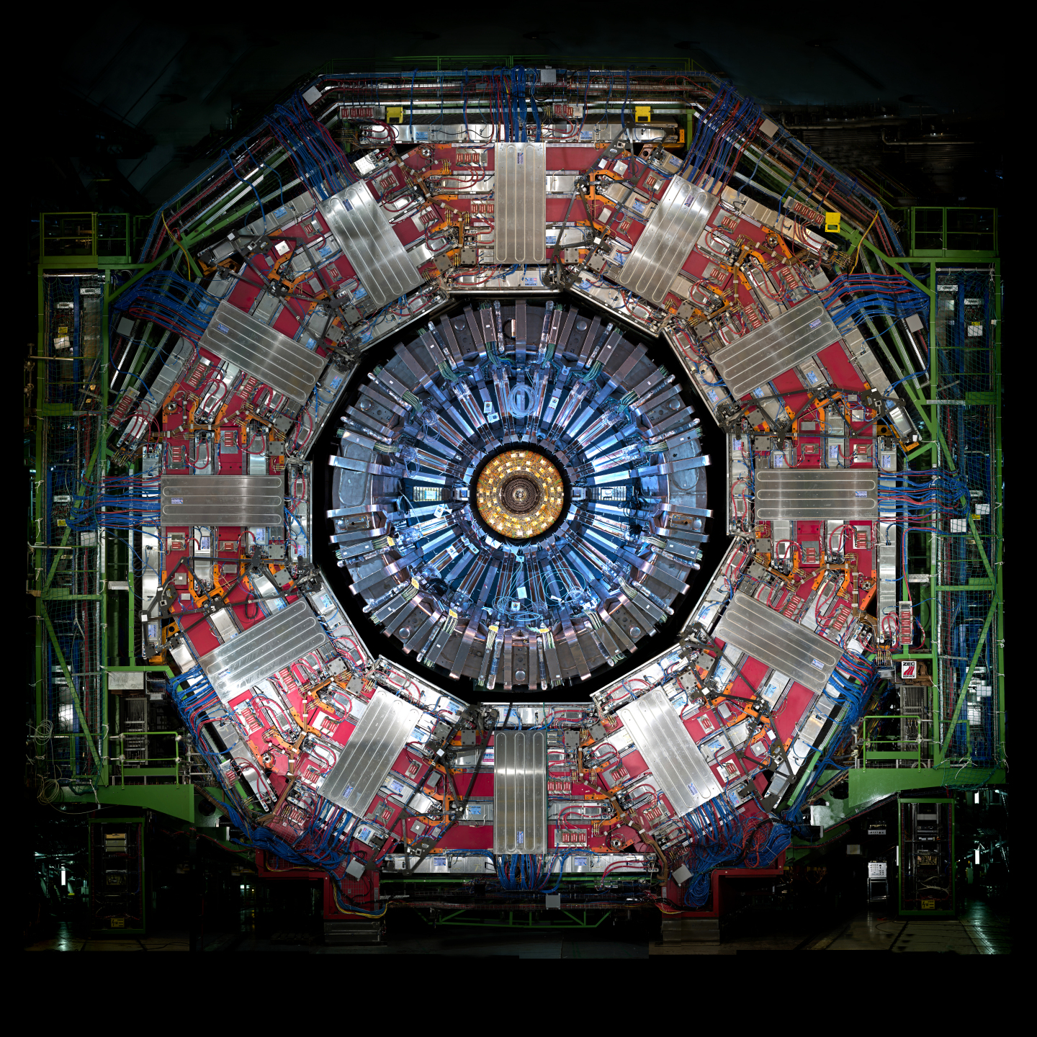
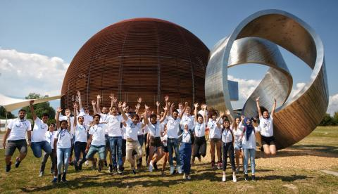

Conclusions
The CERN scientific programme is:
Rich and diverse
From atomic physics to the highest energy frontier
Contributes to technology development/transfer and education
Relevant to wider societal issues – health, information technology, climate, energy
Welcome, join the adventure, bienvenue!

