Slide 1
SHiP Integration
ECN3
HI-ECN3 WP5 coordination meeting
Beatriz Martinez Sutil (BE-EA-DC)
29/04/2025

Slide 2
INDEX
3D models organisation
New coordinate system
Layout P42 line
ECN3 integration
Mezzanine integration
Inventory ECN3

Slide 3
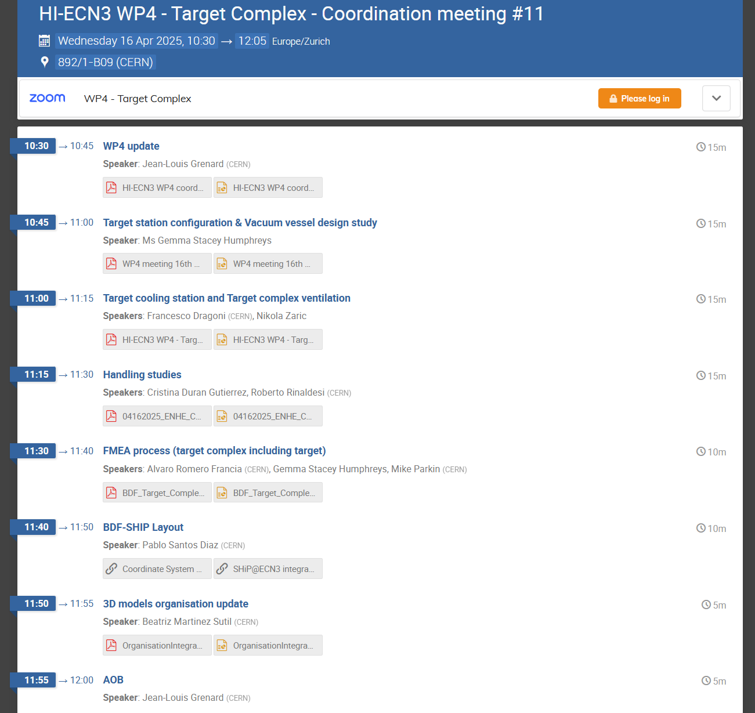
3D models organisation
Presented on WP4 Coordination Meeting #11

Slide 4
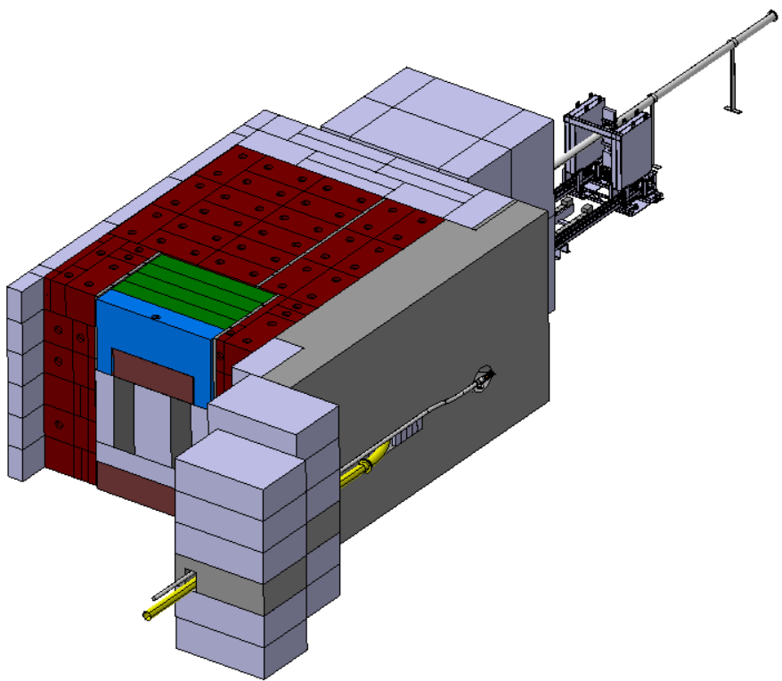
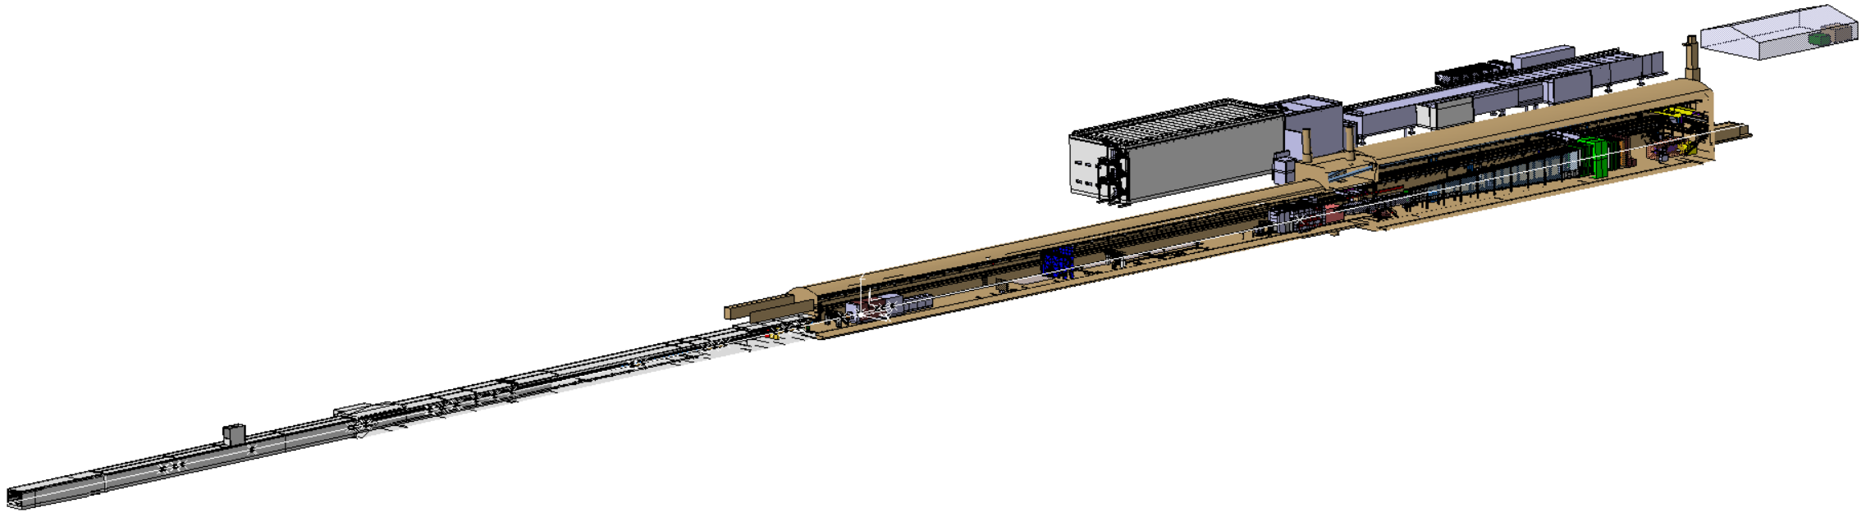
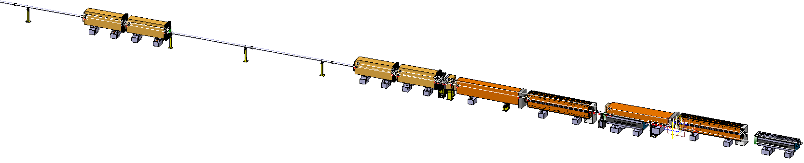
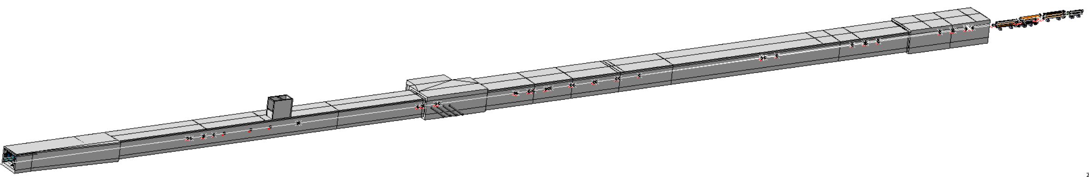
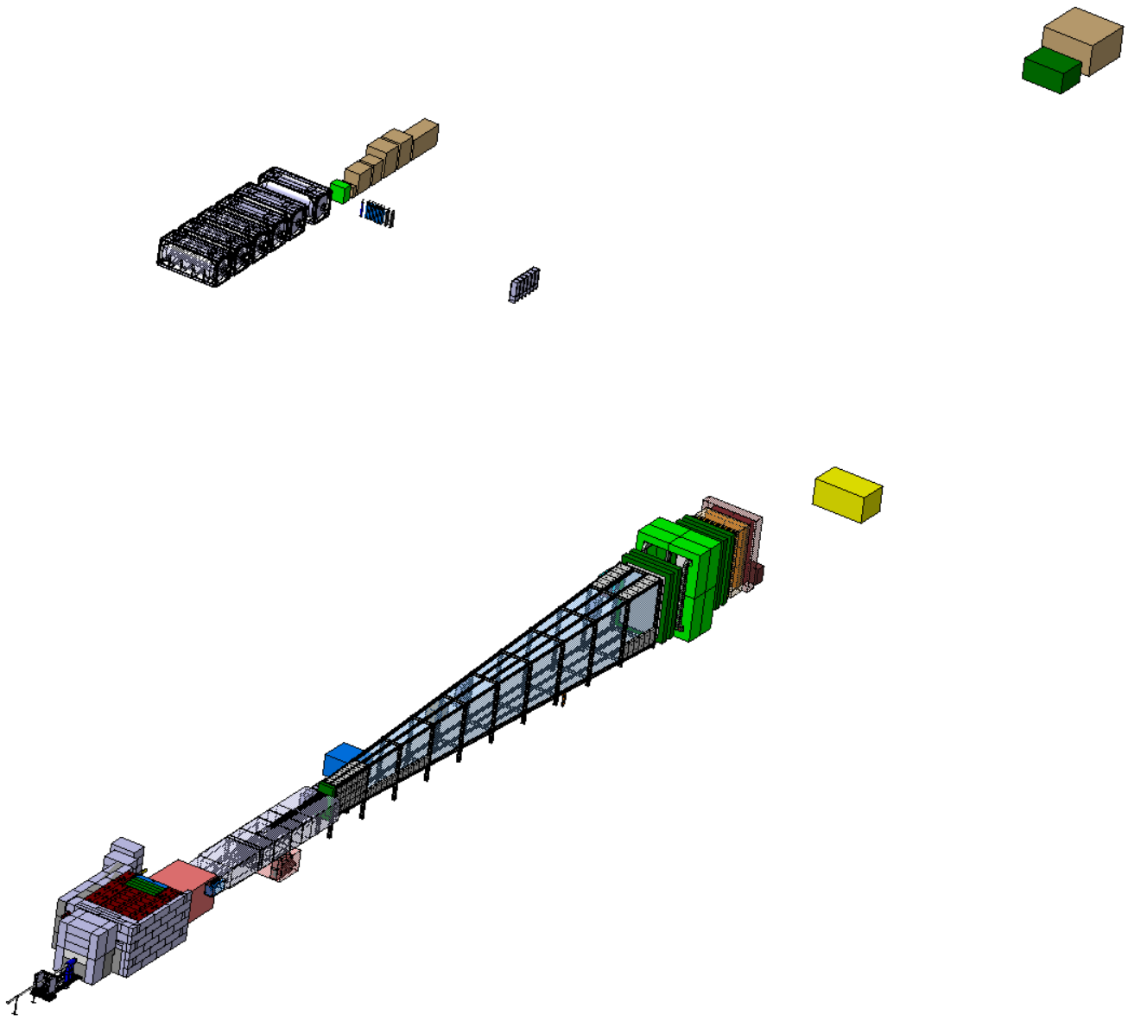
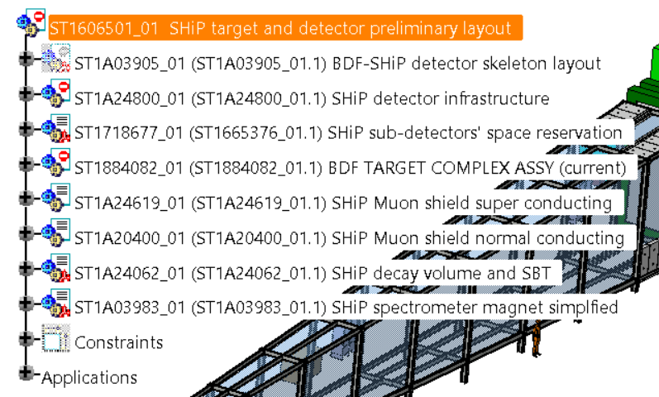
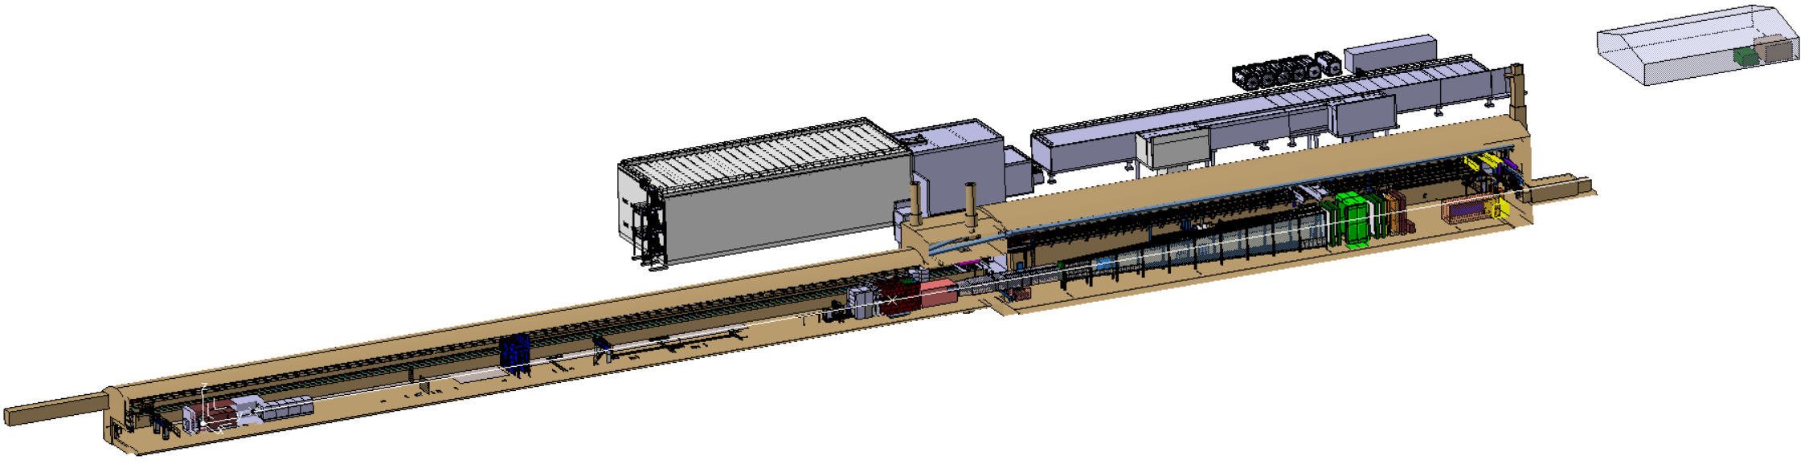
Overview of baseline models I
TT85-ECN3_IntegrationStudy_BDF SHiP_2704
(EA) - ST1967062_01
Layout_P42line_PostLS3_2704
(EA) - ST1949012_01
BDF TARGET COMPLEX ASSY (current)
(STI) - ST1884082_01
TT85+TDC85_BDF-SHiP_2704
(EA) - ST1950060_01
SHiP target and detector preliminary layout
(EP) - ST1606501_01
TCC8+ECN3_BDF-SHiP_2705
(EA) – ST1967028_01

Slide 5
Overview of baseline models II
Name | Reference | C.S. | Responsability | Description
BDF TARGET COMPLEX ASSY (current) | ST1884082_01 | Defined by user | SY-STI | Study of the new target design.
SHiP target and detector preliminary layout | ST1606501_01 | 2705 | EP-SME | Integration detector + target in the SHiP skeleton. Also possible to find the space reservation, as shown in the previous slide.
TCC8+ECN3_BDF-SHiP_2705 | ST1967028_01 | 2705 | BE-EA | Integration of ‘’SHiP target and detector preliminary layout’’ in TCC8-ECN3 cavern. Integration of the new C.Eng. models.
Layout_P42line_PostLS3_2704 | ST1949012_01 | 2704 | BE-EA | New P42 line layout study.
TT85+TDC85_BDF-SHiP_2704 | ST1950060_01 | 2704 | BE-EA | Integration of ‘’SHiP target and detector preliminary layout’’ in TT85-TDC85 cavern.
TT85-ECN3_IntegrationStudy_BDF-SHiP_2704 | ST1967062_01 | 2704 | BE-EA | Integration of ‘’TCC8+ECN3’’ and ‘’TT85+TDC85’’ studies
Table 1.- Summary of the HI-ECN3 study models

Slide 6
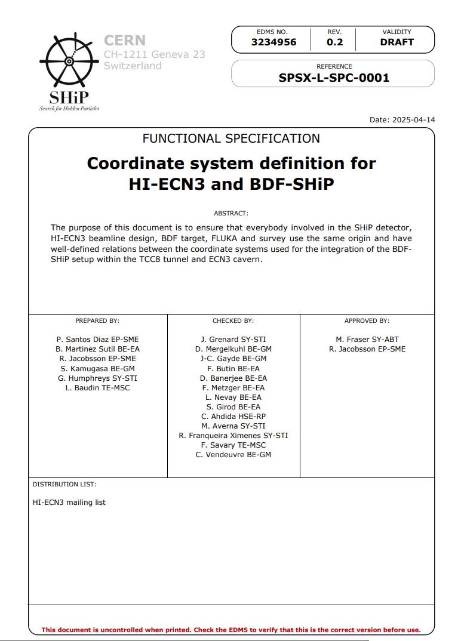
New coordinate system
BDF-SHiP detector skeleton layout (ST1A03905_01) is currently (and temporally) placed in the beginning of 2705.
Once the new coordinate system is defined, the skeleton will be moved with a macro from the beginning of 2705 to the beginning of the new coordinate system.
Coordinate System Definition for HI-ECN3 and BDF-SHiP (EDMS 3234956)

Slide 7
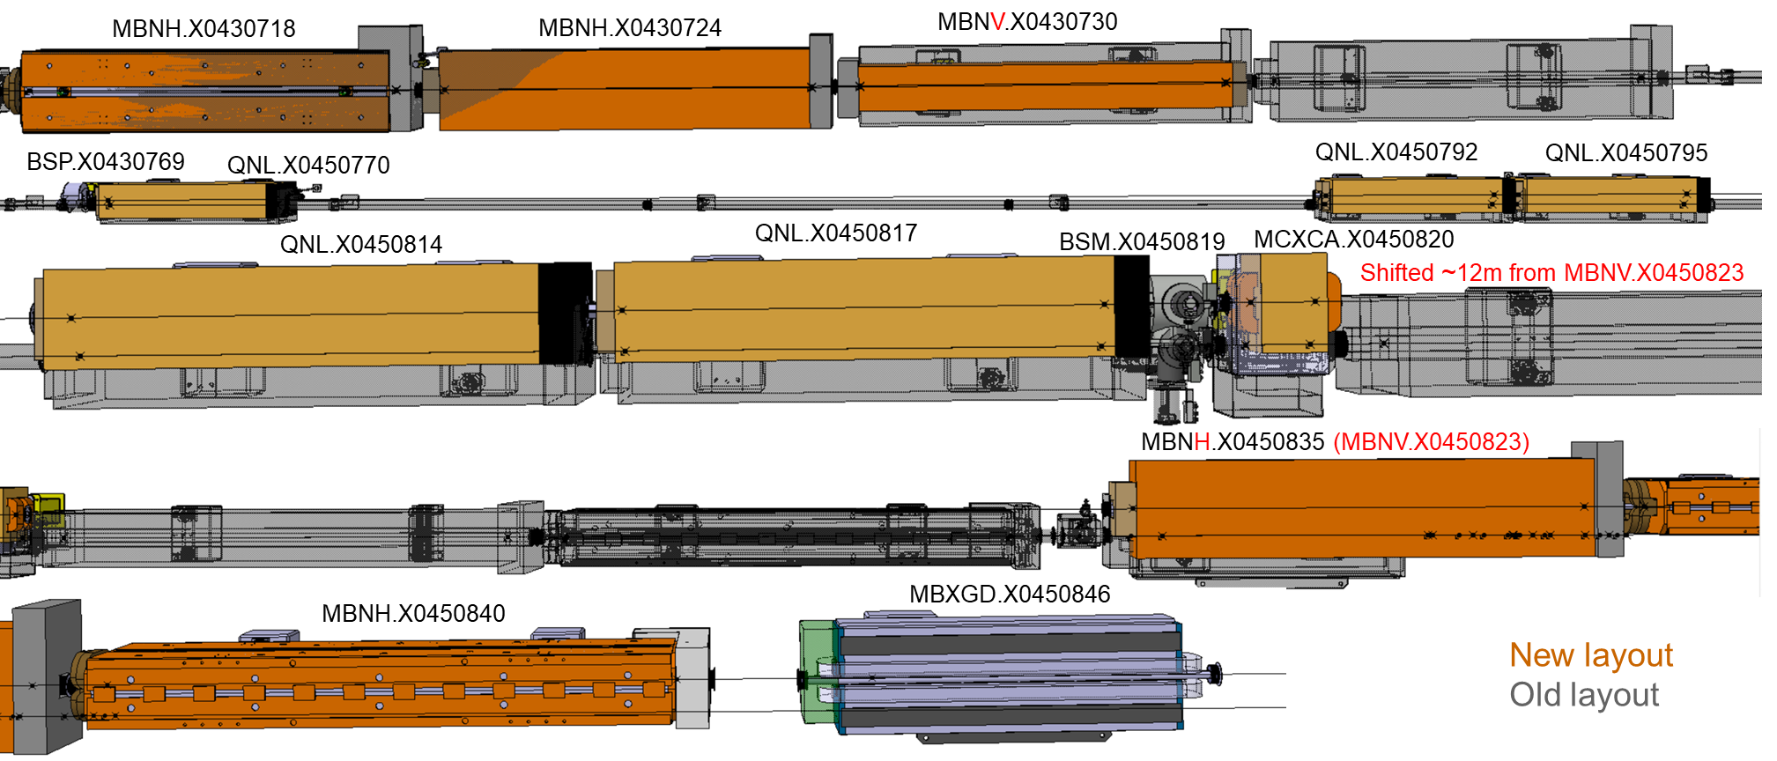
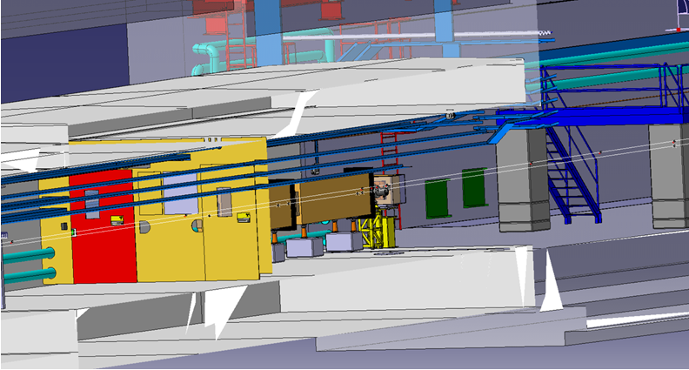
Integration: ST950060_01
Layout: ST194012_01
P42 beam line integration
Last week it was provided new MADX files, but another version should be provided because:
The coordinate system should be 2704, no 0_survey.
The beam instrumentation if the target station is missing.
Stil same version presented in ICEA#48_06-12-2024 [NACONS + HI-ECN3] and HI-ECN3 Layout
The integration team of the fire door N6 is waiting for inputs.

Slide 8
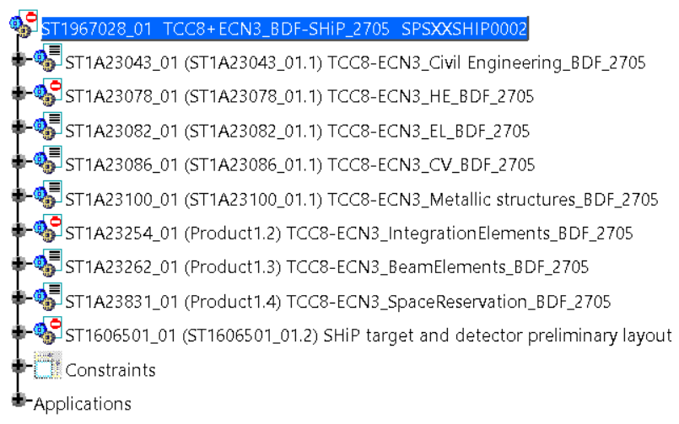
Note: In this model has been added extraordinary the C.Engineering models next, but not all the integration elements (too heavy otherwise)
TCC8-ECN3 model
B.911:
Current – ST1518207_01
Integration new door study - ST1906031_01
B.918 :
Current - ST1544688_01
B.754:
Future - ST1947411_01 (SY-STI-TCD)
New organization inside the integration model

Slide 9
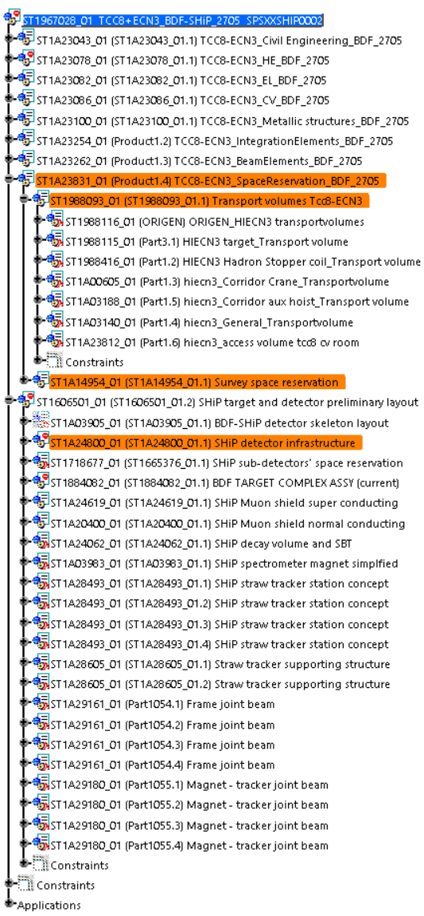
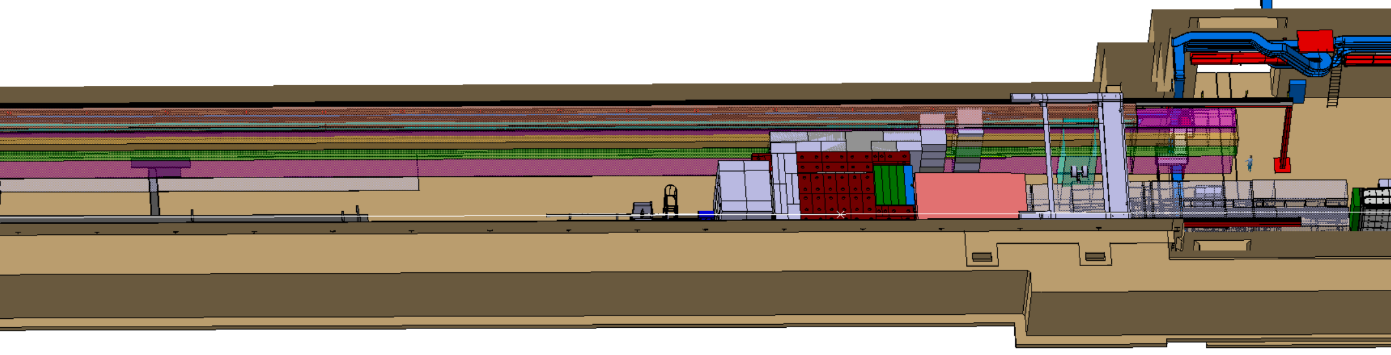
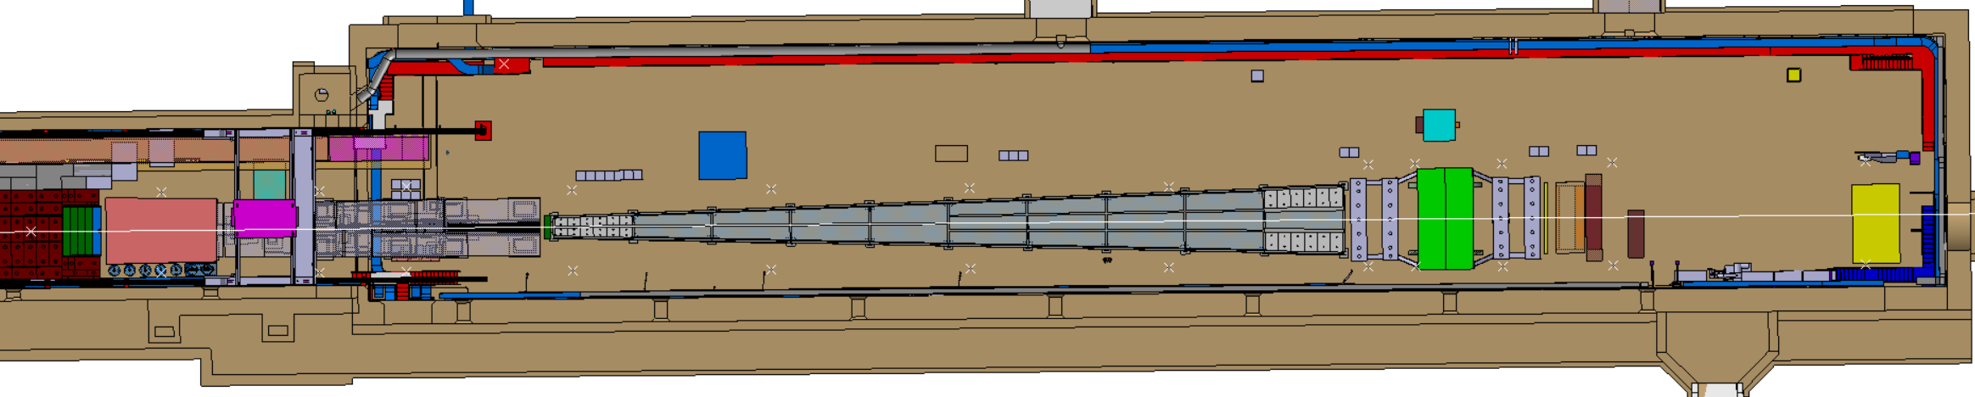
TCC8-ECN3 model: Space reservation
BE_EA
EP_SME
Transport space reservation
Survey space reservation – Requested in Survey in ECN3/TCC8

Slide 10

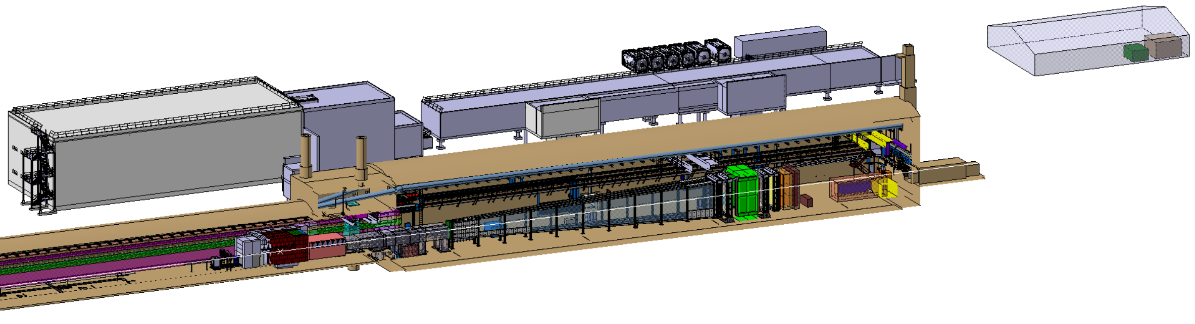
ECN3 integration
Dry risers integration along ECN3
On ICEA #56 was asked if could be possible to restart the fire studies along ECN3
Changes requested by Pablo (almost) done:
ECN3&TCC8 C.E. model in color light brown.
Scenes as the one attached and the ones of the EDMS 3286140: TBD
Removed the CER-699-001-02-001_SKELETON (ST0969898).
ST1606501 inside ST1967028.
Include LAr at the end of the cavern (normally hidden).
Hide the points of the survey network.
For the as-built models:
Job B.920 will be placed inside Job B. 918, that is currently in progress.

Slide 11
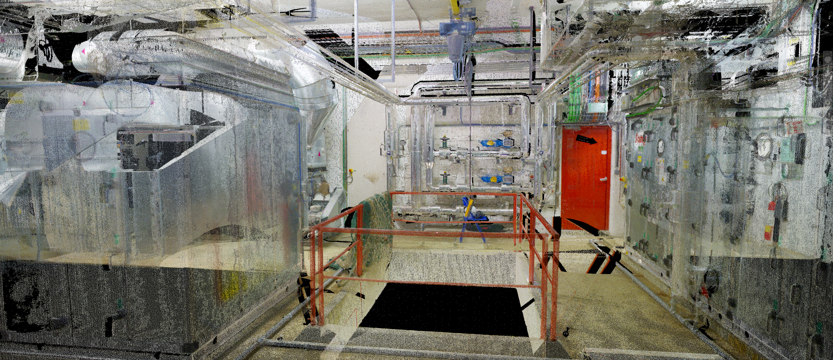
Mezzanine integration
Also in CATIA as ST1A25072
CV is currently working on:
Scans of the area
(made already by them,
need to be processed by BE-EA)
As-Built 3D model
Courtesy of Mathieu Archambault

Slide 12
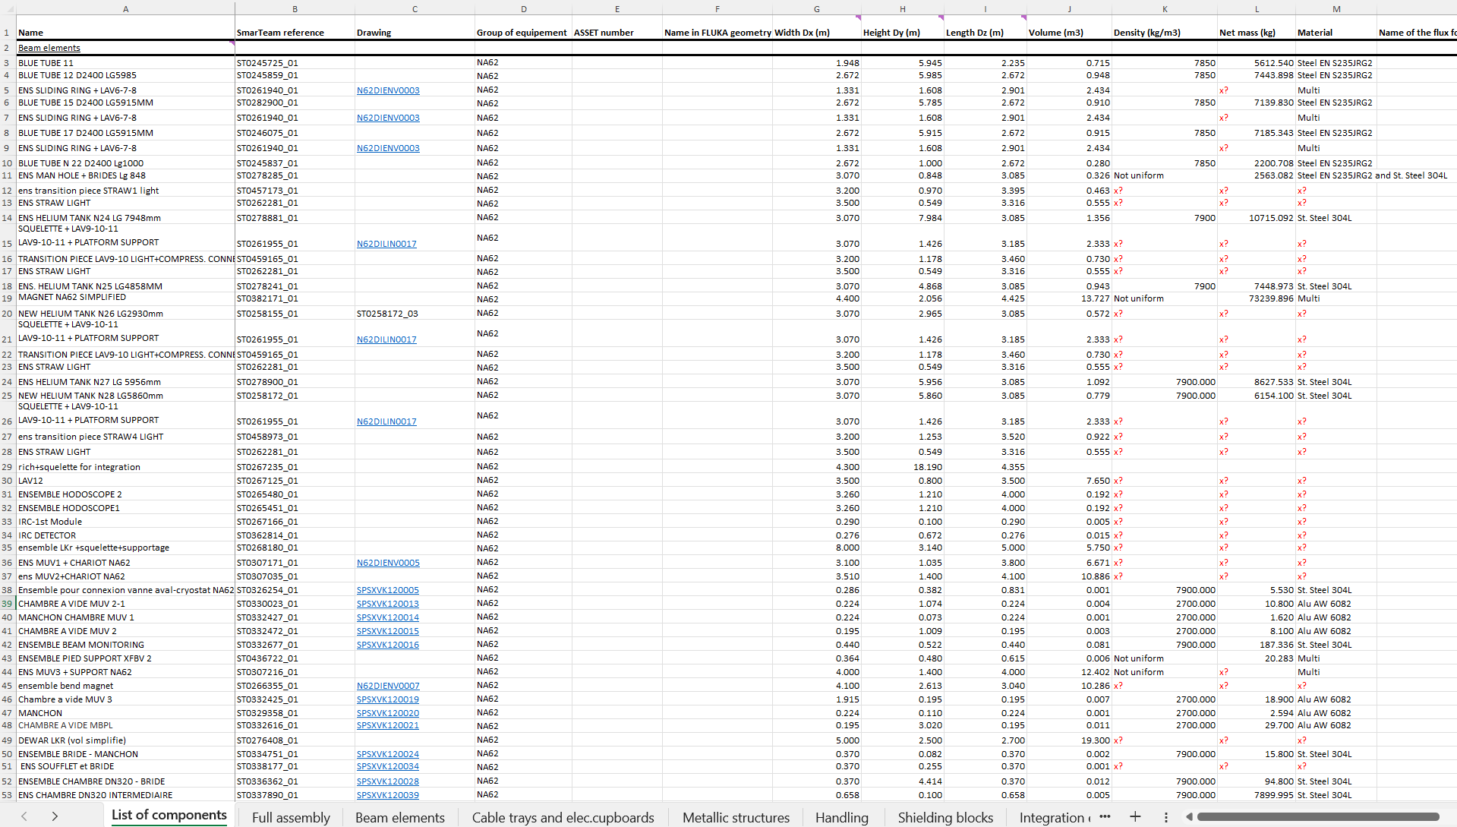
Inventory ECN3
List of all the elements to be dismantled in ECN3
First version of the inventory provided.
Missing some information regarding material and responsibility.
After iteration, a second version will be provided.

