Slide 1
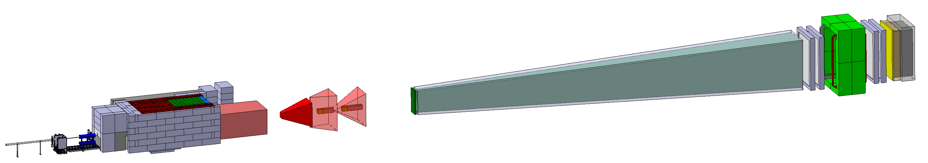
SHIP integration model in ECN3
Pablo Santos Diaz & Richard Jacobsson
HI-ECN3 WP5 coordination meeting (link) / 29-04-2025
CERN, Geneva (Switzerland)

Slide 2
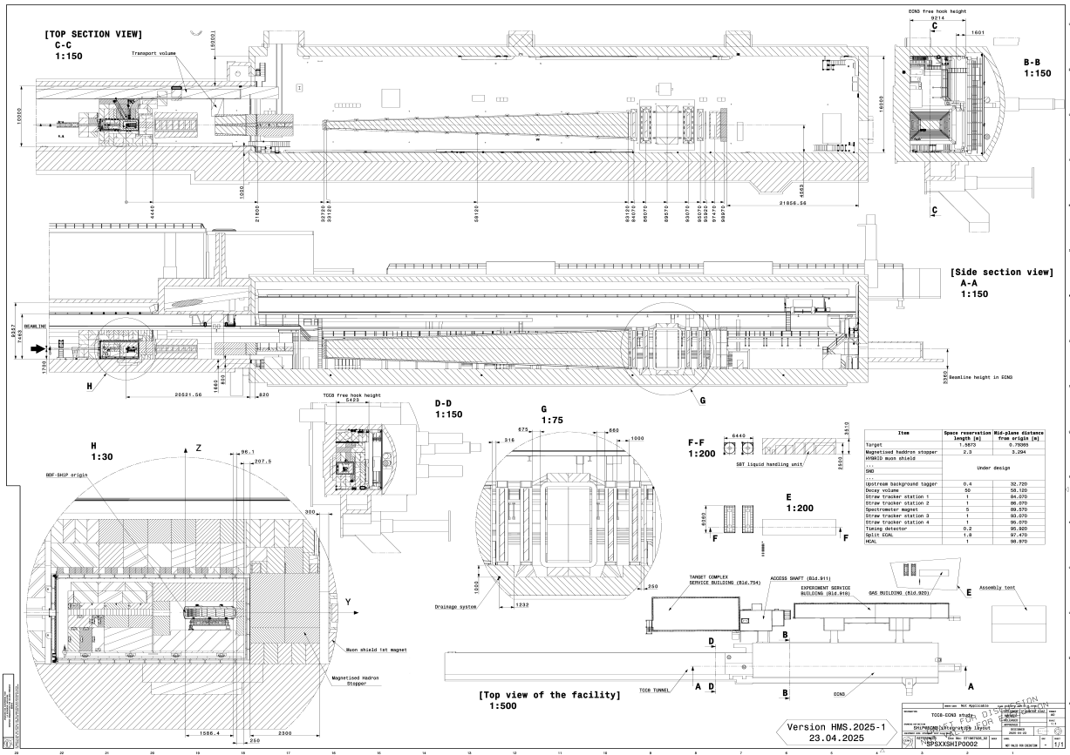
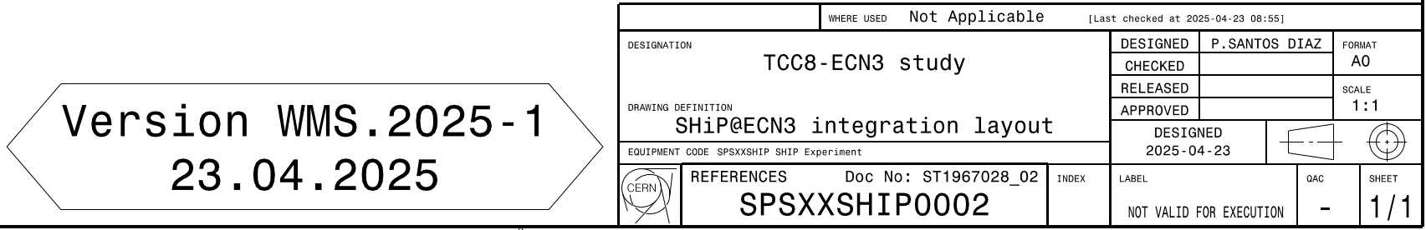
BDF/SHiP@ECN3 layout reference drawing
First version of the BDF/SHiP@ECN3 layout reference drawing with versioning released.
  It can be found in the EDMS 3287817.
The EDMS 3287817 contains:
  Warm Muon Shield configuration layout (WMS).
  Hybrid Muon Shield configuration layout (HMS).
  READ_ME document with the to do list for the
  following version.
  4. Link to the in work Catia version (SPSXXSHIP0002).
MINOR REVISION
MAYOR REVISION
Hybrid Muon Shield
configuration
Year version
Drawing reference code
Released
date

Slide 3
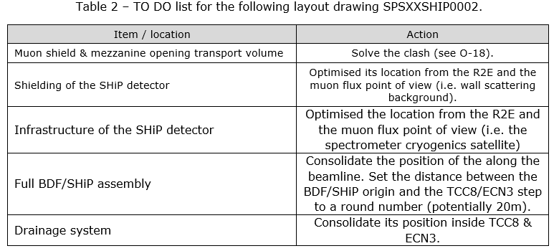
Muon shield & opening transport volume clash
Priority
A
B
C
D
E

Slide 4
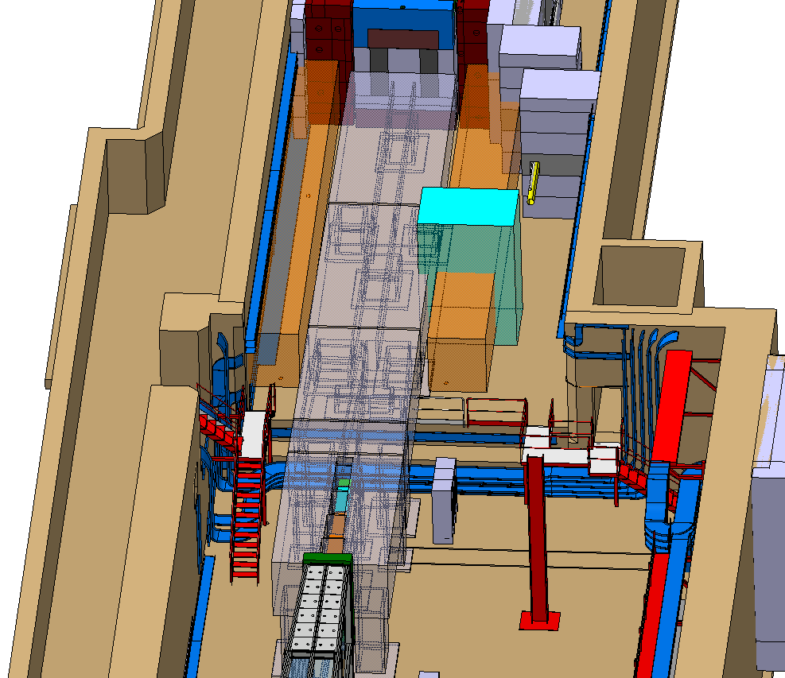
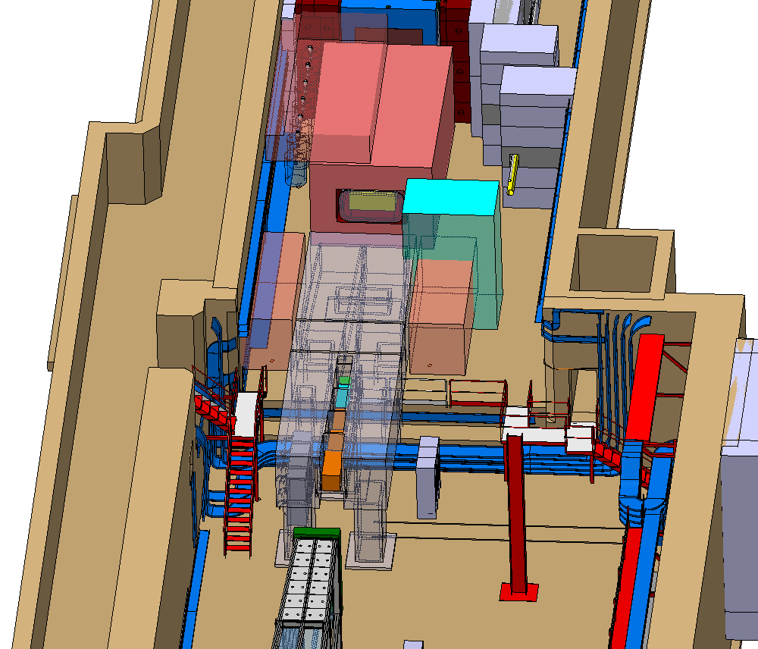
A. Muon shield & mezzanine transport volume clash
WARM muon shield
configuration
Cold heads space reservation above the magnet
HYBRID muon shield
configuration
Mezzanine transport volume
Power supplies
Space reservation for muon detector insertion
Compressors

Slide 5
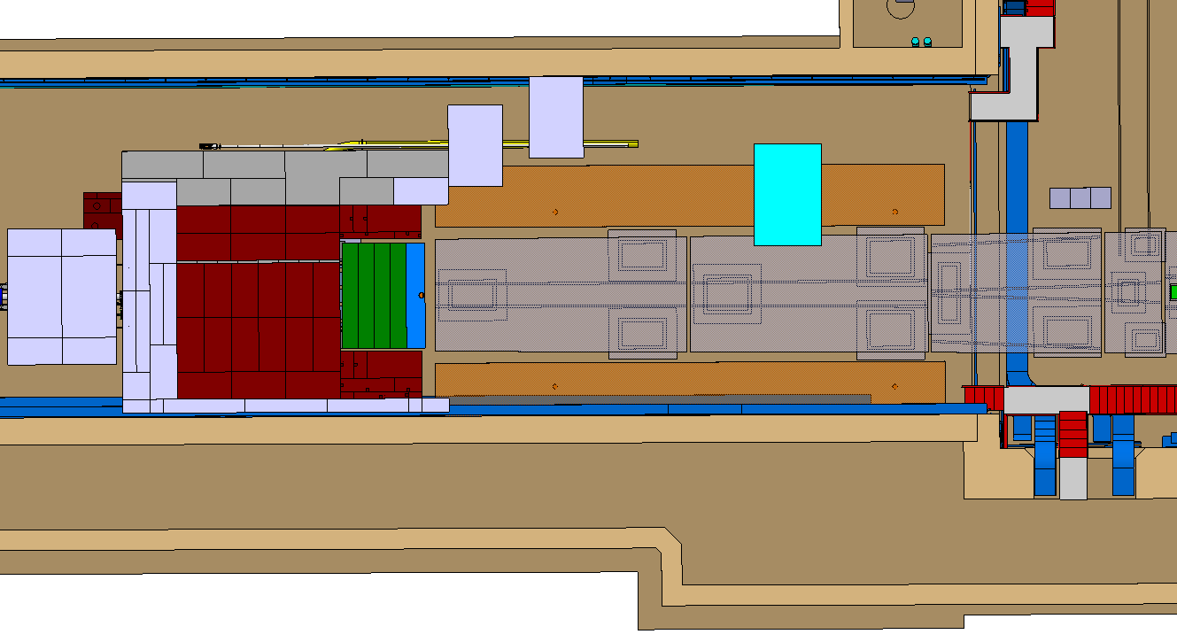
A. Muon shield & mezzanine transport volume (top)
Cable trays on the Salève wall to be removed and services rerouted.
300mm clash between the
mezzanine transport volume and
the muon shield magnet.
  Both in hybrid & warm
  option.
WARM muon shield configuration

Slide 6
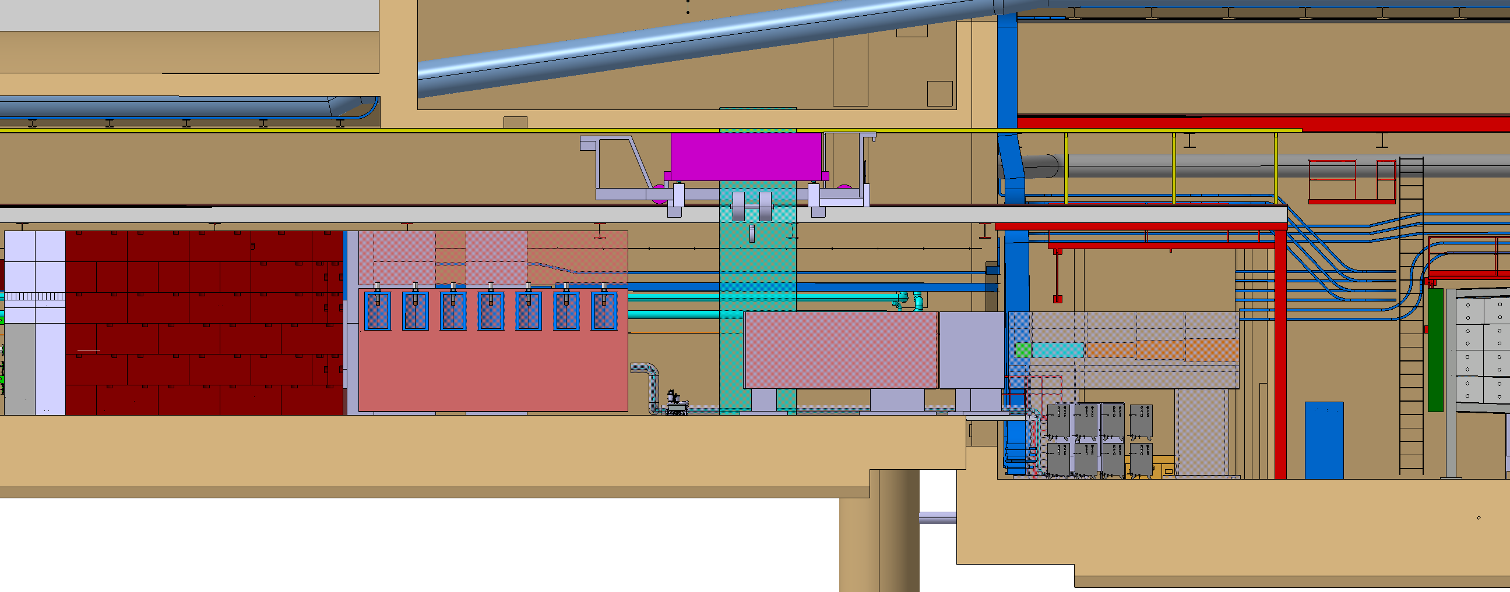
A. Muon shield & mezzanine transport volume (side) II
Integration crowded at the step.
Target services to be integrated.
HYBRID muon shield configuration

Slide 7
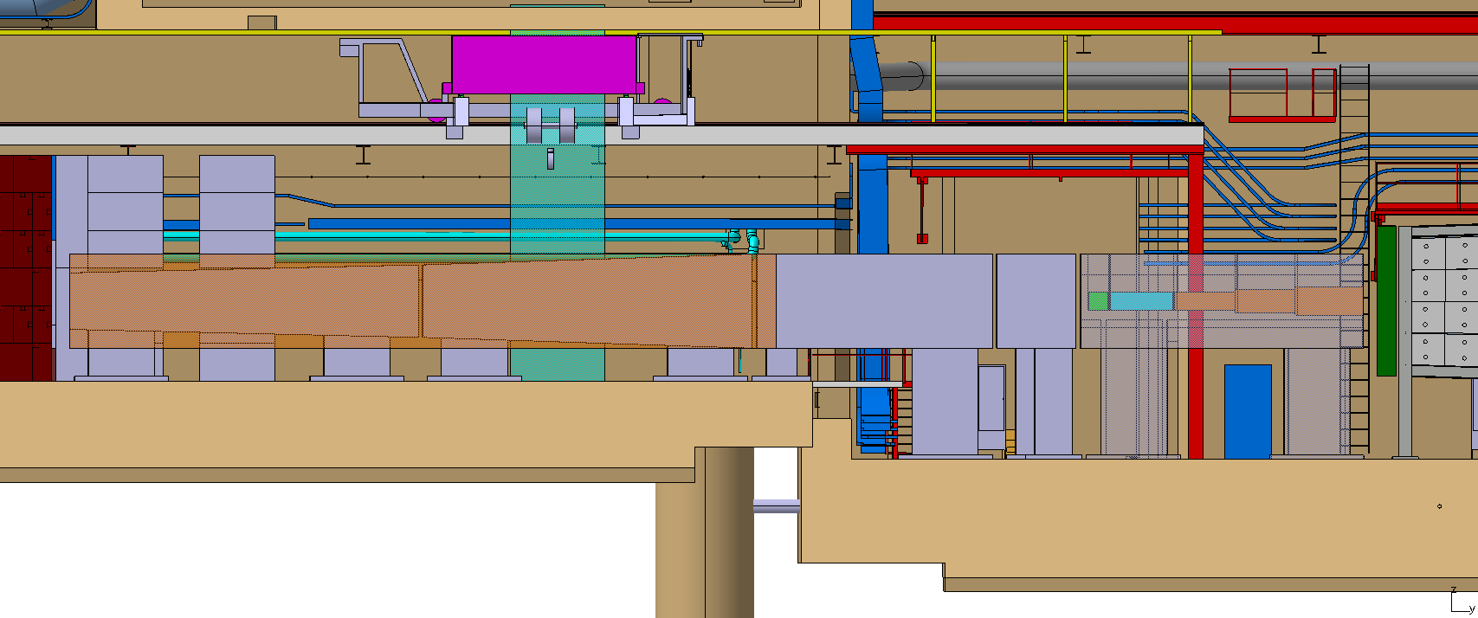
A. Muon shield & mezzanine transport volume (side)
Can the ECN3-TCC8 step support a magnet foot?
Is the TCC & ECN3 joint completely rigid?
If a magnet is supported on both sides, do we need an alignment system/mechanical decoupling to compensate future ground movements?
WARM muon shield configuration

Slide 8
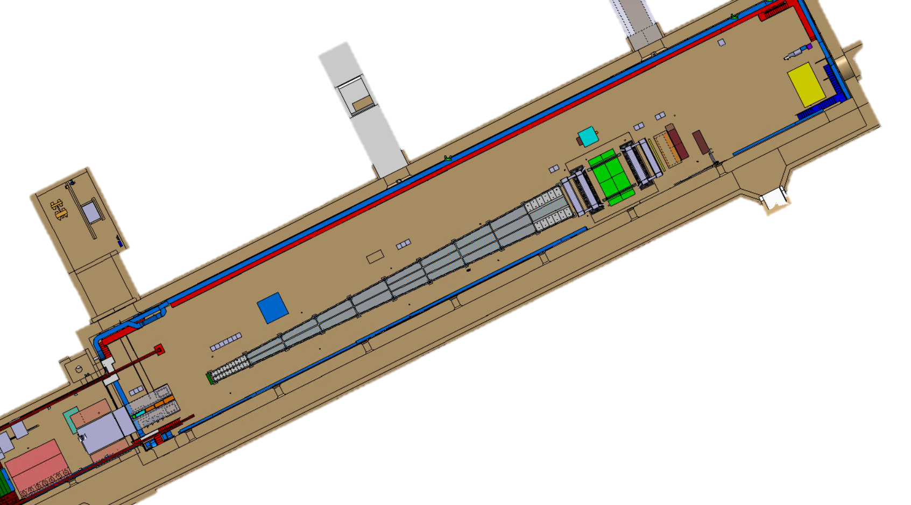
B. SHiP shielding and C. Infrastructure
Location of the shielding and infrastructure to be located wisely depending
on the R2E map.
SHiP to identify the safe infrastructure location along TCC8
& ECN3 and where shielding is required.
Need discussion with R2E
team to set up the dose study at
different heights.
Cryo satelite
Front end electronics
Compressors
Power converters
Power supplies
Helum purification plant
Cold heads
Compressors
HYBRID muon shield configuration

Slide 9
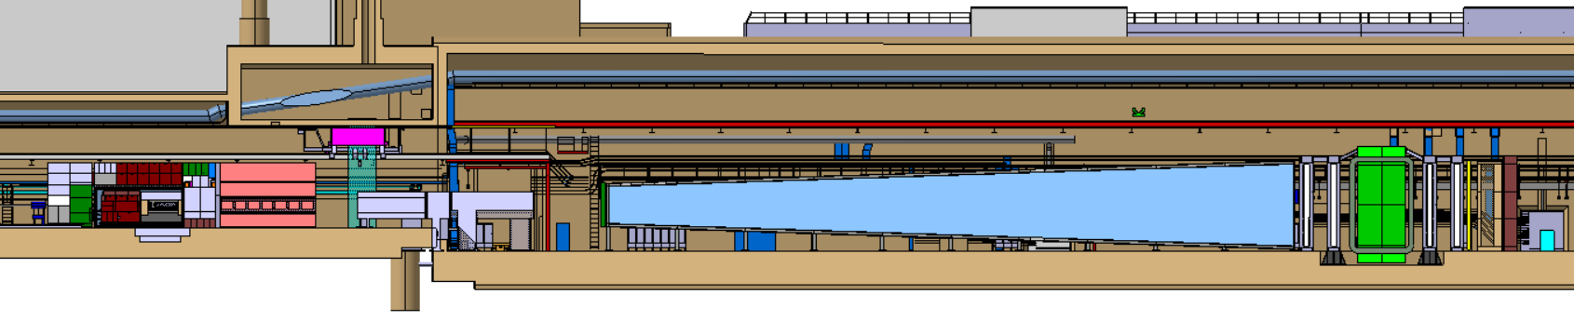
D. Full BDF/SHiP assembly
Movement of the full target complex & detector to make muon shield section 1-2 transition to coincide with the step & set a round number (potentially 20m) in the distance between the BDF/SHiP origin and the TCC8-ECN3 step.
20.517556mm
muon shield section 1-2 transition
BDF-SHiP origin

Slide 10
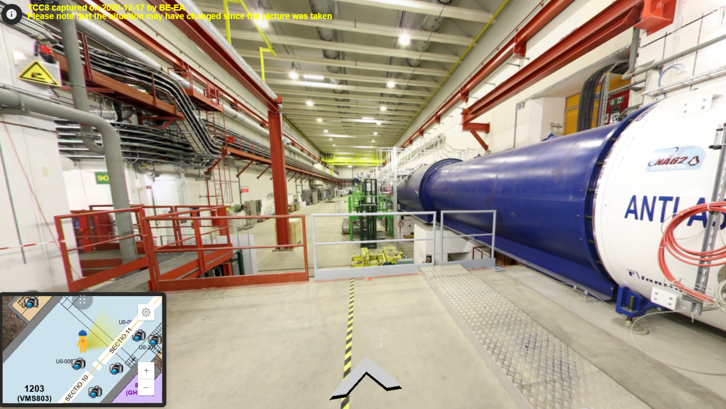
Miscellaneous
E. Draining system location confirmation.
Desired as-built integration:
  918.
  920.
  ECN3/TCC8 side cavern.
  TCC8/ECN3 service galleries.
  ECN3 CV mezzanine.
Tent:
  Ok for option 1 but, where is the storage space
  outside the tent?
Transport:
  Review of the transport rails and crane locations in ECN3 (duplicated model).
  Support of the TCC3 crane rail extension on the Salève wall missing end.

Slide 11
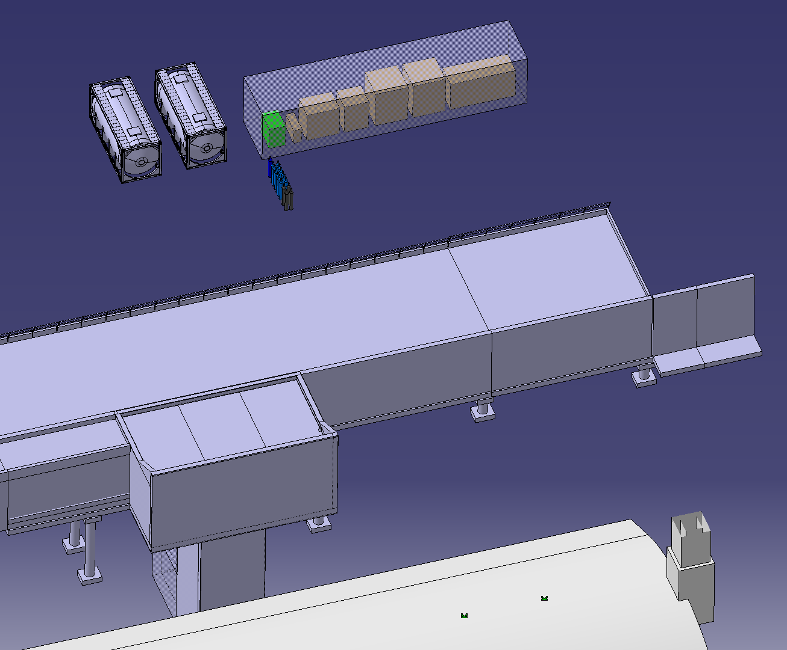
920 rough integration
Borexino Module 0
Tank stirrer
Tank heater
Very first volumes integration.
Optimisation to be done.
Visit with SBT team & CE on 9th of May.
  Everyone interested in welcome to join.
Trench exit towards ECN3
Pumping station
Helium storage gas system
Intermediate buffer tank
Nitrogen gas system
Service building 918
ECN3

Slide 12
Thank you very much for your attention!

