Slide 1
TT7 Shielding Recovery
Tamara Bud (SCE-SAM-FS)
24/04/2025

Slide 2
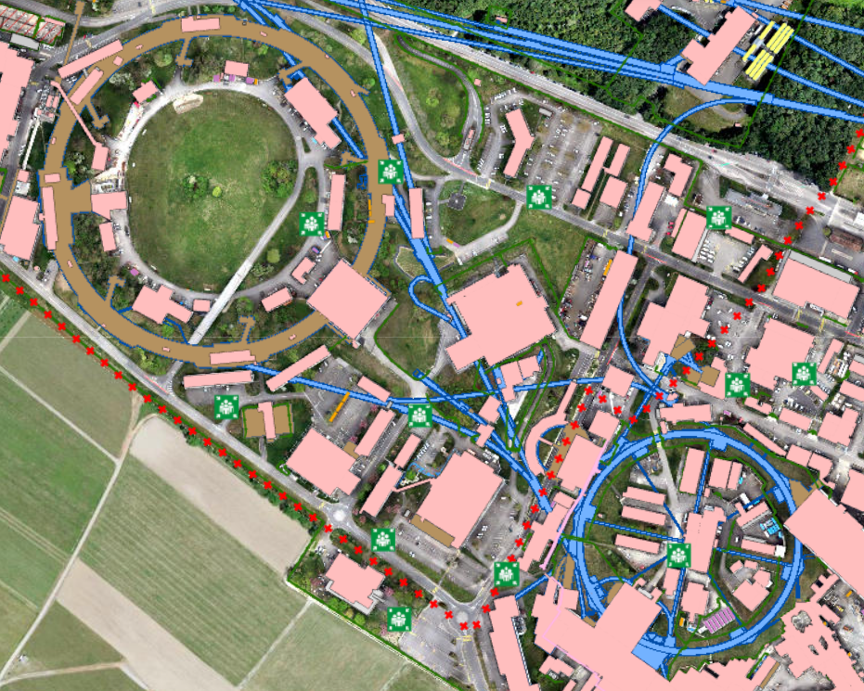
Site Placement
TT7 Buried Shielding

Slide 3
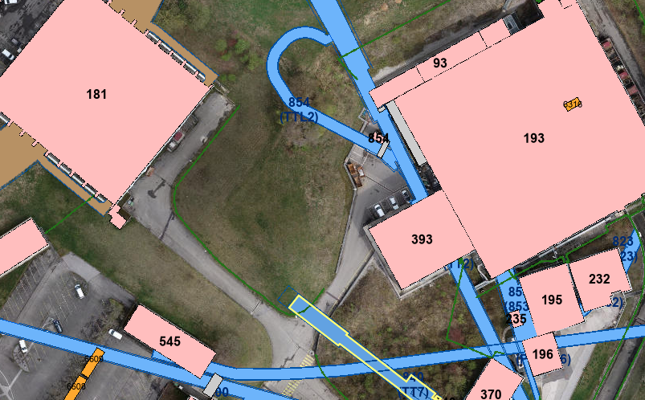
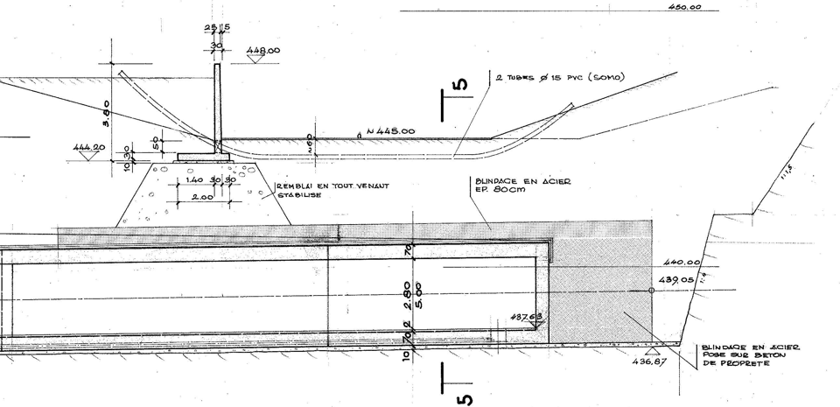
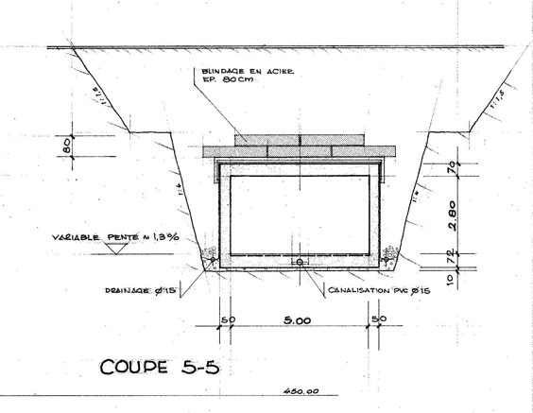
Existing situation
Existing shielding
+448
TT7
+445

Slide 4
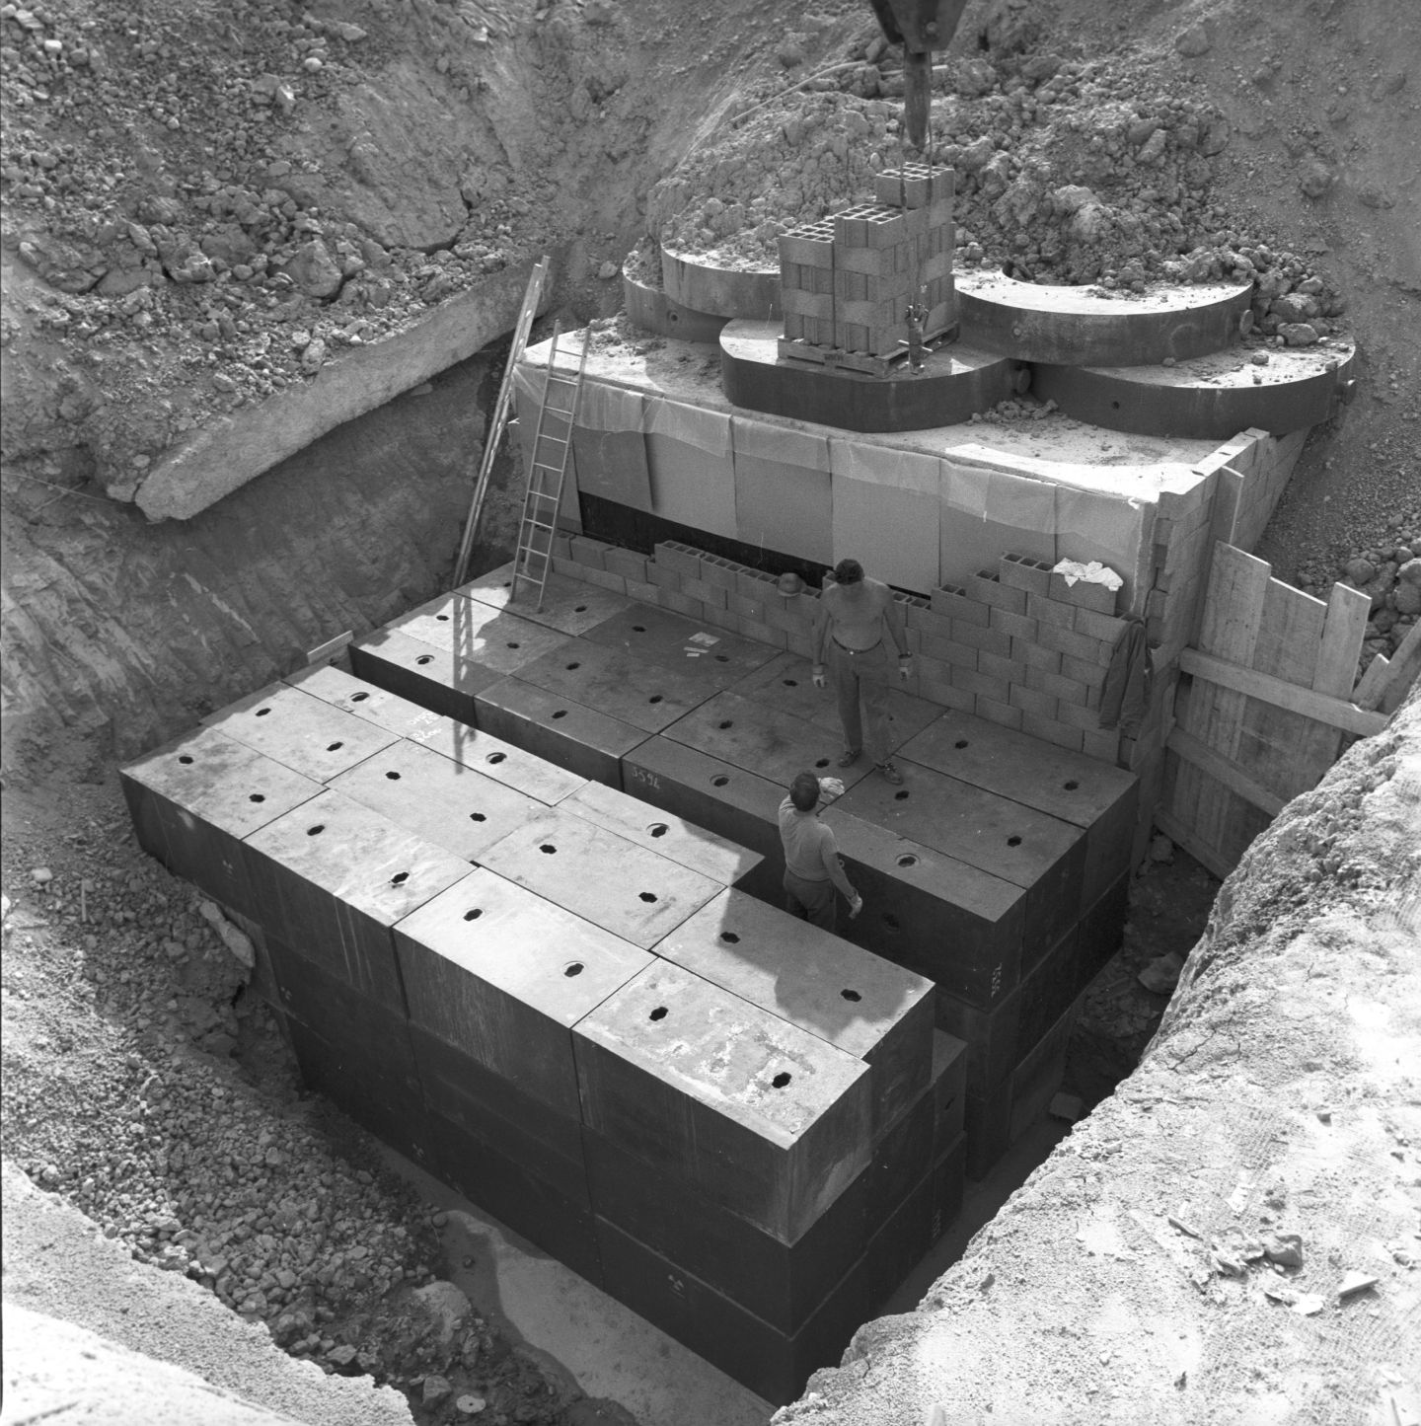
Shielding to be Removed
Cast Iron Block.
  Height 4m
  Length 4m
  Width 6.4m
Dimensions
  1.6m x 0.8m x 0.8m (7.5t) – 52 blocks (390t)
  1.6m x 0.8m x 0.4m (3.8t) – 56 blocks (213t)
  1.6m x 0.8m x 0.2m (1.6t) – 24 blocks (39t)
  0.8m x 0.8m x 0.2m (0.8t) – 131 blocks (105t)
Located on top of the tunnel
  Diameter 2.5m x 0.4m (14t)
Total : 263 blocks to be removed

Slide 5
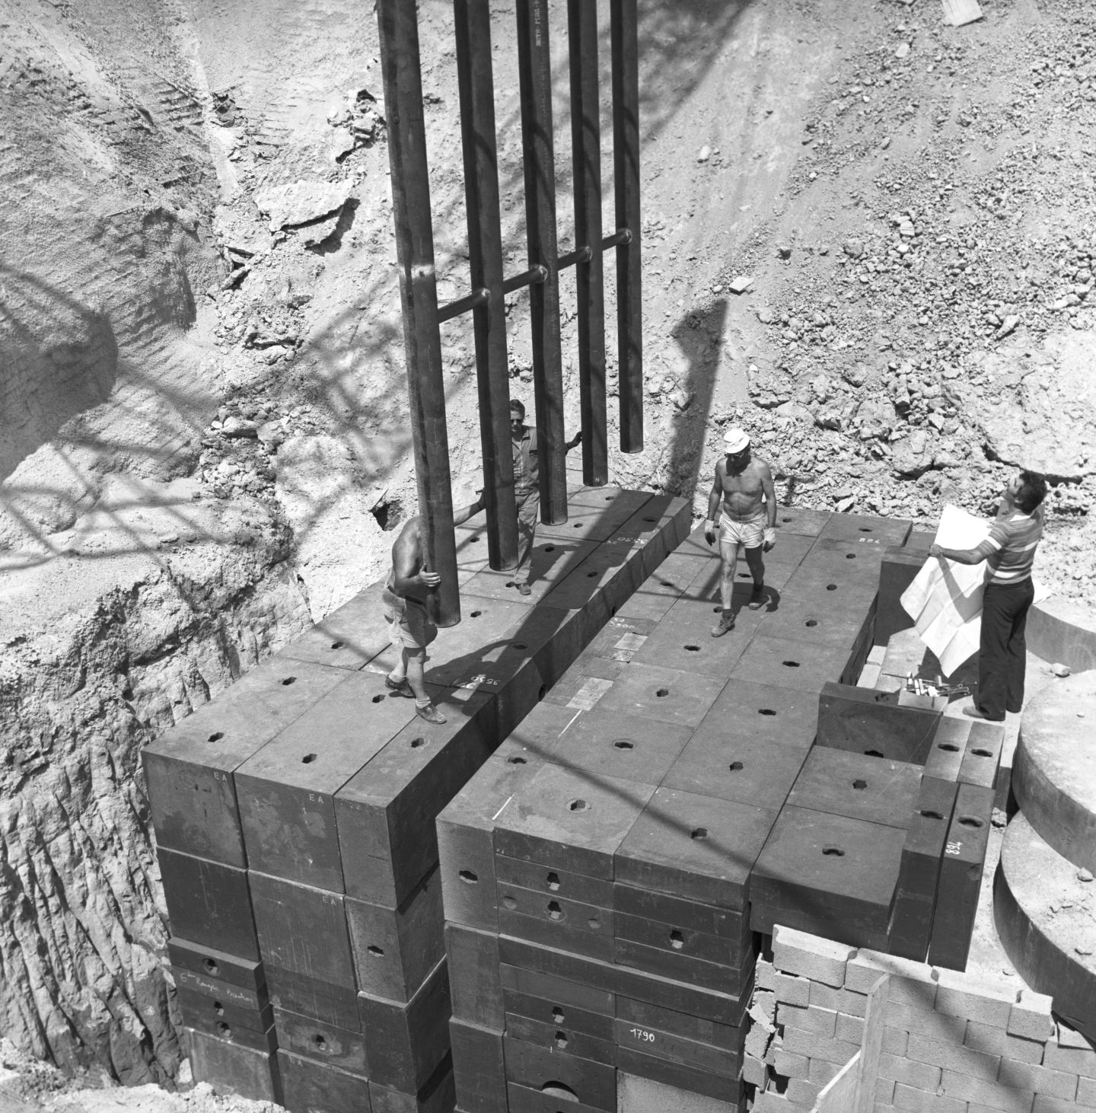
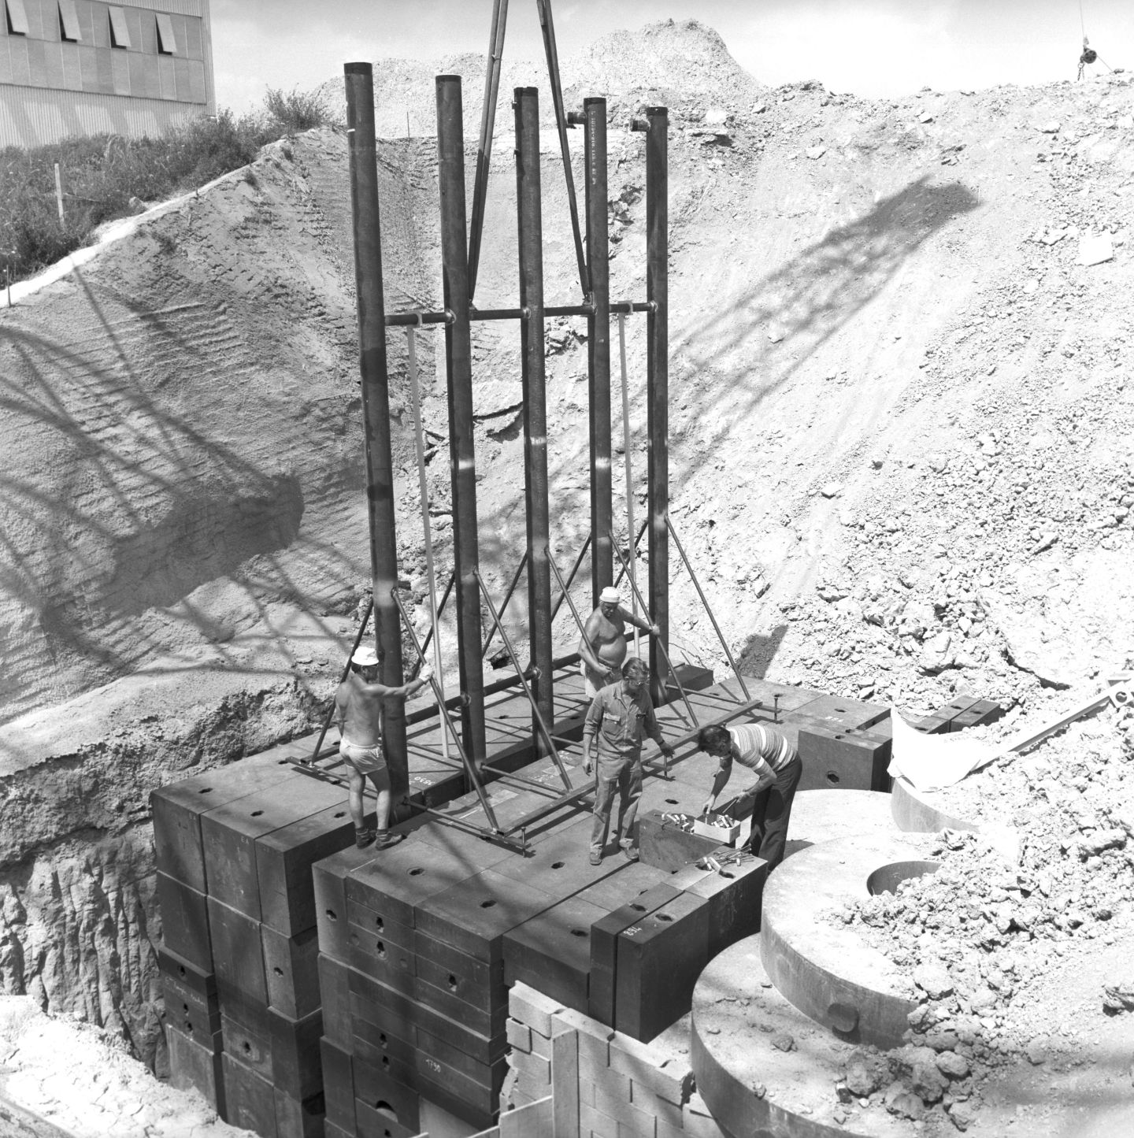
Shielding Placement - Historic

Slide 6
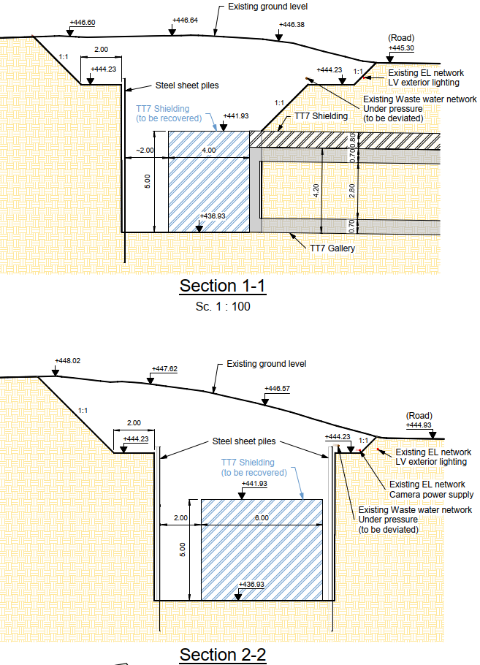
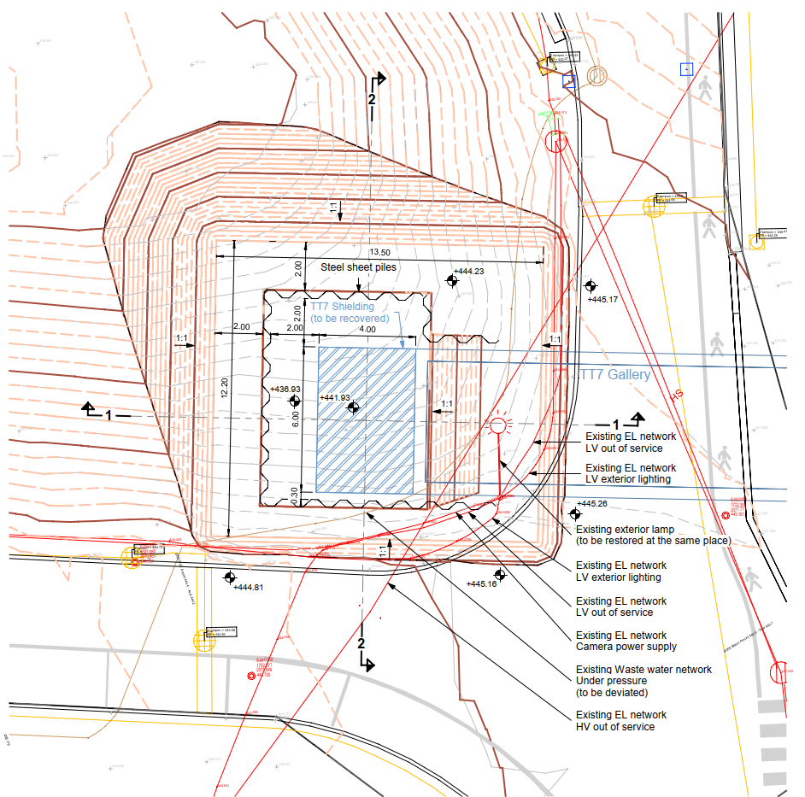
TT7 Shielding Recovery
Civil Engineering works
Shielding on the top to be kept in place

Slide 7
Updated Timeline – April 2025

Slide 8

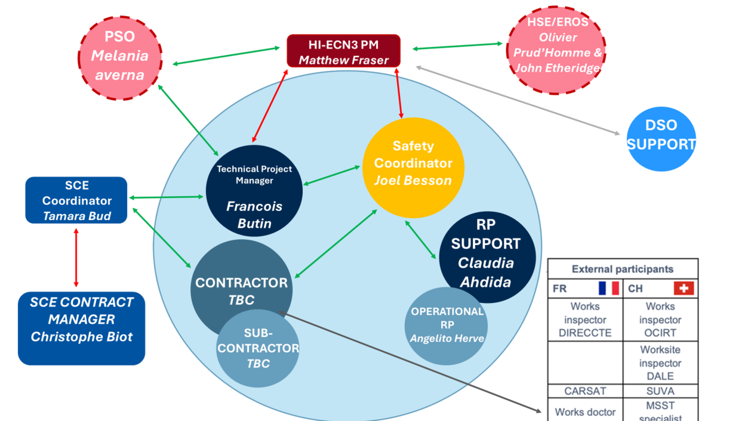

Slide 9

TT7 Shielding Recovery
Procurement updates
All works will be carried out by Contractor Marti, pending return of offer from Marti and contract signature
Marti are the existing framework contractor for the CERN civil works
They will carry out the preparatory works (network diversion, terracing of hill) followed by the “special works” of the excavation of the blocks
No need for a tender process as a result, timeline could be advanced to complete the special works by end of July

Slide 10
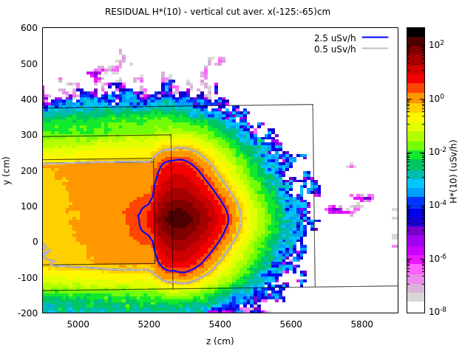
TT7 Shielding Recovery
Radiation & Environmental Protection
Radiation protection is managed by HSE-RP
The residual dose rates in the soil and most of the dump are below the 0.5 µSv/h limit of a Non-designated Area with permanent workplace.
Nonetheless, RP precautions will include:
CERN RP may order work to be interrupted in the event of rain, and excavation covered by waterproof tarpaulin
Soil found to be contaminated will be stored on a platform close to the excavation, with tarpaulins placed above and below the soil before it is returned to the excavation after the blocks have been removed
To protect the environment from contamination related to construction, a gully and sump will be installed and water treatment and neutralisation system will be provided before discharge

Slide 11
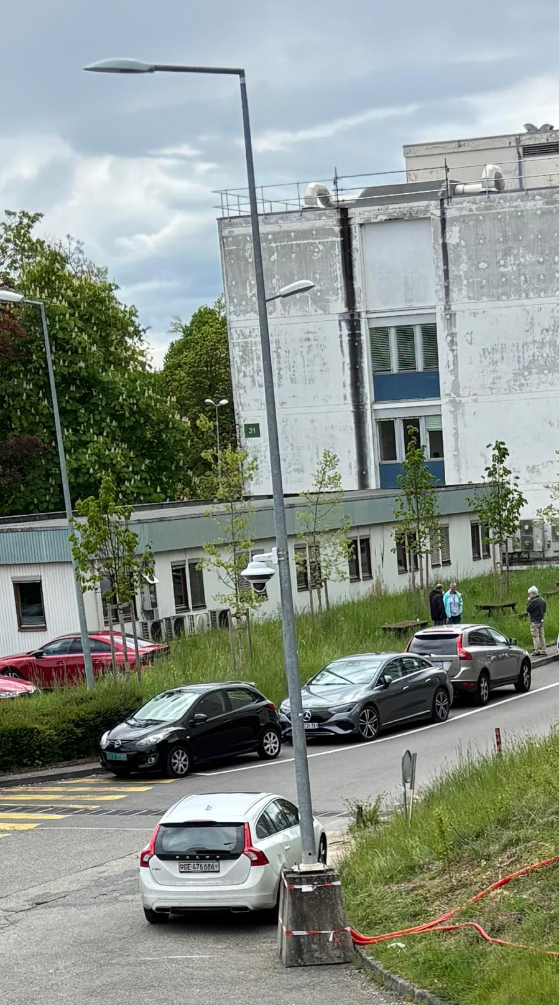
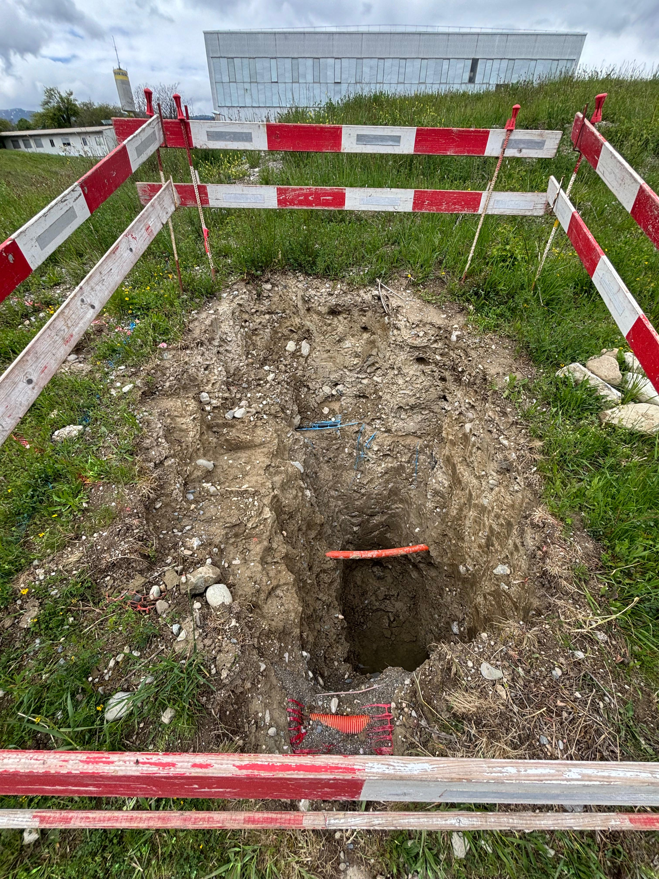
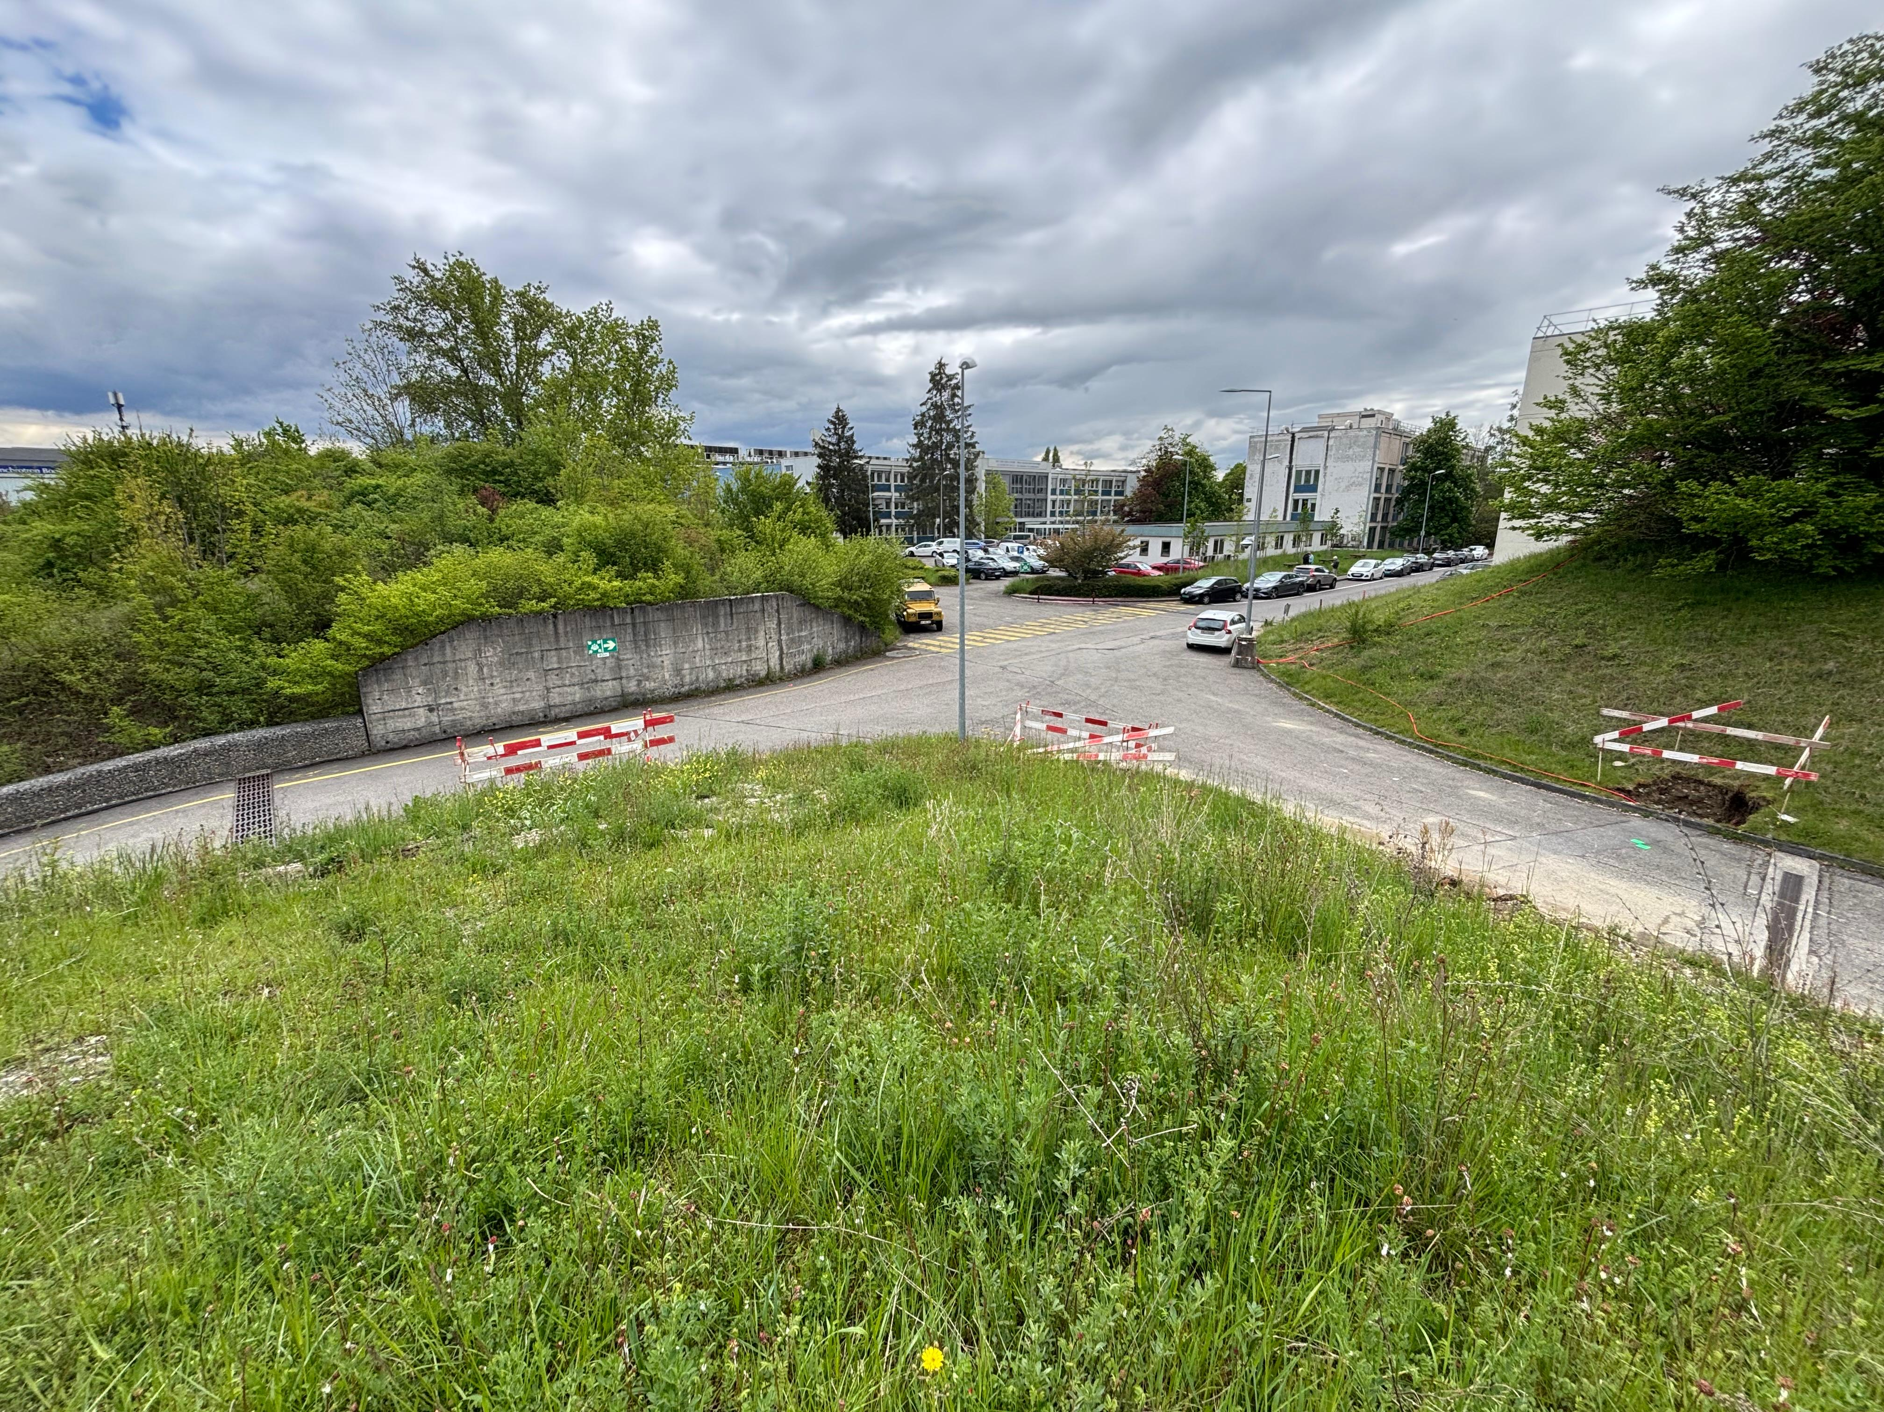
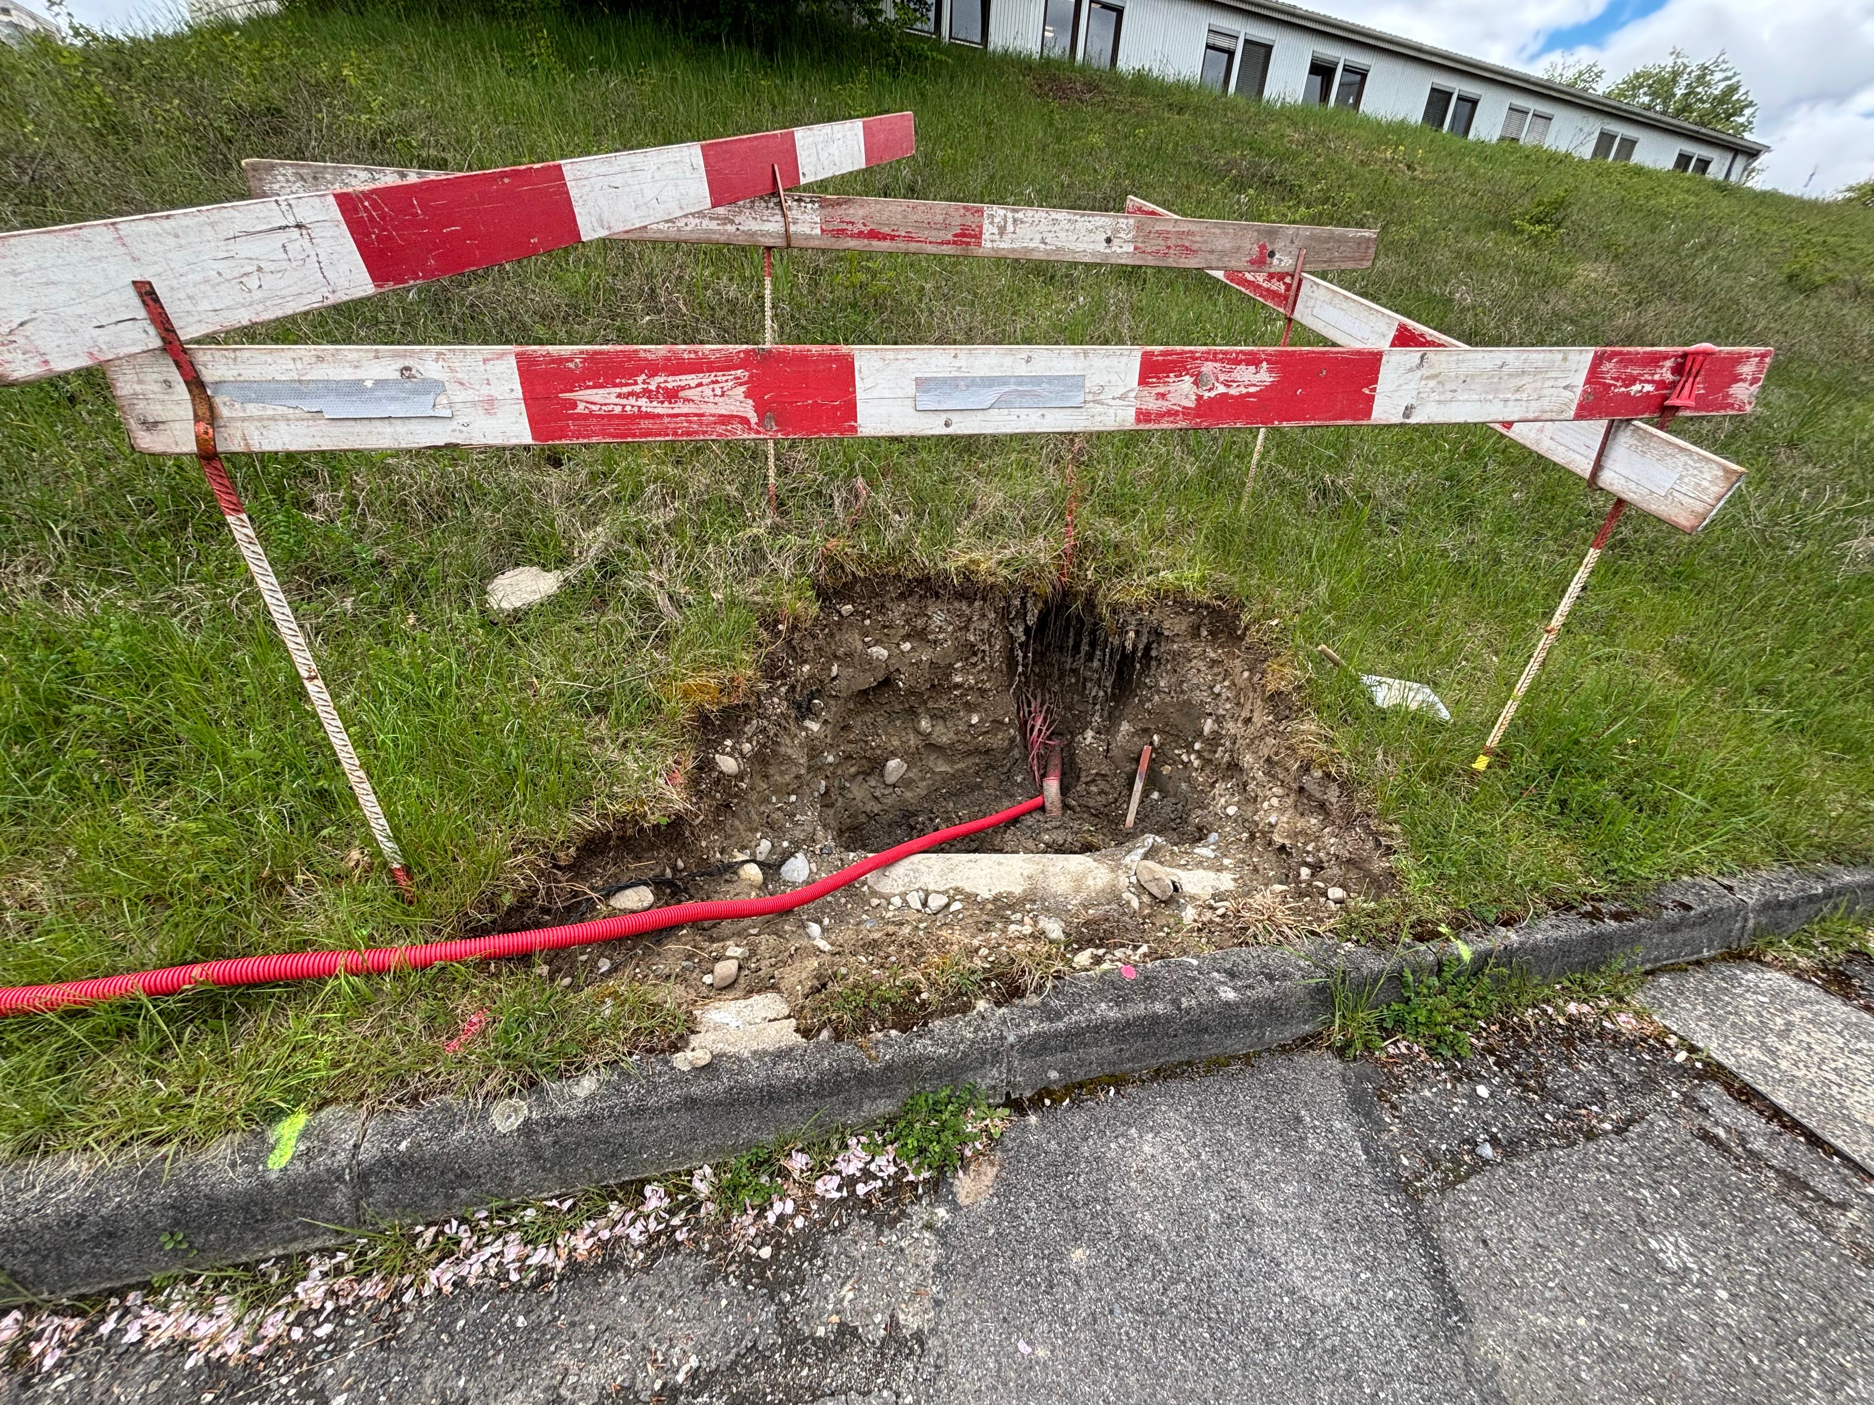
TT7 Shielding Recovery
Worksite Updates

Slide 12
Thank you for your attention !

