Slide 1
Supply of a 3 T Solenoid Magnet System for the
ISOLDE Experiment
Strat-up meeting 15/04/2025
Susana Izquierdo Bermudez

Slide 2

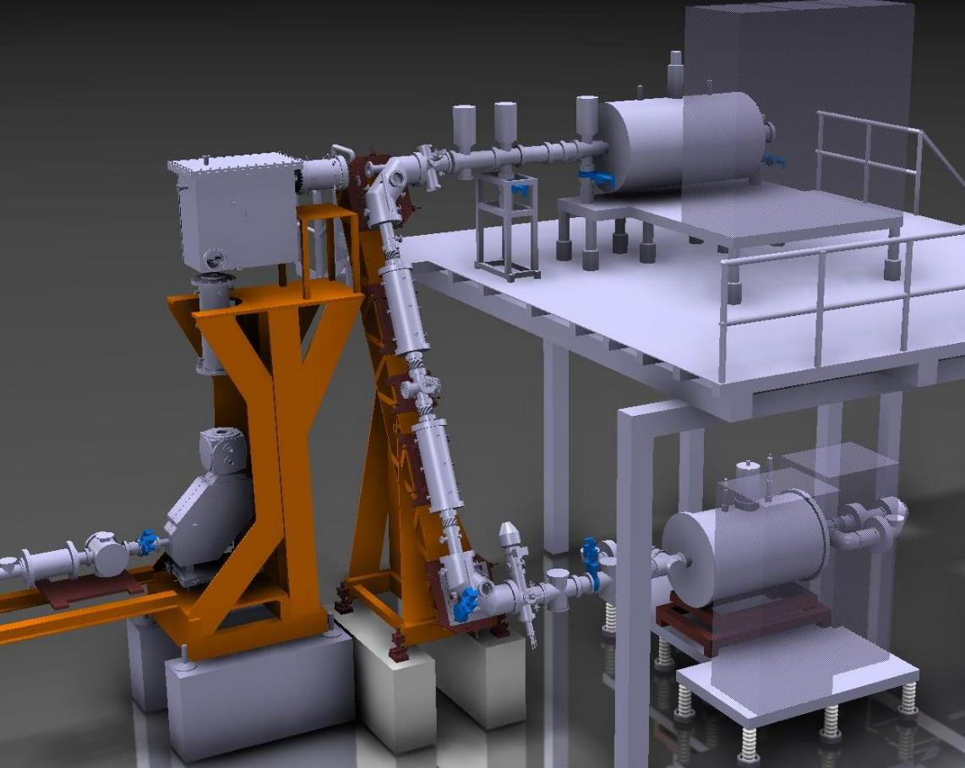



The REXTRAP solenoid in ISOLDE facility
Beamline
REXTRAP solenoid
30 kV HV platform

Slide 3
Consolidation of the REXTRAP Solenoid
Purpose: Guarantee operation of ISOLDE in case of failure of the existing REXTRAP solenoid, which is essential for the operation of the trap and the production and cooling of ISOLDE.
  For details, see approved CONS request EDMS1552257
Deliverable: superconducting solenoid system to be operated at 3 T (horizontal field) at 4.3 K, including Cryostat and ancillaries
  The 3 T solenoid system will be a spare of the existing REXTRAP solenoid operating in ISOLDE Facility at CERN.
  The present 3 T magnet system has been running in persistent current mode since October 1997. The entire system is mounted on a 30 kV high voltage platform.
  The new solenoid will be maintained as a spare, ready to replace the original magnet should it fail. To ensure seamless integration, the new system must be fully compatible with the existing setup and constraints, including its installation and operation in a 30 kV platform. This compatibility is essential to enable rapid deployment and minimize downtime.
Department request: 10959307

Slide 4
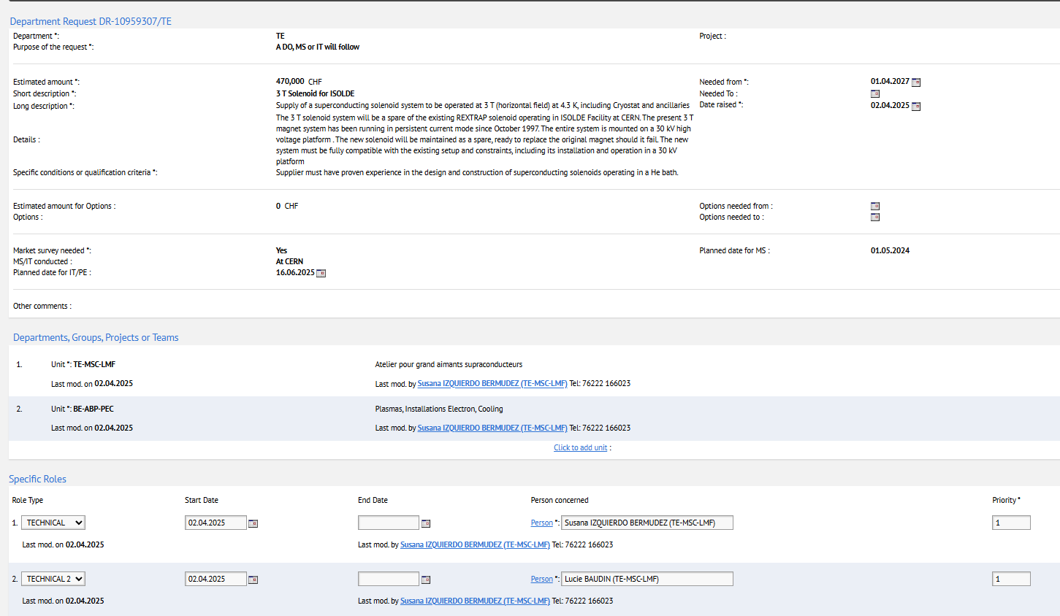
Department Request
  Estimated cost for the full system is 470 kCHF, as estimated in the CONS request (EDMS1552257)
  TE-MSC is leading the procurement of the solenoid
    Susana Izquierdo Bermudez (TECH1)
    Lucie Baudin (TECH2)
  TE-CRG is giving support for the cooling system (Torsten Koettig and Johan Bremer)
  Fredrik Jon Carl Wenander (BE-ABP) is setting requirements for ISOLDE facility

Slide 5
Technical deliverables
One superconducting solenoid magnet that can provide a horizontal operational magnetic field of 3 T in a 120 mm room-temperature aperture, operating in persistent mode with a standalone holding time of 48 h in case of absence of electrical power.
One associated Cryostat with a helium line for pre-cooling.
A bath cooling system based on cryocooler.
Main Magnet Power Supply matching solenoid characteristics and if required, auxiliary Power Supply for additional shim coils.
All needed auxiliary equipment including, but not limited to, demountable current leads for the connection for the solenoid to the Power Supply, passive or active shim coils including the leads and power supply, magnet support and its integration within the Cryostat.

Slide 6
Activities
On the Contractor’s site:
  Design of the full 3 T magnet system including solenoid, cryostat, cooling system, ancillaries and calculation of the field homogeneity;
  Integration of the solenoid magnet, cryocoolers and other components within the Cryostat;
  Factory Acceptance Test (FAT) including field homogeneity profile measurements;
  CE marking of the Supply;
  Packing, and shipping if requested;
On the CERN site:
  Verification of the proper installation of the magnet system and carrying on commissioning activities on CERN site with support of CERN personnel;
  Performing Site Acceptance Tests (SAT) at CERN by Contractor’s qualified personnel and with CERN support;
  Training of CERN personnel.
Target:

Slide 7
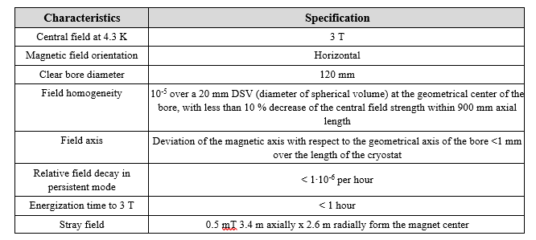
Technical requirements: Solenoid
The 3 T solenoid magnet shall generate 3 T horizontal field. The magnet shall be positioned at a 30 kV platform, feature a Hall probe and comply with the following characteristics and performance requirements listed in Table 1. The Field homogeneity and Field axis should be reproducible after de- and re-energization of the system, i.e. no mechanical adjustment nor magnetic field measurements are required after each cycle.

Slide 8
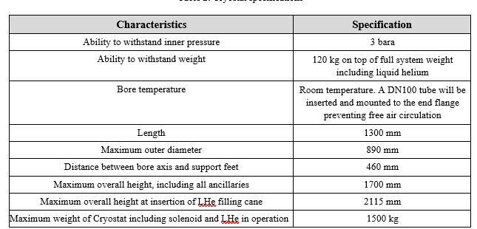
Technical requirements: Cryostat
The Cryostat hosting the magnet shall be positioned at the 30 kV platform. It shall be equipped with adequate cryogenic instrumentation for its operation (e.g. temperature sensors, controllers, heaters and He liquid level sensors). The Cryostat shall comply comply with EN 17527 for Helium cryostats.

Slide 9
Technical requirements: Cooling System
The cryostat should be designed as a Zero boiloff system with a cryocooler recondensing the evaporated helium.
The initial cooldown should be possible via the LHe transfer supply line with sufficiently large He return line cooling the thermal shield.
A temperature controller needs to allow the setting of the He system pressure to be 10 mbar higher than atmospheric pressure.
In case of a power cut, the magnet shall be able to run in superconducting stage for at least 48 hours.
The Cryocooler and all electrical connections (including instrumentation) shall be electrically insulated from the cryostat which is at 30 kV

Slide 10
Technical requirements: power supply and protection
The Magnet Power Supply shall be used to power the solenoid up to its operating field (3 T).
The Magnet Power Supply can be manually controlled and shall allow the solenoid to be powered up to maximum operating field in less than 1 hour. The
Protection Circuits shall protect both solenoid and Magnet Power Supply during ramping.
Once charged, the solenoid is intended to be operated in persistent current mode and with the power supply disconnected. The magnet shall be protected during operation.
A switch heater supply should be provided.

Slide 11
Target schedule
Invitation to Tender issued in Q3 2025 with the subsequent Contract scheduled to be awarded in Q4 2025 or Q1 2026.
The Supply shall be delivered to CERN, installed and commissioned within 18 months after the entry into force of the Contract.

Slide 12
List of firms propose by MSC
WELL BALANCED
FIRM | COUNTRY
ASG superconductors | IT
POORLY BALANCED
FIRM | COUNTRY
TESLA | UK
Scientific Magnetics | UK
Oxford instruments | UK
BNG Bilfinger | GE
Bruker | GE
Danfysik | DK
Bluefors | FI
Cryogenic Ltd | UK
ELIGIBLE FOR LIMITED TENDERING
FIRM | COUNTRY
Jastec Superconductors | Japan
Cryomagnetics | USA
American Magnetics | USA

