Slide 1
Modern tools for simulation and analysis: Geant4, ROOT
P.Hristov
30/09/2011
ISTC-CERN-JINR Summer School
on High Energy Physics and Accelerator Physics

Slide 2
Outlook & References
Data processing and reconstruction, analysis
  J. Boyd, “From raw data to physics”
  https://indico.cern.ch/conferenceDisplay.py?confId=134618
Analysis
  D.Glenzinski, “Physics and Analysis at a Hadron Collider - An Introduction”
  https://indico.cern.ch/conferenceDisplay.py?confId=77805
ROOT
  J.F. Grosse-Oetringhaus, “Introduction to ROOT”
  https://indico.cern.ch/conferenceDisplay.py?confId=134329
Geant4
  J. Apostolakis, “The Geant4 Toolkit: Evolution and Status”
  http://bit.ly/g4mc2010
  U.Penn Geant4 Tutorial (full week)
  http://geant4.slac.stanford.edu/UPenn2011/Agenda.html
  D. Oxley, “An Introduction to Geant4”
  https://ns.ph.liv.ac.uk/~dco/Lectures/An_Introduction_to_Geant4_pdf.pdf

Slide 3
Abbreviations
ECS – Experiment Control System
DCS – Detector Control System
TRG – Trigger
DAQ – Data Acquisition System
CDB – Conditions Data Base
RAW – Raw Data
CALIB – Calibration Procedures
ALIGN – Alignment Procedures
RECO – Reconstruction Procedures
ESD – Event Summary Data
AOD – Analysis Object Data
HITS – Simulated energy deposition at given location and time + MC truth
DIGI – Digitization Procedures
  From analog signal to digital representation
MC truth – the characteristics of the simulated particle and/or “labels” to navigate back to the array of simulated particles

Slide 4

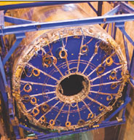
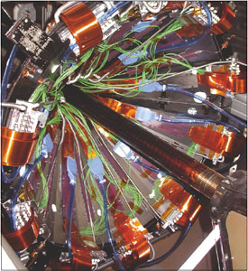
Raw (“Real”) Data Processing
DCS
CALIB
TRG
CDB
ECS
ALIGN
HTL
DAQ
RAW
RECO
ESD

Slide 5
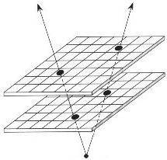
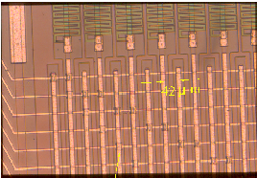
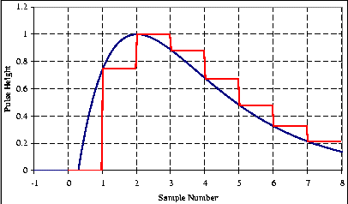
Data reduction/abstraction
particle
y
detector
element
x
Digitization/
Reconstruction --->
helix
(R, d₀, z₀)
Track finding +
Track fit --->
hits
(x₁,y₁,z_{1,} t₁)
(x₂,y₂,z_{2,} t₂)
...
Magnetic field B:
reconstruct
Event 1
p_{x}
p = p_{y}
p_{z}
Event 2
Track 1
Store the
info for every
event and
every track
<-------
Analog signals
Track 2
Track momentum

Slide 6
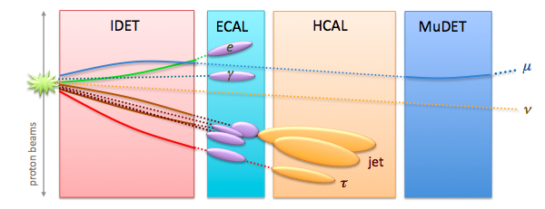
Reconstruction
Detector reconstruction
  Tracking : global methods (Hough transform, combinatorial, etc), local methods (Kalman filter)
    finding path of charged particles through the detector
  Calorimeter reconstruction: clusterization algorithms
    finding energy deposits in calorimeters from charged and neutral particles
  Particle identification: dE/dx; transition radiation; E/p; Cerenkov angle, etc.
Combined reconstruction
  Track/cluster matching
  Electron/Photon identification
  Muon identification
  Jet finding
Calibrations and alignments applied at nearly every step

Slide 7
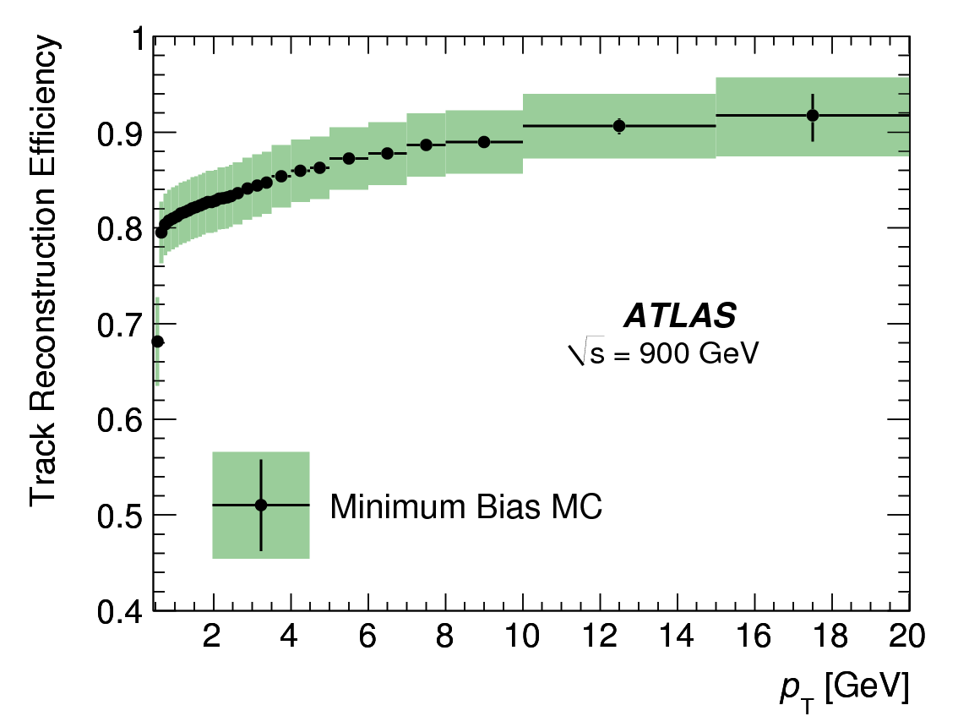
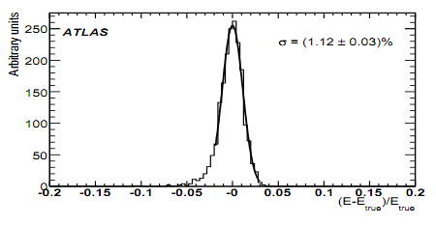
Important figures of merit for reconstructed objects
Efficiency = (Number of Reconstructed Tracks) / (Number of True Tracks)
  how often do we reconstruct the object – e.g. tracking efficiency
Resolution = (Measured_Energy – True_Energy)/ True_Energy
  how accurately do we reconstruct a quantity – e.g. energy resolution
Fake rate = (Number of jets reconstructed as an electron) / (Number of jets)
  how often we reconstruct a different object as the object we are interested in – e.g. a jet faking a electron
For physics analysis it is important
to have high efficiency, good resolution, and low fake rates
to be able to measure the efficiencies, resolutions and fake rates and their uncertainties (not easy)

Slide 8
Resolution: useful expressions
Momentum:
Energy:
Impact parameter:
Examples from CDF & D0
 | CDF | D0
 | 12 | 60 (MeV/c²⁾
 | 2.5 | 6.0 (GeV/c²⁾
 | 3.0 | 3.0 (GeV/c²⁾
 | 16 | 14 (%)
 | 30 | 30 (μm)

Slide 9
Analysis Strategy
Q: What constitutes a complete analysis?
A: A suite of studies which together provide a coherent and thorough description of a particular set of data events
  Should cover all aspects necessary to understand and characterize these events
  Should be well documented via internal notes
  Should be subjected to peer review

Slide 10
Rules of Thumb
Look before you leap
  Plan your analysis strategy carefully even if the analyses are in general more iterative than linear
  Identify those aspects which will drive the sensitivity
  What plots, figures, and tables will be important?
  What data sets will you need?
  What triggers do these data sets use?
  What Monte Carlo (MC) samples will you need?
Trust but verify
  Always ask yourself, “Does this make sense?”
  Know where to find more detailed information if necessary
A stitch in time saves nine
  Sweat the (relevant) details, it will save time in the long run
  When you spot a problem, take the time to understand it

Slide 11
Analysis Basics
Basic inputs to all analyses essentially the same
  Estimate of signal acceptance after all requirements
  Estimate of number of expected background events surviving all selection requirements
  Statistical and systematic uncertainties for each
Basic types of analyses
  Counting experiments (cross sections, BR)
  Determining properties (mass, lifetime)
  Search for something new (small SM σ*BR, new physics (NP))
As you see, we need both “real” data and MC

Slide 12
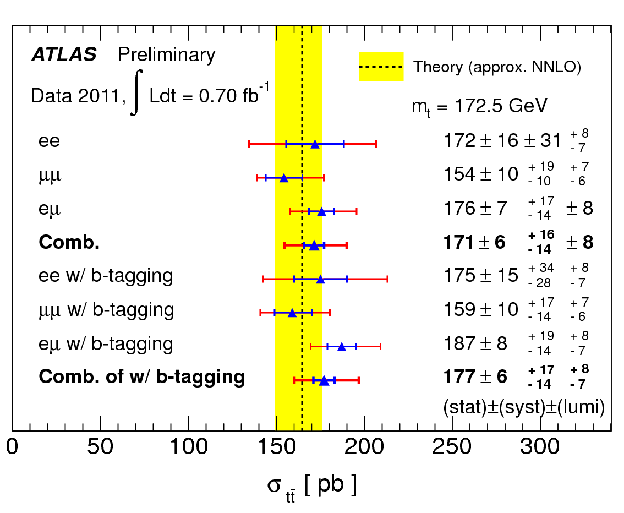
Physics Analysis Steps
~TB
Start with the output of reconstruction
Apply an event selection based on the reconstructed object quantities
  Often calculate new information e.g masses of combinations of particles
  Event selection designed to improve the ‘signal’ to ‘background’ in your event sample
Estimate
  Efficiency of selection
  Background after selection
  Can use simulation for these – but have to use data-driven techniques to understand the uncertainties
Make final plot
  Comparing data to theory
  Correcting for efficiency and background in data
  Include the statistical and systematic uncertainties
~kB

Slide 13
Sensitivity studies (to improve the selection criteria/”cuts”)
You first need to choose a “figure-of-merit” (FOM)
Obvious for measurements
  FOM = minimize the expected uncertainty on the quantity being measured
For searches, a choice needs to be made
Standard FOM are
  Maximize S²/(S+B)
  Minimize expected limit, <Limit>
  Minimize necessary luminosity to achieve a given level of “discovery”, L_{5σ}

Slide 14
Efficiency
We factorized the efficiency into several components
  Used data-driven determinations of efficiency whenever possible (for example the trigger efficiencies)
  Allows some of the work to benefit other analyses since many of the efficiencies are independent of a specific analysis
  Requires some forethought to ensure pieces are consistently defined
  Check the consistency between Data and MC when you estimate efficiencies from MC
Example
  α⋅ ε_{total} = α⋅ ε_{Tracking} ⋅ ε _{Trigger} ⋅ ε _{Vertexer} ⋅ ε _{Analysis}
  αis the geometric and kinematic acceptance

Slide 15
Simulated (“MC”) Data Processing
Event
Generator
Detector
DescriptionGeometry, Materials
CDB
Simulation
Package
(Geant4):
Particle transport
HITS:
E,x,y,z,t
MC truth
Physics
List
DIGI
RAW +
MC truth
RECO
MC ESD

Slide 16
Simulation workflow: Example
Physics simulation
Simulate the physics interaction
(set in the simulation configuration)
Detector Simulation
Simulate the propagation of the electrons through the detector.
Including:
bending in the magnetic field
leaving hits in the tracking detector elements
interacting with the material in the detector
interacting in the calorimeter (detailed description of the EM shower)
Electronics Simulation
Simulate the response of the detector elements to the ‘hits’ from the electron.
Simulate the voltage pulse on the detector and how the detector electronics works.
The output of this stage is very similar to the raw data from the detector.
(but we keep the truth information).
Output of this part is the 4-vector’s of the produced particles.
In this case the 4-vector’s of the 2 electrons from the Z decay.
q
e⁺
Z⁰
q
e⁻
particle
detector
element
Detector simulation step is very CPU intensive. Requires huge computing resources.

Slide 17
Geant4 toolkit on one slide
Mature, extensible kernel
  Powerful geometry modeler, E/B fields, track stacking
Diverse set Physics models (mostly 2 alternatives)
  e-/e+/gamma 10s eV to TeV
  Hadron-nucleus interactions up to 1 TeV
  Neutron interactions from thermal to 1 TeV
  Ion-ion interaction from 100s MeV/n to 10 GeV/n
  Optical, weak (decay of unstable and radioactivity)
Tools for input, output, visualization, scripting
Every increasing use
  Over 2000 citations for G4 NIMA paper (2003)
Product of collaboration of 90 contributors
  Effort: HEP (75%), Biology/medical (15-20%), space (5-10%).
Open Source: Distributed via web. G4 license since 2006.

Slide 18
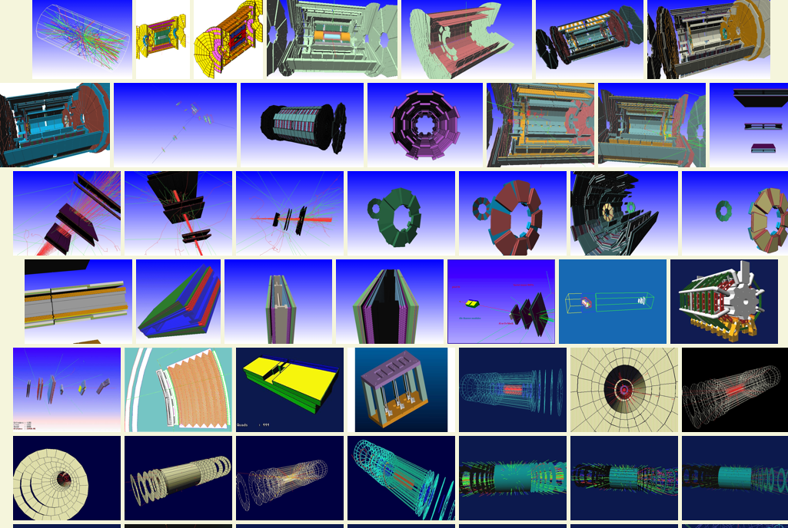
High Energy Physics Experiments

Slide 19
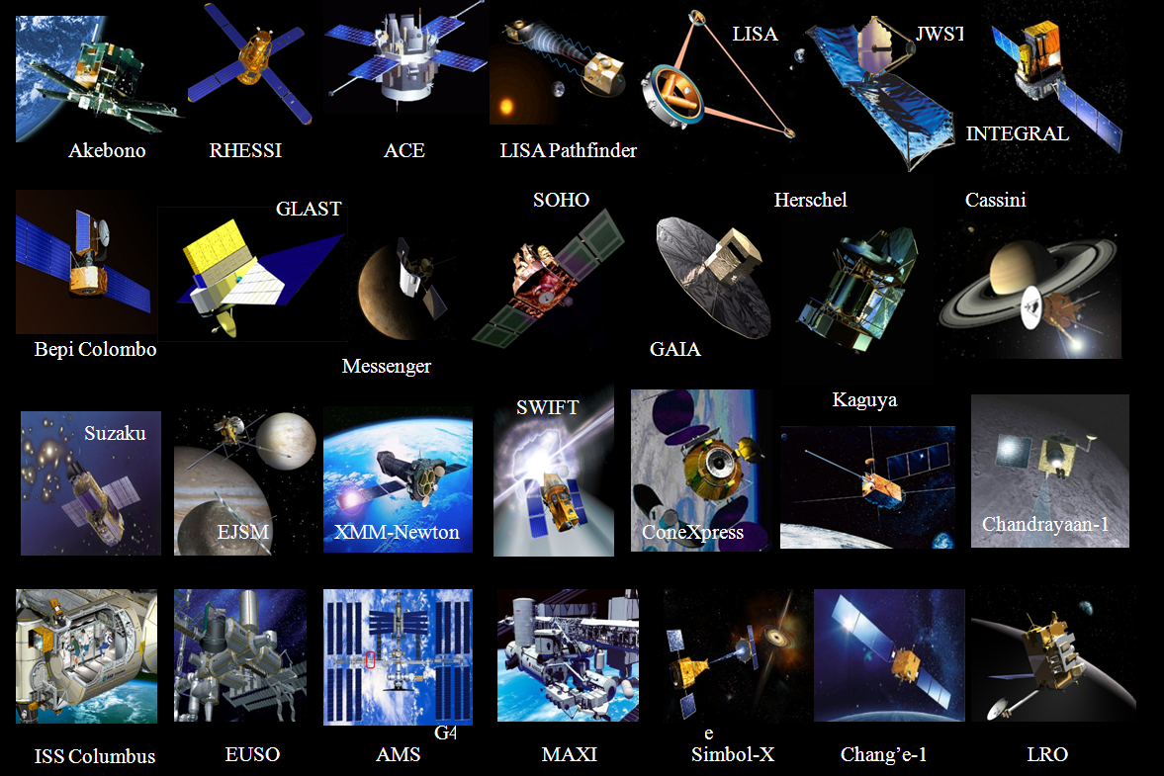
Space: radiation effects, science

Slide 20
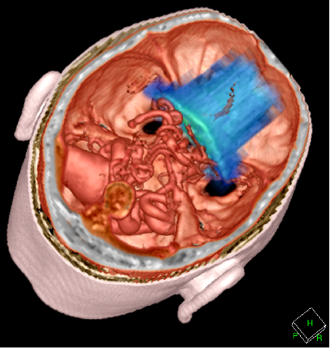
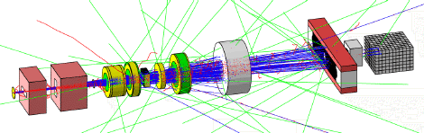
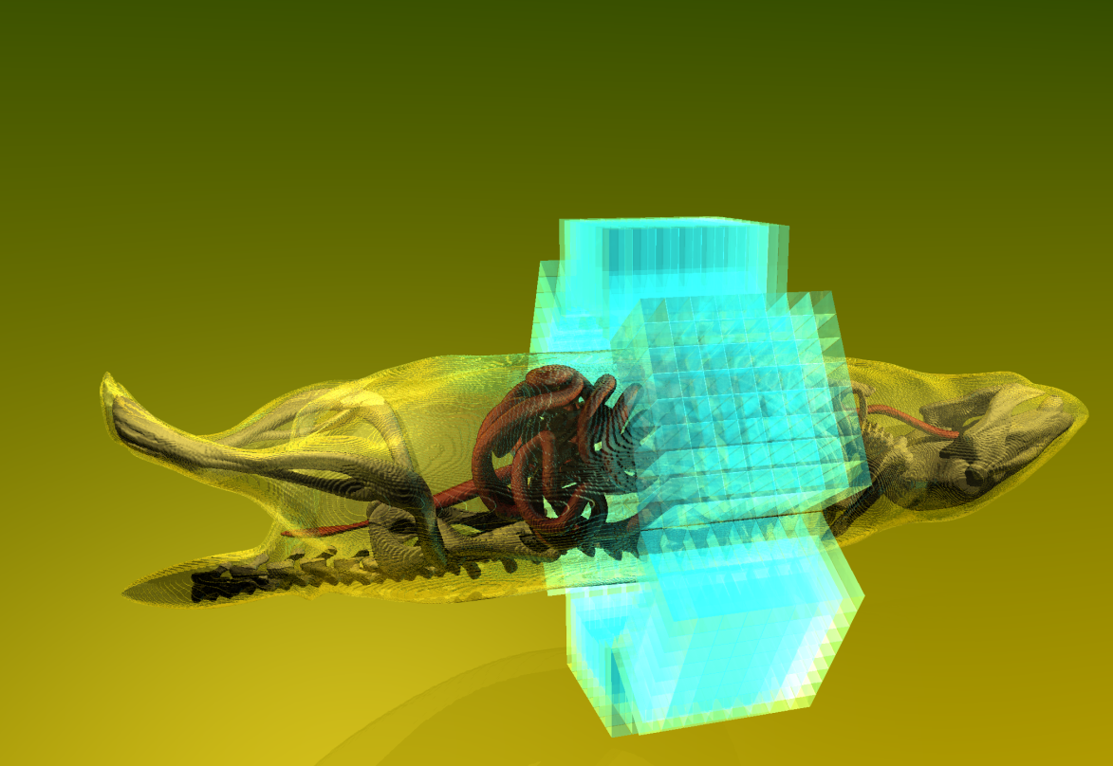
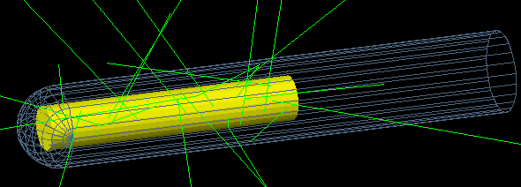
Geant4 @ Medical Science
Four major use cases
  Beam therapy
  Brachytherapy
  Imaging
  Cell Irradiation study

Slide 21
Some Basics
Simplest Geant simulation needs three classes and a main to run
  Geometry
  Primary Generator Action
  Physics List
Running Geant4
  Hard code your commands into your main
  Use a macros – a script containing a list of commands executed sequentially
  Use a GUI
Main
Event
Generator
Geometry
Physics

Slide 22
Defining your materials
Materials are defined based upon their chemical structure
First define your element(s)
Then define your material
Assigned weighted quantities of element to material
Two examples: Argon (element), Water (composite)
Atomic number, molar mass, density
Example: Water H 2O
  Two ingredients : Two hydrogen , one oxygen
  Define hydrogen
  Define Oxygen
  Define Water
  Assign two hydrogen atoms and one oxygen atom to water
See also G4NISTManager class, it allows to build materials (and elements) via names

Slide 23
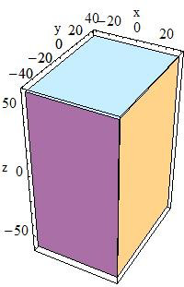
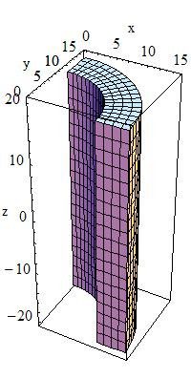
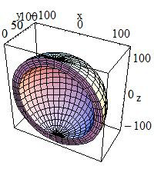
Defining your world
Define all objects within the world
  Shape SOLID (G4SOLID)
  Size LOGIC (G4LOGIC)
  Material PHYSICAL (G4PVPLACEMENT)
  Position
Use the classes provided by Geant4
  Example: Box, Cylinder, Sphere
  Many more existing classes, User’s Guide (4.1.2)

Slide 24
Defining a source
Two types covered here
  Beams
  Stationary sources
Beams are defined in a source file in the Primary Generator Action
Stationary sources can be defined there using random numbers to generate isotropic distributions
Or use pre-defined class in a macro G4GeneralParticleSource
All primary generators are defined in a user Primary Generator Action (a class derived from G4VUserPrimaryGeneratorAction);besides G4GeneralParticleSource there is G4ParticleGun which is more simple generator

Slide 25
Physics List
Geant4 doesn’t “automatically” include any physics
You need to tell Geant4 what physical interactions you are interested in
Originates from particles physics background where “new physics” would need implementing
Include:
  Particles you want (bosons, mesons etc.)
  Interactions you want (photoelectric, Compton, Pair production)
  The correct energy range: different for the energy range you are interested in
  Standard, low energy, very low energy
  Beware of your cut values
Geant4 provides a set of physics lists and it is recommended to users to start with one of these. See more details at:http://geant4.web.cern.ch/geant4/support/index.shtml
--> Physics list

Slide 26
Physics List: Cuts
Cut value defines the extent to which a particle is tracked
Cuts are defined in distance (range )
Converted into energy based on the material
100keV
Cut value = 1mm
γ100 KeV
γ100 KeV
Electron won’t be tracked
Distance < Cut
Electron will be tracked
Distance > Cut

Slide 27
Extracting information from Geant4
Two additional classes (minimum):
  Sensitive Detector
  Hit
  (Event Action) is useful, but not essential
Which volumes are made sensitive is defined in the geometry class
  At logical stage
Hit defines the object of an interaction
  Energy deposit, Position, Interaction type, Detector segment
Hits will only be defined in sensitive detectors (not in passive volumes)
Hits are assigned their attributes (Energy, position) not in the hit class, but in the sensitive detector class
User can extract info at all stages of event processing: stepping, tracking, event, run action. Besides that he can use scorer classes which are a kind of ready to be used by sensitive detectors for accounting various quantities
Geometry
Sensitive
Detector
Output
Hit

Slide 28
Compare C++ codes
Geometry: assigns a volume to be sensitive
Sensitive detector:
  builds a Hit
  assigns it to HitCollection
Hit class defines attributes of the hit
Sensitive Detector either:
  outputs HitCollection
  or sends HitCollection to EventAction file
EventAction:
  necessary to process several HitCollections
  examine several HitCollections, establish HitCollection

Slide 29
Geant4 is MORE…
Kernel: 3 lectures
Geometry: 4 lectures
Materials: 1 lecture
Physics: 3 lectures
EM Physics: 2 lectures
Hadron Physics: 3 lectures
Physics Lists: 1 lecture
Visualization: 3 lectures
Primary particles: 1 lecture
Analysis: 1 lectures
Upgrading: 1 lecture
User interface: 2 lectures
Event biasing: 1 lectures
User documentation and examples: 2 lectures

Slide 30
Suggestions (not only for Geant4)
DO’s
Consult the user guide with any problems or for more detail
Consult the HyperNews forum if you get stuck
Just start playing around with one of the examples
If you get a bug in it you can’t fix, you can always download it again
Always think about what you need in terms of physics and cut values
Do discard physics and events you don’t need: you are the expert of your work
DON’T’s
Treat this lecture as a replacement of the User Guide:
Geant4 is very complex and cannot be explained fully in few slides
Don’t wait until you are a C++ expert before you start
Don’t read the whole user guide before you start
Don’t assume Geant4 will “just get it right”
Don’t let too much detail slow you down
Use the Geant4 novice examples to start with
(sec. 9.1 of the Users Guide for Application developers)
http://geant4.fnal.gov/index_web/novice_examples_explained.shtml

Slide 31
ROOT in a Nutshell
ROOT is a large Object-Oriented data handling and analysis framework
  Efficient object store scaling from KB’s to PB’s
C++ interpreter
Extensive 2D+3D scientific data visualization capabilities
Extensive set of multi-dimensional histograming, data fitting, modeling and analysis methods
Complete set of GUI widgets
Classes for threading, shared memory, networking, etc.
Parallel version of analysis engine runs on clusters and multi-core
Fully cross platform: Unix/Linux, MacOS X and Windows
Notes:
30

Slide 32
ROOT in a Nutshell (2)
The user interacts with ROOT via a graphical user interface, the command line or scripts
The command and scripting language is C++
  Embedded CINT C++ interpreter
  Large scripts can be compiled and dynamically loaded
And for you?
ROOT is usually the interface (and sometimes the barrier)
between you and the data

Slide 33
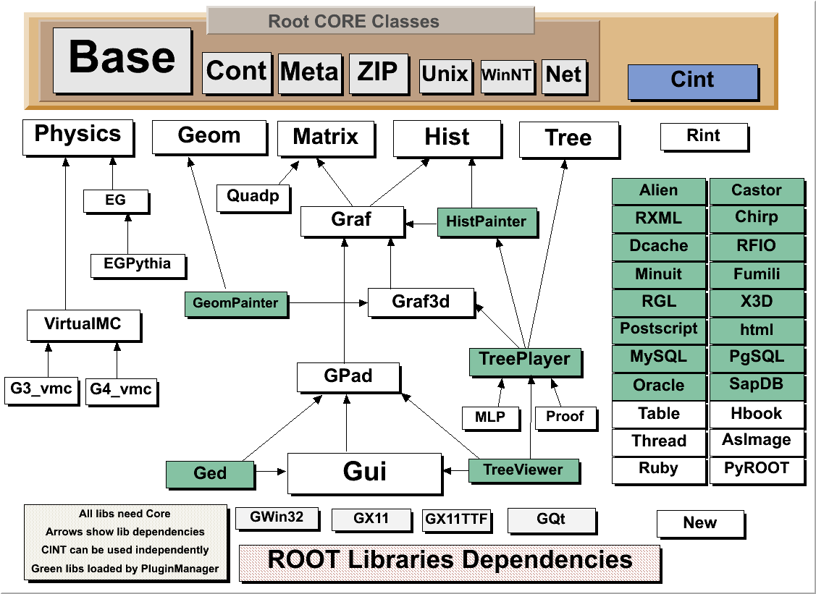
The ROOT Libraries
Over 2,500 classes
3,000,000 lines of code
CORE (8 Mbytes)
CINT (2 Mbytes)
Most libraries linked on demand via plug-in manager (only a subset shown)
100 shared libs
Notes:
32

Slide 34
ROOT: An Open Source Project
The project was started in Jan 1995
First release Nov 1995
The project is developed as a collaboration between:
  Full time developers:
    7 people full time at CERN (PH/SFT)
    2 developers at Fermilab/USA
  Large number of part-time contributors (160 in CREDITS file)
  A long list of users giving feedback, comments, bug fixes and many small contributions
    5,500 users registered to RootTalk forum
    10,000 posts per year
An Open Source Project, source available under the LGPL license
Used by all HEP experiments in the world
Used in many other scientific fields and in commercial world
Notes:
33

Slide 35
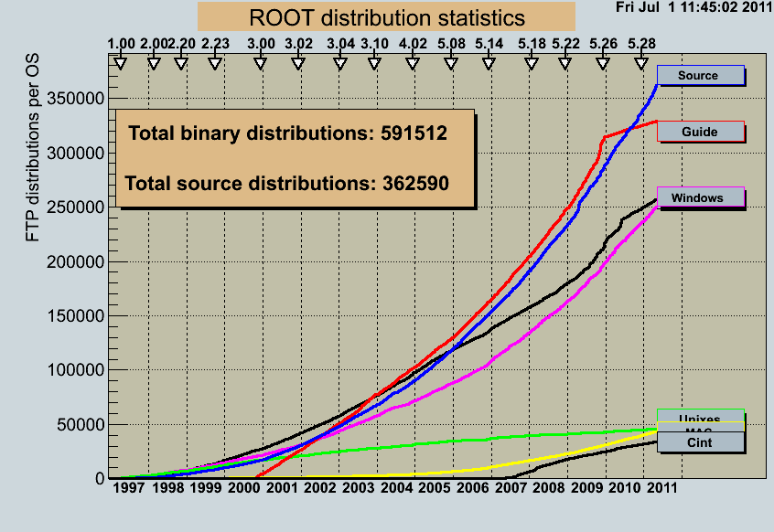
Some ROOT Statistics
ROOT binaries have been downloaded about 600,000 times since 1997
The estimated user base is about 20,000 people

Slide 36
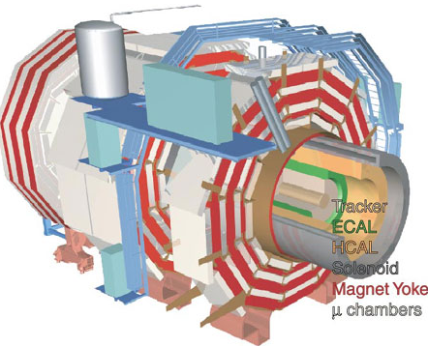
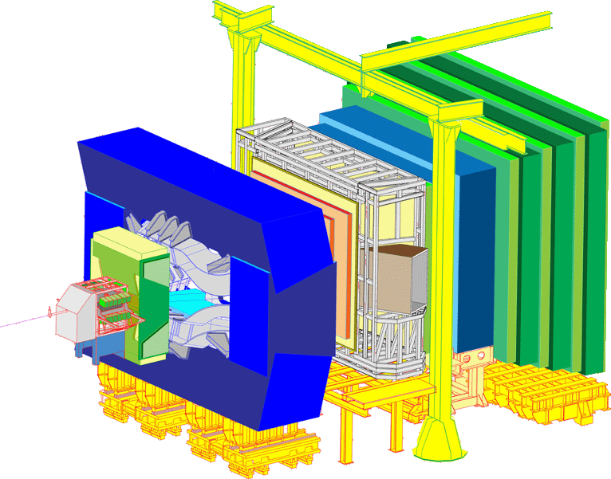
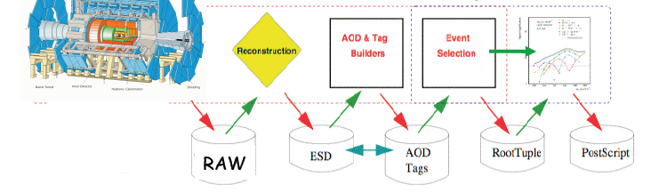
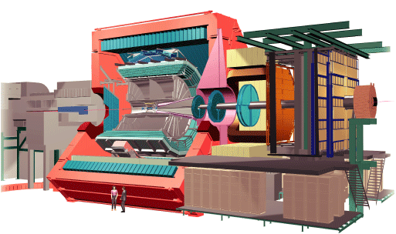
ROOT Application Domains
Data Analysis & Visualization
General Framework
Data Storage: Local, Network

Slide 37
CINT in ROOT
CINT is used in ROOT:
  As command line interpreter
  As script interpreter
  To generate class dictionaries
  To generate function/method calling stubs
  Signals/slots with the GUI
The command line, script and programming language become the same
Large scripts can be compiled for optimal performance

Slide 38
First CINT Example
$ root
root [0] 344+76.8
(const double)4.20800000000000010e+002
root [1] float x=89.7;
root [2] float y=567.8;
root [3] x+sqrt(y)
(double)1.13528550991510710e+002
root [4] float z = x+2*sqrt(y/6);
root [5] z
(float)1.09155929565429690e+002
root [6] .q
$
Display online help with: root [0] .h

Slide 39
Named Macros
It is quite cumbersome to type the same lines again and again
Create macros for commonly used code
Macro = file that is interpreted by CINT
Execute with root [0] .x mymacro.C(10)
Or root [0] .L mymacro.C
root [1] mymacro(10)
int mymacro(int value)
{
int ret = 42;
ret += value;
return ret;
}
saved in mymacro.C

Slide 40
Compile Macros – Libraries
"Library": compiled code, shared library
CINT can call its functions!
Building a library from a macro: ACLiC
(Automatic Compiler of Libraries for CINT)
Execute it with a “+” root [0] .x mymacro.C(42)+
Or root [0] .L mymacro.C+
root [1] mymacro(42)
No Makefile needed
CINT knows all functions in the library mymacro_C.so/.dll

Slide 41
Compiled vs. Interpreted
Why compile?
  Faster execution, CINT has some limitations…
Why interpret?
  Faster Edit → Run → Check result → Edit cycles ("rapid prototyping"). Scripting is sometimes just easier
So when should I start compiling?
  For simple things: start with macros
  Rule of thumb
    Is it a lot of code or running slow? → Compile it!
    Does it behave weird? → Compile it!
    Is there an error that you do not find → Compile it!

Slide 42
Unnamed Macros
{
float ret = 0.42;
return sin(ret);
}
saved in mymacro.C
No function, just statements
Execute with root [0] .x mymacro.C
  No functions, thus no arguments
Named macro recommended!

Slide 43
ROOT Types
You can use native C types in your code (as long as you don’t make your data persistent, i.e. write to files)
ROOT redefines all types to achieve platform independency
  E.g. the type int has a different number of bits on different systems
  int → Int_t float → Float_t
  double → Double_t long → Long64_t (not Long_t)
  etc.
  See $ROOTSYS/include/Rtypes.h

Slide 44
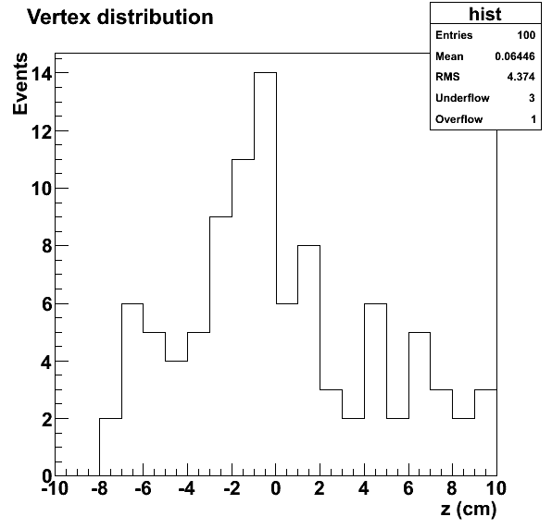
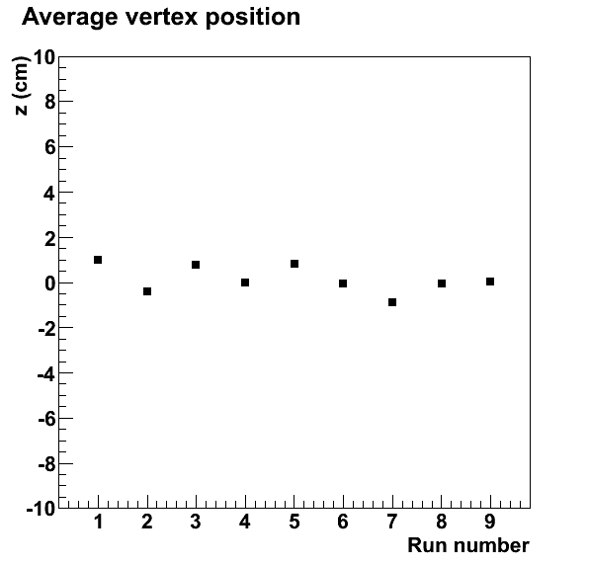
Histograms & Graphs
Histogram
Graph
Container for binned data
  Most of HEP’s distributions
Container for distinct points
  Calculation or fit results
Notes:
axis, title, etc.

Slide 45
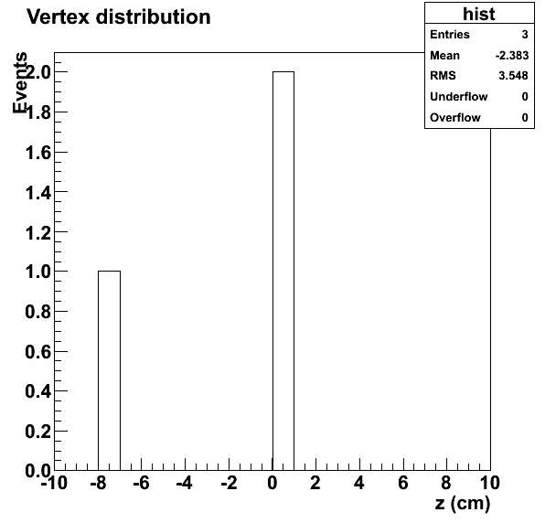
Histograms
Histograms are binned data containers
There are 1, 2 and 3-dimensional histograms → TH1, TH2, TH3
The data can be stored with different precision and in different types (byte, short, int, float, double)
→ TH1C, TH1S, TH1I, TH1F, TH1D
(same for TH2, TH3)
Histogram Example
hist = new TH1F("hist", "Vertex
distribution;z (cm);Events", 20, -10, 10);
hist->Fill(0.05);
hist->Fill(-7.4);
hist->Fill(0.2);
hist->Draw();
NB: All ROOT classes start with T
Looking for e.g. a string? Try TString

Slide 46
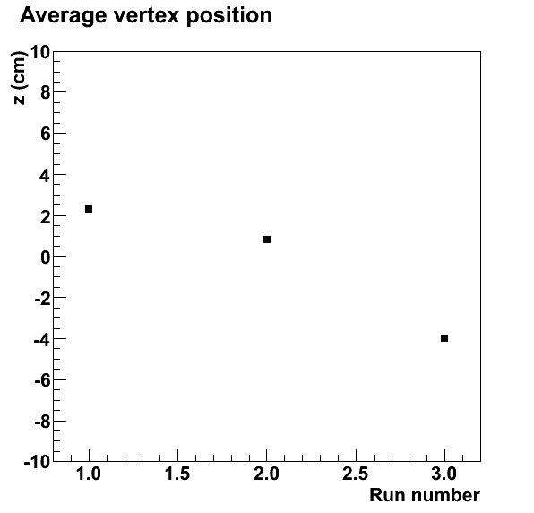
Graphs
A graph is a data container filled with distinct points
TGraph: x/y graph without error bars
TGraphErrors: x/y graph with error bars
TGraphAsymmErrors: x/y graph with asymmetric error bars
Graph Example
graph = new TGraph;
graph->SetPoint(graph->GetN(), 1, 2.3);
graph->SetPoint(graph->GetN(), 2, 0.8);
graph->SetPoint(graph->GetN(), 3, -4);
graph->Draw("AP");
graph->SetMarkerStyle(21);
graph->GetYaxis()->SetRangeUser(-10, 10);
graph->GetXaxis()->SetTitle("Run number");
graph->GetYaxis()->SetTitle("z (cm)");
graph->SetTitle("Average vertex position");

Slide 47
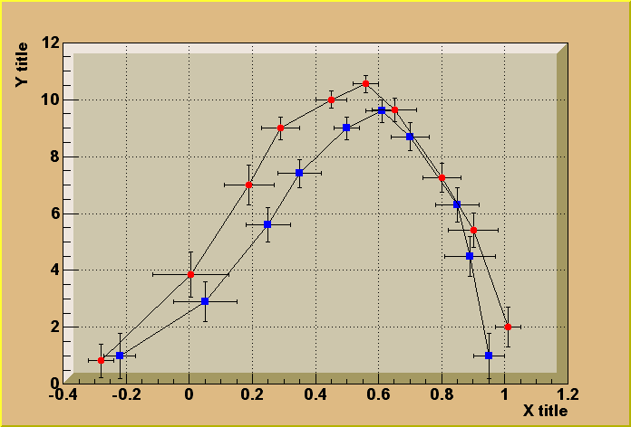
Graphs (2)
TGraphErrors(n,x,y,ex,ey)
TGraph(n,x,y)
$ROOTSYS/tutorials/graphs/gerrors2.C
TCutG(n,x,y)
TMultiGraph
TGraphAsymmErrors(n,x,y,exl,exh,eyl,eyh)

Slide 48
Graphics Objects
You can draw with the command line
The Draw function adds the object to the list of primitives of the current pad
If no pad exists, a pad is automatically created
A pad is embedded in a canvas
You create one manually with new TCanvas
  A canvas has one pad by default
  You can add more
root [ ] TLine line(.1,.9,.6,.6)
root [ ] line.Draw()
root [ ] TText text(.5,.2,”Hello”)
root [ ] text.Draw()
Canvas
Hello
Pad

Slide 49
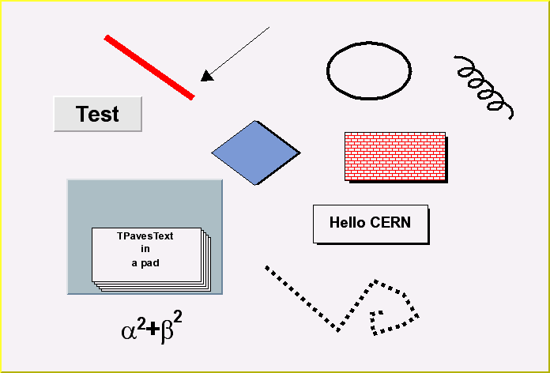
More Graphics Objects
TLine
TArrow
TEllipse
TBox
TButton
TDiamond
TCurvyLine
TText
TMarker
TPave
TPavesText
TCrown
TPaveLabel
TCurlyArc
TPolyLine
TLatex
Can be accessed with the toolbar
View → Toolbar (in any canvas)

Slide 50
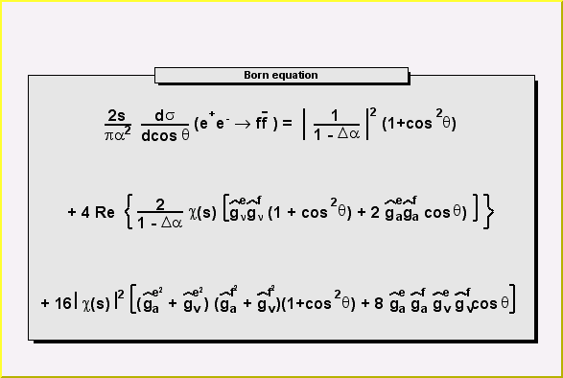
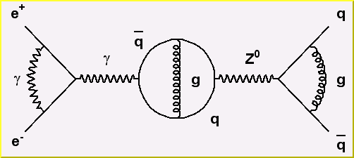
Full LateX support on screen and postscript
$ROOTSYS/tutorials/graphics/latex3.C
Formula or
diagrams can be
edited with the mouse
$ROOTSYS/tutorials/graphics/feynman.C
TCurlyArc
TCurlyLine
TWavyLine
and other building blocks for Feynmann diagrams
A lot more examples come with the ROOT installation

Slide 51
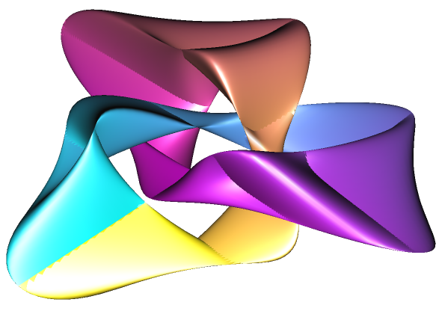
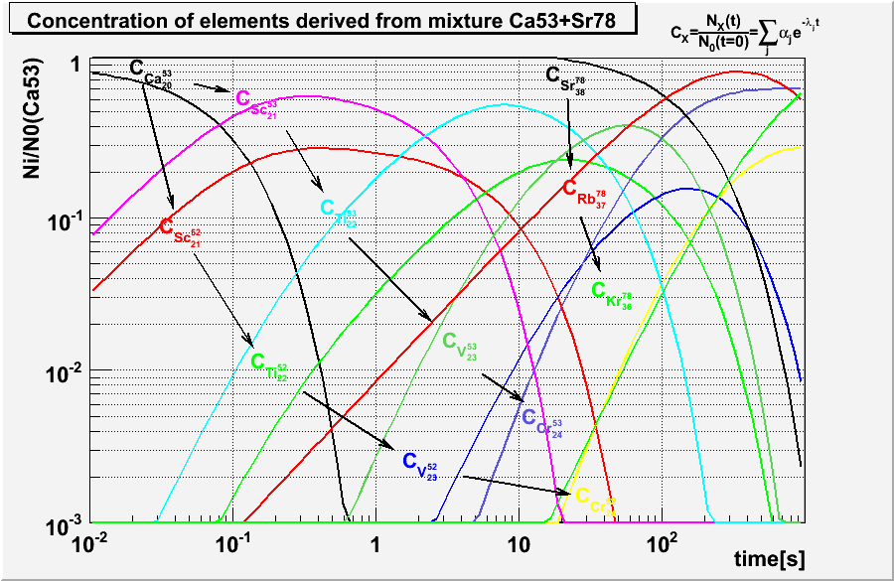
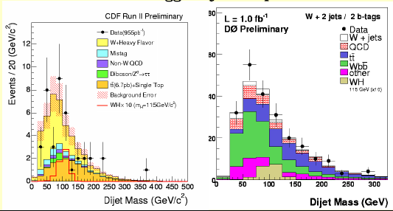
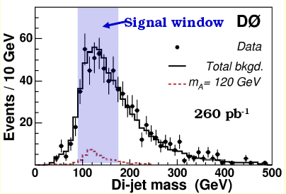
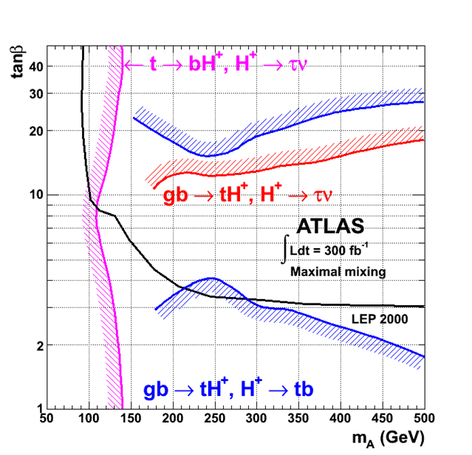
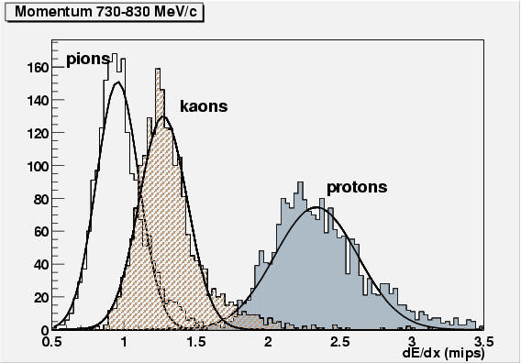
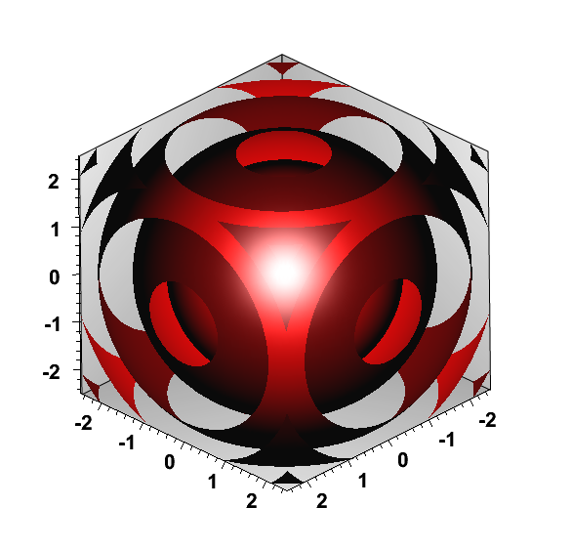
Graphics Examples
TGLParametric
TF3

Slide 52
Input/Output
Object in Memory
sockets
Net File
Web File
http
Buffer
XML File
XML
RDBMS
Streamer
SQL
File on disk
Local
The automatically generated ROOT streamer for each class streams all class members, resolves circular dependencies and multiply referenced objects
→ No streamer function needs to be written
→ No need for separation of transient and persistent classes

Slide 53
Files
TFile is the class to access files on your file system (and elsewhere)
A TFile object may contain directories (TDirectory), like a Unix file system
ROOT files are self describing
  Dictionary for persistent classes written to the file
Support for Backward and Forward compatibility
Files created in 2006 must be readable in 2020

Slide 54
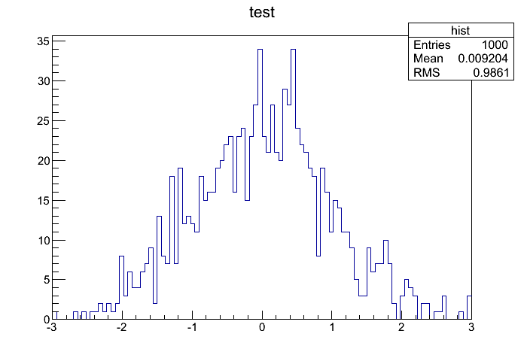
File Example
void keyWrite() {
TFile f("file.root", "new");
TH1F h("hist", "test", 100, -3, 3);
h.FillRandom("gaus", 1000);
h.Write()
}
This works as well for your own class!
void keyRead() {
TFile f("file.root");
TH1F *h = (TH1F*) f.Get("hist");
h.Draw();
}

Slide 55
LHC: How Much Data?
High Level-1 Trigger
(1 MHz)
High No. Channels
High Bandwidth
(500 Gbit/s)
Level 1 Rate
(Hz)
10⁶
1 billion people surfing the Web
LHCB
ATLAS
CMS
10⁵
HERA-B
KLOE
High Data Archive
(5 PetaBytes/year)
10 Gbits/s in Data base
10⁴
CDF II
CDF
10³
H1
ZEUS
ALICE
UA1
NA49
How to store large number of events and data volumes efficiently?
→ ROOT Trees
STAR
10²
10⁴
10⁵
10⁶
10⁷
LEP
Event Size (bytes)

Slide 56
What is a ROOT Tree?
Trees have been designed to support very large collections of objects. The overhead in memory is in general less than 4 bytes per entry.
Trees allow direct and random access to any entry (sequential access is the most efficient)
Trees are structured into branches and leaves. One can read a subset of all branches
High level functions like TTree::Draw loop on all entries with selection expressions
Trees can be browsed via TBrowser
Trees can be analyzed via TTreeViewer

Slide 57
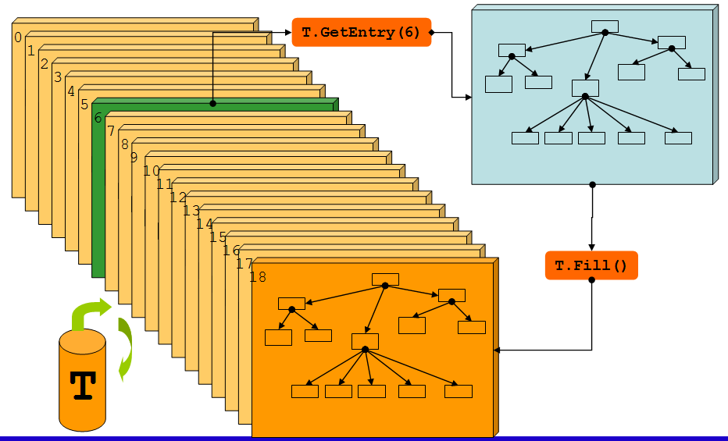
Stored Trees vs. Memory
Tree On Disk
One instance in memory

Slide 58
Trees: Split Mode
The tree is partioned in branches
  Each class member is a branch (in split mode)
  When reading a tree, certain branches can be switched off
  → speed up of analysis when not all data is needed
1 "Event"
Branches
File
point
x y z
x
x
x
x
x
x
x
x
x
x
y
y
y
y
y
y
y
y
y
y
z
z
z
z
z
z
z
z
z
z
Events

Slide 59
TTree - Writing
You want to store 1 million objects of type TMyEvent in a tree which is written into a file
Initialization
Fill the tree (1 million times)
  TTree::Fill copies content of
  member as new entry into the tree
Flush the tree to the file,
close the file
TFile* f = TFile::Open("events.root", "RECREATE");
TTree* tree = new TTree("Events","Event Tree");
TMyEvent* myEvent = new TMyEvent;
TBranch* branch = tree->Branch("myevent",
"TMyEvent", &myEvent);
myEvent->SetMember(…); tree->Fill();
tree->Write();
f->Close();

Slide 60
TTree - Reading
Open the file, retrieve the tree and connect the branch with a pointer to TMyEvent
Read entries from the tree and use the content of the class
TFile *f = TFile::Open("events.root");
TTree *tree = (TTree*)f->Get("Events");
TMyEvent* myEvent = 0;
tree->SetBranchAddress("myevent", &myEvent);
Int_t nentries = tree->GetEntries();
for (Int_t i=0;i<nentries;i++) {
tree->GetEntry(i);
cout << myEvent->GetMember() << endl;
}
A quick way to browse through a tree is to use a TBrowser

Slide 61
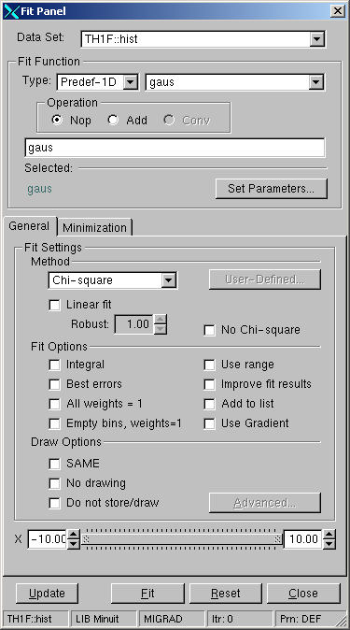
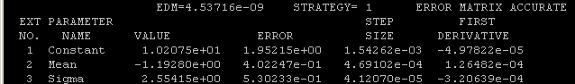
Fitting
Fitting a histogram or graph
With the GUI
  If you just try which functions works well or need a single parameter
  Right click on graph or histogram
  → Fit panel
With the command line / macro
  If you fit many histograms/graphs or several times
hist->Fit("gaus")
hist->FindFunction("gaus")->GetParameter(0)
Fit parameters printed to the screen

Slide 62
ROOT is MORE….
In this talk, I presented the most basic classes typically used during physics analyses
ROOT contains many more libraries, e.g.
  FFT library
  Oracle, MySQL, etc interfaces
  XML drivers
  TMVA (Multi Variate Analysis)
  GRID, networking and thread classes
  Interfaces to Castor, Dcache, GFAL, xrootd
  Interfaces to Pythia, Geant3, Geant4, gdml
  Matrix packages, Fitting packages (i.e. RooFit), etc
  Geometry modeler

Slide 63
One Example: PROOF
Parallel ROOT Facility
Interactive parallel analysis on a local cluster
  Parallel processing of (local) data (trivial parallelism)
  Output handling with direct visualization
  Not a batch system
PROOF itself is not related to Grid
  Can access Grid files
The usage of PROOF is transparent
  The same code can be run locally and in a PROOF system (certain rules have to be followed)
PROOF is part of ROOT
Data does not need to be copied
Many CPUs available for analysis
→ much faster processing
Notes:
62

Slide 64
PROOF Schema
Client –
Local PC
Remote PROOF Cluster
Result
stdout/result
root
root
ana.C
node1
Result
ana.C
Data
root
Data
node2
Result
root
Data
node3
root
Result
Proof master
Proof slave
Data
node4
Notes:
63

Slide 65

Questions

