Slide 1


Decay of heavy hadrons at LHCb and CMS
Xingyu Tong, on behalf of LHCb collaboration
Peking University
QWG Workshop, CERN
Nov 18th , 2025

Slide 2
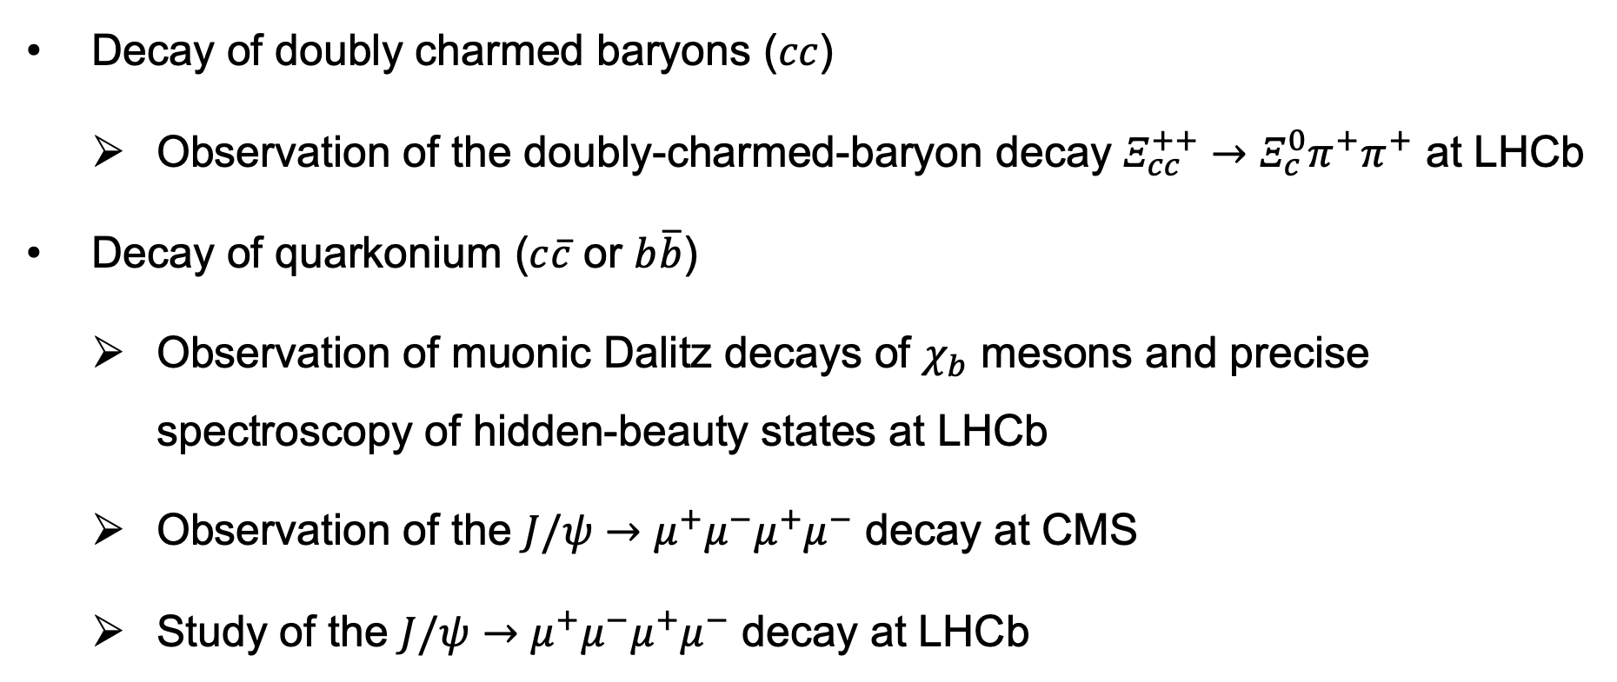
Outlines
Decay of doubly charmed baryons ($cc$)
  Observation of the doubly-charmed-baryon decay $Ξ_{cc}^{++}→Ξ_{c}^{0}π^{+}π^{+}$ at LHCb
Decay of quarkonium ($c\overline{c}$ or $b\overline{b}$)
  Observation of muonic Dalitz decays of $χ_{b}$ mesons and precise spectroscopy of hidden-beauty states at LHCb
  Observation of the $J/ψ→μ^{+}μ^{−}μ^{+}μ^{−}$ decay at CMS
  Study of the $J/ψ→μ^{+}μ^{−}μ^{+}μ^{−}$ decay at LHCb
[JHEP 10 (2025) 136]
[JHEP 10 (2024) 122]
[PRD 109 (2924) L111101]
[JHEP 12 (2024) 062]

Slide 3

Observation of the doubly-charmed-baryon decay $Ξ_{cc}^{++}→Ξ_{c}^{0}π^{+}π^{+}$

Slide 4
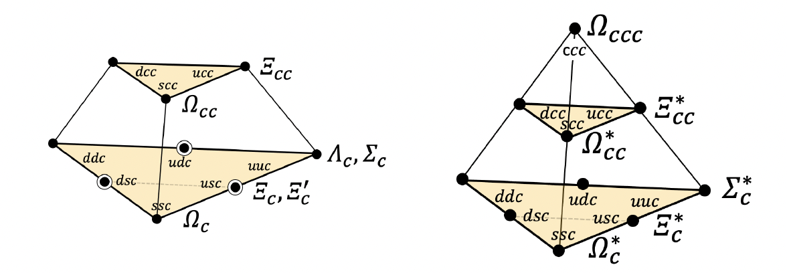
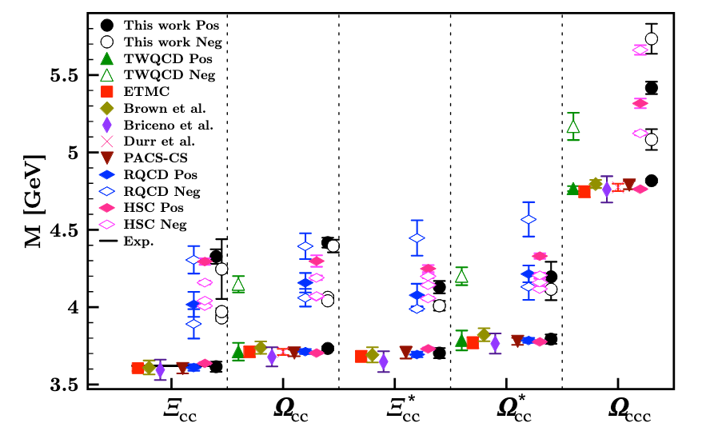

Doubly charmed baryons
Baryons composed of two charm quarks and a light quark
  A $Ξ_{cc}^{ }$ iso-doublet ($ccu; ccd$) and an $Ω_{cc}^{ }$ iso-singlet ($ccs$)
Mass spectrum: quark model predictions
  Lowest-lying states around 3.6 GeV
Lifetime estimations:
  Order-of-magnitude estimation: $τ_{cc}≈\frac{1}{2Γ_{c}}≈400 fs$
  Phenomenological model: $τ\left(Ξ_{cc}^{+}\right)<τ\left(Ω_{cc}^{+}\right)<τ\left(Ξ_{cc}^{++}\right)$
[PRD 102 (2020) 054513]
[JHEP 07 (2023) 061]

Slide 5


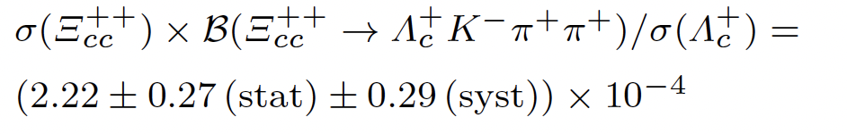
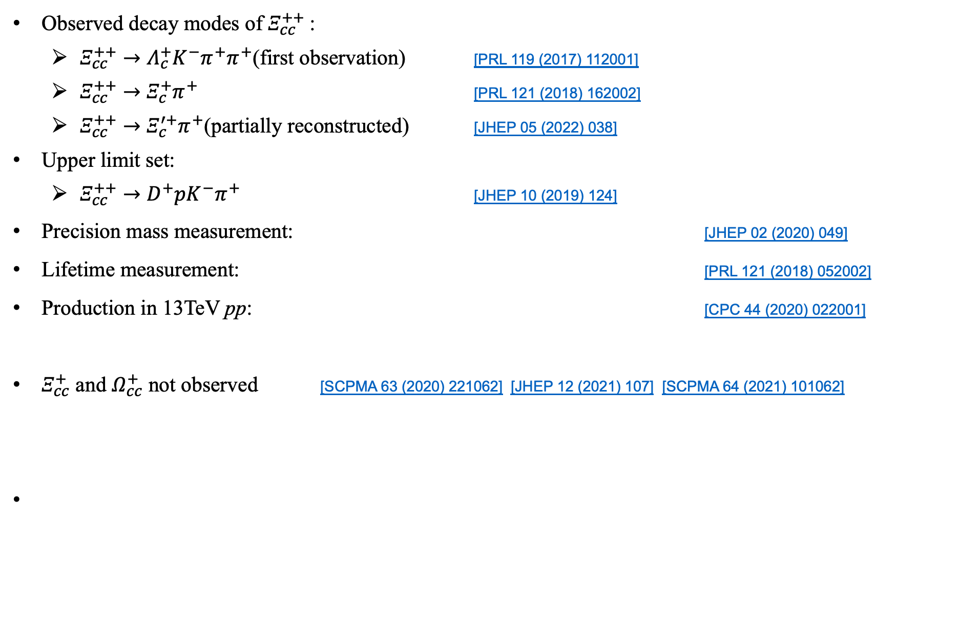
Study of doubly charmed baryons at LHCb
Observed decay modes of $Ξ_{cc}^{++}$:
  $Ξ_{cc}^{++}→$ $Λ_{c}^{+}K^{−}π^{+}π^{+}$(first observation) [PRL 119 (2017) 112001]
  $Ξ_{cc}^{++}→$ $Ξ_{c}^{+}π^{+}$ [PRL 121 (2018) 162002]
  $Ξ_{cc}^{++}→$ $Ξ_{c}^{′+}π^{+}$(partially reconstructed) [JHEP 05 (2022) 038]
Upper limit set:
  $Ξ_{cc}^{++}→$ $D^{+}{pK}^{−}π^{+}$ [JHEP 10 (2019) 124]
Precision mass measurement: [JHEP 02 (2020) 049]
Lifetime measurement: [PRL 121 (2018) 052002]
Production in 13TeV pp: [CPC 44 (2020) 022001]
$Ξ_{cc}^{+}$ and $Ω_{cc}^{+}$ not observed [SCPMA 63 (2020) 221062] [JHEP 12 (2021) 107] [SCPMA 64 (2021) 101062]

Slide 6
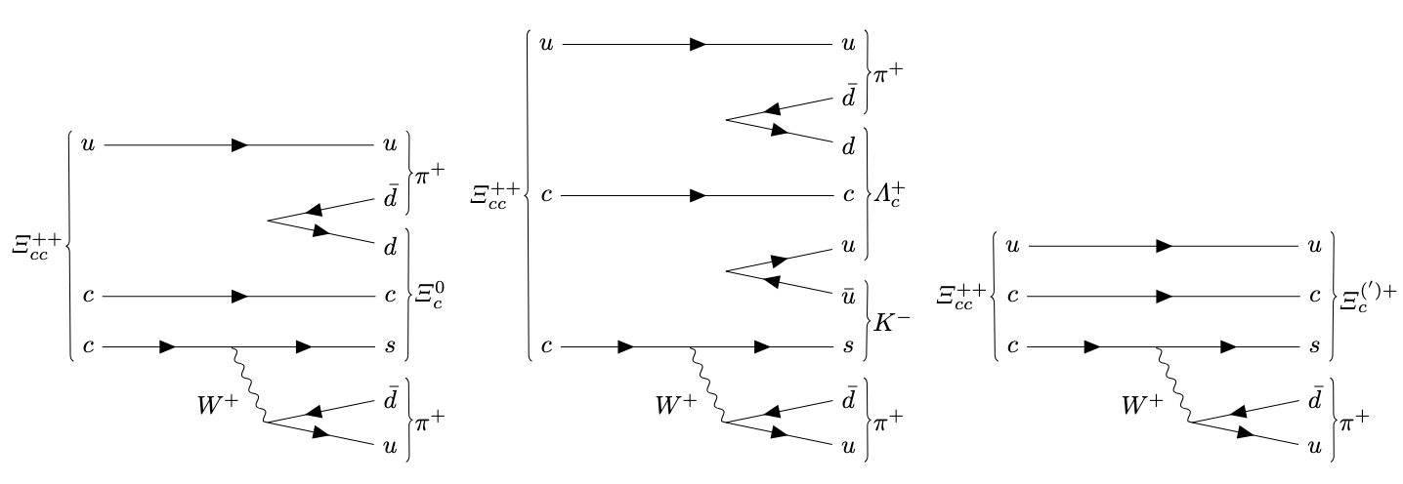
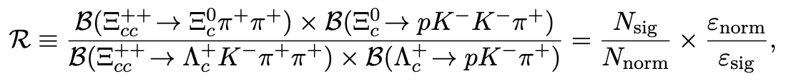

$Ξ_{cc}^{++}→Ξ_{c}^{0}π^{+}π^{+}$ Decay
Same $c→s$ weak transition as $Ξ_{cc}^{++}→$ $Λ_{c}^{+}K^{−}π^{+}π^{+}$ and $Ξ_{cc}^{++}→$ $Ξ_{c}^{(′)+}π^{+}$
  Comparable branching fraction
$Ξ_{cc}^{++}→$ $Λ_{c}^{+}K^{−}π^{+}π^{+}$ as the normalisation channel in branching fraction measurement
  $σ(Ξ_{cc}^{++})$ factored out
  Same final-state particles: systematic uncertainty reduced

Slide 7
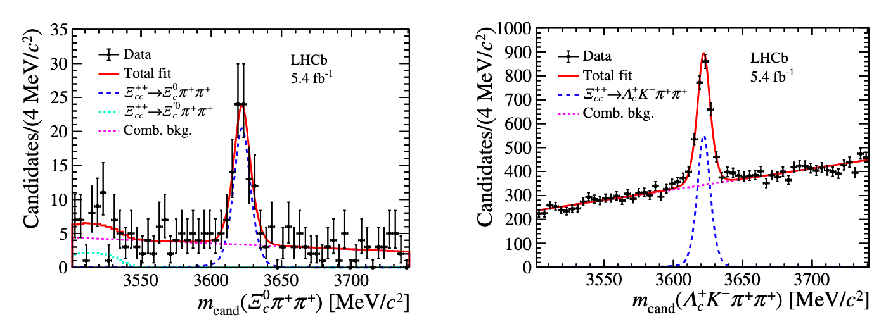
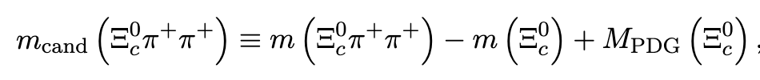

Observation of $Ξ_{cc}^{++}→Ξ_{c}^{0}π^{+}π^{+}$
Dataset: LHCb 2016-2018 pp collision (~ 5.4 fb⁻¹)
MVA-based event selection
Simultaneous fit on signal and normalisation channels
Local significance: > 10$σ$
[JHEP 10 (2025) 136]
First Observation!

Slide 8
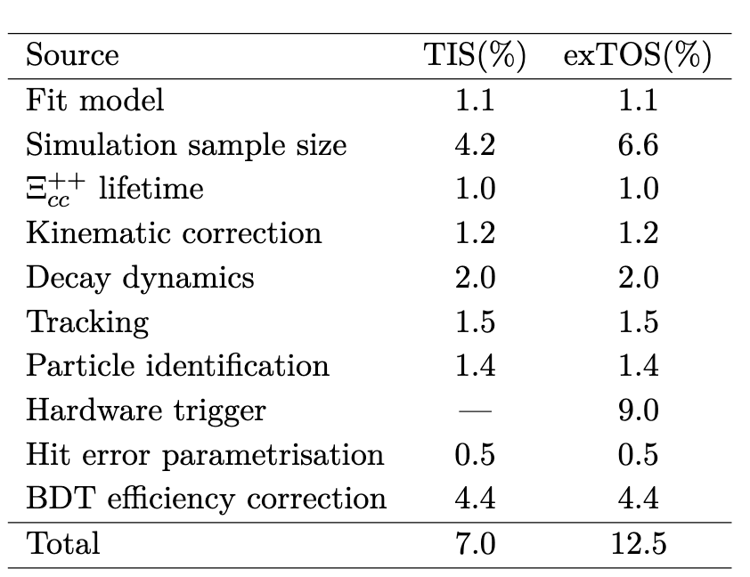
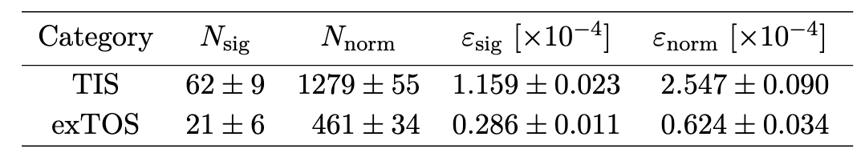
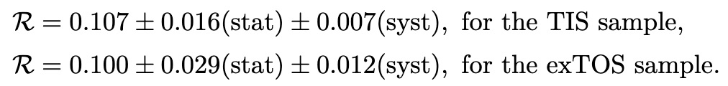

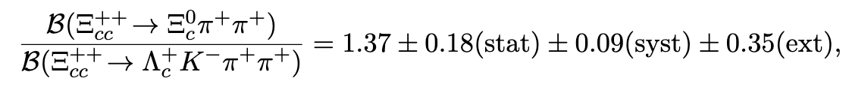

Branching fraction measurement
$N_{sig},N_{norm}$: signal yields, determined from $Ξ_{cc}^{++}$ mass fits
${ε_{sig},ε}_{con}$: efficiencies, calculated with simulated samples
Split in trigger categories: Trigger-Independent-of-Signal(TIS) and exclusive Trigger-On-Signal (exTOS)
Combined results:
Consistent with theoretical predictions
Systematic uncertainties
[JHEP 10 (2025) 136]
[EPJC 77 (2017) 781] [EPJC 78 (2018) 56] [EPJP 136 (2021) 772]

Slide 9
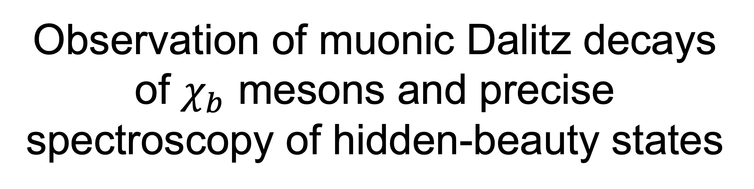
Observation of muonic Dalitz decays of $χ_{b}$ mesons and precise spectroscopy of hidden-beauty states

Slide 10
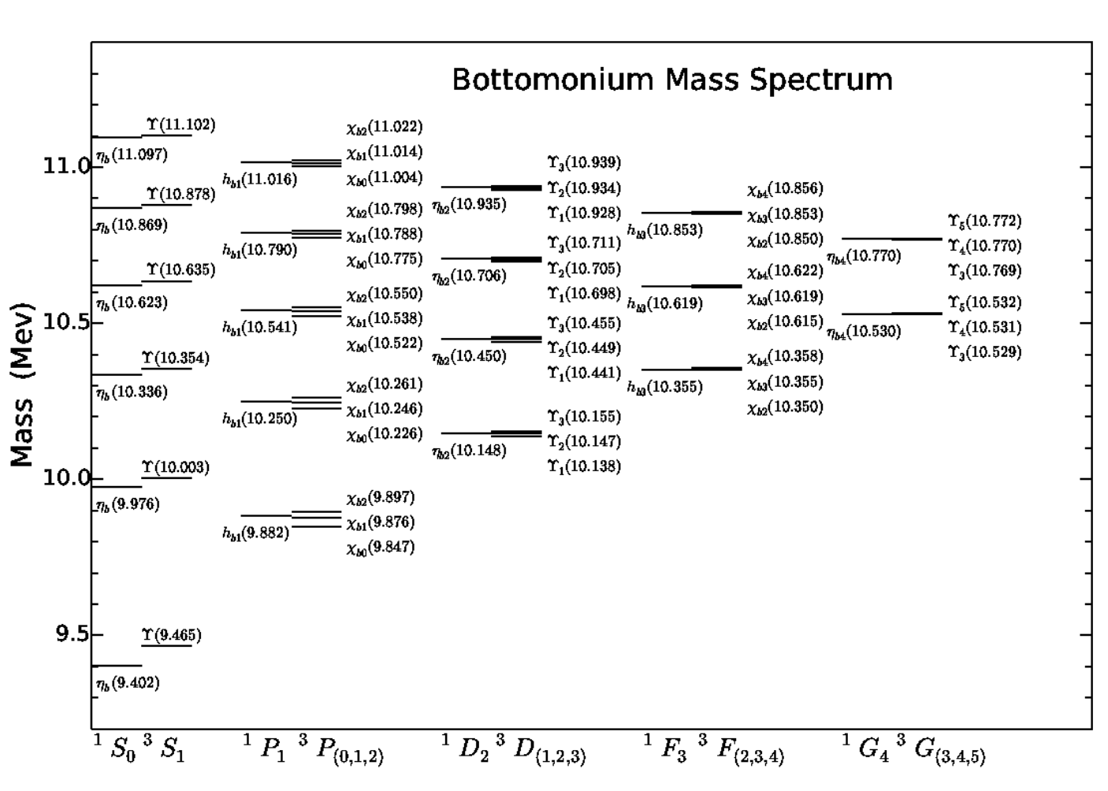
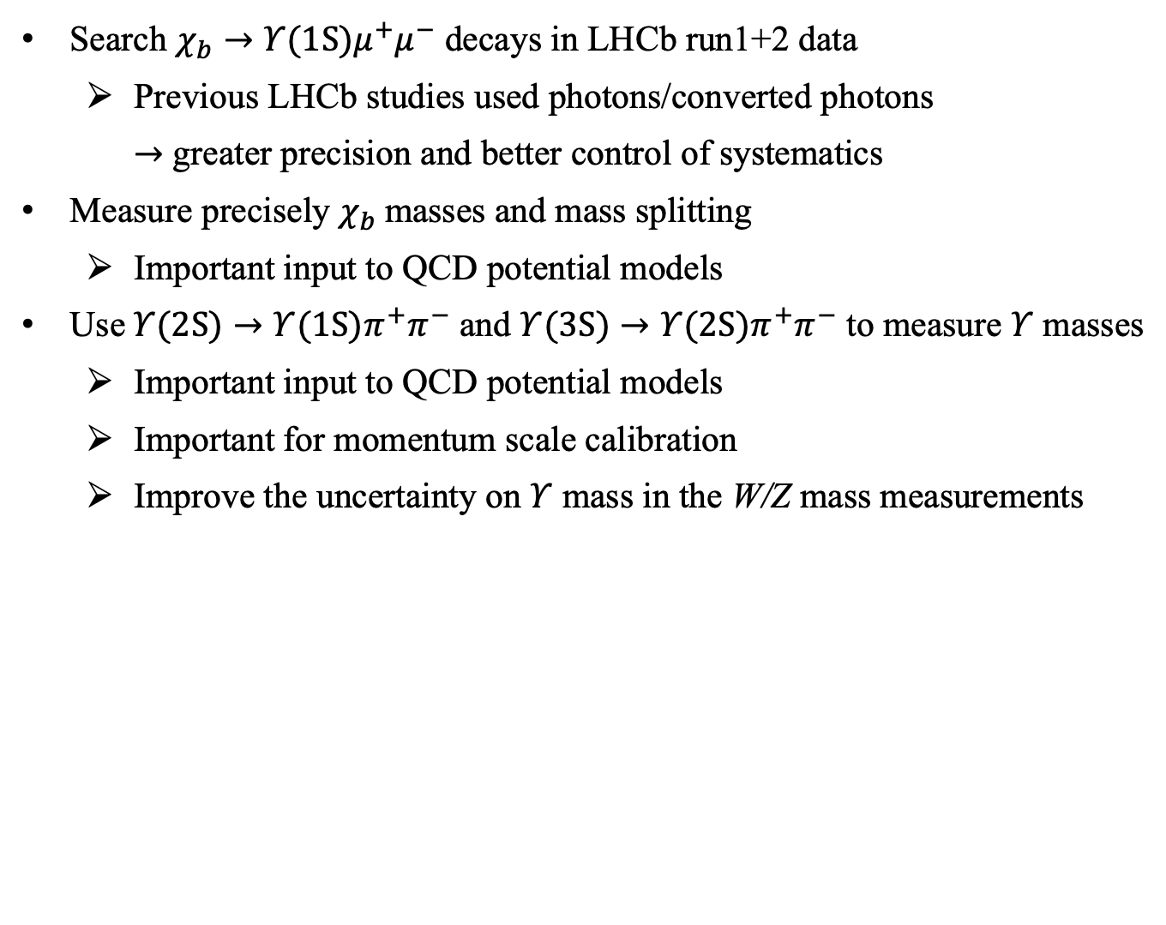
Analysis aims
Search $χ_{b}→{Υ(1S)μ}^{+}μ^{−}$ decays in LHCb run1+2 data
  Previous LHCb studies used photons/converted photons
  $→$ greater precision and better control of systematics
Measure precisely $χ_{b}$masses and mass splitting
  Important input to QCD potential models
Use$Υ(2S)→Υ(1S)π^{+}π^{−}$ and $Υ(3S)→Υ(2S)π^{+}π^{−}$ to measure $Υ$ masses
  Important input to QCD potential models
  Important for momentum scale calibration
  Improve the uncertainty on $Υ$ mass in the W/Z mass measurements

Slide 11
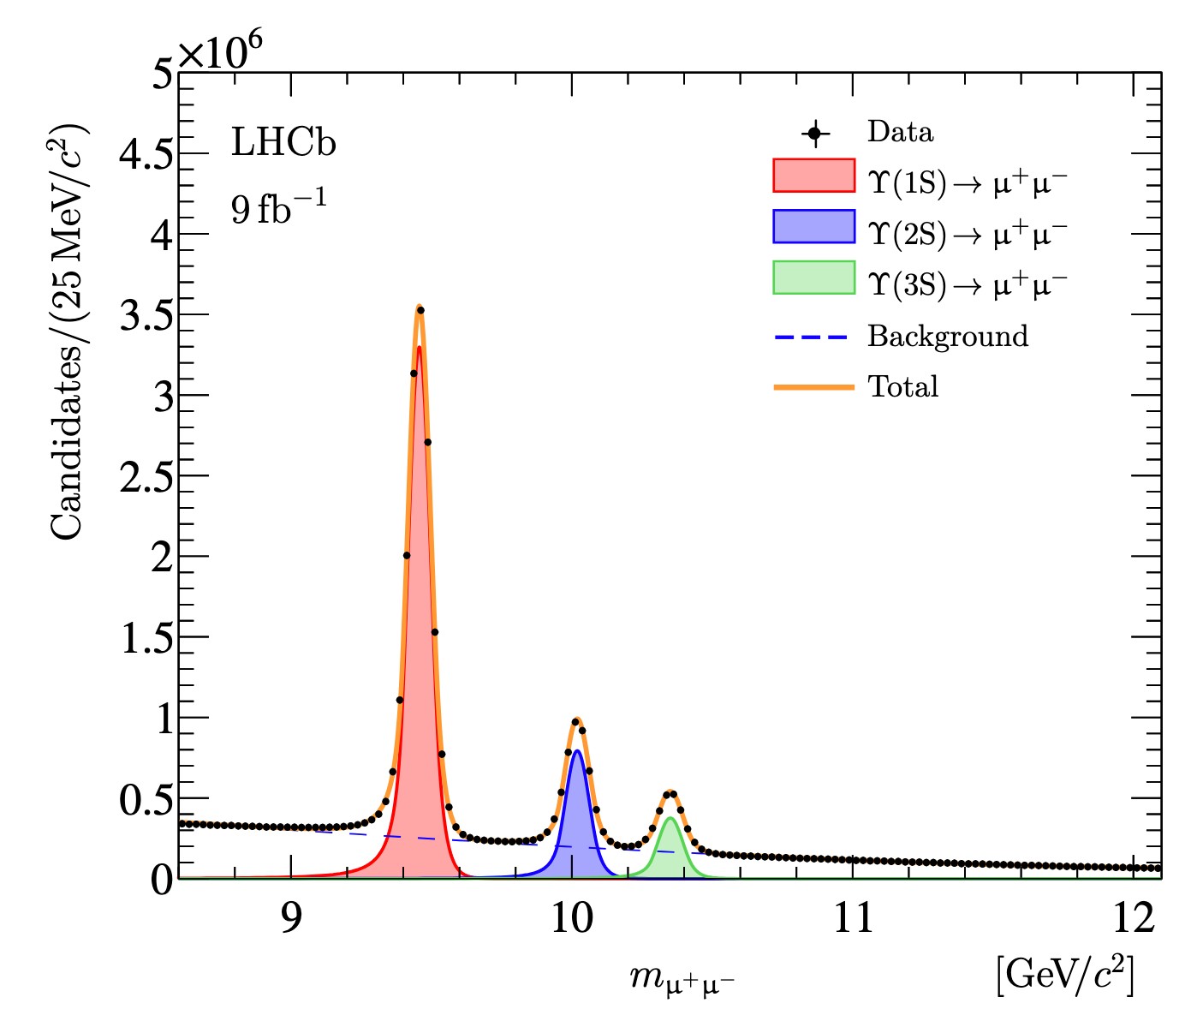
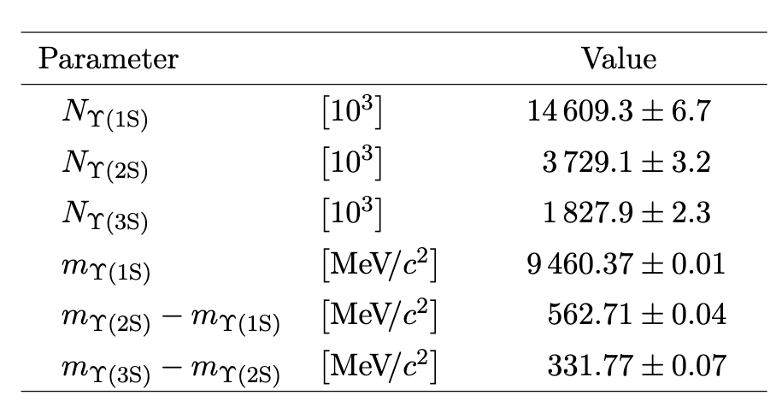
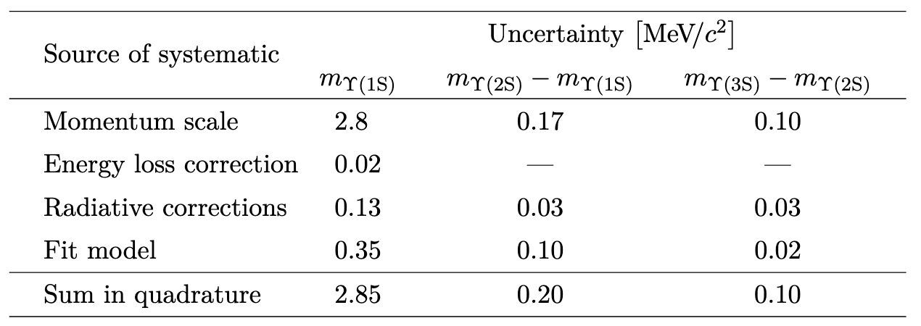
$Υ→μ^{+}μ^{−}$selection and mass fits
Muons selected by the trigger
Self-training BDT selection to reject combinatorial backgrounds
Mass fit: a binned extended maximum-likelihood fit
Systematic uncertainty:
[JHEP 10 (2024) 122]

Slide 12
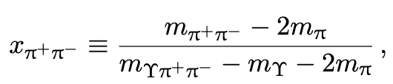
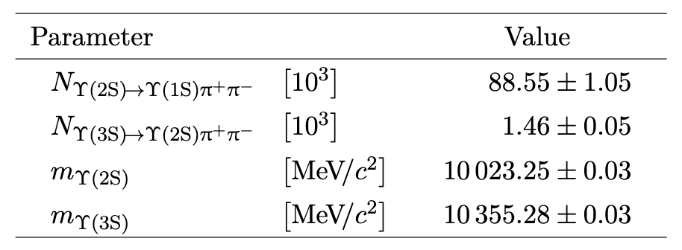
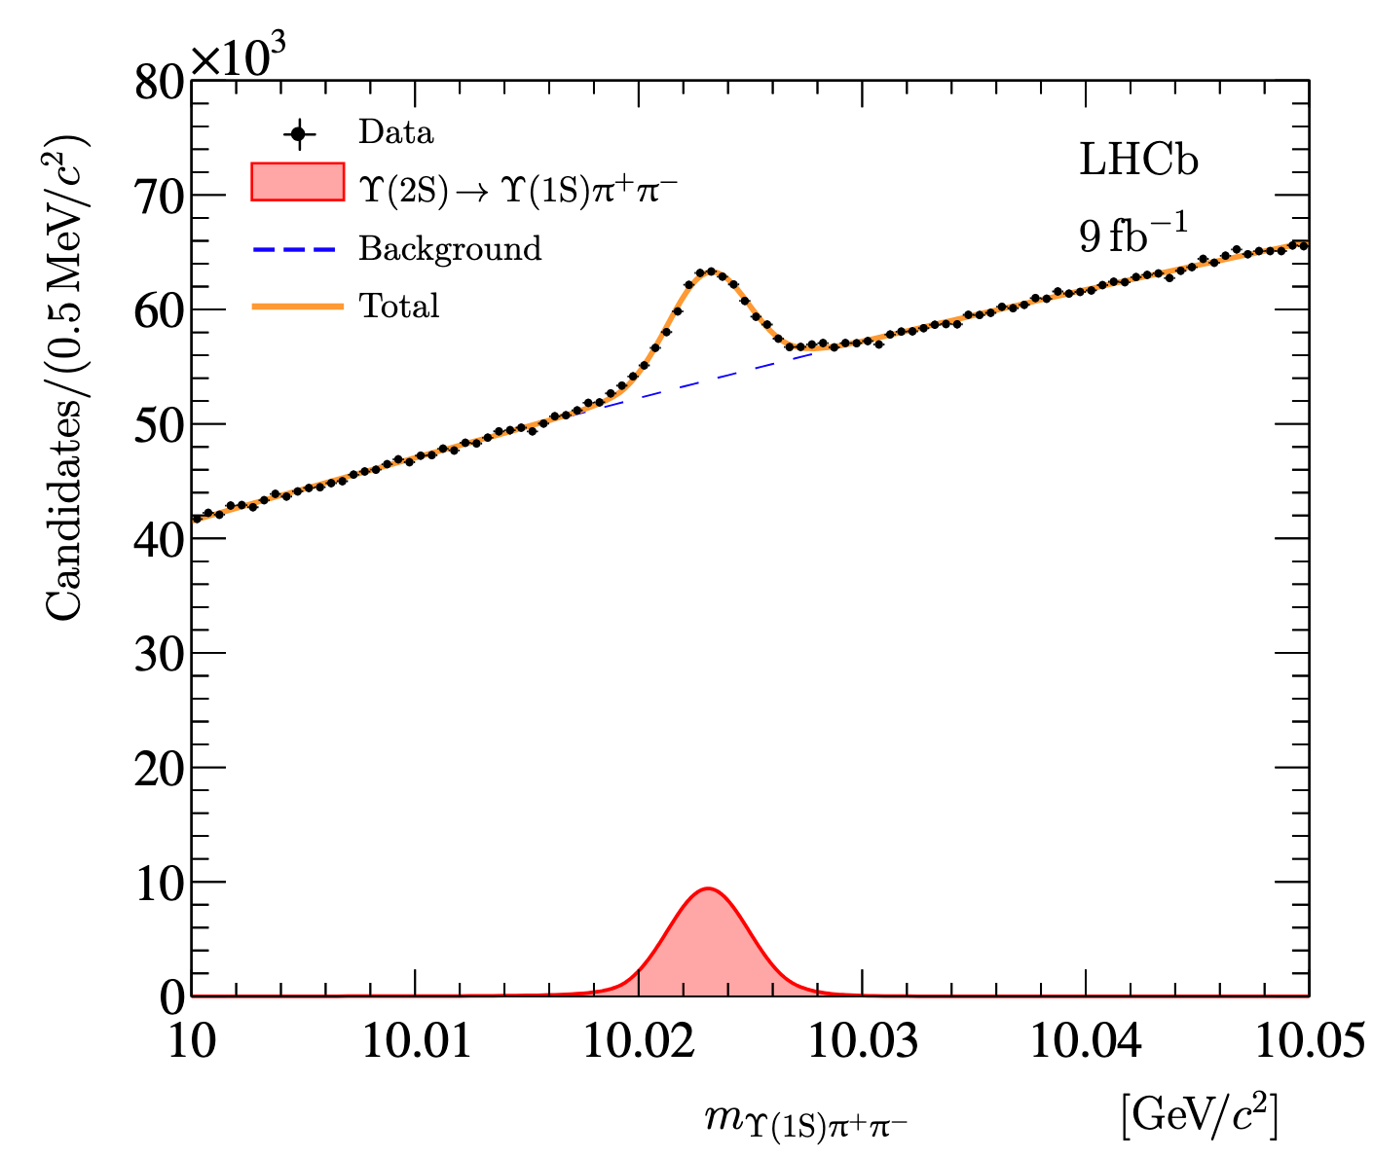
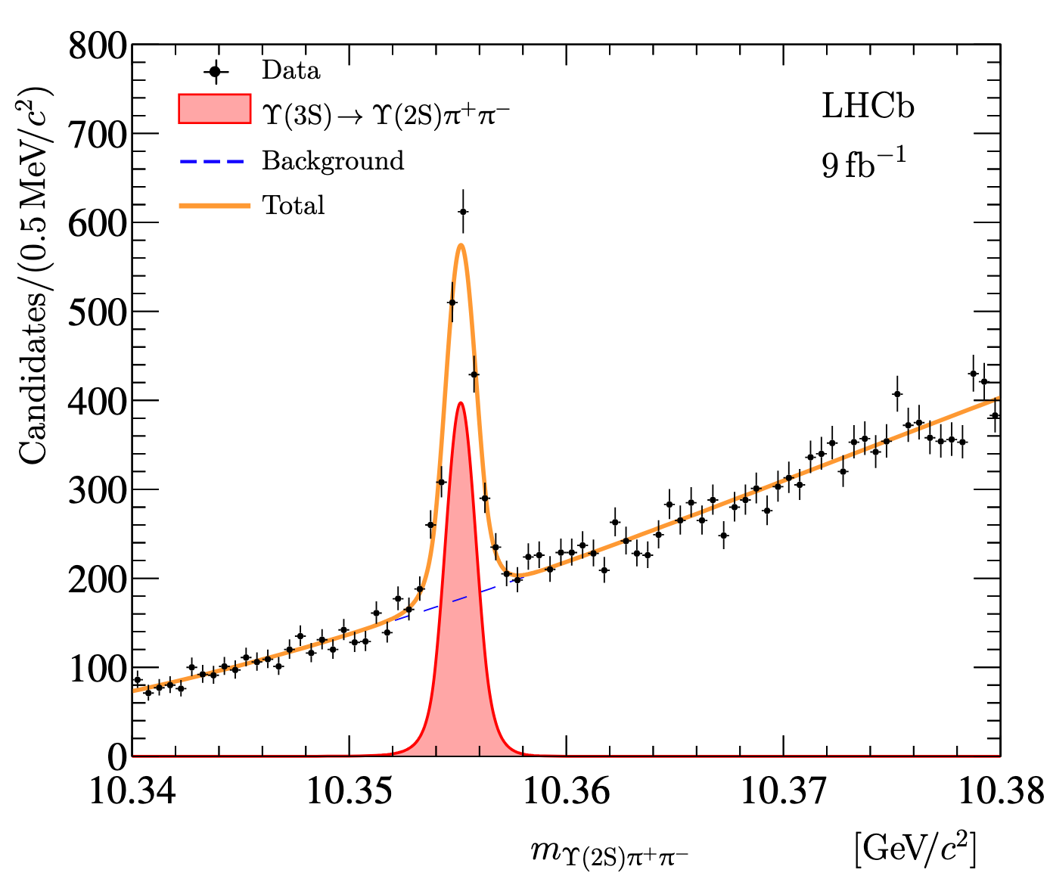

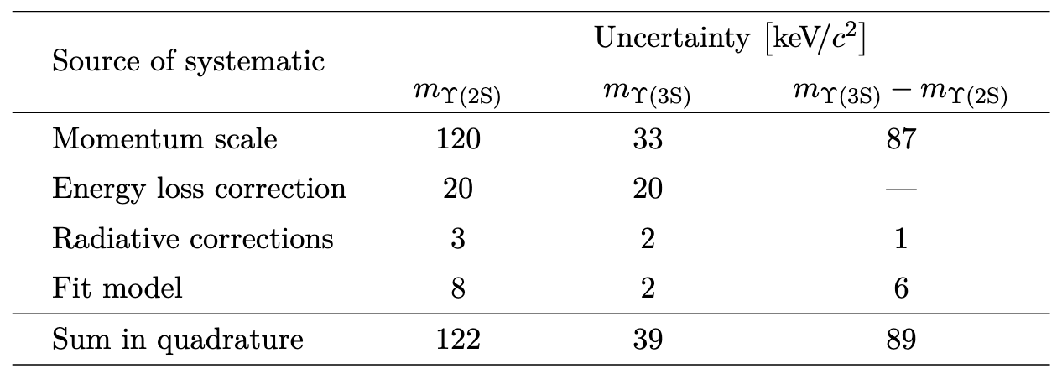
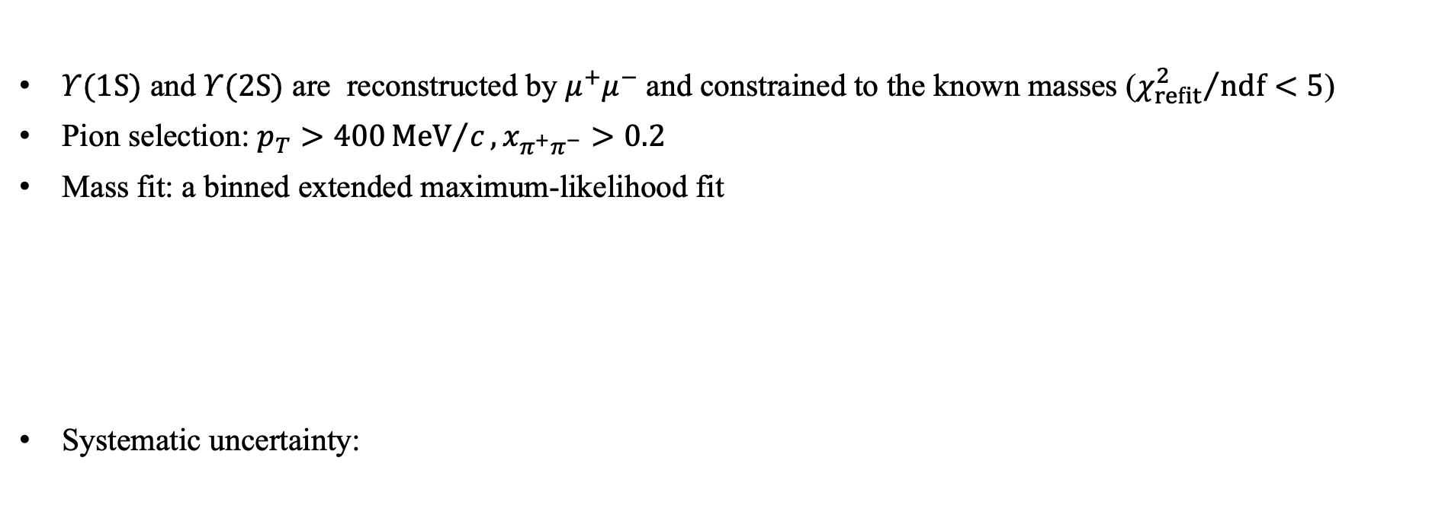
$Υ(2S)→Υ(1S)π^{+}π^{−}$ and $Υ(3S)→Υ(2S)π^{+}π^{−}$
$Υ(1S)$ and $Υ(2S)$ are reconstructed by $μ^{+}μ^{−}$ and constrained to the known masses (${χ_{refit}^{2}}/{ndf}<5$)
Pion selection: $p_{T}>400{MeV}/c, x_{π^{+}π^{−}}>0.2$
Mass fit: a binned extended maximum-likelihood fit
Systematic uncertainty:
[JHEP 10 (2024) 122]

Slide 13
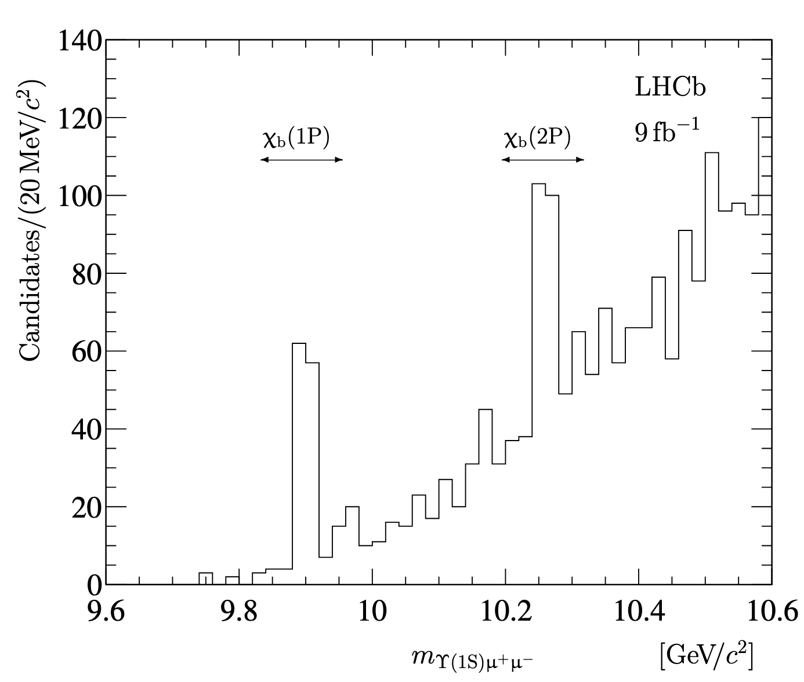
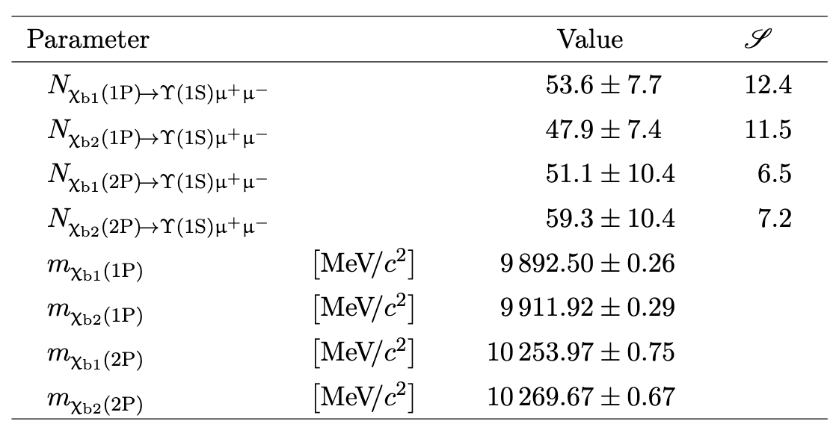
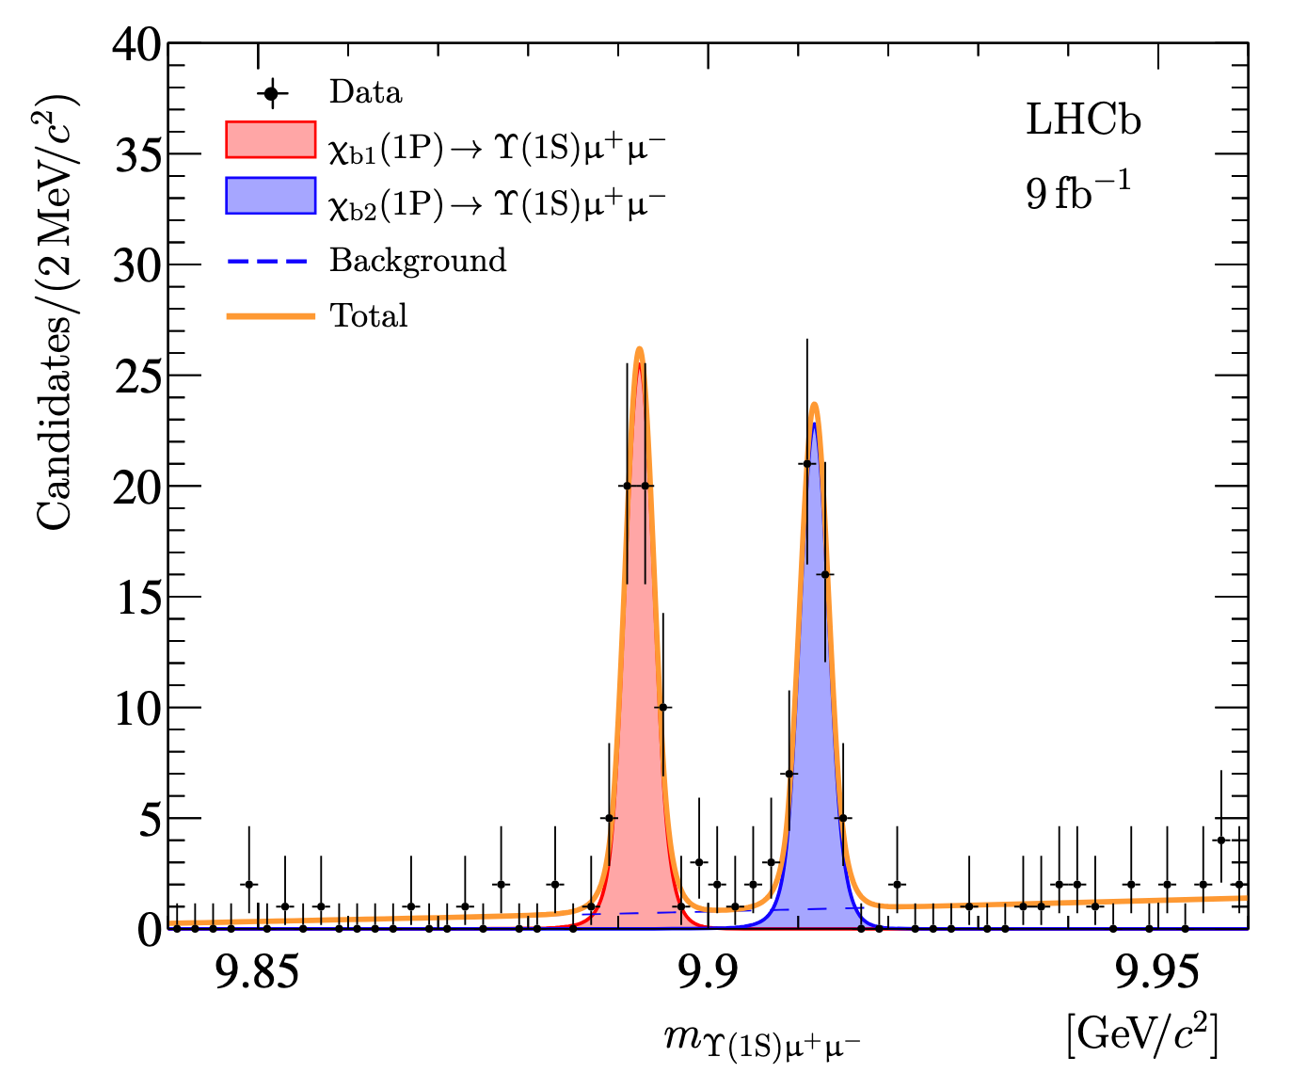
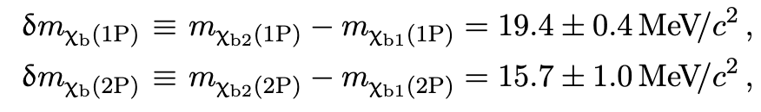
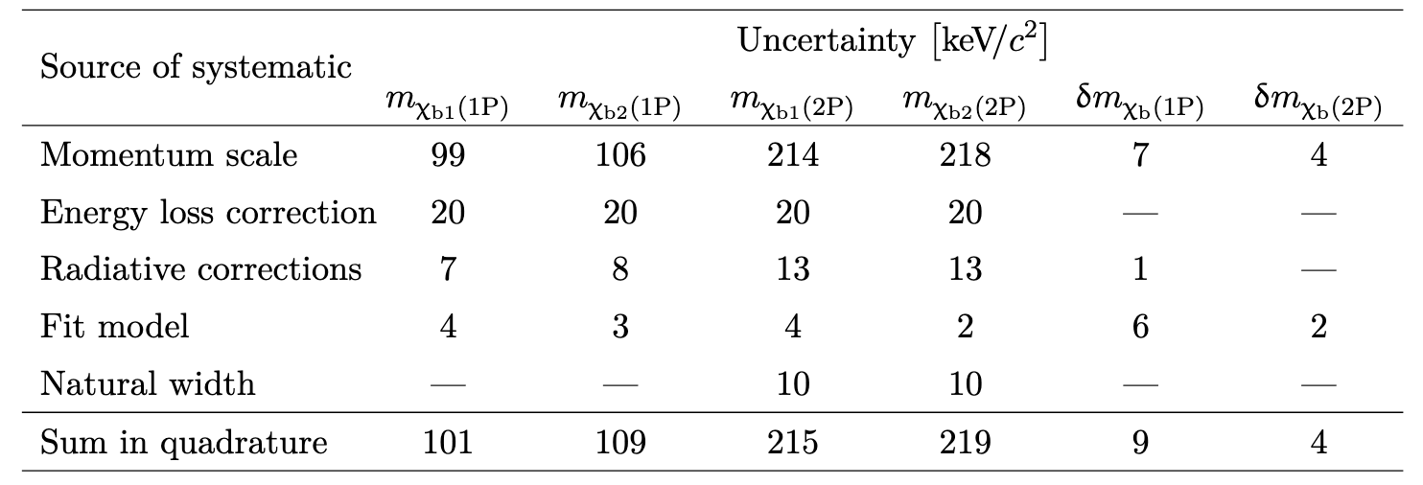
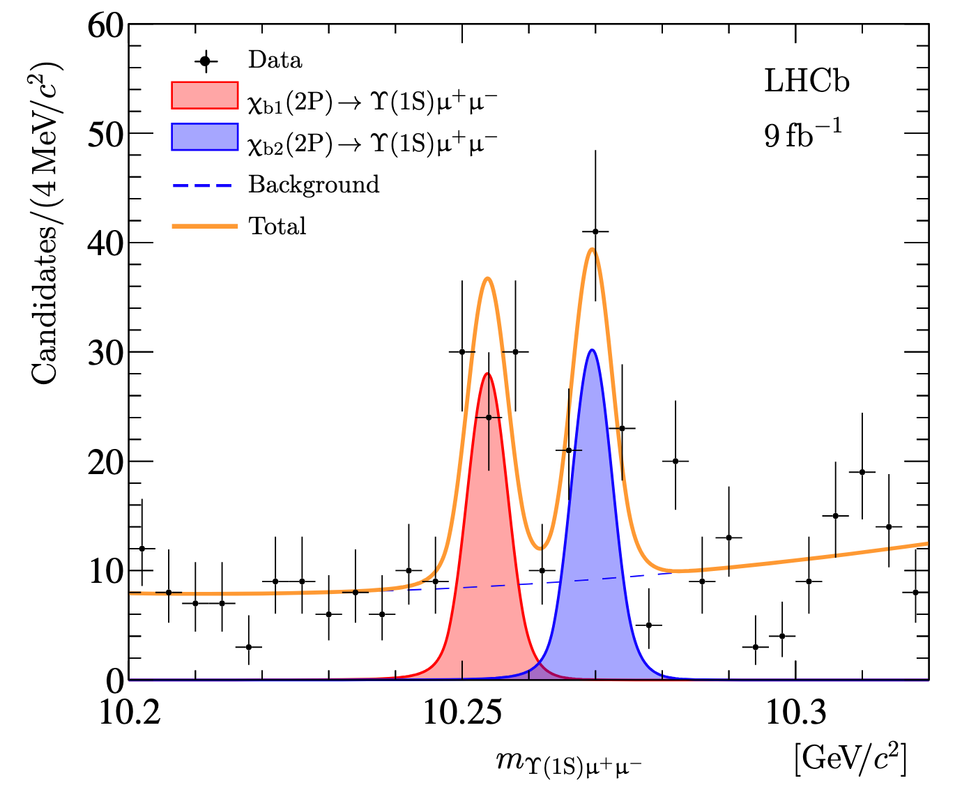

$χ_{b}→{Υ(1S)μ}^{+}μ^{−}$selection and mass fits
$Υ(1S)$ is reconstructed by $μ^{+}μ^{−}$ and constrained to the known mass
Only additional requirement: ${χ_{refit}^{2}}/{ndf}<5$
Mass fit: extended unbinned maximum-likelihood fits in $χ_{b}(1P)$ and $χ_{b}(2P)$ regions
Systematic uncertainty:
First Observation!
[JHEP 10 (2024) 122]

Slide 14
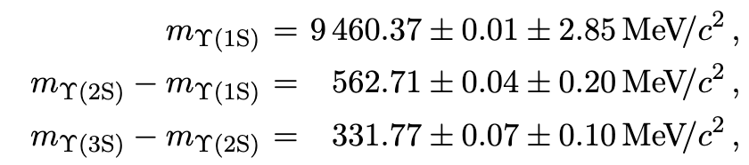
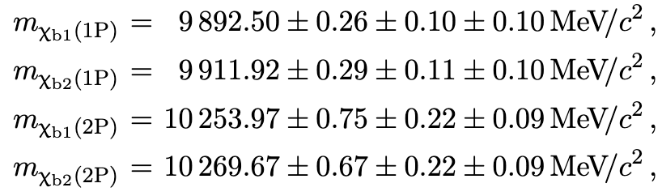
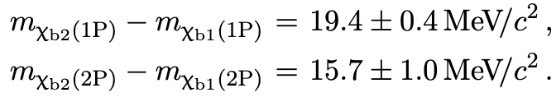
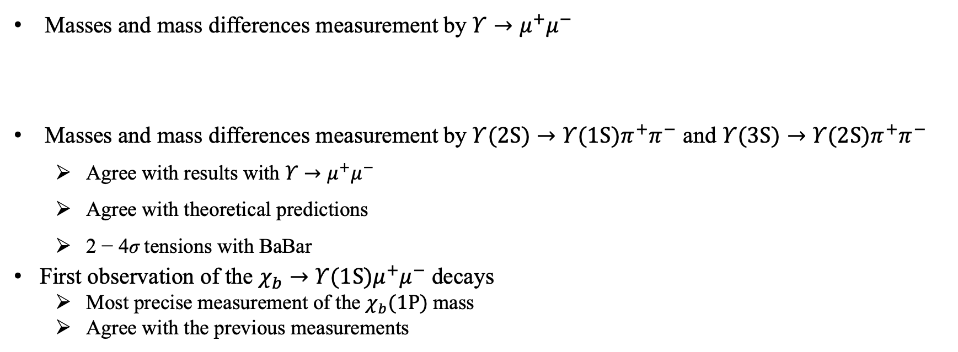
Results
Masses and mass differences measurement by $Υ→μ^{+}μ^{−}$
Masses and mass differences measurement by $Υ(2S)→Υ(1S)π^{+}π^{−}$ and $Υ(3S)→Υ(2S)π^{+}π^{−}$
  Agree with results with $Υ→μ^{+}μ^{−}$
  Agree with theoretical predictions
  2 − 4σ tensions with BaBar
First observation of the $χ_{b}→{Υ(1S)μ}^{+}μ^{−}$ decays
  Most precise measurement of the $χ_{b}(1P)$mass
  Agree with the previous measurements

Slide 15

Observation and study of the
$J/ψ→μ^{+}μ^{−}μ^{+}μ^{−}$ decay

Slide 16
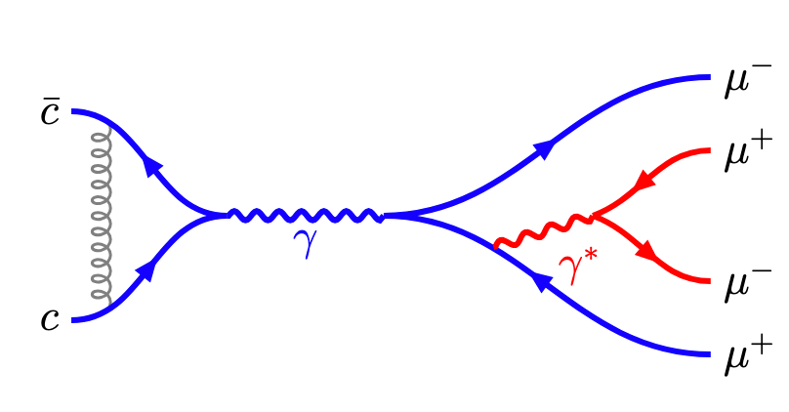

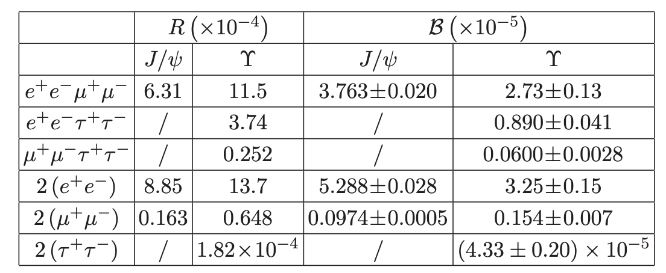
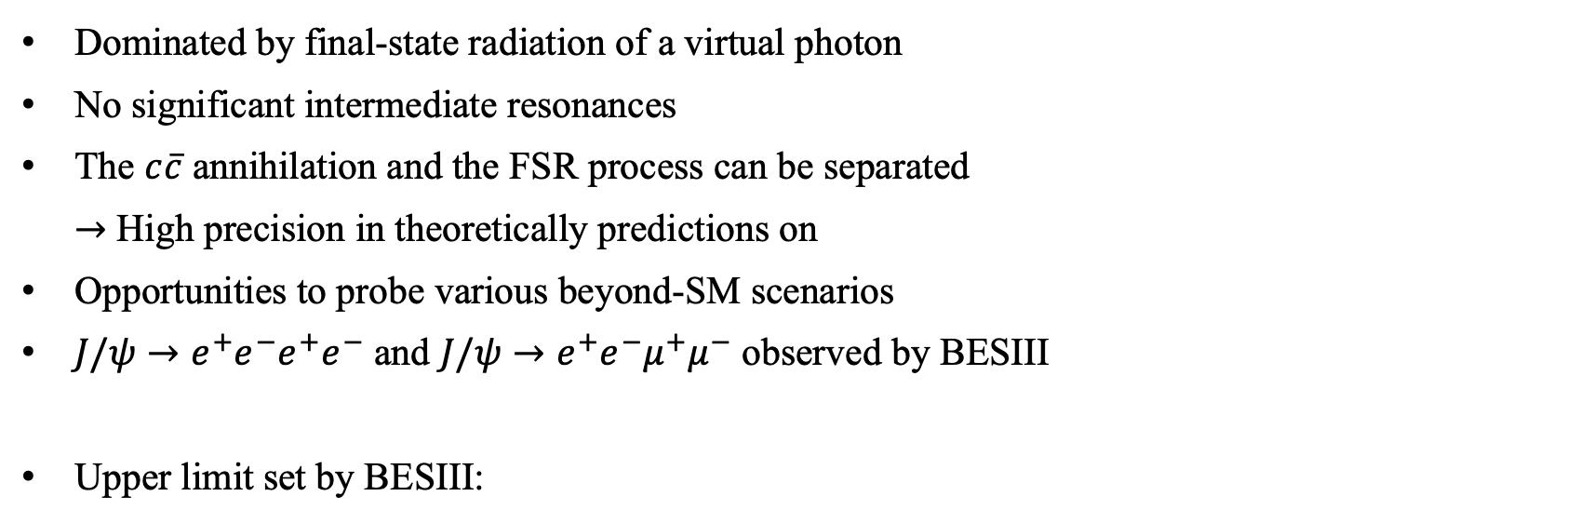
$J/ψ→μ^{+}μ^{−}μ^{+}μ^{−}$ decay
Dominated by final-state radiation of a virtual photon
No significant intermediate resonances
The $c\overline{c}$ annihilation and the FSR process can be separated
$→$ High precision in theoretically predictions on
Opportunities to probe various beyond-SM scenarios
$J/ψ→e^{+}e^{−}e^{+}e^{−}$ and $J/ψ→e^{+}e^{−}μ^{+}μ^{−}$ observed by BESIII
Upper limit set by BESIII:
[PRD 109 (2024) 052006]
[PRD 104 (2021) 094023]

Slide 17
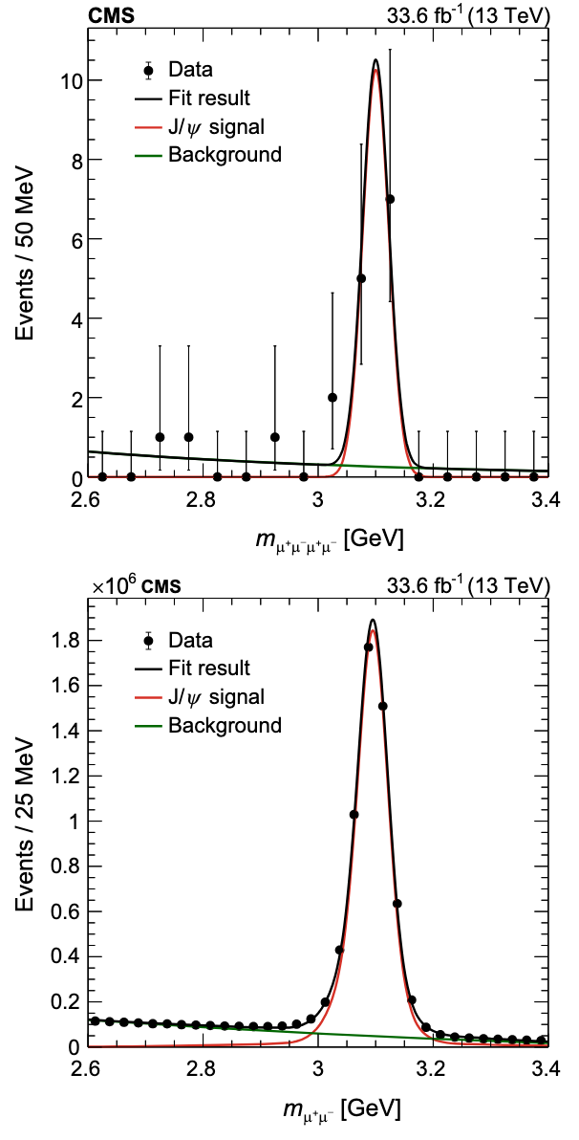


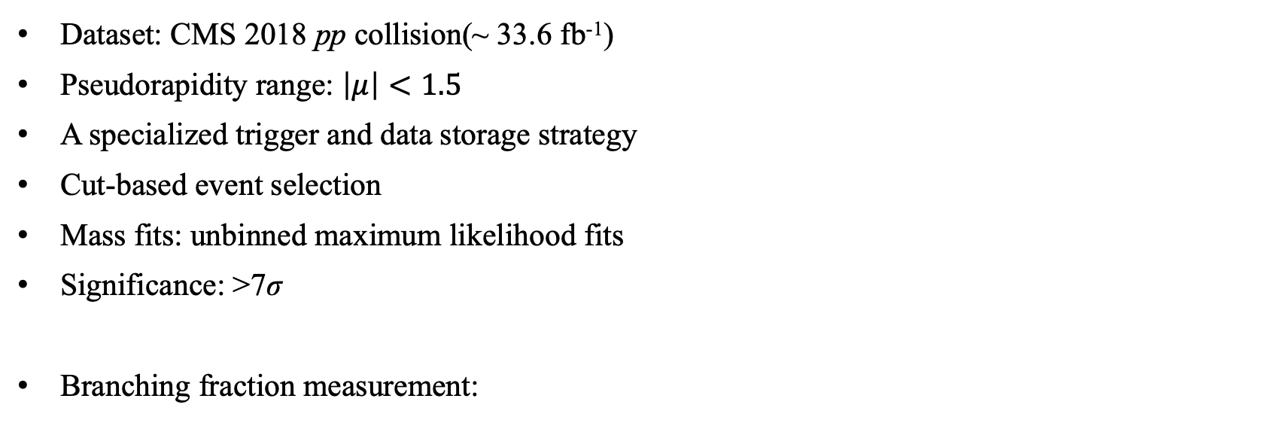
Observation of $J/ψ→μ^{+}μ^{−}μ^{+}μ^{−}$ at CMS
Dataset: CMS 2018 pp collision(~ 33.6 fb⁻¹)
Pseudorapidity range: $\left|μ\right|<1.5$
A specialized trigger and data storage strategy
Cut-based event selection
Mass fits: unbinned maximum likelihood fits
Significance: >7σ
Branching fraction measurement:
First Observation!
[PRD 109 (2924) L111101]

Slide 18
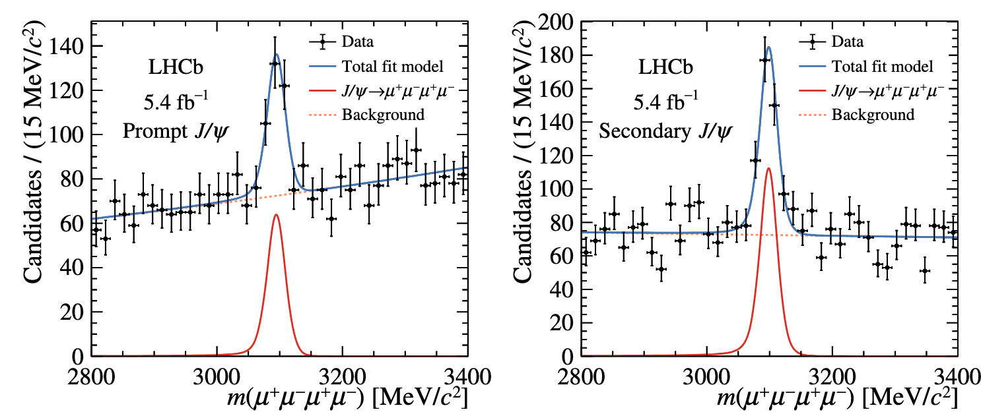
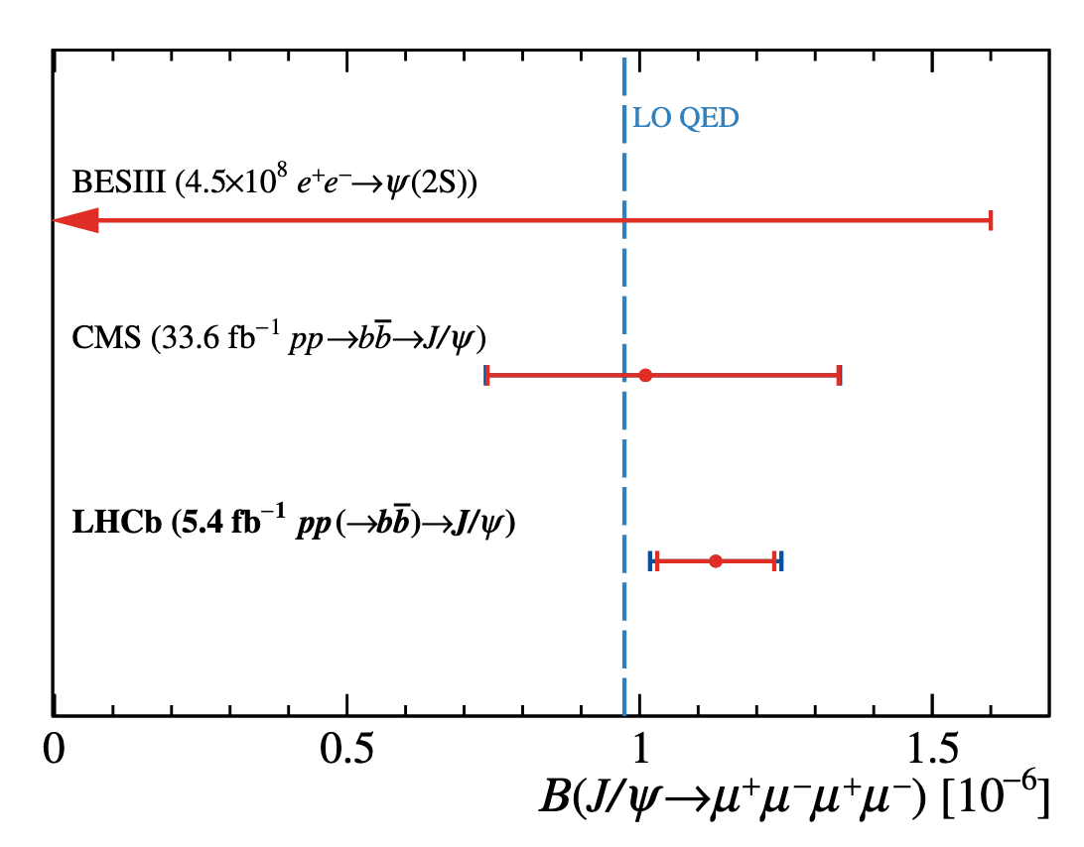


Study of $J/ψ→μ^{+}μ^{−}μ^{+}μ^{−}$ at LHCb
[JHEP 12 (2024) 062]
Dataset: LHCb 2016-2018 pp collision(~ 5.4 fb⁻¹)
Pseudorapidity range: $2<μ<5$
Separated into prompt and secondary $J/ψ$
BDT trained separately for each category
Mass fits: unbinned maximum likelihood fits
Branching fraction measurement:
Most precise measurement of the branching fraction

Slide 19
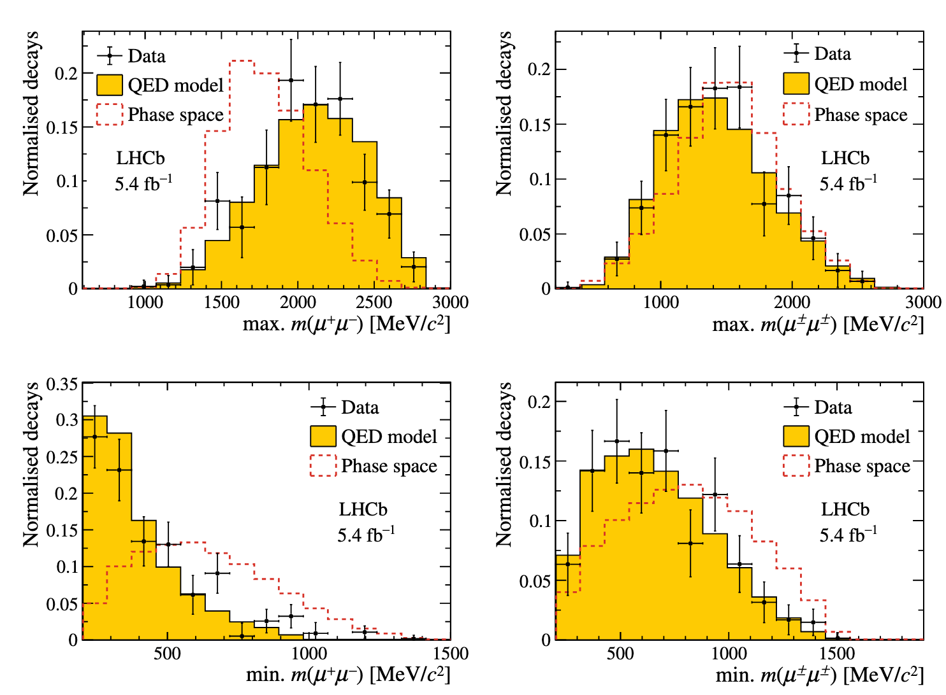
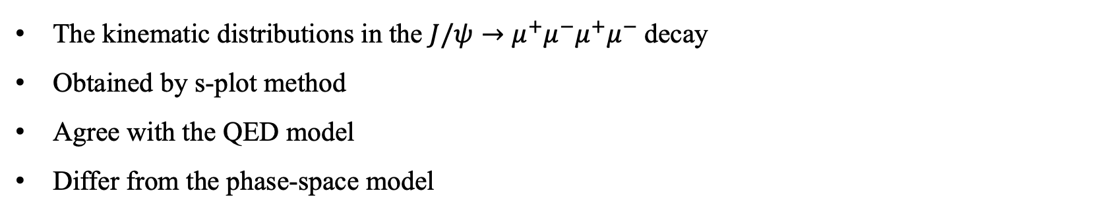
Study of $J/ψ→μ^{+}μ^{−}μ^{+}μ^{−}$ at LHCb
The kinematic distributions in the $J/ψ→μ^{+}μ^{−}μ^{+}μ^{−}$decay
Obtained by s-plot method
Agree with the QED model
Differ from the phase-space model
[JHEP 12 (2024) 062]

Slide 20

Summary
Recent results about decay of heavy hadrons at LHCb and CMS
Doubly charmed baryon:
  New decay mode $Ξ_{cc}^{++}→Ξ_{c}^{0}π^{+}π^{+}$ observed
  Relative branching fraction measured
Bottomonium:
  Masses measurement by $Υ→μ^{+}μ^{−}$, $Υ(2S)→Υ(1S)π^{+}π^{−}$ and $Υ(3S)→Υ(2S)π^{+}π^{−}$
  First observation of the $χ_{b}→{Υ(1S)μ}^{+}μ^{−}$ decays
  Mass and mass splitting measured for$χ_{b}(1P)$ and $χ_{b}(2P)$
Charmonium:
  Observation of $J/ψ→μ^{+}μ^{−}μ^{+}μ^{−}$ at CMS
  Precise measurement of the $J/ψ→μ^{+}μ^{−}μ^{+}μ^{−}$branching fraction at LHCb
More results are coming with run3 data at LHC

Slide 21
Thank you!

Slide 22
Backup

Slide 23



$Υ(2S)→Υ(1S)π^{+}π^{−}$ and $Υ(3S)→Υ(2S)π^{+}π^{−}$

Slide 24


$χ_{b}→{Υ(1S)μ}^{+}μ^{−}$

