Slide 1
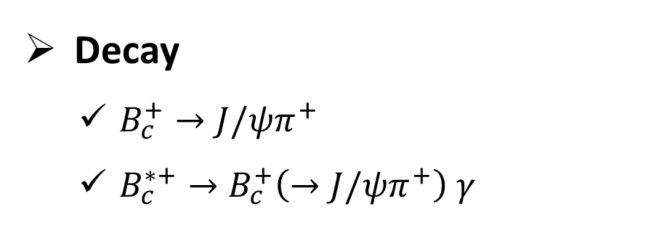
da
The LHCb upgrade and its impact on quarkonium measurements
Decay
$B_{c}^{+}→J/ψπ^{+}$
$B_{c}^{∗+}→B_{c}^{+}\left(→J/ψπ^{+}\right) γ$
Mengzhen Wang (CERN)
on behalf of the LHCb Collaboration
QWG2025
2025/11/17
Checks on MC
Kinematics
Trigger
Efficiency
Checks on Data
Mass

Slide 2
The LHCb experiment and its upgrade

Slide 3
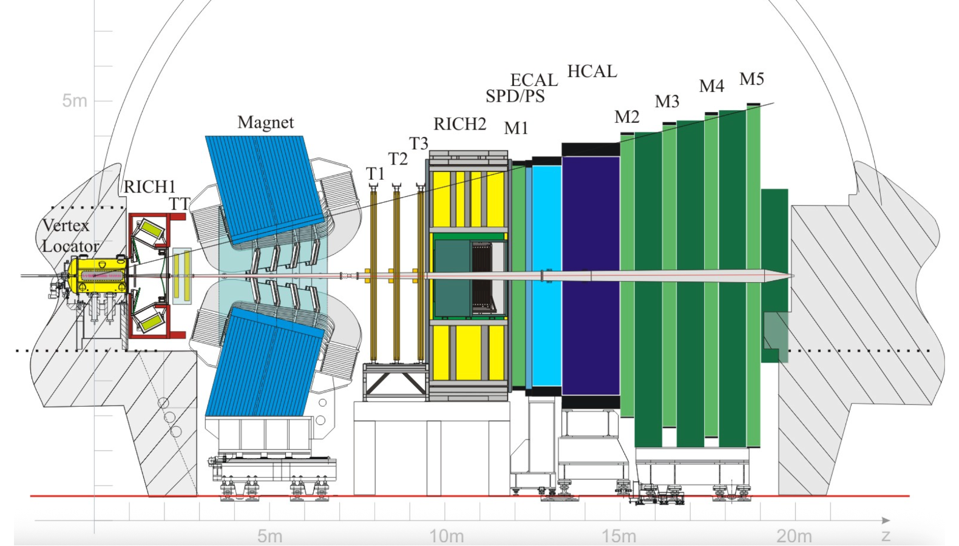



The LHCb experiment (Run1-2)
Single-arm and forward spectrometer, optimized for reconstructing heavy-flavor signals
Tracking system:
Efficient tracking for charged particle and precise momentum measurement
$$δp/p \sim 1\%$$
JINST 3 (2008) S08005,
IJMPA 30:07 (2015) 1530022
Vertex Locator:
High precision vertexing; separate production and decay vertices for weakly decaying b/c hadrons

Slide 4
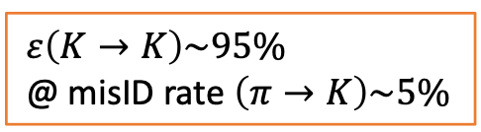
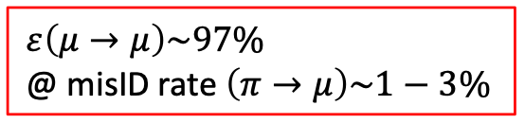

The LHCb experiment (Run1-2)
Single-arm and forward spectrometer, optimized for reconstructing heavy-flavor signals
Calorimeters:
Reconstructing neutral objects and trigger
$$σ\left(E\right)/E\sim 10\%/\sqrt{E}⊕1\%$$
JINST 3 (2008) S08005,
IJMPA 30:07 (2015) 1530022
Cherenkov detector:
Efficient charged hadron identification
Muon system (M1-M5):
Efficiency muon identification and trigger

Slide 5
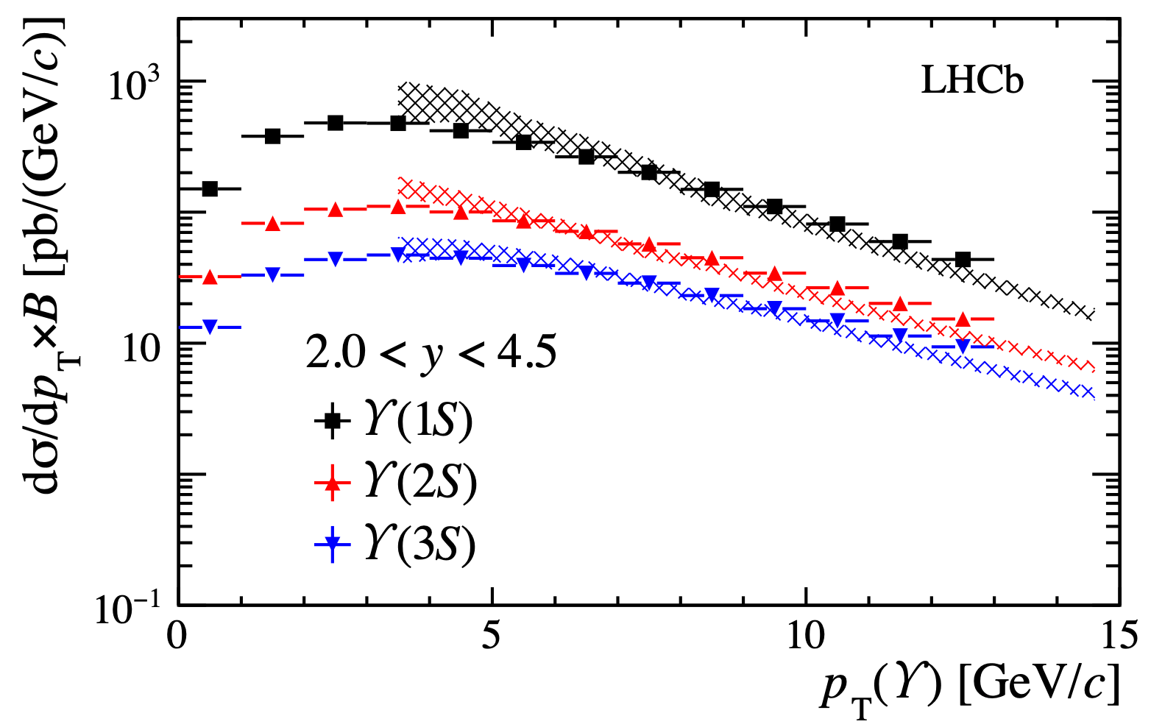
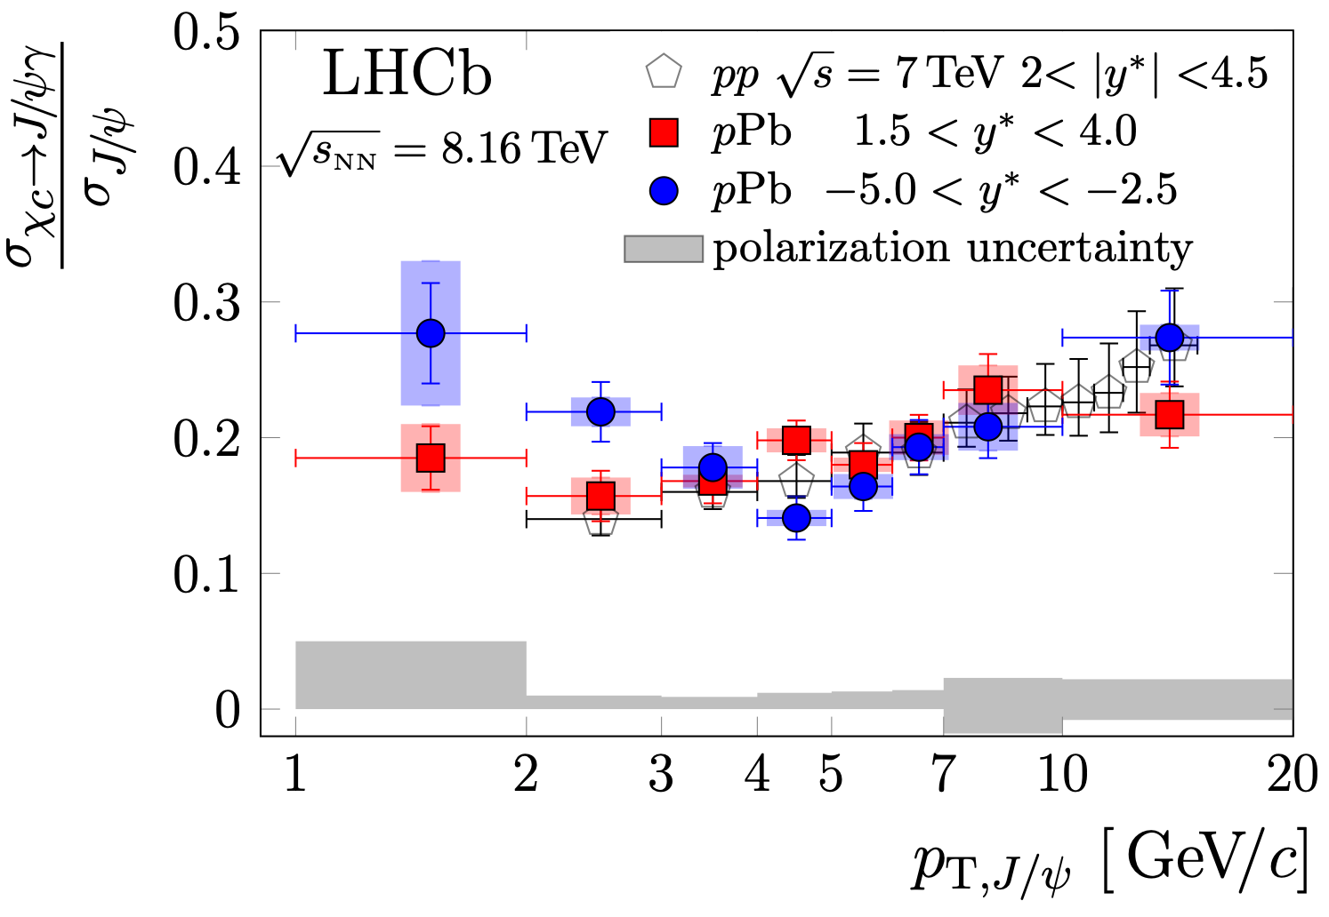
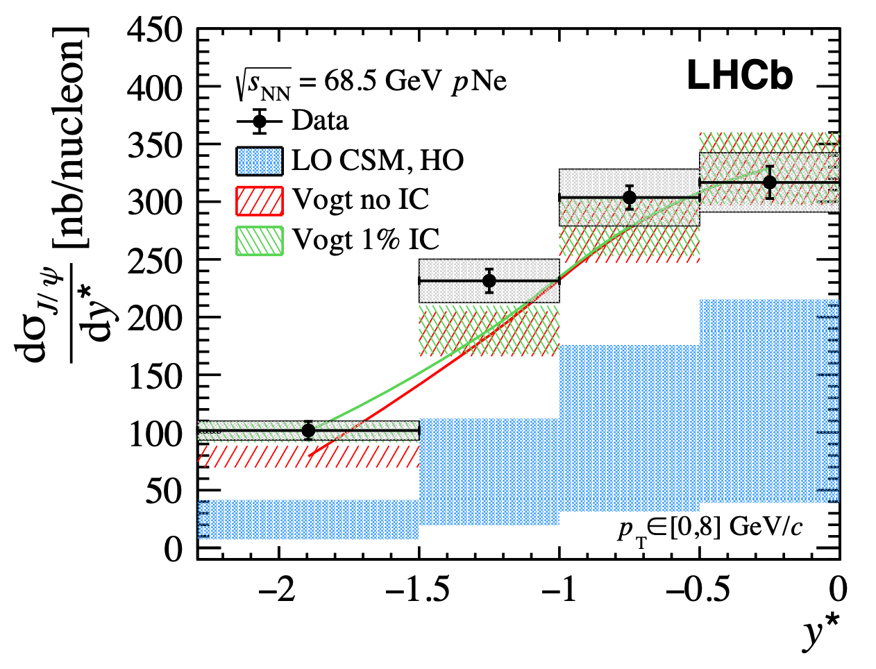
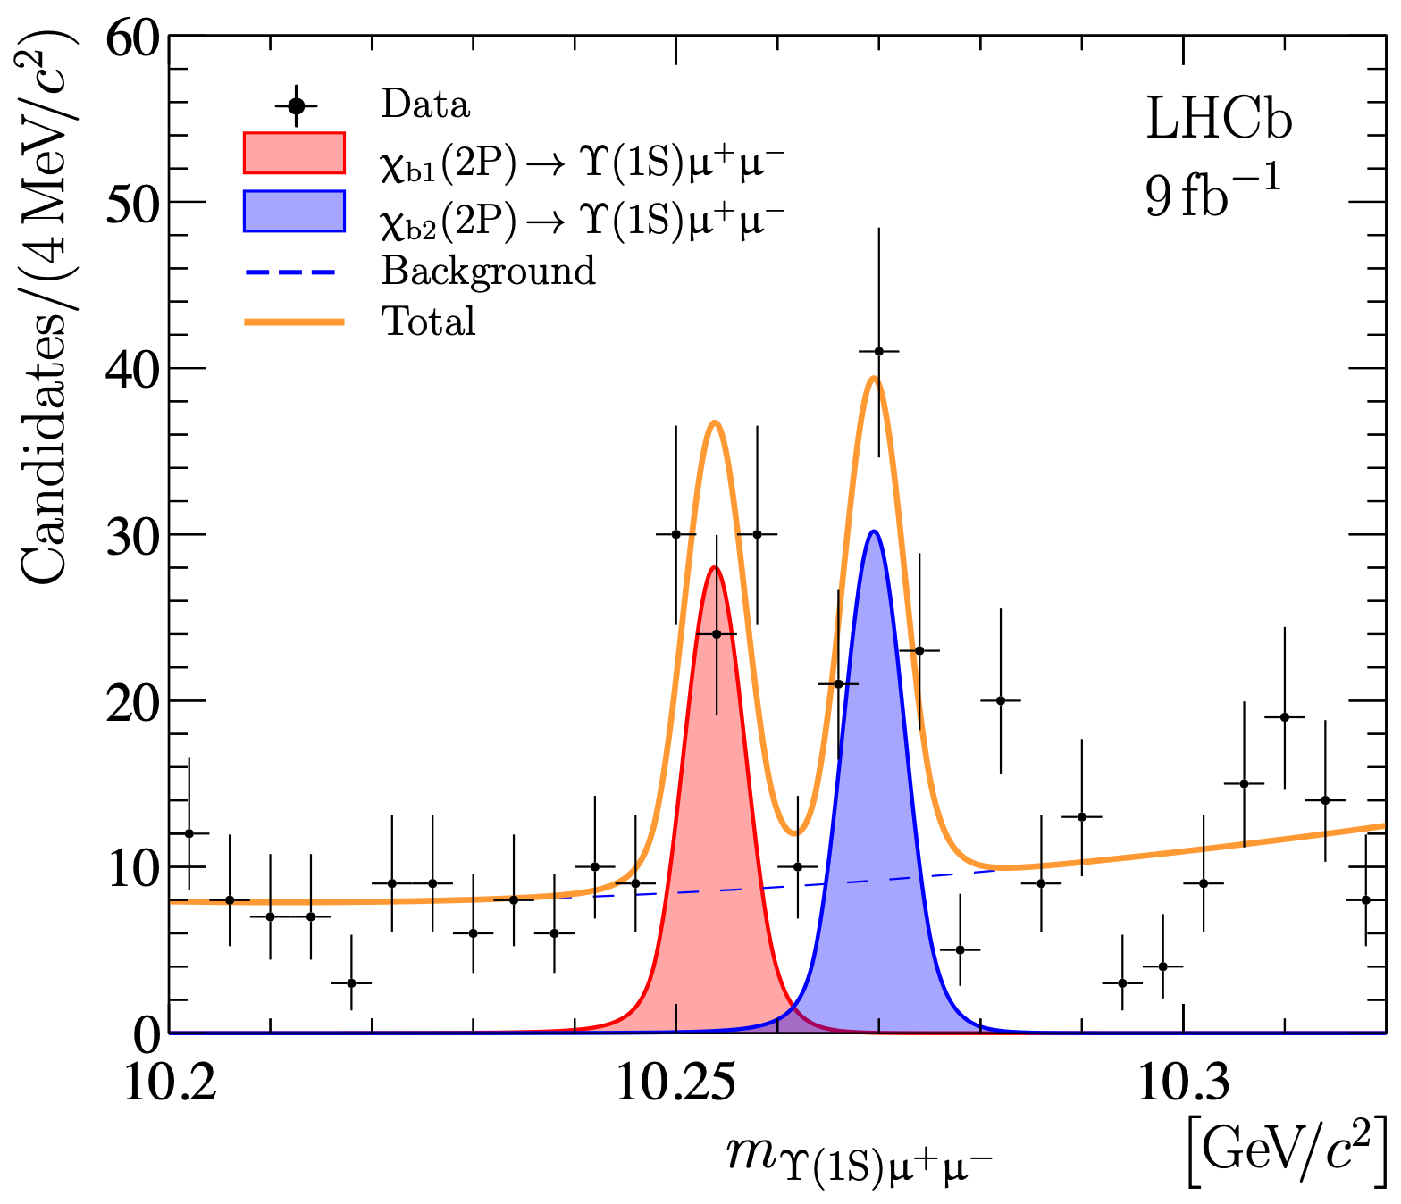
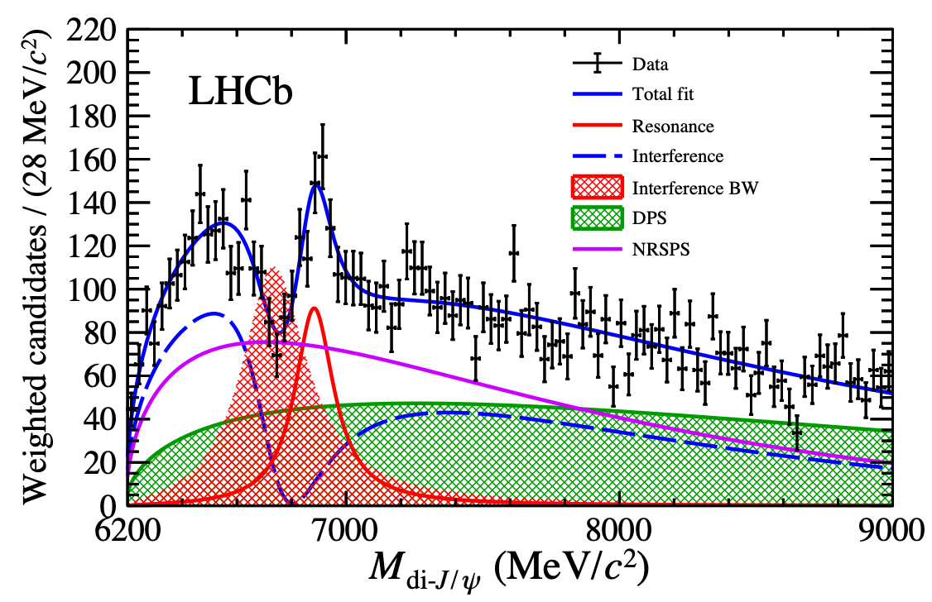
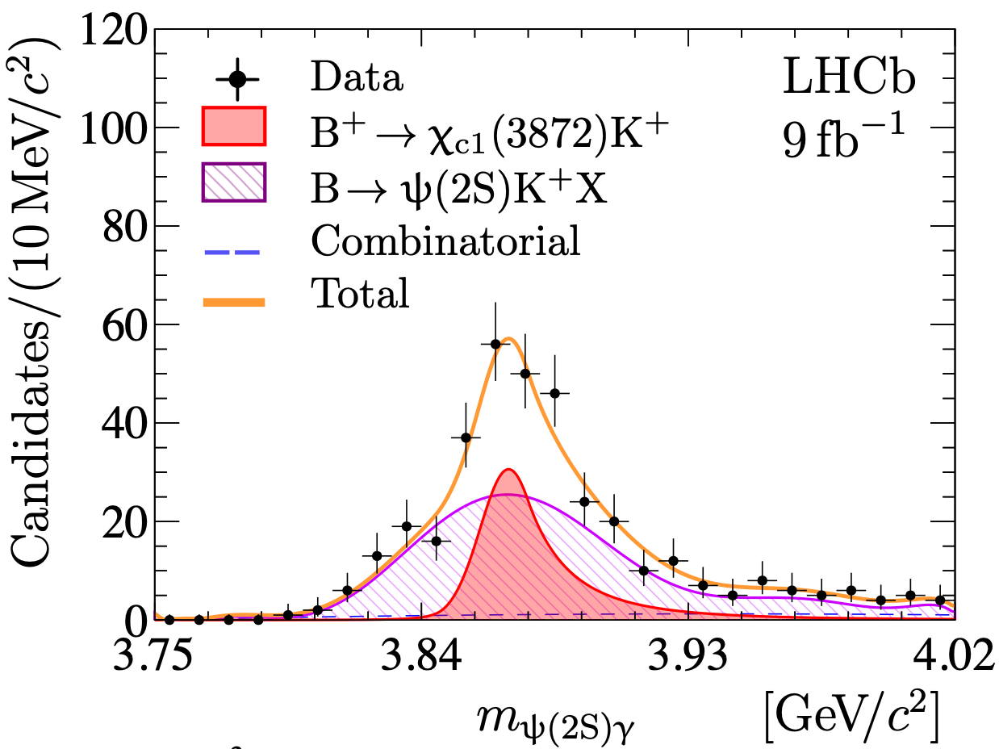

Quarkonia measurement at LHCb Run1-2
Quarkonia production at various types of systems
Spectroscopy studies of Quarkonia(-like) hadrons
JHEP 07 (2018) 134
PRL 132 (2024) 10, 102302
EPJC 83 (2023) 7, 625
$$pp @ 13TeV$$
JHEP 10 (2024) 122
Sci.Bull. 65 (2020) 23, 1983-1993
JHEP 11 (2024) 121

Slide 6
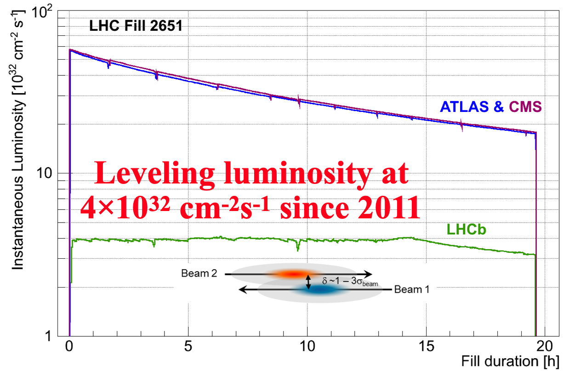
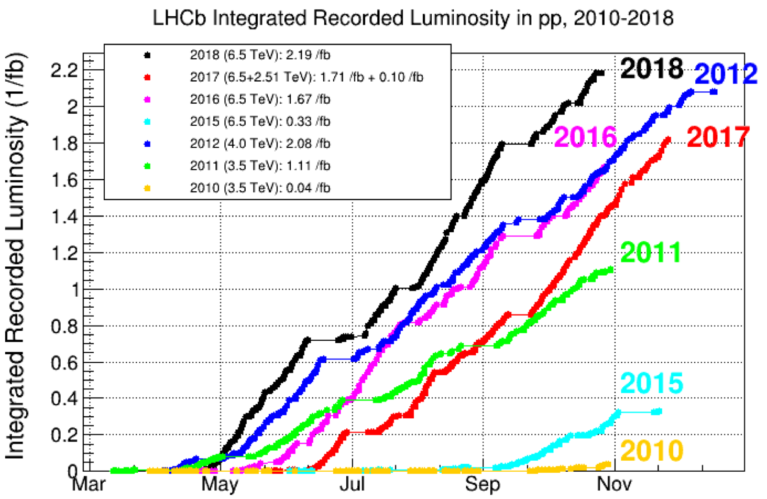
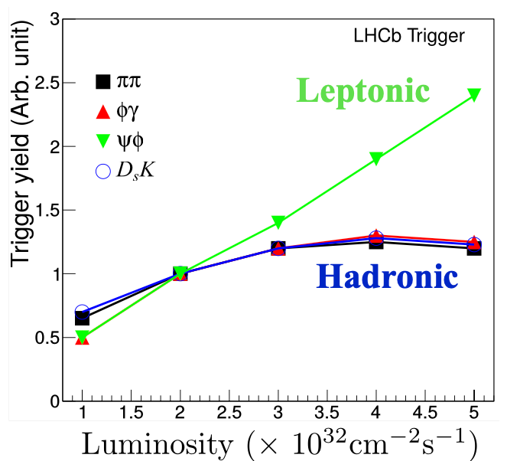
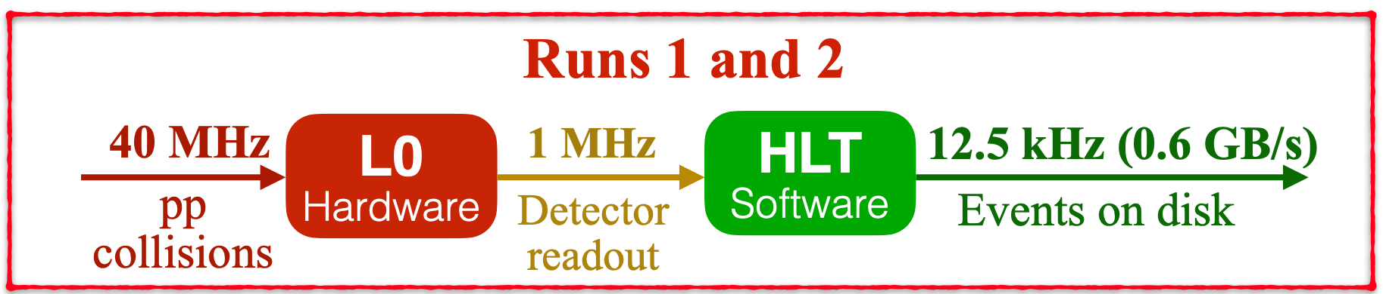
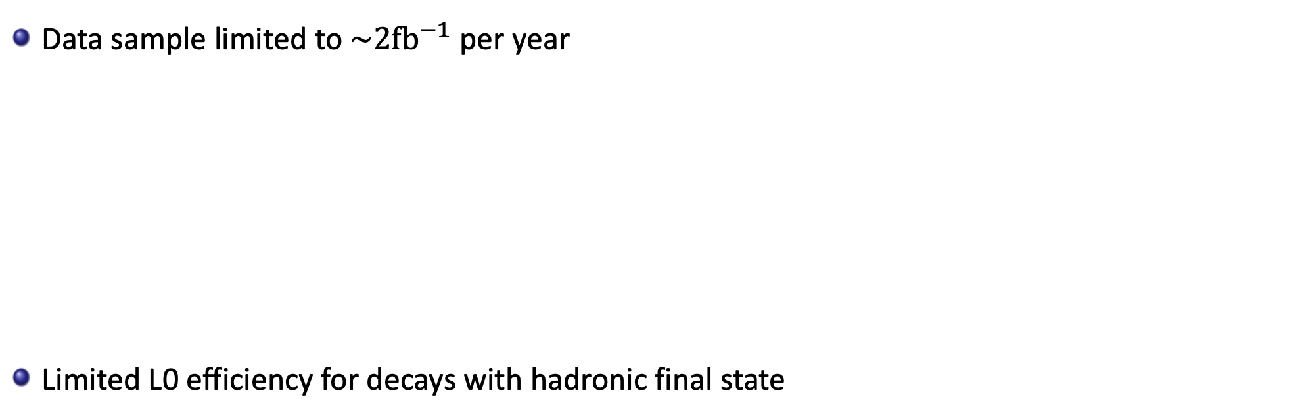
Limitations of LHCb data collection until 2018
Data sample limited to $\sim 2{fb}^{−1}$ per year
Limited L0 efficiency for decays with hadronic final state
Hadronic hardware trigger saturates fast
Would be a show stopper for high-lumi operation
Notes:
saturation

Slide 7
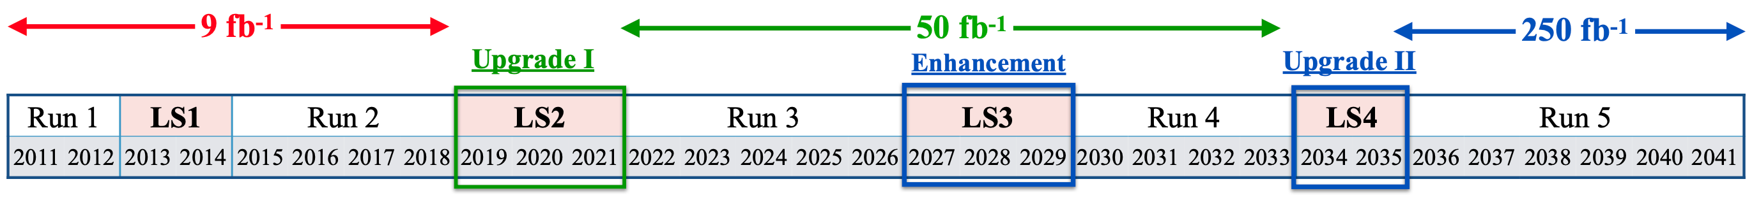

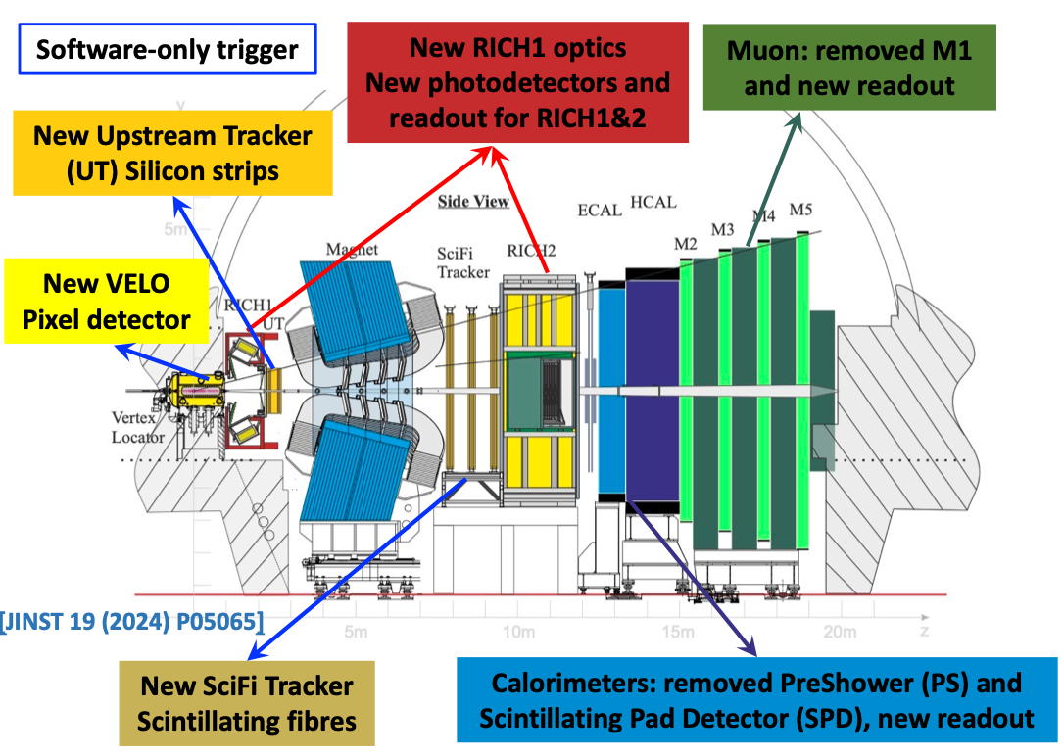
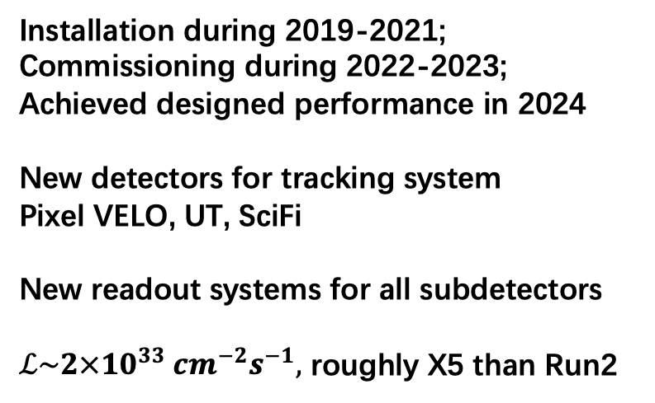
The LHCb Upgrade I
Installation during 2019-2021; Commissioning during 2022-2023;
Achieved designed performance in 2024
New detectors for tracking system
Pixel VELO, UT, SciFi
New readout systems for all subdetectors
$ℒ\sim 2×10^{33} cm^{−2}s^{−1},$ roughly X5 than Run2

Slide 8
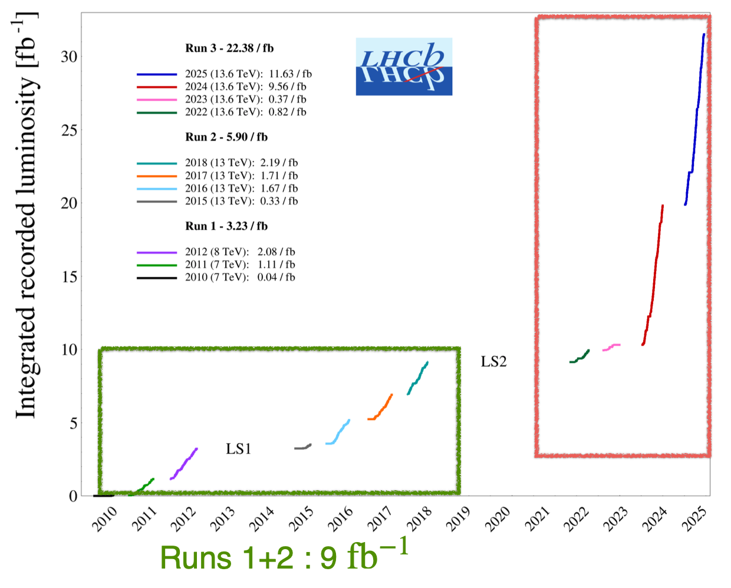

The LHCb Upgrade I
Installation during 2019-2021; Commissioning during 2022-2023;
Achieved designed performance in 2024
New detectors for tracking system
Pixel VELO, UT, SciFi
New readout systems for all subdetectors
$ℒ\sim 2×10^{33} cm^{−2}s^{−1},$ roughly X5 than Run2
Run 3: $>22 {fb}^{−1}$ collected !

Slide 9
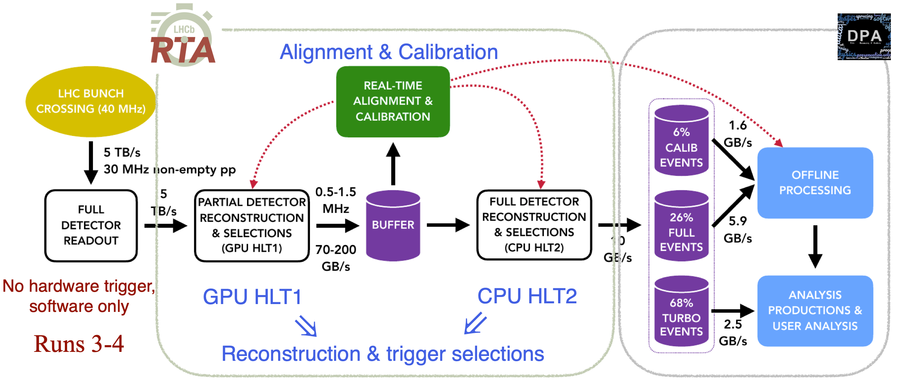
The LHCb Upgrade I
Trigger efficiency for hadronic decays X2 compared to Run2
First purely software trigger in HEP & First software trigger on GPUs !

Slide 10
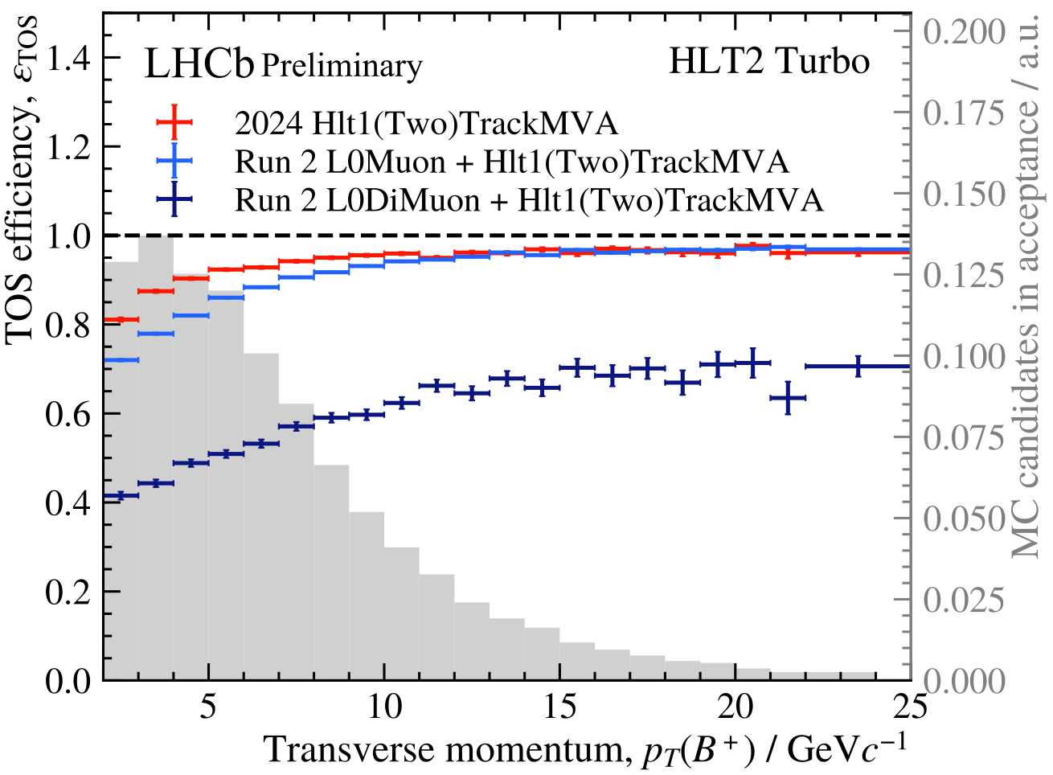
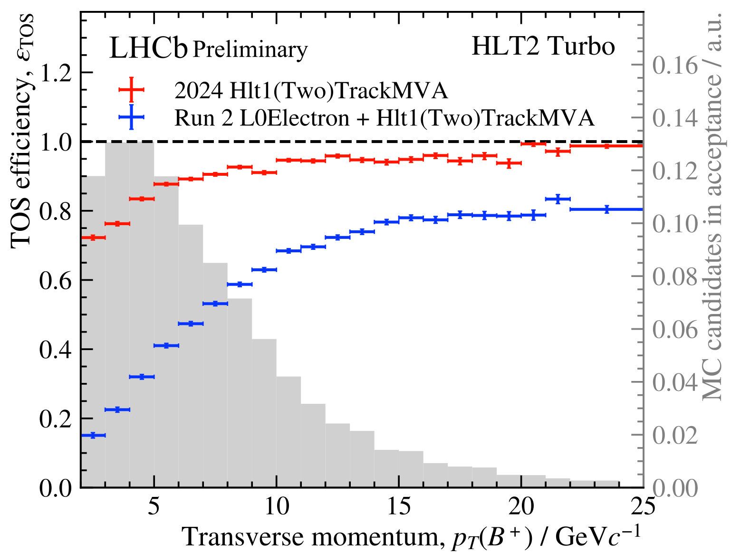
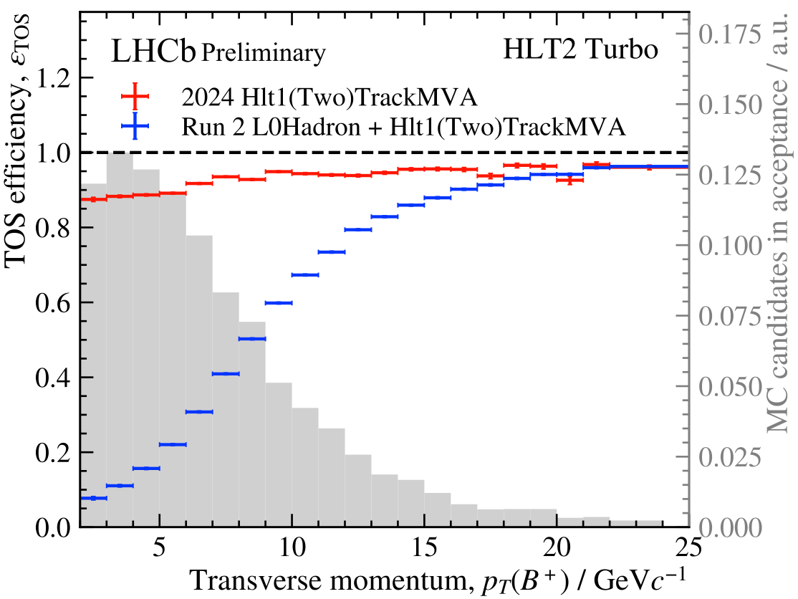



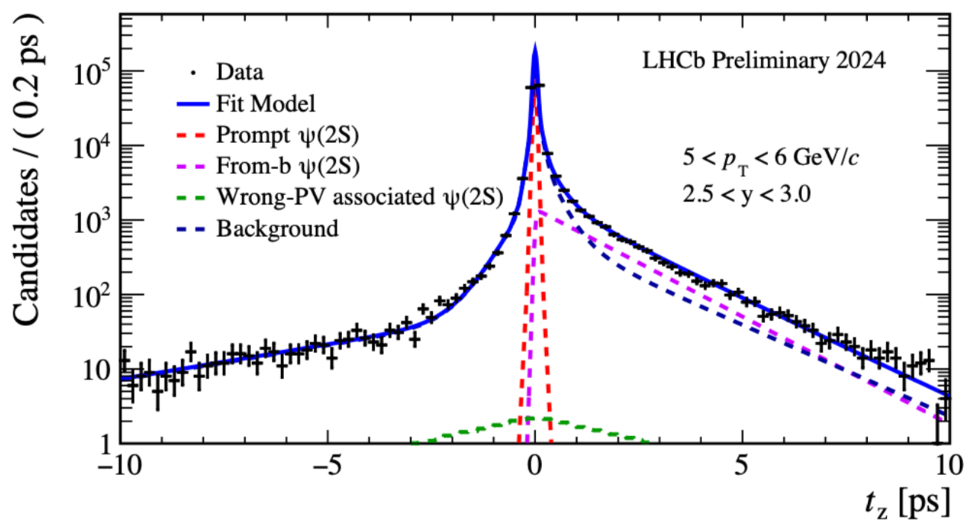
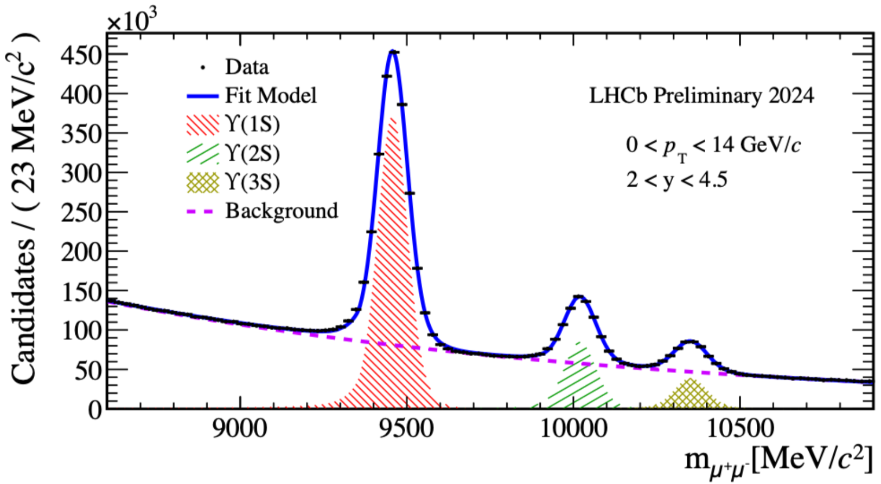
LHCb Run3 performance
LHCB-FIGURE-2024-030
LHCB-FIGURE-2024-030
LHCB-FIGURE-2024-030
(Di)Muon trigger efficiency as high as Run2
Electronic & Hadronic trigger efficiency much higher than Run2
LHCB-FIGURE-2024-024
LHCB-FIGURE-2024-025
Good lifetime resolution
Good mass resolution

Slide 11
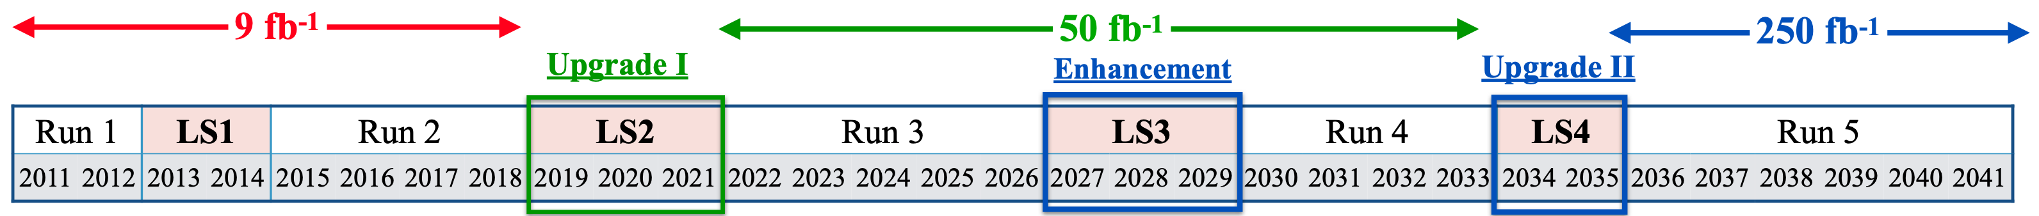
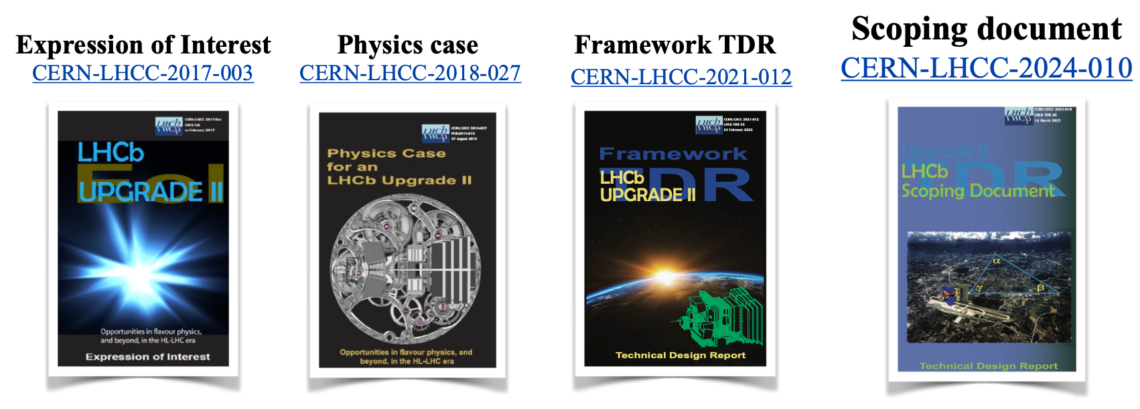
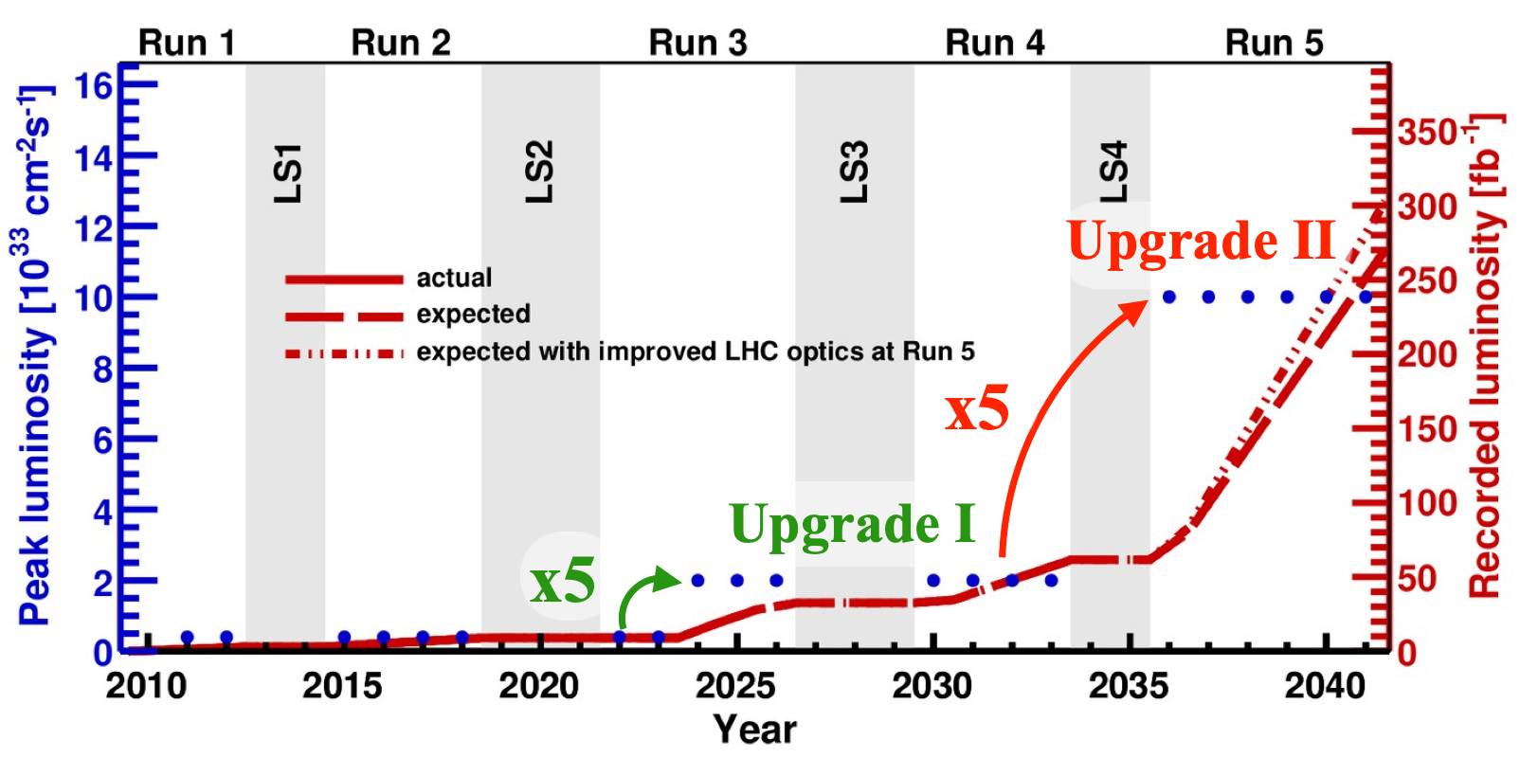

The LHCb Upgrade II
LHCb Upgrade II: Further upgrade to fully exploit HL-LHC
Peaking luminosity: $\left(1.0 \sim 1.5\right)×{10}^{34} cm^{−2}s^{−1}$
5~8 times higher than Run3
Aiming for $300 {fb}^{−1}$
One order of magnitude higher than now. New opportunities for quarkonium physics

Slide 12
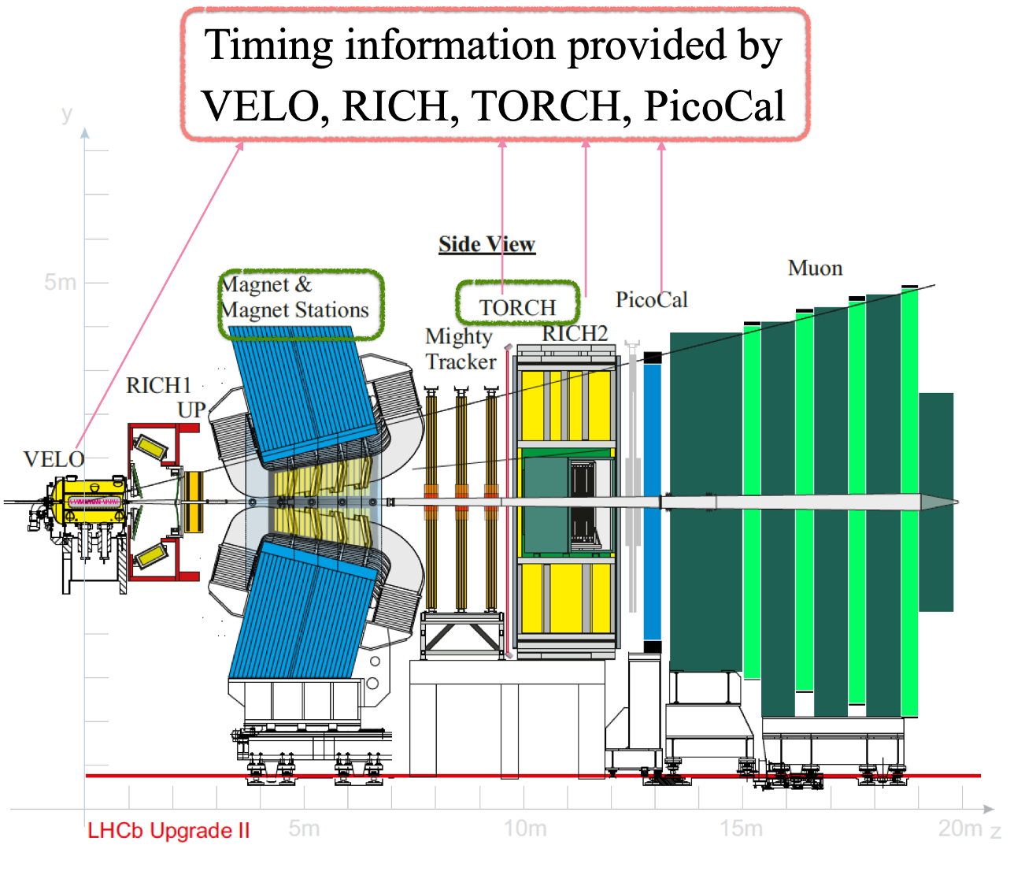
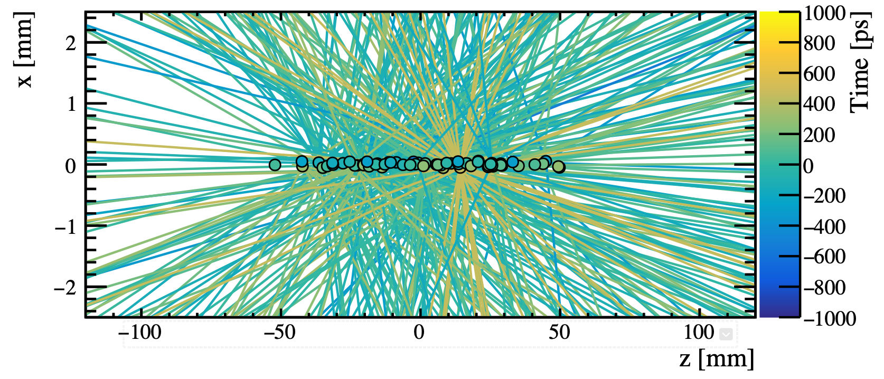
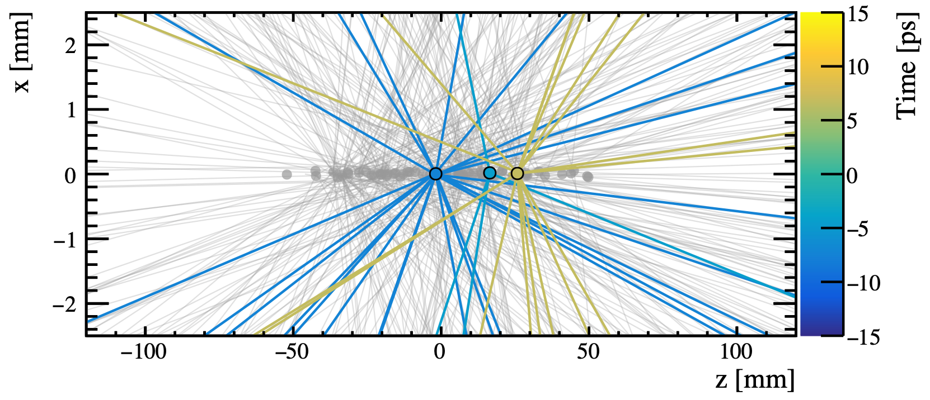
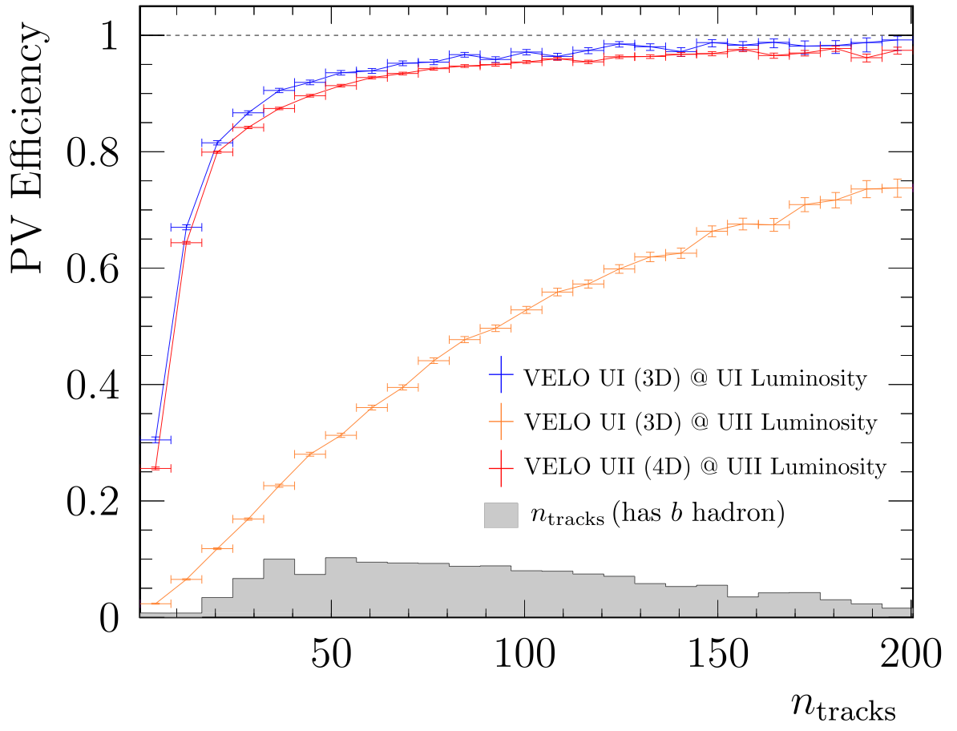
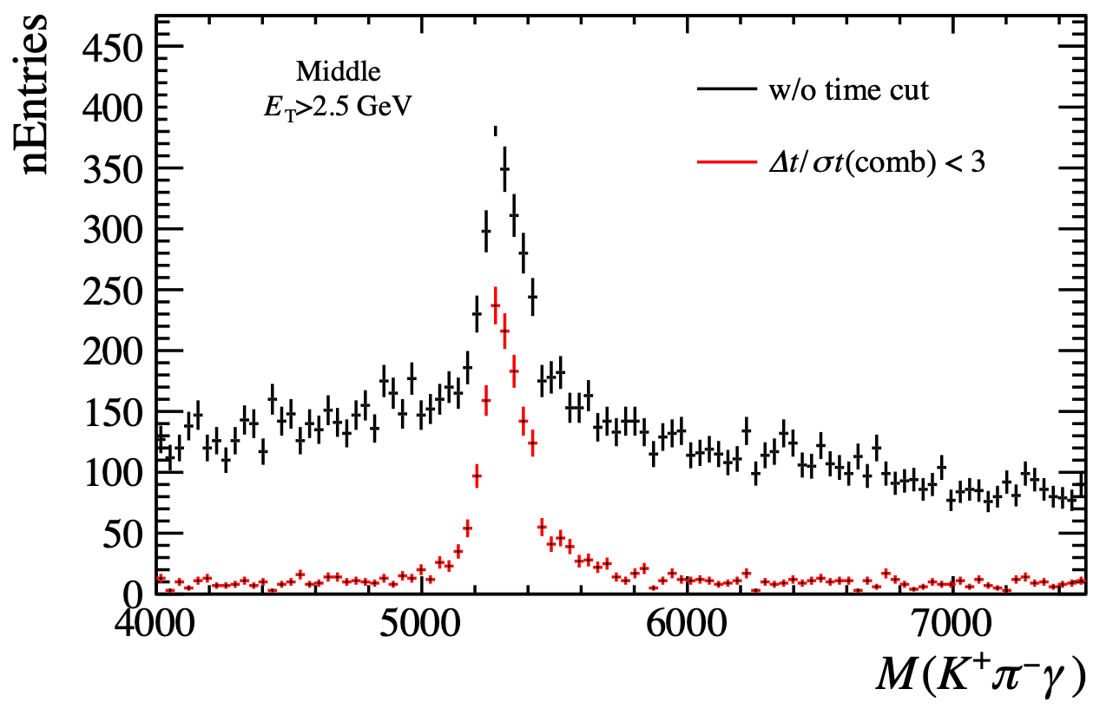
The LHCb Upgrade II
Major challenge: Extremely high pile-ups, ~ 40 visible collisions per event
Time information necessary. Provided by several new detectors
LHCb-TDR-026 (U2 scoping document)
30ps time window
All subdetectors to be upgraded
Two new subdetectors: Magnet Station & TORCH
For Tracking and PID of low-momentum particles

Slide 13
Opportunities of Quarkonium production

Slide 14
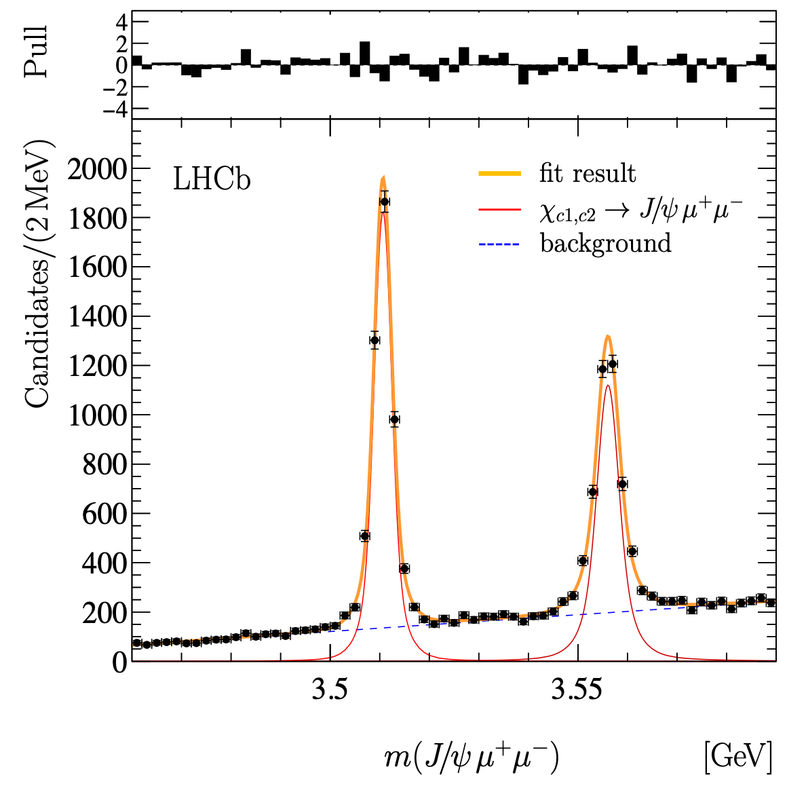
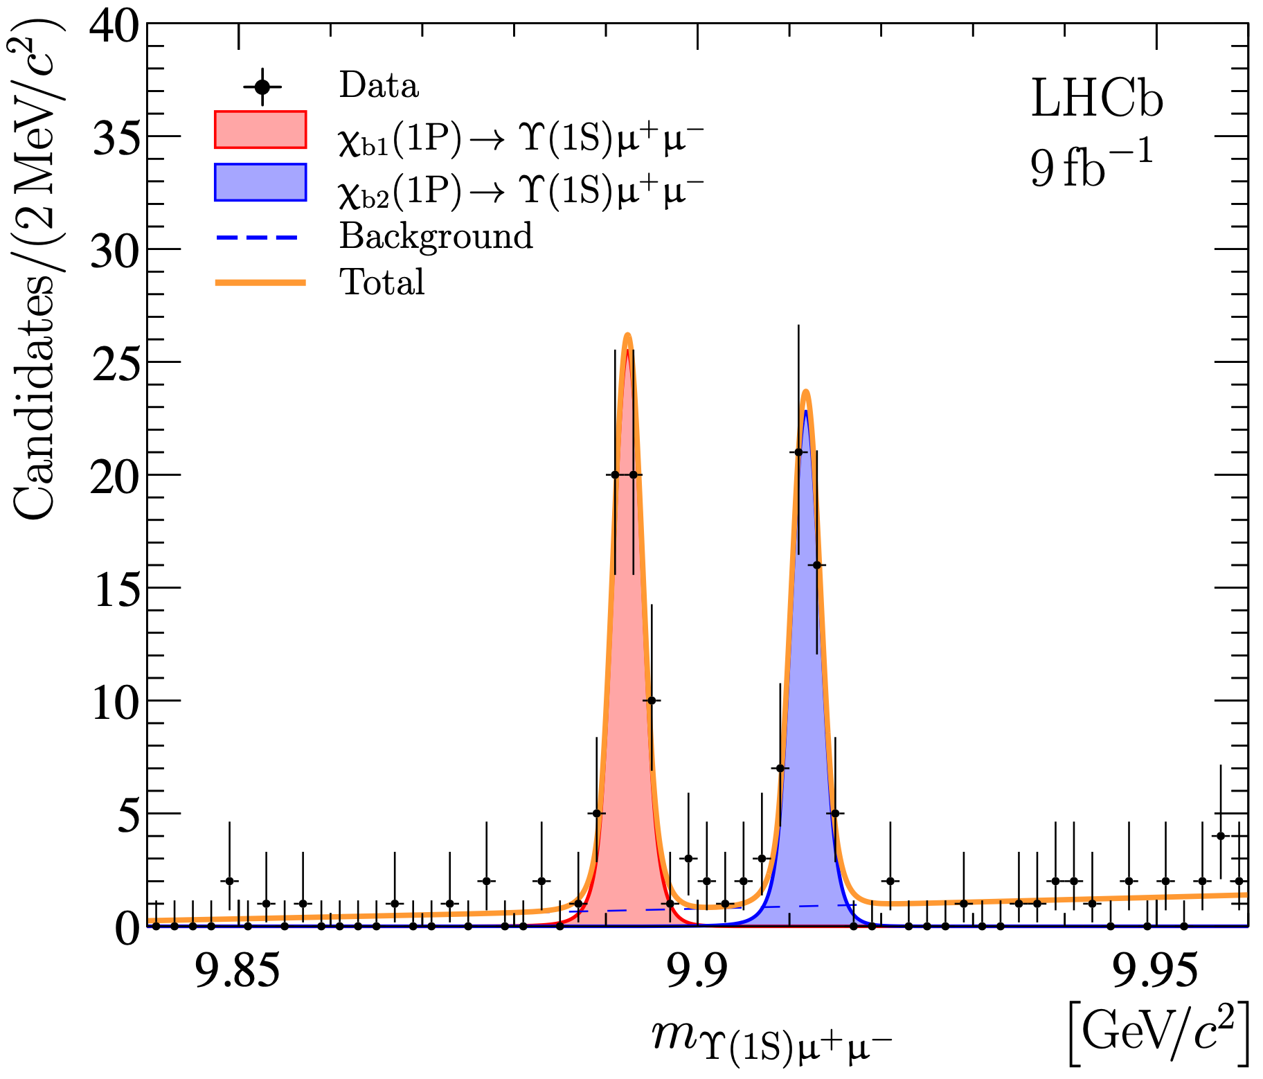

Production & polarization measurement of $χ_{c(b)}$ states
Study production mechanism of $χ_{c(b)}$ itself & understand the feed-down to $J/ψ(Υ)$ production
High-branching-fraction channel $χ_{c(b)}→J/ψ\left(Υ\right)γ$ suffers from limited resolution
$χ_{c(b)}→J/ψ\left(Υ\right)μ^{+}μ^{−}$: background-free environment and good resolution
Small branching fraction, for which the high luminosity of upgrade data could compensate
PRL 119 (2017) 22, 221801
JHEP 10 (2024) 122

Slide 15
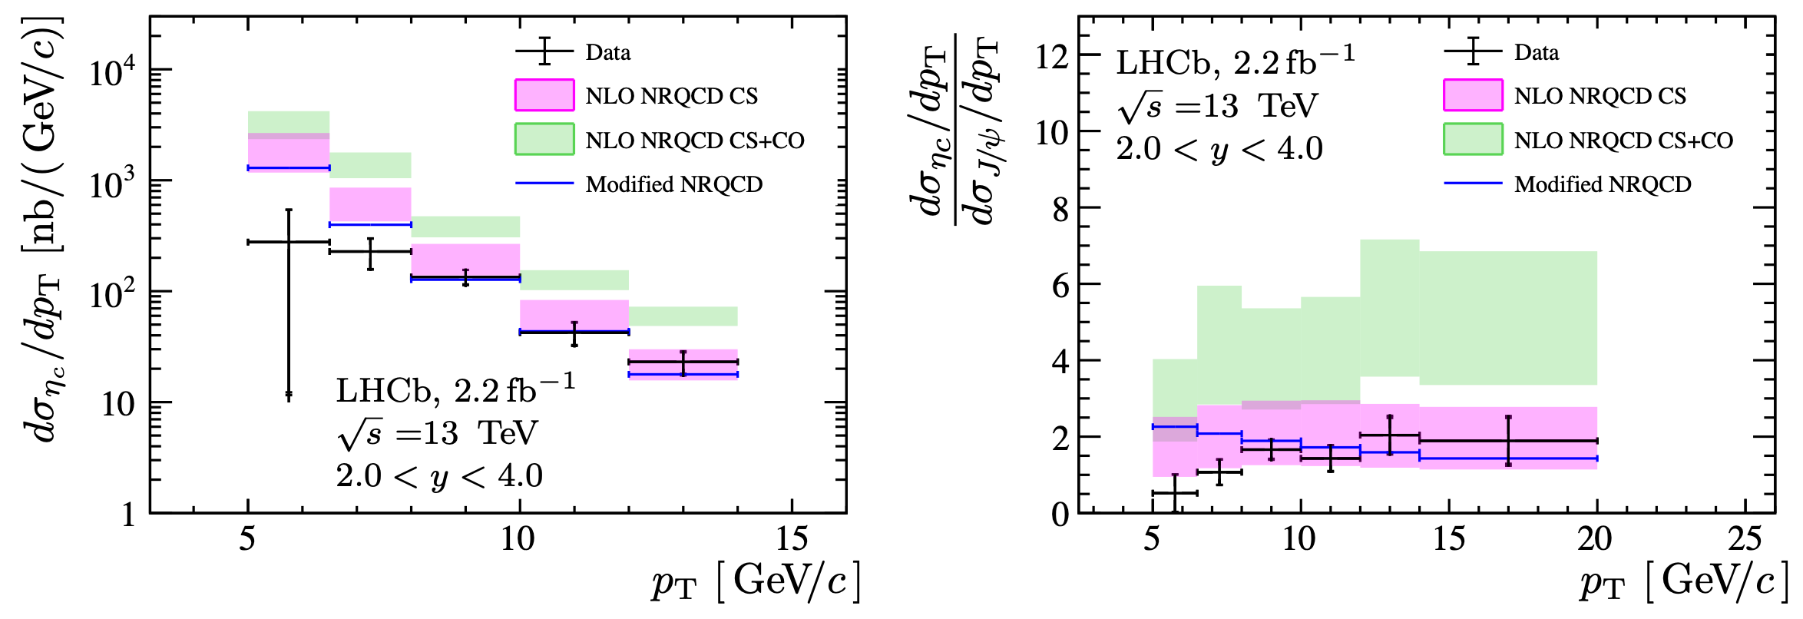
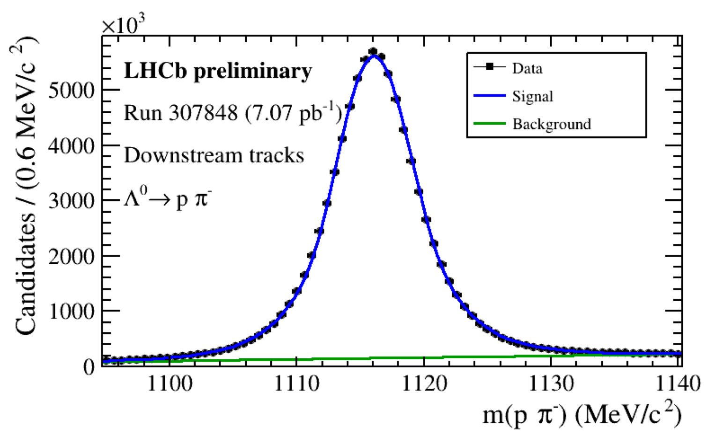




The $η_{c}$ meson production measurement
LHCb latest measurement: 2018 data, $η_{c}→p\overline{p}$, measure the production of $η_{c}(1S)$ & set upper limit for $η_{c}(2S)$
Run3-4: $η_{c}→Λ\overline{Λ}$, benefit from long-lived triggers
For $η_{c}(1S)$ : improved precision and accessible to low-p_{T} region
EPJC 84 (2024) 12, 1274
Tight p_{T} cut in $p\overline{p}$ trigger
Low statistics in low-p_{T} region
For $η_{c}(2S)$ : target on first observation in prompt production and cross-section measurement
From HLT1
LHCb-FIGURE-2024-035

Slide 16
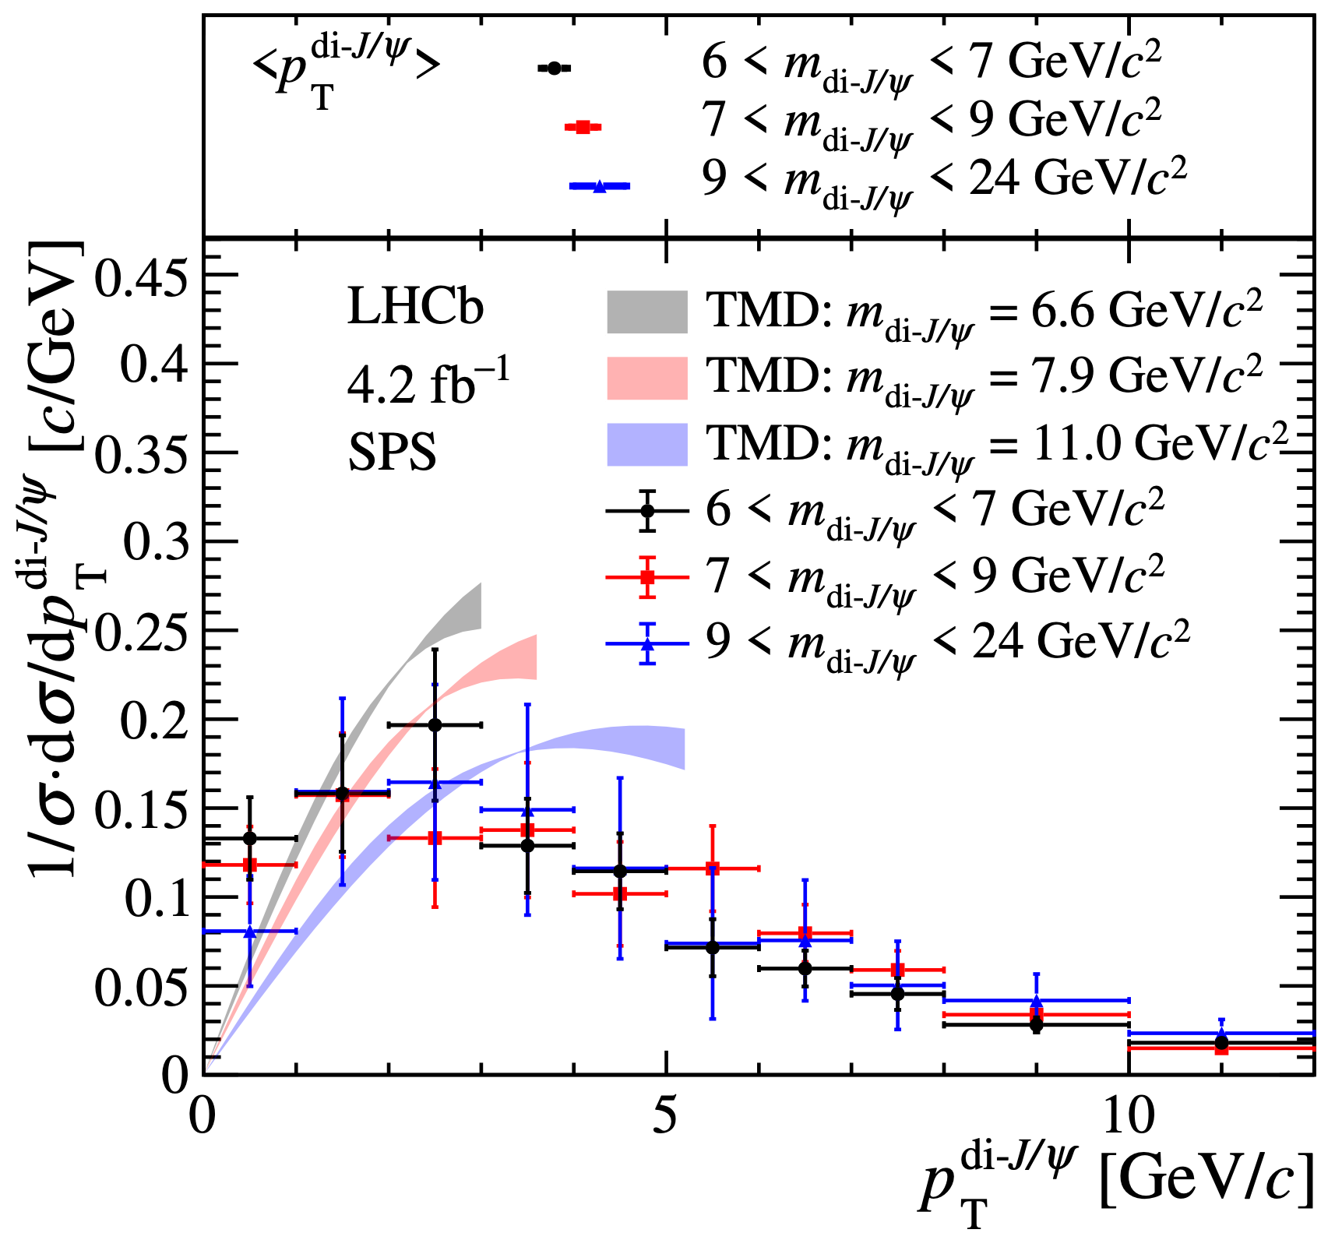
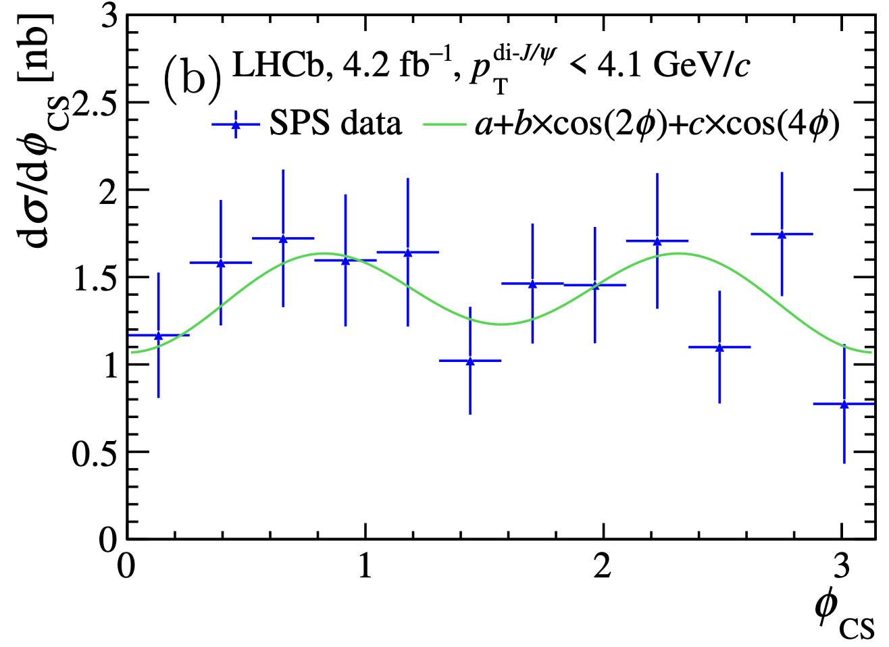
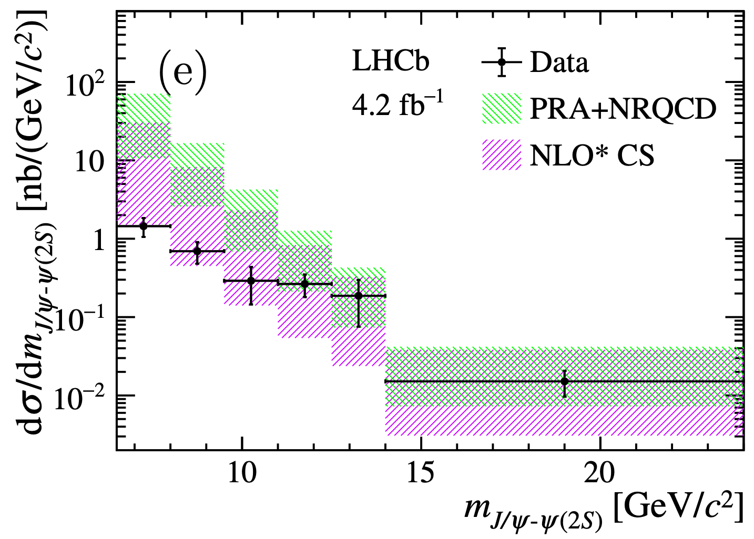




Double quarkonia associate production
Two mechanisms: Single Parton Scattering (SPS) and Double Parton Scattering (DPS)
SPS: Golden channel to probe gluon TMDs & provide new tests to NRQCD
DPS: reveal the profile and correlations of partons inside the protons
Run3: improved precision for di-$J/ψ$ differential measurement
Upgrade II: extend the differential measurements to other combinations: $J/ψ−ψ\left(2S\right), J/ψ−Υ$ ……
$$J/ψ−ψ(2S)$$
$$J/ψ−J/ψ$$
$$J/ψ−J/ψ$$
JHEP 03 (2024) 088
JHEP 05 (2024) 259

Slide 17
Opportunities of Quarkonium(-like) spectroscopy

Slide 18
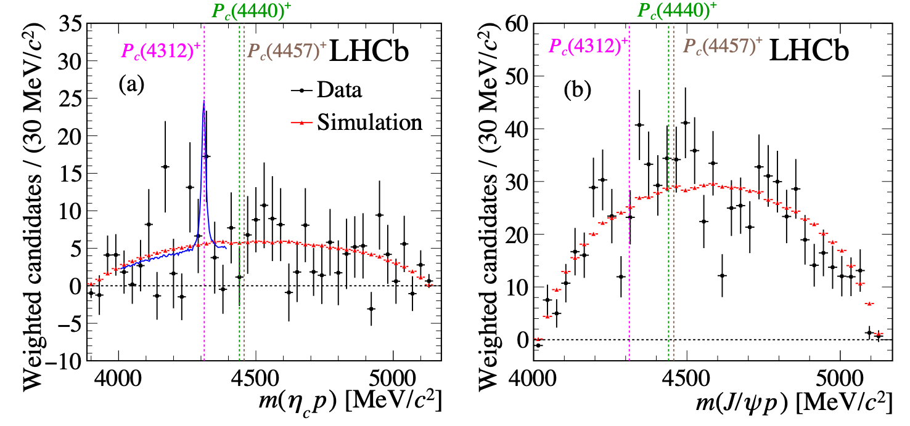
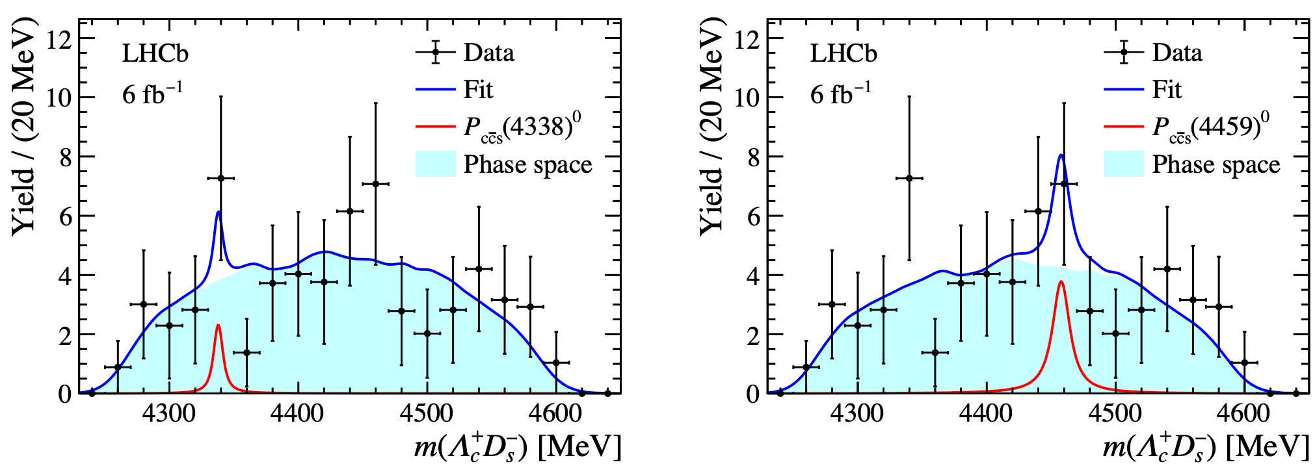


New decay modes of hidden-charm pentaquarks
Nature of hidden-charm pentaquarks still under debating
Measuring their decays to different decay patterns provides valuable inputs to distinguish theory models
Several searches performed during Run1-2 but no evidence is seen yet
With upgrade dataset more precise searches could be performed
Pentaquark search in $Λ_{b}^{0}→η_{c}pK^{−}$ decay
Pentaquark search in $Λ_{b}^{0}→Λ_{c}^{+}D_{s}^{−}K^{+}K^{−}$ decay
PRD 102 (2020) 112012
PRD 112 (2025) 5, 052013

Slide 19
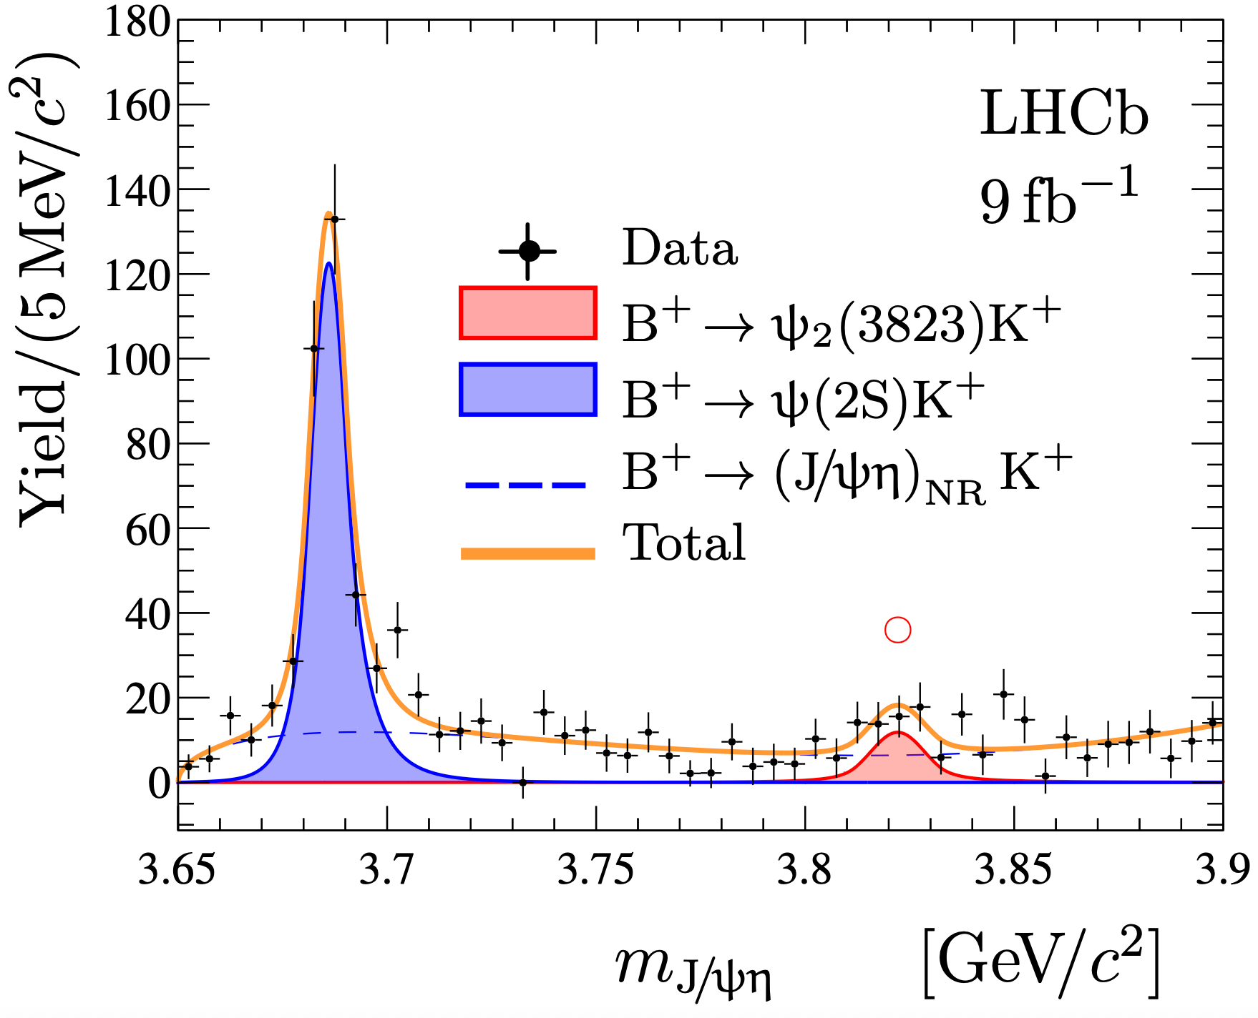
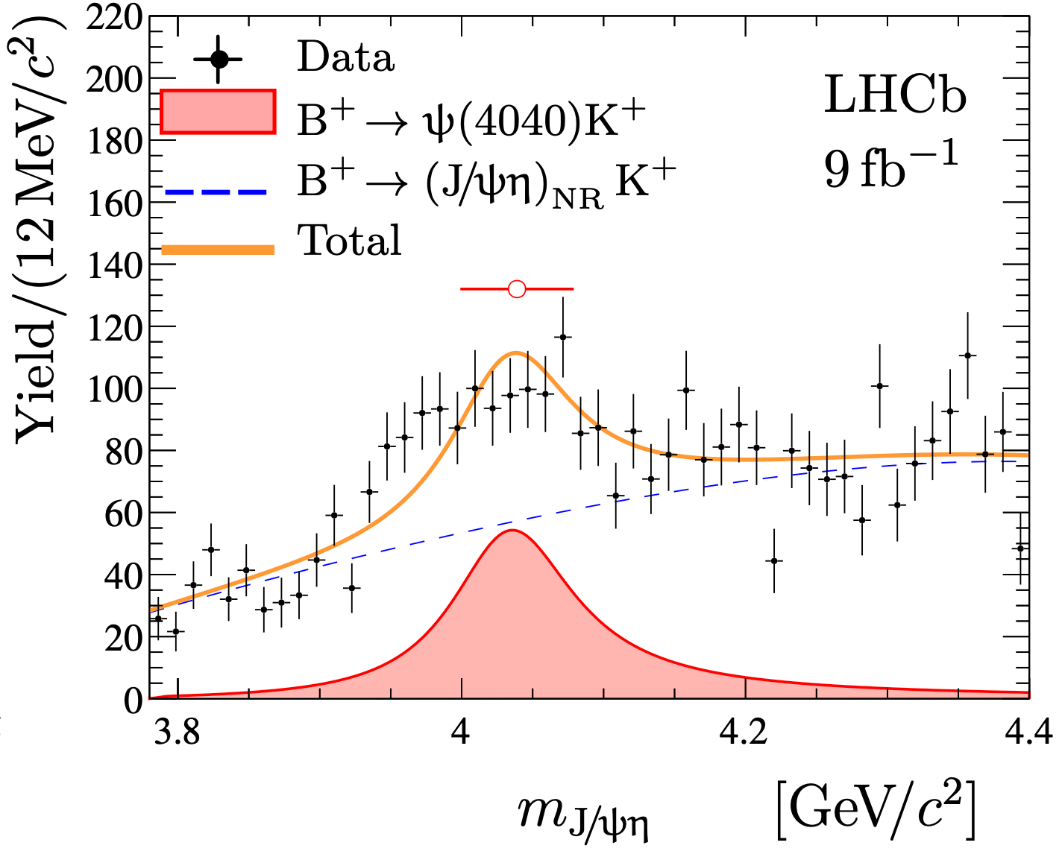


Exotic hadrons with $γ$ in final state
Search of hidden-charm exotic hadrons decaying into $χ_{c}, h_{c}, η$ ......
$χ_{c}→J/ψγ, h_{c}→η_{c}γ, η→γγ……$
Statistical precision limited by $γ$ reconstruction efficiency
Example: a rich exotic contributions in $B^{+}→J/ψφK^{+}$, possible contributions in similar decays $B^{+}→χ_{c}φK^{+},B^{+}→J/ψηK^{+}$ ……
Several hints seen in Run1-2, more precise investigation with Upgrade dataset
JHEP 04(2022)046

Slide 20
Conclusion
Fruitful results of Quarkonium measurements from LHCb during its Run1-2 operation
Exciting prospects with upgrade LHCb
Available Run3 dataset has >2X luminosity of Run1-2
Gearing up for Run4 and Upgrade II
Unprecedentedly large sample size brings new opportunities for Quarkonium measurements
Further understand quarkonium production mechanisms, validate NRQCD ……
Search for new exotic hadrons, probe the nature of known exotic hadrons
……
Thank you for your attention !
Any questions or comments ?

Slide 21
Back Up

Slide 22
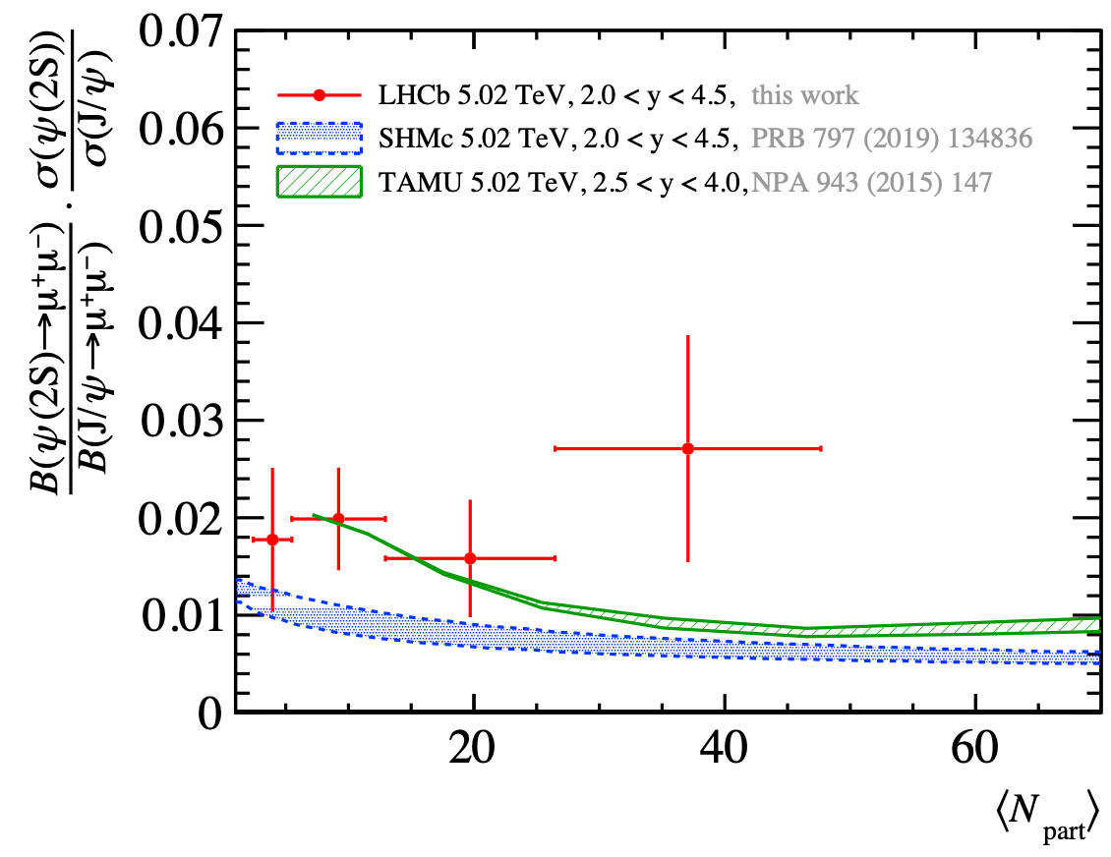


Quarkonia at nuclear ion collisions
Quarkonia suppression is a good probe to study QGP formation
Run3: LHCb has collected PbPb, NeNe and OO collision datasets
Luminosity > Run2; various systems with different sizes and geometries, thus different nuclear effects
JHEP 07 (2025) 235
Run2 PbPb
QGP temperature
LHCb-FIGURE-2025-004
LHCb-FIGURE-2025-012
LHCb-FIGURE-2025-017

Slide 23





Quarkonia at SMOG2 experiment
SMOG2: gas injected in a 20cm storage cell installed upstream of LHCb interaction point
Making LHCb a fixed-target experiment. Unique kinematic region accessible
Unprecedentedly large sample in different collision systems collected in 2024
LHCb-FIGURE-2024-023

