Slide 1

Sparks! Coordination Meeting
16 April 2025

Slide 2
Agenda
Overview presentation
Logistics and technical requirements
Audio-Visual
Design & Identity
Communication (incl Social Media)

Slide 3
Sparks! 2025 19 June
Sparks! Internal Forum
13:00 – 15:30
Globe of Science and Innovation
Quantum Technology Initiative Forum
The aim of this event is to create awareness at CERN about the QTI and explore new areas where colleagues across the organization could engage with the initiative
Lead: QTI
Sparks! connect
16:00 – 18:30
IdeaSquare
CERN Innovation for Urban Futures
The Sparks! connect workshop & networking session will host an external specialised audience in the field of urban technologies and planning, allowing them to meet CERN staff, exploring opportunities for the transfer of CERN’s technology and know-how in their fields.
Lead: KT/ECO
Networking reception
18:30 – 19:30
TBD
Networking reception for the attendees of the Internal Forum, Sparks! connect and the public event speakers (50-70 people)
Lead: ECO/SG
Sparks! Public Event
20:00 – 22:00
Sergio Marchionne Auditorium
Imagining Quantum City
The public event will take the audience through a futuristic journey to a hypothetical “Quantum City”, exploring how quantum mechanics could one day help build more sustainable and inclusive societies.
Lead: ECO/SG

Slide 4
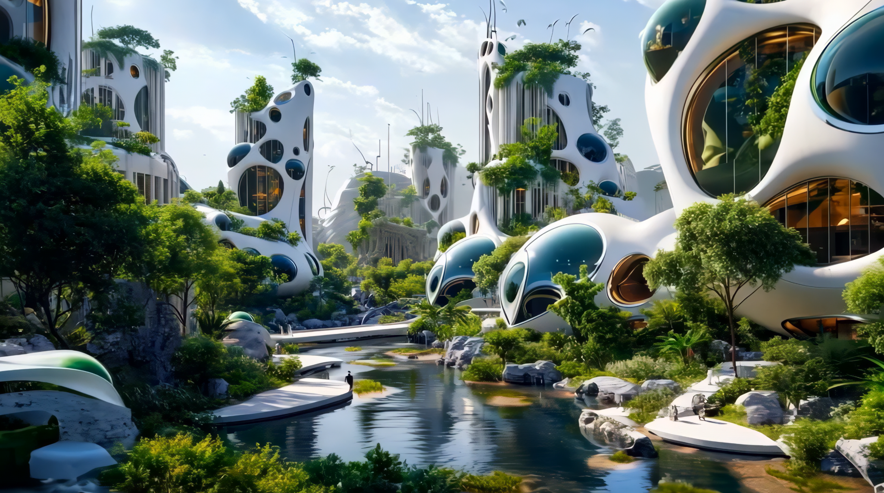
Imagining Quantum City Sparks! Public Event
Throughout history, cities have always served as clusters of innovation. In this spirit, this event will take you through a futuristic journey to a hypothetical “Quantum City”, exploring how quantum mechanics could one day help build more sustainable and inclusive societies.
Chris Luebkeman (moderator) | Futurist, head of Strategic Foresight Hub of ETH Zürich
Carlo Ratti | Architect, professor at MIT (Senseable City Lab), Curator of the 19th Venice Biennale of Architecture
Nicolas Gisin | Physicist and professor at the University of Geneva, founder of ID Quantique
Johanna Sepúlveda | Vice-chair, EU Quantum Flagship Strategic Board, Senior Expert on Quantum Secured Communications at Airbus
Sabrina Maniscalco | Professor of Quantum Information, Computing and Logic at the University of Helsinki, CEO and co-founder of Algorithmiq
CERN Management TBD | Presenting the CERN perspective in 3 time capsules TBD

Slide 5
Imagining Quantum City Sparks! Public Event
20:00 | Opening remarks | Charlotte Warakaulle
20:05 | Introduction | Chris Luebkeman (Moderator)
20:10 | Setting the scene: Technology in the City of tomorrow | Carlo Ratti
20:30 | Introduction to quantum technologies | Nicolas Gisin
20:45 | Quantum communication for cities | Johanna Sepúlveda
21:00 | Quantum computing for cities | Sabrina Maniscalco
21:15 | Discussion (panel) including interventions from the audience | All
21:50 | Q&A | All
22:00 | End

Slide 6
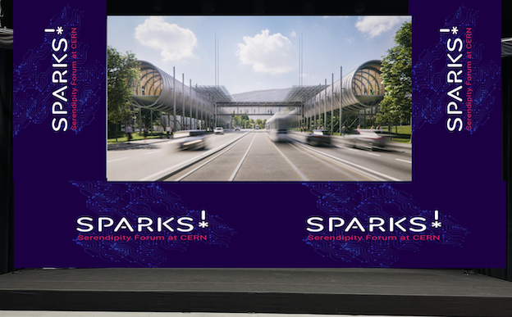
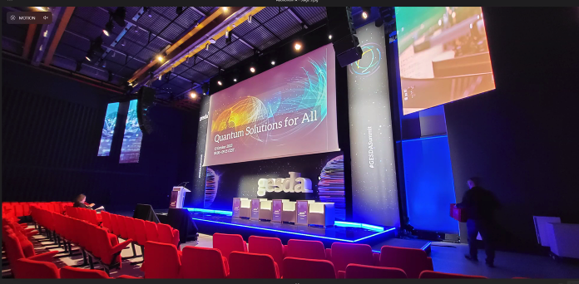
Logistics and Technical requirements
Networking reception at 18h30: location?
Confirm rehearsals times
Backdrop on stage
Stage furniture
Lights and sound
Indico: special conditions?
  Sparks! connect
  Live Stream

Slide 7
Audio-Visual
Live stream:
  Technical requirement check
  confirm with SG if backdrop is ok
Screens on the side of the room as teleprompter
Synch with live stream platforms

Slide 8
Design & Identity
Sparks Visual Identity & theme
Animations
Finalise poster
Other formats?

Slide 9
Communication
To receive next week: Key messages from management
Social Media Activity: plans?
Align Communication activities with external partners (incl: Carlo Ratti)
Align communication activities with internal partners (QTI, C&SF, etc)
Involvement of Press office?
Synch with live stream platform
Communication budget of Sparks!: how to maximise?
Website
Other activities?

