Slide 1
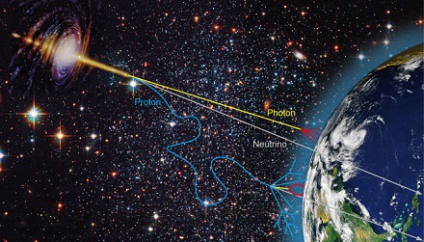

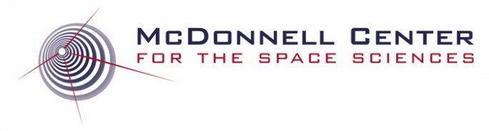
Multi-Messenger Astronomy in the Era of Future Accelerators
Bhupal Dev
Washington University in St. Louis
Corfu2025 Workshop on Future Accelerators
Corfu, Greece
May 1, 2025

Slide 2
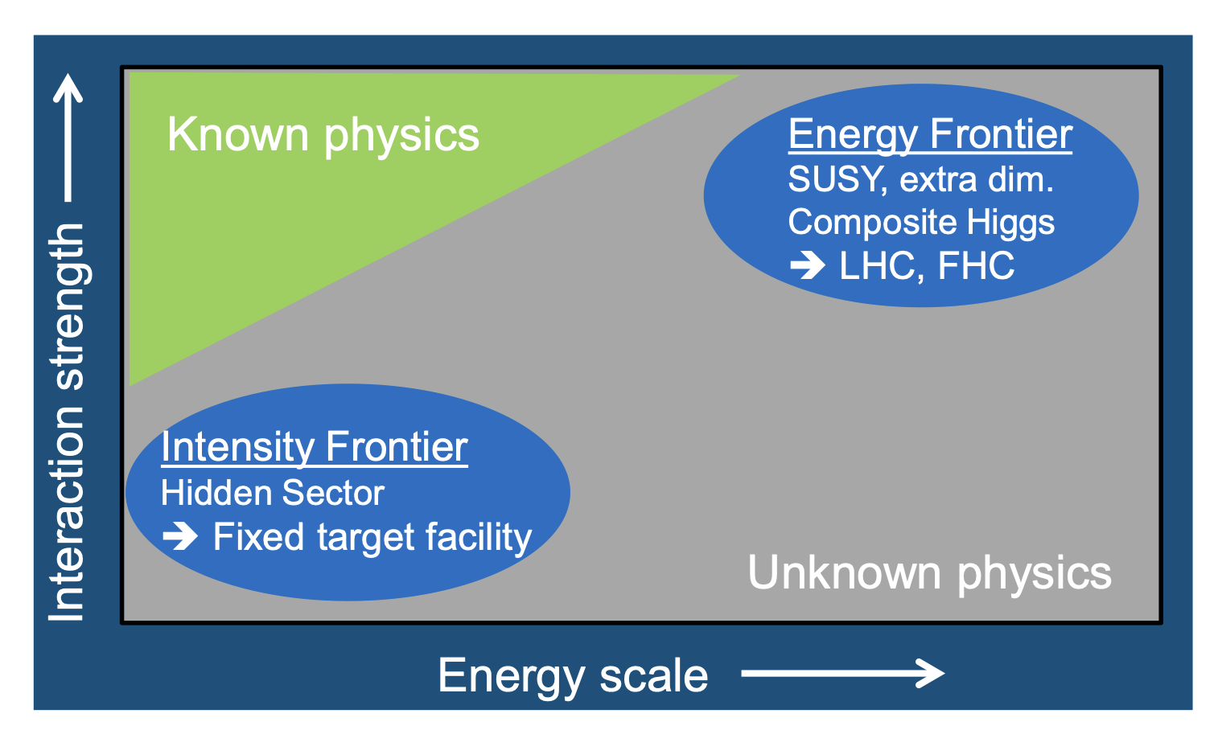
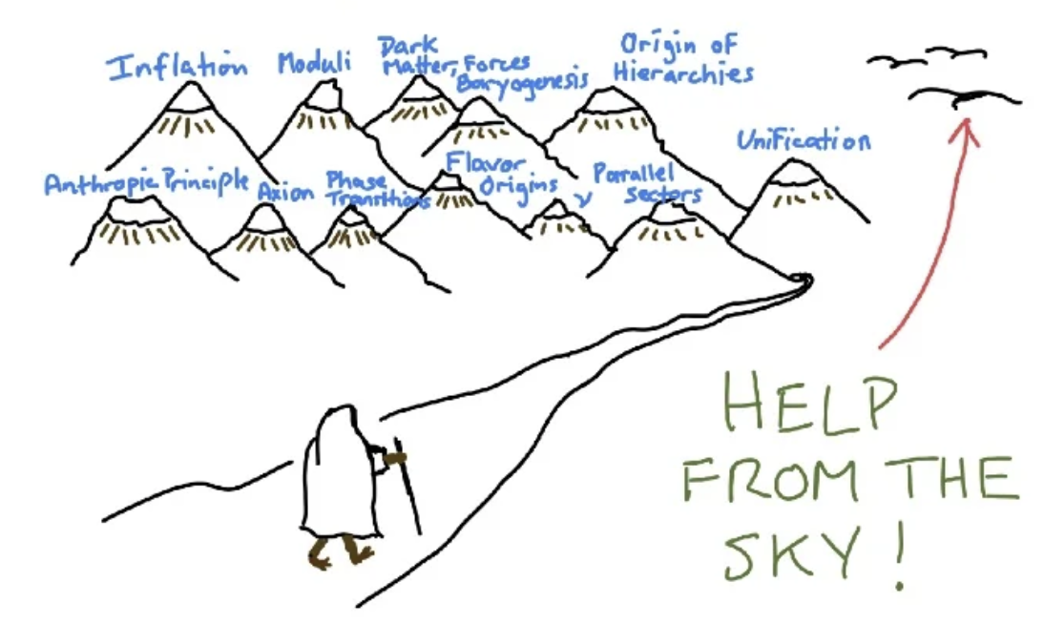

Search for New Physics
arXiv:1504.04855
Figure adapted from R. Sundrum’s talk at Snowmass ‘22

Slide 3
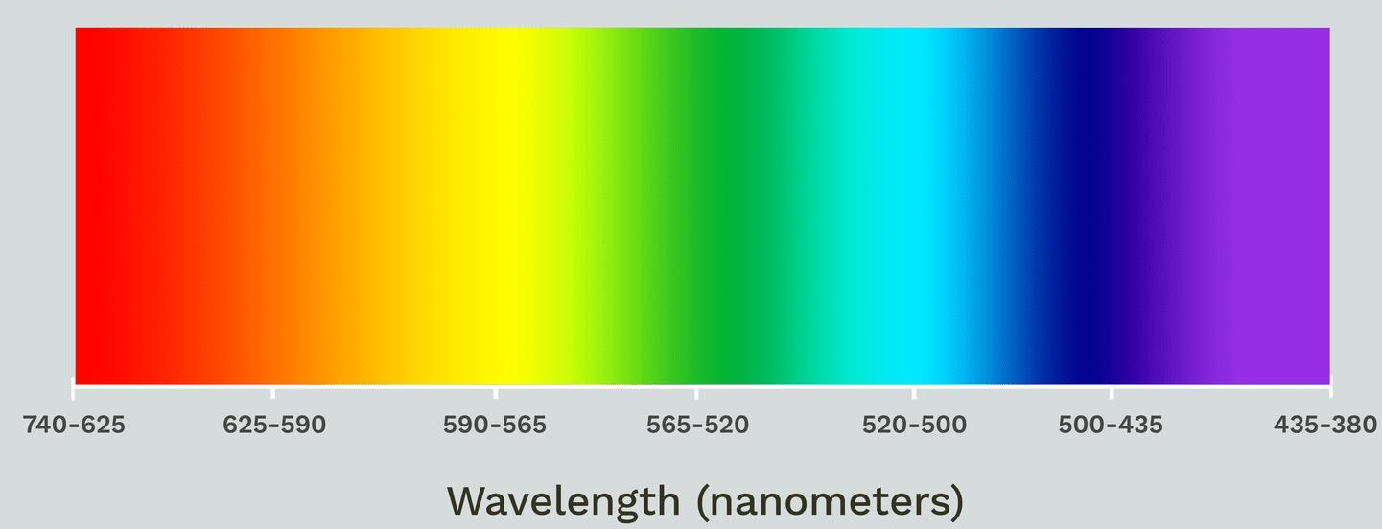
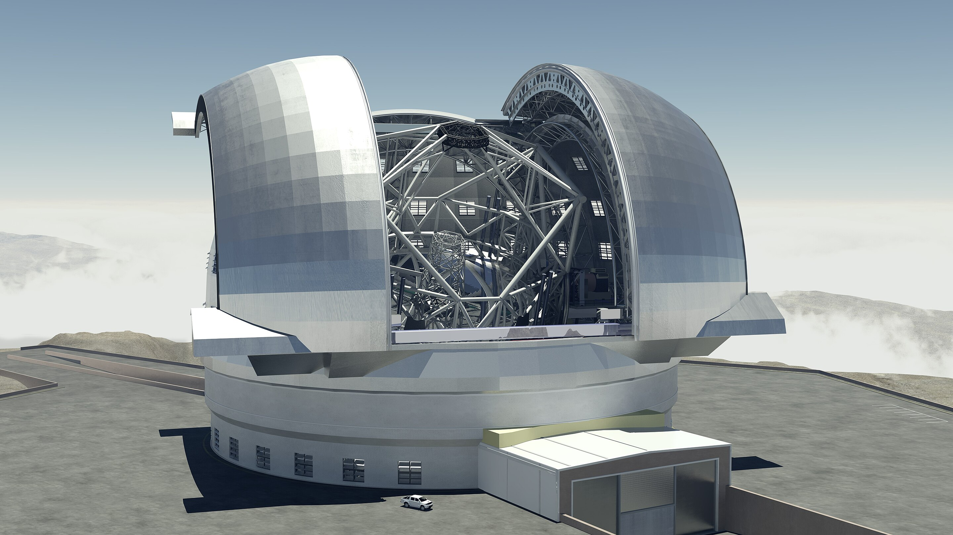
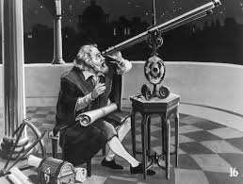
Optical Astronomy
Led to profound discoveries relevant for particle physics, e.g. expansion of the Universe and existence of Dark Matter.

Slide 4
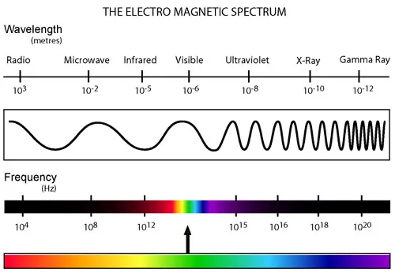
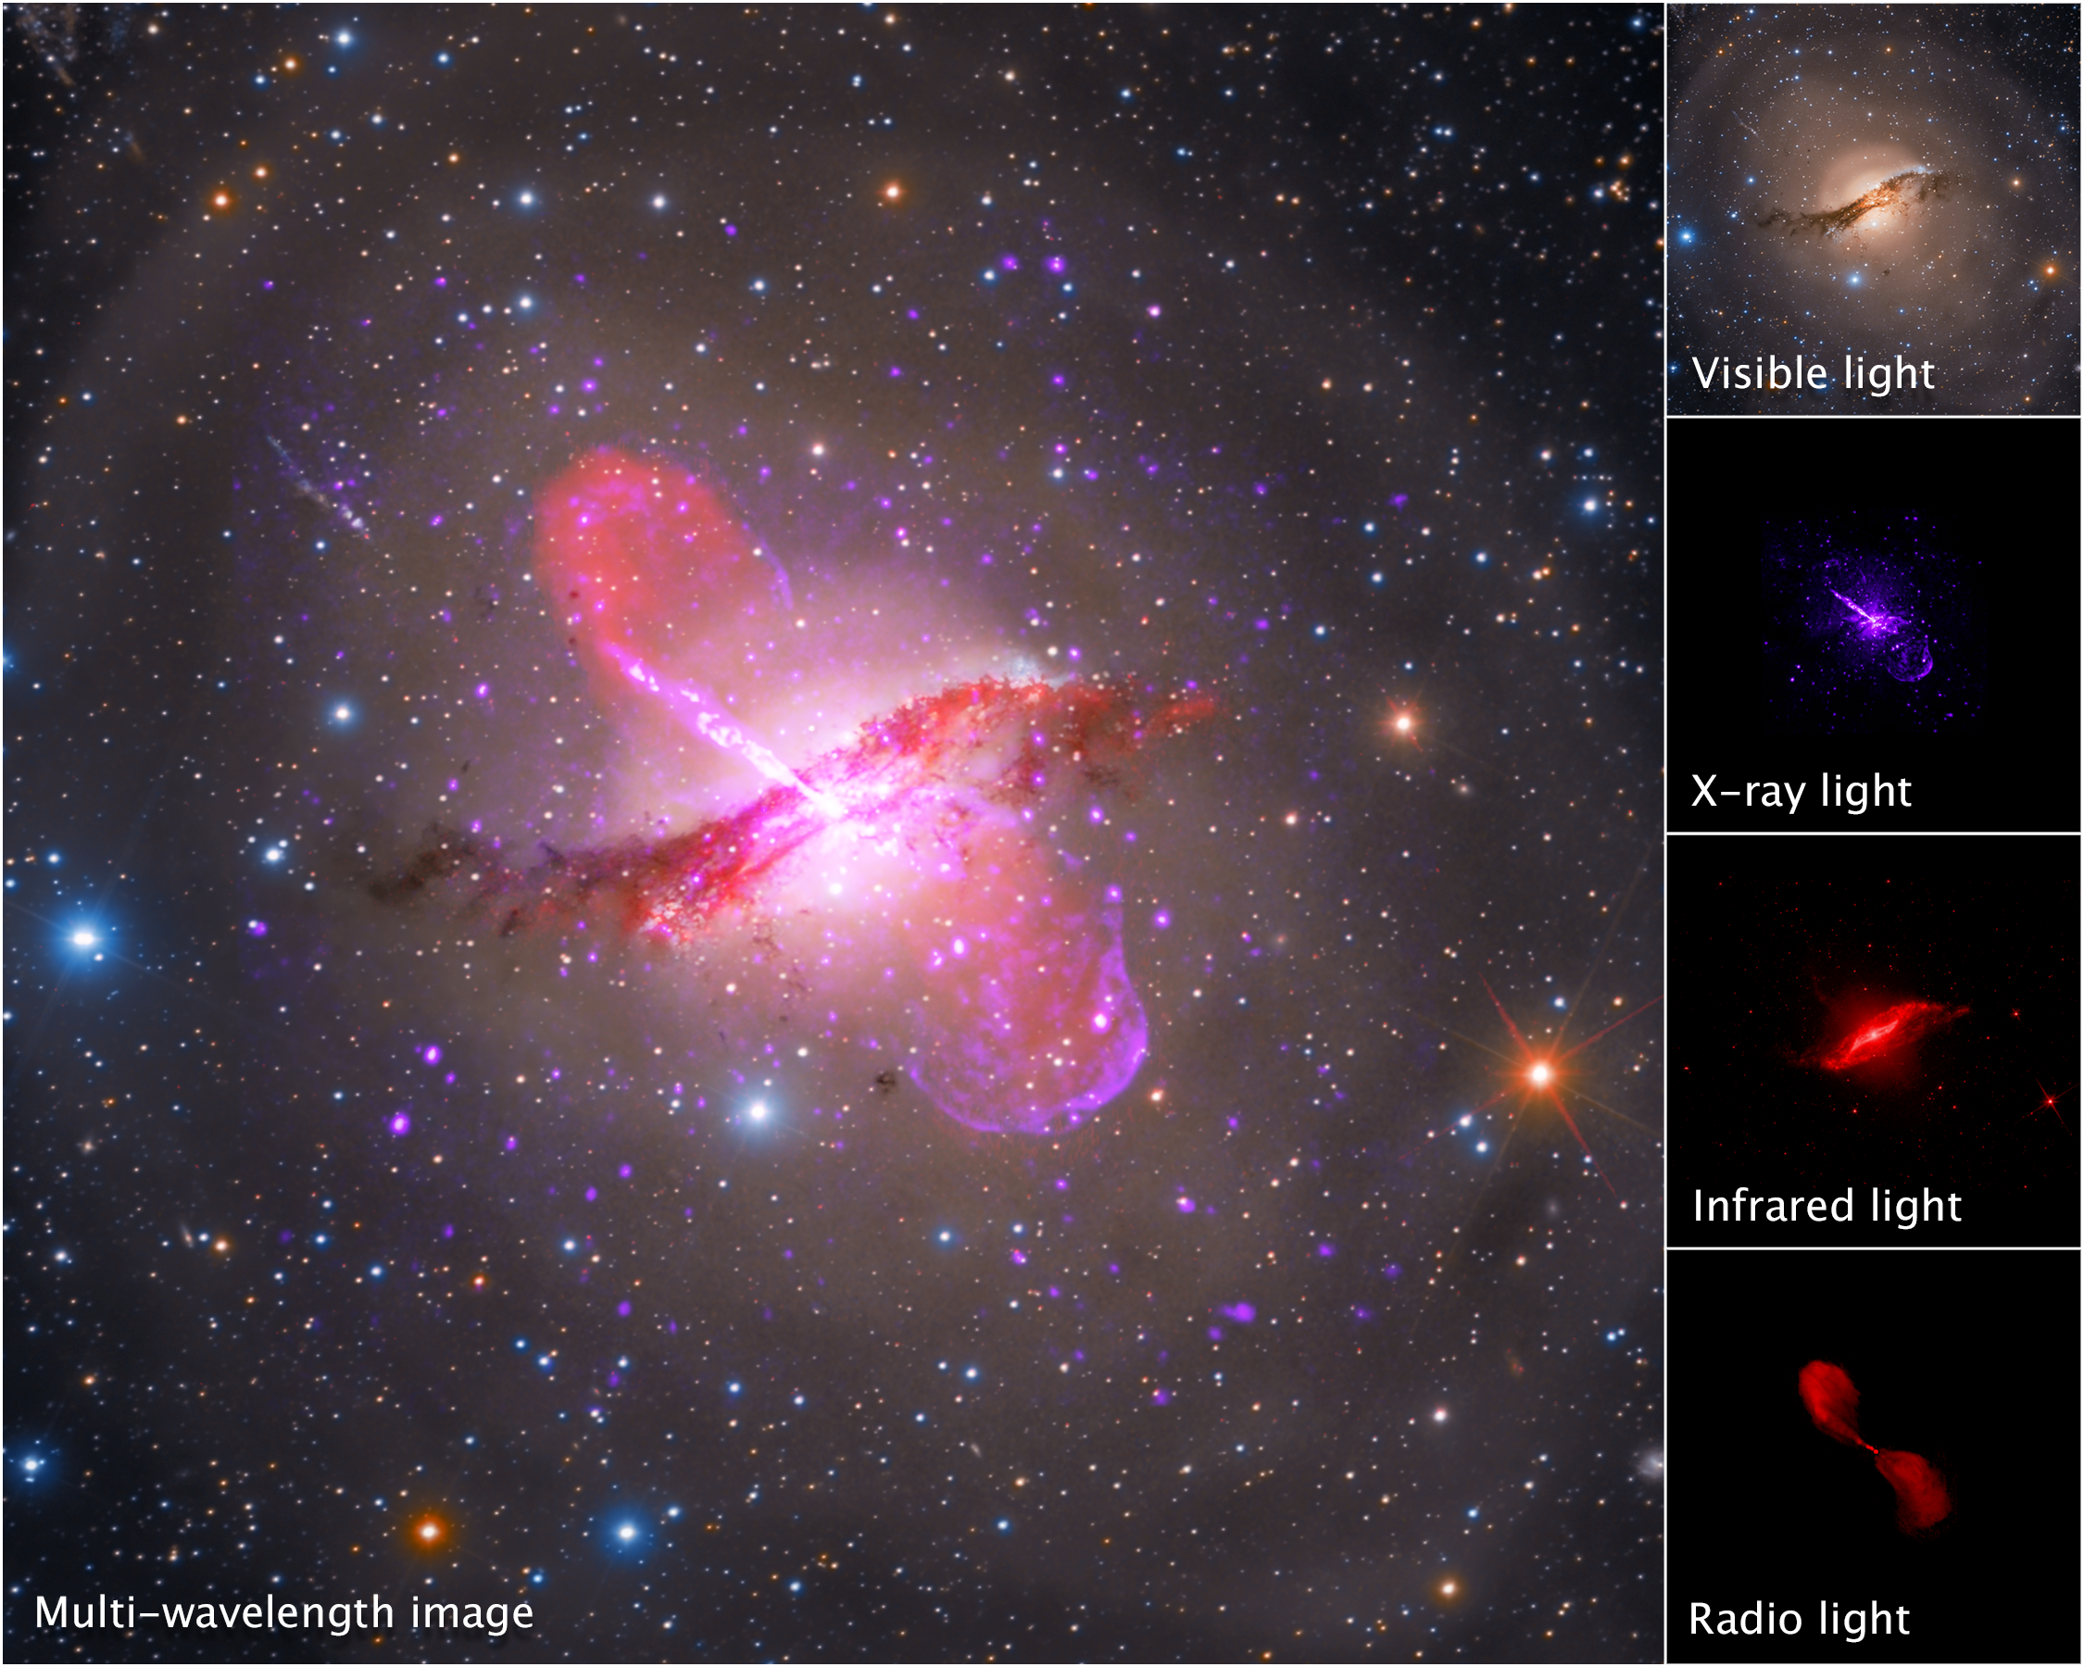
Multi-Wavelength Astronomy
Centaurus A galaxy (NGC 5128)
Led to the discovery of
CMB and precision cosmology.
more than just the sum of parts

Slide 5
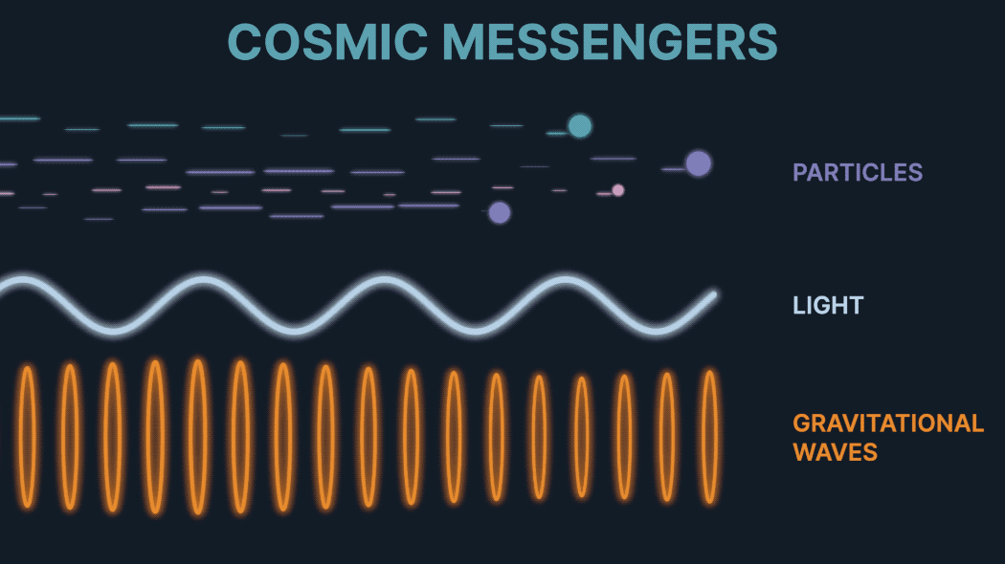
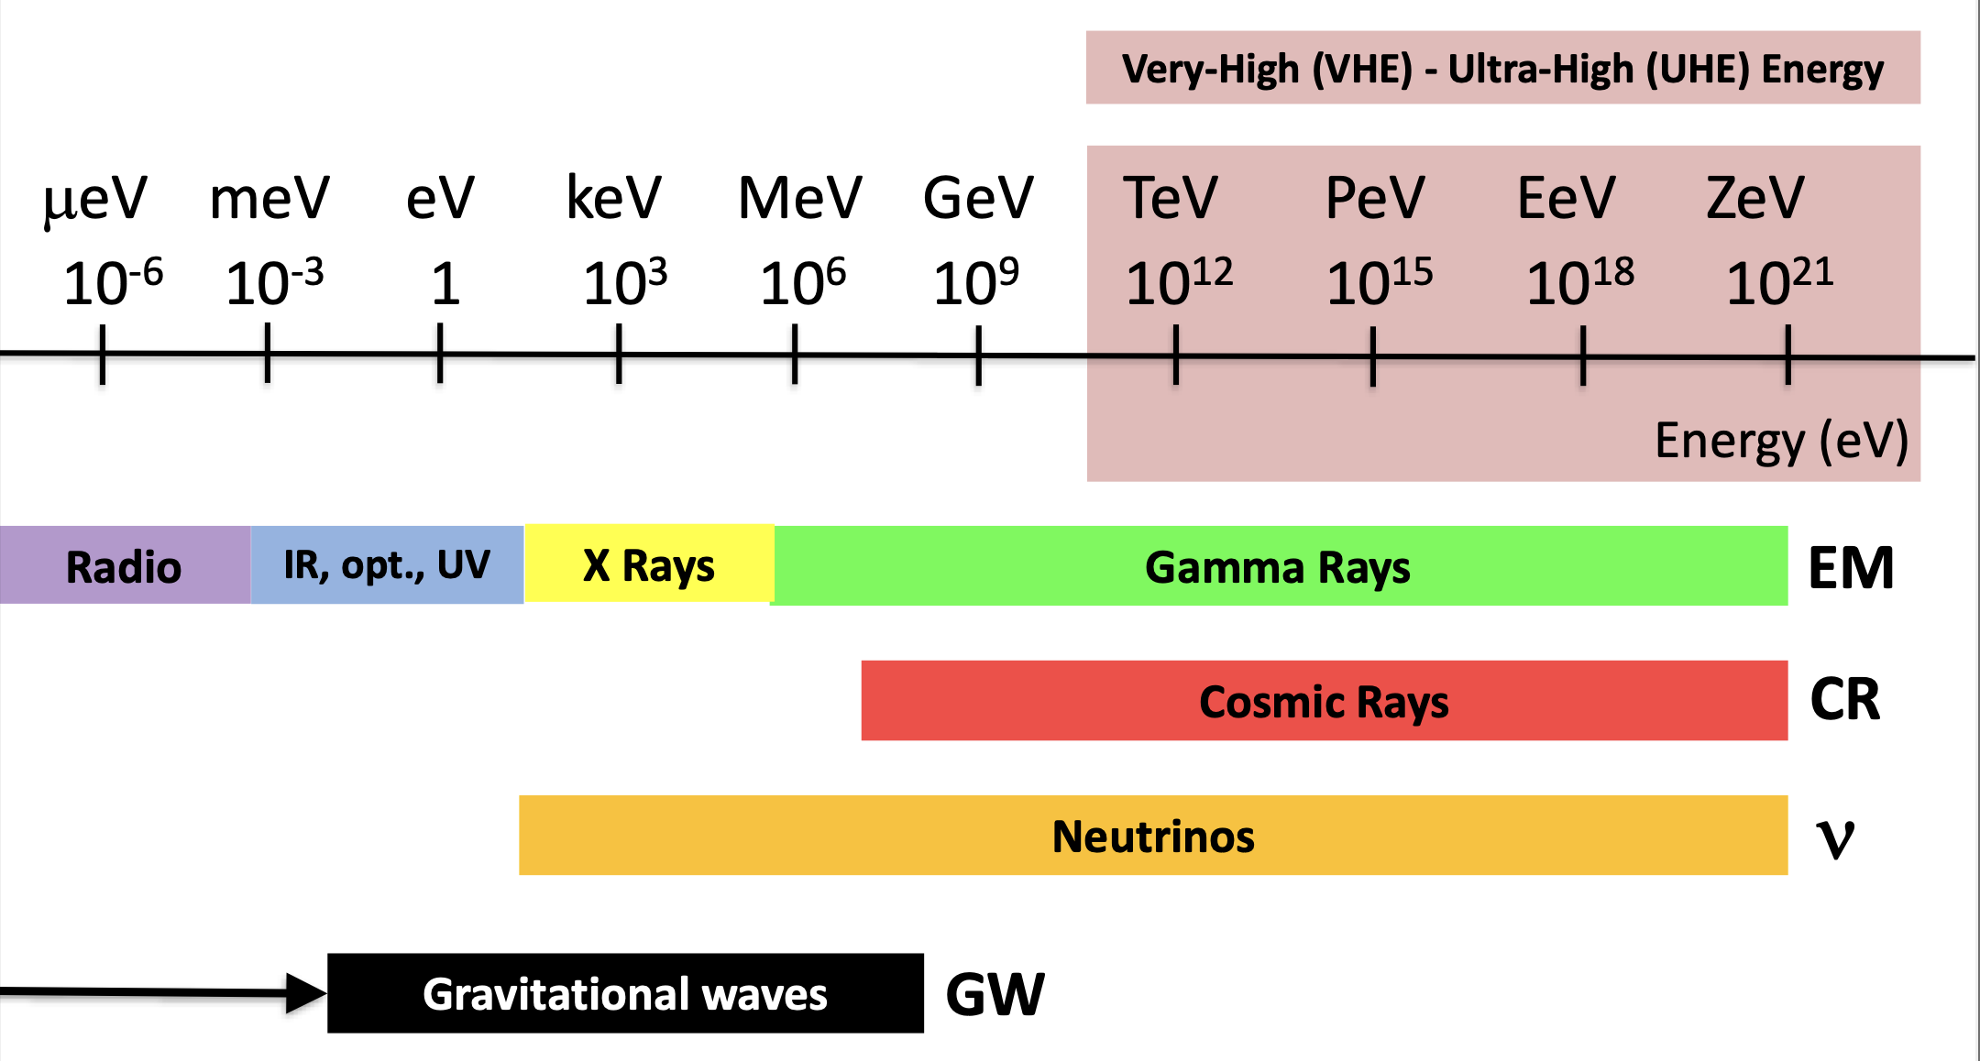
Multi-Messenger Astronomy
Opens a whole new window into the Universe
Enables new discoveries relevant to both Astrophysics and Particle Physics.

Slide 6
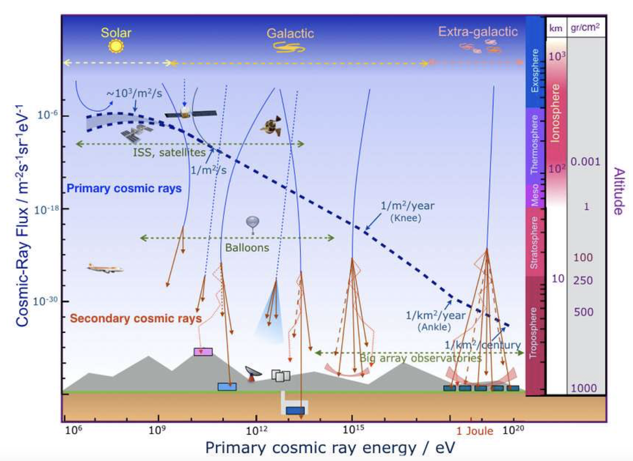
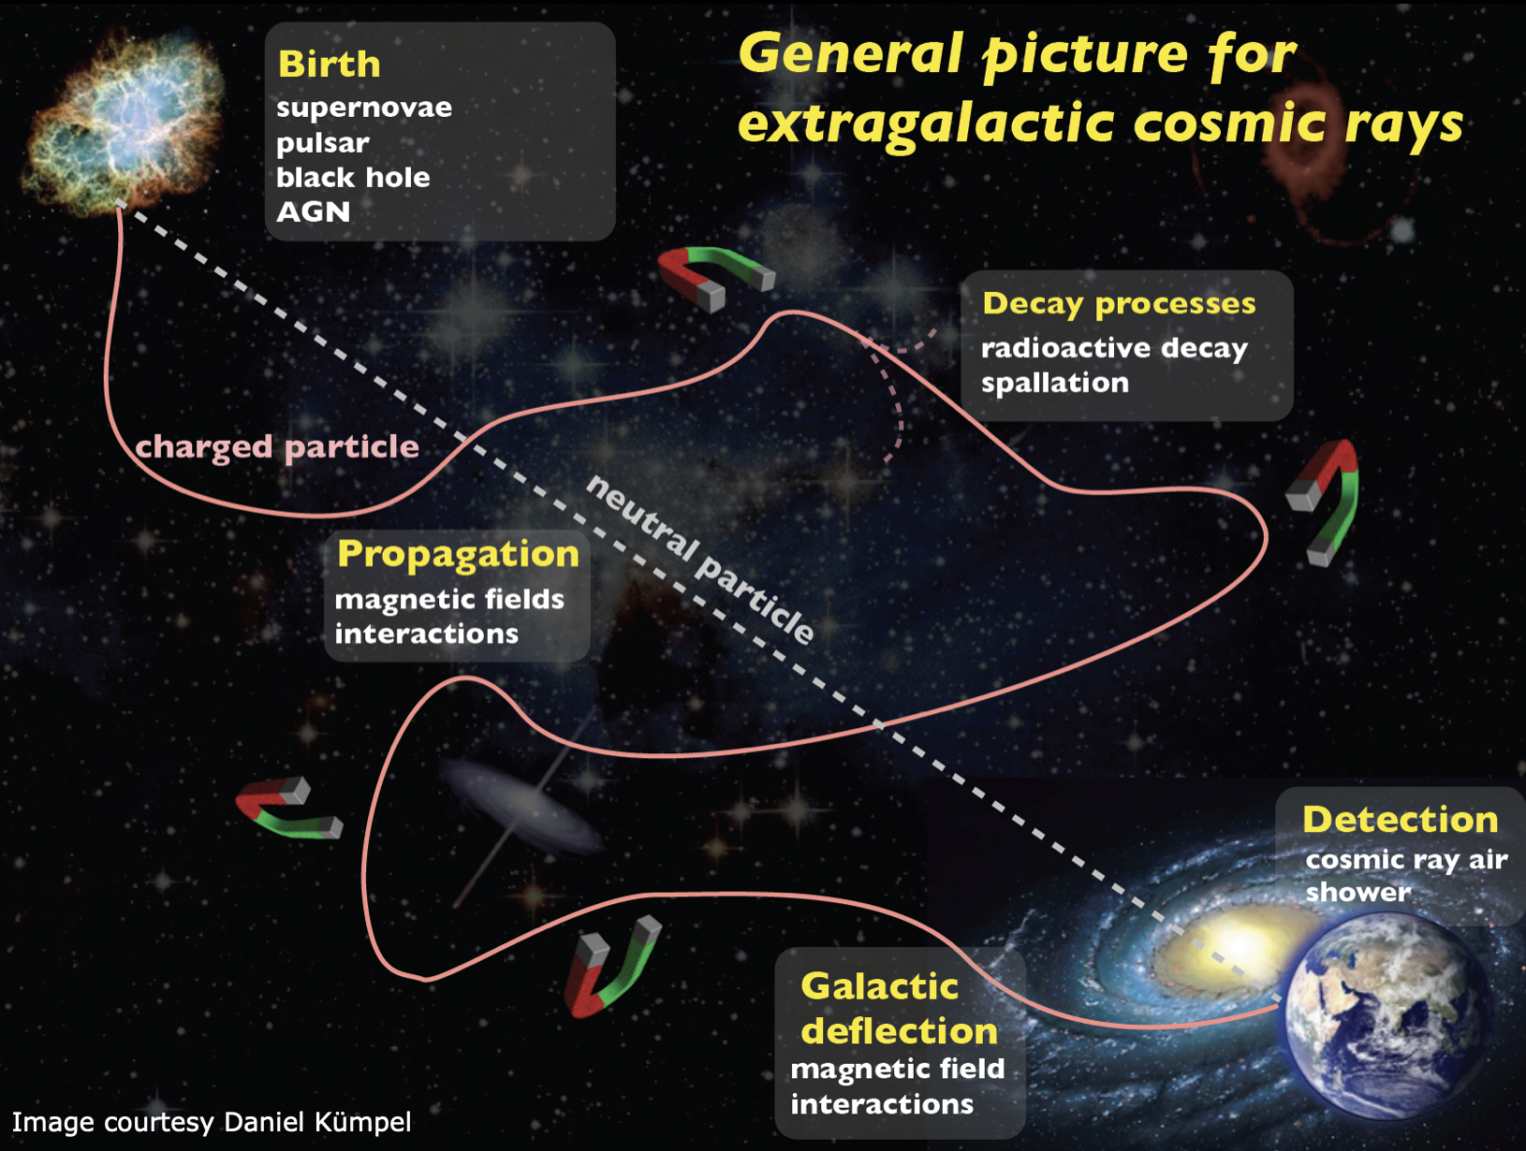
Cosmic Rays
Origin of high-energy cosmic rays is largely unknown.
Do not directly point to their source
Future accelerator-based facilities can shed some light on the cosmic ray mystery.
Notes:
Victor Hess (1912)

Slide 7
Understanding Cosmic Ray Muon Puzzle
Slide from Felix Kling’s talk

Slide 8
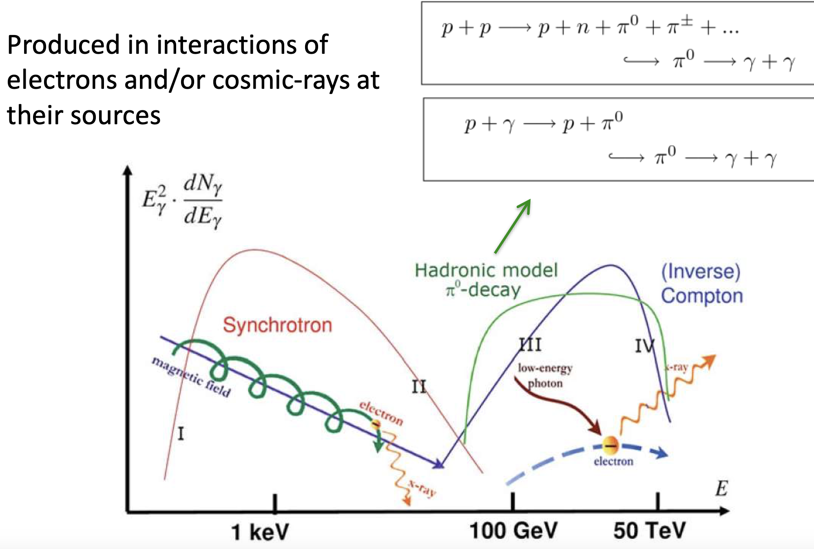
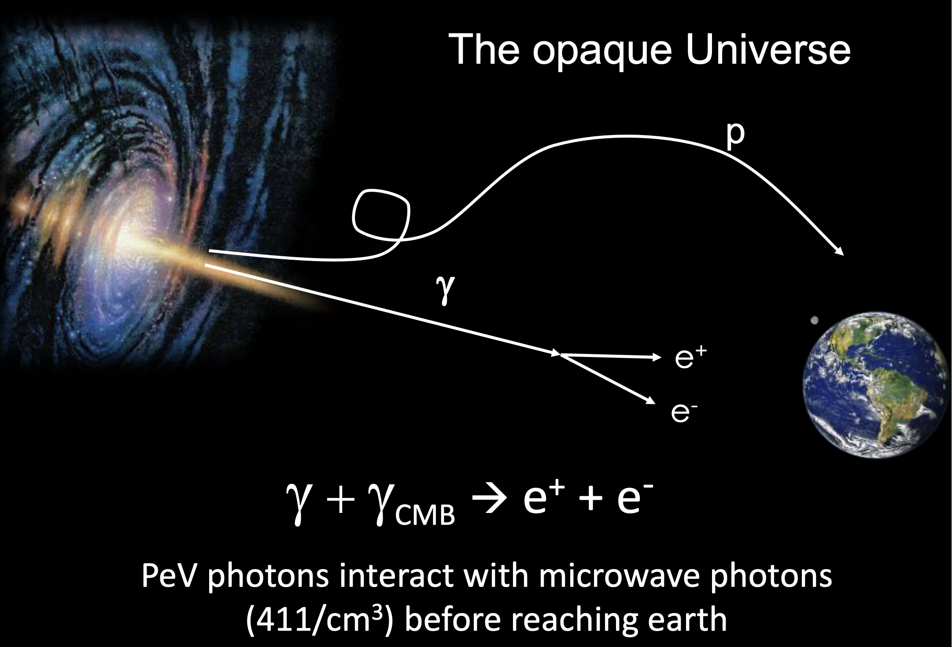
Gamma Rays
Do not expect extragalactic gamma rays beyond ~50 TeV.
Gamma-ray astronomy provides some of the most stringent indirect detection limits on Dark Matter annihilation/decay.
Notes:
Paul Villard (1900)

Slide 9
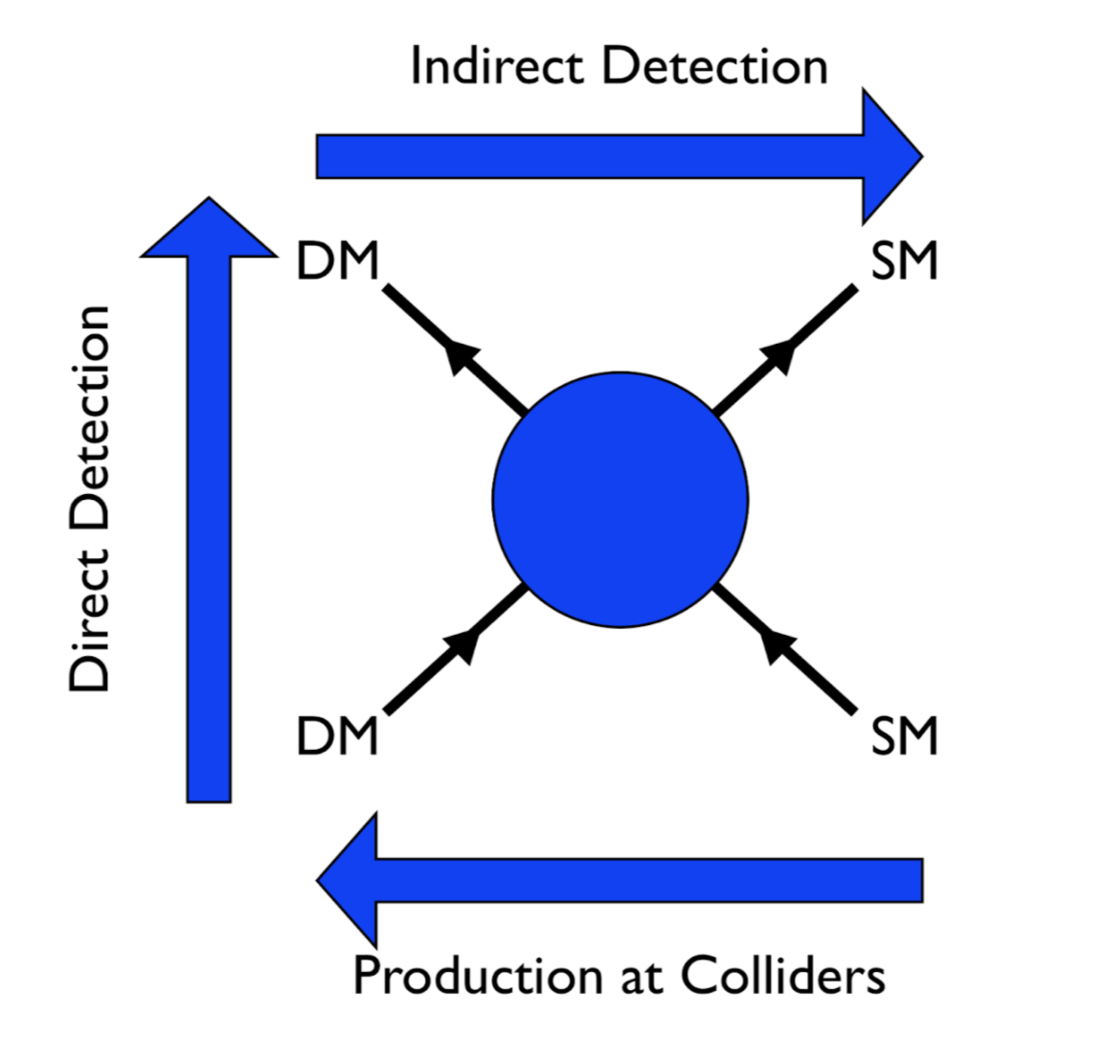
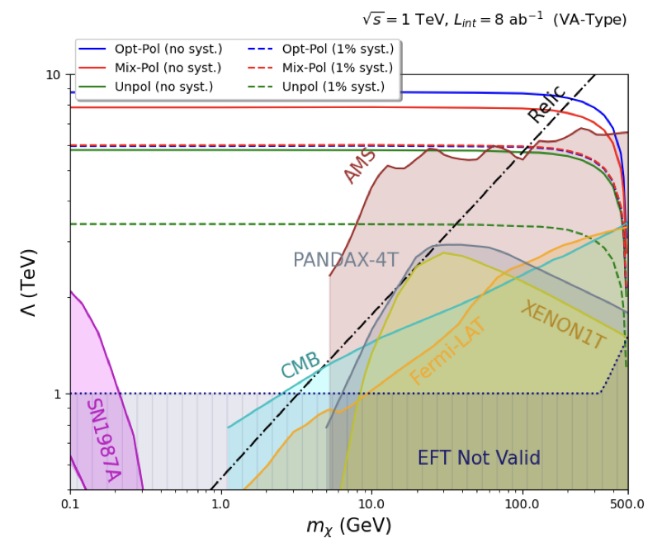
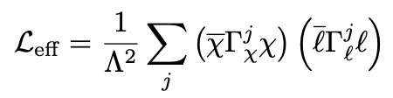
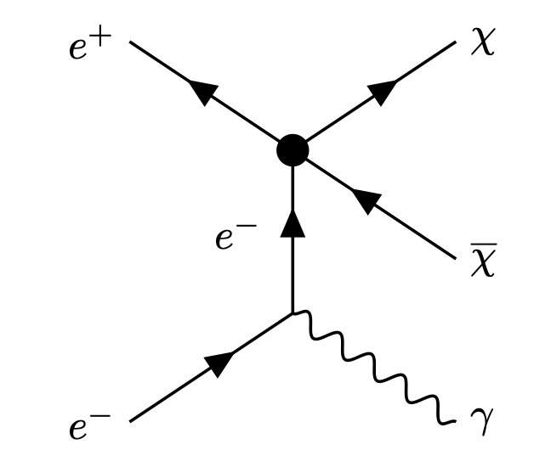
Direct, Indirect vs Collider Constraints on Dark Matter
Kundu, Guha, Das, BD, 2110.06903

Slide 10
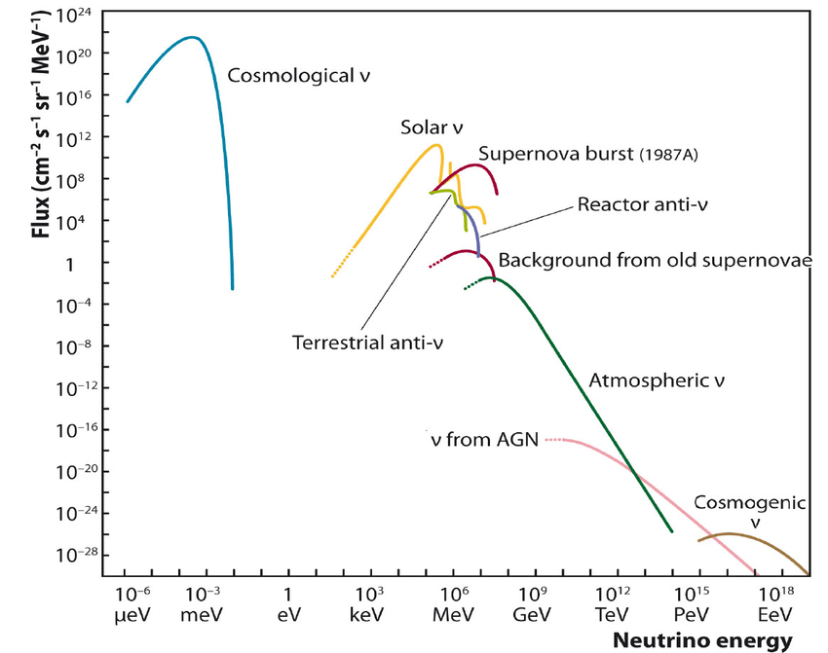
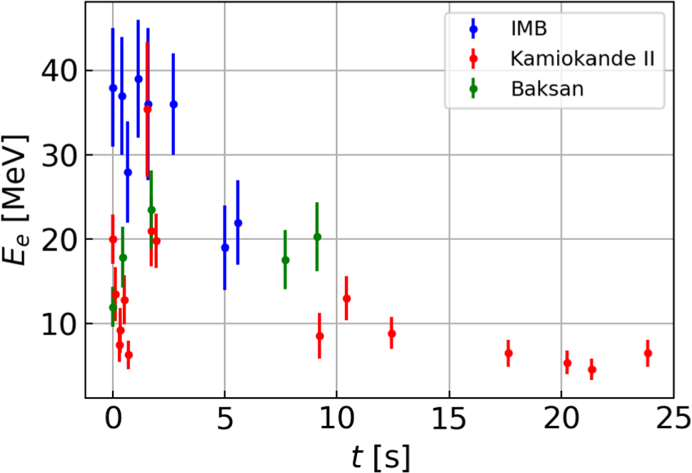
Neutrinos
Solar neutrino
Played a key role in the discovery of neutrino oscillations
Improved supernova modeling;
Constraints on light BSM physics
SN1987A

Slide 11
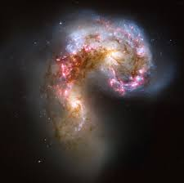
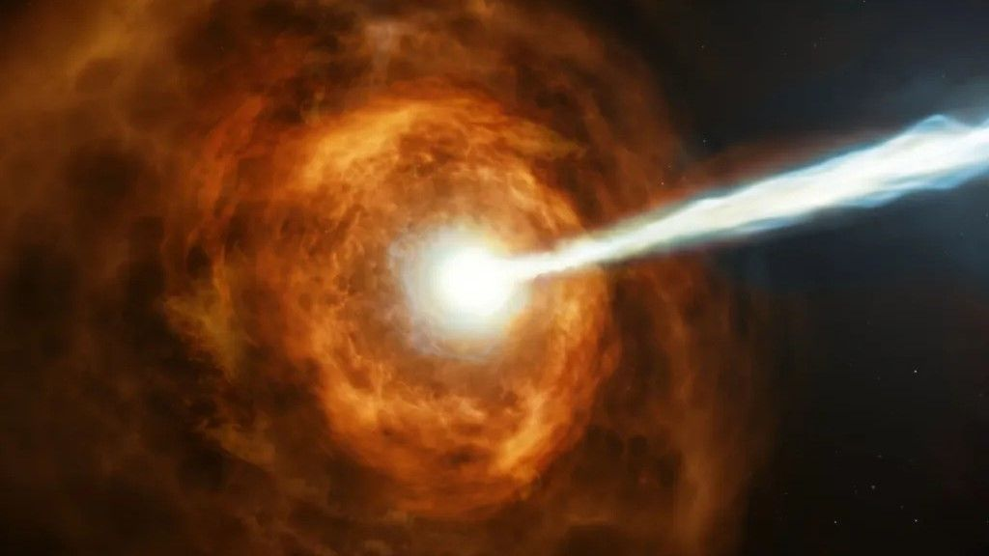
High-Energy Astrophysical Neutrinos

Slide 12
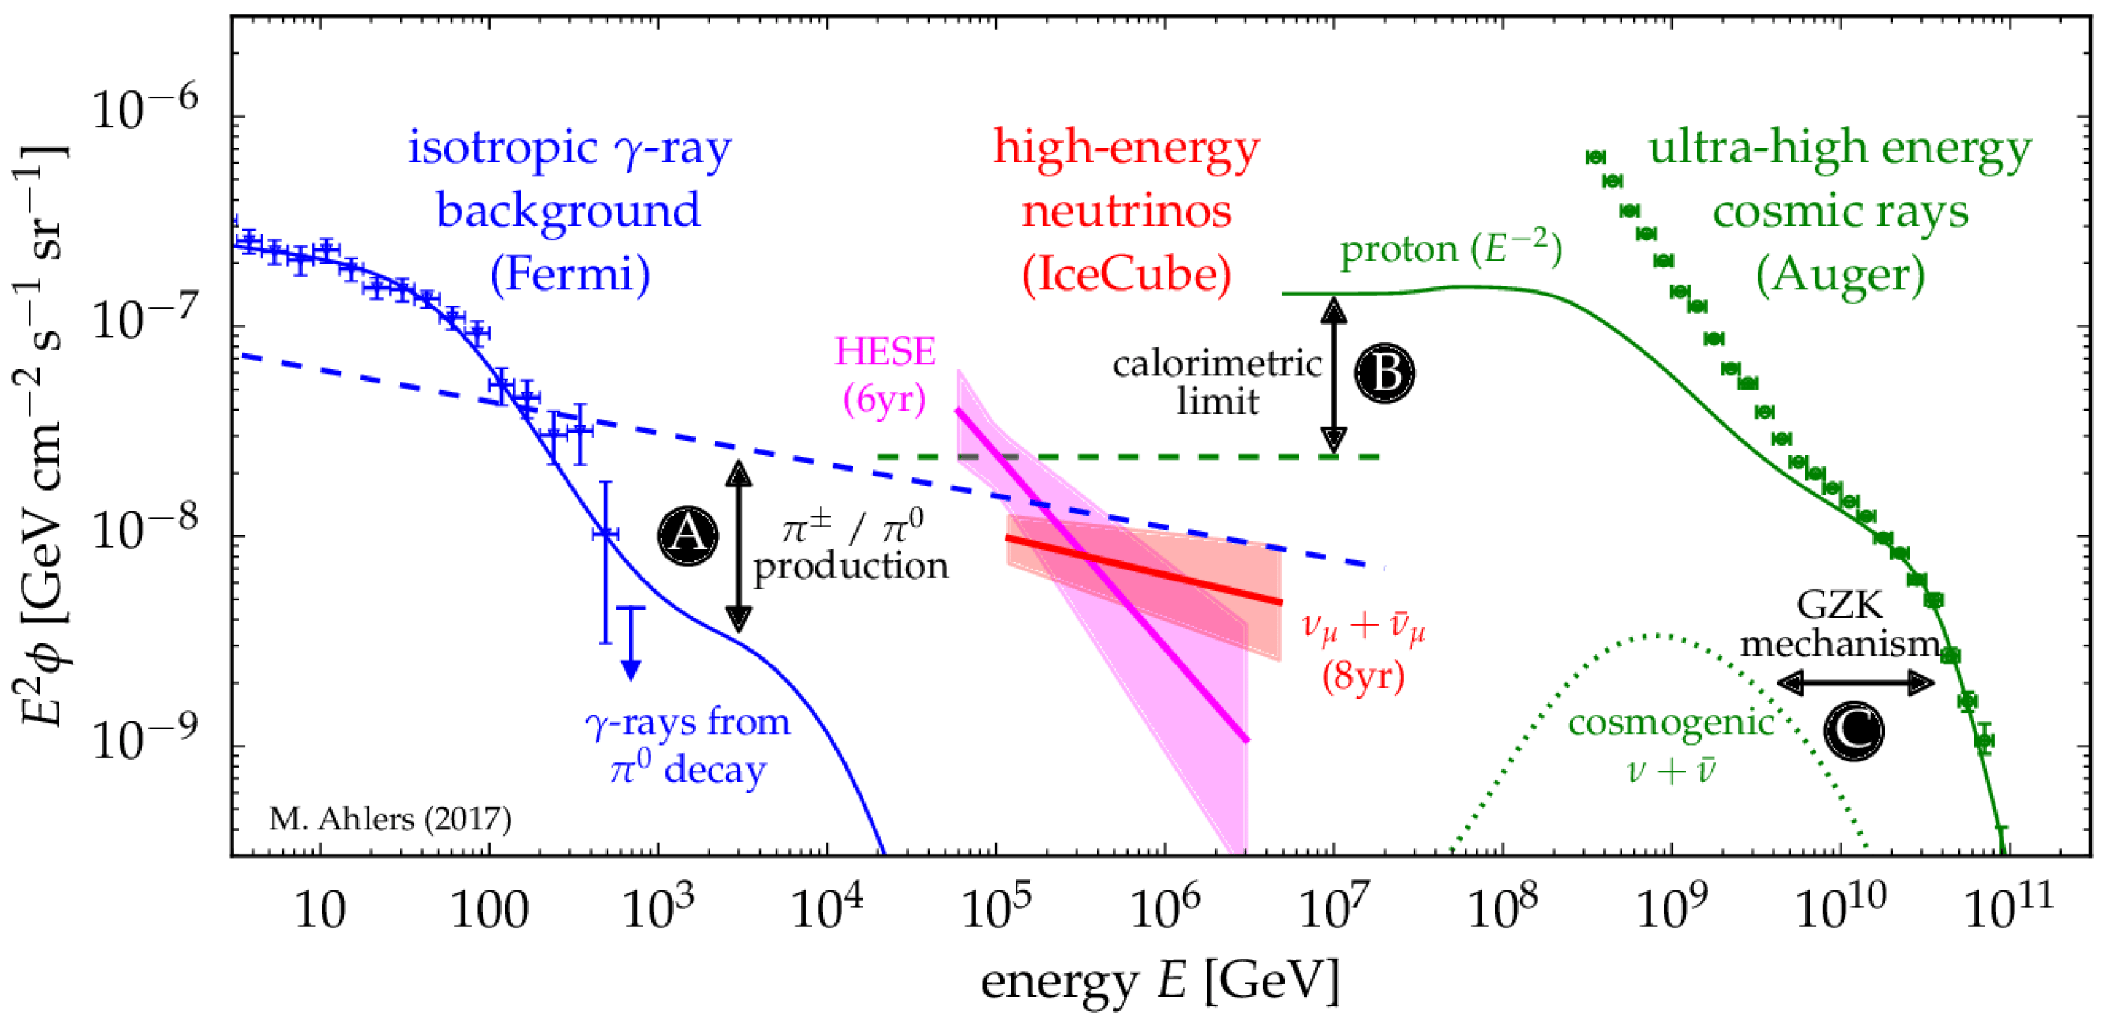
Multi-Messenger Connection

Slide 13
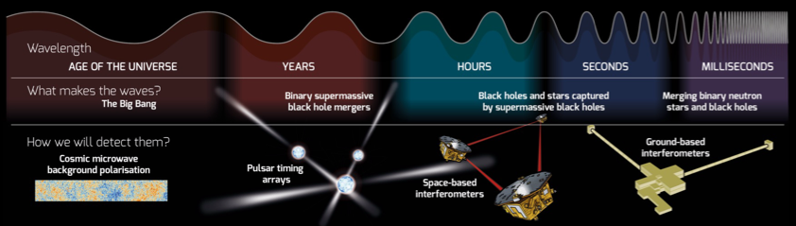
Gravitational Waves
Can be used to probe early-Universe cosmology, e.g.
cosmological phase transitions, topological defects, inflation, (p)reheating.
See talk by Graham White

Slide 14
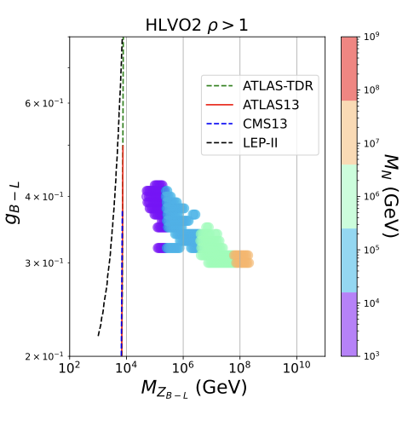
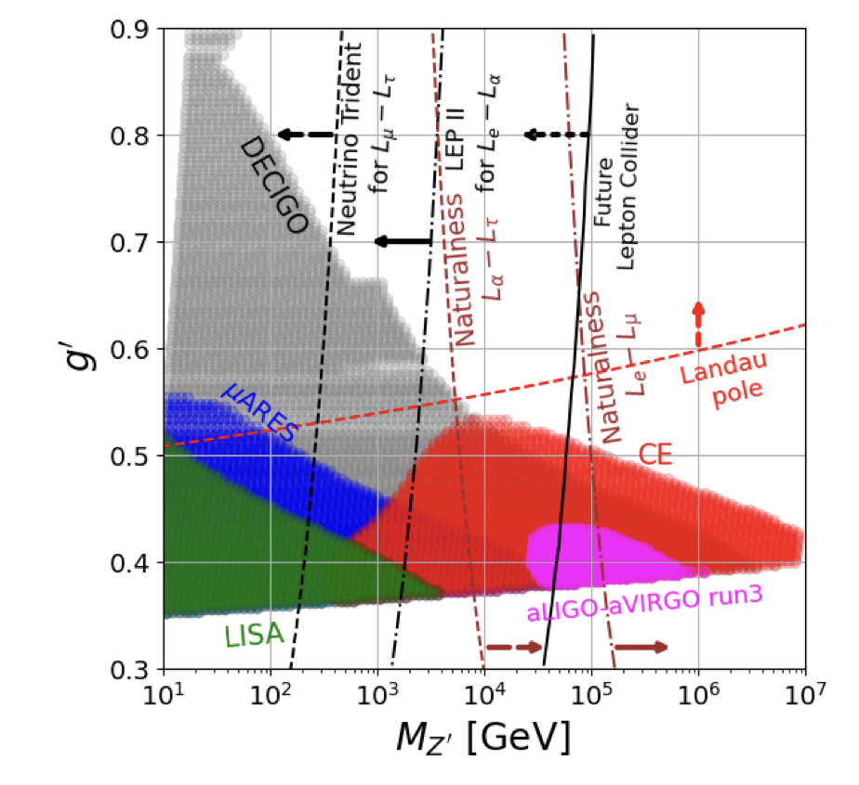
Gravitational Wave versus Future Collider
Already ruling out new parameter space
Dasgupta, BD, Ghoshal, Mazumdar, 2206.07032
Dasgupta, BD, Han, Padhan, Wang, Xie, 2308.12804

Slide 15
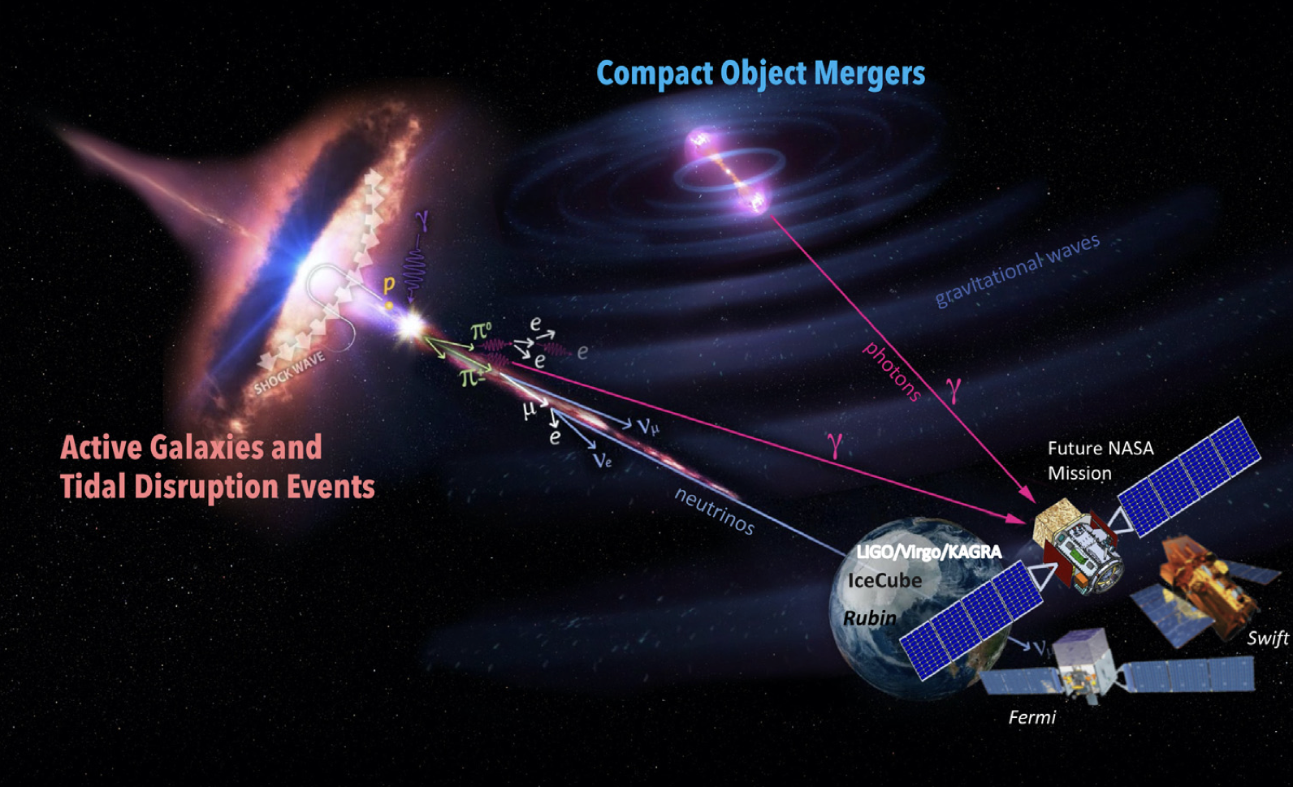
A New Era of Multi-Messenger Astronomy
2109.10841
New opportunities for new physics searches, often complementary to the existing probes.

Slide 16
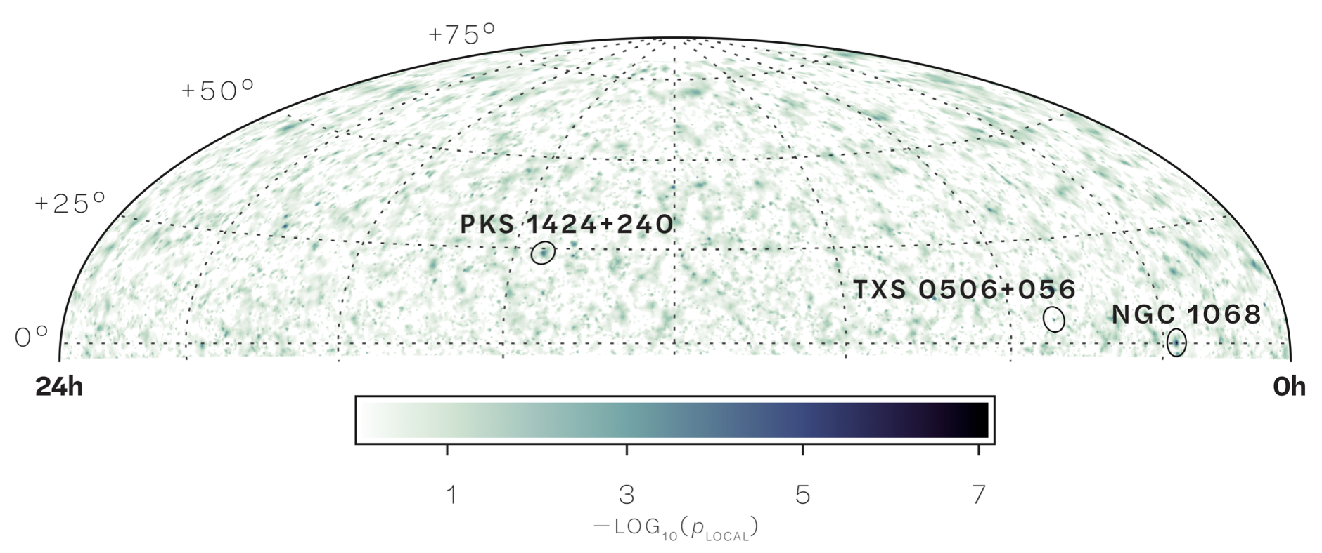
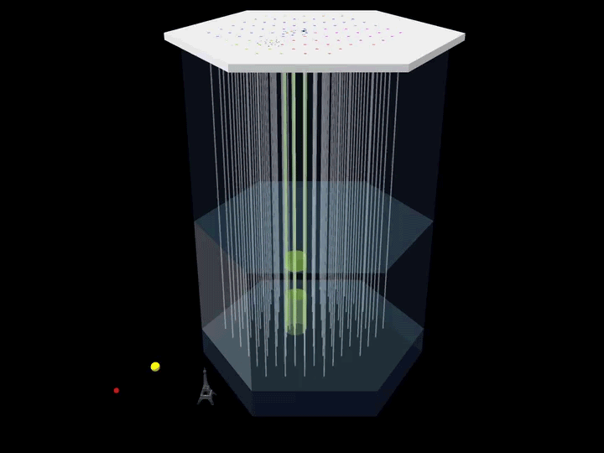
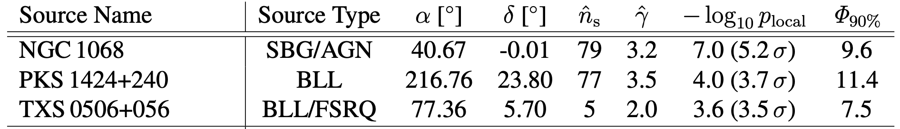
Multi-Messenger Neutrino Astronomy
IceCube Collaboration, 2211.09972 (Science);
1807.08794 (Science).

Slide 17
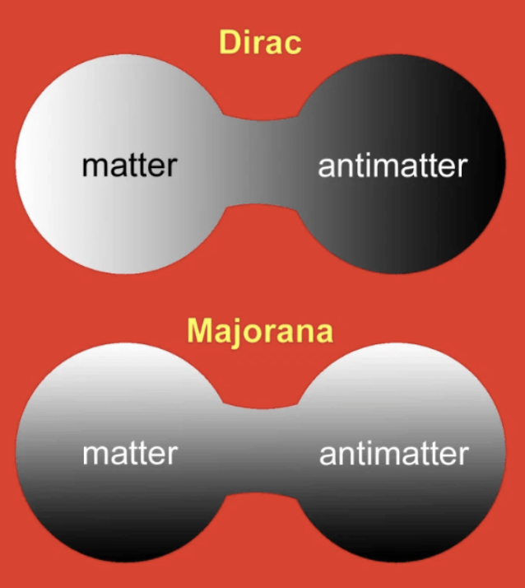
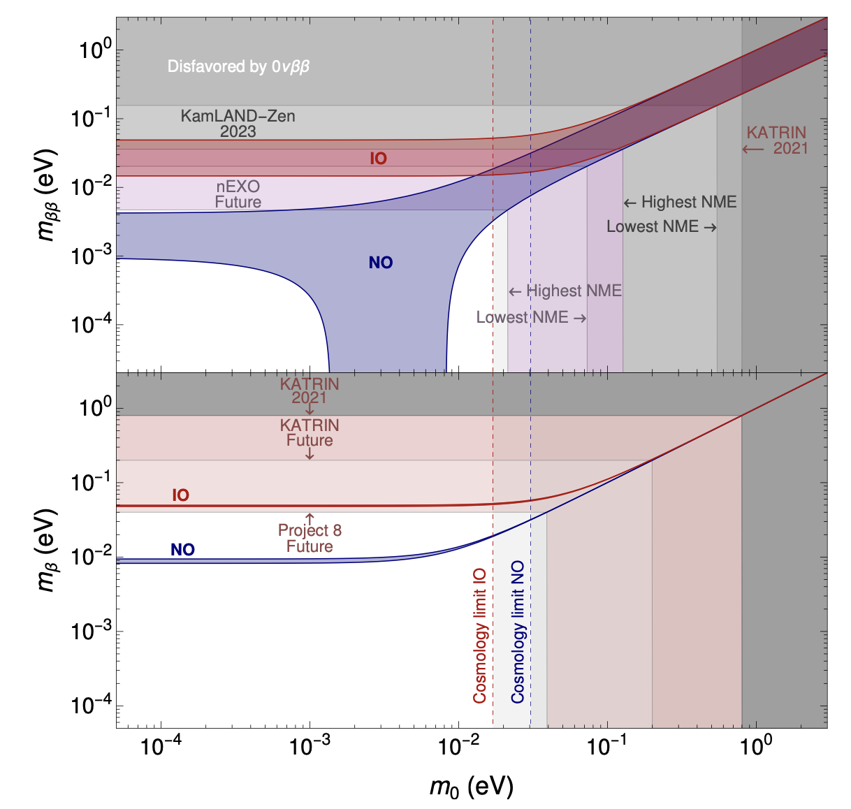
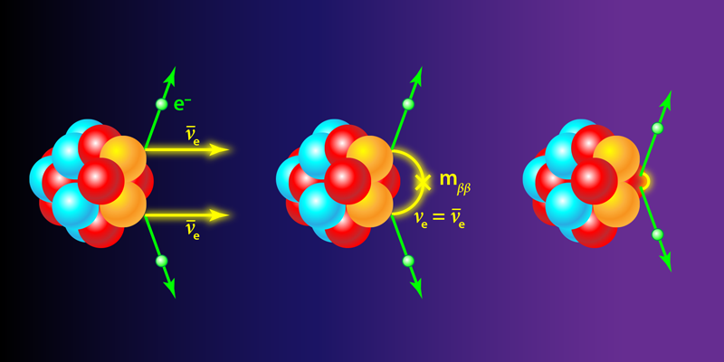
Probing the Nature of Neutrino Mass
What if no signal here?
LNV at colliders is a great alternative.
See talk by Stefan Antusch.
2310.20681

Slide 18
Another Possibility: Pseudo-Dirac Neutrinos

Slide 19
Need Astrophysical Baselines

Slide 20
A New Probe of Pseudo-Dirac Neutrinos
Carloni, Martinez-Soler, Arguelles, Babu, BD, 2212.00737

Slide 21
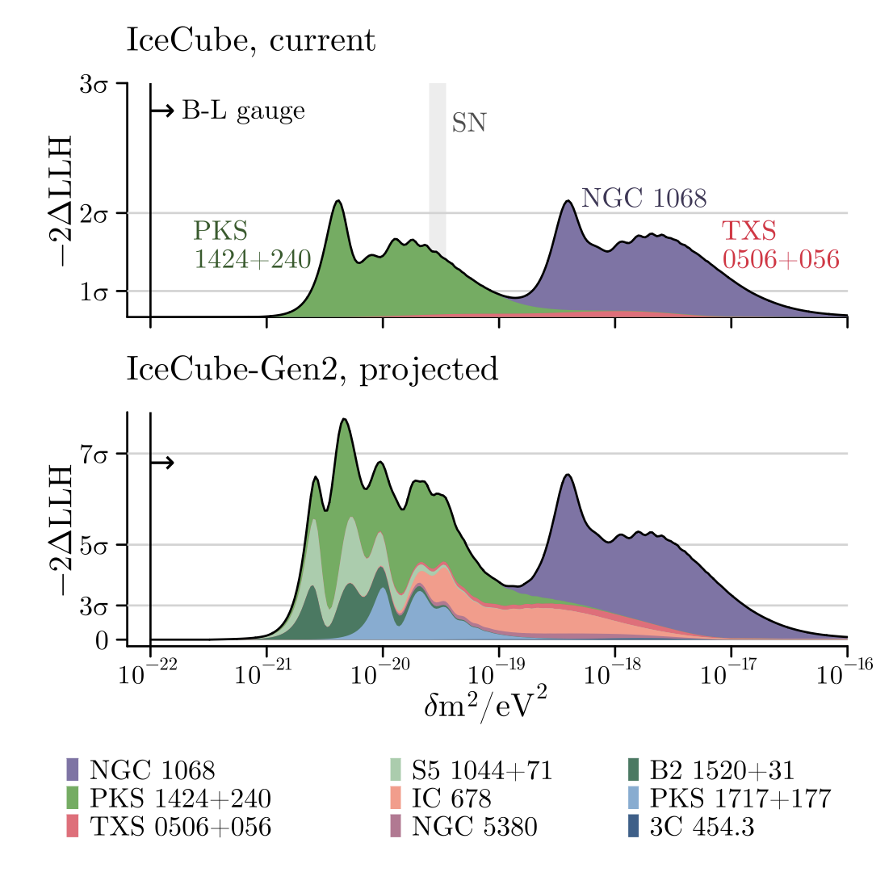
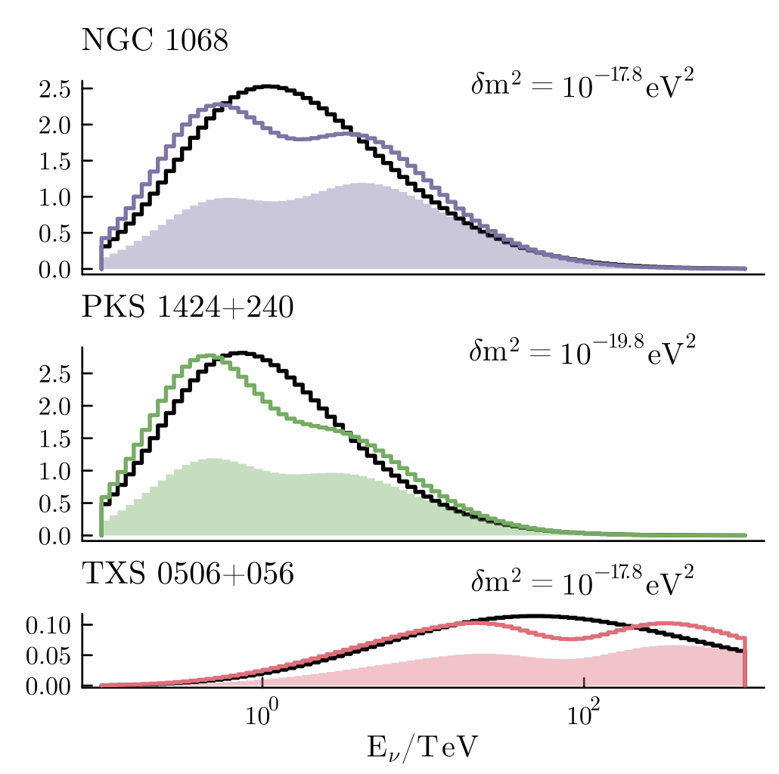
First IceCube Constraints on Pseudo-Dirac Neutrinos
Carloni, Martinez-Soler, Arguelles, Babu, BD, 2212.00737

Slide 22

Hint of Pseudo (or Quasi)-Dirac Neutrinos?
Carloni, Porto, Arguelles, BD, Jana, 2503.19960
Quasi-Dirac neutrinos (Qdinos)

Slide 23
Hidden Neutrino Sources
Malizia et al., 0906.5544 (MNRAS)
BD, Jana, Porto, 2312.17315
Resonant flavor conversion, analogous to the supernova case.
Roughly one in four AGNs is Compton thick.
Maybe the reason why most of the HEN sources are unknown.
Dighe, Smirnov, 9907423 (PRD)
Only way to probe heavily Compton-thick AGNs which are neutrino bright, but with no electromagnetic counterparts.

Slide 24
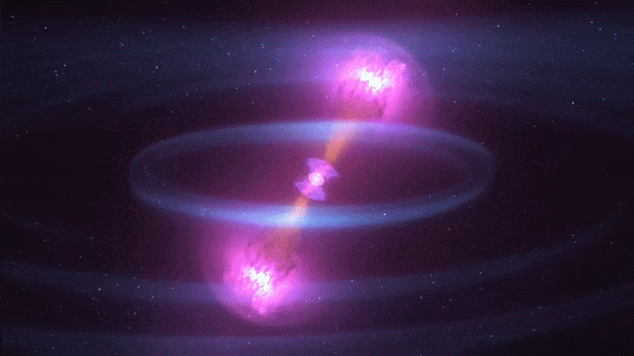
GW170817: Another Multi-Messenger Frontier
Animation

Slide 25
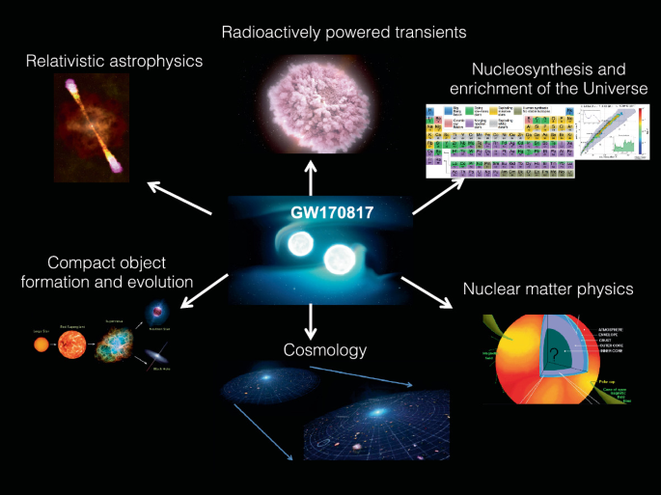

Slide 26
Axion Searches with NS Mergers
Multi-messenger connection
Fiorillo, Iocco, 2109.10364 (PRD)
For small ALP mass
(below neV)
Dietrich, Clough, 1909.01278 (PRD); Harris, Fortin, Sinha, Alford, 2003.09768 (JCAP)
BD, Fortin, Harris, Sinha, Zhang, 2305.01002 (PRL);
Diamond, Fiorillo, Marques-Tavares, Tamborra, Vitagliano, 2305.10327 (PRL)
Negligible effect

Slide 27
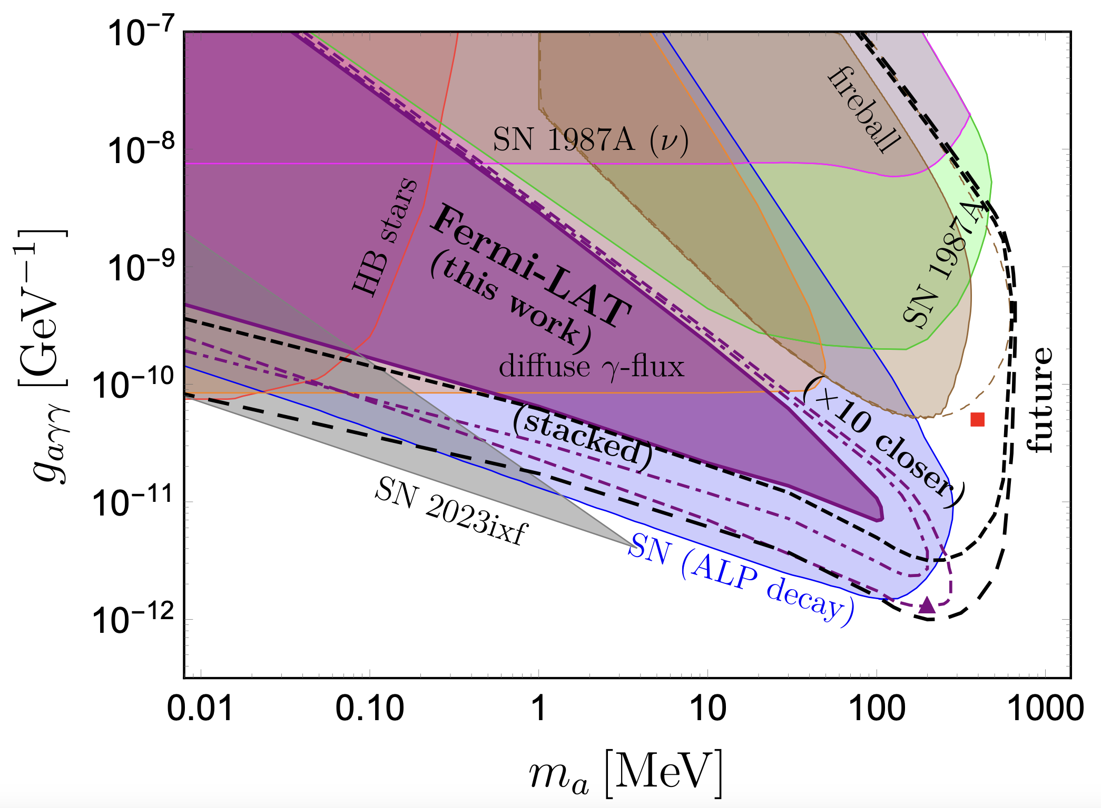

Supernova versus NS Merger
Supernova NS merger
T_{core}: 30 MeV vs 40-100 MeV
Distance: 51 kpc vs 40 Mpc
Rate: ~1/50 yr vs 10-1700/Gpc³ /yr.
Multi-messenger:
Timing info: SNEWS and AMON/
BD, Fortin, Harris, Sinha, Zhang, 2305.01002 (PRL)

Slide 28
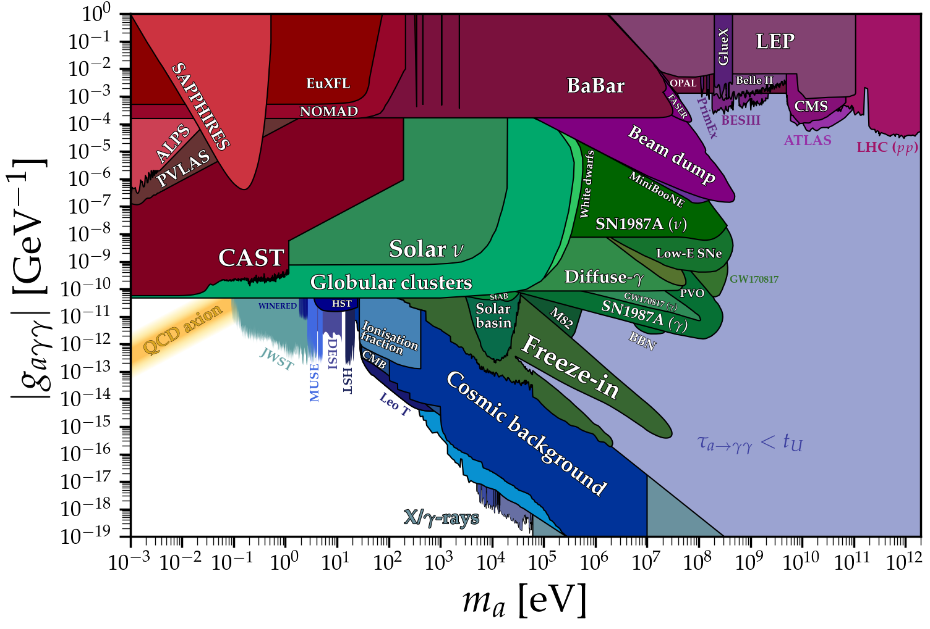
Comparison with Collider Constraints
From https://cajohare.github.io/AxionLimits/

Slide 29
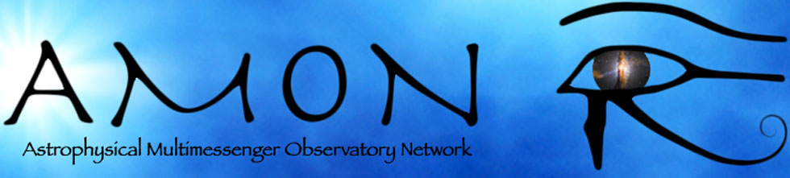
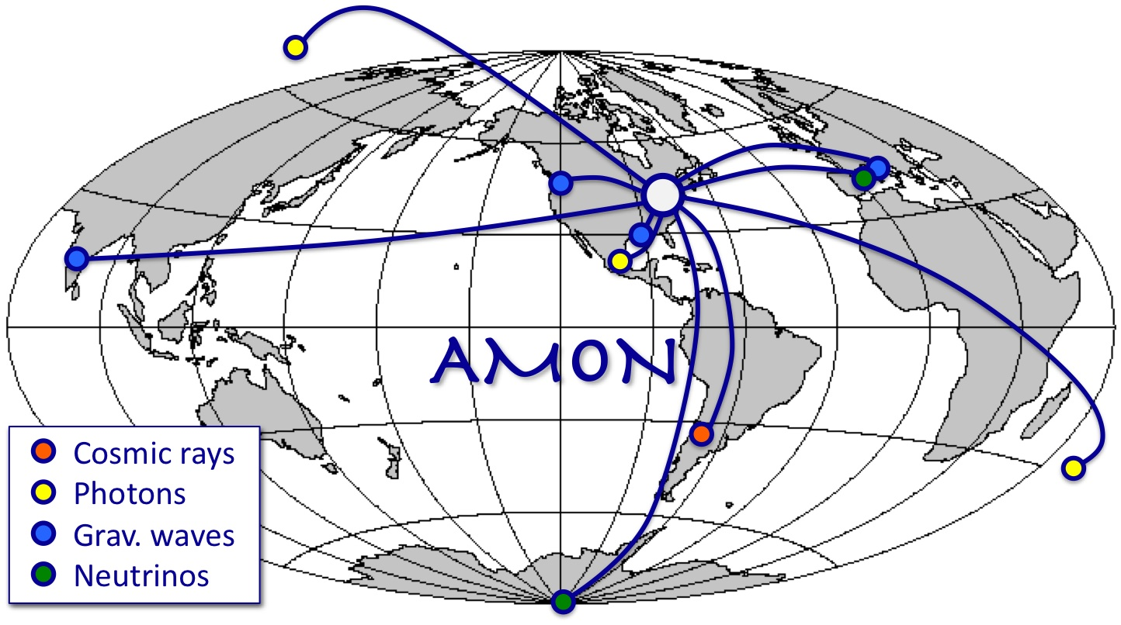
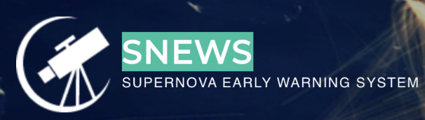
Conclusions
An exciting era of Multi-messenger Astronomy.
Great for both Astrophysics and Particle Physics.
Halzen’s “event of a lifetime” (simultaneous observation of EM, CR, neutrino and GW) just around the corner?
New windows into the (opaque) Universe.
New opportunities for (B)SM physics.
Complementary to accelerator probes.

