Slide 1








Integrated Future Circular Collider programme (ee / hh)
Massimo Giovannozzi
CERN, BE Department
Corfu2025 Workshop on Future Accelerators, 28 April 2025
LHC
PS
SPS
FCC
http://cern.ch/fcc
Work supported by the European Commission under the HORIZON 2020 projects EuroCirCol, grant agreement 654305; EASITrain, grant agreement no. 764879; ARIES, grant agreement 730871, FCCIS, grant agreement 951754, and E-JADE, contract no. 645479
photo: J. Wenninger

Slide 2

Outline
Why a hadron collider after LHC/HL-LHC
FCC integrated study: strategy and plans
Mit-term review and Feasibility Study
FCC-ee
FCC-hh
Outlook
Acknowledgements: A. Abramov, W. Bartmann, M. Benedikt, J. Borburgh, R. Bruce, K. Geiger, B. Goddard, J. Gutleber, R. Lopez, G. Perez Segurana, T. Risselada, P. Thonet, E. Todesco, F. Zimmermann

Slide 3
Why a hadron collider after LHC/HL-LHC
The 2013 Update of the European Strategy for Particle Physics (ESPPU) [1] stated, inter alia, that “...Europe needs to be in a position to propose an ambitious post-LHC accelerator project at CERN by the time of the next Strategy update” and that “CERN should undertake design studies for accelerator projects in a global context, with emphasis on proton–proton and electron-positron high-energy frontier machines. These design studies should be coupled to a vigorous accelerator R&D programme, including high-field magnets and high-gradient accelerating structures, in collaboration with national institutes, laboratories and universities world-wide”.
The LHC discovered the Higgs, but now we are facing another challenging question: “what is next and where is it?”
  Additional particles and interactions must extend the Standard Model (SM), to explain for example, the existence of dark matter (DM), neutrino masses and the observed matter/antimatter asymmetry.
  The SM itself calls for a broader theoretical framework, to provide a rationale for the dynamical origin of electroweak (EW) symmetry breaking (EWSB) and to justify the otherwise unnatural fine tuning needed to prevent quantum corrections pushing the Fermi scale up to the Planck scale.

Slide 4
Why a hadron collider after LHC/HL-LHC
Setting the centre-of-mass energy
  The LHC and other experiments do not concretely point to any specific BSM scenario and mass scale today.
  Rather general arguments support 100 TeV as a sensible target for FCC-hh.
  There is clearly no upper limit to how high the community would like the energy to be. However, there is evidence that 100 TeV is necessary and sufficient to achieve crucial measurements and give clear yes/no answers to some of the important questions that might still be left open after the.
  Note that this center-of-mass energy is (almost) compatible with the magnet technology.
Setting the luminosity goal
  Cross sections for the production of a state of mass M typically scale like 1/M².
  The FCC-hh luminosity should therefore increase w.r.t. the LHC by a factor of (100/14)² ∼ 50, for its discovery reach to be sensitive to masses 100/14 ∼ 7 times larger than at the LHC.
  The baseline FCC-hh integrated luminosity of 20–30 ab⁻¹ exceeds what is obtained with this factor, if rescaled from 300fb⁻¹, the target of the nominal LHC luminosity (the HL-LHC target luminosity is 3000 fb⁻¹).
  A further increase of the luminosity by a factor of 10 beyond these values would only extend the discovery reach by less than 20%.

Slide 5
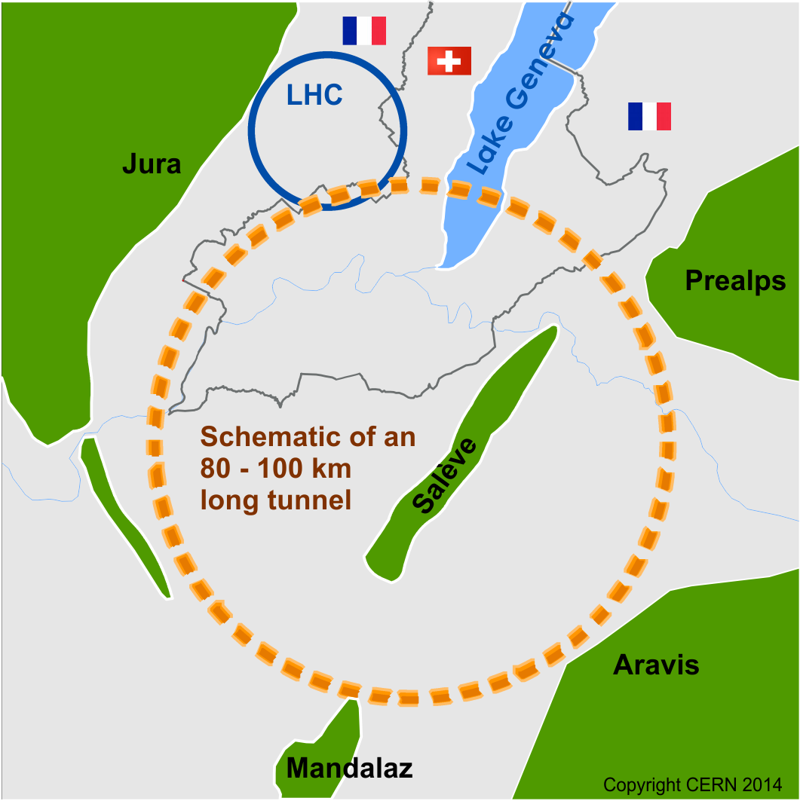
Future Circular Collider Study
launched in 2014
International FCC collaboration (CERN as host lab) to study:
pp-collider (FCC-hh) → defining infrastructure requirements
80-100 km infrastructure in Geneva area
e⁺e⁻ collider (FCC-ee) as a possible first step
p-e (FCC-he) option, HE-LHC …
FCC-he not covered here. Based on FCC-hh and novel ERL technology for the accelerator infrastructure for the electron beam

Slide 6
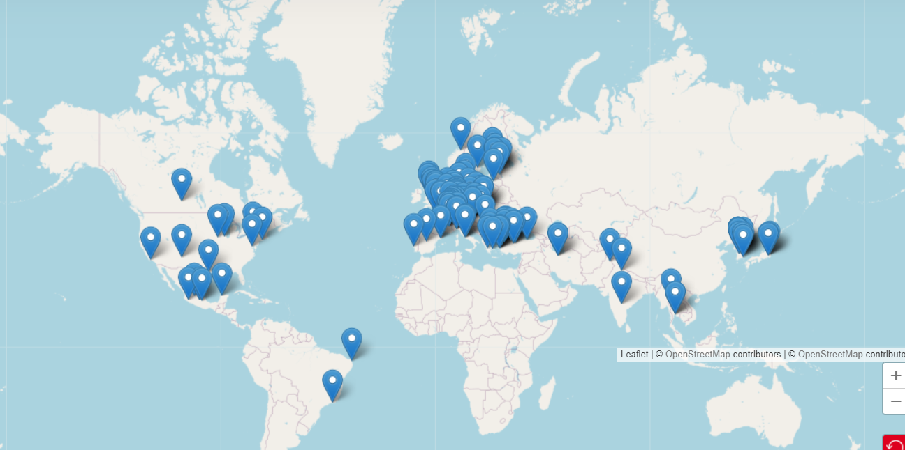


Current status of FCC global collaboration
Increasing international collaboration as a prerequisite for success:
→links with science, research & development and high-tech industry will be essential to further advance and prepare the implementation of FCC
FCC Feasibility Study:
Aim is to increase further the collaboration,
on all aspects, in particular on
Accelerator and Particle/Experiments/Detectors
141 Institutes
32 countries
+
CERN

Slide 7

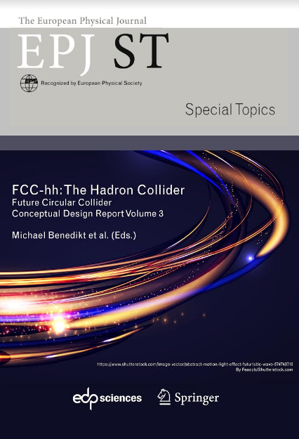
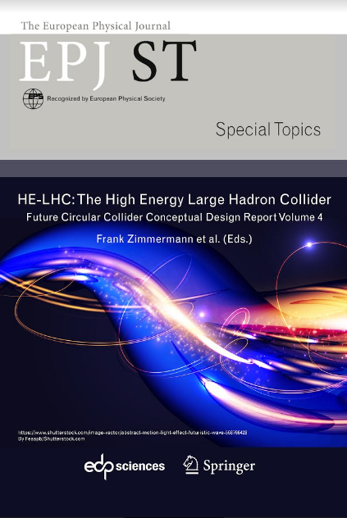
FCC CDR and Study Documentation
FCC-Conceptual Design Reports (completed in 2018):
  Vol 1 Physics, Vol 2 FCC-ee, Vol 3 FCC-hh, Vol 4 HE-LHC
  CDRs published in European Physical Journal C (Vol 1) and ST (Vol 2 – 4)
  EPJ C 79, 6 (2019) 474 , EPJ ST 228, 2 (2019) 261-623 , EPJ ST 228, 4 (2019) 755-1107 , EPJ ST 228, 5 (2019) 1109-1382
Summary documents provided to EPPSU SG
  FCC-integral, FCC-ee, FCC-hh, HE-LHC
  Accessible on http://fcc-cdr.web.cern.ch/
>1350 contributors from
> 350 institutes,
a truly global effort

Slide 8
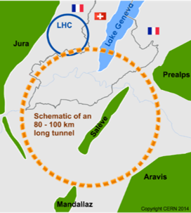
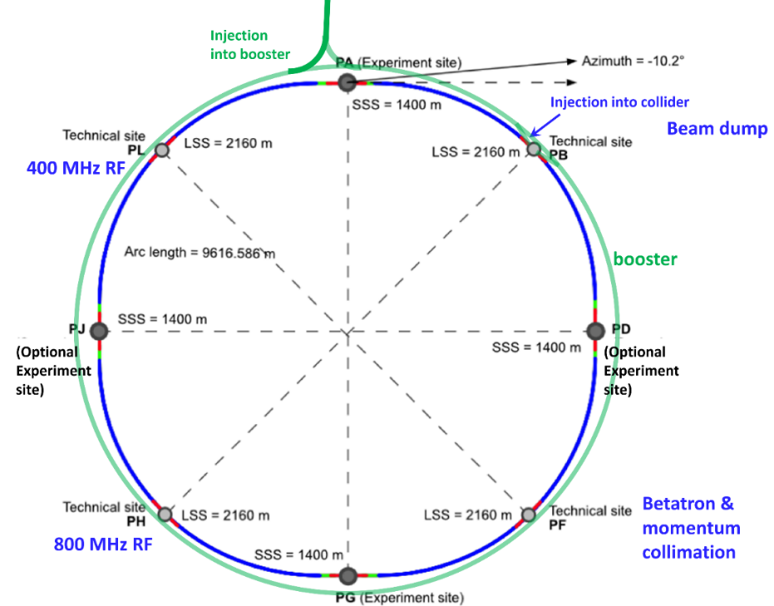
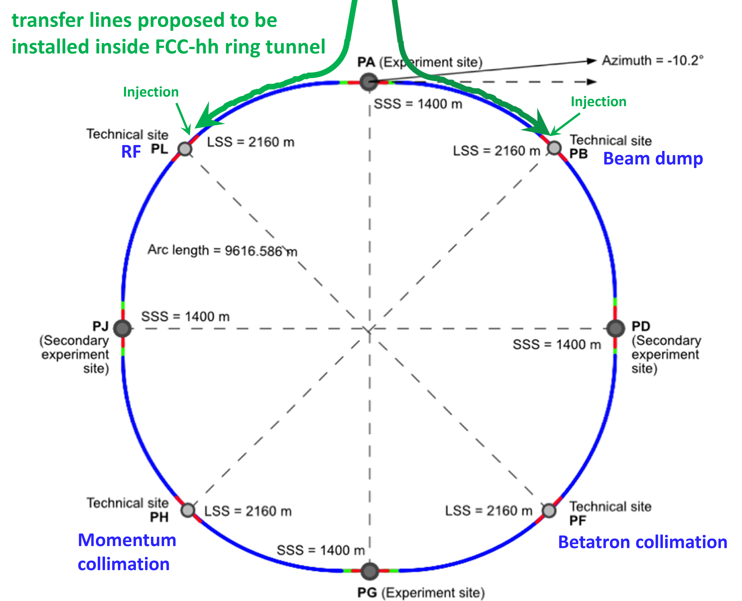
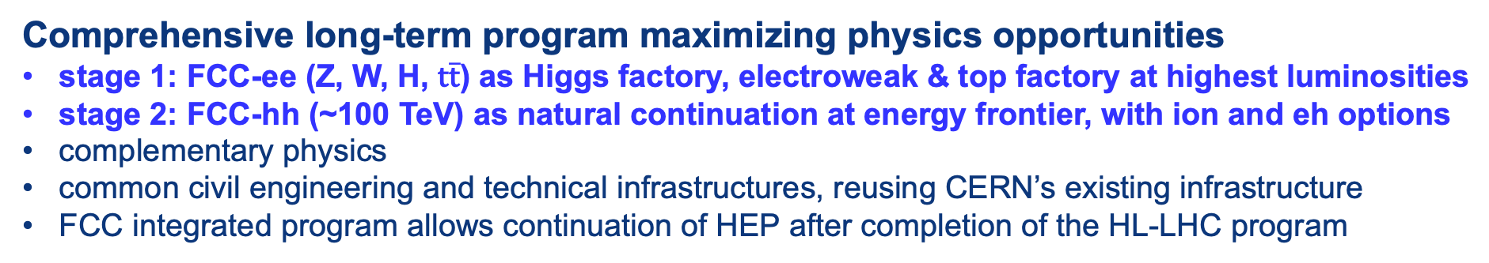
The FCC integrated program
Comprehensive long-term program maximizing physics opportunities
stage 1: FCC-ee (Z, W, H, $\text{t}\overline{\text{t}}$) as Higgs factory, electroweak & top factory at highest luminosities
stage 2: FCC-hh (~100 TeV) as natural continuation at energy frontier, with ion and eh options
complementary physics
common civil engineering and technical infrastructures, reusing CERN’s existing infrastructure
FCC integrated program allows continuation of HEP after completion of the HL-LHC program
FCC-ee
FCC-hh
2020 - 2040
2045 - 2060
2070 - 2090++

Slide 9
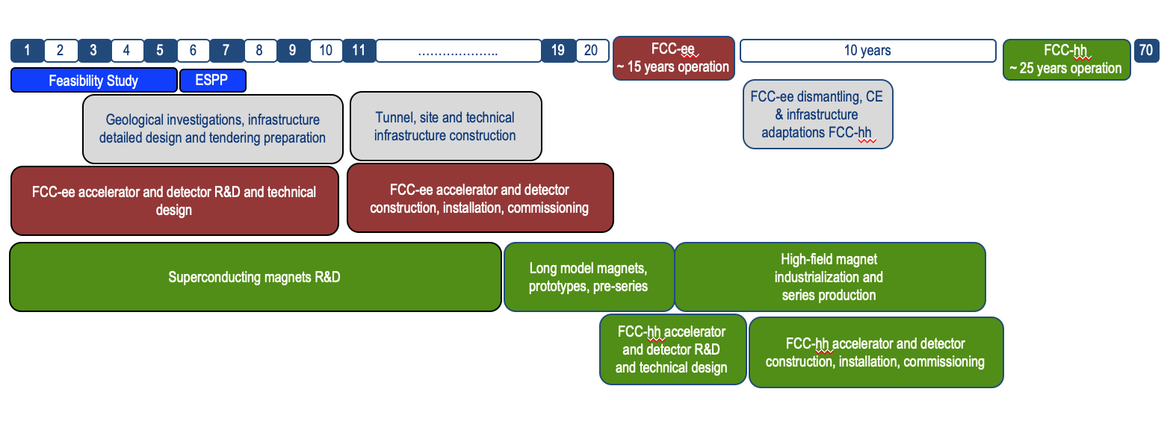
Timeline of the FCC integrated programme
Feasibility Study: 2021-2025
If project approved before end of
decade → construction can start
beginning 2030s
FCC-ee operation ~2045-2060
FCC-hh operation 2070-2090++

Slide 10
FCC Feasibility Study (2021-2025): high-level objectives
demonstration of the geological, technical, environmental and administrative feasibility of the tunnel and surface areas and optimisation of placement and layout of the ring and related infrastructure;
pursuit, together with the Host States, of the preparatory administrative processes required for a potential project approval to identify and remove any showstopper;
optimisation of the design of the colliders and their injector chains, supported by R&D to develop the needed key technologies;
elaboration of a sustainable operational model for the colliders and experiments in terms of human and financial resource needs, as well as environmental aspects and energy efficiency;
development of a consolidated cost estimate, as well as the funding and organisational models needed to enable the project’s technical design completion, implementation and operation;
identification of substantial resources from outside CERN’s budget for the implementation of the first stage of a possible future project (tunnel and FCC-ee);
consolidation of the physics case and detector concepts for both colliders.
Results summarised in a Feasibility Study Report released in March 2025

Slide 11
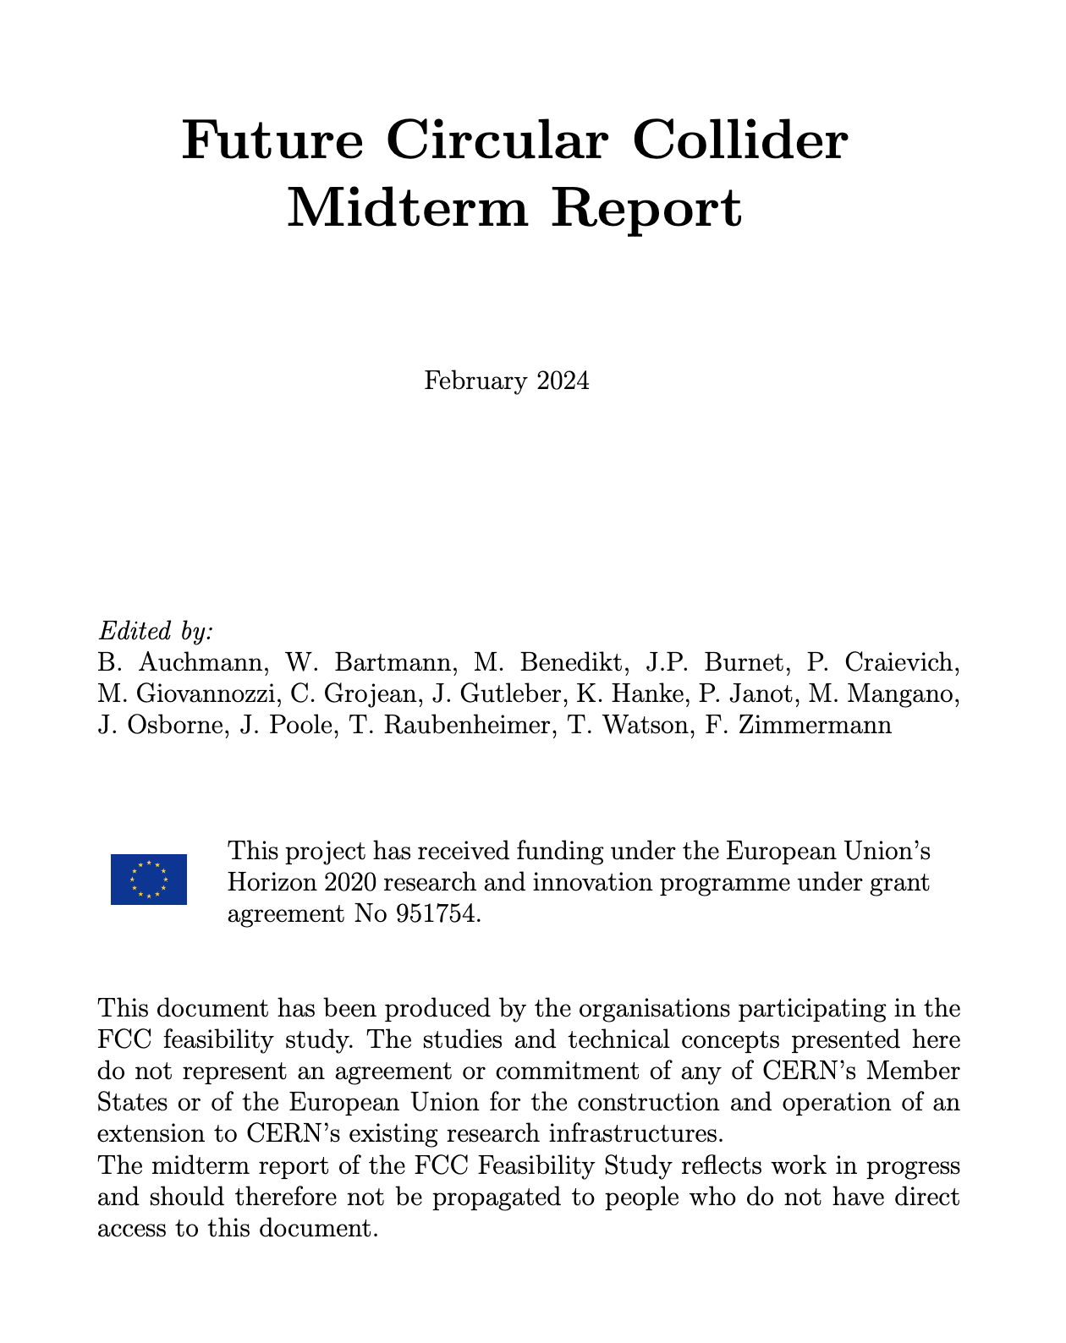
Feasibility Study Mid-Term Review passed!
The goal of the FCC FS mid-term review is to assess the progress of the Study towards the final report.
Deliverables approved by the Council in September 2022:
https://indico.cern.ch/event/1197445/contributions/5034859/attachments/2510649/4315140/spc-e-1183-Rev2-c-e-3654-Rev2_FCC_Mid_Term_Review.pdf
Full Report
8 Chapters/Deliverables
~ 700 pp document
~ 16 editors
~ 500 contributors
Deliverables:
D1 : Definition of the baseline scenario
D2 : Civil engineering
D3 : Processes and implementation studies with the Host States
D4 : Technical infrastructure
D5 : FCC-ee accelerator
D6: FCC-hh accelerator
D7: Project cost and financial feasibility
D8: Physics, experiments and detectors
Many thanks to the SAC, CRP, SPC, FC and the Council for the very useful reviews!
Documents:
Mid-term report (all deliverables except D7)
Executive Summary of mid-term report
Updated cost assessment (D7)
Funding model (D7)
Review process:
Oct 2023: Scientific Advisory Committee (scientific and technical aspects)
and Cost Review Panel (ad hoc committee; cost and financial aspects)
Nov 2023: SPC and FC
2 Feb 2024: Council
All deliverables met, no technical showstoppers
→70-80 recommendations

Slide 12
Main goals for 2024/beginning 2025
Completion of technical work for Feasibility Study until end 2024
  Implementation of recommendations of the mid-term review
  Focus on “feasibility items” and items with important impact on cost/performance
  Develop a risk register
  Update cost estimate to reach cat 3 level on cost uncertainty (-20% / +30%).
  Further develop the funding model based on discussions with CERN Council
  Complete FS by March 2025 as input for ESPP update.
  In parallel, continue work with host states on project definition and responsibilities, authorization procedures, excavation material strategy and regional implementation development.

Slide 13




Feasibility Study Report by March 2025
Structure: 3 Volumes
Vol. 1: Physics, Experiments and Detectors (292 pages)
CERN-FCC-PHYS-2025-0002, https://cds.cern.ch/record/2928193
Vol. 2: Accelerators, Technical Infrastructures, and Safety (629 pages)
CERN-FCC-ACC-2025-0004, http://cds.cern.ch/record/2928793
Vol. 3: Civil Engineering, Implementation & Sustainability (359 pages)
CERN-FCC-ACC-2025-0003, http://cds.cern.ch/record/2928194
In addition documentation on Cost Estimate – Funding Models
Input for Update of European Strategy for Particle Physics
to be prepared with Overleaf & published by EPJ (Springer-Nature) – FCCIS members

Slide 14
Pre-TDR phase from April 2025 until end 2027
Main goal is to provide all information to Council to allow taking a decision on the project by end of 2027 or early 2028
Further develop the civil engineering and the technical design of all major systems and components, so as to provide a more detailed cost estimate with reduced uncertainties
Continuation of technical R&D activities
Work with host states on regional implementation development and authorization process definition to enable launch of environmental impact study in 2026
Continuation of site investigations and perform an overall integration study to specify requirements of technical infrastructure, accelerators and detectors
  Provision of input for civil engineering design if the project goes ahead.
→ Work with international partners to define roles and work packages

Slide 15




Expected timeline until start of construction
2024 |  |  |  | 2025 |  |  |  | 2026 |  |  |  | 2027 |  |  |  | 2028 |  |  |  | 2029 |  |  |  | 2030 |  |  |  | 2031 |  |  |  | 2032 |  |  |  | 2033
Q1 | Q2 | Q3 | Q4 | Q1 | Q2 | Q3 | Q4 | Q1 | Q2 | Q3 | Q4 | Q1 | Q2 | Q3 | Q4 | Q1 | Q2 | Q3 | Q4
Feasibility Study
Pre-TDR Phase
TDR Phase
Construction →→→
FS Report
cost update
ESPPU
2025/26
pre TDR
cost update
TDR
cost update
Project Decision
accelerator design, technical infrastructure design, R&D, towards TDR
engineering design →
Environmental Impact study & Authorization Process
Phase 1 Site Investigations
Phase 2 Site Investigations
CE Concept Design update
CE Tender Design
Construction Design
Start construction
Detector EOI submissions
FC³ formation, call for CDRs
Detector CDRs submitted to FC³

Slide 16
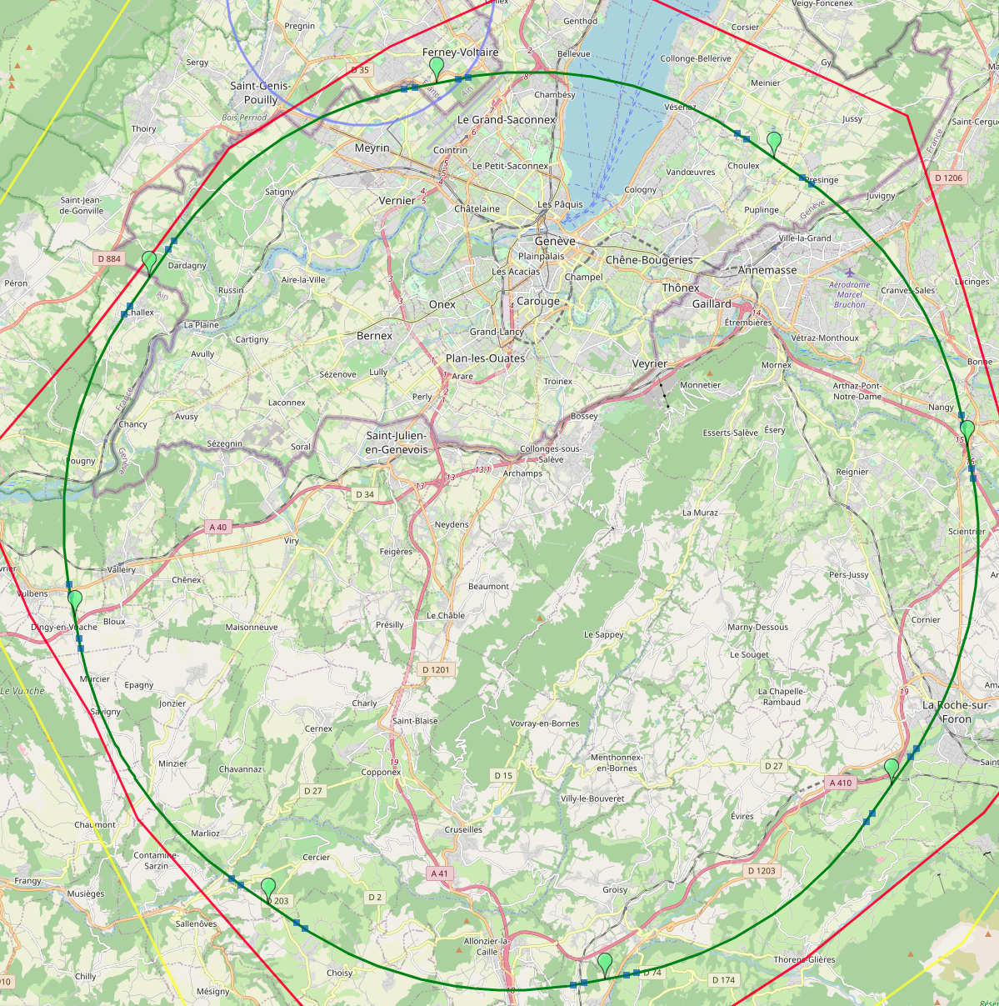
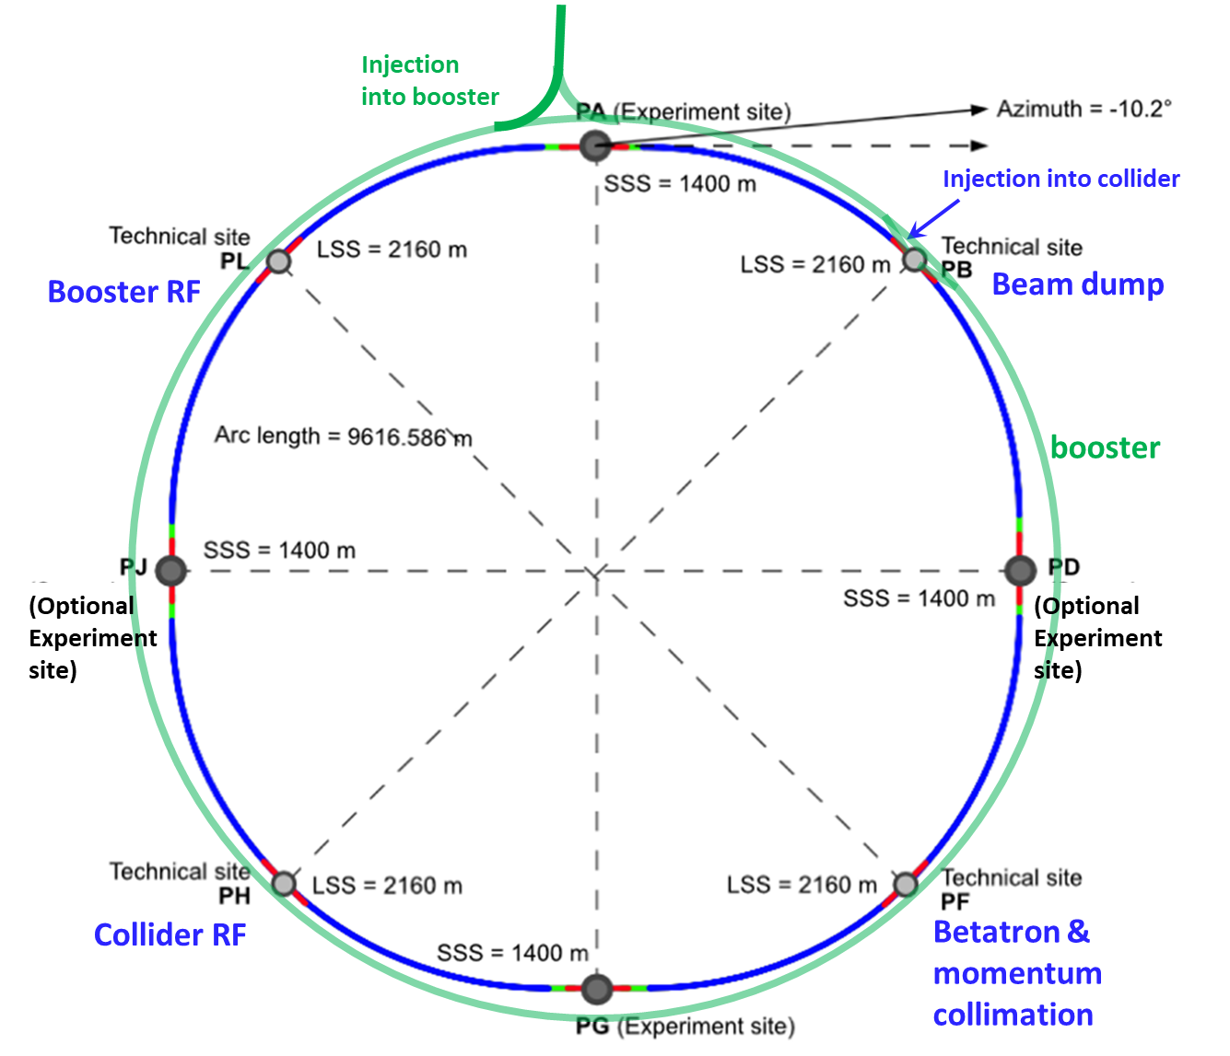
Reference layout and implementation: PA31 - 90.7 km
V. Mertens,
J. Gutleber
Layout chosen out of ~ 100 initial variants, based on geology and
surface constraints (land availability, access to roads, etc.), environment, (protected zones), infrastructure (water, electricity, transport), machine performance etc.
“Avoid-reduce-compensate” principle of EU and French regulations
PA: Experiment
PB: technical
PL: technical
Overall lowest-risk baseline: 90.7 km ring, 8 surface points,
4-fold symmetry
Number of surface sites | 8
Surface requirements | ~40 ha
LSS@IP (PA, PD, PG, PJ) | 1400 m
LSS@TECH (PB, PF, PH, PL) | 2032 m
Arc length | 9.6 km
Sum of arc lengths | 76.9 m
Total length | 90.7 km
PD: experiment
PJ: experiment
PF: technical
PH: technical
16
PG: experiment

Slide 17
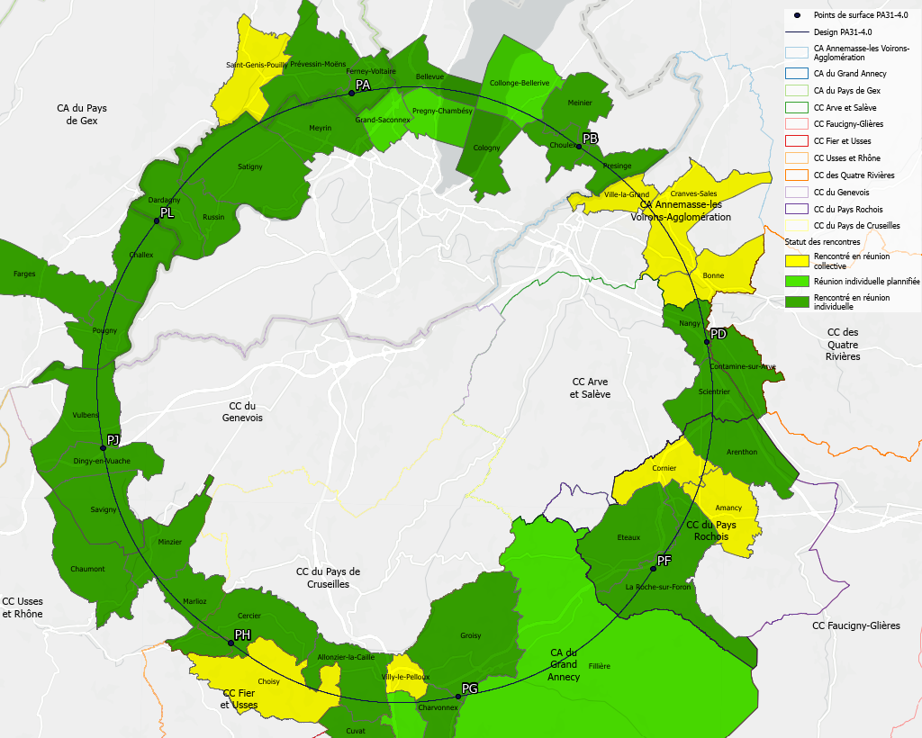
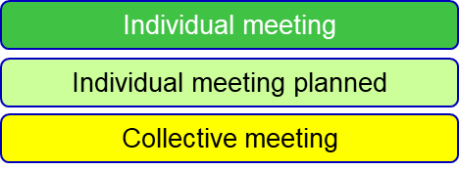
Regional implementation activities
Meetings with municipalities concerned
in France (31) and Switzerland (10)
PA – Ferney Voltaire (FR) – experiment site
PB – Présinge/Choulex (CH) – technical site
PD – Nangy (FR) – experiment site
PF – Roche sur Foron/Etaux (FR) – technical site
PG – Charvonnex/Groisy (FR) – experiment site
PH – Cercier (FR) – technical site
PJ – Vulbens/Dingy en Vuache (FR) experiment site
PL – Challex (FR) – technical site
Detailed work with municipalities and host states
identify land plots for surface sites
understand specific aspects for design
identify opportunities (waste heat, tec.)
reserve land plots until project decision
Status 1 June 2024
The support of the host states is greatly appreciated and essential for the study progress!

Slide 18
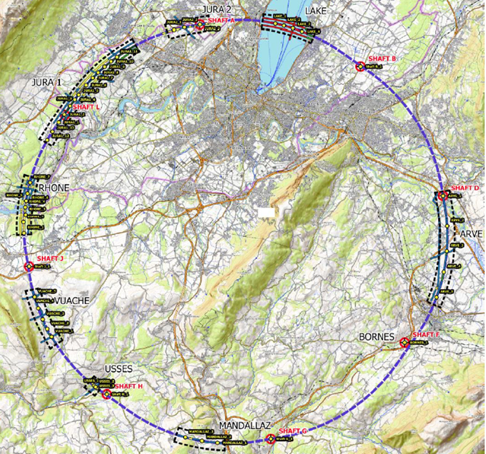
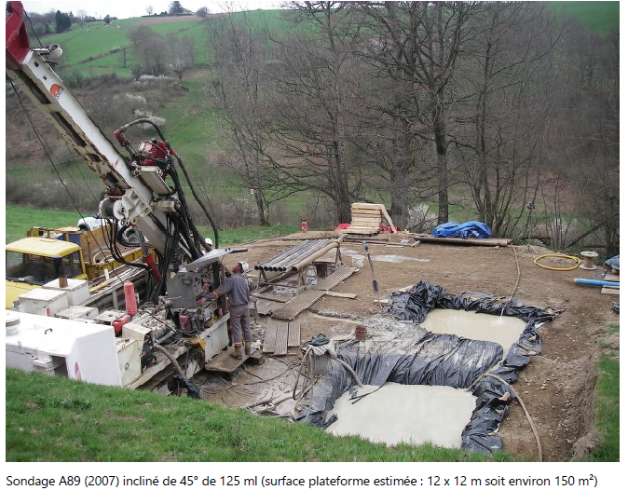
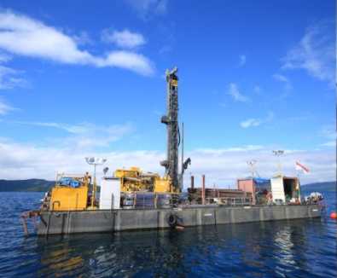
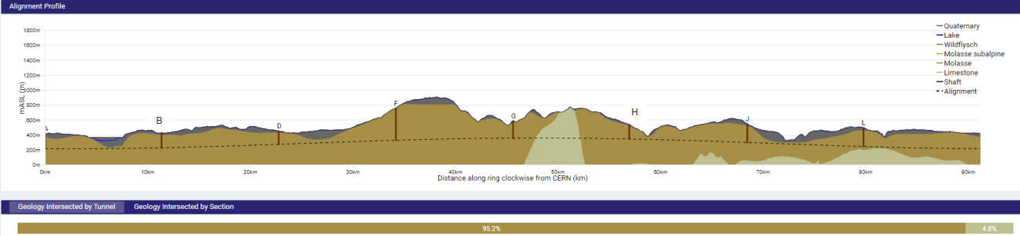
First series of site investigations
Site investigations to identify exact location of geological interfaces:
Molasse layer vs moraines/limestone
~30 drillings and ~100 km seismic lines
Started in July 2024
→ Vertical position and inclination of tunnel
Drilling works on the lake

Slide 19
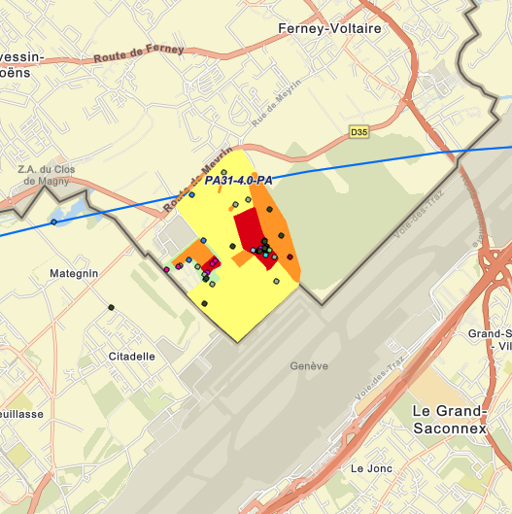
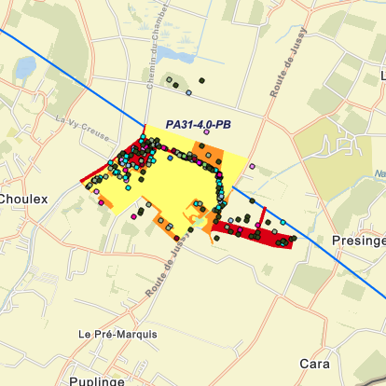
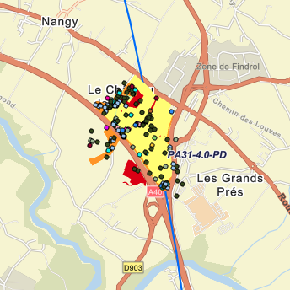
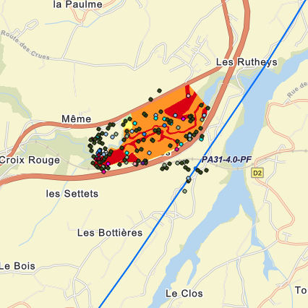
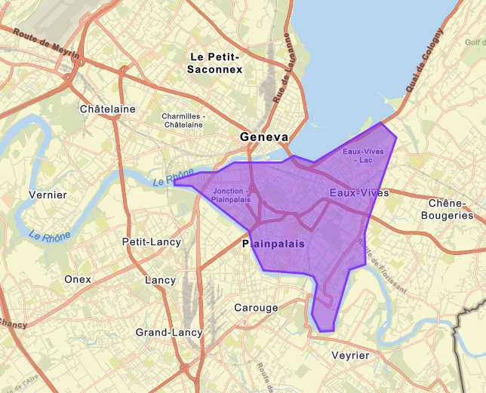
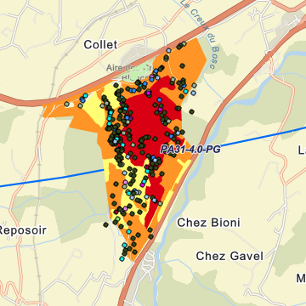
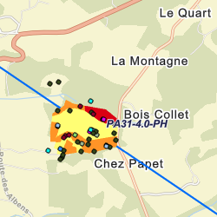
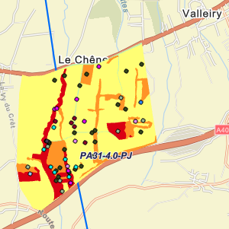
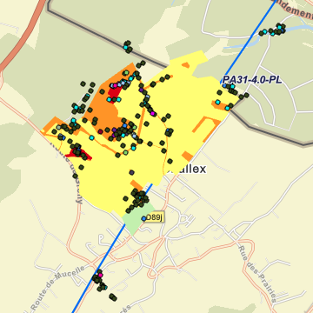
Total area investigated: 585 ha over 4 seasons
PA
PB
PD
PF
585 ha correspond to…
PG
PH
PJ
PL
… Geneva centre

Slide 20
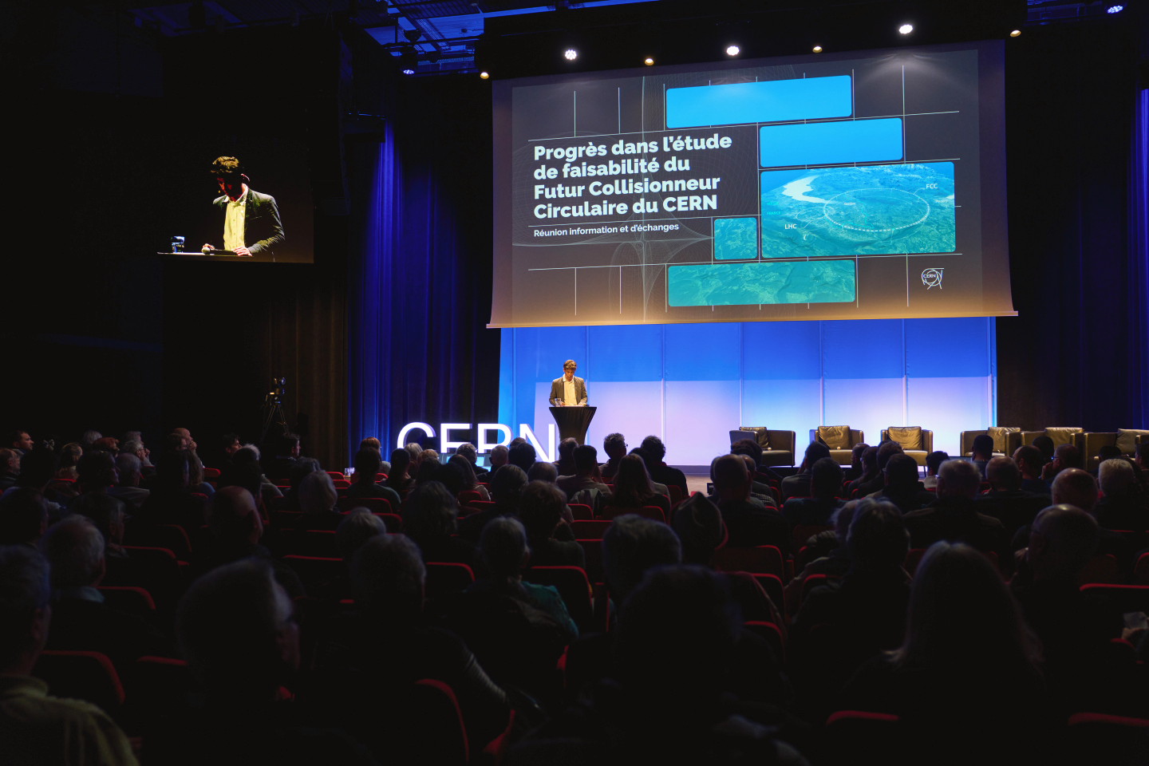
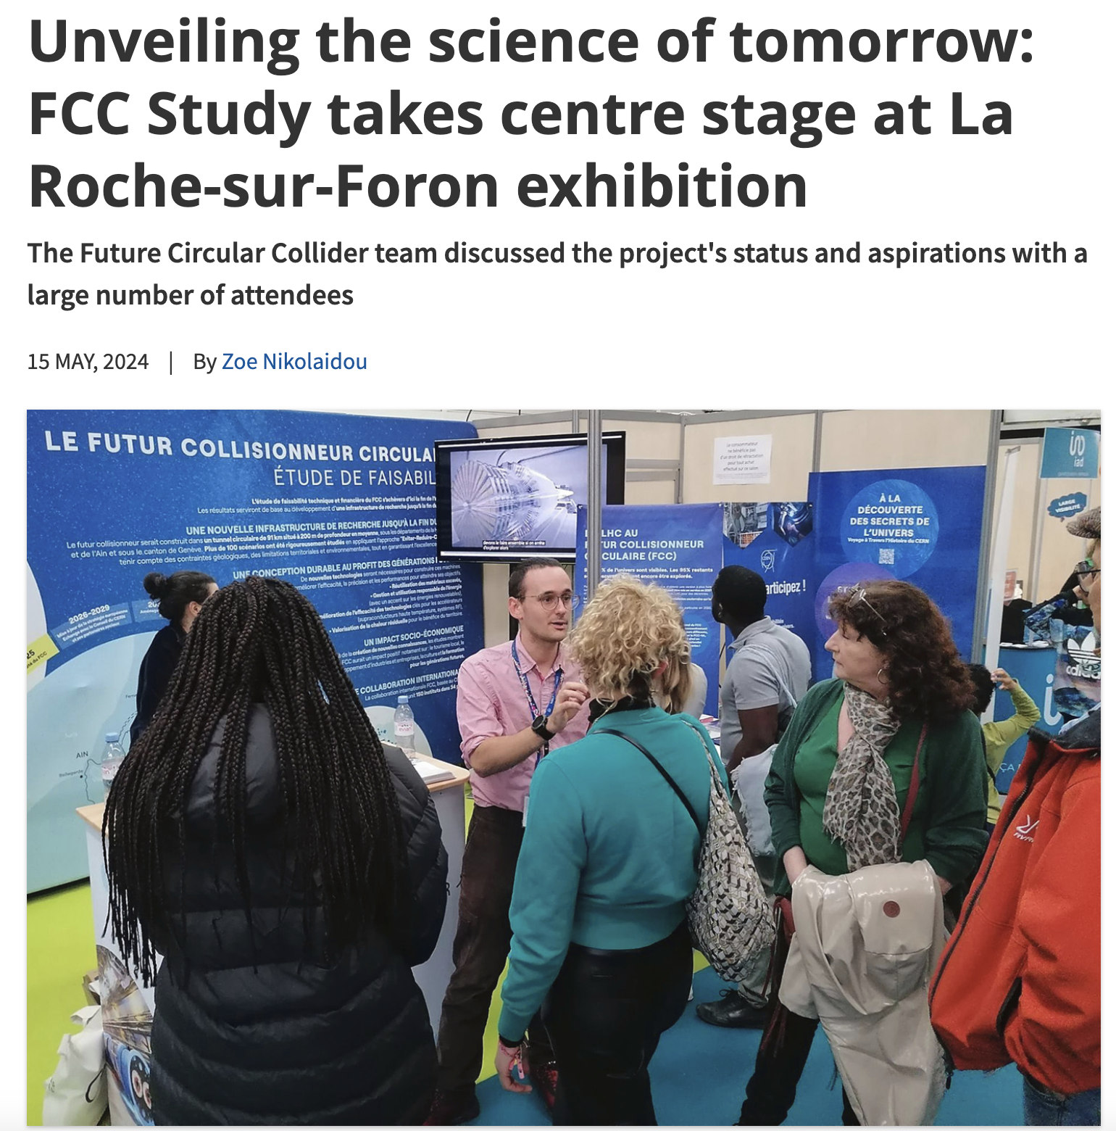
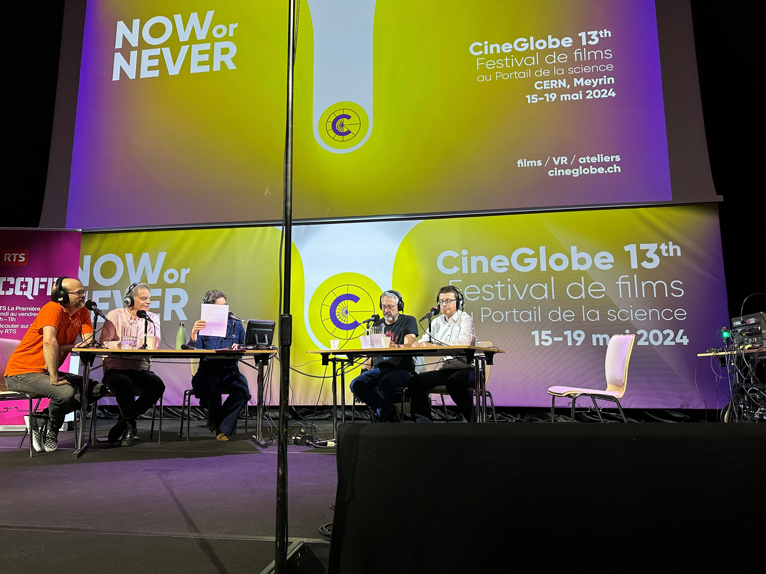
Start of public information & engagement sessions
First public information and discussion meeting at the Science Gateway on the 24th April 2024 at CERN.
The meeting was organised for the local community of our Host States, France and Switzerland, in the Science Gateway. The "Progress of the feasibility study of the Future FCC circular collider" was followed by a discussion with the participants.
La Roche-sur-Foron - Haute Savoie international fare April 27 to May 6 2024
CERN’s participation in the International Fair of Haute-Savoie/Mont Blanc, enhanced by the valuable help of volunteers from the FCC team, resulted in meaningful discussions with more than 2000 members of the local community on topics ranging from the required technological advancements to sustainability measures.
On 15 May 2024, RTS (Radio Télévision Suisse) broadcasted a special program celebrating CERN’s 70th anniversary and hosted at CERN’s Science Gateway.
The event featured a comprehensive look at CERN's illustrious history, groundbreaking achievements, and future ambitions, including the prominently featured Future Circular Collider (FCC) project with study experts interacting with the audience.

Slide 21
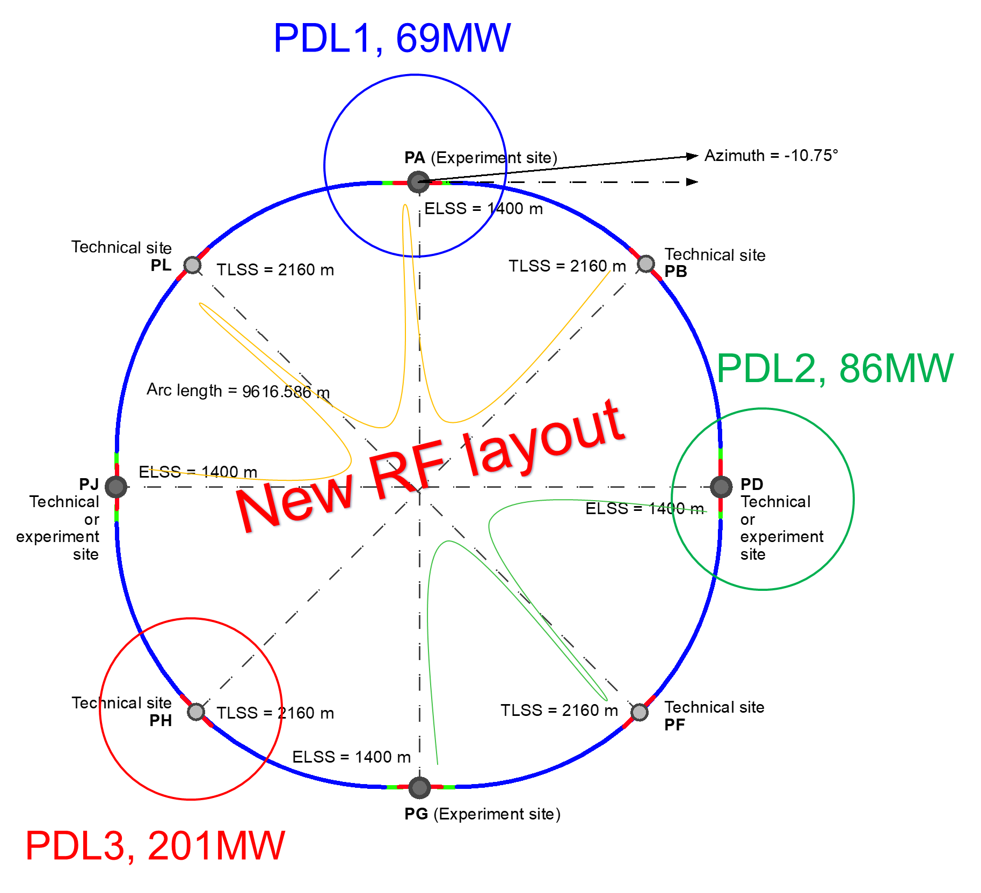
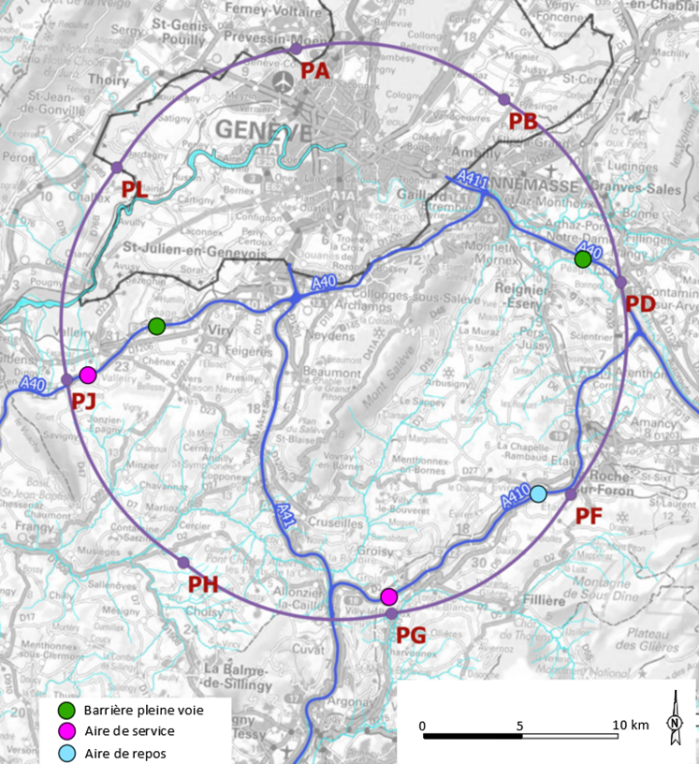
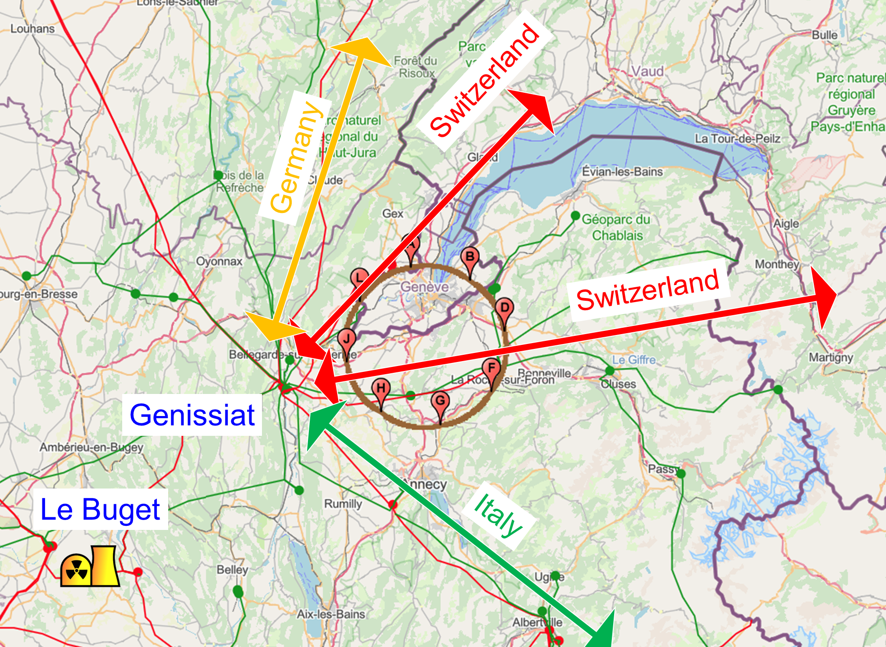
Integration with regional infrastructures
Road accesses developed for all 8 surface sites
Four possible highway connections defined
Less than 4 km of new roads required
Connections to
French electricity grid
connections with
highway network
Electrical connection concept developed with RTE (French electricity grid operator)
Three HV supply points, two new stations & CERN Prevessin
➔ requested loads have no significant impact on grid
R&D efforts aiming at reduction of the energy consumption of FCC-ee and FCC-hh

Slide 22
FCC-ee main machine parameters
Parameter | Z | WW | H (ZH) | ttbar
beam energy [GeV] | 45.6 | 80 | 120 | 182.5
beam current [mA] | 1270 | 137 | 26.7 | 4.9
number bunches/beam | 11200 | 1780 | 440 | 60
bunch intensity [10¹¹] | 2.14 | 1.45 | 1.15 | 1.55
SR energy loss / turn [GeV] | 0.0394 | 0.374 | 1.89 | 10.4
total RF voltage 400/800 MHz [GV] | 0.120/0 | 1.0/0 | 2.1/0 | 2.1/9.4
long. damping time [turns] | 1158 | 215 | 64 | 18
horizontal beta* [m] | 0.11 | 0.2 | 0.24 | 1.0
vertical beta* [mm] | 0.7 | 1.0 | 1.0 | 1.6
horizontal geometric emittance [nm] | 0.71 | 2.17 | 0.71 | 1.59
vertical geom. emittance [pm] | 1.9 | 2.2 | 1.4 | 1.6
vertical rms IP spot size [nm] | 36 | 47 | 40 | 51
beam-beam parameter ξ_{x} / ξ_{y} | 0.002/0.0973 | 0.013/0.128 | 0.010/0.088 | 0.073/0.134
rms bunch length with SR / BS [mm] | 5.6 / 15.5 | 3.5 / 5.4 | 3.4 / 4.7 | 1.8 / 2.2
luminosity per IP [10³⁴ cm⁻²s⁻¹] | 140 | 20 | ≥5.0 | 1.25
total integrated luminosity / IP / year [ab⁻¹/yr] | 17 | 2.4 | 0.6 | 0.15
beam lifetime rad Bhabha + BS [min] | 15 | 12 | 12 | 11
Design and parameters to maximise luminosity at all working points:
allow for 50 MW synchrotron radiation per beam.
Independent vacuum systems for electrons and positrons
full energy booster ring with top-up injection, collider permanent in collision mode
4 years
5 x 10¹² Z
LEP x 10⁵
2 years
> 10⁸ WW
LEP x 10⁴
3 years
2 x 10⁶ H
5 years
2 x 10⁶ tt pairs
x 10-50 improvements on all EW observables
up to x 10 improvement on Higgs coupling (model-indep.) measurements over HL-LHC
x10 Belle II statistics for b, c, τ
indirect discovery potential up to ~ 70 TeV
direct discovery potential for feebly-interacting particles over 5-100 GeV mass range
Up to 4 interaction points → robustness,
statistics, possibility of specialised detectors
to maximise physics output
F. Gianotti

Slide 23
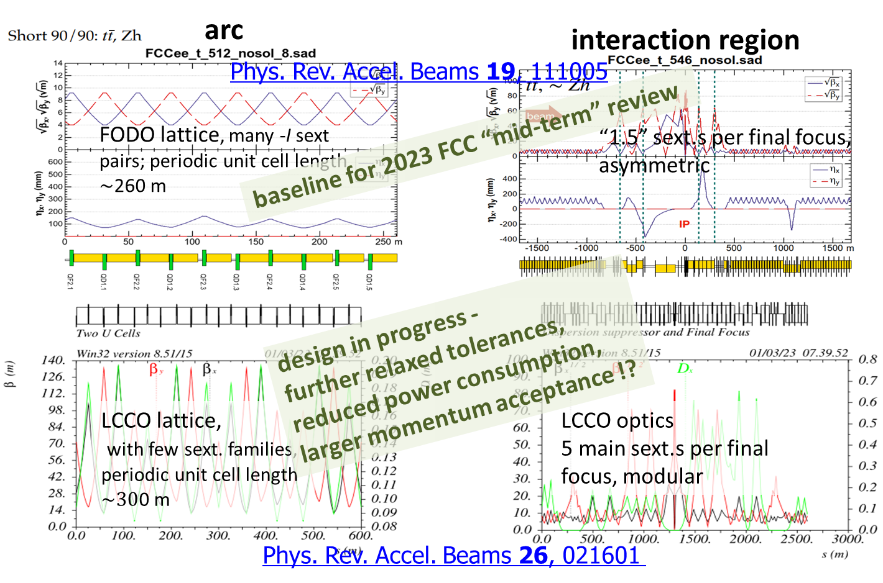
Collider and Booster design
Complete accelerator design and layout
consolidated beam parameters throughout entire chain & different operation modes
definitive collider and booster and optics and layout
beam-based alignment procedures, tolerances and requirements
complete impedance models for booster and collider rings
specifications for design of components and technical infrastructure
full inventory for integration studies and requirements for civil engineering
K. Oide
P. Raimondi

Slide 24
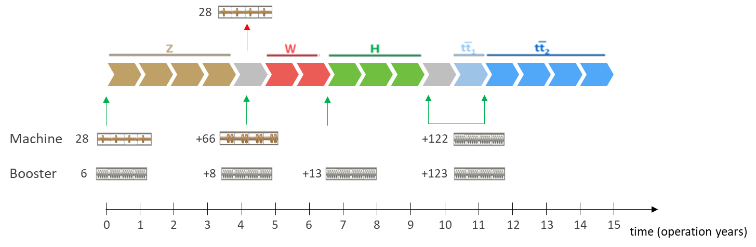
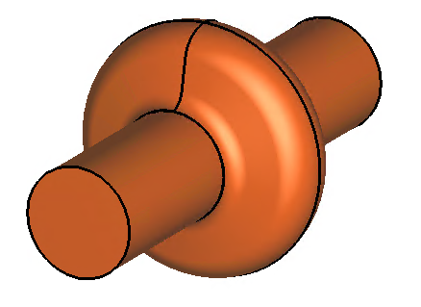
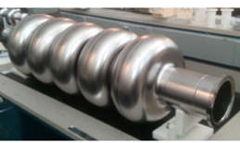
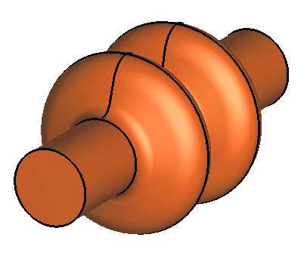

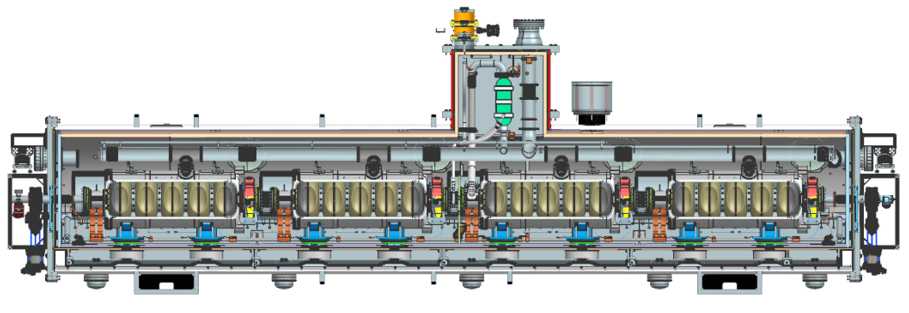

FCC-ee SRF system
FCC-ee SRF system
 | Energy (GeV) | Current (mA) | RF voltage (GV)
Z | 45.6 | 1280 | 0.08
W | 80 | 135 | 1
H | 120 | 26.7 | 2.08
ttb | 182.5 | 5 | 11.67
collider
booster
O. Brunner. F. Peauger
  5-cell
  800 MHz,
  bulk Nb
Z
ttbar,
booster
  1-cell
  400 MHz,
  Nb/Cu
Key technologies:
400 MHz Nb/Cu for collider Z, WW, (Z)H working points
800 MHz bulk Nb for booster & ttbar collider
quasi-continuous evolution of machine configurations
long-term R&D program with international partners
  high Q cavities, thin film coatings (incl. Nb₃Sn), cryomodules, efficient RF power sources
W, H
  2-cell
  400 MHz,
  Nb/Cu
effort to use 2-cell cavities also for Z running to raise operational efficiency
~7 m
I. Karpov

Slide 25
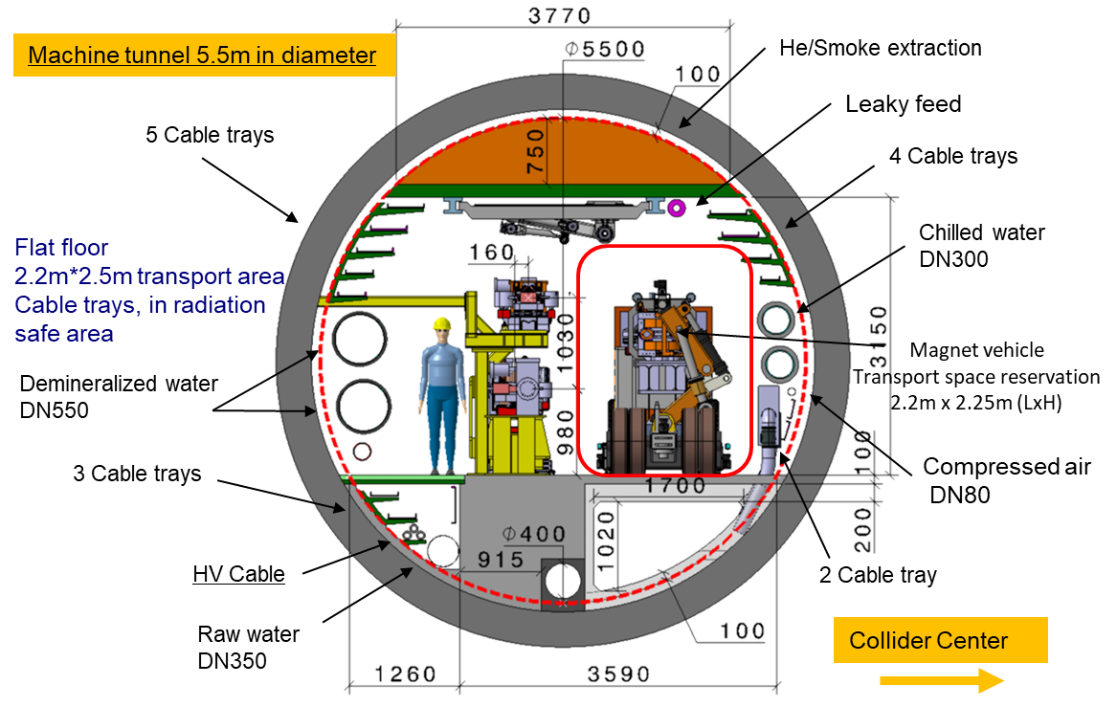
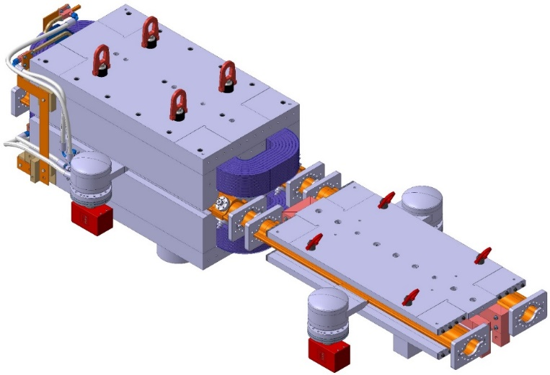
Arc layout and integration optimization
Arc cell optimisation – 80 km total length, dedicated working group active.
Including support, girder and alignment systems, shielding systems
vacuum system with antechamber + pumps, dipole, quadrupole + sext. magnets, BPMs,
cabling, cooling & technical infrastructure interfaces.
Safety aspects, access and transport concept,
  → Confirmation of tunnel diameter
FCC-ee arc half-cell mock up
F. Carra, CERN; F. Valchkova

Slide 26
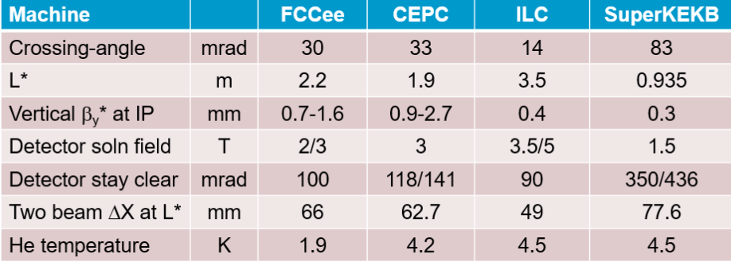
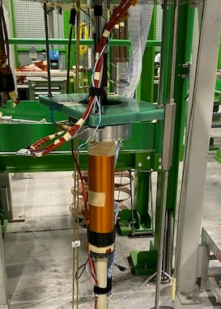
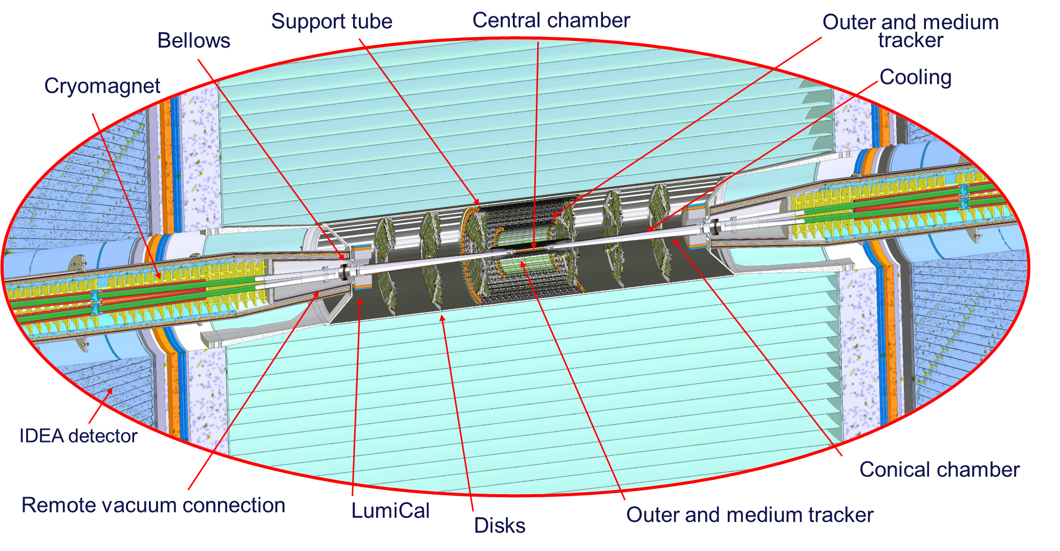
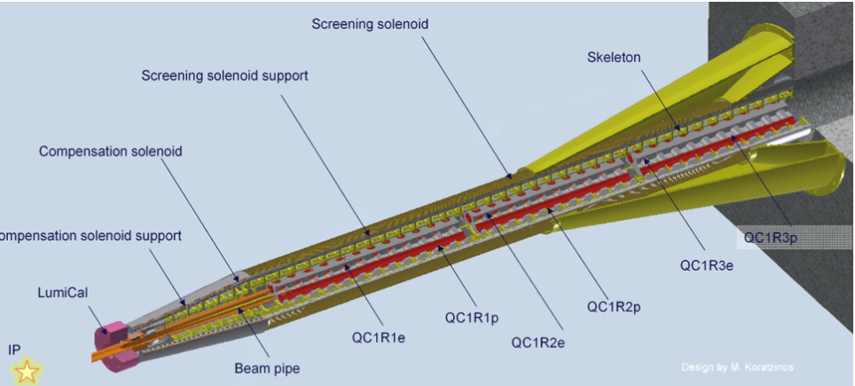
Machine detector interface
Key topics:
SC IR magnet system &Cryostat design
3D integration
IR mock-up / INFN
Q1 prototype tested at cold in SM18 (CERN), October ‘23
J. Seeman, SLAC
P. Tavares , CERN
M. Koratzinos, PSI
M. Boscolo, F. Palla, INFN

Slide 27
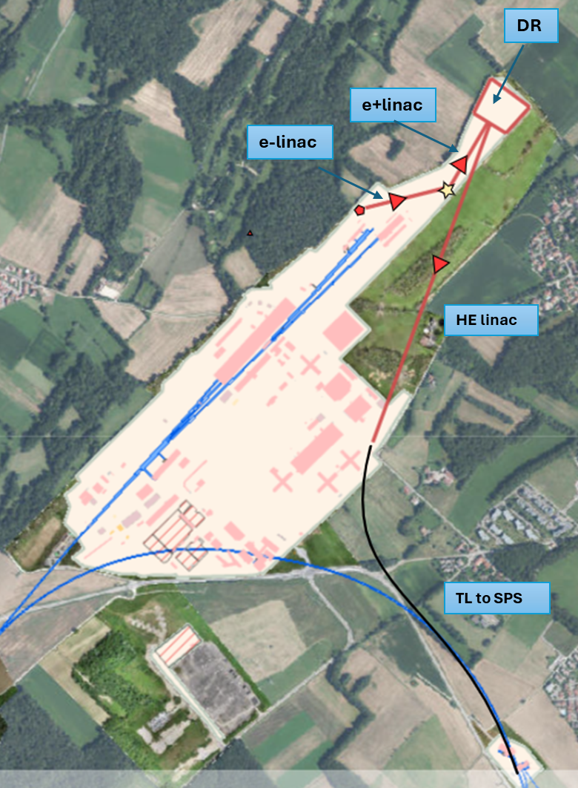
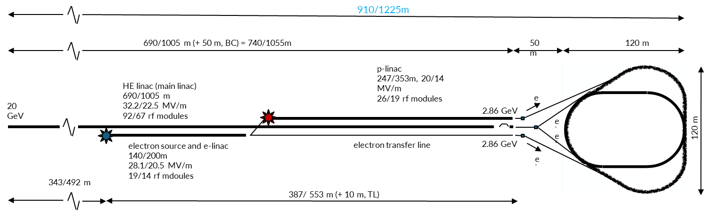
FCC-ee Injector
Overall injector parameter optimisation, following mid-term review recommendations
  Operation frequency, operation gradient vs number of structures/overall length
  Positron production energy, damping ring energy
Injector layout and implementation study on
CERN Prevessin Site
  Technical infrastructure pre-design & integration with services at Prevessin site
  Injector cost estimate update
P. Craievich, W. Bartmann, Y. Papaphilippou, C. Milardi

Slide 28
FCC-hh main machine parameters
parameter | FCC-hh | HL-LHC | LHC
collision energy cms [TeV] | 84 - 120 | 14
dipole field [T] | 14 - 20 | 8.33
circumference [km] | 90.7 | 26.7
arc length [km] | 76.9 | 22.5
beam current [A] | 0.5 | 1.1 | 0.58
bunch intensity [10¹¹] | 1 | 2.2 | 1.15
bunch spacing [ns] | 25 | 25
synchr. rad. power / ring [kW] | 1020 - 4250 | 7.3 | 3.6
SR power / length [W/m/ap.] | 13 - 54 | 0.33 | 0.17
long. emit. damping time [h] | 0.77 – 0.26 | 12.9
peak luminosity [10³⁴ cm⁻²s⁻¹] | ~30 | 5 (lev.) | 1
events/bunch crossing | ~1000 | 132 | 27
stored energy/beam [GJ] | 6.1 - 8.9 | 0.7 | 0.36
Integrated luminosity/main IP [fb⁻¹] | 20000 | 3000 | 300
With FCC-hh after FCC-ee: significant amount of time for high-field magnet R&D,
aiming at highest possible collision energies
Target field range for cryo-magnet R&D
Formidable challenges:
high-field superconducting magnets: 14 - 20 T
power load in arcs from synchrotron radiation: 4 MW → cryogenics, vacuum
stored beam energy: ~ 9 GJ → machine protection
pile-up in the detectors: ~1000 events/xing
optimization of energy consumption: → R&D on cryo, HTS, beam current, …
Formidable physics reach, including:
Direct discovery potential up to ~ 40 TeV
Measurement of Higgs self to ~ 5% and ttH to ~ 1%
High-precision and model-indep (with FCC-ee input)
measurements of rare Higgs decays (𝛄𝛄, Z𝛄, µµ)
Final word about WIMP dark matter
F. Gianotti

Slide 29
High Field Magnet Programme
The 2020 update of the European Strategy for Particle Physics has identified a clear and immediate need for a reinforced R&D on advanced accelerator technologies, and in particular high-field superconducting magnets, including high-temperature superconductors.
The High Field Magnets R&D (HFM) Programme is the response that CERN has initiated, in collaboration with National Laboratories from the Member States and Associate Member States and linking possibly beyond to ongoing worldwide efforts, particularly in the US and Japan.
The HFM Programme – broad goals are:
  Develop an Nb₃Sn accelerator dipole with 14 T operational field for FCC-hh, giving an energy of 85 TeV c.o.m., with a focus on sustainability, cost versus performance, and large-scale production
  Explore the HTS magnet technologies for accelerator applications in the range from 14 T up to 20 T
  Promote the required developments for superconductors
  Highlight the innovative of high field magnets developments, both for particle physics instruments different from FCC, and for societal applications

Slide 30
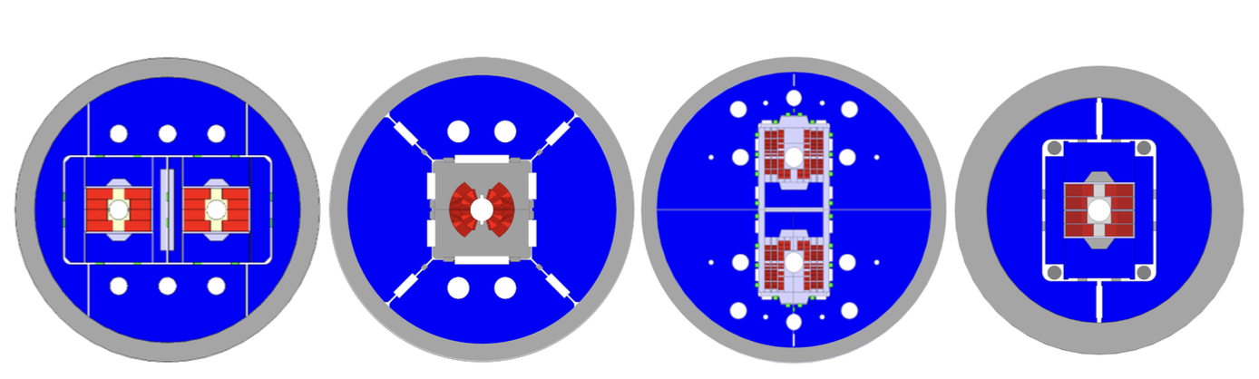
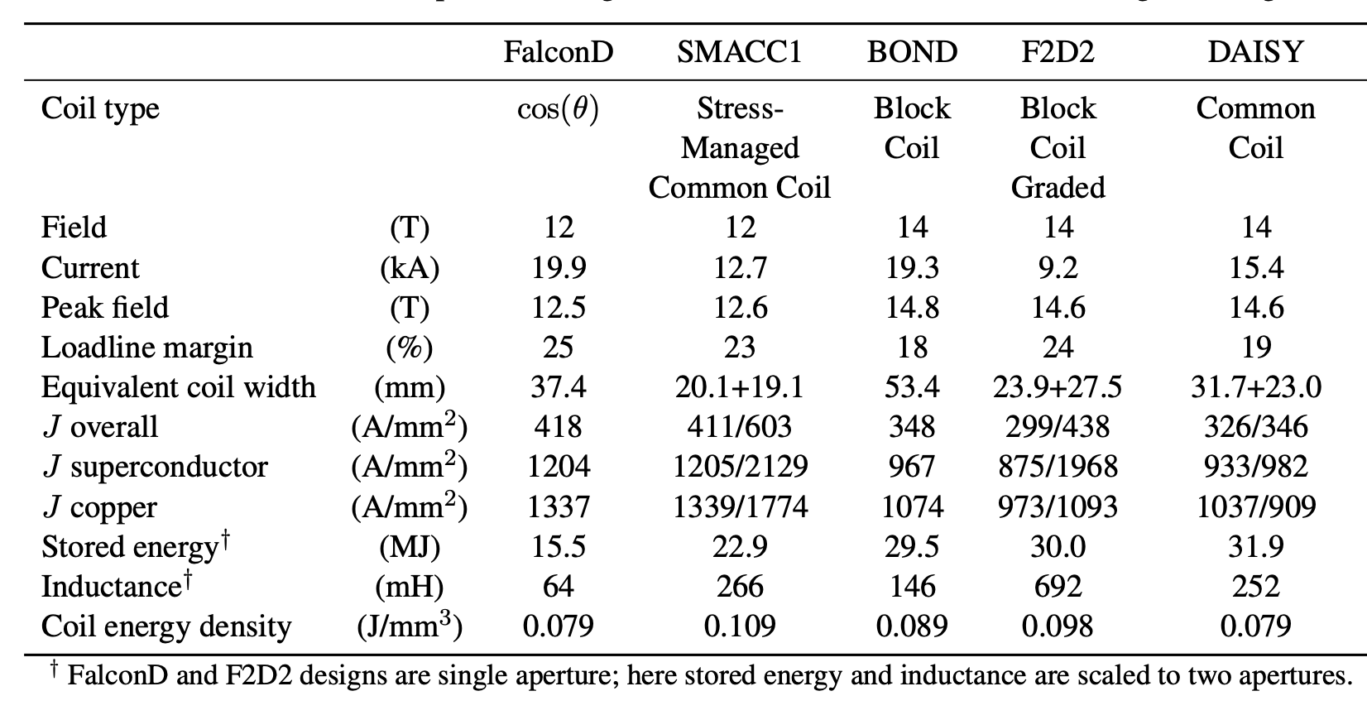
High Field Magnet Programme
Conceptual design of 14 T and 12 T magnets: BOND (left), FalconD (centre left), SMACC1 (centre right), F2D2 (right).

Slide 31
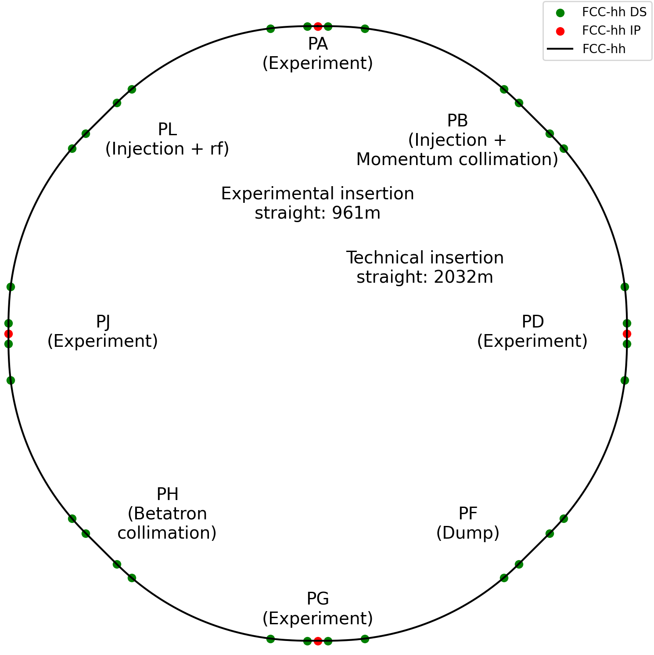
FCC-hh changes from CDR
Circumference: 97.75 km
Circumference: 90.66 km

Slide 32
Layout evolution of the FCC-hh ring
The main drivers
Placement studies
FCC-ee layout (the choice of having four symmetrical experimental IPs)
RF harmonic number to optimize transfer from injector
The main choices
Reduce the length of the ring circumference
Reduce the length of technical insertions
Displace radially the experimental IPs to match position of FCC-ee IPs
Reduce the number of access shafts
Four-fold symmetry
Re-organize functionalities of insertions
Locate transfer lines in ring tunnel

Slide 33
FCC-hh: Layout & main parameters
Target: 90 TeV @ 14T
Parameter | Value
Collision energy cms [TeV] | 84.6 – 120.8
Dipole field [T] | 14(Nb₃Sn) - 20(HTS/Hybrid)
Circumference [km] | 90.66
Although some of the circumference reduction comes from technical insertion, lost ~6.5km of arcs.
Maximize dipole filling factor to maximize collision energy.

Slide 34


Longer arc cells
~213m
~275m
CDR: 12-dipole cell
FS: 16-dipole cell

Slide 35

Longer arc cells
Increase dipole filling factor
Although reduction in the number of dipoles w.r.t. CDR, ~4% increase compared to a 12-dipole configuration for the current placement.
Larger beam sizes can be accommodated by a minor review of the beam screen geometry
Cell has 90 degrees phase advance.
Tunes
  Q_{x} = 80.28 (inj.) / 80.31 (coll)
  Q_{y} = 78.31 (inj) / 78.32 (coll)
 | CDR cell 12-dipole | 12-dipole | 16-dipole
# dipoles | 4668 | 4288 | 4464
Cell length (m) | 213.03 | 213.03 | 275.79
Circumference (km) | 97.75 | 90.66 | 90.66
Total # of dipoles | 4668 | 4288 | 4464
Cell filling factor | 0.80 | 0.80 | 0.82
Dipole field (T) | 16 | 14 - 20 | 14 - 20
Beam Energy (TeV) | 50.6 | 40.6 – 58.1 | 42.3 – 60.4

Slide 36




Experiment insertions
Injection $β^{∗}=10m$
Four identical experimental insertions except for crossing scheme
Collision $β^{∗}=30cm$
Superconducting dipoles in experimental insertions (from HL-LHC)
Non-linear correctors from HL-LHC
G. Perez-Segurana

Slide 37



Dispersion suppressor of experiment insertions
MQ19
MQ16
MQ12
MQ6
Displacing dipoles towards the IP moves the position of the IP outwards.
Maintaining upstream dipole distribution makes FCC-ee and FCC-hh arcs overlap.
Keep regular positioning of quadrupoles to ensure transverse focusing.
Shortening of the straight section to keep circumference constant.
New geometry CDR geometry
G. Perez-Segurana

Slide 38
Further optimisation of dipole filling factor
Intense efforts are devoted to further increasing the dipole filling factor. Two strategies are considered
Study regular cell layout with longer dipoles
  Interesting side effect: reduction of the number of magnets in the ring.
Study regular cell layout with combined-function magnet
  Interesting side effect: a single type of magnet needed for the arcs.

Slide 39
Alternative design of regular arcs
A non-baseline, alternative design of arcs and dispersion suppressors based on combined-function (CF) magnets have been studied.
Main advantages:
  Increase the dipole filling factor
  Simplify magnet production (no main
  quadrupoles)
Possible disadvantage:
  Dipole field limited by peak field in the coil
  The quadrupole component limits the dipole
  one
  Sketch of separated-function (top) and combined-function (bottom) cells

Slide 40

Alternative design of regular arcs
CDR FODO cell
12-dipole CF cell
16-dipole CF cell
Other considerations
Main advantages:
  Smaller beta-functions and dispersion
Possible disadvantage:
  Smaller optical functions imply stronger
  chromatic sertupoles
Further optimization: make longer cells
Improves dipole filling factor
$12−dipole SF →0.80 →12−dipole CF →0.86 →16−dipole CF →0.9$
Reduces quadrupole component
Reduces strength of chromatic sextupoles

Slide 41
Considerations on transfer lines
The new layout has impact on the design of the transfer lines
Two scenarios at hand, the injector is:
  LHC (baseline): injection energy is 3.3 TeV
  A superconducting SPS (option): injection energy is 1.3 TeV
  The injection points are
    PB: clockwise beam
    PL: counter-clockwise beam
  To save tunnel length the transfer line tunnels join
  the ring tunnel close to PA.
  The transfer lines then run in the ring tunnel until the
  injection point
Optics
  FODO cell equal to that of the FCC-hh ring
  Same transverse focusing used also for the part of
  transfer lines upstream of the ring tunnel

Slide 42


Considerations on transfer lines
Courtesy J. Osborne, W. Bromiley, A. Navascues
Injection tunnel towards PL: 4.1 km
Injection tunnel towards PB: 6.1 km

Slide 43

Considerations on transfer lines magnets
Magnet concepts under consideration
Electromagnets
Permanent magnets
Iron dominated
Iron dominated
Shimmed Halbach
Parameters of the transfer lines in ring tunnel

Slide 44



Electromagnet: Iron Dominated Concept
These designs are conventional and well understood.
The length and volume of magnets present significant challenges:
  The dipole length is set at 5 m to minimize interconnection gaps.
  The yokes must have adequate torsional rigidity.
The key optimization focus is the coil cross-section.
The goal is to minimize the total lifetime cost by carefully balancing:
  Copper volume (capital investment)
  Power usage (overhead cost)
  Infrastructure requirements, i.e. cooling plant, cabling, power converters (capital investment)
Dipole concept
280mm x 500mm cross-section
Quadrupole concept
220mm x 220mm cross-section

Slide 45


Permanent Magnet Concepts
Permanent Magnets (PMs) are highly suitable for transfer line specifications:
  Single-pass beam requires less stringent field quality requirements
PMs are already used in accelerators, although on a smaller scale.
Temperature dependence of PMs is sufficiently small.
The lifetime radiation dose is expected to be compatible with NdFeB or SmCo PMs.
  The provisional designs use a high coercivity NdFeB grade (N42UH)
Developing industrial-scale assembly processes will be a significant focus of future research.
Halbach dipole magnet for FASER experiment
Transverse radiation dose plots for FCC-hh collider

Slide 46


PM: Iron dominated Concept
The iron yoke helps to smooth irregularities in permanent magnet blocks.
  Field quality can be improved using pole shims
  Magnet yoke can be manufactured with good accuracy
Both designs offer field strength adjustment, allowing for a decrease in the field within the aperture.
  Dipole: Shunts can be inserted to partially short-circuit the magnetic flux
  Quadrupole: Shims can be radially adjusted to increase the magnetic reluctance of the flux circuit
The volume of PM blocks must be minimised.
We will iterate the magnet geometry to maximise utilisation of the PMs' maximum energy product (BH_{max})
The combined PM mass is 950 tonnes (N42UH, unoptimised)
Dipole concept
Quadrupole

Slide 47



PM: Shimmed Halbach Concept
Halbach configurations are the most efficient arrangements of permanent magnet blocks.
Similar to coil-dominated superconducting magnets, Halbach are susceptible to manufacturing tolerances.
  Magnetisation errors: deviations in the magnitude and direction of magnetisation in PM blocks.
  Assembly errors: variations in block positions.
The CBETA team at BNL has achieved remarkable success in developing shimmed Halbach magnets:
  After assembly, harmonic errors are measured and then mitigated by placing tuning iron rods around the bore.
  Reduced quality assurance is required during manufacturing which decreases overall production costs.
Dipole Halbach configuration
Shimmed combined function Halbach (left) and CBETA return arc (right)

Slide 48


PM: Shimmed Halbach Concept
Transfer line dipole (left) and quadrupole (right) Halbach concepts
Ideal Halbach magnets inherently achieve optimal field strength and field quality.
  The combined PM mass is 625 tonnes (N42UH).
However, real Halbach magnets fall short due to accumulated manufacturing errors.
Our challenge is to determine the achievable field quality in manufactured magnets by:
  Conducting a prototyping campaign
  Utilising stochastic modelling tools
From the experience of the CBETA production run, we extrapolate that the FCC-hh specifications can be met.
  Provides valuable empirical data on field errors before and after shimming.
⌀86
GFR
20
40
⌀52

Slide 49

Qualitative Costs Comparison
Reliably estimating lifetime costs at this early stage is challenging due to high uncertainties.
  However, permanent magnet concepts are anticipated to be the more cost-effective solution.
The required volume of permanent magnets is realistic compared to industrial production:
  Required PM volume: 625 to 950 tonnes
  Global neodymium PM production by 2030: 200 k-tonnes per year

Slide 50

Considerations on transfer lines
Design of transfer lines in the ring tunnel (for 3.3 TeV)
Integration
  Outcome of first studies is encouraging
  Further studies are needed to
  consider detail, e.g.
    Shielding
    Machine protection
  Normal conducting solution
  Permanent magnet solution
Courtesy F. Valchkova-Georgieva

Slide 51


A last look at the timeline
FCC-hh as stage 2 of FCC integrated programme
2070
2074
FCC-hh as stage 1 of FCC integrated programme
2054
2055

Slide 52


..and at power consumption
Estimates of the power consumption of the two phases of the FCC integrated programme have been worked out.
FCC-ee FCC-hh
Courtesy F. Valchkova-Georgieva

Slide 53
Outlook: FCC Main Goals for Coming Years
The FCC Feasibility Study has been concluded. We are (eagerly) waiting for the ESPP response.
By 2027-2028, possible FCC project approval, start of CE design contract:
  specifications to enable CE tender design by 2028
  refined input for environmental evaluation and project authorisation process
  requires overall integration study and designs based on technical pre-design of accelerators, technical infrastructure and detectors
By 2031-32, possible start of CE construction:
  CE groundbreaking
  TDR to enable prototyping, industrialization towards component production
Strong collaboration with US and further international partners is essential for success!

Slide 54
Outlook: FCC Main Goals for Coming Years
The FCC integrated programme is a mature proposal to provide powerful tools for the physics investigation of the entire century.
It builds on a strong, highly-motivated and broad international community.
It will be a source of creative and inspiring research for young phisicists for the decades to come.
Thanks a lot for your attention!!!

Slide 55

“The greatest adventure is what lies ahead.”
- J.R.R. Tolkien

Slide 56
Spare Slides

Slide 57
Feasibility study goals and roadmap
Highest priority goals:
Financial feasibility
Technical and administrative feasibility of tunnel: no show-stopper for ~100 km tunnel
\
Technologies of machine and experiments: magnets; minimised environmental impact; energy efficiency & recovery
Gathering scientific, political, societal and other support
>2045 first
ee collisions
>2030
start tunnel
construction
>2038
machine
installation
~2028 approval
2026/7
ESPPU
>2030 - 37
element production
2025/26
Feasibility proof
>2026 - 30 full
technical design
2014 FCC
study kickoff
2020
ESPPU
2020 FCCIS
kickoff
2025/26
Financing model
Operation concept
2013
ESPPU
2018 FCC CDR
2020-25
FCC Feasibility Study
FCCIS H2020 DS
2012 Higgs discovery announced
2011 circular Higgs factory proposal

Slide 58




CE underground and surface site development
Full 3D model of all underground structures as basis for costing and scheduling exercises with external consultant.
Experiment Site (PA)
Generic study of experiment site and technical site done by FNAL
Bills of quantities extracted from FNAL designs
Basis for cost estimate by consultant with experience on industrial constructions in CH-FR area.

Slide 59
Review of short straight sections
Main quadrupole
Orbit correctors & main sextupoles
Longer cells require lower gradient.
Increase the maximum gradient from 367 T/m to 400 T/m.
6.4 m to 4.1 m
Modest increase of dipole corrector strength allows shortening while keeping the same integrated strength.
Sextupoles still able to correct chromaticity
  1.2 m to 1.1 m
  Nest orbit corrector with main sextupole
Trim quadrupoles, skew quadrupoles and octupoles
Able to correct tune and linear coupling.
Maintain the same amplitude detuning considered in previous studies.
0.5 m to 0.45 m

Slide 60



Review of short straight sections
Landau octupole
Trim quadrupole
Skew quadrupole
Main quadrupole
Orbit corrector
Spool sextupole
Main sextupole
Spool decapole
These 16 dipole arc cells result in less cells and therefore fewer short straight sections and fewer correctors.
However, higher $β$-functions and dispersion make correctors more efficient
G. Perez-Segurana

Slide 61
Review of short straight sections
Gains in filling factor by either fitting more regular cells in the arcs or increasing the number of dipoles in the dispersion suppressors.
G. Perez-Segurana

Slide 62


Review of insertions
Injection clockwise beam & momentum collimation – PB
Beam dump – PF
Injection and collimation systems separated by matching section
Reduction of the space requirement for injection elements with additional vertical dipoles
G. Perez-Segurana

Slide 63


Review of insertions
High beta collimation optics following HL-LHC studies
Betatron collimation – PH
Low beta
High beta
Primary collimators placed in doglegs to avoid showers of neutrals
Constant inter-beam distance allows shared optics between both beams
G. Perez-Segurana

Slide 64


Review of insertions
Injection and RF – PL
Injection elements
RF section
Clockwise circulating beam
Counter-clockwise injected beam
Additional constraints for injected beam
Increased inter-beam distance for RF elements (~900m available)
G. Perez-Segurana

