Slide 1
Physics highlights & future perspectives of LHC experiments
Piet Verwilligen – INFN sez. Bari
on behalf of the ATLAS, ALICE, CMS & LHCb collab
International Workshop on Future Accelerators
Corfu 28-04-2025 – 02-05-2025

Slide 2




References
LHCC Open sessions 2024
ICHEP 2024
  https://indico.cern.ch/event/1291157
LHC Days in Split 2024
LHC Chamonix Workshop 2025
  https://indico.cern.ch/event/1469359
Moriond Electroweak & QCD 2025
  https://indico.in2p3.fr/event/35965
  https://indico.cern.ch/event/1480248
Quark Matter 2025
  https://indico.cern.ch/event/1334113
European Strategy Update
for Particle Physics (ESUPP)
  2018-2020: https://indico.cern.ch/event/765096
  2024-2026: https://indico.cern.ch/event/1439855

Slide 3
Outline
The Large Hadron Collider
  ATLAS, ALICE, CMS & LHCb experiments
  LHC Performance so far
LHC Physics Highlights
  Higgs Physics
  Electroweak Physics
  BSM Searches
  Flavour Physics
  Heavy-Ion Physics
HL-LHC Project
  Perspectives
  Experiment Upgrades
HL-LHC Physics Prospects
  Higgs, EWSB
  Top & EWK
Talk | Speaker | Time
Higgs Phys | A.Bethani | Fri 9:30
EWK Phys | J.Maurer | Today 12:00
Top + QCD | M.Stratmann | Wed 16:00
Flavour Phys | M.Schmelling | Wed 9:30
BSM Searches | L.Soffi | Tue 9:30
HL-LHC Project | Y.Papaphilippou | Wed 12:15
Det Upgrades | F.Carnesecchi | Today 16:00

Slide 4
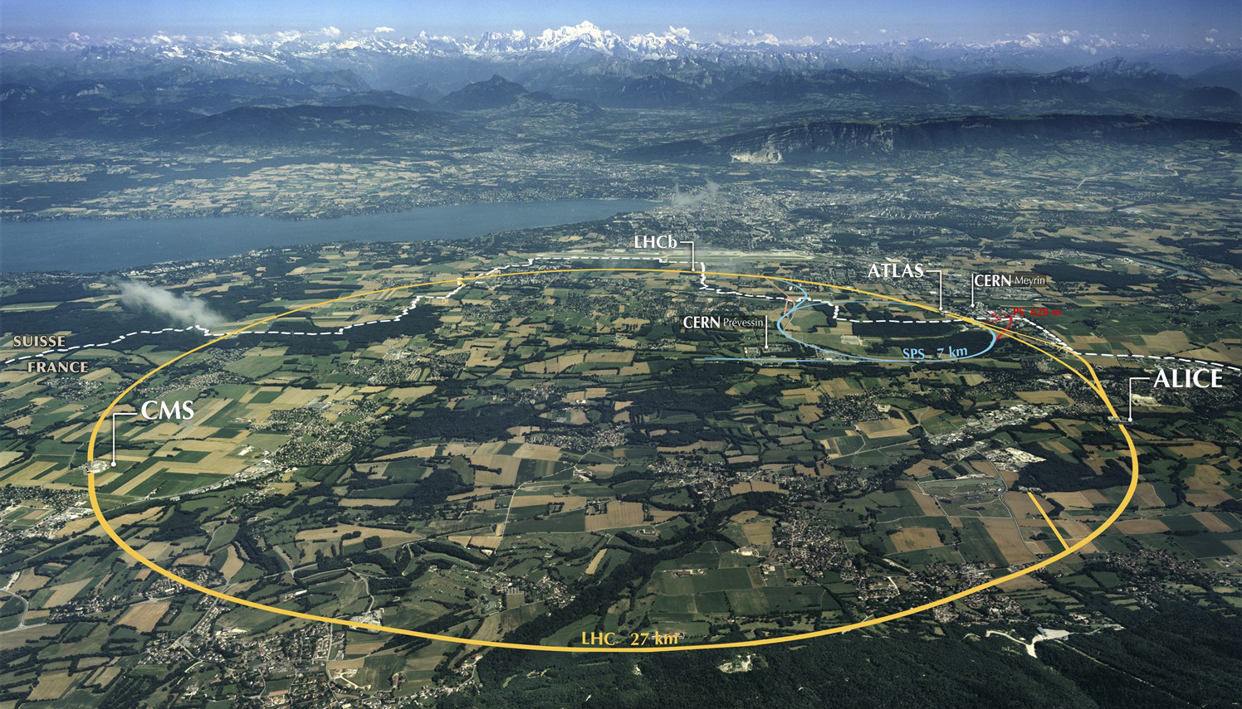
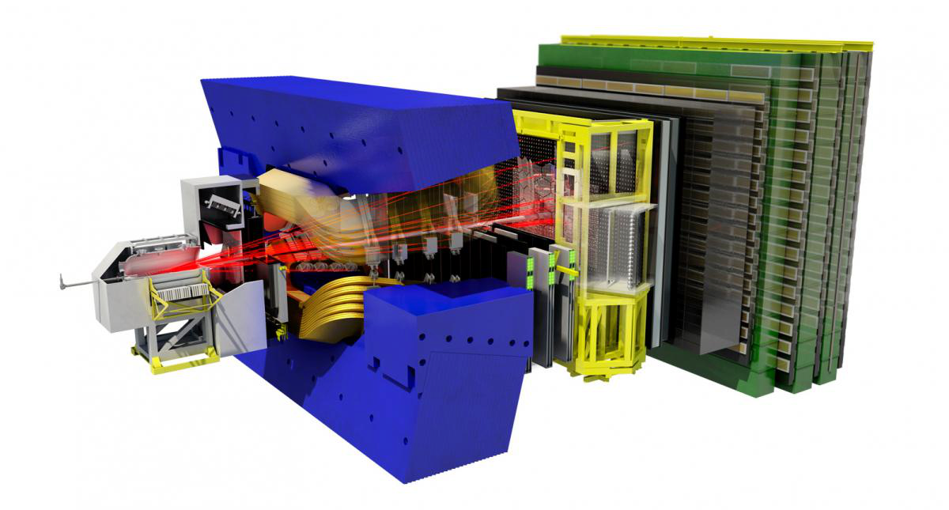
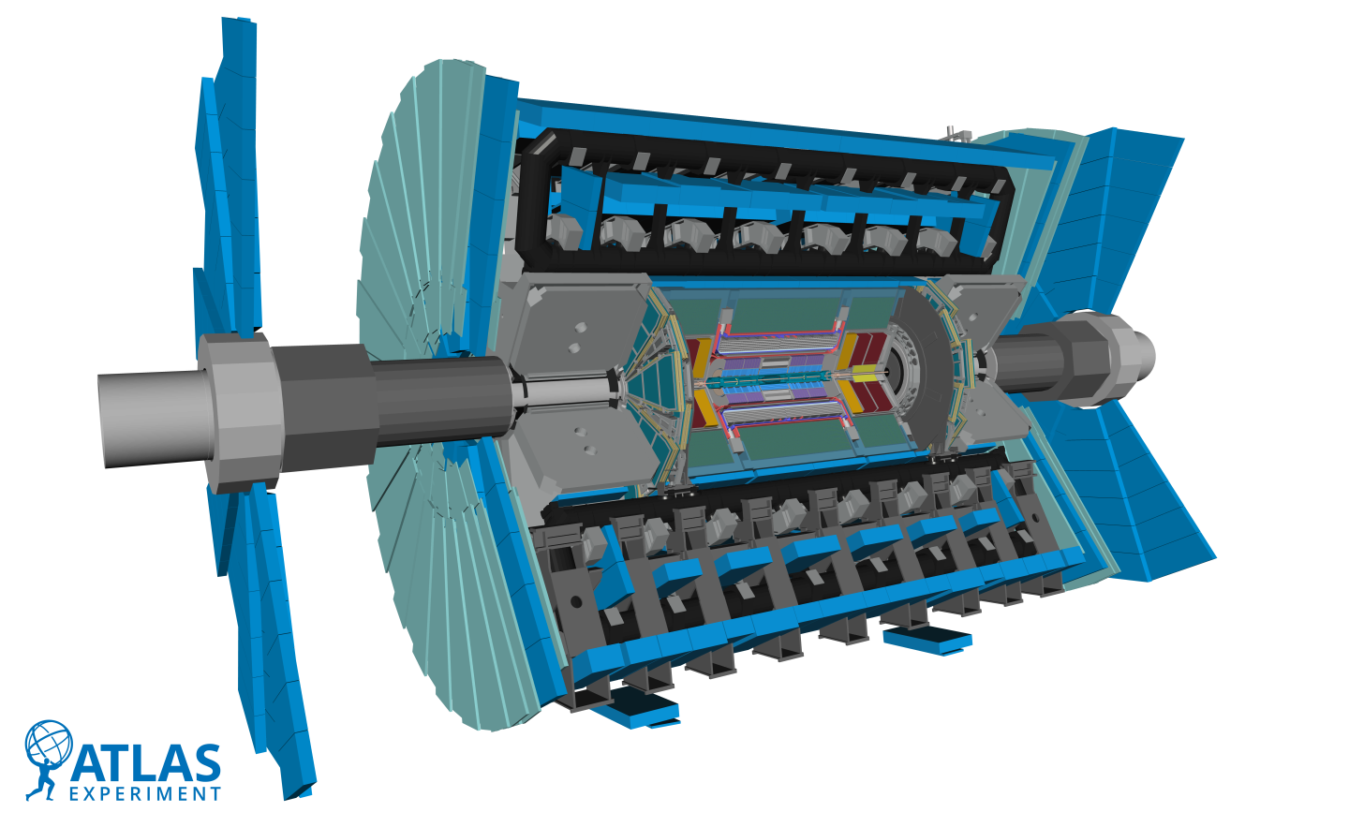
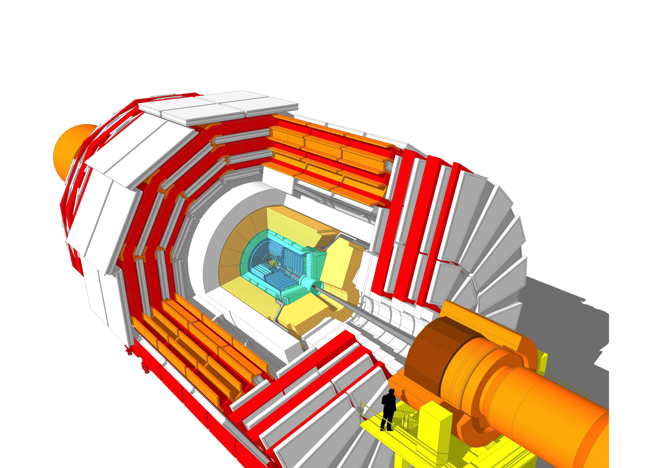
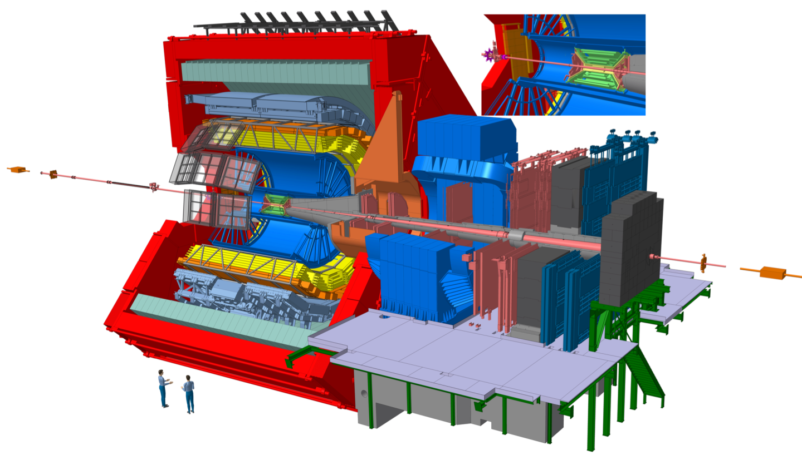
The Large Hadron Collider &
ATLAS, ALICE, CMS & LHCb experiments

Slide 5
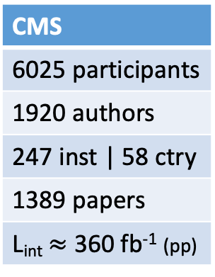
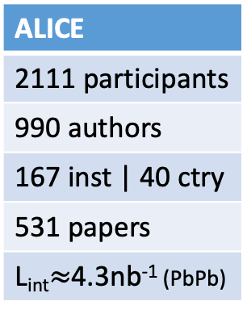
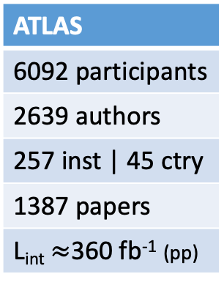
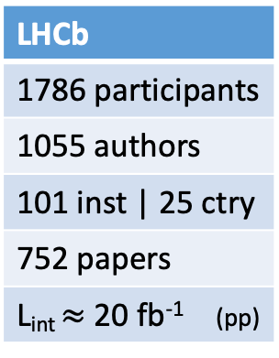
The Large Hadron Collider &
ATLAS, ALICE, CMS & LHCb experiments
ATLAS
6092 participants
2639 authors
257 inst | 45 ctry
1387 papers
L_{int}$≈$360 fb⁻¹ (pp)
ALICE
2111 participants
990 authors
167 inst | 40 ctry
531 papers
L_{int}$≈$4.3nb⁻¹ (PbPb)
CMS
6025 participants
1920 authors
247 inst | 58 ctry
1389 papers
L_{int}$≈$ 360 fb⁻¹ (pp)
LHCb
1786 participants
1055 authors
101 inst | 25 ctry
752 papers
L_{int} $≈$ 20 fb⁻¹ (pp)

Slide 6
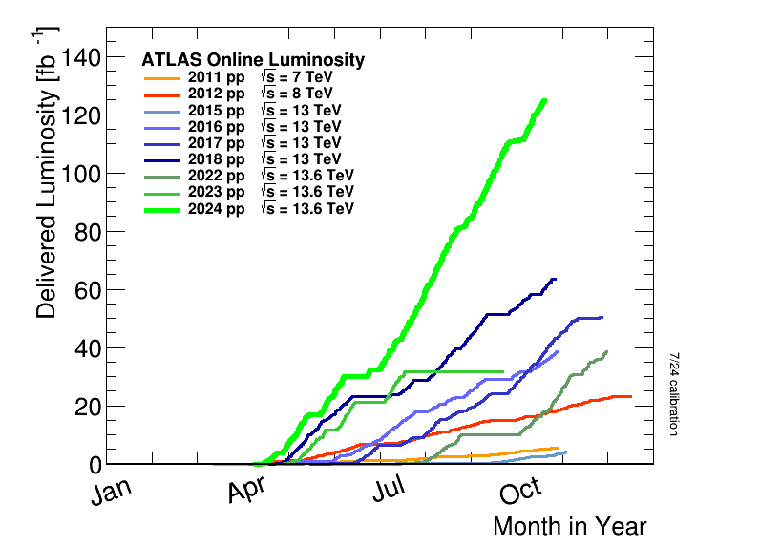
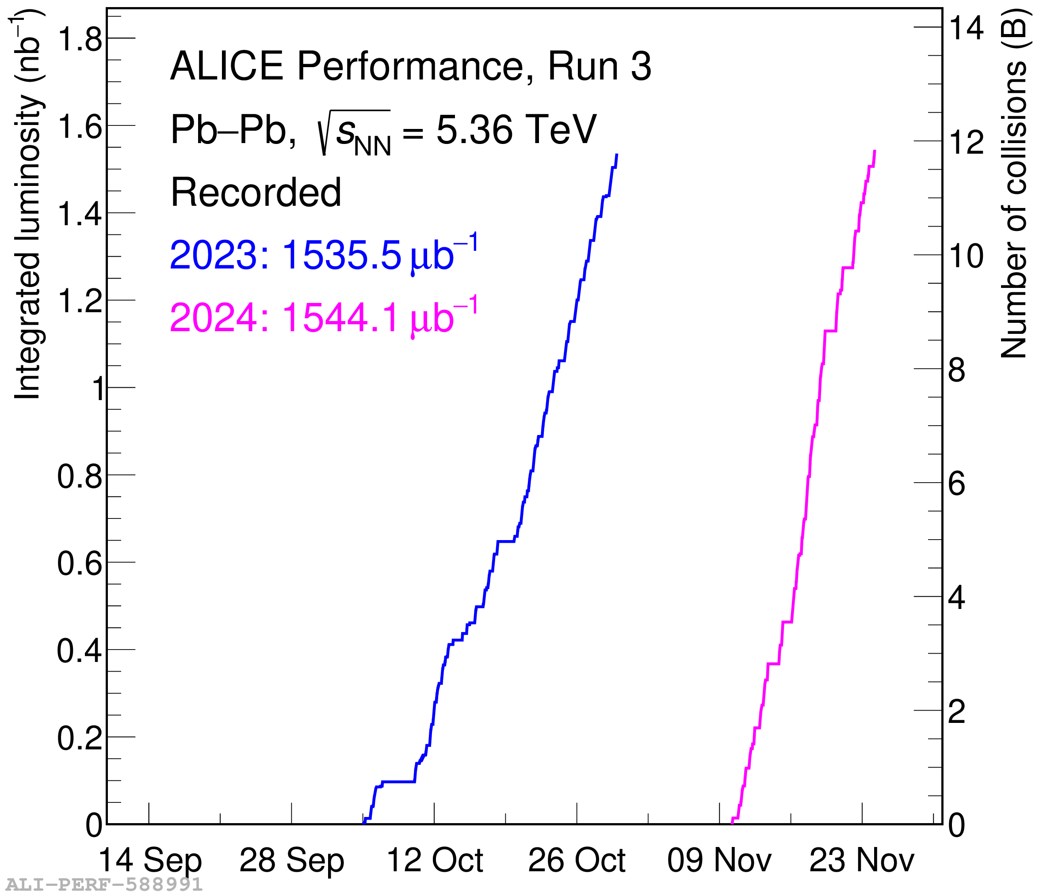


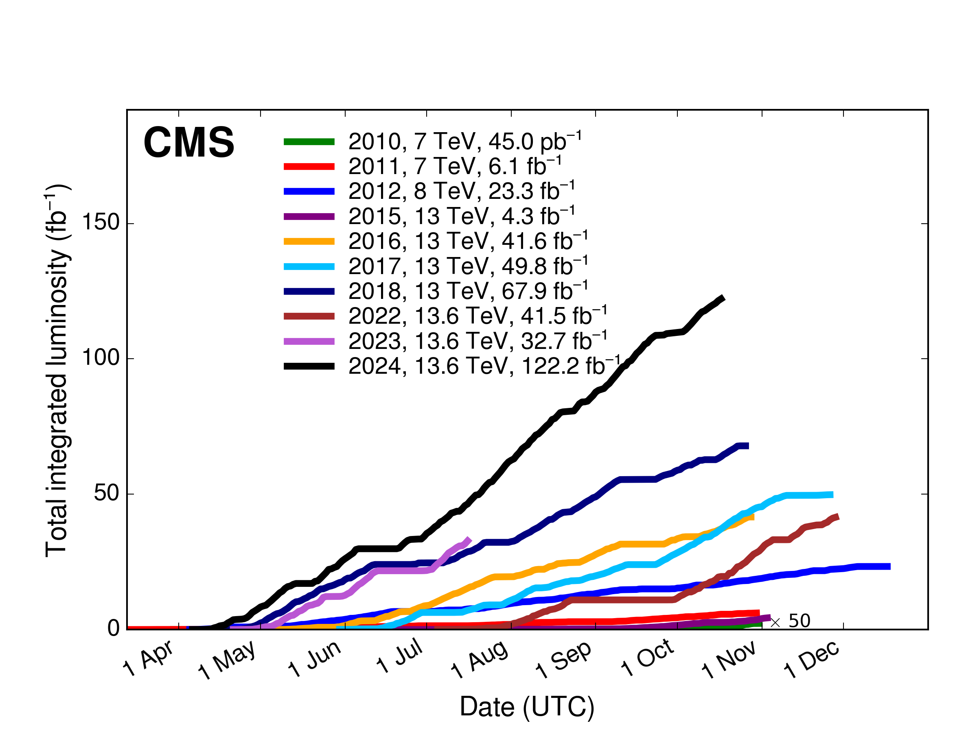

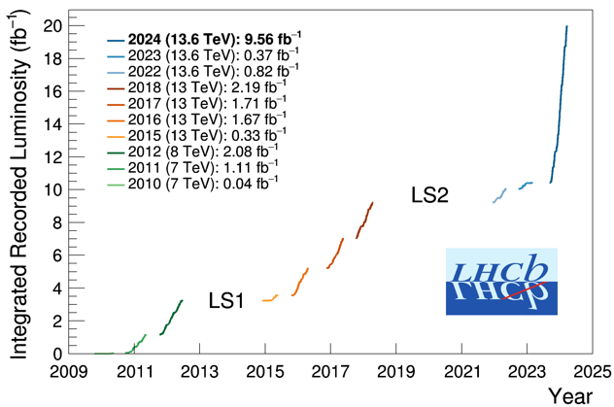

LHC Performance so far
2024
2018
2024 first year @
$ℒ$ = 2$∙$10³³ cm⁻² s⁻¹
2024
2018
2012

Slide 7
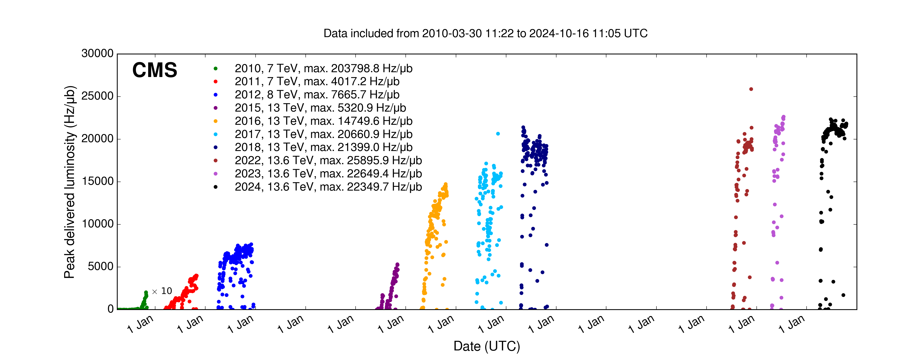




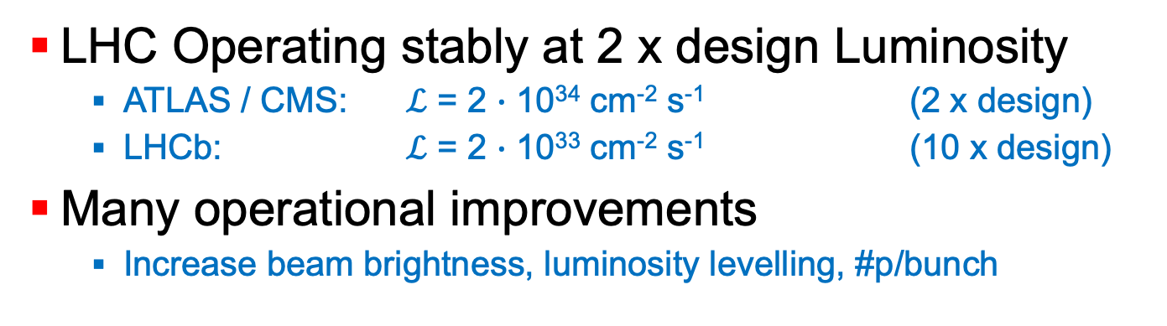
LHC Performance so far
LHC Operating stably at 2 x design Luminosity
  ATLAS / CMS: $ℒ$ = 2 $∙$ 10³⁴ cm⁻² s⁻¹ (2 x design)
  LHCb: $ℒ$ = 2 $∙$ 10³³ cm⁻² s⁻¹ (10 x design)
Many operational improvements
  Increase beam brightness, luminosity levelling, #p/bunch
https://bpt.web.cern.ch/lhc/ >> statistics
CERN-ACC-NOTE-2013-0041 & CERN-ACC-NOTE-2019-0007
1.40 - 1.60 E11
protons/bunch
1.00 – 1.25 E11
protons/bunch
2x design
$$β^{∗} 30cm$$
$$β^{∗} 40cm$$
design
50ns
25ns
150ns
75ns
$Δx$ levelling
$α$ levelling
$β^{∗}$levelling
$$β^{∗} 80cm$$

Slide 8
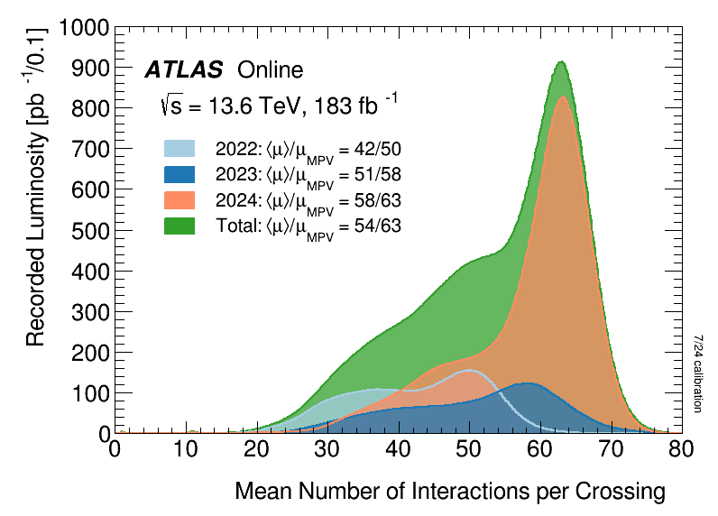
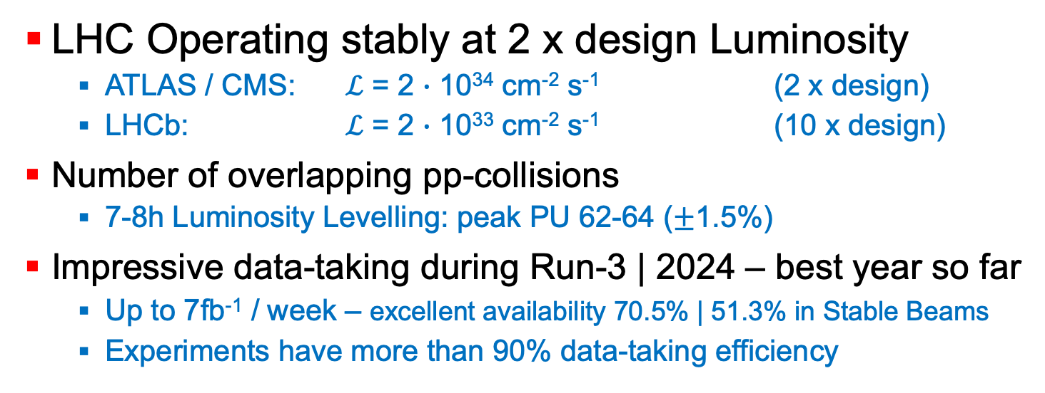
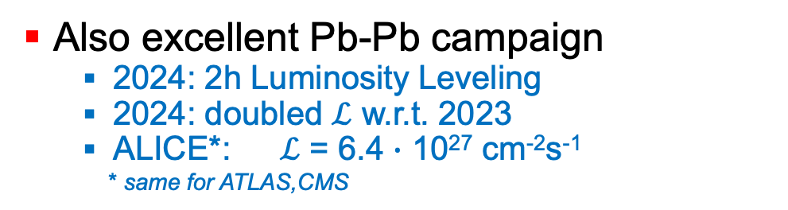
LHC Performance so far 2024
LHC Operating stably at 2 x design Luminosity
  ATLAS / CMS: $ℒ$ = 2 $∙$ 10³⁴ cm⁻² s⁻¹ (2 x design)
  LHCb: $ℒ$ = 2 $∙$ 10³³ cm⁻² s⁻¹ (10 x design)
Number of overlapping pp-collisions
  7-8h Luminosity Levelling: peak PU 62-64 ($±$1.5%)
Impressive data-taking during Run-3 | 2024 – best year so far
  Up to 7fb⁻¹ / week – excellent availability 70.5% | 51.3% in Stable Beams
  Experiments have more than 90% data-taking efficiency
Also excellent Pb-Pb campaign
  2024: 2h Luminosity Leveling
  2024: doubled $ℒ$ w.r.t. 2023
  ALICE*: $ℒ$ = 6.4 $∙$ 10²⁷ cm⁻²s⁻¹
  * same for ATLAS,CMS

Slide 9
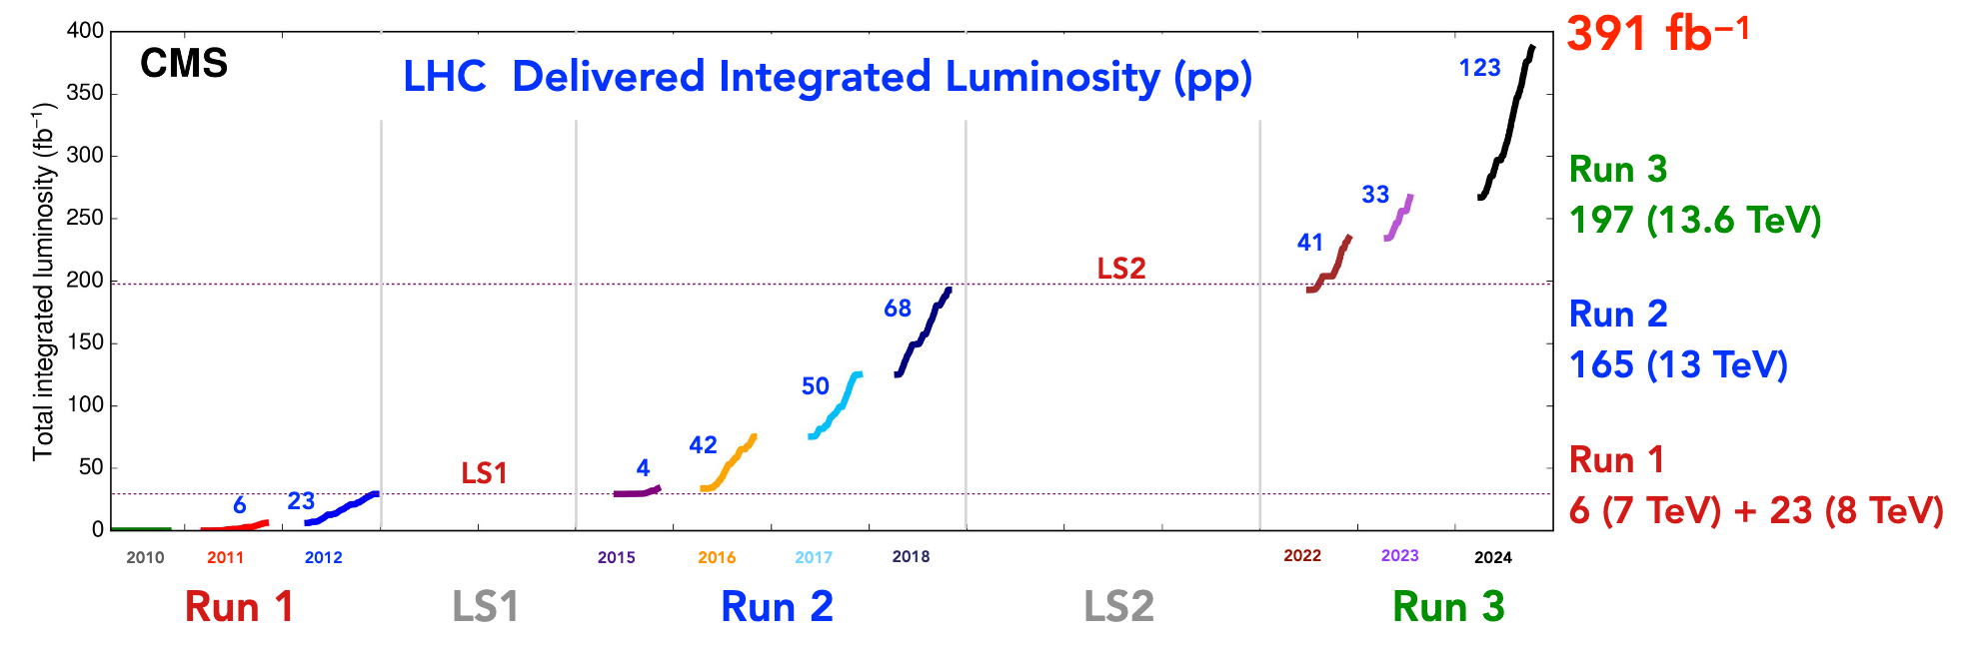
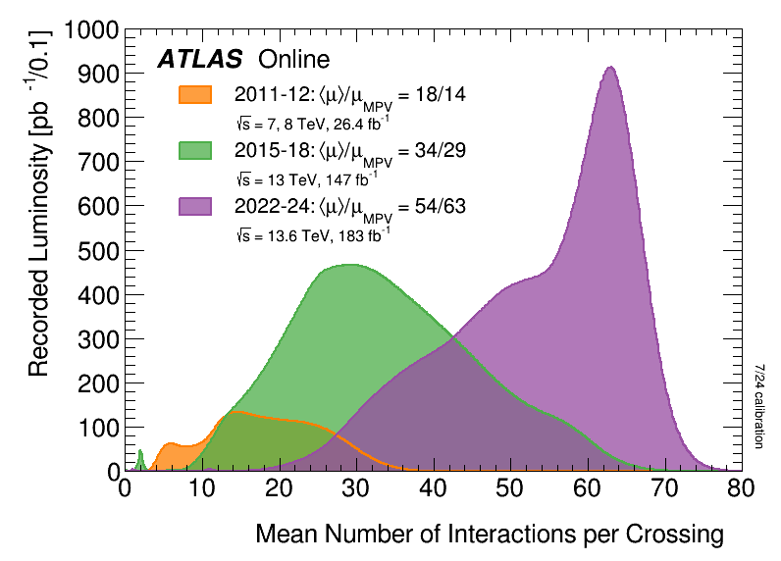



LHC Performance so far L_{int}
$\sqrt{s}$ = 13.6 TeV
$\sqrt{s}$ = 13.0 TeV
$\sqrt{s}$ = 7 & 8 TeV
Recorded pp luminosity by ATLAS, CMS, LHCb
*Recorded PbPb luminosity by ALICE
 | ATLAS | CMS | LHCb | ALICE*
Run-1 | 26.4 fb⁻¹ | 27.3 fb⁻¹ | 3.18 fb⁻¹ | 0.1 nb⁻¹
Run-2 | 147.0 fb⁻¹ | 150.9 fb⁻¹ | 5.93 fb⁻¹ | 0.8 nb⁻¹
Run-3 | 183.4 fb⁻¹ | 180.8 fb⁻¹ | 10.75 fb⁻¹ | 3.0 nb⁻¹
Total | 356.8 fb⁻¹ | 359.0 fb⁻¹ | 19.9 fb⁻¹ | 4.4 nb⁻¹

Slide 10
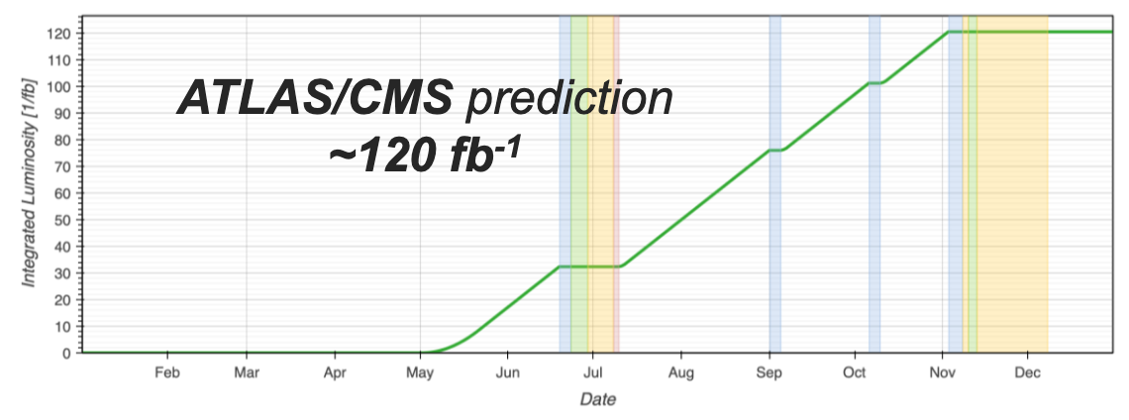
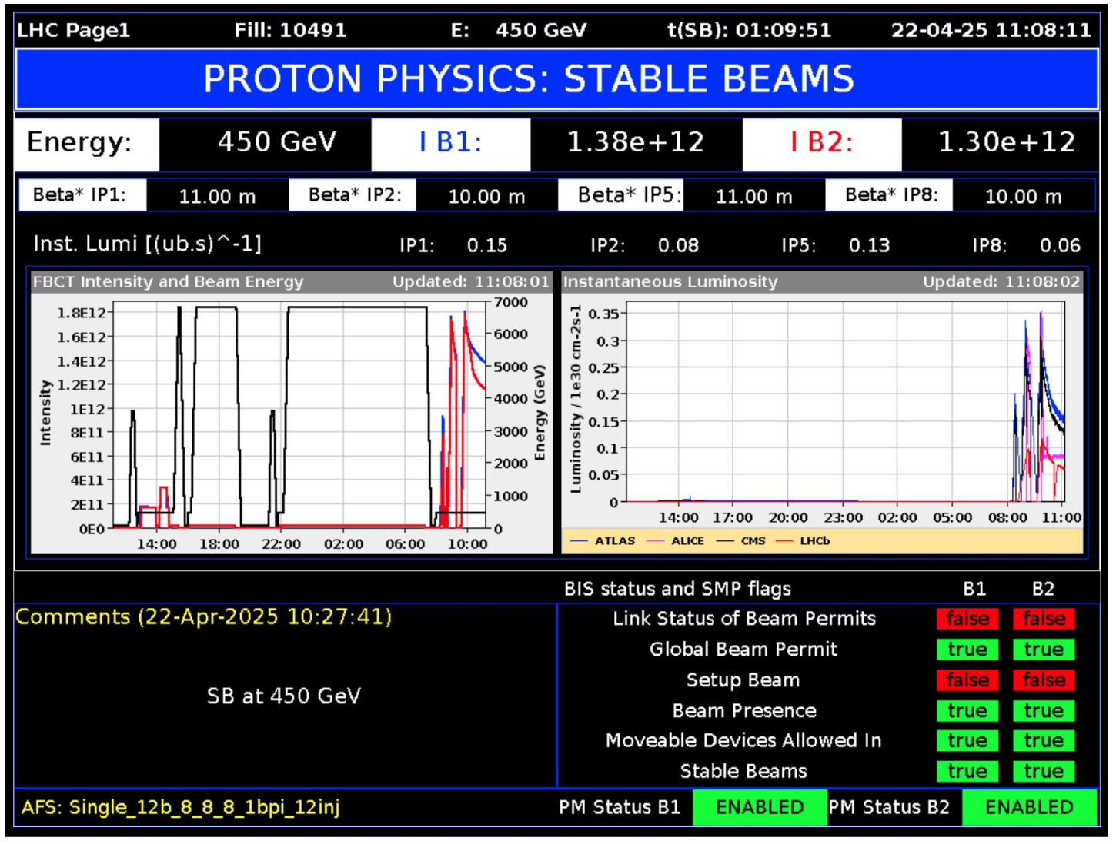
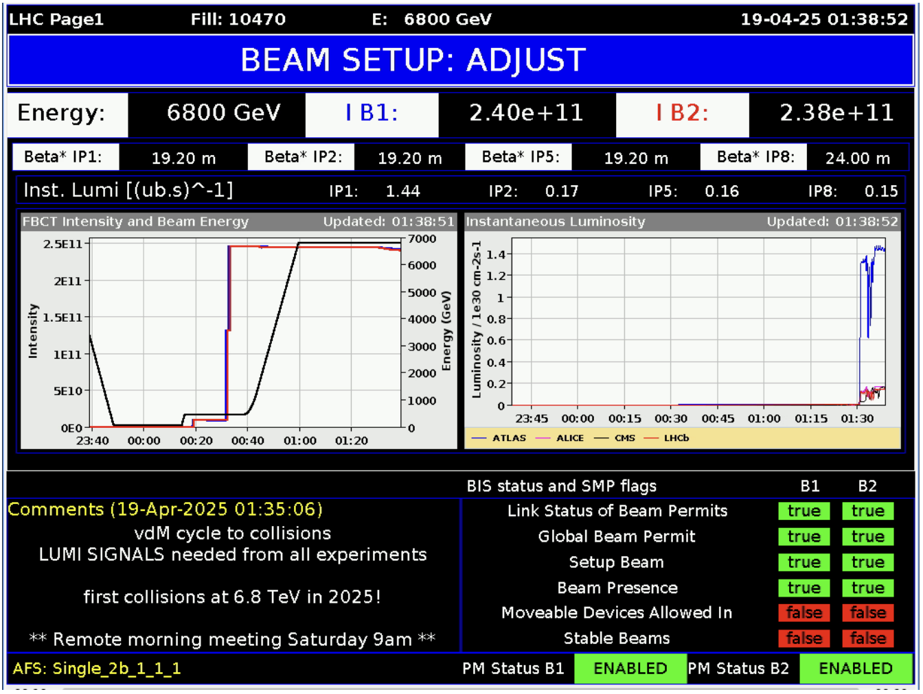
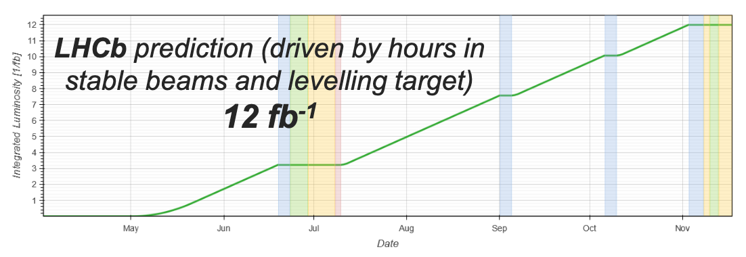


LHC Performance today
Forecast for 2025:
  So far beams up to 1.6 10¹¹ protons/bunch (Run-3 target: 1.8E11/b)
  End of Run-3 is last opportunity to test HL-LHC beams
    HL-LHC target: 2.3 10¹¹ protons / bunch
  2025 is dominated by pp-run + final PbPb run
  Target 120 fb⁻¹ to ATLAS/CMS and 12 fb⁻¹ to LHCb
First collisions at $\sqrt{s}$=13.6 TeV last Saturday
First stable beams at $\sqrt{s}$=0.9 TeV last Tuesday
LHC Beam Performance Tracking: https://bpt.web.cern.ch/

Slide 11
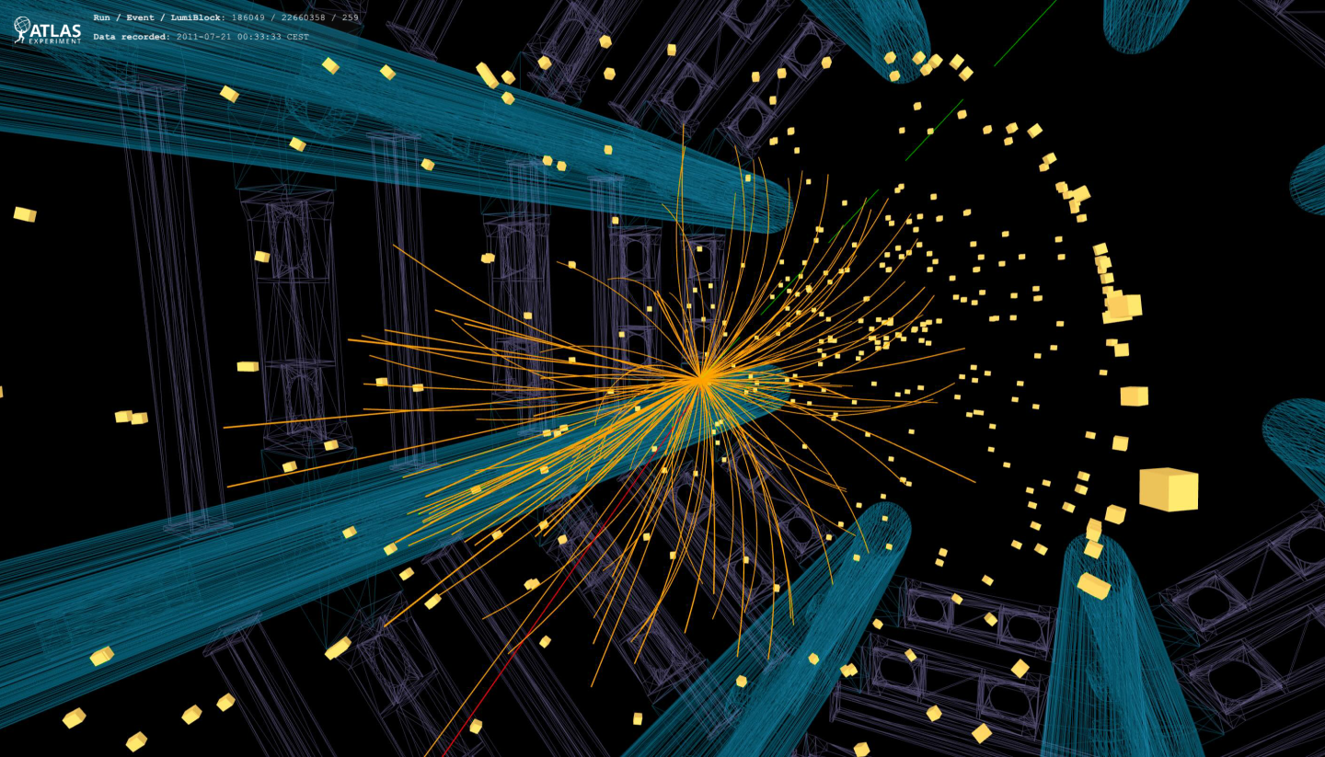
LHC Physics
Graphics Overview
Higgs Physics
Standard Model
Precision Measurements
Flavour
Beyond the Standard Model
Heavy Ion collisions

Slide 12





CMS & ATLAS publication in Physics Reports
Cross-Sections – Stairway to heaven
Top Quark Mass
High-density QCD
Search for Heavy Resonances through H-boson decay
Dark Sector Searches
Vector-Like Quarks & Leptons
Data scouting & Data Parking
https://www.sciencedirect.com/journal/physics-reports/vol/1116/suppl/C
https://www.sciencedirect.com/journal/physics-reports/vol/1115/suppl/C
772p
Characterizing the Higgs boson
EWK, QCD & Flavour studies
Top Physics
Search for additional scalars & exotic H decays
Quest for Supersymmetry discovery
Exotic Jungle Beyond The Standard Model
386p

Slide 13
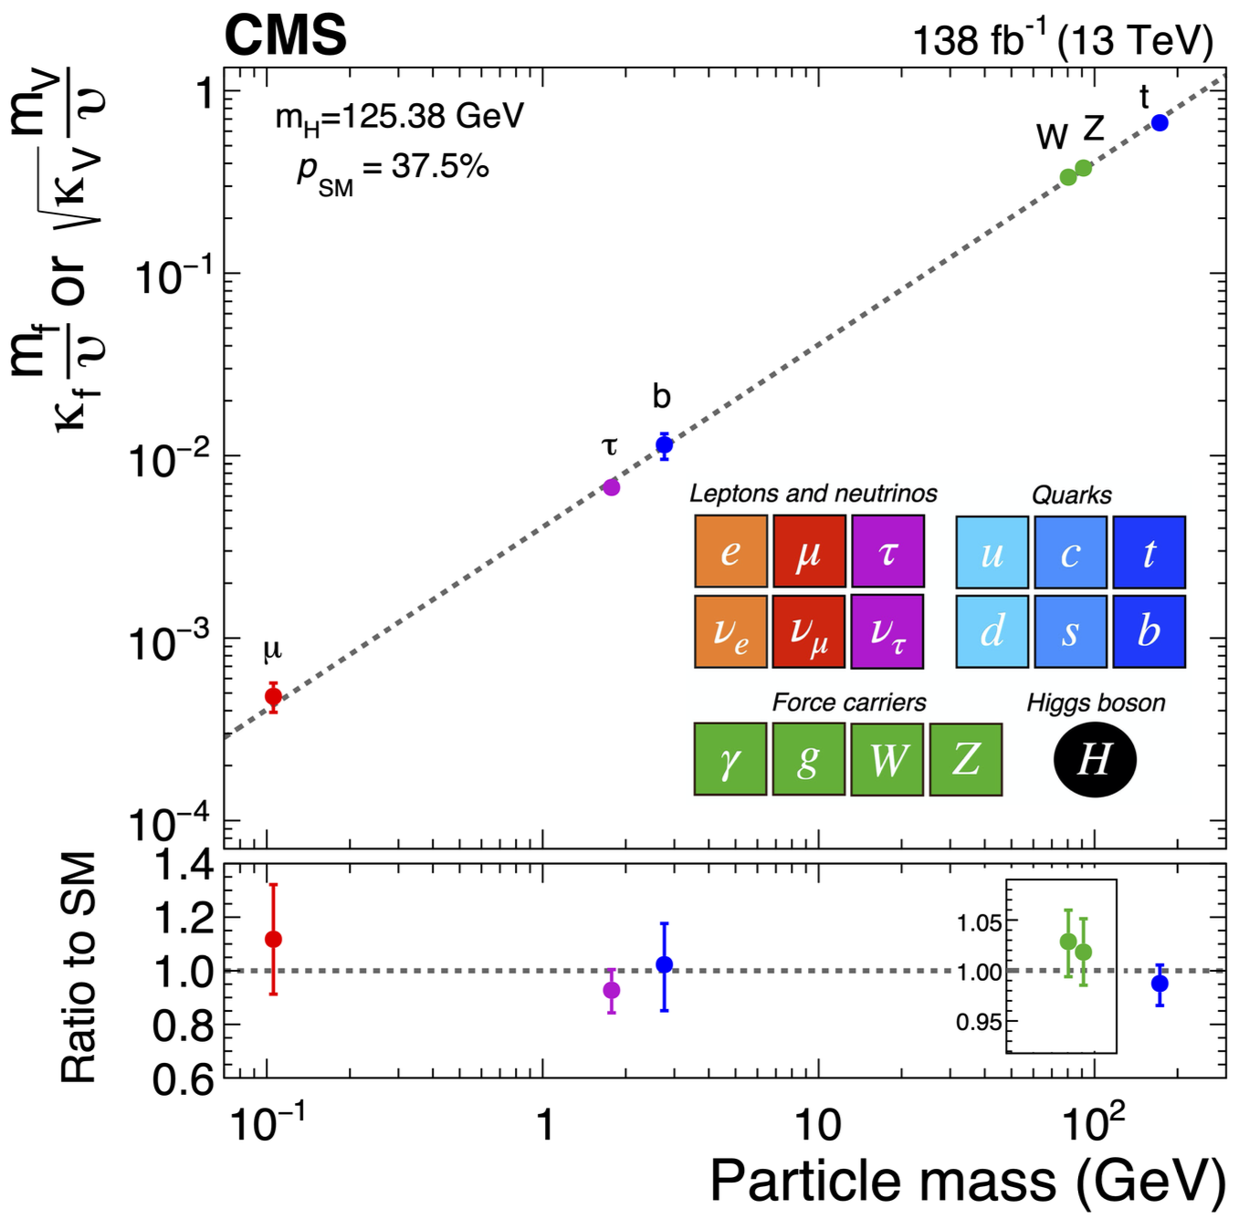
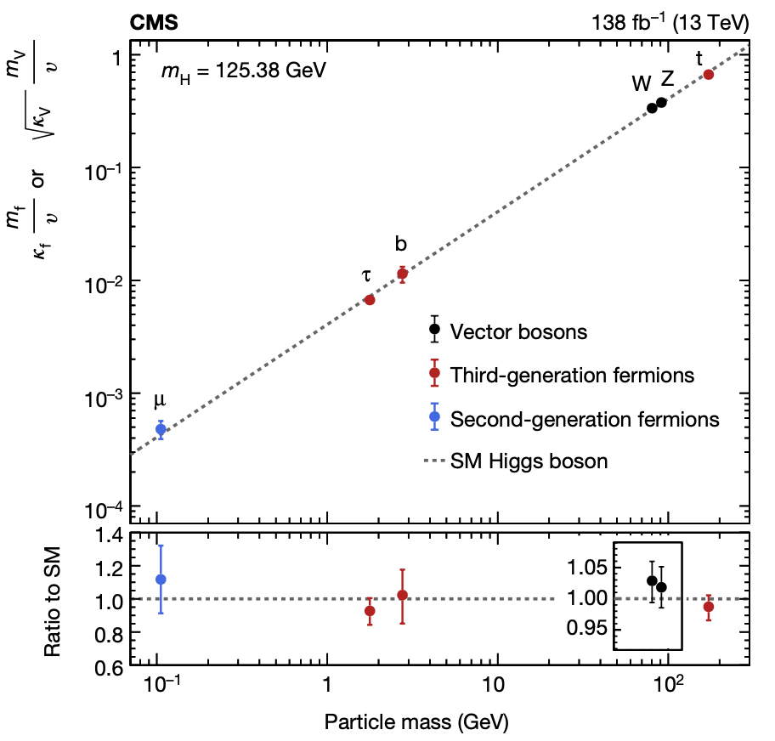





Higgs Physics overview
$$λf∝\frac{mf}{v}$$
More about Higgs:
Friday 9:30
A. Bethani
$$λV∝\frac{m_{V}^{2}}{v}$$
Higgs discovery was gigantic milestone
  It completes the SM
  It is the only fundamental scalar
  (i.e. spin-0 boson)
Essential to measure all properties of the Higgs boson up to the best possible precision
  Yukawa couplings
    Mass, New particles?
  H Mass & Width
  Shape of Potential
V-bosons
^{3rd} gen $q$
^{3rd} gen $ℓ$
2nd gen $ℓ$

Slide 14
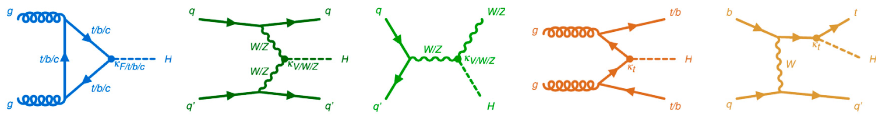
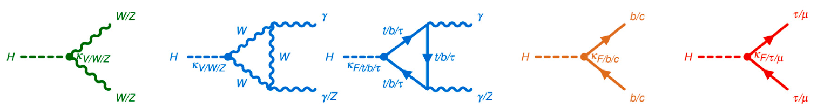

Higgs Physics production and Decay
Nearly 13 years after the discovery, ATLAS & CMS have been performing extensive set of measurements to characterize H
  Analyzed entire Run 2: 140 fb⁻¹ = 10 x discovery dataset
Explore all accessible Higgs boson production & decay modes
  Production (bbH and tH not yet discovered)
  Decay (evidence for H$→μμ$ and H$→Zγ$ – not yet for H$→cc$)
Excellent overview in 10-year discovery papers in Nature from ATLAS and CMS (Nature 607 52-59 & 60-68 (2022) – worth reading!) and the ATLAS Physics Report on Higgs characterization (Phys Rep. 1116 (2025))
ggF
VBF
ttH
tH
VH

Slide 15
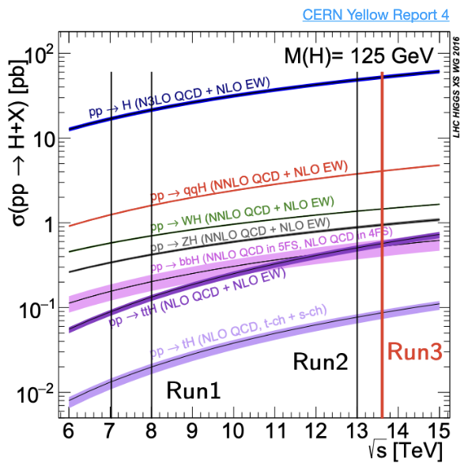
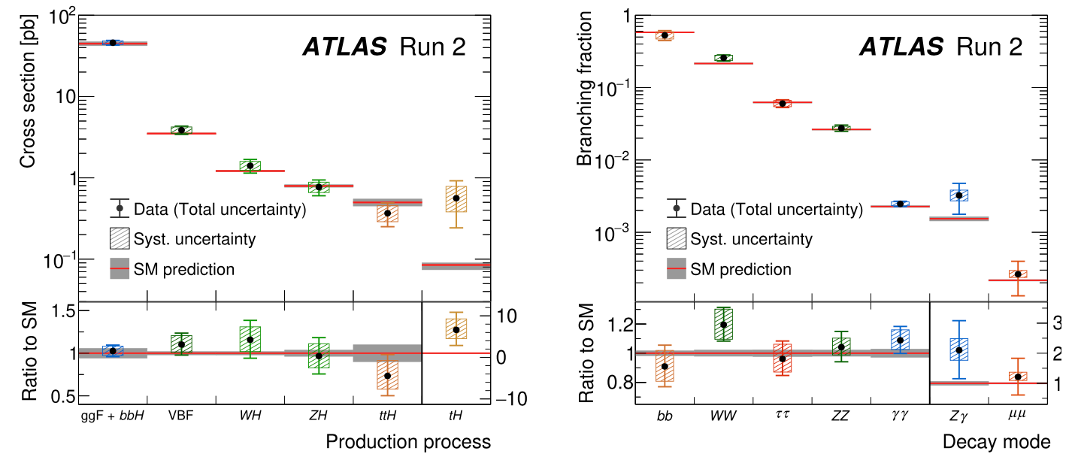

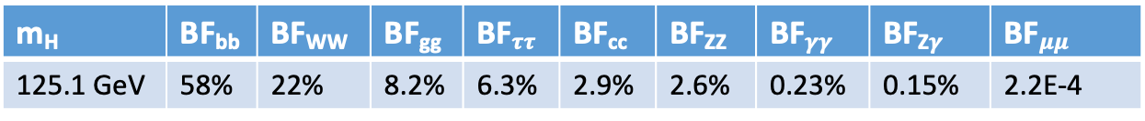
Higgs Physics production and Decay
https://www.sciencedirect.com/journal/physics-reports/vol/1116/suppl/C
1%
Higgs Decay Branching Fractions from CERN Yellow Report CERN-2017-002 & LHC HWG twiki
m_{H} | BF_{bb} | BF_{WW} | BF_{gg} | BF$ττ$ | BF_{cc} | BF_{ZZ} | BF$γγ$ | BF_{Z}$γ$ | BF$μμ$
125.1 GeV | 58% | 22% | 8.2% | 6.3% | 2.9% | 2.6% | 0.23% | 0.15% | 2.2E-4

Slide 16
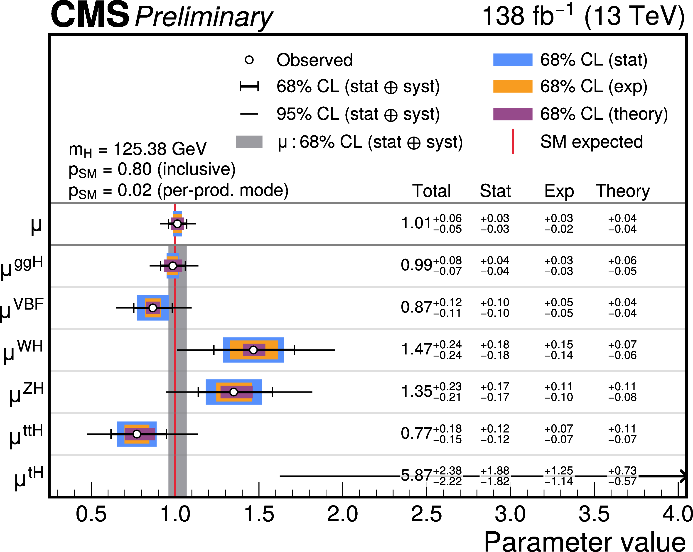
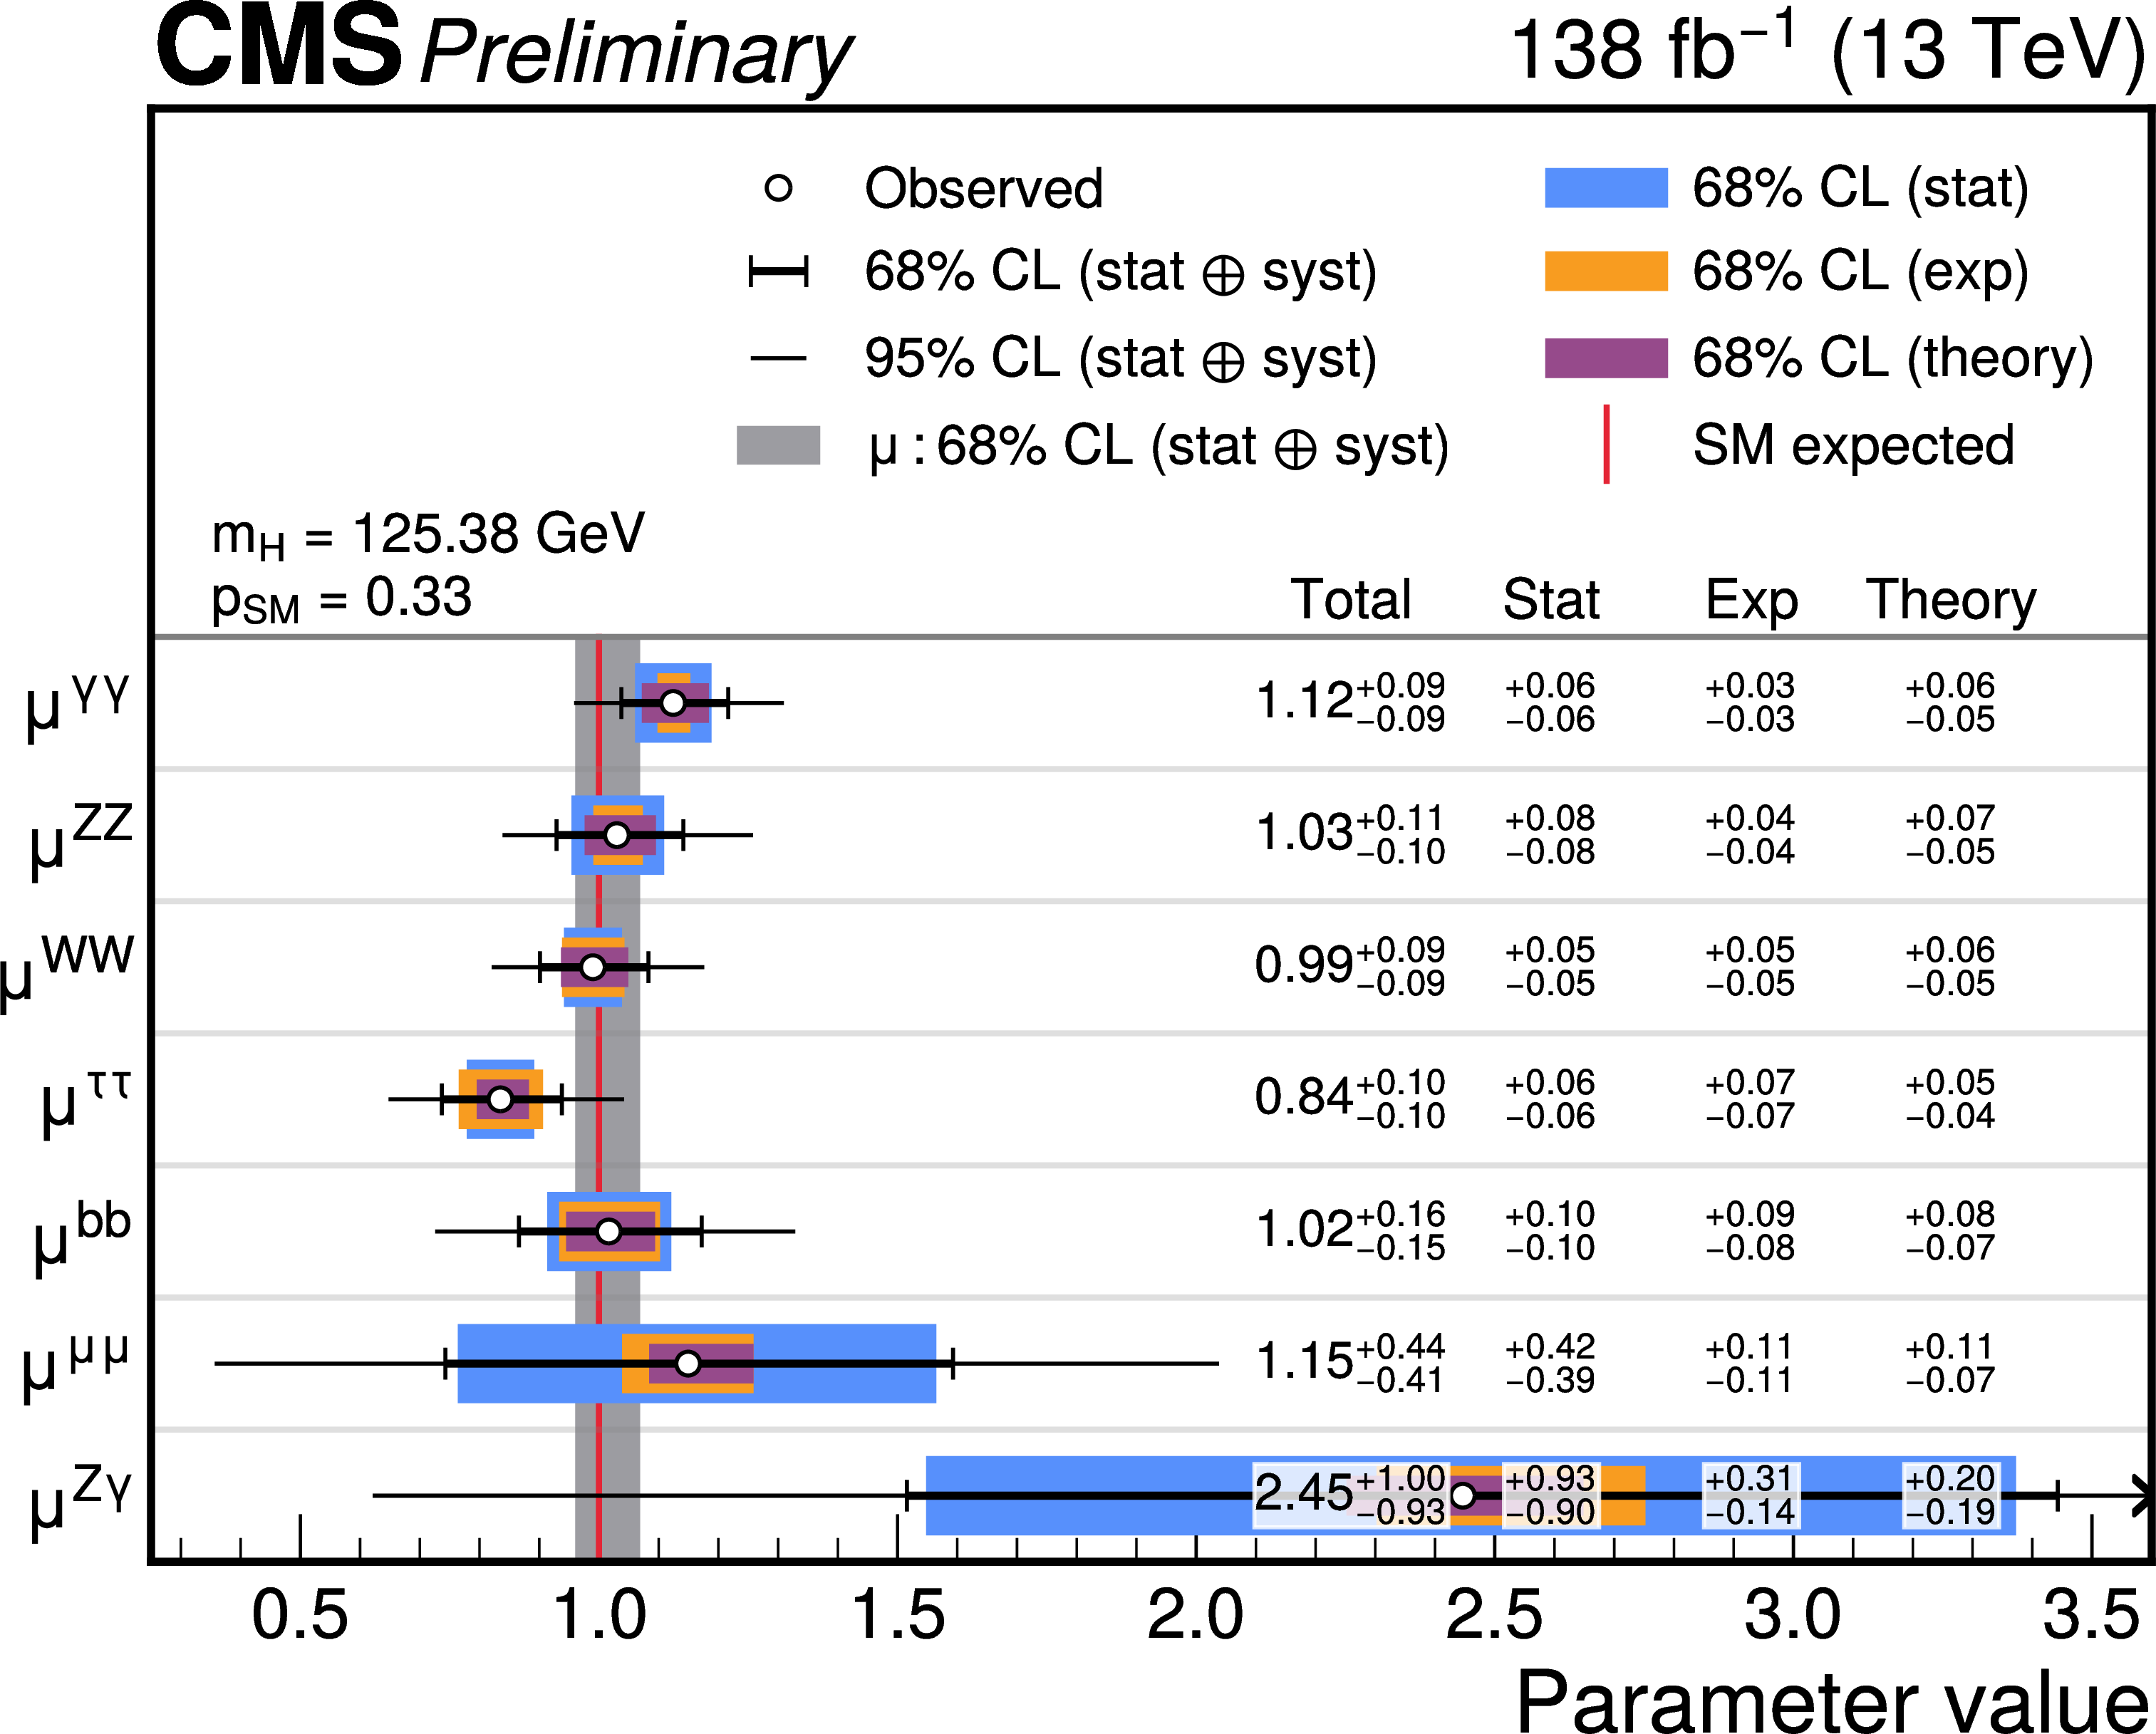

Higgs Physics signal strenght
Production: $μi=σi/σSM$
Decay: $μf=BFf/BFSM$
Investigate agreement observed signal yields and SM expectations:
  Fit data with model that introduces signal strength parameters
CMS-PAS-HIG-21-018 update w.r.t. CMS “Higgs 10” Nature publication & Phys Report
Left: The measured inclusive (μ) and per-production mode (μ^{i}) signal-strength modifiers. Right: The measured per-decay channel signal-strength modifiers, μ^{f}. The thick (thin) black lines indicate the 68% (95%) CL intervals, with the theoretical systematic, experimental systematic and statistical components of the 68% intervals indicated by the purple, orange, and blue bands, respectively. The grey band shows the 68% CL interval on the inclusive signal-strength modifier. The p_{SM} values are shown in the plot to indicate the compatibility with the SM hypothesis.

Slide 17
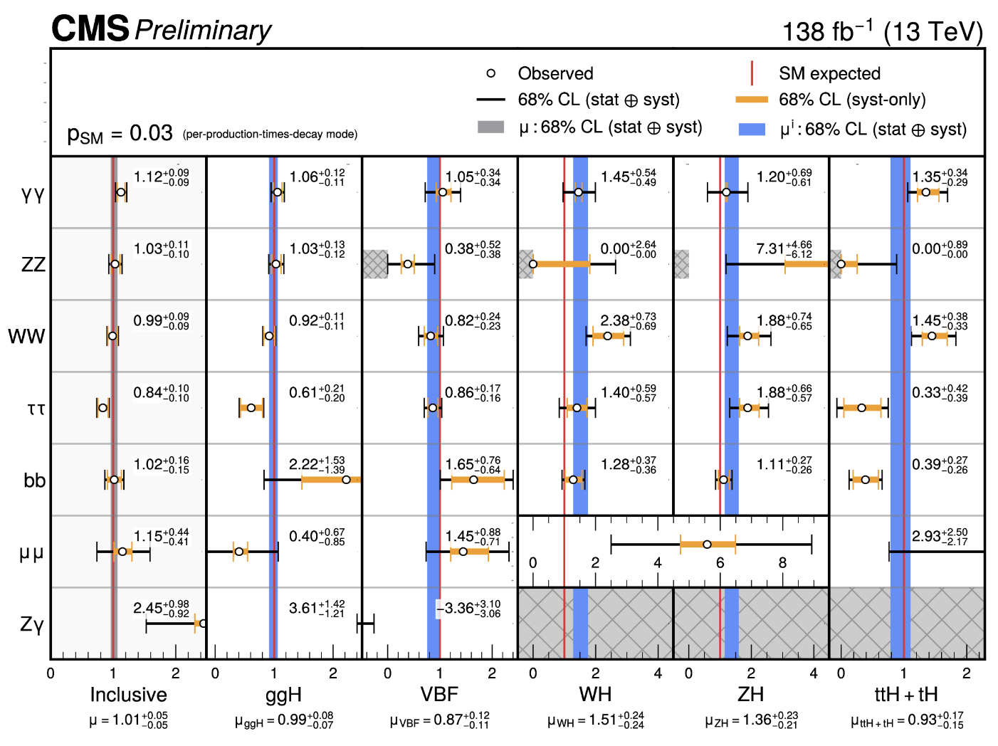


Higgs Physics production $×$ decay signal strength
Decay channel
Latest CMS Higgs combination at $\sqrt{s}$=13 TeV
CMS-PAS-HIG-21-018
Production mechanism

Slide 18
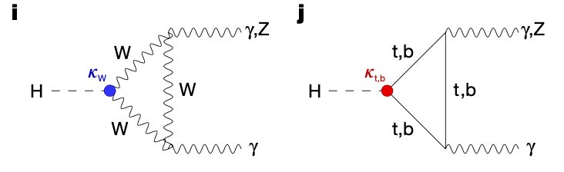


Higgs Physics coupling strength modifiers $κ$
Beyond the SM Physics is expected to affect production & decay modes in a correlated way
$κ$-framework to probe deviations from SM
  $σ_{i}$scaled by $κ_{i}^{2}$: $κ_{i}^{2}= σ_{i}/σ_{i}^{SM}$
  $Γ\text{j}$ scaled by $κ_{i}^{2}$: $κ_{j}^{2}=Γ\text{j}/Γ_{SM}^{j}$
Example: H$→γγ$: BF$γγ ∝ κ_{γ}^{2}={\left({1.26 κ}_{W} −0.26 κ_{t}\right)}^{2}$

Slide 19
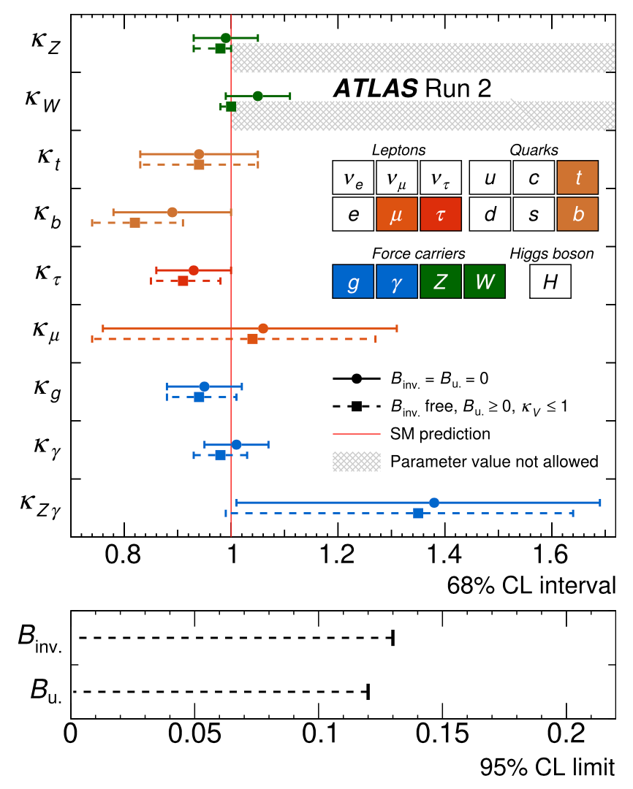
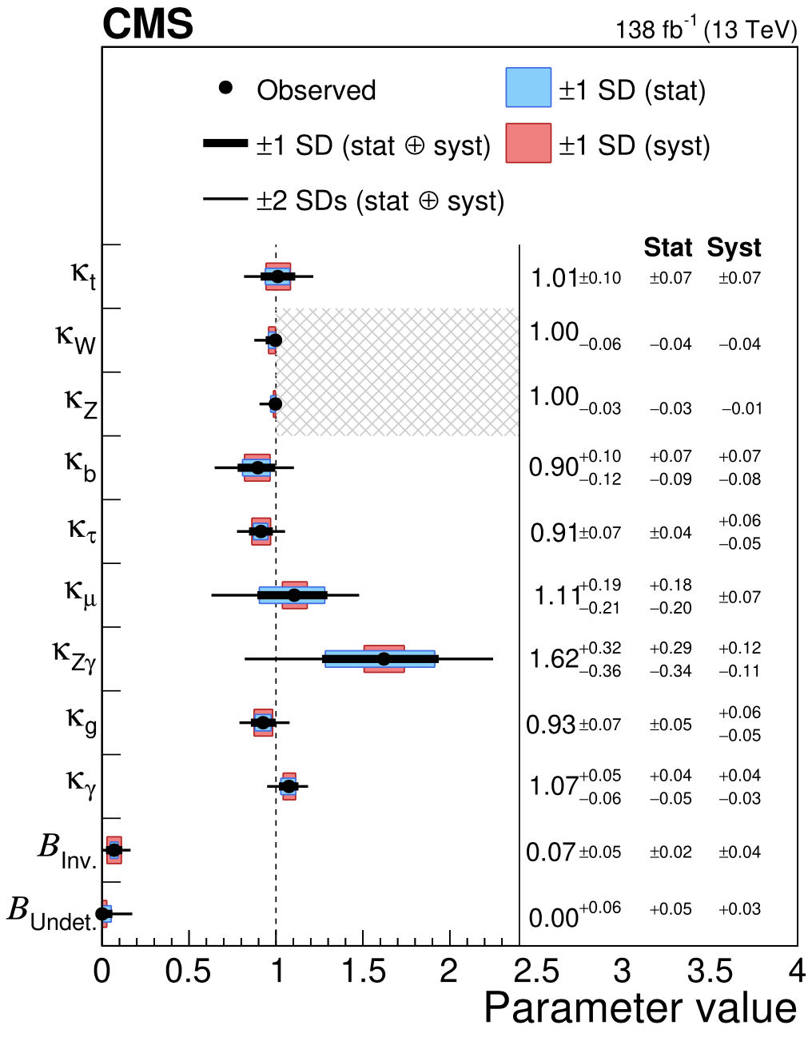
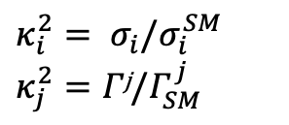
Higgs Physics coupling strength modifiers $κ$
$$κ_{i}^{2}= σ_{i}/σ_{i}^{SM}$$
$$κ_{j}^{2}=Γ\text{j}/Γ_{SM}^{j}$$
https://www.sciencedirect.com/journal/physics-reports/vol/1116/suppl/C
https://www.sciencedirect.com/journal/physics-reports/vol/1115/suppl/C

Slide 20
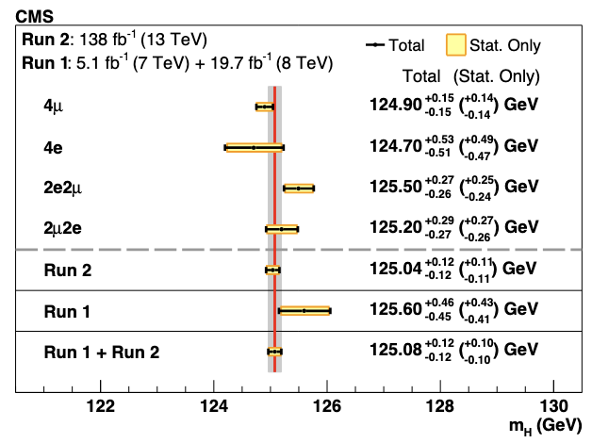
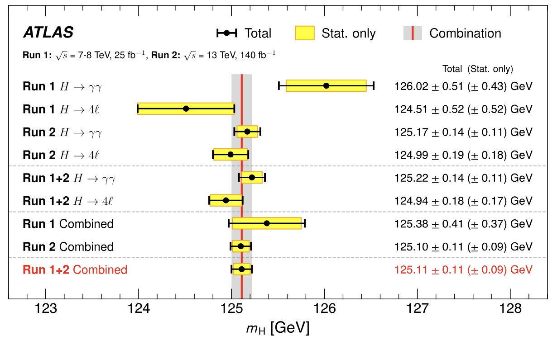

Higgs Physics mass M_{H}
Mass is crucial input for global Electroweak Fit
  Run 1 + Run 2 combination performed by ATLAS & CMS
    ATLAS: H($γγ$) and H(4$ℓ$) m_{H} = 125.11 $±$ 0.11 GeV
    CMS: H(4$ℓ$) m_{H} = 125.08 $±$ 0.12 GeV
    Both measurements / combinations still statistically limited!
CMS: arXiv:2409.13663
ATLAS: PRL 131.251802

Slide 21
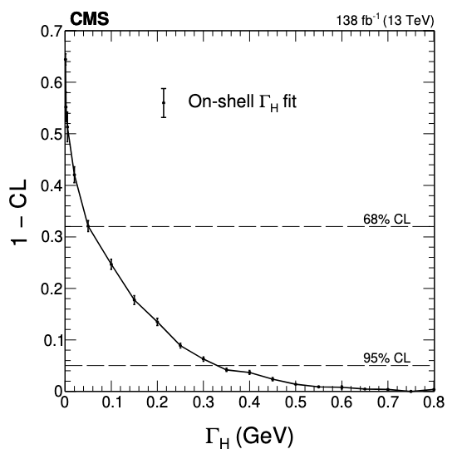
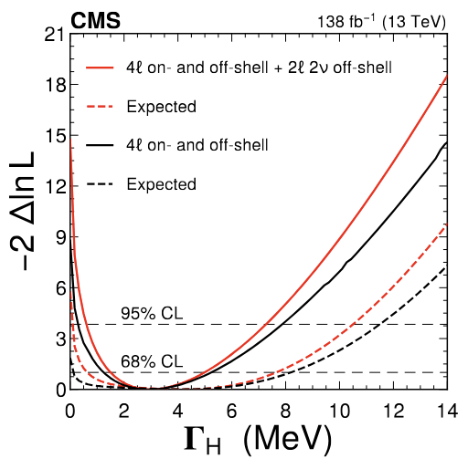
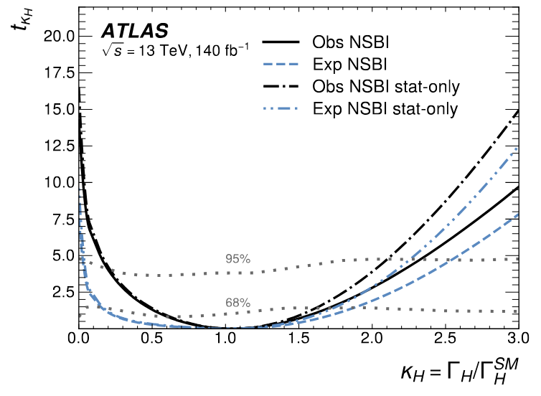
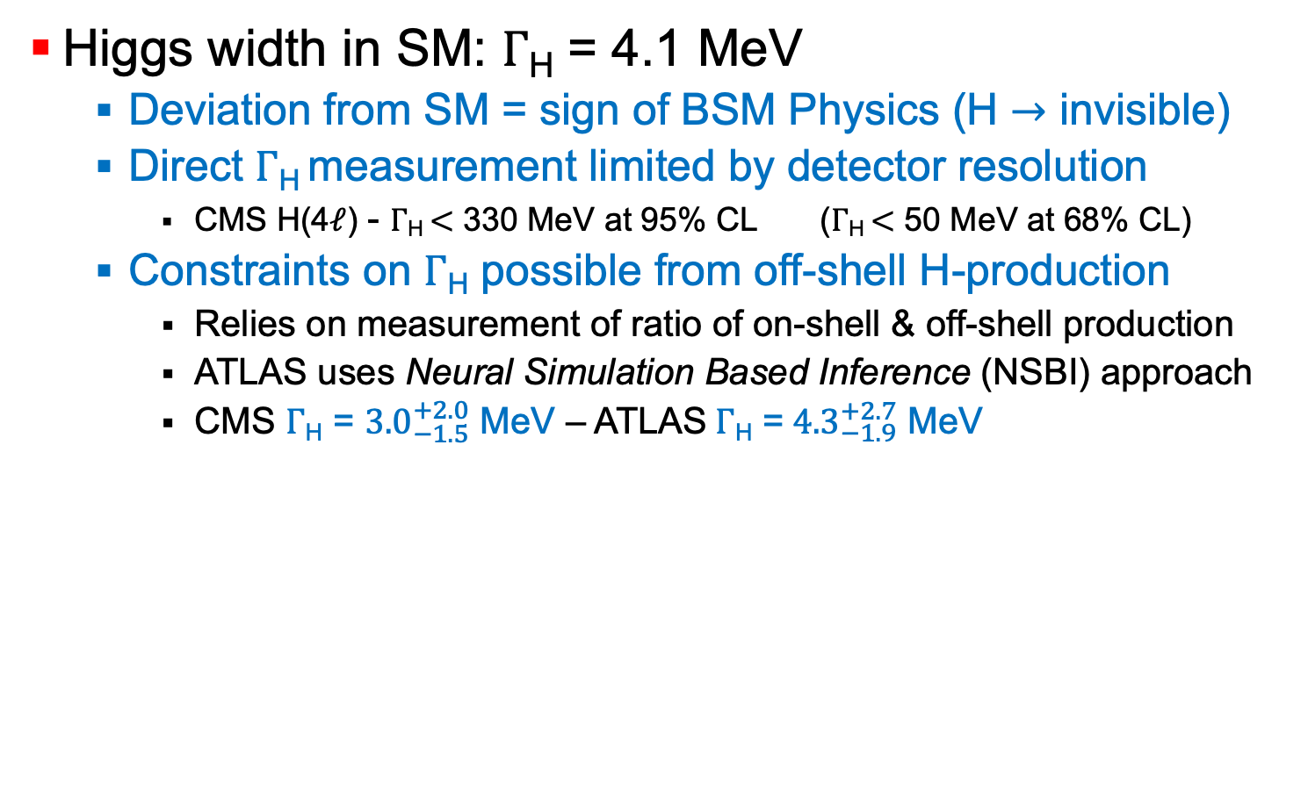

Higgs Physics decay width $Γ$_{H}
Higgs width in SM: $Γ$_{H} = 4.1 MeV
  Deviation from SM = sign of BSM Physics (H $→$ invisible)
  Direct $Γ$_{H} measurement limited by detector resolution
    CMS H(4$ℓ$) - $Γ$_{H} $<$ 330 MeV at 95% CL ($Γ$_{H} $<$ 50 MeV at 68% CL)
  Constraints on $Γ$_{H} possible from off-shell H-production
    Relies on measurement of ratio of on-shell & off-shell production
    ATLAS uses Neural Simulation Based Inference (NSBI) approach
    CMS $Γ$_{H} = ${3.0}_{−1.5}^{+2.0}$ MeV – ATLAS$Γ$_{H} =${ 4.3}_{−1.9}^{+2.7}$ MeV
CMS: arXiv:2409.13663
ATLAS: arXiv:2412.01548
Test statistic

Slide 22
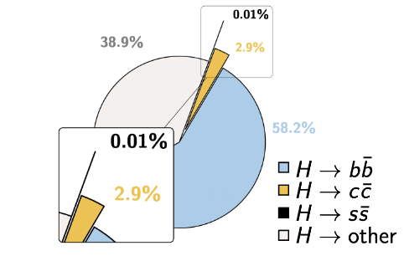





Higgs Physics coupling to charm quarks
Smart usage of physics-oriented Machine Learning to achieve sensitivity
  Multiple heavy-flavour jets in final states (ttH(cc): 2b + 2c)
  Use ParticleNet for Run 2 + NN Event classification
    simultaneous b- & c-jet identification
    Factor ~2 better than DeepJet Run 2
  Simult. ttH(bb) & ttH(cc) measurem
  1D constraint on $κc$ : |$κc$| < 3.0 obs.
    Equal to orig. 3000 fb⁻¹ HL-LHC projection
b jets
light jets
CMS-PAS-HIG-24-018
c jets

Slide 23





Higgs Physics
Higgs to invisible
long lifetime & short width
Sensitive probe for small couplings to new particles
BSM may distort BF H$→$inv
H(ZZ)$→$4$ν$ (BF = 0.1%)
Phys. Lett. B 842 (2023) 137963
  Constrain BF(H$→$inv) => constrain DM
  Upper limit on BF(H$→$inv) 10.7% at 95%CL
Upper Limit on Spin-Independent DM-Nucleon scattering for m_{DM} < 60 GeV

Slide 24



Higgs Physics differential $σ$
JHEP 05 (2023) 028
JHEP 08 (2023) 040

Slide 25







Higgs Physics di-Higgs searches
ggF
VBF
Constrain triple-Higgs coupling ($λ3| κλ$) and quartic VVHH coupling ($κ2V$)
HH-production 1000x rarer than single-H production
  $σH= 54 ±2.6$pb $σHH {=32.76}_{−6.83}^{+1.95}$ fb
  Many different decay channels need to be considered
Constrain the shape of Higgs potential:
actual coupling
coupling modifier
$$V\left(H\right)= \frac{1}{2}m_{H}^{2}H2+λ3H3+\frac{λ4}{4}H4$$
H
H
H
$$λ3$$
$$λ4$$
H
H
H
H

Slide 26





Higgs Physics di-Higgs searches
CMS: CMS-PAS-HIG-20-011
ATLAS: PRL 133 101801 (2024)
Upper limit on HH production:
  2.9 x SM (ATLAS) 3.5 x SM (CMS)
Strong constraints on $κλ , κ2V$
  0.6 (0.6) < $κ2V$ < 1.5 ATLAS (1.4 CMS)
  -1.2 (-1.4) < $κλ$ < 7.2 ATLAS (7.0 CMS)

Slide 27


Higgs Physics di-Higgs searches
CMS: CMS-PAS-HIG-20-011
ATLAS: PRL 133 101801 (2024)
Upper limit on HH prod:
  2.9 x SM (ATLAS) 3.5 x SM (CMS)
Strong constraints on $κλ , κ2V$
  0.6 (0.6) < $κ2V$ < 1.5 ATLAS (1.4 CMS)
  -1.2 (-1.4) < $κλ$ < 7.2 ATLAS (7.0 CMS)

Slide 28





Higgs Physics
Higgs potential
$$V\left(φ\right)=μ^{2}φ^{+}φ+λ{\left(φ^{+}φ\right)}^{2}$$
Shape Higgs potential:
Ways to measure $λ$₃:
  HH and HHH production
    HH possible at HL-LHC
    HHH challenging at HL-LHC
  Precision measurements
  of single-Higgs production
    Simplified Template Cross Sections
    LHC Higgs WG LHCHWG-22-002
    Unified parametrization between
    experiments, agreed upon with theorists
    Will provide best statistical power
$$V\left(H\right)= \frac{1}{2}m_{H}^{2}H2+λ3H3+\frac{λ4}{4}H4$$

Slide 29



Higgs Physics
Simplified Template Cross-Sections STXS
CMS Run-2 Higgs combination provides ultimate sensitivity
Combination of all production & decay modes
  $μ= {1.014}_{−0.053}^{+0.055}$
Interpretation with coupling modifiers
H self-coupling ($λ3$) constraints
  $κλ$ in [-3.34, 9.55] from STXS
  $κλ$ in [-1.2, 7.2] from H+HH
CMS-PAS-HIG-21-018

Slide 30



Higgs Physics
Early Run-3 measurements
H($γγ$) & H(ZZ) xs measured at 13.6 TeV (CMS 2022 data)
Inclusive differential xs measured in H$→$ZZ(4$ℓ$)
(ATLAS 2023 + 2024 data)
  Goal: measure Higgs cross-section differentially across different variables of interest: p_{T}(4$ℓ)$, y(4$ℓ)$, m₃₄, n_{jets}

Slide 31







Standard Model precision measurements sin $θW$
More about EWK:
Today 12:00
J. Mauer
Measurement of the Weak Mixing Angle: sin $θW$
  Forward-Backward Asymmetry in Drell-Yan production
  Analysis full Run-2 dataset: CMS 138 fb⁻¹ LHCb 5.3fb⁻¹ at $\sqrt{s}$ = 13 TeV
  Very precise measurements at a hadron collider
  sin $θW$ = 0.23157 $±$ 0.00031
  sin $θW$ = 0.23147 $±$ 0.00044
CMS
CMS-SMP-22-010 – arXiv:2408.07622
LHCB-PAPER-2024-028 - JHEP 2412 (2024) 026
LHCb
Syst dominated
Stat dominated

Slide 32







Standard Model precision measurements M_{Z}
Measurement of the Z-boson mass:
  First dedicated measurement of M_{Z} at LHC
  M_{Z} = 91184.2 $±$ 8.5 $±$ 4.3 MeV
  Eagerly waiting M_{Z} results from ATLAS and CMS
LHCB-PAPER-2025-008
CERN Seminar 18-03-2025
M_{Z} = 91187.2 $±$ 2.1 MeV
M_{Z} = 91192.3 $±$ 7.1 MeV
M_{Z} = 91184.2 $±$ 9.5 MeV

Slide 33






Standard Model precision measurements M_{W}
Extract W-boson mass from $p_{T}^{μ}$ only (less PU-sensitive)
  Binned profile ML-fit to 16.8 fb⁻¹ (50% 2016 data - $\left\langle μ\right\rangle$ = 27)
  2880 $p_{T}^{μ}$ - $η_{T}^{μ}$ - $q^{μ}$ bins | closure with M_{Z} (no independent measurement)
Validation of momentum scale calibration with M_{Z}
$\sim$ 60M $W^{+}$ events
CMS-SMP-23-002 – arXiv:2412.13872
$\sim$ 46M $W^{−}$ events

Slide 34



Standard Model precision measurements M_{W}
Extract W-boson mass from $p_{T}^{μ}$ only (less PU-sensitive)
  Binned profile ML-fit to $p_{T}^{μ}$ - $η_{T}^{μ}$ - $q^{μ}$ to 16.8 fb⁻¹ (50% 2016 data)
  M_{W} = 80360.2 $±$ 9.9 MeV (most precise at the LHC)
CMS-SMP-23-002 – arXiv:2412.13872

Slide 35




Standard Model precision measurements M_{top}
More about Top:
Wednesday 16:00
M. Stratmann
ATLAS + CMS combination Run-1
  Most precise measurement today (< 0.2%)
  M_{top} = 172.52 $±$ 0.33 GeV
M_{top} with boosted top quarks
  Hadronic top candidate reconstructed as large jet
  Used full Run-2 dataset ATLAS
ATLAS & CMS collab – doi:10.1103/PhysRevLett.132.261902
ATLAS – arXiv:2502.18216

Slide 36




Standard Model lepton flavour universality in top (W) decays
Use top as a precise source of W bosons
  probe universality of the coupling of leptons to EWK V
    Ratio R($τ/μ$) = B(W$→$ $τν$) / $\text{B}\text{(}\text{W}→$ $μν$)
    $\text{Ratio} \text{R}\text{(}μ/e\text{) = }\text{B}\text{(}\text{W}→$ $μν$) / $\text{B}\text{(}\text{W}→$ e$ν$)
Nature Phys. 17 813-818 (2021)
Eur. Phys. J. C 84 (2024) 993
0.45%

Slide 37




Standard Model top quark properties
top lifetime $≈5 {10}^{−25}$s
hadronisation $≈{10}^{−23}$s
Spin decorrelation $≈{10}^{−21}$s
Quantum entanglement
  Spin information top quark is transmitted to decay particles
  SM predicts entangled spins for $t\overline{t}$ states at the production threshold and at high masses of the $t\overline{t}$ system
  Peres-Horodecki criterion $→$ determine if state can be separated
  1st observation entangled QM state at high m($t\overline{t}$)
  > 5$σ$ in ATLAS & CMS
ATLAS – Nature 633 542-547 (2024)
CMS – Phys.Rev.D. 110 (2024) 112016

Slide 38






Standard Model Toponium $η$($t\overline{t}$) observation of pseudoscalar excess at $t\overline{t}$ theshold
  Analysis explores m($t\overline{t}$) and 2
  angular observables (c_{hel}, c_{han})
    access to correlation of $t$ and $\overline{t}$ spin
  Color singlet should show up with
  peak below m($t\overline{t}$) threshold
    Eagerly waiting ATLAS analysis
CMS – arXiv:2503.22382
cerncourier.com/a/cms-observes-top-antitop-excess-2

Slide 39

Searches for New Physics
SUSY where are you?
More about BSM:
Tomorrow 9:30
L. Soffi
Example from ATLAS
1 TeV
Inclusive
searches
3rd generation
ATLAS-PHYS-PUB-2024-014 – latest update: AUG 2024
EWK
searches
LLP
RPV
Many models excluding NP > 1 TeV

Slide 40

Searches for New Physics overview of CMS Exotica searches
More about BSM:
Tomorrow 9:30
L. Soffi
1 TeV
10 TeV
Other searches
Contact interactions
Dark matter
Likewise Exotica searches are excluding high mass scalars and vectors well above 1 TeV
RPV SUSY
https://cms-results.web.cern.ch – latest update: MAR 2024
Extra
Dimensions
Excited fermions
Heavy fermions
Heavy Gauge Bosons

Slide 41

Searches for New Physics overview of ATLAS Exotica searches
More about BSM:
Tomorrow 9:30
L. Soffi
Extra
Dimensions
Heavy Gauge Bosons
Contact interactions
ATL-PHYS-PUB-2023-008 – latest update: MAR 2023
Dark matter
Leptoquarks
Heavy fermions
Excited fermions
Other searches
1 TeV
10 TeV

Slide 42




Searches for New Physics and many more …
More about BSM:
Tomorrow 9:30
L. Soffi
hMSSM
2HDM+a
Higgs boson mediated
hidden sector with LLPs
Heavy Neutral Lepton 2ndgen

Slide 43



Searches for New Physics new strategies
Since Run 2 new data taking strategies
  Optimize data-taking – explore intensity frontier
  Example from CMS – similar techniques in other exps
  Parking: delayed reconstruction – store RAW 3.5 kHz
    Initially for flavour physics studies – now also high-p_{T} (e.g. HH$→4b)$
  Scouting: analysis with HLT trigger objects 20 - 25kHz
    Use bandwidth access to low thresholds – drop RAW data
    Extend search window to low masses
https://www.sciencedirect.com/journal/physics-reports/vol/1115/suppl/C
Normal: 2.5 kHz

Slide 44
Flavour Physics as a window to New Physics
More about Flavour:
Wednesday 9:30
M.Schmelling
Flavour physics provides unique probe to BSM
  Origin matter – anti-matter
  Why three generations – patterns in mass & mixing
In SM there no FCNC at tree-level
  Theory: very clean predictions for many rare &
  CP-violating processes in the SM
  Contributions due to off-shell particles in the loops
  Precision measurements => probe contributions due to BSM particles up to 10 TeV or higher
Focus is on improving experimental precision
  & investigating unexplored regions of phase space
LHC-PUB-2025-001

Slide 45












Flavour Physics
CP-violation in the quark sector CKM matrix
More about Flavour:
Wednesday 9:30
M.Schmelling
CP violation
Measurement $α$:
exploiting isospin
relations between decay rates and CP violation parameters in B → ππ, ρπ and ρρ decays
small theoretical uncertainty
$(\overline{ρ},\overline{η}$)
LHC-PUB-2025-001
Measurement $γ$:
evaluated from CP violation effects in B+ → DK⁺ and similar processes
with neutral D meson reconstructed in a final state accessible to both $D^{0}$ and $\overline{D^{0}}$ decays
Measurement $β$:
determined from mixing-induced CP violation in B₀ → J/ψK⁰_{S}
small theoretical uncertainty
Total amount of CP-violation determined by $(\overline{ρ},\overline{η}$)
  Can be constrained by several complementary meas.
    E.g. at tree-level by CKM-$γ$ and |V_{ub}|, |V_{cb}|
    E.g. through loops by FCNC (CKM-$β$ and B-meson osc: $Δ$m_{d} & $Δ$m_{s})

Slide 46


Flavour Physics
Simultaneous determination CKM-$γ$
Slide: I. Bachiller – LHCC Sept 2024

Slide 47






Flavour Physics
Exotic hadrons
23 exotic hadrons discovered at LHC so far
  5 pentaquarks & 18 tetraquarks
    Strikingly close to meson-meson/baryon thr
    Narrow-width signals
  One of the least-expected outcomes LHC
1st measurement of symmetry properties all-charm tetraquarks by CMS: true $T_{c\overline{c}c\overline{c}}$ or $c\overline{c}$ molecule?
  data consistent with $J^{PC}=2_{m}^{+}$
CERN Courier November 2024
CERN Seminar April 8th, 2025

Slide 48

Heavy Ion Physics
LHC as a Quark-Gluon-Plasma (QGP) Lab
ALICE Run 1 & Run 2 legacy
  Study many-body QCD at the largest temperature in QGP
  Explored hadron-hadron strong interactions & QCD in pp
  Initial QGP temp > 5 x QCD deconfinement temp T_{pc} = 155-158 MeV
  Matter created in PbPb at LHC
    Largest temperature & energy density
    Longer lifetime (10⁻²³s) and larger volume
    Most rapid expansion (0.7 c)
  Elliptic flow observed for all hadrons
  Jet quenching allowing multi-messenger exploration QGP structure
  Reduced E-loss for b- w.r.t c-quarks
    Dead-cone effect
  Many more results …
Eur. Phys. J. C 84 (2024) 813
327p

Slide 49

Heavy Ion Physics
LHC as a Quark-Gluon-Plasma (QGP) Lab
Slide: A. Schmah – Quark Matter 2025

Slide 50

Heavy Ion Physics
LHC as a Quark-Gluon-Plasma (QGP) Lab
bla
Slide: A. Schmah – Quark Matter 2025

Slide 51


Heavy Ion Physics first observation of $t\overline{t}$ production in PbPb
Slide: R. Longo - Quark Matter 2025

Slide 52

Heavy Ion Physics
Radial Flow v₀ as probe for expansion QGP
Slide: R. Longo - Quark Matter 2025

Slide 53

High Luminosity LHC at a glance
More about HL-LHC:
Wednesday 12:15
Y.Papaphilippou
HL-LHC will extend LHC Physics Reach
  Relies on key innovations that push accelerator technology beyond limits
  Many new technologies
  5 – 7.5 x design luminosity
  10 x Phase-1 dataset
Goals pp-collisions
  3000 fb⁻¹ to ATLAS/CMS
  50 fb⁻¹ to LHCb upgrade I
  300 fb⁻¹ to LHCb upgrade II
Goals Heavy-Ion collisions
  PbPb 13 nb⁻¹
  pPb 50 nb⁻¹

Slide 54





High Luminosity LHC
Timeline
More about Detector:
Today 16:00
F.Carnesecchi
You are here
LS2
ALICE & LHCb:
Phase-1 Upgrades
CMS & ATLAS: Phase-2 Upgrades:
new Trk, new/upgraded CALO, addition of Timing, L1 Trigger 1MHz/750kHz, extra muon chambers, luminosity
LHCb: 40MHz, New Trk, …
ALICE: 50kHz (TPC), New Trk, …
End ATLAS/CMS Phase 1: 500fb⁻¹
ALICE & LHCb:
Phase-2 Upgrades
LHCb Phase 1: $ℒ$= 2.0 E33 cm⁻²s⁻¹
End LHCb Phase 1: 50fb⁻¹
LHCb Phase 2: $ℒ$= 1.5 E34 cm⁻²s⁻¹
LHCb: new Trk, upgraded CALO & RICH, addition of Timing in Pixels & TORCH ,…
End ATLAS/CMS Phase 2: 500fb⁻¹
End LHCb Phase 2: 300fb⁻¹
Nominal scenario foresees $ℒ$= 5.0 E34 cm⁻²s⁻¹
With ion runs => L_{int} < 3000 fb⁻¹
Ultimate scenario foresees $ℒ$= 7.5 E34 cm⁻²s⁻¹
after LS4 – depends on machine margins => L_{int} > 3000 fb⁻¹

Slide 55


HL-LHC Physics prospects
Input EU Particle Phys Strategy Update (EPPSU)
HL-LHC projections documented in CERN YR 2018 (CERN-2019-007) with substantial update for 2021 Snowmass process (ATL-PHYS-PUB-2022-018)
Update few key areas (ATL-PHYS-PUB-2025-018) for ESUPP’26
Extrapolations of partial/full Run-2 results to 3000 fb⁻¹
  And for combination of ATLAS & CMS results
Different scenarios for systematics
  “S2” reduced syst uncrt, theoretical uncert reduced by 50%
  “S3” recent improvement in object reconstruction w.r.t. S2
Detector upgrades & SW improvements offer significantly enhanded trigger, tracking & PU suppression capabilities
  Expected to more than compensate for the challenges posed by the increased pileup
Success HL-LHC physics program critically depends on timely & succesfull completion of detector upgrades
Non-complete report – mainly dedicated to Higgs
1418p
116p

Slide 56







HL-LHC Physics prospects
Observation of Rare Higgs Decays
Evidence found for H$→μμ$ and H $→$Z$γ$ in Run-2 data
  CMS found evidence (3.0$σ$ obs 2.5 $σ$ exp) for H$→μμ$ in 2021 (ATLAS 2.0$σ$ obs 1.7 exp)
  Run 2 ATLAS+CMS combination led to evidence (3.4$σ$) for H $→$ Z$γ$ in 2024
Improved tracking in Phase-2 ATLAS & CMS Experiments
  improvement in di-muon mass resolution => measure couplings H$→μμ$ and H $→$Z$γ$ to 3 - 7%
Prospects from ATLAS/CMS:
  CMS: 5$σ$H$→μμ$ at HL-LHC with 300 fb-1 at $\sqrt{s}$ = 14 TeV – earlier if combined w/ Run 2&3
  ATLAS: Observation H $→$Z$γ$ with 2000 fb⁻¹ (CMS: 4.8$σ$)
380M Higgs bosons / Experiment in 3ab⁻¹ will allow to hunt for rare H$→J/ψγ$ & H$→φγ$
H$→μμ$
H $→$Z$γ$
H $→$Z$γ$

Slide 57




HL-LHC Physics prospects
Sensitivity to VH(bb) and VH(cc)
VH production mode is crucial for probing H(cc)
  Recent improvements by simultaneous b- & c-tagging
  improved Run 2 limit on signal strength $μ_{VH}^{cc}$ by factor 3 (to 12 x SM)
    Analysis improvements are equivalent to 8.5 x increase in L_{int}
  ATLAS: $μ_{VH}^{cc}$ = 1.0 $±$ 1.1 and VH(cc) signal significance of 0.9$σ$
ATLAS+ CMS combination:
  Expect 1.6$σ$ for VH(cc) with 3 ab⁻¹ and |$κc$| < 1.5 at 95% CL
Study Higgs boson in LHCb with 300 fb⁻¹: VH(bb) & VH(cc)
S2
S3
Projected constraints on $κb$ , $κc$

Slide 58




HL-LHC Physics prospects
Precision Higgs boson couplings
2018
2025
$\sim$ 2018
CERN-2019-007
ATL-PHYS-PUB-2025-018
-30%
-31%
Higgs Production Processes expected to be measured with 1.6 – 5.7% uncertainty
Coupling modifiers $κ$ expected to be meas’d with 1.6 – 3.6% uncertainty (except $κμ$ and $κZγ$)
Theory uncertainties are still dominant (and scenario S2 assumes already reduction by 50%)

Slide 59


HL-LHC Physics prospects
Precision Higgs boson couplings
2025
2025
ATL-PHYS-PUB-2025-018
Projection of ratio of coupling modifiers $λXY= κX/κY$
  eliminates dependence on width $Γ$_{H} and common syst uncert
  $κgZ= κgκZ/κH$ represents high-precision of gg$→$H$→$ZZ

Slide 60



HL-LHC Physics prospects
Higgs boson width & mass
Status Run 2 Analyses:
  Mass: m_{H} = 125.11 $±$ 0.11 GeV - ATLAS H($γγ$) + H(4$ℓ$) comb
    Still waiting CMS Run 2 H($γγ$) result and H($γγ$) + H(4$ℓ$) combination
  Width: $Γ$_{H} = ${3.0}_{−1.5}^{+2.0}$ MeV (CMS) – $Γ$_{H} =${ 4.3}_{−1.9}^{+2.7}$ MeV (ATLAS)
Projection HL-LHC:
  m_{H} extrap. YR2018 assumed 10-20 MeV as “possible”
    2021: Upgraded Tracker CMS: $σ\left(m4μ\right)$ improves with 25%
    $σ$(m_{H}) =$±20$ (stat) $±15$ MeV (syst) = $±25$ MeV (for 4$μ$ channel)
CERN-2019-007 & ATL-PHYS-PUB-2022-018
    $σ$(m_{H}) =$±20$ (stat) $±70$ MeV (syst) (for $γγ$ channel)
    Combination of ATLAS + CMS: $σ$(m_{H}) $±21$ MeV
  $Γ$_{H} extrap. based on CMS Run 2 Analysis:
    $Γ$_{H} = ${4.1}_{−1.1}^{+1.0}$ MeV (off-shell – $±$177 MeV direct measurement)
      S2 scenario, extra 10% on QCD NNLO K-factor for gg bkg
    Combination of ATLAS + CMS: $Γ$_{H} = ${4.1}_{−0.8}^{+0.7}$ MeV
  BR( H$→$ invisible ) expected <2.5% (is 10% now)

Slide 61



HL-LHC Physics prospects
Higgs boson cross sections
10%
H($γγ$) STXS projected to 3000 fb⁻¹
0-jets
1-jet
2-jets
inclusive
10%
ggF
VBF
VH
ttH

Slide 62


HL-LHC Physics prospects
Standard Model Precision Measurements
In general: very hard to extrapolate to the HL-LHC systematic uncertainties
m_{W} measurement (current best: $Δm$ = 9.9 MeV)
  ATLAS / CMS – expected $σ$: 5 MeV
  LHCb – expected $σ$: few MeV
  LHCb complementary vs ATLAS/CMS
    $≠$ kinematic regions affected $≠$ by PDF
    m_{W} measured in fwd region constrain PDF
    Suppress PDF uncert in LHC m_{W} average
m_{t} measurement (CMS+ATLAS $Δm$ = 330 MeV)
  m_{t} extraction from J/$ψ$ inside b-jet
    New TRK: $Δ$m(J/$ψ$ +$μ$) improved by factor 2
  $m_{t}^{pole}$ (indirect - from $t\overline{t}$ cross section): 200 MeV
  Ultimate HL-LHC precision (from l+jets)
    Expected better than 0.1% (170 MeV)

Slide 63



HL-LHC Physics prospects
EWK vacuum stability
Extrapolations based on $t\overline{t}$+jet and $t\overline{t}$ with boosted top-quarks
Profile likelihood fit
syst uncert simultaneously constrained with data
Externalize all uncert
Systematic uncert kept fixed in the fit
Under hypothesis that SM is valid up to the Planck scale
  m_{t} & m_{H} provide information on stability of our universe
  Fundamental test of the SM and potential tensions therein
  ATLAS & CMS have numerous measurements with $≠$ techniques
  2025 Updated estimates: $Δ m_{t}^{pole}$~ 200 MeV - $Δm_{H}$ ~ 21 MeV
  A conclusive statement is within reach … in 15 years from now …
ATL-PHYS-PUB-2025-018

Slide 64





HL-LHC Projections
Di-Higgs production
ggF
VBF
Di-Higgs searches can constrain triple-Higgs $λ3(κλ$) and quartic VVHH ($κ$_{2V}) coupling (modifiers)
3000 fb⁻¹ projection (scenario S2 for systematic uncertainties)
  Expected: ATLAS: 4.2$σ$ CMS 3.8$σ$ (comb most sensitive channels)
ATL-PHYS-PUB-2025-006 | CMS-HIG-20-011
No syst
S2
No syst
S2

Slide 65



HL-LHC Projections
Di-Higgs production
ggF
VBF
Di-Higgs searches can constrain triple-Higgs $λ3$ ($κλ$) and quartic VVHH ($κ$_{2V}) coupling (modifiers)
3000 fb⁻¹ projection (scenario S2 for systematic uncertainties)
  Expected: ATLAS: 4.2$σ$ CMS 3.8$σ$ (comb most sensitive channels)
  Dedicated projection for VBF (ATLAS): 9.7 x SM
ATL-PHYS-PUB-2025-006 | CMS-HIG-20-011
  Total signal strength: 0.5 x SM

Slide 66



HL-LHC Projections
Di-Higgs production
ggF
VBF
Di-Higgs searches can constrain triple-Higgs $λ3(κλ$) and quartic VVHH ($κ$_{2V}) coupling (modifiers)
3000 fb⁻¹ projection (scenario S2 for systimatic uncertainties)
  Expected: ATLAS: 4.2$σ$ CMS 3.8$σ$ (comb most sensitive channels)
  $κλ$ constrained [0.6-1.5] ATLAS - [0.6-1.6] CMS (S2) 95% CL
ATL-PHYS-PUB-2025-006 | CMS-HIG-20-011

Slide 67







HL-LHC Projections
Di-Higgs production
ggF
VBF
Di-Higgs searches can constrain triple-Higgs $λ3(κλ$) and quartic VVHH ($κ$_{2V}) coupling (modifiers)
3000 fb⁻¹ projection (scenario S2 for systematic uncertainties)
Combined ATLAS + CMS significance: 7.2 $→$ 7.6$σ$
Combined constraint on $κλ$ = $κ3$ : [-26% +29%]
ATL-PHYS-PUB-2025-006 | CMS-HIG-20-011
ATLAS + CMS HL-LHC combination
Baseline / S2 syst uncert
Recent
Improvements / S3
5$σ$

Slide 68





HL-LHC Projections
Triple-Higgs production
$$λ4$$
Resonant cascade
Direct Resonant HHH
HHH provides access to $λ4$
Search targetting Resonant & Non Resonant decays
  Can involve BSM heavy scalars (h_{i}, h_{j})
  Channel: HHH $→$ 6b quarks
  Run 2 analysis ATLAS ATLAS + CMS comb (2 x 3ab⁻¹)
Resonant HH + H
Fully Non-Resonant HHH
Phys.Rev.D 111 032006
ATL-PHYS-PUB-2025-018
Combined HL-LHC
extrapolation can constrain unitary region

Slide 69

HL-LHC Projections
Other Projections
lba
Many more Highlights, Projections & Combinations:
  Sensitivity to exclude at 95% CL generic high-scale physics models enabling a strong first-order electroweak phase transition in the early universe
  Observation of longitudinally polarised vector boson scattering W_{L}W_{L} process
  Measurement of extremely rare processes such as 4 top
  Constraints on anomalous interactions between top and Z, probing new physics up to 2 TeV
Goal:
  Update physics goals HL-LHC
  Provide realistic assessment
  HL-LHC physics reach
ATL-PHYS-PUB-2025-018
28p

Slide 70




HL-LHC Projections
Flavour projections
Many more highlights, details, projections & combinations:
$Δγ$ = 2.8$°$
$Δβ$ = 0.57$°$
Summer
2023
2-9 fb-1
ATL-PHYS-PUB-2025-020
20 years
30x data
$Δγ$ = 0.3$°$
$Δβ$ = 0.08$°$
LHCb
Phase-2
300 fb⁻¹
18p

Slide 71





HL-LHC Projections
Flavour Physics
HL-LHC / Phase-2
Phase-1
CKM matrix:
  Today $γ$ ~2.8$°$ precision
    other predictions ~1$°$
    LHCb Phase-2 ~0.3$°$
  Today sin2$β$ stat limited
CPV in $B_{s}^{0}$ $\overline{B_{s}^{0}}$ oscillations
  $φ_{s}$ = 37$±$1 mrad in SM
  CMS/LHCb sens by Run 4
  LHCb Phase 2 ~ 1mrad
CPV in $D_{s}^{0}$ $\overline{D_{s}^{0}}$ oscillations
  ~ O(10⁻⁵)
  Within reach with 300 fb⁻¹
Leptonic B-decays
  5$σ$ $B_{d}^{0}→μμ$
Lepton Flavour violation in $τ$

Slide 72


HL-LHC Projections
Heavy Ion collisions at HL-LHC
Primary goal ALICE: measure properties QGP
  Determine properties of strongly interacting matter
  = understand the condensed matter of QCD
Outlook for Run-3 & Run-4
  LS2: Major detector upgrade:
    ITS3: track IP resolution improved by factor 2 (mat budget, radius)
    TPC with GEM readout: Run at 50kHz
    FOCAL: high granularity CAL for neutral pion detection
  Enhanced low-mass for di-electron & heavy flavour
  Gluon PDF in nucleus at low $x$ (10⁻⁶) and small $Q^{2}$
  $ℓℓ$: 1st measurement thermal emission of EM radiation QGP
Outlook beyond Run-4
  Low-pT beauty (good theoretical control)
  Multi-charm baryons (probe QGP hadronization)
  $D−\overline{D}$ angular correlations (charm thermalization)
  Azimuthal asymmetry EM radiation
  Chiral siymmetry restoration (deconfinement Phase Transition (PT))
  Fluctuation of conserved charges (PT strongly interacting matter)
ALICE-PUBLIC-2025-005

Slide 73

HL-LHC Projections
Heavy Ion collisions at HL-LHC
lba
Slide: A. Schmah – Quark Matter 2025

Slide 74
Conclusions
Wealth of Run 2 (13 TeV – 140 fb⁻¹) results now streaming out of LHC experiments
  LHC is discovery machine that does really well on precision physics
LHC is working hard to have delivered more than 500 fb⁻¹ to the experiments by mid-2026
  Excellent performance of the LHC in 2024
  Harvest of Run 3 will be rich – full dataset 3x statistics Run 2
HL-LHC is an unique opportunity for us all to explore many of the remaining open questions
  Some projections made 8 years ago are already outdated
  Continuous improvement in analysis techniques

Slide 75
Backup

Slide 76

STXS bin merging scheme

Slide 77




Statistical Model Higgs Combination
From: Nature 607 60-68 (2022)
another good source: CMS-PAS-HIG-21-018

Slide 78

CMS Phase-2 upgrade
Slide: Gautier Hamel de Monchenault

Slide 79

ATLAS Phase-2 upgrade
Slide: Ludovico Pontecorvo

Slide 80


HL-LHC Project
Expected Luminosity
ATLAS/CMS
  Nominal (left top)
  Ultimate (right top)
LHCb Phase 2
  Right bottom

Slide 81


Current status CKM matrix

Slide 82

LHCb Phase 2 Discovery Potential

Slide 83



HL-LHC operation
Matteo Solfaroli – Moriond QCD

