Slide 1
Medipix and Timepix: eyes on the femtoworld around us
Erik H.M. Heijne
Inst. of Experimental and Applied Physics of the
Czech Technical University, Prague
CERN EP Department, Geneva
Nikhef, Amsterdam
23 September 2025 Symposium on Timepix and Medipix

Slide 2
1967 – 2025 semiconductor imaging chips
1987 – 2025 'our' single particle tracking/imaging chips
several other teams also active on these devices
early on: Oxford (Damerell), CPPM, PSI/Dectris,.
later: Fermilab, MPI Munchen, DESY,..
market semiconductor chips for visible imaging
1995 some millions US$ 2024 some tens of billions $
(estimation 7 billion units)

Slide 3
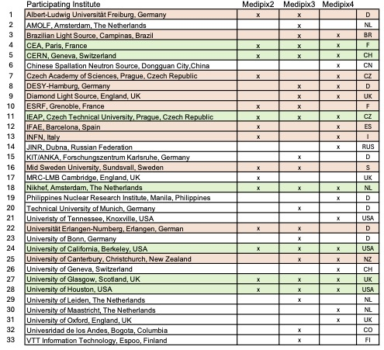
Overview participants Medipix 2 – 3 – 4 collaborations
*1999
*2005
*2016
2025 all still active
7 continuous members
25 from
10 member states
8 from
6 non-member states
17
22

Slide 4
Aim of CERN is elementary particle physics
instruments & expertise in analysis of individual quanta
should be exploited in other fields of science & industry
This is aim of the Medipix Collaborations
applications often slow to become reality
CERN is only one among many participants
Medipix also provides continuity and expertise in
microelectronics ASIC design and silicon technology
for future CERN experiments

Slide 5
Aim of CERN is elementary particle physics
instruments & expertise in analysis of individual quanta
should be exploited in other fields of science & industry
This is aim of the Medipix Collaborations
applications often slow to become reality
CERN is only one among many participants
Medipix also provides continuity and expertise in
microelectronics ASIC design and silicon technology
for future CERN experiments
in the quantumworld particles only exist when they interact
interaction in Si crystal can show who it is, and its kinetic energy

Slide 6
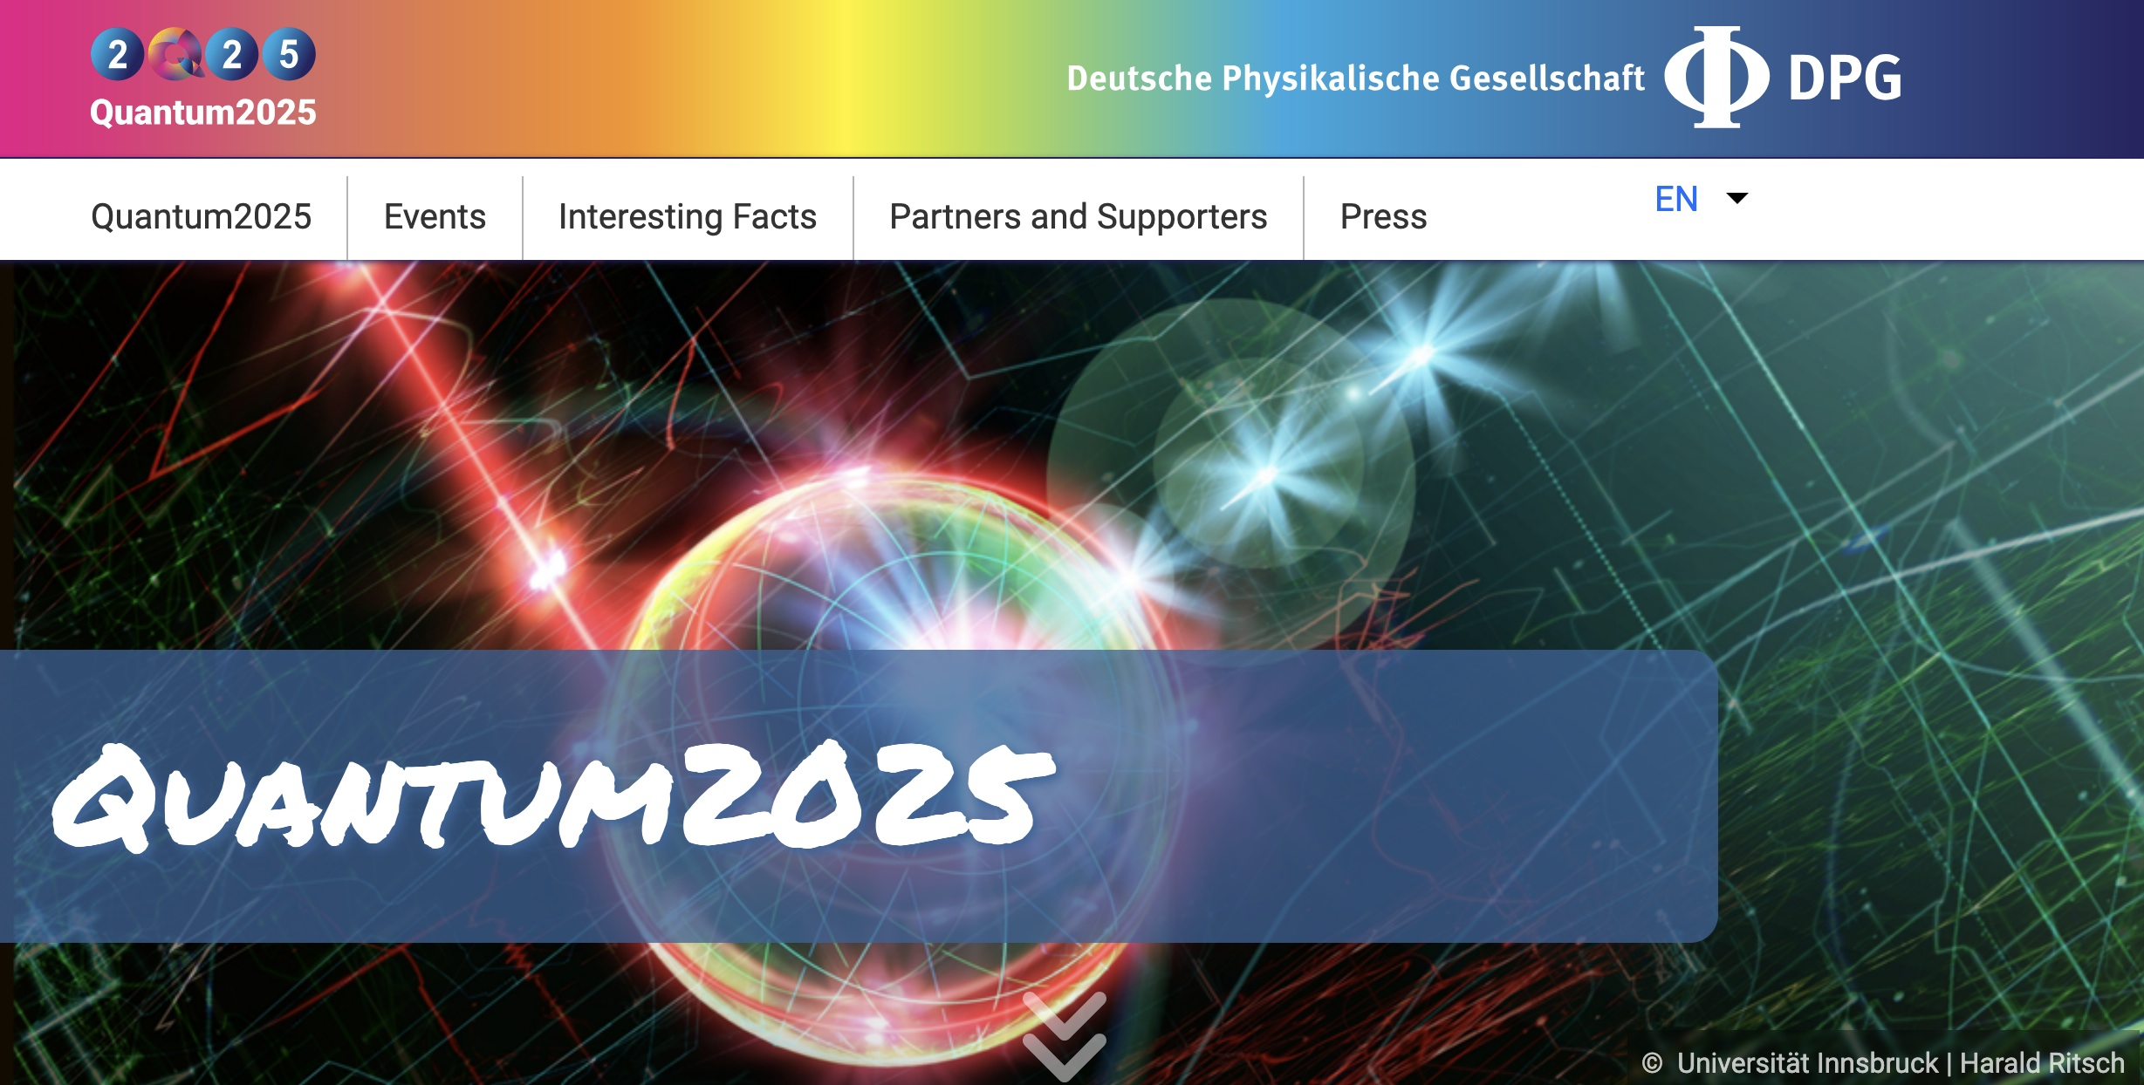
2025 : 100 years of quantum mechanics

Slide 7
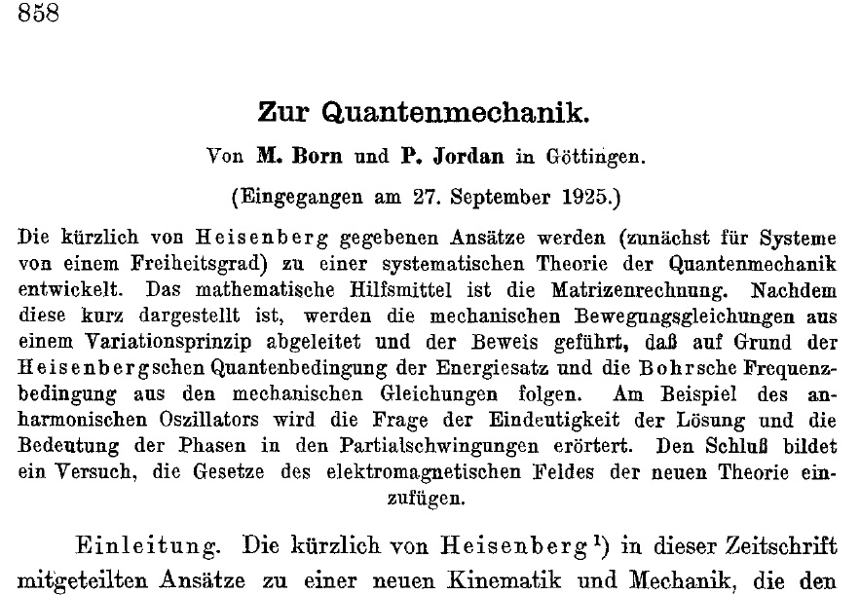
2025 : 100 years of quantum mechanics

Slide 8
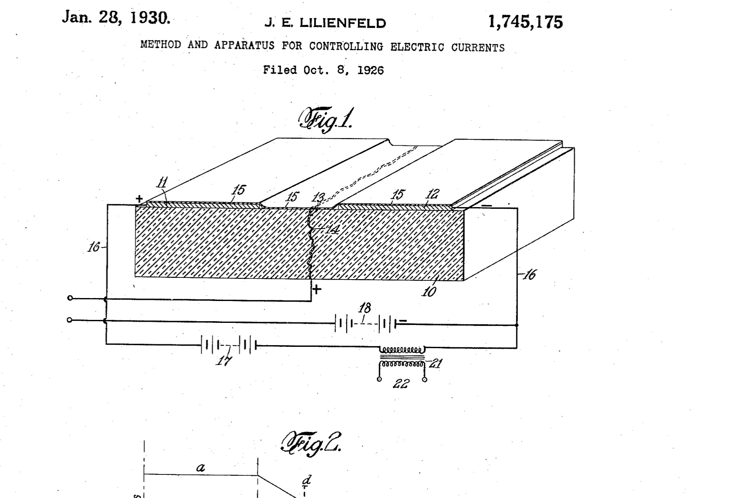

2025 : 100 years of 'Field Effect' current control
submitted 1925
in Canada
his patent led
to continuous efforts
but
only ~ 1960 comes
a working FET transistor
materials (oxide)
problems continue
until ~ 1975
still in 1977
RCA describes
'enclosed FET'
(allows also -> radhard)

Slide 9
history
2005 Collaboration Medipix3 & Timepix
2005 Collaboration Medipix3 & Timepix
20 years
but also 100 years
1925 Quantum mechanics
27 September
1925 Patent on Field Effect Current regulator
Lilienfeld in Canada

Slide 10
Impact of Timepix
study composition of radiation fields
e.g. ATLAS inside & environment
outer space, around nuclear reactor,
identification and properties
use radiation quanta to study materials
medical material, also in-vivo
time-dependent structural behaviour
various modes in electron microscopy
cryo, eels, ...
identification and properties
wider applications than particle tracking

Slide 11
monolithic particle tracking vs quantum analysis with hybrid Timepix
tracking detector
origin of the single quantum detectors
thin sensor layer is better
may use monolithic design limited signal processing?
matrix of small pixels
quantum analysis 'hybrid' imager Timepix
hybrid stack allows different semiconductor sensors
thick sensor layer allows better energy measurement
and better stopping power for γ photons
thickness > 10x pixel pitch gives typical cluster shapes
on-pixel ADC
<100ps timestamp gives 3D position of charge generation
readout chip in nm CMOS node: more processing power
more to come ...

Slide 12
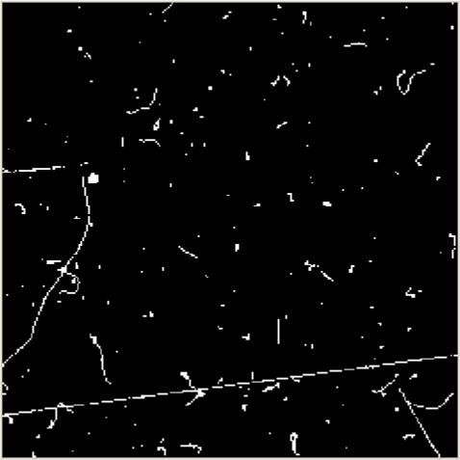
from 2000 Medipix hybrid detector identifies particles
256 x 256 pixels
sensor matrix 300 µm
pixels count 'hits'
can be dosimeter
e⁻
Identifies Quanta
electron
photon
MIP (muon)
alpha's from decay
neutron
via interaction -> alpha
n->α
photon
muon
energetic e⁻
a pixel records up to 16k hits
in adjustable exposure time
ms – minutes - days
gives large dynamic range
frame from IEAP CTU Prague

Slide 13
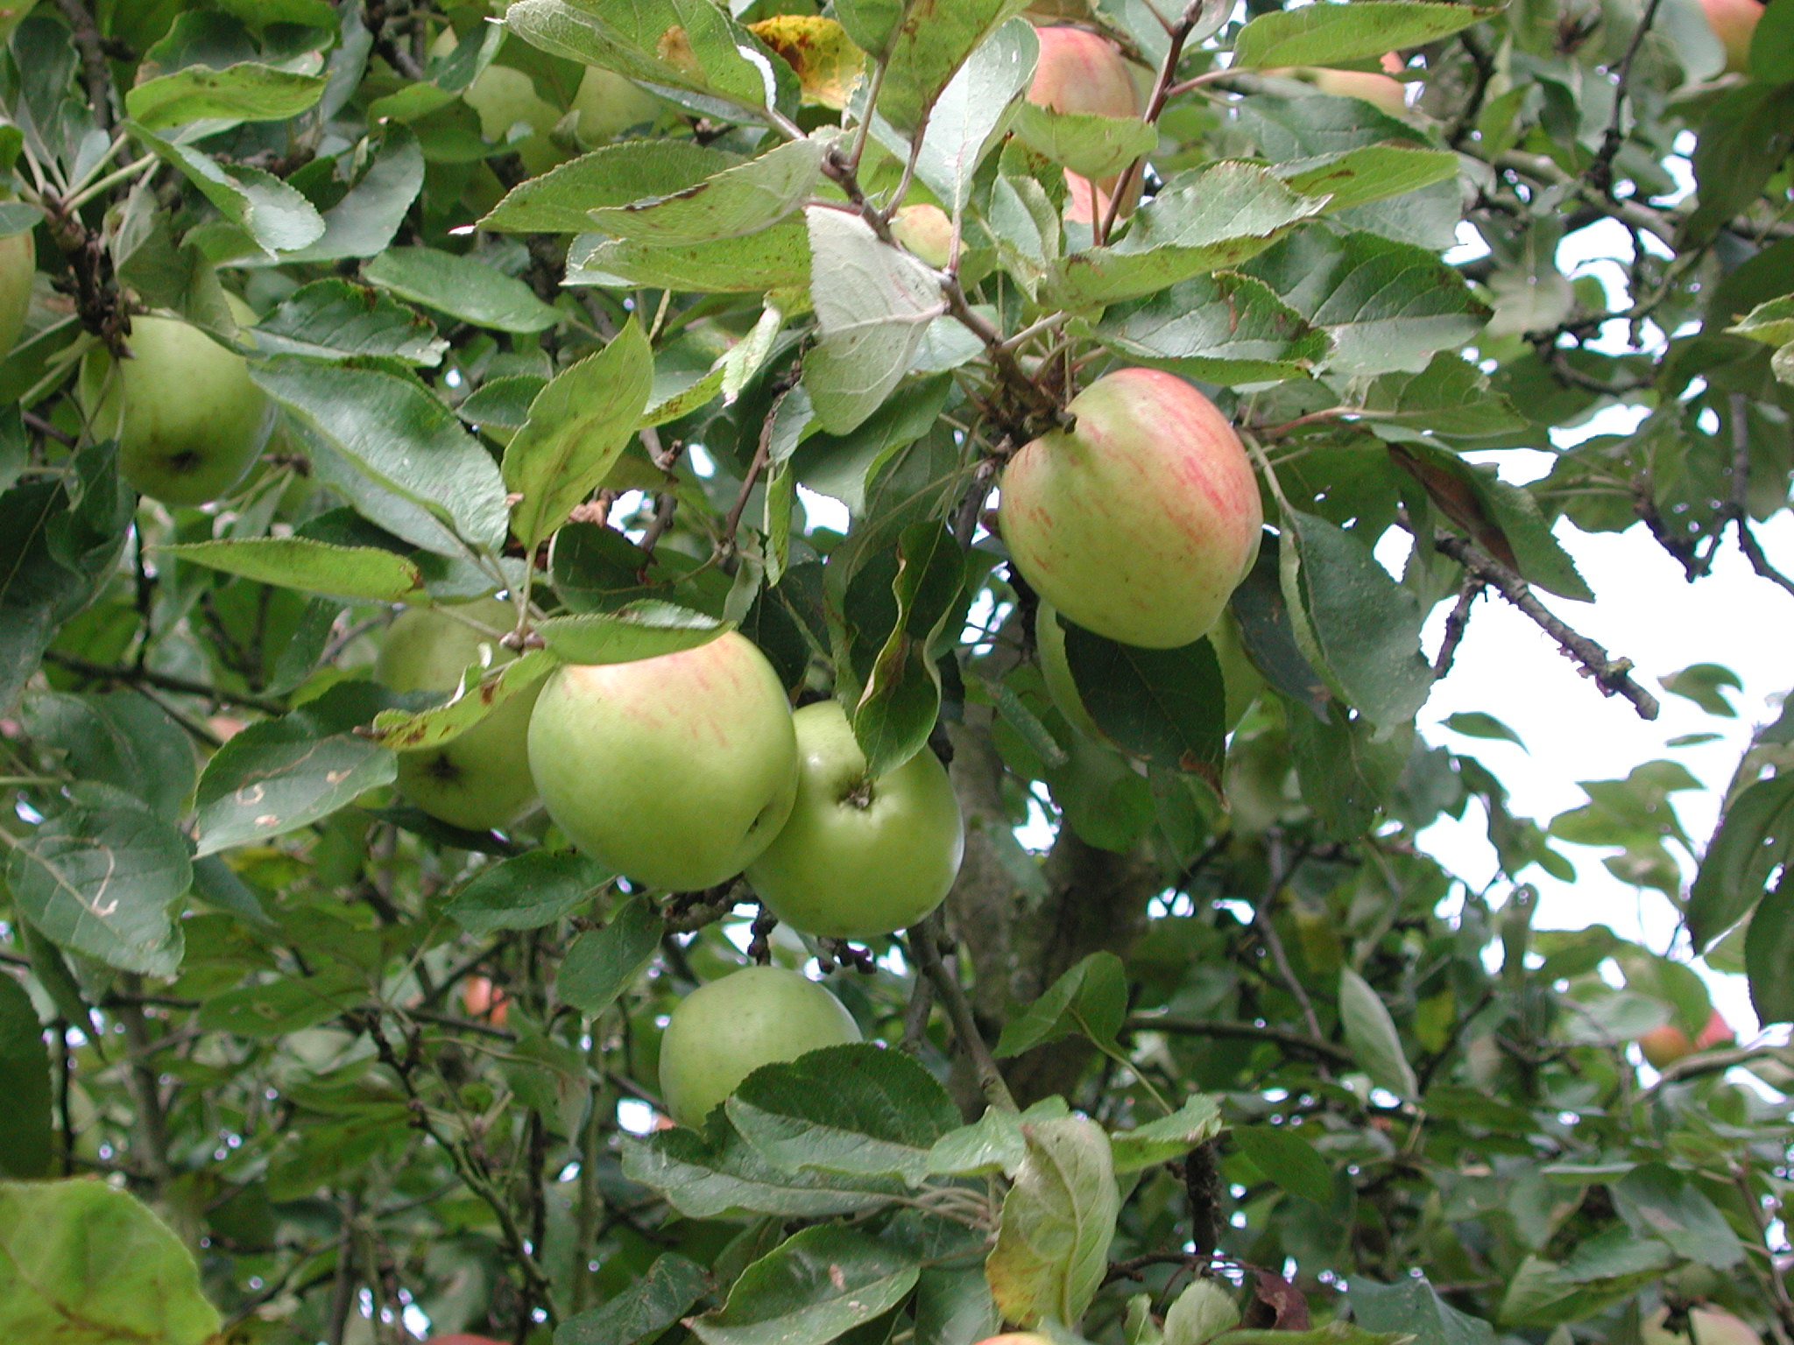
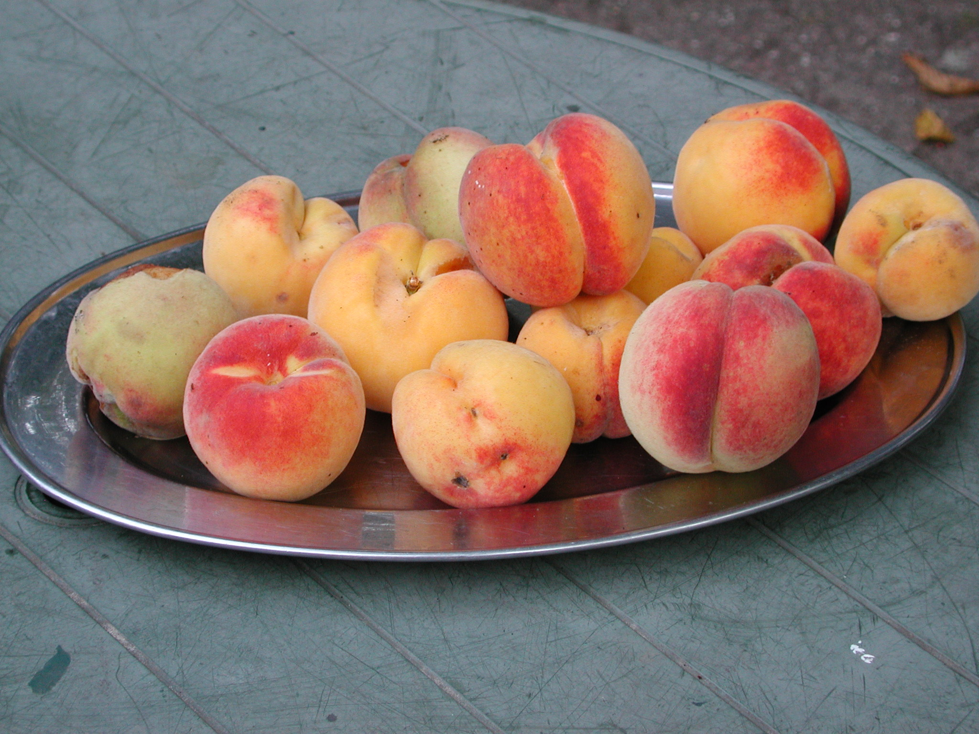
eyes see shapes and colours
distinguishing shapes and colors
important factor in human survival

Slide 14
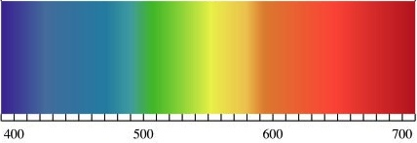
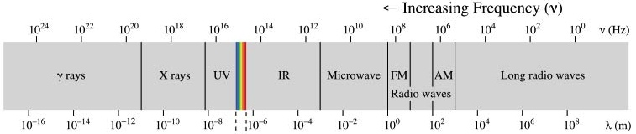
Extended E.M. Radiation Spectrum
‘visible’
for humans
absorption depth in Si
“transparent” if λ >1200nm
<1µm
<4µm
<8µm
Si
Si
Ge
detect
CdTe
domain
Si sensitive
domains
resonant electronic circuits
to determine photon energy
X-
vis
1MeV
1keV
1eV

Slide 15
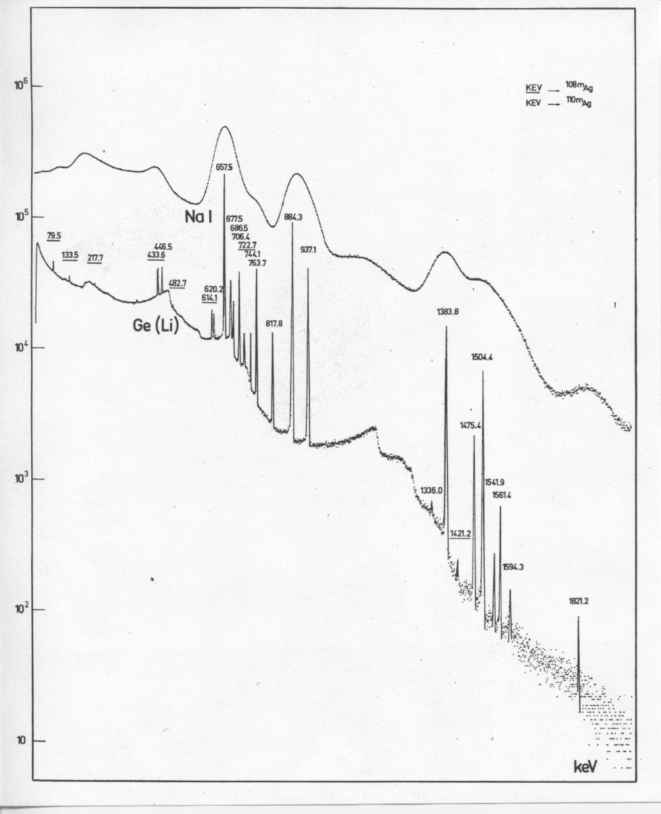
Comparison of Germanium with Sodium Iodide for gamma-ray spectra of silver 108 & 110 ^{108m}Ag ^{110m}Ag
^{108m}Ag ^{110m}Ag
semiconductor detectors
enable characterization of
electronic & nuclear signatures
of elements.
photon energy = 'colour'
Ge covers higher γ energies
than Si, and is more precise
alternative for long wavelength:
frequency/ 'colour' can be
determined with
resonant electronic circuit
PRESENTATION Veljko RADEKA
DESY WORKSHOP Oct 2008
1821.2 keV

Slide 16
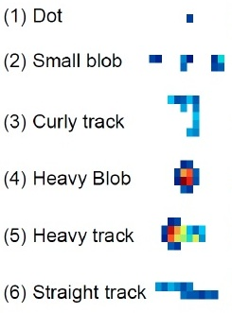
characteristic cluster patterns in Timepix
Photons and electrons (10keV)
Photons and electrons (~100keV
Electrons (MeV range)
Heavy ionizing particles with short range (alpha particles,…)
Heavy energetic ionizing particles (MeV protons,nuclei, Fe, …)
Energetic light charged particles (MIP, Muons,…)

Slide 17
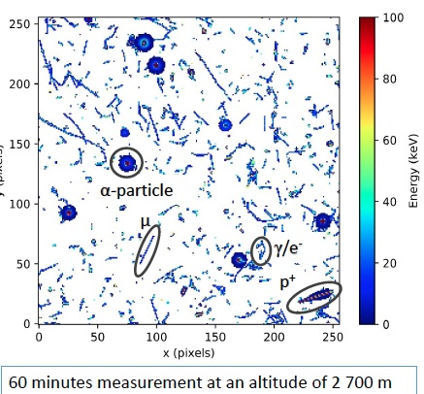
2007 Timepix hybrid detector can analyze quanta
256 x 256 pixels
sensor matrix Si, GaAs, CdTe,.
pixels can analyze
amplitudes & timing
e⁻
Identifies Quanta
electron
photon
MIP (muon)
alpha's from decay
neutron
via interaction -> alpha
ion (proton or heavier)
n->α
photon
muon
energetic e⁻
this frame again
from IEAP CTU Prague

Slide 18
pixel detectors and femtoworld
nanoelectronics technology approaches
dimensions of molecules and atoms
interactions of elementary quanta with the
silicon devices reveal basic mechanisms
nanoscopy with electrons or protons
excitations in electronic Si crystal structure
tiny changes in charge become measurable
on 1 attofarad capacitance 1 electron produces ~100mV

Slide 19
'Electronic' emulsion
Medipix and Timepix
provide information on single quanta
particles – photons
comparable to old-fashioned
photographic plate or nuclear emulsion
orders of magnitude faster
timestamp, amplitude in each pixel
information within µs available
can directly be stored electronically
searchable data
etc.
not yet matching spatial precision

Slide 20
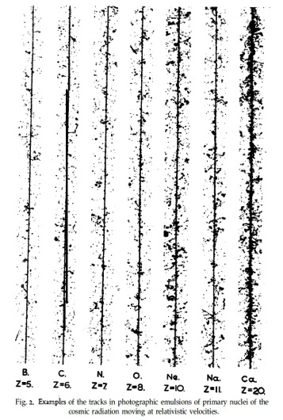
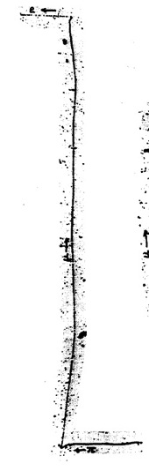
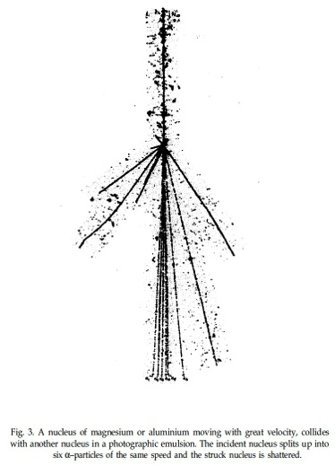
discoveries in photographic emulsion
1935 – 1965 Illford Ltd Kodak "nuclear emulsions"
Cecil Powell : 1946 pion discovery Nobel 1950
incoming
Mg or Al
nuclear
interaction
π-µ-e
ions in cosmic rays,
balloons/mountains
Powell, Fowler & Perkins- Pergamon 1959
6 x α
in cosmic
radiation
Z= 5
6
7
8
10
11
20
20 µm

Slide 21
first steps with silicon at CERN
PS/ SPS neutrino beam – energy spectrum measurement

Slide 22
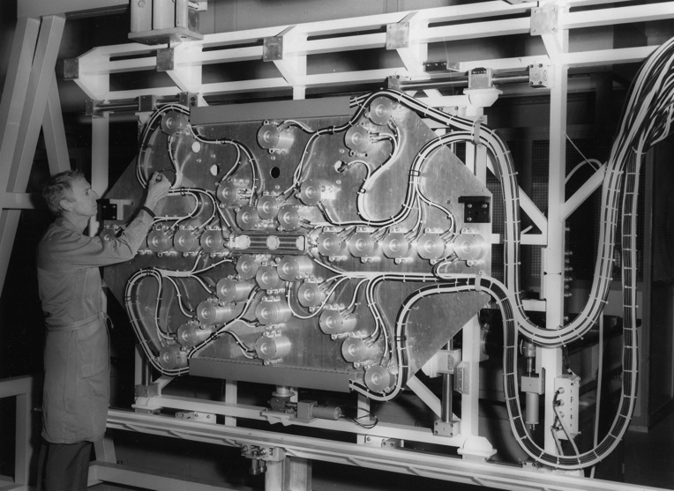
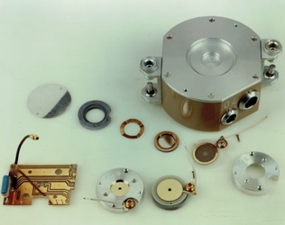
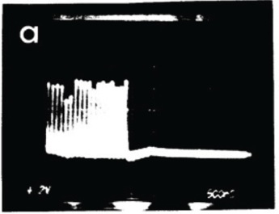
Muon flux integration with Si detectors 1975
SPS typical density 10⁶ cm⁻² in 23µs
6 planes in
underground Fe shield
each with
~40 Si diodes
~ 1cm²
relative calibration
by moving box
absolute calibration
by nuclear emulsion
SPS neutrino beam profile monitoring
integrate
2.5 µs beam
18 bunches
PS beam

Slide 23
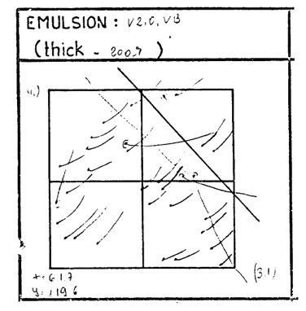
measure intense muon flux (bunches of 10 ns)
Calibration of the Si diode detectors
counting tracks in a nuclear emulsion
on moveable reference box
typically 10⁶ cm⁻² muons
signal current from each diode
is integrated during 20 µs or 2ms
calibration problem: not only muons
also ~20% delta-electrons
can these be distinguished electronically ?
different shape, angular distribution
'dream' to give them different 'colours'
~50µm

Slide 24
working with silicon
can we do more with silicon technology ?
make extremely small detectors for high rate
how to implement amplifier circuits in ASIC ?

Slide 25
history
1978
looking into microelectronics
with Pierre Jarron
surprising photo in trade journal:
one square micron
in future
could contain lots of electronic processing

Slide 26
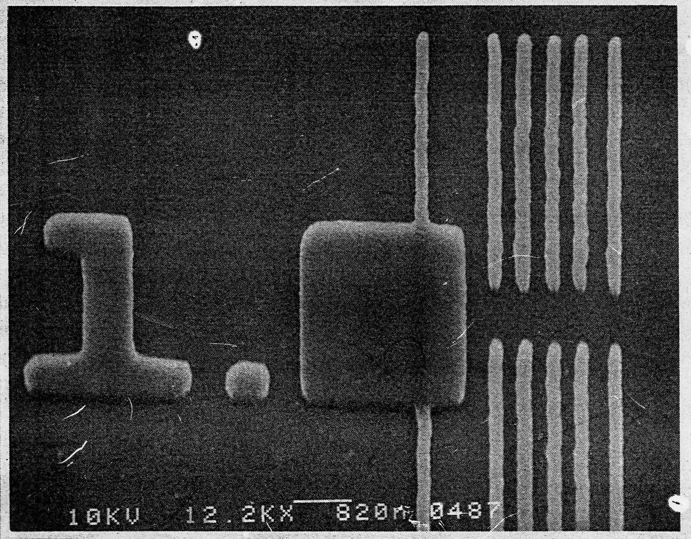
MICROELECTRONICS
MICROSTRIP DETECTORS :
PATENTS ~ 1965 “CHECKER BOARD” PHILIPS
NOT MUCH USED BY LACK OF COMPACT READOUT
one square micron
early proton lithography
PROJECTIVE ION-BEAM ETCHING
0.15 µm LINES on 8mmx8mm FIELD
VIENNA, HOUSTON ~ 1988
TRUE 2-D SENSORS MUCH BETTER

Slide 27
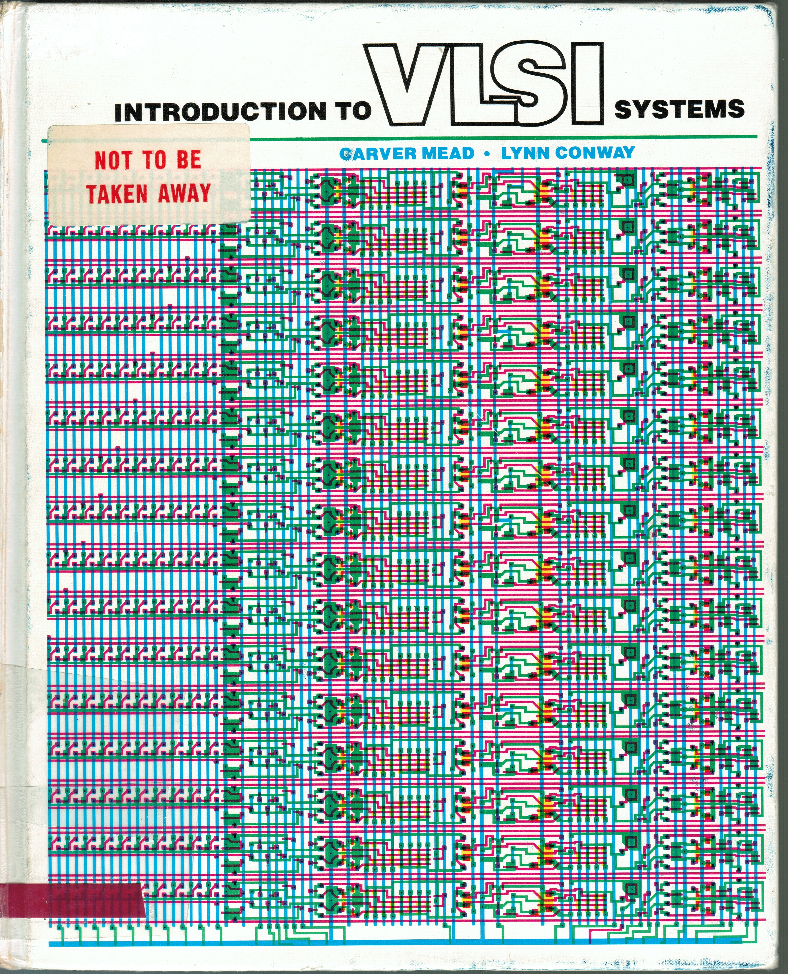
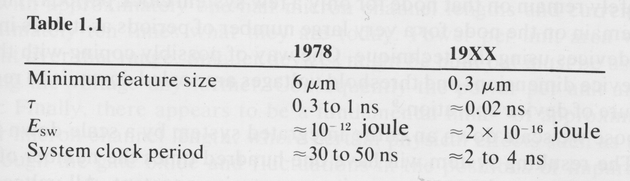
~ 1979 Mead-Conway 'revolution'
Carver Mead & Lynn Conway
Caltech – PARC Xerox Pasadena / Palo Alto
Introduction to VLSI systems
Addison-Wesley 1979 ISBN 0-201-04358-0
nMOS layouts- extensive circuits etc.
Course & MPW exercises at MIT
start of 'revolution' in ASIC

Slide 28
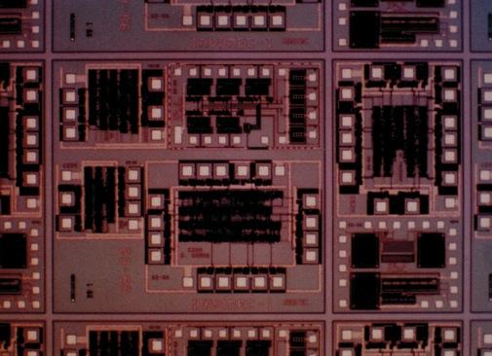
now real need for ASIC design 'in-house' CERN multi-project chip 1986
in collaboration with
IMEC Leuven (B)
Carl Das & Bart DeMey
3µm CMOS
MIETEC, Oudenaarde (B)
chip with circuits by:
Björn Hallgren
Pierre Jarron
Mike Letheren
George McPherson
+ Alessandro Marchioro
Bert van Koningsveld
2 weeks training in Leuven
+ leased telephone-line (25kCHF !)
to access IMEC design software

Slide 29
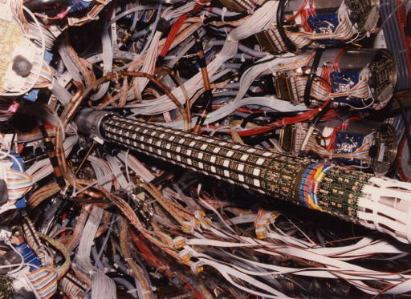
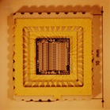
Hermetic Si pad detector for UA2
Cylindrical detector array
collaboration with
Claus Gößling and Alan Clark
U. Dortmund, U. Genève
FIRST Si barrel detector
in collider experiment
FIRST Si array with
ASIC chip readout
~5 mm thin CYLINDER around beam pipe
ONLY POSSIBLE using "AMPLEX" chip
16-channel circuit design Pierre Jarron + collaboration IMEC
R. Ansari et al. NIMA279(1989) 388
1986 – 1988 start of LAA microelectronics project

Slide 30
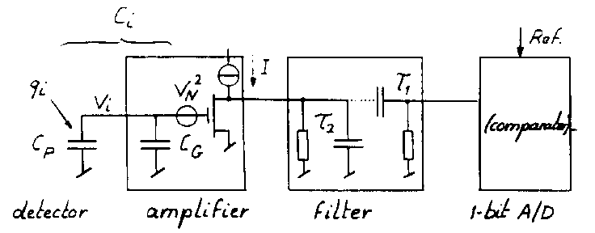
Signal processing possible in each pixel 1988 ?
Schematic Diagram
sketch by prof Eric Vittoz, EPFL & CSEM
for the 1988 Leuven Pixel Workshop
NIM A275 (1989) 472

Slide 31
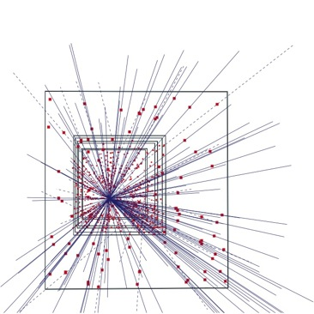
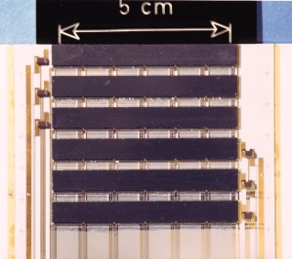
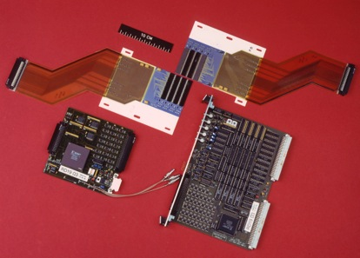
RD19 pixel telescope in Omega WA94
Si detectors quickly adopted in experiments
high density
high rate
no noise hits
µm precision
'thin' detectors
~1995

Slide 32
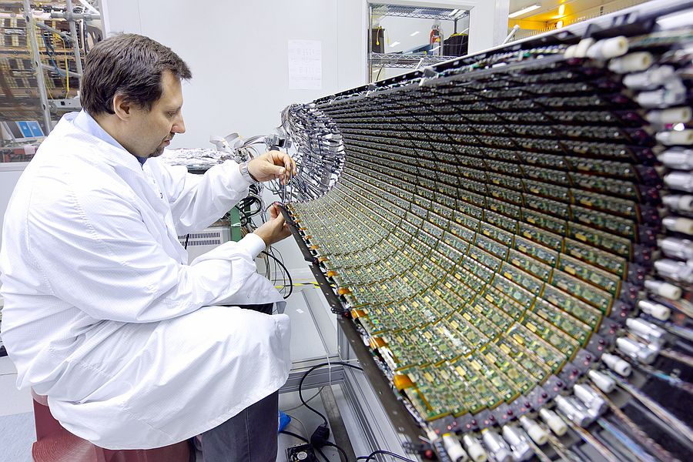
applied in ATLAS & CMS innermost Si pixel layer
~2007
source: CERN- ATLAS

Slide 33
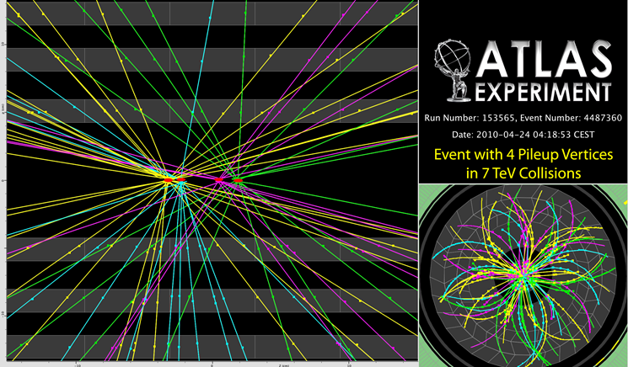
Reconstruction uses 3->4 ->5 inner pixel layers
ATLAS pixel detector - crossing with 4 interactions
2010
10cm
early
6.6cm
now
4.8cm
now
early 7cm
vacuum beam pipe
source: CERN- ATLAS

Slide 34
particles at high density high rate can now be recorded with segmented detectors
muon flux at ν-SPS was ~10⁶ cm⁻² in 10µs spill
~30 hits on 50µmx50µm ' instantaneous' 10¹¹ cm⁻² s⁻¹
comparable to X-ray photon flux
medical imaging with pulsed source
CT 120kVp ~10⁹ cm⁻² s⁻¹
often ms exposures used
LHC experiments continuously, 3.2x10⁷ pulses s⁻¹ 40MHz
6x10⁸ collisions ~10¹⁰ tracks s⁻¹ on 0.2m² inner pixels
ATLAS pixel is 50x250µm total inner layer 16 million pixels
then ~ 100 – 1000 hits per pixel per second
~1970 only charge integration is possible
from ~2000 photon counting is discussed
close to vertex the pixel detectors are only solution
still low probability of overlap

Slide 35
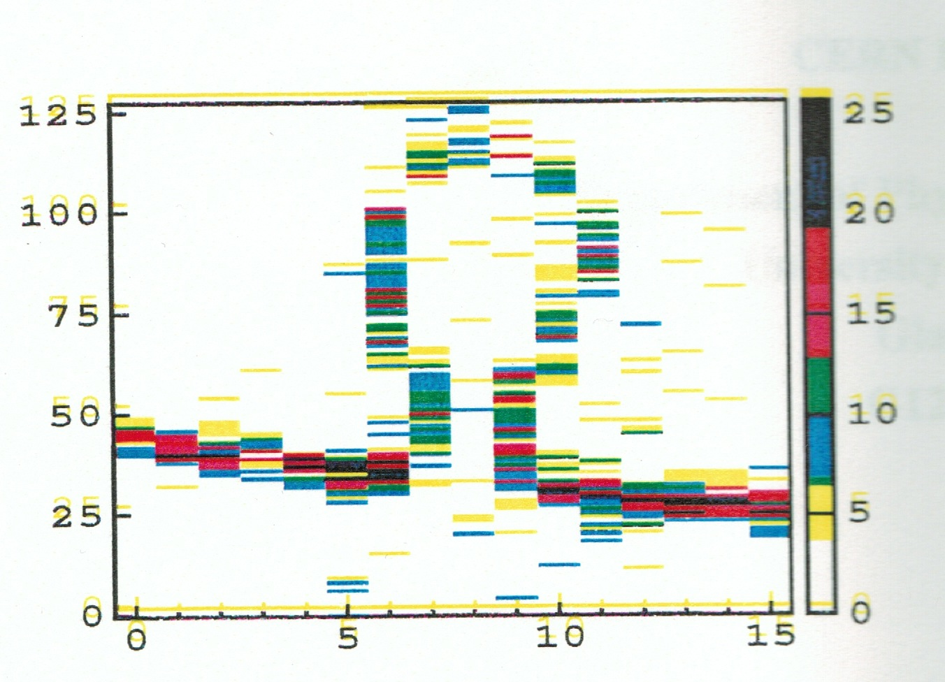
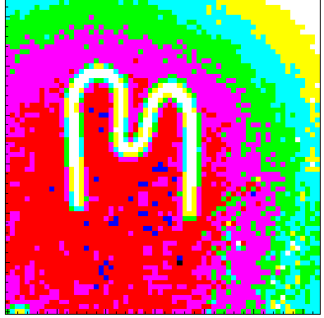
history
some PhD students at CERN experimented
with the Omega detector and radioactive sources
to look at objects instead of particle tracking
Cinzia da Via used a 0.5mm steel wire bent as Ω
Bettina Mikulec imaged M on the PCC chip
~1998
not yet 'Medipix' started ~1996
in a common effort with INFN Pisa
resulted in the Photon Counting Chip PCC
soon joined by
Freiburg and Glasgow Universities
working on hybridization with GaAs sensor for conversion efficiency

Slide 36
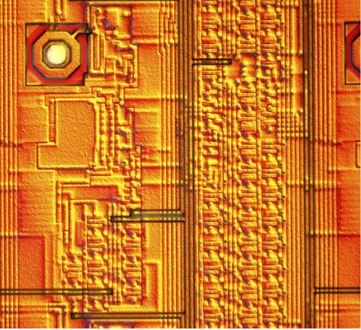
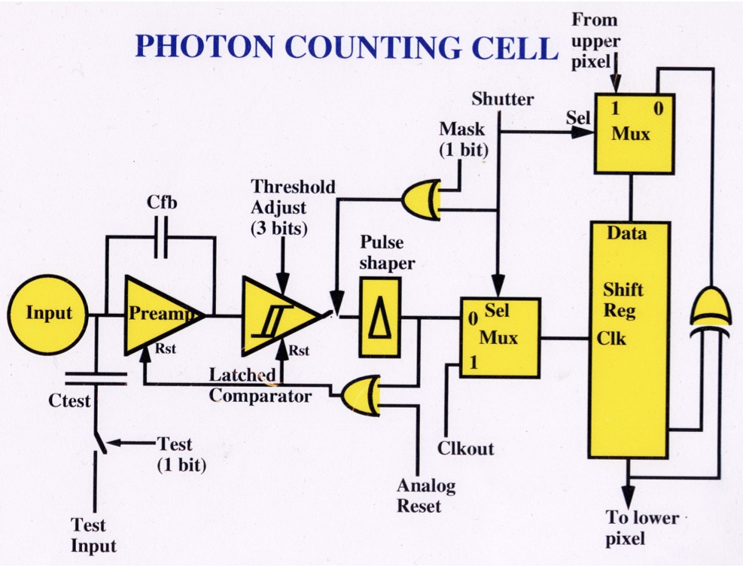
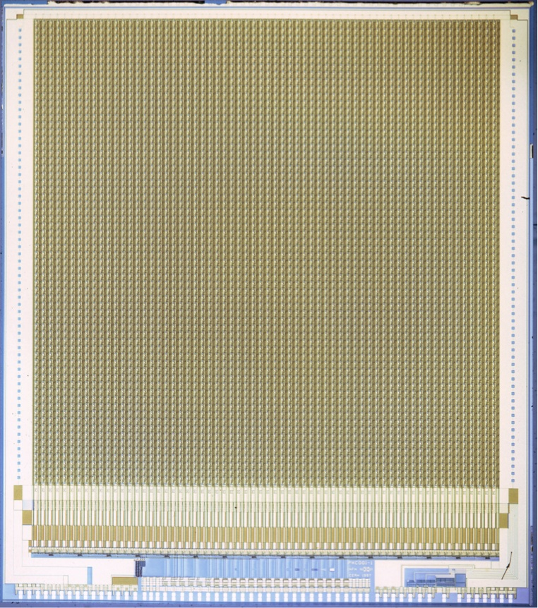
1997 imaging chip follows particle tracking chips
A Readout Chip for a 64 x 64 Pixel Matrix
with 15-bit Single Photon Counting PCC
M. Campbell, E.H.M. Heijne, G. Meddeler, E. Pernigotti, W. Snoeys
IEEE Trans. Nucl. Sci. 45 (1998) 751-753
pixel size 170µm x 170µm only counting, single threshold
64 x 64
10.9 mm

Slide 37
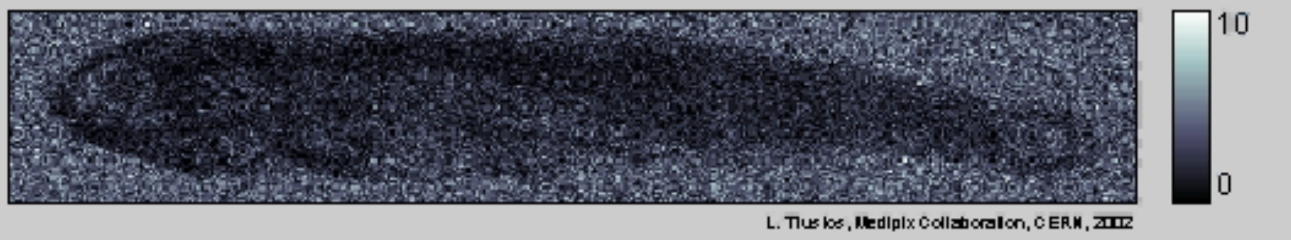
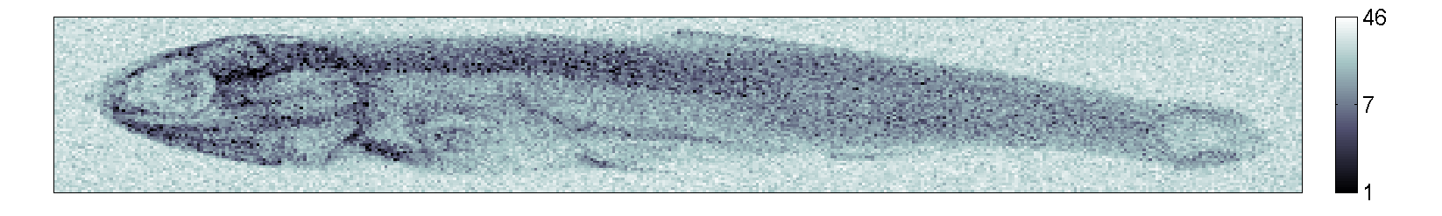
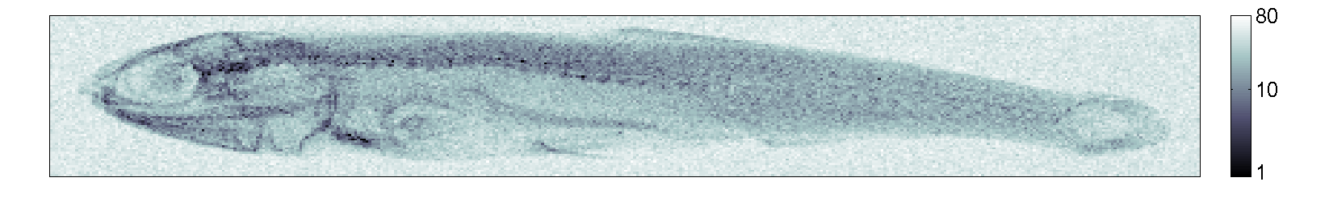
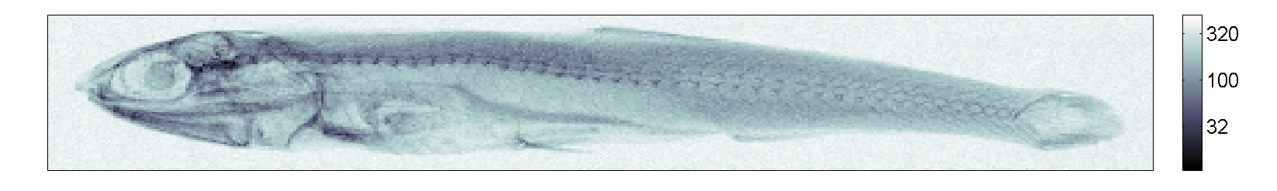
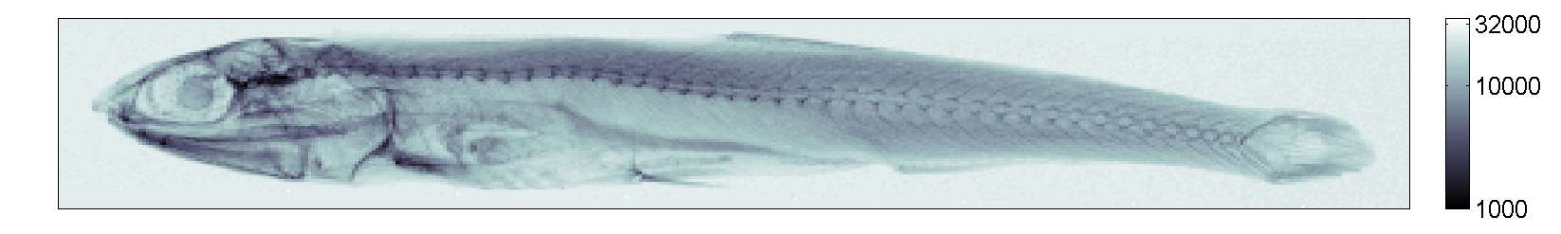
Lukas Tlustos 2002 photon counting chip PCC

Slide 38
Lukas Tlustos 2002 photon counting chip PCC
illustrated progressive photon counting
and improving image quality – still white/black

Slide 39
1999 formal start Medipix
Michael Campbell proposes dedicated effort
towards photon counting chip
with medical imaging in mind
this will independently build on RD19 expertise
and extend scope, using 0.25µm CMOS
aiming at 'small' pixels, large 3-sides buttable matrix
and more signal processing: 2 thresholds

Slide 40
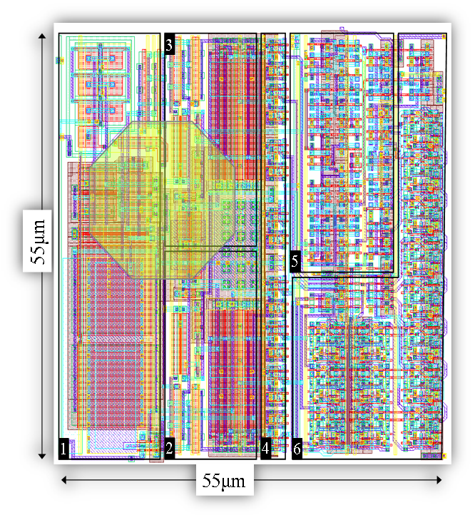
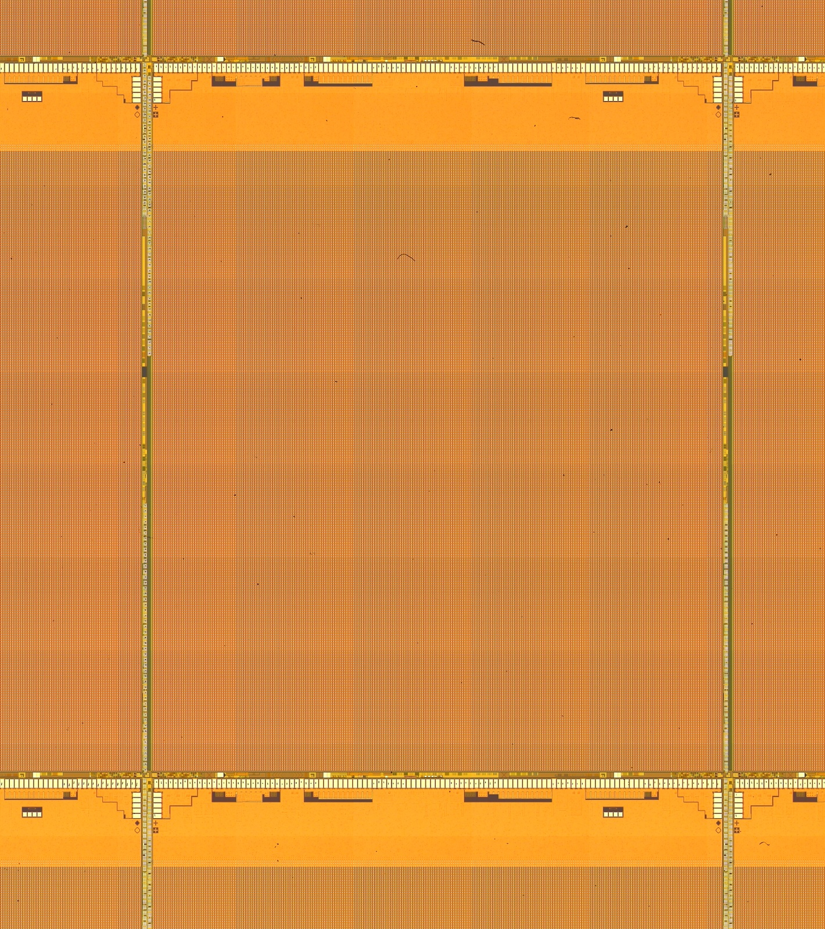
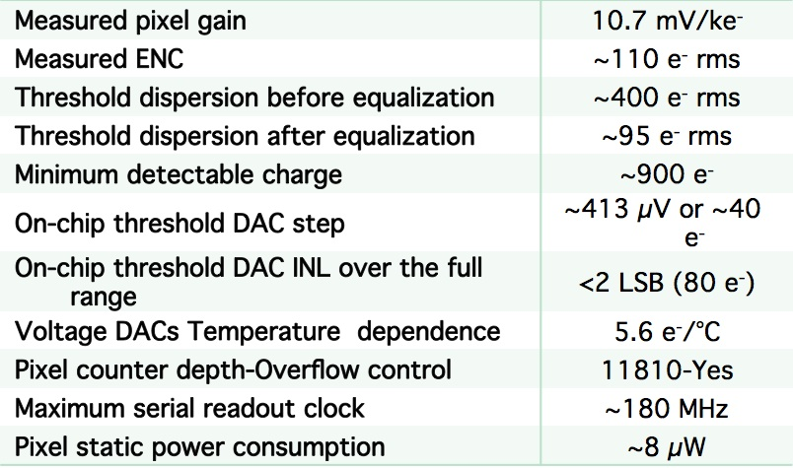
Medipix2: Mpix2MXR20 (iteration 2005)
14111 µm

Slide 41
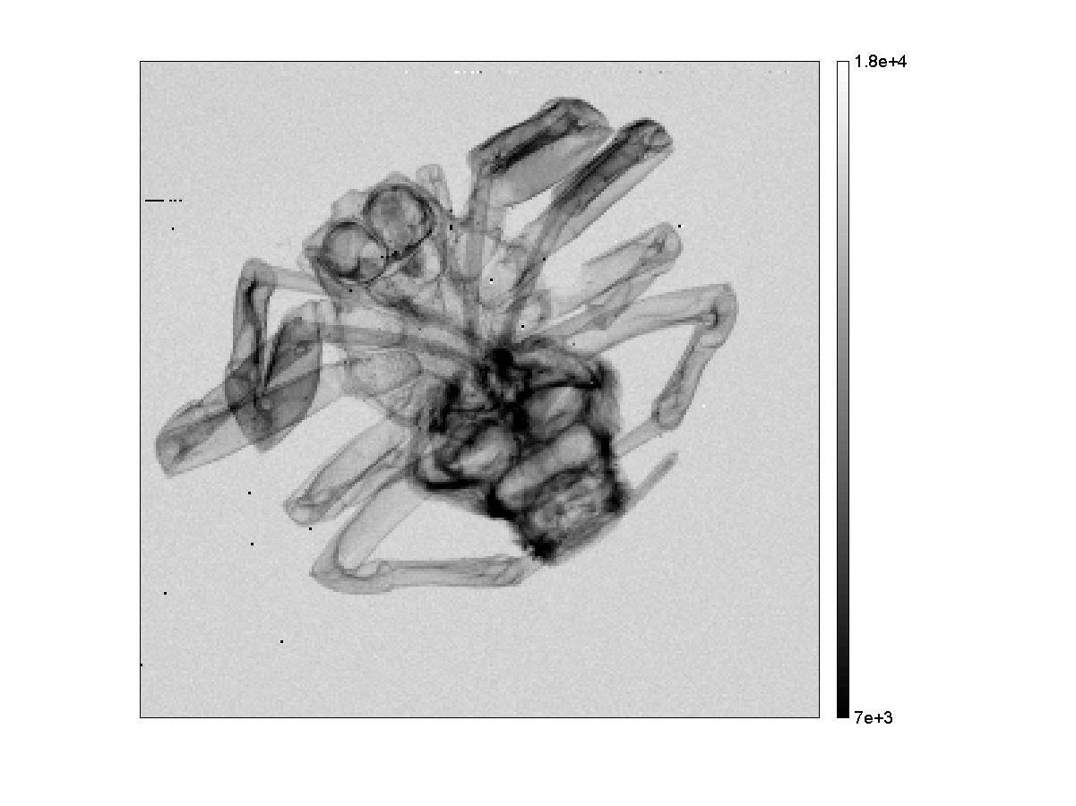
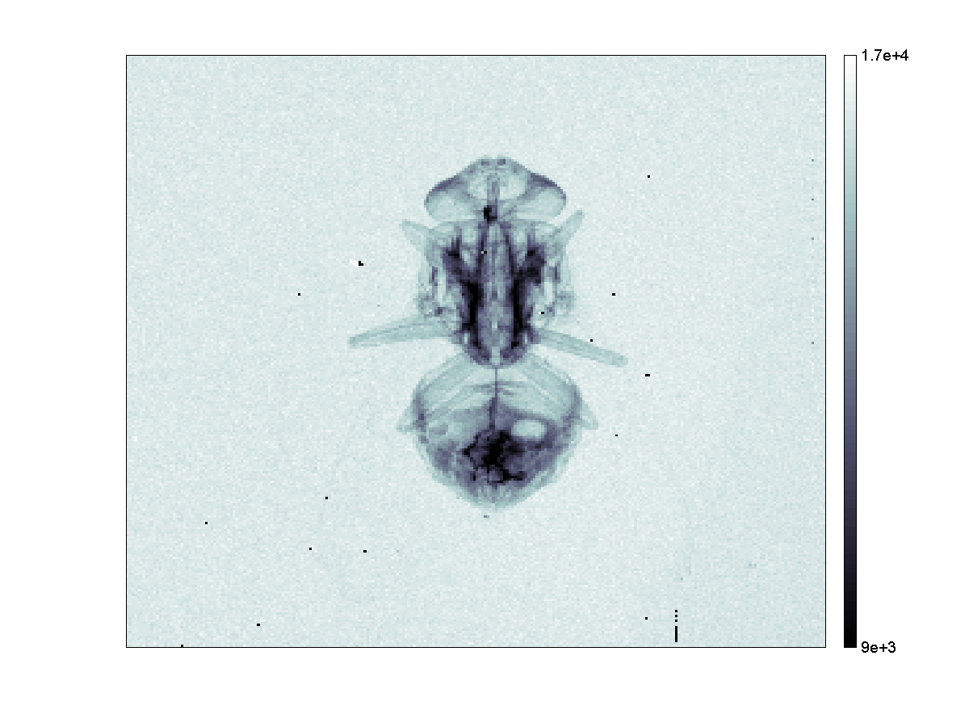
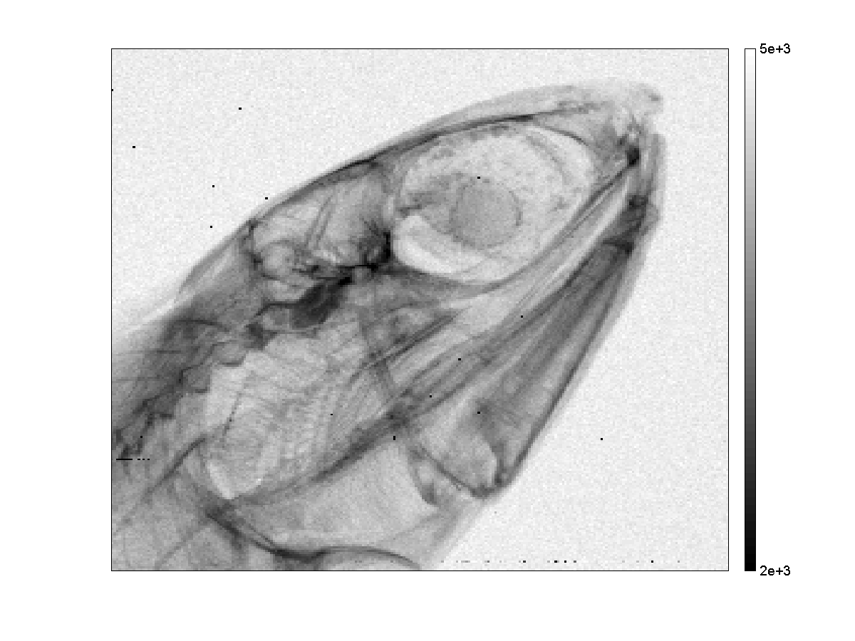
early images Medipix Si assembly
Narrow threshold distribution and
± narrow spectra
8-14kV, 15-35kV
125μm Al FOIL
5mm PMMA
THRESHOLD EQUALIZATION
FLAT-FIELD CORRECTIONS
APPLIED
Lukas Tlustos, CERN

Slide 42
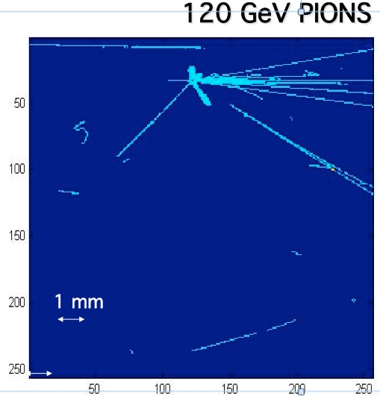
pixel devices in beam and lab
exposing the Medipix device in a particle beam
there is no use for the 14-bit register
only 0's and 1's
mentioning this while at Nikhef:
Jan Visschers suggests to send the clock to all pixels
and record arrival time by counting until the stop
Jan Timmermans comes in, and immediately
wants this chip for drift measurement in gas-filled TPC
Harry van de Graaf already showed naked chips to get signals
Xavi Llopart is new designer at CERN and is asked
to modify the Medipix design in this sense
Xavi then adds a Wilkinson-type ADC in-pixel as well.

Slide 43
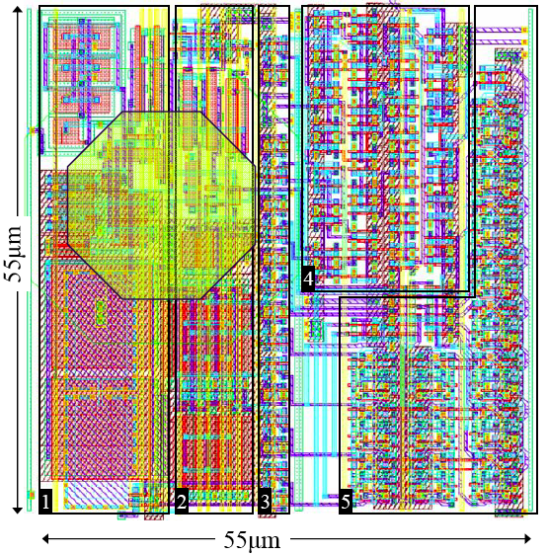
TIMEPIX CELL LAYOUT
DESIGNER
first Timepix
Xavier LLOPART
CERN
PhD Thesis p. 107
Sundsvall 2007
1. PREAMPLIFIER CSA
2. THRESHOLD, 4-BIT TUNING
3. 8-BIT CONF REGISTER
4. REF_CLK & SYNCHR LOGIC
5. 14-BIT COUNTER

Slide 44
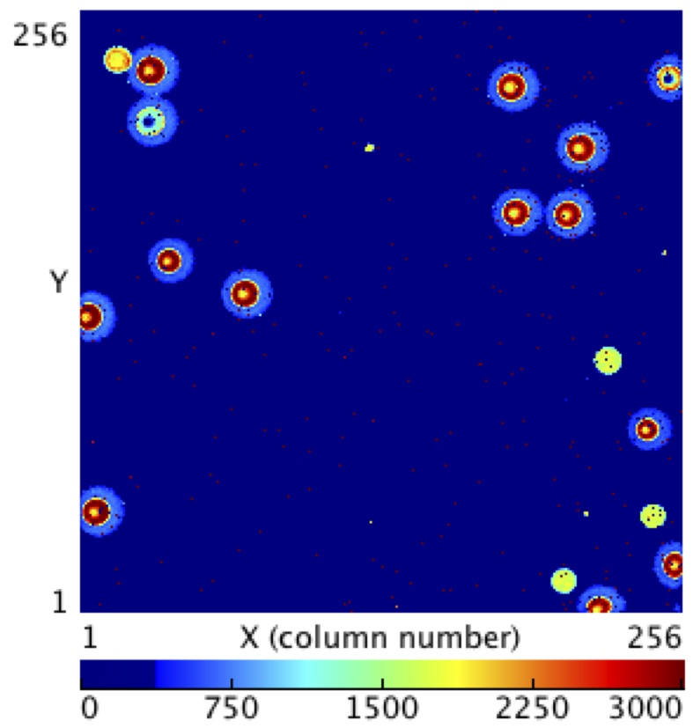

Timepix can distinguish different particles/quanta
also many ion studies
by Houston/NASA
Pinsky+Tlustos cs.
CERN high energy ion beam 2013
different ions at perpendicular incidence
CERN high energy ion beam 2013
- lead ion Pb grazing angle
+many delta electrons
center saturated
- lighter unknown ion

Slide 45
3 generations of Timepix discribed later
by now numerous applications
and Timepix is starting point for new tracking chips in LHC

Slide 46






dosimetry at the Int Space Station ISS
4s Timepix exposure
taken in ISS
passing through SAA
South Atlantic Anomaly

Slide 47




dosimetry with TPX on ESA satellite Proba-V
frames in LEO orbit ~800km,
different positions
courtesy Carlos Granja IEAP-CTU (2015)
ion track with ∂ electrons

Slide 48



progress in X-ray images: 1998 - 2019
Lukas Tlustos 2001
photon counting
a fly on first PCC
MARS Bio imaging Canterbury NZ
exposure with single photon analysis
X-ray CT using Medipix3
no distortion by the metal
more advanced processing of single photons
full potential finally begins to be exploited

Slide 49
Thank You

Slide 50
Electronics vs Nature ?
microelectronics
mankind's invention, clearly 'nice' but
needs electricity=artificial power, brute force, not sustainable, .....
nature
efficient processes just there
use of sunlight & chemistry (electro-chemistry)
incredible density of information
reproducibility built-in duplication
energy efficiency
built-in recycling,... ..
one example in nature:
makes + installs each spring ~10³⁵ (?) solar cells
these provide energy + also store it in wood for future
they are disposed of, and recycled within the year

Slide 51
Spares

Slide 52

Ionization different in crystals with quantum bandgap structure
EELS Electron Energy Loss Spectroscopy
VERY thin sample: few nm
drawings from Gatan – Ametek
https://eels.info/about/overview
use magnetic deflection behind TEM
until now mostly use CCD

Slide 53

Ionization different in crystals with quantum bandgap structure
EELS Electron Energy Loss Spectroscopy
many ways to use scattered electrons
VERY thin sample: few nm
energy spectrum of the loss in eV
of transmitted electrons
drawings from Gatan – Ametek
https://eels.info/about/overview
use magnetic deflection behind TEM
until now mostly use CCD

Slide 54
often many years until applications
1868 Lockyer spectroscopic discovery of helium
1895 Röntgen X-rays immediately exploited
1896 Becquerel radioactivity shows up in photoplates
1900 Planck quantization of black body radiation
1905 Einstein minimum energy needed to ionize
Ruherford-Bohr hydrogen atom model
1925 Heisenberg-Born formal quantum mechanics
1925 Lilienfeld patent field effect current regulator
1932 Chadwick discovery of neutron
1946 Powell discovery of pion
+ many other milestones

Slide 55


Si Microstrip detector
segmentation, full signal processing connected to each element
including ADC, memory and transmission
conceived at 1979 IEEE-Nuclear Science Symposium in San Francisco implemented in collaboration at Enertec, Strasbourg, February 1980
first test setup CERN May 1980 2009 VELO tracker in LHCb

Slide 56

Pasadena Caltech
Carver Mead
ISSCC 2013 https://www.youtube.com/watch?v=pwh1Sakio8s The evolution of technology
various talks on Youtube
microelectronics and
technology in general
1979 started 'revolution' in ASIC

Slide 57






segmented Si detectors need readout chips ~1985
SLAC/(DELPHI)
Microplex 1983
Walker, Parker, Hyams, Shapiro
NIM A226 (1984) 200
Chips NOT to scale
CDF-SVX Kleinfelder 1988
Kleinfelder et al. IEEE TNS 35(1988) 171
CAMEX64/ALEPH-MPI
Buttler, Lutz, Hosticka
Becker et al. IEEE TNS 36(1989) 246
RAL/DELPHI
MX1 MX2 1987
Seller, Allport, Tyndel
IEEE TNS 35(1988) 176
AMPLEX (UA2)
Pierre Jarron 1987
classical, continuous feedback
actually the first in a collider:1988
Beuville et al. NIM A288 (1990) 157

Slide 58


Experiments exploit electronics
1967
2008
BOL experiment at IKO, Amsterdam,
operational ~1966-73
insertion of the CMS Si tracker;
a few people stand by,
operational 2008-now

Slide 59
some history of detectors
led to discovery of elementary particles :
photographic plates most precise, dE/dx
elaborate processing
Wilson cloud chamber
gas-filled ionization chamber
spark chamber
bubble chamber
silicon pixel detector ?

Slide 60
pixel detector / micropattern detector
detector OF patterns that are characteristic for each particle
NOT: detector WITH created/imprinted patterns
obvious confusion with the previous 'microstrip detector'
therefore: naming not widely accepted

Slide 61


Timepix3 Timepix4 radiation imager 65536 ADC+TDC 229378 ADC+TDC
Increasing complexity & functionality
2021 Timepix4 faster, lower power, larger area,..
24.64
timestamps
< 200ps
14.1
448x512
28.16
256x256

Slide 62


Typical Muon Trails with ∂-electrons ...
T3-1500
T3-1504
T3-1507

Slide 63

Si detectors and electronics in our team 1970 - 2024
2007 Timepix
65536 diodes
with circuits in USB stick
2023 Timepix4 229 376 diodes
with circuits
and TSV connect
1978 2 diodes
and circuits in smaller box
2007
2023
1978
1988 AMPLEX
chips for
readout of
16 pad diodes
10cm CMOS wafer
~1967 large diodes
only one in each box
1987
1967

Slide 64


Timepix to replace'classical' methods
molecular mass spectrometry
'traditionally' by very slow gel-electrophoresis
synchrotron X-ray diffraction
'traditionally' by photography
real-time recording
can follow sample degradation

Slide 65

silicon for DNA analysis
Crick & Watson used DNA single crystal and X-ray diffraction photography
limited structural analysis
nano CMOS technology using ion-sensitive FET:
now the "lab-on-silicon-chip" changes everything

Slide 66

slide J. Rothberg, plenary 1.3 –IEEE-ISSCC 2017

Slide 67
A million years of humanity progress characterized by use of materials and tools dating often based on nuclear physics techniques
Stone Age : paleo/meso/neolithic
tools of flint (silex = 'dirty' quartz-SiO₂ )
Pottery Age
art, ceramic vessels allow cooking and storing food
Bronze Age
begin of processing metals: weapons and art
Iron Age
heavy tools, constructions and transportation
Silicon Age ('anthropocene', 'Crawfordian')
information processors, again based on Si & SiO₂

