Slide 1
The Medipix ASIC family
With emphasis on Medipix3
Rafael Ballabriga Suñé on behalf of the Medipix team @CERN
Symposium on Timepix and Medipix
23rd September 2025
rafael.ballabriga@cern.ch
CERN Microelectronics Section

Slide 2
Outline
Motivation
Medipix3 prototype chip
Medipix3.0
Medipix3RX
Charge Summing Mode
Through Silicon Vias
Medipix4
Summary and conclusions
Acknowledgements
Notes:
In my presentation I will discuss the different chips from the medipix3 prototype chip until the latest Medipix4 chip.
I will review some of the lessons learnt.

Slide 3
Motivation

Slide 4
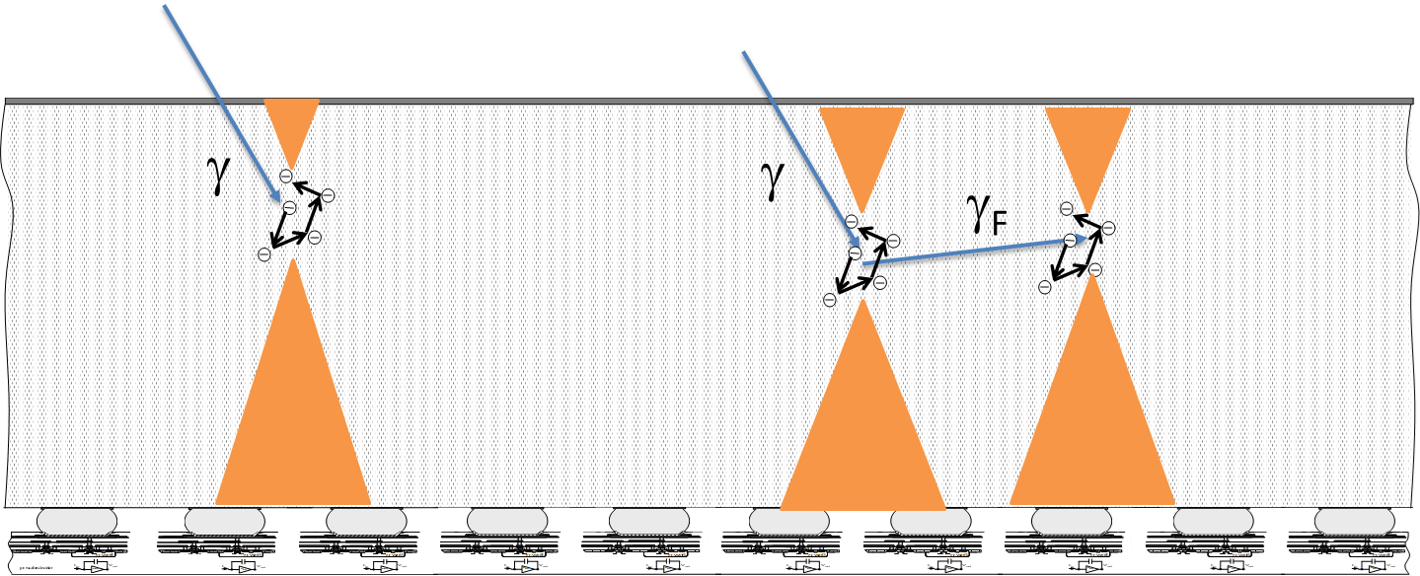
Medipix: The Essence
The essence of this family of chips is to achieve spectral resolution at high spatial resolution while processing the largest possible incoming flux (which requires on-pixel hardware algorithms).
To achieve that, we need to address the distortions in the energy spectrum caused by charge sharing and fluorescence photons.
Notes:
Spectral resolution in an X-ray detector is a measure of how precisely the detector can distinguish between photons of different energies.
When an X-ray photon interacts with the detector, it produces a signal proportional to its energy. Due to electronic noise, charge sharing, statistical fluctuations, and other physical effects, photons of the same energy don’t produce exactly the same signal, but rather a distribution of measured values.
Spectral resolution quantifies the sharpness of this distribution and therefore the detector’s ability to separate two nearby energy peaks.
It is usually expressed as the full width at half maximum (FWHM) of the response function to a monochromatic X-ray line, often given in electronvolts (eV) or as a percentage of the photon energy.

Slide 5
Charge Sharing
Simulated Data
Si 300μm, 55μm pixel
10keV monochromatic photon beam
Charge diffusion produces “charge sharing” tail
Its impact is higher the smaller the pixel wrt the sensor thickness
But in some situations “Charge Sharing is our friend” Stanislav Pospisil
Simulation: L. Tlustos
Notes:
This is one of the first simulations to validate the new architecture by L. Tlustos.
It simulates a hybrid pixel detector architecture with a three hundred micrometer thick silicon sensor and fifty five micron pixel pitch.
The simulation was done with a 10keV photon beam.
In blue the spectrum seen by one pixel working independently of its neighbours is shown. Because some of the charge deposited in the sensor is “shared” between pixels, the spectrum seen by one pixel has a low energy tail. The electronic noise of the pixel front end is simulated to be 100e-.
The influence of this effect on the spectrum increases as the pixel pitch is decreased with respect to the thickness of the sensor material.
This charge sharing tail means that any residual threshold variation between pixels produces a fixed pattern which varies with the incoming energy spectrum.
Of course, for some purposes, like for example finding the location of the deposition with sub-pixel resolution, “charge sharing is our friend” quoting Stanislav Pospisil.

Slide 6
Charge Sharing
Simulated Data
Si 300μm, 55μm pixel
100e⁻ r.m.s. noise
10keV monochromatic photon beam
Distortion in the energy spectrum is corrected by analog summing and assigning the contribution to the pixel with the largest deposition
Simulation: L. Tlustos
Acknowledgements for key simulations: D. Pennicard 2011 JINST 6 P06007
Notes:
This is one of the first simulations to validate the Medipix3 architecture.
It simulates a hybrid pixel detector architecture with a three hundred micrometer thick silicon sensor and fifty five micron pixel pitch.
The simulation was done with a 10keV photon beam.
In blue the spectrum seen by one pixel working independently of its neighbours is shown. Because some of the charge deposited in the sensor is “shared” between pixels, the spectrum seen by one pixel has a low energy tail. The electronic noise of the pixel front end is simulated to be 100e-.
The influence of this effect on the spectrum increases as the pixel pitch is decreased with respect to the thickness of the sensor material.
This charge sharing tail means that any residual threshold variation between pixels produces a fixed pattern which varies with the incoming energy spectrum.
In red we can see the spectrum measured by the pixel in an architecture in which the signal in a cluster of pixels is summed and then the charge is assigned to the pixel with the largest deposition.
David Pennicard did also key simulations to simulate the charge summing architecture in the Medipix3RX chip with sensors.

Slide 7
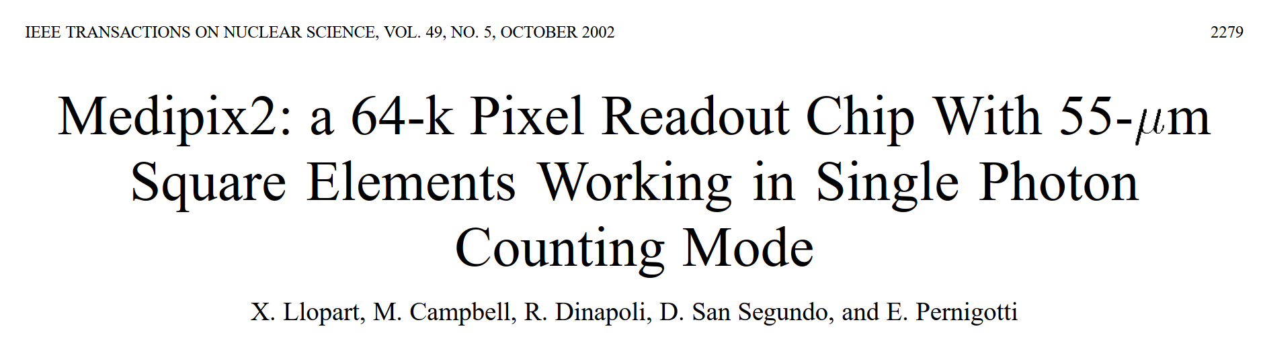
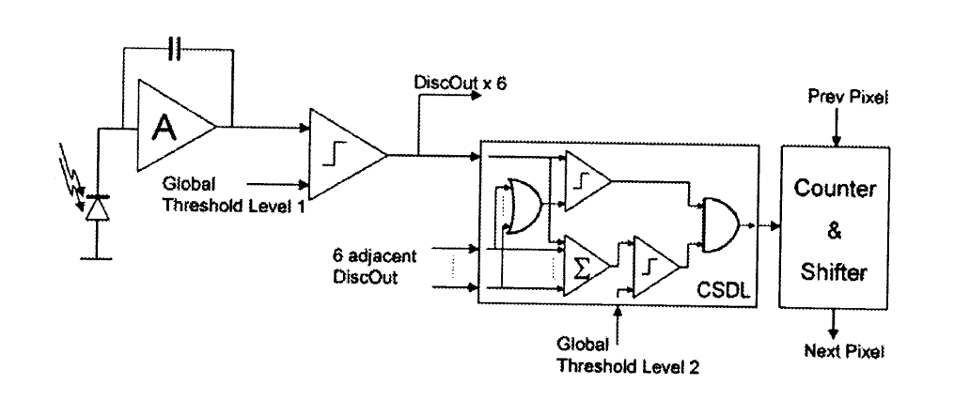
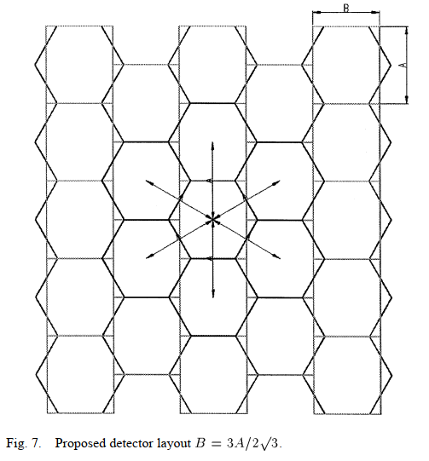
October 2002
0.25μm CMOS
Future developments section
“We describe two different approaches to reduce or cancel the effects of charge sharing, one at the detector level and the other one at the electronics level.”
Detector level: use hexagonal pixels to create an homogeneous environment for each pixel where the distance between neighbouring pixels is constant in all directions.
Electronics level: “The discriminator output pulse length is proportional to the charge of the detected particle in this case”.
Position information: “if the local pulse length is longer than any of the other six neighboring pixel pulses, then the local pixel collected the biggest share of charge generated by the incoming detected particle”
Energy information: “adding up all the discriminator pulses, one can get the total deposited charge in this seven-pixel cluster”
The two conditions must be asserted to increment the counter.
[…] very difficult to achieve with our actual design technology (0.25μm minimum gate length and 6-metal layers). This can be overcome by moving to newer commercial CMOS deep submicron technologies with smaller gate length and more interconnection metal layers. […]
Notes:
The first ideas for the implementation of the architecture were already presented in the Medipix2 paper in October 2002.
In the proposed scheme of Fig. 8 the pixels in the cluster share the information of their discriminator output pulse (DiscOut). A voltage level discriminator generates this pulse with a threshold level set to a fixed value in the entire pixel matrix, slightly higher than the amplifier electronic noise (typically three times higher). The discriminator output pulse length is proportional to the charge of the detected particle in this case. Two items of useful information can be obtained from the local pulse and the six neighboring pixels pulses. First, if the local pulse length is longer than any of the other six neighboring pixel pulses, then
the local pixel collected the biggest share of charge generated by the incoming detected particle. This gives information of the position where the particle converted with an error smaller than with respect to the pixel centroid (where is the apothem of the hexagonal pixel). Second, adding up all the discriminator pulses, one can get the total deposited charge in this seven-pixel cluster, which is compared with a global threshold level (global threshold level) in order to count only the photons with energies higher than the fixed threshold. These two last conditions must then be asserted at the same time to increment the counter.
This proposed system has to face two major constraints. First, the design and layout of a multipixel structure with connections between them, which must be contained in a very small pixel size (between 40–60 um side), is very difficult to achieve with our actual design technology (0.25-um minimum gate length and 6-metal layers). This can be overcome by moving to newer commercial CMOS deep submicron technologies with smaller gate length and more interconnection metal layers. The second constraint is the design of very low noise amplifier and discriminator cells, in order to minimize the threshold spread distribution and mismatch between adjacent channels.

Slide 8
Medipix3 prototype chip

Slide 9
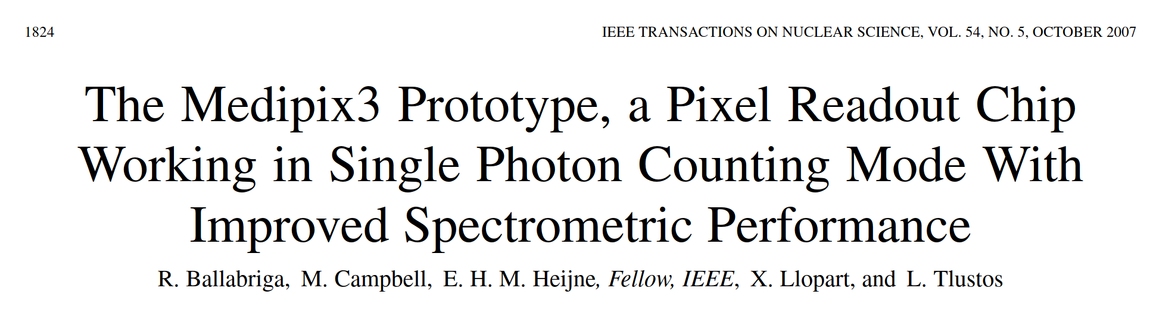
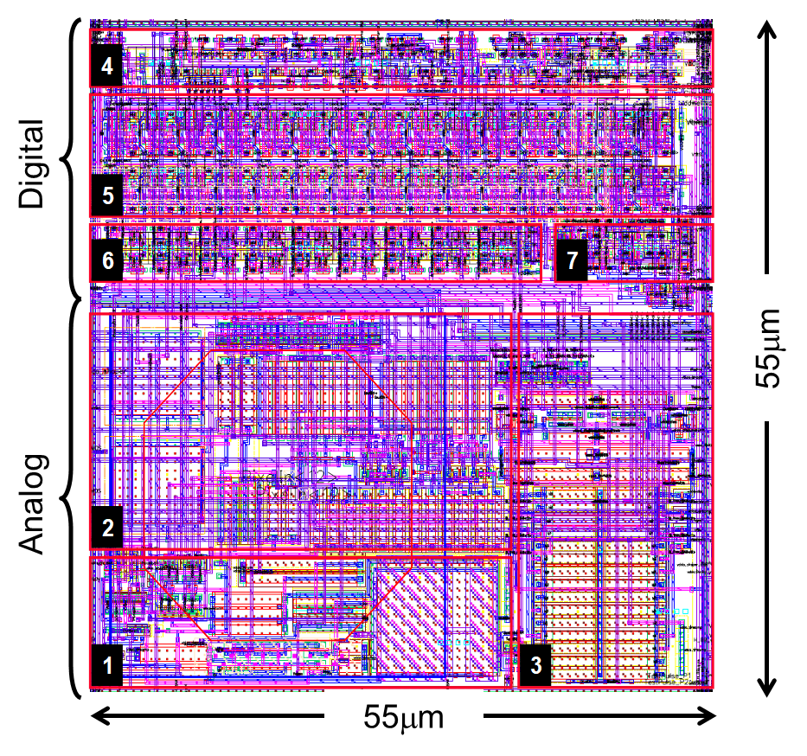
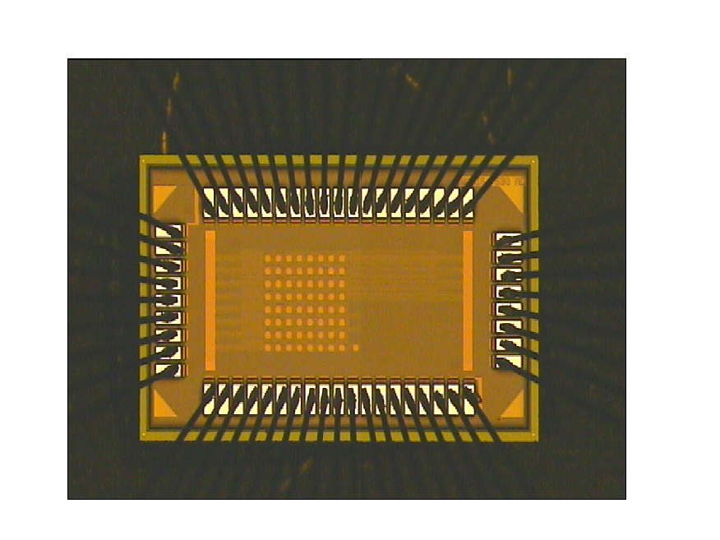
Start design: June 2004
Submission: December 2005
0.13μm CMOS
2mm
1) Preampliﬁer. 2) Shaper. 3) 2x discriminators containing a 4-bit DAC each for threshold adjustment. 4) Control Logic. 5) 2x 15-bit counters. 6) 19x conﬁguration bits. 7) Arbitration logic for charge allocation.
1.2mm
Notes:
We started the design of the prototype chip in June 2004 and submitted the chip in one of the first MPW runs in December 2005.
The chip was very small and contained a matrix of 8x8 pixels to test the different blocks in the new technology.

Slide 10
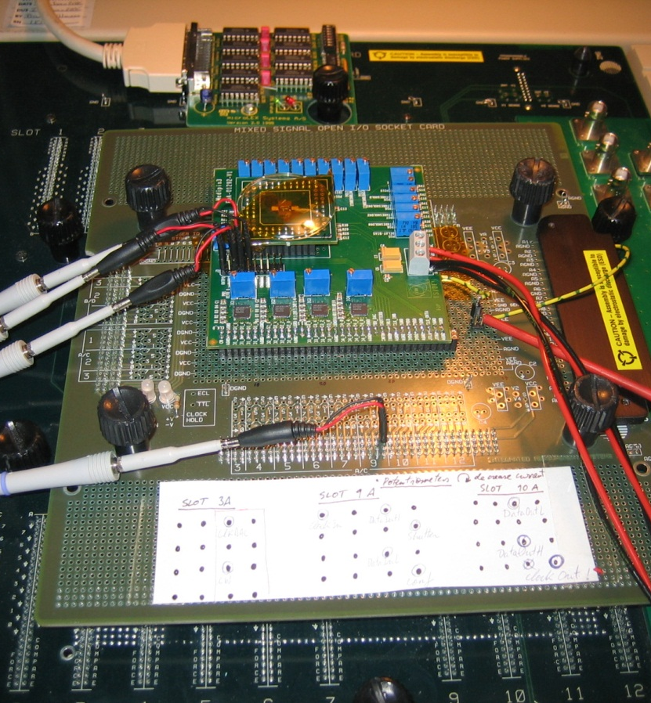
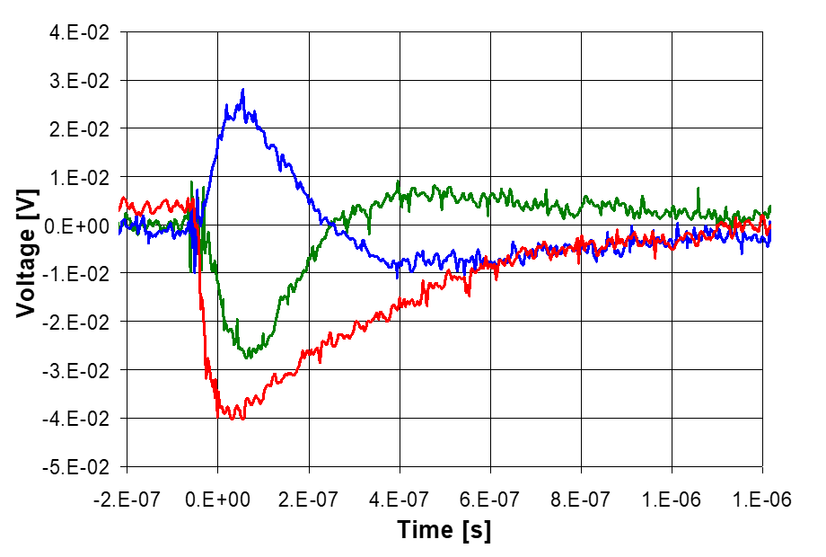
0.13μm CMOS
Electrical Measurements
Testing in building 14 at CERN using an Integrated Measurements System Advanced Test System (IMS ATS) digital IC tester

Slide 11
Medipix3.0

Slide 12
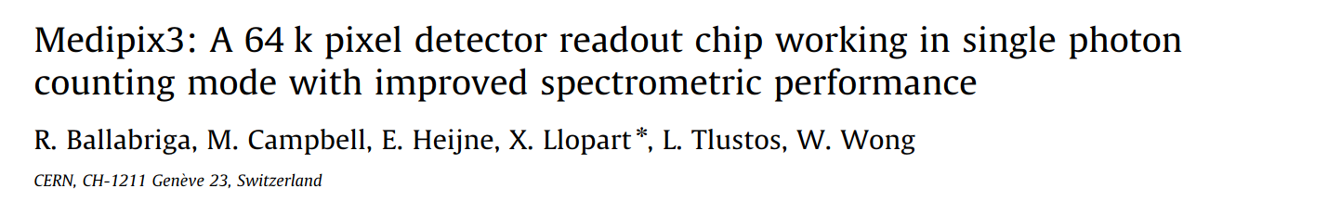
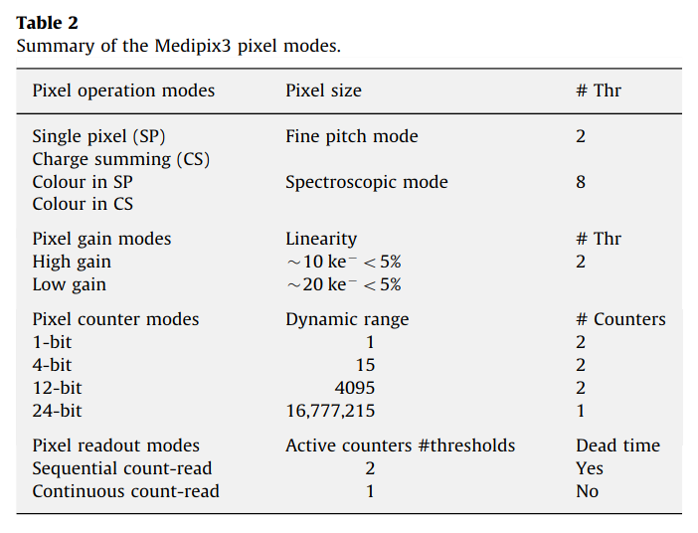
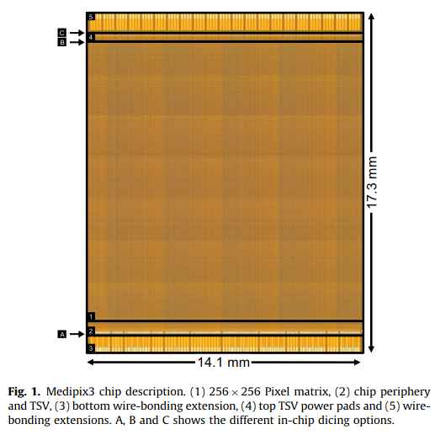
0.13μm CMOS
Submission: September 2008
First large scale mixed-mode chip in 0.13μm in the HEP community
Novelty:
Inter-pixel communication to minimize charge sharing
Test vehicle for TSV
Notes:
The first version of the Medipix3 was submitted in 2008.
It contained many modes of operation wrt its predecessor Medipix2 and it was the first large scale mixed mode chip in the High Energy Physics community.
Key novel features were
the inter pixel communication to minimize the impact of charge sharing and
The fact that it was a test vehicle to test for TSV

Slide 13
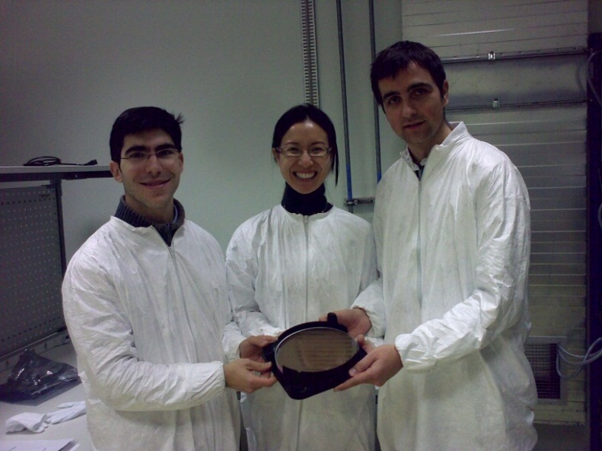
0.13μm CMOS
Submission: September 2008

Slide 14
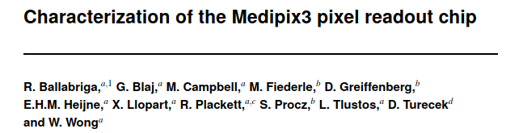
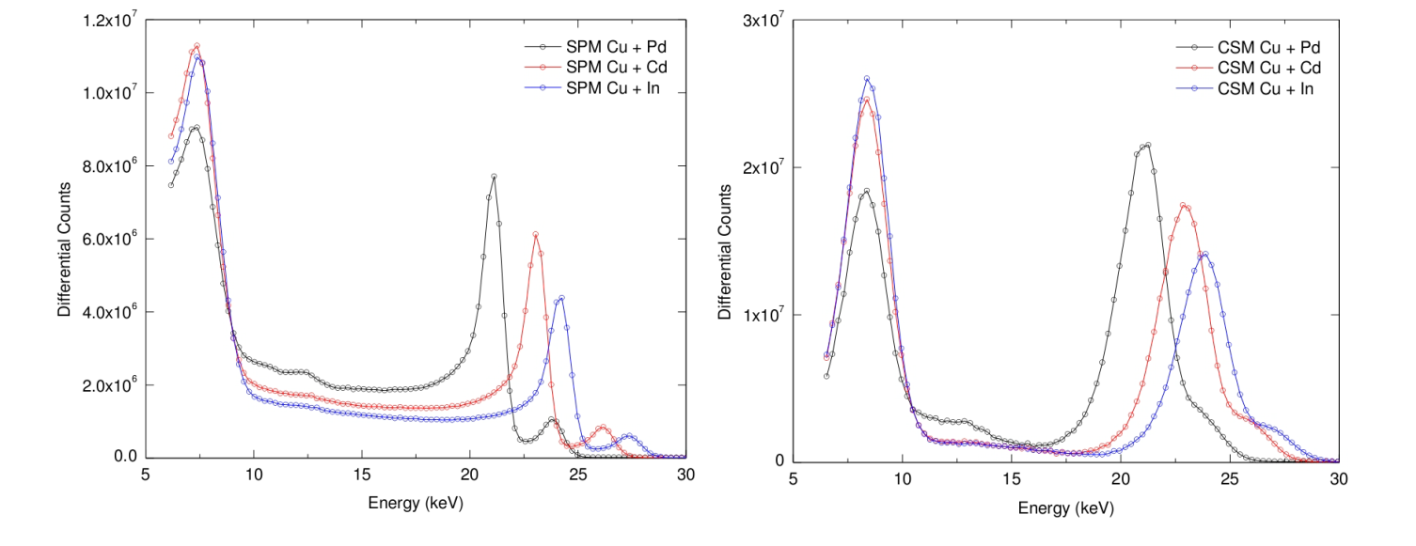
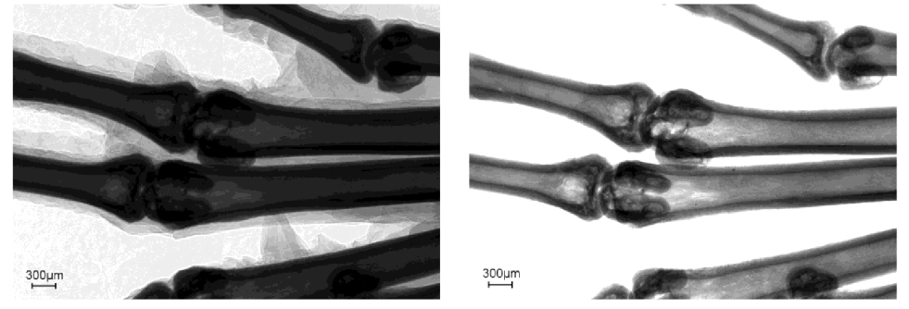
R. Ballabriga et al 2011 JINST 6 C01052
The chip showed promising results
Low noise
Uniformity of the pixel matrix parameters
Stability
Charge summing concept
But “Pioneers get shot by the Indians” Larry Pinsky
The first Medipix3 full chip
limitations:
Random Telegraphic Noise
Anomalous mismatch
Charge Summing imaging
R. Ballabriga, G. Blaj (CERN).
Characterization at Diamond Light Source was key (E. Gimenez, I. Horswell, N. Tartoni)
S. Procz (FMF)
Notes:
The chip showed some promising results in terms of
Low noise
Uniformity of the pixel matrix parameters
Stability (this is a parameter that probably was key in enabling the dissemination of the technology)
Charge summing concept
But “Pioneers get shot by the Indians” Larry Pinsky
The first Medipix3 full chip
limitations:
Random Telegraphic Noise
Anomalous mismatch
Charge summing imaging

Slide 15
Random Telegraphic Noise
We measured RTN on individual pixels
Sudden step-like transitions between two or more discrete states
2 hour measurement RTN on less than 1% of the pixels showing RTN
Different frequencies (changes between states from tens of second to hours)
65
60
55
50
Effective threshold (nA)
45
40
35
30
0 100 200 300 400 500 600 700 800 900 1000
time (s)

Slide 16
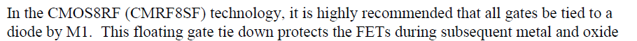
Antenna effects
RIE (Reactive Ion Etch) and plasma processes can build up charge on gate
Gate oxide damage
n+
n+
p- substrate
Wafer grounded on chuck
The cause was found to be gate oxide damage during wafer processing
CMOS processes are not optimized for our large/mixed-mode chips
The solution was to change the architecture of the bias distribution (buffers) and add tie down diodes.
Our experience was shared with other designs in HEP, preventing the same issues
Text from: Design kit and Technology training CMOS8RF (CMRF8SF) V1700, p.148

Slide 17
Antenna effects
RIE (Reactive Ion Etch) and plasma processes can build up charge on gate
Gate oxide damage
Non-destructive alternate discharge path
n+
n+
n+
p- substrate
Wafer grounded on chuck
The cause was found to be gate oxide damage during wafer processing
CMOS processes are not optimized for our large/mixed-mode chips
The solution was to change the architecture of the bias distribution (buffers) and add tie down diodes.
Our experience was shared with other designs in HEP, preventing the same issues
Text from: Design kit and Technology training CMOS8RF (CMRF8SF) V1700, p.148

Slide 18
Imaging in CSM (Medipix 3.0)
Single Pixel Mode
Charge Summing Mode
We observed granularity in the Charge Summing Mode image due to incorrect hit allocation
Pixels with lower threshold in their vicinity “win” the hit more often
This is due to the sensitivity of the architecture to high threshold dispersion

Slide 19
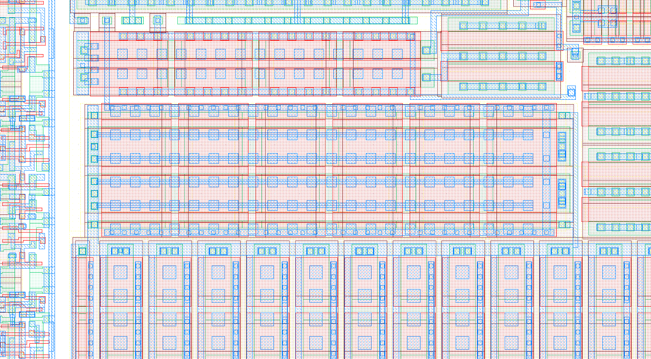
Many lessons were learnt
Diode for protection against process induced damage connected at M1 level
Symmetrical metal coverage
dummy devices
well edge placed identical for both devices
segmentation in 6

Slide 20
Medipix3RX:
The Charge Summing Mode

Slide 21
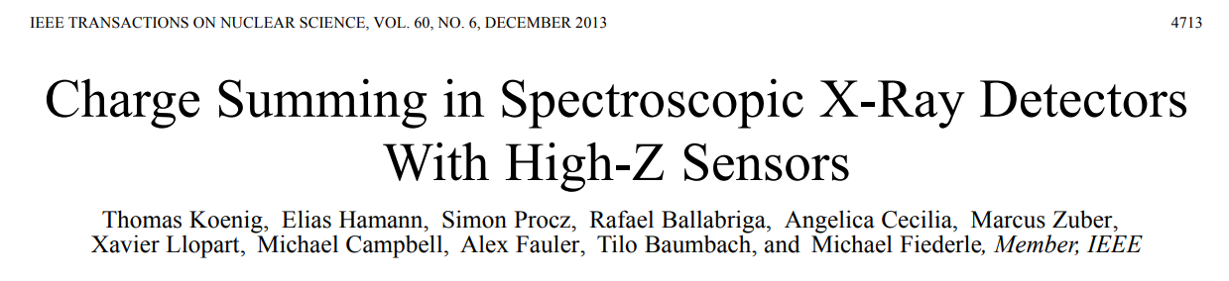
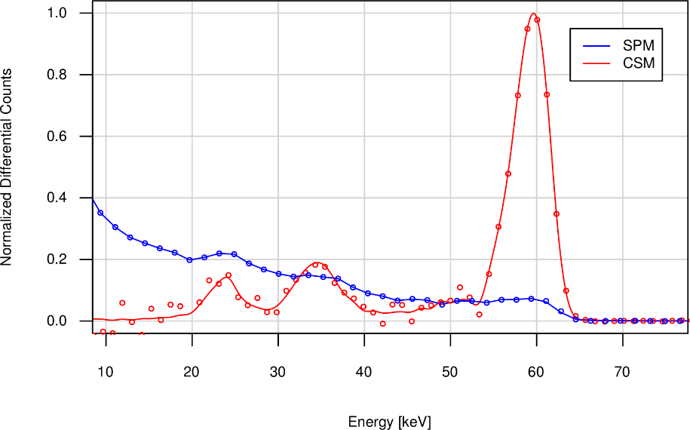
60keV, 2mm CdTe, 110μm pitch
~4.4KeV FWHM
Energy spectrum in Single Pixel Mode and in Charge Summing Mode
Sum of all the pixels in the chip ~16k pixels
Fluorescence photons are included in charge sum if their deposition takes place within the volume of the pixels neighbouring the initial deposition
I
Notes:
CT of a phantom
0.15s acquisition
720 projections
Reduced SNR can be observed for the high threshold in SPM which is related to the reduced DQE (less reduction in CSM)
Different contrast in SPM and CSM.
The K-edge of gadolinium (50.2KeV) can be discovered in the CSM images (this is not the case for the SPM images)
The gain in CSM amounts to 45% for the iodine and 30% for gadolinium solutions compared to pmma.

Slide 22
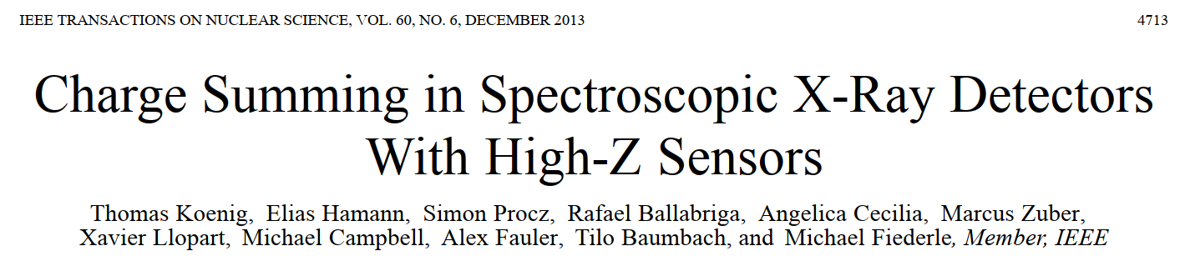
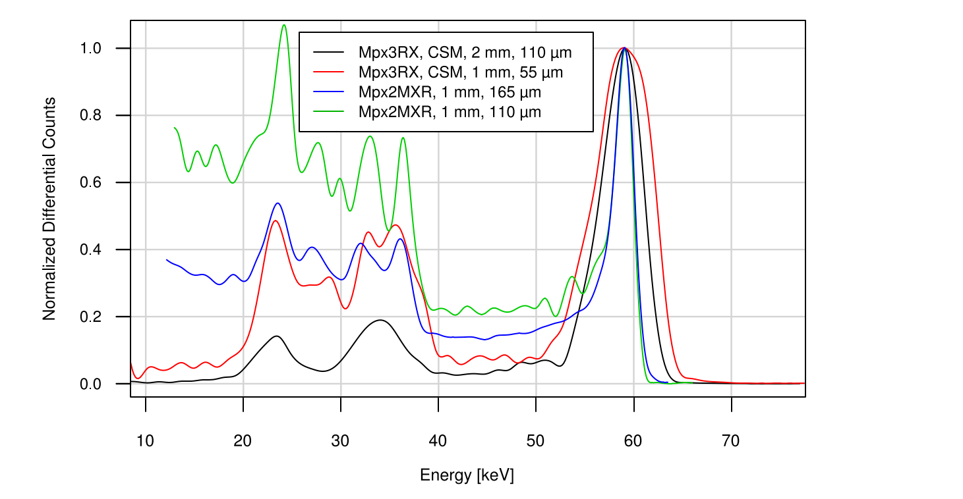
For 55um pixel (CSM), we measure an energy response function very similar to that observed for a pixel pitch of 165 µm in SPM.
This amounts to an eﬀective reduction of the pixel area by about an order of magnitude at constant energy response.

Slide 23
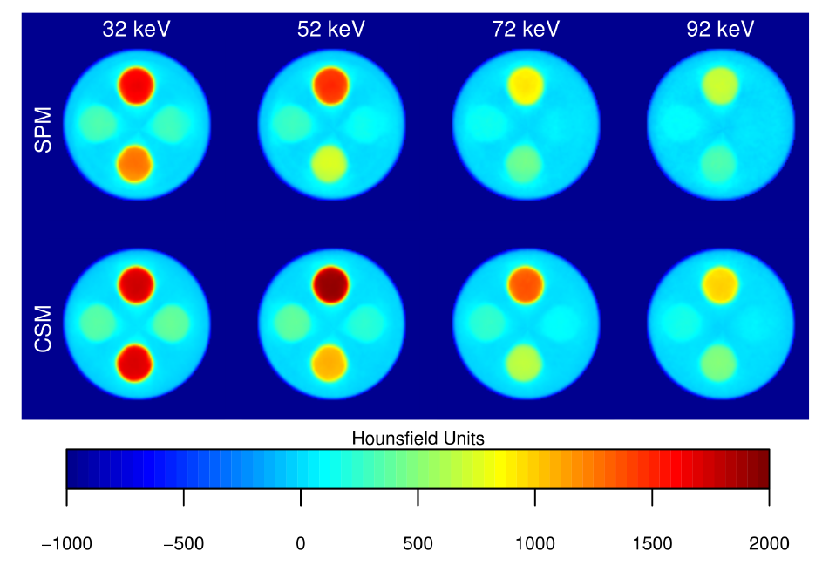
Gd
I
I
Ga K-edge can be identified in CSM images
SNR higher in CSM for the higher energy thresholds
Notes:
CT of a phantom
0.15s acquisition
720 projections
Reduced SNR can be observed for the high threshold in SPM which is related to the reduced DQE (less reduction in CSM)
Different contrast in SPM and CSM.
The K-edge of gadolinium (50.2KeV) can be discovered in the CSM images (this is not the case for the SPM images)
The gain in CSM amounts to 45% for the iodine and 30% for gadolinium solutions compared to pmma.

Slide 24
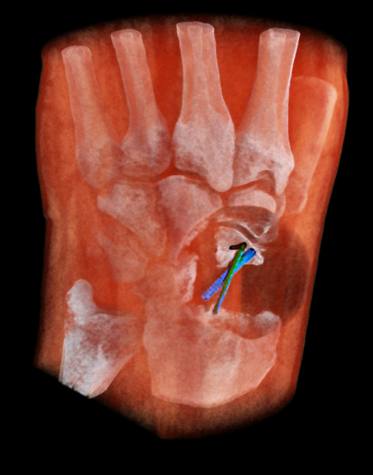
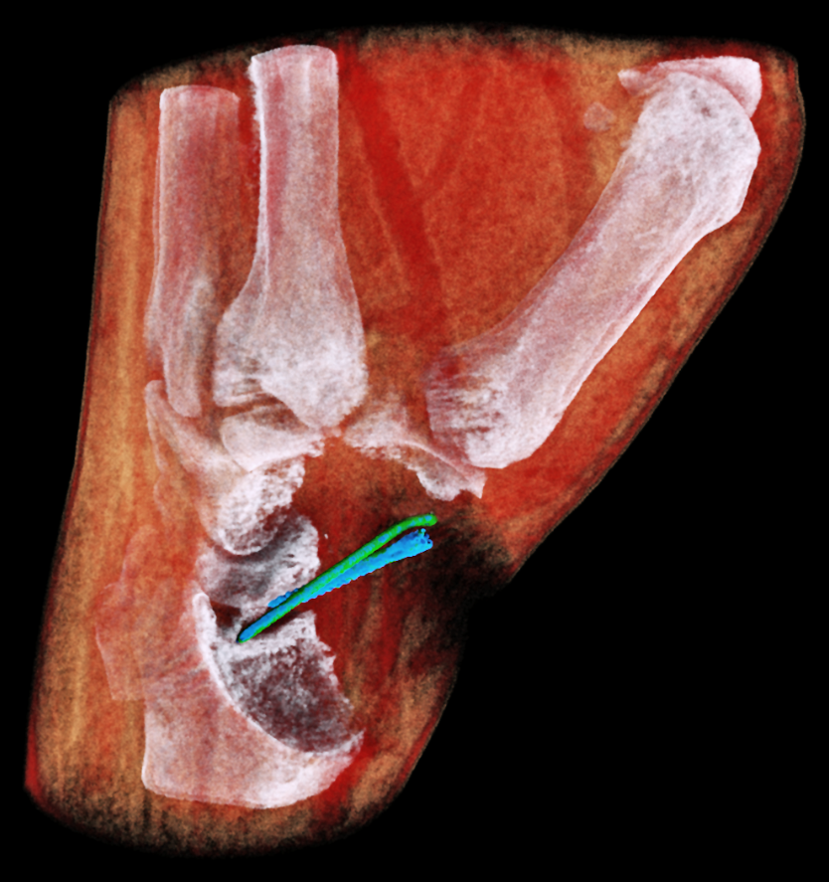
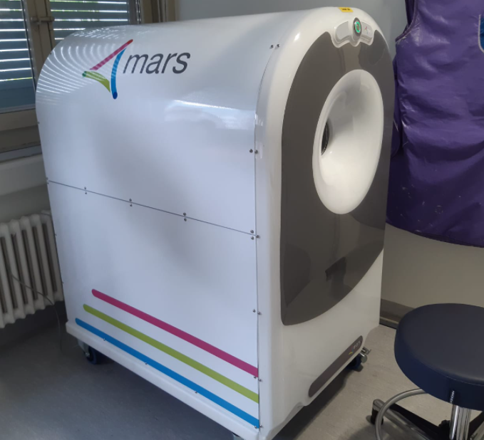
MBI MARS clinical trial image (1x12 Medipix3RX with CdZnTe detectors (~24cm²))
200K pixels
Wrist with titanium screw and steel wire
Scanner installed at Centre Hospitalier Universitaire Vaudois (CHUV), Lausanne, Switzerland
Courtesy: MARS team

Slide 25
Medipix3RX:
Through Silicon Vias

Slide 26
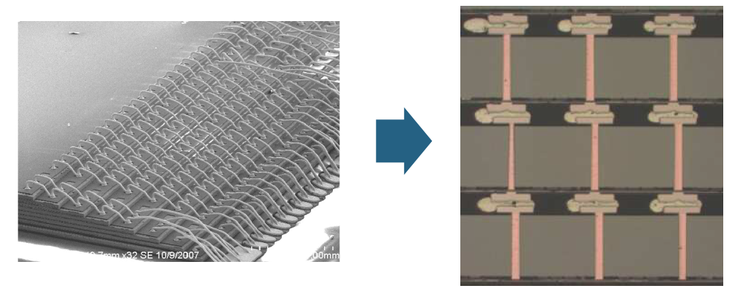
TSVs
A Through Silicon Via (TSV) is a vertical electrical connection that allows to create 3D integrated circuits (Denser / more compact / shorter interconnects (i.e. faster))
64Gb DDR4 DRAM 3D, Samsung (2015)

Slide 27
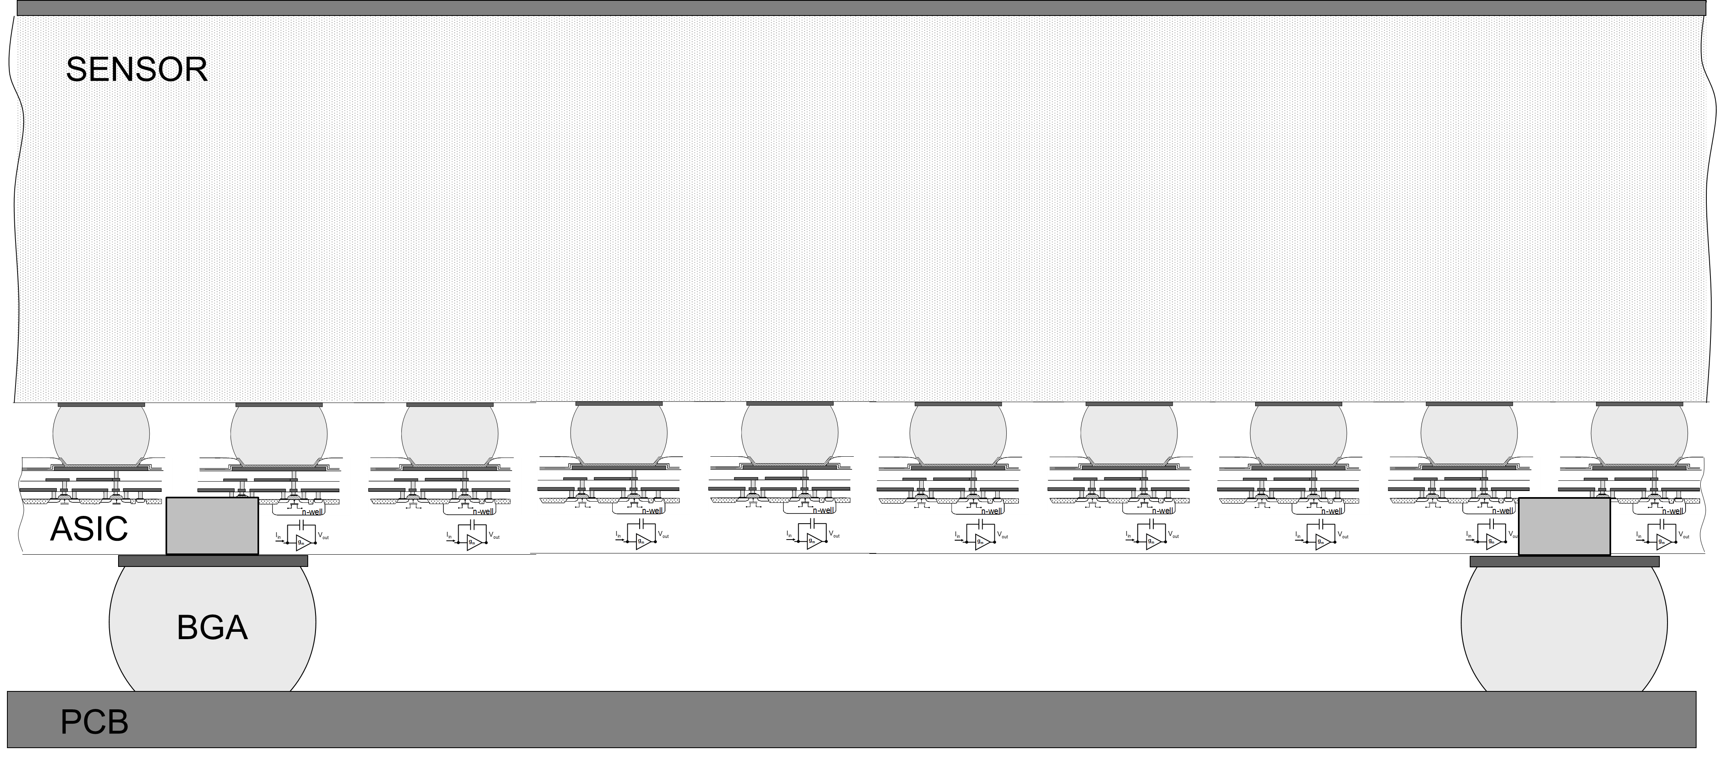
TSVs
A Through Silicon Via (TSV) is a vertical electrical connection that allows to create 3D integrated circuits (Denser / more compact / shorter interconnects (i.e. faster))
TSVs allow the design of more compact systems without wire bonds towards large and seamless detection systems.

Slide 28

Through Silicon Vias on the Medipix3RX ASIC
J. Alozy

Slide 29
Medipix4

Slide 30
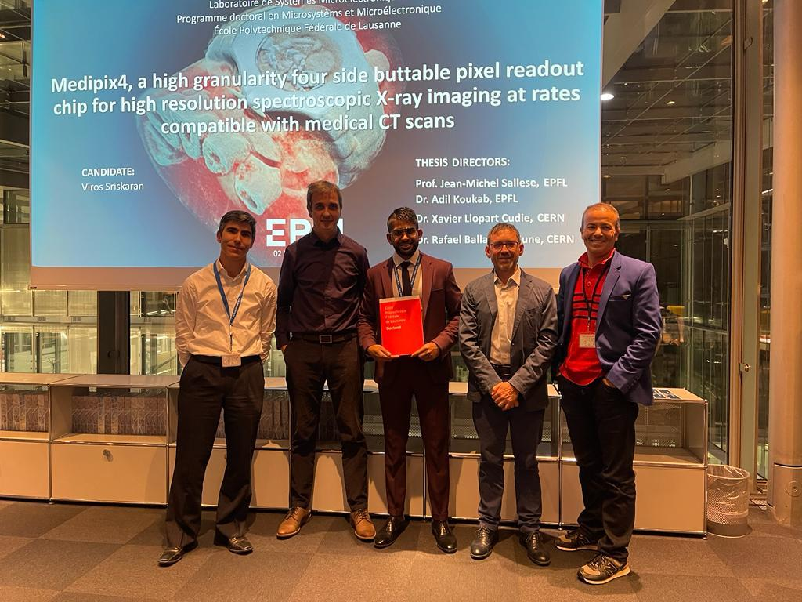
“The Design and Implementation in 0.13μm CMOS of an Algorithm Permitting Spectroscopic Imaging with High Spatial Resolution for Hybrid Pixel Detectors” R. Ballabriga 2009, (Medipix3)
Closed defense:
June 2022
Public defense: December 2022
“Medipix4, a High Granularity Four Side buttable Pixel Readout Chip for High Resolution Spectroscopic X-ray Imaging at Rates Compatible with Medical CT Scans” V. Sriskaran 2022
(0.13μm CMOS Submission: Q2 2022 (V1 (1 mask change) Q2 2023))

Slide 31
Feature | Medipix3RX (2011) | Medipix4 (2022)
Technology | 130 nm + 8 metals | 130 nm + 9 metals
Pixel pitch (µm) | Fine pitch mode: 55 μm Spectroscopic Mode: 110 μm | Fine pitch mode: 75 μm Spectroscopic Mode: 150 μm
Number of pixels | Fine pitch mode: 256x256 Spectroscopic Mode: 128x128 | Fine pitch mode: 320x320 Spectroscopic Mode: 160x160
Matrix arrangement | 3-side buttable (test vehicle for TSVs) | 4-side buttable
Sensitive area (cm²) | 1.98 | 5.76
Sensitive area / Total active area (%) | Without TSV: 88.7% With TSVs: 94.6% | Without TSV: 93.5% With TSVs: 99.4%
Acquisition mode | Single Pixel Mode (SPM) / Charge Summing Mode (CSM) | Single Pixel Mode (SPM) / Charge Summing Mode (CSM)
Energy Resolution (measurement, preliminary) | SPM: 1.4 keV FWHM (Cu Ka) CSM: 2.0 keV FWHM (Cu Ka) | SPM: 2.0 keV FWHM (Cu Ka) CSM: 2.6 keV FWHM (Cu Ka)
Dynamic Range (keV, CdTe) | 110 | 150
Count Rate (10% dead time loss) (Mphotons/mm²s) Spectroscopic Mode with CSM | 4.3 | 19
Number of thresholds in SM-CSM | 4 SPMa + 4 CSM | 1 SPMa + 7 CSM
Pixel counters in SRW, Fine Pitch Mode (bit depth) | 2x [1, 2, 6, 12] or 1x [24] | 2x [1, 2, 6, 12]
Pixel counters in SRW, Spectroscopic Mode (bit depth) | 8x [1, 2, 6, 12] or 4x [24] | 8x [1, 2, 6, 12]
Pixel counters in CRW, Fine Pitch Mode (bit depth) | 1x [1, 2, 6, 12] | 2x [1, 12]
Pixel counters in CRW, Spectroscopic Mode (bit depth) | 4x [1, 2, 6, 12] | 8x [1, 12]
Area increases x1.86
DR increases x1.36
CR increases x4.3
3+ CSM thresholds
SPM: Single Pixel Mode, CSM: Charge Summing Mode
SRW: Sequential Read Write, CRW: Continuous Read Write

Slide 32
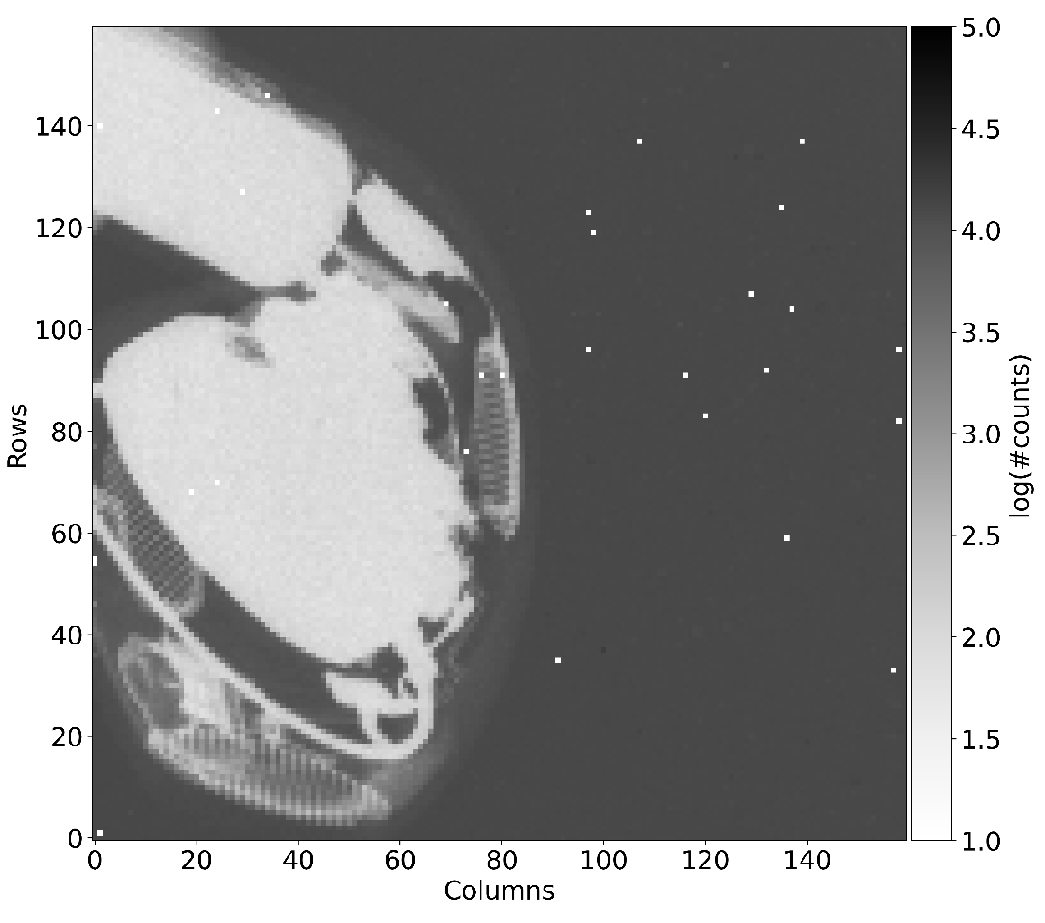
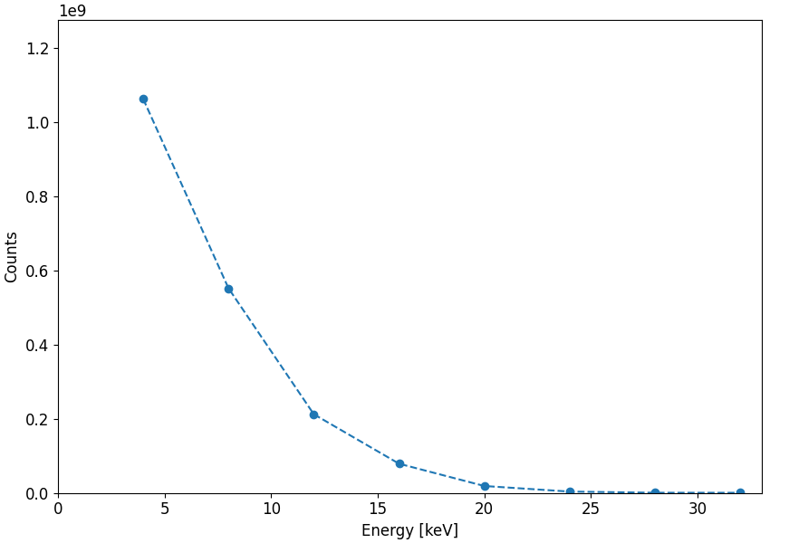
Medipix4 first images
Acquisition Spectroscopic mode (150μm pixel), CSM, 24-bit counter, THRL = 5 keV, higher THR at 4 keV step each (flat field corrected and log scale)
10.0 s acquisition
Tube settings: 30 kV, 10 mA
Ongoing measurements: R. Bolzonella

Slide 33
Maximum count rates (Mcps/mm²) vs pixel size (μm)
Medipix4 (Measurement, 75um pixel, CSM, Si sensor, 25kVp, THL @4.6keV)
CT (Prismatic detectors, Acquired by GE)
CT (CEA,Siemens)
CT (chromAix1, Philips)
CT (chromAix2, Philips)
CT (CIX 0.2)
Medipix3
CT (DXRay)
Simulation 80keV photons, 2mm CdTe, -800V, 100e- r.m.s. noise (no threshold dispersion, no charge trapping)

Slide 34
Summary and Conclusions

Slide 35
Summary and conclusions
The essence of this family of chips is to achieve spectral resolution at high spatial resolution while processing the largest possible incoming flux (which requires on-pixel hardware algorithms).
To achieve that, we need to address the distortions in the energy spectrum caused by charge sharing and fluorescence photons (Medipix3).
Medipix 4 aims to address these distortions while dealing with a larger photon flux.
Every chip went beyond the state of the art in terms of innovations in the architecture and thanks to advances in the microelectronics industry.
It was not always an easy path (Random Telegraphic Noise, unexpected mismatch) in part due to the uniqueness of our designs.
Collaboration has been key to bring competences on different topics (design, physics simulations, characterization (imaging properties, synchrotron)).

Slide 36
Acknowledgements

Slide 37
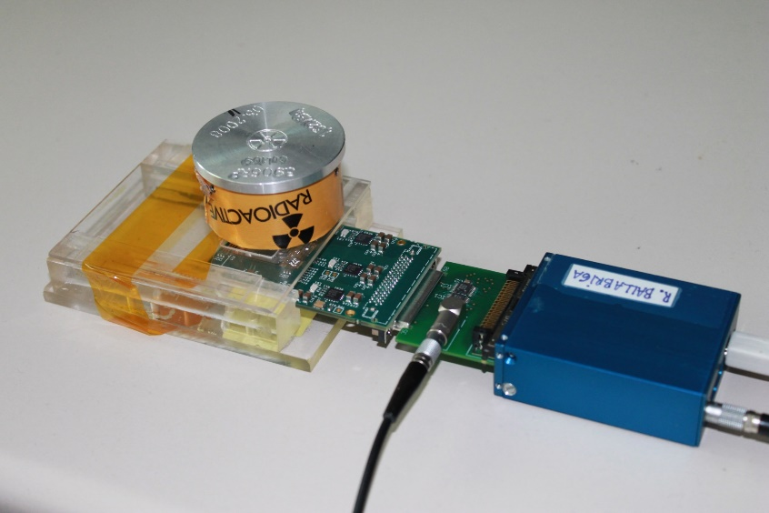
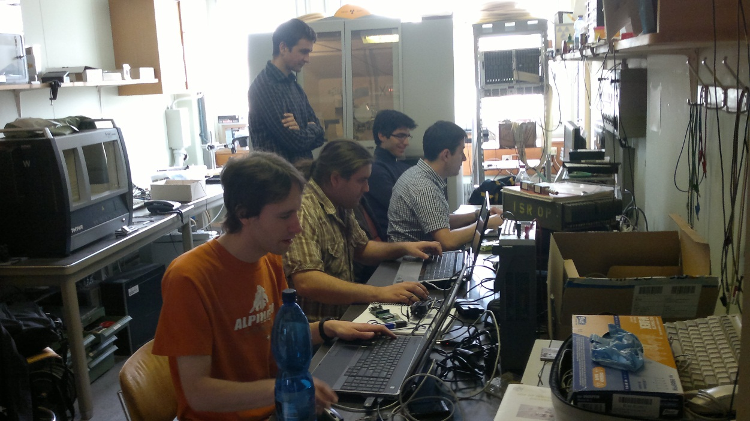
To readout system developers
In particular to IEAP, CTU in Prague for preparing the system that we used for the initial Medipix3 characterization
IEAP, CTU: D. Turecek, V. Kraus, M. Holik
CERN: R. Ballabriga, X. Llopart

Slide 38
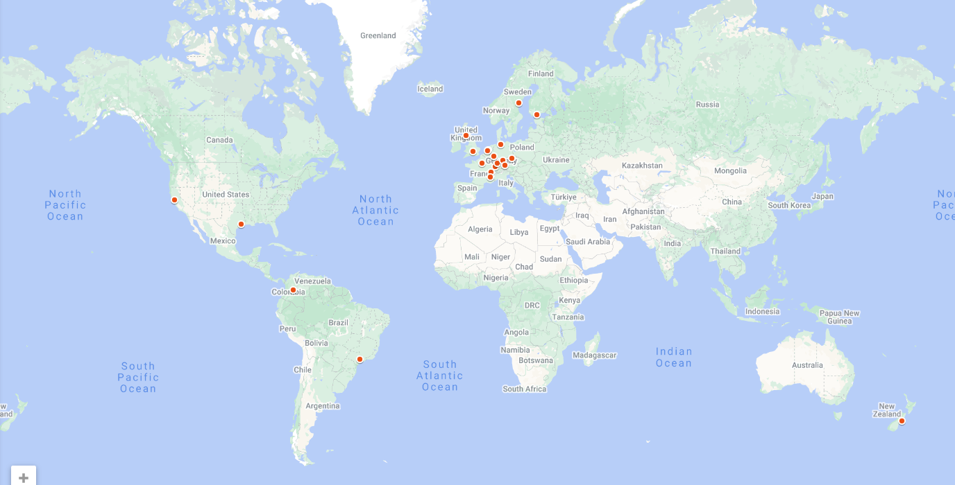
Medipix 2, 4 and 3 collaborations
For always supporting us providing resources, encouragement and new ideas and concepts
Albert-Ludwig Universität Freiburg (Germany), AMOLF (The Netherlands), Brazilian Light Source (Brazil), CEA (France), CERN (Switzerland), DESY-Hamburg (Germany), Diamond Light Source (UK), ESRF (France), IEAP, Czech Technical University (Czech Republic), KIT/ANKA, Forschungszentrum Karlsruhe (Germany), Mid Sweden University (Sweden), NIKHEF (The Netherlands), Universidad de los Andes (Colombia), University of Bonn (Germany), University of California (USA), University of Canterbury (New Zealand), Universität Erlangen-Nurnberg (Germany), University of Glasgow (UK), University of Houston (USA), University of Leiden (The Netherlands), Technical University of Munich (Germany), VTT Information Technology (Finland)

Slide 39






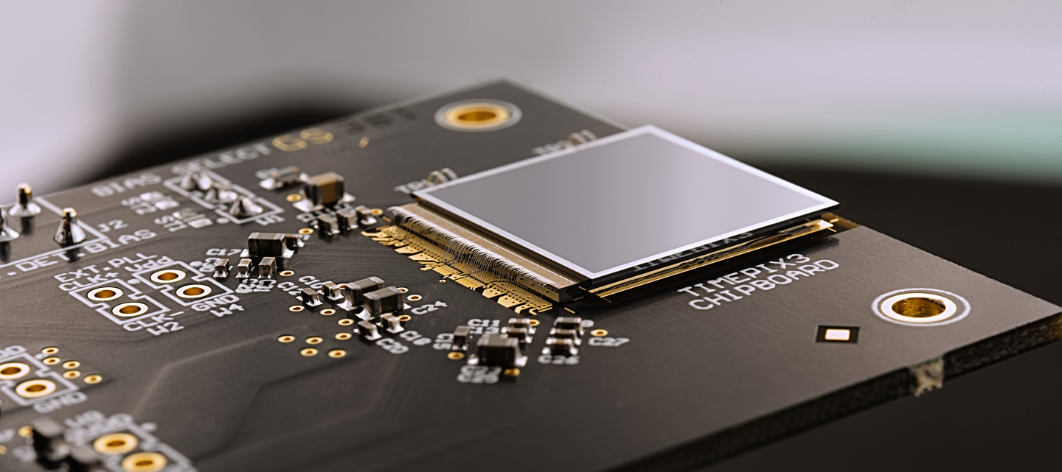



For always supporting us providing, for their feedback that helped improving and for the dissemination of the technology
MEDIPIX3 Licensees
TIMEPIX3 Licensees
ADVACAM s.r.o.
Amsterdam Scientific Instruments (ASI)
Kromek (R&D)
Lund Univ (R&D)
ADVACAM s.r.o.
Amsterdam Scientific Instruments (ASI)
Malvern Panalytical
MARS Bio Imaging (MBI)
Quantum Detectors (QD)
X-Spectrum
Pi-TEC

Slide 40

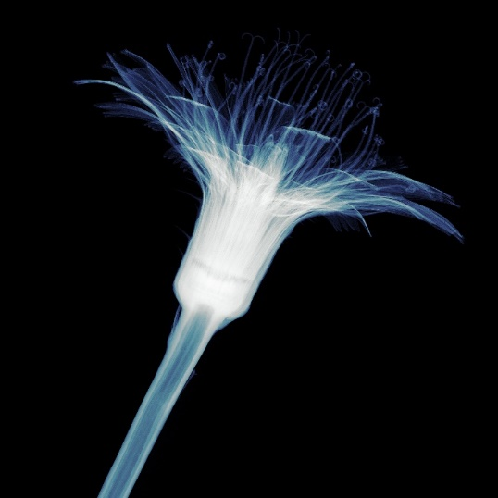
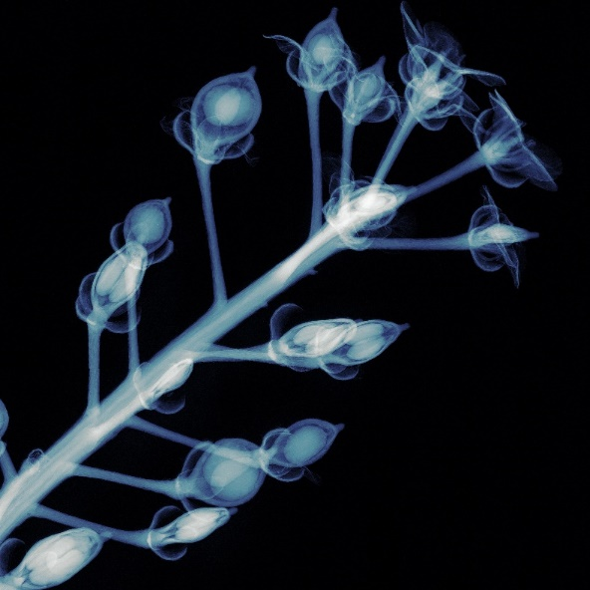
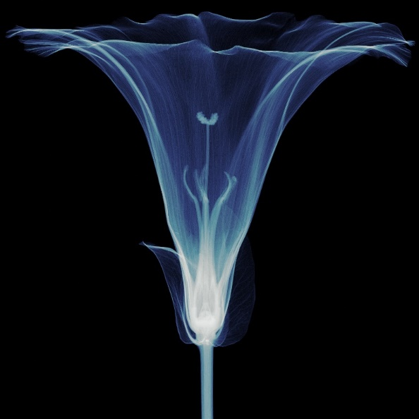
Tack
Obrigado
Děkuji
Merci
Gracias
Grazie
Thank you
Dank u
Grazcha
Kiitos
Ngā mihi
Danke
Gràcies

Slide 41
Additional slides

Slide 42
On-Pixel Charge Sharing Correction
1. TH0 is applied to the local signal
2. Arbitration circuitry identifies the pixel with largest charge and supresses the pixels with lower signal
3. In parallel, the charge has been reconstructed in the analog summing circuits
4. The pixel with highest charge checks the adjacent summing circuits to see if at least one of them exceeds Charge Summing node Threshold
Advantage of having small pixels without disadvantage of charge sharing
In Charge Summing Mode (CSM) the energy is reconstructed and each photon is counted once

Slide 43
Charge sharing
Notes:
Charge sharing is the effect that is produced when the signal due to an individual photon is spread over a cluster of pixels. This is due to several effects:
The radius of the initial charge cloud which is determined by the range of the photoelectron
Charge repulsion
Charge diffusion inside the semiconductor detector material

Slide 44
Fluorescence
Notes:
The other effect we have to deal with is fluorescence photons. After a photo electric effect interaction, the atom from which the photoelectron was ejected relaxes emitting a fluorescence photon that will travel some distance away before depositing its energy (interacting),

Slide 45
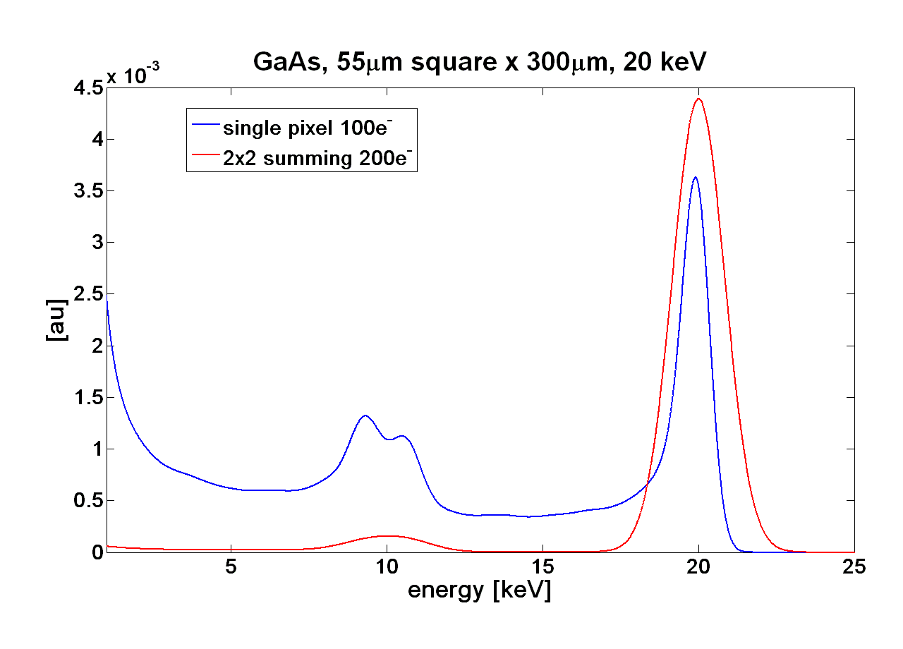
Fluorescence photons
Simulated Data
GaAs 300μm, 55μm pixel
100e⁻ r.m.s. noise
20keV monochromatic photon beam
the charge deposited by the fluorescence photon will be included in the charge sum provided the deposition takes place in the sensor volume of the pixels neighbouring the initial conversion
Material |  | Nª | K_{α1} [keV]^{b} | K_{α2} [keV] ^{b} | d_{α1} [µm]^{c} | d_{α2} [µm]^{c} | η[%]^{d}
Si |  | 14 | 1.74 | 1.74 | 11.86 | 11.86 | 4.1
GaAs | Ga, 48.20% As, 51.80% | 31 33 | 9.25 10.54 | 9.22 10.50 | 40.62 15.62 | 40.28 15.47 | 50.5 56.6
CdTe | Cd, 46.84% Te, 53.16% | 48 52 | 23.17 27.47 | 22.98 27.20 | 113.20 59.32 | 110.75 57.85 | 83.6 87.3
Z
Energy fluorescence photons [keV]
Mean free path of fluorescence photon [μm]
Fluorescence yield [%]
Simulation: L. Tlustos

Slide 46
On-Pixel Charge Sharing Correction
1. TH0 is applied to the local signal
2. Arbitration circuitry identifies the pixel with largest charge and supresses the pixels with lower signal
3. In parallel, the charge has been reconstructed in the analog summing circuits
4. The pixel with highest charge checks the adjacent summing circuits to see if at least one of them exceeds Charge Summing node Threshold
Advantage of having small pixels without disadvantage of charge sharing
In Charge Summing Mode (CSM) the energy is reconstructed and each photon is counted once

