Slide 1

Enabling Novel Sensor Designs with Timepix
Medipix and Timepix symposium
22 September 2025
Martin van Beuzekom

Slide 2
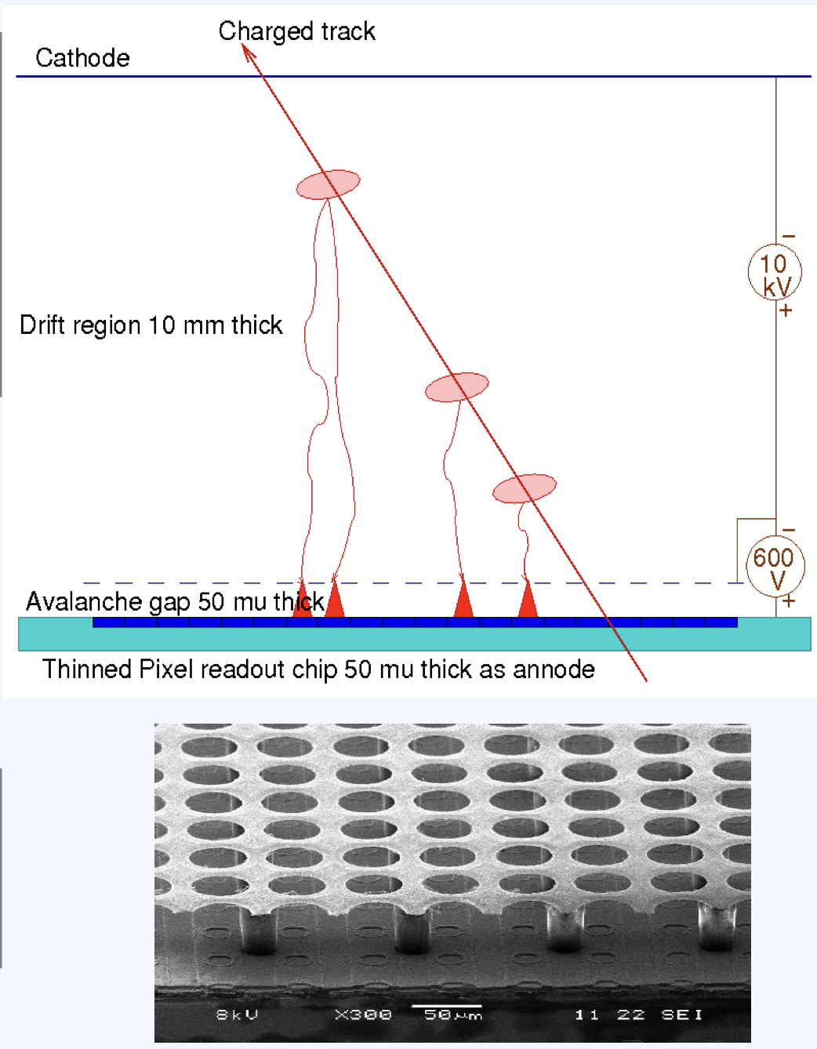
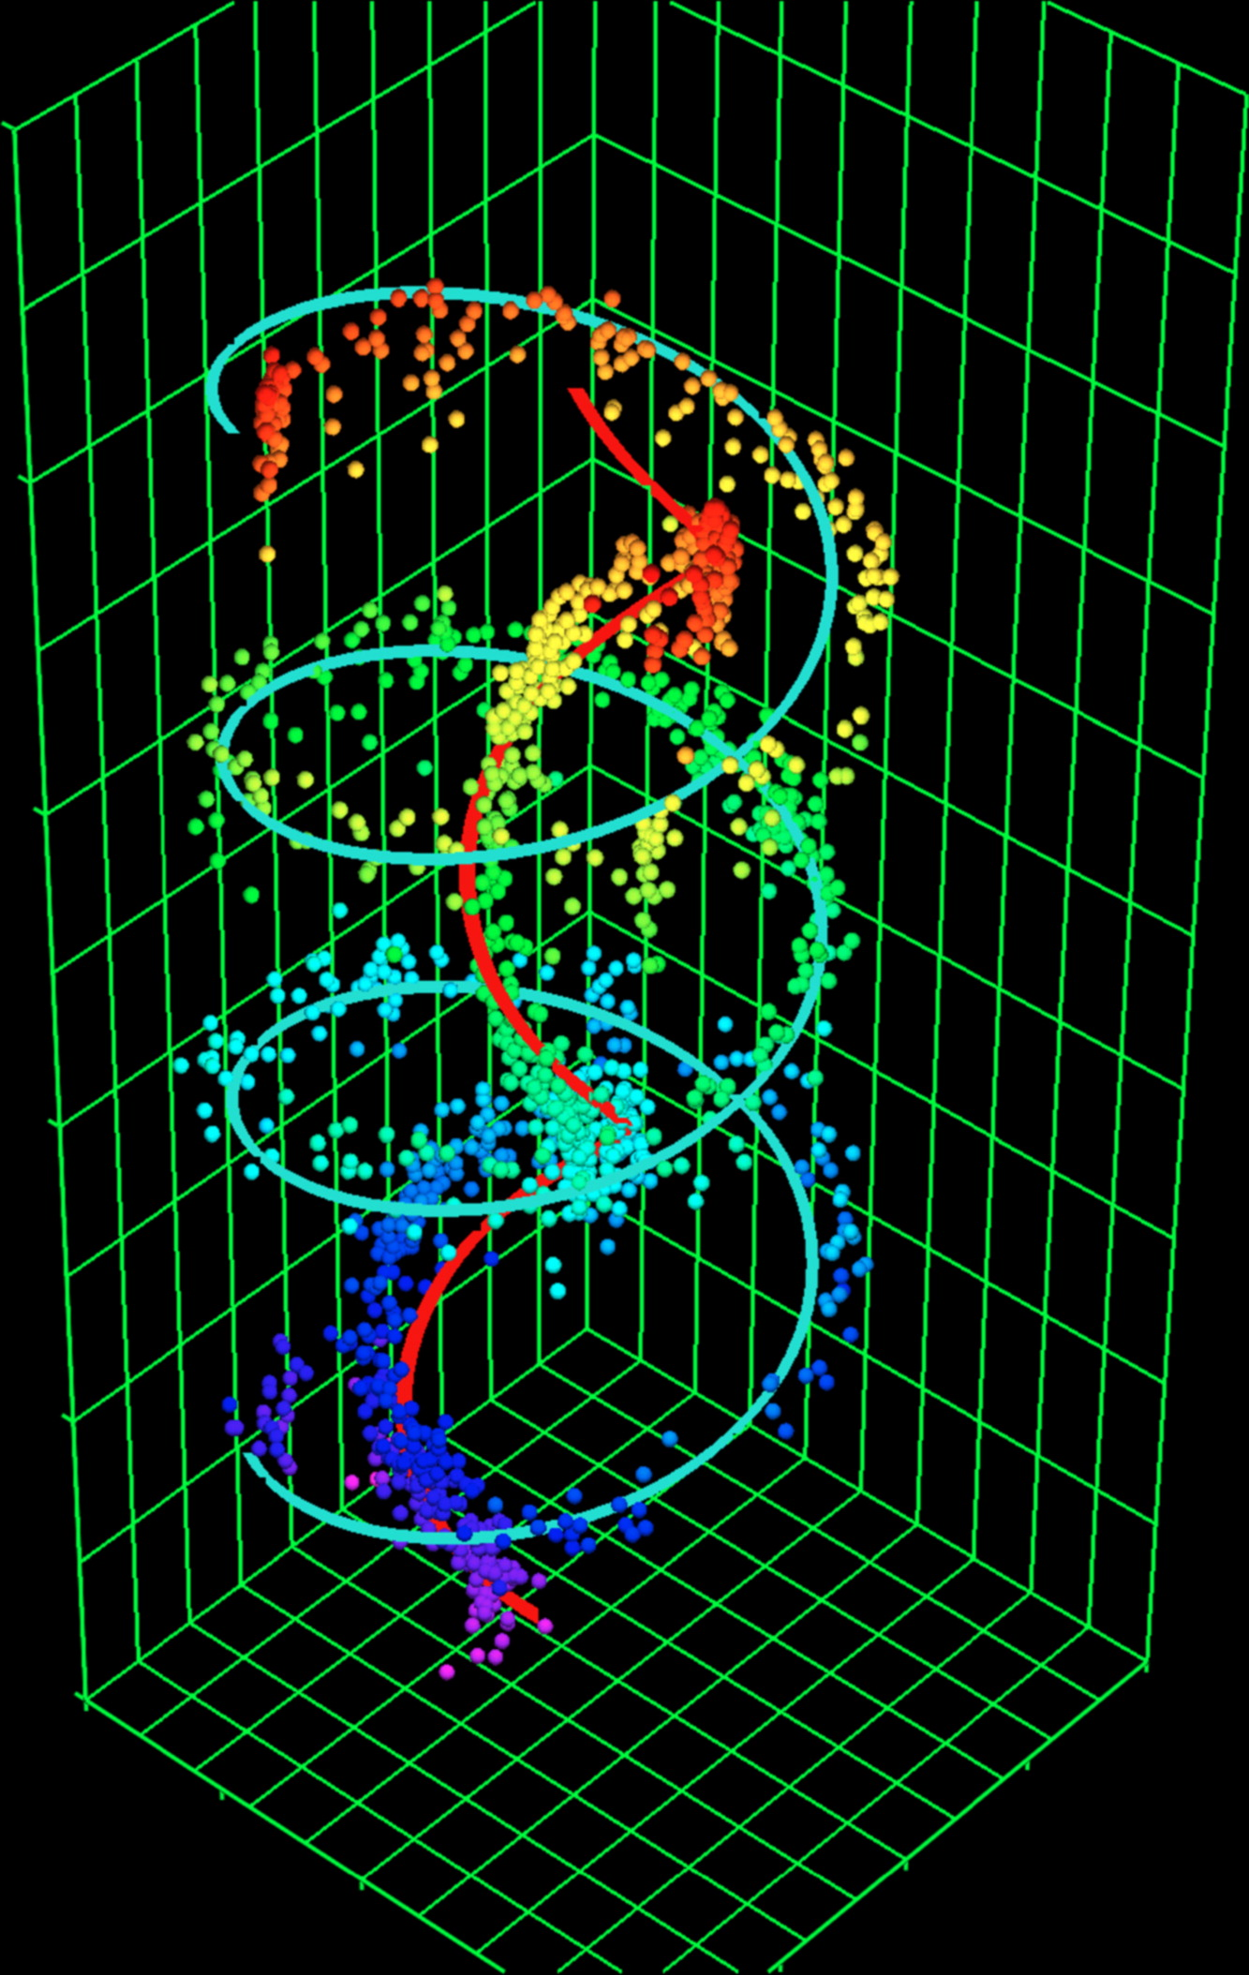
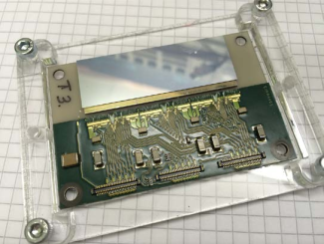
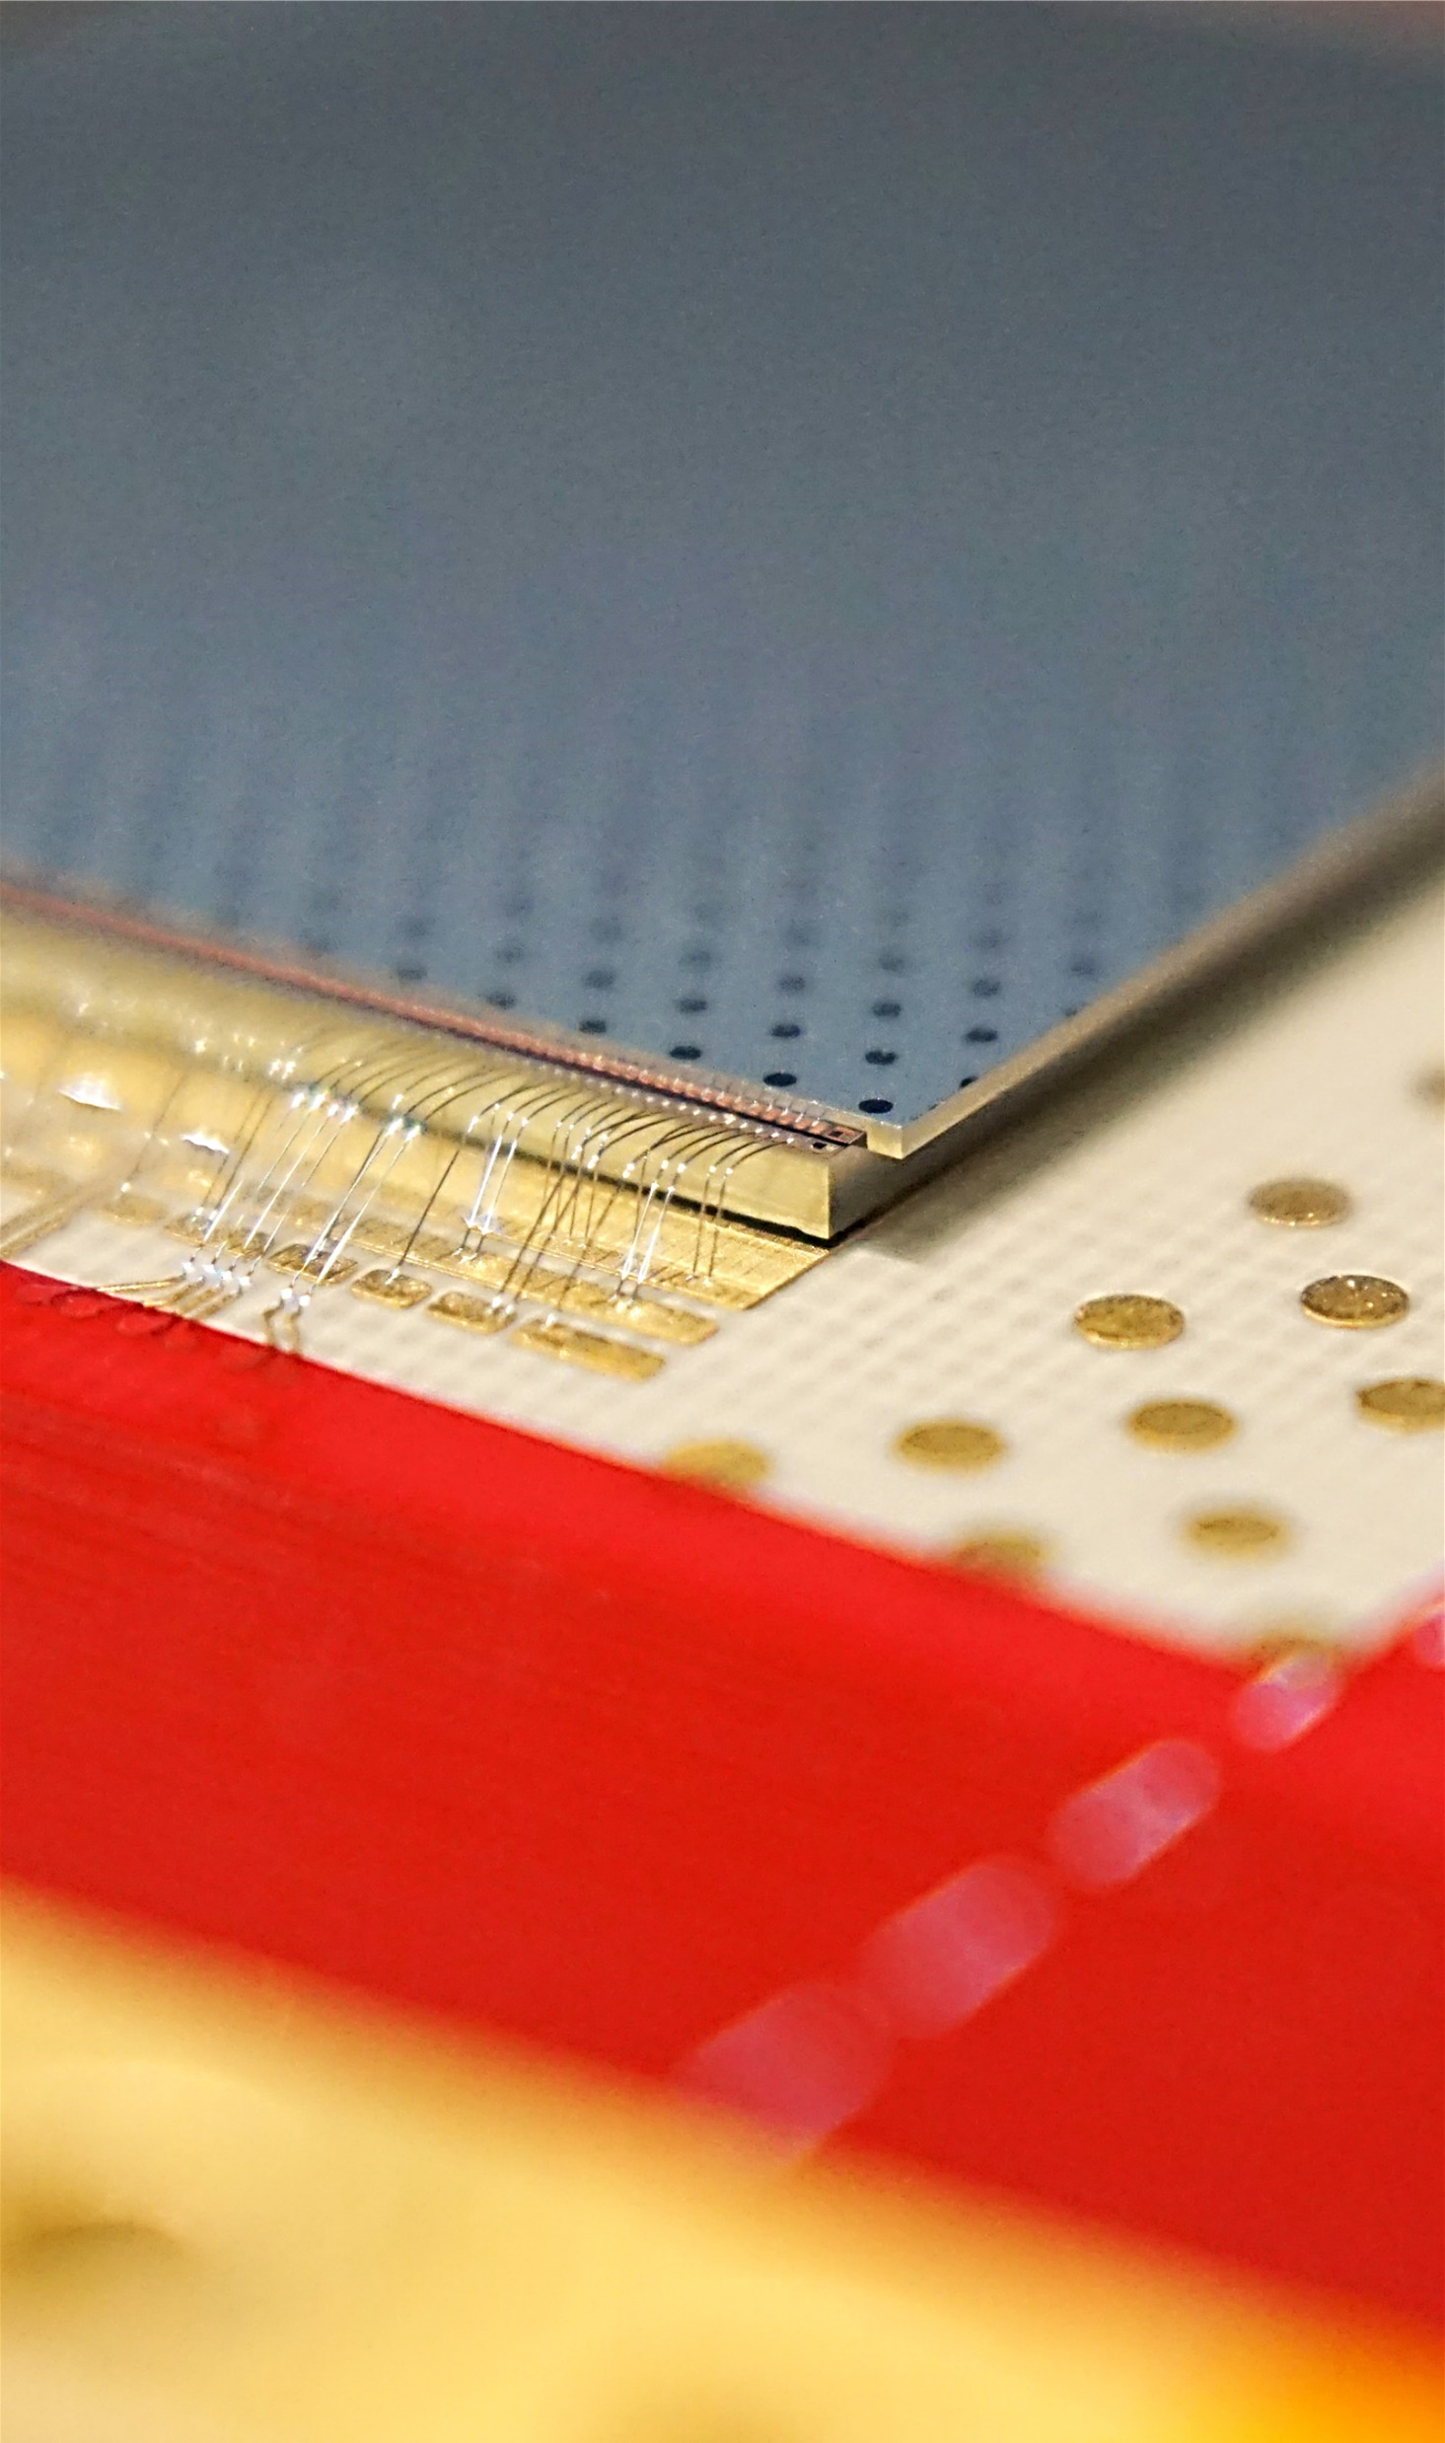
Long history of sensor development with Timepix1-4
Silicon
Sensor
LHCb VELO sensor
qualification with Timepix3
Wirebonds
Timepix4
InGrid/Gridpix on Timepix1
Silicon sensor on Timepix4
We use Timepix primarily for charged particle tracking
But also some photon (visible & X-ray) detectors
Focus changed from Gaseous to Semiconductor sensors (mainly silicon)

Slide 3
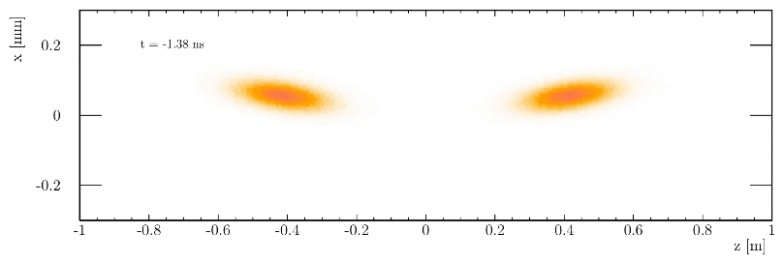
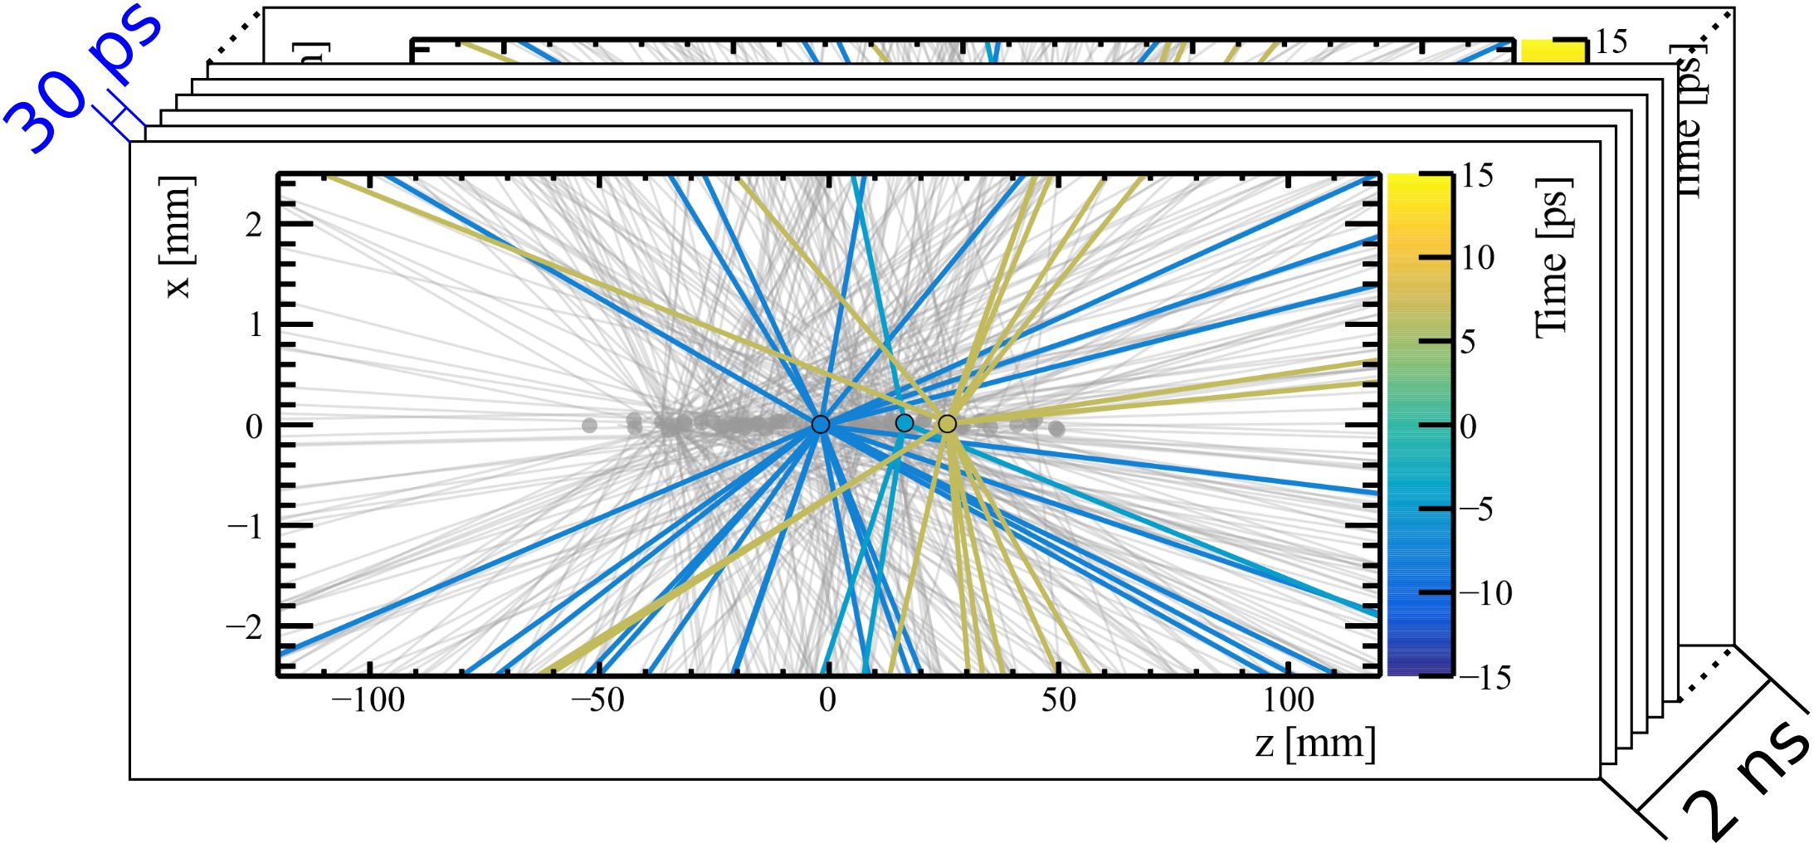
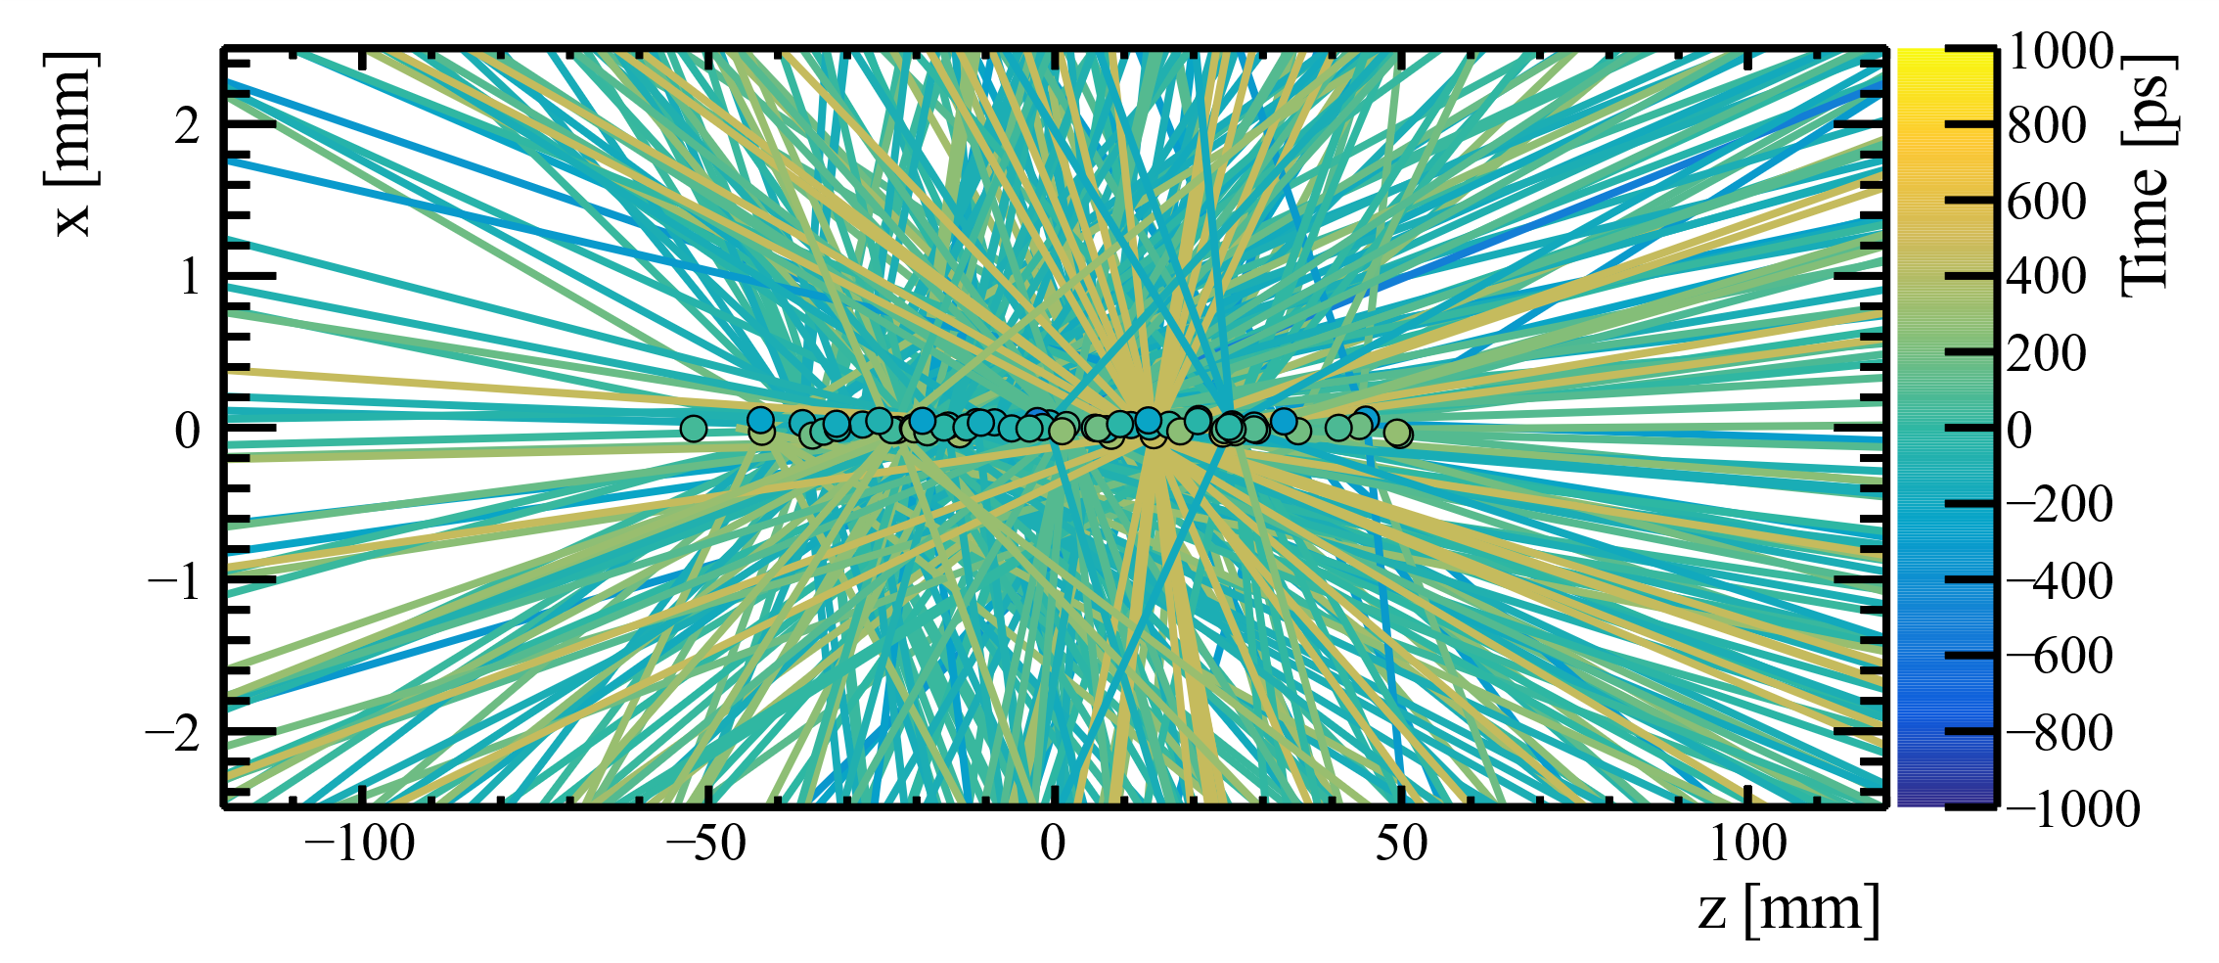
Why timing: 4D tracking
Courtesy Tim Evans
Future accelerators have an increasingly complicated tracking environment
Time is important for the track reconstruction; separation of tracks in time
Fewer tracks per time ‘frame’ → simplifies reconstruction
0.5 mm
2 meter
Single bunch crossing
Timing
2 ns → 30 ps
© LHCb collaboration

Slide 4
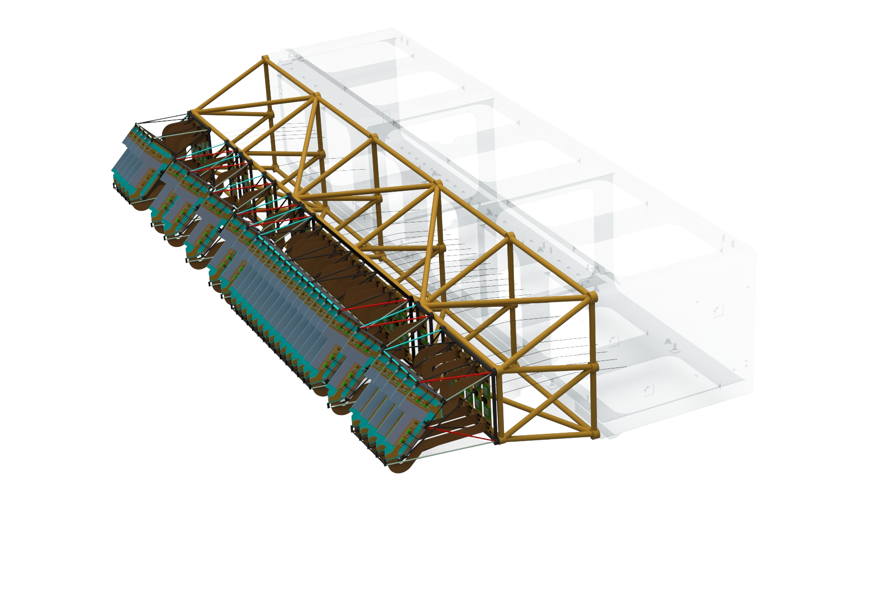
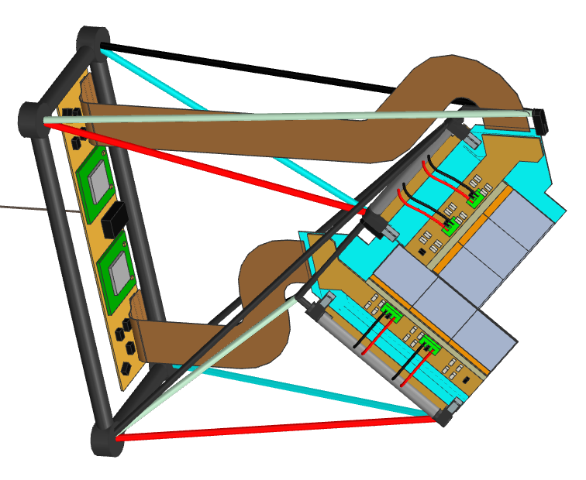
Requirements for 4D trackers
Time resolution of order 50 ps per hit/pixel
Spatial resolution of 10 μm
High readout bandwidth of tens of Gbit/s/cm²
Radiation >20 MGy (5x10¹⁶ 1 MeV n_{eq} /cm²)
Large systems with 10⁷ to 10⁹ pixels
Up to several square meters
of sensitive area
LHCb Vertex Locator
(Upgrade-II)
1 m

Slide 5
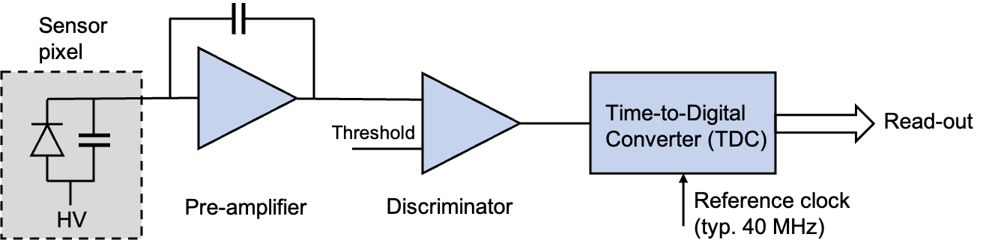
Silicon pixel sensors
Fast silicon sensors consist e.g. of p-type silicon bulk with n-type pixel implants
Effects relevant for good time resolution mostly happen below the surface
Pixels have a non-zero thickness -> ‘voxel’
Timepix

Slide 6
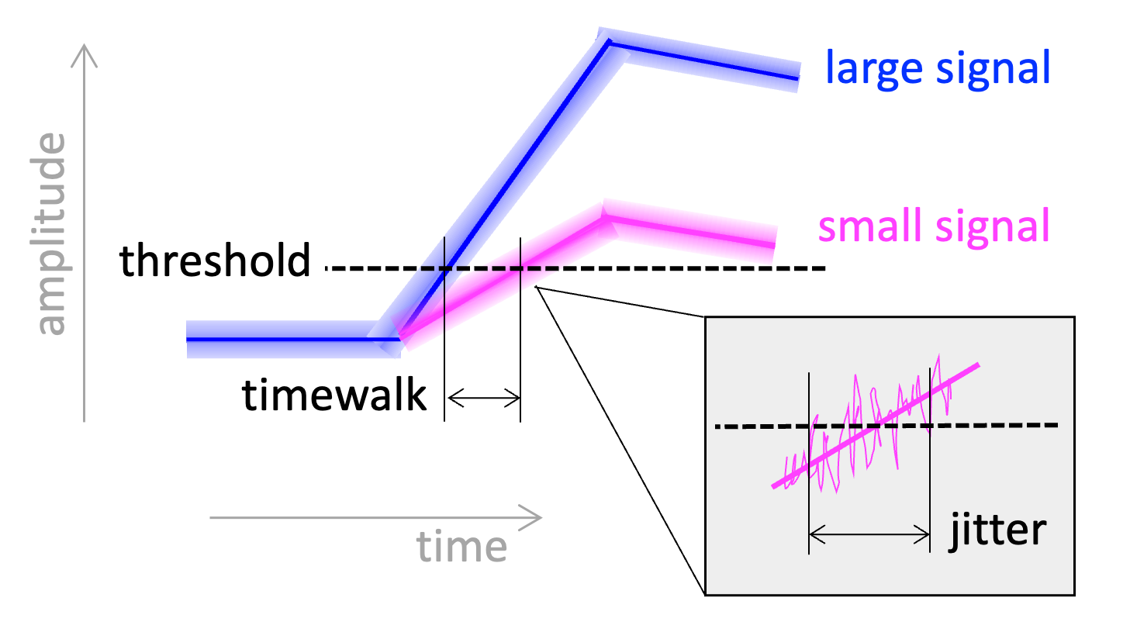
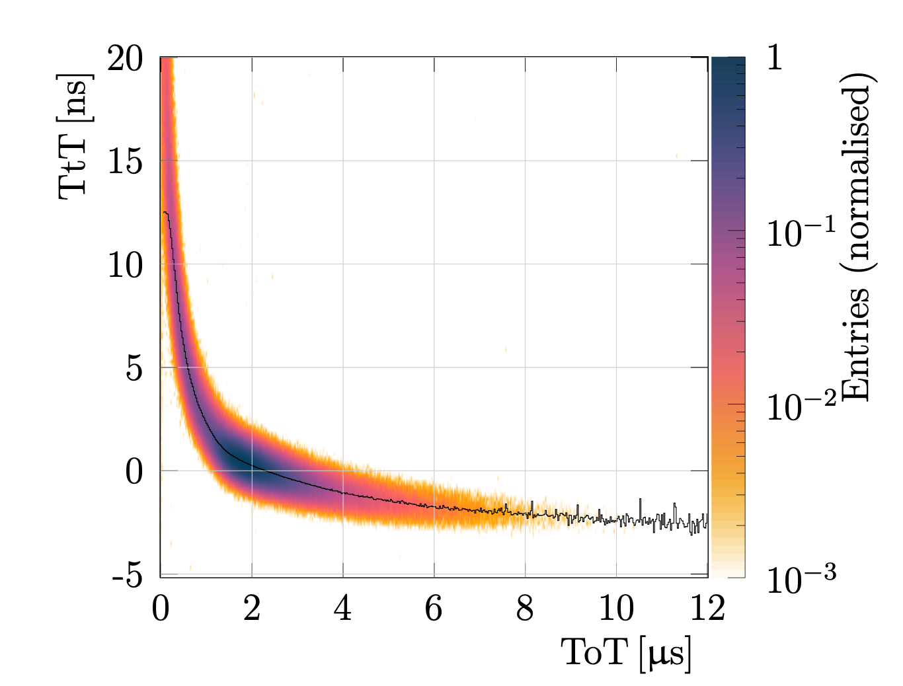
Time resolution
Timewalk [ns]
Time resolution =
σ_{t}²(sensor) +
σ_{t}²(jitter) + σ_{t}²(timewalk)
+ σ_{t}²(TDC)
Need:
Large signal
Short rise time
Low threshold
Limited by pixel
area and power
Need:
High Signal-to-Noise
Short rise time
Signal [a.u.]
[K. Akiba, DOI 10.1088/1748-0221/18/02/P02011

Slide 7
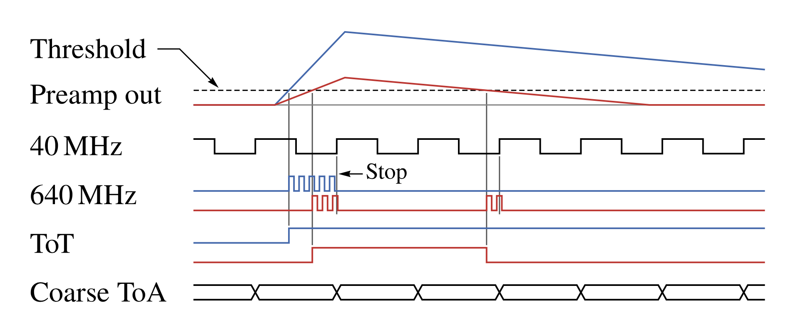
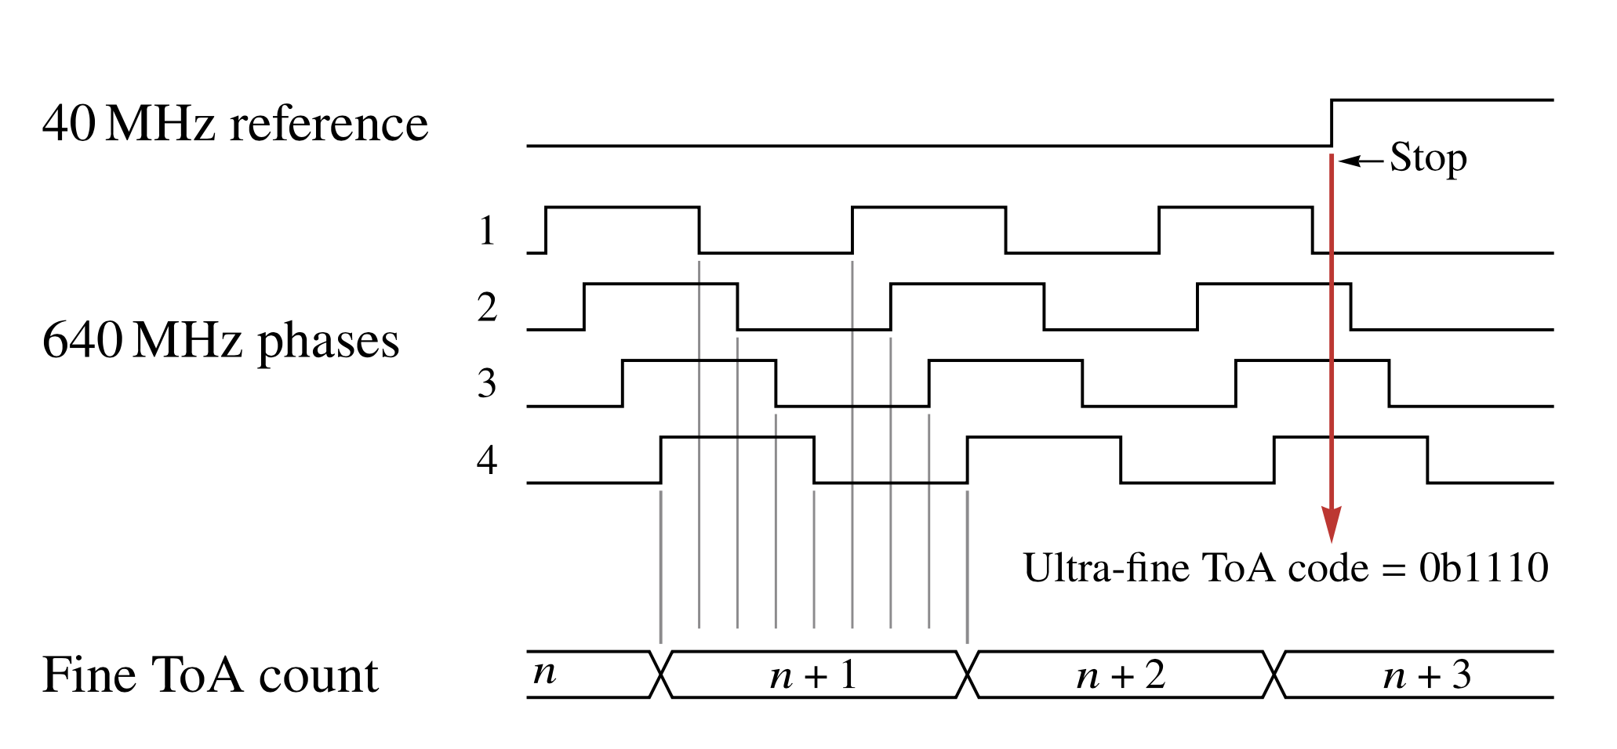
Time measurement with Timepix4 ASIC
Base clock of 40 MHz
Hit starts local 640 MHz oscillator (VCO)
1.56 ns bins nominally
Count #clock cycles = fToA (count)
VCO per group of 2x4 pixels
Oscillator is stopped by first rising edge of 40 MHz clock
Time-over-Threshold is representative for signal amplitude
In addition the internal state of ring oscillator is captured –> 195 ps bins (56 ps_{rms})

Slide 8
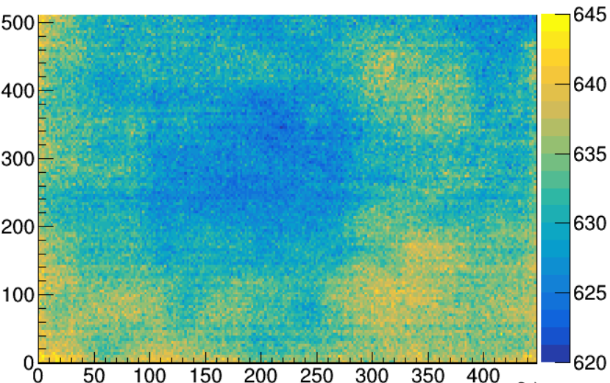
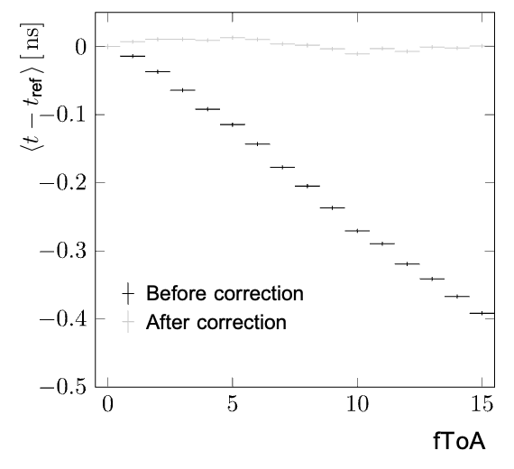
Does Timepix4 have a good resolution out of the box?
The nominal VCO frequency is 640 MHz
However, there is a significant frequency spread across the matrix (VCOs are not identical)
Without correction, time resolution can increase by by hundreds of picoseconds
-> Have to (be able to) determine the VCO frequency of each pixel
Row
Frequency [MHz]
400 ps
10 MHz difference
= 400 ps over 25 ns
Col
25 ns
K. Akiba, arXiv:2503.15207
arXiv:2503.15207

Slide 9
How we test our sensors

Slide 10
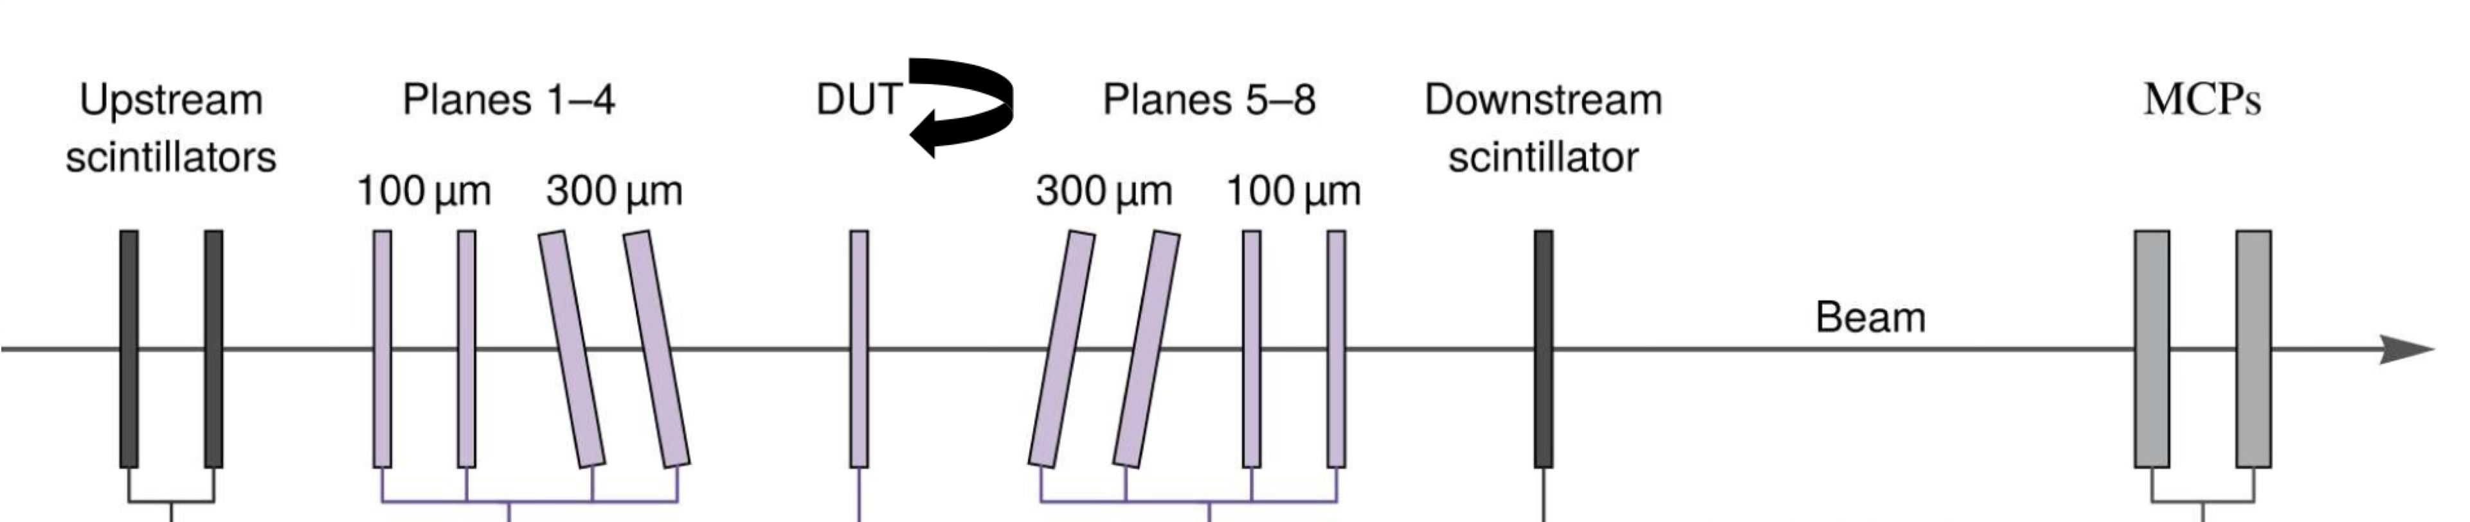
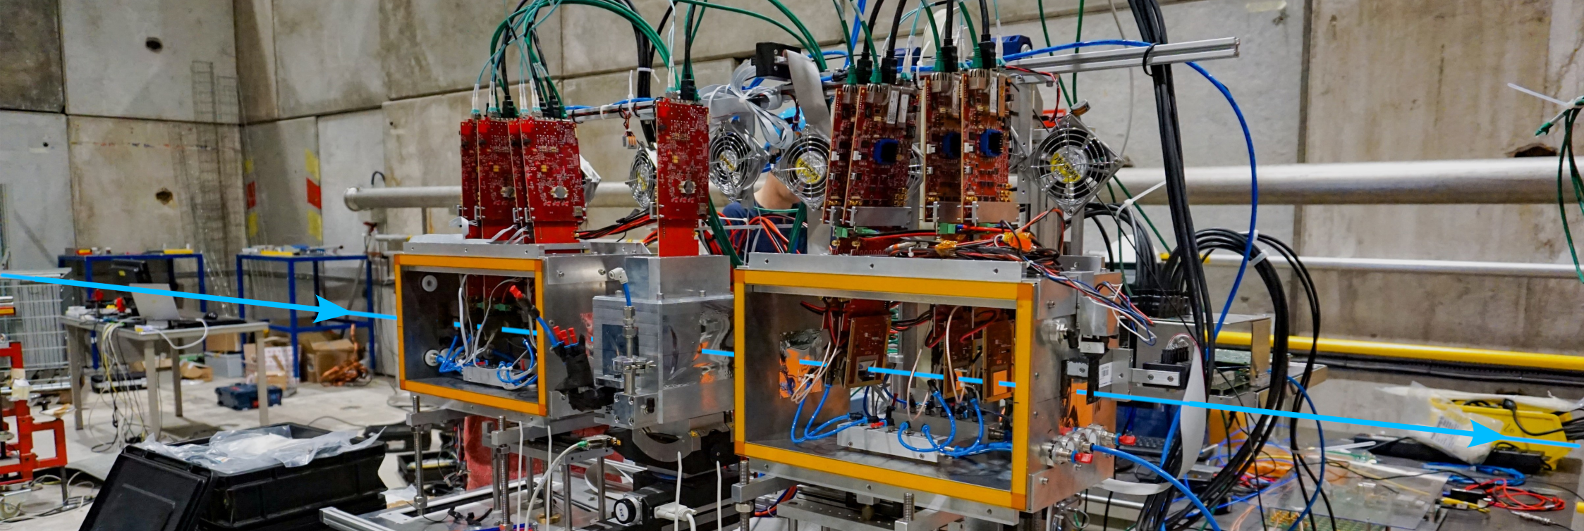
Timepix4 beam telescope at SPS H8 beam line

Slide 11
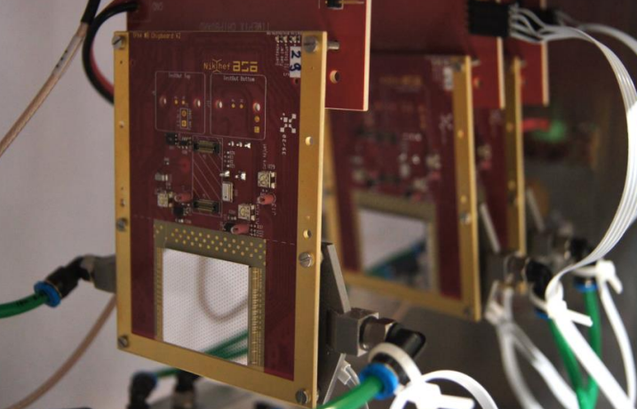
Telescope performance
180 GeV/c mixed hadron beam
2-3 μm pointing resolution
Allows intrapixel studies
12 ps time resolution with MCP
~ 90 ps with timepix4 only
4D-tracking demonstrator
Timepix4

Slide 12
How sensors affect timing

Slide 13
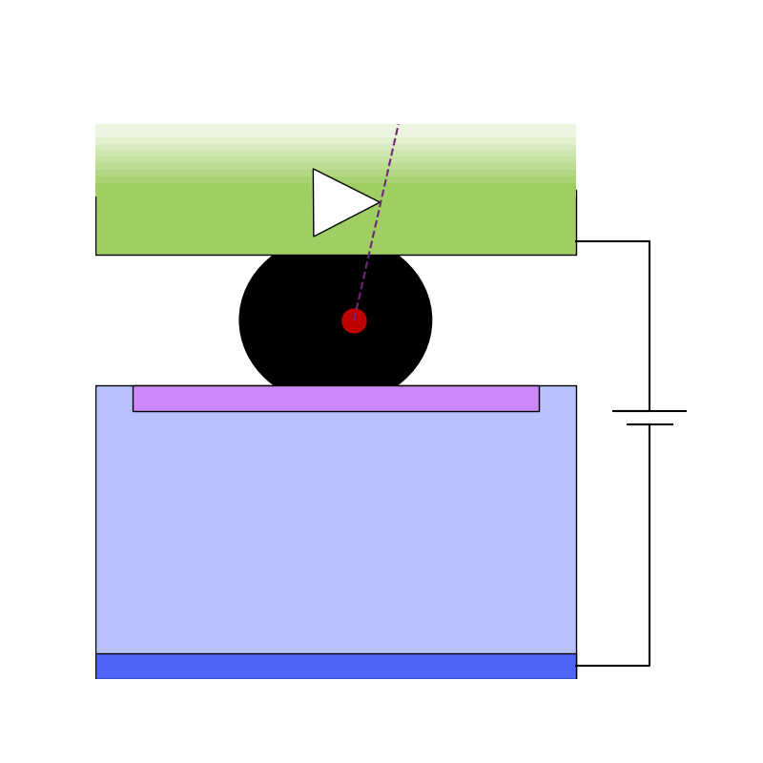
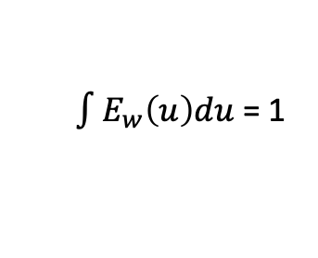


A closer look at the sensor: signal induction
Current is induced in the electrodes when charges move
Both the electrons and holes induce current
described by Ramo-Shockley theorem
Weighting field E_{w} describes the coupling between location of the charge and the collecting electrode(s)
E_{w} defined by the geometrical arrangement of electrodes
$$i\left(t\right)=q\vec{v (x,y,z)}∙ \vec{E_{w}(x,y,z)}$$
$$and v=f(Edrift)$$
$\int{E_{w}\left(u\right)du}$ = 1

Slide 14
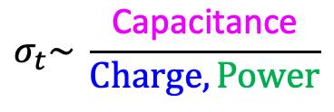
How to get good time resolution (electronics viewpoint)
$$σ_{t}\sim \frac{\text{Ca}\text{pacitance}}{Charge, Power}$$
Time resolution
Minimise capacitance C
Small pixel -> can fit less functionality per pixel
Small electrode -> less uniform fields -> more sensitive to drift time differences
Maximise signal Q in shortest possible time (dQ/dt = current)
Short drift distance, high drift speed (large bias voltage), avalanche gain
Large power P
Last resort, ‘costly’ in terms of material needed to provide power and cooling

Slide 15
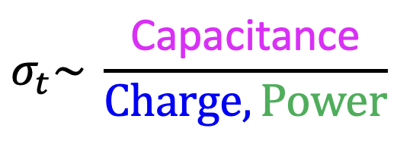
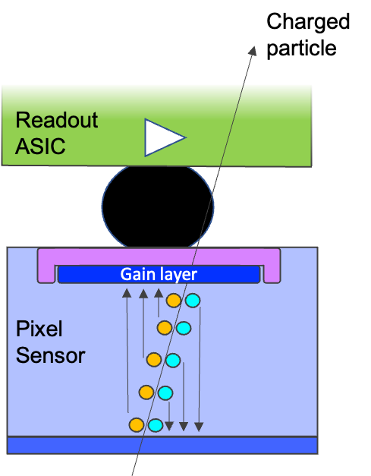
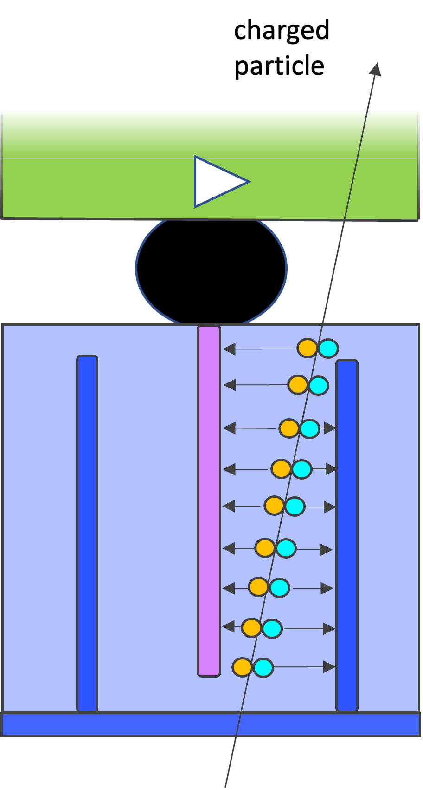
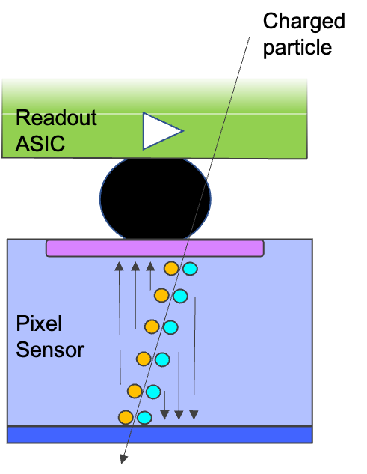
Overview of different hybrid sensors
Low Gain Avalanche Detector (LGAD)
3D
Planar
Small signal if thin
Medium capacitance
Reasonably rad. hard
Large signal (gain)
Medium capacitance
Modest rad. hard
Large signal (thick)
Rad. Hard (shown 3E16)
High capacitance
More material

Slide 16
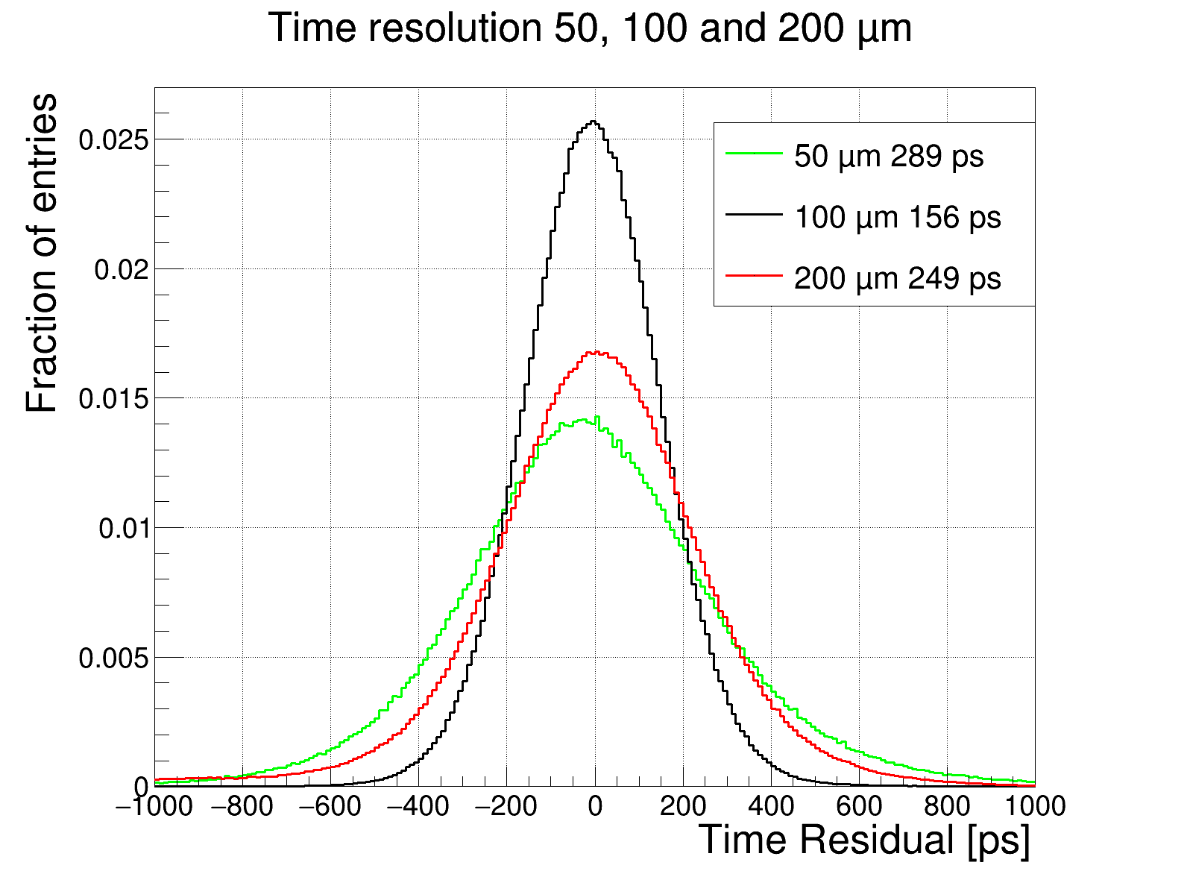
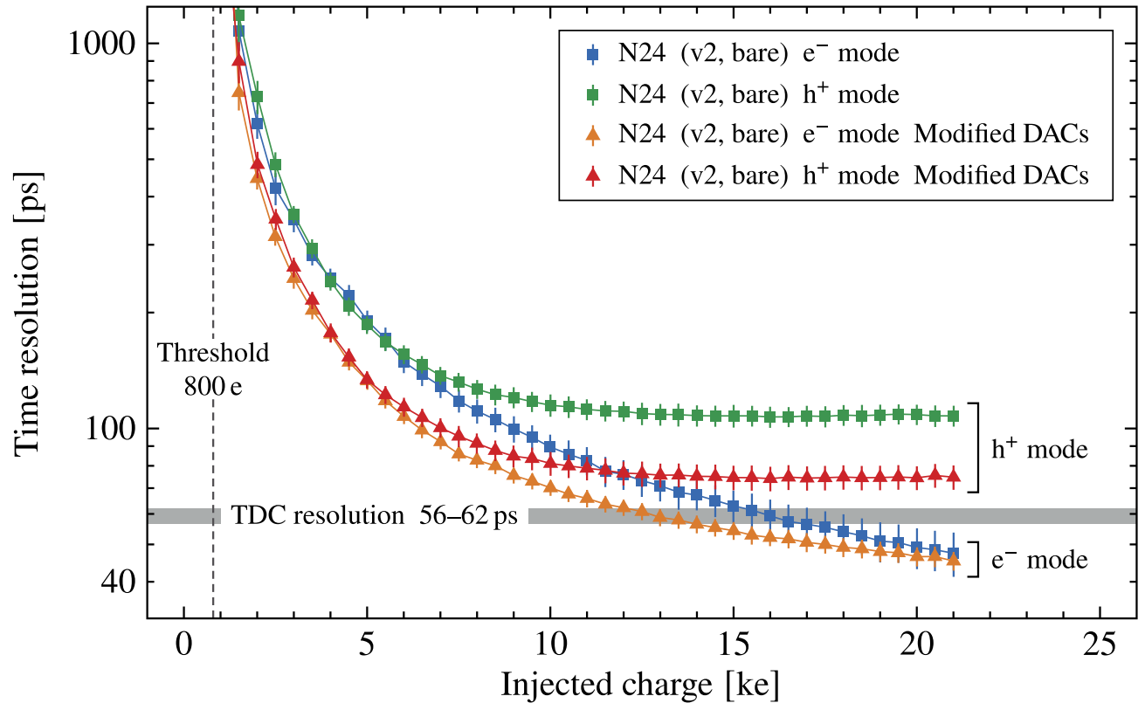
What can be achieved with planar sensors?
Planar (electron collecting) sensors on Timepix4 as benchmark
Though thicker sensors give more signal, time resolution does not improve
Drift time is too long; ‘extra’ charge arrives too late
Very thin sensor do not provide enough signal; front-end jitter dominates
50 μm
100 μm
200 μm
Preliminary
Testpulse
No sensor
[K. Heijhoff, DOI: 10.1088/1748-0221/17/07/P07006]
Mean time resolution of the TPX4 analog front-end versus injected charge

Slide 17
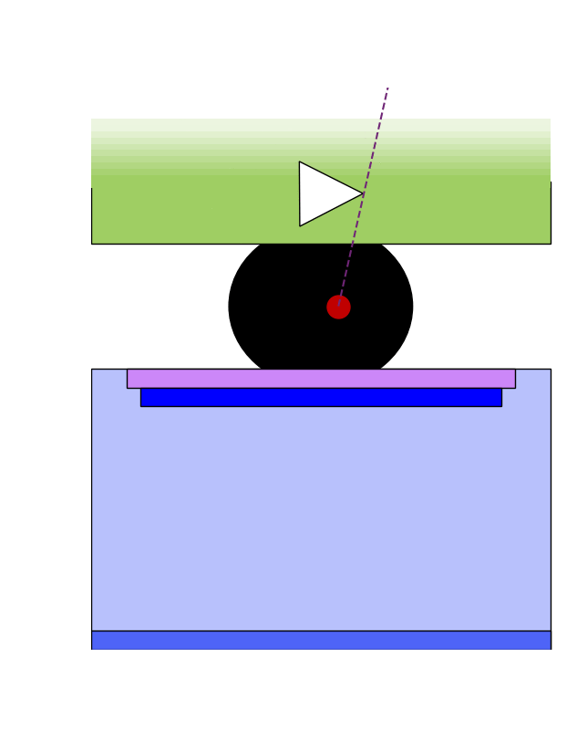
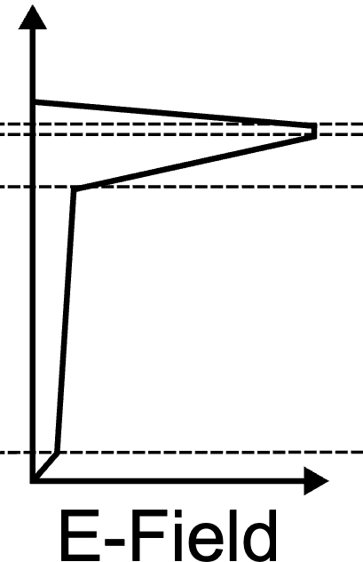
Low Gain Avalanche Detector (LGAD)
Avalanche multiplication in a high electric field
High E-field from high (acceptor) doping level
Sensitive to radiation damage
Electrons ( ) accelerate, collide and liberate extra electrons, which in turn liberate more electrons
Most of the induced current is from the
backward travelling holes ( )
Aim for gain of order 10
Atlas / CMS achieve ~30 ps resolution with
1 mm ‘pixels’ in a 50 μm thick sensor
Accelerate
Accelerate
Collide
Accelerate
Collide
Accelerate
Gain layer

Slide 18
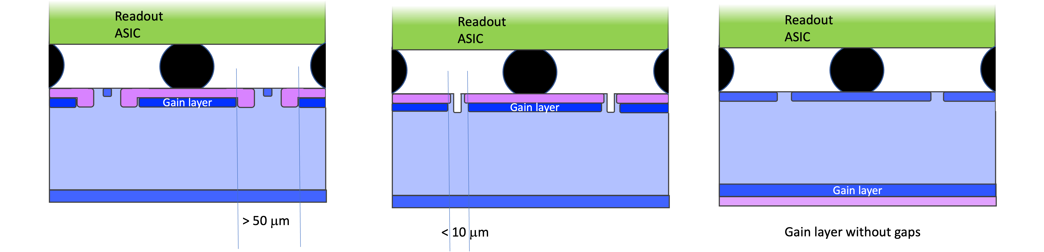
What about LGADs with small pixels?
Regular LGADs have a ‘dead’ (no-gain) region between pixels of > 50 μm
Junction termination extension (JTE) because of high E-fields
Not a problem for ATLAS/CMS size pixels
But very low efficiency for small pixels
Alternatives: trench isolation (TI-LGAD), inverted LGAD
'regular’
(JTE + p-stop)
Trench isolated
Inverted LGAD
JTE
p-stop

Slide 19
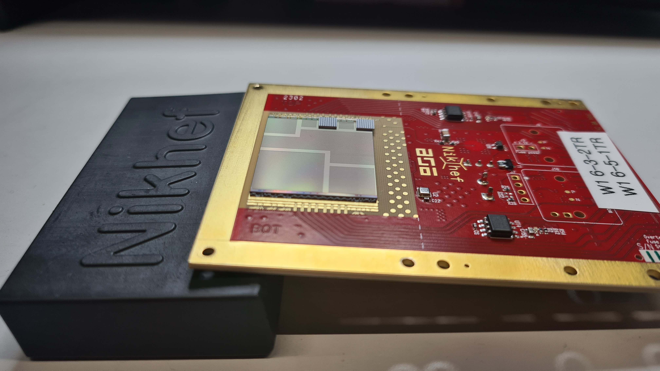
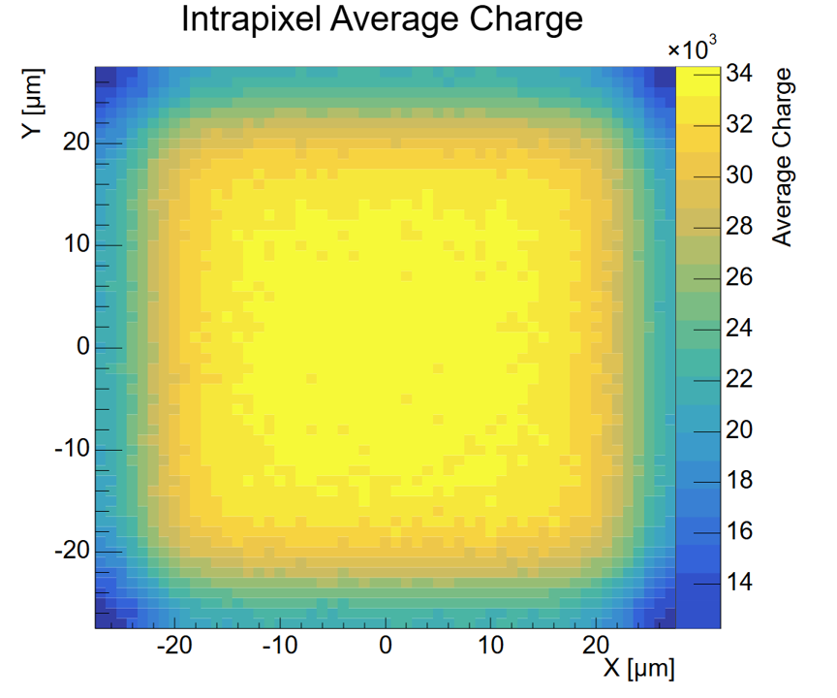
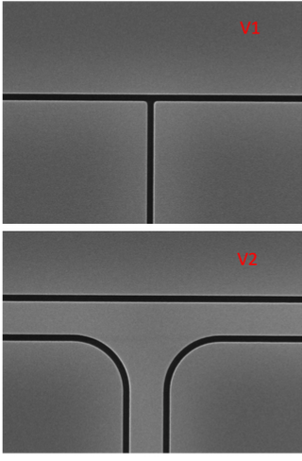
TI-LGAD on Timepix4
here they are
Tested multiple sensor variants
1 or 2 trenches
Different distance gain layer to trench
Different doping levels, Carbon co-implantation (radiation hardness)
Top view, single pixel
1 and 2 trenches
Preliminary
Gain of ~11
Best time resolution achieved is 99 ps
For the innermost 40% of the pixel
Expect improvement by cooling the sensor, and higher voltage operation

Slide 20
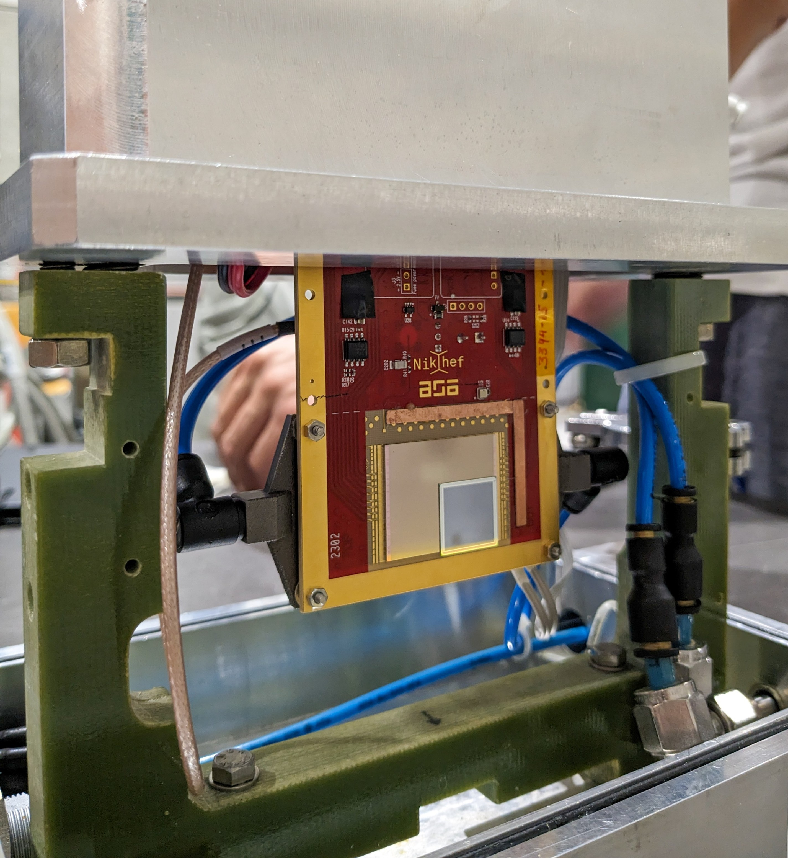
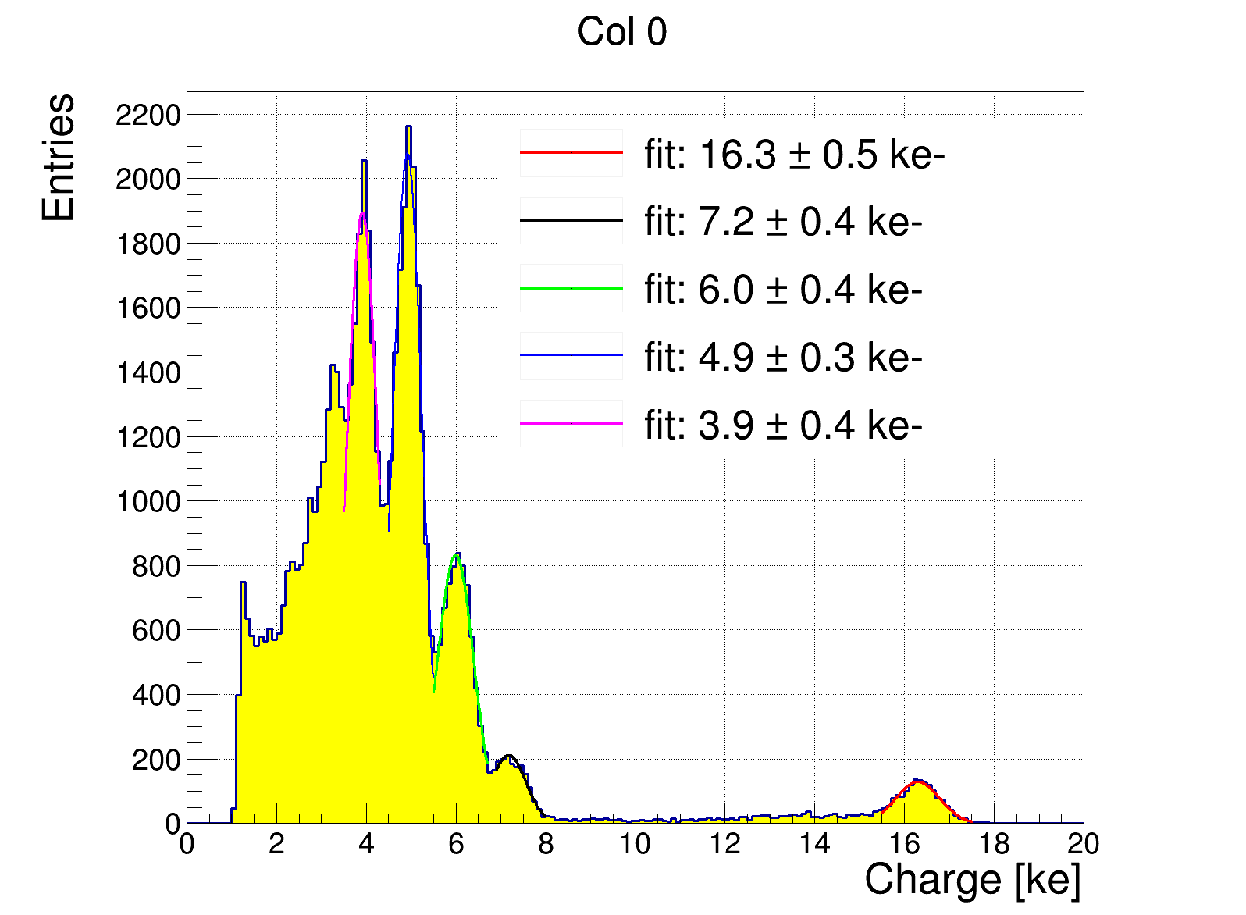
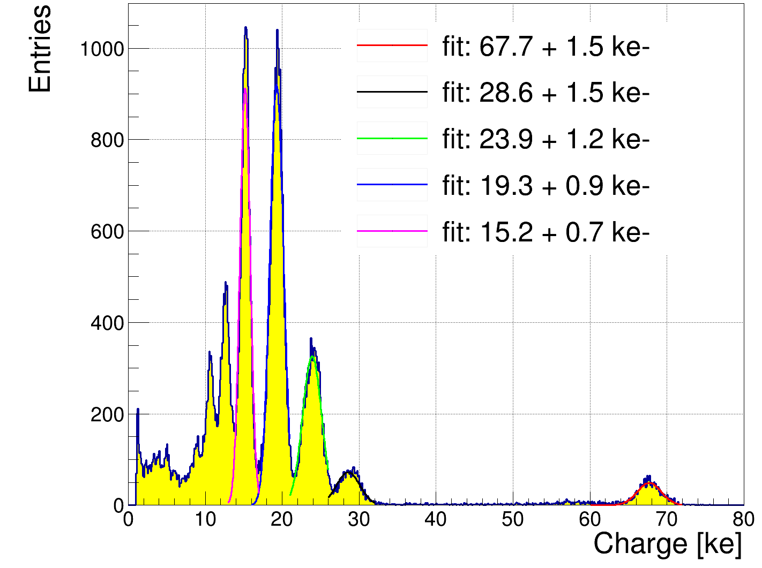

Inverted LGAD (provided by Glasgow University)
Continuous gain layer on back side -> uniform response across pixel
Hole collecting devices -> Timepix4 front-end not optimal
Currently we only have 250 μm thick sensors, with a gain of only ~4
Hence time resolution is not great, ~370 ps
Unfortunately, two thin sensor productions failed
These are still very interesting devices for studies, not only timing
14 mm
No gain region
Am-241 spectrum
Gain region
14 mm
Preliminary
Preliminary

Slide 21
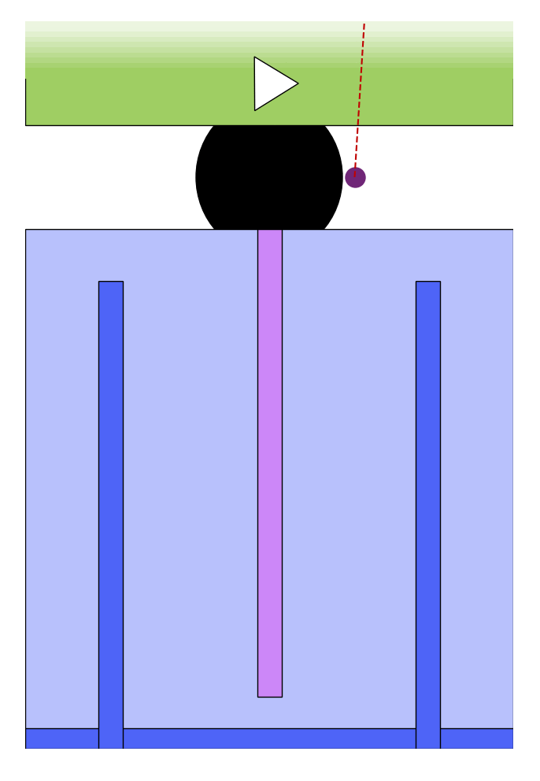
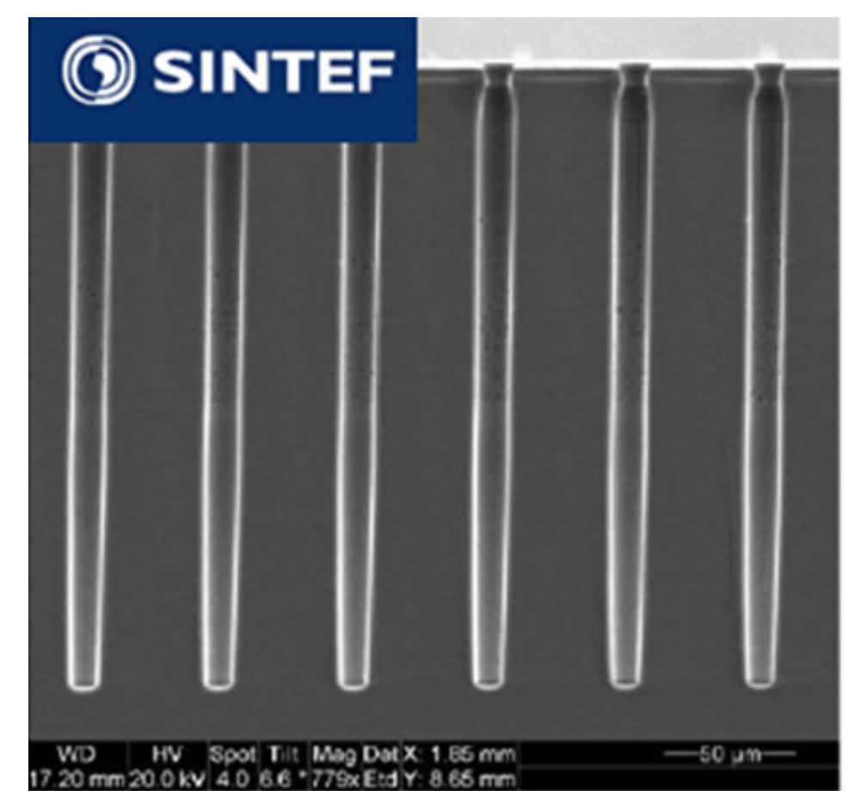
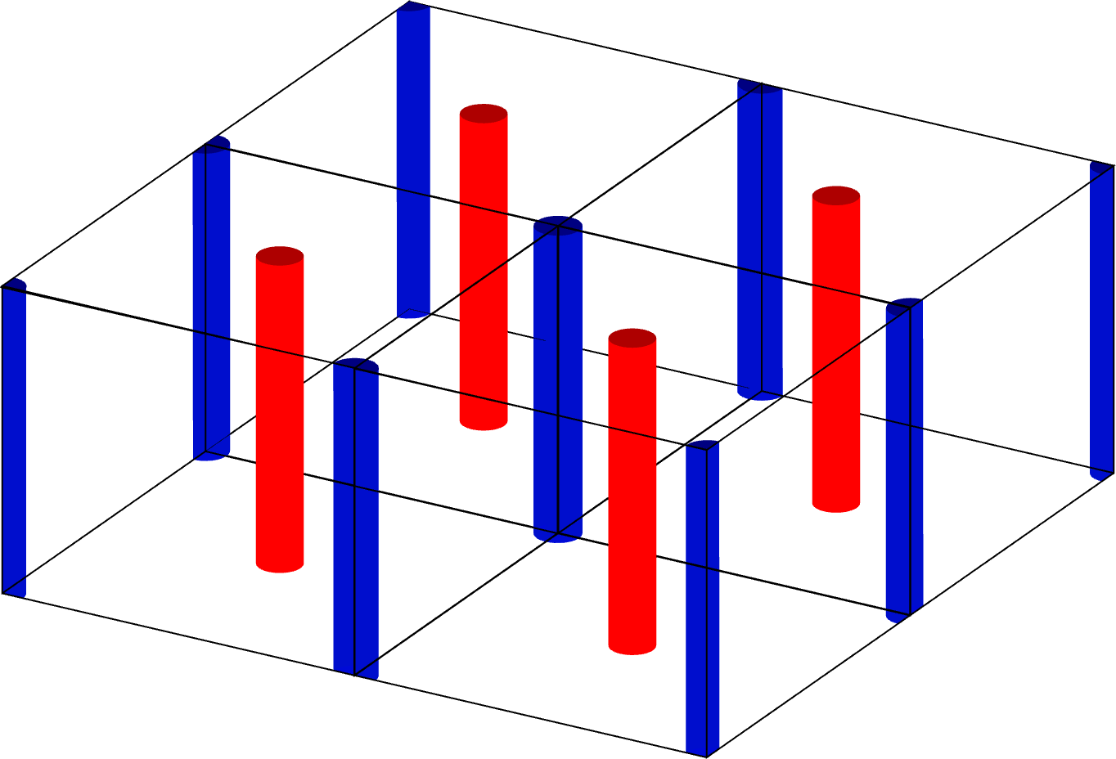
3D silicon sensors
The electrodes of 3D sensors penetrate the silicon bulk
Electron-hole pairs drift perpendicular to track direction
Track length (= signal magnitude) decoupled from drift distance
O(5 μm) holes etched via Deep Reactive Ion Etching (DRIE), then doped
Shown to be sufficiently radiation hard

Slide 22
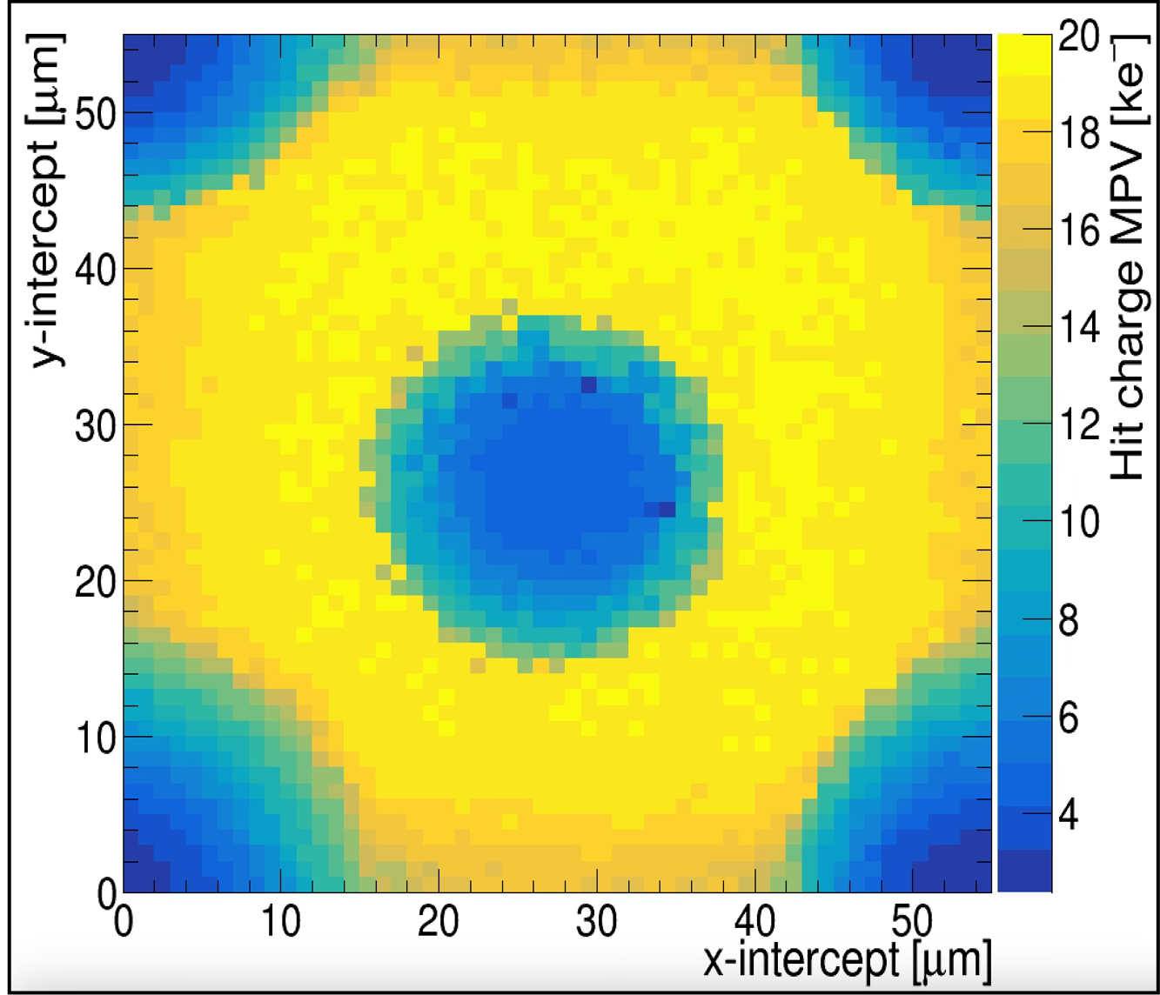
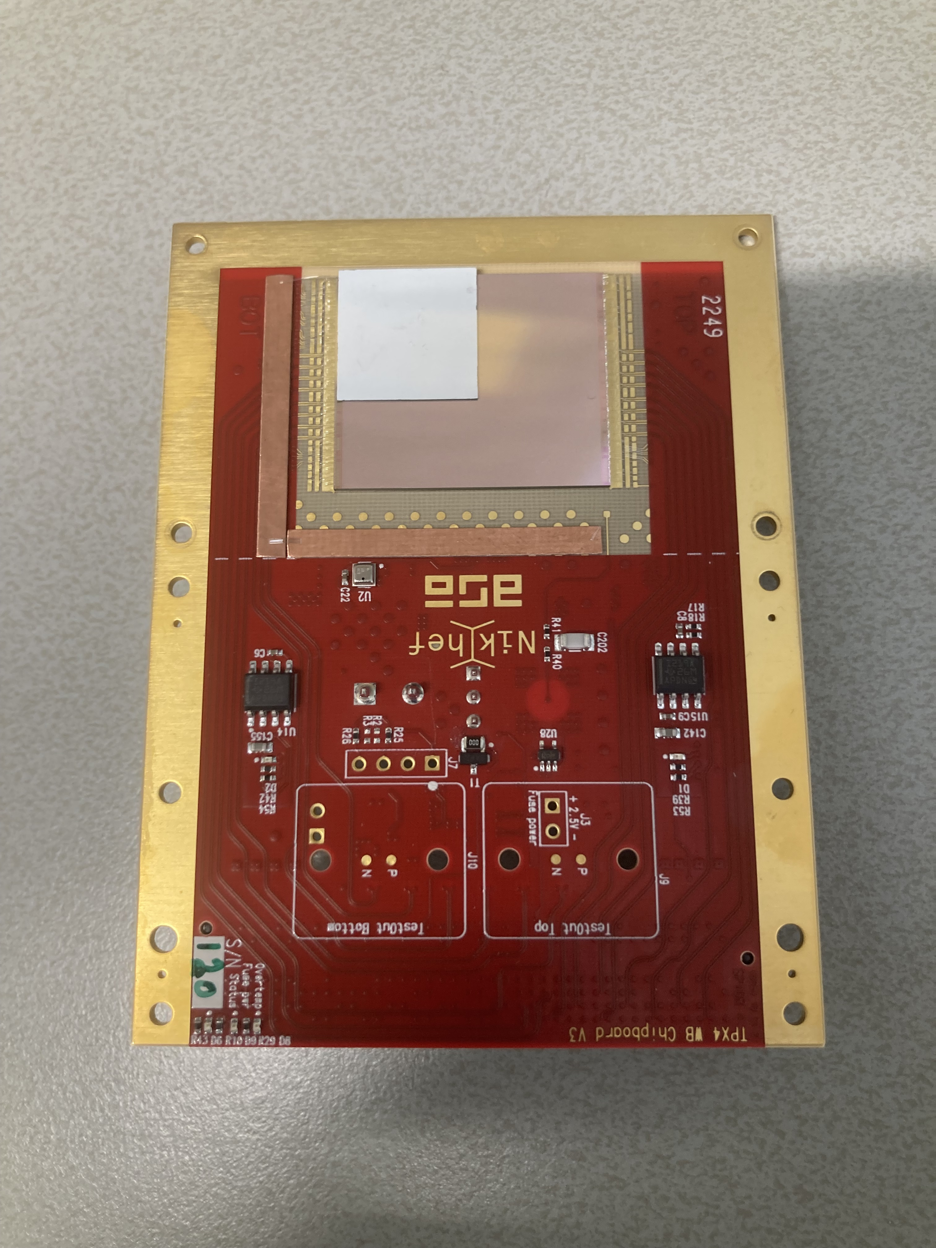
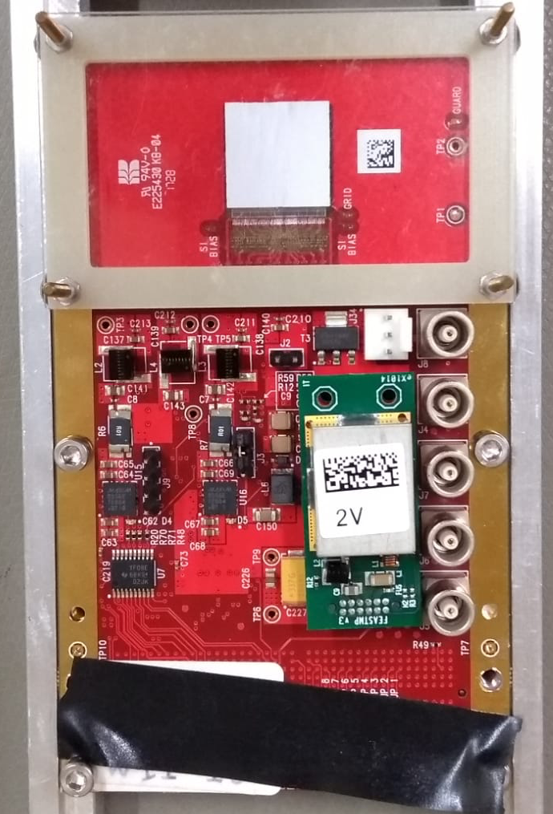
3D sensor on Timepix3 and Timepix4
Recent sensor batches suffer from excessive leakage current
Hence, transplanted old 3D sensor (2012) from TPX3 to TPX4 (by Advafab)
Unfortunately hole collecting, and large diameter pillars
Timepix3
Timepix4

Slide 23
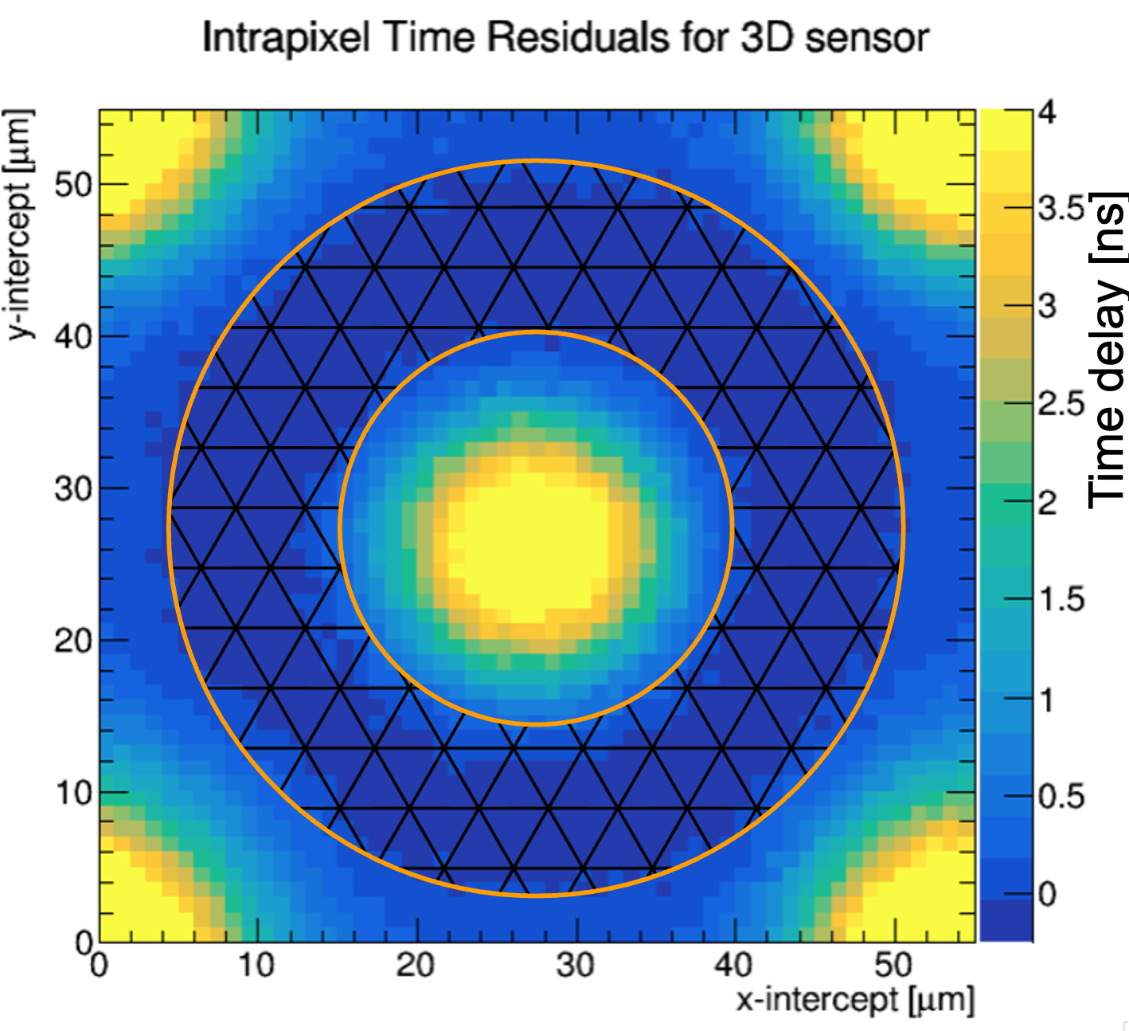
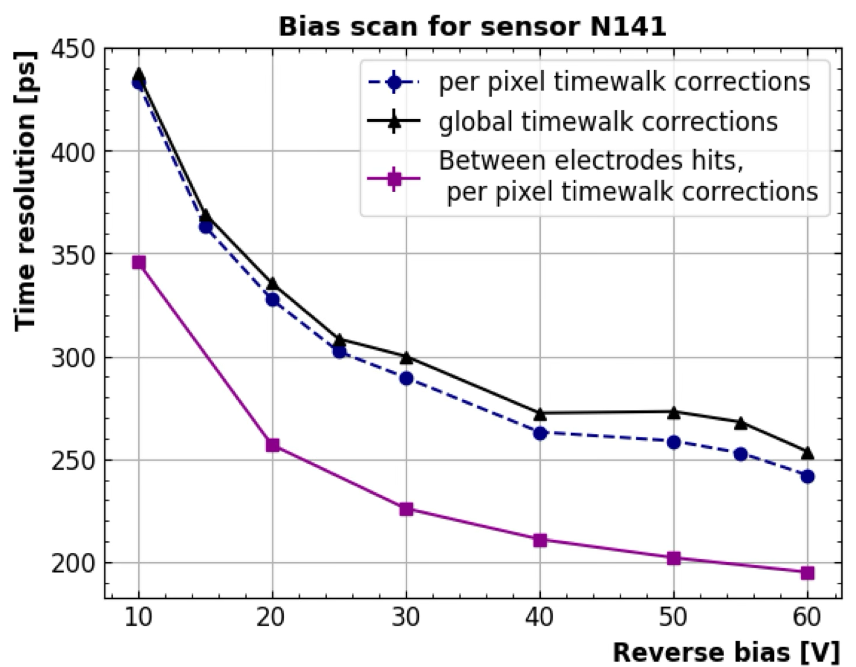
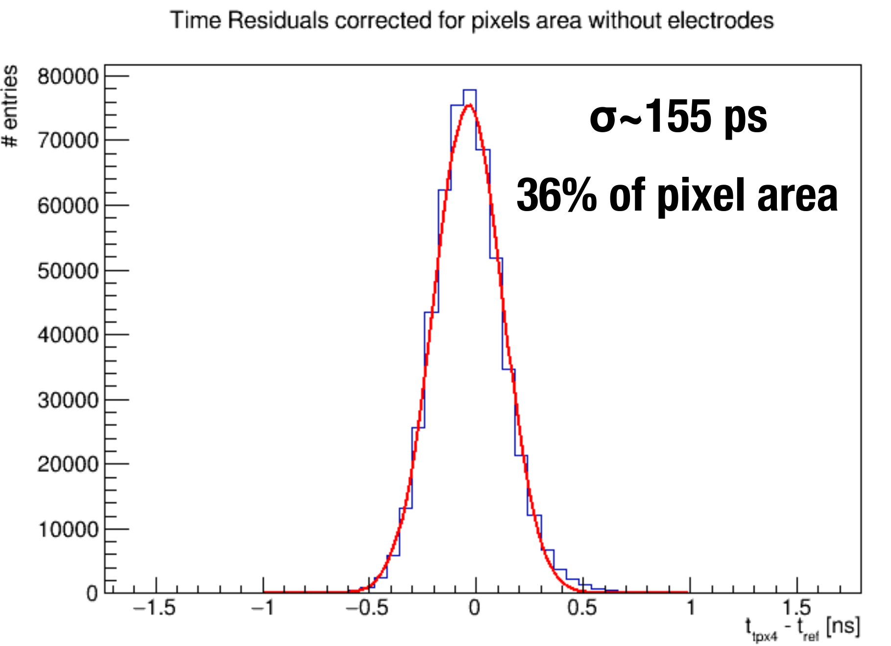
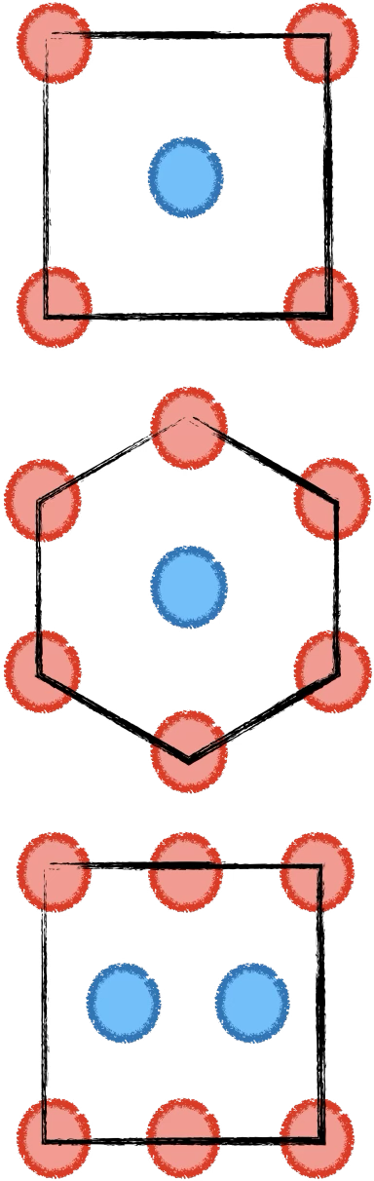
3D time resolution
Preliminary
New sensor productions are being launched
Narrower and shorter pillars (lower capacitance)
Electron collecting
Different layouts
Preliminary

Slide 24
Summary
The Timepix family provides an excellent platform for testing novel sensors in realistic conditions
Large number of pixels, which brings corresponding challenges
In addition to ‘single pixel’ performance tests
Why Timepix?
ASICs with superior performance, thanks to a world class design team
Many operation modes, tuning options -> flexibility / versatile
Excellent support
Benefits of a large and very active collaboration
What’s next?
More sensors with gain: thin iLGAD, TI-LGAD, AC-LGAD, SPAD, SiEM
3D sensors with lower capacitance, and possibly with gain
Other sensor material such as SiC

Slide 25
Thank you!

Slide 26
Backup slides

Slide 27
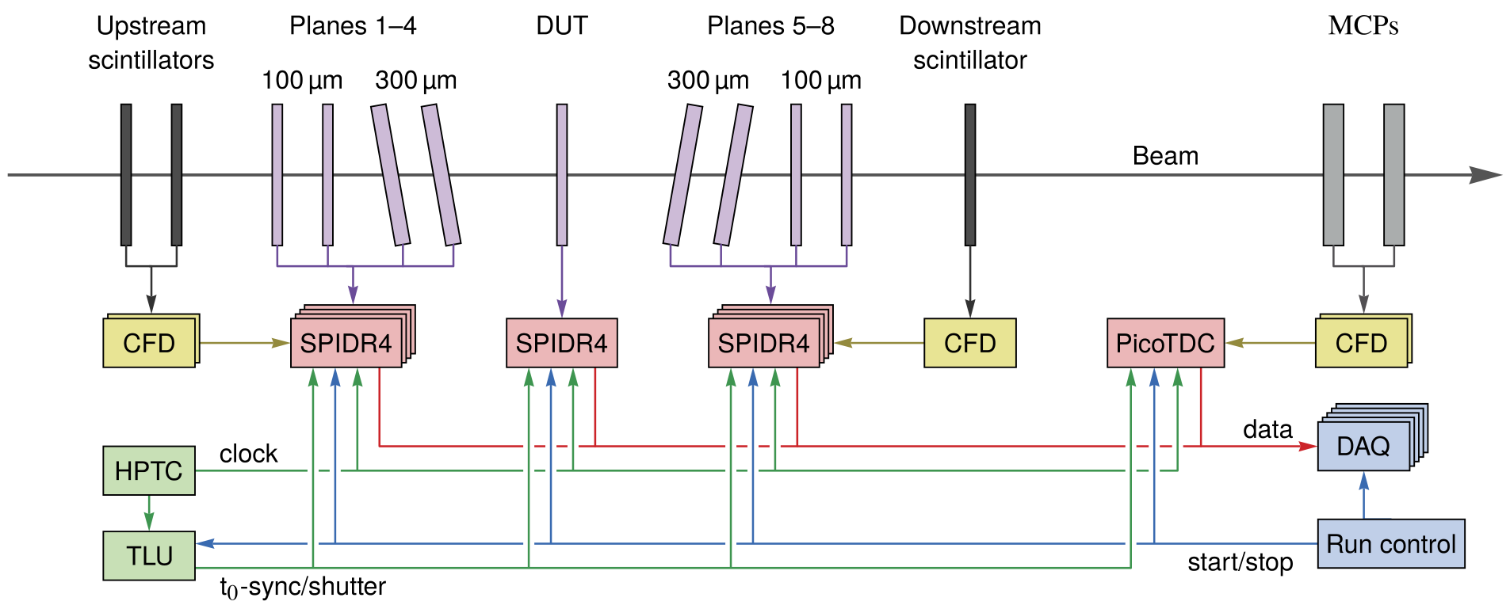
Timepix4 telescope configuration
12 ps time res.
Writing paper with performance of Timepix4 telescope

Slide 28
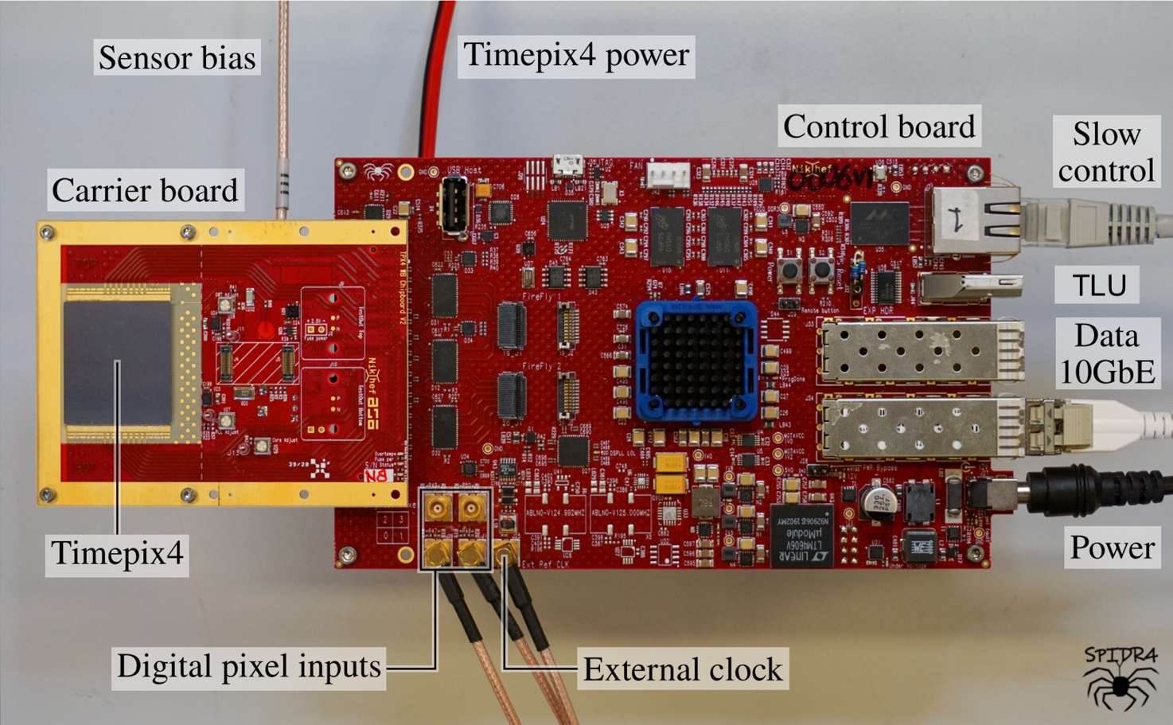
Timepix4 and SPIDR4 readout
Sensor
Wirebonds
Timepix4
512x448 pixels, 55 um pitch

Slide 29
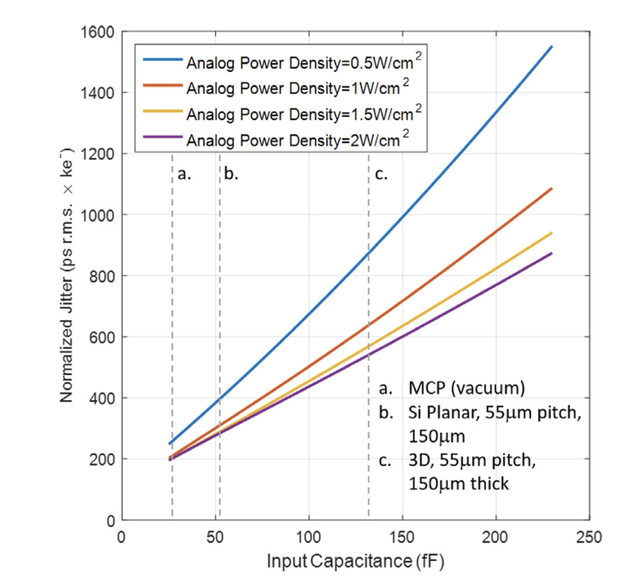


Simulation and example from a real sensor
$$σ_{t}{ Q}^{β}\sim \frac{C^{α}}{P^{γ}}$$
3D sensor, influence of capacitance on jitter
With testpulses
Disconnected pixel
R. Balabriga, https://doi.org/10.1016/j.nima.2022.167489

Slide 30


iLGAD at grazing angle
Current iLGADs are 250 µm thick
Perpendicular tracks not ideal for good timing:
Initial signal is small , and amplified signal is late / slow
And TPX4 threshold can not be set high enough to trigger on amplified signal
And, very non-uniform weighting field due to small pixels
Hence using grazing angle tracks to (partially) mitigate thickness effects
E. Dall'Occo et al 2021 JINST 16 P07035
[DOI: 10.1088/1748-0221/16/07/P07035]

Slide 31



Timewalk as function of depth in iLGAD
Timewalk curve is now a strong function of depth, while charge distribution is the same
For tracks near pixel implant, curve is dominated by small (non amplified) electron signal
For tracks near gain layer, curve is dominated by amplified hole signal
preliminary
preliminary
preliminary

