Slide 1
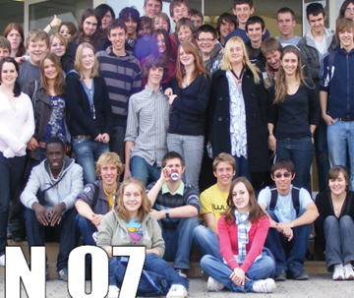
TIMEPIX@school
From small beginnings to
inspiring young people and their
teachers across Europe and beyond

Slide 2
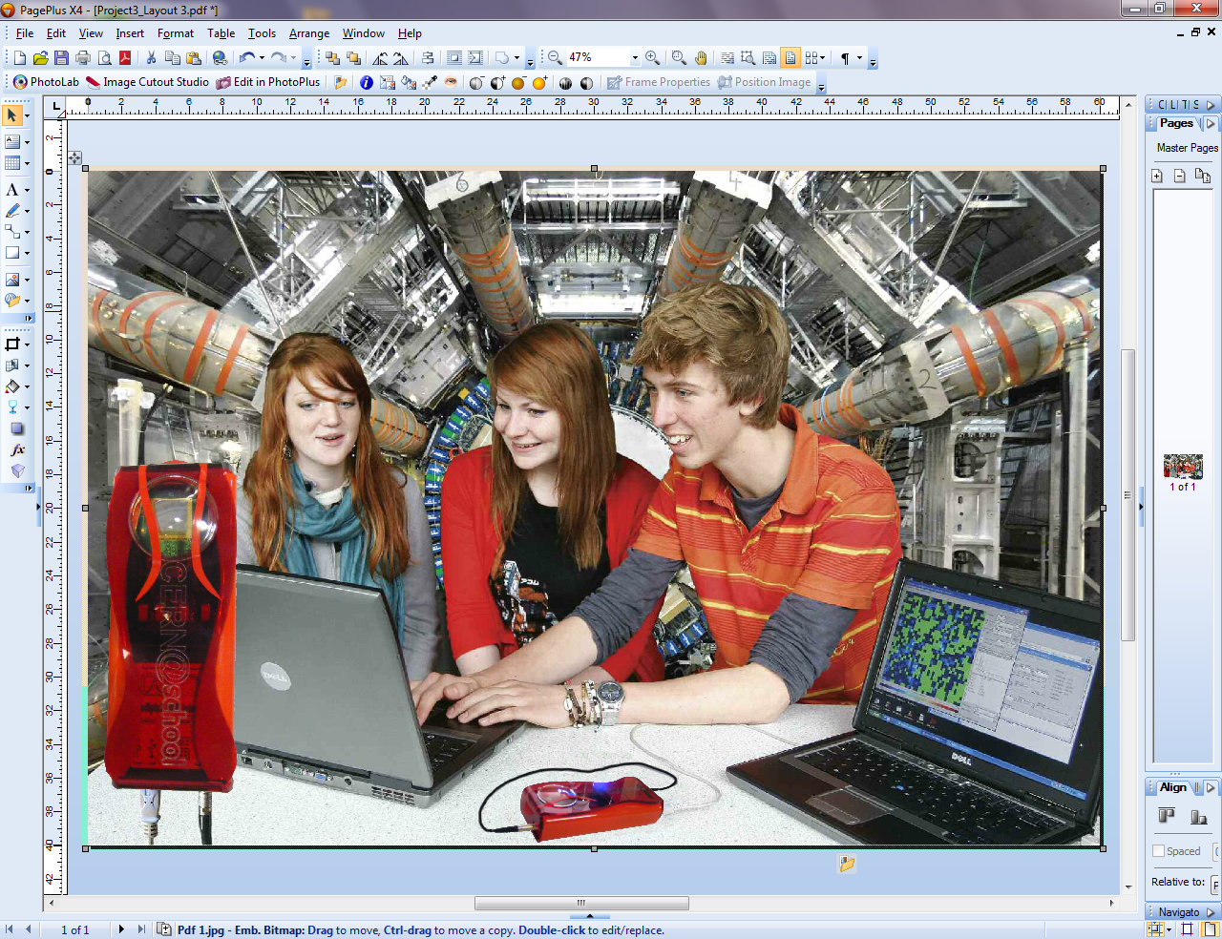

Slide 3
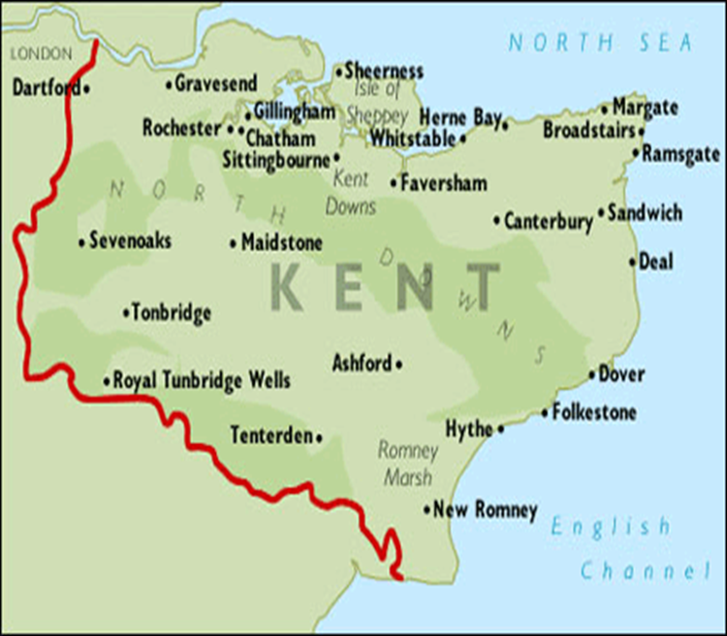
Original
pilot schools
Huge thanks to
Stanislav Pospíšil and IEAP for the original kits
Norton Knatchbull - Ashford
Fort Pitt - Rochester
Canterbury High – Canterbury
Simon Langton Boys – Canterbury
Cranbrook School – Cranbrook
Dartford Girls - Dartford
Dover Boys – Dover
St Edmunds - Canterbury
Oakwood Park – Maidstone
Maidstone Girls’ – Maidstone
Bennett Memorial – Tunbridge Wells

Slide 4
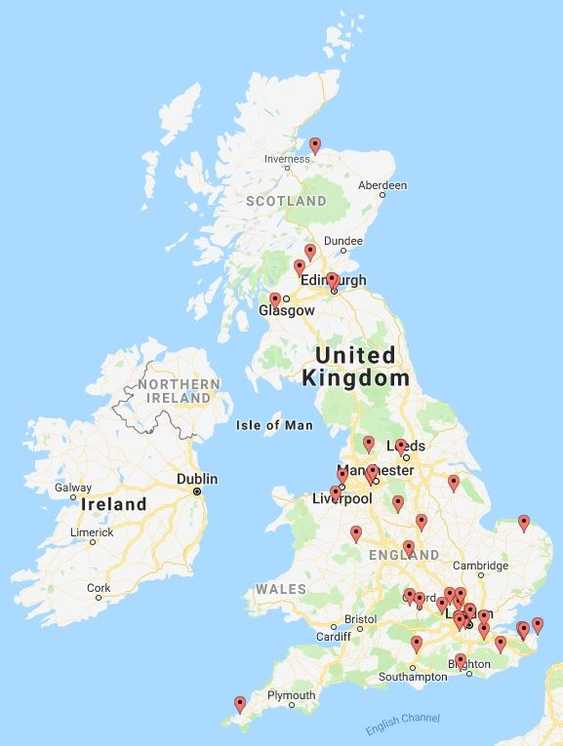
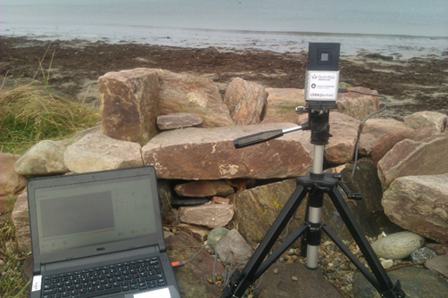
CERN@school
goes nationwide

Slide 5
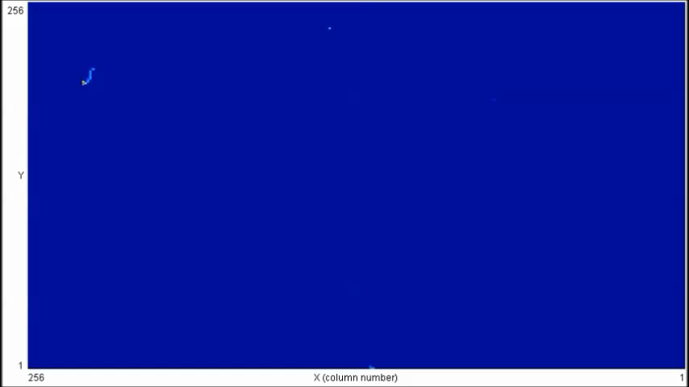
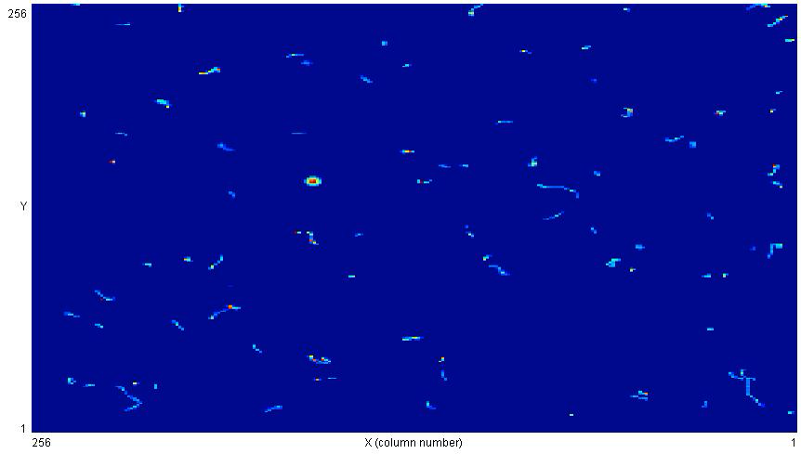
CERN@school
Research investigations:
  Geomagnetic storms and charged particles.
  (4 hours 30 minutes @ 30 s per frame)
Research investigations:
  Uranium glass beads.
  (5 minutes @ 10 s per frame)

Slide 6
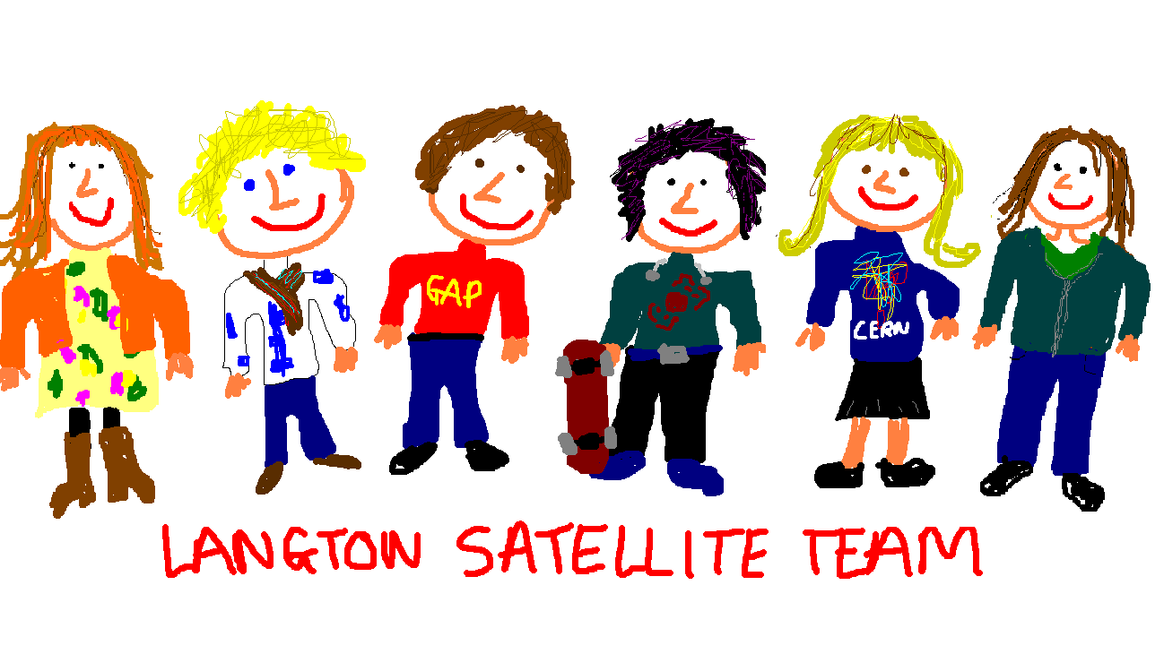

Slide 7
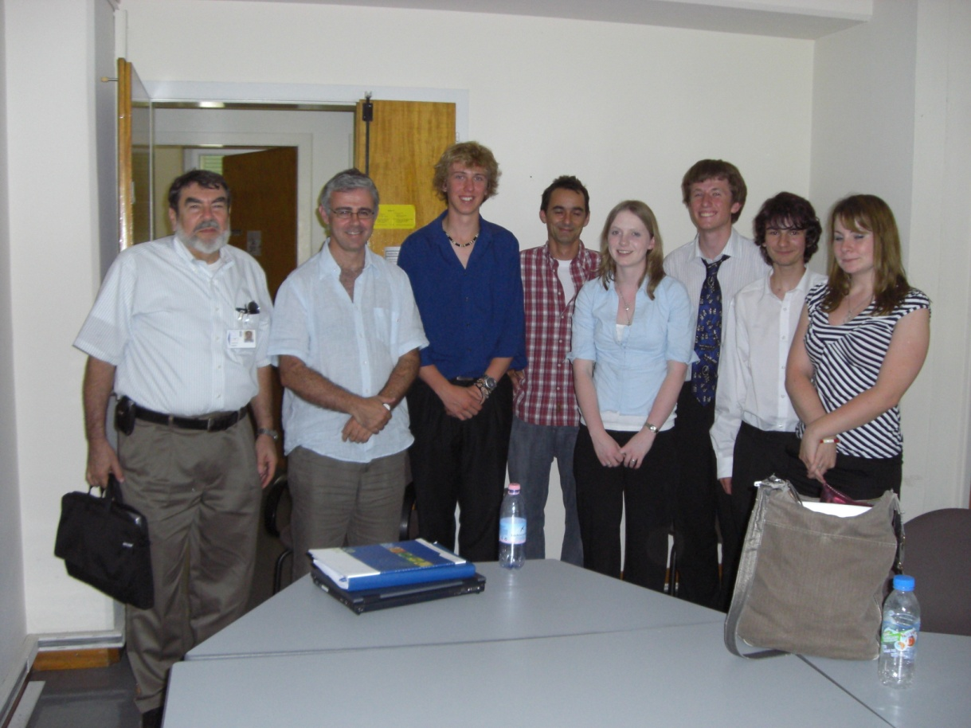
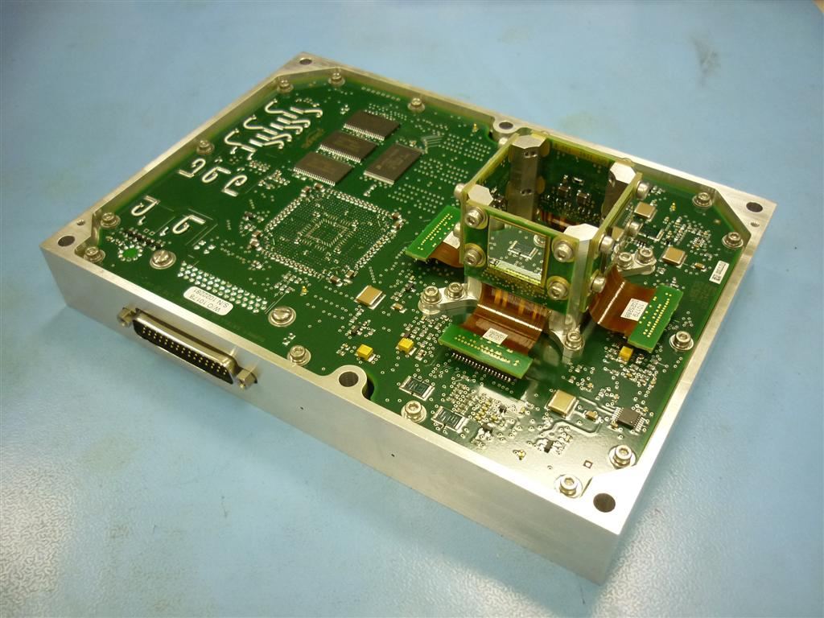
The LUCID team is here with Larry Pinsky and Michael Campbell. Larry said “It’s like playing at being NASA or the European Space Agency, but they’re not really playing, they’re doing the real thing.”
Help from Stanislav Pospíšil was invaluable in making LUCID happen.

Slide 8


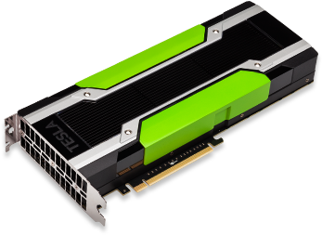


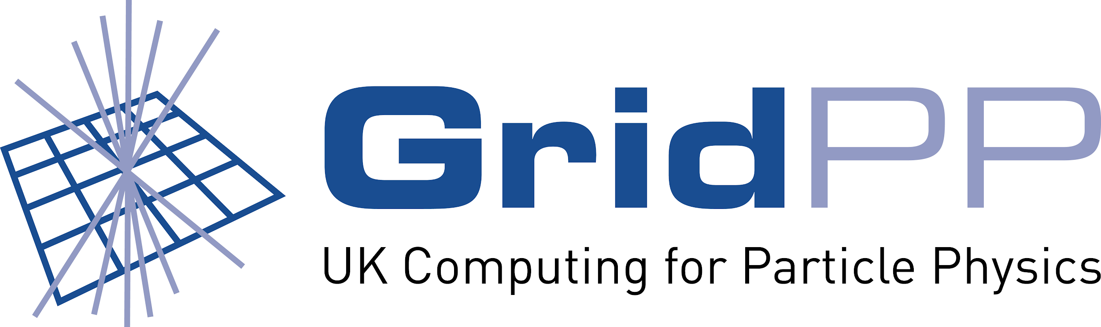
Processing LUCID Data
Get data from payload
Convert data to x,y,ToT
Upload data to GridPP
Generate JDLs
Run Tensorflow!
Submit to TAPAS
Submit jobs

Slide 9
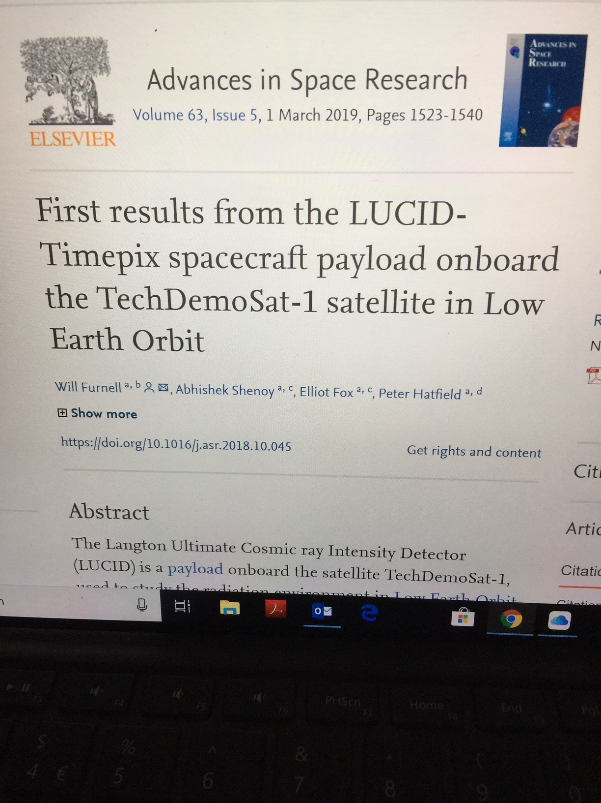

Slide 10
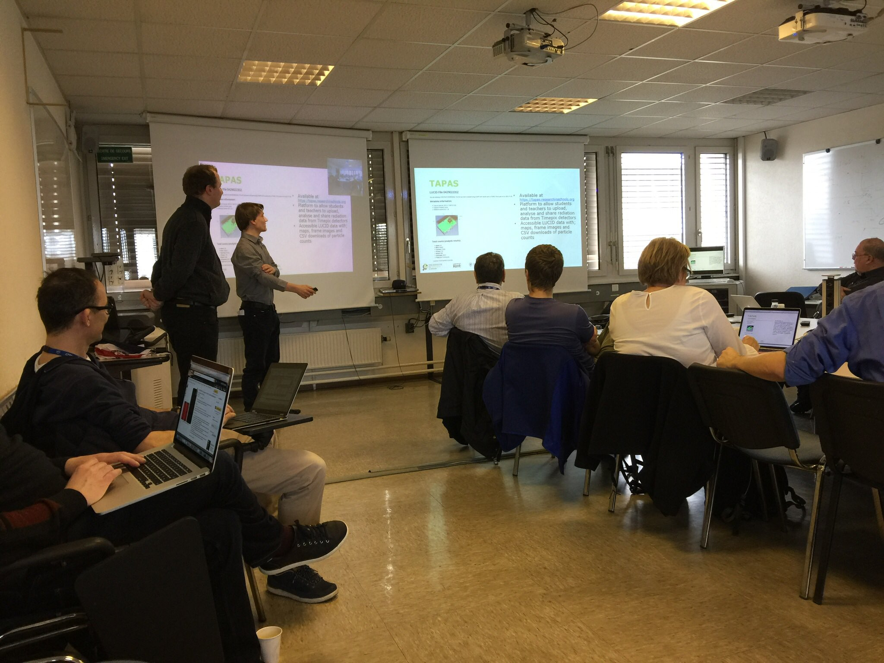
Present at CERN
Will Furnell
Six years at STFC ‘it really has enabled me to have the career I have today’

Slide 11
TIMEPIX@school allows young people access to the excitement of measuring radiation in space

Slide 12
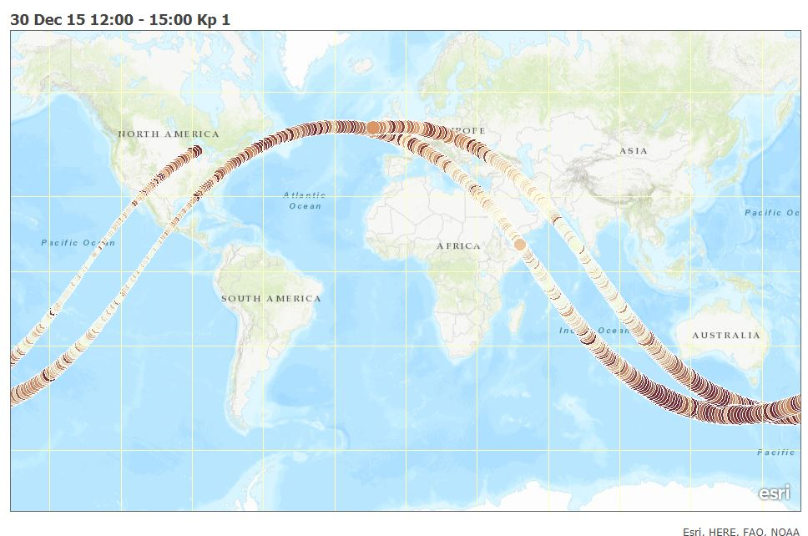
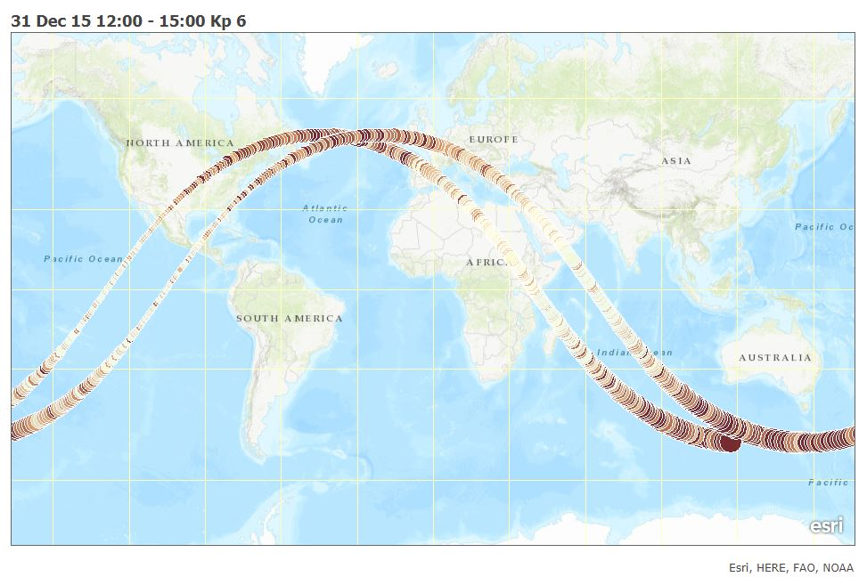
TimPix
Data made available during Tim Peake’s Principia mission

Slide 13
Recognition of teachers and the team
The Spanish National Centre for Particle,
Astroparticle and Nuclear Physics (Centro Nacional
de Física de Partículas, Astropartículas y Nuclear,
CPAN) awarded an outreach award in 2022.
Daniel Parcerisas (Sagrada Familia, Gava) accepted the
award at the CPAN 2022 annual meeting in Bilbao,
Spain, on behalf of the awarded team, composed
of Rafael Ballabriga (EP-ESE-ME, CERN), Eugeni
Graugés (University of Barcelona), Anna Argudo
(University of Barcelona), David Corrons (La Salle
Manlleu), Iolanda Huguet (INS Mollerusa IV),
Esther Pallares (University of Barcelona), Hernan
Pino (Institut Sant Nicolau, LIWU), Francesc Salvat
(SY-STI-BMI, CERN) and Sonia Tarancon (Santo
Angel).

Slide 15
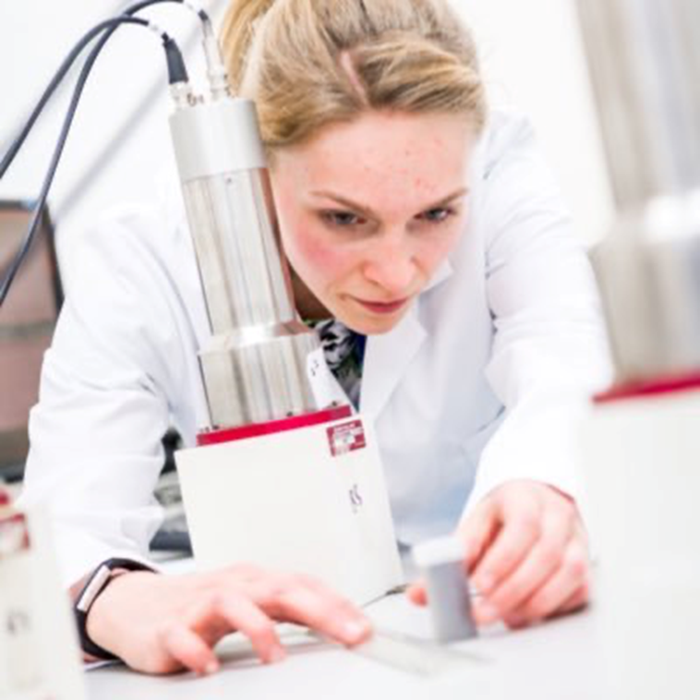
Opportunities
Chantal Nobbs here now doing fusion research. At school she said ‘Using the Timepix chip was inspirational and made scientific research seem more achievable. It showed me that physics research is happening and gave me confidence that I could be part of it and that research can be an exciting job.’

Slide 16
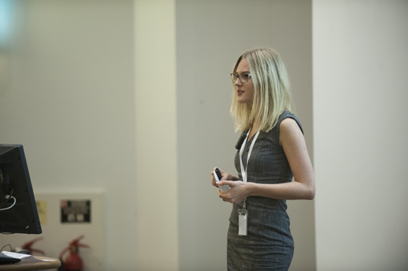
More views from students
To have that confidence built at that age stood me in great stead as I was making decisions about my future. Not only was I inspired by all of the fascinating science that I learned through the experiments that we were able to conduct with TimePix, but I felt as though my peers and I could really, meaningfully contribute.
It was a completely unique experience and I am very grateful.’
Anna, TIMEPIX@school pilot high school user, now works in Data Analysis.
‘
Katherine
speaking at a
conference

Slide 17
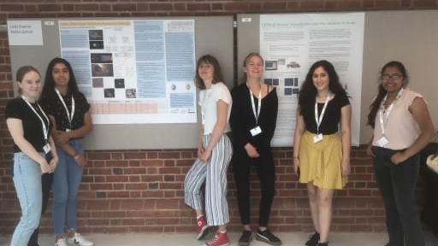
Students presenting at IRIS conference

Slide 18
Comments from teachers
The Timepix detector has transformed the way I teach and the way the students can conceptualise and understand radiation.
To be able to ‘see’ radiation and make clear the different properties rather than hear clicks on a Geiger counter is transformative and enables my students to have a much clearer understanding of radiation. Students who use the detector for further research realise they can contribute to physics and this is really empowering.
It really opened my eyes to what students are capable given the right circumstances. This view spread through the department and contributed hugely to getting the ball rolling with STEM work we do today.

Slide 19
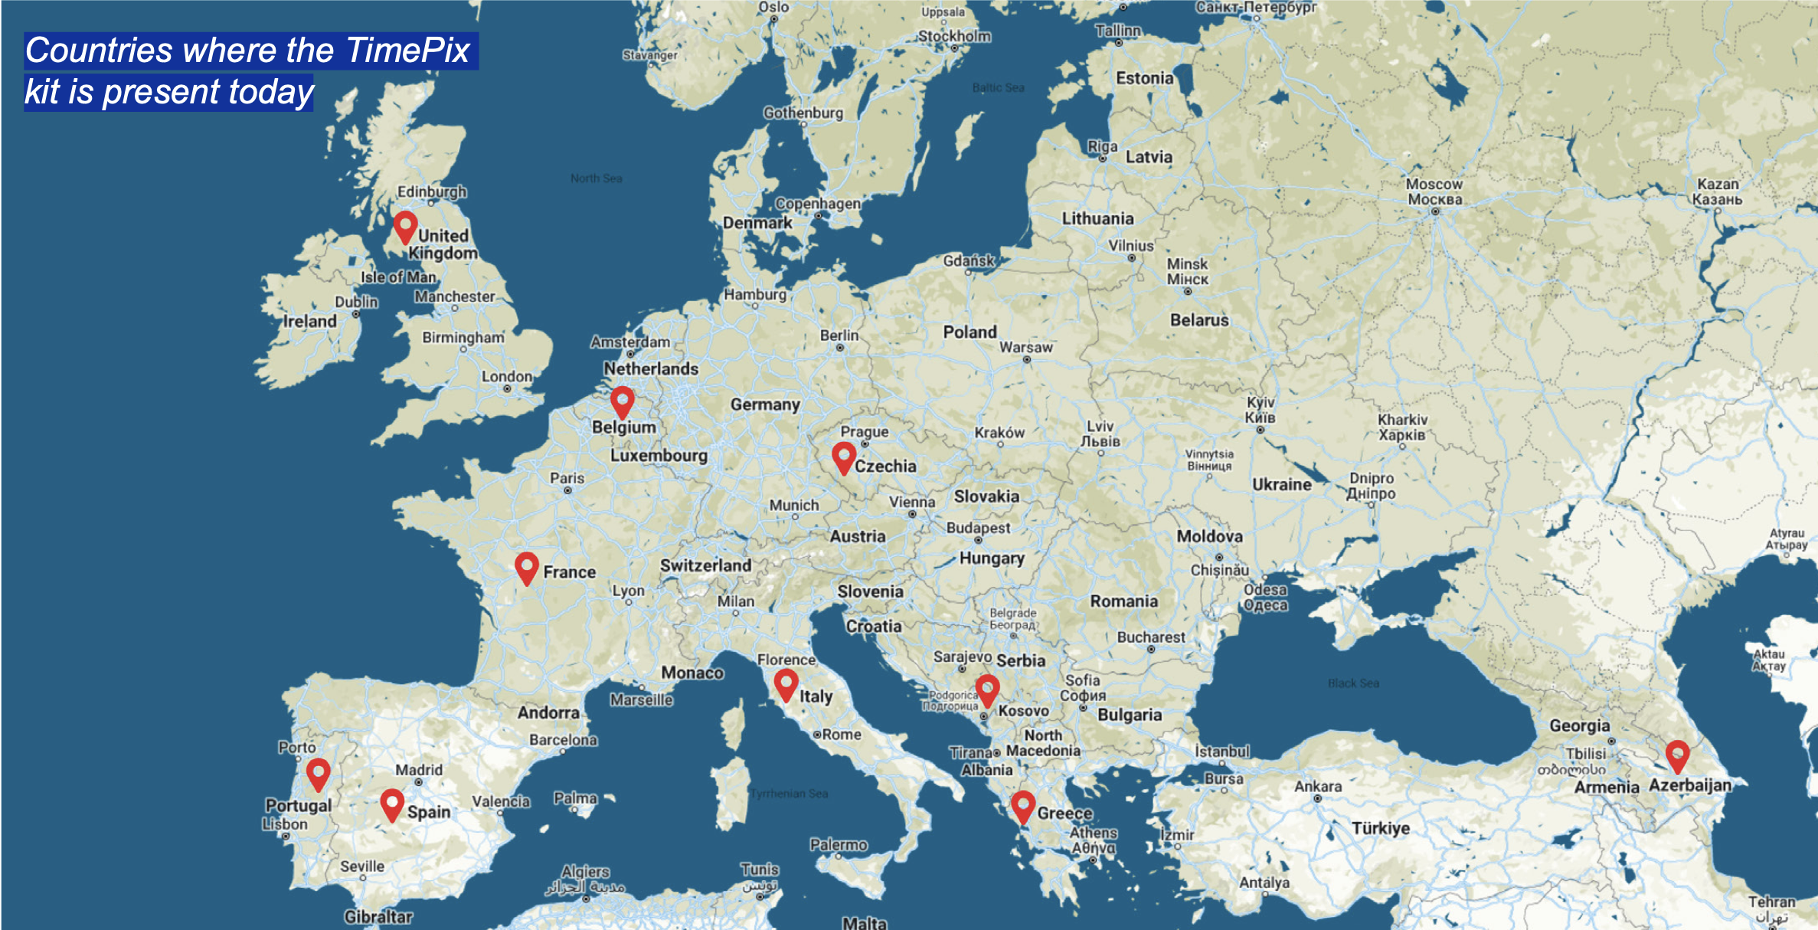

Slide 20
Next steps
Let’s get Timepix technology into every classroom.
All students should be able to carry out hands on experiments and study the radiation around them.
They will be using the same devices as those found at CERN, in hospitals and museums around the world, and even on the International Space Station.
This allows young people to see how exciting and rewarding a career in STEM can be.
Imagine the transformation! It would make a huge difference to people choosing STEM careers.

Slide 21
