Slide 1
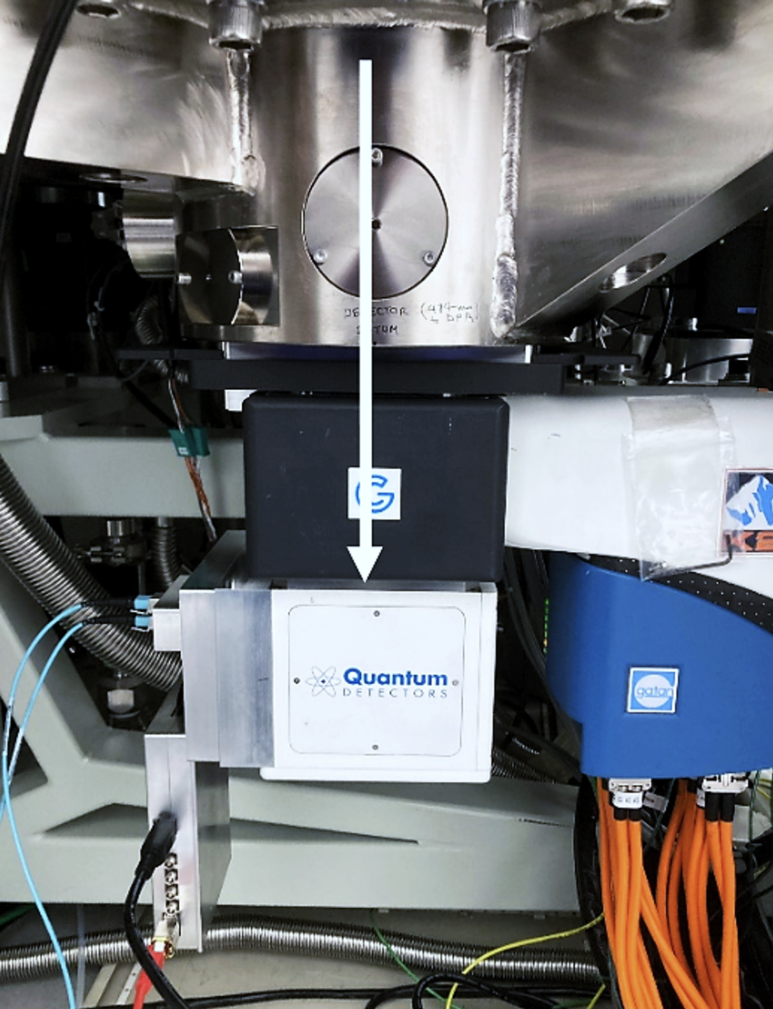
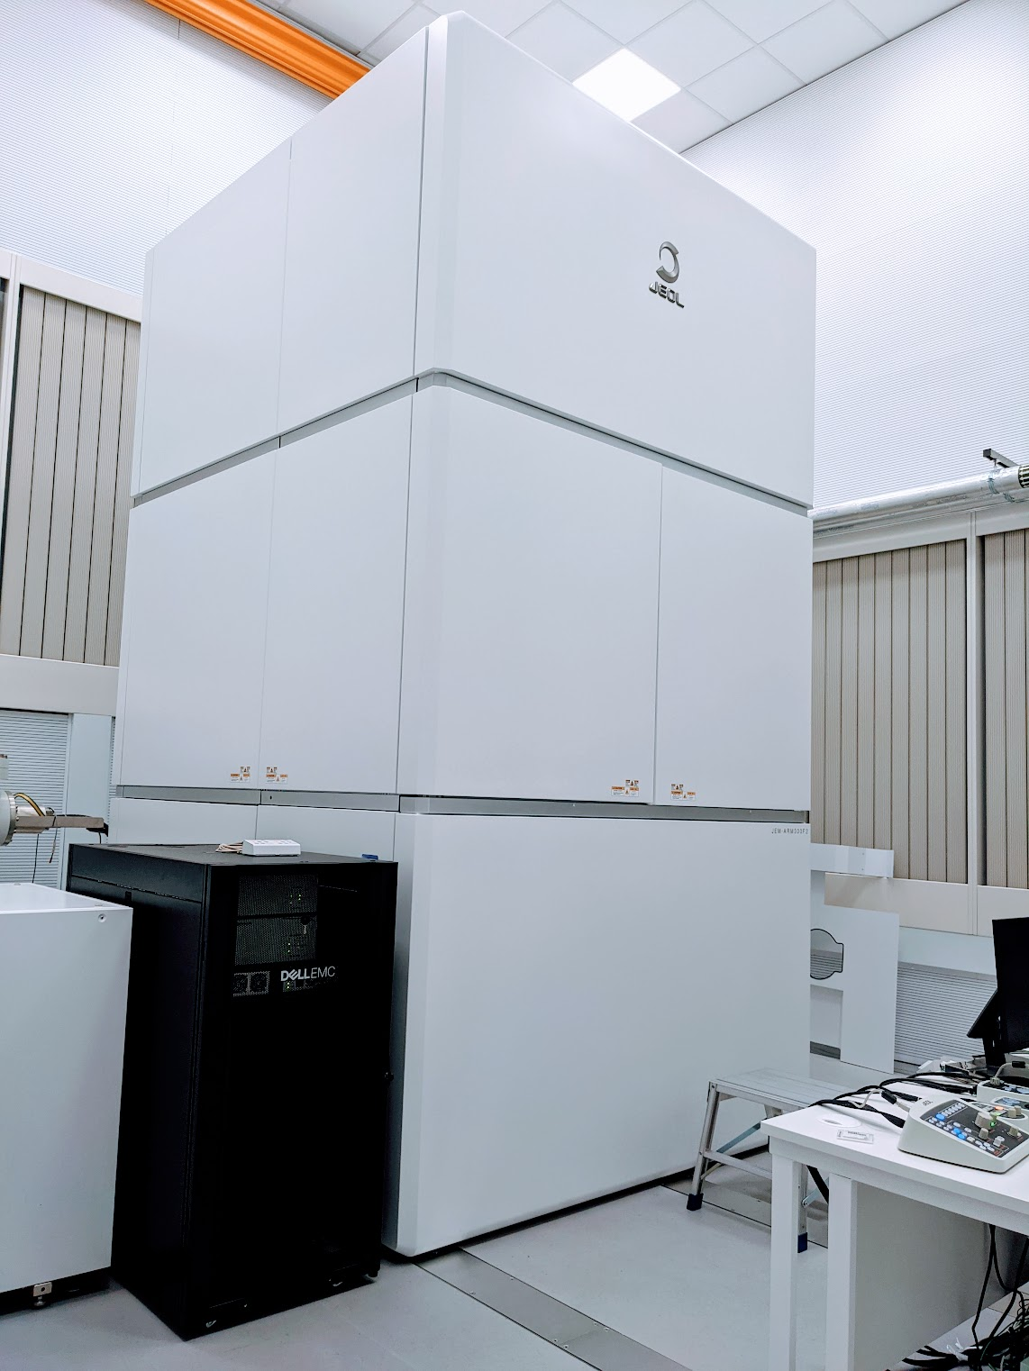



Applications of the TimePix 4 Sensor to Low Fluence Imaging and Diffraction with Electrons
Angus Kirkland
RFI
Marcus Gallagher-Jones,
Zhiyuan Ding
Jon Barnard
Oxford
Richard Plackett
Nina Dimova
CERN, September, 2025
Notes:
Thanks to team
Thanks to organisers

Slide 2
Summary
Desirable Features of Direct Electron Detectors
Medium Voltage Performance Metrics
  Comparison with existing thin MAPS sensors
  Clustering and TOT analyses
Use of TP for Serial ED
CERN, September, 2025
Notes:
3 main areas
Basic features of direct electron detectors
TP4 performance metrics – comparison with MAPS and clustering methods
Initial applications to SPARSE ED Data

Slide 3
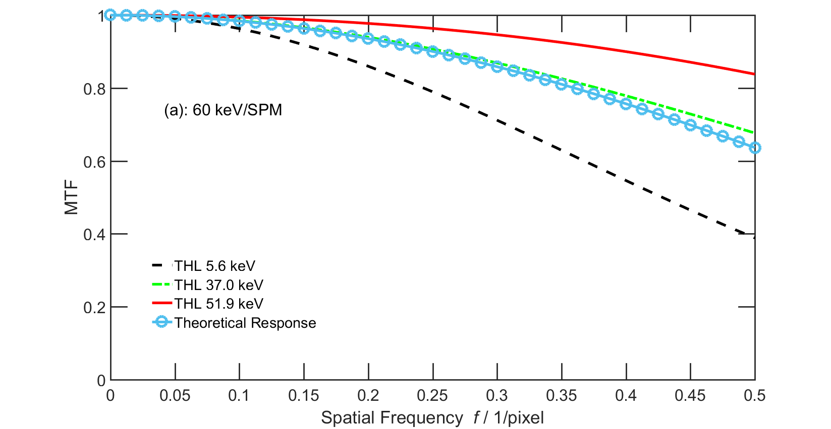
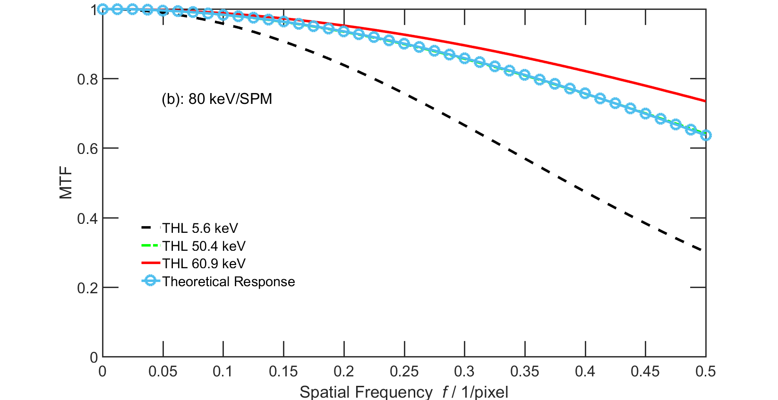
Direct Electron Detectors – a wishlist…
Voltage invariant performance metrics (DQE, NPS and MTF) (60-300kV)
  For hybrid sensors MTF and DQE are worse at higher voltages due to sensor thickness
  The reverse of thin MAPS behaviour
Large pixel arrays (1024 x 1024 minimum, ideally 2048 x 2048)
  – important for structural biology, less so for 4D STEM
High speed readout (10kHz for frame-based detection) and zero noise
High dynamic range (EELS and ED) in counting mode
60kV
80kV
Medipix Merlin 4S
Ultramicroscopy, 182, 44, 2017.
Notes:
Desirable features – many common to all detectors
Specific to EM voltage invariant performance
Large pixel arrays – particularly for structural biology; less key for ptychography and related 4D STEM
High speed – flux limited at 0.1ms for cold FEG
High dynamic range (EELS and ED)
TP4 meets all of these except the first

Slide 4
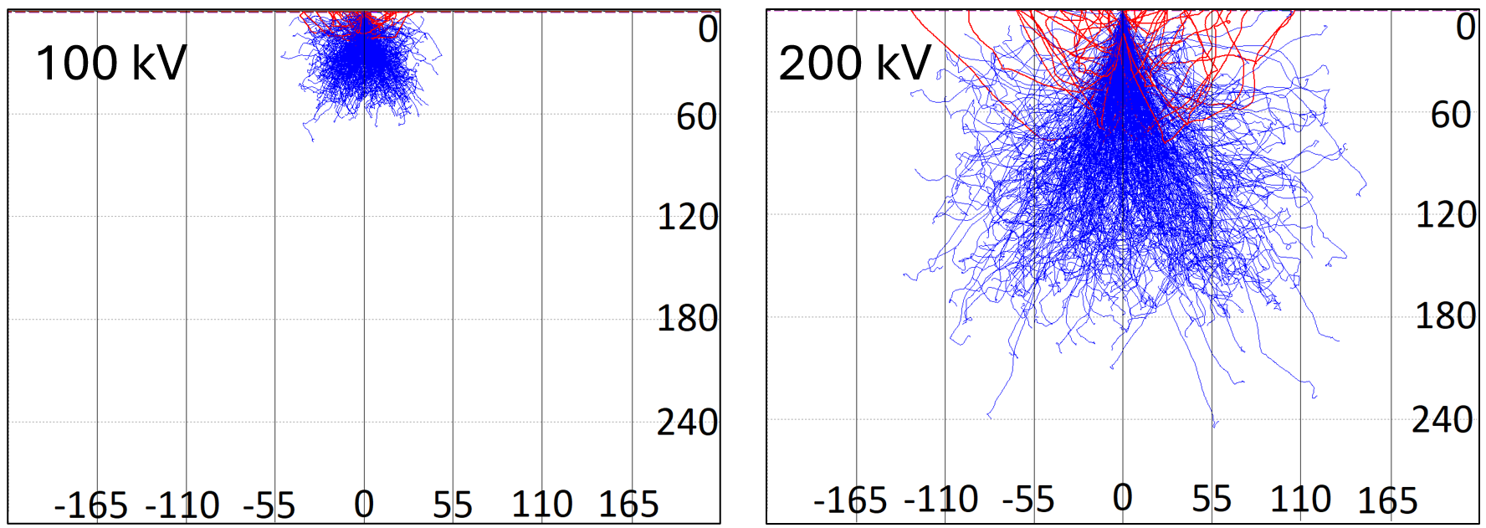
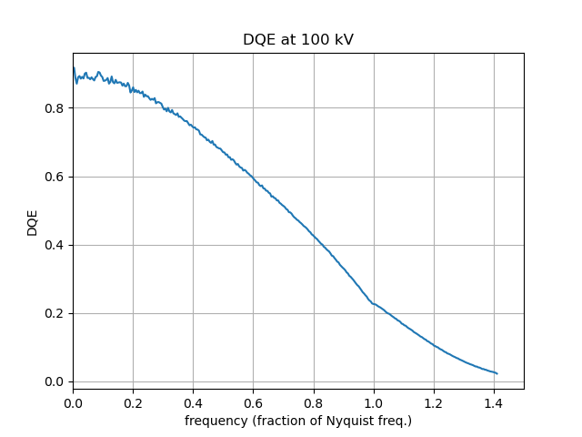
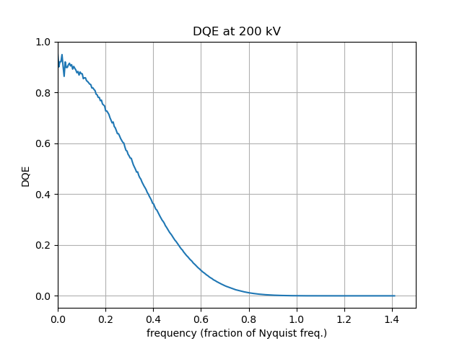
Performance Metrics
Solutions
Cluster compensation
High z sensors
Larger pixels in Si
Nina Dimova
Nuclear Physics A, 170335, 2025.
Notes:
Back to voltage issue
Problem with large pixels is scattering in sensor – charge in multiple pixels
100kV largely contained in 1-2 pixels but at 200kV significantly wider scattering
Later see clustering to reduce this
Alternatives high z sensors
Evident in DQE – better at 100kV with less spread

Slide 5
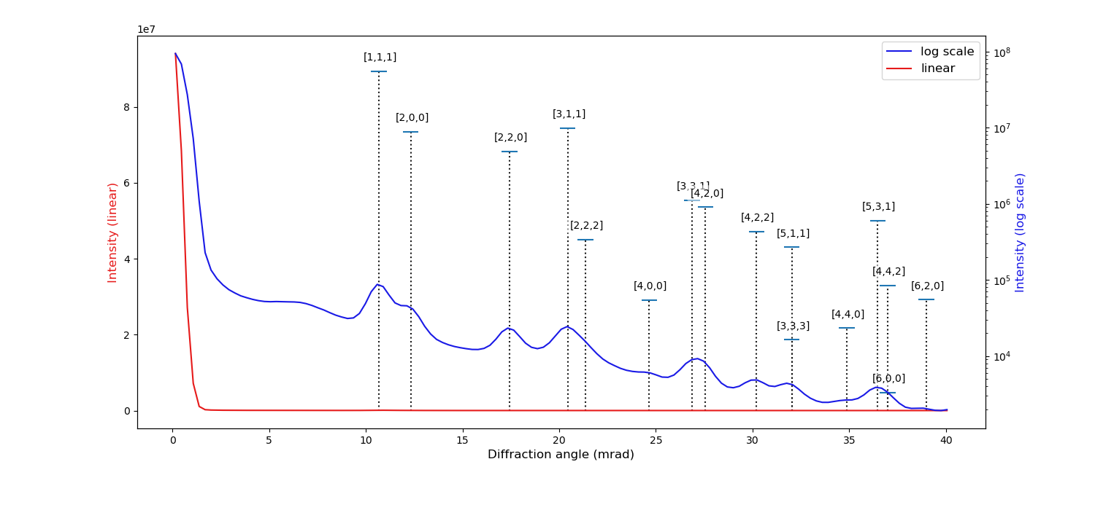
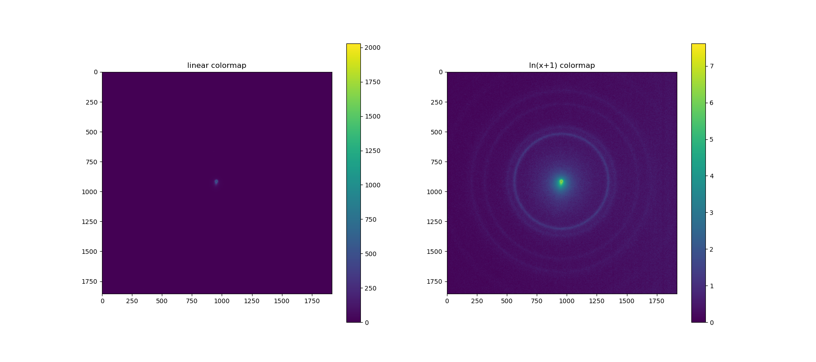
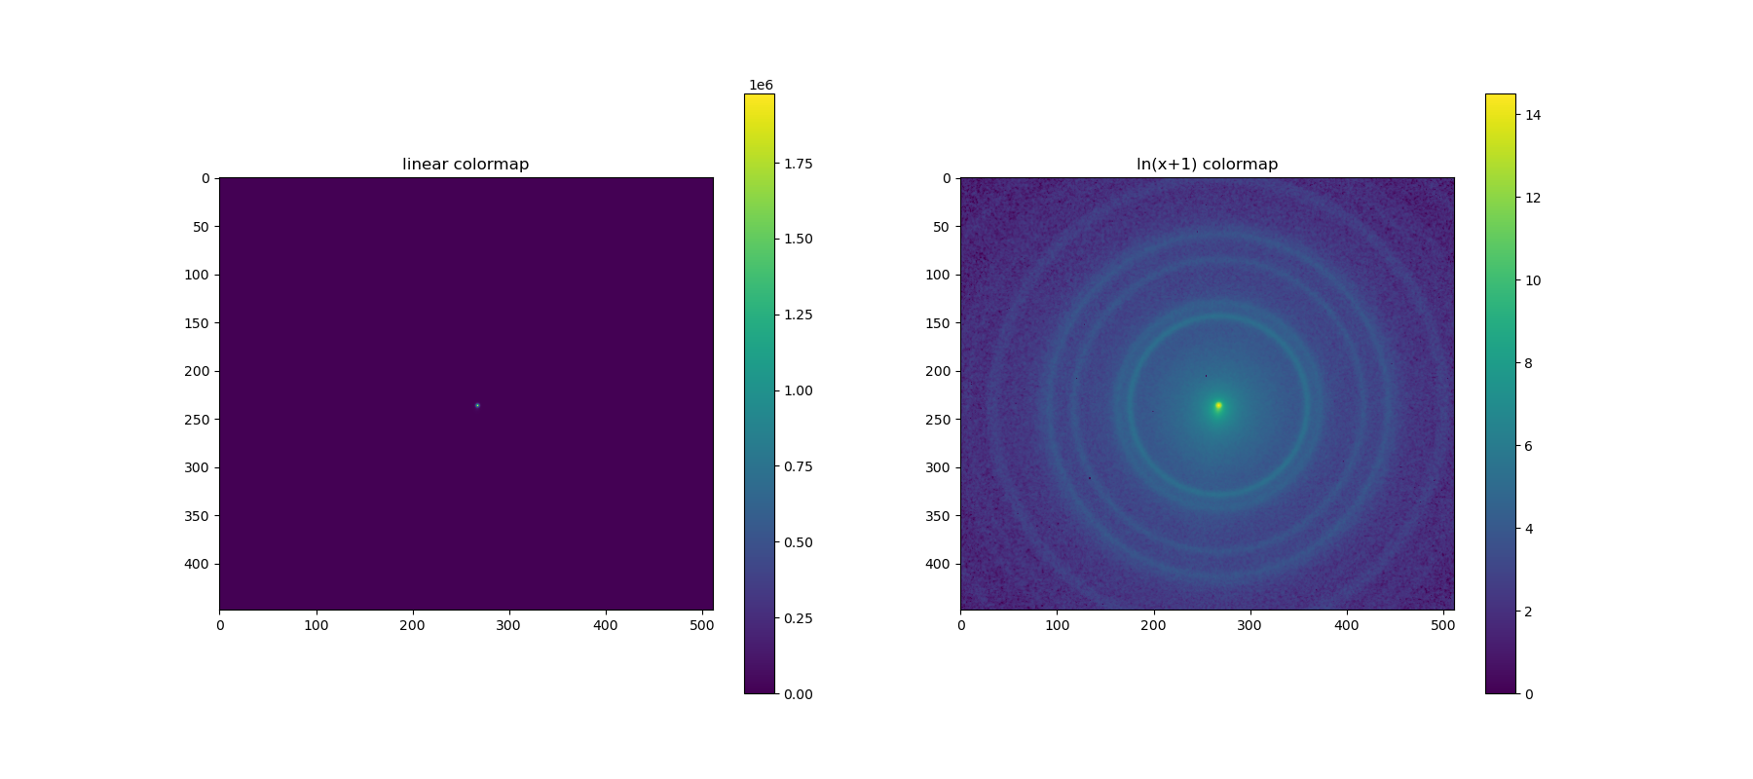
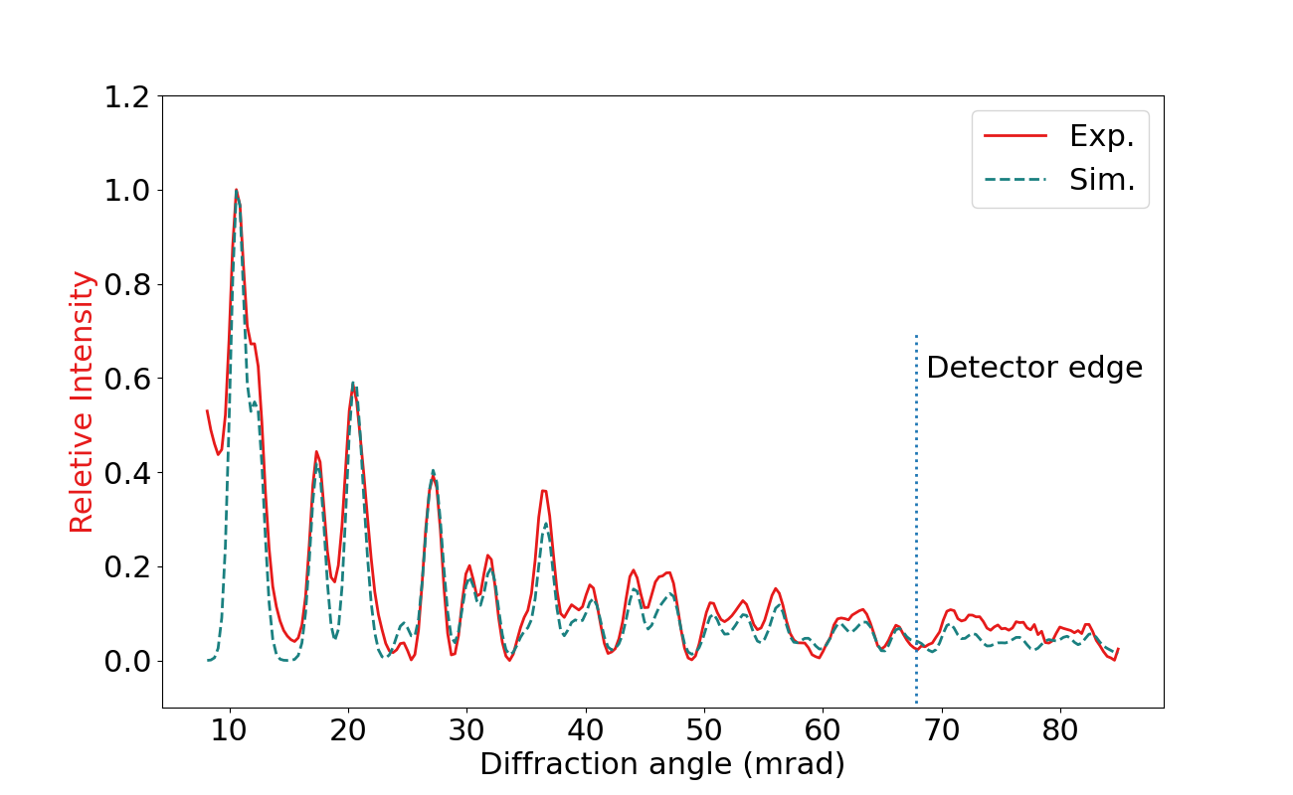
Performance Comparison with MAPS
70mrad = 10pm
K2 MAPS 4096 x 4096 x 9μm pixels
TP4 v1.0
Zhiyuan Ding
Notes:
Comparison with MAPS
– advantages of event driven detection
Limit at ca 70mrad for single TP4 (= 0.1A spacing)

Slide 6
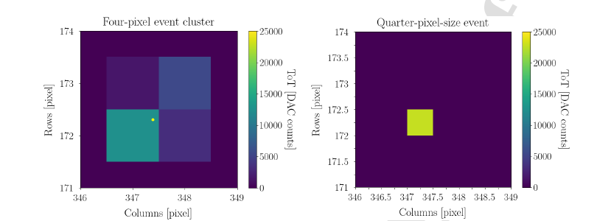
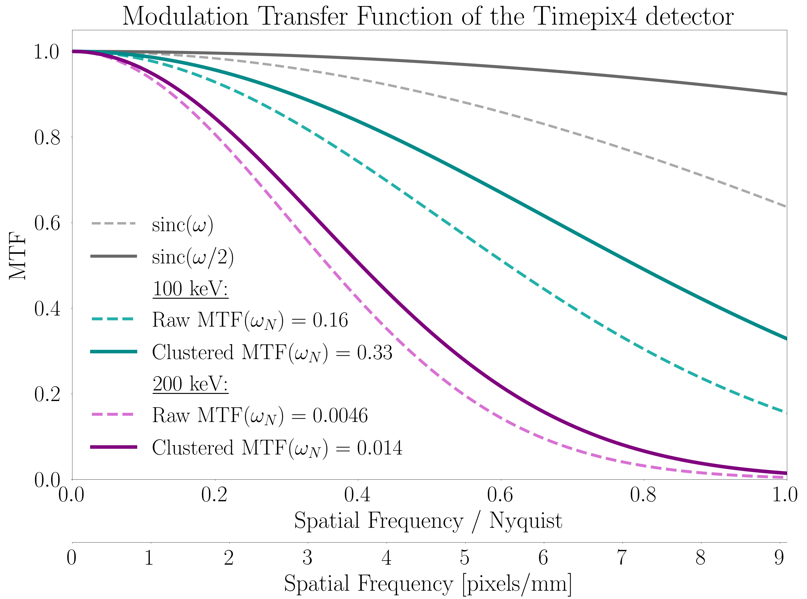
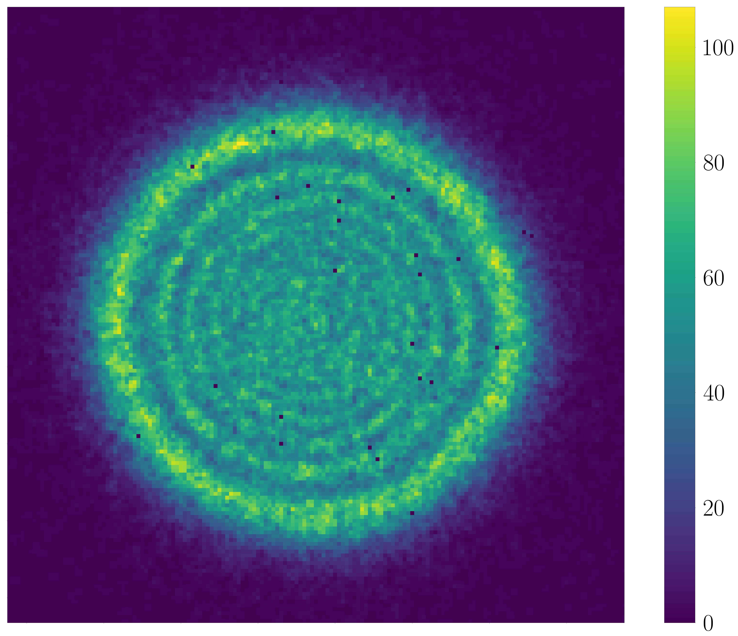
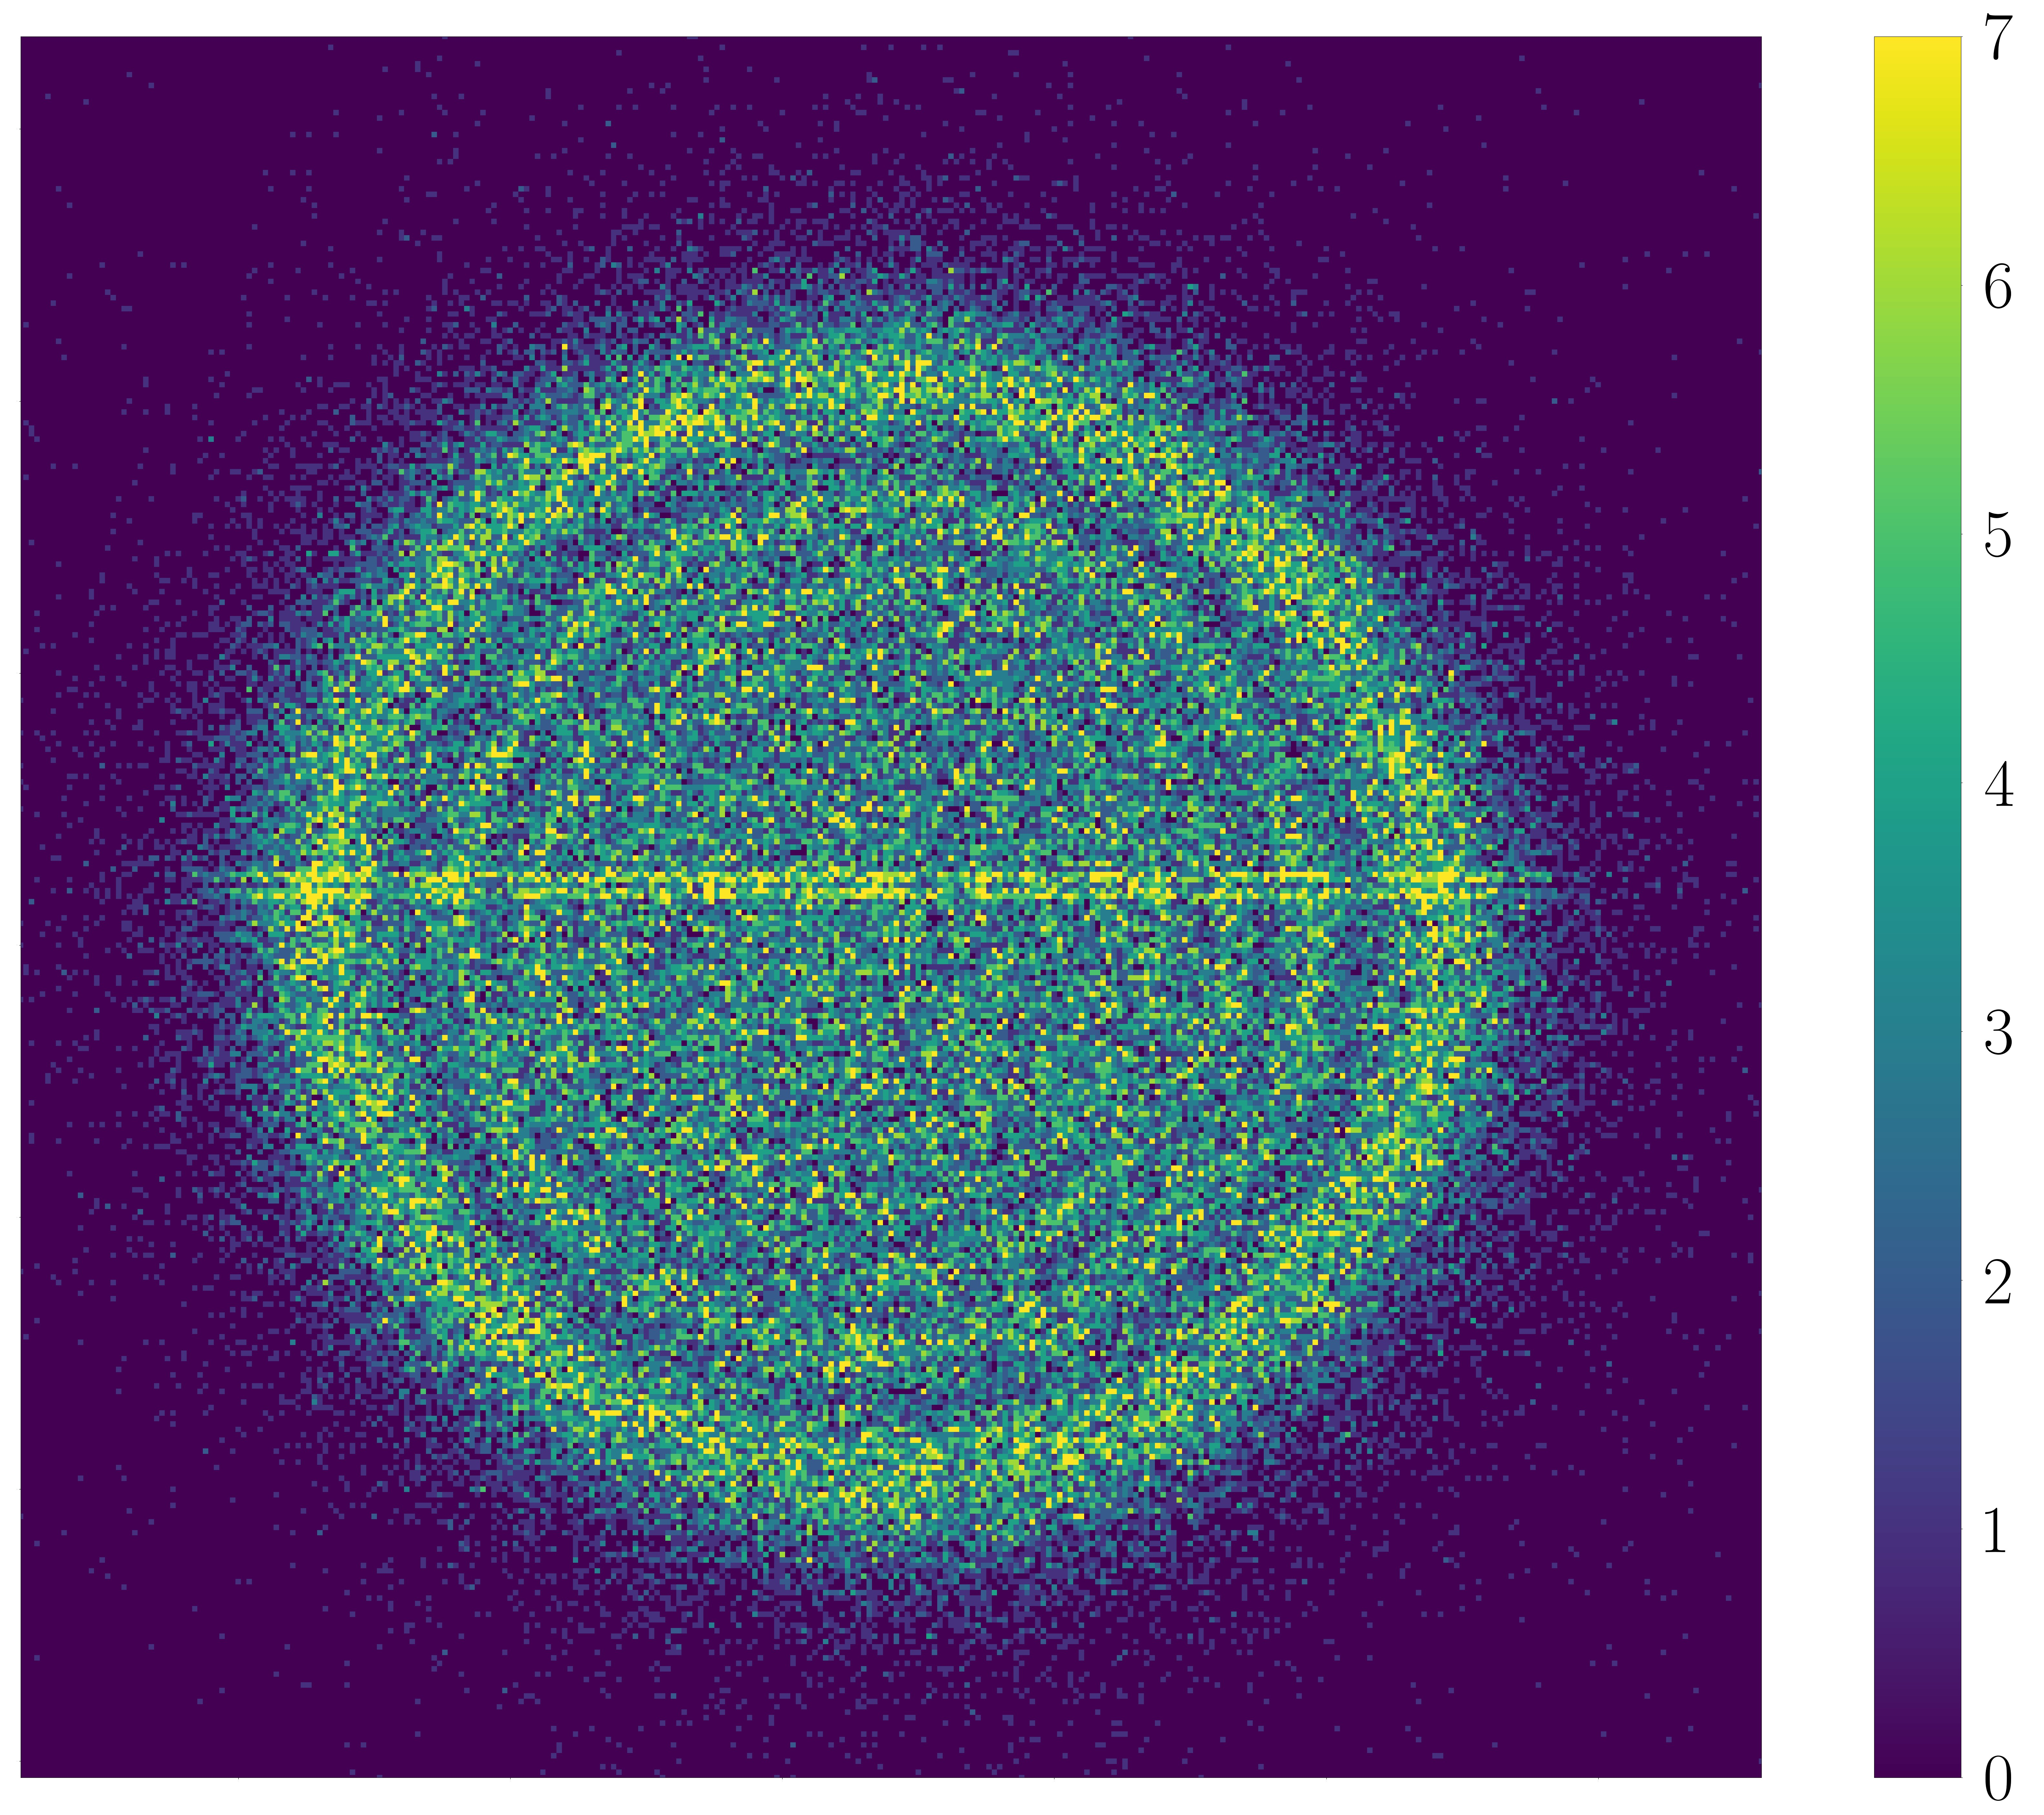
Event Clustering
Nina Dimova
Nuclear Physics A, 170335, 2025.
Notes:
Improve MTF due to spread by clustering (Nina)
Black theoretical
Green 100kV
Pink 200kV
Look at MTF curves - bigger change at 100kV due to larger clusters at 200kV

Slide 7
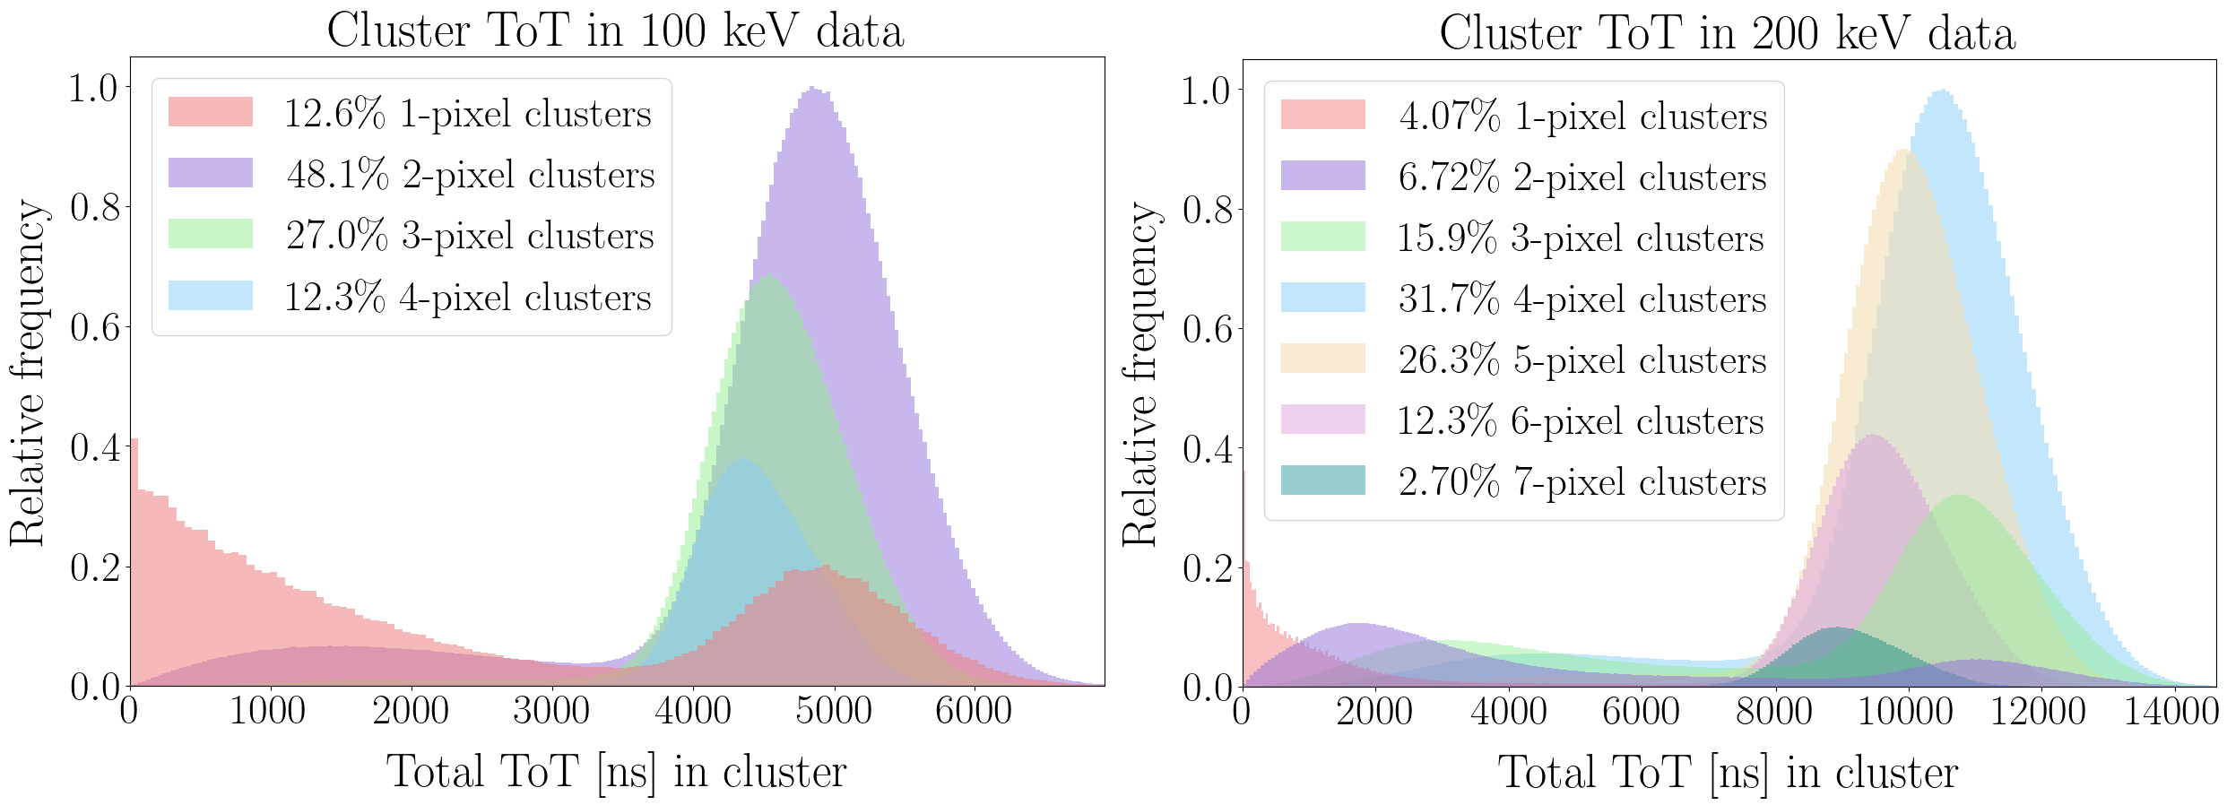
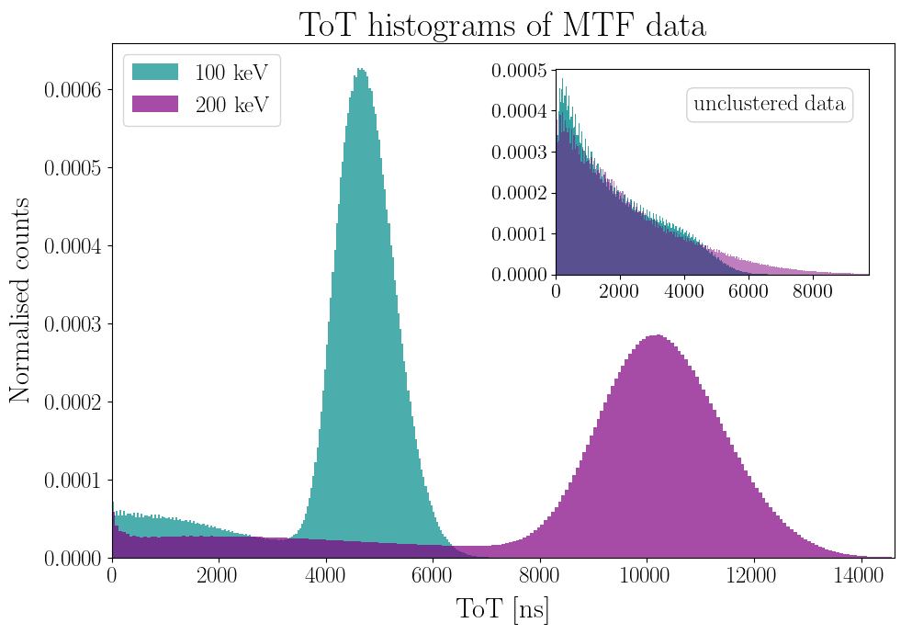
TOT Clustering Analysis
Data Energy, (angle) | Raw MTF at Nyquist | Clustered MTF at Nyquist | Improvement factor
100 keV, (4◦) | 0.16 ± 0.0061 | 0.34 ± 0.010 | 2.12 ± 0.020
200 keV, (4◦) | 0.0046 ± 0.000069 | 0.014 ± 0.00015 | 3.16 ± 0.018
Nina Dimova
Nuclear Physics A, 170335, 2025.
Notes:
Detailed analysis of TOT (Charge deposition)
100kV 1-4 pixels dominant
200kV 2-6 pixels dominant– larger clusters at 200kV not compensated

Slide 8
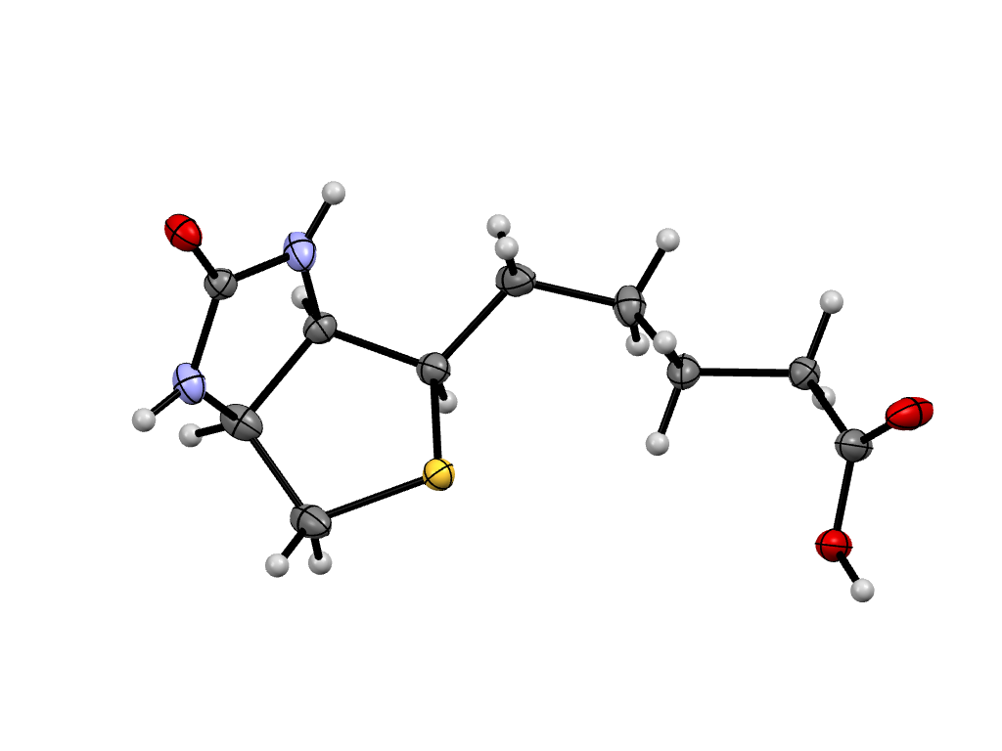
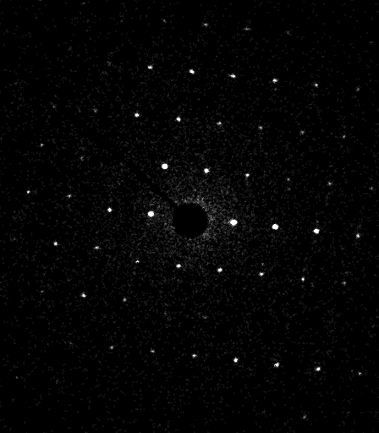
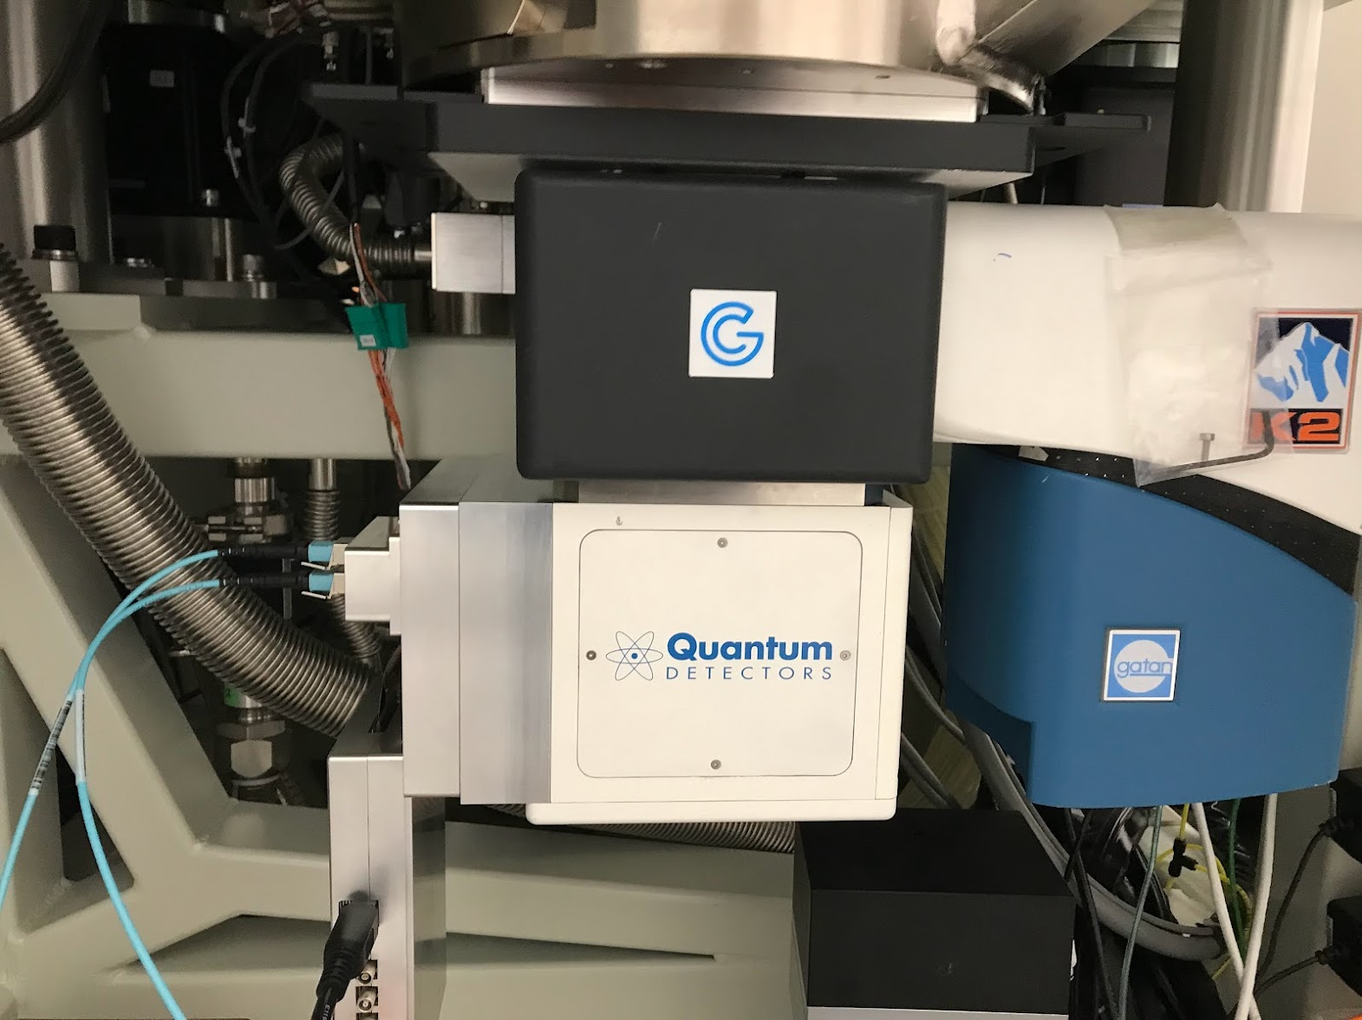
TP4 for Sparsely Sampled ED Data
10º s⁻¹; 0.005 s / “frame”
Data collection
Oscillation per frame (º) | 0.5
Fluence (e⁻/Å²/º) | 0.005
Crystals merged | 4
Data reduction
Space group | P2₁2₁2₁
Resolution (Å) | 10.55 – 0.90
R_{merge} | 0.148
Refinement
GooF | 1.098
0.9 Å
TimePix4 v1.0
448 × 512 x 55 μm pixels
Time bin <200ps
Marcus Gallagher-Jones
CERN, September, 2025
Notes:
If data is sparse what is the best detector
Next Generation – Event Driven Detection only hits counted NO ZEROS
Biotin Ref Marcus – early data
DP’s are sparse
Sparsity again – 2nd gen detection event driven Event driven here used for micro ED continuous stage rotation at high speed
detector timing fast enough to keep up

Slide 9
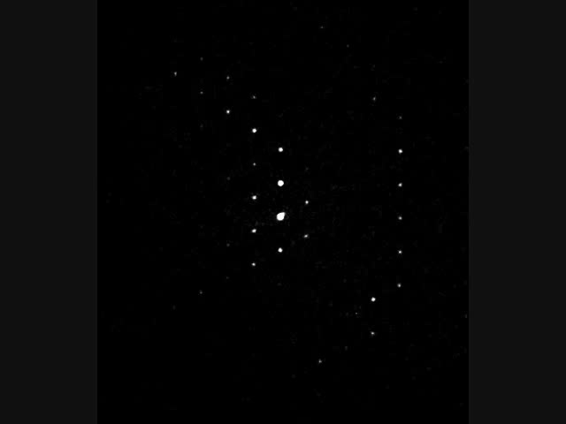
TP4 for Sparsely Sampled MicroED Data
0.55 Å
200kV, energy filtered with a 30 eV slit.
Frame time = 100 ms.
Rotation speed = 10 º s⁻¹
Total fluence = 0.3 e⁻/Å².
Marcus Gallagher-Jones
CERN, September, 2025
Notes:
The top edge of the detector is 0.72 Å and the corners are 0.55 Å!

Slide 10
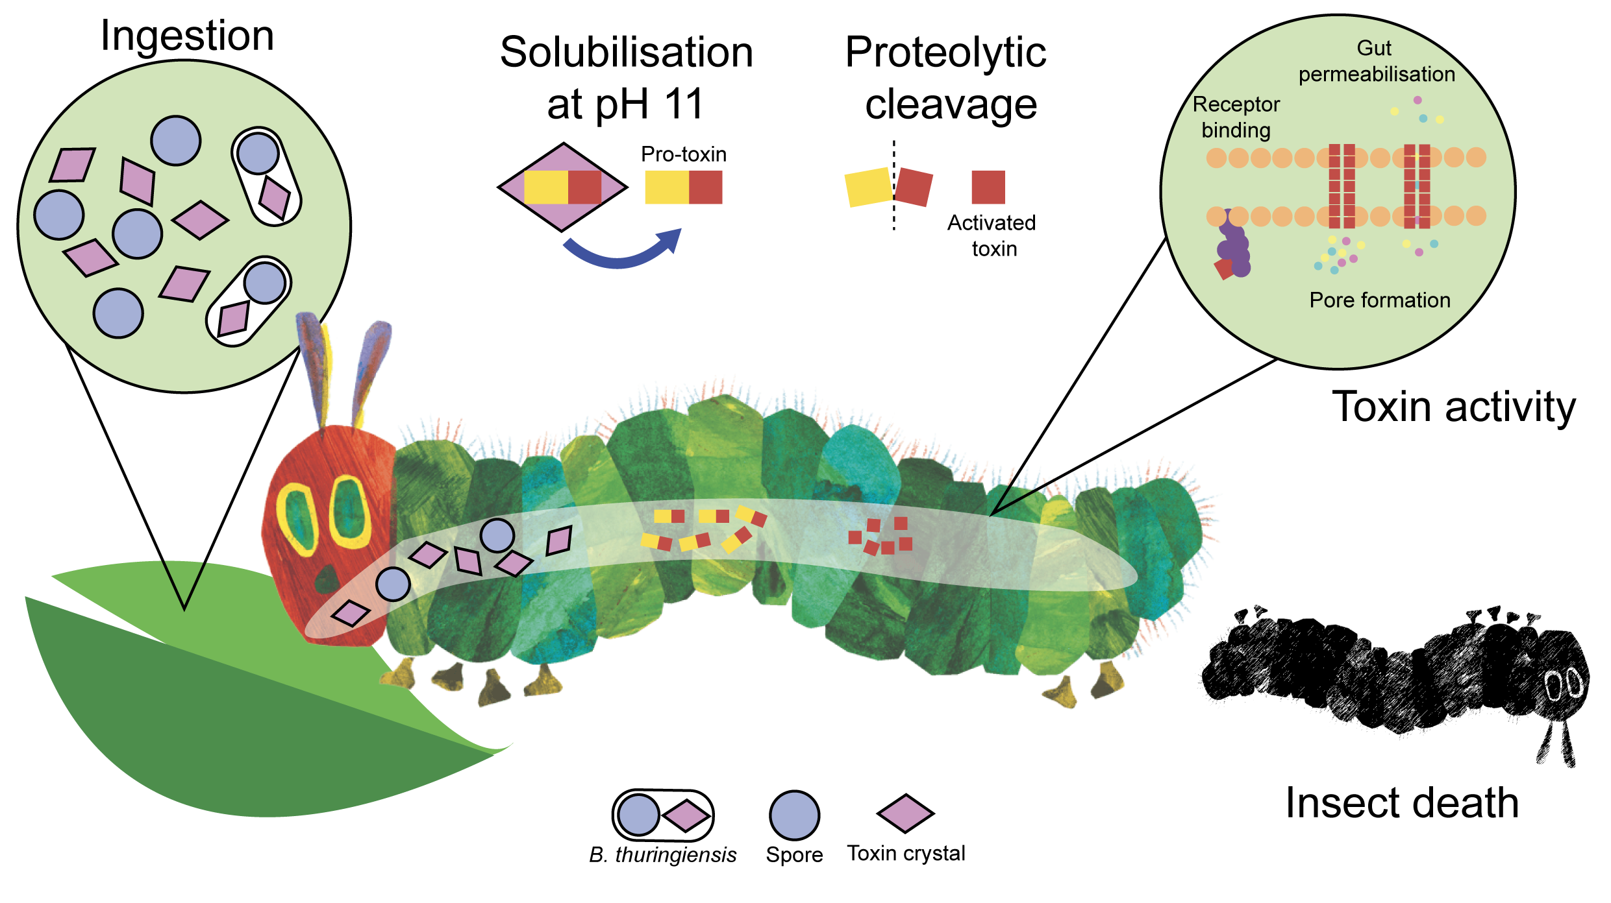
Example: Insecticidal Proteins of Bacillus Thuringiensis
CERN, September, 2025
Notes:
Case study - Bacillus Thuringiensis
Spores – solubilized and cleaved in gut – toxin – insect specific – dead hungry caterpillar

Slide 11
Protein Targets of High Importance for Human Health
Mosquitoes
Black flies
Hook worms
CERN, September, 2025
Notes:
Vectors for several critical diseases

Slide 12
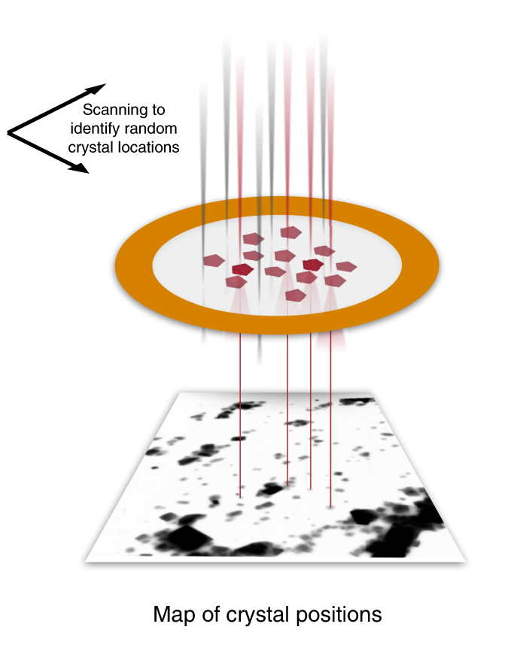
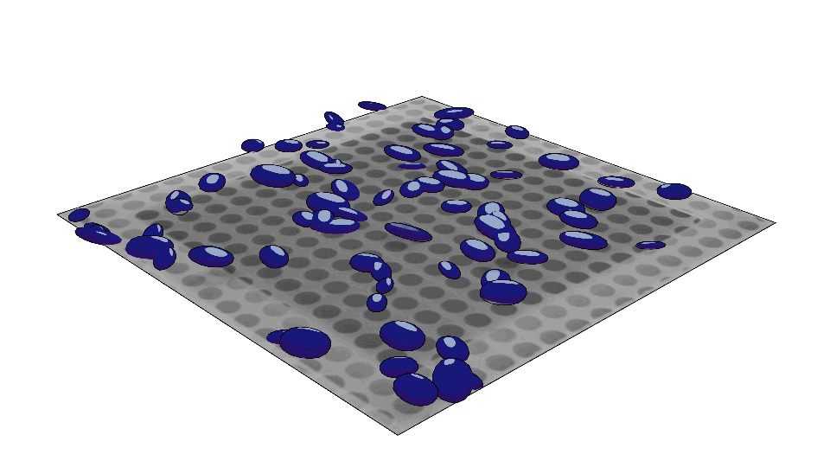

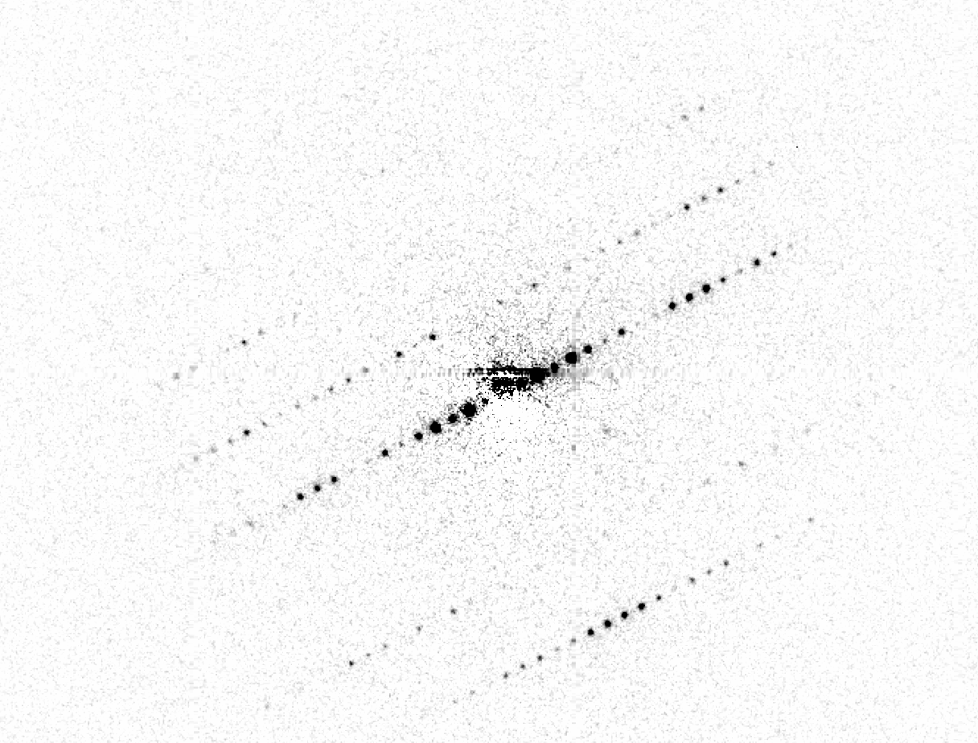


SerialED – A scanning nanobeam technique
SerialED combines STEM with parallel nanobeam diffraction to capture single diffraction patterns.
Data collection is similar to fixed target serial crystallography.
Bücker et al., Nature Communications, 11, 996. 2020
CERN, September, 2025
Notes:
Serial ED schematic

Slide 13
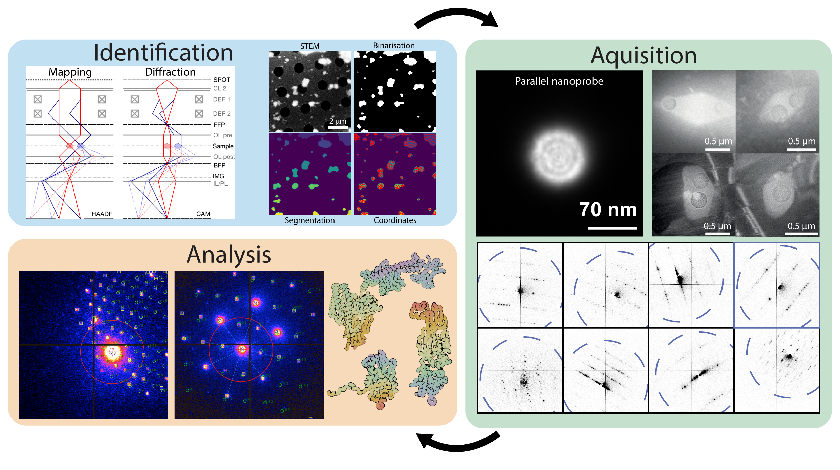
SerialED Workflow
STEM scan has a total fluence of 0.004 e-/Å^2
Diffraction data is taken as ’dose-fractionated’ frames (5 ms x 10) on a MerlinEM 4s detector.
Microscope, scan coils and detector fully automated via python scripting.
CERN, September, 2025
Notes:
Mapping to diffraction – change of optics
This example Merlin but equally valid better) with TP4

Slide 14
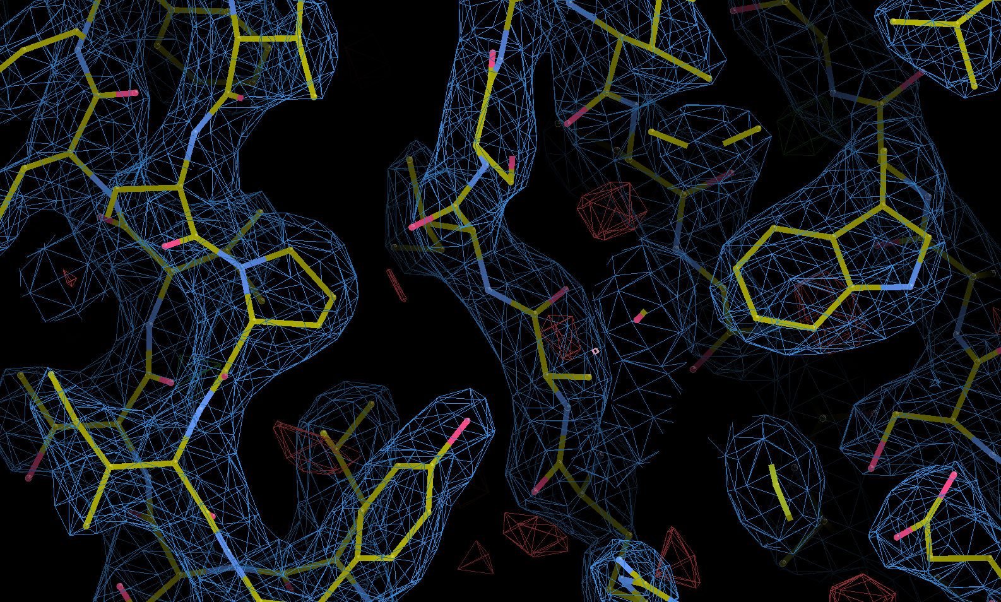
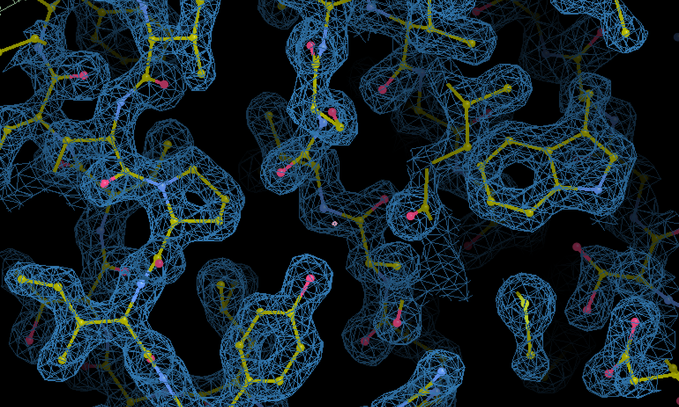
Greater clarity can be achieved using SerialED
SerialED
MicroED
CERN, September, 2025
Notes:
Better than conventional Micro ED

Slide 15
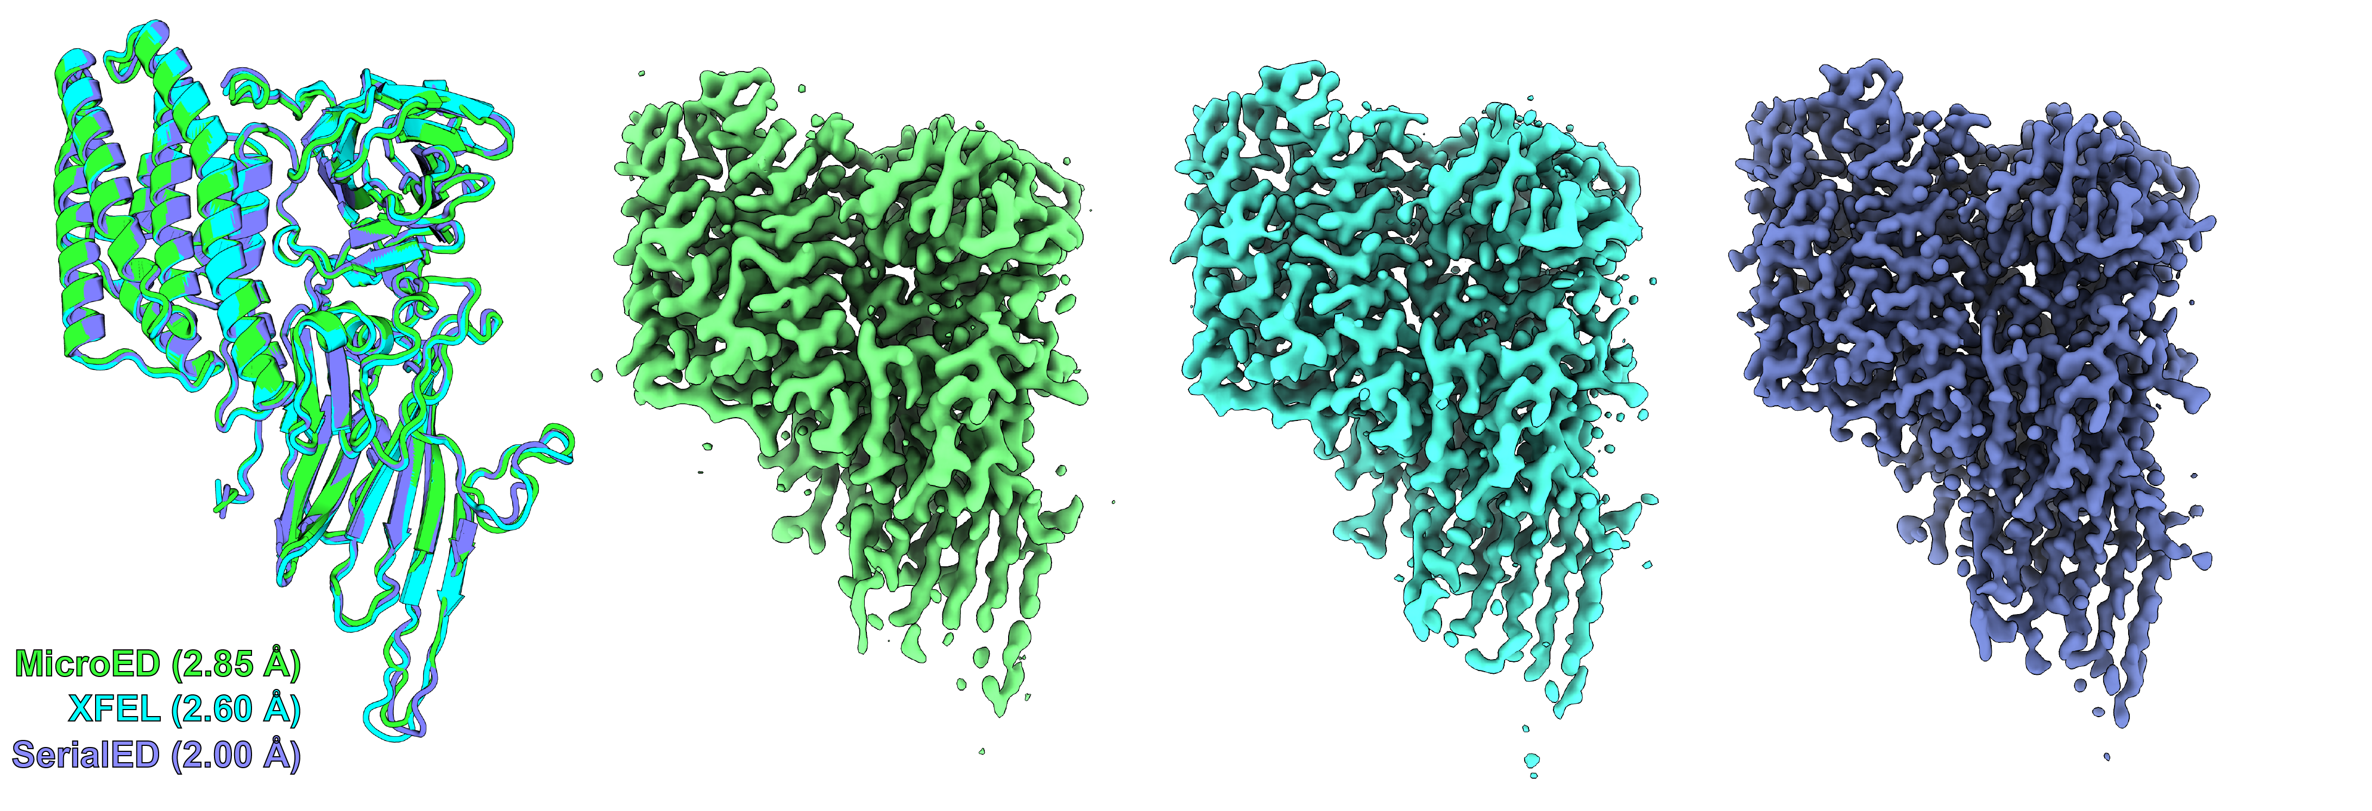
1.9 Å structure of Cry11Aa by SerialED
Data from 39 crystals
Data from ~ 50,000 crystals
Data from ~ 14,000 crystals
(F20)
Gallagher-Jones et al. (bioRxiv 2025.06.24.661318)
CERN, September, 2025
Notes:
Bacterial Toxin structures – cf or better than XFEL due to strong interaction

Slide 16
Conclusions
Event Driven Detectors including TP4 have significant advantages for EM applications, particularly where data is sparse e.g. ED
Performance Metrics improved by clustering to reduce effects of electron spread in a thick sensor
  Performance better than MAPS at low voltage but poorer at high voltage for Si sensors
Future requirements for larger pixel array and high z materials for higher voltage operation
CERN, September, 2025

Slide 17
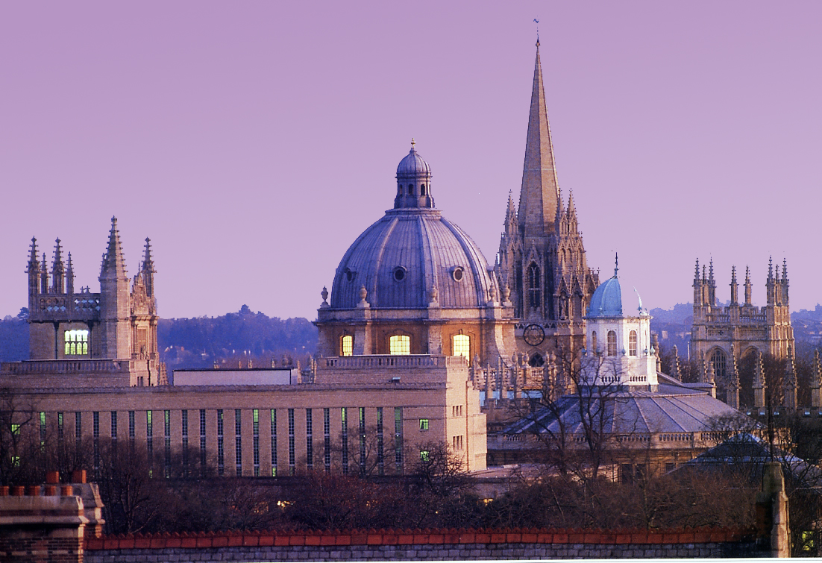
Thank you

Slide 18
Fig 1: *TP4* X-grating diffraction image without beam stop. Left: linear colormap. Right: ln(x+1) colormap. 200 kV, camera length 300mm, pixel size 0.11531 mrad.

Slide 19
Fig 2: *K2* X-grating diffraction image without beam stop. Left: linear colormap. Right: ln(x+1) colormap. 200 kV, camera length 300mm, pixel size 0.02715 mrad.

Slide 20
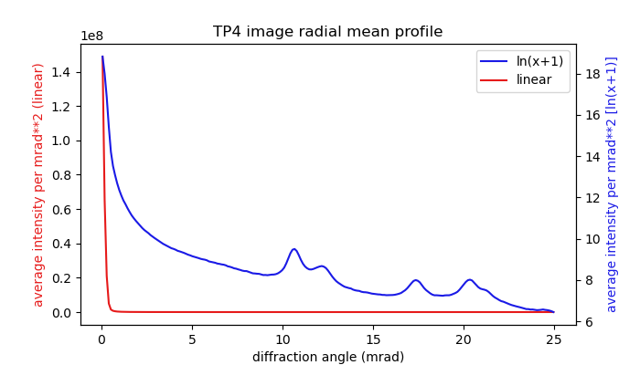
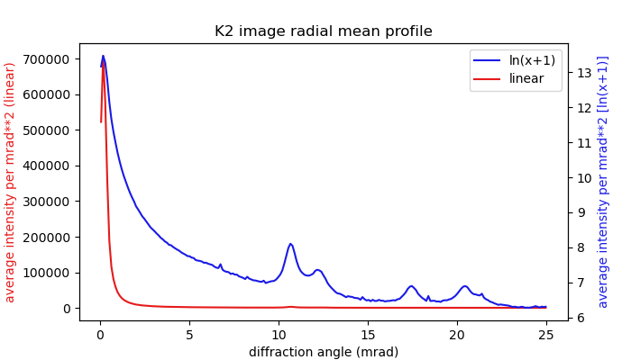
Fig 3: Radial mean profile of *TP4* X-grating diffraction image
Fig 4: Radial mean profile of *K2* X-grating diffraction image

Slide 21
DQE
raw data (no clustering)

Slide 22
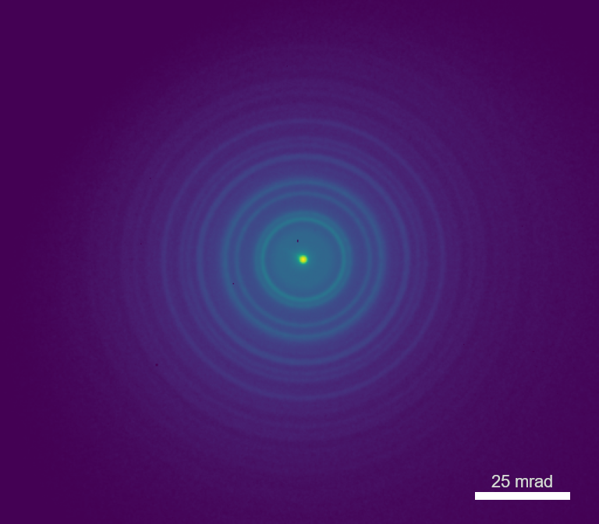
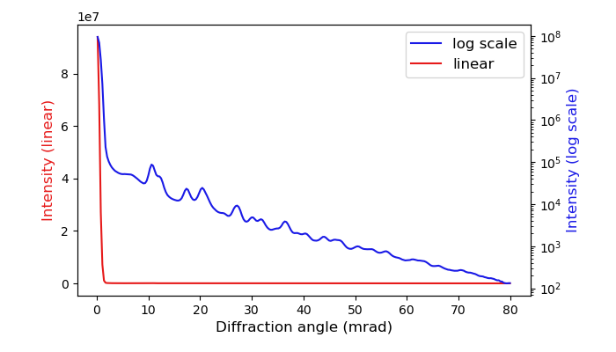
200 kV X-grating diffraction
(a)
(b)
Polycrystalline Parallel-Beam Diffraction image and average radical line profile. (a) Diffraction rings of X-grating (gold nanoparticles) recorded by Timepix4 detector. colormap is log-scale. (b) Average radical line profile of the diffraction image in (a), plotted in both linear (red line) and log scale (blue line).

Slide 23
Average radical line profile of the diffraction image and FCC gold reflections. The line profile is plotted in both linear (red line) and log scale (blue line).

Slide 24
Comparasion of experimental diffraction intensity (background subtracted, red line) and simulated diffraction intensity (green dash line). The mark “Detector edge” in the figure indicates the detector edge closest to the central diffraction spot. From the comparison with the simulation, the distinguishable diffraction signal on experiment data extends at least to 70–75 mrad.

Slide 25
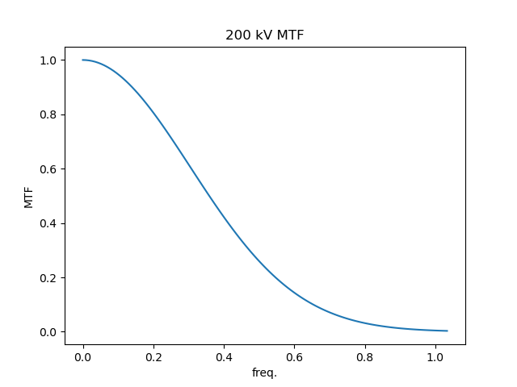
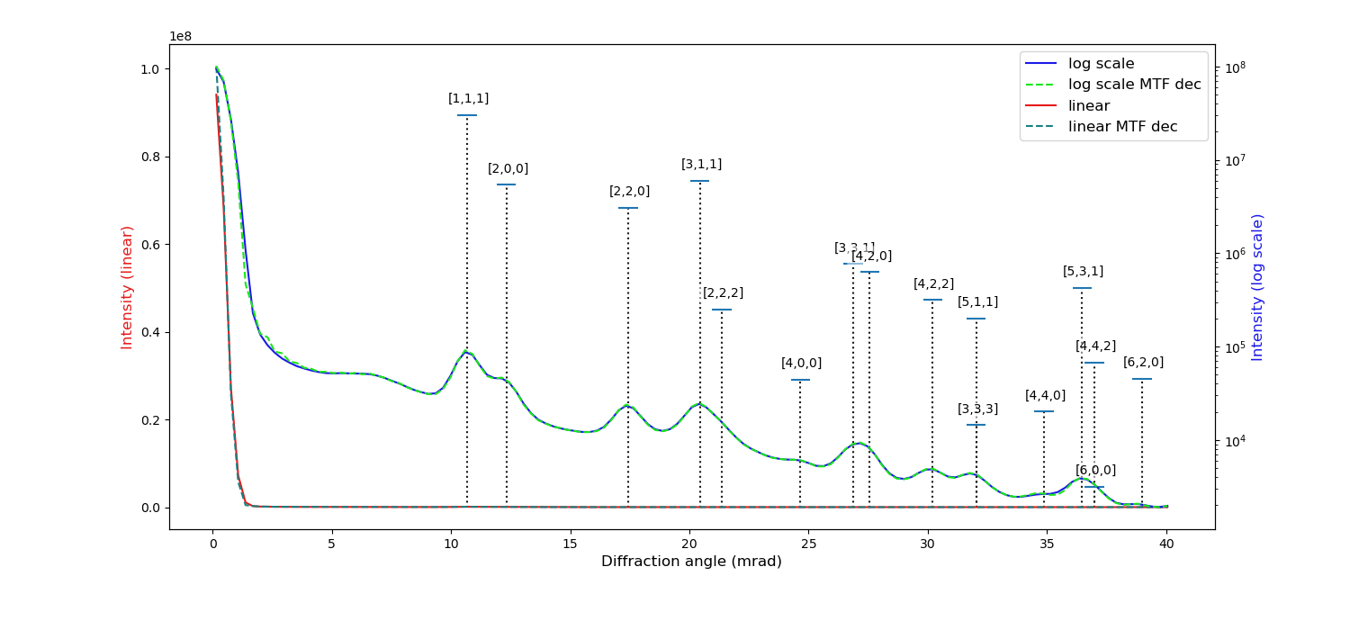
MTF compensation
MTF compensation (deconvolution) was applied to the diffraction image, and the dashed line represents the line profile after MTF compensation. In this dataset, MTF compensation did not significantly improve the resolution of the diffraction rings.

Slide 26
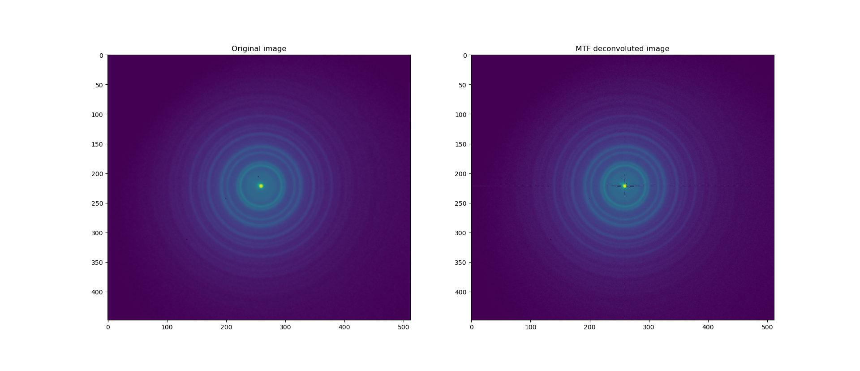
MTF compensation, original image vs MTF compensation image
there are some high frequency artefacts in low-frequency area.

Slide 27
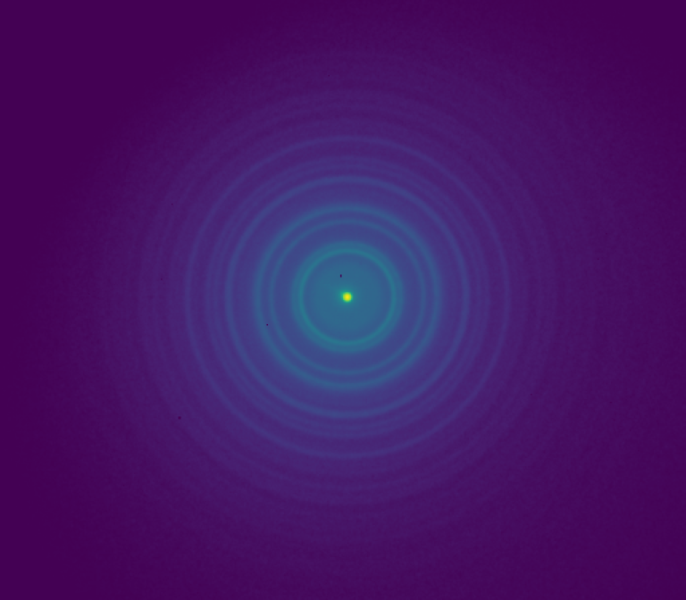
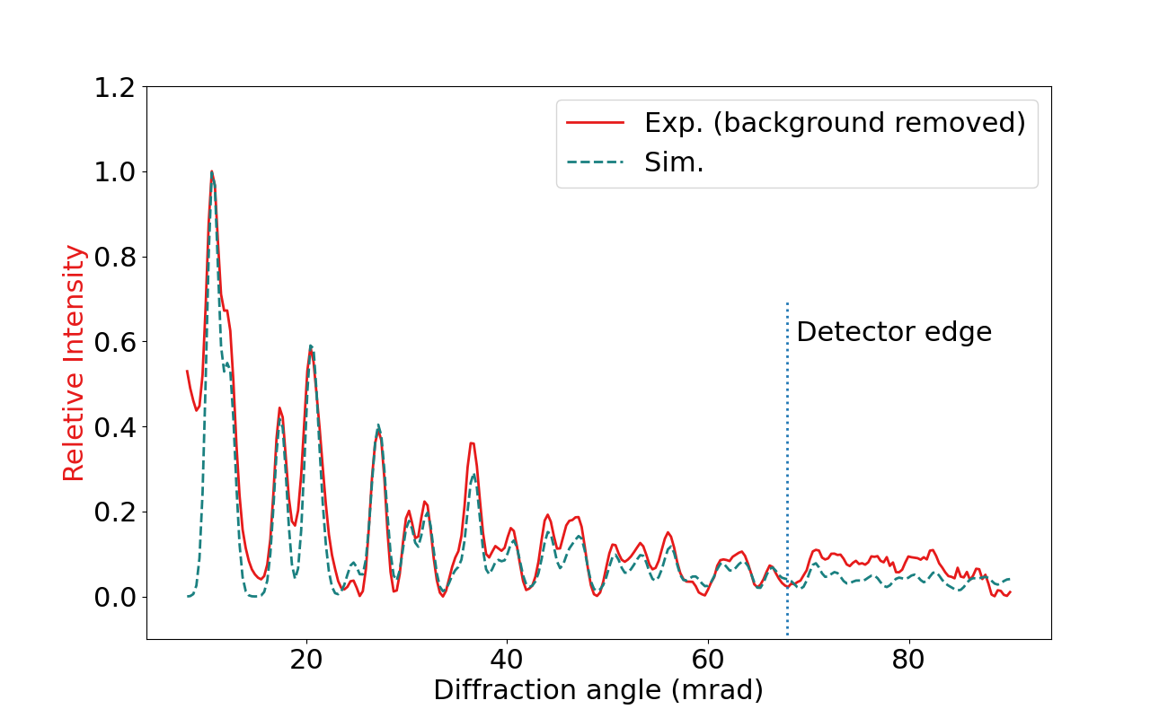

Slide 29
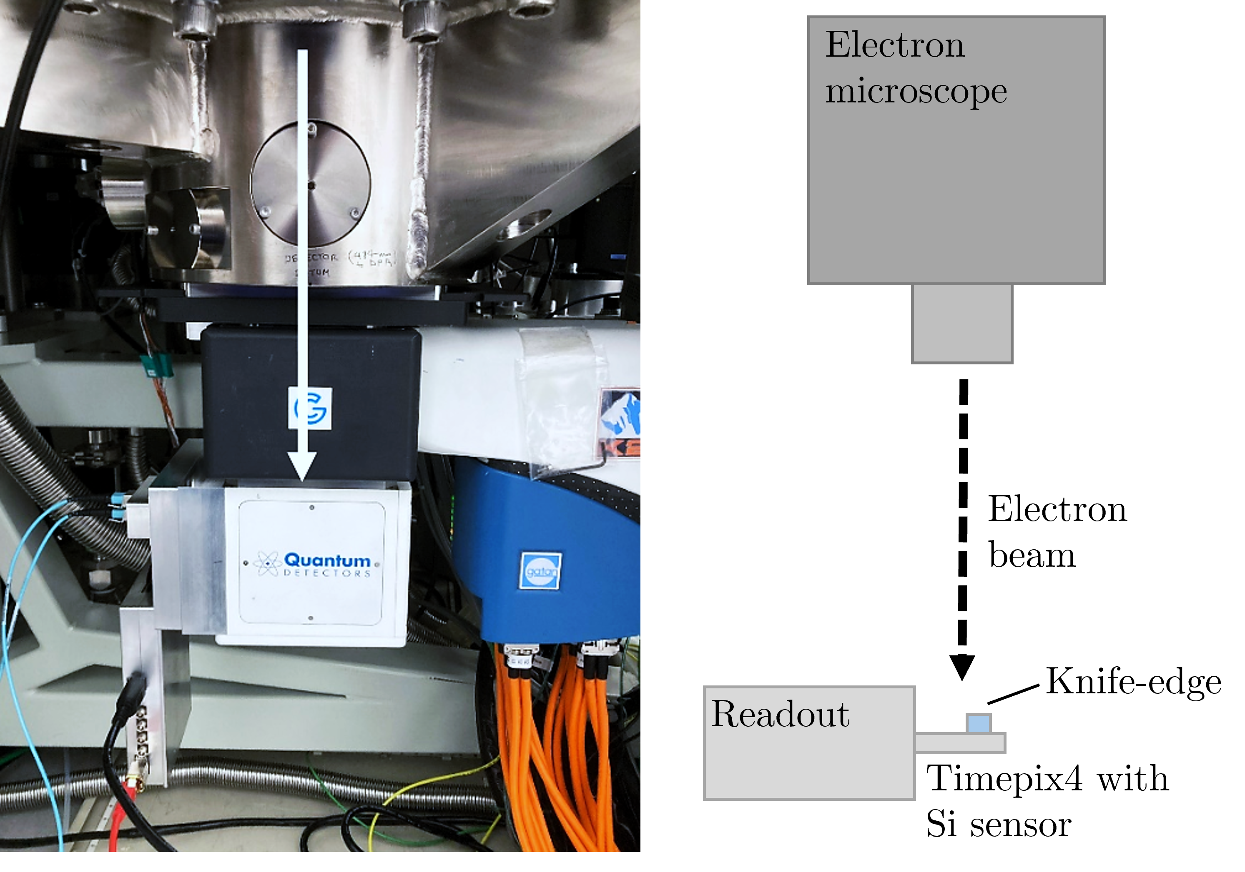
Data Energy, (angle) | Raw MTF at Nyquist | Clustered MTF at Nyquist | Improvement factor
100 keV, (4◦) | 0.16 ± 0.0061 | 0.34 ± 0.010 | 2.12 ± 0.020
200 keV, (4◦) | 0.0046 ± 0.000069 | 0.014 ± 0.00015 | 3.16 ± 0.018

Slide 31
