Slide 1

MARS Extremity Spectral Photon-Counting CT Meets Conventional CT Image Quality While Providing Improved Patient Experience
Jack Consolini¹, Silvia Benitez¹, Eric A. Bogner¹, Ranqing Lan², Anthony P.H. Butler^{3,4}, Jennifer A. Clark^{3,4}, Matthew F. Koff¹
¹Department of Radiology and Imaging, Hospital for Special Surgery, New York, NY, USA
²Department of Biostatistics and Bioinformatics, Hospital for Special Surgery, New York, NY, USA
³MARS Bioimaging, Christchurch, New Zealand
⁴Univesrity of Otago, Christchurch, New Zealand
Symposium on Timepix and Medipix 2025
Session Date/Time: 23 September 2025 340-405PM

Slide 2
Declaration of Financial Interests or Relationships
Speaker Name: John Carrino
I have no conflicts of interest to disclose.
The authors declare that MARS Bioimaging who provided funding support assisted in the study design and review of study results. MARS Bioimaging did not have any role in the collection, analysis, and interpretation of data.

Slide 3

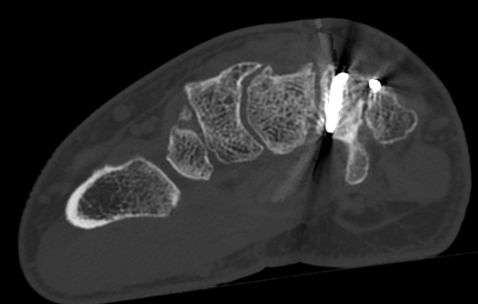
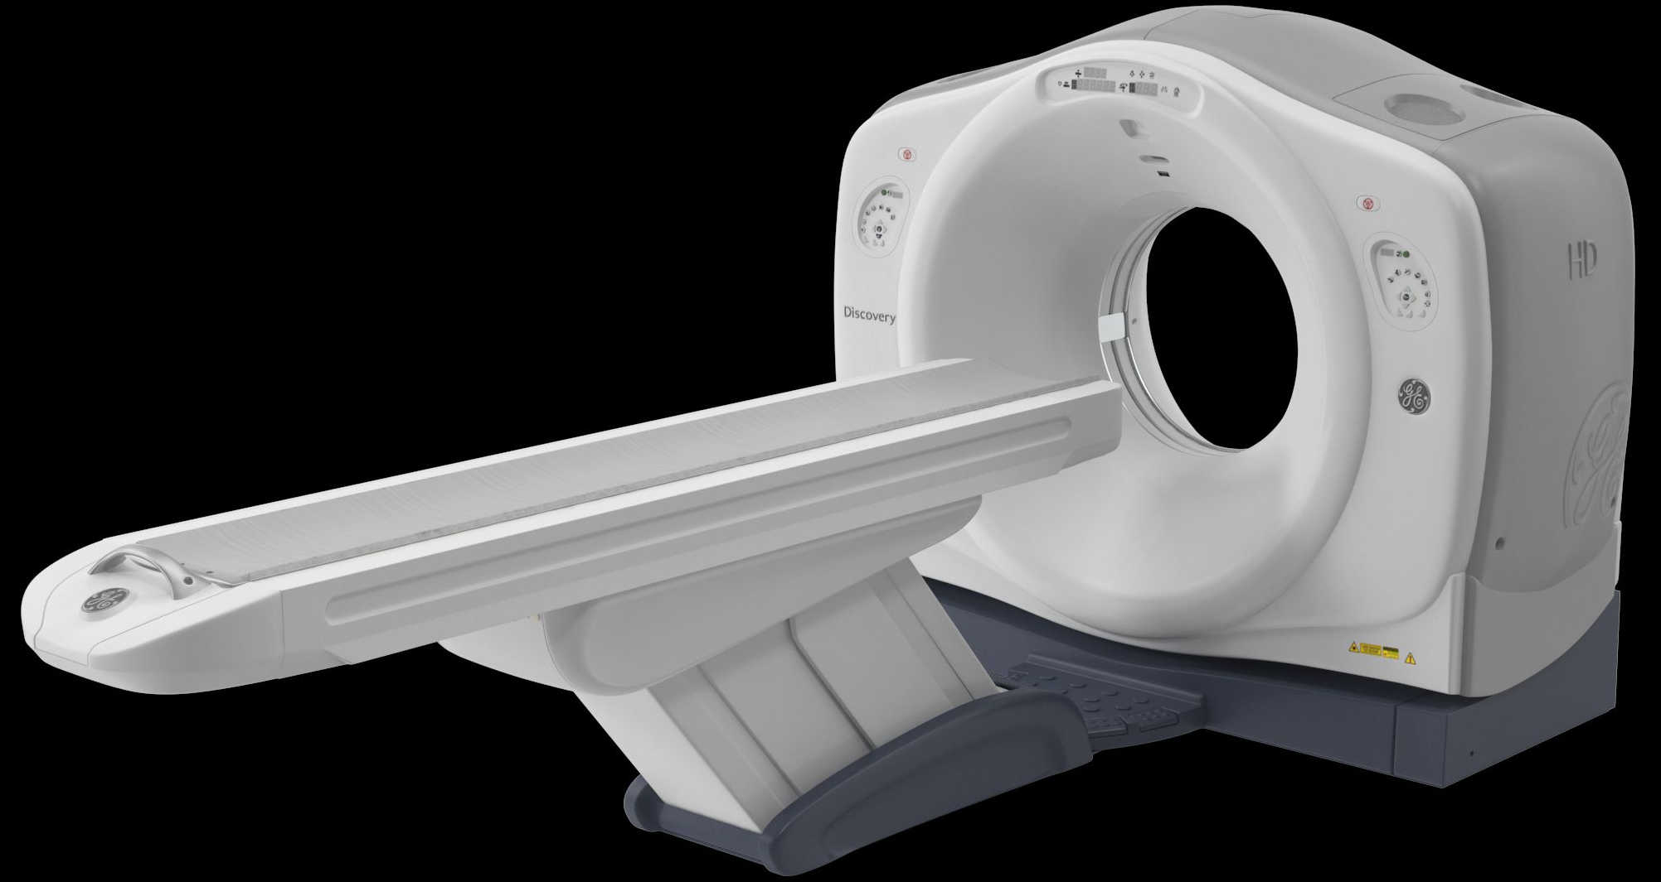
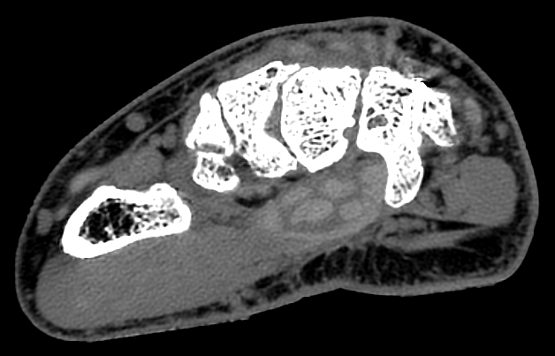
Background
Large-bore Multi-detector CT (MDCT) systems are essential within musculoskeletal imaging for pre- and post-operative wrist assessment
Fracture/ bone-metal interface
Axial
GE Discovery CT720 HD (GE Healthcare, Waukesha, WI, US)
Soft tissues
Axial
Diagnostic Wrist Imaging
Notes:
Large bore, multi-detector CT (MDCT) systems, such as the GE Discovery CT750 HD (GE Healthcare, Waukesha, WI, US), have become essential within musculoskeletal imaging for pre- and post-operative assessment [1–3].

Slide 4
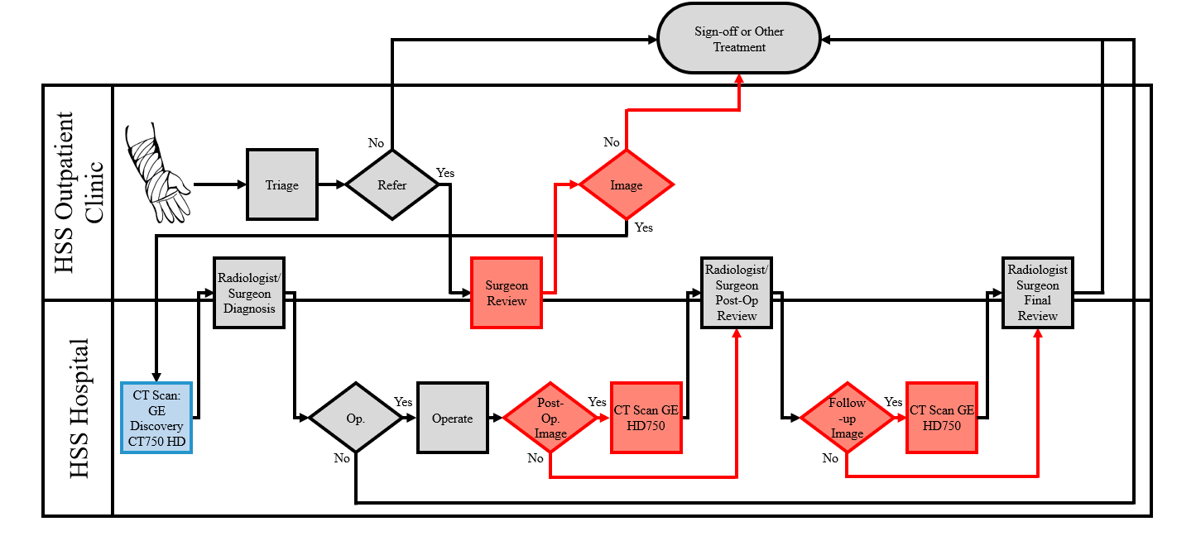
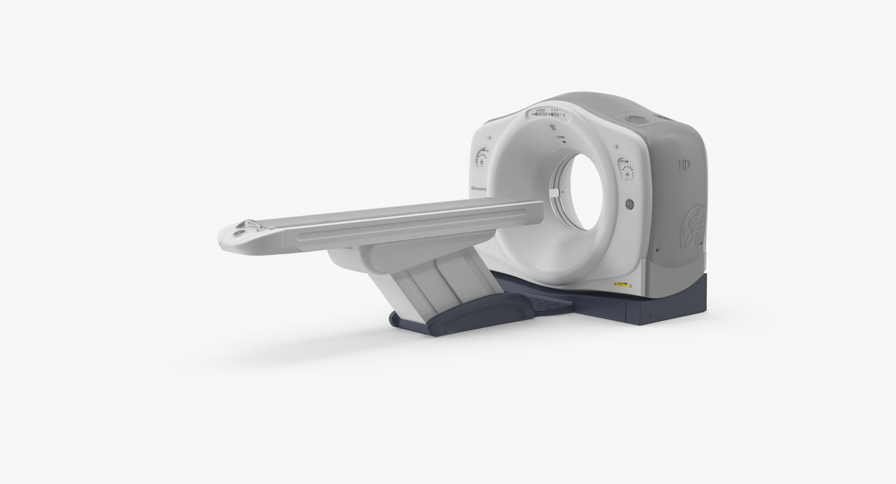
Background
However, structure and power requirements of conventional MDCT limit efficiency of the clinical care pathway
Notes:
High power consumption and required infrastructure (lead-shielded rooms, reinforced flooring) restrict their deployment outside of major hospitals, limiting access for patients who may have logistical challenges such as long travel distances or limited transportation options.

Slide 5
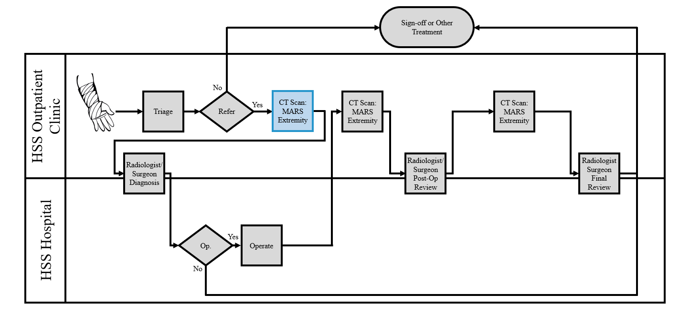
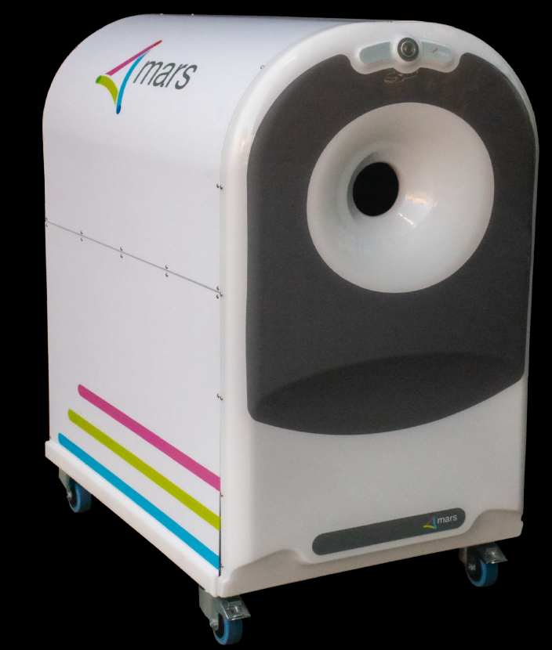
Background
MARS spectral-photon counting (SPCCT) may address limitations of conventional CT without reduction in diagnostic image quality
Current Clinical Workflow
Proposed Clinical Workflow
Notes:
The newly developed MARS small bore extremity spectral photon counting CT scanner permits visualization of soft tissues, fluid, bone, and hardware while requiring standard power requirements and no room shielding, making for ease of deployment within the outpatient clinic.

Slide 6

Background
SPCCT uses photon-counting detectors instead of energy-integrating detectors
MARS SPCCT is capable of:
High resolution images (110$μ$m isotopic voxels)
Material and molecular imaging
Minimization of metallic artifact without need for additional reconstructions
At <25% radiation exposure than MDCT
Greffier et al. Diagn Interv Imaging 2025 Anderson et al. Contrast Media Mol Imaging 2014 Taguchi et al. Med Phys 2023
Healy et al. Atherosclerosis 2023
MARS Extremity (MARS Bioimaging, Christchurch, New Zealand)
Notes:
Unlike conventional MDCT scanners that use energy-integrating detectors, the MARS Extremity captures the characteristic attenuation of different materials at multiple energy ranges [4–6], as has been previously described in [7]. The MARS Extremity is an advanced SPCCT technology capable of generating high-resolution images (110$μ$m isotopic voxels) with minimal metallic artifacts and radiation exposure up to 25 times less than MDCT while taking up a small footprint (~0.75 m²) within an ordinary (non-lead shielded) room.

Slide 7
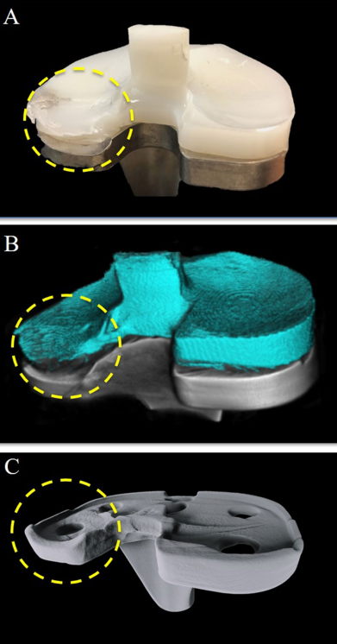
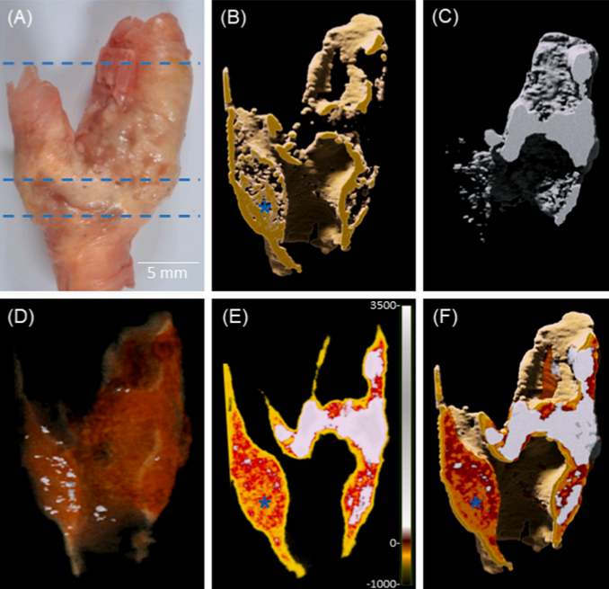
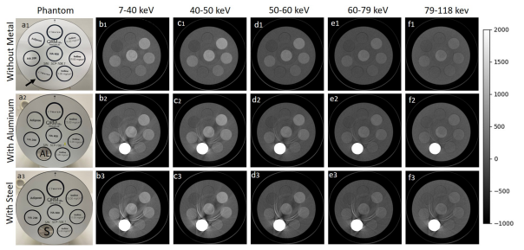
Background
MARS SPCCT technology has:
Histopathological measurements of Excised Carotid Plaques Healy et al. Atherosclerosis 2023 Zainon et al. Eur Radiol 2012
Detection of Total Knee Arthroplasty Failure Lau et al. Sci Rep 2021
Material Quantification in Presence of Metal Tariq et al. PloS One 2024
Notes:
MARS photon-countingSPCCT technology has demonstrated promising results in preclinical studies of: material identification and quantification in the presence of metal [13], histopathological measurements of excised carotid plaques [7,14], development of quantitative images for radiotherapy applications [15], and detection of total knee arthroplasty implant failure [10]. These findings highlight the need for clinical validation to assess MARS technology translatability to in-vivo diagnostic use in the outpatient clinic.

Slide 8
Objectives
Compare MARS Extremity SPCCT to large-bore MDCT for wrist imaging
Visualization of bone, soft tissue, and hardware
Operational efficiency
Patient experience
Hypotheses
SPCCT will provide equivalent image quality while maintaining operational efficiency and patient experience
VS
MDCT
SPCCT
Notes:
With promising results in pre-clinical studies, this study sought to perform the first clinical evaluation of the MARS extremity SPCCT scanner, to establish its diagnositic equivalence to the GE Discovery CT750 HD with respect to bone, soft tissue, and hardware visualization for wrist imaging.

Slide 9
Methodology
Enrollment
MDCT & SPCCT Acquisition
VGC Assessment
Operational and Patient Assessment
Statistical Analysis
Patients were identified from the hospital’s routine clinical practices as scheduled to receive a pre- or post-operative wrist CT scan
Exclusion criteria
Age > 80 or < 18
Irremovable cast
Forearms exceeding SPCCT bore
Notes:
This prospective observational study was conducted following local institutional review board approval with patient informed consent and HIPAA compliance. Patients aged 18-80 years were identified from the hospital’s routine clinical practices as scheduled to receive a pre- or post-operative wrist CT scan (Fig. 1). Patients were consecutively consented, excluding those with non-removable wrist casts or forearms exceeding the bore diameter. A randomized crossover schedule determined whether MDCT or SPCCT was performed first.

Slide 10
Methodology
Enrollment
MDCT & SPCCT Acquisition
VGC Assessment
Operational and Patient Assessment
Statistical Analysis
MDCT Acquisition
(GE Discovery CT750 HD)
Kilovoltage Peak = 120-140kVp​
X-ray Tube Current = 240-475 mA​
Exposure Time = 1095-1875 ms
Gantry Tilt = 0 deg
Rotation Direction = clockwise
Slice Thickness = 0.20-0.36 mm​
Reconstruction Matrix = 512 x 512
SPCCT Acquisition
(MARS Extremity)
Kilovoltage Peak = 118kVp​
X-ray Tube Current = 0.061 mA​
Exposure Time = 160 ms
Projections per Gantry Rotation = 373 pr/rot
Rotation Direction = clockwise
Slice Thickness = 0.09 mm​
Reconstruction Matrix = 512 x 512
Three planar and long axis reformations were generated from all raw data
Notes:
MDCT was performed on GE Discovery CT750 HD scanner (GE Healthcare, Waukesha, WI, US). Images were acquired, headfirst-prone position, using bone and soft tissue reconstruction algorithms. Acquisition parameters were: kilovoltage peak: 120-140kVp, slice thickness: 0.20-0.36 mm, X-ray tube current: 240-475 mA, exposure time: 1095-1875 msec, gantry tilt: 0°, rotation direction: clockwise, and reconstruction matrix of 512 x 512 pixels. Three plane reformats were generated (GE Advantage Workstation, GE Healthcare, Waukesha, WI, US) (Fig. 2, left). Postprocessing for metal artifact reduction was employed for metallic hardware.
SPCCT was performed on MARS Extremity scanner (MARS Bioimaging Ltd., Christchurch, New Zealand). Participants sat facing the scanner, with the wrist on an arm support in a prone position with flexed elbow. The wrist was wrapped to limit movement. A foam block was provided for palm support. Axial images were acquired with acquisition parameters: kilovoltage peak: 118kVp, slice thickness: 0.09 mm, X-ray tube current: 0.061 mA, exposure time: 160 msec per projection, projections per gantry rotation: 373pr/rot, rotation direction: clockwise, and reconstruction matrix of 512 x 512 pixels. Three planar and long axis reformations were generated to match the corresponding MDCT scan orientation and slice thickness (Fig. 2) to account for positional variability. No metal artifact reduction software was employed.

Slide 11
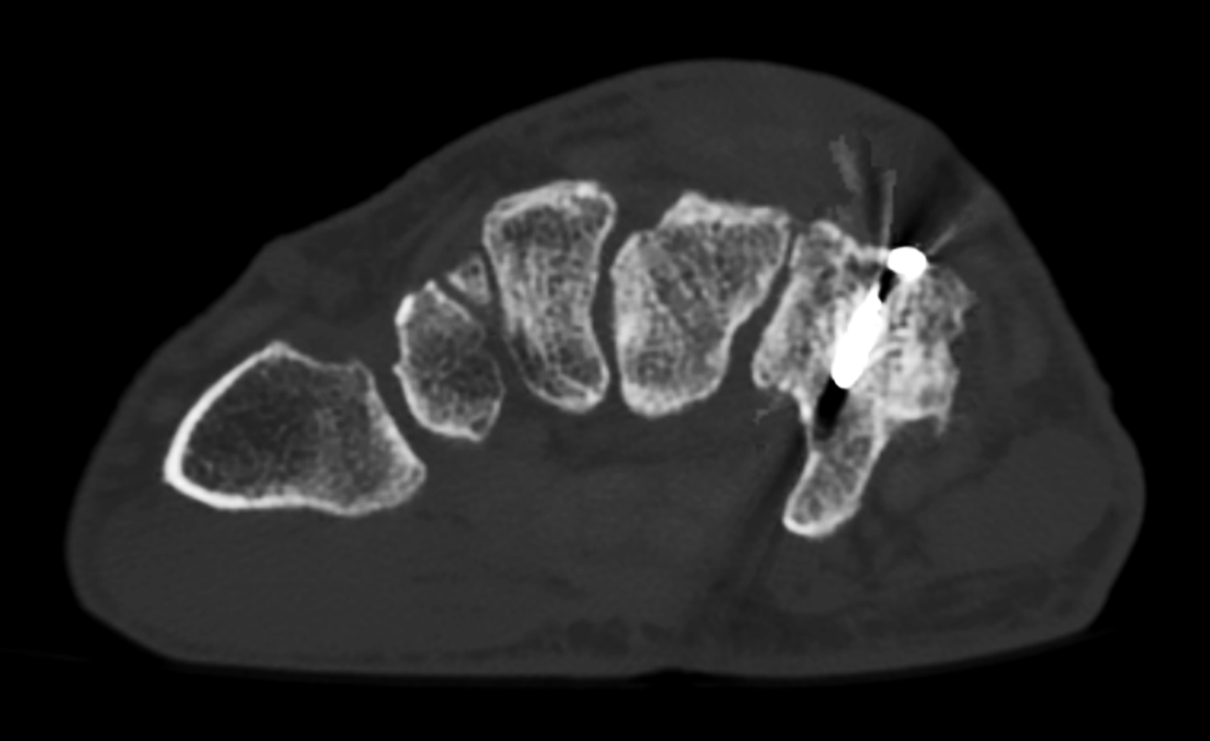
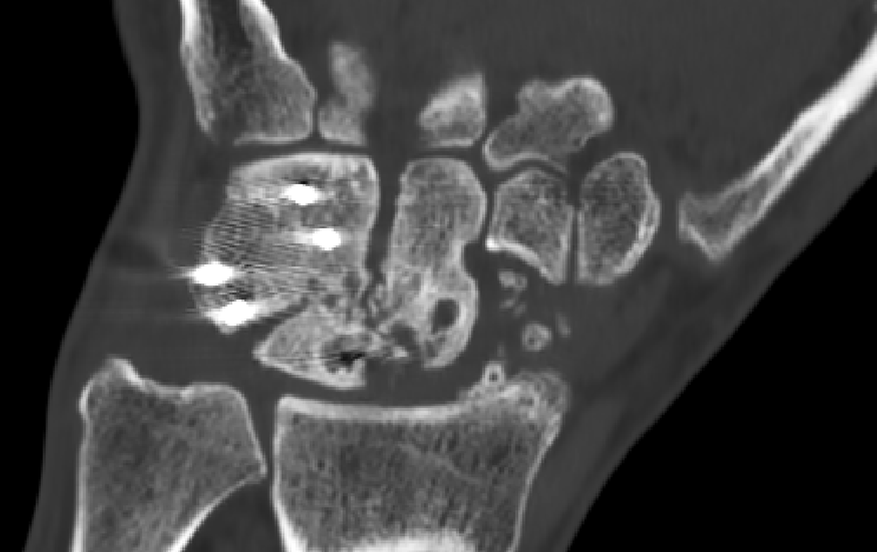
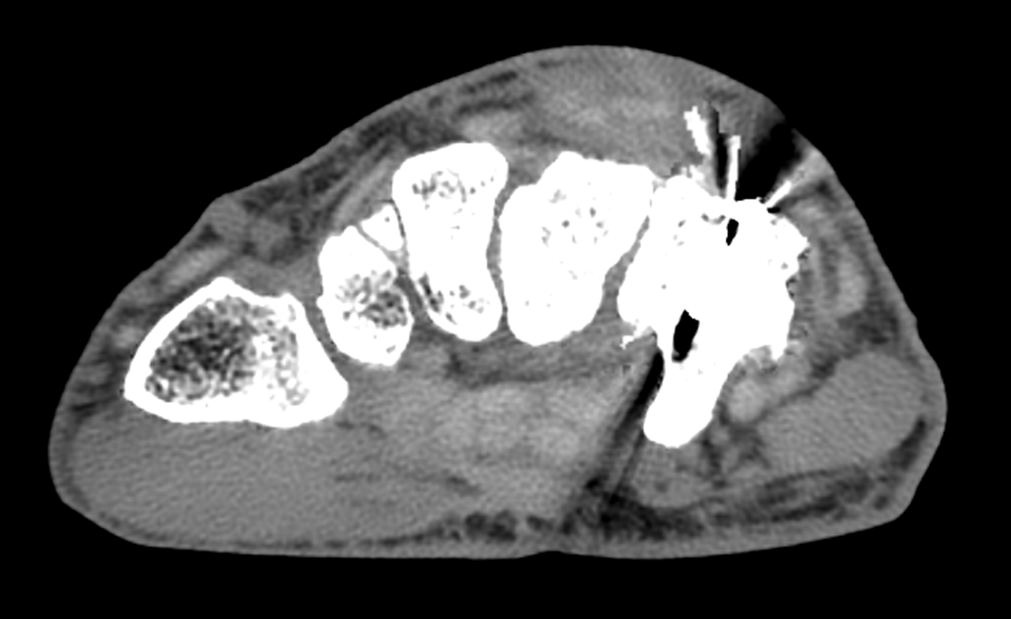
Methodology
Enrollment
MDCT & SPCCT Acquisition
VGC Assessment
Operational and Patient Assessment
Statistical Analysis
5./6. Differentiation of tendon, ligaments, and muscles
1. Visually sharp trabeculae
3. Visualization of bone-metal interface
4. Visually sharp fracture margins
2. Visually sharp cortical margins
Axial
Coronal
Axial
Notes:
Reformatted images were deidentified and coded to blind the rater to acquisition hardware and , acquisition parameters, and participant identity. A board-certified musculoskeletal radiologist with over 20 years of experience (EAB) was provided MDCT and SPCCT images within the rater’s native picture archiving and communication system (PACS) viewer, Sectra IDS7 (Sectra Medical Systems, Linköping, Sweden). Image quality was evaluated using Båth and Månsson’s [16] visual grading characteristics (VGC) analysis. Six criteria assessed visualization of: 1) cortical margins, 2) trabeculae, 3) the bone-metal interface, 4) fracture margins, 5) tendons and muscles, and 6) ligaments. Manual windowing was permitted. Three criteria assessed image quality: 7) image noise, 8) motion artifact, and 9) overall diagnosis sufficiency. The VGC used a five-point Likert scale, with grades: “confident criteria are not fulfilled,” “somewhat confident criteria are not fulfilled,” “indecisive about whether criteria are fulfilled,” “somewhat confident criteria are fulfilled,” and “confident criteria are fulfilled” (Table 2). “Not applicable” could be selected when appropriate.

Slide 12
Methodology
Enrollment
MDCT & SPCCT Acquisition
VGC Assessment
Operational and Patient Assessment
Statistical Analysis
5./6. Differentiation of tendon, ligaments, and muscles
1. Visually sharp trabeculae
3. Visualization of bone-metal interface
4. Visually sharp fracture margins
2. Visually sharp cortical margins
Axial
Coronal
Axial
7. Interference in diagnosis due to image noise | 8. Interference in diagnosis due to motion artifact | 9. Overall diagnosis sufficiency
Notes:
Reformatted images were deidentified and coded to blind the rater to acquisition hardware and , acquisition parameters, and participant identity. A board-certified musculoskeletal radiologist with over 20 years of experience (EAB) was provided MDCT and SPCCT images within the rater’s native picture archiving and communication system (PACS) viewer, Sectra IDS7 (Sectra Medical Systems, Linköping, Sweden). Image quality was evaluated using Båth and Månsson’s [16] visual grading characteristics (VGC) analysis. Six criteria assessed visualization of: 1) cortical margins, 2) trabeculae, 3) the bone-metal interface, 4) fracture margins, 5) tendons and muscles, and 6) ligaments. Manual windowing was permitted. Three criteria assessed image quality: 7) image noise, 8) motion artifact, and 9) overall diagnosis sufficiency. The VGC used a five-point Likert scale, with grades: “confident criteria are not fulfilled,” “somewhat confident criteria are not fulfilled,” “indecisive about whether criteria are fulfilled,” “somewhat confident criteria are fulfilled,” and “confident criteria are fulfilled” (Table 2). “Not applicable” could be selected when appropriate.

Slide 13
Methodology
Enrollment
MDCT & SPCCT Acquisition
VGC Assessment
Operational and Patient Assessment
Statistical Analysis
Operational Efficiency: Time was tracked for each step of visit
Patient experience: Participant-recorded 14-question survey following examination
Patient brought to exam room
Patient briefing
Patient Positioned
Acquisition
Patient Debriefed
Clinical Evaluation
Notes:
Efficiency was evaluated by tracking CT acquisition and VGC evaluation times, including bringing participant to exam room, describing process, positioning, acquiring images, and debriefing. The “clinical evaluation” time consisted of the amount of time required to perform the full VGC grading assessments for each subject.
Experience was evaluated using participant-reported satisfaction surveys after both acquisitions. Participants completed 14-question questionnaires with four grades: "not at all," "somewhat," "moderately so," "very much so". The responses were examined to establish the proportion of each grade relative to total possible responses (n=51).

Slide 14
Methodology
Enrollment
MDCT & SPCCT Acquisition
VGC Assessment
Operational and Patient Assessment
Statistical Analysis
Compare MARS Extremity SPCCT to large-bore MDCT for wrist imaging
VGC Assessment
Assessed via proportional agreement w/ 95% confidence intervals
Operational efficiency
Wilcoxon signed-rank test evaluated differences in time assessments w/ significance threshold of 0.05
3. Patient experience
Percentage of responses were compared
Notes:
The percentages of agreement, with 95% confidence intervals (CI), were reported for the nine VGC assessments as was the overall agreement rate based on combined assessments. For operational metrics, median and interquartile range (IQR) were reported. The Wilcoxon signed-rank test was used to compare each paired time metric. Patient satisfaction responses were reported as numbers and percentages. A significance threshold of 0.05 was used for all statistical tests. Analyses conducted in R version 4.1.0 [17].

Slide 15
Subject Characteristics
Assessed for eligibility n=328 wrists (226 patients)
Excluded (n=277)
Ineligible (n=31)
Eligible but not recruited (n=44)
Reason for exclusion unavailable (n=202)
Total enrolled n=51 wrists (49 participants, Age: 47.5 ± 16.8 years)
Unusable participant data
Pathology outside of SPCCT acquisition FOV (n=12)
Raw SPCCT data unacquired (n=2)
Time assessment not performed (n=13)
Data available for analysis:
Visual grading characteristic analysis n=37
Operational efficiency n=38
Patient experience n=51
Notes:
A total of 51 wrist CT scans (49 enrolled participants, Age: 47.5 ± 16.8 years [mean ± standard deviation]) were acquired (Fig. 1 and Table 1), of which 37 scan pairs were evaluated. Fourteen Twelve SPCCT cases were omitted from theexcluded from analysis as operator training issues resulted in inadequate coverageomission of the region of interest. Two scans were omitted due to data loss because of user error. The comparison of the operational efficiency was performed across 38 MDCT and the corresponding 38 SPCCT scans (Fig. 4). Operational times were not tracked for the first thirteen participants.

Slide 16
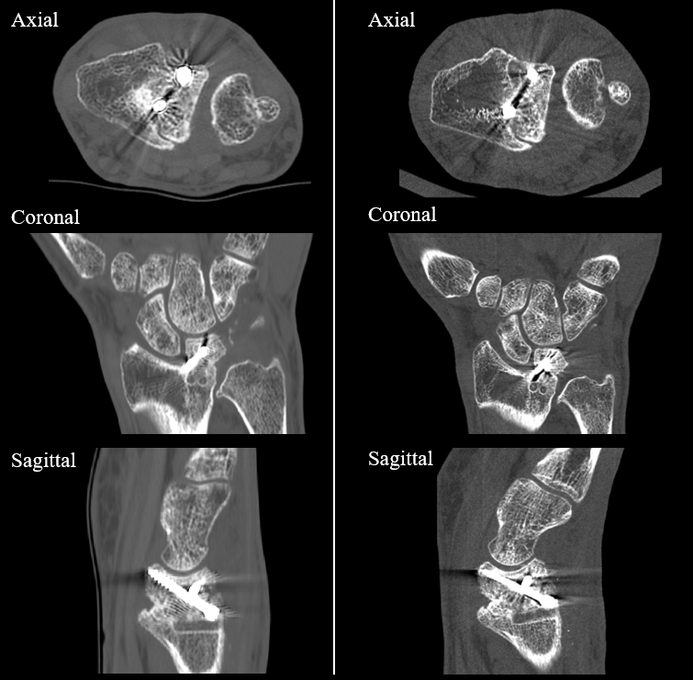
Results
Overall image quality Agreement=97.3% (CI: 0.86-1.00)
Visually sharp trabeculae Agreement=100% (CI: 0.91–1.00)
Visually sharp cortical margins Agreement=95% (CI: 0.82–0.99)
Bone-metal interface Agreement=95% (CI: 0.76–1.00)
Fracture margins Agreement=97% (CI: 0.85–1.00)
Conventional MDCT
MARS SPCCT
Notes:
Full diagnostic confidence was present in all MDCT images and in 36 of 37 (97.3%) SPCCT images (Table 2). Perfect or near-perfect agreement between scanners was found for overall image quality, agreement=97.3% (CI: 0.86-1.00) and visualization of trabeculae, agreement=100% (CI: 0.91–1.00), cortical margins, agreement=95% (CI: 0.82–0.99), the bone-metal interface, agreement=95% (CI: 0.76–1.00), and fracture margins, agreement=97% (CI: 0.85–1.00).

Slide 17
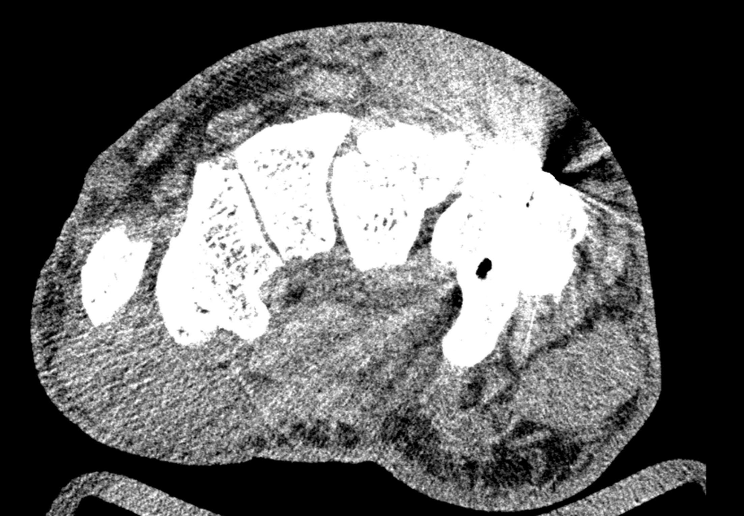
Results
Poor agreement for visualization of soft tissues (agreement=27% [CI: 0.15–0.43]) and ligaments (agreement=59% [CI: 0.43–0.74])
Conventional MDCT
MARS SPCCT
Notes:
Poor agreement was found for soft tissue visualization, agreement=27% (CI: 0.15–0.43), and ligament visualization, agreement=59% (CI: 0.43–0.74).

Slide 18
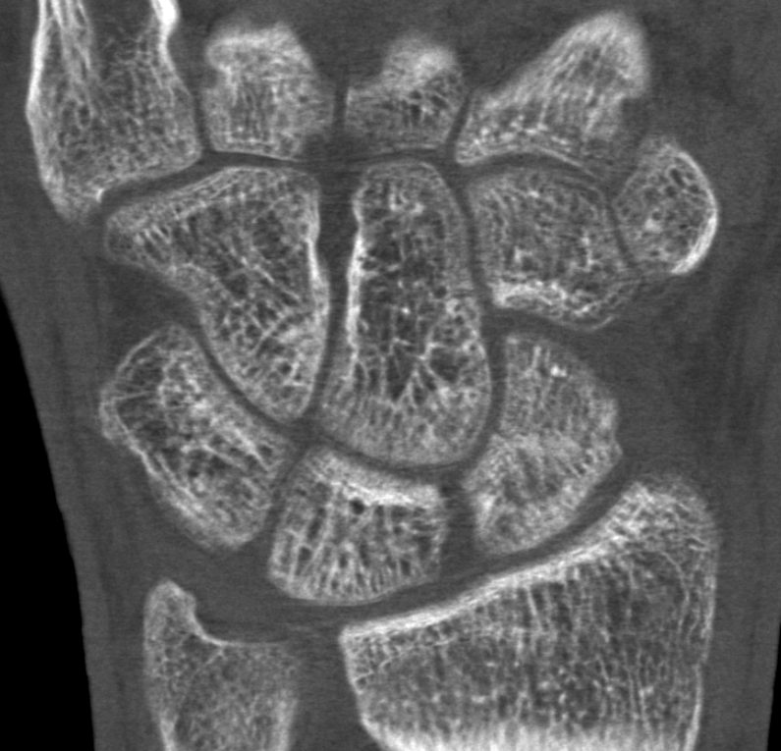
Results
Image noise did not affect diagnosis (agreement=95% [CI: 0.82–0.99])
Motion artifact was present in 10 of 37 MARS SPCCT scans (agreement=73% [CI: 0.57–0.85]), but did not affect diagnostic confidence
MARS SPCCT
Notes:
Substantial to almost perfect agreement was found for factors related to image noise, agreement=95% (CI: 0.82–0.99), and motion artifact, agreement=73% (CI: 0.57–0.85).

Slide 19
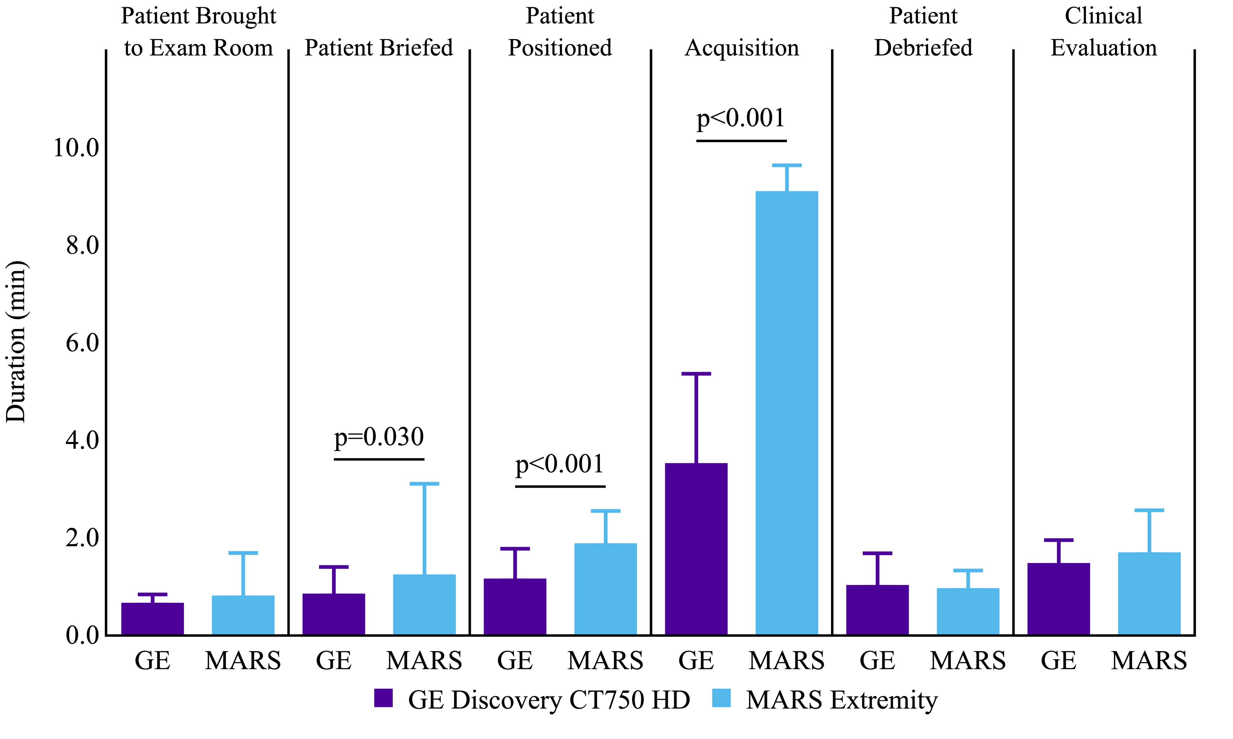
Results
Notes:
As compared to MDCT, the SPCCT required a longer briefing time (median: 1.0 [0.5-1.0] min vs. 0.5 [0.5–1.0] min, p=0.03), a longer positioning time (median: 2.0 [1.0–2.0] min vs. 1.0, [1.0–1.0] min, p<0.001) and had a longer acquisition time (3 [3.0–3.0] min vs. 9 [9.0–9.0] min, p<0.001). Room entry, debriefing, and clinical evaluation times were similar (p>0.44). Clinical evaluation was similar across scanners (p=0.53); MDCT shared a median time of 1.4 minutes (IQR: 1.0–1.7 min) with the SPCCT scanner (IQR: 1.2–1.9 min).

Slide 20

Results
MDCT and SPCCT showed nearly identical patient experience across 14 questions
5 participants felt “very much” safer during SPCCT scanning
3 participants with shoulder mobility limitations described SPCCT scanning as preferable
GE Discovery CT750 HD | MARS Extremity
Not at all | Not at all
Somewhat | Somewhat
Moderately so | Moderately
Very much so | Very much so
I felt safe
0 | 0.2 | 0.4 | 0.6 | 0.8 | 1.0
Proportion of Responses
Notes:
MDCT and SPCCT showed nearly identical experience distributions across 14 questions and 1–5 participants found the SPCCT scanner provided an improved imaging experience over the MDCT scanner. Five more participants felt “very much” safer during SPCCT scanning (Fig. 5). Only one question showed a SPCCT disadvantage: two more participants moderately or somewhat wanted to exit the SPCCT scanner.

Slide 21
Discussion
MARS Extremity SPCCT was found to produce diagnostically equivalent images to that of conventional large-bore MDCT
36/37 SPCCT rated equivalent to MDCT
One SPCCT was downgraded due to motion artifact
Operator mispositioning likely contributed to motion
Reduction of scan times may reduce motion
Soft tissue visualization was poor
Dedicated soft tissue algorithm
Acquisition time was the only meaningful operational increase
Optimization of scan protocol will lead to reduced scan times
Notes:
This study evaluated the diagnostic image quality of the MARS Extremity SPCCT scanner to a conventional large-bore MDCT system. Of the 37 evaluated SPCCT images, 36 were rated diagnostically equivalent to MDCT images, with one downgraded to "somewhat confident" due to motion artifact and image noise. An additional SPCCT scan had image noise without affecting image quality.
Motion artifacts occurred in 10 of 37 (27.0%) SPCCT acquisitions, but only reduced diagnostic confidence in one case and did not impair visualization of trabeculae or fracture margins, the primary pathologies assessed using CT. Early positioning challenges contributed to motion, with 14 cases excluded due to operator mispositioning the participant. Technologist familiarity improved positioning over time, and patient comfort could be further enhanced with forearm support.
The MDCT images enabled greater confidence in the differentiation of tendons and muscles (36/37, 97.3%), as compared to SPCCT images (9/37, 24.3%). This was anticipated in the absence of a soft tissue reconstruction algorithm in the current SPCCT scanning protocol. However, assessment was still feasible with appropriate windowing, particularly when tendon location correlated with fracture patterns. Ligament visualization was limited across systems, reinforcing that this is an inherent limitation of current CT protocols. Development of a soft tissue algorithm may enhance future SPCCT capabilities.
Briefing and positioning times differed significantly between systems (p<0.03), but the actual difference (~ 60 sec) was minimal. Acquisition time was the only meaningful operational increase between scanners (median diff.=6.0 min) and is expected to decrease with protocol optimization. SPCCT reformatting time decreased as technologists became familiar with the software.

Slide 22
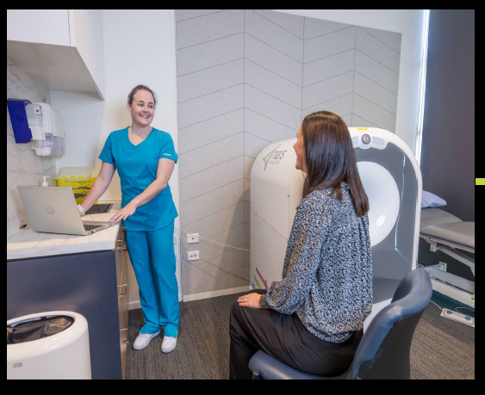
Conclusions
MARS Extremity may provide improvement in patient experience for individuals with limited shoulder mobility without compromising image quality
Further clinical testing to required to:
Optimize scan protocol
Evaluate soft tissue algorithm
Find optimal patient positioning to reduce motion
Notes:
This clinical trial demonstrated that the MARS Extremity SPCCT scanner provides wrist CT images with non-inferior image quality to a MDCT scanner, while offering a moderate improvement in of patient experience, particularly for individuals with limited shoulder mobility. Although SPCCT scan times were longer with the prototype system, this did not significantly impact overall operational efficiency and must be balanced against the challenges of positioning an upper extremity body-part body part in a large-bore scanner. As SPCCT technology continues to advance, scan durations are expected to decrease. In additionAdditionally, operating the the ability to operate the MARS scanner in an unmodified outpatient facility, without loss of diagnostic quality, may improve patient access and enable more efficient care pathways.

Slide 23
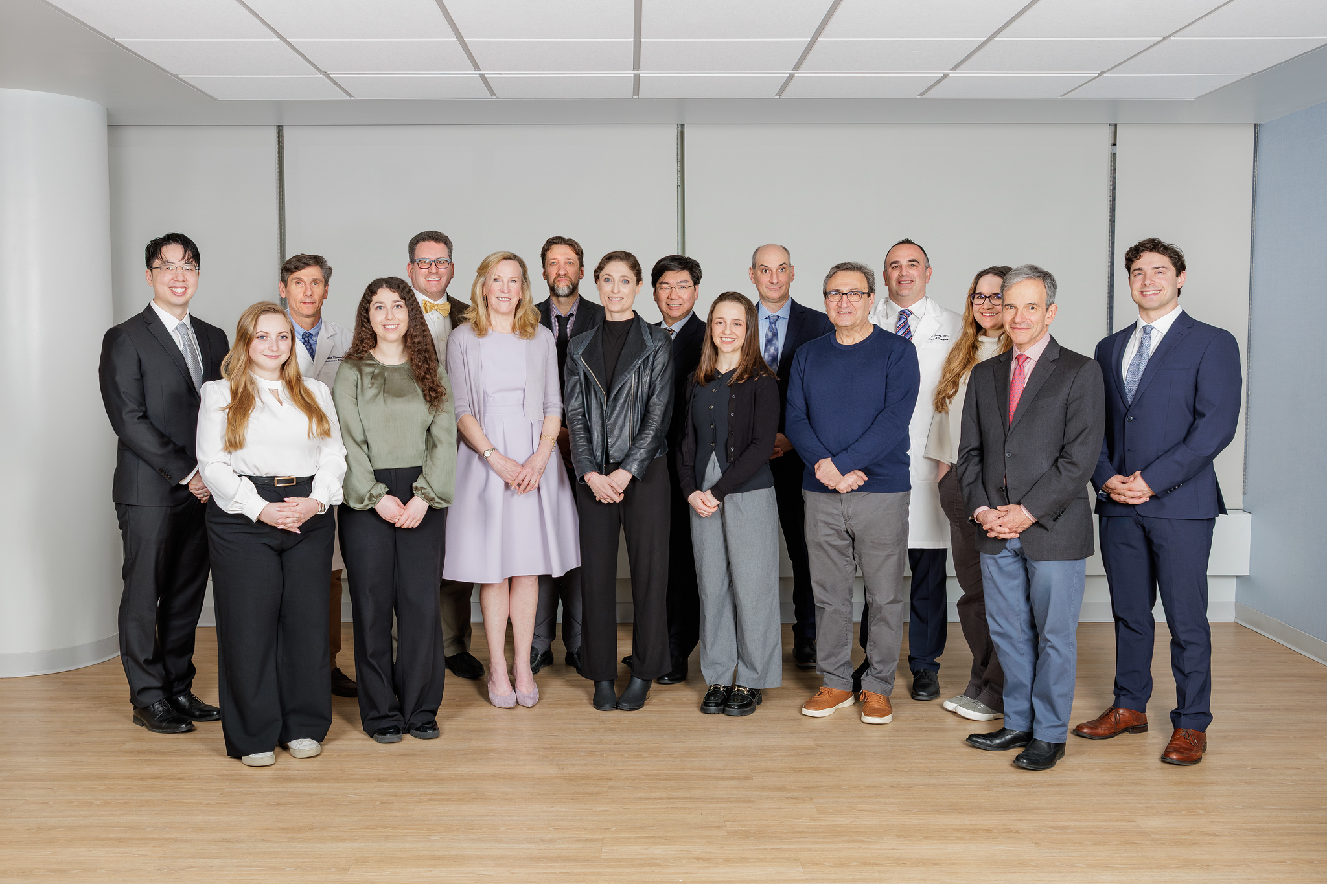
Thank You!
HSS MRI Lab
Matthew Koff, PhD
Ek Tsoon Tan, PhD
Hollis Potter, MD
Kevin Koch, PhD
Darryl Sneag, MD
Alissa Burge, MD
Diego Jaramillo, MD
Richard Kijowski, MD
Sarah Pownder, DVM
Michael Parides, PhD
Erin Argentieri
Jack Consolini
Ali Lowe
Emma McKinney

