Slide 1

25 years of working with the Medipx collaborations
Roelof de Vries
23th September 2025

Slide 2
Content
Who we are and what we do
A little bit of history
The Medipix 2 experience
The next generation: Medipix 3
Looking back
Looking forward

Slide 3






Our Owners – Spectris plc
www.spectris.com
Total number of employees for Spectris: 8200. At Malvern Panalytical: 2600.

Slide 4
Malvern Panalytical Almelo
Formerly known as Philips Analytical
Focusing on X-ray Fluorescence and X-ray Diffraction
Located in Almelo since the mid seventies
Sold to Spectris in 2002
Merged with Malvern on 1 January 2017
Employing 520 people in Almelo, 80 in Eindhoven, the Netherlands
95 people working in R&D
Malvern Panalytical acquires Micromeretics ans SciAps in 2024
Spectris sold to KKR on 27th August 2025

Slide 5
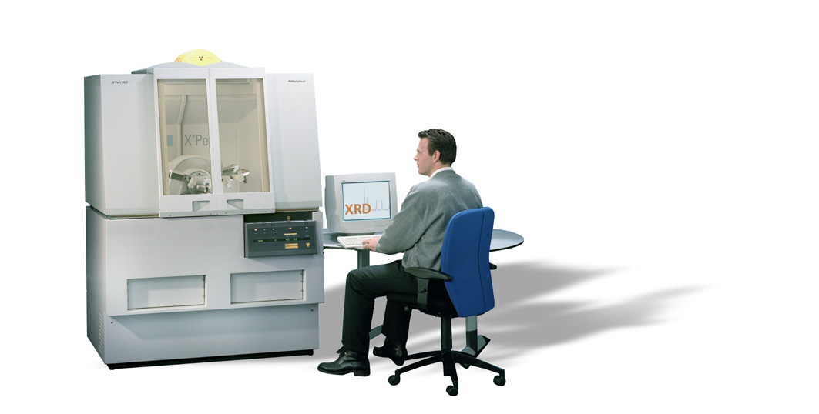
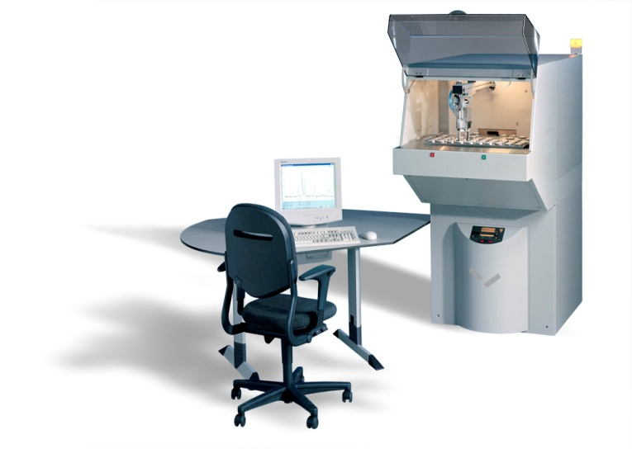
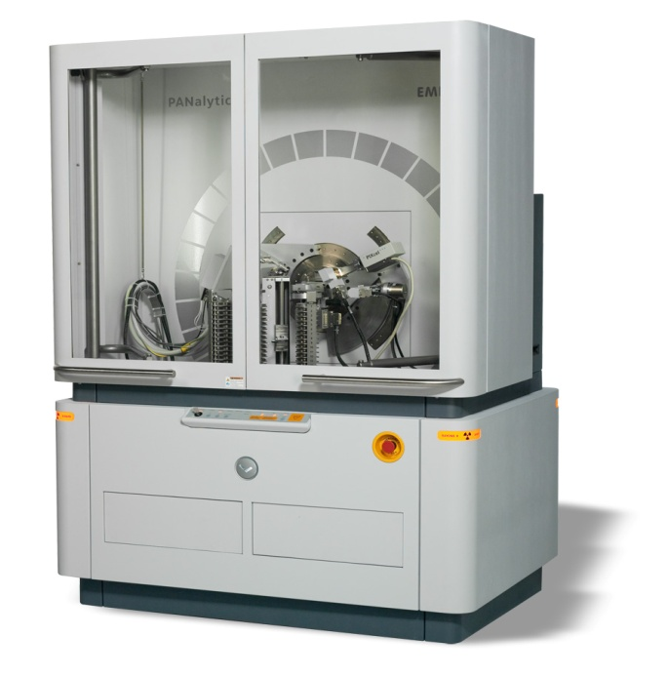
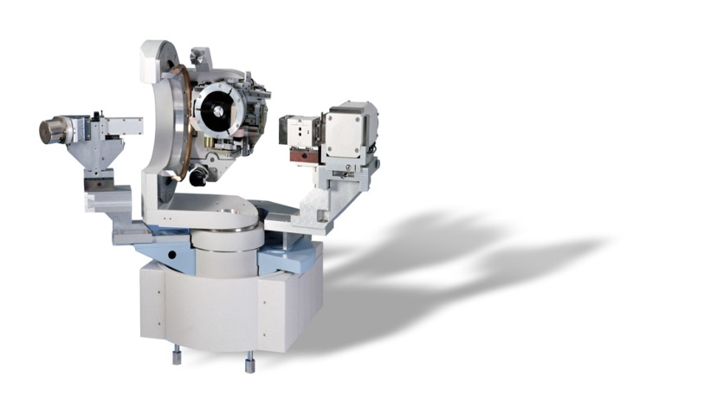
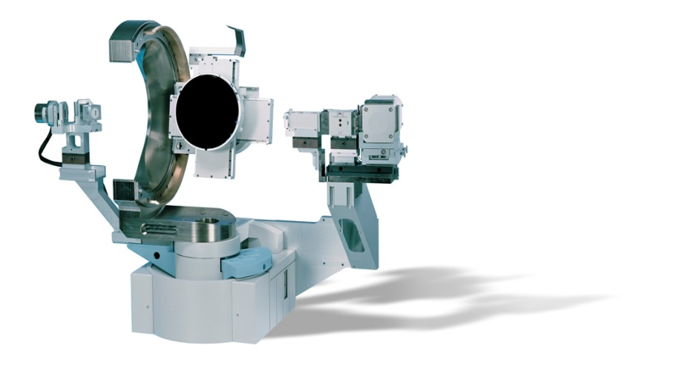
X-ray diffractometers
X’Pert PRO
CubiX PRO

Slide 6
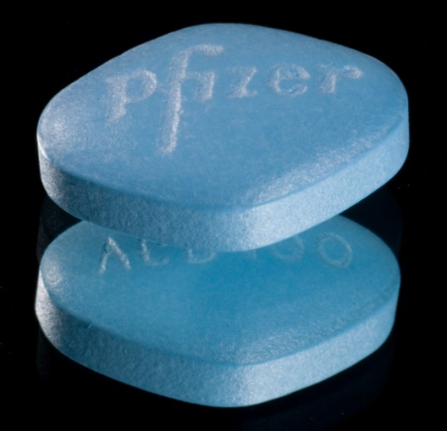
A typical example

Slide 7
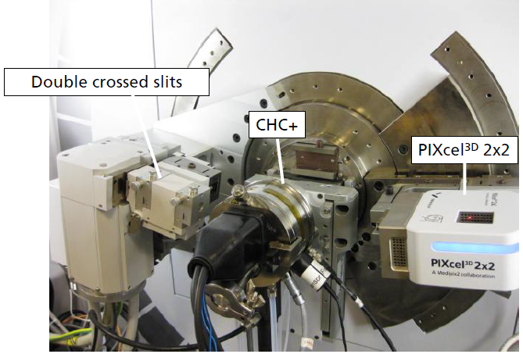
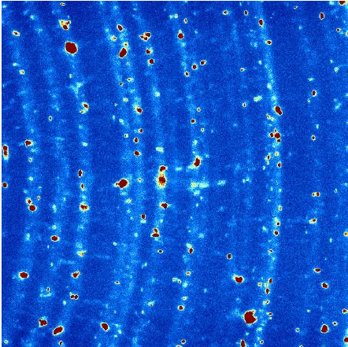
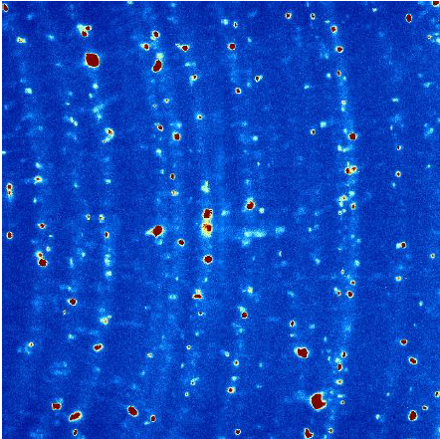
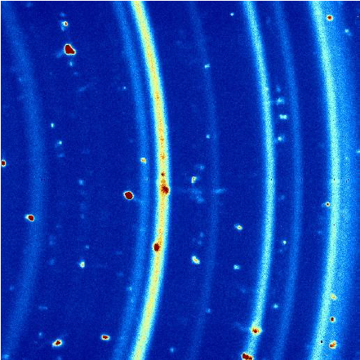
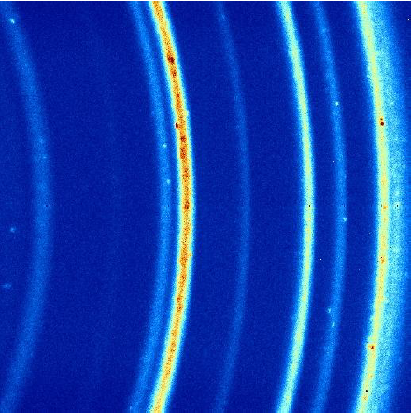
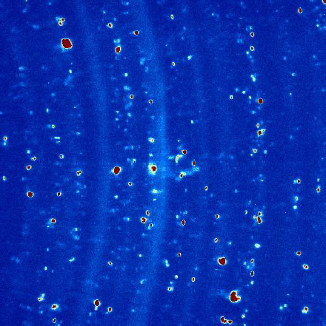
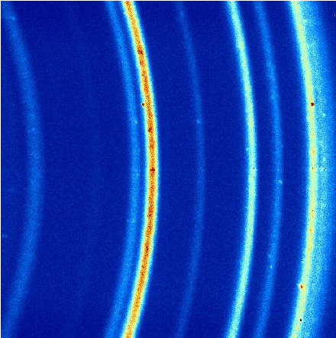
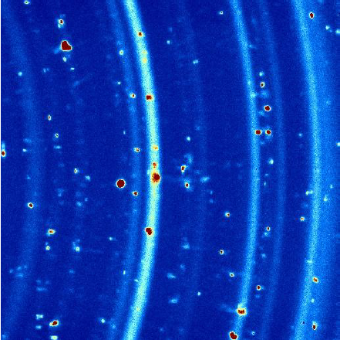
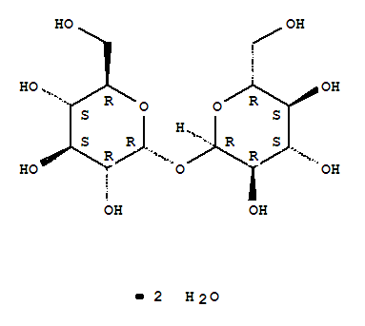
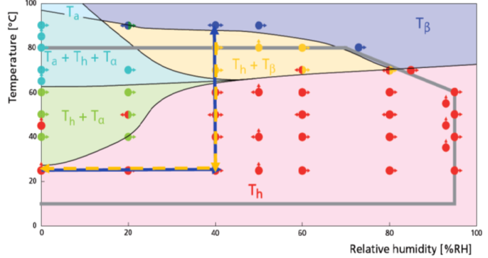
What we wanted to do: XRD powder trehalose dihydrate

Slide 8
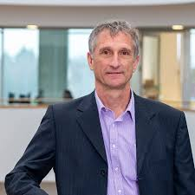

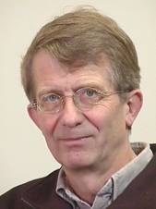

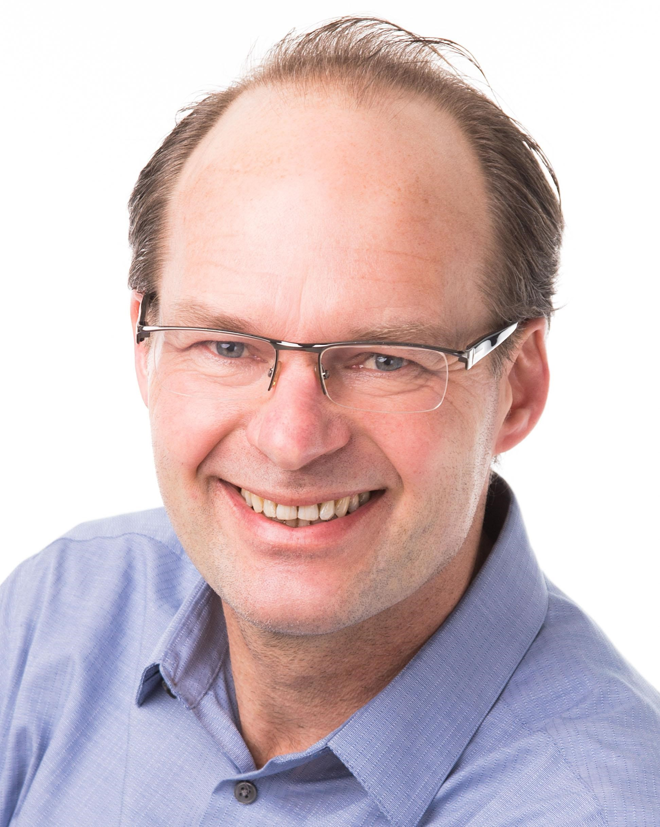
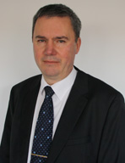
How it all started
A little bit of history

Slide 9
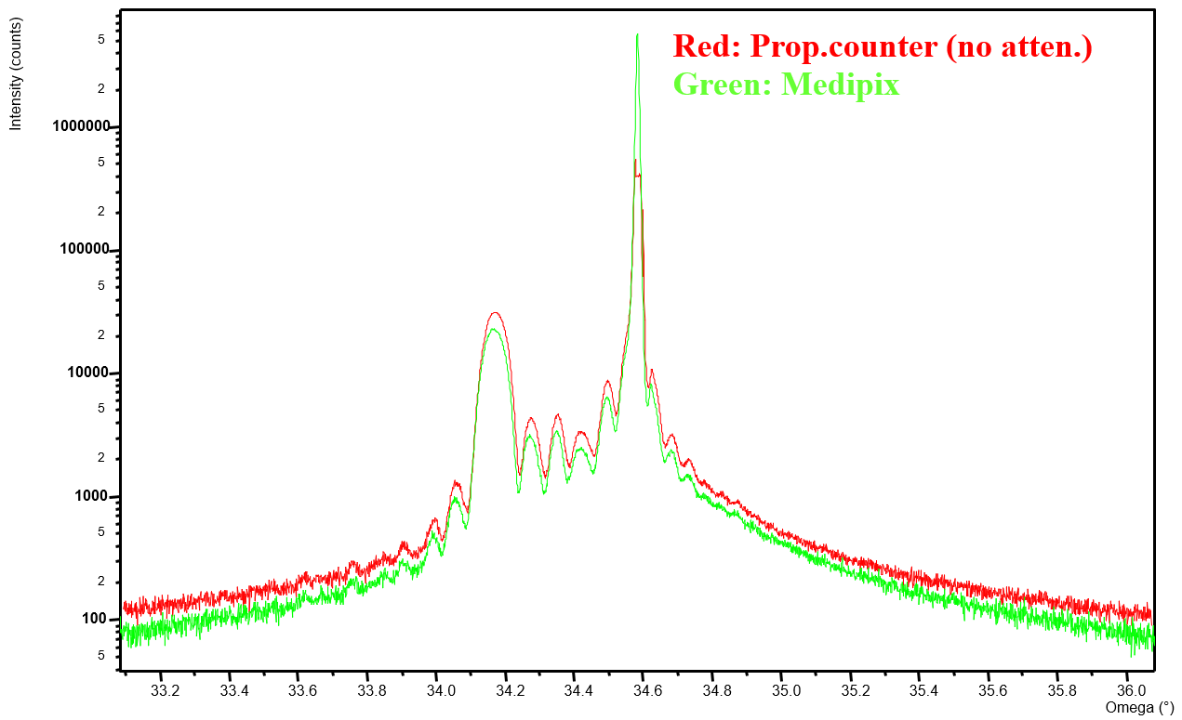
Medipix 2 in diffraction: rocking curve
Much higher dynamic range

Slide 10
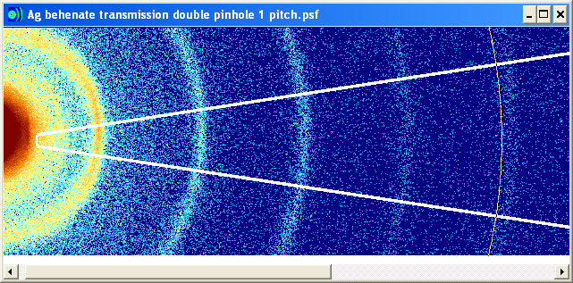
Pixel vs strip detector
PIXcel 3D, 2D scan with pointfocus setup
1D adding
2D integration (XRD2DScan)
22/09/2025

Slide 11
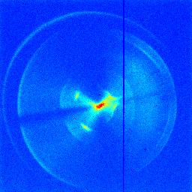
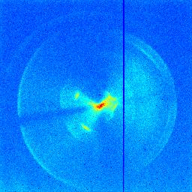
Midefix DK178860
X-ray tube focus

Slide 12
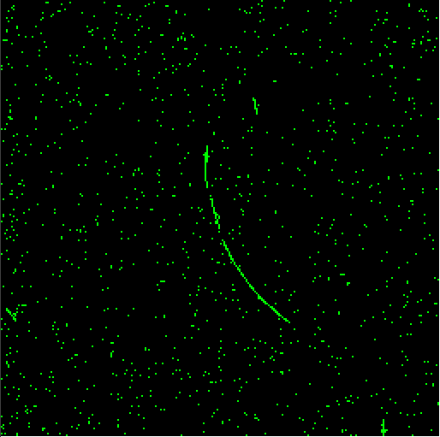
BACKGROUND in Medipix2 CHIP
EXPOSURE at Panalytical
TRACK over ~ 140 PIXELS
RADIUS of CURVATURE
r = 6.9 mm
PROBABLY MUON
BENT by EARTH FIELD ?
B = 5 x 10⁻⁵ T
p = 0.3 B r
--> momentum
p ~ 100 eV
(not possible ??
10 MeV µ has range ~5 mm)
(in reality field higher ?)

Slide 13
Threshold scan to detect noise level of
pixel (threshold = 5)
Pixel (45,45)
Pixel (100,100)

Slide 14
Threshold scan to detect noise level of
pixel (threshold = 5)
Pixel (12,34)
Pixel (34,56)

Slide 15
Threshold scan to detect noise level of
pixel (threshold = 5)
Pixel (88,68)
Pixel (206,180)

Slide 16
Threshold scan to detect noise level of
pixel (threshold = 5)
Pixel (49,117)
Pixel (93,28)

Slide 17
Problems with Medipix 2
Rain drops
  => Solved in chip
Pixels becoming noisy (sometimes)
=> Real time software developed able to detect and correct this
Small drift in threshold (especially visible using Co and Cr radiation)
  => Solved by selection

Slide 18
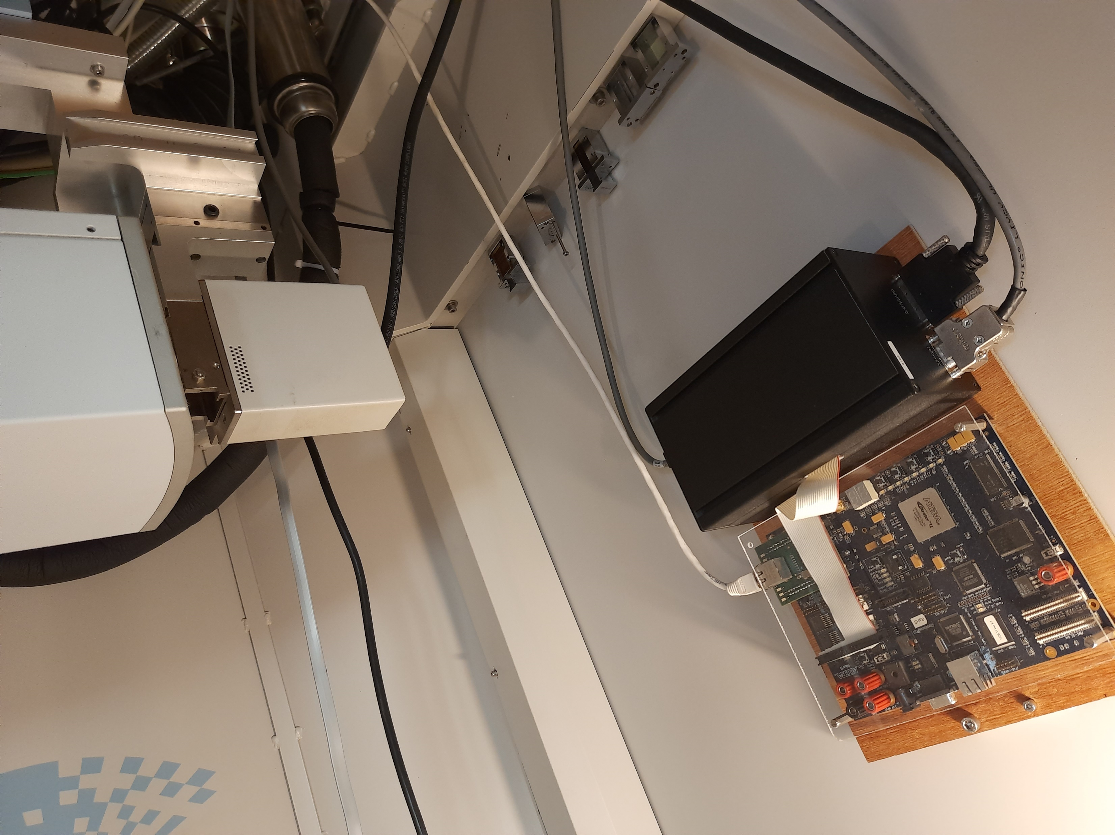
Oldest working Medipix detector (to my knowledge)
Medipix 2 detector running Since 2008 at Dannalab, Enschede, The Netherlands.

Slide 19
Properties Medipix 3
Much more robust
Stable thresholds
Lower minimum threshold
Factor of 2 more radiation hard compared to Medipix 2
Higher frame rates possible

Slide 20
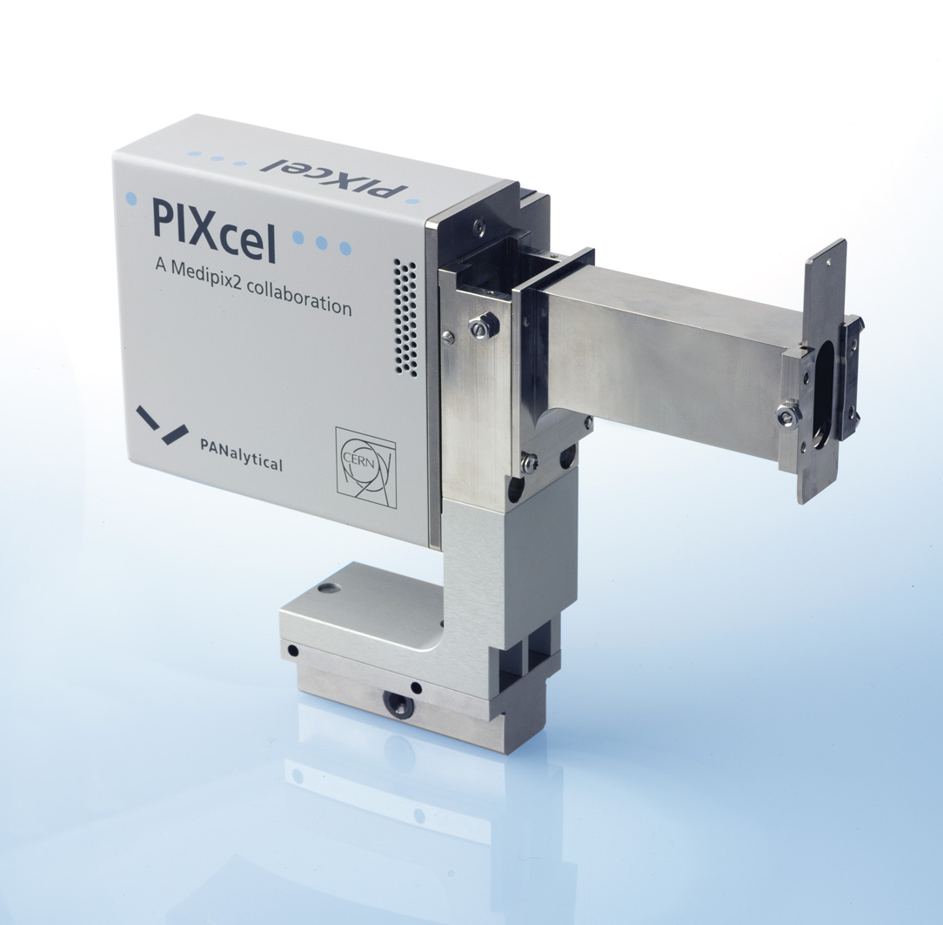
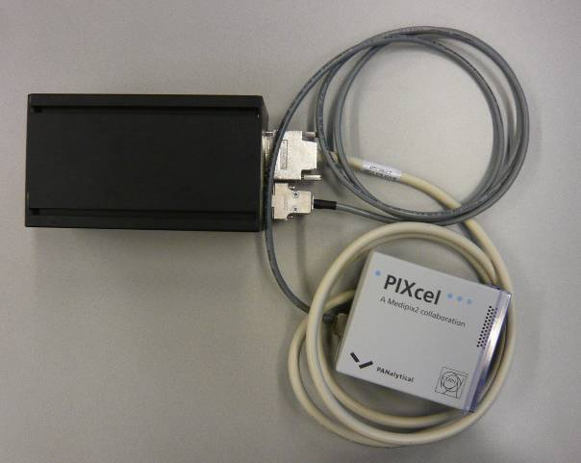
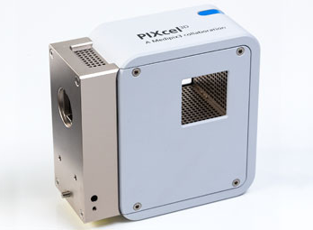
Evolution of the product
August 2007: 1D version, Medipix 2
August 2010: 2D version, read out electronics integrated, Medipix 2
August 2014: 2D version, Medipix 3, improved design.

Slide 21
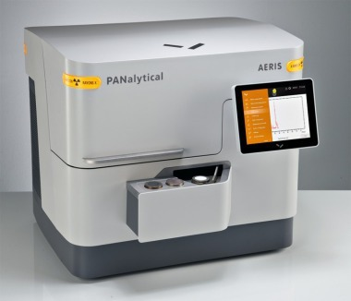
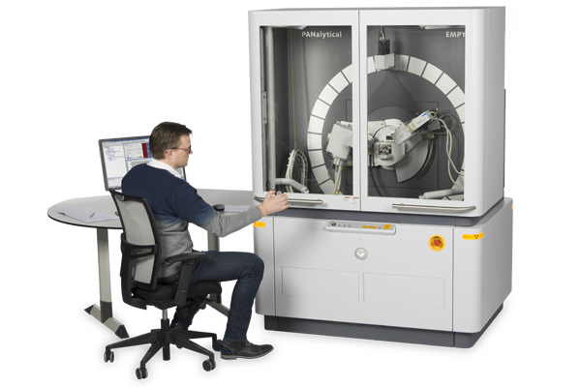
Systems where Medipix 3 is used
Empyrean and AERIS

Slide 22
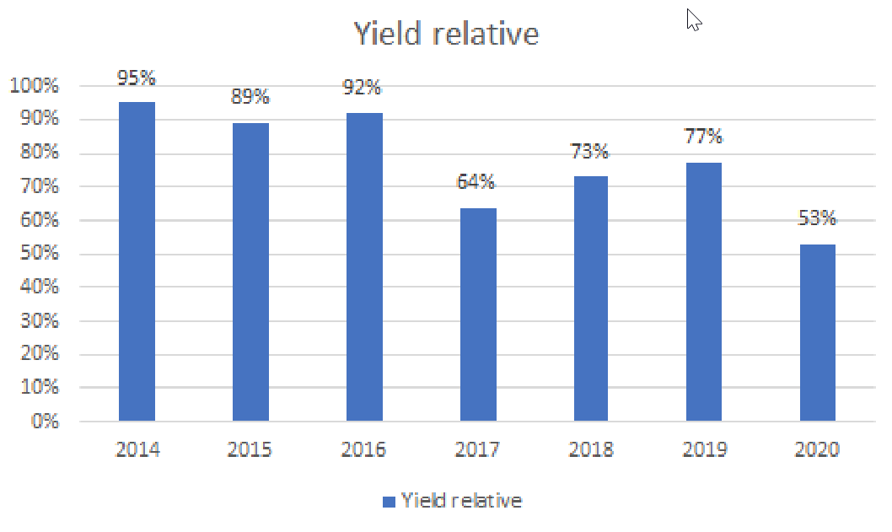
Yield Medipix 3 assemblies

Slide 23
Reasons for lower yield
Lower quality raw material
Moving of production equipment
Change in personnel in supply chain
“Bad” wafer
Electrostatic discharge

Slide 24
Issues to overcome (1):
1 hit counter problem
  => threshold pulsing
Occasionally random values of pixels
=> Solve in software: Real time analysis of acquisitions
Reduced counter depth
=> Redesign of software on system level
Noisy pixels over time
=> Software running in detector to identify these and switch off the pixel if it is (frequently) noisy.

Slide 25
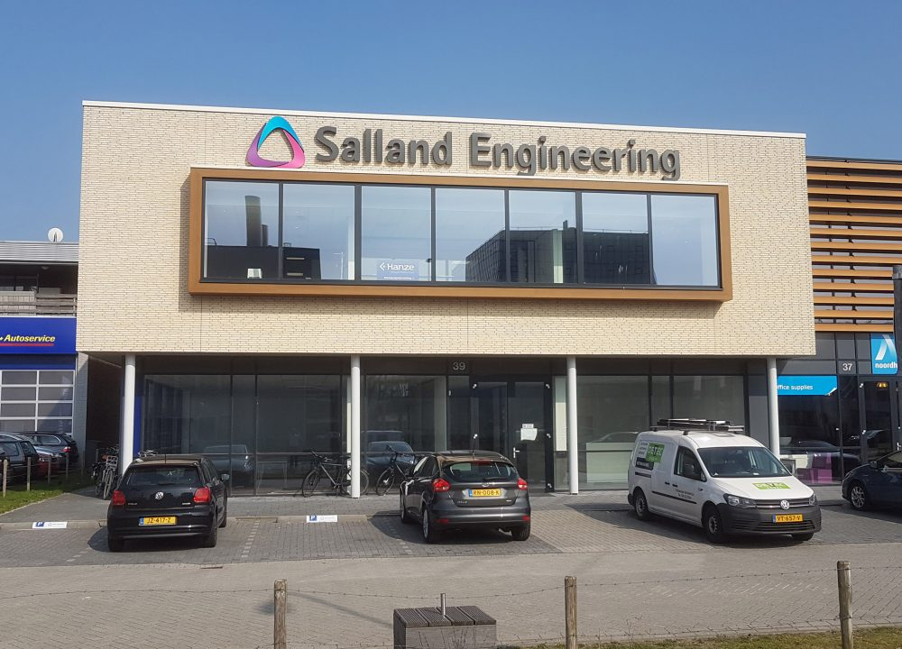
Issues to overcome (2):
Salland engineering

Slide 26
Looking back
Medipix technology has had (and still has) a large impact on the system performance in X-Ray diffraction.
The technical support from the collaboration has been great!
About 1500 detectors based on Medipix 2 sold.
Roughly 2500 detectors based on Medipix 3 sold.
Medipix 3 is the most reliable detector we ever had in our systems.

Slide 27
Looking forward
Medipix 3 is still the work horse in X-ray diffraction
=> 75% of Empyrean systems and 100% of AERIS systems
Looking forward to incorporate either Timepix 4 or Medipix 4 in future products

