Slide 1
Some examples of scientific impact
M. Campbell¹, J. Alozy, R. Bolzonella, R. Ballabriga, E.H.M. Heijne², X. Llopart, M. Saphorster³ and L. Tlustos²
CERN, PH Department
1211 Geneva 23
Switzerland
¹ Honorary Professor at Glasgow University
² also with IEAP, Prague
³ also with DFKZ, Heidelberg
Notes:
I am going to talk about the hybrid pixel detector readout chips that have been designed at CERN in the framework of the Medipix2 and 3 collaborations.

Slide 2
Disclaimer
I can never do justice to the huge amount of high-quality work and publications from our Collaboration members with ~25 min
I have tried to select topics which are complementary to those covered in the other presentations
These are just a few examples from those who provided recent input to me
There is a bibliography in the backup slides
Apologies if your favourite detector or application is missing

Slide 3
Outline
Collaboration publications
Other synchrotron science applications
Medipix3 at the Brazilian light source
Timepix3 at Diamond
Timepix4 at DESY
Detection of gamma rays at CEA Saclay
Visible light imaging
4Dphoton (INFN Ferrara)
Neutron detection and imaging
Timepix devices developed by UC Berkeley
On-going developments at the China Spallation Neutron Source
Time of Flight Mass Spectrometry (Maastricht/Nikhef)
Future High Energy Physics experiments
Gridpix for large area TPC readout (Bonn/Nikhef)
Possible applications in IEC (Glasgow)
Some personal observations

Slide 4
Outline
Collaboration publications
Other synchrotron science applications
Medipix3 at the Brazilian light source
Timepix3 at Diamond
Timepix4 at DESY
Detection of gamma rays at CEA Saclay
Visible light imaging
4Dphoton (INFN Ferrara)
Neutron detection and imaging
Timepix devices developed by UC Berkeley
On-going developments at the China Spallation Neutron Source
Time of Flight Mass Spectrometry (Maastricht/Nikhef)
Future High Energy Physics experiments
Gridpix for large area TPC readout (Bonn/Nikhef)
Possible applications in IEC (Glasgow)
Some personal observations

Slide 5
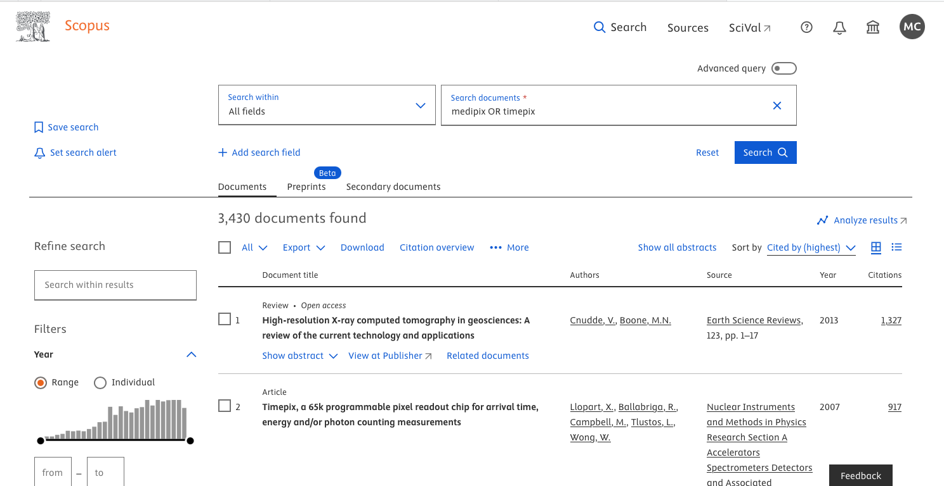
Scopus search “medipix” OR “timepix”
Extracted from Scopus: 19th Sept 2025

Slide 6
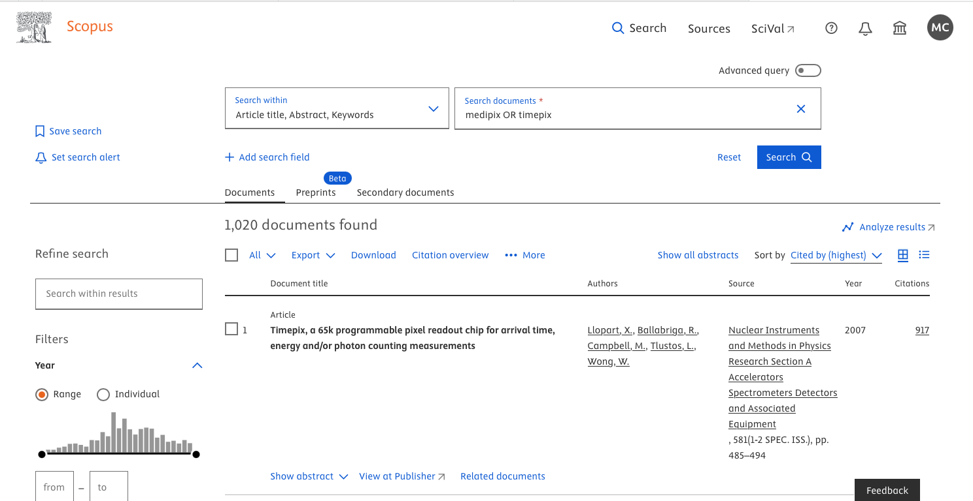
Scopus search “medipix” OR “timepix”
Extracted from Scopus: 19th Sept 2025

Slide 7
Top 10 publications mentioning ‘Medipix’ OR ‘Timepix’ in Abstract, Title, Keywords by number of citations
Citations | Authors | Title | Year | Source title | Volume | Issue | Page | EID
912 | Llopart X.; Ballabriga R.; Campbell M.; Tlustos L.; Wong W. | Timepix, a 65k programmable pixel readout chip for arrival time, energy and/or photon counting measurements | 2007 | Nucl. Inst. and Meth. A | 581 | 1-2 SPEC. ISS. | 485 | 2-s2.0-35348817342
674 | Llopart X.; Campbell M.; Dinapoli R.; San Segundo D.; Pernigotti E. | Medipix2: A 64-k pixel readout chip with 55-μm square elements working in single photon counting mode | 2002 | IEEE Transactions on Nuclear Science | 49 I | 5 | 2279 | 2-s2.0-0036815755
463 | Poikela T.; Plosila J.; Westerlund T.; Campbell M.; Gaspari M.D.; Llopart X.; Gromov V.; Kluit R.; Beuzekom M.V.; Zappon F.; Zivkovic V.; Brezina C.; Desch K.; Fu Y.; Kruth A. | Timepix3: A 65K channel hybrid pixel readout chip with simultaneous ToA/ToT and sparse readout | 2014 | Journal of Instrumentation | 9 | 5 | C05013 | 2-s2.0-84903648134
254 | Ballabriga R.; Campbell M.; Heijne E.H.M.; Llopart X.; Tlustos L. | The Medipix3 prototype, a pixel readout chip working in single photon counting mode with improved spectrometric performance | 2007 | IEEE Transactions on Nuclear Science | 54 | 5 | 1824 | 2-s2.0-35348948593
248 | Jakubek J. | Precise energy calibration of pixel detector working in time-over-threshold mode | 2011 | Nucl. Inst. and Meth. A | 633 | SUPPL. 1 | S262 | 2-s2.0-79959818317
215 | McMullan G.; Chen S.; Henderson R.; Faruqi A.R. | Detective quantum efficiency of electron area detectors in electron microscopy | 2009 | Ultramicroscopy | 109 | 9 | 1126 | 2-s2.0-67650544797
200 | Ponchut C.; Rigal J.M.; Clément J.; Papillon E.; Homs A.; Petitdemange S. | MAXIPIX, a fast readout photon-counting X-ray area detector for synchrotron applications | 2011 | Journal of Instrumentation | 6 | 1 | C01069 | 2-s2.0-79952662448
199 | Ballabriga R.; Campbell M.; Heijne E.; Llopart X.; Tlustos L.; Wong W. | Medipix3: A 64 k pixel detector readout chip working in single photon counting mode with improved spectrometric performance | 2011 | Nucl. Inst. and Meth. A | 633 | SUPPL. 1 | S15 | 2-s2.0-79959823582
182 | Turecek D.; Holy T.; Jakubek J.; Pospisil S.; Vykydal Z. | Pixelman: A multi-platform data acquisition and processing software package for Medipix2, Timepix and Medipix3 detectors | 2011 | Journal of Instrumentation | 6 | 1 | C01046 | 2-s2.0-79952653981
169 | Holy T.; Jakubek J.; Pospisil S.; Uher J.; Vavrik D.; Vykydal Z. | Data acquisition and processing software package for Medipix2 | 2006 | Nucl. Inst. and Meth. A | 563 | 1 | 254 | 2-s2.0-33745003477
Extracted from Scopus: 12th Aug 2025

Slide 8
Top 10 publications mentioning ‘Medipix’ OR ‘Timepix’ in Abstract, Title, Keywords by number of citations
Citations | Authors | Title | Year | Source title | Volume | Issue | Page | EID
912 | Llopart X.; Ballabriga R.; Campbell M.; Tlustos L.; Wong W. | Timepix, a 65k programmable pixel readout chip for arrival time, energy and/or photon counting measurements | 2007 | Nucl. Inst. and Meth. A | 581 | 1-2 SPEC. ISS. | 485 | 2-s2.0-35348817342
674 | Llopart X.; Campbell M.; Dinapoli R.; San Segundo D.; Pernigotti E. | Medipix2: A 64-k pixel readout chip with 55-μm square elements working in single photon counting mode | 2002 | IEEE Transactions on Nuclear Science | 49 I | 5 | 2279 | 2-s2.0-0036815755
463 | Poikela T.; Plosila J.; Westerlund T.; Campbell M.; Gaspari M.D.; Llopart X.; Gromov V.; Kluit R.; Beuzekom M.V.; Zappon F.; Zivkovic V.; Brezina C.; Desch K.; Fu Y.; Kruth A. | Timepix3: A 65K channel hybrid pixel readout chip with simultaneous ToA/ToT and sparse readout | 2014 | Journal of Instrumentation | 9 | 5 | C05013 | 2-s2.0-84903648134
254 | Ballabriga R.; Campbell M.; Heijne E.H.M.; Llopart X.; Tlustos L. | The Medipix3 prototype, a pixel readout chip working in single photon counting mode with improved spectrometric performance | 2007 | IEEE Transactions on Nuclear Science | 54 | 5 | 1824 | 2-s2.0-35348948593
248 | Jakubek J. | Precise energy calibration of pixel detector working in time-over-threshold mode | 2011 | Nucl. Inst. and Meth. A | 633 | SUPPL. 1 | S262 | 2-s2.0-79959818317
215 | McMullan G.; Chen S.; Henderson R.; Faruqi A.R. | Detective quantum efficiency of electron area detectors in electron microscopy | 2009 | Ultramicroscopy | 109 | 9 | 1126 | 2-s2.0-67650544797
200 | Ponchut C.; Rigal J.M.; Clément J.; Papillon E.; Homs A.; Petitdemange S. | MAXIPIX, a fast readout photon-counting X-ray area detector for synchrotron applications | 2011 | Journal of Instrumentation | 6 | 1 | C01069 | 2-s2.0-79952662448
199 | Ballabriga R.; Campbell M.; Heijne E.; Llopart X.; Tlustos L.; Wong W. | Medipix3: A 64 k pixel detector readout chip working in single photon counting mode with improved spectrometric performance | 2011 | Nucl. Inst. and Meth. A | 633 | SUPPL. 1 | S15 | 2-s2.0-79959823582
182 | Turecek D.; Holy T.; Jakubek J.; Pospisil S.; Vykydal Z. | Pixelman: A multi-platform data acquisition and processing software package for Medipix2, Timepix and Medipix3 detectors | 2011 | Journal of Instrumentation | 6 | 1 | C01046 | 2-s2.0-79952653981
169 | Holy T.; Jakubek J.; Pospisil S.; Uher J.; Vavrik D.; Vykydal Z. | Data acquisition and processing software package for Medipix2 | 2006 | Nucl. Inst. and Meth. A | 563 | 1 | 254 | 2-s2.0-33745003477
Extracted from Scopus: 12th Aug 2025

Slide 9
Top 10 publications mentioning ‘Medipix’ OR ‘Timepix’ in Abstract, Title, Keywords by number of citations
Citations | Authors | Title | Year | Source title | Volume | Issue | Page | EID
912 | Llopart X.; Ballabriga R.; Campbell M.; Tlustos L.; Wong W. | Timepix, a 65k programmable pixel readout chip for arrival time, energy and/or photon counting measurements | 2007 | Nucl. Inst. and Meth. A | 581 | 1-2 SPEC. ISS. | 485 | 2-s2.0-35348817342
674 | Llopart X.; Campbell M.; Dinapoli R.; San Segundo D.; Pernigotti E. | Medipix2: A 64-k pixel readout chip with 55-μm square elements working in single photon counting mode | 2002 | IEEE Transactions on Nuclear Science | 49 I | 5 | 2279 | 2-s2.0-0036815755
463 | Poikela T.; Plosila J.; Westerlund T.; Campbell M.; Gaspari M.D.; Llopart X.; Gromov V.; Kluit R.; Beuzekom M.V.; Zappon F.; Zivkovic V.; Brezina C.; Desch K.; Fu Y.; Kruth A. | Timepix3: A 65K channel hybrid pixel readout chip with simultaneous ToA/ToT and sparse readout | 2014 | Journal of Instrumentation | 9 | 5 | C05013 | 2-s2.0-84903648134
254 | Ballabriga R.; Campbell M.; Heijne E.H.M.; Llopart X.; Tlustos L. | The Medipix3 prototype, a pixel readout chip working in single photon counting mode with improved spectrometric performance | 2007 | IEEE Transactions on Nuclear Science | 54 | 5 | 1824 | 2-s2.0-35348948593
248 | Jakubek J. | Precise energy calibration of pixel detector working in time-over-threshold mode | 2011 | Nucl. Inst. and Meth. A | 633 | SUPPL. 1 | S262 | 2-s2.0-79959818317
215 | McMullan G.; Chen S.; Henderson R.; Faruqi A.R. | Detective quantum efficiency of electron area detectors in electron microscopy | 2009 | Ultramicroscopy | 109 | 9 | 1126 | 2-s2.0-67650544797
200 | Ponchut C.; Rigal J.M.; Clément J.; Papillon E.; Homs A.; Petitdemange S. | MAXIPIX, a fast readout photon-counting X-ray area detector for synchrotron applications | 2011 | Journal of Instrumentation | 6 | 1 | C01069 | 2-s2.0-79952662448
199 | Ballabriga R.; Campbell M.; Heijne E.; Llopart X.; Tlustos L.; Wong W. | Medipix3: A 64 k pixel detector readout chip working in single photon counting mode with improved spectrometric performance | 2011 | Nucl. Inst. and Meth. A | 633 | SUPPL. 1 | S15 | 2-s2.0-79959823582
182 | Turecek D.; Holy T.; Jakubek J.; Pospisil S.; Vykydal Z. | Pixelman: A multi-platform data acquisition and processing software package for Medipix2, Timepix and Medipix3 detectors | 2011 | Journal of Instrumentation | 6 | 1 | C01046 | 2-s2.0-79952653981
169 | Holy T.; Jakubek J.; Pospisil S.; Uher J.; Vavrik D.; Vykydal Z. | Data acquisition and processing software package for Medipix2 | 2006 | Nucl. Inst. and Meth. A | 563 | 1 | 254 | 2-s2.0-33745003477
Extracted from Scopus: 12th Aug 2025

Slide 10
Top 10 publications mentioning ‘Medipix’ OR ‘Timepix’ in Abstract, Title, Keywords by number of citations
Citations | Authors | Title | Year | Source title | Volume | Issue | Page | EID
912 | Llopart X.; Ballabriga R.; Campbell M.; Tlustos L.; Wong W. | Timepix, a 65k programmable pixel readout chip for arrival time, energy and/or photon counting measurements | 2007 | Nucl. Inst. and Meth. A | 581 | 1-2 SPEC. ISS. | 485 | 2-s2.0-35348817342
674 | Llopart X.; Campbell M.; Dinapoli R.; San Segundo D.; Pernigotti E. | Medipix2: A 64-k pixel readout chip with 55-μm square elements working in single photon counting mode | 2002 | IEEE Transactions on Nuclear Science | 49 I | 5 | 2279 | 2-s2.0-0036815755
463 | Poikela T.; Plosila J.; Westerlund T.; Campbell M.; Gaspari M.D.; Llopart X.; Gromov V.; Kluit R.; Beuzekom M.V.; Zappon F.; Zivkovic V.; Brezina C.; Desch K.; Fu Y.; Kruth A. | Timepix3: A 65K channel hybrid pixel readout chip with simultaneous ToA/ToT and sparse readout | 2014 | Journal of Instrumentation | 9 | 5 | C05013 | 2-s2.0-84903648134
254 | Ballabriga R.; Campbell M.; Heijne E.H.M.; Llopart X.; Tlustos L. | The Medipix3 prototype, a pixel readout chip working in single photon counting mode with improved spectrometric performance | 2007 | IEEE Transactions on Nuclear Science | 54 | 5 | 1824 | 2-s2.0-35348948593
248 | Jakubek J. | Precise energy calibration of pixel detector working in time-over-threshold mode | 2011 | Nucl. Inst. and Meth. A | 633 | SUPPL. 1 | S262 | 2-s2.0-79959818317
215 | McMullan G.; Chen S.; Henderson R.; Faruqi A.R. | Detective quantum efficiency of electron area detectors in electron microscopy | 2009 | Ultramicroscopy | 109 | 9 | 1126 | 2-s2.0-67650544797
200 | Ponchut C.; Rigal J.M.; Clément J.; Papillon E.; Homs A.; Petitdemange S. | MAXIPIX, a fast readout photon-counting X-ray area detector for synchrotron applications | 2011 | Journal of Instrumentation | 6 | 1 | C01069 | 2-s2.0-79952662448
199 | Ballabriga R.; Campbell M.; Heijne E.; Llopart X.; Tlustos L.; Wong W. | Medipix3: A 64 k pixel detector readout chip working in single photon counting mode with improved spectrometric performance | 2011 | Nucl. Inst. and Meth. A | 633 | SUPPL. 1 | S15 | 2-s2.0-79959823582
182 | Turecek D.; Holy T.; Jakubek J.; Pospisil S.; Vykydal Z. | Pixelman: A multi-platform data acquisition and processing software package for Medipix2, Timepix and Medipix3 detectors | 2011 | Journal of Instrumentation | 6 | 1 | C01046 | 2-s2.0-79952653981
169 | Holy T.; Jakubek J.; Pospisil S.; Uher J.; Vavrik D.; Vykydal Z. | Data acquisition and processing software package for Medipix2 | 2006 | Nucl. Inst. and Meth. A | 563 | 1 | 254 | 2-s2.0-33745003477
Extracted from Scopus: 12th Aug 2025

Slide 11
Top 10 publications mentioning ‘Medipix’ OR ‘Timepix’ in Abstract, Title, Keywords by number of citations
Citations | Authors | Title | Year | Source title | Volume | Issue | Page | EID
912 | Llopart X.; Ballabriga R.; Campbell M.; Tlustos L.; Wong W. | Timepix, a 65k programmable pixel readout chip for arrival time, energy and/or photon counting measurements | 2007 | Nucl. Inst. and Meth. A | 581 | 1-2 SPEC. ISS. | 485 | 2-s2.0-35348817342
674 | Llopart X.; Campbell M.; Dinapoli R.; San Segundo D.; Pernigotti E. | Medipix2: A 64-k pixel readout chip with 55-μm square elements working in single photon counting mode | 2002 | IEEE Transactions on Nuclear Science | 49 I | 5 | 2279 | 2-s2.0-0036815755
463 | Poikela T.; Plosila J.; Westerlund T.; Campbell M.; Gaspari M.D.; Llopart X.; Gromov V.; Kluit R.; Beuzekom M.V.; Zappon F.; Zivkovic V.; Brezina C.; Desch K.; Fu Y.; Kruth A. | Timepix3: A 65K channel hybrid pixel readout chip with simultaneous ToA/ToT and sparse readout | 2014 | Journal of Instrumentation | 9 | 5 | C05013 | 2-s2.0-84903648134
254 | Ballabriga R.; Campbell M.; Heijne E.H.M.; Llopart X.; Tlustos L. | The Medipix3 prototype, a pixel readout chip working in single photon counting mode with improved spectrometric performance | 2007 | IEEE Transactions on Nuclear Science | 54 | 5 | 1824 | 2-s2.0-35348948593
248 | Jakubek J. | Precise energy calibration of pixel detector working in time-over-threshold mode | 2011 | Nucl. Inst. and Meth. A | 633 | SUPPL. 1 | S262 | 2-s2.0-79959818317
215 | McMullan G.; Chen S.; Henderson R.; Faruqi A.R. | Detective quantum efficiency of electron area detectors in electron microscopy | 2009 | Ultramicroscopy | 109 | 9 | 1126 | 2-s2.0-67650544797
200 | Ponchut C.; Rigal J.M.; Clément J.; Papillon E.; Homs A.; Petitdemange S. | MAXIPIX, a fast readout photon-counting X-ray area detector for synchrotron applications | 2011 | Journal of Instrumentation | 6 | 1 | C01069 | 2-s2.0-79952662448
199 | Ballabriga R.; Campbell M.; Heijne E.; Llopart X.; Tlustos L.; Wong W. | Medipix3: A 64 k pixel detector readout chip working in single photon counting mode with improved spectrometric performance | 2011 | Nucl. Inst. and Meth. A | 633 | SUPPL. 1 | S15 | 2-s2.0-79959823582
182 | Turecek D.; Holy T.; Jakubek J.; Pospisil S.; Vykydal Z. | Pixelman: A multi-platform data acquisition and processing software package for Medipix2, Timepix and Medipix3 detectors | 2011 | Journal of Instrumentation | 6 | 1 | C01046 | 2-s2.0-79952653981
169 | Holy T.; Jakubek J.; Pospisil S.; Uher J.; Vavrik D.; Vykydal Z. | Data acquisition and processing software package for Medipix2 | 2006 | Nucl. Inst. and Meth. A | 563 | 1 | 254 | 2-s2.0-33745003477
Extracted from Scopus: 12th Aug 2025

Slide 12
Outline
Collaboration publications
Other synchrotron science applications
Medipix3 at the Brazilian light source
Timepix3 at Diamond
Timepix4 at DESY
Detection of gamma rays at CEA Saclay
Visible light imaging
4Dphoton (INFN Ferrara)
Neutron detection and imaging
Timepix devices developed by UC Berkeley
On-going developments at the China Spallation Neutron Source
Time of Flight Mass Spectrometry (Maastricht/Nikhef)
Future High Energy Physics experiments
Gridpix for large area TPC readout (Bonn/Nikhef)
Possible applications in IEC (Glasgow)
Some personal observations

Slide 13
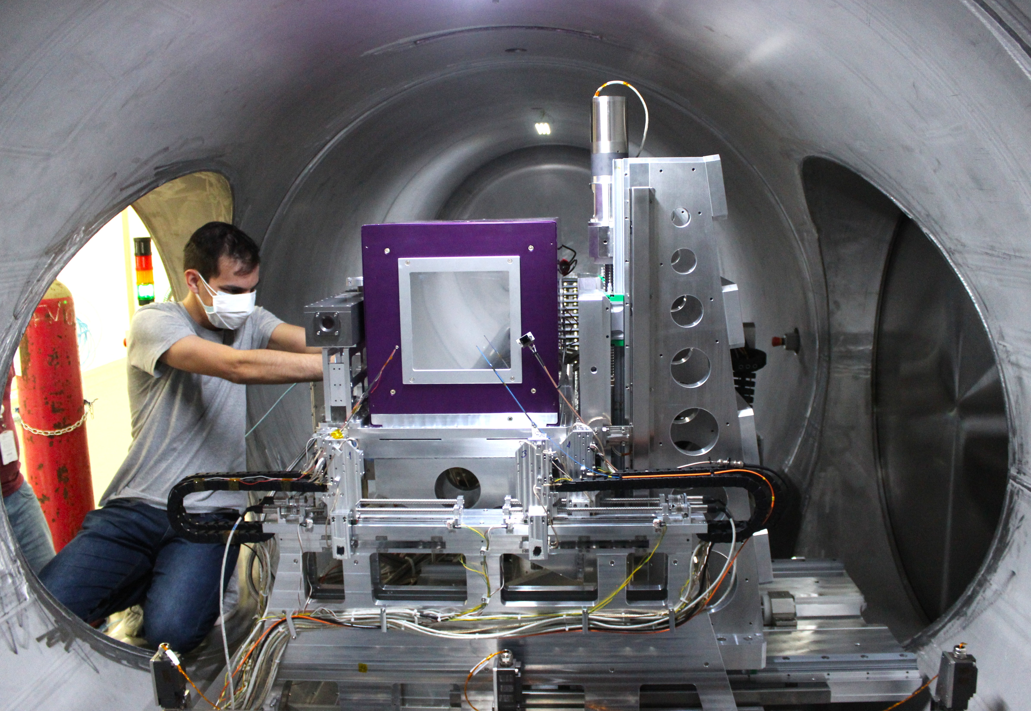
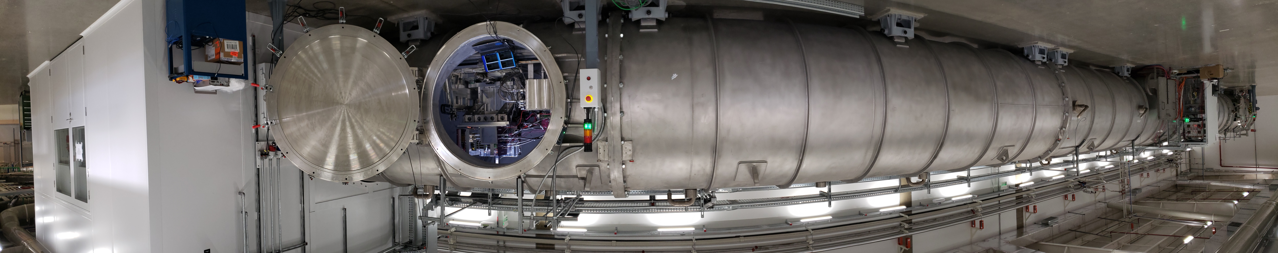

Medipix3 at LNLS Brazil
PIMEGA 540D
Medipix3-based
144 ASICs
300µm Silicon Sensors,
9.4 megapixels (3072 × 3072 pixels)
vacuum compatible
2000 frames per second.
Slide courtesy of J-M Polli

Slide 14
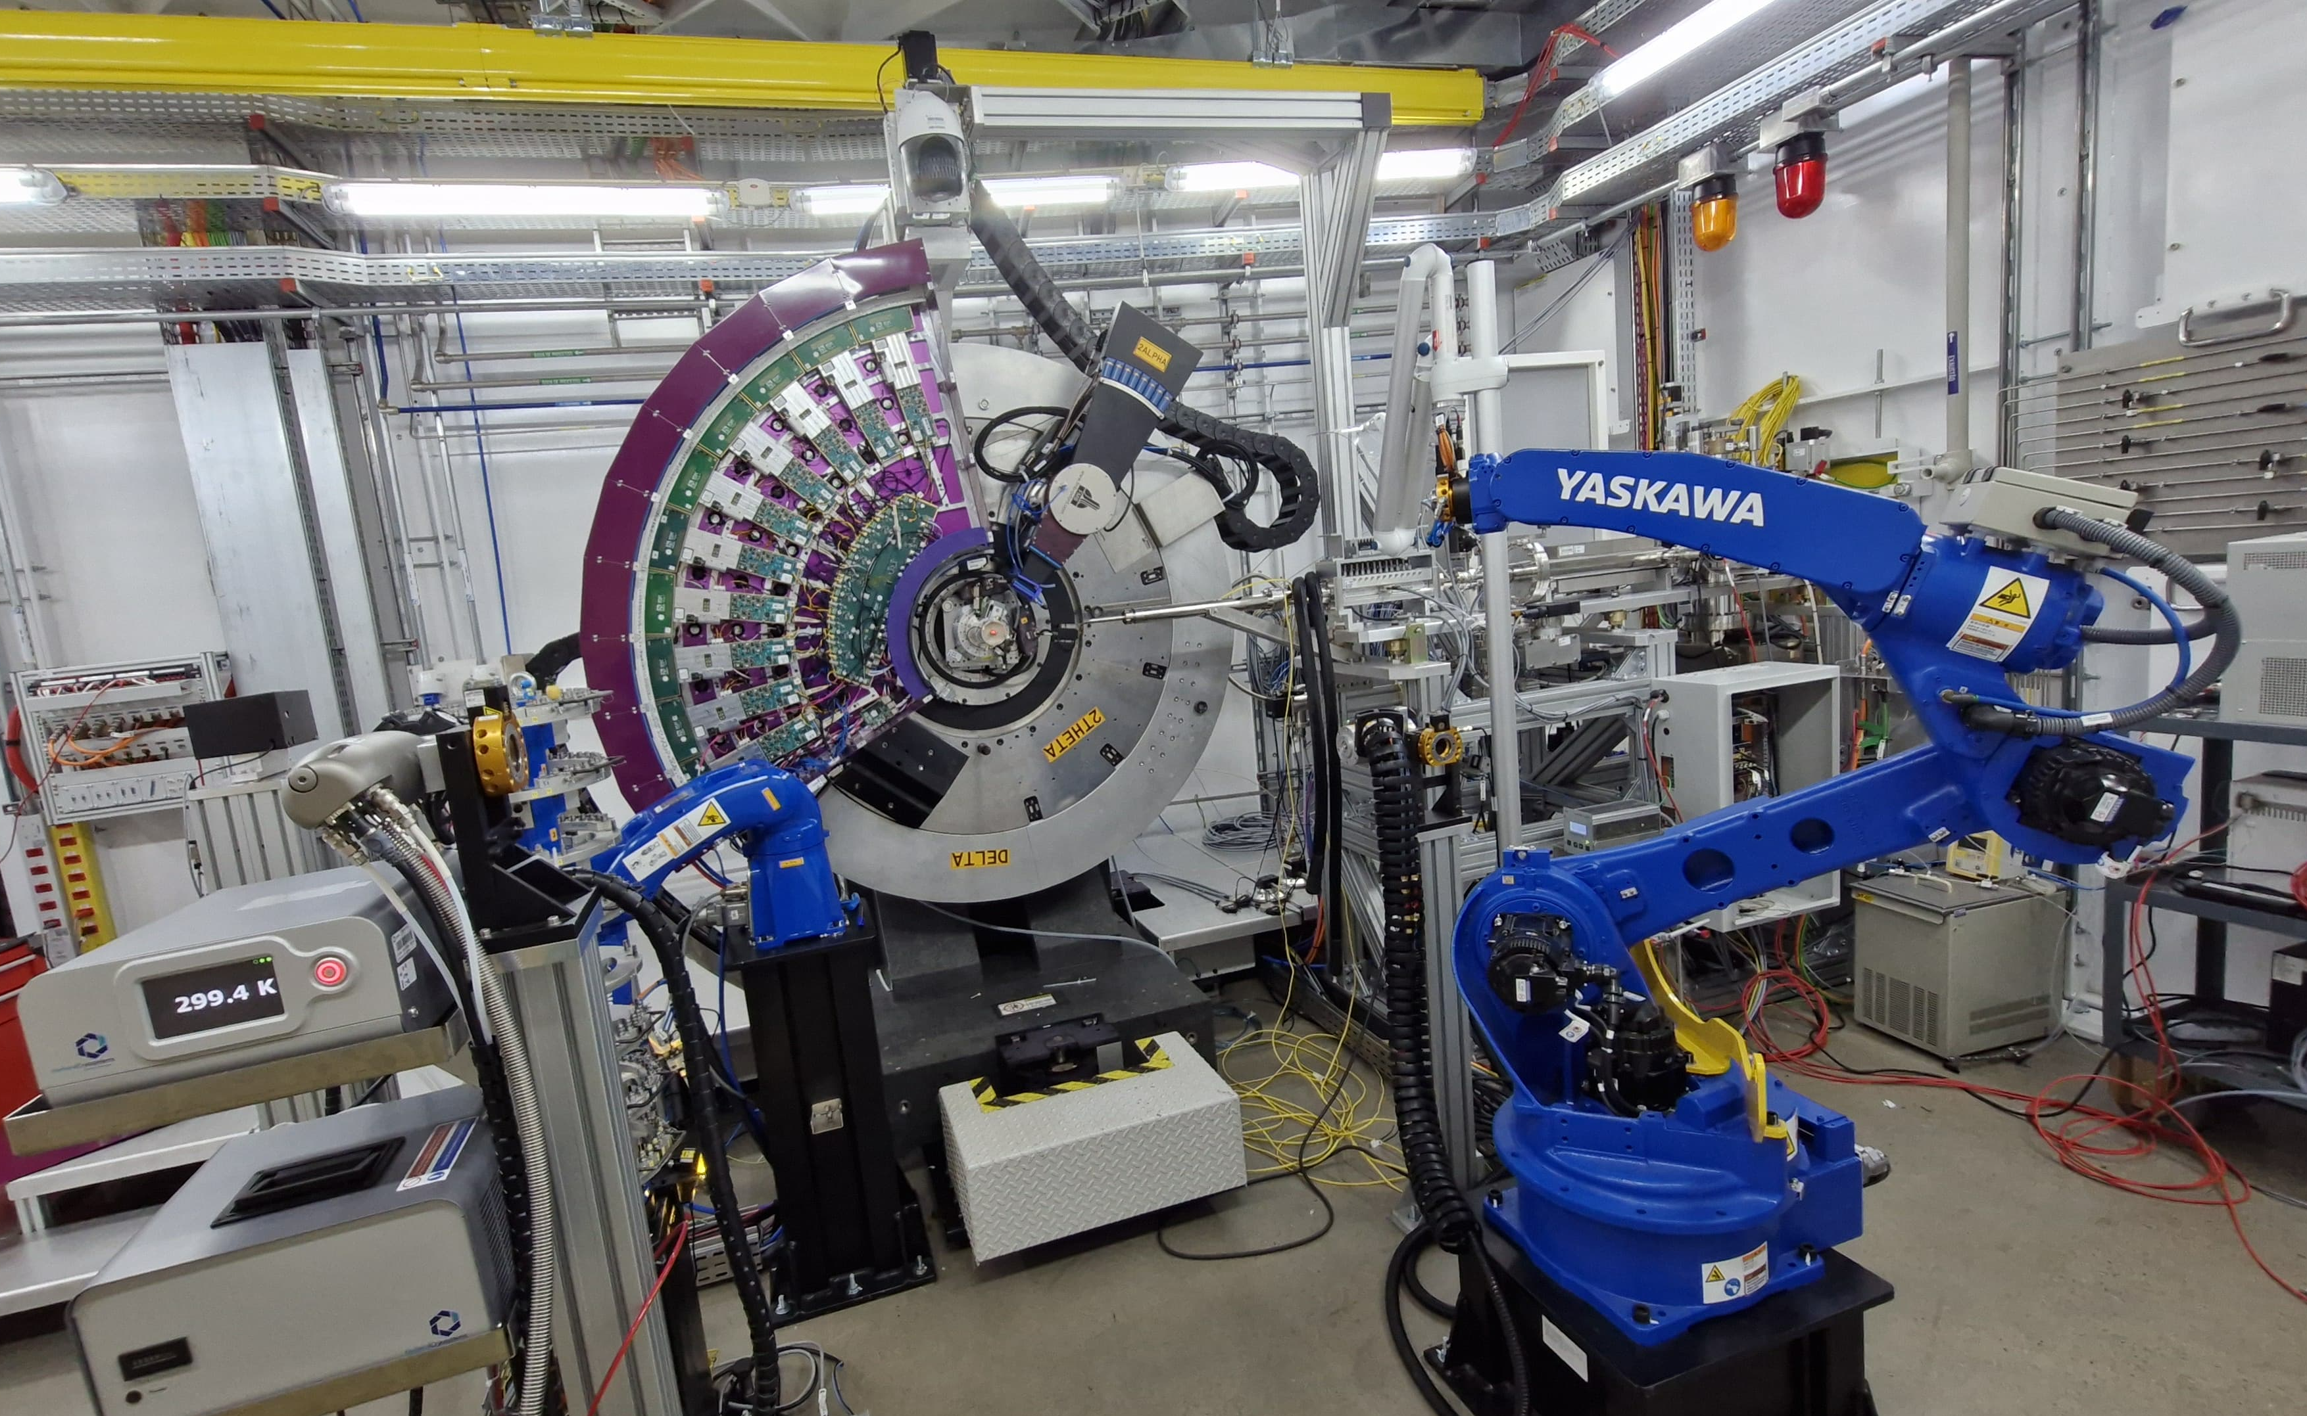
Medipix3 at LNLS Brazil
PIMEGA 450D
Medipix3-based
120 ASICs
675µm Silicon Sensors
7.9 megapixels (256 x 30720 pixels)
A 1.7 m long arc
1000 Frames Per Second.
Slide courtesy of J-M Polli

Slide 15
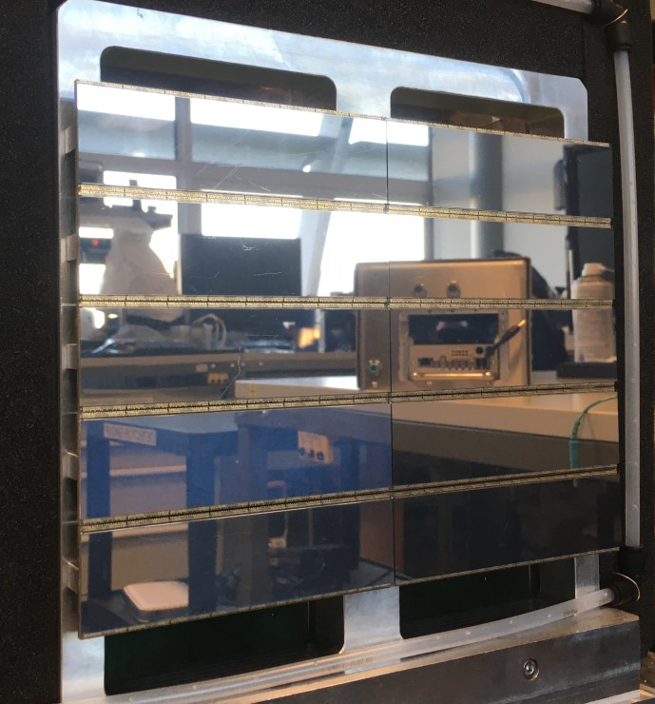
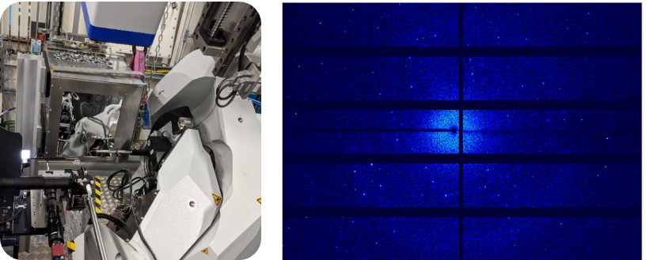

Timepix3 at Diamond Light Source
Tristan
Timepix3-based
160 ASICs
300µm Silicon Sensors
10 megapixels (4096 x 4096 pixels)
Streamed data
25ns timestamp per hit
Slide courtesy of D. Omar

Slide 16
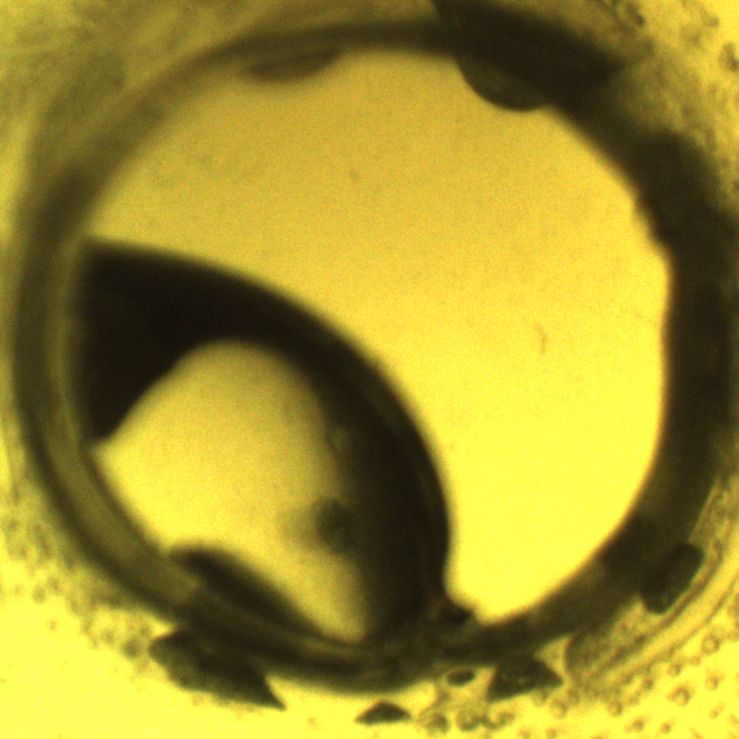

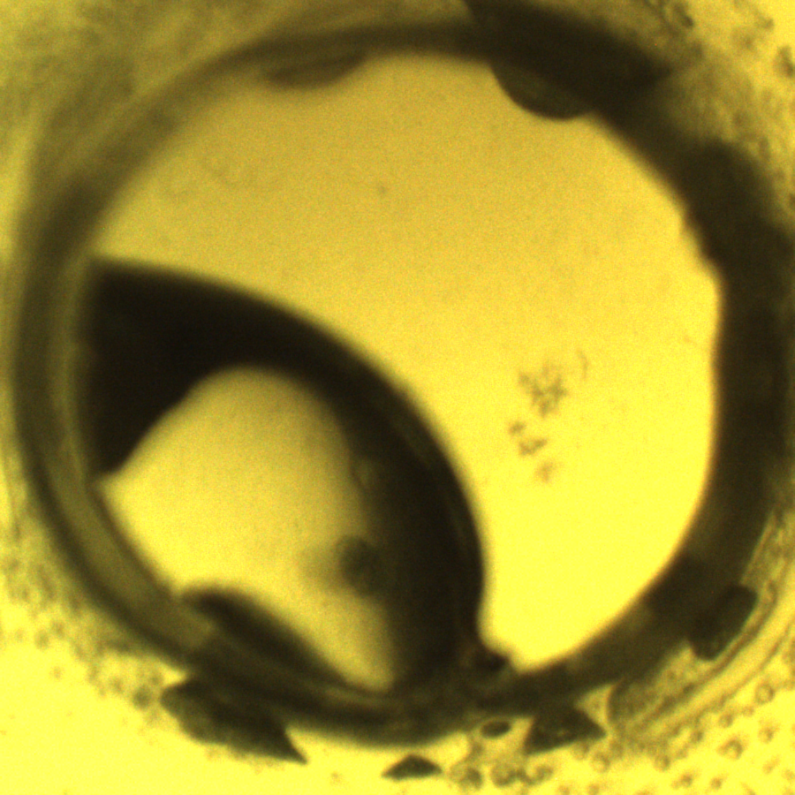
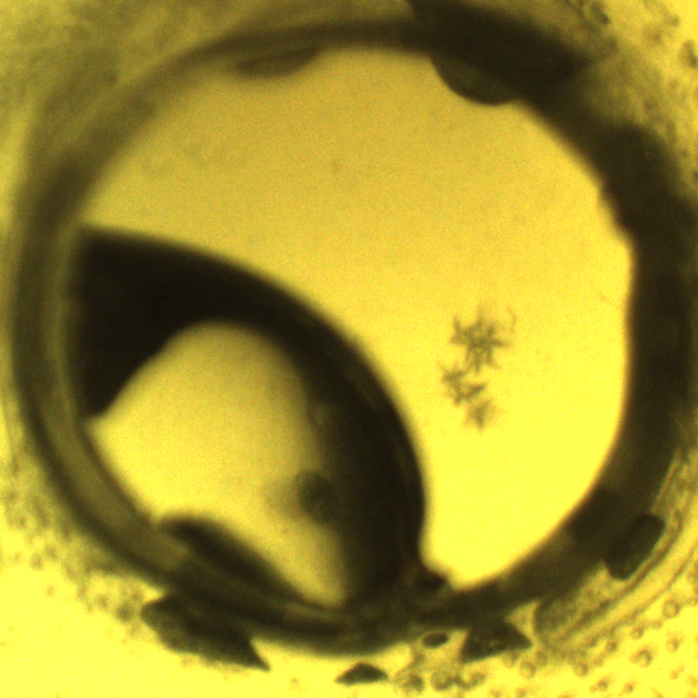
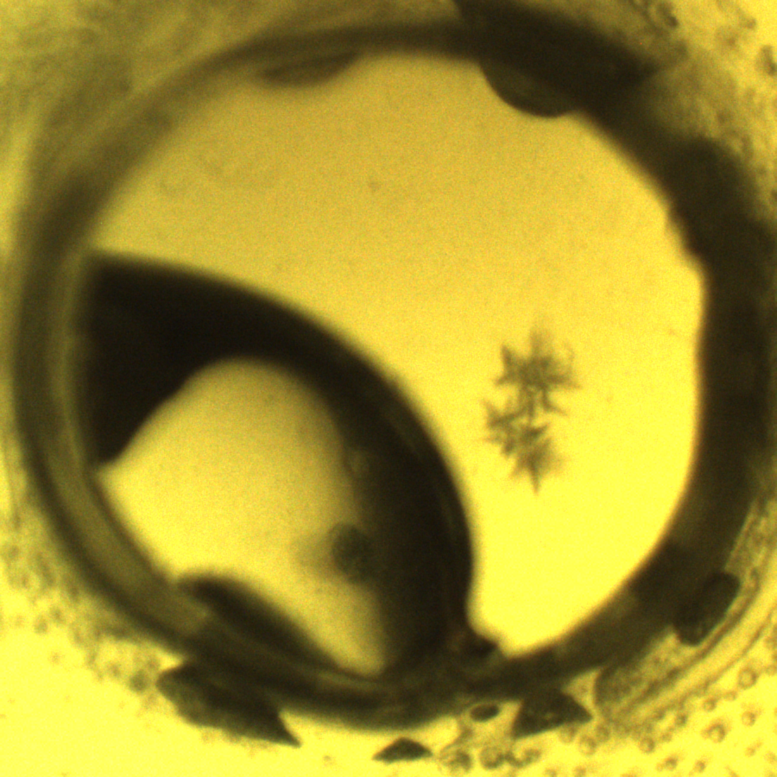
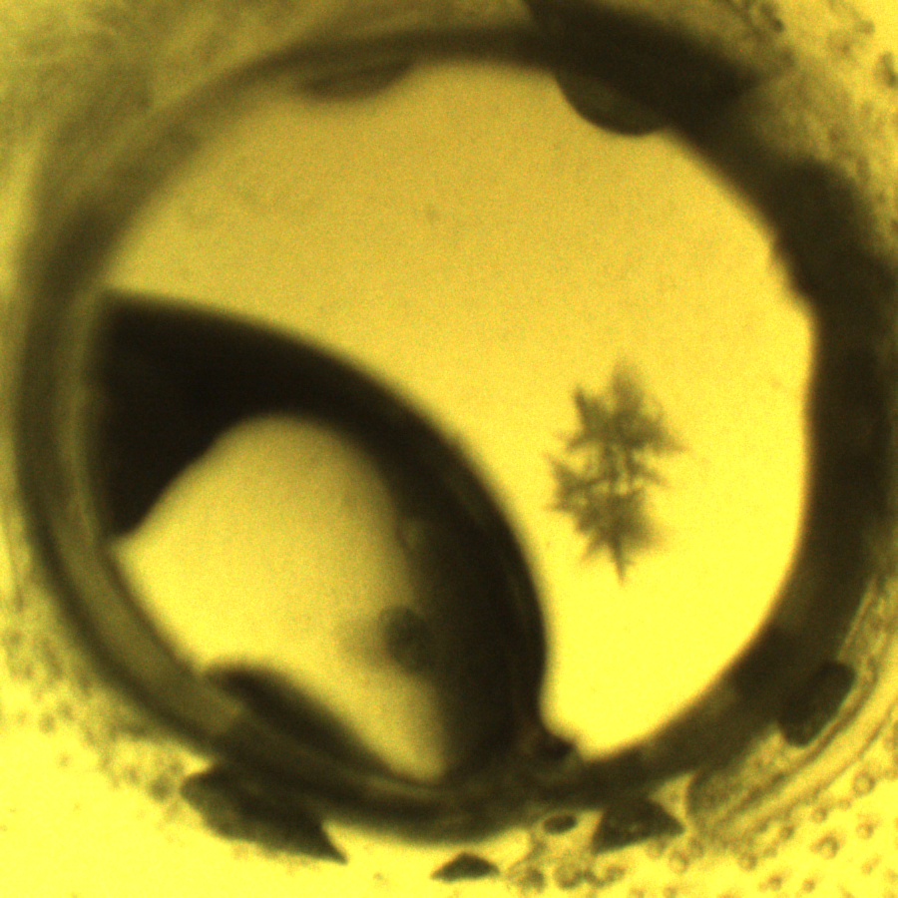
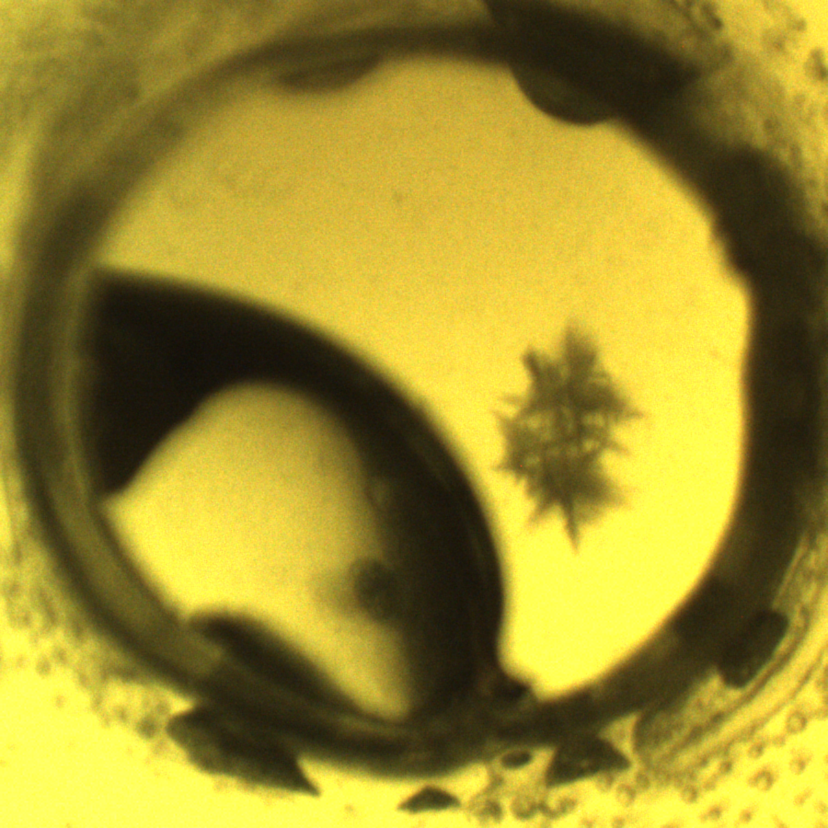
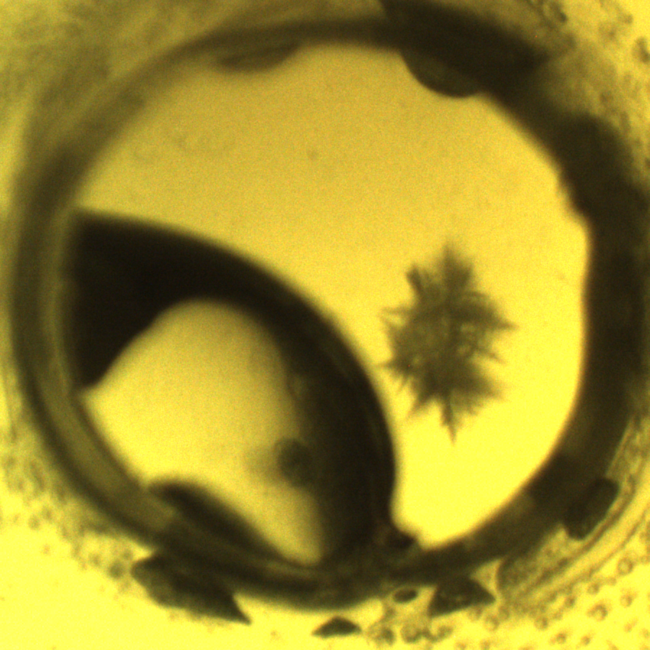
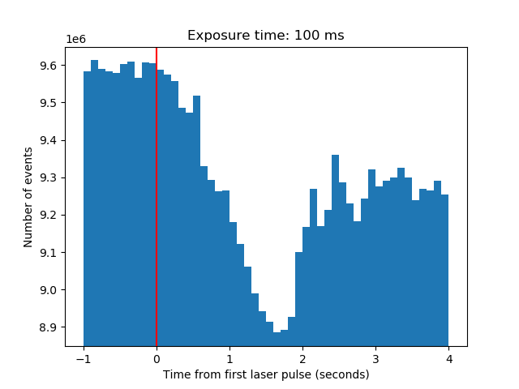
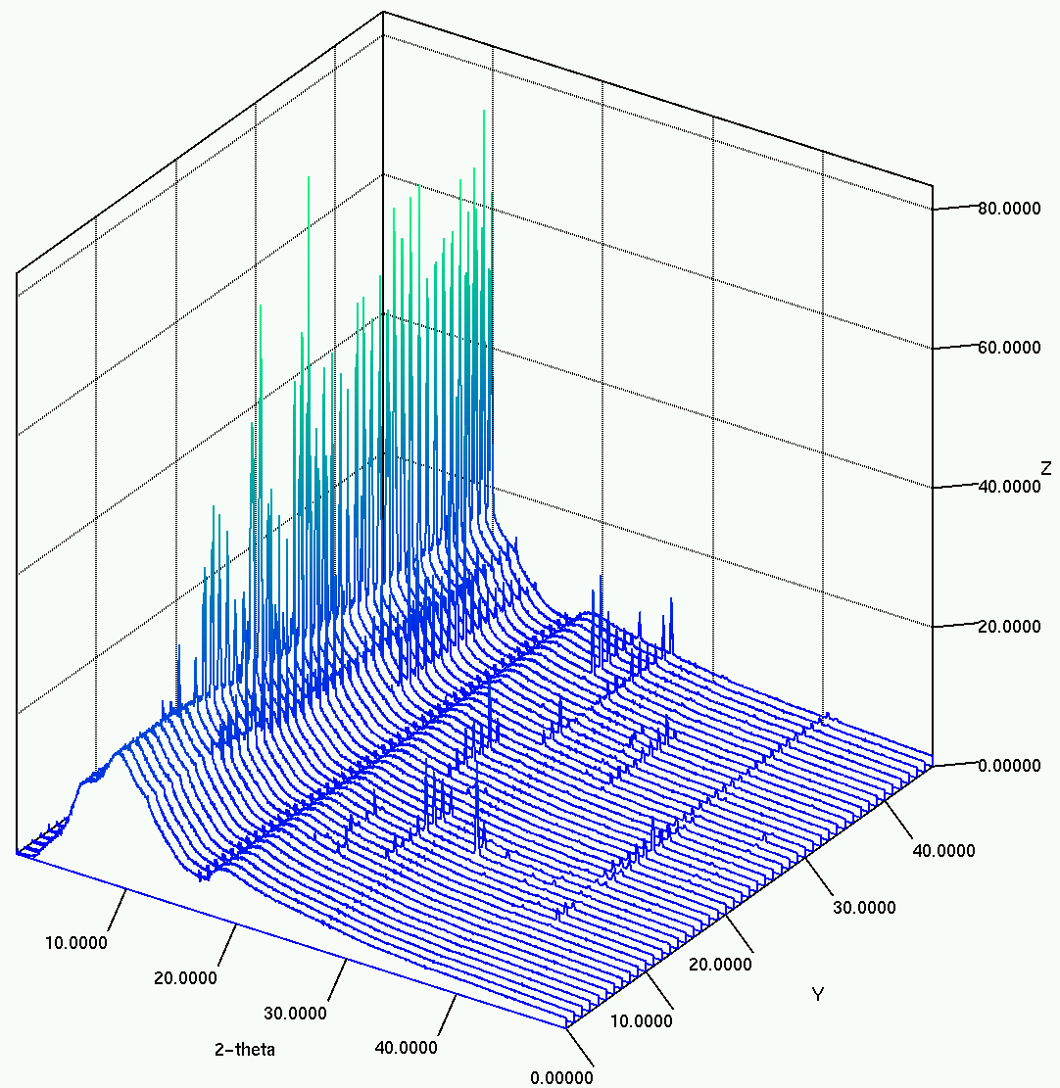
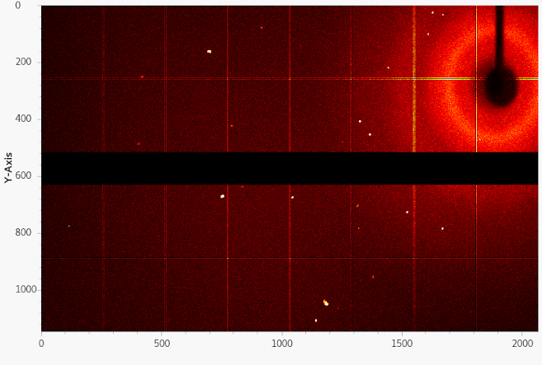
Timepix3 at Diamond Light Source
Laser shot
(time zero)
Formation of crystals
time
Tristan image of diffraction from laser induced nucleation.
Histogram of events after single laser shot (red line) with 100 ms binning.
Diffraction peaks present within first time-bin after single laser exposure
Slide courtesy of D. Omar

Slide 17
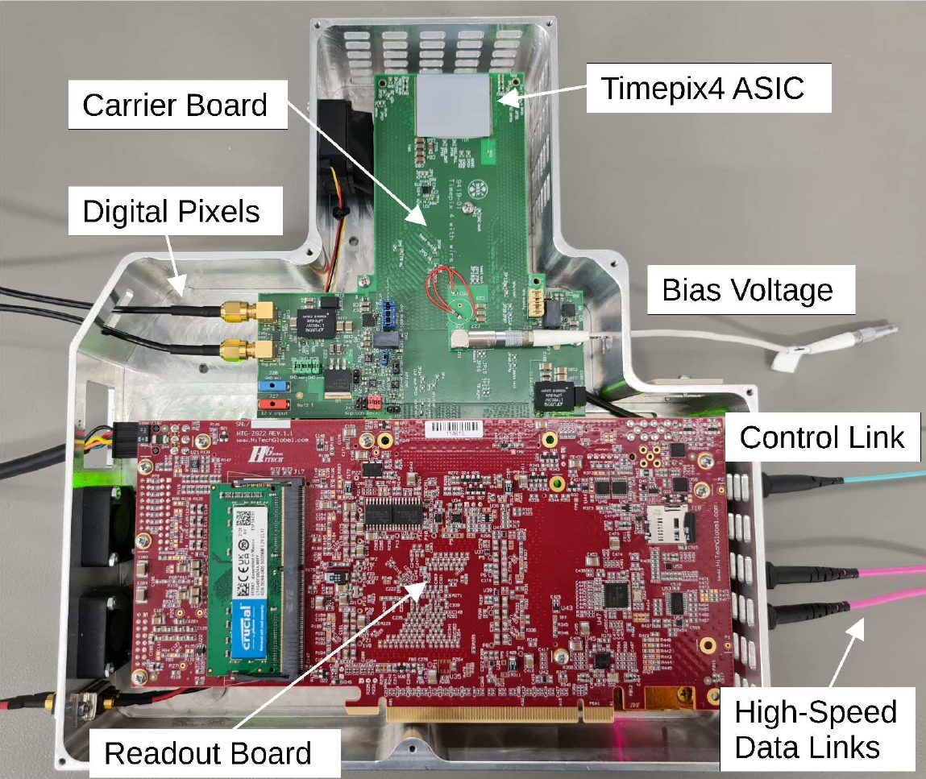

Timepix4 at DESY
TEMPUS single-chip prototype developed by DESY
Main detector in various user experiments
Check the usability of the high-speed serialisers
Explore the event-driven mode
Scientific experiments made so far:
Nuclear Resonance Scattering (NRS)
Parametric Down Conversion for Ghost Imaging
X-ray Photo Correlation Spectroscopy (XPCS)
Slide courtesy of J Correa

Slide 18
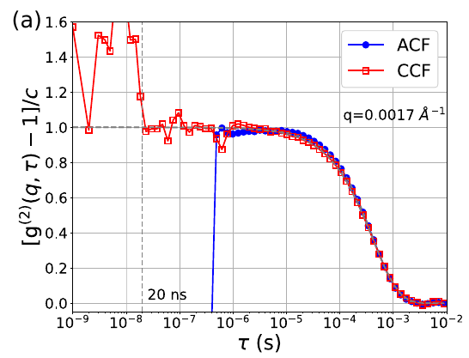
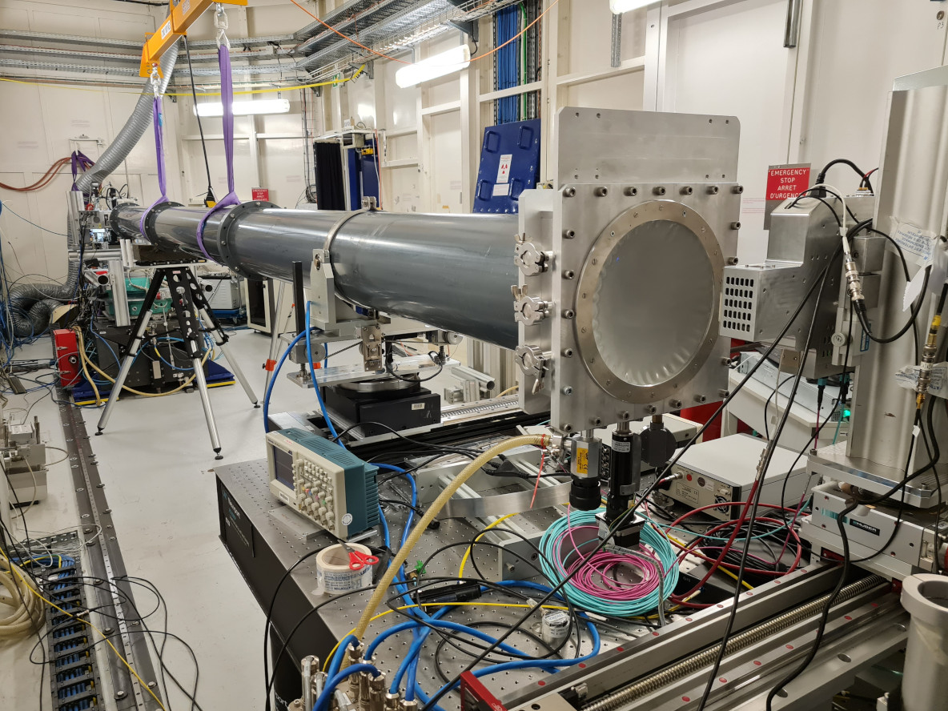
Timepix4 at DESY
X-ray Photo Correlation Spectroscopy and X-ray Cross-Correlation Analysis – sub μs correlation functions
Campaigns at ESRF – ID10, APS - 8ID and Eu.XFEL - MID
In a recent experiment we demonstrated that using
TEMPUS we could reach correlations:
Down to 250 ns for the speckles smaller than a pixel
Down to 20 ns for speckles larger than a single pixel
Slide courtesy of J Correa

Slide 19
Outline
Collaboration publications
Other synchrotron science applications
Medipix3 at the Brazilian light source
Timepix3 at Diamond
Timepix4 at DESY
Detection of gamma rays at CEA Saclay
Visible light imaging
4Dphoton (INFN Ferrara)
Neutron detection and imaging
Timepix devices developed by UC Berkeley
On-going developments at the China Spallation Neutron Source
Time of Flight Mass Spectrometry (Maastricht/Nikhef)
Future High Energy Physics experiments
Gridpix for large area TPC readout (Bonn/Nikhef)
Possible applications in IEC (Glasgow)
Some personal observations

Slide 20

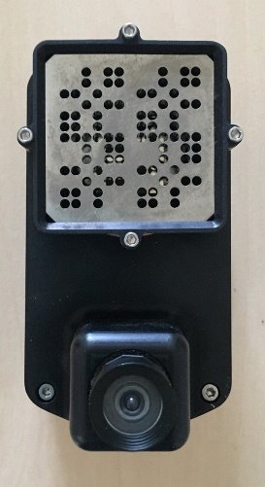
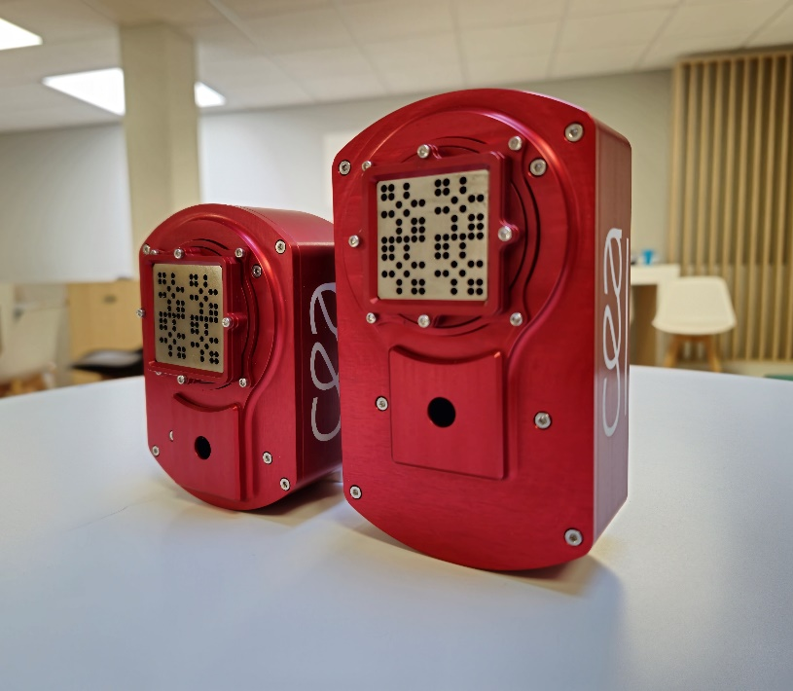





Gamma ray detection at CEA-LIST
More than 30 years of expertise at in the field of ionizing radiation imaging, leading to Nanopix Family, the most compact coded aperture gamma cameras in the world!
A combination of
Medipix collaboration ASICs,
miniaturised electronics,
specific spatially-coded aperture collimators
and embedded algorithms
allowing to remotely visualize radioactivity
Developments in close collaboration with :
Nanopix (2015)
Timepix inside
Nanopix2 (2019)
Timepix inside
Nanopix3 (2025)
Timepix3 inside
Slide courtesy of V. Schoepff

Slide 21
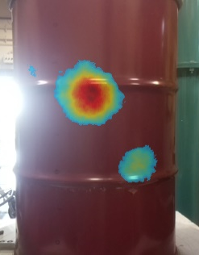
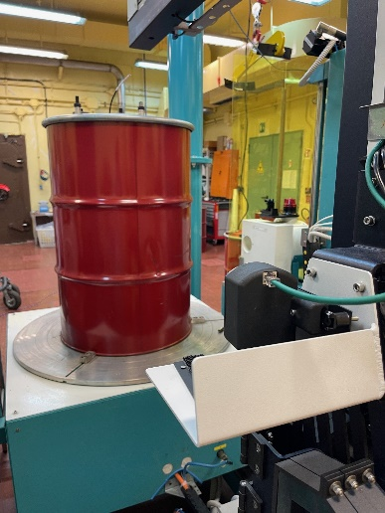
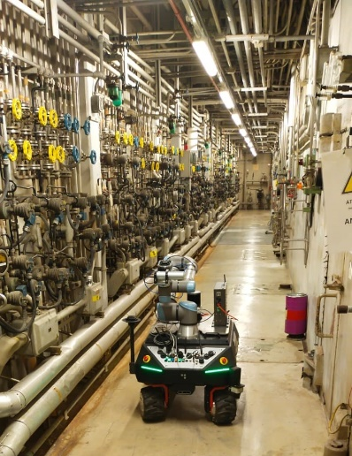
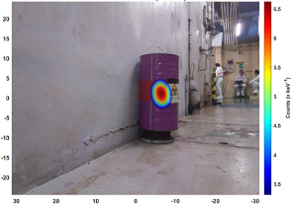
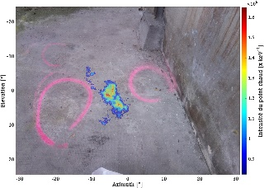
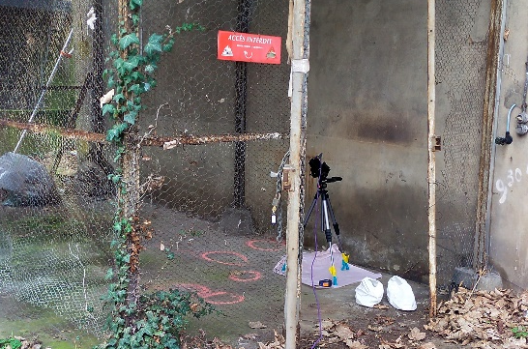
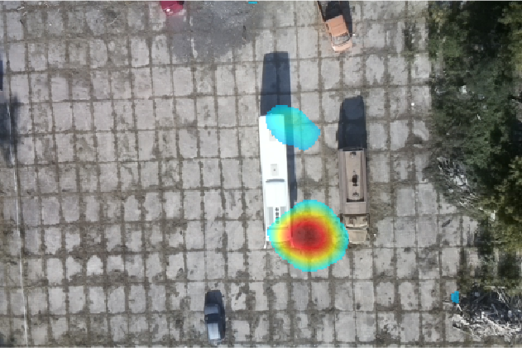
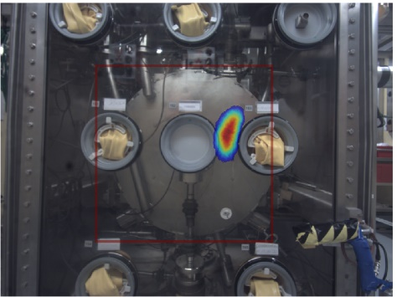

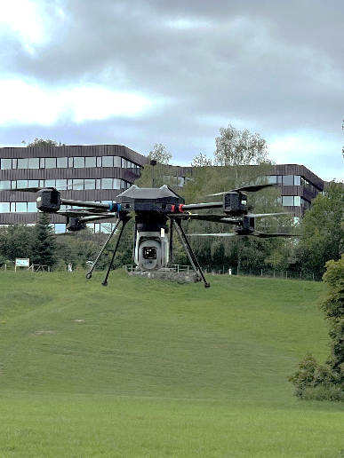



Gamma ray detection at CEA-LIST
Nuclear Waste Management
Dismantling & decommissioning
Post-accidental situations
Homeland Security
Operational radiation protection
Marie Curie’s lab, France
Slide courtesy of V. Schoepff

Slide 22
Outline
Collaboration publications
Other synchrotron science applications
Medipix3 at the Brazilian light source
Timepix3 at Diamond
Timepix4 at DESY
Detection of gamma rays at CEA Saclay
Visible light imaging
4Dphoton (INFN Ferrara)
Neutron detection and imaging
Timepix devices developed by UC Berkeley
On-going developments at the China Spallation Neutron Source
Time of Flight Mass Spectrometry (Maastricht/Nikhef)
Future High Energy Physics experiments
Gridpix for large area TPC readout (Bonn/Nikhef)
Possible applications in IEC (Glasgow)
Some personal observations

Slide 23
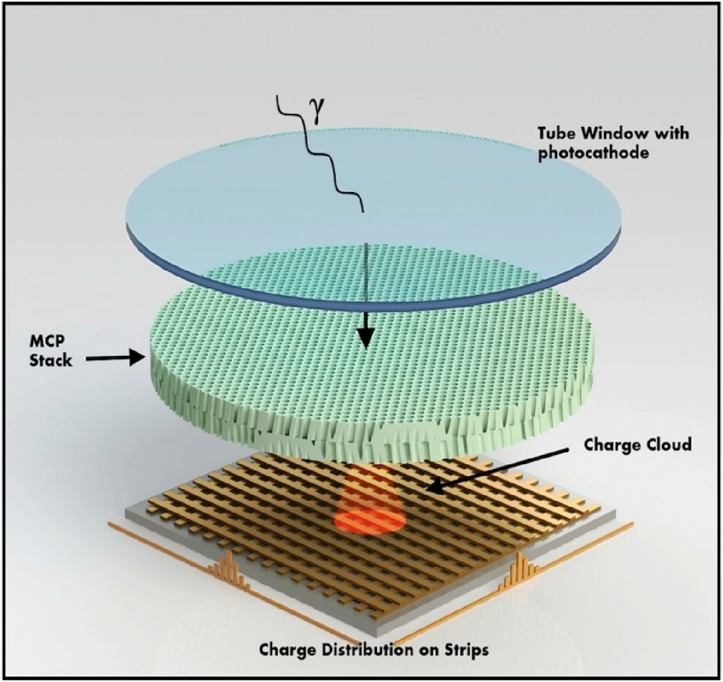
What if incoming particles deposit charge which is too low to be detected in a pixel?
Advantage of direct pixel ASIC readout – MCP gain can be substantially reduced and therefore its lifetime is in significantly increased
Slide courtesy of A. Tremsin

Slide 24
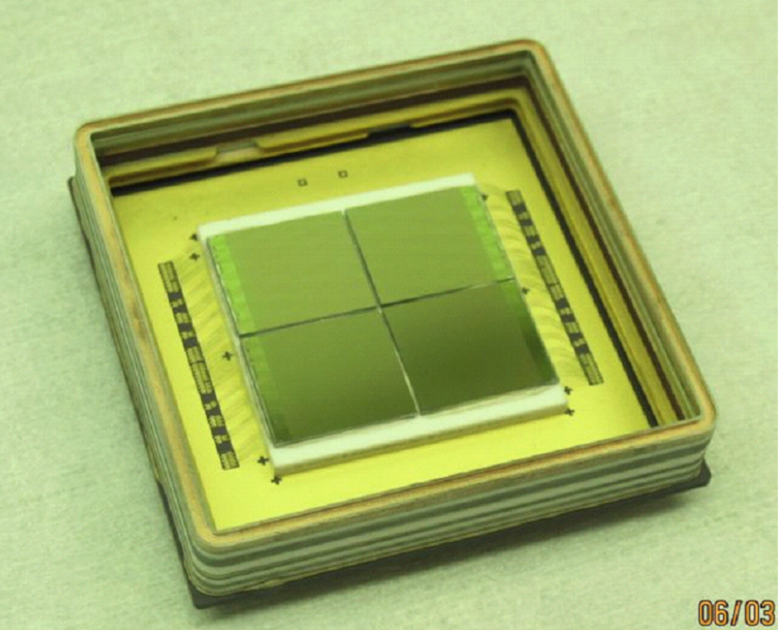
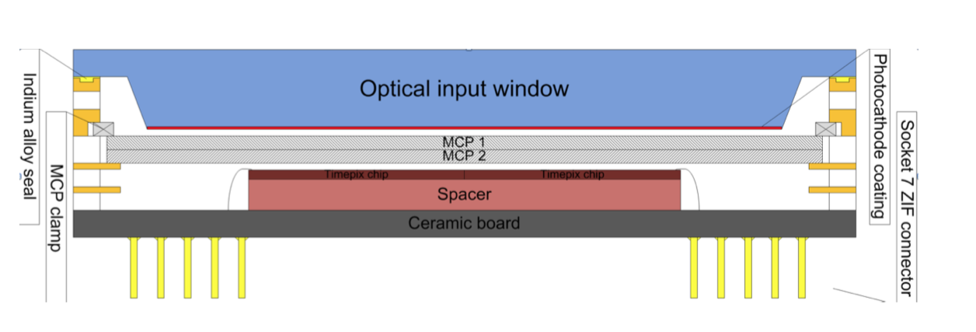
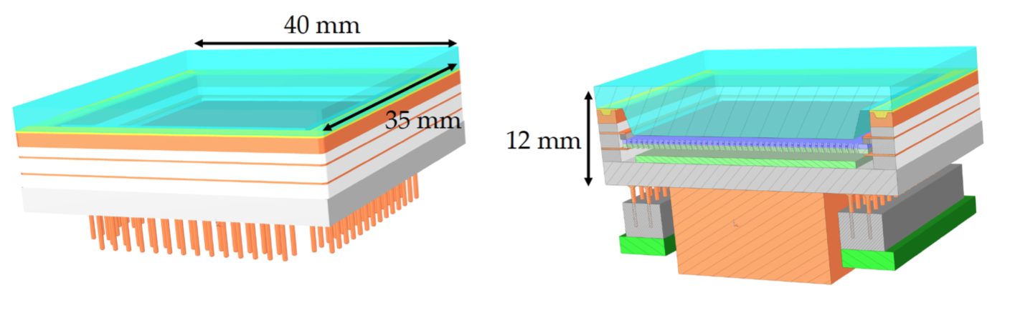

4Dphoton: Integrate Timepix4 in a photo tube
Concept already proven with 4 Timepix chips
See: J Vallerga et al. https://iopscience.iop.org/article/10.1088/1748-0221/9/05/C05055
Ongoing effort with Timepix4 started
See: M. Fiorini et al. https://iopscience.iop.org/article/10.1088/1748-0221/13/12/C12005/pdf
Slide courtesy of M. Fiorini

Slide 25
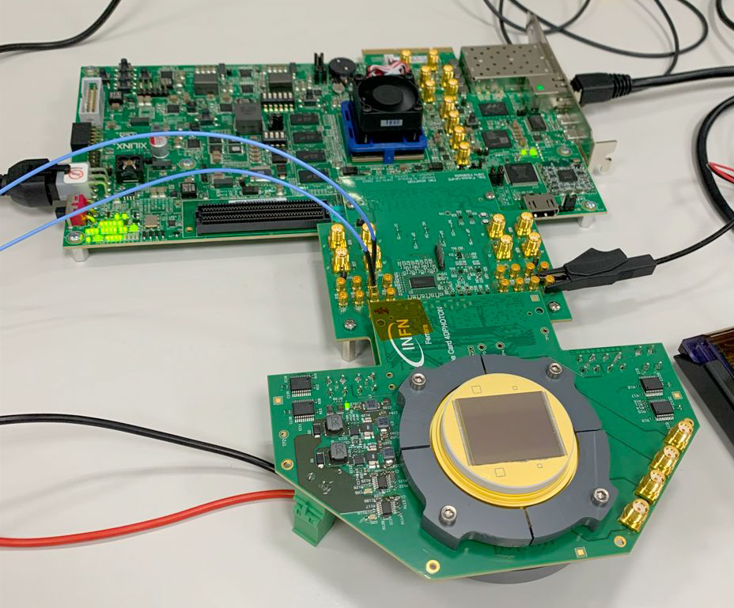
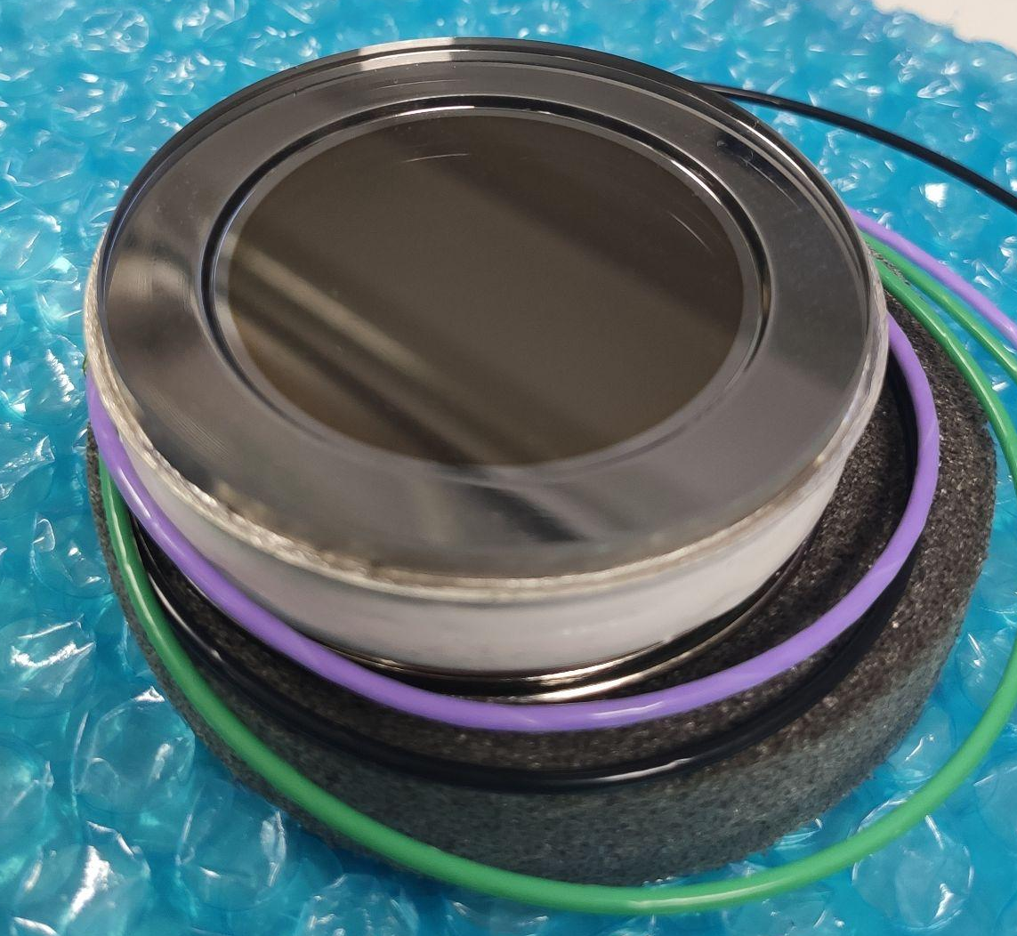
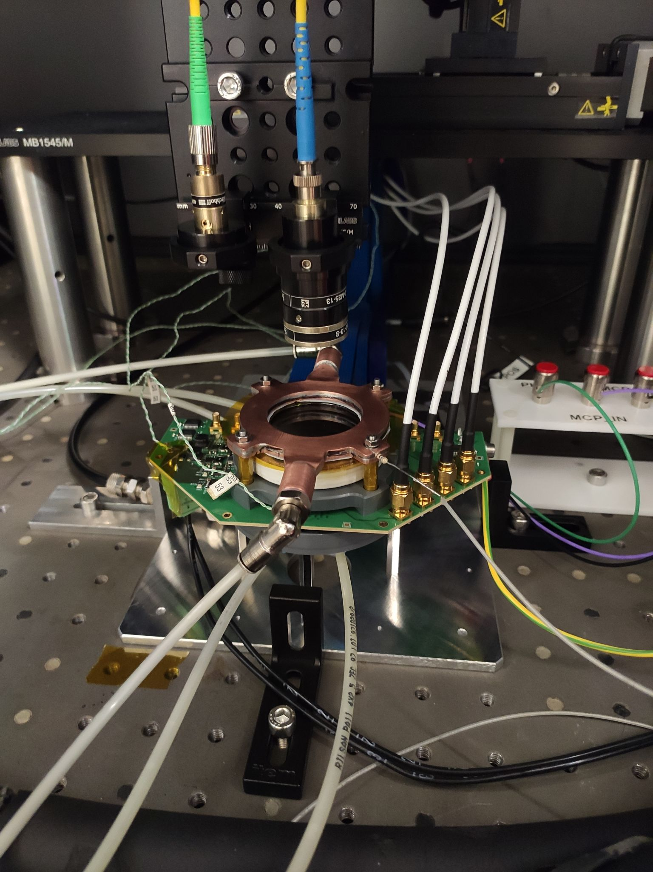
4Dphoton: Integrate Timepix4 in a photo tube
CERAMIC CARRIERS
Custom design and Pin Grid Array (PGA) by INFN, and produced by Kyocera
Laser 405 nm
MCP-PMT prototypes
Prototype vacuum tube produced by Hamamatsu Photonics Japan (HPK)
First prototypes received in 2024
Main characteristics:
Multi-alkali S20 photocathode
peak QE > 30% at 380 nm
6 μm MCP channel diameter (7.5 μm pitch)
Several variants for complete characterization
2-MCP stack and 3-MCP stack
1d - 2d - 3d end-spoiling
HV
Dry air

Slide 26
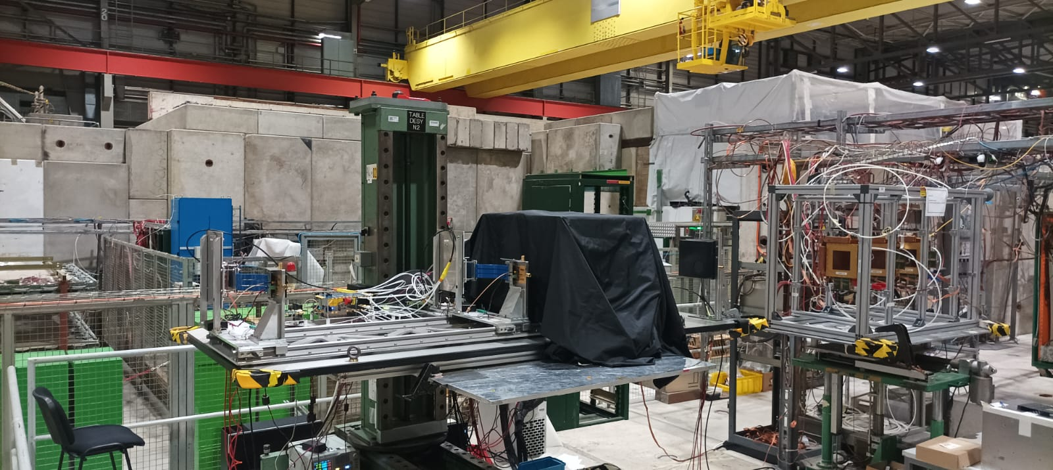
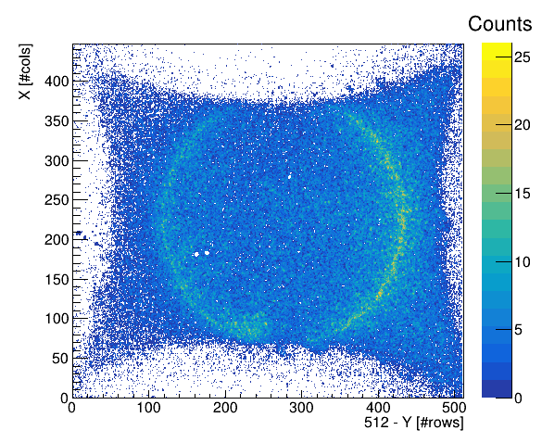
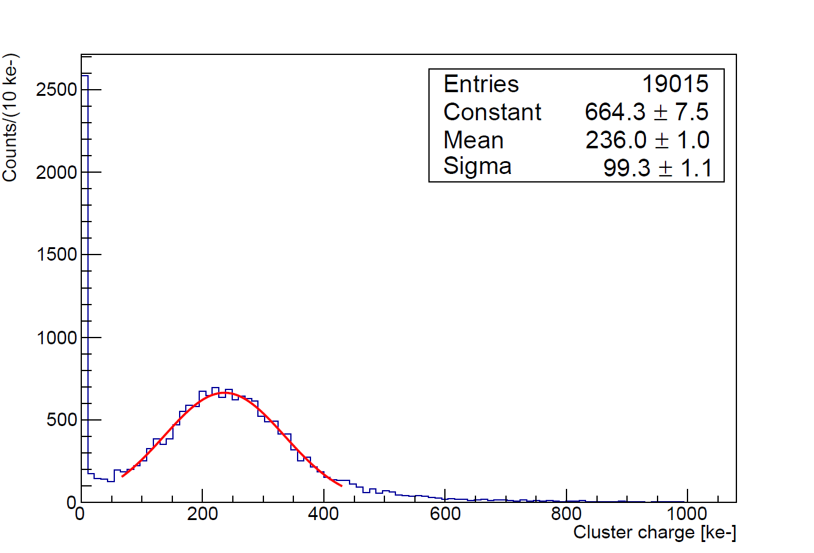
4Dphoton: Integrate Timepix4 in a photo tube
Characterization Measurements
Dark Count Rate (DCR) and gain measurements performed on dark noise acquisitions
Timing resolution measurements:
single pixel resolution reaching a plateau at 95 ps
cluster resolution improving up to 65 ps
Test beam campaign
Tracking system: 2 Timepix4 assemblies bonded to 300 μm thick p-on-n planar Si sensors
RICH setup: Cherenkov radiator and optics setup
Timing system: 2 Cherenkov detectors
PicoTDC to precisely measure the timing of the detectors
MCP_in-MCP_out = 2400 V
1 minute shutter
E[Q] = 236.0 ke-
Slide courtesy of M. Fiorini

Slide 27
Outline
Collaboration publications
Other synchrotron science applications
Medipix3 at the Brazilian light source
Timepix3 at Diamond
Timepix4 at DESY
Detection of gamma rays at CEA Saclay
Visible light imaging
4Dphoton (INFN Ferrara)
Neutron detection and imaging
Timepix devices developed by UC Berkeley
On-going developments at the China Spallation Neutron Source
Time of Flight Mass Spectrometry (Maastricht/Nikhef)
Future High Energy Physics experiments
Gridpix for large area TPC readout (Bonn/Nikhef)
Possible applications in IEC (Glasgow)
Some personal observations

Slide 28
How about neutrons?
No need for photo-cathode
Dope MCP with a neutron absorbed (¹⁰B or ^{nat}Gd)
Integrate MCP and ASIC in beam vacuum

Slide 29
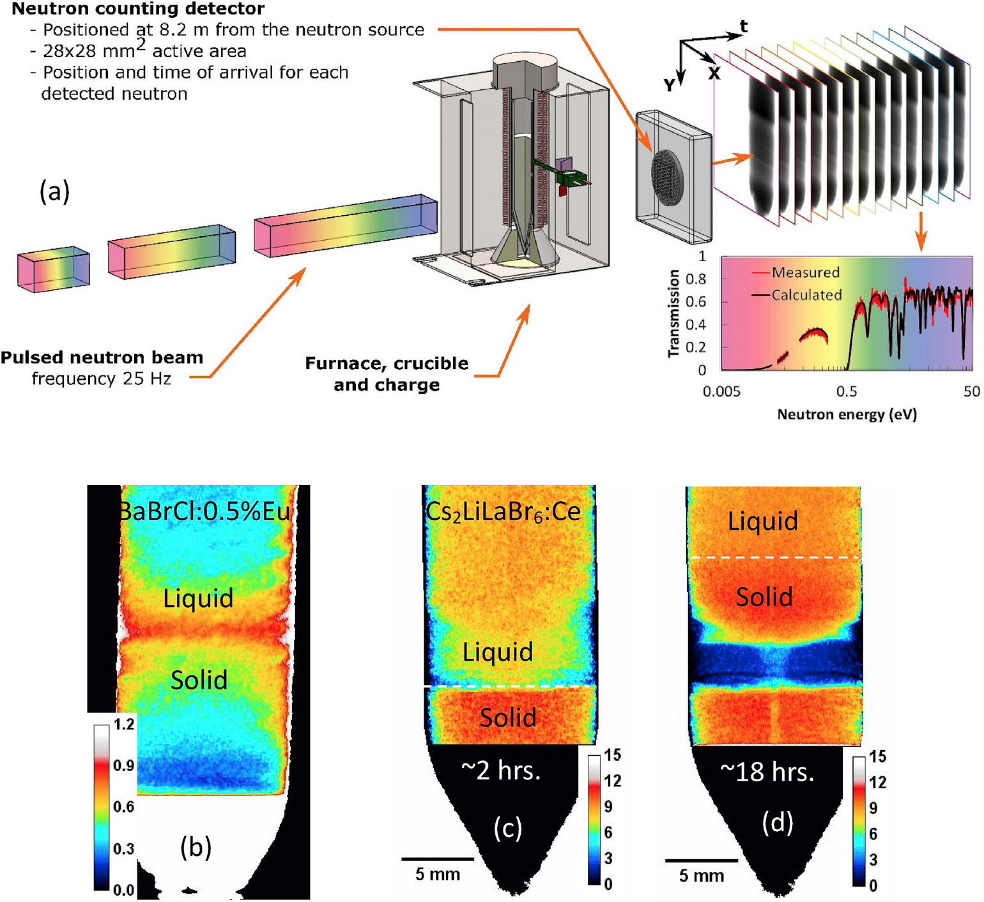
Neutron detector development at UC Berkeley
Early versions were Timepix-based
Timepix3-based systems now deployed
Timepix4-based systems in preparation
This example shows how a neutron beam can be used to help optimise crystal growth: (b) Eu concentration (c) and (d) Li concentration
Neutron energies used: 1meV to 10keV in one experiment
Slide courtesy of A. Tremsin

Slide 30
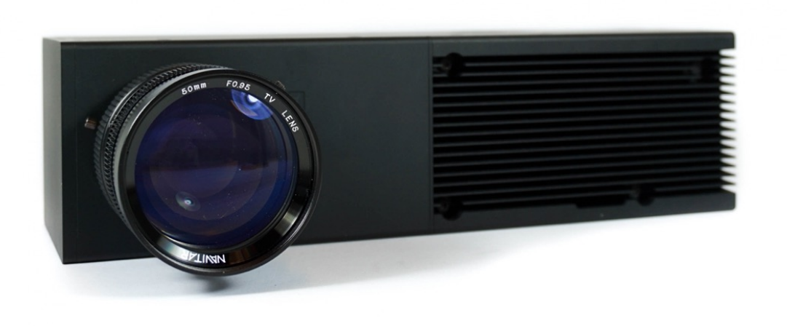
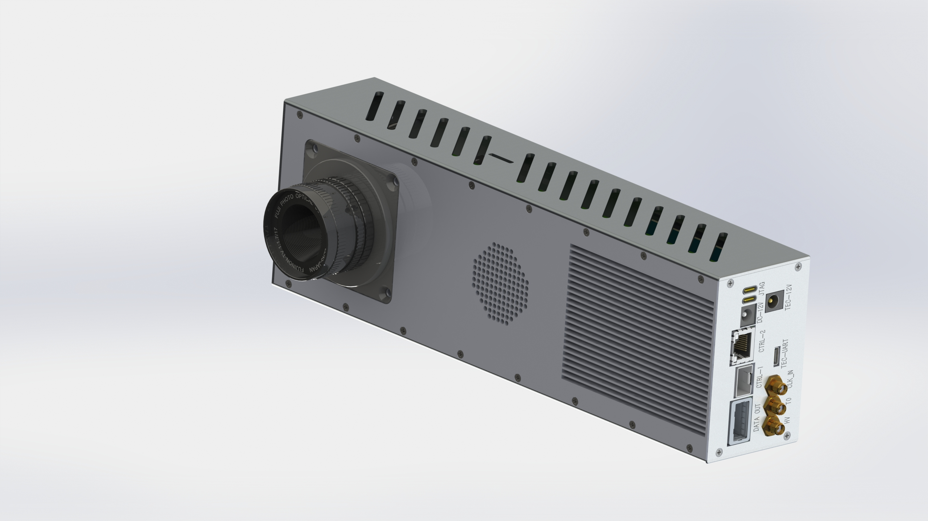
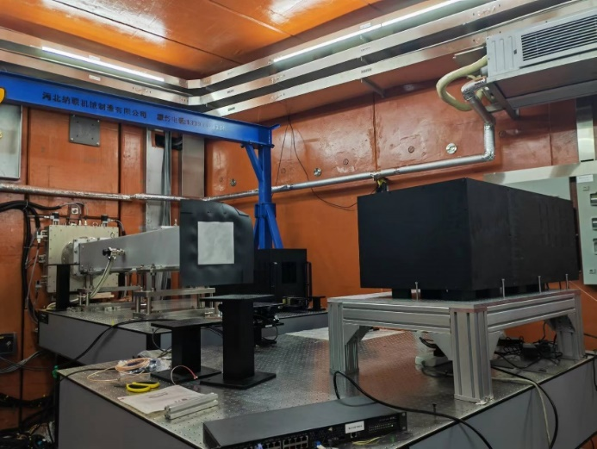
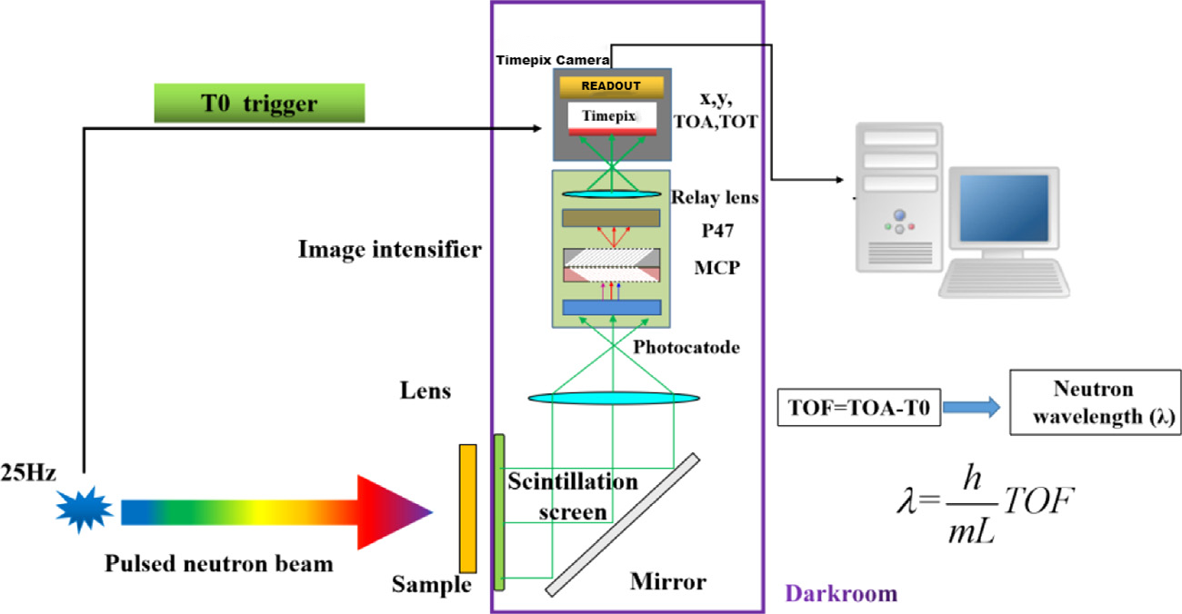


Neutron detector development at CSNS (China)
ASI TPX3Cam
CSNS Timepix4 Camera
CSNS BL13
ERNI Neutron Detector
Scintillator Neutron Detector + Event Driven Timepix Camera:
⁶LiF/ZnS and (Gd₂O₂S (Tb/⁶LiF)) for thermal neutron detection
Scintillation light coupled to a image intensifier for amplifiying
Timepix Camera for TOA registering of photon events
Advantages: Adjustable FOV (with different spatial resolution), no vaccum operation
Slide courtesy of H. Lui

Slide 31
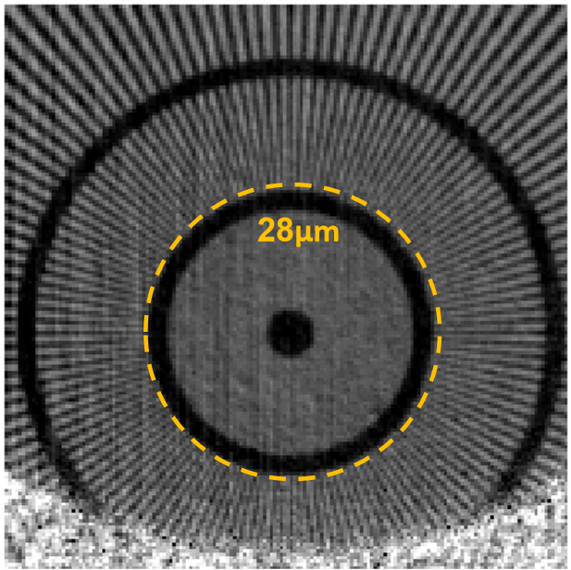
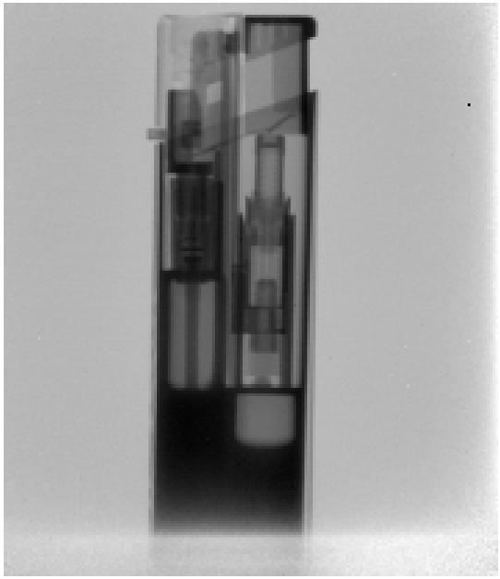
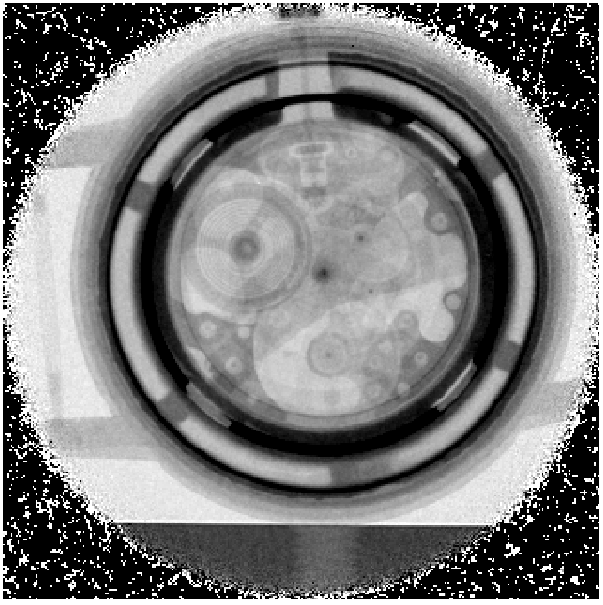
Neutron detector development at CSNS (China)
Neutron transmission imaging with Timepix4 Camera
~ 28um spatial resolution (GOS)
Metal shell lighter
(ZnS)
Metal Watch
(ZnS)

Slide 32
Outline
Collaboration publications
Other synchrotron science applications
Medipix3 at the Brazilian light source
Timepix3 at Diamond
Timepix4 at DESY
Detection of gamma rays at CEA Saclay
Visible light imaging
4Dphoton (INFN Ferrara)
Neutron detection and imaging
Timepix devices developed by UC Berkeley
On-going developments at the China Spallation Neutron Source
Time of Flight Mass Spectrometry (Maastricht/Nikhef)
Future High Energy Physics experiments
Gridpix for large area TPC readout (Bonn/Nikhef)
Possible applications in IEC (Glasgow)
Some personal observations

Slide 33
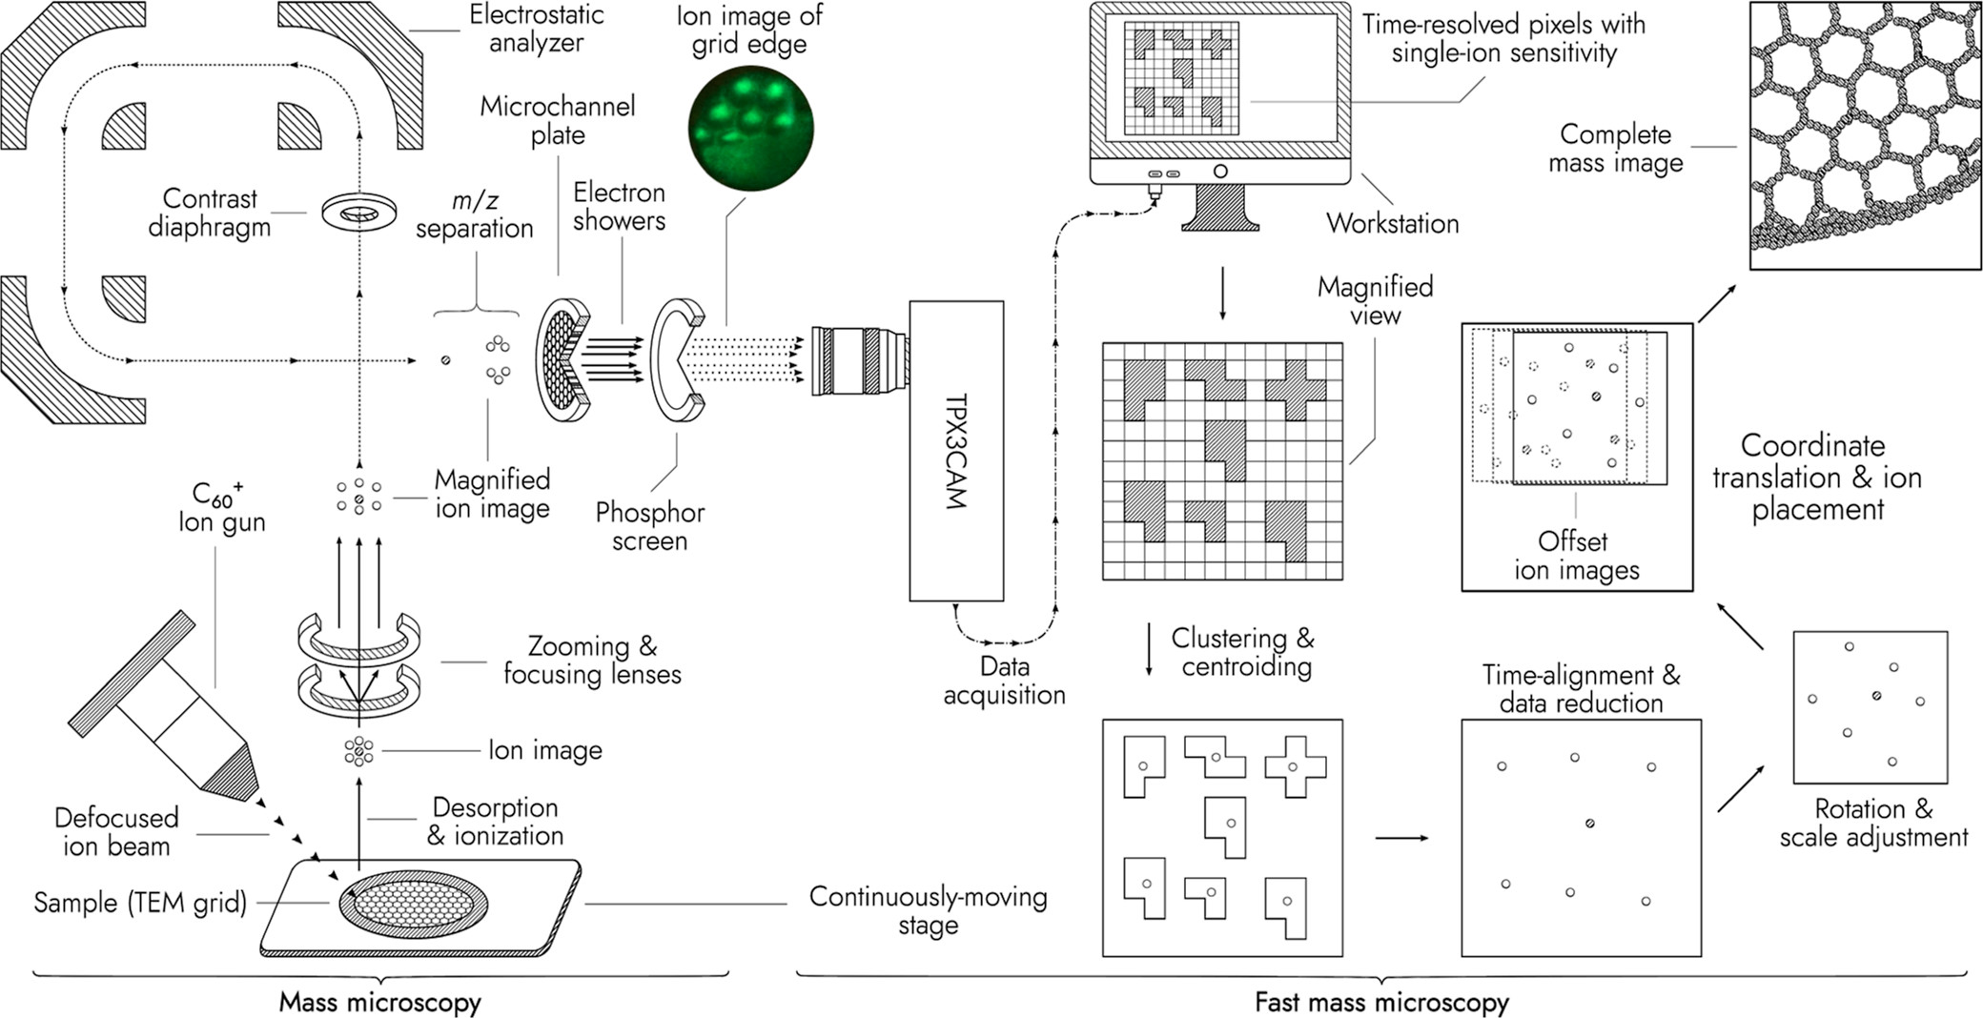


Time of Flight Mass Spectrometry at Maastricht
Slide courtesy of R. Heeren

Slide 34

Time of Flight Mass Spectrometry at Maastricht
Imaging time 33.3 mins compared with 2 months…
Slide courtesy of R. Heeren

Slide 35

Time of Flight Mass Spectrometry at Maastricht
Mass images of rat brain using Timepix3cam
Each area (a) to ( e) highlights different (m/z) regions and therefore different molecules
(f) and (g) indicate zooms with pixel sizes of 2μm and 0.5 μm respectively
Full image size 1.3 Gpixels
18 mm
16.5 mm
Slide courtesy of R. Heeren

Slide 36
Outline
Collaboration publications
Other synchrotron science applications
Medipix3 at the Brazilian light source
Timepix3 at Diamond
Timepix4 at DESY
Detection of gamma rays at CEA Saclay
Visible light imaging
4Dphoton (INFN Ferrara)
Neutron detection and imaging
Timepix devices developed by UC Berkeley
On-going developments at the China Spallation Neutron Source
Time of Flight Mass Spectrometry (Maastricht/Nikhef)
Future High Energy Physics experiments
Gridpix for large area TPC readout (Bonn/Nikhef)
Possible applications in IEC (Glasgow)
Some personal observations

Slide 37




Gridpix for large area TPC readout (Bonn/Nikhef)
50 µm
⁵⁵Fe decay: 5.9 keV photon
→ ~225 electrons
Micromegas on a pixelated readout ASIC
Gas amplification increases signal of single electron to detection level
=> high efficiency to see all primary electron
→ improve spatial and energy resolution.
Slide courtesy of J Kaminski

Slide 38




Gridpix for large area TPC readout (Bonn/Nikhef)
Development with Timepix
TPC with 160 GridPixes
Development with Timepix3
TPC with 32 GridPixes
high precision measurements
Demonstrated
- feasibility of large
number of GridPixes
- excellent spatial
resolution (systematics
below 10 µm)
- excellent energy
resolution for 1 m long
tracks; dE/dx ~ 3%
Slide courtesy of J Kaminski

Slide 39








Timepix4 Tracker for the ePIC detector at the EIC
2xStations to measure scattered electrons of different momenta, each with 4 layers of Timepix4
EIC at BNL, USA
“A machine that will unlock the
secrets of the strongest force in
Nature”.
Construction: 2026
Data taking early 2030’s
UoG building Low-Q2 Taggers.
Only Timepix4 can operate at the required data density rates
Timepix4
Front End Board
Slide courtesy of D. Manueski

Slide 40


Timepix4 Tracker for the ePIC detector at the EIC
The Low-Q2 Tagger will detect scattered electrons from collisions at the ePIC detector interaction point, tagging the virtual photon momentum.
Challenging high energy physics detector. (Design still being finalized)
Large area detector (For Timepix)
Total 144 Timepix4 chips (Dependent on beampipe design)
2 Stations, each 4 Layers of 3x6 Timepix4
About 1000cm² of Timepix4.
TSV technology required
High, nonuniform data rates
10+ tracks every 10 ns bunch crossing
Up to maximum 20kHz per pixel
Synchrotron and other beam backgrounds
Total estimation 600 Gb/s
Require front end data filtering by FPGA
Close to electron beam
As close as possible to beam to maximize acceptance
Not too close to introduce beam impedance
Reconstruction through magnets
Dipole and quadrupoles before detectors.
Machine learning to reconstruct initial momentum from track.
Rate Distribution of Bremsstrahlung and DIS scattered electrons
Slide courtesy of D. Manueski
Extends physics range of central detector

Slide 41

Some personal observations
Some compare High Energy Physics with a famous Italian design:
Beautiful
Expensive
But almost completely useless
With the Medipix Collaborations we have demonstrated that the pursuit of advanced detector readout concepts can impact many other areas of science
But some elements are required:
Individual and collective imagination/vision
A willingness to pool ideas and resources
Openness to the requirements of others
Highly skilled engineers
Access to leading edge processes
Organisation, tenacity, patience
Fair and workable licensing
Philippe Starck
Juicy Salif citrus squeezer
Finnish Design Shop

Slide 42
And, finally..
Thanks to all of you (and also those not present) for the continuing, friendly and enthusiastic collaboration over the last years. Our team was boosted morally by each collaboration meeting
Thanks to all those at CERN (esp. in EP and KT) who supported our team and kept us going in spite of sometimes challenging circumstances
Thanks also to our industrial partners who took a leap of faith to make our developments available to a wider community. You have been responsible for bringing our developments to the wider world

Slide 43


Mouse skull
Medipix3
X-ray tube 25kVp
8 x 6 tiles
500μm GaAs
Bias: -200 V
SPM 24-Bit
TH0 6 keV
Medipix3RX images: S. Procz et al.

Slide 44

SD Card
CF card
Medipix3
Width: 42.8 mm
Mag. 1.74x
CdTe 1mm
Bias: -290 V
SPM 24-Bit
8x7 tiles
Medipix3RX images: S. Procz et al.

Slide 45

Thank you for your attention!
Medipix3RX images: S. Procz et al.

Slide 46



Bibliography
https://www.nature.com/commsmat
Ptychographic X-ray computed tomography of porous membranes with nanoscale resolution
Górecki, R., Polo, C.C., Kalile, T.A. et al. Ptychographic X-ray computed tomography of porous membranes with nanoscale resolution. Commun Mater 4, 68 (2023).
https://doi.org/10.1038/s43246-023-00396-x
https://doi.org/10.1021/acs.nanolett.4c03662
DOI: 10.1103/PhysRevB.111.144103

Slide 47
Bibliography
[1] A. G. Jarvis, H. A. Sparkes, S. E. Tallentire, L. E. Hatcher, M. R. Warren, P. R. Raithby, D. R. Allan, A. C. Whitwood, M. C. R. Cockett, S. B. Duckett, J. L. Clark, I. J. S. Fairlamb, CrystEngComm 2012, 14, 5564-5571.
[2] Coppens et al., Chem Commun., 2004, 2144.
[3] M. R..Warren et al., Angew. Chem., 2009, 121, 5821-5824
[1] Cormary et al., Inorg. Chem., 2012, 51, 7492-7501.
[2] Schaniel et al., Adv. Mat., 2007, 19, 723-726.
Tristan –a 10 Million Pixel Large Area Time Resolved Detector for Synchrotron use.
David Omar, Giulio Crevatin, Alan Greer, Ian Horswell, Jonathan Spiers, Richard Placket, Paul Booker, Gale Lockwood, Dan Beckett, Emily Galvin, John Lipp, Michelangelo Di Palo, Mark Warren, Scott Williams, and Nicola Tartoni1 DOI 10.1109/TNS.2022.3204064
J. Correa et al. (2024). J. Synchrotron Rad. 31. https://doi.org/10.1107/S1600577524005319
Y. Chushkin et al. (2025). J. Synchrotron Rad. 32 https://doi.org/10.1107/S1600577525006599
A.S. Tremsin, J.V. Vallerga, "Unique capabilities and applications of Microchannel Plates detectors with Medipix/Timepix readout", Radiation Measurements 130 (2020) 106228.
https://doi.org/10.1016/j.radmeas.2019.106228
A.S. Tremsin, Y. Gao, A. Makinde, H.Z. Bilheux, J.C. Bilheux, K. An, T. Shinohara, K. Oikawa, "Monitoring residual strain relaxation and preferred grain orientation of additively manufactured Inconel 625 by in-situ neutron imaging", Additive Manufacturing 46(2021) 102130.
https://doi.org/10.1016/j.addma.2021.102130

Slide 48
Bibliography
https://doi.org/10.1021/acs.analchem.2c02870
Anal. Chem. 2022, 94, 14652−14658
NÌM A535 (2004) 506-510
NIM A845 (2017) 233-235
TNS, 64, 5, 2017, pp 1159
NIM A 1075 (2025) 170397
NIM A 1081 (2026) 170840

Slide 49
Backup

Slide 50

All publications - Author names

Slide 51

All publications - Affiliations

Slide 52

All publications - Subject areas

