Slide 1



Superconductivity Global Alliance (ScGA) an Overview
Professor Ziad Melhem
Chairman of the ScGA
Founder and CEO
Oxford Quantum Solutions Ltd.
Oxford, UK
Since 1st Feb 2021
Professor in Practice,
Dept. of Physics, Lancaster University Superconducting Devices and Low-Temperature Technologies & Applications
Since 1st of Dec 2022
Non-Executive Director Intelliconnect Europe Ltd Instrumentations & Cryo-electronics for Quantum and Space applications
Since 1st Jan 2022
ziad.melhem@oxqsol.com

Slide 2
Contents
Introduction
Opportunities and Market
Superconductivity impact on sustainability
Superconductivity Global Alliance (ScGA)
Grand Challenges and Strategic Roadmap
Summary

Slide 3
Introduction
1 December 2025
Page 3

Slide 4
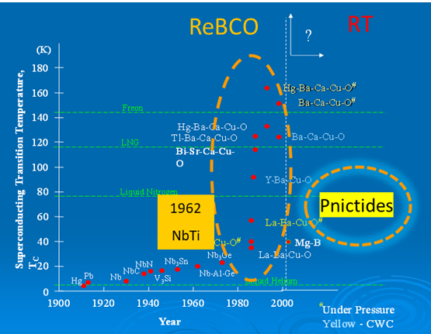
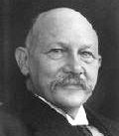
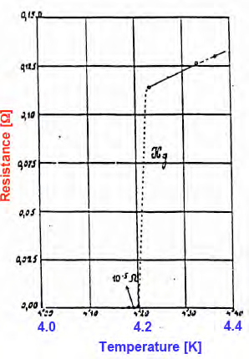
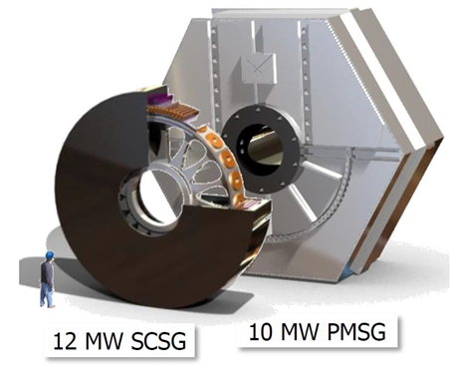
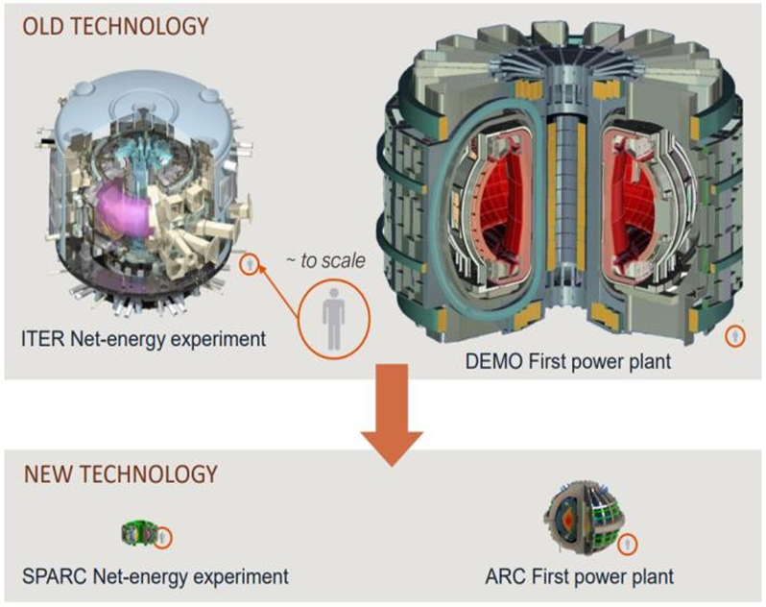
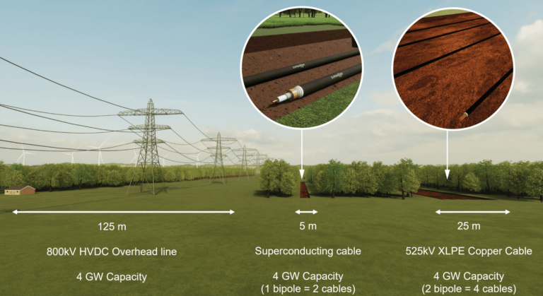
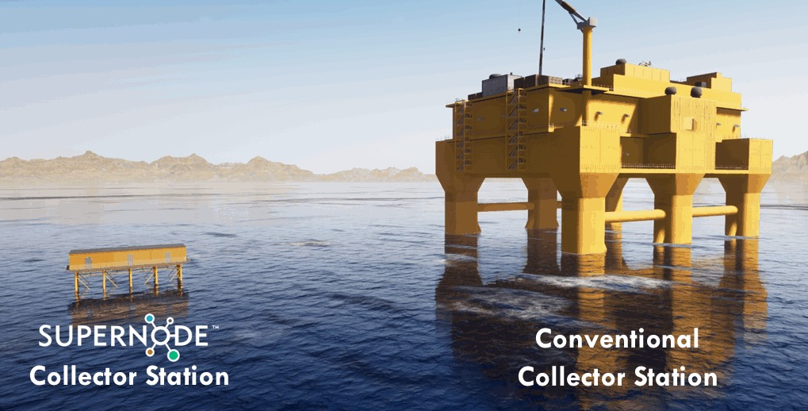
Introduction to Superconductivity!
Superconductivity is a phenomenon where a material can conduct electricity without resistance when cooled below a certain temperature.
Zero electrical resistance & the expulsion of magnetic fields (Meissner effect).
October 1911 (Reported in November 1911)
“On the sudden change in the rate at which the resistance of mercury disappears”
Heike Kamerlingh Onnes (1853-1926)
“Door meten tot weten”
(“Through measurement to knowledge”)
x5-10 improvement in Transmission
> 50 % reduction in size
> 60 % reduction in size
> 80 % reduction in size
Image Courtesy of Supernode
Image Courtesy: Changwon University
Image Courtesy of Supernode
Image Courtesy of ITER and CFS
1 December 2025
Page 4

Slide 5
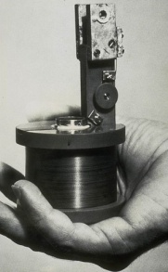
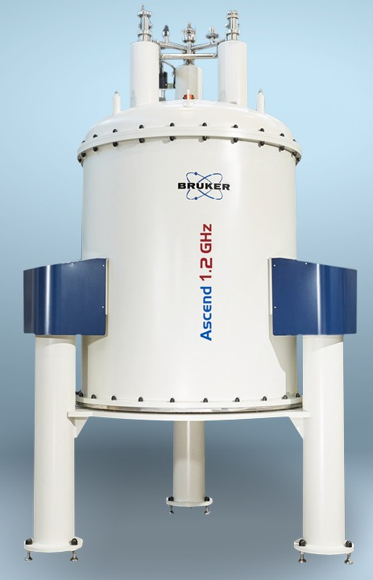
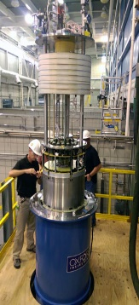
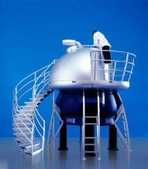

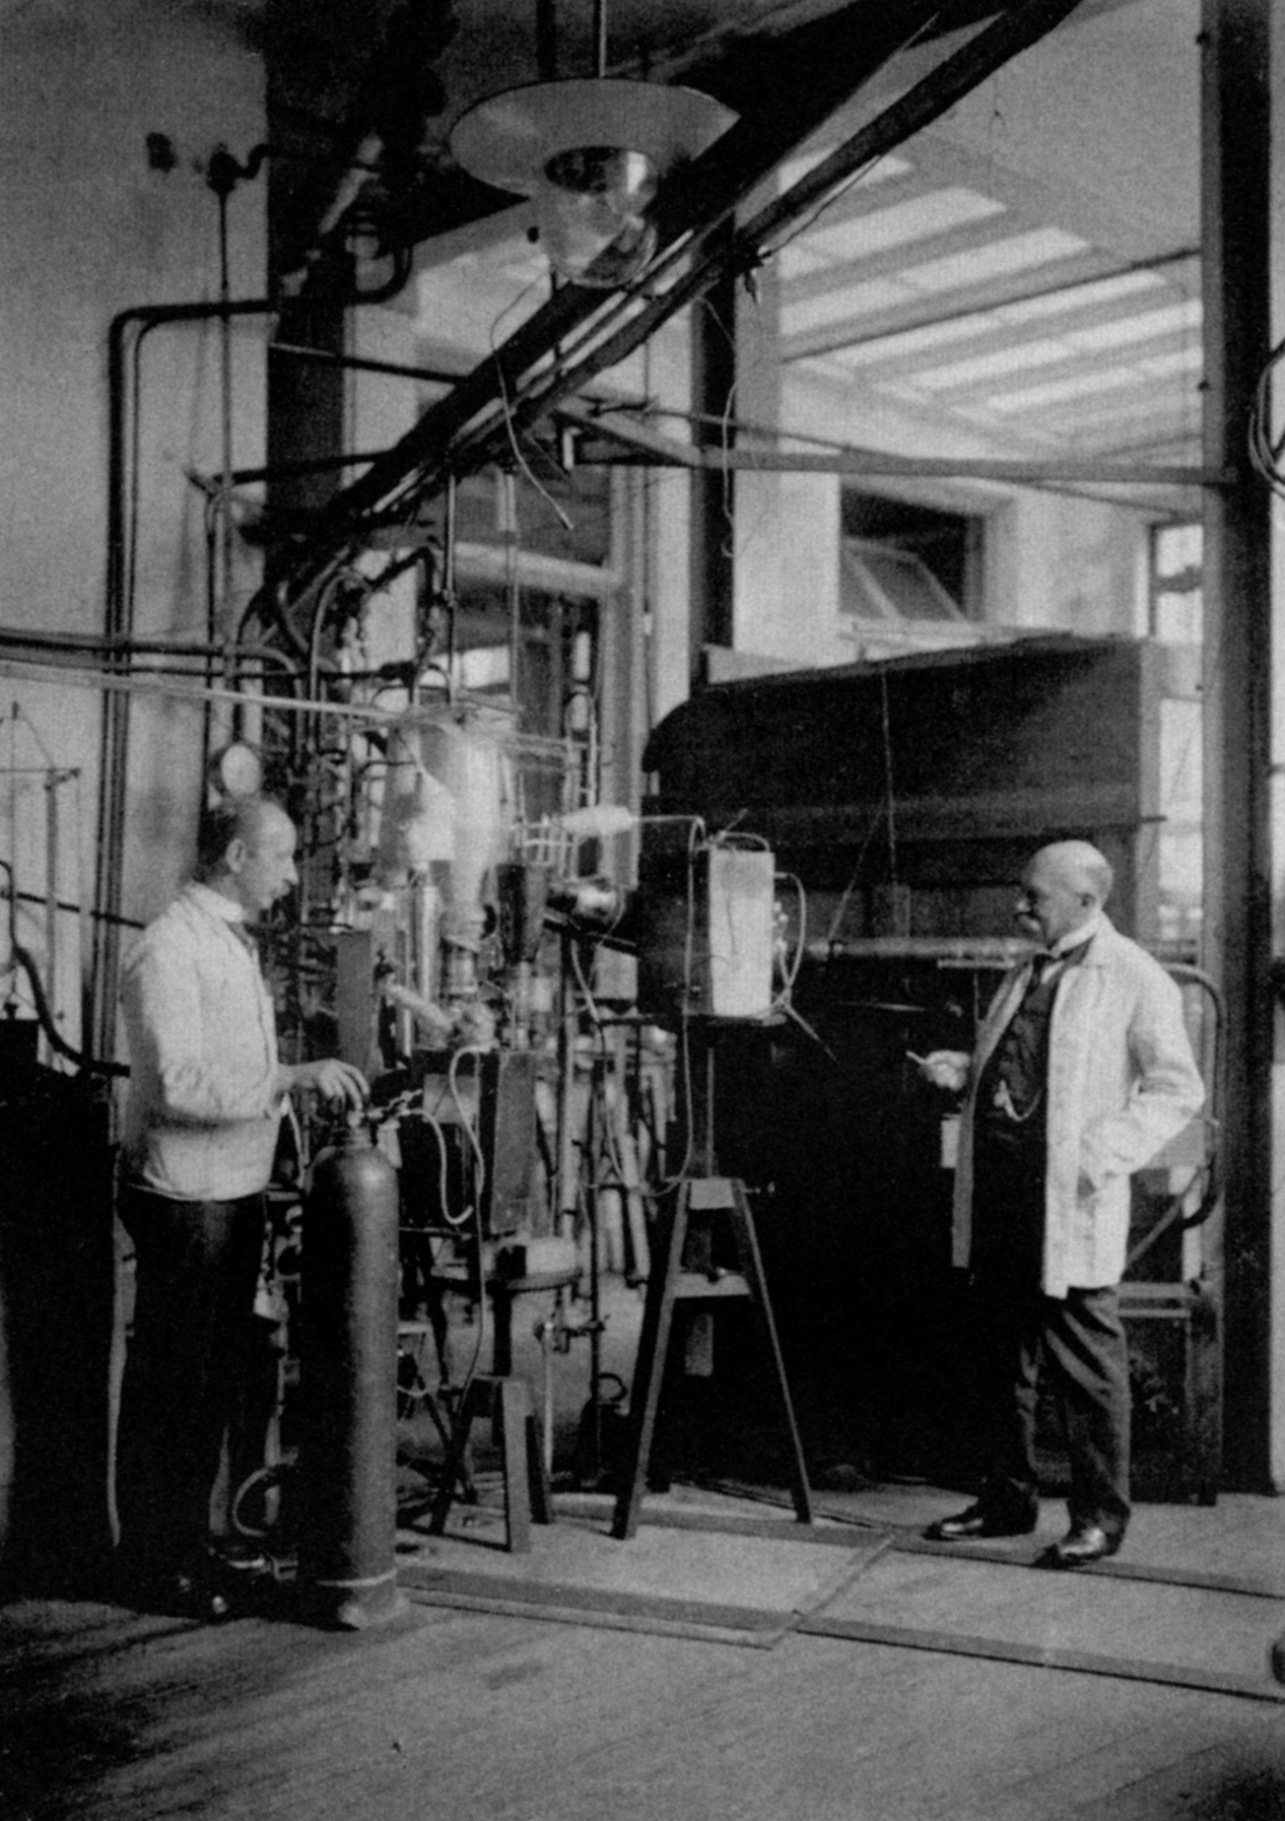
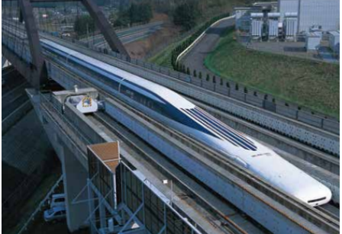
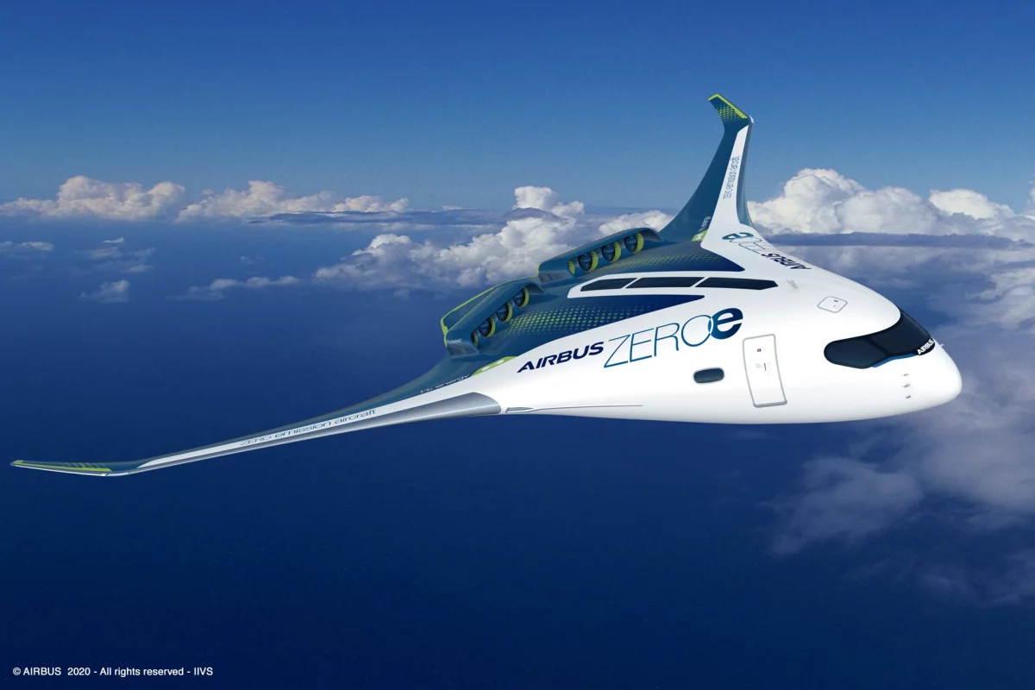
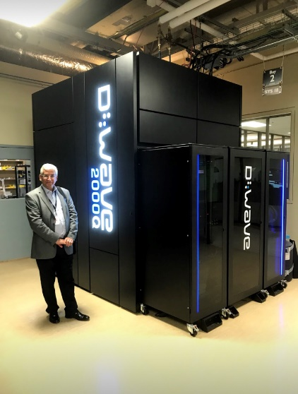

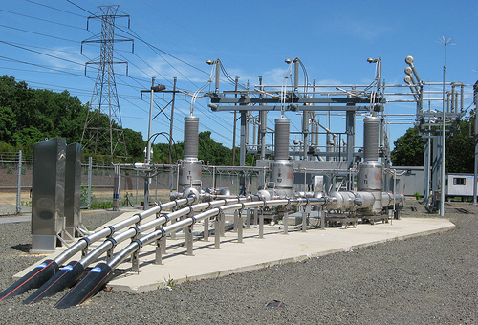
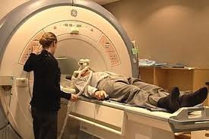
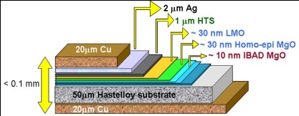

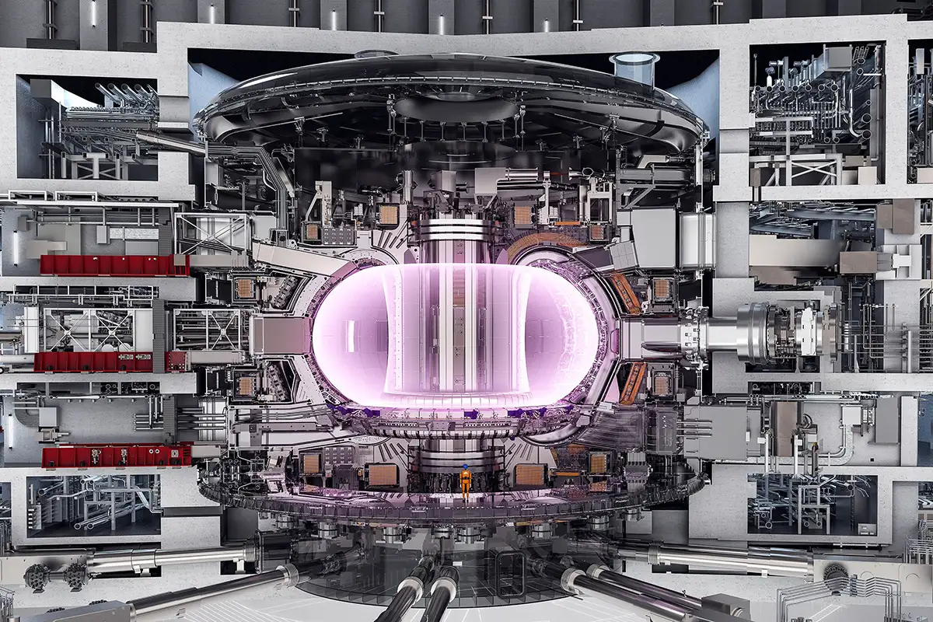
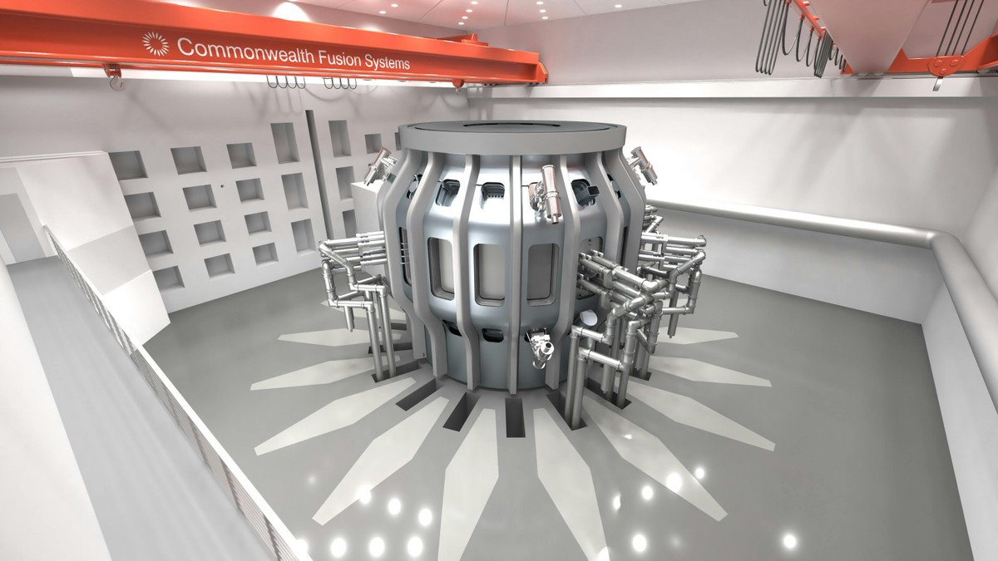
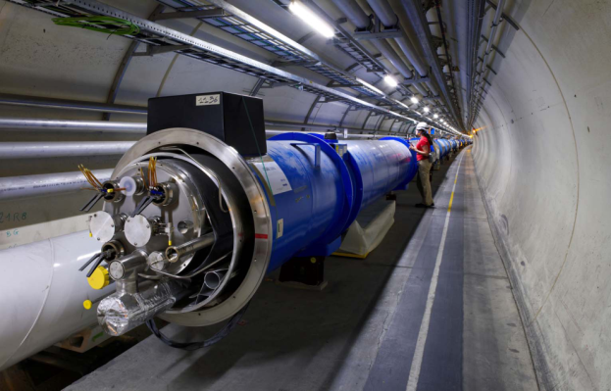
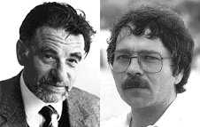
History of Superconductivity
1910
The
Discovery
1920 -1950
The Theory
1960 -1980 Applications & Volume Productions
Research Magnets
NMR &MRI
Physics Magnets
I
HTS discovery (1986)
2000 - 2020
New Frontiers
High Field Magnets
Energy Applications
HTS production & Demonstrators
2020 -
Future Commercial Superconductivity
Compact, highly efficient applications
Energy
Healthcare
Quantum
Fusion
Transport
Large Scale
Courtesy of Bruker
Courtesy of Oxford Instruments
Courtesy of NHMFL
Courtesy of Airbus
Courtesy of AMSC
Courtesy of CERN
Courtesy of Tokamak Energy
Courtesy of ITER
Courtesy of CFS
1 December 2025
Page 5

Slide 6
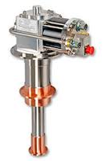
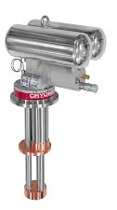
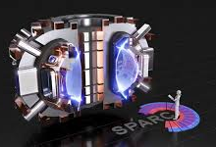


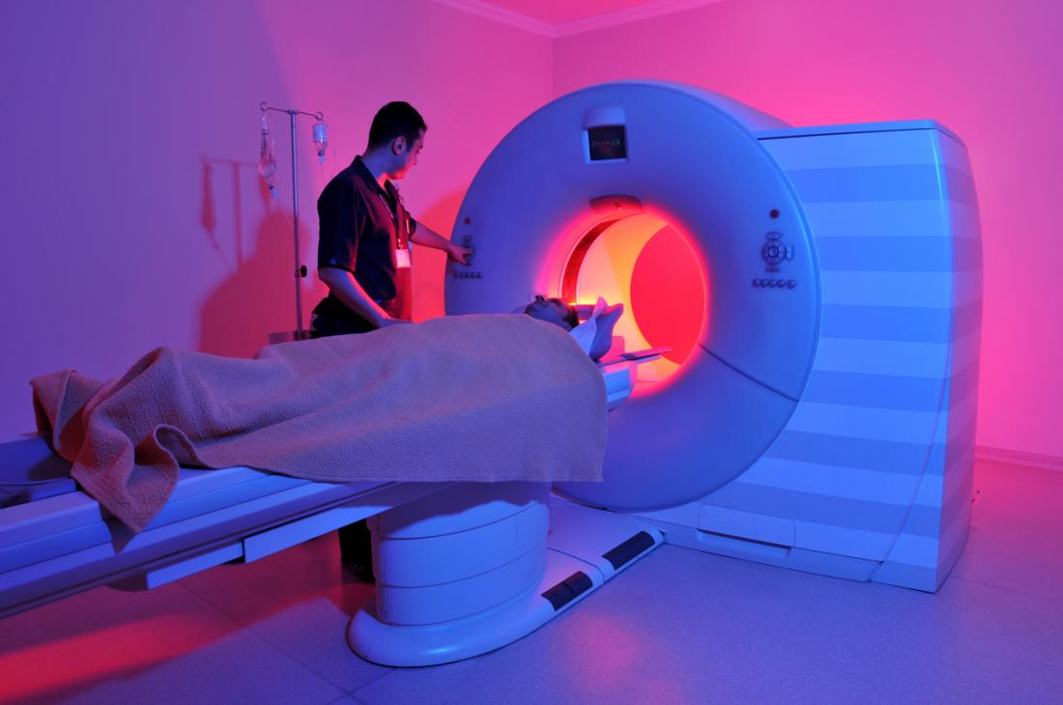
Drivers for Superconducting Apps – Four primary ones!
Green Economy
Trend for
Current & Future Economy
UN Sustainable Development Goals (17 in Total)
LTS with Cryogen Free solutions
LTS for the Future
HTS for the future @ > 4 Kelvin
HTS for the Future
Greener, Healthier, More Prosperous, and Sustainable Future

Slide 7
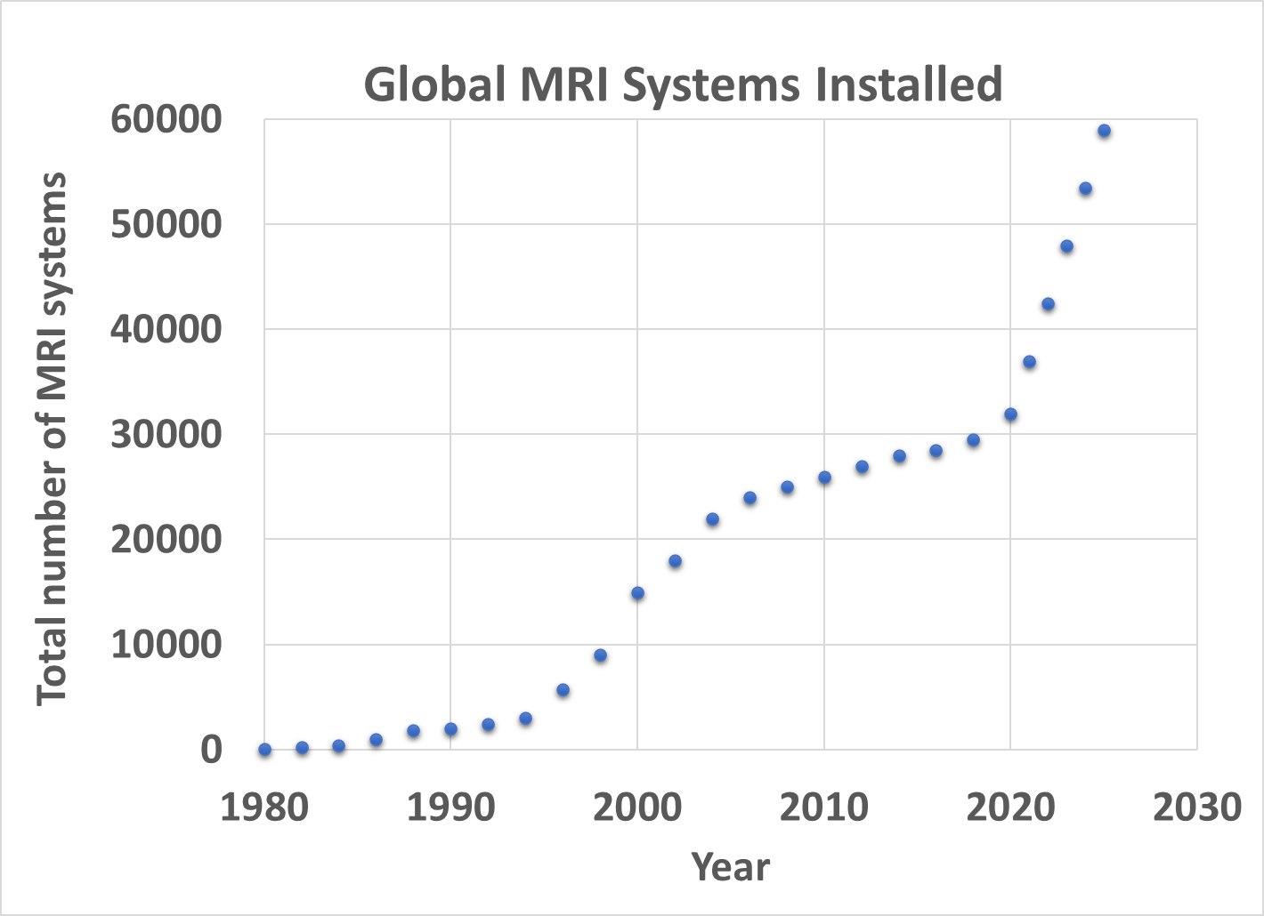
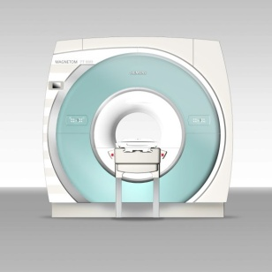
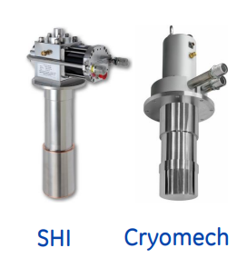
MRI is a large volume production business- Led to new standard in Wire Supply, Cryogenics and Instrumentation
> 60,000 (2024)
~ $ 7-8 B
1st commercial MRI system
Key takeaway:
MRI scale-up enabled:
NbTi wire supply
Cost-effective NbTi wire
Cryogenics management
New cryogen-free enabling technologies
Good example of SC use for commercial products scale-up
1st Cryocooler for MRI system
> 40,000 4 K GM SHI cryocoolers delivered, since 1995

Slide 8
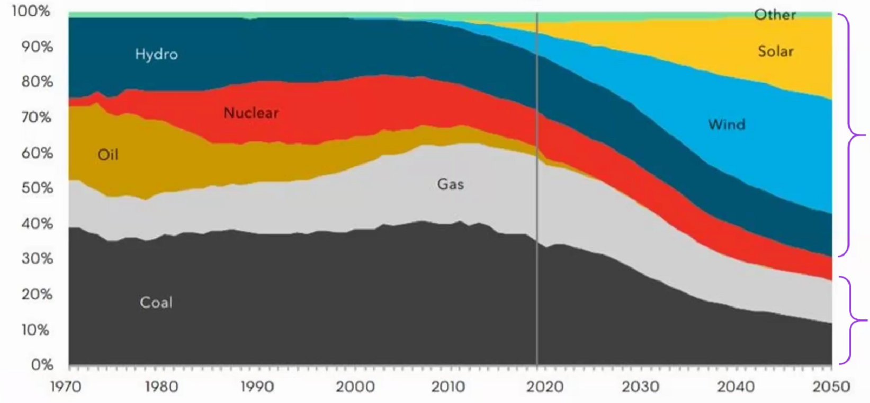
Estimated Global Electricity Generation Mix – A Challenge among many! New Energy Outlook 2020 report by Bloomberg (2020)
Actual generation
Energy Outlook up to 2050
Now -30% of global CO₂ emissions.
Power consumption could ~ triple by 2050.
Renewables
2020: 38%
2030: 53%
2040: 60%
2050: 70%
Fossil (Target for Clean energy like Fusion)
2020: 62%
2030: 47%
2040: 40%
2050: 30%
Key takeaway
Estimated investment in Electricity generation ~ $20 Trillion by 2050
~ 30% generation by Fossil fuels is equivalent to $ 6.6 trillion
The potential addressable market for Fusion is VERY LARGE! (> 50 private companies! ~40% SC)

Slide 9
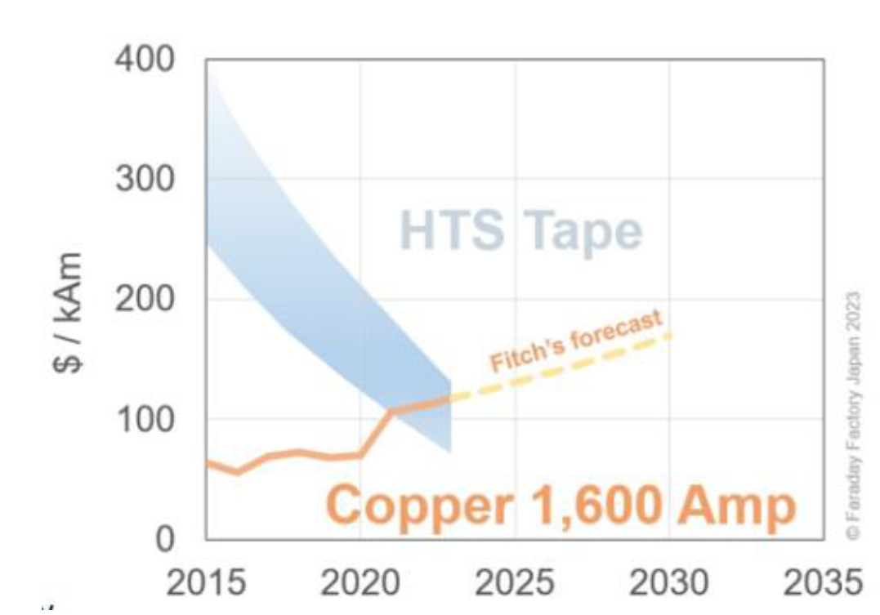
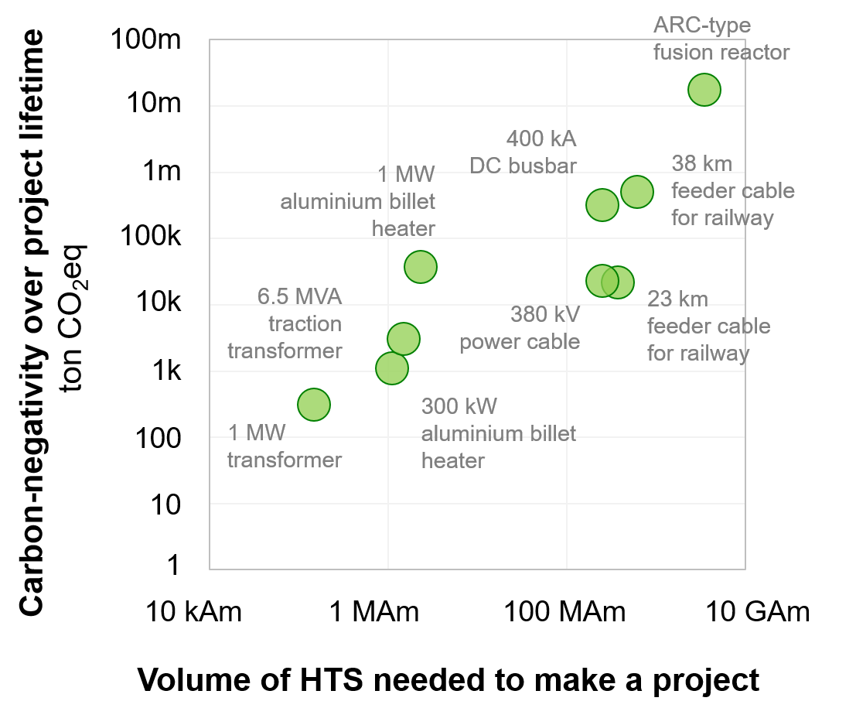

HTS-based technologies are very climate-positive technologies & will be competitive vs. Copper – The Cost Challenge
2-5 MAm
HTS will be competitive vs CU
On Losses
On Cost
Courtesy of Sergey Samoilenkov

Slide 10
Opportunities & Market
1 December 2025
Page 10

Slide 11
Selection of Superconducting applications and potential markets
TAM ~ 50 trillion by 2050
Power Applications
Fusion
Generators, Transformers, SMES, SFCL,
Sc Quantum Computers
Health care
MRI/NMR
$40 B
Mkt by 2050 PSMARKET Res 2024
Cancer Treatment
$20 B
Mkt by 2050 PSMARKET Research 2024
Science Discovery
Transport Aviation
$625.7 B
Mkt by 2035
(~10% Electric)
Maglev Trains
$1.18 tr
Mkt by 2035
~40% electric
$1.5 tr
(TMR 2021)
Compact Nuclear Fusion
$40 tr
Mkt by 2050,
$8 B
V. Reports 2024
Mkt by 2031
$ 50 B
10% SC Q Computing
Mkt by 2035
Bloomberg 2022
Mkt by 2040
Wind power generators

Slide 12
Superconductivity’s impact on sustainability
01/12/2025
Page 12

Slide 13









Strategic Alignment with UN SDGs Superconductivity directly supports several of the UN Sustainable Development Goals (SDGs)
SDG | #3 | #4 | #7 | #9 | #11 | #12 | #13 | #14
Superconductivity Contribution | Medical (MRI/NMR) imaging, magnetic drug delivery, low-energy diagnostics | Hands-on demonstrations (e.g. levitation), STEM engagement | Lossless transmission HTS cables, Fusion power Efficient transmission Renewable integration | Advanced materials, Smart grids, Quantum infrastructure | compact power systems, urban resilience, Low-emission transport, resilient power Maglev transport, | Modular cryostats, Recyclable alloys, Lifecycle design | Reduced CO₂ emissions via electrification and efficiency, Reduced CO₂ via energy savings electrification | Magnetic separation for microplastic cleanup
9 out of 17 need superconductivity
ScGA aims to build the cross-sector partnerships needed to scale these technologies.

Slide 14

Superconductivity in Sustainable Technologies & Impact Efficiency/ Low losses/ Sustainable/Compact/ New innovations
1.
Energy Efficiency and Loss Reduction
Compact, high-capacity grids
Facilitate microgrids and Data centres
2.
Grid Resilience & Renewable Integration
Stabilise grids & microgrids with renewable energy
Decentralised, flexible power systems— New sources
3.
Sustainable Transportation
Improve efficiency in electric transport & aerospace applications.
frictionless, low-emission transport.
4.
Quantum and Digital Infrastructure
Ultra-efficient computing with minimal energy footprint.
Secure, low-power data transmission.
5.
Healthcare & Environmental Monitoring
Precise & compact diagnostics & treatment
Emerging applications include water purification & food quality

Slide 15
Superconductivity Global Alliance (ScGA)
1 December 2025
Page 15

Slide 16

ScGA Ambition, Vision and Investment Strategy For a Greener, Healthier, More Prosperous, & Sustainable future
The Ambition
Sc from the Frontiers end to Mainstream technologies
Core Vision
Make SC economically viable
Foster cross-industry adoption & supply chain by 2035
Investment Strategy
National Initiatives and Government Incentives
Public funding, Venture capital & strategic investors
Strategic Vision
Sustainability and Net Zero
Societal impact

Slide 17
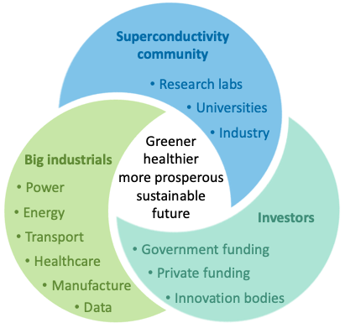
ScGA Initiative
for the Future
SMART Electronics and Computing Markets
SMART Industry, Energy, Power, and Transport Markets
SMART Healthcare Markets
SMART Science Markets
Established
Planning
Superconductivity
In progress
Target 1
Target 2
Target 3
Target 4
Target 5
Public and private
Consortia/
Partnerships
SC Global Summit
National Strategy for SC
National initiative for grand challenges
~ > 1 B Euro
Notes:
To summarise

Slide 18
ScGA Objectives
Catalyze
Catalyze Innovation: Accelerate the transition of superconducting technologies from research labs into real-world applications across industries.
Build
Public-Private Partnerships: Build collaborations between governments, industry, universities, and research labs to fund and deliver superconducting solutions.
Develop
Strategic Roadmaps: Develop global roadmaps and white papers identifying grand challenges where superconductivity can make transformative impact.
Support
Commercialisation: Support the creation of consortia and initiatives to fast-track superconducting products into markets such as energy grids, healthcare imaging, quantum computing, and transportation.

Slide 19
























































































ScGA initiative Members (> 250) (Research and Industry)
Industry, University & RI
ISIS-31

Slide 20
Grand Challenges & Strategic Roadmap
ScGA current outcome
1 December 2025
Page 20

Slide 21
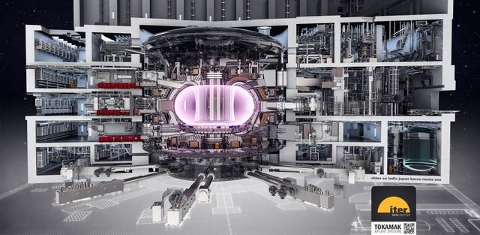
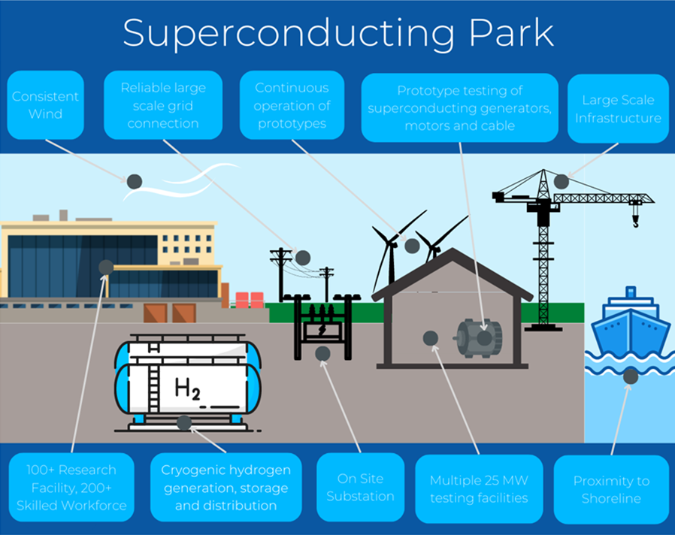
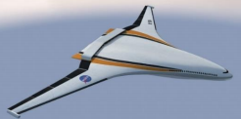

ScGA - Grand challenges – (30 in total (2025))
Fusion (5)
Robust manufacturing strategy
Energy & Power (5)
Regional power/energy centers
Transport (5)
All SC motor
Training and skills
standards - SC power/energy technologies
Showcase power technologies -SC substation
All SC generators
DC SC cable
AC SC cable
SC Power-electronics
Regional Superconducting centers
Public and private investments and partnerships
IP management
Designs of a 25 MW SC wind generator
Tests for SC Cables
Healthcare (5)
MRI
1. Remote MRI
2. NMR for Drug & Personalized Medicine
3. UHF MRI
Particle Therapy
1. Radiotherapy - Accelerators
2. Radiotherapy - Beamline Gantry Magnets
SC Electronics & QIP (4)
Challenges in Fabrication Processes:
1. SC materials for the 300 mm process using NbN or NbTiN..
Challenges in Enabling Technologies or Capabilities:
1. Develop electronic design tools
2. Extend cryogenic performance to
3. Shared test facilities & Training
Science Discovery (9)
High-Energy Physics
4. 40 T SC Magnet for Muons
Nuclear Physics
1. 10 T Axion Detector
2. 30 T Axion Detectors
HMF Science
1. 40 T SC Magnet
2. 60 T Hy-Magnet
3. HF Cryogen-Free Magnets
2. SRF Cavities
3. 20 T Large Bore Solenoid for Muons:
1. 20 T Dipole Magnets
Courtesy of Google
Courtesy of CERN
Courtesy of Oxford Instruments

Slide 22

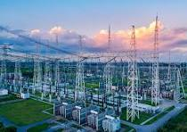

ScGA - Superconductivity Strategic Roadmap
2025–2030
- R&D,
- Pilots,
- Early commercial adopters
2030–2035
- Commercial deployment begins,
- Infrastructure scaling
2035–2045
- Mass adoption
- Global integration
1 December 2025
Page 22

Slide 23
Summary
1 December 2025
Page 23

Slide 24
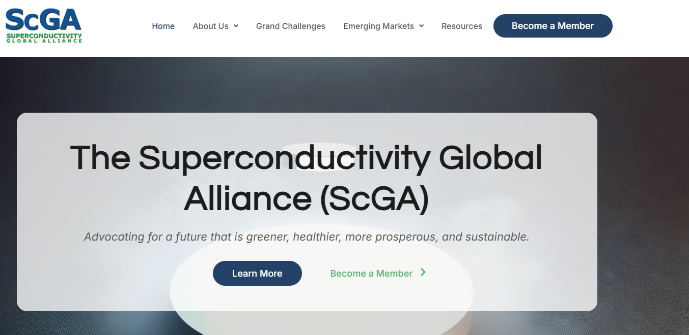
Summary
ScGA Vision:
Greener, Healthier, More Prosperous, and Sustainable Future
Superconductivity critical for a sustainable future
9 out of 17 UN SDGs will be impacted by superconductivity
Market Potential:
SC market could reach >$100 billion by 2035 (from ~$10 B 2025)
Grand Challenges:
30 grand challenges across various sectors, 10-year strategic roadmap
Superconductivity needs accelerated investment
Private & public partnerships & National & Global Initiatives.
ScGA Website –SCGA.UK

Slide 25







Concluding remarks
6 WPs have been finalized and will be released soon!
We are moving into the Engagement stage with the stakeholders
Join the ScGA initiative
As we move into an era where sustainability is paramount, superconductivity offers a chance to reshape our future.
We invite researchers, innovators, policymakers, funders, and passionate individuals to join ScGA on this exciting journey towards a greener, healthier, more prosperous, and sustainable world.
For further details, please get in touch with ziad.melhem@oxqsol.com or any member of the ScGA
Acknowledgments for contributions and sponsorship with thanks to
ScGA IOC, Editorial Board, WG Conveners, and Members > 150
IOP, BCC, IEEE-CSC, ESAS, University of Oxford, CSSJ, AIST, ISIS-31, imec, BRIDG, MagCorp,
and the Faraday Japan Factory for sponsoring various activities
ziad.melhem@oxqsol.com

