Slide 1
AC Heating of Impregnated Coil Samples in He II Environment
T. Koettig, P. Borges de Sousa, K. Puthran (CERN TE/CRG-CL)
CERN, TE/CRG-CL

Slide 2
Contents
Introduction to the measurement idea
Experimental campaign – small-scale coil sample testing
  Sample preparation
  Set-up description and measurement procedure
  Comparison external DC heating vs. AC inductive heating
  Frequency dependency
Summary

Slide 3
Introduction
He II Heat Transfer experimental set-up has been established at the Central Cryogenic Laboratory at CERN to qualify the thermal performance of samples of superconducting magnet coils
Adapted to test Nb₃Sn impregnated coil samples
Step function heating response shows the thermal performance of the coil cooling

Slide 4
Contents
Introduction
Experimental campaign – small-scale coil sample testing
  Sample preparation
  Set-up description and measurement procedure
  Typical results and their interpretation
  Key takeaways (I)
Numerical assessment – application to full-scale cold magnets and cold masses
  Coil geometry
  Numerical approach, boundary conditions
  Results for HL-LHC inner triplet quadrupoles for nominal luminosity
  Key takeaways (II)
Summary

Slide 5
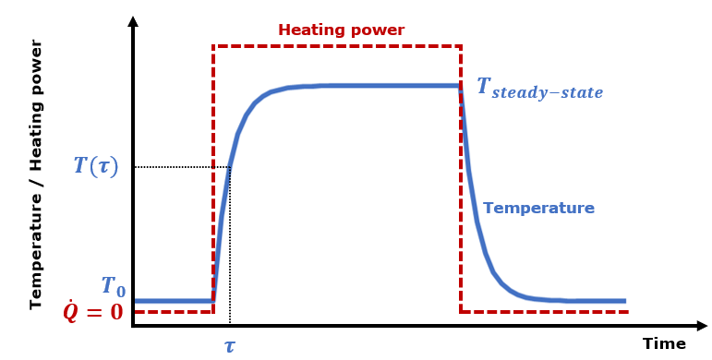
Experimental set-up & measurement procedure
Typical measurement run:
Heat load sweep from 0 to ~ 1000 W/m²
Sweeps done for bath temperatures of 1.8 K, 1.9 K, 2.0 K and 2.1 K
From each measurement point, a steady-state temperature and time constant (with associated temperature) are extracted for each sensor
Typical measurement for each heat input
Experimental set-up
Experiment allows for extraction of:
Steady-state temperature rise as function of applied heat load
Temperature response as function of time
Global and interlayer heat exchange coefficients*
Solid material properties, Kapitza resistance
Qualitative and quantitative* information about He presence in the sample as well as its location within the coil

Slide 6
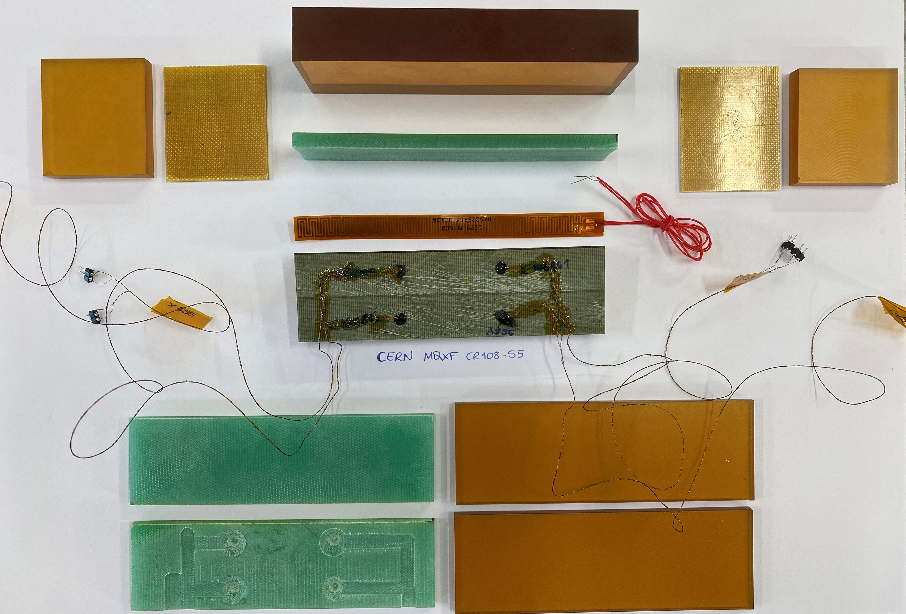
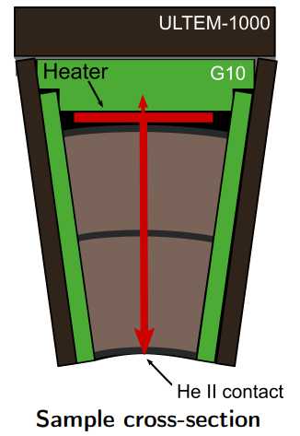
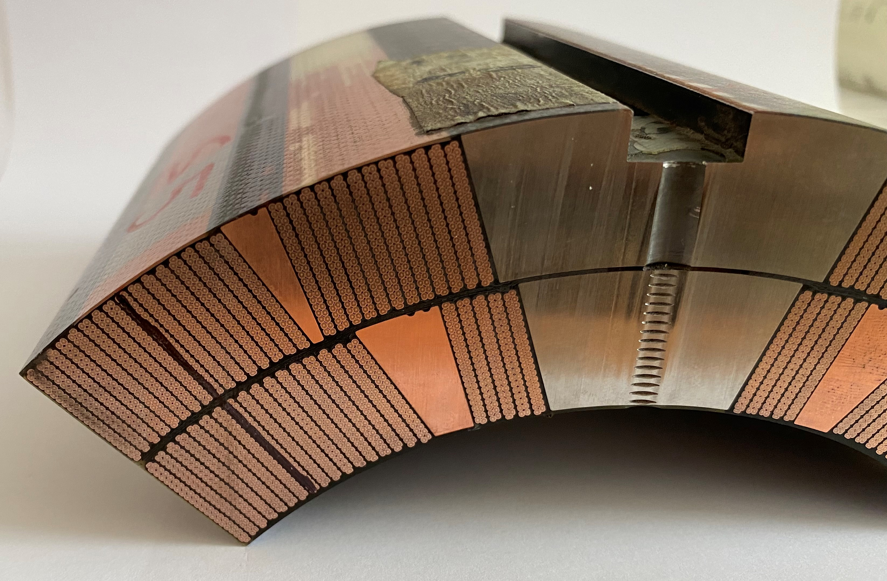
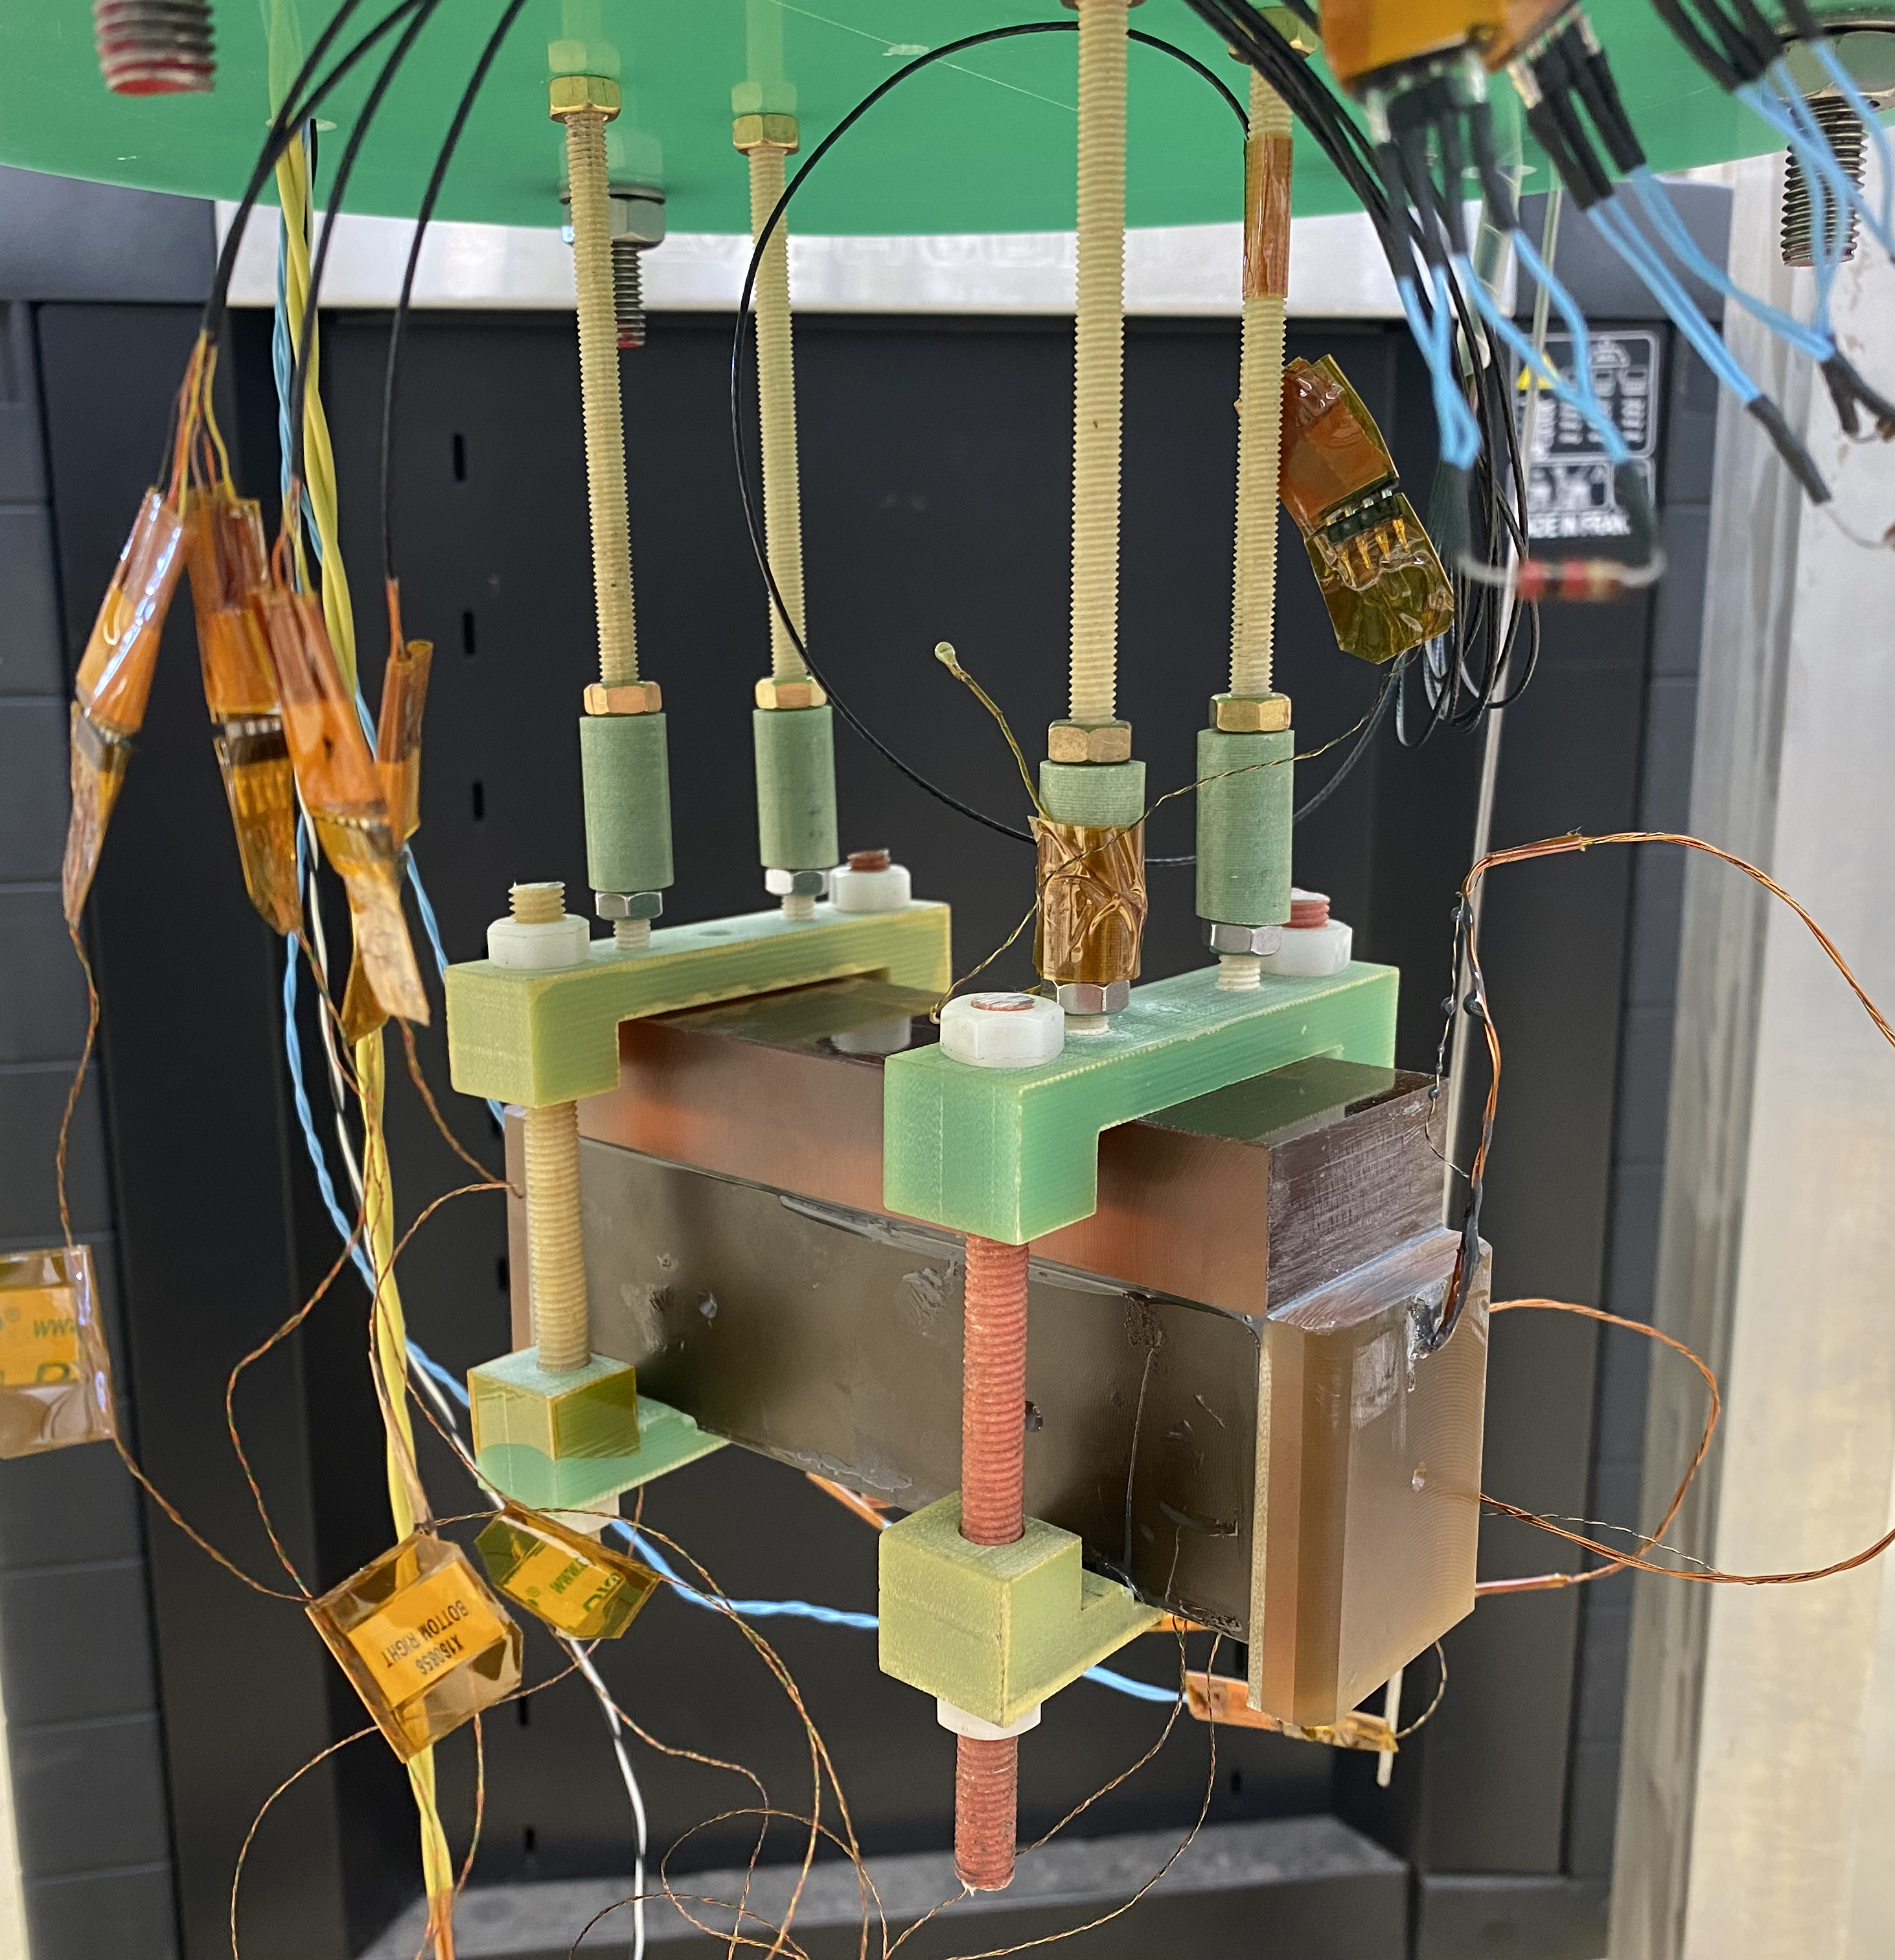
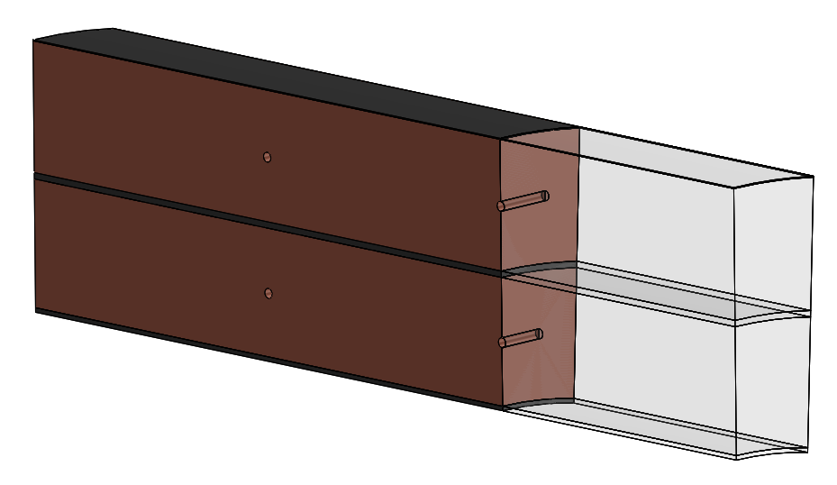
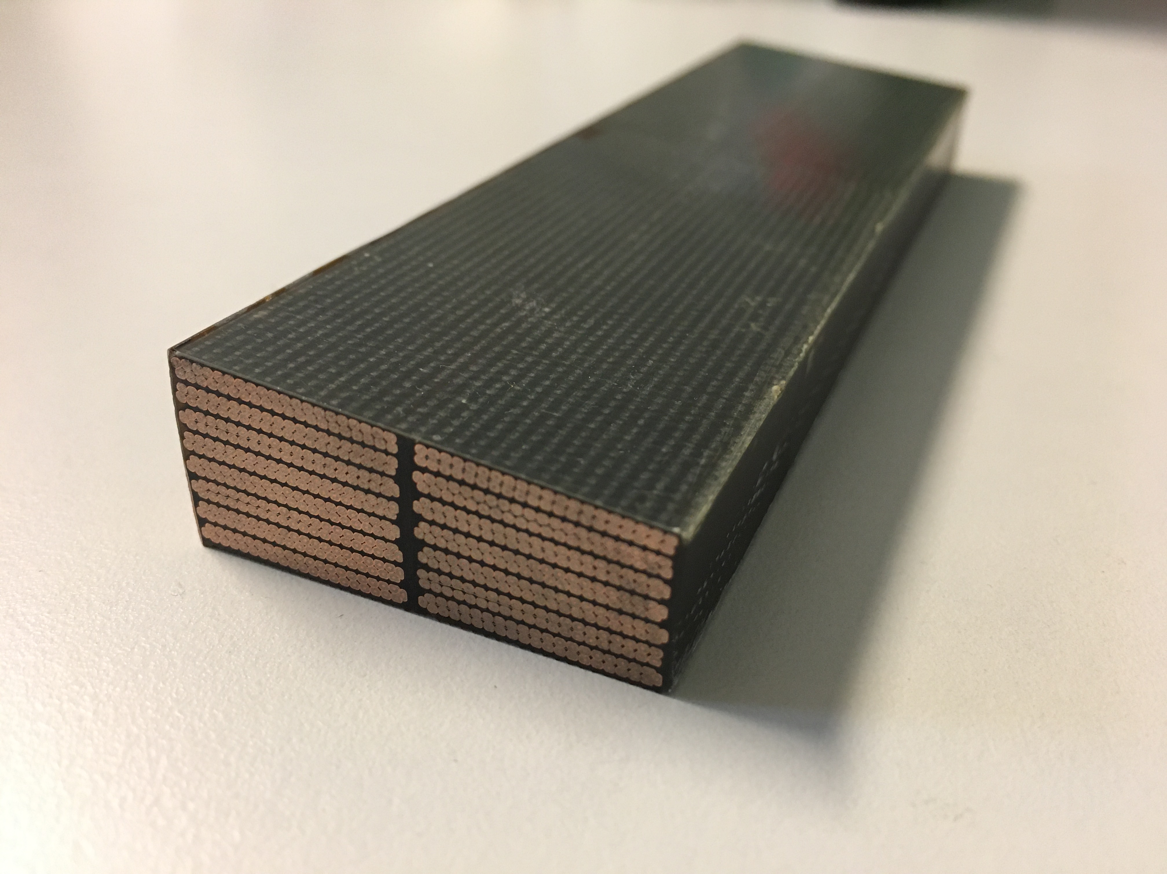
Sample preparation
instrumented sample is encased in 2 layers of insulation on all sides (except for inner surface, He contact)
Sample cut from larger
MQXF/D11T section
(8 cables in outer layer,
7 cables in inner layer)
Polyimide electric heater
bonded to the outer insulation
Sample is mounted on test set-up and ready for measurements in saturated He II
Outer layer
Inner layer
2 temperature sensors per layer (45 mm apart), each probing centre of the cut sample cross-section
* Maximum length allowed by setup ~140 mm, longer than twist pitch

Slide 7
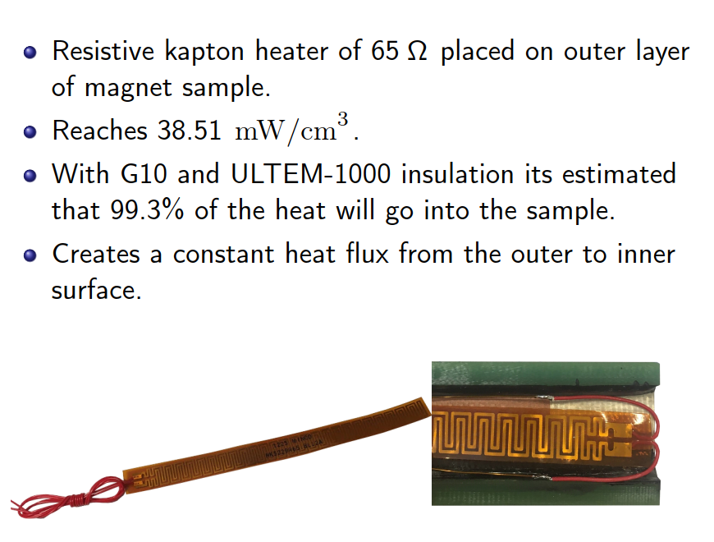
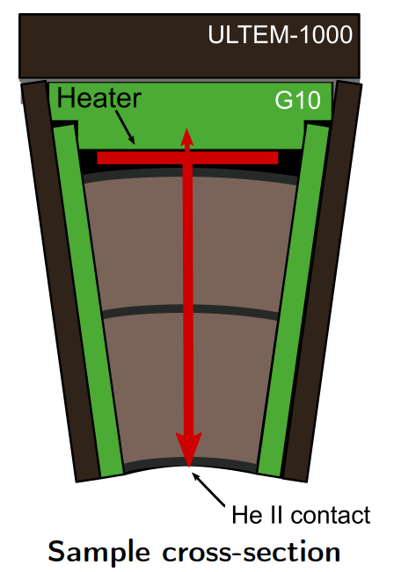
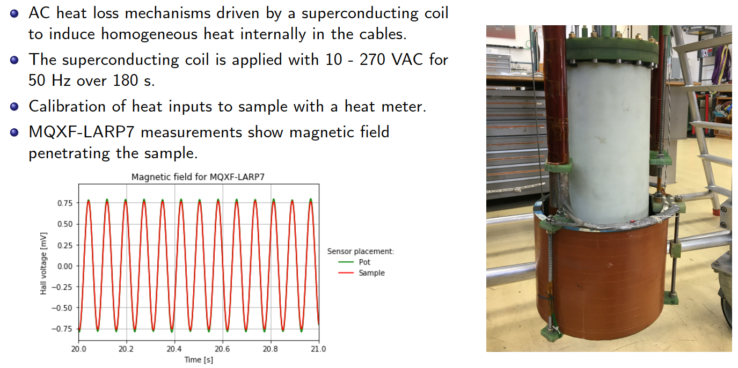
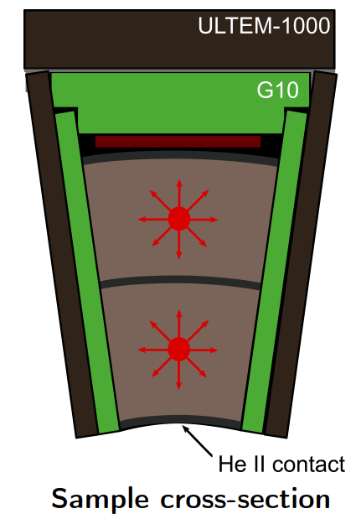
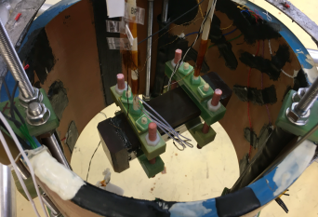
Heating options
Resistive heating on outer layer
AC magnetic field heating of the coil
Calorimeter insert
External
SC coil
Two Hall sensors are placed:
  One inside the center of the sample
  One outside as reference

Slide 8
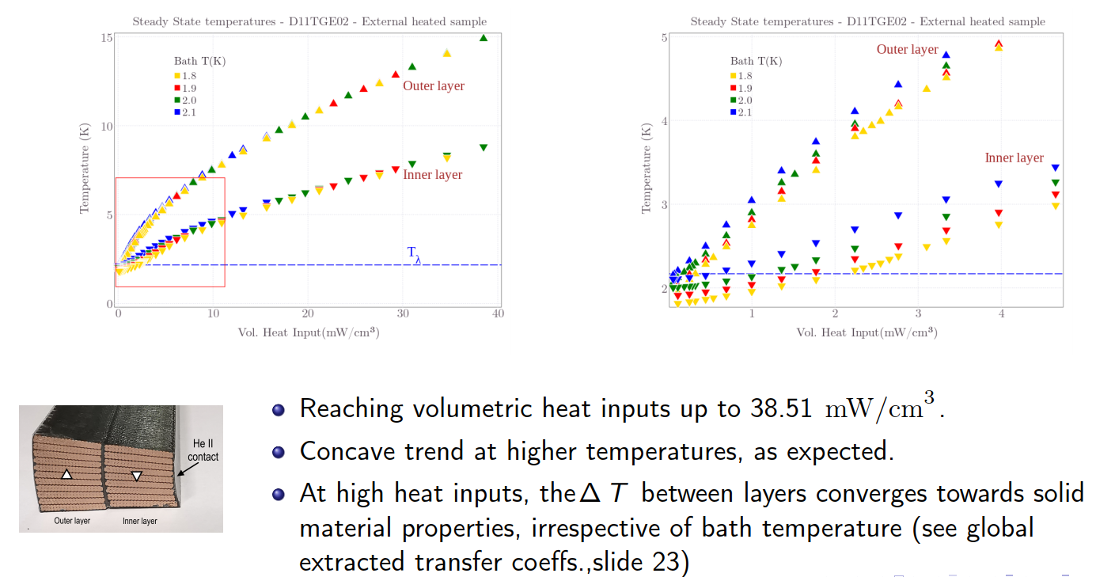
Typical external heating results I

Slide 9
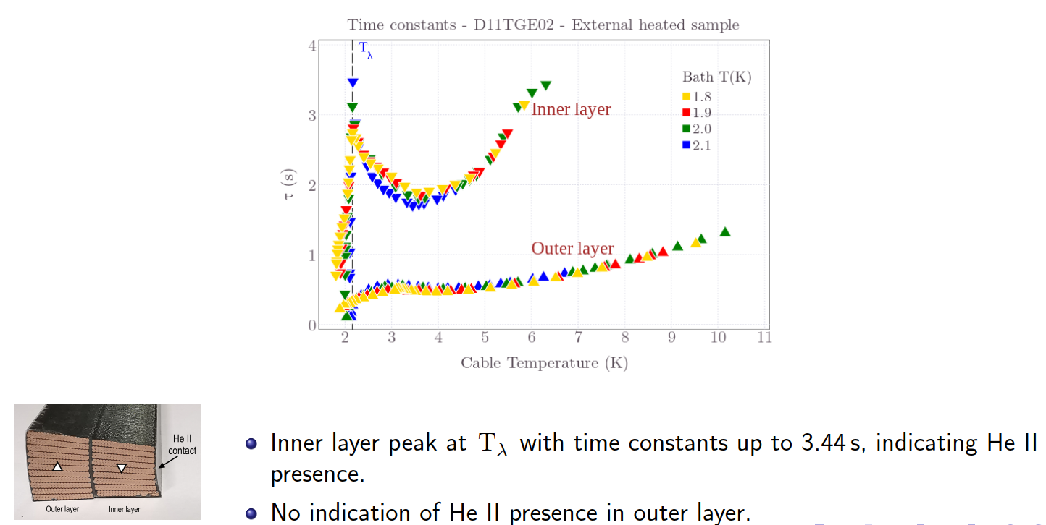
Typical external heating results II

Slide 10
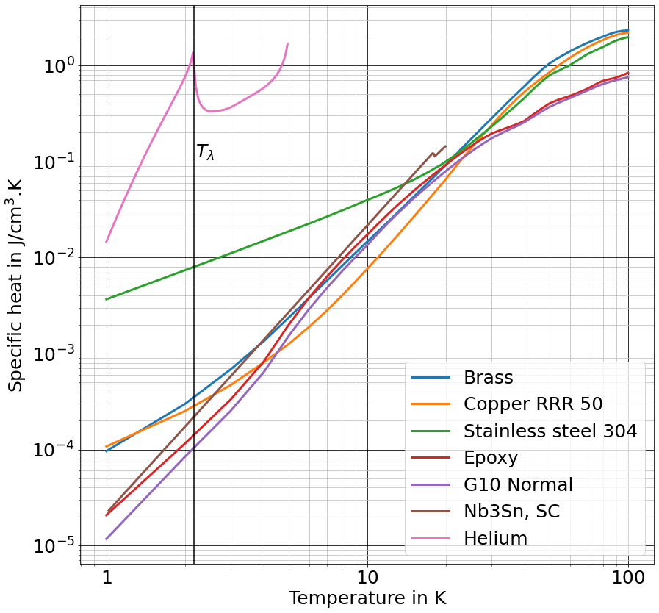
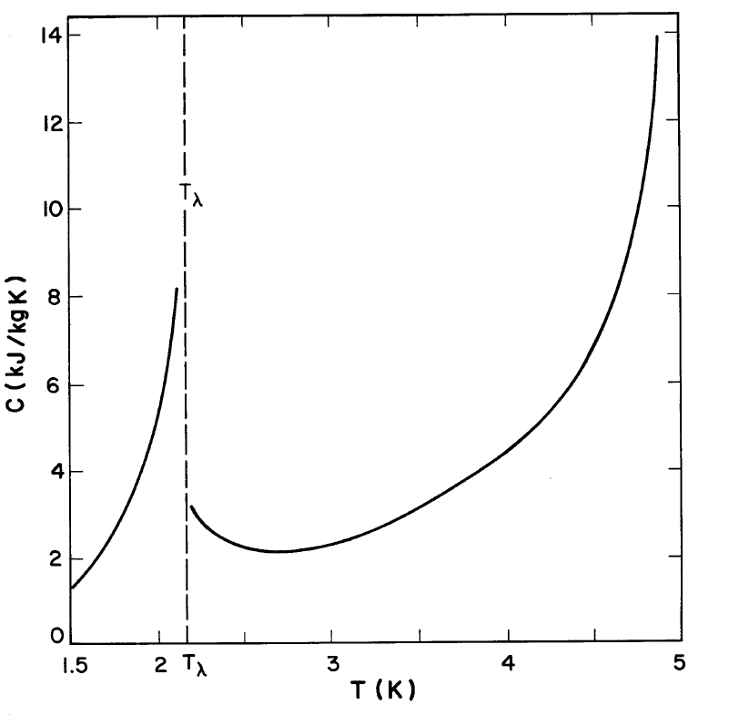
Interpretation of transient results
Example: D11T GE-02
$c_{p}$is vanishingly small at $T≈T_{λ}$ for most solid materials, but He II has an unmistakable peak at its transition from He I to He II
Specific heat of (some) constituent materials of coil sample
Time constant of sample defined as:
$i$ refers to different contributions to the
time constant:
  Materials that make up the coil sample
  (Cu, Nb₃Sn,epoxy, glass fibre…)
  Additional insulation, glue, He that has penetrated/permeated the sample…
$$τ=\sum_{i=0}^{n}{\frac{ρ_{i}{c_{p}}_{i}V_{i}}{hA_{s}}}$$
specific heat of
saturated He around $T_{λ}$
Source: Sciver, S.W. (2012), Helium cryogenics: Second edition
Material data from: HePak, Cryocomp, MATPRO

Slide 11
AC inductive heating

Slide 12
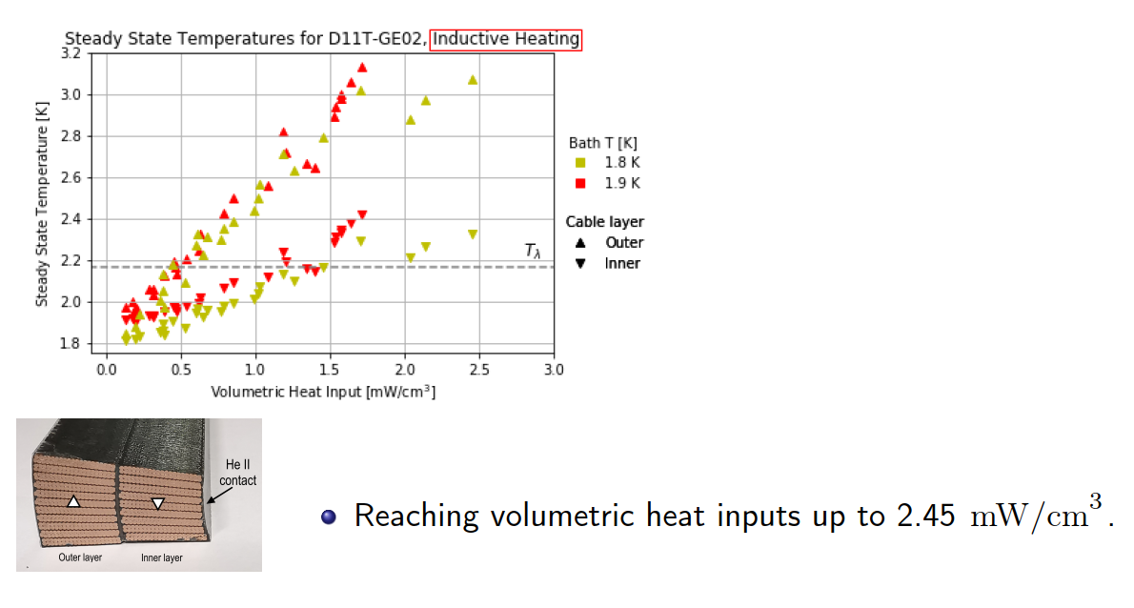
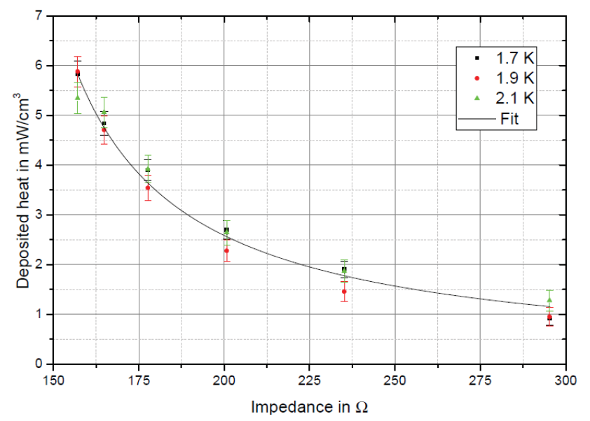
AC inductive heating results 50 Hz – steady state
External resistor bank allows for variation of deposited heat load
Reaching volumetric heat inputs up to 2.45 mW/cm³

Slide 13
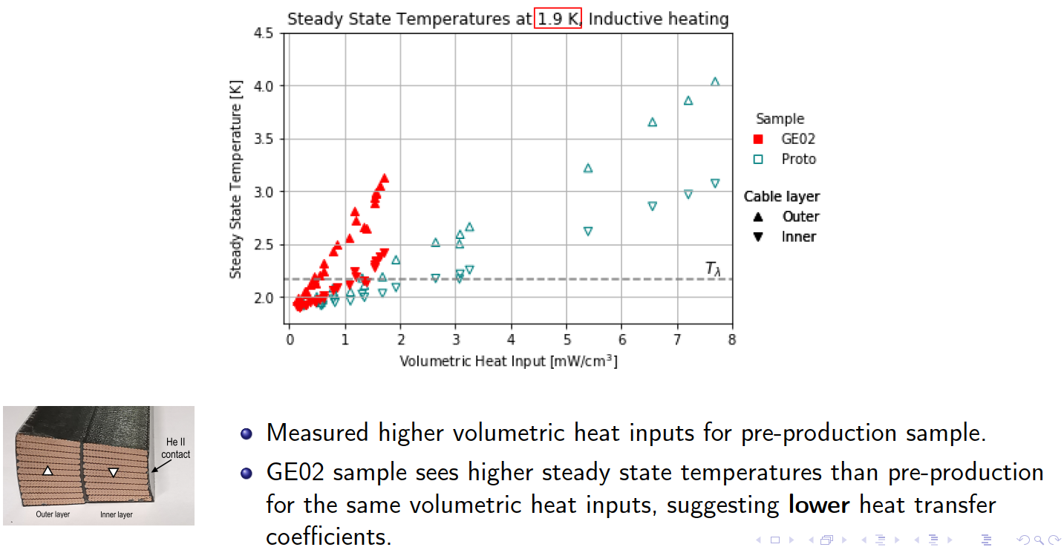
AC inductive heating results 50 Hz – steady state

Slide 14
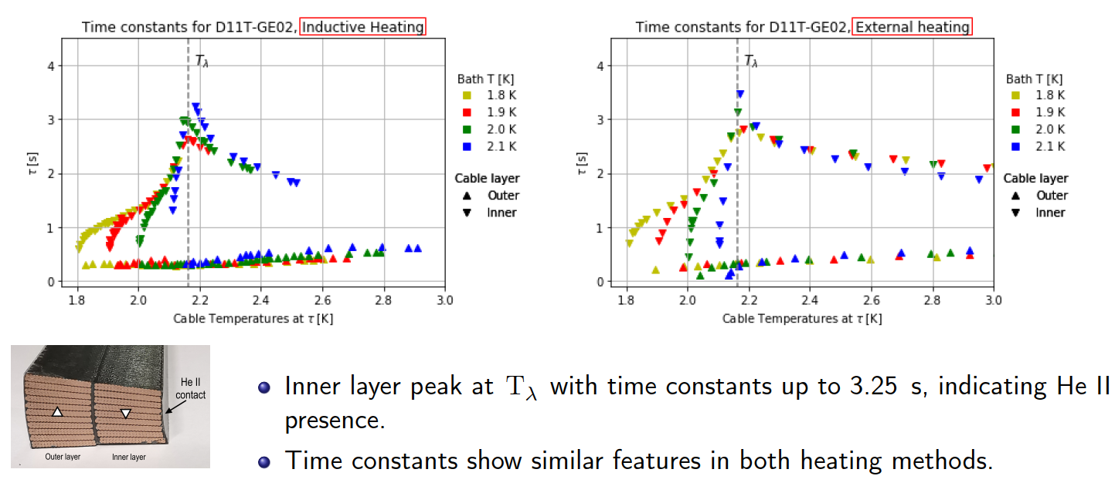
AC inductive heating results 50 Hz – time constant

Slide 15
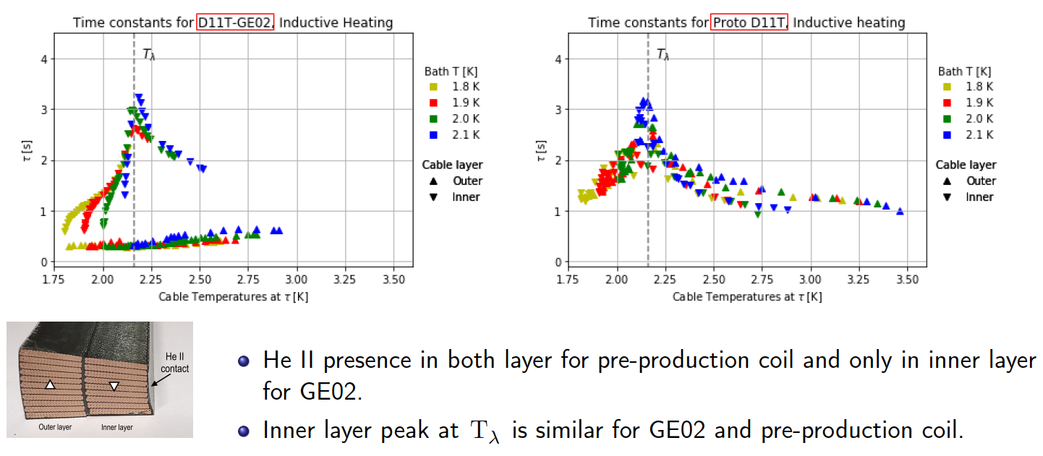
AC inductive heating results 50 Hz – time constant

Slide 16
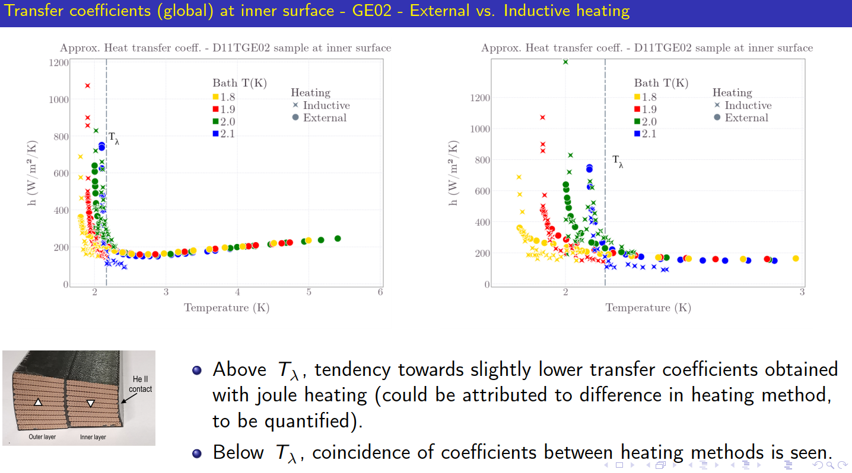
AC inductive heating results 50 Hz – time constant

Slide 17
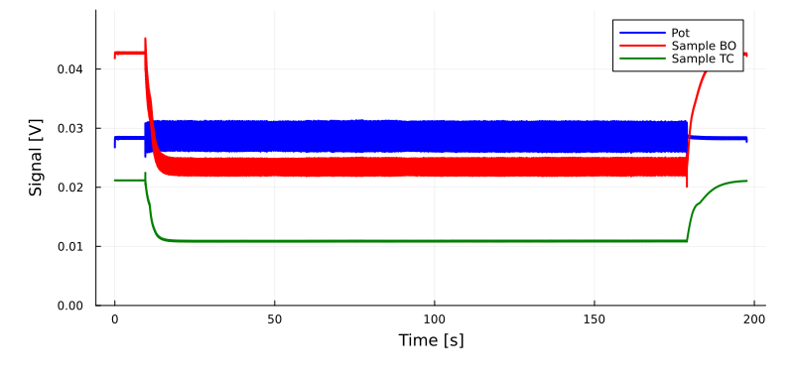
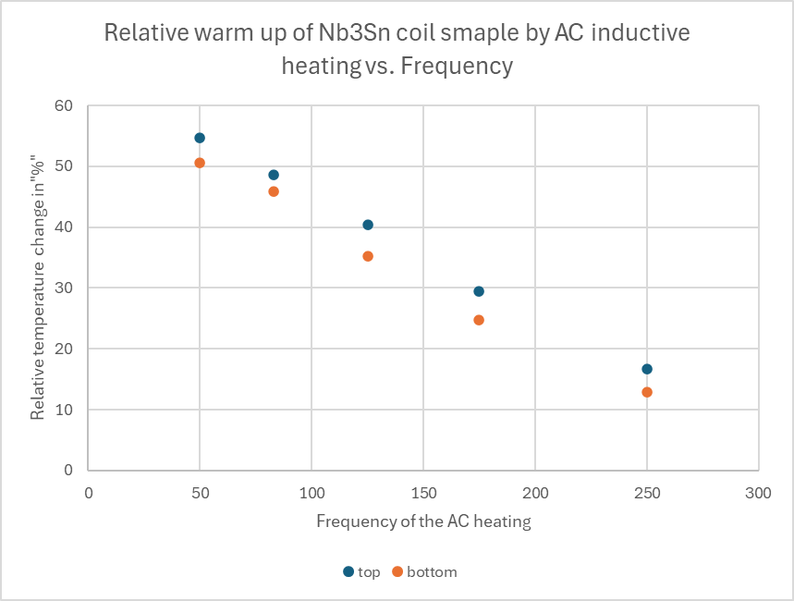
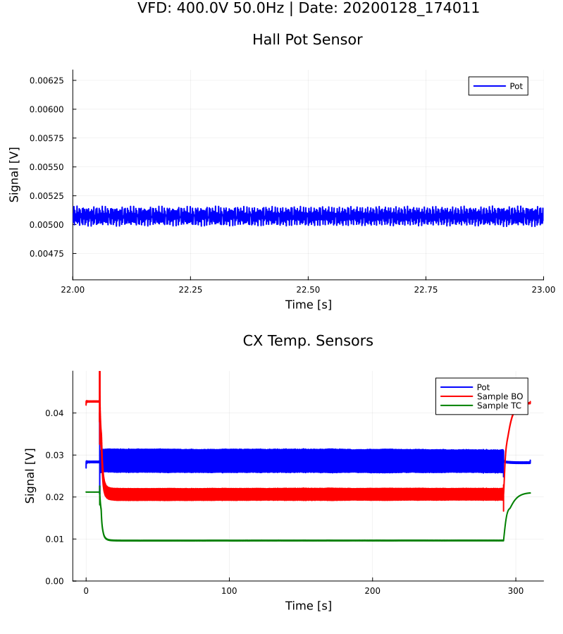
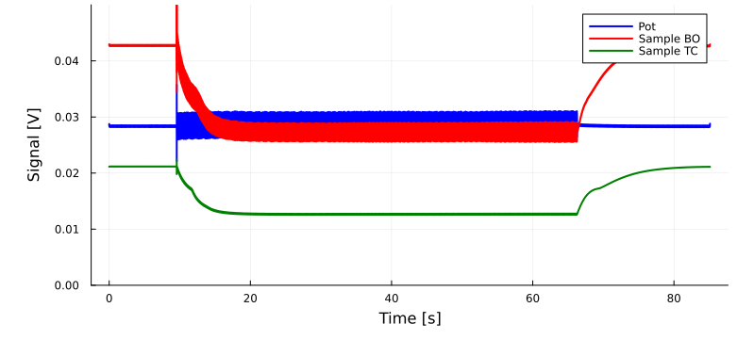
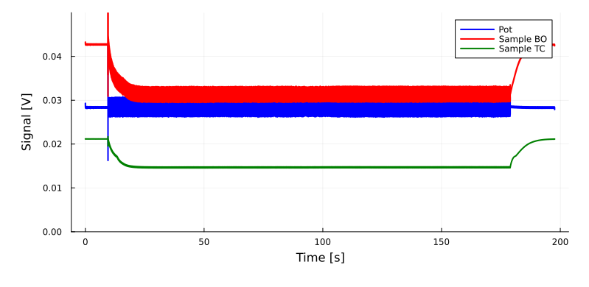
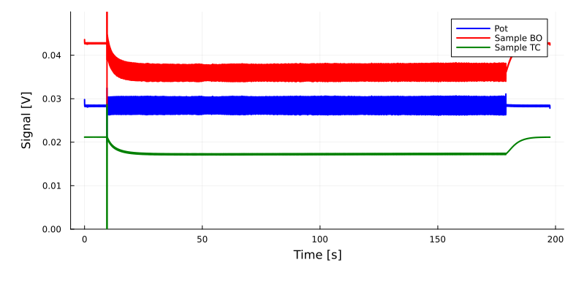
AC inductive heating results frequency
83 Hz
125 Hz
50 Hz
175 Hz
Voltage drops of the Cernox sensors, drop means warming up from He II 1.9 K bath temperature
250 Hz

Slide 18
Summary
Experimental assessment of small-scale magnet coil samples:
    Enables the study the heat transfer mechanisms of He II-cooled impregnated Nb₃Sn coil samples
    Enables qualitative information about presence of He in the structure, which is useful as a diagnostics tool for impregnation quality and aging mechanisms.
    Enables extraction of measured material property data, especially of composite with no reliableor highly variable literature data available
    In view of the novel Quench protection schemes:
      AC heating demonstrated the amount of heating that can be generated
      50 Hz inductive heating was extensively tested
      Other frequencies showed …
      Consider presence of He in the impregnation! May vary your Quench protection reaction?

Slide 19
Thank you for your attention!

Slide 20
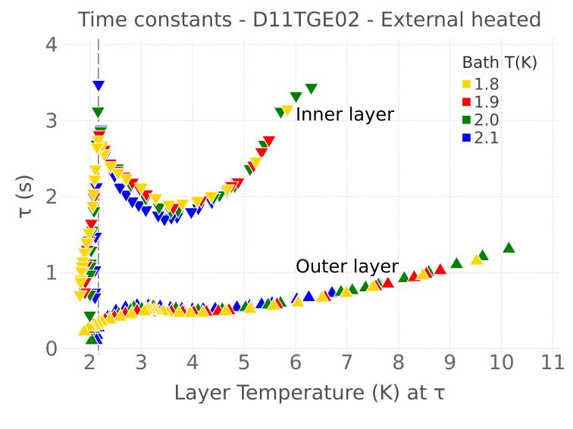
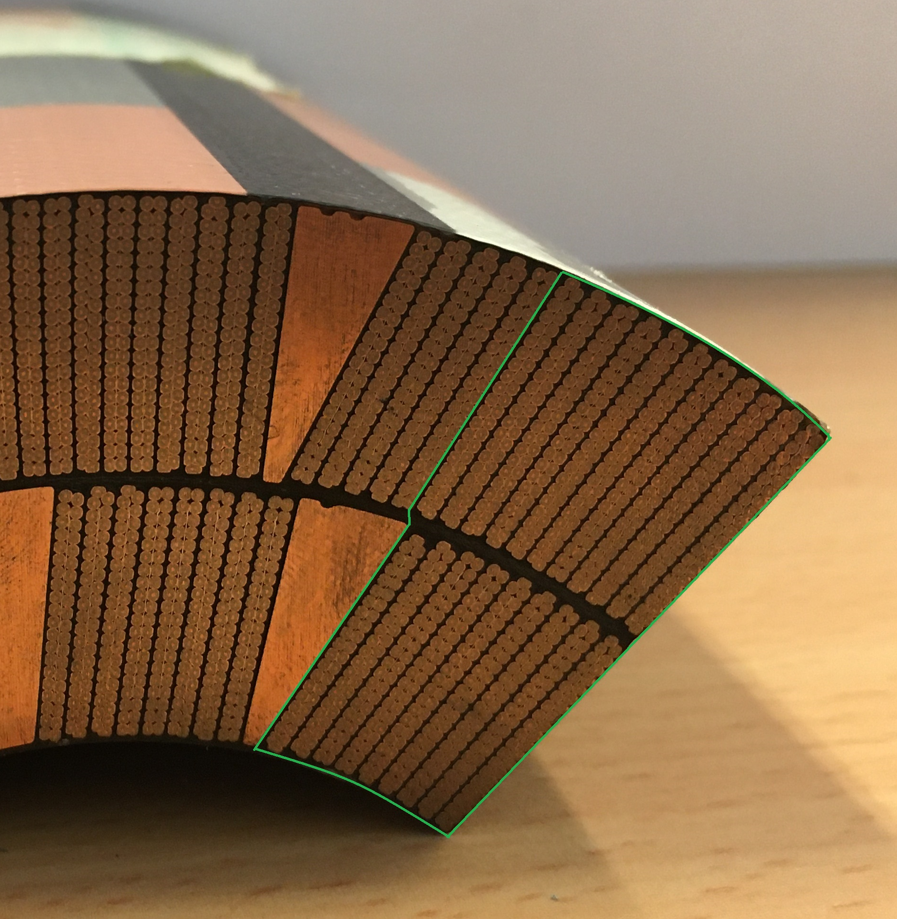
Interpretation of transient results
Example: D11T GE-02
Time constants as function of layer T
Time constant of sample defined as:
$i$ refers to different contributions to the
time constant:
  Materials that make up the coil sample
  (Cu, Nb₃Sn,epoxy, glass fibre…)
$$τ=\sum_{i=0}^{n}{\frac{ρ_{i}{c_{p}}_{i}V_{i}}{hA_{s}}}$$
Courtesy Kirtana Puthran
  $A_{S}$, $ρ_{i}, V_{i}$ do not change (appreciably) with temperature
  $h$ does not suffer abrupt changes
$c_{p}$is vanishingly small at $T≈T_{λ}$ for most solid materials.
What can produce a peak in the sample’s heat capacity (seen in its measured time constant) at or around $T_{λ}?$
11T-GE02
Outer layer
D11T GE-02 inner layer shows unusual behaviour
Inner layer
He II contact

Slide 21
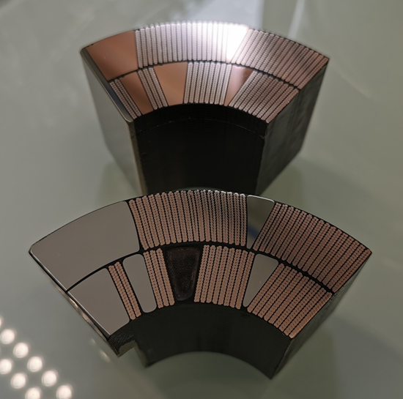

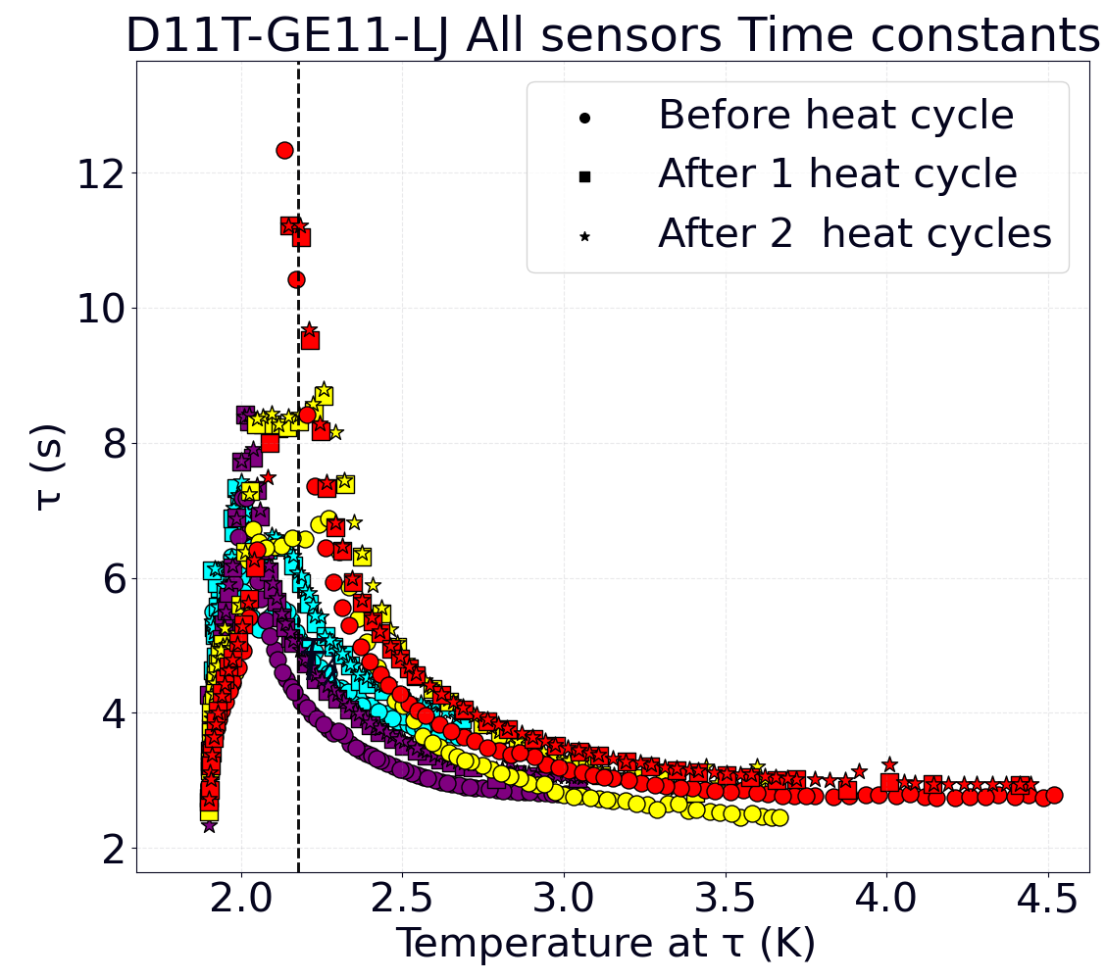
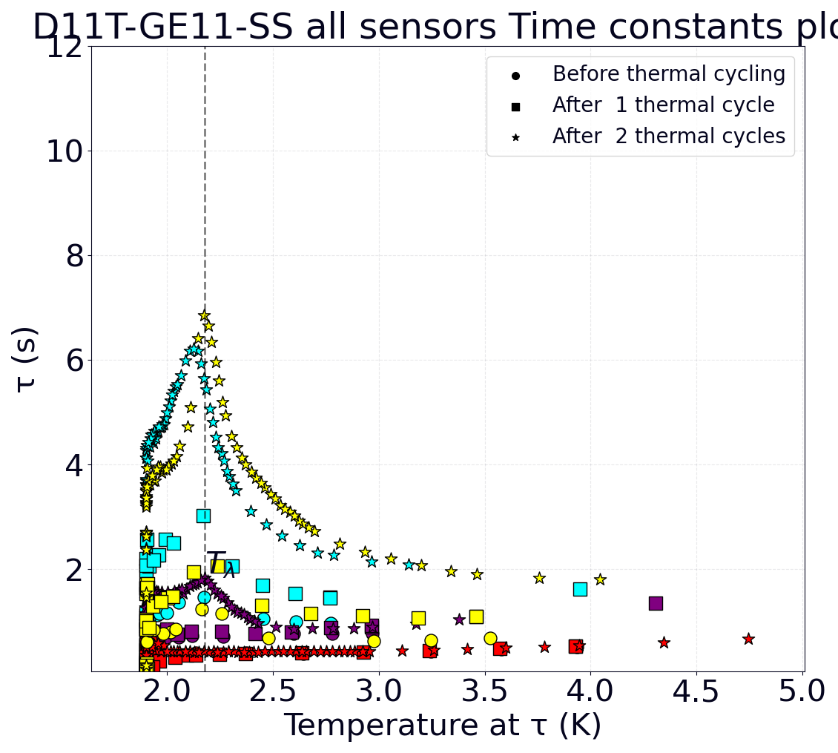
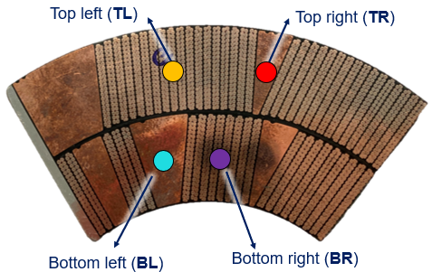
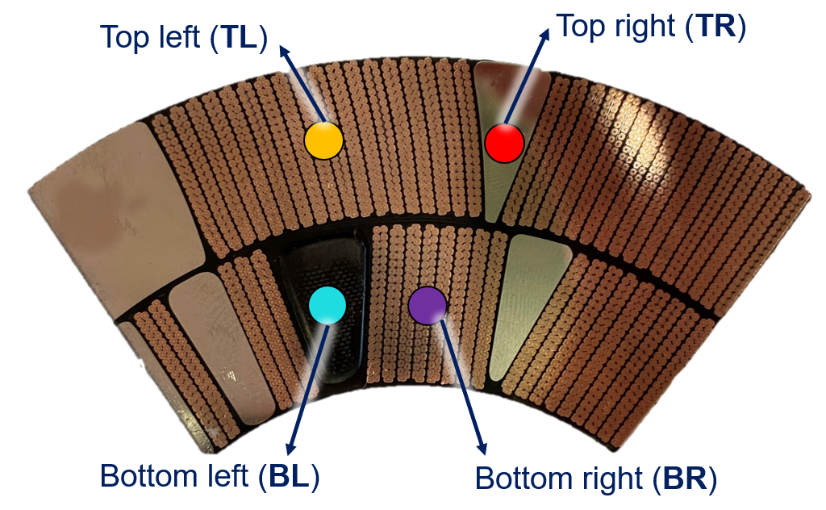
11T virgin coil GE11: 1.9 K - 25 K tests
Straight section
D11T-GE11-SS
Both samples from connection side of 11T coil GE11 (virgin coil), one from the straight section and one from the layer jump zone
Moderate temperature excursions (from 1.9 K to 25 K): scans pre-cycle, after 35, after 70 cycles.
Peaks at or near T_{λ} indicate presence of He in the coil
Layer jump
D11T-GE11-LJ
D11T-GE11-SS (straight section)
D11T-GE11-LJ (layer jump)
Results show a clear He signature that is present even before cycling and that evolves dramatically with increased number of (modest) temperature excursions.
In more inhomogeneous parts of the coil, He presence is pronounced from the start but does not noticeably increase further.
After cooldown
After 35 cycles
After 70 cycles
After cooldown
After 35 cycles
After 70 cycles

Slide 22
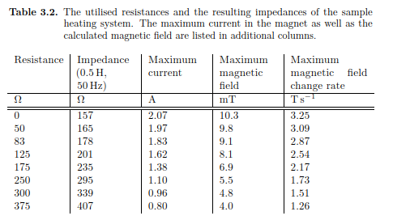
External coil data

