Slide 2
AFT and Equipment Asset Management
Goran Perinic, Peter Jurcso

Slide 3
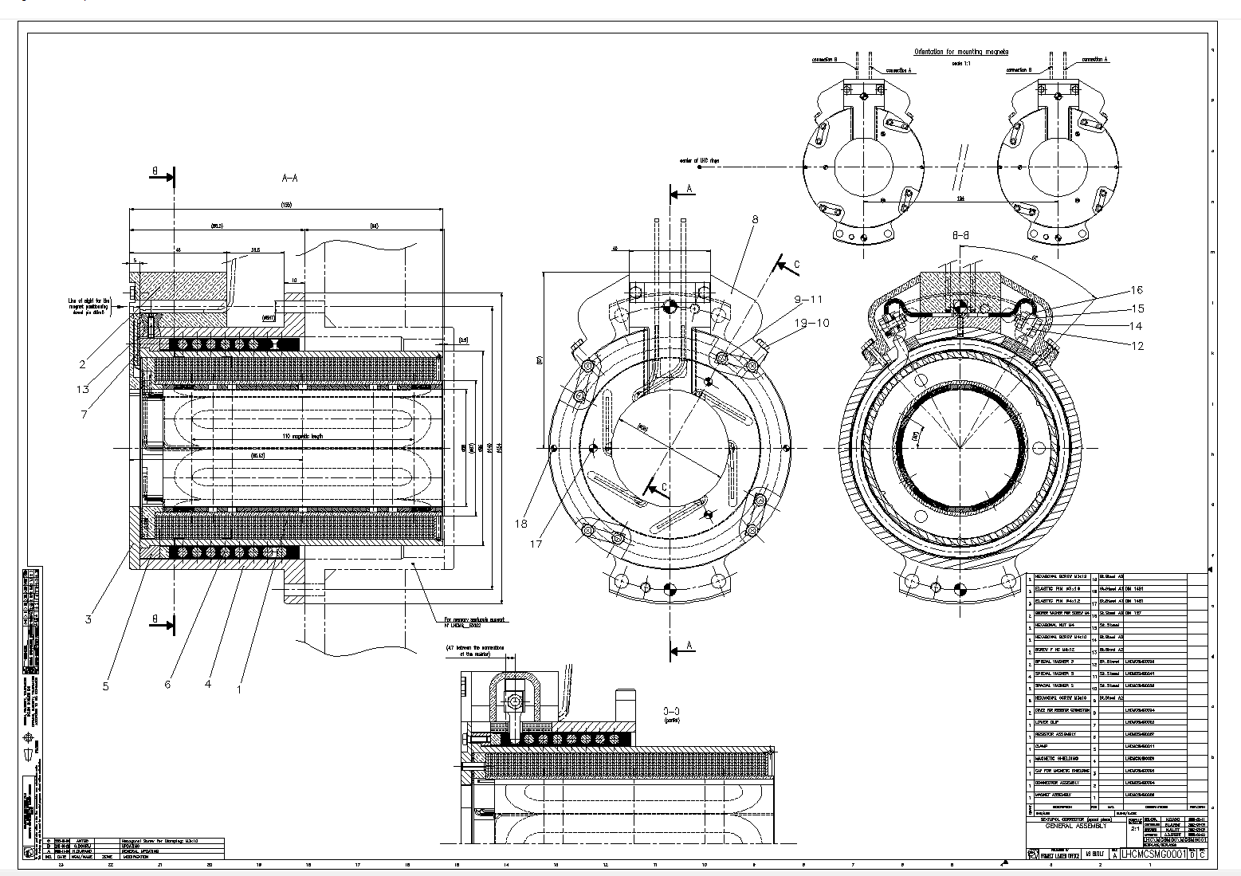
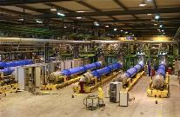
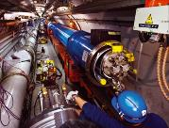
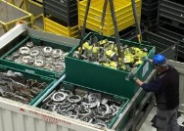
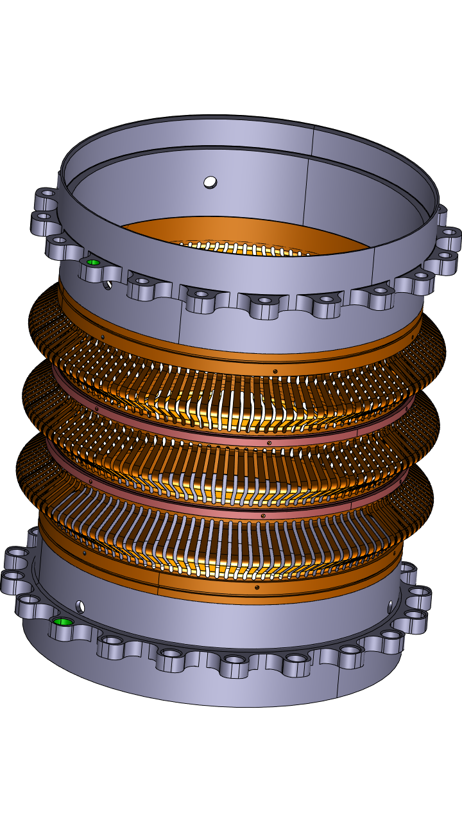
Managing the Digital Thread of Engineering Data
CERN’s installations have very long lifecycles and important information is generated in each phase.
It is essential to capture this information and manage the links between data originating from the different lifecycle phases: The Digital Thread of engineering data.
The value of aggregated and properly linked data exceeds by far the value of dispersed data.
50+ years
Specification & Requirements
Design
Manufacturing
Installation & Commissioning
Operation & Maintenance
Dismantling
& Waste management

Slide 4
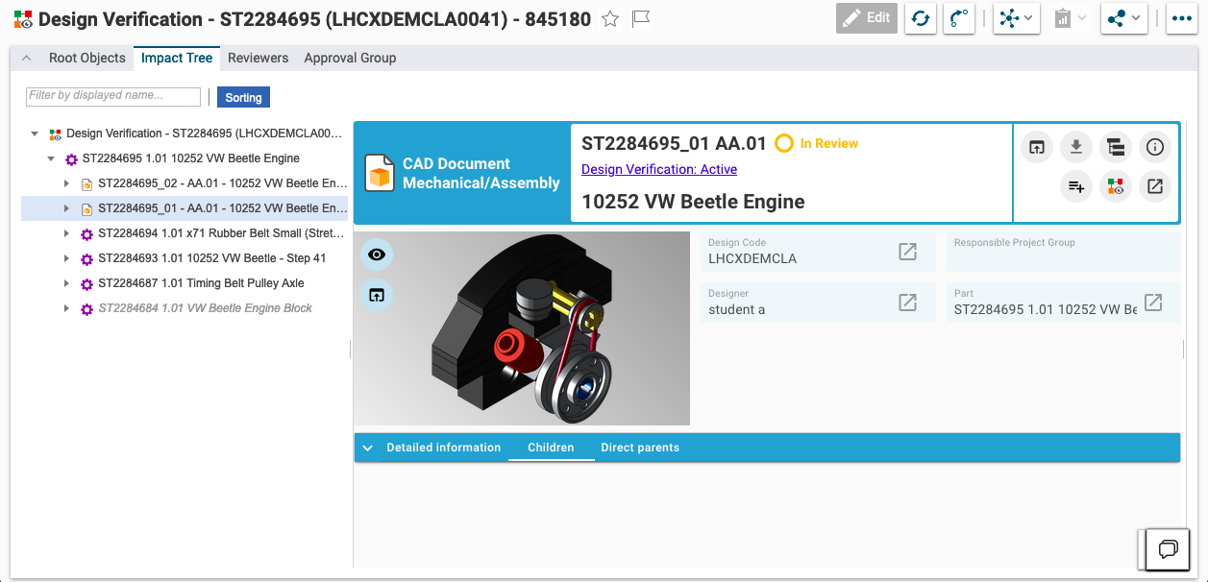


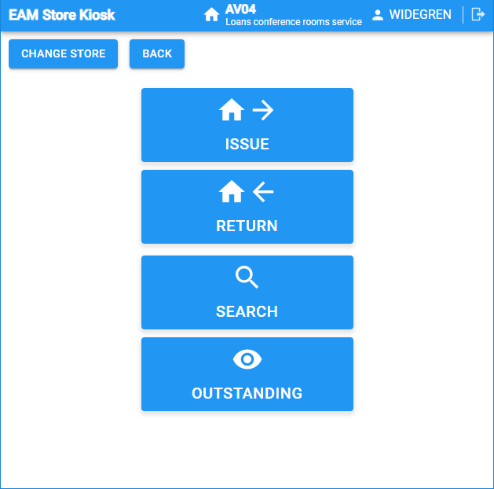
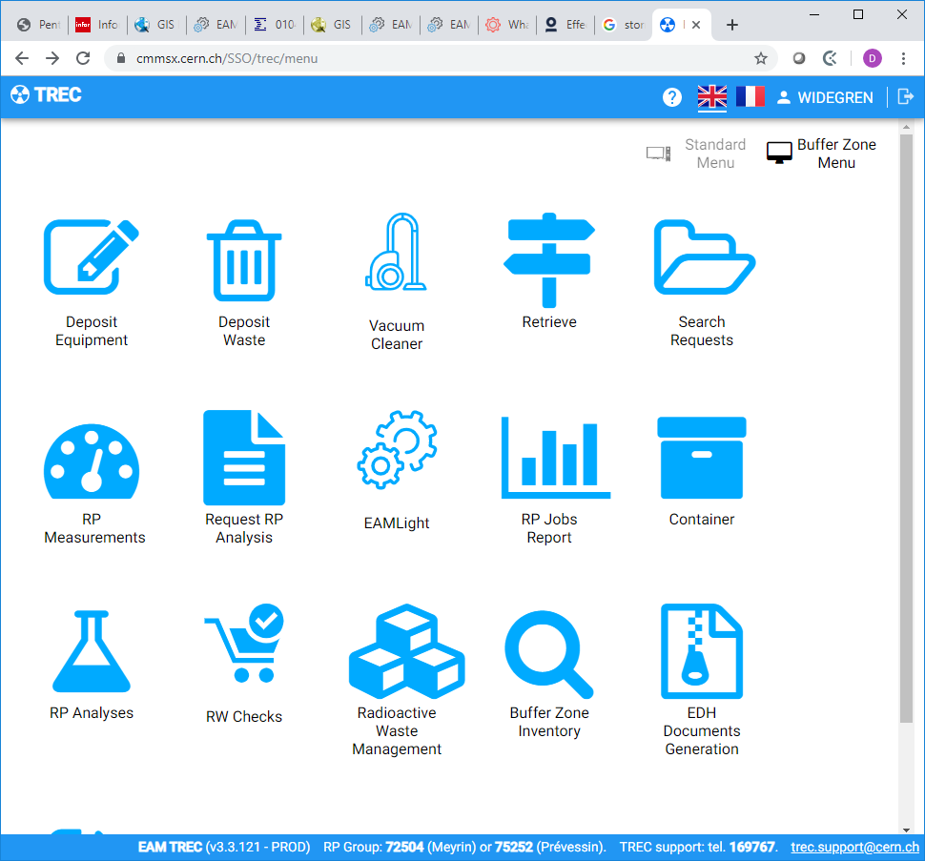
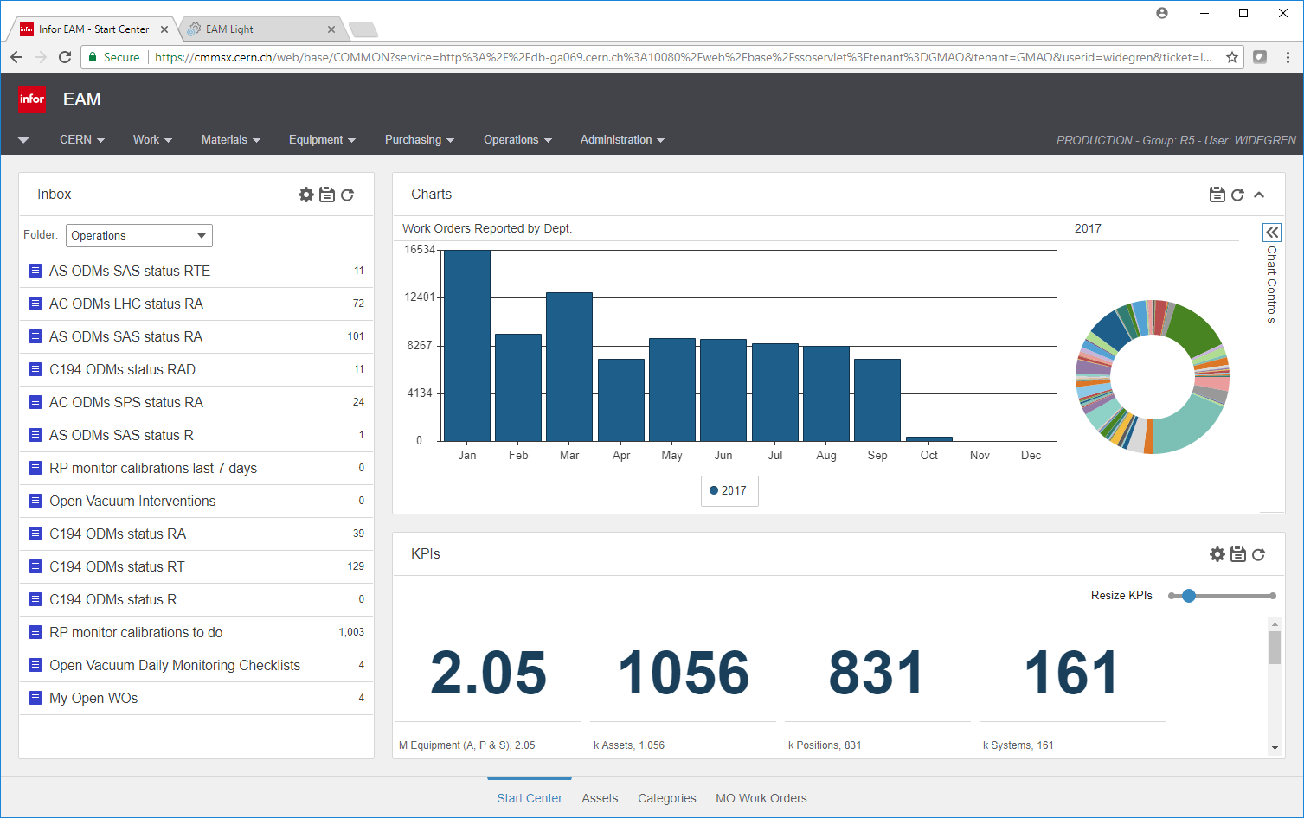
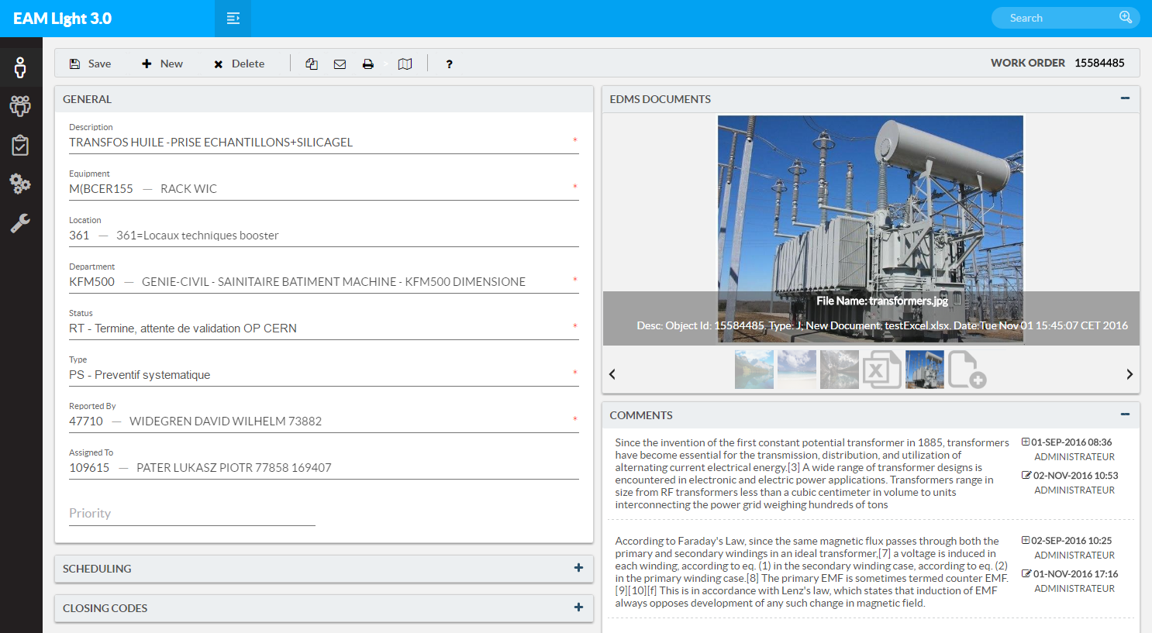
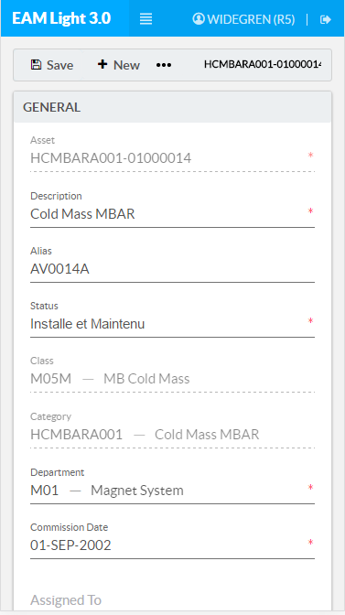
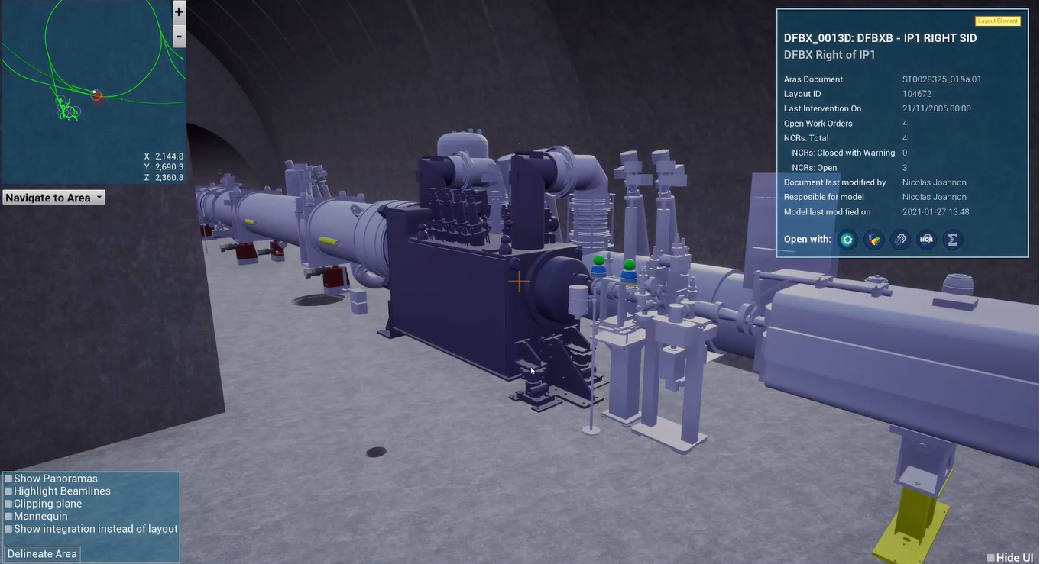

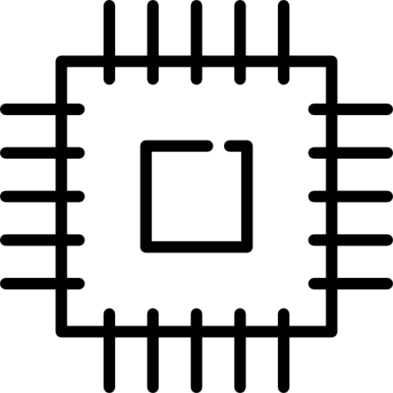





Our Digital Asset Management Platform
DESIGN & CONFIG.
MANAGEMENT
MANUFACTURING &
INSTALLATION
OPERATION & MAINTENANCE
DISPOSAL & WASTE
MANAGEMENT
PLM
Product Lifecycle Management
MTF
Manufacturing & Test Folder
HxGN EAM
Enterprise Asset Management
TREC
Radioactive Traceability
PLM
EAM
FINANCIAL DEPRECIATION
Plant, Property & Equipment
WEB SERVICES HUB
System Integrations via Standard APIs
REPORTING & ANALYTICS
Business Intelligence & Data Warehousing
DIGITAL TWINS
Engineering Digital Twins with 3D Visualization
ERP(s)
Other apps.
SCADA
Control Systems
IoT Data
Sensor logs
Databases
Specialist data
Geolocations
GIS & Metrology data
Supplier APIs
Data exchange
And more..
30+ Integrations

Slide 5
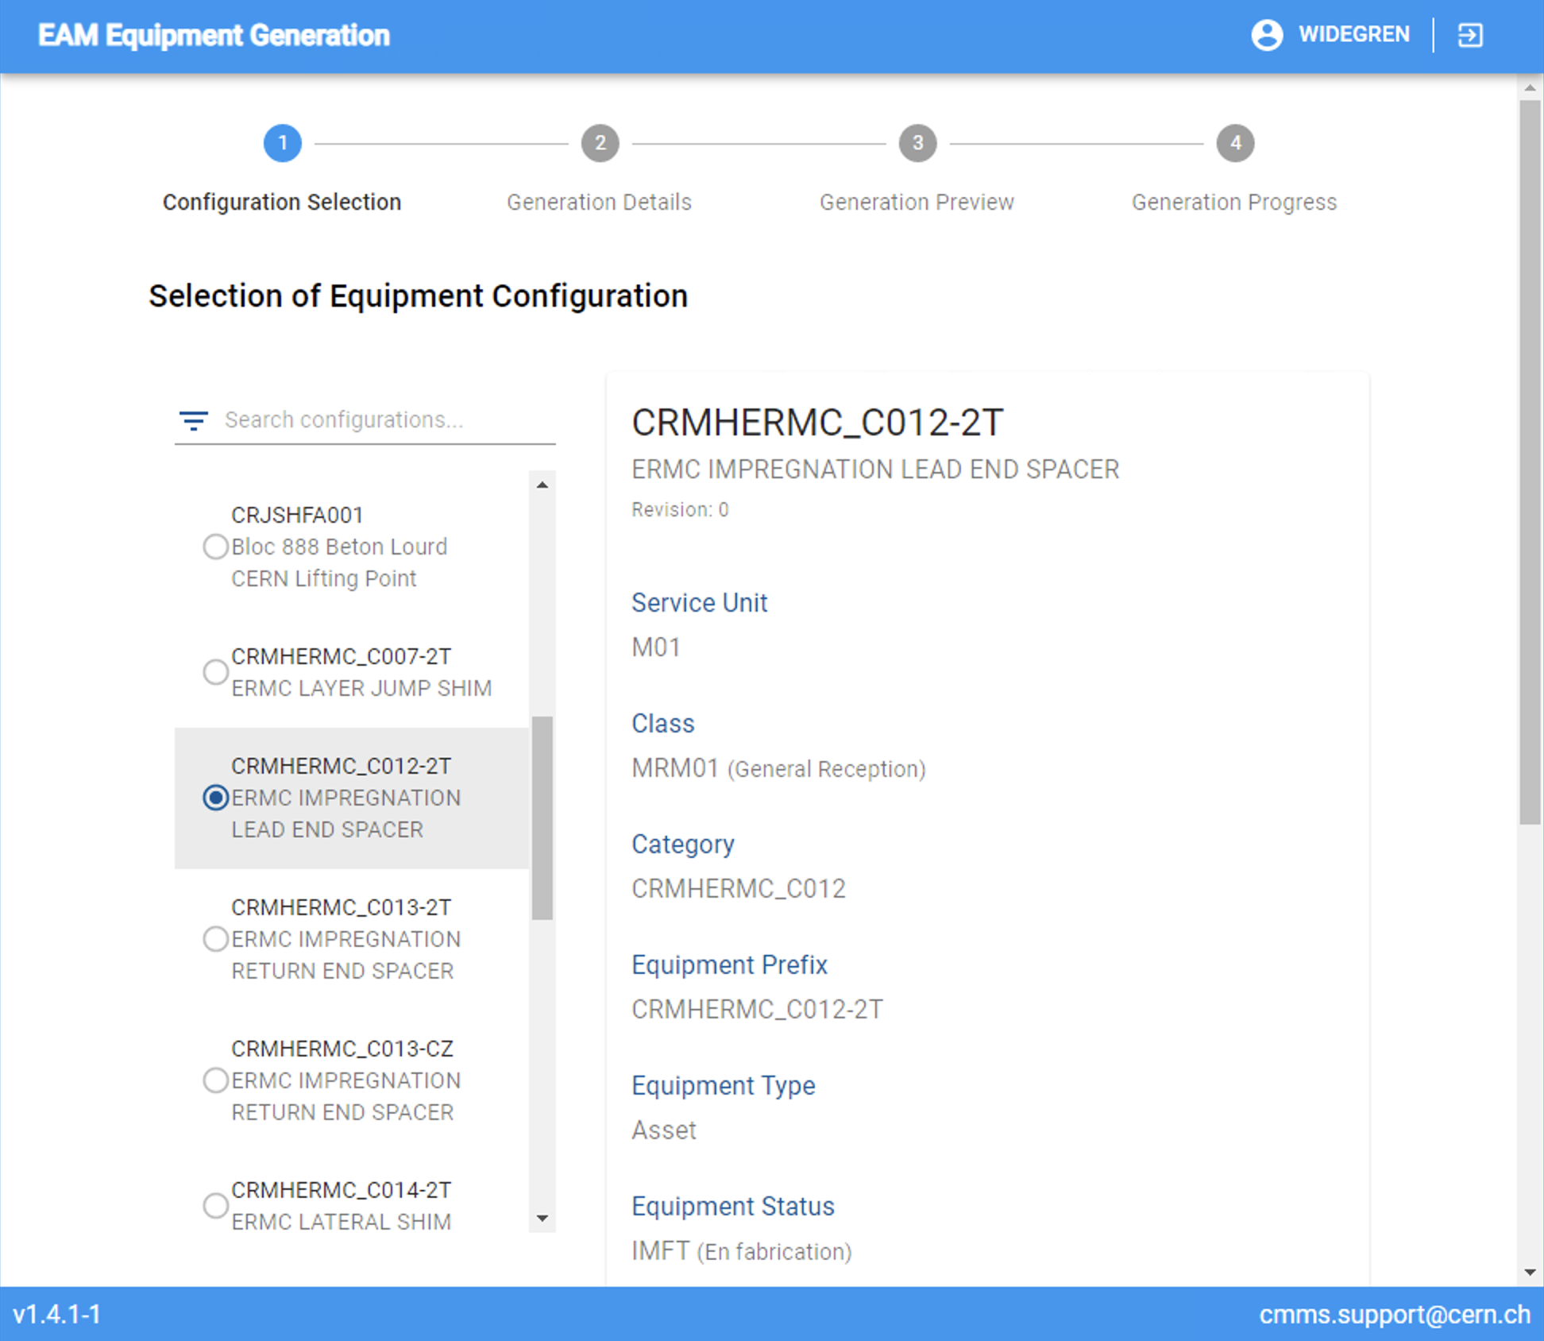
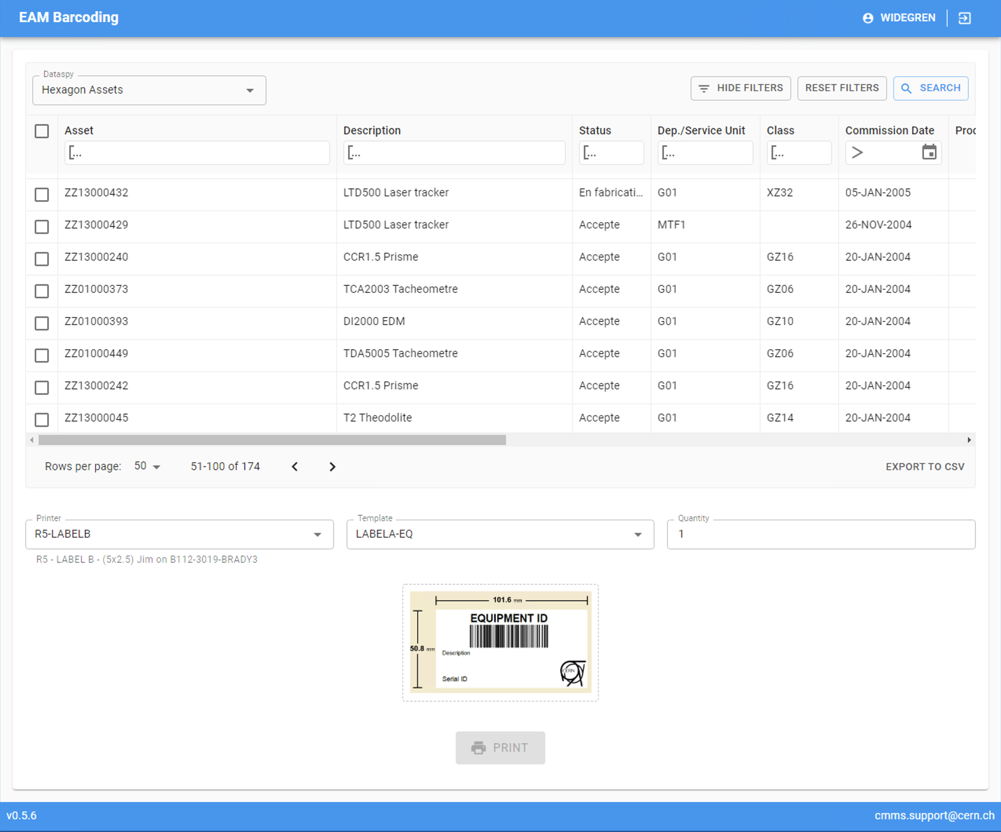
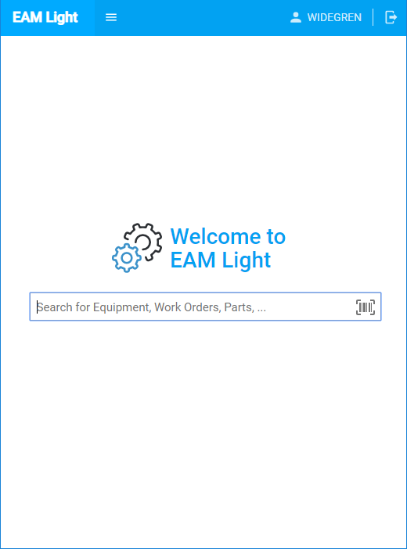
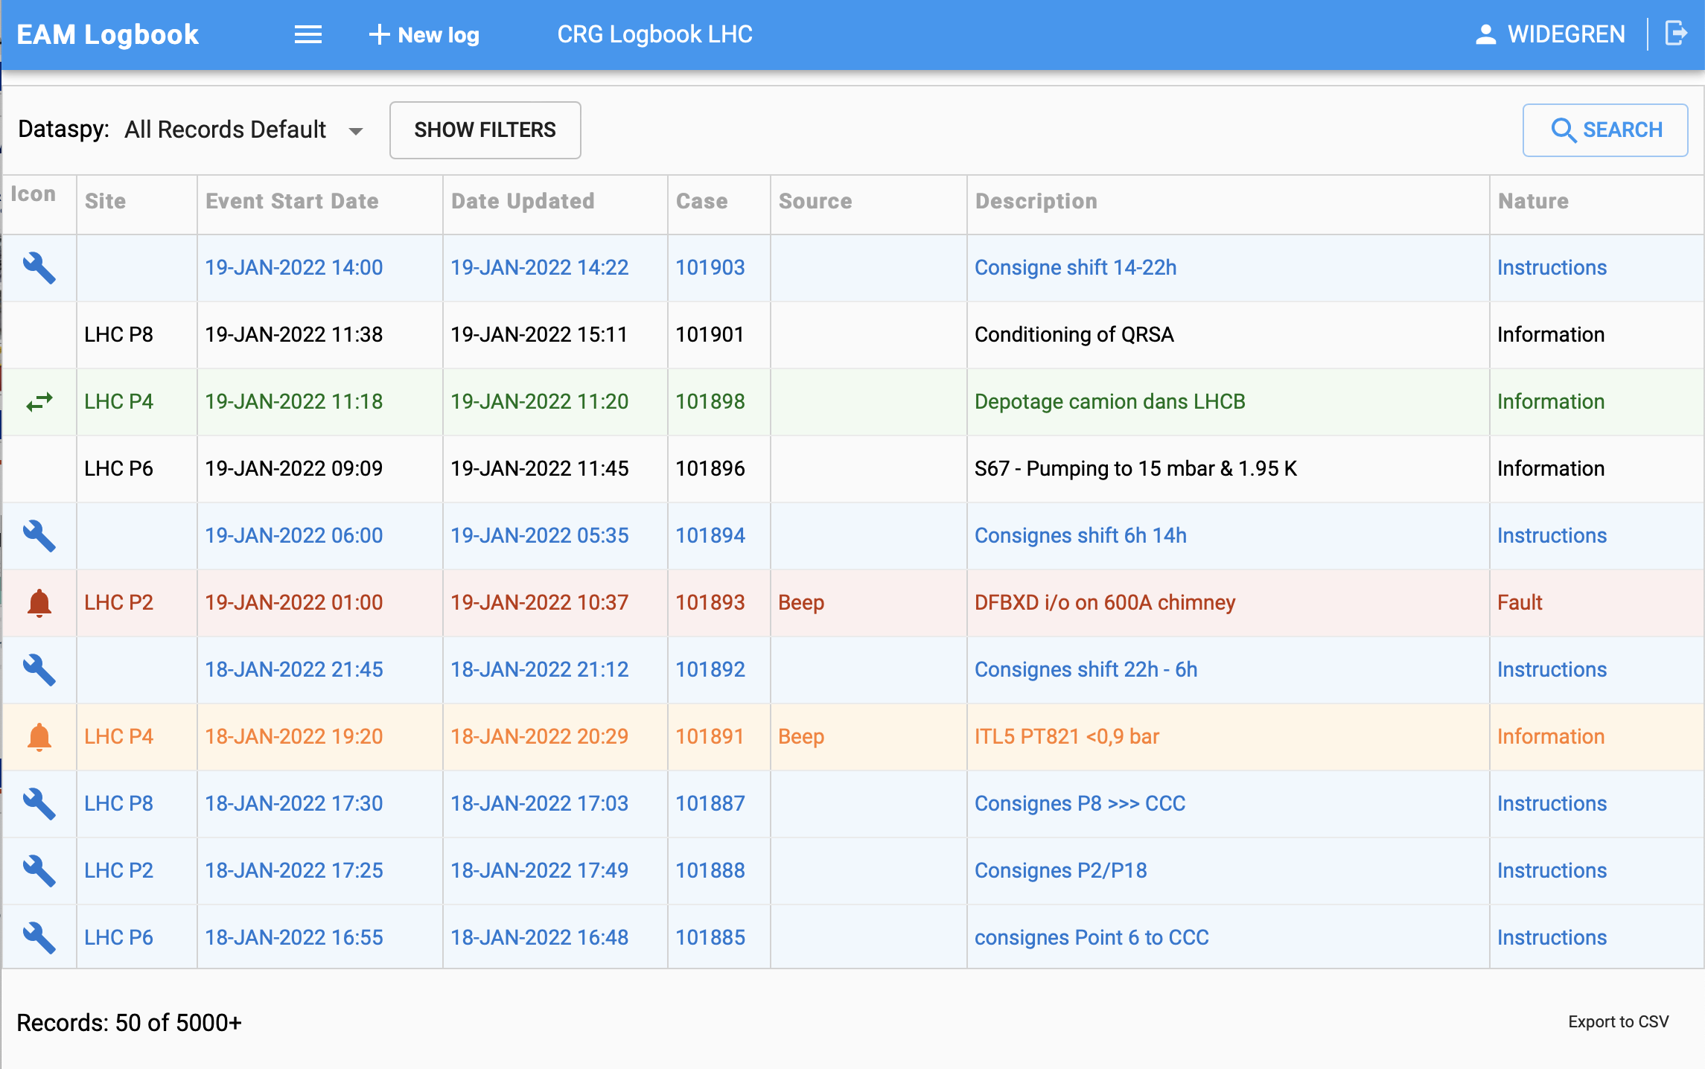
What is EAM?
EAM Eqp. Generator Equipment Creation
EAM Barcoding Barcode Printing
EAM is today an asset & maintenance
management system used CERN-wide.
The main functionalities of EAM are:
The equipment inventory
  Technical properties
  Links to documents
  Organization in asset breakdown structures
  and functional breakdown structures
The event registry
  Logistics events (reception, storage, transport, installation)
  Quality assurance events (manufacturing steps)
  Compliance events (safety inspections, RP measurements)
  Operation events (e.g. breakdowns)
  Maintenance events
EAM Light Mobile/Simplified Interface
TREC Radioactive Traceability
EAM Logbook Issue Management

Slide 6
Accelerator equipment data in EAM
Operational accelerator equipment data is
  Published from Layout and/or
  Entered directly in EAM
Detailed equipment life cycle is accessible
  Manufacturing details including manufacturing steps and documentation
  Non-conformities discovered
  Events related to installation
  Repairs and maintenance work orders
  Available spares and part usage
  Could serve as basis of reliability calculations

Slide 7
Need for EAM and AFT integrations
AFT is aimed to trace beam related problems
EAM is generally used also for equipment outside the accelerator complex
Registering problems in different systems is double effort
EAM Logbook functionally can bridge the gap

Slide 8
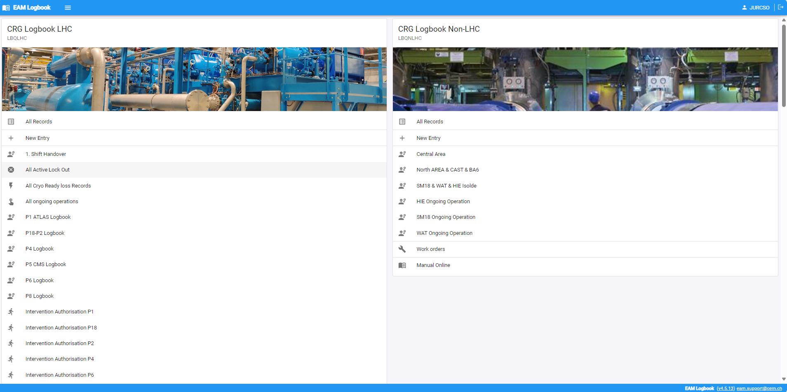
EAM Logbook
Out of the box EAM Case Management functionality adapted to CERN needs
Specific user interface
Current users are
  Cryo – LHC and non-LHC
  CV
  EN-EL
  Access Control
Link equipment
to event and follow ups

Slide 9
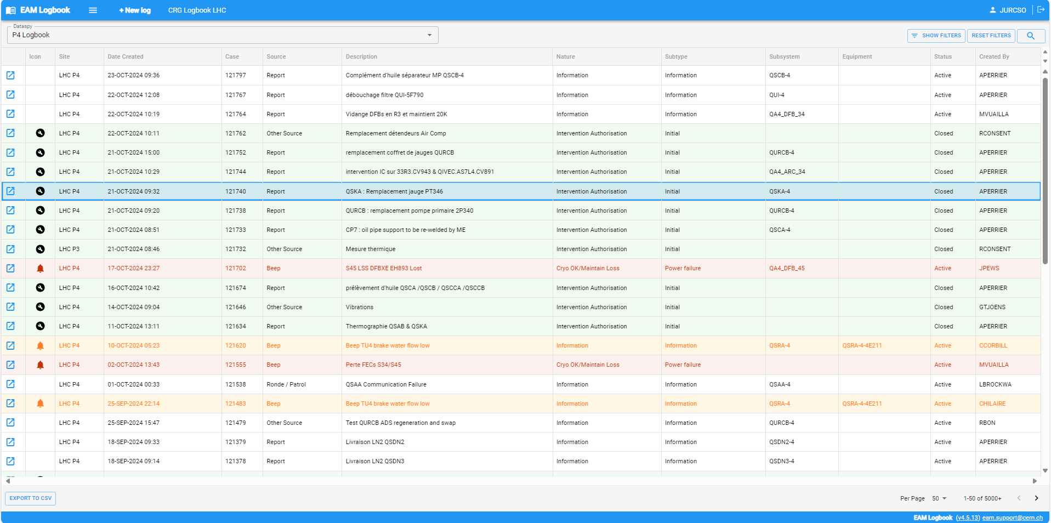
Classic log event register

Slide 10
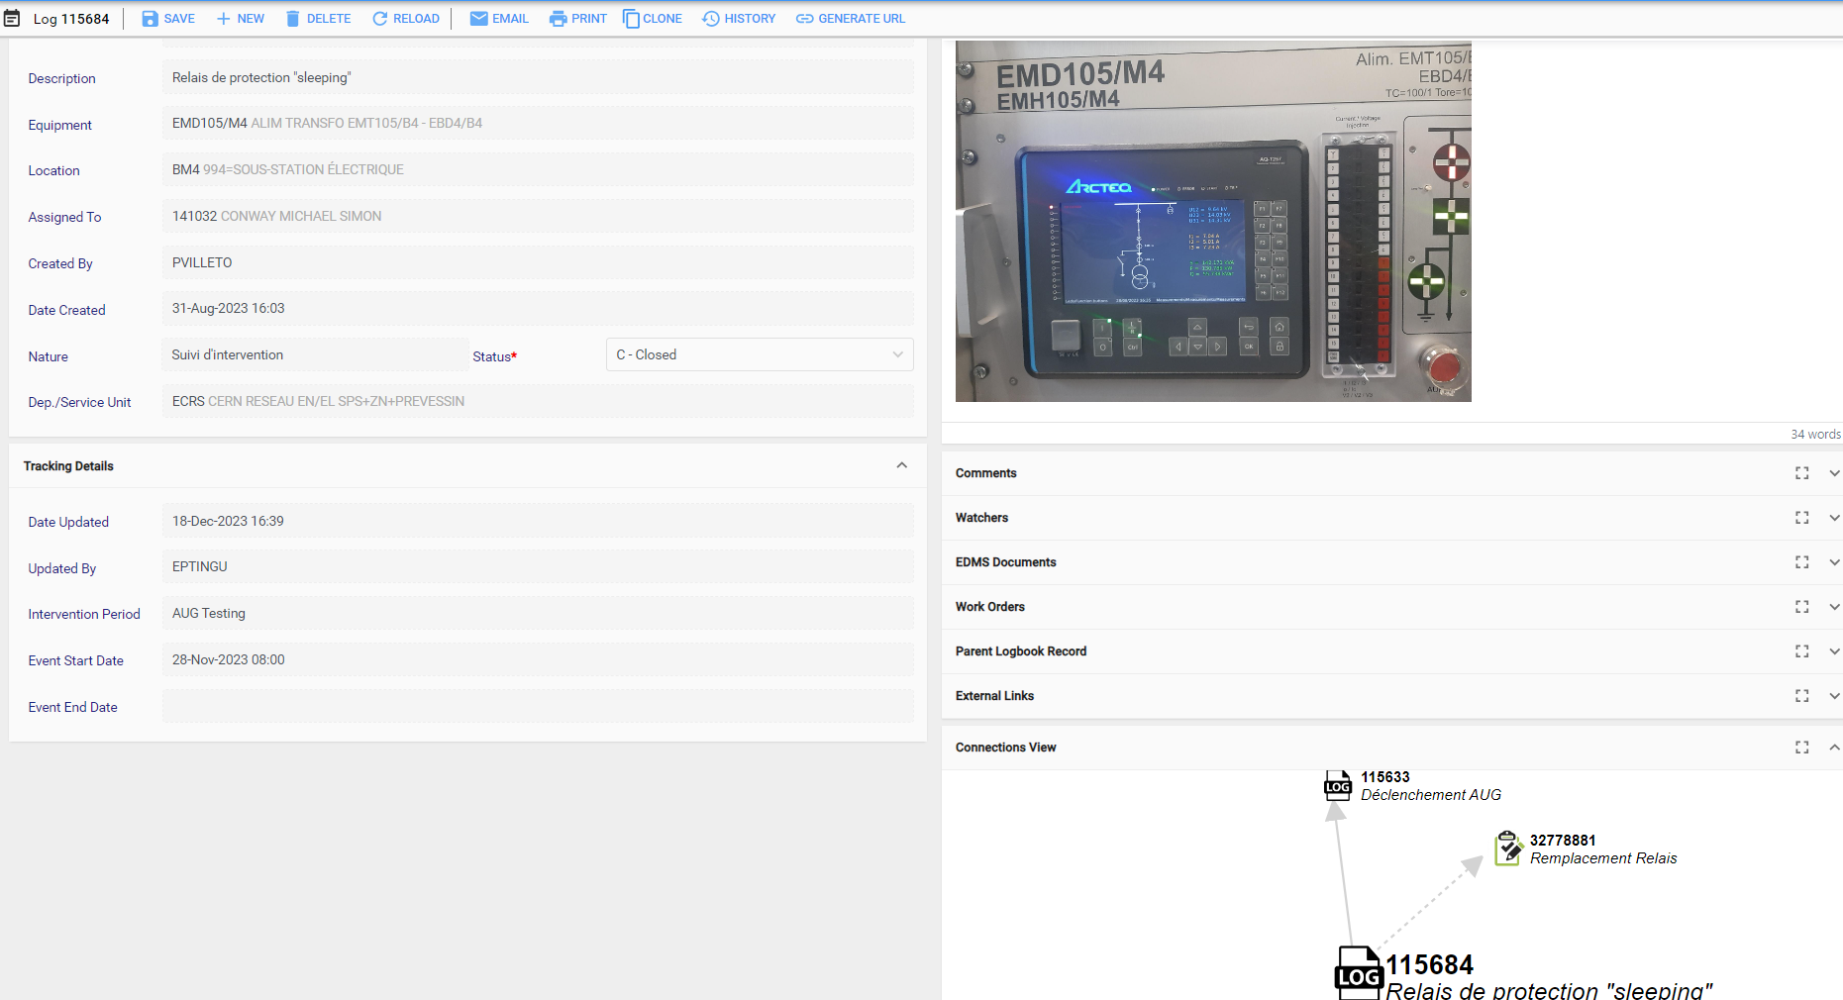
With default blocks – EN-EL

Slide 11
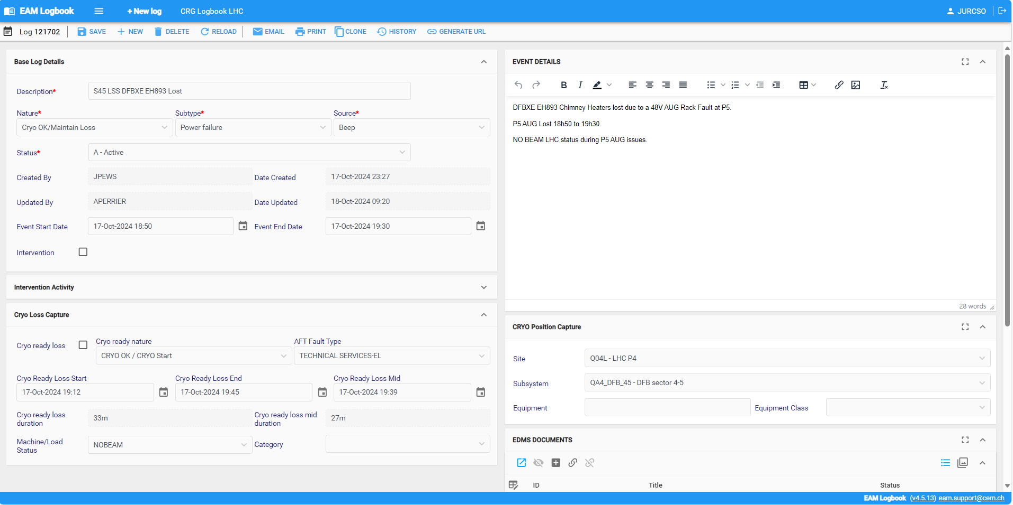
With specific details - Cryo

Slide 12
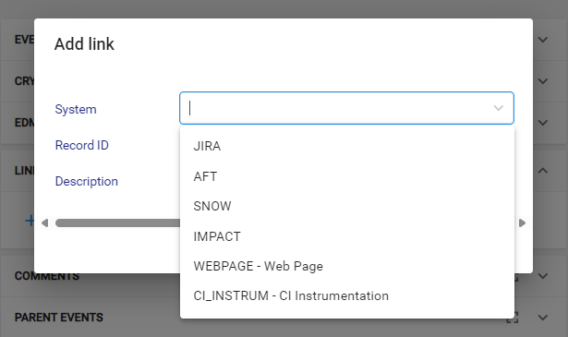
EAM links AFT
Some groups are automatically creating work orders for expert interventions based on specific AFT events (EN-EA-EC)
EAM logbook entries can be manually linked to AFT amongst others
The challenge is finding the related AFT events easily
New logbook module was developed to facilitate the selection of the fault

Slide 13
New functionality
Suggested selection of possibly related AFT, not yet linked events based on
  Equipment/system
  Event time window
Search for parent AFT event
  Some global events affecting all accelerators
Transferring significant information from AFT to Logbook
  Pre-defined set of fields
  To avoid manual double entry requirement

Slide 14
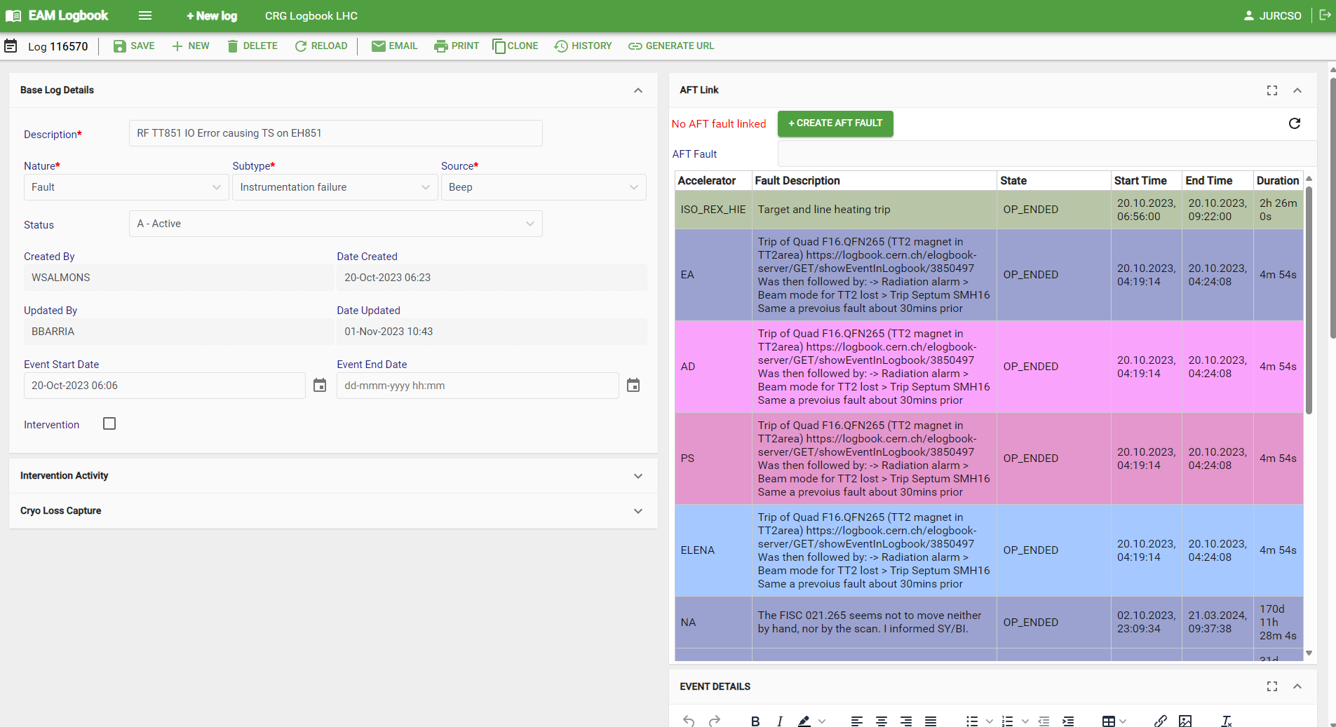
Example AFT Links based on time window

