Slide 1
Mini Lecture Course: Accelerator Design for a Multi-TeV Muon Collider
Lecture 1: Overview of Muon Collider
Katsuya Yonehara
4/21/2025

Slide 2
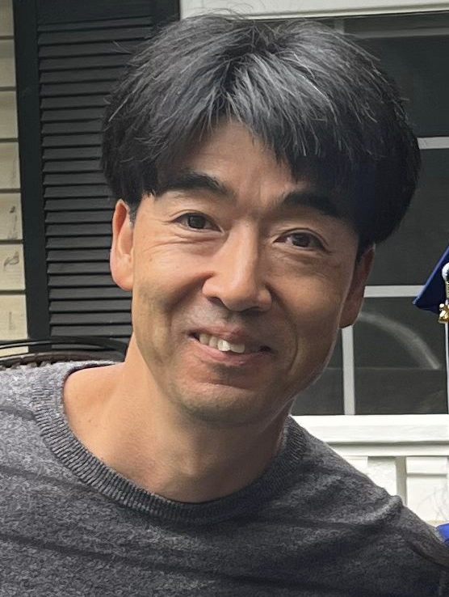
My profile
Katsuya Yonehara
Senior Scientist at Fermilab
Experimental physicist
Accelerator and Particle Physics
Currently working on high power targetry for neutrino facilities like NuMI and LBNF
You can contact me through
During the lecture
Email to yonehara@fnal.gov
USMCC Slack chat

Slide 3
Scope of the lecture series
My goal is to convey our past studies and accumulated knowledges related to muon colliders to the new generation
Target audience: Lecture materials are being prepared for graduate students, engineers, and researchers who do not have a background in accelerator physics, however, the lecture are open to all interested participants!
Tentative agenda (1-2 hours per session):
  Overview of the muon collider
  Emittance evolution and stability conditions in phase space
  Review of ionization cooling channels
  RF cavities in ionization cooling channels
  (TBD) Interactions and kinematics
  (TBD) Review of the MICE experiment & demo channel

Slide 4
Recommended paper and textbook
G. Dugan, PRSTAB 4,104001 (2001) for expert level
"Theory and Design of Charged Particle Beams", Martin Reiser, Print ISBN:9783527407415 |Online ISBN:9783527622047 |DOI:10.1002/9783527622047 for entry level reader
"Particle Accelerator Physics", Helmut Wiedemann, https://link.springer.com/book/10.1007/978-3-319-18317-6 for entry and advanced level reader
"Accelerator Physics", SY Lee, https://library.oapen.org/handle/20.500.12657/50490 for advanced level reader

Slide 5
Overview of Muon Collider Design
Quickly go through the design concept of muon colliders

Slide 6
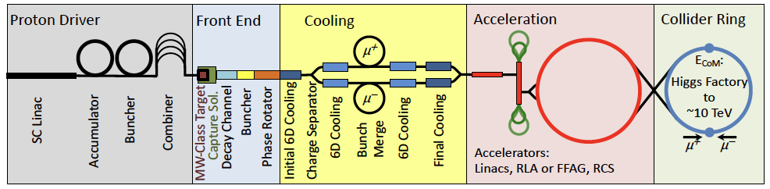
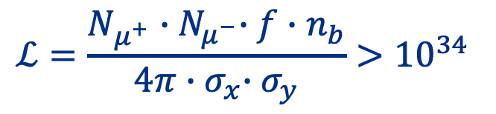
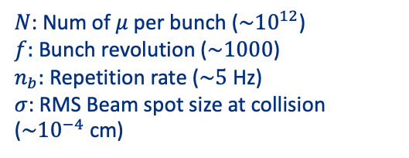
Overview of Muon Collider
Proton beam-based muon collider
Our story starts from luminosity…
Number of particles cross at an Interaction Point (IP) per second
$$ℒ=\frac{N_{μ^{+}}{∙N}_{μ^{−}}∙f∙n_{b}}{4π{∙σ}_{x}∙σ_{y}}>{10}^{34}$$
$N$: Num of $μ$ per bunch ($\sim {10}^{12}$)
$f:$ Bunch revolution ($\sim 1000$)
$n_{b}:$ Repetition rate ($\sim 5$ Hz)
$σ$: RMS Beam spot size at collision ($\sim {10}^{−4}$ cm)
cm⁻² s⁻¹
Beam crossing area at IP

Slide 7
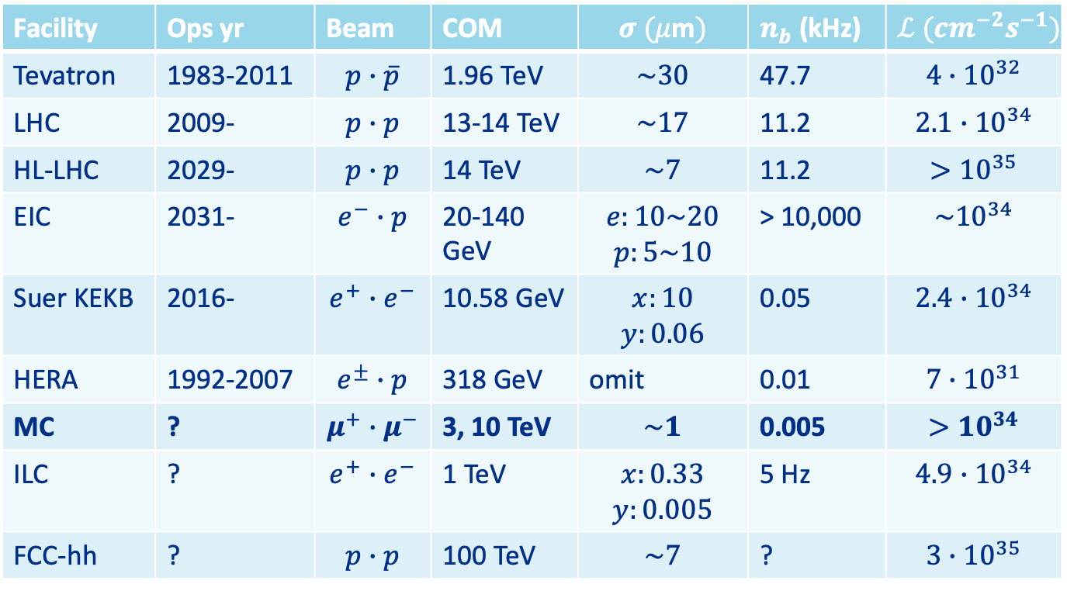
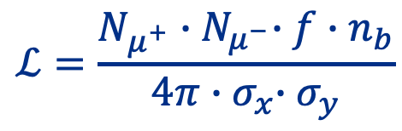
Collider Luminosities
$$ℒ=\frac{N_{μ^{+}}{∙N}_{μ^{−}}∙f∙n_{b}}{4π{∙σ}_{x}∙σ_{y}}$$
At the present time
Facility | Ops yr | Beam | COM | $$σ (μ\text{m})$$ | $n_{b}$ (kHz) | $$ℒ ({cm}^{−2}s^{−1})$$
Tevatron | 1983-2011 | $$p∙\overline{p}$$ | 1.96 TeV | $$\sim 30$$ | 47.7 | $${4∙10}^{32}$$
LHC | 2009- | $$p∙p$$ | 13-14 TeV | $$\sim 17$$ | 11.2 | $$2.1∙{10}^{34}$$
HL-LHC | 2029- | $$p∙p$$ | 14 TeV | $$\sim 7$$ | 11.2 | $${>10}^{35}$$
EIC | 2031- | $$e^{−}∙p$$ | 20-140 GeV | $$e:10\sim 20$$ $$p:5\sim 10$$ | > 10,000 | $${\sim 10}^{34}$$
Suer KEKB | 2016- | $$e^{+}∙e^{−}$$ | 10.58 GeV | $$x:10$$ $$y:0.06$$ | 0.05 | $${2.4∙10}^{34}$$
HERA | 1992-2007 | $$e^{±}∙p$$ | 318 GeV | omit | 0.01 | $${7∙10}^{31}$$
MC | ? | $$μ^{+}∙μ^{−}$$ | 3, 10 TeV | $$\sim 1$$ | 0.005 | $${>10}^{34}$$
ILC | ? | $$e^{+}∙e^{−}$$ | 1 TeV | $$x:0.33$$ $$y:0.005$$ | 5 Hz | $$4.9∙{10}^{34}$$
FCC-hh | ? | $$p∙p$$ | 100 TeV | $$\sim 7$$ | ? | $$3∙{10}^{35}$$

Slide 8
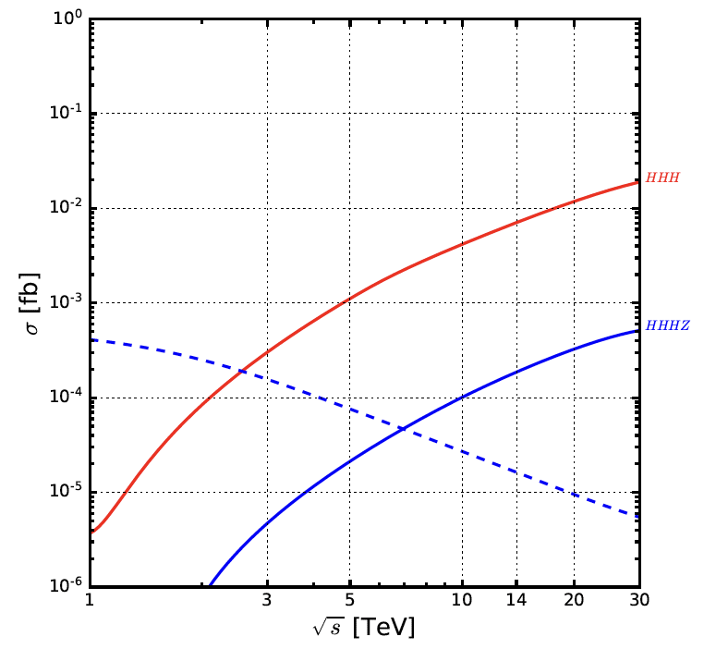
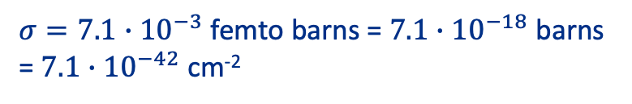


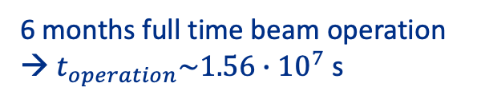
Examine Luminosity in Muon Collider
I am, particularly interested in three Higgs productions
Self coupling
Possibly coupling with SUSY particles (BSM), or find internal structure of Higgs
Analogous to a glue-ball (pomeron)
Ex) $μμ→WW→HHH$, VBF at 14 TeV
$σ=7.1∙{10}^{−3}$ femto barns = $7.1∙{10}^{−18}$ barns = $7.1∙{10}^{−42}$ cm⁻²
$$1 barn={10}^{−24} {cm}^{−2}$$
6 months full time beam operation → $t_{operation}\sim 1.56∙{10}^{7}$ s
$f_{μμ→HHH}\sim 7.1∙{10}^{−42}×1.56∙{10}^{7}×{10}^{34}\sim 0.1$event/year

Slide 9
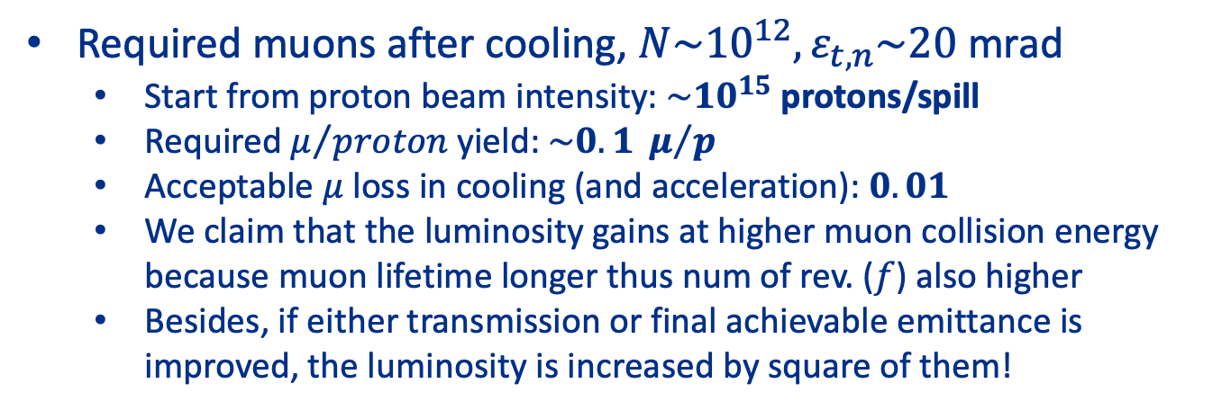
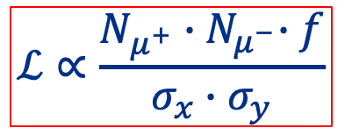
Overview of Muon Collider
Proton beam based muon collider
Required muons after cooling, $N\sim {10}^{12}, ε_{t,n}\sim 20$ mrad
  Start from proton beam intensity: $\sim {10}^{15}$ protons/spill
  Required $μ/{proton}$ yield: $\sim 0.1 μ/p$
  Acceptable $μ$ loss in cooling (and acceleration): $0.01$
  We claim that the luminosity gains at higher muon collision energy because muon lifetime longer thus num of rev. ($f$) also higher
  Besides, if either transmission or final achievable emittance is improved, the luminosity is increased by square of them!
$$ℒ∝\frac{N_{μ^{+}}{∙N}_{μ^{−}}∙f}{σ_{x}∙σ_{y}}$$

Slide 10
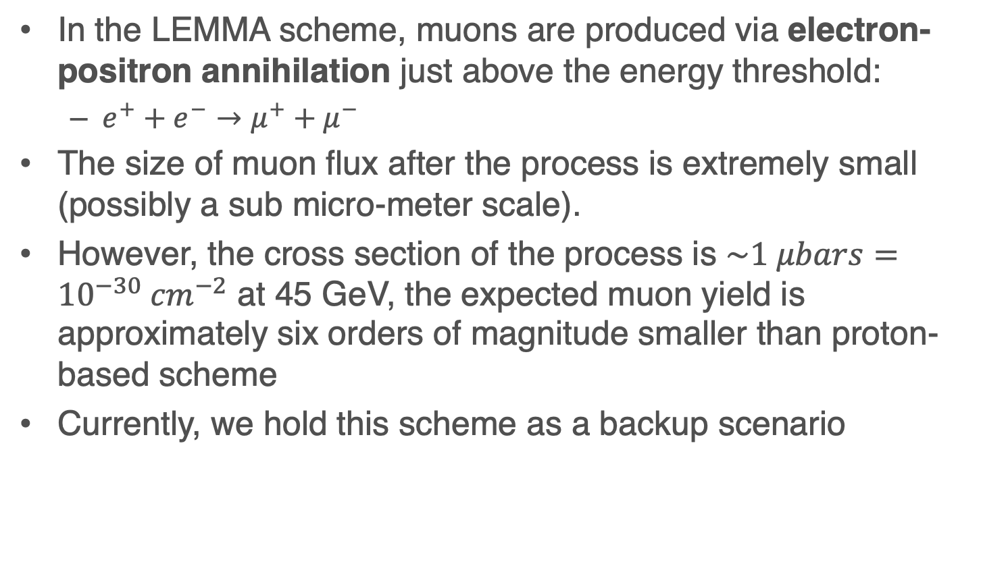
Low EMittance Muon Accelerator (LEMMA)
In the LEMMA scheme, muons are produced via electron-positron annihilation just above the energy threshold:
  $e^{+}+e^{−}→μ^{+}+μ^{−}$
The size of muon flux after the process is extremely small (possibly a sub micro-meter scale).
However, the cross section of the process is $\sim 1 μbars={10}^{−30} {cm}^{−2}$ at 45 GeV, the expected muon yield is approximately six orders of magnitude smaller than proton-based scheme
Currently, we hold this scheme as a backup scenario

Slide 11
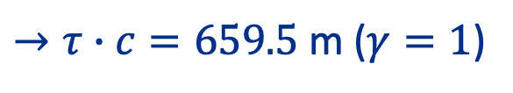
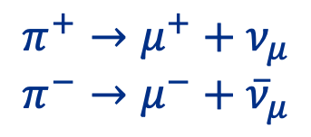


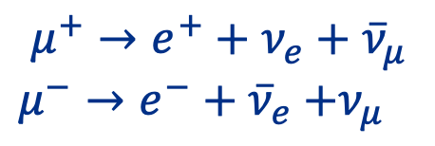
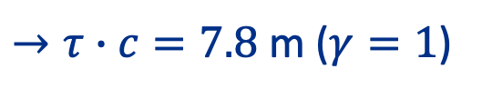
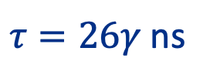
Overview of Muon Collider
Intense proton beam strikes pion production target
$$p+A→π^{±}+A′$$
Pions are eventually decayed
$$π^{+}→μ^{+}+ν_{μ}$$
$$π^{−}→μ^{−}+{\overline{ν}}_{μ}$$
Pion lifetime
$τ=26γ$ns
$→τ∙c=7.8$ m ($γ=1$)
Muons are eventually decayed as well
$$μ^{+}→e^{+}+ν_{e}+{\overline{ν}}_{μ}$$
$μ^{−}→e^{−}+{\overline{ν}}_{e}$ $+ν_{μ}$
Muon lifetime
$τ=2.2γ μ$s
$→τ∙c=659.5$ m ($γ=1$)

Slide 12
Challenge in producing low emittance muon beam
Initial muon phase space is too large to achieve the goal luminosity
  Phase space cooling is required
    Initial muon phase space is similar as basketball
    Required muon phase space after cooling is sub-millimeter
Muons have a finite lifetime
  Need fast cooling scheme
    Ionization cooling

Slide 13
Intuitive picture of beam cooling
Interpret of the beam cooling:
Similar as refrigerator!

Slide 14
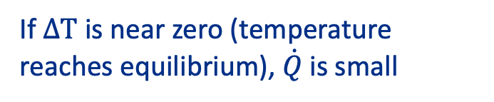

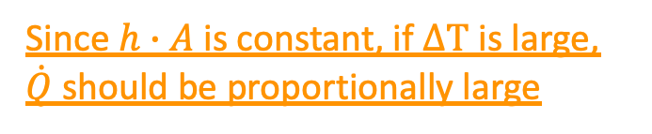

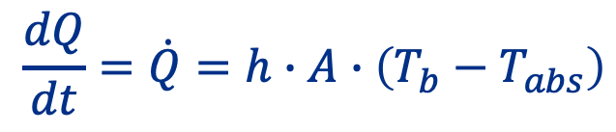




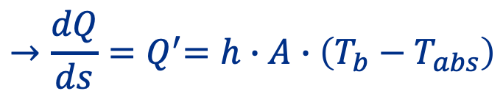
Beam cooling
Heat flows from warm object to cold object
Heat flows
Heat flows when
$$T_{b}$$
$$T_{abs}$$
$$T_{b}>T_{abs}$$
$$Q′$$
Equilibrium condition
$$T_{b} \sim { T}_{abs}$$
$$\frac{dQ}{dt}=\dot{Q}=h∙A∙\left(T_{b}−T_{abs}\right)$$
Since $h∙A$ is constant, if $∆T$ is large, $\dot{Q}$should be proportionally large
Heat transfer rate
$${→\frac{dQ}{ds}=Q}^{′}=h∙A∙\left(T_{b}−T_{abs}\right)$$
If $∆T$ is near zero (temperature reaches equilibrium), $\dot{Q}$is small
$s$ is a path length

Slide 15
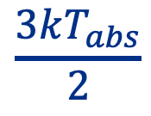


Beam cooling
Beam temperature flows into absorber temperature
Beam
Absorber
Heat flows when
q (momentum)-transfer
via coulomb interaction
$$\frac{3kT_{abs}}{2}$$
$$T_{b}>T_{abs}$$
$$\frac{∆p_{⊥}^{2}}{m}=kT_{b}$$
Equilibrium condition
$$T_{b} \sim { T}_{abs}$$
$∆p$: Momentum in CM frame
How to effectively generate high transverse momentum in a beam?
Transverse momentum is maximized at cooling region

Slide 16
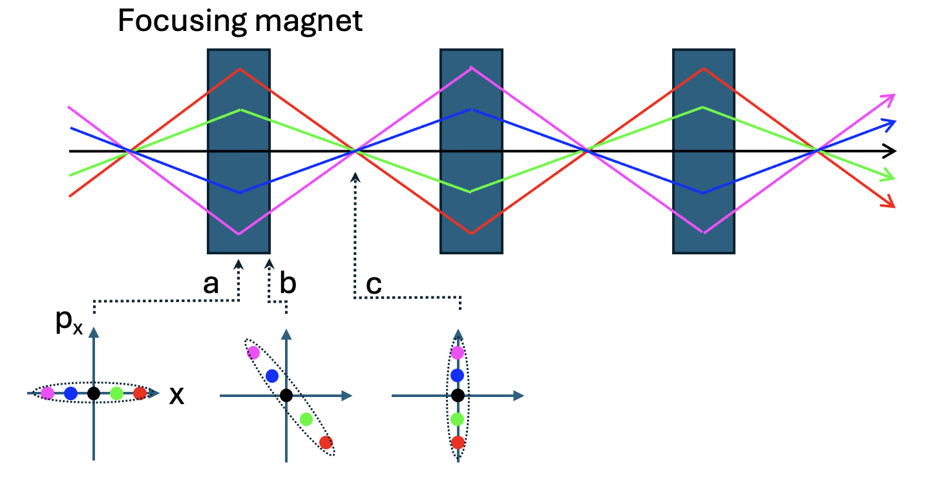
Beam cooling
Beam temperature flows into absorber temperature
Beam
Absorber
Heat flows when
q (momentum)-transfer
via coulomb interaction
$$\frac{3kT_{abs}}{2}$$
$$T_{b}>T_{abs}$$
$$\frac{∆p_{⊥}^{2}}{m}=kT_{b}$$
Equilibrium condition
$$T_{b} \sim { T}_{abs}$$
Put absorber at point “c”
a: maximum beta function
c: minimum beta function
Transverse phase space is rotated along beam path

Slide 17
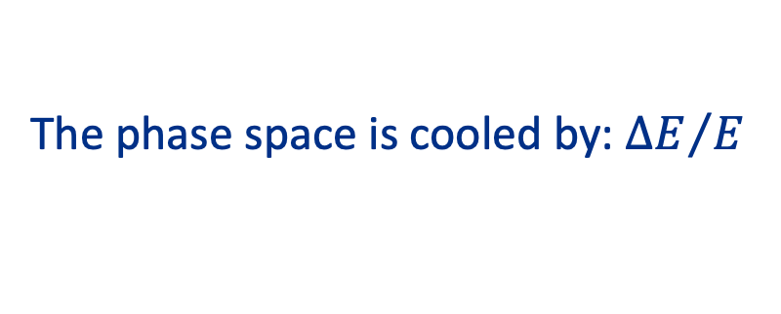




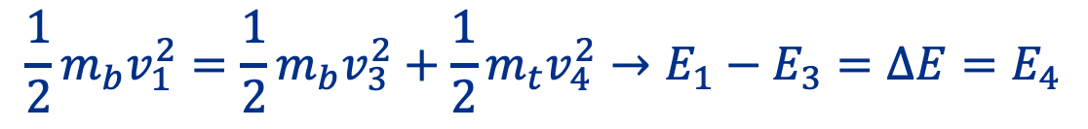


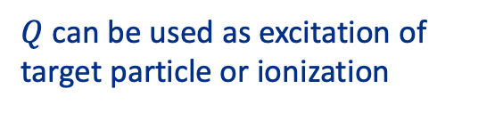
Energy transfer process
$$μ$$
$$v_{1}$$
$$v_{3}$$
$$v_{2}=0$$
$$v_{4}$$
Energy transfer in an elastic scattering:
$$\frac{1}{2}m_{b}v_{1}^{2}=\frac{1}{2}m_{b}v_{3}^{2}+\frac{1}{2}m_{t}v_{4}^{2}→E_{1}−E_{3}=∆E=E_{4}$$
This is a transferred energy
The phase space is cooled by: ${∆E}/E$
Inelastic case: $E_{1}−E_{3}=∆E=E_{4}+Q$
$Q$ can be used as excitation of target particle or ionization

Slide 18

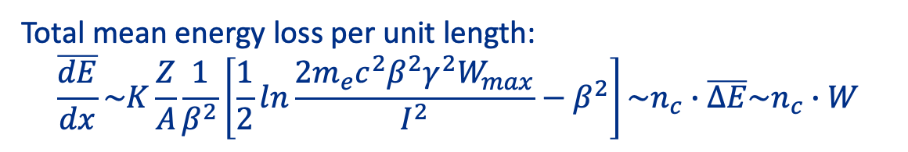










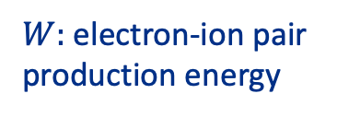
Energy transfer in ionization cooling
(intuitive approach)
Electron looks to be a free particle
Beam direction
$$μ$$
$$e^{−}$$
$$e^{−}$$
$$∆E_{2}$$
$$∆E_{3}$$
$$∆E_{5}$$
$$∆E_{4}$$
$$e^{−}$$
$$e^{−}$$
$$e^{−}$$
$$∆E_{1}=I+δE$$
Total mean energy loss per unit length:
$$\overline{\frac{dE}{dx}}\sim K\frac{Z}{A}\frac{1}{β^{2}}\left[\frac{1}{2}ln\frac{2m_{e}c^{2}β^{2}γ^{2}W_{max}}{I^{2}}−β^{2}\right]\sim n_{c}∙\overline{∆E}\sim n_{c}∙W$$
Bethe equation
$W:$ electron-ion pair
production energy

Slide 19
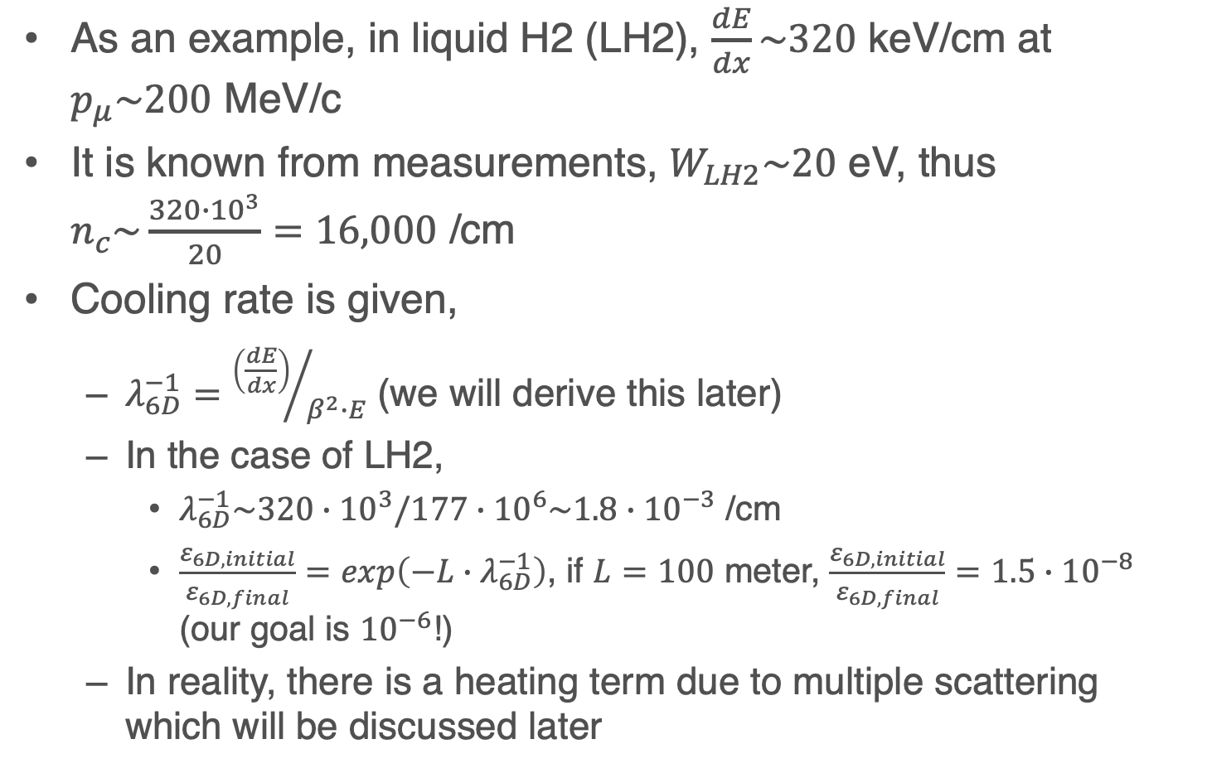
Pure cooling rate
As an example, in liquid H2 (LH2), $\frac{dE}{dx}\sim 320$ keV/cm at $p_{μ}\sim 200$ MeV/c
It is known from measurements, $W_{LH2}\sim 20$ eV, thus $n_{c}\sim \frac{320∙{10}^{3}}{20}=16,000$ /cm
Cooling rate is given,
  $λ_{6D}^{−1}={\left(\frac{dE}{dx}\right)}/{β^{2}∙E}$ (we will derive this later)
  In the case of LH2,
    $λ_{6D}^{−1}\sim 320∙{10}^{3}/177∙{10}^{6}\sim 1.8∙{10}^{−3}$ /cm
    $\frac{ε_{6D, initial}}{ε_{6D,final}}=exp\left(−L∙λ_{6D}^{−1}\right)$, if $L=100$ meter, $\frac{ε_{6D, initial}}{ε_{6D,final}}=1.5∙{10}^{−8}$ (our goal is ${10}^{−6}$!)
  In reality, there is a heating term due to multiple scattering which will be discussed later

Slide 20
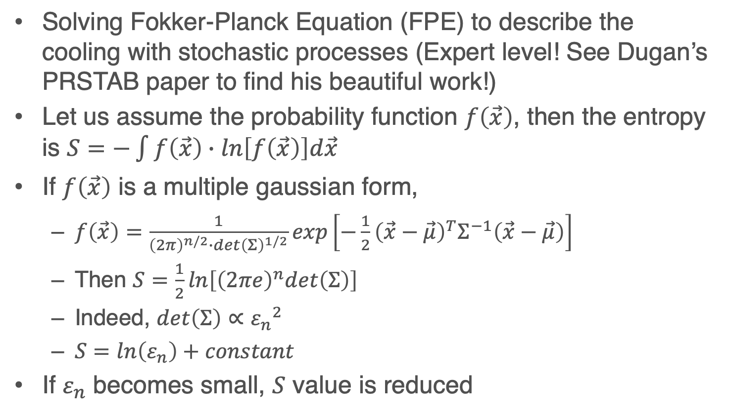
Beam cooling in thermodynamics
Solving Fokker-Planck Equation (FPE) to describe the cooling with stochastic processes (Expert level! See Dugan’s PRSTAB paper to find his beautiful work!)
Let us assume the probability function $f\left(\vec{x}\right)$, then the entropy is $S=−\int{f\left(\vec{x}\right)∙ln\left[f\left(\vec{x}\right)\right]d\vec{x}}$
If $f\left(\vec{x}\right)$ is a multiple gaussian form,
  $f\left(\vec{x}\right)=\frac{1}{{\left(2π\right)}^{n/2}∙{det\left(Σ\right)}^{1/2}}exp\left[−\frac{1}{2}{\left(\vec{x}−\vec{μ}\right)}^{T}Σ^{−1}\left(\vec{x}−\vec{μ}\right)\right]$
  Then $S=\frac{1}{2}ln\left[{\left(2πe\right)}^{n}det\left(Σ\right)\right]$
  Indeed, $det\left(Σ\right)∝{ε_{n}}^{2}$
  $S=ln\left(ε_{n}\right)+constant$
If $ε_{n}$ becomes small, $S$ value is reduced

Slide 21
Our first approach to beam dynamics
Interpret the beam dynamics:
We apply a concept of harmonic oscillation to evaluate the beam dynamics equations

Slide 22
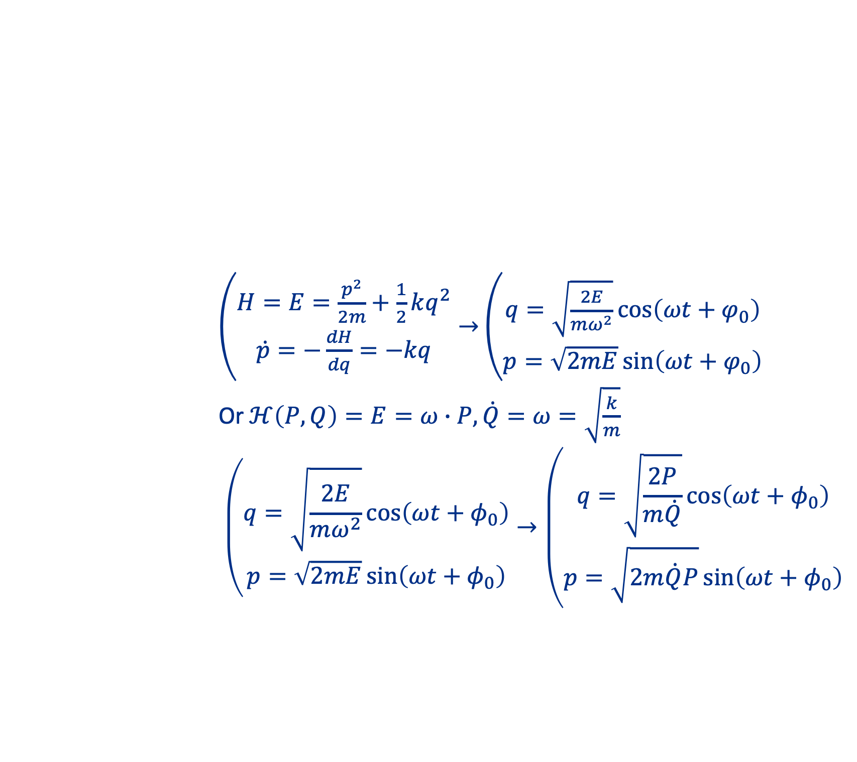
Transverse beam dynamics
Beam dynamics is analogous to the dynamics of a simple harmonic motion
  Solving harmonic oscillator via canonical transformation
$\left(\begin{matrix}H=E=\frac{p^{2}}{2m}+\frac{1}{2}kq^{2} \\ \dot{p}=−\frac{dH}{dq}=−kq\end{matrix}\right.→$ $\left(\begin{matrix}q=\sqrt{\frac{2E}{mω^{2}}}\cos\left(ωt+φ_{0}\right) \\ p=\sqrt{2mE}\sin\left(ωt+φ_{0}\right)\end{matrix}\right.$
Or $ℋ\left(P,Q\right)=E=ω∙P, \dot{Q}=ω=\sqrt{\frac{k}{m}}$
$$\left(\begin{matrix}q=\sqrt{\frac{2E}{mω^{2}}}\cos\left(ωt+φ_{0}\right) \\ p=\sqrt{2mE}\sin\left(ωt+φ_{0}\right)\end{matrix}\right.→\left(\begin{matrix}q=\sqrt{\frac{2P}{m\dot{Q}}}\cos\left(ωt+φ_{0}\right) \\ p=\sqrt{2m\dot{Q}P}\sin\left(ωt+φ_{0}\right)\end{matrix}\right.$$

Slide 23
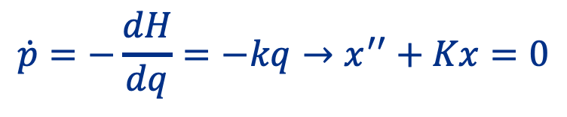
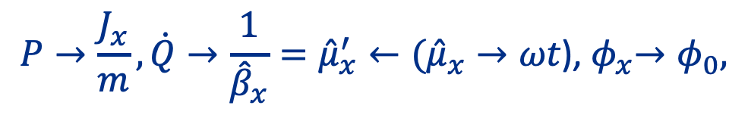

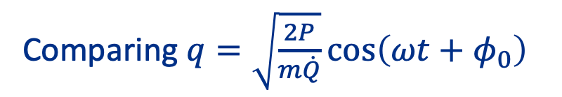
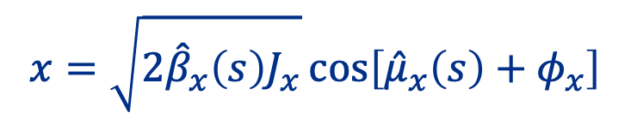

Transverse beam dynamics
Harmonic motion → Hill’s equation (translate the differentiation from $t$ to $s$)
$$\dot{p}=−\frac{dH}{dq}=−kq→x^{′′}+Kx=0$$
Non-linear & coupling beam dynamics can be investigated through non-linear harmonic oscillators, which most likely uses a perturbation theory
Let us use following general solution for $x$
$$x=\sqrt{2{\hat{β}}_{x}\left(s\right)J_{x}}\cos\left[{\hat{μ}}_{x}\left(s\right)+φ_{x}\right]$$
Comparing $q=\sqrt{\frac{2P}{m\dot{Q}}}\cos\left(ωt+φ_{0}\right)$
$$P→\frac{J_{x}}{m},\dot{Q}→\frac{1}{{\hat{β}}_{x}}={\hat{μ}}_{x}^{′}←{({\hat{μ}}_{x}→ωt\text{)}\text{,} φ}_{x}→φ_{0},$$

Slide 24
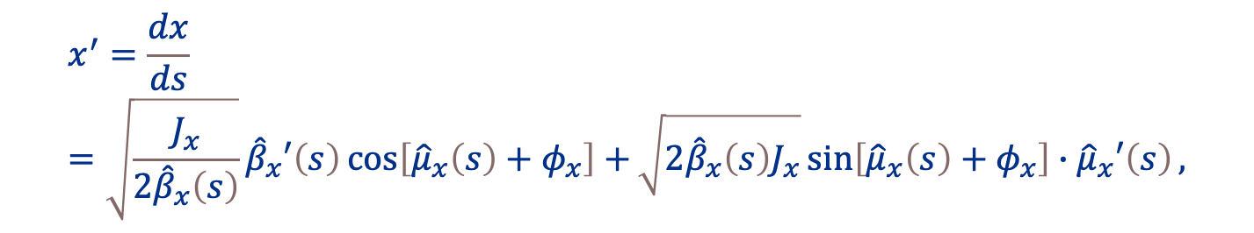

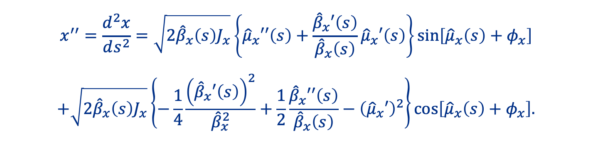
Transverse beam dynamics
Let us confirm
  Differentiate $x$ and $x′′$
$$x^{′}=\frac{dx}{ds}=\sqrt{\frac{J_{x}}{{2\hat{β}}_{x}\left(s\right)}}{\hat{β}}_{x}′\left(s\right)\cos\left[{\hat{μ}}_{x}\left(s\right)+φ_{x}\right]+\sqrt{2{\hat{β}}_{x}\left(s\right)J_{x}}\sin\left[{\hat{μ}}_{x}\left(s\right)+φ_{x}\right]∙{\hat{μ}}_{x}′\left(s\right),$$
$$x^{′′}=\frac{d^{2}x}{ds^{2}}=\sqrt{2{\hat{β}}_{x}\left(s\right)J_{x}}\left\{{\hat{μ}}_{x}′′\left(s\right)+\frac{{\hat{β}}_{x}′\left(s\right)}{{\hat{β}}_{x}\left(s\right)}{\hat{μ}}_{x}′\left(s\right)\right\}\sin\left[{\hat{μ}}_{x}\left(s\right)+φ_{x}\right]$$
$$+\sqrt{2{\hat{β}}_{x}\left(s\right)J_{x}}\left\{−\frac{1}{4}\frac{{\left({\hat{β}}_{x}′\left(s\right)\right)}^{2}}{{\hat{β}}_{x}^{2}}+\frac{1}{2}\frac{{\hat{β}}_{x}′′\left(s\right)}{{\hat{β}}_{x}\left(s\right)}−{\left({\hat{μ}}_{x}′\right)}^{2}\right\}\cos\left[{\hat{μ}}_{x}\left(s\right)+φ_{x}\right].$$

Slide 25
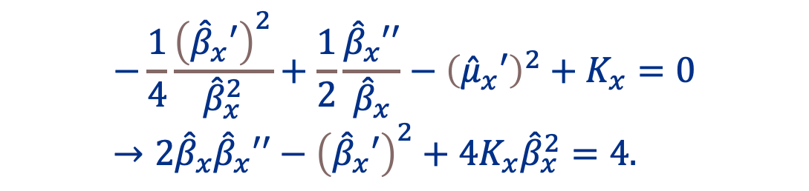
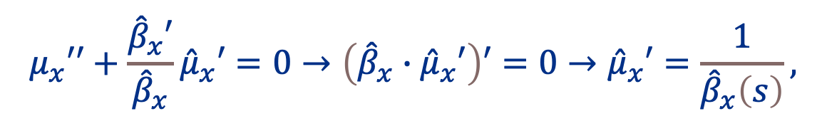
Transverse beam dynamics
Substitute into Hill’s equation
  Since right-handed-side of Hill’s equation is zero, the coefficient of trigonal functions should be zero
$$μ_{x}′′+\frac{{\hat{β}}_{x}′}{{\hat{β}}_{x}}{\hat{μ}}_{x}′=0→\left({\hat{β}}_{x}∙{\hat{μ}}_{x}′\right)′=0→{\hat{μ}}_{x}′=\frac{1}{{\hat{β}}_{x}\left(s\right)},$$
This is what we look into!
$$−\frac{1}{4}\frac{{\left({\hat{β}}_{x}′\right)}^{2}}{{\hat{β}}_{x}^{2}}+\frac{1}{2}\frac{{\hat{β}}_{x}′′}{{\hat{β}}_{x}}−{\left({\hat{μ}}_{x}′\right)}^{2}+K_{x}=0→2{\hat{β}}_{x}{\hat{β}}_{x}′′−{\left({\hat{β}}_{x}′\right)}^{2}+4K_{x}{\hat{β}}_{x}^{2}=4.$$
The second equation is often called envelop equation

Slide 26
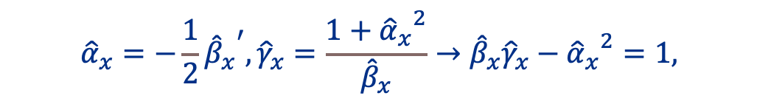
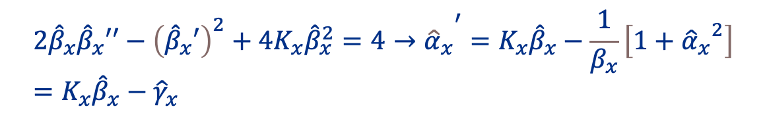

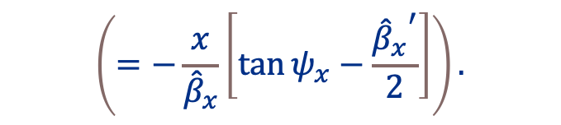
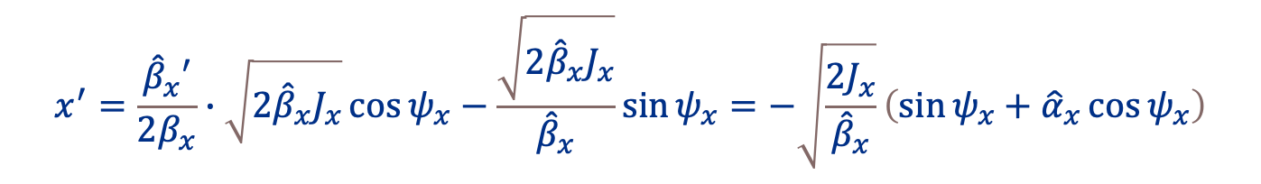

Transverse beam dynamics
Proposing further transformations
Surprisingly (or expectedly), $x$ and $x′$ becomes much simple
Envelop equation is also simplified
$${\hat{α}}_{x}=−\frac{1}{2}{{\hat{β}}_{x}}^{′}, {\hat{γ}}_{x}=\frac{1+{{\hat{α}}_{x}}^{2}}{{\hat{β}}_{x}}→{\hat{β}}_{x}{\hat{γ}}_{x}−{{\hat{α}}_{x}}^{2}=1,$$
$$x=\sqrt{2{\hat{β}}_{x}J_{x}}\cos{ψ_{x}},$$
$$x^{′}=\frac{{\hat{β}}_{x}′}{2β_{x}}∙\sqrt{2{\hat{β}}_{x}J_{x}}\cos{ψ_{x}}−\frac{\sqrt{2{\hat{β}}_{x}J_{x}}}{{\hat{β}}_{x}}\sin{ψ_{x}=−\sqrt{\frac{2J_{x}}{{\hat{β}}_{x}}}\left(\sin{ψ_{x}+{\hat{α}}_{x}\cos{ψ_{x}}}\right)}$$
$$\left(=−\frac{x}{{\hat{β}}_{x}}\left[\tan{ψ_{x}}−\frac{{{\hat{β}}_{x}}^{′}}{2}\right]\right).$$
$${2{\hat{β}}_{x}{\hat{β}}_{x}′′−{\left({\hat{β}}_{x}′\right)}^{2}+4K_{x}{\hat{β}}_{x}^{2}=4→{\hat{α}}_{x}}^{′}=K_{x}{\hat{β}}_{x}−\frac{1}{β_{x}}\left[1+{{\hat{α}}_{x}}^{2}\right]=K_{x}{\hat{β}}_{x}−{\hat{γ}}_{x}$$

Slide 27
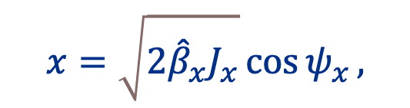
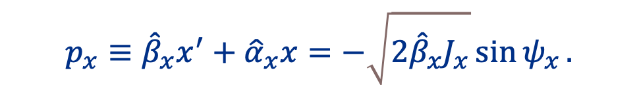

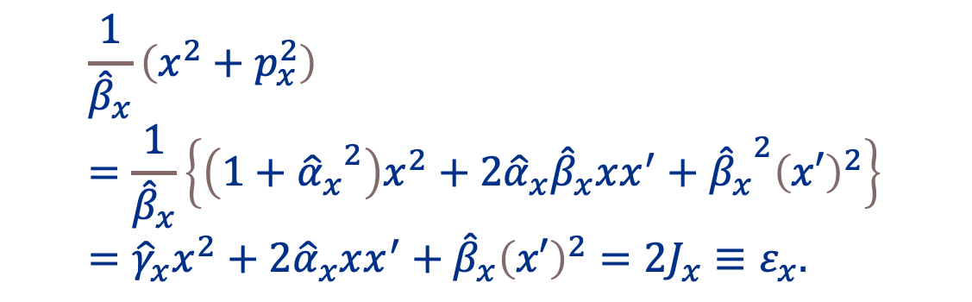
Transverse beam dynamics
We introduce a (new) canonical momentum
Then,
$$p_{x}≡{\hat{β}}_{x}x^{′}+{\hat{α}}_{x}x=−\sqrt{2{\hat{β}}_{x}J_{x}}\sin{ψ_{x}}.$$
$$x=\sqrt{2{\hat{β}}_{x}J_{x}}\cos{ψ_{x}},$$
$$\frac{1}{{\hat{β}}_{x}}\left(x^{2}+p_{x}^{2}\right)=\frac{1}{{\hat{β}}_{x}}\left\{\left(1+{{\hat{α}}_{x}}^{2}\right)x^{2}+2{\hat{α}}_{x}{\hat{β}}_{x}xx^{′}+{{\hat{β}}_{x}}^{2}{\left(x′\right)}^{2}\right\}={\hat{γ}}_{x}x^{2}+2{\hat{α}}_{x}xx^{′}+{\hat{β}}_{x}{\left(x′\right)}^{2}=2J_{x}≡ε_{x}.$$
$${\hat{γ}}_{x}=\frac{1}{{\hat{β}}_{x}}\left[1+{{\hat{α}}_{x}}^{2}\right]$$
$ε_{x}$ is called the Courant-Snyder invariant, or emittance

Slide 28
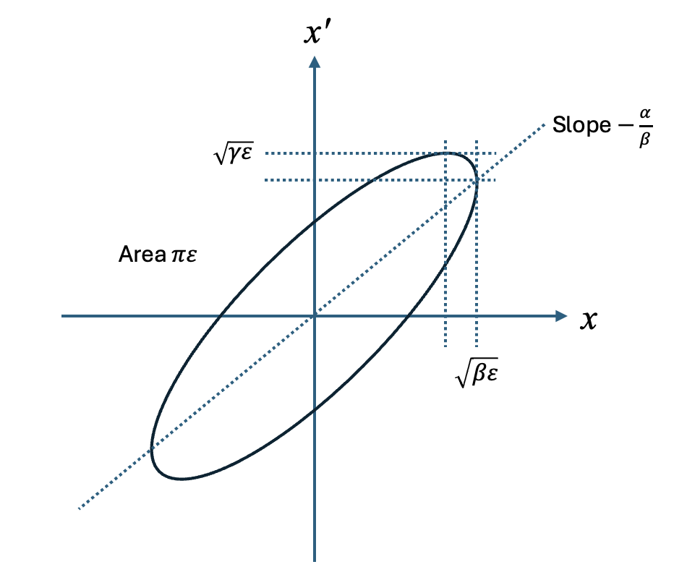

Courant-Snyder invariant (phase ellipse)
$x$ and $p_{x}$form a circle with radius $\sqrt{{\hat{β}}_{x}∙ε_{x}}$

Slide 29





Summary
We have a solution for particle motion using analogous to the simple harmonic motion
Smaller $β_{x}$ makes amplitude of $x′$ larger while amplitude of $x$ smaller
How do we find $β$?
  Can we solve $β$ from envelop equation?
$$x=\sqrt{2{\hat{β}}_{x}J_{x}}\cos{ψ_{x}},$$
$$x^{′}={−\sqrt{\frac{2J_{x}}{{\hat{β}}_{x}}}\left(\sin{ψ_{x}+{\hat{α}}_{x}\cos{ψ_{x}}}\right)}$$
$$\frac{1}{{\hat{β}}_{x}}=ψ_{x}′$$
$${2{\hat{β}}_{x}{\hat{β}}_{x}′′−{\left({\hat{β}}_{x}′\right)}^{2}+4K_{x}{\hat{β}}_{x}^{2}=4→{\hat{α}}_{x}}^{′}=K_{x}{\hat{β}}_{x}−\frac{1}{{\hat{β}}_{x}}\left[1+{{\hat{α}}_{x}}^{2}\right]=K_{x}{\hat{β}}_{x}−{\hat{γ}}_{x}$$

Slide 30






Find$\hat{β}$,$\hat{α}$,$\hat{γ}$(Twiss parameter) from phase space evolution
Assume the density function is given, $ρ\left(x,x′\right)$
The rms beam emittance is then,
$$〈x〉=\int{x∙ρ\left(x,x^{′}\right)dxdx^{′}}, 〈x^{′}〉=\int{x^{′}}∙ρ\left(x,x^{′}\right)dxdx^{′},$$
$$σ_{x}^{2}=\int{{\left(x−〈x〉\right)}^{2}}∙ρ\left(x,x^{′}\right)dxdx^{′},$$
$$σ_{x^{′}}^{2}=\int{{\left(x^{′}−〈x^{′}〉\right)}^{2}}∙ρ\left(x,x^{′}\right)dxdx^{′},$$
$$σ_{xx′}=\int{\left(x−〈x〉\right)}\left(x^{′}−〈x^{′}〉\right)∙ρ\left(x,x^{′}\right)dxdx^{′}.$$
$$ε_{x,rms}=\sqrt{Det\left[σ^{2}\right]}=\sqrt{σ_{x}^{2}∙σ_{x^{′}}^{2}−σ_{xx′}^{2}}.$$

Slide 31







Find$\hat{β}$,$\hat{α}$,$\hat{γ}$(Twiss parameter) from phase space evolution
If the beam distribution function is a function of the Courant-Snyder invariant, the $σ$-matrix is given
$$\left(\begin{matrix}σ_{x}^{2} & σ_{xx′} \\ σ_{xx′} & σ_{x′}^{2}\end{matrix}\right)=ε_{rms}\left(\begin{matrix}\hat{β} & −\hat{α} \\ −\hat{α} & \hat{γ}\end{matrix}\right).$$
$$ε_{x,rms}=\sqrt{Det\left[σ^{2}\right]}=\sqrt{σ_{x}^{2}∙σ_{x^{′}}^{2}−σ_{xx′}^{2}}.$$
${\hat{β}}_{x}$=$\frac{σ_{x}^{2}}{ε_{rms}}$
${\hat{α}}_{x}$=$−\frac{σ_{xx′}^{2}}{ε_{rms}}$
${\hat{γ}}_{x}$=$\frac{σ_{x′}^{2}}{ε_{rms}}$
Note:$\tilde{K}=\left(\begin{matrix}\hat{β} & −\hat{α} \\ −\hat{α} & \hat{γ}\end{matrix}\right)$ is a symplectic matrix, ie ${\tilde{K}}^{T}Ω\tilde{K}=Ω$
where using $\hat{β}\hat{γ}={\hat{α}}^{2}+1$

Slide 32
Extra slides

Slide 33


Overview of Muon Collider
Proton beam based muon collider
$π^{±}/μ^{±}$ capture magnets
Solenoid base
Massive & expensive
Most efficient
Horn base
Cheap
Charge dependence

Slide 34


Overview of Muon Collider
Proton beam based muon collider
Buncher and Phase rotator
Simulation
Stratakis et al.
Neuffer
Captured muons
Decay channel
Buncher
Concept
Phase rotation

Slide 35


Ionization interactions vs frictional interactions
Low energy (< 100 eV) incident particle feels a screened Coulomb potential ${S_{e}\left(E\right)}_{Lindhard−Scharff}=kE^{1/2}$
Nuclei
Low energy
incident particle
High energy
incident particle
High energy (> MeV) incident particle interact individual atom (electrons)
$$S_{e}{\left(E\right)}_{Bethe}=KE^{−1}ln\left({γ_{e}E}/{\overline{I}}\right)$$
Electron cloud
Screened Coulomb
potential

Slide 36



Wide range of energy loss value in PDG
frictional
ionization
$$kE^{1/2}$$
$$−KE^{−1}ln\left({γ_{e}E}/{\overline{I}}\right)$$
Muon momentum range is typically 100 ~ 300 MeV/c for ionization cooling (HF solenoid final channel uses p ~ 50 MeV/c)

Slide 37
Other beam cooling techniques
Stochastic cooling
Electron cooling
Laser cooling

