Slide 1
Mini Lecture Course: Accelerator Design for a Multi-TeV Muon Collider
Lecture 2: Phase stability
Katsuya Yonehara
4/28/2025

Slide 2

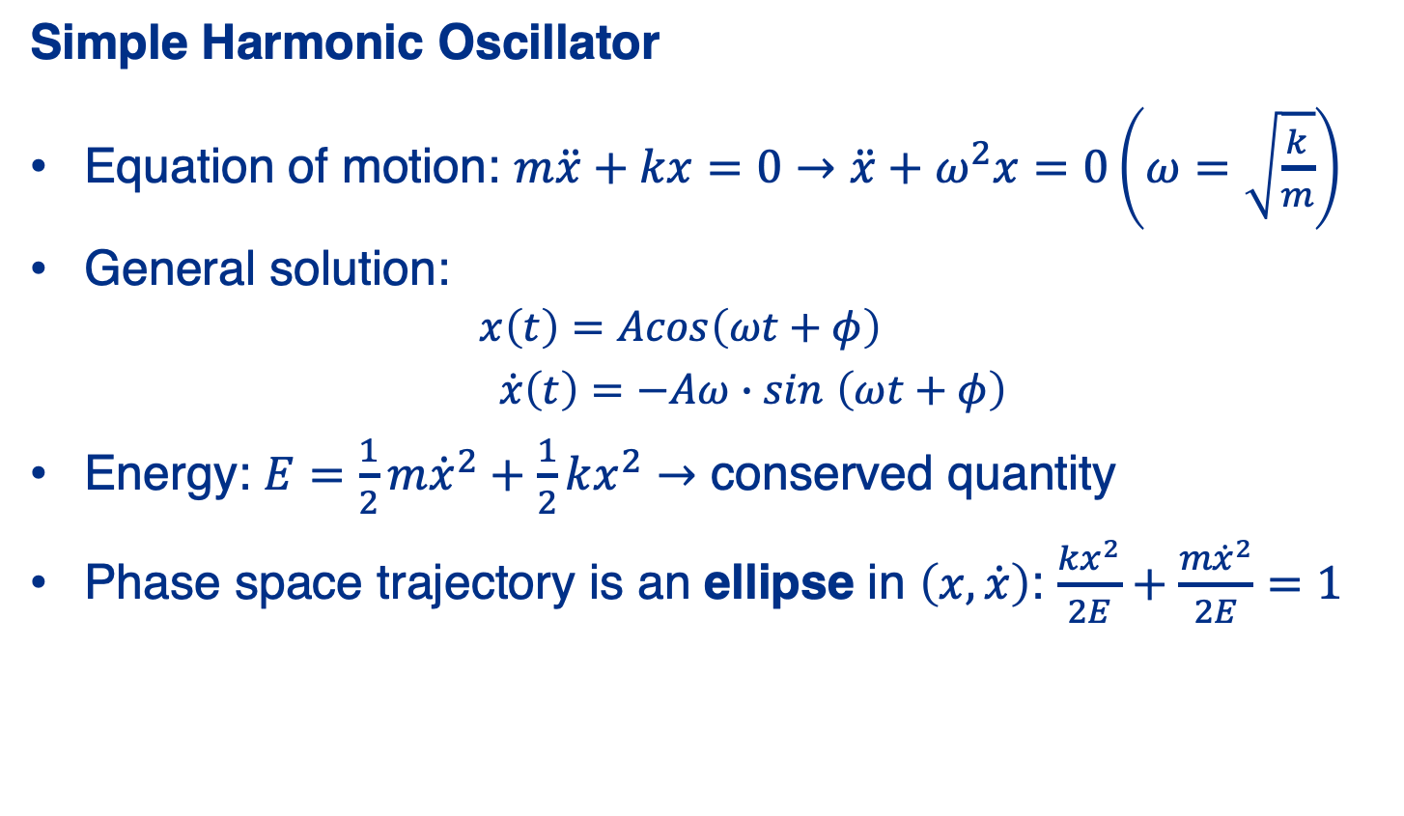

Harmonic Oscillation Refresher
Simple Harmonic Oscillator
Equation of motion: $m\ddot{x}+kx=0→\ddot{x}+ω^{2}x=0\left(ω=\sqrt{\frac{k}{m}}\right)$
General solution:
  $$x\left(t\right)=Acos\left(ωt+φ\right)$$
  $\dot{x}\left(t\right)=−Aω∙sin$ $\left(ωt+φ\right)$
Energy: $E=\frac{1}{2}m{\dot{x}}^{2}+\frac{1}{2}kx^{2}→$ conserved quantity
Phase space trajectory is an ellipse in $\left(x,\dot{x}\right)$: $\frac{kx^{2}}{2E}+\frac{m{\dot{x}}^{2}}{2E}=1$
$$\dot{x}$$
$$x$$

Slide 3





Phase Space Area and Action Variable
Area of Phase Space Ellipse
Let: $x_{max}=A, p_{max}=mωA$
Phase space area: $𝒜=πx_{max}p_{max}=π∙mωA^{2}=2π∙J$
Action variable: $J=\frac{1}{2π}\oint{pdq}=\frac{E}{ω}$ (conserved)
In beam physics: $J∝ε$, the emittance
$$p_{x}$$
$$mωA$$
$$A$$
$$x$$

Slide 4
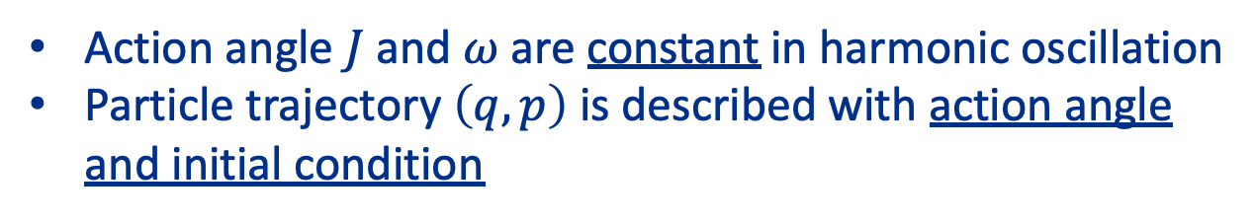

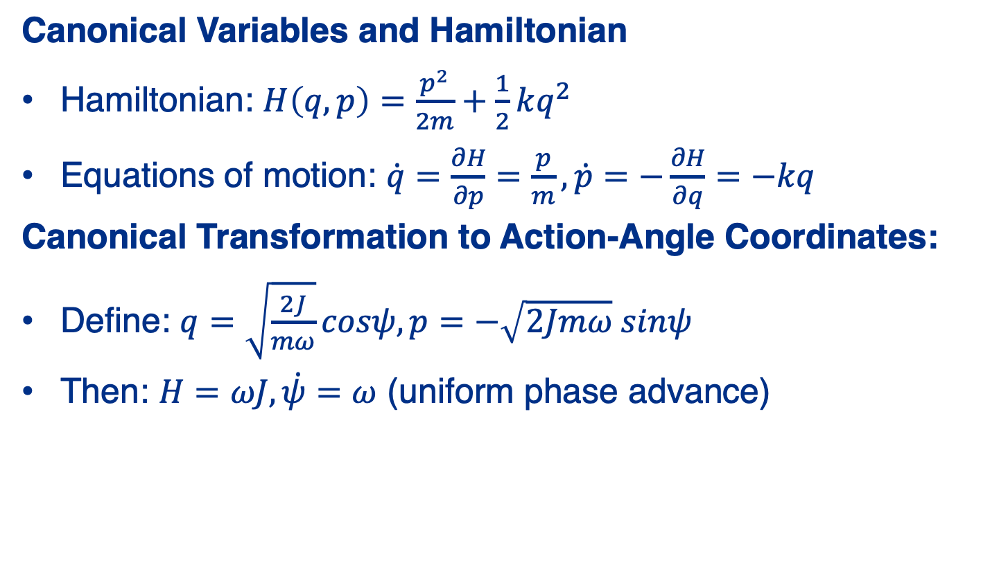



Hamiltonian and Canonical Transformation
Canonical Variables and Hamiltonian
Hamiltonian: $H\left(q,p\right)=\frac{p^{2}}{2m}+\frac{1}{2}kq^{2}$
Equations of motion: $\dot{q}=\frac{∂H}{∂p}=\frac{p}{m}, \dot{p}=−\frac{∂H}{∂q}=−kq$
Canonical Transformation to Action-Angle Coordinates:
Define: $q=\sqrt{\frac{2J}{mω}}cosψ, p=−\sqrt{2Jmω} sinψ$
Then: $H=ωJ, \dot{ψ}=ω$ (uniform phase advance)
Action angle $J$ and $ω$ are constant in harmonic oscillation
Particle trajectory $\left(q,p\right)$ is described with action angle and initial condition
$$p_{x}$$
Ellipse
$$J$$
Single point
$$x$$
$$ω$$

Slide 5
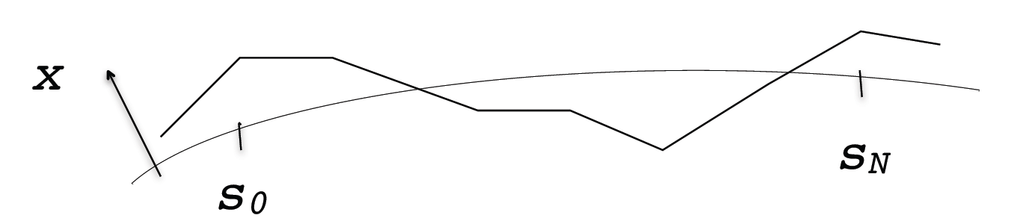


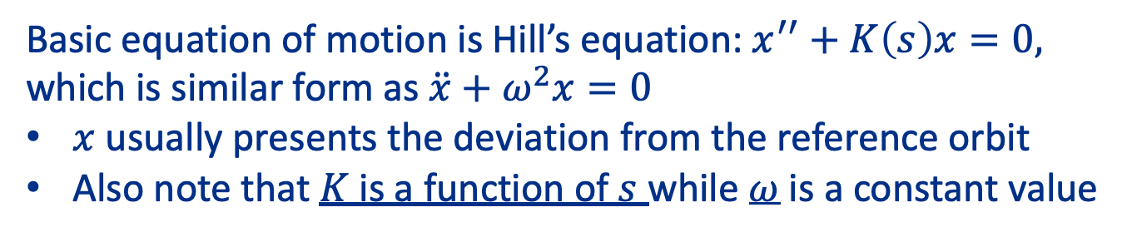
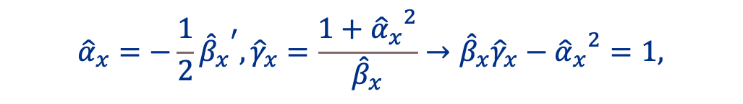
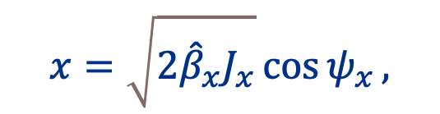
Transition to Beam Optics
Action angle in beam optics is $ε \left(J\right)$ and $\hat{β}$
$$p_{x}≡{\hat{β}}_{x}x^{′}+{\hat{α}}_{x}x=−\sqrt{2{\hat{β}}_{x}J_{x}}\sin{ψ_{x}}.$$
$$x=\sqrt{2{\hat{β}}_{x}J_{x}}\cos{ψ_{x}},$$
$${\hat{α}}_{x}=−\frac{1}{2}{{\hat{β}}_{x}}^{′}, {\hat{γ}}_{x}=\frac{1+{{\hat{α}}_{x}}^{2}}{{\hat{β}}_{x}}→{\hat{β}}_{x}{\hat{γ}}_{x}−{{\hat{α}}_{x}}^{2}=1,$$
Basic equation of motion is Hill’s equation: $x^{′′}+K\left(s\right)x=0,$
which is similar form as $\ddot{x}+ω^{2}x=0$
$x$ usually presents the deviation from the reference orbit
Also note that $K$ is a function of $s$ while $ω$ is a constant value
Reference orbit
Deviation from reference

Slide 6
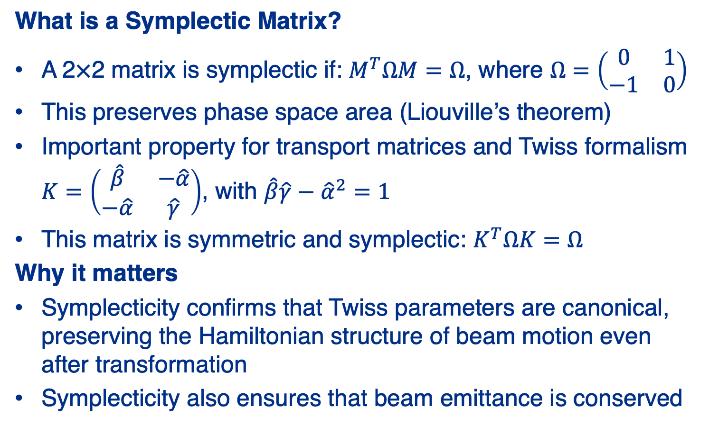
Reminder on Symplectic Matrices
What is a Symplectic Matrix?
A 2×2 matrix is symplectic if: $M^{T}ΩM=Ω$, where $Ω=\left(\begin{matrix}0 & 1 \\ −1 & 0\end{matrix}\right)$
This preserves phase space area (Liouville’s theorem)
Important property for transport matrices and Twiss formalism $K=\left(\begin{matrix}\hat{β} & −\hat{α} \\ −\hat{α} & \hat{γ}\end{matrix}\right)$, with $\hat{β}\hat{γ}−{\hat{α}}^{2}=1$
This matrix is symmetric and symplectic: $K^{T}ΩK=Ω$
Why it matters
Symplecticity confirms that Twiss parameters are canonical, preserving the Hamiltonian structure of beam motion even after transformation
Symplecticity also ensures that beam emittance is conserved

Slide 7
Discussion item for lecture 2
Emittance evolution in Ionization cooling
Transverse phase space stability
Thin lens & paraxial approximations
Longitudinal phase space stability

Slide 8
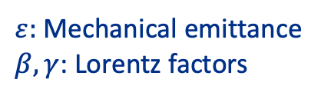

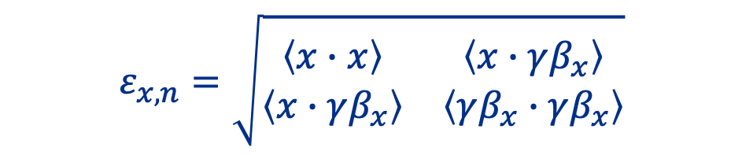
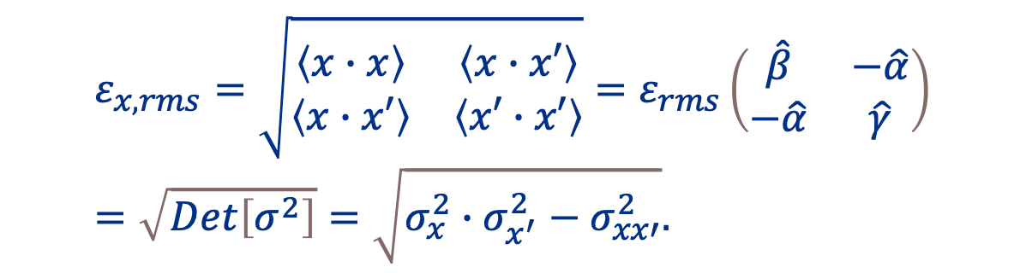
Normalized emittance
NB: Normalized emittance is invariant under acceleration, whereas mechanical emittance shrinks with increasing beam energy
$$ε_{n}=βγ∙ε$$
$ε:$ Mechanical emittance
$β, γ$: Lorentz factors
Mechanical emittance (kinetic energy included)
$$ε_{x,rms}=\sqrt{\begin{matrix}\left\langle x∙x\right\rangle & \left\langle x∙x′\right\rangle \\ \left\langle x∙x′\right\rangle & \left\langle x′∙x′\right\rangle \end{matrix}}=ε_{rms}\left(\begin{matrix}\hat{β} & −\hat{α} \\ −\hat{α} & \hat{γ}\end{matrix}\right)=\sqrt{Det\left[σ^{2}\right]}=\sqrt{σ_{x}^{2}∙σ_{x^{′}}^{2}−σ_{xx′}^{2}}.$$
Normalized emittance (no change by kinetic energy)
$$ε_{x,n}=\sqrt{\begin{matrix}\left\langle x∙x\right\rangle & \left\langle x∙γβ_{x}\right\rangle \\ \left\langle x∙γβ_{x}\right\rangle & \left\langle γβ_{x}∙γβ_{x}\right\rangle \end{matrix}}$$
NB: we extract $\hat{β},$ $\hat{α}$, $\hat{γ}$ (Twiss parameter) from mechanical emittance

Slide 9
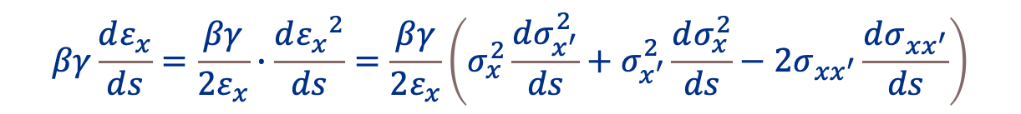
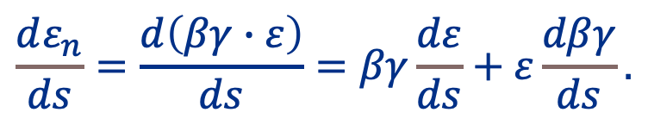
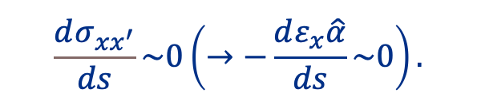
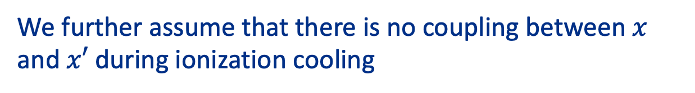
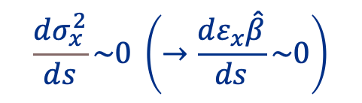
Emittance evolution (Transverse)
$$\frac{dε_{n}}{ds}=\frac{d\left(βγ∙ε\right)}{ds}=βγ\frac{dε}{ds}+ε\frac{dβγ}{ds}.$$
First term,
$$βγ\frac{dε_{x}}{ds}=\frac{βγ}{2ε_{x}}∙\frac{d{ε_{x}}^{2}}{ds}=\frac{βγ}{2ε_{x}}\left(σ_{x}^{2}\frac{dσ_{x^{′}}^{2}}{ds}+σ_{x^{′}}^{2}\frac{dσ_{x}^{2}}{ds}−2σ_{xx^{′}}\frac{dσ_{xx^{′}}}{ds}\right)$$
Assume there is no beam spot size variation
$$\frac{dσ_{x}^{2}}{ds}\sim 0 \left(→\frac{dε_{x}\hat{β}}{ds}\sim 0\right)$$
NB: We assume that Liouville's theorem is adiabatically preserved during ionization cooling (slide 18)
We further assume that there is no coupling between $x$ and $x′$ during ionization cooling
$$\frac{dσ_{xx^{′}}}{ds}\sim 0\left(→−\frac{dε_{x}\hat{α}}{ds}\sim 0\right).$$

Slide 10
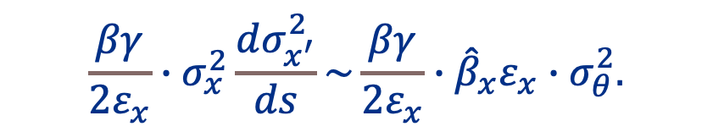
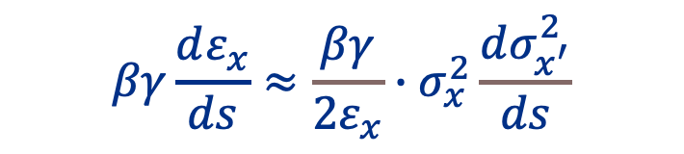
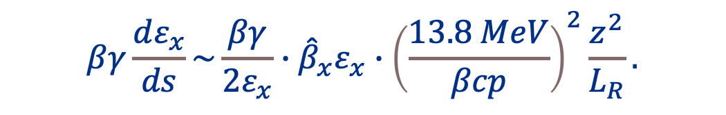

Emittance evolution (Transverse)
Residual term
$$βγ\frac{dε_{x}}{ds}≈\frac{βγ}{2ε_{x}}∙σ_{x}^{2}\frac{dσ_{x^{′}}^{2}}{ds}$$
We involve multiple scattering process,
$$\frac{βγ}{2ε_{x}}∙σ_{x}^{2}\frac{dσ_{x^{′}}^{2}}{ds}\sim \frac{βγ}{2ε_{x}}∙{\hat{β}}_{x}ε_{x}∙σ_{θ}^{2}.$$
$$σ_{θ}^{2}\sim {\left(\frac{13.8 MeV}{βcp}\right)}^{2}\frac{z^{2}}{L_{R}}.$$
We will investigate multiple
scattering in later session
Thus, we finally gain
$$βγ\frac{dε_{x}}{ds}\sim \frac{βγ}{2ε_{x}}∙{\hat{β}}_{x}ε_{x}∙{\left(\frac{13.8 MeV}{βcp}\right)}^{2}\frac{z^{2}}{L_{R}}.$$

Slide 11
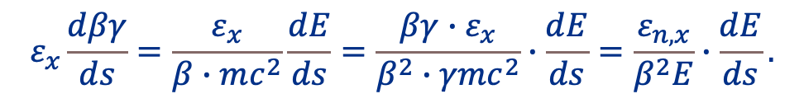
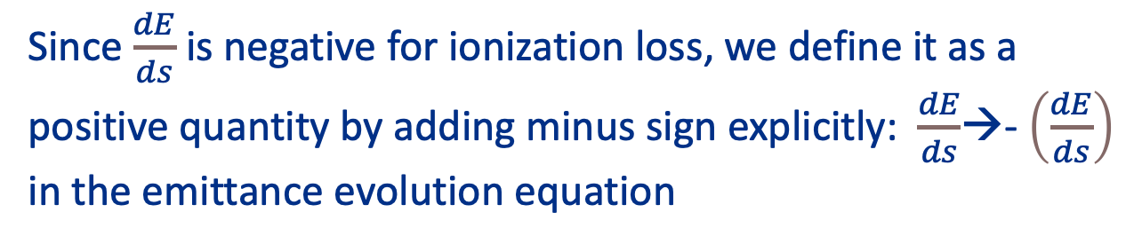
Emittance evolution (Transverse)
$$\frac{dε_{n}}{ds}=\frac{d\left(βγ∙ε\right)}{ds}=βγ\frac{dε}{ds}+ε\frac{dβγ}{ds}.$$
Second term,
$$ε_{x}\frac{dβγ}{ds}=\frac{ε_{x}}{β∙mc^{2}}\frac{dE}{ds}=\frac{βγ∙ε_{x}}{β^{2}∙γmc^{2}}∙\frac{dE}{ds}=\frac{ε_{n,x}}{β^{2}E}∙\frac{dE}{ds}.$$
Since $\frac{dE}{ds}$ is negative for ionization loss, we define it as a positive quantity by adding minus sign explicitly: $\frac{dE}{ds}$→- $\left(\frac{dE}{ds}\right)$ in the emittance evolution equation

Slide 12
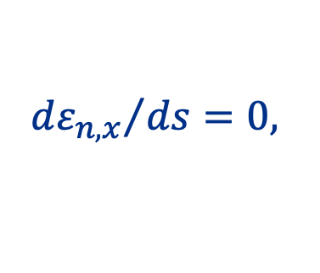
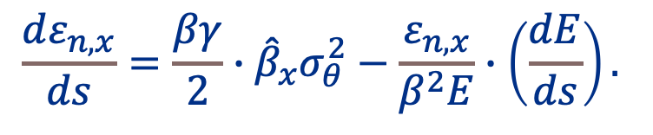
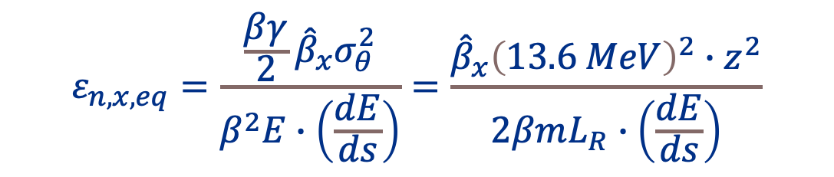
Emittance evolution (Transverse)
Final form is
$$\frac{dε_{n,x}}{ds}=\frac{βγ}{2}∙{\hat{β}}_{x}σ_{θ}^{2}−\frac{ε_{n,x}}{β^{2}E}∙\left(\frac{dE}{ds}\right).$$
The equilibrium emittance is obtained from this,
$${dε_{n,x}}/{ds=0, }$$
$$ε_{n, x,eq}=\frac{\frac{βγ}{2}{\hat{β}}_{x}σ_{θ}^{2}}{β^{2}E∙\left(\frac{dE}{ds}\right)}=\frac{{\hat{β}}_{x}{\left(13.6 MeV\right)}^{2}∙z^{2}}{2βmL_{R}∙\left(\frac{dE}{ds}\right)}$$
To reach low emittance: low${\hat{β}}_{x}$, large $\left(\frac{dE}{ds}\right),$and long $L_{R}$

Slide 13
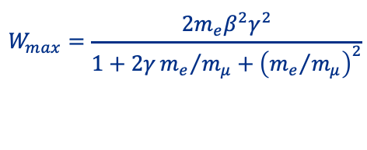
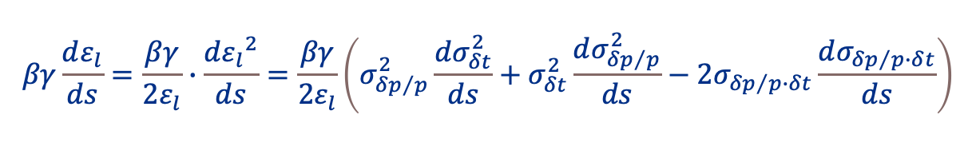

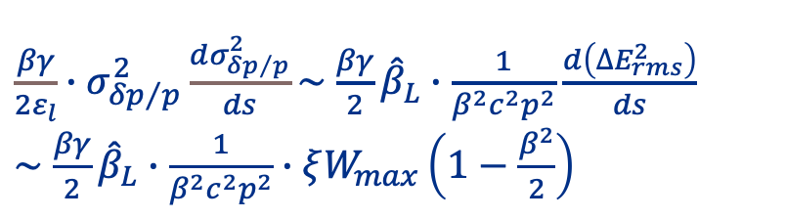
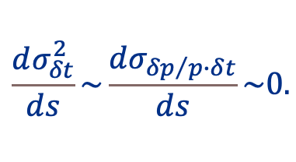
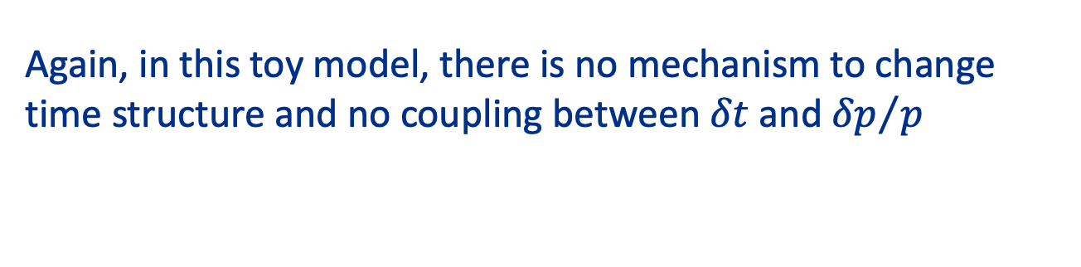
Emittance evolution (Longitudinal)
$$\frac{dε_{n}}{ds}=\frac{d\left(βγ∙ε\right)}{ds}=βγ\frac{dε}{ds}+ε\frac{dβγ}{ds}.$$
First term for longitudinal,
$$βγ\frac{dε_{l}}{ds}=\frac{βγ}{2ε_{l}}∙\frac{d{ε_{l}}^{2}}{ds}=\frac{βγ}{2ε_{l}}\left(σ_{{δp}/p}^{2}\frac{dσ_{δt}^{2}}{ds}+σ_{δt}^{2}\frac{dσ_{{δp}/p}^{2}}{ds}−2σ_{{δp}/p∙δt}\frac{dσ_{{δp}/{p∙δ}t}}{ds}\right)$$
Again, in this toy model, there is no mechanism to change time structure and no coupling between $δt$ and ${δp}/p$
$$\frac{dσ_{δt}^{2}}{ds}\sim \frac{dσ_{{δp}/{p∙δ}t}}{ds}\sim 0.$$
While the energy straggling effect is included,
${\frac{βγ}{2ε_{l}}∙σ}_{{δp}/p}^{2}\frac{dσ_{{δp}/p}^{2}}{ds}\sim$ $\frac{βγ}{2}{\hat{β}}_{L}∙\frac{1}{β^{2}c^{2}p^{2}}\frac{d\left({∆E}_{rms}^{2}\right)}{ds}$
$\sim$ $\frac{βγ}{2}{\hat{β}}_{L}∙\frac{1}{β^{2}c^{2}p^{2}}∙ξW_{max}\left(1−\frac{β^{2}}{2}\right)$
$$ξ=153.4\frac{z^{2}}{β^{2}}\frac{Z}{A}$$
keV g/cm²
$$W_{max}=\frac{2m_{e}β^{2}γ^{2}}{1+2γ{m_{e}}/{m_{μ}+{\left({m_{e}}/{m_{μ}}\right)}^{2}}}$$

Slide 14
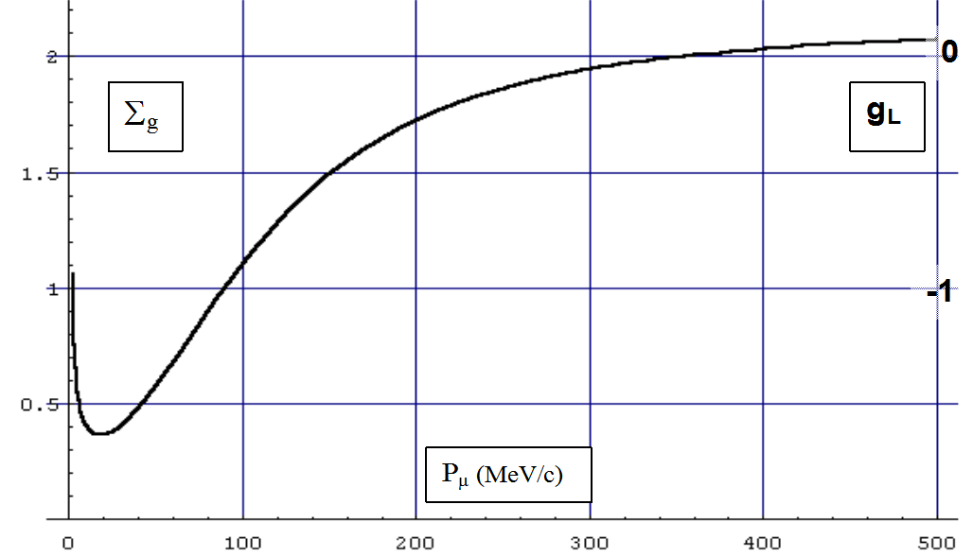
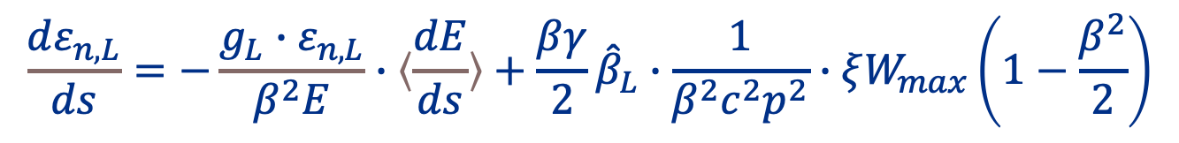
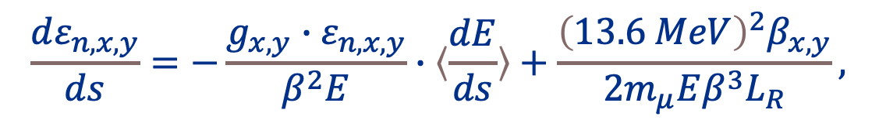
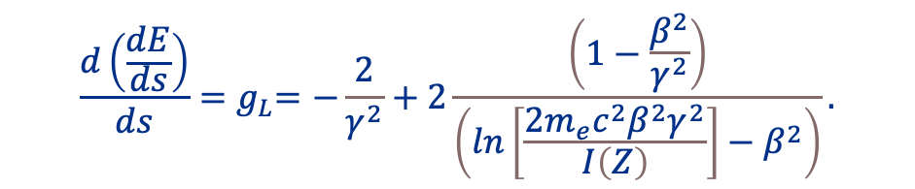
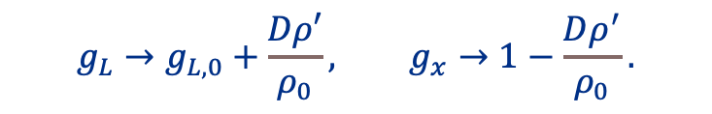


Emittance evolution (Dispersion coupling)
Add coupling parameter
$$\frac{dε_{n,x,y}}{ds}=−\frac{g_{x,y}∙ε_{n,x,y}}{β^{2}E}∙〈\frac{dE}{ds}〉+\frac{{\left(13.6 MeV\right)}^{2}β_{x,y}}{2m_{μ}Eβ^{3}L_{R}},$$
$$\frac{dε_{n,L}}{ds}=−\frac{g_{L}∙ε_{n,L}}{β^{2}E}∙〈\frac{dE}{ds}〉+\frac{βγ}{2}{\hat{β}}_{L}∙\frac{1}{β^{2}c^{2}p^{2}}∙ξW_{max}\left(1−\frac{β^{2}}{2}\right)$$
Where $g_{x,y}$ and $g_{L}$ are a partition number
$$\frac{d\left(\frac{dE}{ds}\right)}{ds}{=g}_{L}=−\frac{2}{γ^{2}}+2\frac{\left(1−\frac{β^{2}}{γ^{2}}\right)}{\left(ln\left[\frac{2m_{e}c^{2}β^{2}γ^{2}}{I\left(Z\right)}\right]−β^{2}\right)}.$$
$g_{L,0} at p\sim 350$MeV/c
where $g_{L}=0$
To compensate positive $g_{L,0}$, dispersion + wedge absorber
$$g_{L}→g_{L,0}+\frac{Dρ′}{ρ_{0}}, g_{x}→1−\frac{Dρ^{′}}{ρ_{0}}.$$
Indeed, dispersion induces coupling between transverse and longitudinal
$$Σ_{g}=g_{x}+g_{y}+g_{L}=2+g_{L, 0}.$$

Slide 15
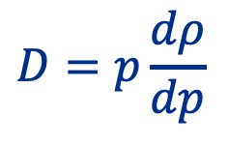





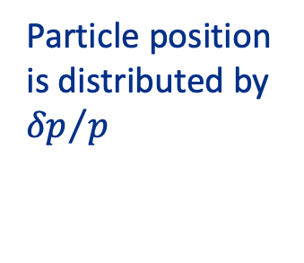

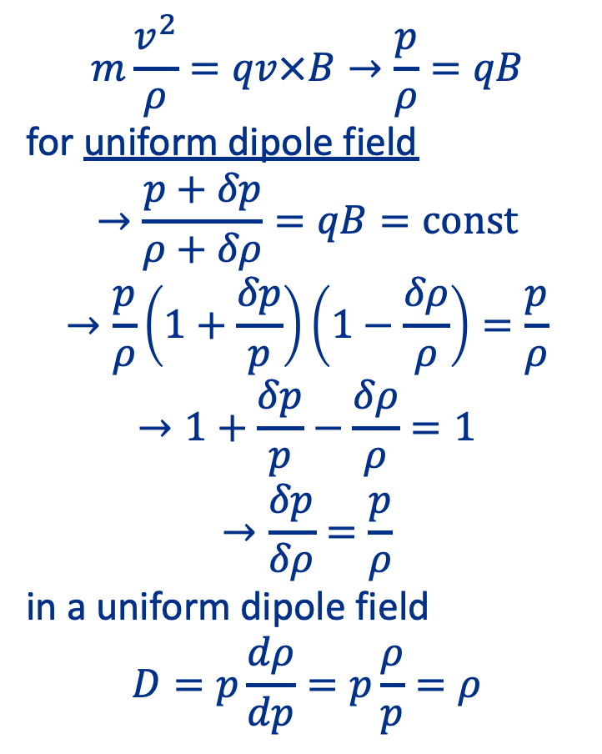
Emittance exchange with Dispersion
Beam momentum is translated into beam position by dipole magnet
$$m\frac{v^{2}}{ρ}=qv×B→\frac{p}{ρ}=qB$$
for uniform dipole field
$$→\frac{p+δp}{ρ+δρ}=qB=const$$
$$→\frac{p}{ρ}\left(1+\frac{δp}{p}\right)\left(1−\frac{δρ}{ρ}\right)=\frac{p}{ρ}$$
$$→1+\frac{δp}{p}−\frac{δρ}{ρ}=1$$
$$→\frac{δp}{δρ}=\frac{p}{ρ}$$
in a uniform dipole field
$$D=p\frac{dρ}{dp}=p\frac{ρ}{p}=ρ$$
NB: Beam emittance is not exchanged without absorber
$$ρ−δρ$$
$$p−δp$$
$$ρ$$
Particle position is distributed by ${δp}/p$
$$p$$
$$p+δp$$
$$ρ+δρ$$
Top view of dipole magnet
This phenomenon is called dispersion
$$D=p\frac{dρ}{dp}$$

Slide 16


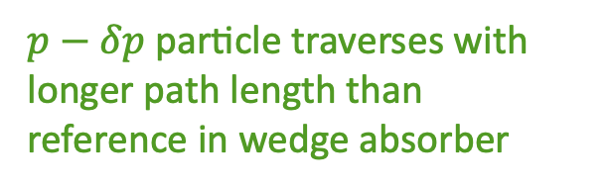


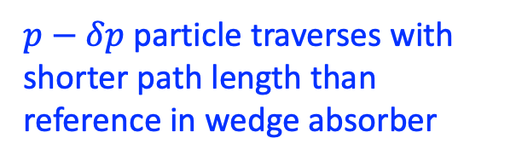


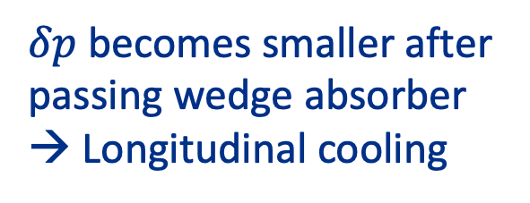
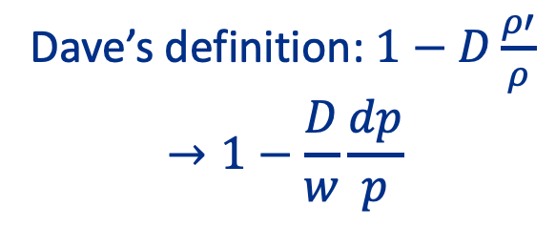


Longitudinal cooling with emittance exchange
$p−δp$ particle traverses with
shorter path length than reference in wedge absorber
$$α$$
$p$ particle is a reference particle
$$l= 2w\left(1−\frac{dp}{wp}D\right)\tan{\frac{α}{2}}$$
$$w$$
$$−δx$$
$$l=2w\tan{\frac{α}{2}}$$
$$+δx$$
$p−δp$ particle traverses with
longer path length than reference in wedge absorber
$$l=2w\left(1+\frac{dp}{wp}D\right)\tan{\frac{α}{2}}$$
Wedge absorber
$δp$ becomes smaller after passing wedge absorber
→ Longitudinal cooling
Dave’s definition: $1−D\frac{ρ′}{ρ}$
$$→1−\frac{D}{w}\frac{dp}{p}$$

Slide 17
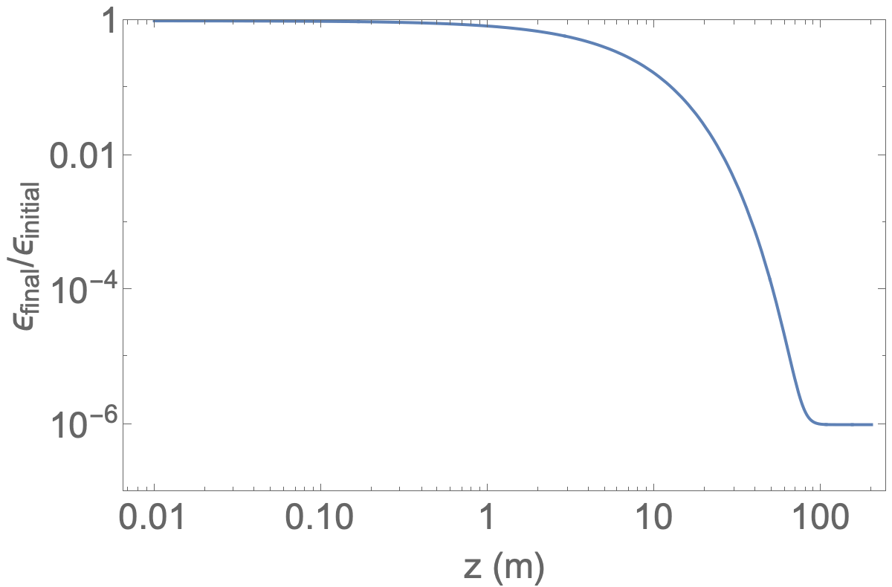

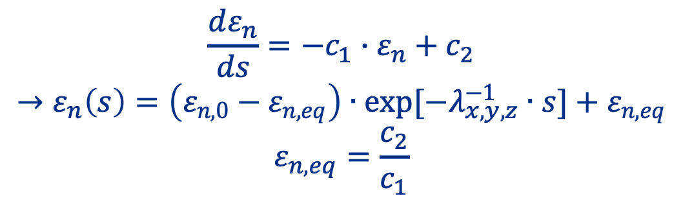
Emittance evolution
Constant term
$$\frac{dε_{n,x,y}}{ds}=−\frac{g_{x,y}∙ε_{n,x,y}}{β^{2}E}∙〈\frac{dE}{ds}〉+\frac{{\left(13.6 MeV\right)}^{2}β_{x,y}}{2m_{μ}Eβ^{3}L_{R}},$$
$$\frac{dε_{n,L}}{ds}=−\frac{g_{L}∙ε_{n,L}}{β^{2}E}∙〈\frac{dE}{ds}〉+\frac{βγ}{2}{\hat{β}}_{L}∙\frac{1}{β^{2}c^{2}p^{2}}∙ξW_{max}\left(1−\frac{β^{2}}{2}\right)$$
$$\frac{dε_{n}}{ds}={−c}_{1}∙ε_{n}+c_{2}$$
$$→ε_{n}\left(s\right)=\left(ε_{n,0}−ε_{n,eq}\right)∙exp[−λ_{x,y,z}^{−1}∙s]+ε_{n,eq}$$
$$ε_{n,eq}=\frac{c_{2}}{c_{1}}$$
LH2
Plot shows that the required cooling channel length is < 100 m in LH2 if the equilibrium emittance is 10⁻⁶ (initial emittance is 1.0) unit is arbitrary in this discussion
$λ^{−1}=0.18$m⁻¹

Slide 18
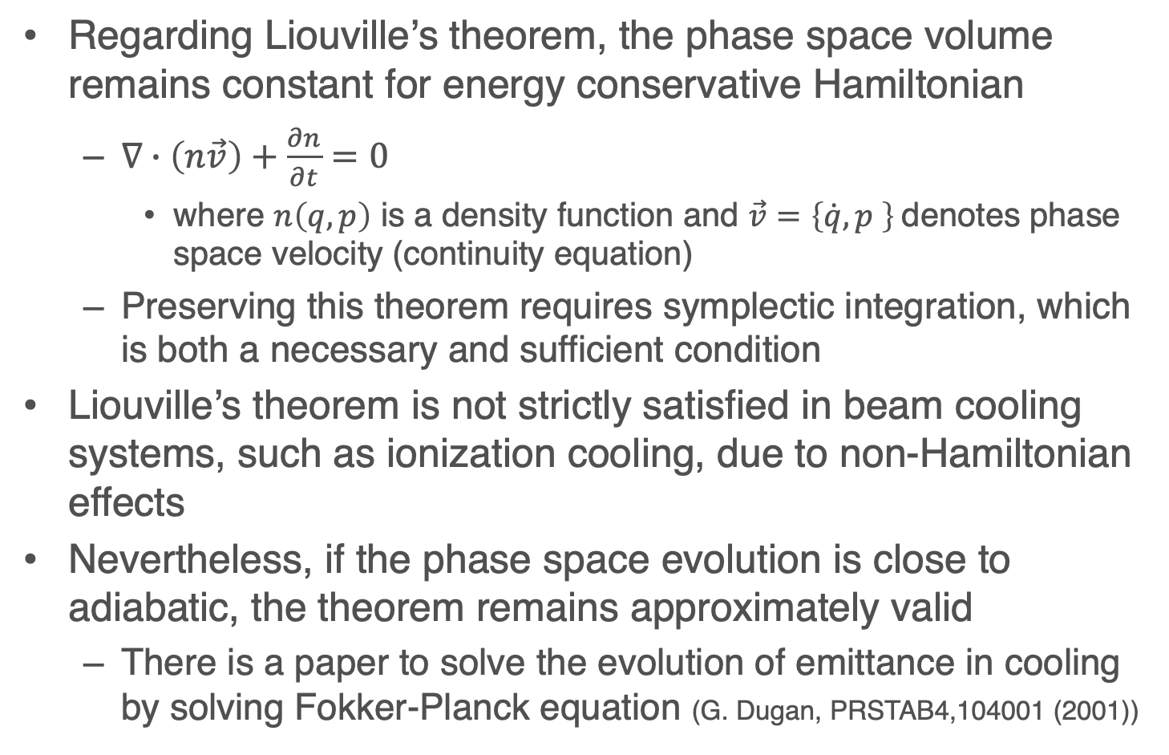
How do we treat Liouville's theorem in cooling?
Regarding Liouville’s theorem, the phase space volume remains constant for energy conservative Hamiltonian
  $∇∙\left(n\vec{v}\right)+\frac{∂n}{∂t}=0$
    where $n\left(q,p\right)$ is a density function and $\vec{v}=\left\{\dot{q},p \right\}$denotes phase space velocity (continuity equation)
  Preserving this theorem requires symplectic integration, which is both a necessary and sufficient condition
Liouville’s theorem is not strictly satisfied in beam cooling systems, such as ionization cooling, due to non-Hamiltonian effects
Nevertheless, if the phase space evolution is close to adiabatic, the theorem remains approximately valid
  There is a paper to solve the evolution of emittance in cooling by solving Fokker-Planck equation (G. Dugan, PRSTAB4,104001 (2001))

Slide 19
Transverse Phase Space Stability

Slide 20
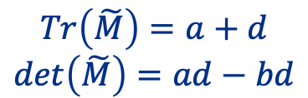
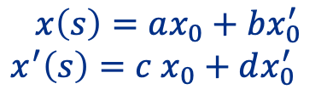
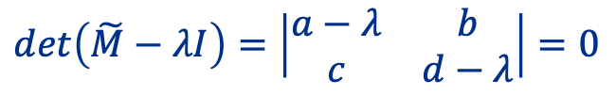

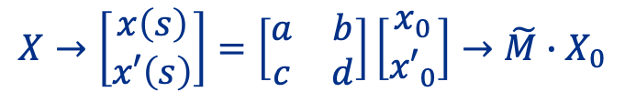
Beam dynamics and stability condition
Solution of Hill’s equation $x^{′′}\left(s\right)+κ\left(s\right)x\left(s\right)=0$ is in general
$$x\left(s\right)=ax_{0}+bx_{0}^{′}$$
$x^{′}\left(s\right)=c$ $x_{0}+dx_{0}^{′}$
Equation of motion can be solved if initial condition is known
As we usually do for the harmonic oscillation,
$$X→\left[\begin{matrix}x\left(s\right) \\ x′\left(s\right)\end{matrix}\right]=\left[\begin{matrix}a & b \\ c & d\end{matrix}\right]\left[\begin{matrix}x_{0} \\ {x′}_{0}\end{matrix}\right]→\tilde{M}∙X_{0}$$
$$Tr\left(\tilde{M}\right)=a+d$$
$$det\left(\tilde{M}\right)=ad−bd$$
Extracting eigenvalues from $\tilde{M}$,
$$det\left(\tilde{M}−λI\right)=\left|\begin{matrix}a−λ & b \\ c & d−λ\end{matrix}\right|=0$$
$$λ^{2}−\left(a+d\right)λ+\left(ad−bc\right)=0→λ^{2}−Tr\left(\tilde{M}\right)λ+det\left(\tilde{M}\right)=0$$

Slide 21






Beam dynamics and stability condition
$${\tilde{M}}^{T}Ω\tilde{M}=Ω$$
$→{\left(\begin{matrix}a & b \\ c & d\end{matrix}\right)}^{T}∙\left(\begin{matrix}0 & 1 \\ −1 & 0\end{matrix}\right)∙\left(\begin{matrix}a & b \\ c & d\end{matrix}\right)=$ $\left(\begin{matrix}0 & 1 \\ −1 & 0\end{matrix}\right)$
$→ad−bc=1$ (if energy conservation is required, then using symplectic integration is a sufficient condition)
If there is no energy change, $\frac{dH}{ds}=0$,
$det\left(\tilde{M}\right)=ad−bd=1$
$${→λ}^{2}−\left(a+d\right)+1=0→λ^{2}−Tr\left(\tilde{M}\right)λ+1=0$$
Solution of this equation is
$$λ=\frac{Tr\left(\tilde{M}\right)±\sqrt{{Tr\left(\tilde{M}\right)}^{2}−4}}{2}=\frac{\left(a+d\right)±\sqrt{{\left(a+d\right)}^{2}−4}}{2}$$
We notice if $\cos\left(σ\right)=\frac{1}{2}Tr\left(\tilde{M}\right)=\frac{\left(a+d\right)}{2},$
$$λ=\frac{\left(a+d\right)±\sqrt{{\left(a+d\right)}^{2}−4}}{2}=\frac{\left(a+d\right)}{2}±\sqrt{\frac{{\left(a+d\right)}^{2}}{4}−1}→λ_{1,2}=\cos\left(σ\right)±\sqrt{\cos^{2}\left(σ\right)−1}=\cos\left(σ\right)±i\sin\left(σ\right)=e^{±iσ}$$

Slide 22



Beam dynamics and stability condition
If $\left|a+d\right|≤2, λ_{1,2}$is a periodic solution→Beam motion is stable
For our convenience, we use following relations,
$$→\tilde{M}=\left[\begin{matrix}\cos{σ+\hat{α}\sin{σ}} & \hat{β}\sin{σ} \\ −\hat{γ}\sin{σ} & \cos{σ−\hat{α}\sin{σ}}\end{matrix}\right]$$
Or $\tilde{M}=\tilde{I}\cos{σ}+\tilde{J}\sin{σ}$
where $\tilde{I}=\left[\begin{matrix}1 & 0 \\ 0 & 1\end{matrix}\right],\tilde{J}=\left[\begin{matrix}\hat{α} & \hat{β} \\ −\hat{γ} & −\hat{α}\end{matrix}\right]$
$$a+d=2\cos\left(σ\right)$$
$$a−d=2\hat{α}\sin\left(σ\right)$$
$$b=\hat{β}\sin\left(σ\right)$$
$$c=−\hat{γ}\sin\left(σ\right)$$
$$det\left(\tilde{M}\right)=ad−bc$$
$=\left(\cos{σ+\hat{α}\sin{σ}}\right)∙\left(\cos{σ−\hat{α}\sin{σ}}\right)−$ $\hat{β}\sin{σ}∙\left(−\hat{γ}\sin{σ}\right)$
$$=\hat{β}\hat{γ}−{\hat{α}}^{2}=1$$
These relations are still within a canonical framework!

Slide 23










Beam dynamics and stability condition
Investigate $\tilde{J}$
$${\left(\tilde{J}\right)}^{2}=\left[\begin{matrix}\hat{α} & \hat{β} \\ −\hat{γ} & −\hat{α}\end{matrix}\right]∙\left[\begin{matrix}\hat{α} & \hat{β} \\ −\hat{γ} & −\hat{α}\end{matrix}\right]=\left[\begin{matrix}−1 & 0 \\ 0 & −1\end{matrix}\right]=−\tilde{I}$$
$${\left(\tilde{M}\right)}^{3}={\left(\tilde{M}\right)}^{2}∙\tilde{M}$$
$${\left(\tilde{M}\right)}^{2}={\left(\tilde{I}\cos{σ}+\tilde{J}\sin{σ}\right)}^{2}$$
$$={\tilde{I}}^{2}\cos^{2}σ+2\tilde{I}∙\tilde{J}∙sinσ∙cosσ+{\tilde{J}}^{2}\sin^{2}σ$$
$$=\tilde{I}\left(\cos^{2}σ−\sin^{2}σ\right)+2\tilde{J}sinσ∙cosσ$$
$$=\tilde{I}cos2σ+\tilde{J}sin2σ$$
$$=\left(\tilde{I}cos2σ+\tilde{J}sin2σ\right)∙\left(\tilde{I}cosσ+\tilde{J}sinσ\right)$$
$$={\tilde{I}}^{2}cos2σ∙cosσ+{\tilde{J}}^{2}sin2σ∙sinσ$$
$$+\tilde{I}\tilde{J}cos2σ∙sinσ+\tilde{I}\tilde{J}sin2σ∙cosσ$$
$$cos2σ∙cosσ=\frac{1}{2}\left(cos3σ+cosσ\right)…$$
$$=\tilde{I}cos3σ+\tilde{J}sin3σ$$
$${→\left(\tilde{M}\right)}^{N}={\left(\tilde{I}\cos{σ}+\tilde{J}\sin{σ}\right)}^{N}=\tilde{I}cosNσ+\tilde{J}sinNσ$$
$$λ_{1,2}=\cos\left(σ\right)±i\sin\left(σ\right)=e^{±iσ}→λ_{1}=\frac{1}{λ_{2}}$$
This statement is the same general solution from a parametric oscillator, especially it is called Floquet’s theorem

Slide 24
Stability of Periodic Phase Space from Mathieu equation

Slide 25






Floquet function
Floquet’s theorem is applicable to linear differential
equations with periodic coefficients
$$\frac{dX}{dt}=A\left(t\right)X$$
where $A\left(t+T\right)=A\left(t\right)$, $T$ is a period
A general solution will be
This is $λ_{1,2}$ in our case
$$X\left(t\right)=e^{μt}p\left(t\right)$$
where $p\left(t+T\right)=p\left(t\right)$, $p\left(t\right)$ is called Floquet function, $μ$ is the Floquet exponent
As we notice, it is similar as a forced oscillator
$→μ$ is pure imaginary, then $X\left(t\right)$ is a stable oscillation
$→μ$ contains real, then $X\left(t\right)$ is a forced oscillation, growing or decaying exponentially over time

Slide 26







Mathieu equation with Floquet’s theorem
As you may have noticed, our process is the reverse of the conventional forced harmonic oscillator problem. The general equation of forced harmonic oscillator in the beam dynamics is so called Mathieu equation,
$$\frac{d^{2}x}{dt^{2}}+\left(δ+ε∙cos\left(t\right)\right)x=0$$
$δ$: stiffness parameter
$ε:$ no specific name given
In the case $ε=0$, it is a condition to obtain Hill’s equation
$$\frac{d^{2}x}{dt^{2}}+f\left(t\right)∙x=0, f\left(t+T\right)=f\left(t\right)$$
Stable phase space ($S$)
Unstable phase space ($U$)
Introduce Floquet function,
$X\left(t\right)=e^{μt}p\left(t\right), X\left(t\right)=\left[\begin{matrix}x \\ x′\end{matrix}\right]$
For the stable condition, $μ→±iσ$
as we evaluated
Stable phase space from Mathieu equation

Slide 27


Envelope equation
Here is an envelope of beam
Single particle tracking
Multi particle tracking

Slide 28






Phase amplitude form
From Floquet’s theorem,
$$u=w\left(s\right)e^{iψ\left(s\right)}$$
$$v=w\left(s\right)e^{−iψ\left(s\right)}$$
$$→\left(\begin{matrix}u\left(s+S\right)=λ_{1}u\left(s\right) \\ v\left(s+S\right)=\frac{1}{λ_{1}}v\left(s\right)\end{matrix}\right.$$
Those are any solutions of $x\left(s\right)$ as linear combination of $u$ and $v$,
$$x\left(s\right)=A∙w\left(s\right)cos\left[ψ\left(s\right)+φ\right]$$
Use Wronskian, $W=uv^{′}−vu′$ as a constant (symplectic condition),
$W=−2iw^{2}ψ^{′}≡−2i$ (as constant)
$$→\frac{dψ}{ds}=ψ^{′}=\frac{1}{w^{2}}$$
Therefore, Hill’s equation yields the differential equation,
$$w^{′′}+κw−\frac{1}{w^{3}}=0$$
This is another forms of envelope equation

Slide 29




Envelope equation
Use following,
$$x=A∙wcos\left[ψ+φ\right]$$
$$x′=A\left[w^{′}cos\left[ψ+φ\right]−wψ^{′}sin\left[ψ+φ\right]\right]$$
$$→\frac{x^{2}}{w^{2}}+{\left(wx^{′}−w^{′}x\right)}^{2}=A^{2}$$
$$ψ^{′}=\frac{1}{w^{2}}$$
By comparing,
$$\hat{γ}x^{2}+2\hat{α}xx^{′}+\hat{β}{x′}^{2}=ε→\left(\begin{aligned}\begin{matrix}\hat{β}=w^{2} \\ \hat{α}=−ww′ \\ \hat{γ}=\frac{1}{w^{2}}+{w′}^{2}=\frac{1+{\hat{α}}^{2}}{\hat{β}}\end{matrix} \\ ε=A^{2}\end{aligned}\right.$$

Slide 30








Envelope equation
The maximum point
$$x_{m}\left(s\right)=\sqrt{ε∙\hat{β}\left(s\right)}=\sqrt{ε}∙w\left(s\right)$$
$${→x}_{m}^{′′}+κx_{m}−\frac{ε^{2}}{x_{m}^{3}}=0$$
Sometimes the matrix transformation is written by $w$ for envelop calculation
$$\tilde{M}=\left(\begin{matrix}cos\left(ψ\right)−ww^{′}sin\left(ψ\right) & w^{2}sin\left(ψ\right) \\ −\frac{1+w^{2}{w′}^{2}}{w^{2}}sin\left(ψ\right) & cos\left(ψ\right)+ww^{′}sin\left(ψ\right)\end{matrix}\right)$$
Betatron tune
(number of betatron oscillations per $C$)
$$ν=\frac{Nσ}{2π}=\frac{1}{2π}\int_{s}^{s+C}{\frac{ds}{\hat{β}}}$$
$$σ=\int_{s}^{s+S}{\frac{ds}{w^{2}}=\int_{s}^{s+S}{\frac{ds}{\hat{β}}}}$$

Slide 31



Summary
Emittance evolution with ionization cooling
  Longitudinal cooling is induced by dispersion, which is so called emittance exchange
Phase space stability
  Stability condition, $\left|Tr\left(\tilde{M}\right)\right|≤2$, where $\tilde{M}$ is a transfer matrix
  Stability condition is identified from Mathieu equation
Thin lens and paraxial approximations to examine a simple transfer matrix
$$\frac{dε_{n,x,y}}{ds}=−\frac{g_{x,y}∙ε_{n,x,y}}{β^{2}E}∙〈\frac{dE}{ds}〉+\frac{{\left(13.6 MeV\right)}^{2}β_{x,y}}{2m_{μ}Eβ^{3}L_{R}},$$
$$\frac{dε_{n,L}}{ds}=−\frac{g_{L}∙ε_{n,L}}{β^{2}E}∙〈\frac{dE}{ds}〉+\frac{βγ}{2}{\hat{β}}_{L}∙\frac{1}{β^{2}c^{2}p^{2}}∙ξW_{max}\left(1−\frac{β^{2}}{2}\right)$$

Slide 32
Longitudinal beam dynamics
Define beam parameters related to longitudinal motion
Find stable phase space

Slide 33




RF acceleration (I) (General concept)
RF cavity 1
$$E\left(s,t\right)=E_{0}sin\left(ks+ωt+φ_{reference}\right)$$
Start point
RF cavity 1
s = s1
Reference particle
RF cavity 2
$$φ_{reference}$$
Most channel designs, the RF phase of reference particle is the same for each RF cavity.
Standing wave electric field
generated in a pill-box (cylinder)
metal wall resonator (detail will be discussed in later session)
Reference particle
RF cavity 2
s = s1+s2
$$φ_{reference}$$
NB: In a cooling channel, the RF cavity is used to compensate
Energy loss in absorber, thus the particle’s kinetic energy is constant

Slide 34
RF acceleration (II) (General concept)
Particle 1
RF cavity 1
s = s1
Reference particle
$$φ_{reference}$$
On the other hand, non-reference particles have a different RF phase at each RF cavity.
RF cavity 2
s = s1+s2
Reference particle
Particle 1
$$φ_{reference}$$

Slide 35
Synchrotron motion (General concept)
Particle 1 gains higher energy than the reference particle at RF cavity 1 since the RF gradient of Particle 1 is higher than the reference particle
At RF cavity 2, Particle 1 arrives earlier than the reference particle since Particle 1 has more kinetic energy at RF cavity 1, then Particle 1 gain less energy than the reference particle
As a result, Particle 1 is oscillated around the reference particle
This is referred as synchrotron motion
ref
p1
RF cavity 1
RF cavity 2

Slide 36




Analogy of Pedram (General concept)
From wikipedia
Reference particle
$$φ_{reference}$$
Longitudinal phase space
of particle 1
$$dE_{kin, particle 1}$$
$$dt_{particle 1}$$
NB: Early arrival particle gains low energy while late arrival particle gains high energy

Slide 37


Separatrix
Stational rf bucket
rf bucket for acceleration
rf bucket for acceleration

Slide 38








Traveling path length variation with momentum
Momentum compaction factor
(path length variation by $p$)
Circumference
$$C=2πR$$
$$α_{c}=\frac{p}{2πR}\frac{2πdR}{dp}=\frac{p}{R}\frac{dR}{dp}=\frac{p}{C}\frac{dC}{dp}$$
R=bending radius
(Phase) Slip factor
(particle revolution variation by $p$)
$$p$$
$$p+δp$$
$$η=\frac{p}{f_{r}}\frac{df_{r}}{dp}$$
$$p=mv=βγmc→\frac{dp}{p}=\frac{dβ}{β}+\frac{d{\left(1−β^{2}\right)}^{−1/2}}{{\left(1−β^{2}\right)}^{−1/2}}={\left(1−β^{2}\right)}^{−1}\frac{dβ}{β}=γ^{2}\frac{dβ}{β}$$

Slide 39








Dispersion, Momentum compaction and Slip factor
For individual dipole, a particle position is varied by its momentum
$$ds_{0}=ρdθ→ds=\left(ρ+x\right)dθ$$
Dispersion is given
$$dl=ds−ds_{0}$$
$$\frac{ds−ds_{0}}{ds_{0}}=\frac{x}{ρ}=\frac{D}{ρ}\frac{dp}{p}→D=x\frac{p}{dp}$$
In circular periodic motion,
(see slide 15, where $x=dρ$ )
$$ΔC=\oint{dl=\oint{x∙dθ=\oint{x∙\frac{ds_{0}}{ρ}=\oint{x∙\frac{p}{dp}∙\frac{dp}{p}\frac{ds_{0}}{ρ}}}=\oint{D∙\frac{dp}{p}\frac{ds_{0}}{ρ}}}}$$
$$α_{c}=\frac{p}{C}\frac{dC}{dp}=\frac{1}{C}\oint{D∙\frac{ds_{0}}{ρ}→\frac{1}{C}\sum_{i}{{\overline{D}}_{i}∙θ_{i}}}$$
${\overline{D}}_{i}$: Average dispersion
per beam element

Slide 40





Dispersion, Momentum compaction and Slip factor
Number of revolutions
$$f_{r}=\frac{v}{2πR}=\frac{βγ}{2πR}→\frac{df_{r}}{f_{r}}=\frac{dβ}{β}−\frac{dR}{R}=\frac{dβ}{β}−α_{c}\frac{dp}{p}$$
$$p=βγmc→\frac{dp}{p}=\frac{dβ}{β}+\frac{dγ}{γ}=γ^{2}\frac{dβ}{β}$$
$$\frac{df_{r}}{f_{r}}=\frac{dβ}{β}−α_{c}\frac{dp}{p}=\frac{1}{γ^{2}}\frac{dp}{p}−α_{c}\frac{dp}{p}=\left(\frac{1}{γ^{2}}−α_{c}\right)\frac{dp}{p}$$
(Phase) Slip factor
NB: We use a circulator motion to introduce the momentum compaction factor and slip factor, but those can be defined for any periodic channel, e.g. $R$ and $f_{r}$ are a Larmor radius and Larmor frequency, respectively
$$η=\left(\frac{1}{γ^{2}}−α_{c}\right)$$

Slide 41










Interpret momentum compaction and slip factor
$$α_{c}=\frac{p}{C}\frac{dC}{dp}$$
Reference particle
for $η<0$
C
$$\frac{dC}{dp}>0→α_{c}>0$$
Reference particle
for $η>0$
$$\frac{dC}{dp}<0→α_{c}<0$$
p
$$\frac{df_{r}}{f_{r}}=\left(\frac{1}{γ^{2}}−α_{c}\right)\frac{dp}{p}=η\frac{dp}{p}$$
$η=0:$Transition, isochronous
$η>0$: Below transition, higher momentum particle revolute faster
$η<0$: Above transition, higher momentum particle revolve slower
$$f_{r}$$
$$\frac{df_{r}}{dp}>0→η>0$$
$$\frac{df_{r}}{dp}<0→η<0$$
p

Slide 42



Longitudinal phase space
Energy gain for synchrotron particle (reference particle) is
  $\frac{dE_{s}}{dz}=\frac{dp_{s}}{dt}=e∙E_{0}sin\left(φ_{s}\right)$
  For non-reference particle
  $\frac{dE_{kin}}{dz}=eE_{0}\left[sin\left(φ_{s}−φ\right)−sinφ_{s}\right]$
  $\sim eE_{0}cos\left(φ_{s}\right)∙φ$
The rate of change of the phase is
  $\frac{dφ}{dz}=ω_{rf}\left[\frac{dt}{dz}−{\left(\frac{dt}{dz}\right)}_{s}\right]=ω_{rf}\left(\frac{1}{v}−\frac{1}{v_{s}}\right)\sim −\frac{ω_{rf}}{v_{s}^{2}}\left(v−v_{s}\right)$
Using $dγ=γ^{3}β∙dβ$,
  ${∆E}_{kin}=E−E_{s}=m_{0}c^{2}\left(γ−γ_{s}\right)=m_{0}c^{2}γ_{s}^{3}β_{s}∙dβ=m_{0}γ_{s}^{3}v_{s}\left(v−v_{s}\right)$
  $\frac{dφ}{dz}=−\frac{ω_{rf}}{m_{0}v_{s}^{3}γ_{s}^{3}}∙{∆E}_{kin}$
Reference particle
$$E_{0}$$
$$φ_{s}$$

Slide 43



Longitudinal phase space
Apply differentiation of $z$ on both terms
  $\frac{d^{2}φ}{dz^{2}}=−$ $\frac{ω_{rf}}{m_{0}v_{s}^{3}γ_{s}^{3}}\frac{dE_{kin}}{dz}$
  $=$ $−$ $\frac{ω_{rf}}{m_{0}v_{s}^{3}γ_{s}^{3}}$ $eE_{0}cos\left(φ_{s}\right)∙φ$
  $\frac{d^{2}φ}{dz^{2}}+Ω_{s}^{2}φ=0$
  $Ω_{s}^{2}=$ $\frac{ω_{rf}}{m_{0}v_{s}^{3}γ_{s}^{3}}$ $eE_{0}cos\left(φ_{s}\right)$
These show the synchrotron motion for linac where dispersion is assumed to be zero
Reference particle
$$E_{0}$$
$$φ_{s}$$

Slide 44


Longitudinal phase space
If the beam magnet and rf cavity are positioned with period, following relation must be satisfied
  $ω_{rf}=h∙ω_{r},$
    $ω_{rf}$is rf frequency, $ω_{r}$ is a revolution frequency, and $h$ is a harmonic number ($h$ must be integer)
1
2
10
Accelerator ring
3
Red ellipse is rf bucket
9
$$h=10$$
4
8
5
7
6

Slide 45





Longitudinal phase space
RF phase$Δφ$ changes as
Download citation
$f_{RF}=h∙f_{r}→Δφ=−h∙Δθ$ with $θ=\int{ω_{r}dt}$
For a given particle with respect to the reference one, the change in angular revolution frequency is
$$∆ω_{r}=\frac{d}{dt}\left(Δθ\right)=−\frac{1}{h}\frac{d}{dt}\left(Δφ\right)=−\frac{1}{h}\frac{dφ}{dt}$$

Slide 46



Longitudinal phase space
Since $η=\frac{p_{s}}{ω_{rs}}{\left(\frac{dω_{r}}{dp}\right)}_{s}, E^{2}=E_{0}^{2}+p^{2}c^{2}$ and $∆E=v_{s}Δp=ω_{rs}R_{s}Δp$, one gets the first order equation
$$\frac{ΔE}{ω_{rs}}=−\frac{p_{s}R_{s}}{hηω_{rs}}\frac{d\left(Δφ\right)}{dt}=−\frac{p_{s}R_{s}}{hηω_{rs}}\dot{φ}$$
The second first-order equation follows from the energy gain of a particle:
$$\frac{dE}{dt}=\frac{ω_{r}}{2π}e\hat{V}sin\left(φ\right),$$
$$→2π\frac{d}{dt}\left(\frac{ΔE}{ω_{rs}}\right)=e\hat{V}\left(sin\left(φ\right)−sin\left(φ_{s}\right)\right)$$

Slide 47





Longitudinal phase space
Therefore, we obtain following 2nd order differential equation:
$$\frac{d}{dt}\left[\frac{R_{s}p_{s}}{hηω_{rs}}\frac{dφ}{dt}\right]+\frac{e\hat{V}}{2π}\left(sin\left(φ\right)−sin\left(φ_{s}\right)\right)=0$$
$$\ddot{φ}+\frac{Ω_{s}^{2}}{cos\left(φ_{s}\right)}\left(sin\left(φ\right)−sin\left(φ_{s}\right)\right)=0$$
$→$ $\ddot{φ}+$ $Ω_{s}^{2}φ=0$ (if $\left(φ\right)$ is small)
$$Ω_{s}^{2}=\frac{hηω_{rs}e\hat{V}cos\left(φ_{s}\right)}{2πR_{s}p_{s}}$$
Stability condition when $Ω_{s}$ is real→$η∙cos\left(φ_{s}\right)>0$
Since a cooling channel is periodic structure, we often use this synchrotron frequency and set $h=1$

Slide 48



Longitudinal phase space
Let us extract the Hamiltonian of the longitudinal motion
$$\ddot{φ∙}\dot{φ}+\frac{Ω_{s}^{2}}{cos\left(φ_{s}\right)}\left(\dot{φ}∙sin\left(φ\right)−\dot{φ}∙sin\left(φ_{s}\right)\right)=0$$
$$→\frac{{\dot{φ}}^{2}}{2}−\frac{Ω_{s}^{2}}{cos\left(φ_{s}\right)}\left(cos\left(φ\right)+φ∙sin\left(φ_{s}\right)\right)=I$$
$$→\frac{{\dot{φ}}^{2}}{2}+Ω_{s}^{2}\frac{{\left(Δφ\right)}^{2}}{2}=I′$$

Slide 49


Longitudinal phase space
Hamiltonian shows the separatrix
Transition point of the separatrix
$$φ_{m}$$

Slide 50


Longitudinal phase space
Hamiltonian is constant at $φ_{m}$
$$\frac{{\dot{φ}}^{2}}{2}−\frac{Ω_{s}^{2}}{cos\left(φ_{s}\right)}\left(cos\left(φ\right)+φ∙sin\left(φ_{s}\right)\right)$$
$$=−\frac{Ω_{s}^{2}}{cos\left(φ_{s}\right)}\left(cos\left(π−φ_{s}\right)+\left(π−φ_{s}\right)∙sin\left(φ_{s}\right)\right)$$
Maximum phase $\ddot{φ}=0$ happens with $φ=φ_{s}$,
$$\frac{{\dot{φ}}_{max}^{2}}{2}−\frac{Ω_{s}^{2}}{cos\left(φ_{s}\right)}\left(cos\left(φ_{s}\right)+φ_{s}∙sin\left(φ_{s}\right)\right)$$
$$=−\frac{Ω_{s}^{2}}{cos\left(φ_{s}\right)}\left(cos\left(π−φ_{s}\right)+\left(π−φ_{s}\right)∙sin\left(φ_{s}\right)\right)$$

Slide 51



Longitudinal phase space
Maximum phase
$${\dot{φ}}_{max}^{2}=2Ω_{s}^{2}\left[2+\left(2φ_{s}−π\right)tan\left(φ_{s}\right)\right]$$
Which translates into the acceptance in energy
$${\left(\frac{ΔE}{E_{s}}\right)}_{max}=±β\sqrt{−\frac{e\hat{V}}{πhηE_{s}}\left[2 cos\left(φ_{s}\right)+\left(2φ_{s}−π\right)sin\left(φ_{s}\right)\right]}$$
For a cooling channel, we set $h=1$

Slide 52
Extra slide

Slide 53












Thin lens & paraxial approximations
Focusing magnet functions to kick particle into transverse direction
Transverse kick is an impulse force, $f_{⊥}=p_{⊥}∙δ\left(z\right)$, i.e. thin lens approximation
We also apply a paraxial approximation where $p_{z}$ is constant
Transverse kick
Note: Focusing length is defined below
$$f_{⊥}$$
Parallel beam
$$\left(x_{1},x_{1}′\right)=(x_{1},0)$$
$$x_{1}$$
$$α$$
$$x_{2}=0$$
focused beam
$$\left(x_{2},x_{2}′\right)=(0,x_{2}′)$$
Lens
$$f$$
Kick strength is proportional for most focusing lens
$${\left[\begin{matrix}x \\ x′\end{matrix}\right]}_{after kick=2}=\left[\begin{matrix}1 & 0 \\ −\frac{1}{f} & 1\end{matrix}\right]∙{\left[\begin{matrix}x \\ x′\end{matrix}\right]}_{before kick=1}$$
$$\left[\begin{matrix}0 \\ x_{2}′\end{matrix}\right]=\left[\begin{matrix}1 & 0 \\ −\frac{1}{f} & 1\end{matrix}\right]∙\left[\begin{matrix}x_{1} \\ 0\end{matrix}\right]=\left[\begin{matrix}x_{1} \\ −\frac{x_{1}}{f}\end{matrix}\right]$$
$$x_{2}^{′}=−\frac{x_{1}}{f}=−tanα$$
$$x_{2}=1∙x_{1}$$
$x_{2}$: Transverse beam position does not change right after lens
$$x_{2}^{′}=−\frac{1}{f}∙x_{1}+1∙x_{1}′$$
$x_{2}$’: Transverse beam angle is changed by transverse kick plus initial angle

Slide 54


FODO cell in collider ring
FODO cell consists of Focusing-Drift-Defocusing-Drift component
F
D
F
D
6.5 cell to form one betatron period

Slide 55





FODO cell in collider ring
FODO cell consists of Focusing-Drift-Defocusing-Drift component
${\tilde{M}}_{FODO}={\tilde{M}}_{half drift}∙$ ${\tilde{M}}_{Defocus}∙{\tilde{M}}_{half drift}∙ {\tilde{M}}_{focus}$
$$=\left[\begin{matrix}1 & \frac{L}{2} \\ 0 & 1\end{matrix}\right]∙\left[\begin{matrix}1 & 0 \\ \frac{1}{f} & 1\end{matrix}\right]∙\left[\begin{matrix}1 & \frac{L}{2} \\ 0 & 1\end{matrix}\right]∙\left[\begin{matrix}1 & 0 \\ −\frac{1}{f} & 1\end{matrix}\right]$$
$$=\left[\begin{matrix}1−\frac{L}{2f}−\frac{L^{2}}{4f^{2}} & L+\frac{L^{2}}{4f} \\ −\frac{L}{2f^{2}} & 1+\frac{L}{2f}\end{matrix}\right]=cos\left(μ\right)∙\tilde{I}+sin\left(μ\right)∙\tilde{J}$$
$$\tilde{I}=\left[\begin{matrix}1 & 0 \\ 0 & 1\end{matrix}\right]$$
$$\tilde{J}=\left[\begin{matrix}\hat{α} & \hat{β} \\ −\hat{γ} & −\hat{α}\end{matrix}\right]$$
Stability condition, $\left|Tr\left(\tilde{M}\right)\right|≤2$
$$2−\frac{L^{2}}{4f^{2}}=2cos\left(μ\right)=2−4\sin^{2}\left(\frac{μ}{2}\right)→sin\left(\frac{μ}{2}\right)=±\frac{L}{4f}$$

Slide 56



FODO cell in collider ring
In the FODO cell, maximum $\hat{β}$ appears in the center of focusing magnet to the next center of focusing magnet,
$${\tilde{M}}_{f to f}={\tilde{M}}_{half focus}∙ {\tilde{M}}_{half drift}∙{\tilde{M}}_{Defocus}∙ {\tilde{M}}_{half drift}∙{\tilde{M}}_{half focus}$$
$$=\left[\begin{matrix}1 & 0 \\ −\frac{1}{2f} & 1\end{matrix}\right]∙\left[\begin{matrix}1 & \frac{L}{2} \\ 0 & 1\end{matrix}\right]∙\left[\begin{matrix}1 & 0 \\ \frac{1}{f} & 1\end{matrix}\right]∙\left[\begin{matrix}1 & \frac{L}{2} \\ 0 & 1\end{matrix}\right]∙\left[\begin{matrix}1 & 0 \\ −\frac{1}{2f} & 1\end{matrix}\right]$$
$$=\left[\begin{matrix}1−\frac{L^{2}}{8f^{2}} & L+\frac{L^{2}}{4f} \\ \frac{L}{4f^{2}}\left(\frac{L}{4f}−1\right) & 1−\frac{L^{2}}{8f^{2}}\end{matrix}\right]$$

Slide 57




FODO cell in collider ring
Because maximum $\hat{β},$ $\hat{α}=\frac{\hat{β}′}{2}=0$
$${\tilde{M}}_{f to f}=\left[\begin{matrix}cos\left(μ\right) & {\hat{β}}_{max}sin\left(μ\right) \\ −\frac{sin\left(μ\right)}{{\hat{β}}_{max}} & cos\left(μ\right)\end{matrix}\right]=\left[\begin{matrix}1−\frac{L^{2}}{8f^{2}} & L+\frac{L^{2}}{4f} \\ \frac{L}{4f^{2}}\left(\frac{L}{4f}−1\right) & 1−\frac{L^{2}}{8f^{2}}\end{matrix}\right]$$
$$cos\left(μ\right)=1−\frac{L^{2}}{8f^{2}}→sin\left(\frac{μ}{2}\right)=\frac{L}{4f}$$
$${\hat{β}}_{max}=\frac{L\left(1+\frac{L}{4f}\right)}{sin\left(μ\right)}=L\left(\frac{1+sin\left(\frac{μ}{2}\right)}{sin\left(μ\right)}\right)$$
Minimum $\hat{β}$occurs in defocusing-to-defocusing magnets,
$${\hat{β}}_{min}=L\left(\frac{1−sin\left(\frac{μ}{2}\right)}{sin\left(μ\right)}\right)$$

Slide 58

Low $\hat{β}$ insertion section
Low beta insertion is designed for making a long straight section, which is needed to locate RF cavities, beam injection/extraction, and collider detectors
We would like to make a long $L_{2}$ line as a long straight section

Slide 59



Low $\hat{β}$ insertion section
$${\tilde{M}}_{f to f}={\tilde{M}}_{L_{1}}∙ {\tilde{M}}_{F}∙{\tilde{M}}_{L_{2}}∙ {\tilde{M}}_{D}∙{\tilde{M}}_{L_{1}}$$
$$=\left[\begin{matrix}1 & L_{1} \\ 0 & 1\end{matrix}\right]∙\left[\begin{matrix}1 & 0 \\ −\frac{1}{f} & 1\end{matrix}\right]∙\left[\begin{matrix}1 & L_{2} \\ 0 & 1\end{matrix}\right]∙\left[\begin{matrix}1 & 0 \\ \frac{1}{f} & 1\end{matrix}\right]∙\left[\begin{matrix}1 & L_{1} \\ 0 & 1\end{matrix}\right]$$
$$=\left[\begin{matrix}1−\frac{L_{1}L_{2}}{f^{2}}+\frac{L_{2}}{f} & {2L}_{1}+L_{2}−\frac{L_{1}^{2}L_{2}}{f^{2}} \\ −\frac{L_{2}}{f^{2}} & 1−\frac{L_{1}L_{2}}{f^{2}}−\frac{L_{2}}{f}\end{matrix}\right]$$

Slide 60






Low $\hat{β}$ insertion section
$$\left[\begin{matrix}1−\frac{L_{1}L_{2}}{f^{2}}+\frac{L_{2}}{f} & {2L}_{1}+L_{2}−\frac{L_{1}^{2}L_{2}}{f^{2}} \\ −\frac{L_{2}}{f^{2}} & 1−\frac{L_{1}L_{2}}{f^{2}}−\frac{L_{2}}{f}\end{matrix}\right]$$
$$=\left[\begin{matrix}cos\left(μ\right)+\hat{α}sin\left(μ\right) & \hat{β}sin\left(μ\right) \\ −\hat{γ}sin\left(μ\right) & cos\left(μ\right)−\hat{α}sin\left(μ\right)\end{matrix}\right]$$
Common for ee collider
$$\frac{L_{2}}{f}=\hat{α}sin\left(μ\right)→L_{2}=\hat{α}fsin\left(μ\right)$$
To maximize $L_{2}$, $μ=\frac{π}{2}$
$$cos\left(\frac{π}{2}\right)=0→1−\frac{L_{1}L_{2}}{f^{2}}=0,$$
$$f^{2}=L_{1}L_{2}, \hat{α}=\frac{L_{2}}{f}, \hat{γ}=\frac{L_{2}}{f^{2}}, \hat{β}=L_{1}+L_{2}$$
It is worth to note that the transfer matrix at a $π/2$ insertion is $\tilde{M}=\tilde{J}$

Slide 61






Unstable condition
If $\left|a+d\right|>2$, we could have different condition
We will use following conditions
$$a+d=2\cosh\left(σ\right)$$
$$a−d=2\hat{α}\sinh\left(σ\right)$$
$$b=\hat{β}\sinh\left(σ\right)$$
$$c=−\hat{γ}\sinh\left(σ\right)$$
We still have
$$Tr\left(\tilde{M}\right)=1→\left(1−{\hat{α}}^{2}\right)+\hat{β}\hat{γ}=0$$
$$→\tilde{M}=\left[\begin{matrix}\cosh{σ+\hat{α}\sinh\left(σ\right)} & \hat{β}\sinh\left(σ\right) \\ −\hat{γ}\sinh\left(σ\right) & \cosh{σ−\hat{α}\sinh\left(σ\right)}\end{matrix}\right]$$
Or $\tilde{M}=\tilde{I}cosh σ+\tilde{J}\sinh{σ}$
where $\tilde{I}=\left[\begin{matrix}1 & 0 \\ 0 & 1\end{matrix}\right],\tilde{J}=\left[\begin{matrix}\hat{α} & \hat{β} \\ −\hat{γ} & −\hat{α}\end{matrix}\right]$
Note: $\tilde{J}$is still a symplectic matrix, i.e. ${\tilde{J}}^{T}Ω\tilde{J}=Ω$
Hyperbolic functions represent that particle motions are divergence along $s$

Slide 62
Harmonic oscillator
Demonstrate analogy of harmonic oscillators
  How the canonical transformation is useful by using an example of simple harmonic oscillator

Slide 63




Simple Harmonic Oscillator
Let us begin from Hamiltonian for a simple harmonic oscillator
$$H=\frac{p^{2}}{2m}+\frac{mω^{2}x^{2}}{2}→\left(\begin{matrix}\dot{x}=\frac{∂H}{∂p}=\frac{p}{m} \\ \dot{p}=−\frac{∂H}{∂x}=−mω^{2}x\end{matrix}\right.$$
Of course, we can solve these from $\ddot{x}+{ω_{0}}^{2}x=0,$
but $x$ and $p$ are coupled
We approach different way using different canonical variables
$$\frac{d}{dt}\left[\begin{matrix}x \\ p\end{matrix}\right]=\left[\begin{matrix}0 & \frac{1}{m} \\ −mω^{2} & 0\end{matrix}\right]∙\left[\begin{matrix}x \\ p\end{matrix}\right]→\frac{d\vec{η}}{dt}=\tilde{M}∙\vec{η}$$
This shows that the matrix $\tilde{M}$ is transforming $\vec{\dot{η}}→\vec{η}$

Slide 64



Simple Harmonic Oscillator
Obtain eigenvalue of $\tilde{M}$ via solving $det\left(\tilde{M}−λ∙I\right)=0$
$$λ^{2}−\frac{1}{m}∙\left(−mω^{2}\right)=0→λ=±iω$$
Corresponding eigenvector is
$${\vec{v}}_{±}=α\left[\begin{matrix}1 \\ ±imω\end{matrix}\right]$$
We would like to convert the original canonical basis
from $\left\{{\vec{e}}_{x},{\vec{e}}_{p}\right\}$ to eigenvector basis $\left\{{\vec{e}}_{v_{+}},{\vec{e}}_{v_{−}}\right\}$, We introduce
$T=\left\{{\vec{v}}_{+},{\vec{v}}_{−}\right\}=α\left[\begin{matrix}1 & 1 \\ +imω & −imω\end{matrix}\right]$, $T^{−1}=\frac{1}{2α}\left[\begin{matrix}1 & −\frac{1}{imω} \\ 1 & \frac{1}{imω}\end{matrix}\right]$

Slide 65




Simple Harmonic Oscillator
Then the new basis is
$$\vec{a}=\left[\begin{matrix}{\vec{a}}_{−} \\ {\vec{a}}_{+}\end{matrix}\right]=T^{−1}∙\vec{η}=\frac{1}{2α}\left[\begin{matrix}x−\frac{ip}{mω} \\ x+\frac{ip}{mω}\end{matrix}\right]$$
Note ${\vec{a}}_{−}={{\vec{a}}_{+}}^{∗}$, complex conjugate
So, let us redefine $a=a_{+}, a^{∗}=a_{−}$
$$2α^{2}a^{∗}a=2α^{2}\left(\frac{1}{2α}\left(x−\frac{ip}{mω}\right)∙\frac{1}{2α}\left(x+\frac{ip}{mω}\right)\right)=\frac{p^{2}}{2m^{2}ω^{2}}+\frac{x^{2}}{2}=\frac{H}{mω^{2}}$$
Let us put $α=\frac{1}{\sqrt{2mω}}$, then $H=ωJ,$ new basis is
$$\left(\begin{matrix}a=\sqrt{\frac{mω}{2}}\left(x+\frac{ip}{mω}\right) \\ a^{∗}=\sqrt{\frac{mω}{2}}\left(x−\frac{ip}{mω}\right)\end{matrix}\right.$$

Slide 66






Simple Harmonic Oscillator
The time evolution of the new basis are
$$\dot{a}=\left\{a,H\right\}=−iωa$$
$${\dot{a}}^{∗}=\left\{a^{∗},H\right\}=+iωa^{∗}$$
where we use $H=ωaa^{∗}$ and $\left\{a,a^{∗}\right\}=−i$
$→\frac{d}{dt}\left[\begin{matrix}a^{∗} \\ a\end{matrix}\right]=\left[\begin{matrix}+iω & 0 \\ 0 & −iω\end{matrix}\right]$ $\left[\begin{matrix}a^{∗} \\ a\end{matrix}\right]$
These can be easily solved
$$\left(\begin{matrix}a\left(t\right)=a\left(t_{0}\right)e^{−iω\left(t−t_{0}\right)} \\ a^{∗}\left(t\right)=a^{∗}\left(t_{0}\right)e^{−iω\left(t−t_{0}\right)}\end{matrix}\right.$$
Let us put back $x$ and $p$
$$\left(\begin{matrix}x=\sqrt{\frac{1}{2mω}}\left(a^{∗}+a\right)=\sqrt{\frac{2}{mω}}Re\left(a\right) \\ p=i\sqrt{\frac{1}{2mω}}\left(a^{∗}−a\right)=\sqrt{2mω}Im\left(a\right)\end{matrix}\right.$$

Slide 67




Simple Harmonic Oscillator
Implement an initial condition,
$$a\left(t_{0}\right)=\sqrt{\frac{mω}{2}}\left(x_{0}+i\frac{p_{0}}{mω}\right)$$
$$→\left(\begin{matrix}x\left(t\right)=x_{0}\cos\left(ωt\right)+\frac{p_{0}}{mω}\sin\left(ωt\right) \\ p\left(t\right)=p_{0}\cos\left(ωt\right)−mωx_{0}\sin\left(ωt\right)\end{matrix}\right.$$
$$→\left[\begin{matrix}x\left(t\right) \\ p\left(t\right)\end{matrix}\right]=\left[\begin{matrix}\cos\left(ωt\right) & \frac{1}{mω}\sin\left(ωt\right) \\ −mω\sin\left(ωt\right) & \cos\left(ωt\right)\end{matrix}\right]∙\left[\begin{matrix}x_{0} \\ p_{0}\end{matrix}\right]$$
For 2nd order quantization (quantize field) in Quantum mechanics, $\left\{a,a^{∗}\right\}=−i→\left[\hat{a},{\hat{a}}^{†}\right]=\frac{h}{2π}$
Annihilation
operator
$\hat{N}={\hat{a}}^{†}$ $\hat{a}$
Creation
operator

