Slide 1
Mini Lecture Course: Accelerator Design for a Multi-TeV Muon Collider
Lecture 3: Characterize Solenoid-based cooling channels
June 9, 2025
Katsuya Yonehara
Senior Scientist

Slide 2
Scope of today’s lecture
Review previous lectures
Explore solenoid-based cooling channel using simplified toy models
  Single Solenoid Coil
  Multiple Solenoid Coils
  Multiple Solenoid Coils and alternating polarity configuration
Review key theoretical analysis of FOFO channels
  K.J. Kim and C.Wang, PRL85, 760 (2000)
  G. Penn and J. Wurtele, PRL85, 764 (2000)
  G. Dugan, PRAB4, 104001 (2001)
Introduction to specific solenoid-based cooling channel designs
  Rectilinear channel (Stratakis et al.)
  Helical channel using (Derbenev et al.)
  HFOFO channel (no formal theoretical paper published)

Slide 3

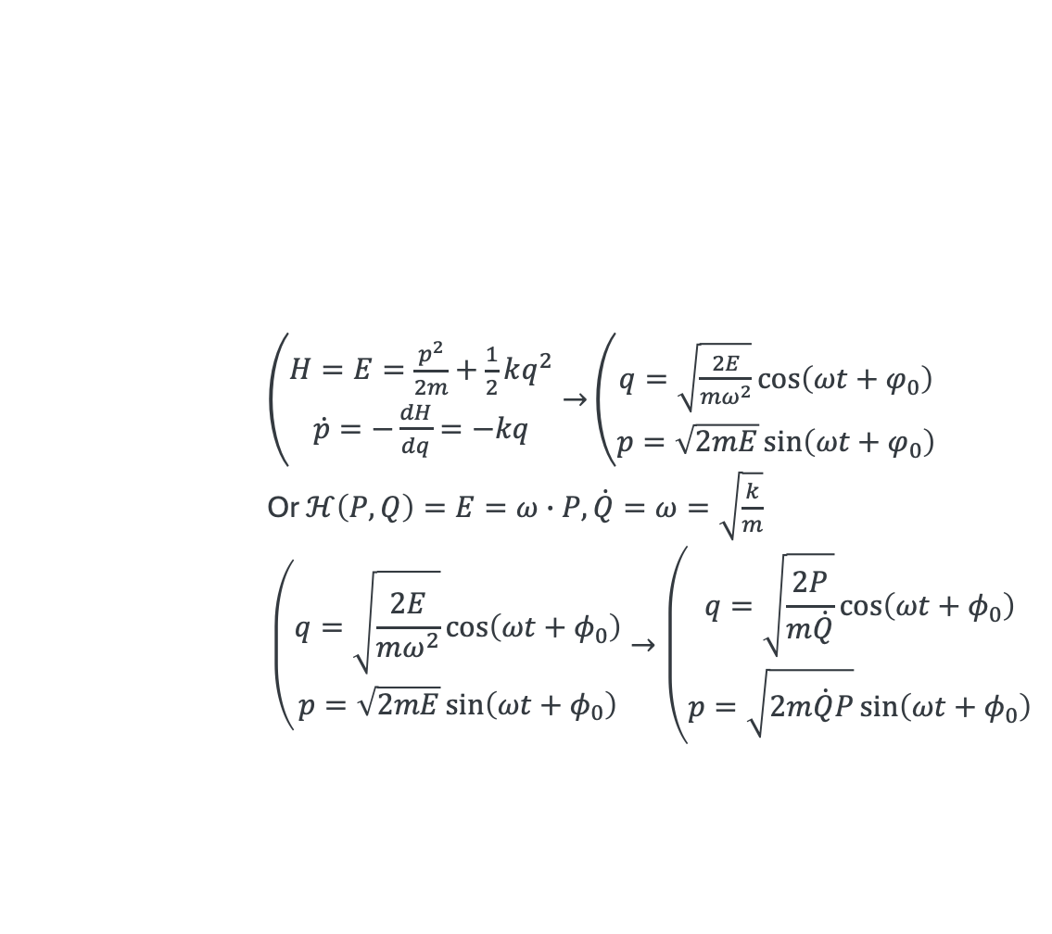
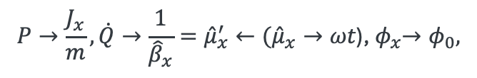

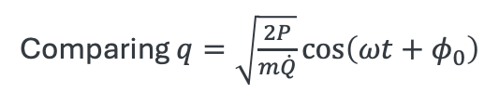
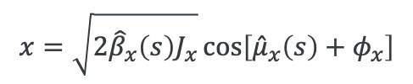
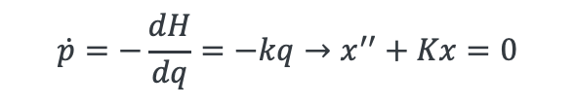
Quick Review of Previous Lecture (I)
Beam dynamics is analogous to the dynamics of a simple harmonic motion
  Solving harmonic oscillator via canonical transformation
Harmonic motion → Hill’s equation (translate the differentiation from $t$ to $s$)
$\left(\begin{matrix}H=E=\frac{p^{2}}{2m}+\frac{1}{2}kq^{2} \\ \dot{p}=−\frac{dH}{dq}=−kq\end{matrix}\right.→$ $\left(\begin{matrix}q=\sqrt{\frac{2E}{mω^{2}}}\cos\left(ωt+φ_{0}\right) \\ p=\sqrt{2mE}\sin\left(ωt+φ_{0}\right)\end{matrix}\right.$
Or $ℋ\left(P,Q\right)=E=ω∙P, \dot{Q}=ω=\sqrt{\frac{k}{m}}$
$$\left(\begin{matrix}q=\sqrt{\frac{2E}{mω^{2}}}\cos\left(ωt+φ_{0}\right) \\ p=\sqrt{2mE}\sin\left(ωt+φ_{0}\right)\end{matrix}\right.→\left(\begin{matrix}q=\sqrt{\frac{2P}{m\dot{Q}}}\cos\left(ωt+φ_{0}\right) \\ p=\sqrt{2m\dot{Q}P}\sin\left(ωt+φ_{0}\right)\end{matrix}\right.$$
Mechanical harmonic oscillation framework
$$\frac{d}{dt}→\frac{ds}{dt}\frac{d}{ds}$$
$$\dot{p}=−\frac{dH}{dq}=−kq→x^{′′}+Kx=0$$
Translation from harmonic oscillation to beam dynamics
$$x=\sqrt{2{\hat{β}}_{x}\left(s\right)J_{x}}\cos\left[{\hat{μ}}_{x}\left(s\right)+φ_{x}\right]$$
$$P→\frac{J_{x}}{m},\dot{Q}→\frac{1}{{\hat{β}}_{x}}={\hat{μ}}_{x}^{′}←{({\hat{μ}}_{x}→ωt\text{)}\text{,} φ}_{x}→φ_{0},$$
Comparing $q=\sqrt{\frac{2P}{m\dot{Q}}}\cos\left(ωt+φ_{0}\right)$

Slide 4
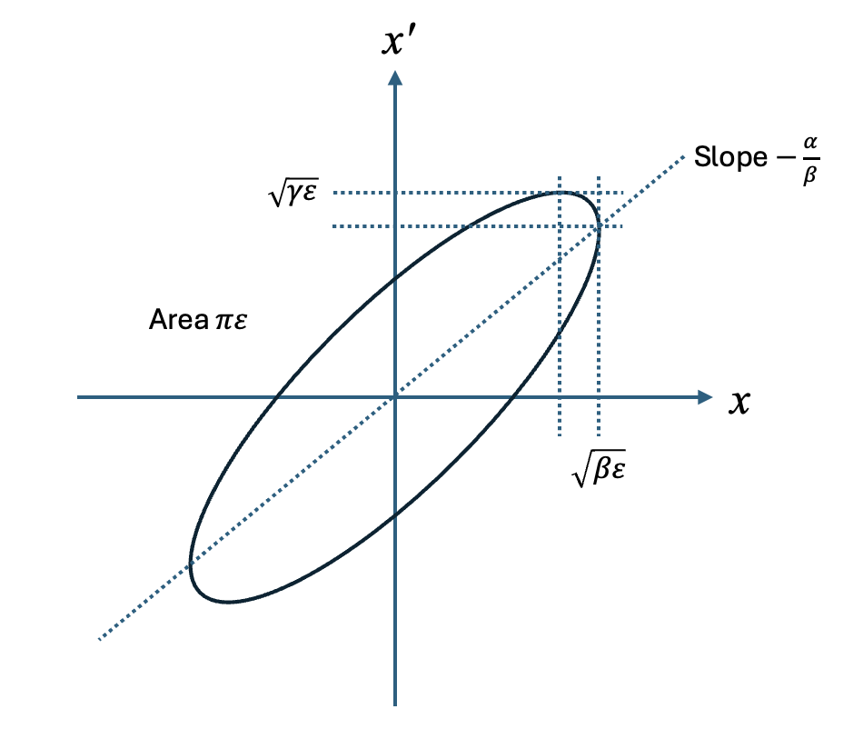
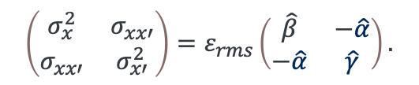
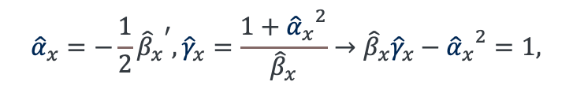
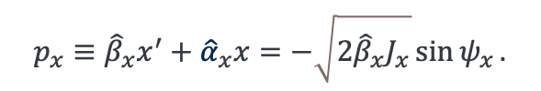
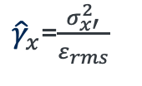

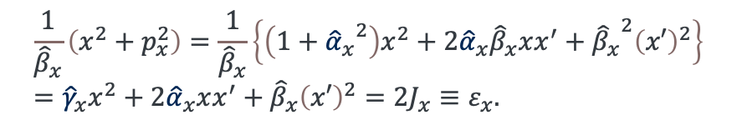

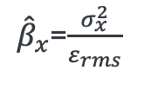

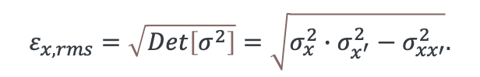

Quick Review of Previous Lecture (II)
Introduce new canonical momentum
The beam (gaussian) distribution function is a function of the Courant-Snyder invariant; The $σ$-matrix is given
$$p_{x}≡{\hat{β}}_{x}x^{′}+{\hat{α}}_{x}x=−\sqrt{2{\hat{β}}_{x}J_{x}}\sin{ψ_{x}}.$$
$$ψ_{x}={\hat{μ}}_{x}+φ_{x}$$
$$x=\sqrt{2{\hat{β}}_{x}J_{x}}\cos{ψ_{x}}$$
$$\frac{1}{{\hat{β}}_{x}}\left(x^{2}+p_{x}^{2}\right)=\frac{1}{{\hat{β}}_{x}}\left\{\left(1+{{\hat{α}}_{x}}^{2}\right)x^{2}+2{\hat{α}}_{x}{\hat{β}}_{x}xx^{′}+{{\hat{β}}_{x}}^{2}{\left(x′\right)}^{2}\right\}={\hat{γ}}_{x}x^{2}+2{\hat{α}}_{x}xx^{′}+{\hat{β}}_{x}{\left(x′\right)}^{2}=2J_{x}≡ε_{x}.$$
$ε_{x}$ is called the Courant-Snyder invariant, or emittance
Twiss parameters from phase space
$$\left(\begin{matrix}σ_{x}^{2} & σ_{xx′} \\ σ_{xx′} & σ_{x′}^{2}\end{matrix}\right)=ε_{rms}\left(\begin{matrix}\hat{β} & −\hat{α} \\ −\hat{α} & \hat{γ}\end{matrix}\right).$$
${\hat{β}}_{x}$=$\frac{σ_{x}^{2}}{ε_{rms}}$
${\hat{α}}_{x}$=$−\frac{σ_{xx′}^{2}}{ε_{rms}}$
${\hat{γ}}_{x}$=$\frac{σ_{x′}^{2}}{ε_{rms}}$
$$ε_{x,rms}=\sqrt{Det\left[σ^{2}\right]}=\sqrt{σ_{x}^{2}∙σ_{x^{′}}^{2}−σ_{xx′}^{2}}.$$
$${\hat{α}}_{x}=−\frac{1}{2}{{\hat{β}}_{x}}^{′}, {\hat{γ}}_{x}=\frac{1+{{\hat{α}}_{x}}^{2}}{{\hat{β}}_{x}}→{\hat{β}}_{x}{\hat{γ}}_{x}−{{\hat{α}}_{x}}^{2}=1,$$

Slide 5

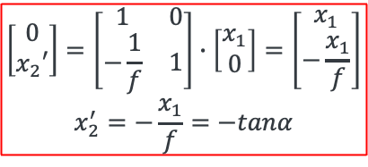







Quick Review of Previous Lecture (III)
Solution of Hill’s equation $x^{′′}\left(s\right)+κ\left(s\right)x\left(s\right)=0$
$|Tr\left(\tilde{M}\right)|≤2, λ_{1,2}$is a periodic solution → Beam motion is stable
Thin lens and paraxial approximation
$$X→\left[\begin{matrix}x\left(s\right) \\ x′\left(s\right)\end{matrix}\right]=\left[\begin{matrix}a & b \\ c & d\end{matrix}\right]\left[\begin{matrix}x_{0} \\ {x′}_{0}\end{matrix}\right]→\tilde{M}∙X_{0}$$
$$det\left(\tilde{M}−λI\right)=\left|\begin{matrix}a−λ & b \\ c & d−λ\end{matrix}\right|=0$$
$$→λ_{1,2}=\cos\left(μ\right)±\sqrt{\cos^{2}\left(μ\right)−1}=\cos\left(μ\right)±i\sin\left(μ\right)=e^{±iμ}$$
$\tilde{M}=\left[\begin{matrix}\cos{μ+\hat{α}\sin{μ}} & \hat{β}\sin{μ} \\ −\hat{γ}\sin{μ} & \cos{μ−\hat{α}\sin{μ}}\end{matrix}\right]$ Or $\tilde{M}=\tilde{I}\cos{μ}+\tilde{J}\sin{μ}$, where $\tilde{I}=\left[\begin{matrix}1 & 0 \\ 0 & 1\end{matrix}\right],\tilde{J}=\left[\begin{matrix}\hat{α} & \hat{β} \\ −\hat{γ} & −\hat{α}\end{matrix}\right]$
Definition of focusing length
Parallel beam
$$\left(x_{1},x_{1}′\right)=(x_{1},0)$$
$$\left[\begin{matrix}0 \\ x_{2}′\end{matrix}\right]=\left[\begin{matrix}1 & 0 \\ −\frac{1}{f} & 1\end{matrix}\right]∙\left[\begin{matrix}x_{1} \\ 0\end{matrix}\right]=\left[\begin{matrix}x_{1} \\ −\frac{x_{1}}{f}\end{matrix}\right]$$
$$x_{2}^{′}=−\frac{x_{1}}{f}=−tanα$$
$$x_{1}$$
$$α$$
$$x_{2}=0$$
focused beam
$$\left(x_{2},x_{2}′\right)=(0,x_{2}′)$$
$$f$$

Slide 6
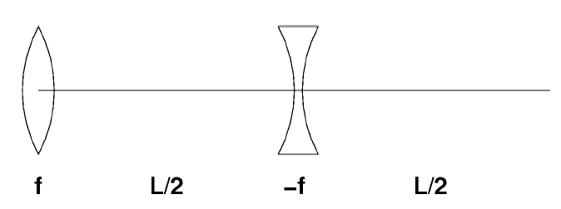
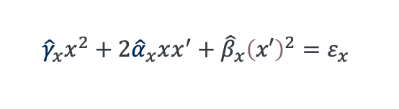



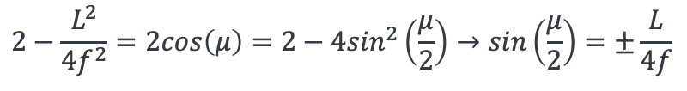
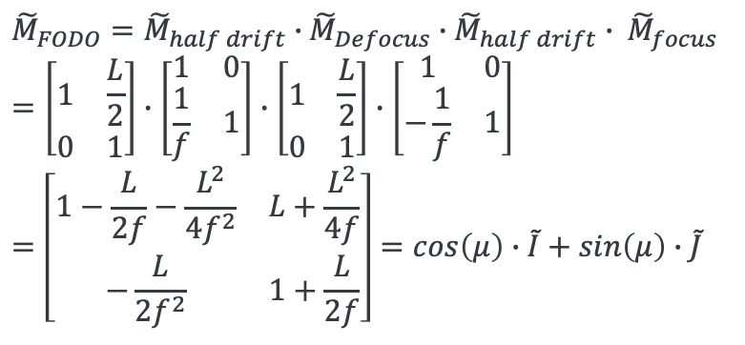
Quick Review of Previous Lecture (IV)
Thin lens and paraxial approximation
Stability condition, $\left|Tr\left(\tilde{M}\right)\right|≤2$
${\tilde{M}}_{FODO}={\tilde{M}}_{half drift}∙$ ${\tilde{M}}_{Defocus}∙{\tilde{M}}_{half drift}∙ {\tilde{M}}_{focus}$
$$=\left[\begin{matrix}1 & \frac{L}{2} \\ 0 & 1\end{matrix}\right]∙\left[\begin{matrix}1 & 0 \\ \frac{1}{f} & 1\end{matrix}\right]∙\left[\begin{matrix}1 & \frac{L}{2} \\ 0 & 1\end{matrix}\right]∙\left[\begin{matrix}1 & 0 \\ −\frac{1}{f} & 1\end{matrix}\right]$$
$$=\left[\begin{matrix}1−\frac{L}{2f}−\frac{L^{2}}{4f^{2}} & L+\frac{L^{2}}{4f} \\ −\frac{L}{2f^{2}} & 1+\frac{L}{2f}\end{matrix}\right]=cos\left(μ\right)∙\tilde{I}+sin\left(μ\right)∙\tilde{J}$$
$$cos μ+\hat{α}∙sin μ=1−\frac{1}{2}\frac{L}{f}−\frac{1}{4}\frac{L^{2}}{f^{2}}$$
$$\hat{β}∙\sin{μ}=L+\frac{L^{2}}{4f^{2}}$$
$$−\hat{γ}∙\sin{μ=−\frac{L}{2f^{2}}}$$
$$cos μ−\hat{α}∙sin μ=1+\frac{1}{2}\frac{L}{f}$$
Example:
Phase advance per cell $μ=70$ degrees
Focusing length $f=1.23$ m
→$L=4f∙sin\left(\frac{μ}{2}\right)=2.46$m
$$\hat{α}=−1.26, \hat{β}=2.53, \hat{γ}=1.01$$
$$2−\frac{L^{2}}{4f^{2}}=2cos\left(μ\right)=2−4\sin^{2}\left(\frac{μ}{2}\right)→sin\left(\frac{μ}{2}\right)=±\frac{L}{4f}$$
$${\hat{γ}}_{x}x^{2}+2{\hat{α}}_{x}xx^{′}+{\hat{β}}_{x}{\left(x′\right)}^{2}=ε_{x}$$
Demonstrate FODO cell in G4Beamline

Slide 7
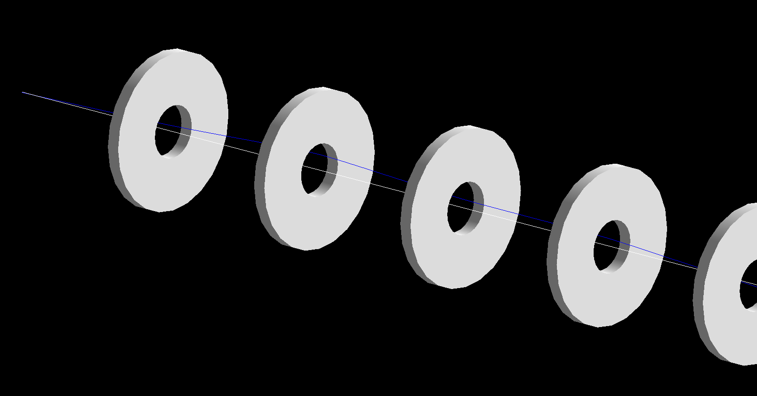
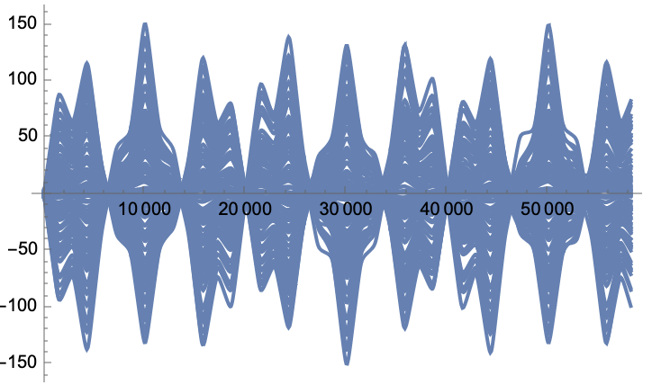
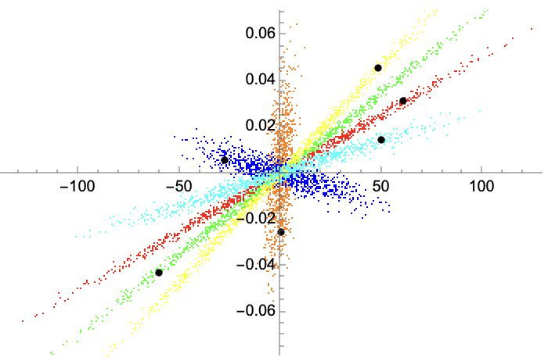
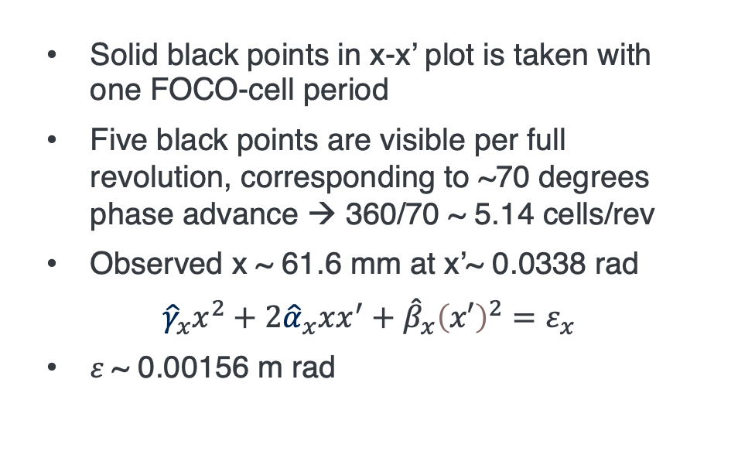
Demo: FODO cell ($μ=$70 deg)
fodocell_phase60_05160030.nb
x (mm)
z (mm)
x’ (rad)
5
1
Solid black points in x-x’ plot is taken with one FOCO-cell period
Five black points are visible per full revolution, corresponding to ~70 degrees phase advance → 360/70 ~ 5.14 cells/rev
Observed x ~ 61.6 mm at x’~ 0.0338 rad
$${\hat{γ}}_{x}x^{2}+2{\hat{α}}_{x}xx^{′}+{\hat{β}}_{x}{\left(x′\right)}^{2}=ε_{x}$$
$ε$~ 0.00156 m rad
4
6
x (mm)
2
3

Slide 8
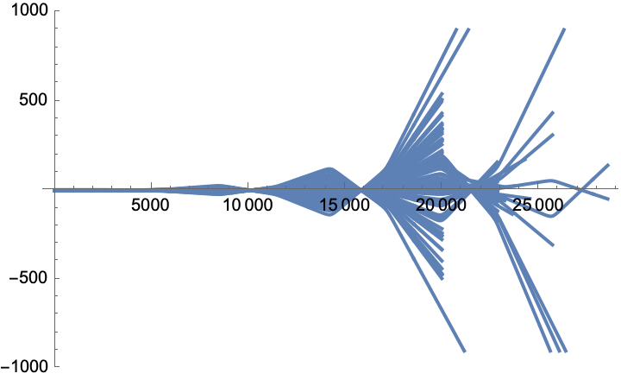

Demo: FODO cell (Unstable condition)
fodocell_unstable_05160040.nb
If the FODO lattice set with $\left|Tr\left(\tilde{M}\right)\right|>2,$ the beam optics must be unstable
With the drift gap increased to 5710 mm, the FODO cell exceeds the stability condition
Since $sin\left(\frac{μ}{2}\right)>1$ has no real solution, the optics become unstable

Slide 9
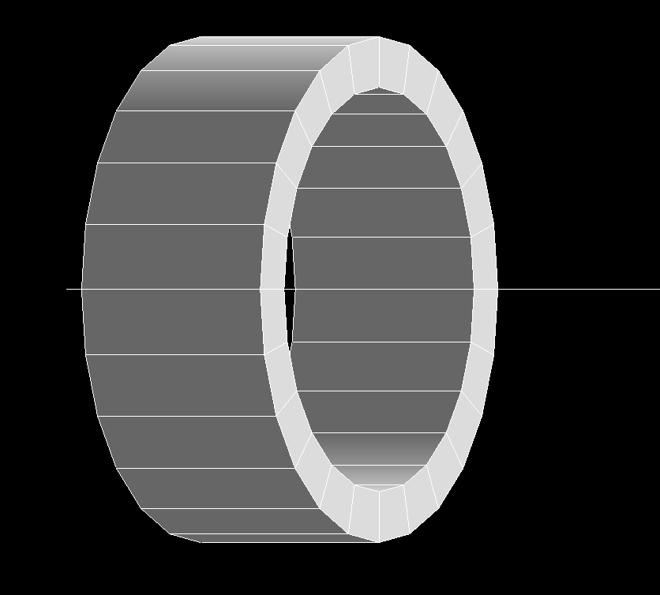
Demo: Single Solenoid Coil
fofocell_fernow_focus_05220060.nb
Coil length L
Fernow coil (referred from PRSTAB 10, 064001 (2007)
Coil length = 400 mm
Coil inner radius = 400 mm
Coil thickness = 100 mm
Current = 100 Amp/mm2
Coil inner radius a
Coil thickness t

Slide 10
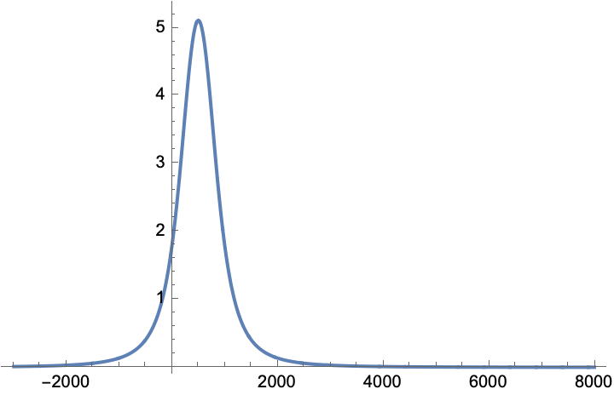




Demo: Single Solenoid Coil
fofocell_fernow_focus_05220060.nb
Conventional Solenoid Focusing Model $\frac{1}{f}=\frac{eB_{z}}{2mγ}$
As the formula shows, the focusing length is independent from the coil geometry
→ Thin lens approximation
The estimated focusing length $f$
Solenoid center (z = 500 mm)
$B_{z}$ profile on coil axis z
(Tesla)
Coil length $L$ = 400 mm
Coil inner radius $a$= 400 mm
Coil thickness $t$ = 100 mm
Current $I$ = 100 Amp/mm2
Observed peak magnetic field $B_{z}$ = 5.1 Tesla
$f=$ 300 mm@ 200 MeV/c
NB: $f<L$
$f=0.3$m
NB: Solenoid field calculation may depend on the simulator; We use G4Beamline which may differ from ICOOL

Slide 11
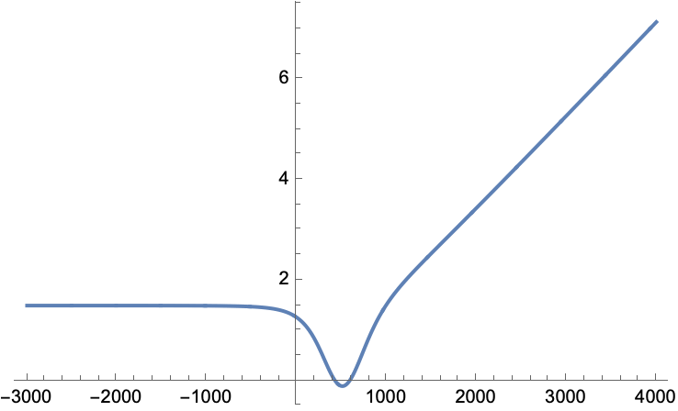
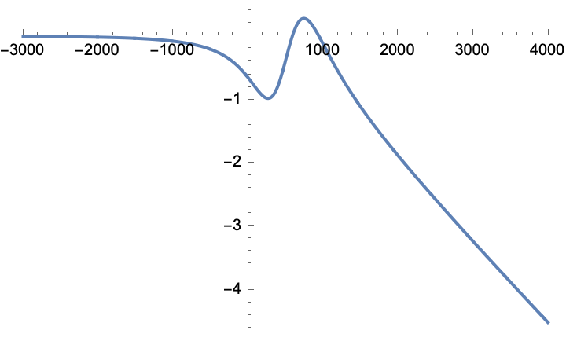



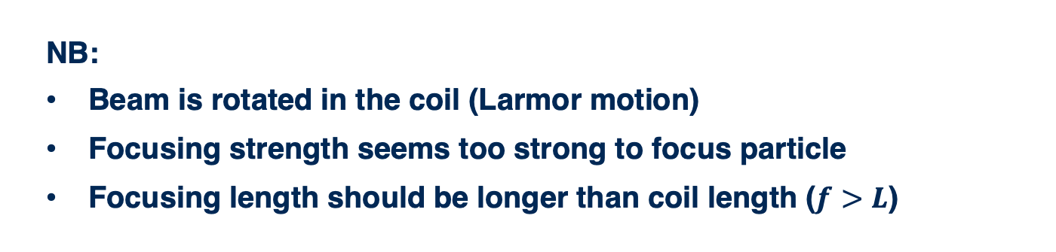

Demo: Single Solenoid Coil
fofocell_fernow_focus_05220060.nb
$$x (mm)$$
$$y (mm)$$
$$z (mm)$$
Solenoid center (z = 500 mm)
$$z (mm)$$
Solenoid center (z = 500 mm)
NB:
Beam is rotated in the coil (Larmor motion)
Focusing strength seems too strong to focus particle
Focusing length should be longer than coil length ($f>L$)

Slide 12
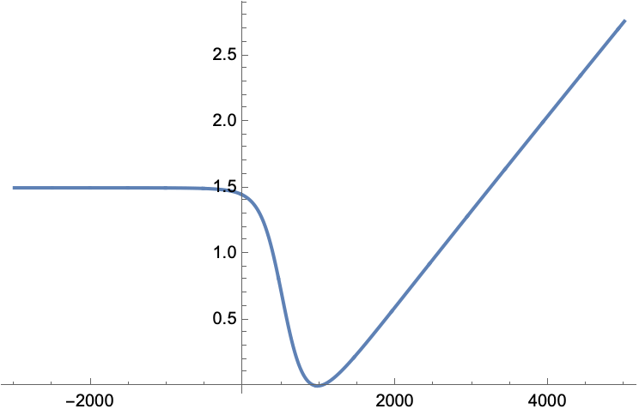
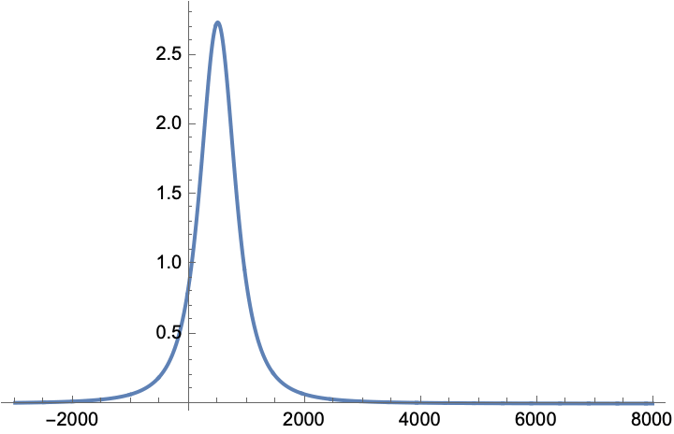
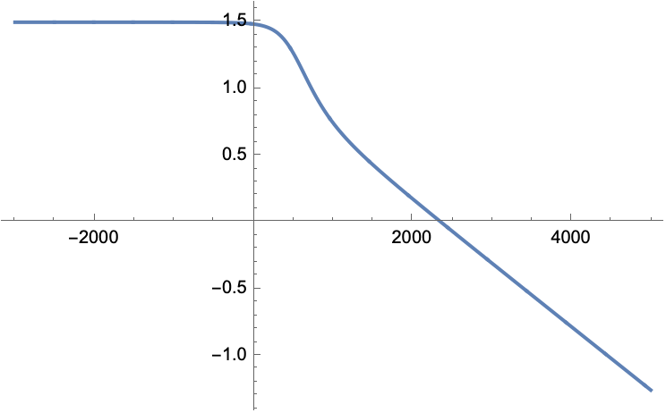
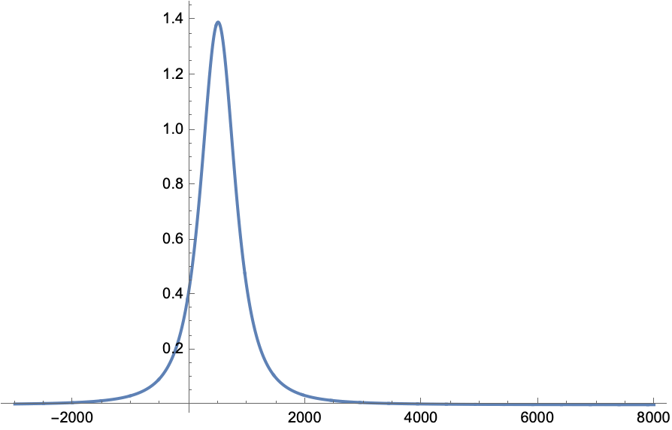
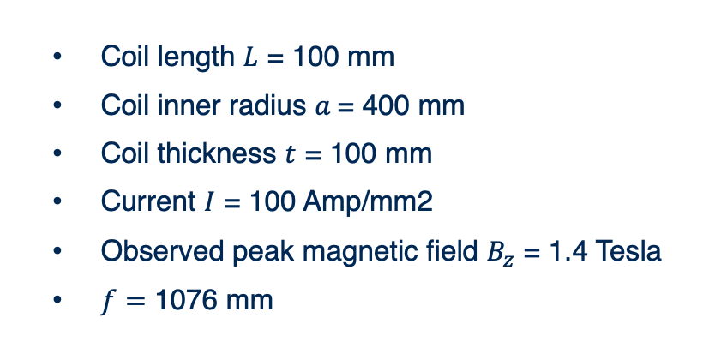

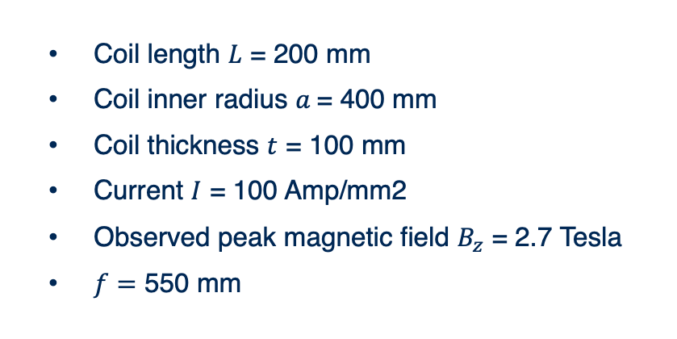


Demo: Single Solenoid Coil
fofocell_fernow_focus_05220070.nb
Solenoid center (z = 500 mm)
Coil length $L$ = 200 mm
Coil inner radius $a$= 400 mm
Coil thickness $t$ = 100 mm
Current $I$ = 100 Amp/mm2
Observed peak magnetic field $B_{z}$ = 2.7 Tesla
$f=$ 550 mm
$$x (mm)$$
$$B_{z}$$
$$z (mm)$$
Focusing length agrees well with prediction
Observed focusing length is ~500 mm
Solenoid center (z = 500 mm)
Coil length $L$ = 100 mm
Coil inner radius $a$= 400 mm
Coil thickness $t$ = 100 mm
Current $I$ = 100 Amp/mm2
Observed peak magnetic field $B_{z}$ = 1.4 Tesla
$f=$ 1076 mm
Observed focusing length is ~1800 mm
Prediction is underestimated

Slide 13



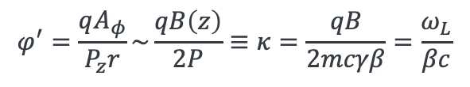




Induced Angular Momentum
Set the Larmor rotation frame
The linearized equations of motion is given
Twiss parameters
Introduce the normalized canonical angular momentum
$$X_{R}=xcos\left(φ\right)−ysin\left(φ\right)$$
$$Y_{R}=xsin\left(φ\right)+ycos\left(φ\right)$$
$$φ^{′}=\frac{qA_{φ}}{P_{z}r}\sim \frac{qB\left(z\right)}{2P}≡κ=\frac{qB}{2mcγβ}=\frac{ω_{L}}{βc}$$
$ω_{L}$ is a Larmor angular velocity
$$ω_{L}=\frac{qB}{2mγ}$$
$$X_{R}^{′′}+κ^{2}X_{R}=0, Y_{R}^{′′}+κ^{2}Y_{R}=0$$
$$X_{R}=A_{1}\sqrt{{\hat{β}}_{p}}cos\left(Φ−Φ_{1}\right)$$
$$Y_{R}=A_{2}\sqrt{{\hat{β}}_{p}}cos\left(Φ−Φ_{2}\right)$$
$$2{\hat{β}}_{p}{\hat{β}}_{p}^{′′}−{\left({\hat{β}}_{p}′\right)}^{2}+4{{\hat{β}}_{p}}^{2}κ^{2}−4=0$$
$$L_{canonical}=2mcε_{n}∙ℒ$$

Slide 14
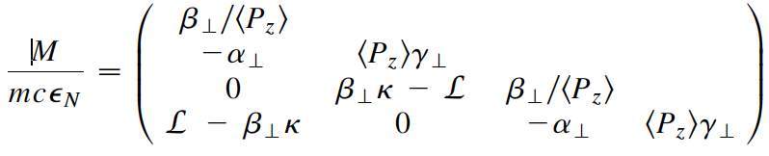



Induced Angular Momentum
The transverse covariance matrix includes angular momentum
$$det\left(M\right)=\left[\left\langle x^{2}\right\rangle \left\langle P_{x}^{2}\right\rangle −{\left\langle xP_{x}\right\rangle }^{2}−{\left\langle xP_{y}\right\rangle }^{2}\right]$$
Or, taking 4x4 matrix to estimate emittance
$$ε_{t}={\left(Det\left[{\tilde{M}}_{4×4}\right]\right)}^{1/4}$$

Slide 15



FOFO Channel
Fernow’s coil (referred from PRSTAB 10, 064001 (2007))
$$B_{z}$$
and (b)
Non-flipping solenoid coil
Difference between (a) and (b) is an initial beam condition whether beam starts from coil center or in the coil gap
$$β$$
Coil
Absorber
RF
(c) and (d)
Flipping solenoid coil

Slide 16

Demo: FOFO Channel
fofostudy_fernow_fig1a_05280140.nb
Fernow’s coil (referred from PRSTAB 10, 064001 (2007)
Coil length = 400 mm
Coil inner radius = 400 mm
Coil thickness = 100 mm
Current = 100 Amp/mm2
Period = 1000 mm
and (b)
Non-flipping solenoid coil

Slide 17





Demo: FOFO Channel
fofostudy_fernow_fig1a_05280140.nb
x’ (rad)
Filamentation due to mismatching
x’ (rad)
x (mm)
x (mm)
Red: Initial phase space
Red: Initial phase space
$$ε_{⊥}=4.5 mm$$
$$β_{max}=0.70 m$$
$$ε_{⊥}=5.0 mm$$
$$β_{max}=0.13 m$$

Slide 18





Demo: FOFO Channel
fofostudy_fernow_fig1b_05280150.nb
x’ (rad)
x’ (rad)
Red: Initial phase space
x (mm)
x (mm)
Red: Initial phase space
$$ε_{⊥}=2.1 mm$$
$$β_{max}=0.13 m$$
$$ε_{⊥}=2.1 mm$$
$$β_{max}=0.73 m$$

Slide 19







Beta function and passband (stability condition)
Stability condition for solenoid-based channel is quite different from FODO channel because the FOFO solenoid magnet does not follow the thin lens approximation
Instead, the stability condition can be predicted from Mathieu equation
NB: Table shows passband in different coil configurations from us (e.g. $I=40 A/mm2)$
Thin solenoid coil
Matheu equation can be solved numerically
$$\ddot{r}+\frac{r}{4}{\left(\frac{eB_{z}}{mcγβ}\right)}^{2}=0$$
Our simulation
(agreed very well)
Thick solenoid coil
0.73 m
$$B_{z}→B_{0}sin\left(kz\right)$$
$$→\ddot{r}+r{\left(\frac{eB_{0}}{2mcγβ}\right)}^{2}\sin^{2}\left(kz\right)=0$$
0.13 m
$$\frac{d^{2}y}{dυ^{2}}+\left[a−2qcos\left(2υ\right)\right]y=0$$

Slide 20


Demo: FOFO Channel
fofostudy_fernow_fig1a_05280140.nb
Fernow’s coil (referred from PRSTAB 10, 064001 (2007)
Coil length = 400 mm
Coil inner radius = 400 mm
Coil thickness = 100 mm
Current = $±$100 Amp/mm2
Period = 1000 mm
(c) and (d)
Flipping solenoid coil

Slide 21





Demo: FOFO Channel
fofostudy_fernow_fig1c_05290160.nb
x’ (rad)
x’ (rad)
x (mm)
x (mm)
Red: Initial phase space
Red: Initial phase space
$$ε_{⊥}=1.6 mm$$
$$β_{max}=1.08 m$$
$$ε_{⊥}=1.6 mm$$
$$β_{max}=0.18 m$$

Slide 22




Demo: FOFO Channel
fofostudy_fernow_fig1d_05280170.nb
x’ (rad)
x’ (rad)
x (mm)
x (mm)
Red: Initial phase space
Red: Initial phase space
$$ε_{⊥}=1.6 mm$$
$$β_{max}=0.97 m$$
$$ε_{⊥}=1.6 mm$$
$$β_{max}=0.18 m$$

Slide 23



FOFO Bandpass
Transmission efficiency
Stop band
$p$(GeV/c)
It seems that the stop band momentum range is different from Fernow’s paper; This may be because g4beamline uses different field calculation formula from ICOOL (?)

Slide 24

Rectilinear Channel
Stratakis demonstrated the advanced FOFO channel
So called Rectilinear channel
Solenoid coil is tilted in vertical direction to induce dispersion
Top view
Side view
RF cavities
Absorber
Solenoid coil
(coil is slightly tilted in vertical direction)

Slide 25


Rectilinear Channel
Initial cooling channel use $p>p_{π}$ region
→ Benefit a large momentum acceptance

Slide 26


Rectilinear Channel
Later cooling channel use $∆p_{2}$ region
→ $\hat{β}$ is flat in $p$ → Good for advanced cooling

Slide 27




Helical Cooling Channel
Use continuous combined magnet (straight solenoid + helical dipole & quadrupole magnets)
→ No stop band due to a periodic focusing channel
Rotation of reference particle (red line), which is based on cyclotron motion
Equations of motion on the reference frame
$$u_{1}^{′′}+\frac{q−1}{1+κ^{2}}ku_{2}^{′}+k^{2}{\hat{D}}^{−1}u_{1}=0$$
$${\hat{D}}^{−1}=\frac{κ^{2}+\left(1−κ^{2}\right)q}{1+κ^{2}}+g$$
$$u_{2}^{′′}−\left(q−1\right)ku_{1}^{′}+k^{2}\left(q−g\right)u_{2}=0$$
$$g=\frac{−{\left(1+κ^{2}\right)}^{3/2}}{pk^{2}}\frac{∂b}{∂a}$$

Slide 28


Helical Cooling Channel
Challenge of designing helical cooling channel is following
Helical magnet is complicated
RF cavities must be inserted into a helical magnet
If helical channel is used, the matching has to flip sign of the momentum compaction factor from positive to negative

Slide 29





Helical FOFO
Yuri claims that FOFO has an issue to produce low $\hat{β}$ and high $D,$ (which is ideal for ionization cooling) because
$$D_{x,RFOFO}\sim \frac{R}{Q_{x}^{2}}\sim \frac{{\overline{β}}_{x}^{2}}{R}$$
$R$: circumference of RFOFO, or the length of one cell period of rectilinear channel
His concept starts from a periodic orbit with near pi resonance
$$x_{p.o.}=\frac{1}{sin\left(πQ_{x}\right)}$$
where $x_{p.o.}$ is a periodic orbit, $Q_{x}$ is a tune, then
$$D_{x}=\frac{δx_{p.o.}}{δp}\sim −{πQ}_{x}^{′}\frac{cos\left(πQ_{x}\right)}{\sin^{2}\left(πQ_{x}\right)}={−πQ}_{x}^{′}∙x_{p.o.}cot\left(πQ_{x}\right)$$

Slide 30





HFOFO
$$cot\left(πQ\right)$$
$$Q$$
$$D_{x}=\frac{δx_{p.o.}}{δp}\sim {−πQ}_{x}^{′}∙x_{p.o.}cot\left(πQ_{x}\right)$$
This is good since $D$ can be extremely large when $Q_{x}$ is integer
($Q_{x}′$ is called a chromaticity)
Making integer $Q$ channel means making $π$ phase advanced FOFO channel → Helical FOFO channel
Helical FOFO channel could have a large momentum acceptance by tuning higher order chromaticity
Helical orbit permits a large acceptance
Alternative solenoid eliminates angular momentum
Forming one period with multiple solenoid cells induces a weak focusing (6 solenoid coils induce one period)

Slide 31


HFOFO
Initial HFOFO channel has 6 solenoid coils to induce one beta oscillation
Reference particle has a position offset from solenoid coil center
Absorber is located low $\hat{β}$ and high $D$ region while RF cavities are located other regions
Tilted solenoid induces dispersion

Slide 32
Feasibility of Cooling Channel
Channel requires strong magnetic fields
Channel requires high gradient RF fields
Channel should be compact, so that integration is challenging
Channel should be accessible and replaceable
Channel should have a large tolerance
Channel should be radiation hard
Channel requires high resolution beam instrumentation

Slide 33

Summary
M. Palmer, Muon Collider Workshop 2019 in CERN
Target
Y
VCC→ Rectilinear Cooling Channel
HCC→ Helical Cooling Channel
HFOFO is not shown this plot but it has similar as Initial (x)
Final Cooling Channel expected to be High Field Solenoid Channel
Bunch merge transforms multi-bunched beam into single bunched beam
Specification Achieved (simulations)
•
•
•
For acceleration to
multi-TeV collider
Front End
For acceleration to NuMAX (325MHz injector acceptance 3mm,24mm)
Phase
Rotator
Final
Exit Front End
(15mm,45mm)
Initial Cooling
Longitudinal Emittance (mm)
Initial
(X)
Initial
(Y)
Final
Cooling
post-merge 6D Cooling
pre-merge
6D Cooling (original design)
For acceleration
to Higgs Factory
HCC
Bunch
Merge
VCC &
Hybrid

