Slide 1
Mini Lecture Course: Accelerator Design for a Multi-TeV Muon Collider
Lecture 4: Particle Interactions with Matter
June 9, 2025
Katsuya Yonehara
Senior Scientist

Slide 2
Scope of today’s lecture
What is a particle interaction?
Pion production
Electromagnetic interactions
Stochastic process and Monte Carlo method
Citation of today’s lecture
Particle Data Group
  https://pdg.lbl.gov
Geant4 Physics Reference
  https://geant4.web.cern.ch/docs/

Slide 3







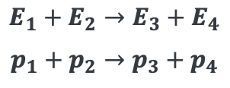

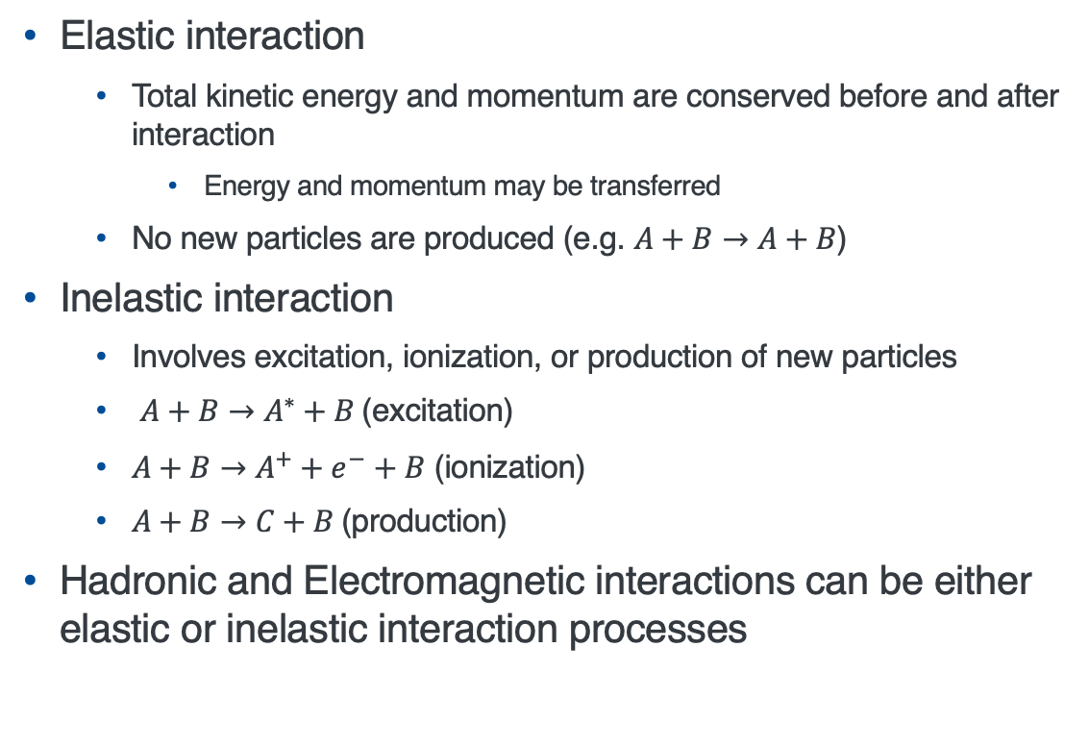

What is interaction?
Elastic scattering
$$A$$
$$B$$
Elastic interaction
  Total kinetic energy and momentum are conserved before and after interaction
    Energy and momentum may be transferred
  No new particles are produced (e.g. $A+B→A+B$)
Inelastic interaction
  Involves excitation, ionization, or production of new particles
  $A+B→A^{∗}+B$(excitation)
  $A+B→A^{+}+e^{−}+B$ (ionization)
  $A+B→C+B$(production)
Hadronic and Electromagnetic interactions can be either elastic or inelastic interaction processes
$$E_{1}+E_{2}→E_{3}+E_{4}$$
$$p_{1}+p_{2}→p_{3}+p_{4}$$
Inelastic scattering
$$B$$
$$A$$
$$B$$
$$A^{∗}$$
$$D$$
$$C$$
or
$$E$$
More possible
Final states
or

Slide 4


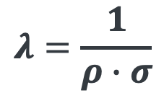
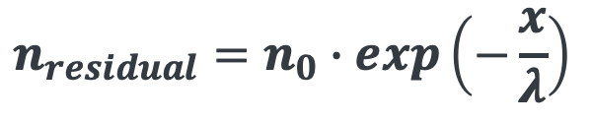
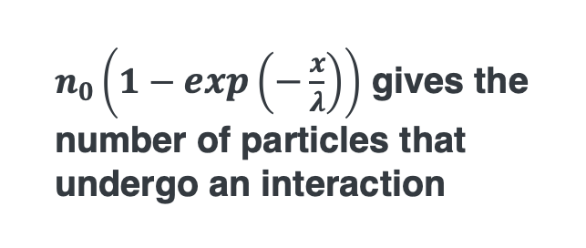
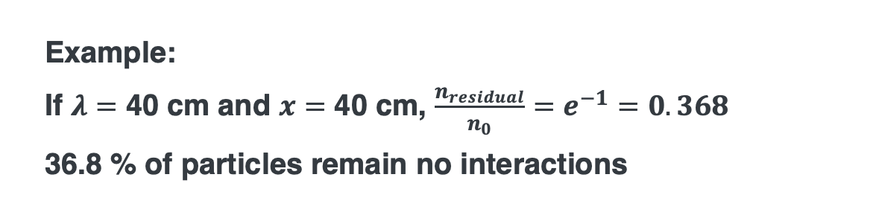
Describing interactions in calculations
Material (or target)
Incident particle
Interaction is a stochastic process
The probability of interaction is governed by the cross section
$$λ=\frac{1}{ρ∙σ}$$
$λ:$ Mean free path length (example unit cm)
$ρ:$ Number density of interacting material (example unit atoms/cm³)
$σ:$ Cross section for specific interaction (example unit cm²)
$$n_{residual}=n_{0}∙exp\left(−\frac{x}{λ}\right)$$
$n_{0}:$ Number of incident particles
$x:$ Path length
Example:
If $λ=$ 40 cm and $x=$ 40 cm, $\frac{n_{residual}}{n_{0}}=e^{−1}=0.368$
36.8 % of particles remain no interactions
$n_{0}\left(1−exp\left(−\frac{x}{λ}\right)\right)$ gives the number of particles that undergo an interaction

Slide 5
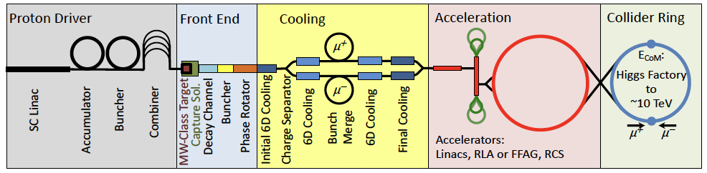
Particle Interactions with matter
Proton beam-based muon collider
Pion production target
Hadronic interactions
Electromagnetic interactions
Ionization cooling channel
Electromagnetic interactions
Beam window & Beam dump
Hadronic & Electromagnetic interactions
Minor but critical interactions process for system performance!

Slide 6
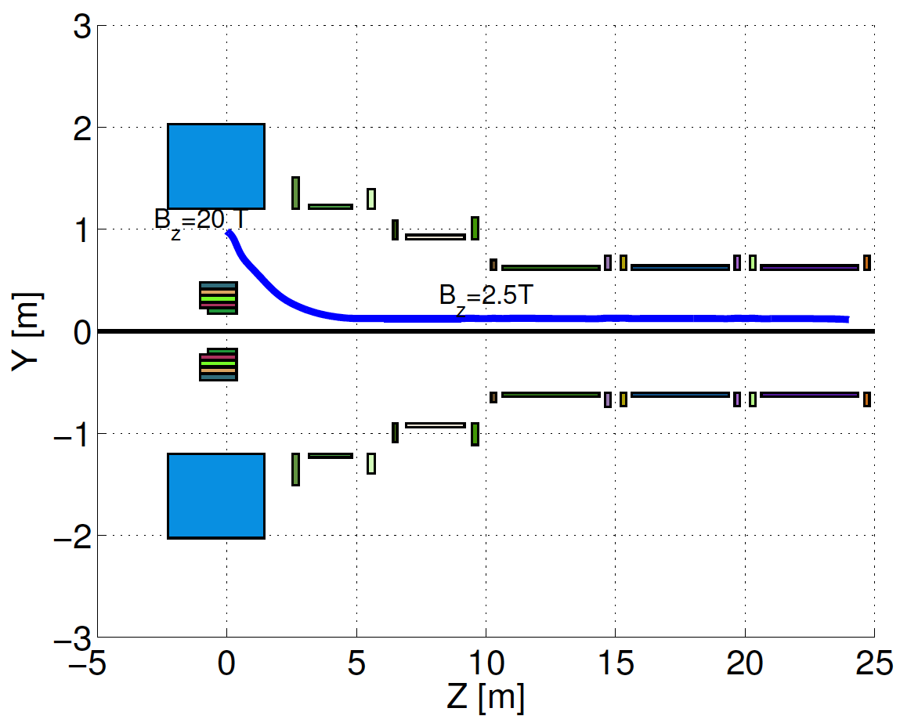
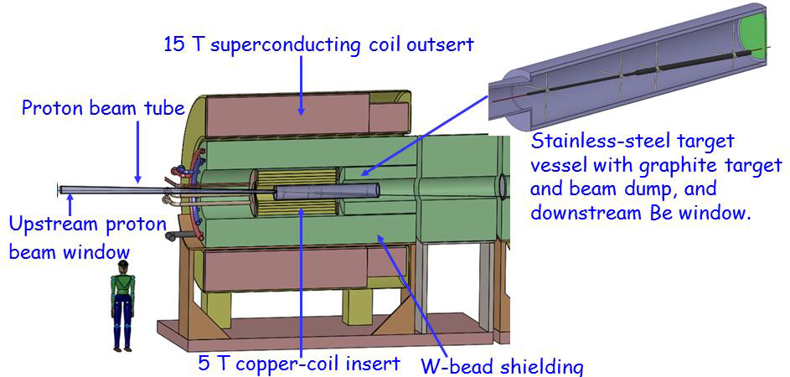
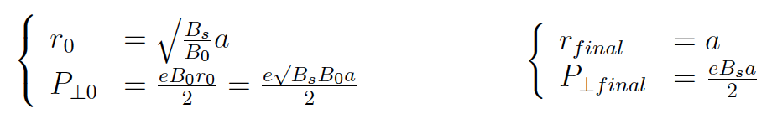

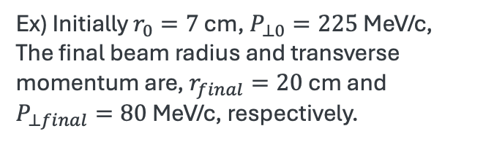
IMCC Target and Pion Capture Solenoid
Pion capture solenoid magnet
Pions should be confined within this volume
$$\frac{dp_{φ}}{dz}=−\frac{er}{2}\frac{db_{z}}{dz}$$
C Target
Option
Ex) Initially $r_{0}=7$ cm, $P_{⊥0}=225$ MeV/c,
The final beam radius and transverse momentum are, $r_{final}=20$ cm and $P_{⊥final}=80$ MeV/c, respectively.

Slide 7

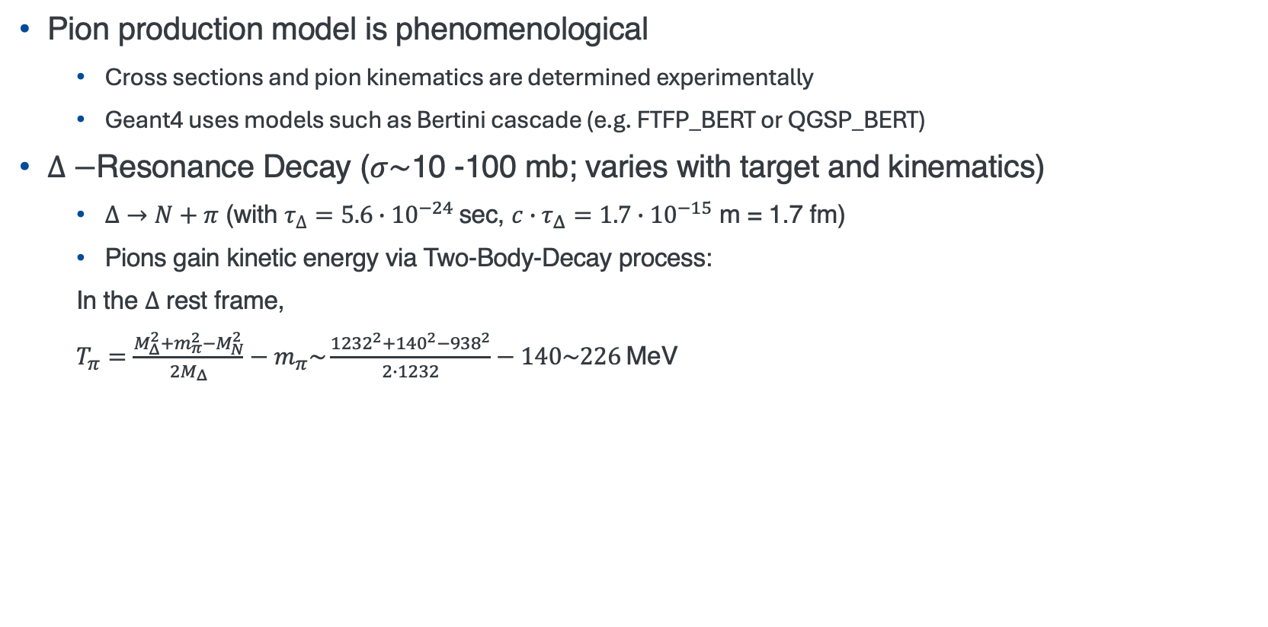
(Soft) Pion Production
Brief review of nuclear physics in later slides
Pion production model is phenomenological
  Cross sections and pion kinematics are determined experimentally
  Geant4 uses models such as Bertini cascade (e.g. FTFP_BERT or QGSP_BERT)
$Δ−$Resonance Decay ($σ\sim$10 -100 mb; varies with target and kinematics)
  $Δ→N+π$ (with $τ_{∆}=5.6∙{10}^{−24}$sec, $c∙τ_{Δ}=1.7{∙10}^{−15}$ m = 1.7 fm)
  Pions gain kinetic energy via Two-Body-Decay process:
  In the $Δ$ rest frame,
  $T_{π}=\frac{M_{Δ}^{2}+m_{π}^{2}−M_{N}^{2}}{2M_{Δ}}−m_{π}\sim \frac{{1232}^{2}+{140}^{2}−{938}^{2}}{2∙1232}−140\sim 226$MeV
NB: Quick unit reference
Size of nucleon: $r\sim 1$ fm
Size of nuclei: $r\sim 1.2A^{1/3}$ fm
barn = ${10}^{−24}$ cm² = ${\left(10 fm\right)}^{2}$
mb = ${10}^{−27}$ cm²

Slide 8

(Soft) Pion Production
Direct Multi-Pion Production
  $σ\sim$10 mb for high energy protons in range 1-10 GeV
  $p+N→N+N+π^{+}+π^{−}+π^{0}+…$
  These pions typically have kinetic energies of 100 - 300 MeV, influenced by nuclear medium effects such as Fermi motion
Pion angular distribution is isotropic in the center-of-mass frame

Slide 9
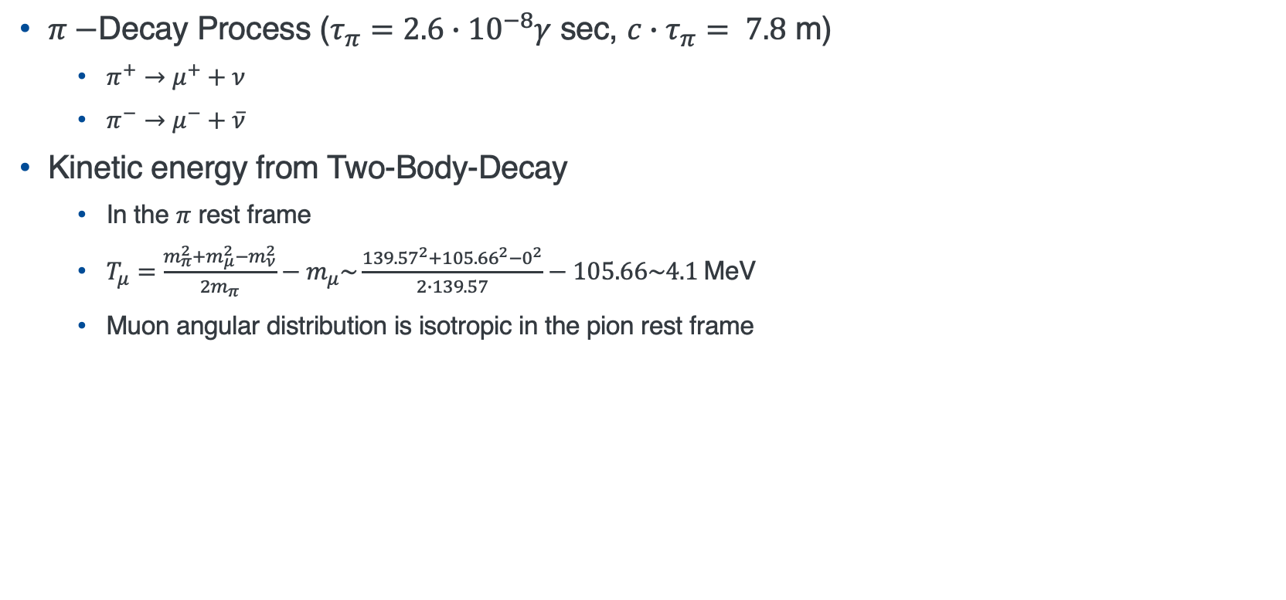
Muon Production
$π−$Decay Process ($τ_{π}=2.6∙{10}^{−8}γ$ sec, $c∙τ_{π}= 7.8$ m)
  $π^{+}→μ^{+}+ν$
  $π^{−}→μ^{−}+\overline{ν}$
Kinetic energy from Two-Body-Decay
  In the $π$ rest frame
  $T_{μ}=\frac{m_{π}^{2}+m_{μ}^{2}−m_{ν}^{2}}{2m_{π}}−m_{μ}\sim \frac{{139.57}^{2}+{105.66}^{2}−0^{2}}{2∙139.57}−105.66\sim 4.1$MeV
  Muon angular distribution is isotropic in the pion rest frame
Pion Kinetic energy: ~200 MeV
Muon Kinetic energy: ~4 MeV
Initial muon phase space is determined by pion energy and momentum spread

Slide 10
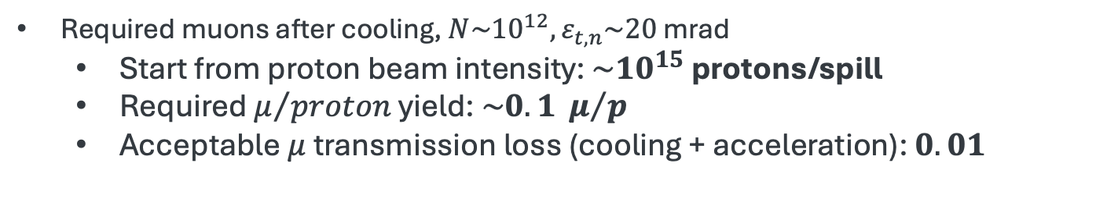
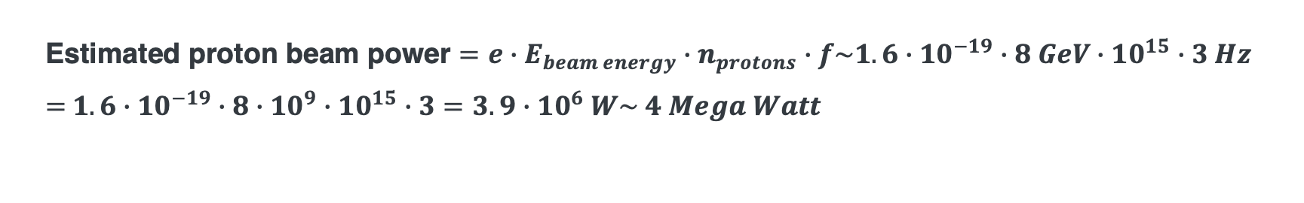
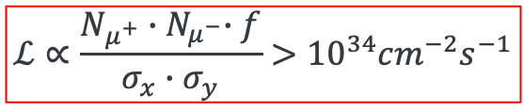
Recap: Target Pion/Muon capture efficiency for MC
Proton beam based muon collider
Required muons after cooling, $N\sim {10}^{12}, ε_{t,n}\sim 20$ mrad
  Start from proton beam intensity: $\sim {10}^{15}$ protons/spill
  Required $μ/{proton}$ yield: $\sim 0.1 μ/p$
  Acceptable $μ$ transmission loss (cooling + acceleration): $0.01$
$$ℒ∝\frac{N_{μ^{+}}{∙N}_{μ^{−}}∙f}{σ_{x}∙σ_{y}}>{10}^{34}{cm}^{−2}s^{−1}$$
Estimated proton beam power $=e∙E_{beam energy}∙n_{protons}∙f\sim 1.6∙{10}^{−19}∙8 GeV∙{10}^{15}∙3 Hz$
$=$ $1.6∙{10}^{−19}∙8∙{10}^{9}∙{10}^{15}∙3=3.9∙{10}^{6} W\sim 4 Mega Watt$

Slide 11
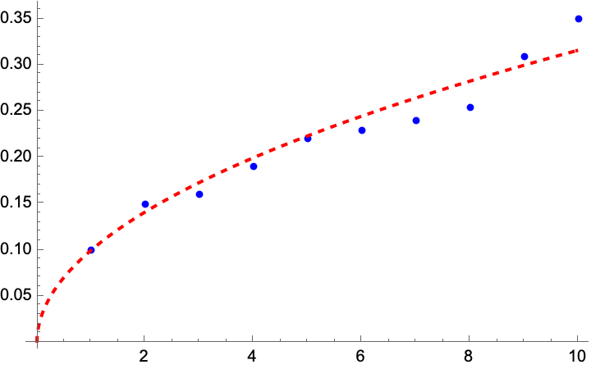
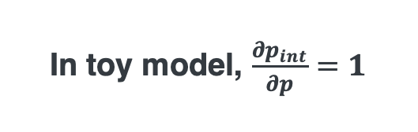

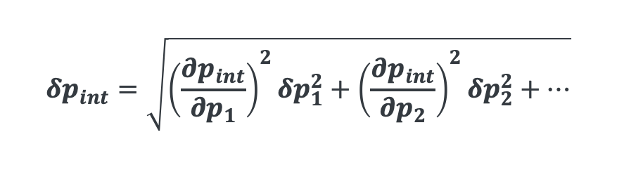
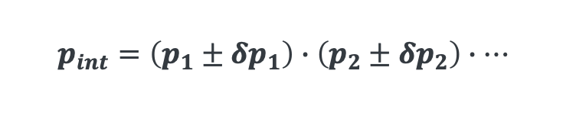
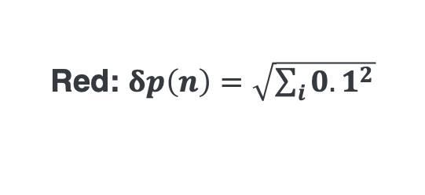
Uncertainty in Pion Yield from Thick Targets
Simulations of pion production in thick targets (multiple interaction lengths) often yield inaccurate pion yields and phase space distributions
  Interaction length quantifies the probability of hadronic interaction per unit length
Neutrino production targets, like the NuMI graphite target, typically span several interaction lengths (e.g. ~2.5$λ$)
  Yield prediction uncertainty are on the order of ~10 % in the GeV range
Experimental validation (e.g. HARP, NA49, NA61) is essential to constrain models
Error
In toy model, $\frac{∂p_{int}}{∂p}=1$
Toy model for interaction error
$$p_{int}=\left(p_{1}±δp_{1}\right)∙\left(p_{2}±δp_{2}\right)∙…$$
Apply an orthogonal error propagation
Red: $δp\left(n\right)=\sqrt{\sum_{i}{{0.1}^{2}}}$
$$δp_{int}=\sqrt{{\left(\frac{∂p_{int}}{∂p_{1}}\right)}^{2}{δp}_{1}^{2}+{\left(\frac{∂p_{int}}{∂p_{2}}\right)}^{2}{δp}_{2}^{2}+…}$$
Blue: generate sample data with random number
Number of events

Slide 12
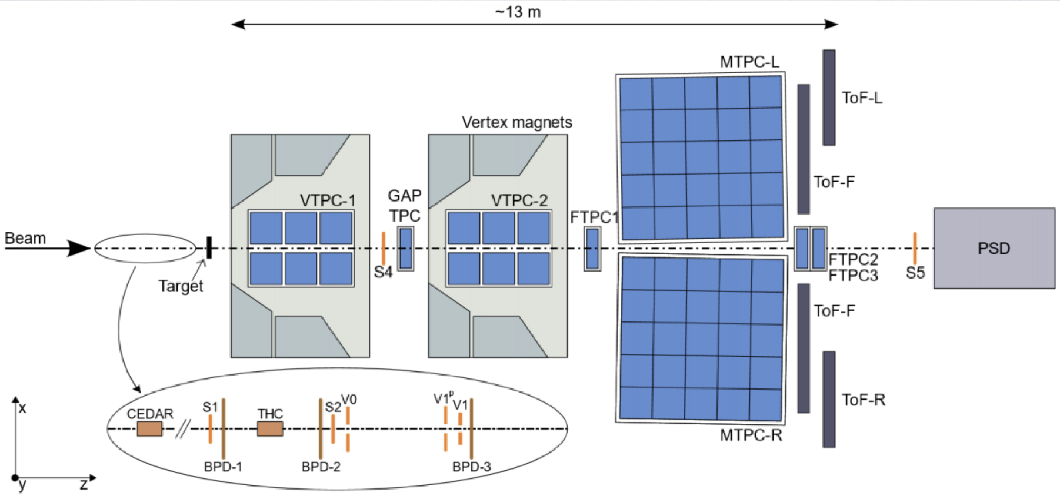
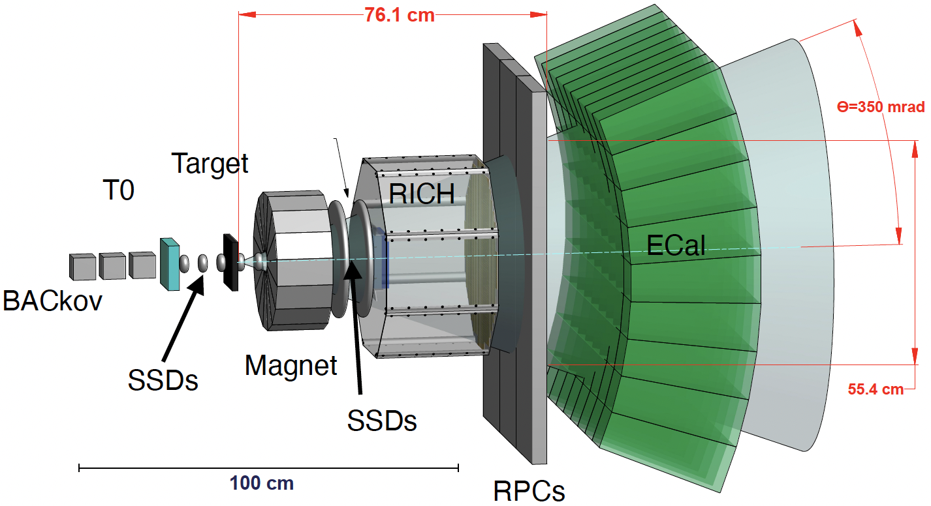
Measuring pion production with thick targets
NA61/SHINE at CERN
EMPHATIC at Fermilab
Pion production measurements with muon collider targets may be needed to improve the accurate of production model

Slide 13
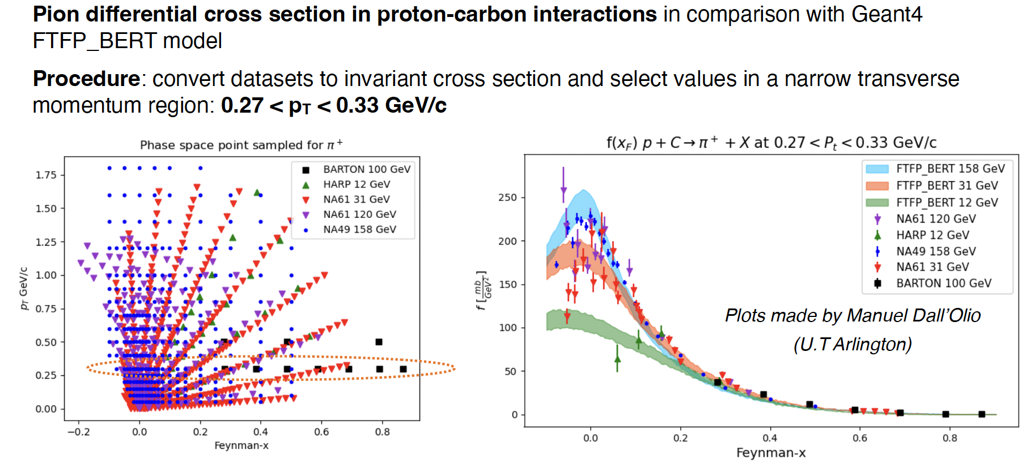
Corrections to Pion Production model for Thick Targets
Example of NA49+NA61 result

Slide 14
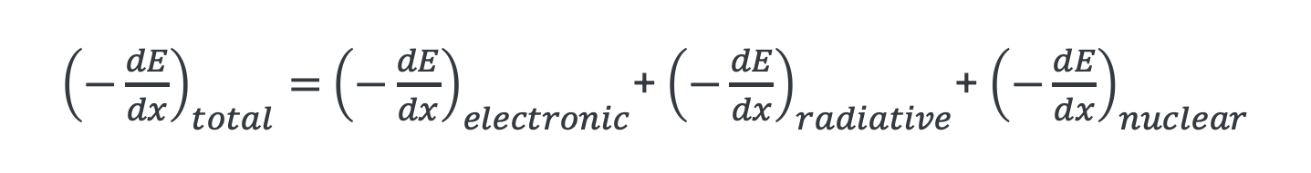
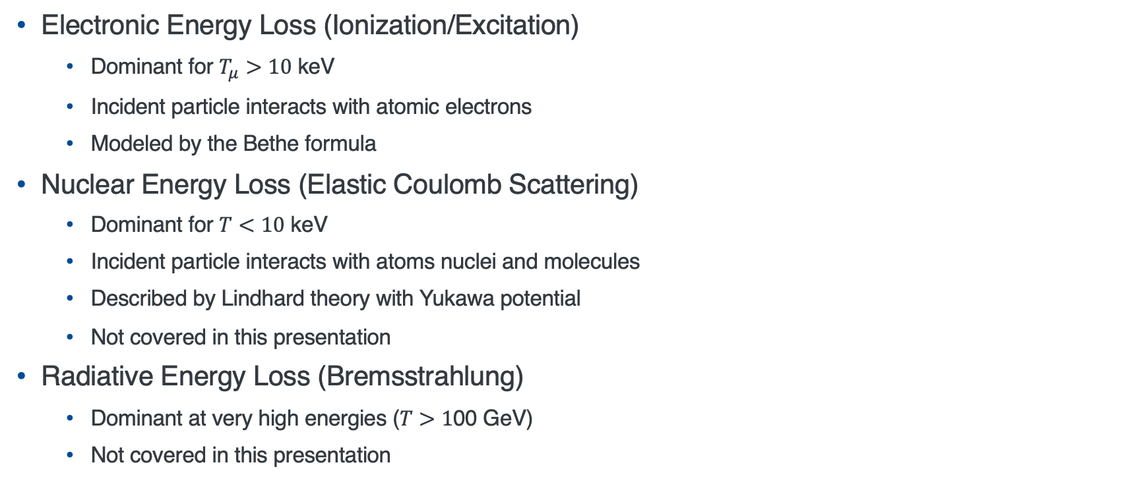
Electromagnetic Interactions
Stopping Power: Quantifying Electromagnet Energy Loss
${\left(−\frac{dE}{dx}\right)}_{total}=$ ${\left(−\frac{dE}{dx}\right)}_{electronic}$+ ${\left(−\frac{dE}{dx}\right)}_{radiative}$+ ${\left(−\frac{dE}{dx}\right)}_{nuclear}$
Electronic Energy Loss (Ionization/Excitation)
  Dominant for $T_{μ}>10$ keV
  Incident particle interacts with atomic electrons
  Modeled by the Bethe formula
Nuclear Energy Loss (Elastic Coulomb Scattering)
  Dominant for $T<10$ keV
  Incident particle interacts with atoms nuclei and molecules
  Described by Lindhard theory with Yukawa potential
  Not covered in this presentation
Radiative Energy Loss (Bremsstrahlung)
  Dominant at very high energies ($T>1$00 GeV)
  Not covered in this presentation

Slide 15
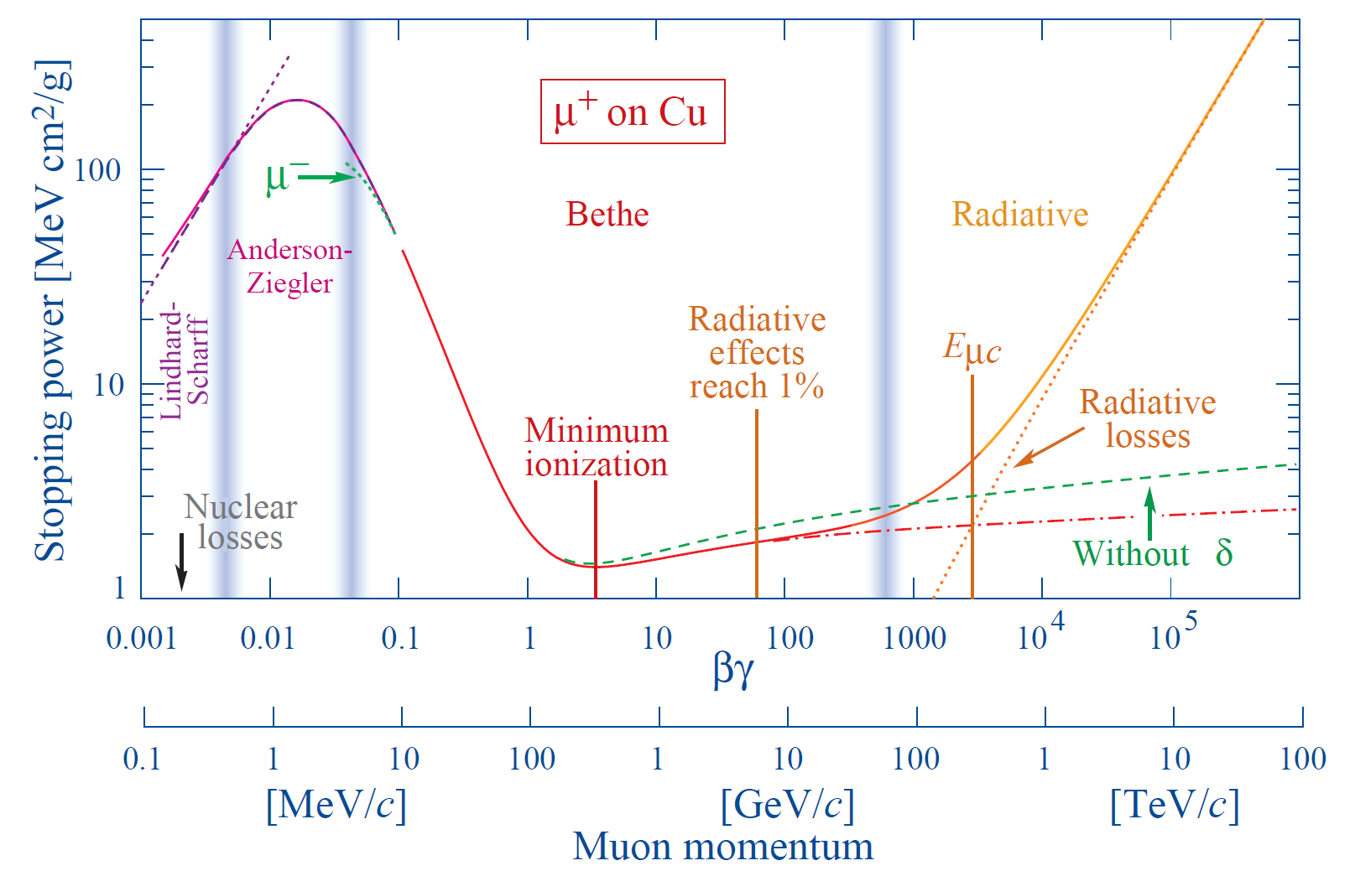
Stopping Power vs Muon Momentum
Electronic losses dominate from 10 MeV/c
Minimum ionization loss is around 300 MeV/c
Nuclear loss is dominate below 10 MeV/c

Slide 16
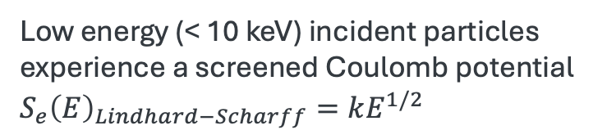
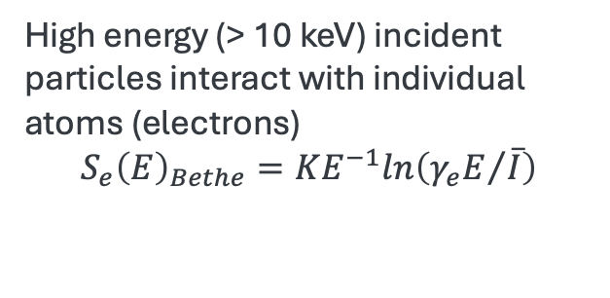
Visualizing Electronic vs Nuclear stopping interactions
Low energy (< 10 keV) incident particles experience a screened Coulomb potential ${S_{e}\left(E\right)}_{Lindhard−Scharff}=kE^{1/2}$
Nuclei
High energy
incident particle
Low energy
incident particle
High energy (> 10 keV) incident particles interact with individual atoms (electrons)
$$S_{e}{\left(E\right)}_{Bethe}=KE^{−1}ln\left({γ_{e}E}/{\overline{I}}\right)$$
Electron cloud
Screened Coulomb
potential

Slide 17
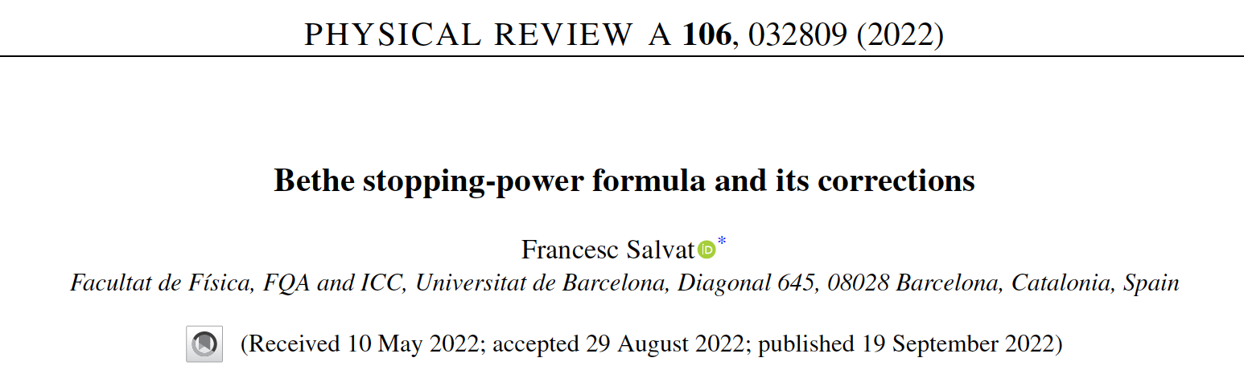
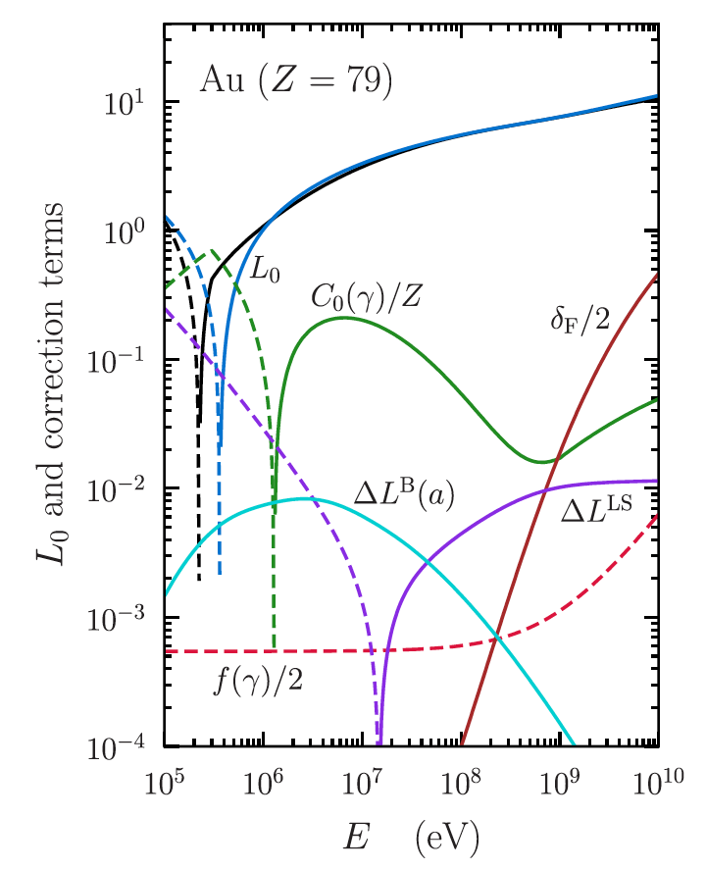
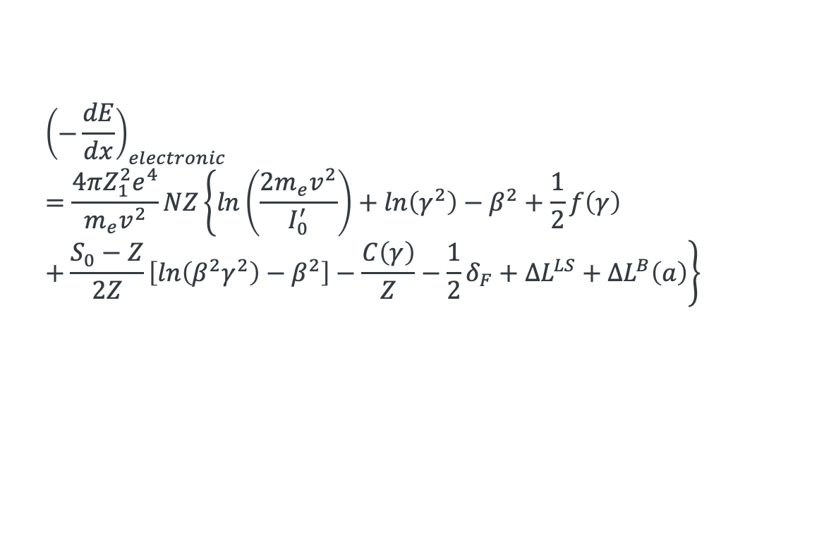
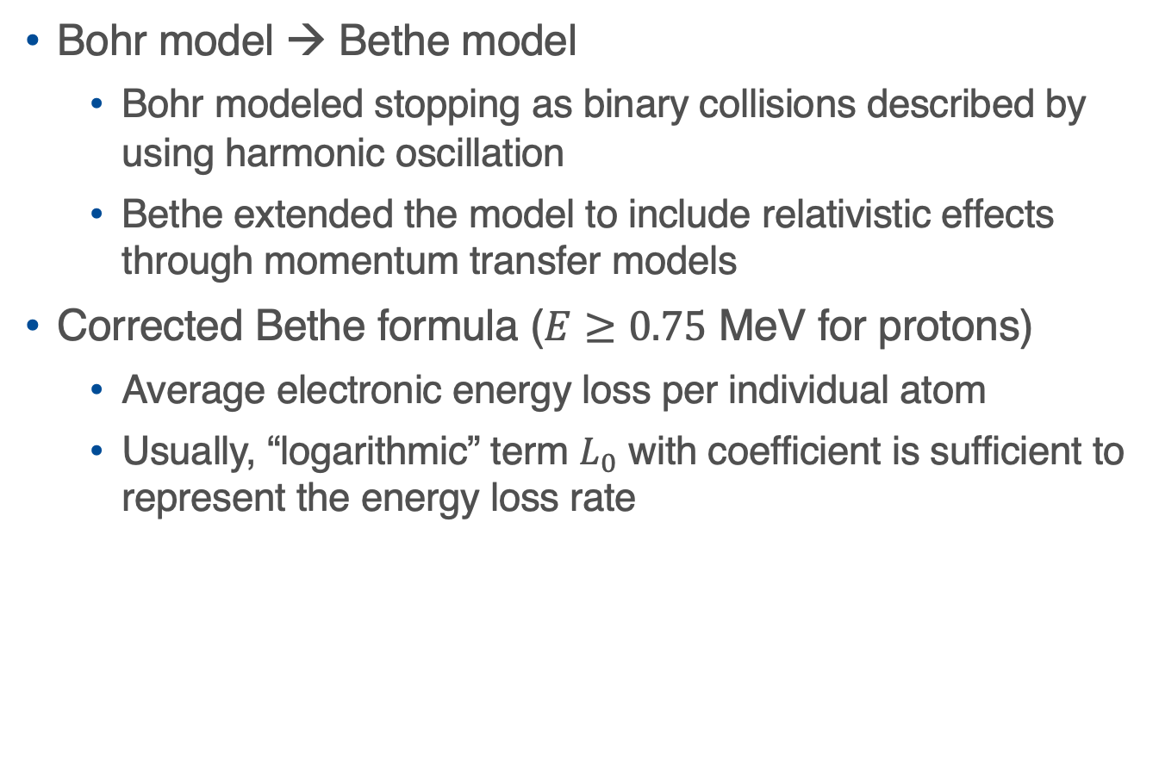

Corrected Bethe-Bloch formula for Electronic Stopping Power
Bohr model → Bethe model
  Bohr modeled stopping as binary collisions described by using harmonic oscillation
  Bethe extended the model to include relativistic effects through momentum transfer models
Corrected Bethe formula ($E≥0.75$ MeV for protons)
  Average electronic energy loss per individual atom
  Usually, “logarithmic” term $L_{0}$ with coefficient is sufficient to represent the energy loss rate
$L_{0}≡ln\left(\frac{2m_{e}v^{2}}{I_{0}^{′}}\right)$ $+ln\left(γ^{2}\right)−β^{2}$
$${\left(−\frac{dE}{dx}\right)}_{electronic}=\frac{4πZ_{1}^{2}e^{4}}{m_{e}v^{2}}NZ\left\{ln\left(\frac{2m_{e}v^{2}}{I_{0}^{′}}\right)+ln\left(γ^{2}\right)−β^{2}+\frac{1}{2}f\left(γ\right)+\frac{S_{0}−Z}{2Z}\left[ln\left(β^{2}γ^{2}\right)−β^{2}\right]−\frac{C\left(γ\right)}{Z}−\frac{1}{2}δ_{F}+ΔL^{LS}+ΔL^{B}\left(a\right)\right\}$$

Slide 18
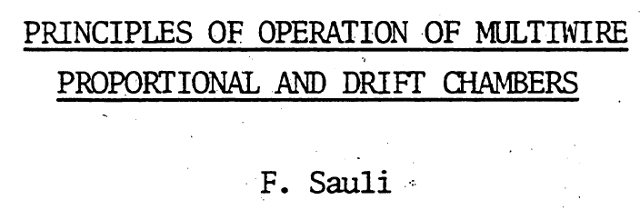
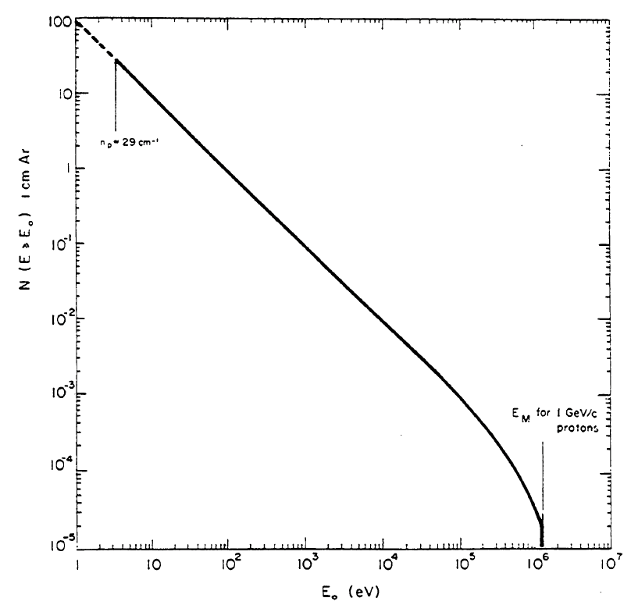
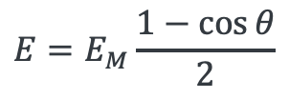
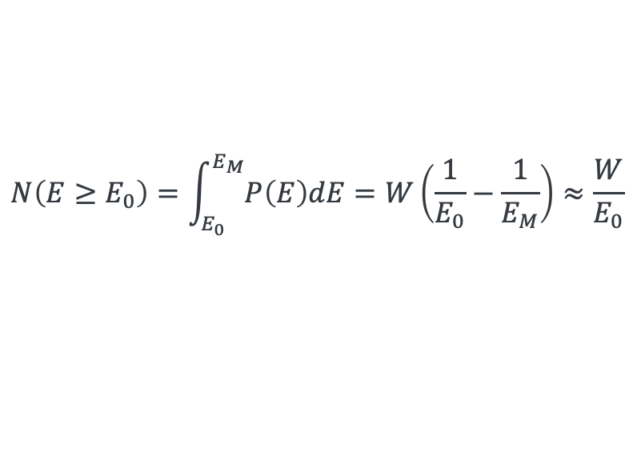
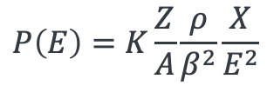
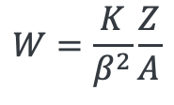
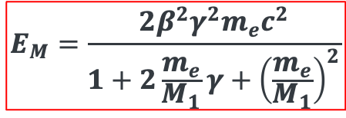
Energy Spectrum of knocked-out electrons
The plot shows that a 1 GeV/c proton produces ~10 electrons per cm in argon with energy > 15 eV
$$P\left(E\right)=K\frac{Z}{A}\frac{ρ}{β^{2}}\frac{X}{E^{2}}$$
$$N\left(E≥E_{0}\right)=\int_{E_{0}}^{E_{M}}{P\left(E\right)dE}=W\left(\frac{1}{E_{0}}−\frac{1}{E_{M}}\right)≈\frac{W}{E_{0}}$$
Maximum energy transfer
(head-on collision)
$$E_{M}=\frac{2β^{2}γ^{2}m_{e}c^{2}}{1+2\frac{m_{e}}{M_{1}}γ+{\left(\frac{m_{e}}{M_{1}}\right)}^{2}}$$
$$W=\frac{K}{β^{2}}\frac{Z}{A}$$
$$E=E_{M}\frac{1−\cos{θ}}{2}$$
NB: Definition of delta electrons (KE > 1 keV)

Slide 19
Frictional Stopping via Nuclear Interactions
Dominant at low kinetic energies (< 10 keV)
Sometimes modeled as frictional interaction
Involves Coulomb scattering between incident particle and atomic nuclei (or molecules)
Originally described as binary collisions
At even lower energies, inelastic scattering and atomic excitation could contribute
While not covered in detail here, nuclear stopping dominates energy loss at low energies

Slide 20
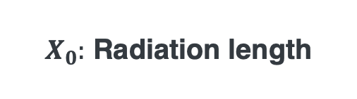
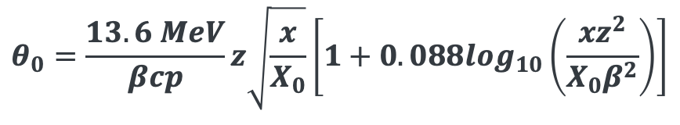
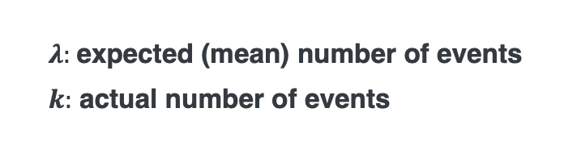

Multiple Coulomb Scattering
Particle Data Group
$$θ_{0}=\frac{13.6 MeV}{βcp}z\sqrt{\frac{x}{X_{0}}}\left[1+0.088\log_{10}\left(\frac{xz^{2}}{X_{0}β^{2}}\right)\right]$$
$X_{0}:$ Radiation length
The logarithmic correction term is typically negligible for most practical cases
NB:
The number of scattering interactions follows a Poisson distribution,
$$P\left(k;λ\right)=\frac{λ^{k}}{k!}e^{−λ}$$
When the expected number of events $λ$ becomes large, the Poisson distribution approaches a Gaussian (normal) distribution
The multiple scattering angle $θ_{0}$ represents the root mean square (RMS) deflection
$λ:$expected (mean) number of events
$k:$ actual number of events

Slide 21



Geometrical Representations of Multiple Scattering

Slide 22


Multiple Scattering in Geant4 simulation
Send 1Million muons (zero transverse size) into 10 mm Liquid Hydrogen
$p_{μ}=200$MeV/c
Plot shows transverse displacement (unit mm)
NB: There are three sources
Blue: Knocked out low energy electrons
Orange: Knocked out delta electrons
Green: Interacting with hydrogen nuclei
Last two interactions contribute most significantly to muon beam phase space growth

Slide 23
Energy Straggling (to be covered later)
Another stochastic processes contributing longitudinal phase space growth
We will explore energy straggling in a later session during ”Demonstrator” lecture

Slide 24
Guidance on Physics Models in Geant4 for Beam simulations
Geant4 is Monte Carlo based particle tracking simulation
  Track individual particle until particle reaches boundaries and/or threshold
    Boundary can be geometrical boundary and/or apply kill command to eliminate in specific volume
    Threshold can be based on energy cuts or maximum simulation time
    If you use the same random seed, Geant4 repeats the same events and processes
Geant4 has physics model for hadronic interactions
The model is prepared for specific purpose
For generating pion events, the Geant4 team suggests to use QGSP_BERT
  QGSP is based on Quark Gluon model while BERT stands for Bertini cascade model
  Therefore, FTFP_BERT is alternate model; For low energy region (below 10 GeV? I guess), Bertini model is used for hadronic interactions
Painting phase space
  Need relatively high statistics to characterize the beam optics

Slide 25







Review of nuclear physics
U
$$λ∝A^{1/3}$$
Nuclear size: $r=r_{0}A^{1/3}$, $r_{0}\sim 1.2$ fm
  Determined from electron scattering
  Most nuclei is sphere shape
  Nuclear interaction length: $λ∝A^{1/3}\sim \frac{A}{r^{2}}$
Nucleon binding energy (see bottom right plot)
Nucleons in Nuclei follows Fermi Gas model
  Nuclei has strange behavior since kinetic energy is larger than binding energy!
Nuclear has shell structure, similar as atom
  Nucleon can be excited
  Emit gamma rays when nucleon are de-excited
D
He
Li
H
Fermi Gas Model:
$$k_{F}^{p}={\left(\frac{3π^{2}Z}{Ω}\right)}^{1/3}$$
$ε_{F}=\frac{{\left(ℏk_{F}\right)}^{2}}{2m}=37$MeV
$p\sim \sqrt{{\left(ε_{F}+m\right)}^{2}−m^{2}}\sim 255$MeV/c
$$BE=\left(N∙m_{n}+Z∙m_{z}−M\right)c^{2}$$

Slide 26



Table of Nuclides
https://www-nds.iaea.org/relnsd/vcharthtml/VChartHTML.html
$A$: Atomic mass
$Z:$ Atomic number (number of protons)
$N:$ Number of neutrons
$$A\sim Z+N$$
Z
Proton rich
Nb, Mo, Zr, Y
etc
W
Magic number (Z or N)
=2, 8, 20, 28, 50, 82, 126
Fe, Ti, V, Co,
Mn, etc
Neutron
N
Neutron rich
Nuclei consists of protons and neutrons
  $Z\sim N$ stable for light element
  $Z<N$ stable for heavy element
    Need more neutrons to overcome coulomb repulsive forces generated by protons
  Isotope: Same $Z$ different $N$
  Isobar: Same $A$ different $Z$
  Isomer: Metastable state
  (Isotone: Same $N$ different $Z$)
Proton
Nuclei

